Slide 1
Toward Improving Hurricane Intensity Forecast: the Operational Regional Model Perspective
Xuejin Zhang (UM/CIMAS)
Sundararaman Gopalakrishnan (AOML/HRD)
Vijay Talapragada (NCEP/EMC)
Acknowledgement
Frank Marks, Robert Rogers, and Shirley Murillo
HRD Modeling team
HRD DA team
EMC HWRF team
DTC

Slide 2
Outline
Background
  HFIP objectives
  Observations
  Understanding
HWRF development
  Framework expansion
  Physics improvement
  Ocean coupling
  Vortex initialization & Cycling
  Data Assimilation
Advances in HWRF forecast
  Model configuration
  Retrospective forecasts
  Real-time parallel forecast effort
  Genesis effort

Slide 3
Background

Slide 4

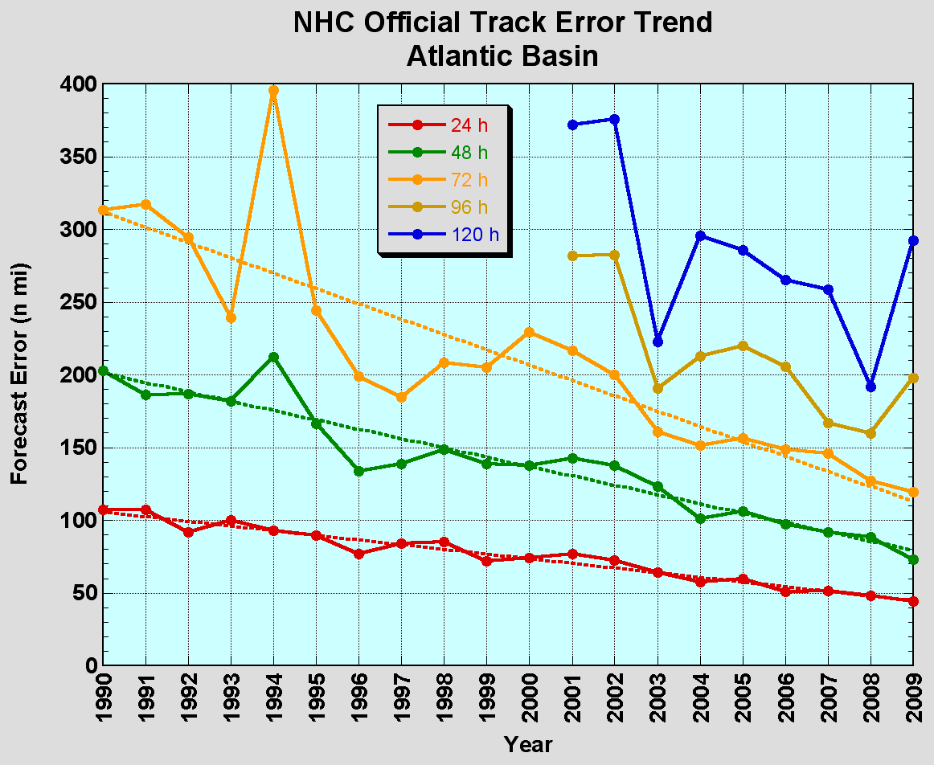
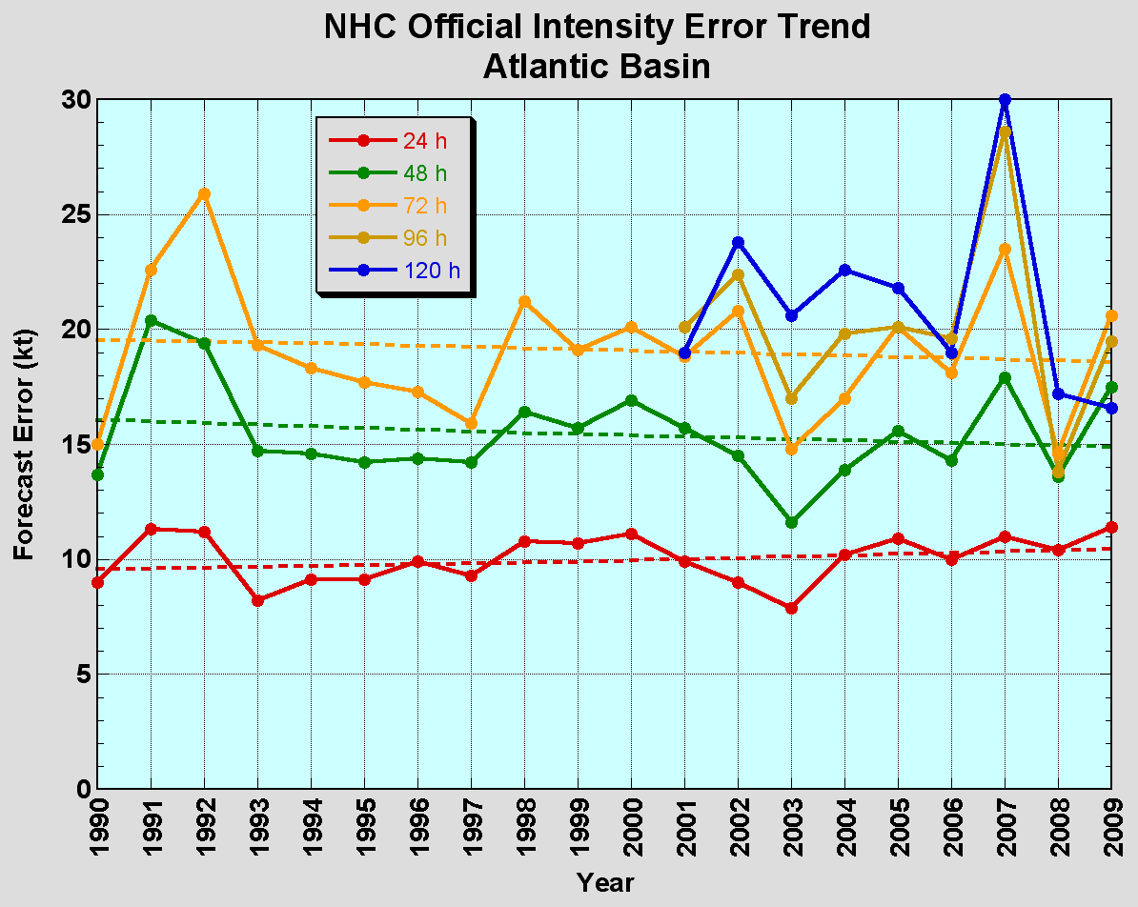
The Good – Track forecast improvements
The Bad - Intensity forecasts no real gains
No progress with intensity in last 15-20 years
Errors cut in half over past 15 years
10-year improvement - As accurate at 48h as we were at 24h in 2000
24-48h intensity forecast off by 1 category
Off by 2 categories 5-10% of time
Credit: F. Marks

Slide 5
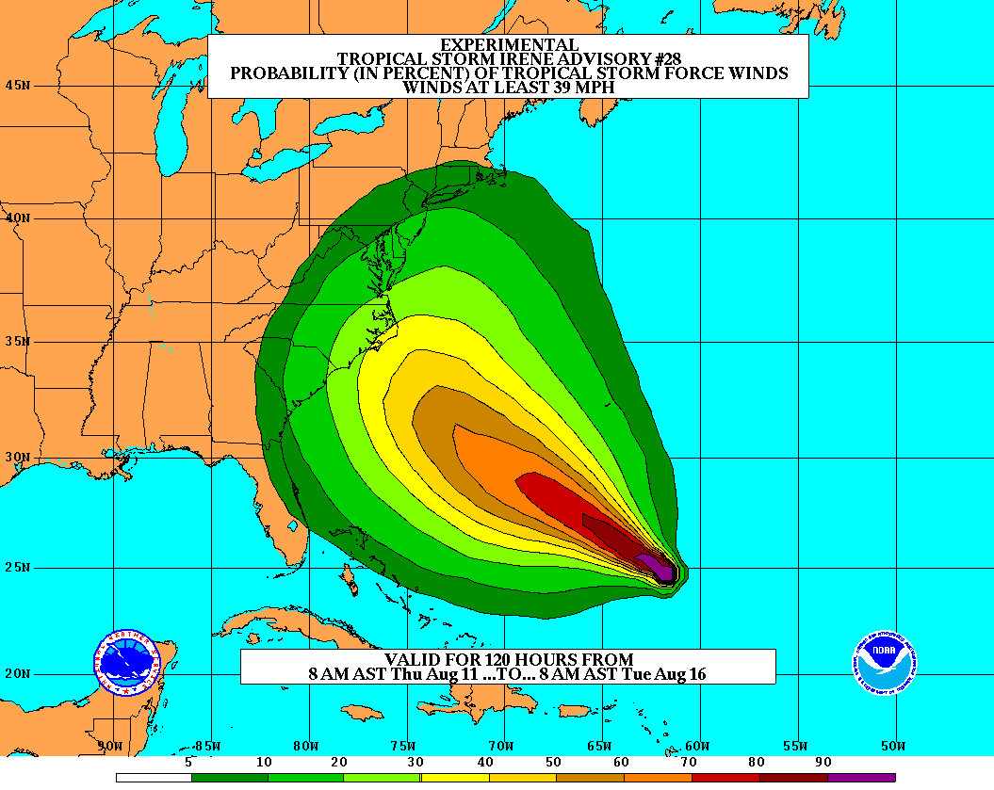
Goals
Improve Forecast Accuracy
  Hurricane impact areas (track) – 50%
  in 10 years
  Severity (intensity) – 50% in 10 years
  Special Focus on Rapid Intensity Change (RI)
Extend forecast reliability out to 7 days
Quantify, bound and reduce forecast uncertainty to enable risk management decisions
http://www.hfip.org/
Credit: F. Marks

Slide 6


Airborne Observation
NOAA Gulfstream-IV jet:
High attitude: ~30,000 ft
Purpose
  Hurricane synoptic environment
Instruments
  GPS dropsonde
NOAA P-3:
High attitude: ~10,000 ft
Purpose
  Hurricane inner core environment
Instruments:
  GPS dropsonde
  AXBT
  Doppler Radar
  Expandable other instruments
Credit: R. Rogers & S. Murillo

Slide 7
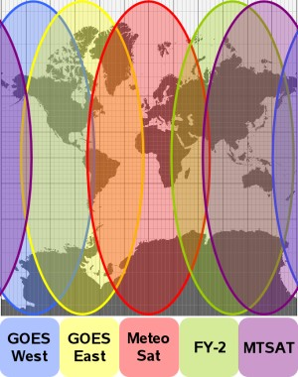
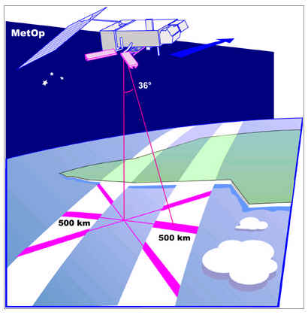
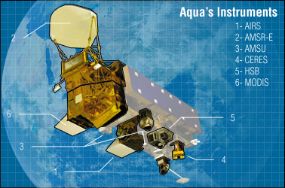
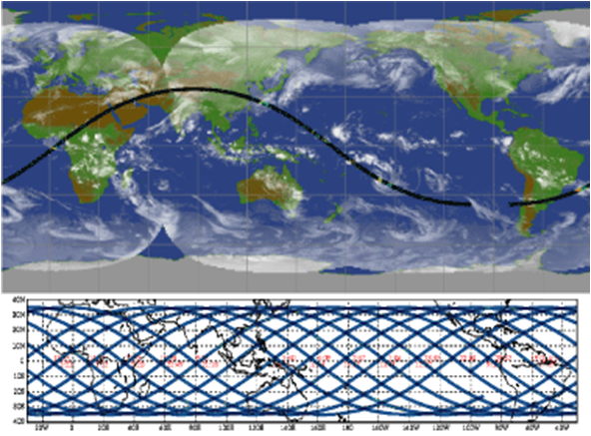
Satellite Observation
Geostationary
  visible, infrared, water vapor channels
  cloud structure, cloud-drift winds
Polar-orbiting
  active scatterometer
  surface wind speed and direction
Polar-orbiting
  passive microwave channels
  precipitation structure, ice scattering
Credit: R. Rogers

Slide 8
Understanding from Observations
Synoptic environment
Vortex structure
Convective structure
PBL structure
Microphysical structure
3D storm structure
Important parameters for model input

Slide 9
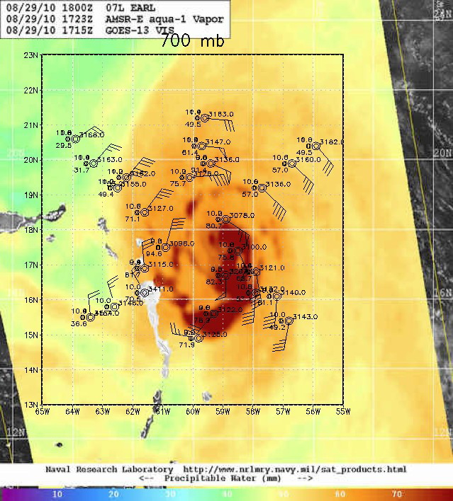
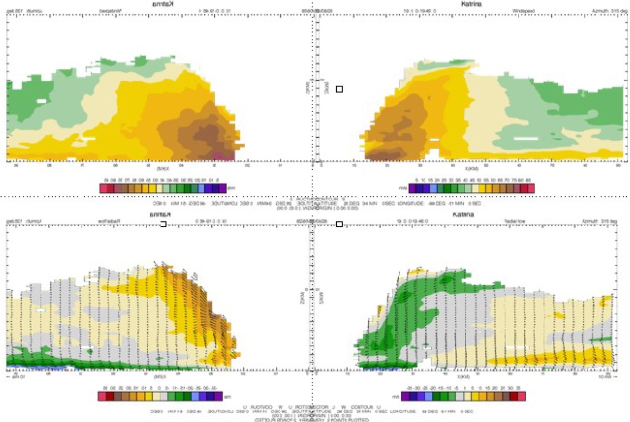
Understanding from Observation
Synoptic environment
Vortex Structure
Tangential wind
Radial and vertical wind
Credit: R. Rogers

Slide 10
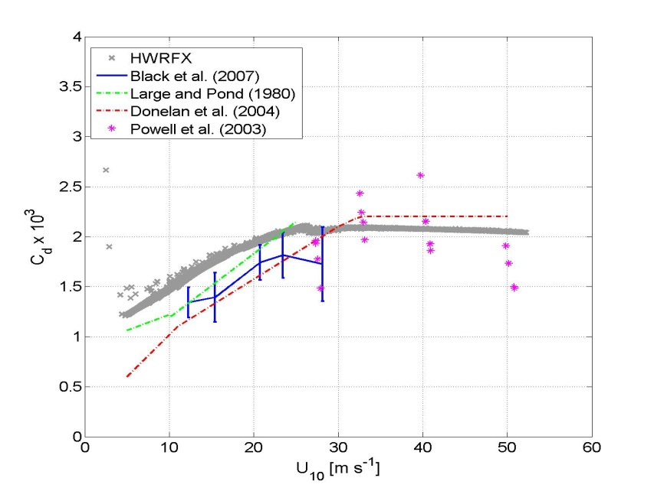
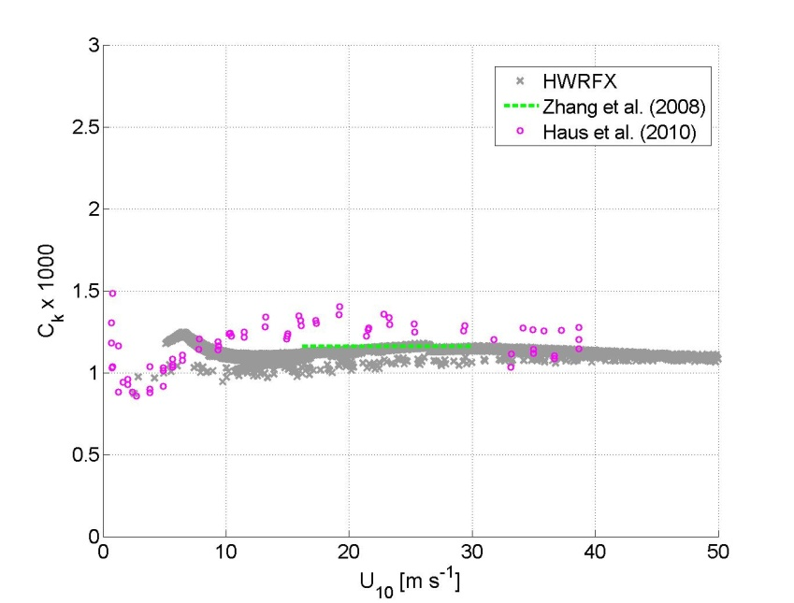
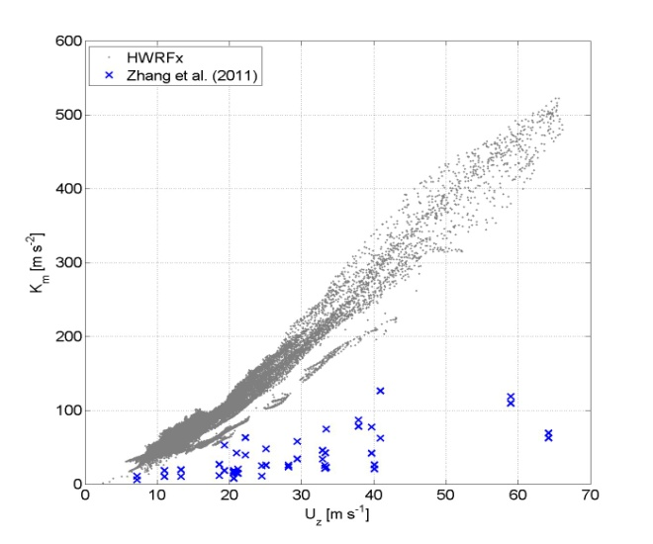
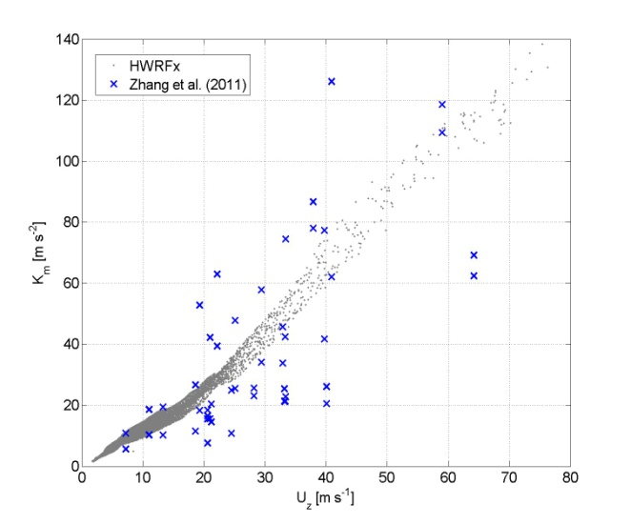
Understanding from Observation
Current HWRF
Current HWRF
Current HWRF
Original GFS
Gopalakrishnan et al. 2011

Slide 11
HWRF Development

Slide 12
Major HWRF active developments
Model framework expansion (HRD-EMC)
  New model internal storm track algorithm
  Multiple nest framework
  Idealized test
Physics improvement (EMC-HRD)
  New GFS convection
  Modified PBL
  Modifications to treatment of horizontal diffusion
Vortex initialization & Cycling (EMC-HRD)
  Improve vortex initialization for more realistic storm size and intensity corrections
  Cycle multiple-nest fields
Couple to HYCOM ocean model in the Atlantic (EMC)
Data assimilation
  GSI & Hybrid DA (EMC)
  HEDAS & Regional Hybrid DA (HRD-EMC)
Model compatibility (EMC)
  Add configuration flexibility
  Add multi-platform compatibility
Code management (EMC-DTC)
  Establish a community repository of the operational HWRF
  Upgrade HWRF infrastructure to V3.2+
Credit: V. Tallrpragada
Notes:
12

Slide 13
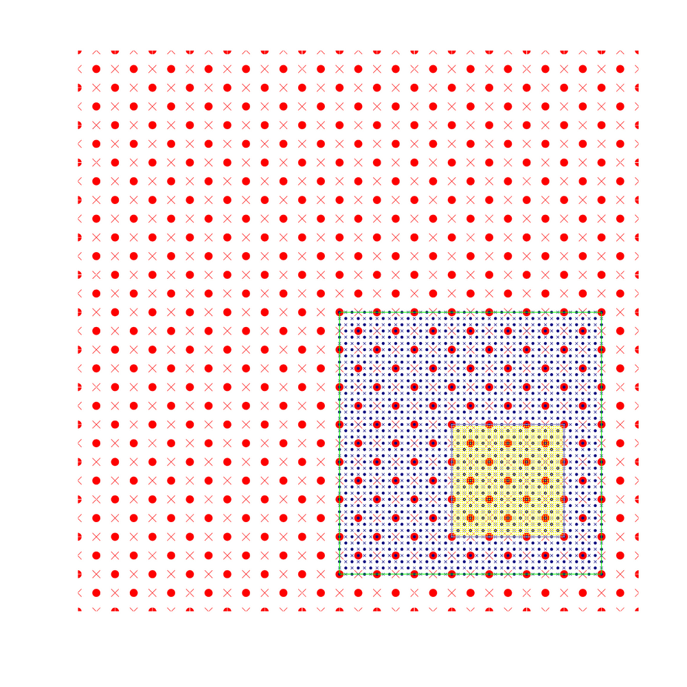
Moving Nest
Moving Characteristics
Starting point at mass points
Aligning at mass points
Mediate domain follows the inner most domain
Centroid MSLP follow
• Mass points
× Wind points

Slide 14
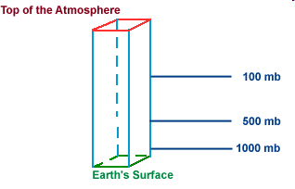
Vertical Mass Adjustment
50 hPa
50 hPa
50 hPa
100 hPa
420 hPa
Downscale
420 hPa
500 hPa
Feedback
850 hPa
Earth’s Surface
1000 hPa
Earth’s Surface
Coarse Grid
Reference Surface
Fine Grid
Pressure indirectly interpolated between parent hybrid and nested hybrid
The height, temperature and moisture fields from the parent domain are vertically interpolated onto pre-defined standard pressure surfaces.
The above meteorological fields from the mother domain are further interpolated horizontally onto nested grids on the same pressure surface.
Finally, by using the high-resolution topography over the nested domain, pseudo hydrostatic mass balancing is carried out to prescribe the initial values in the nested domain.

Slide 15
High-Resolution HWRF Upgrades and Bug-fixes
 | Stream 1.5 HWRF | Upgrade or Bug-fix
Moving nest | New algorithm | Upgrade
Microphysics | Ferrier | Bug-fix (moving nest hydrometer initialization)
Surface scheme | GFDL | Upgrade (based on observation C_{D} & C_{H})
PBL scheme | GFS | Upgrade (based on observation K_{m})
Cumulus Parameterization | New CP (27-9 KM) No CP (3-KM) | Upgrade (Random cloud top, Convection overshoot, Max cloud base mass flux, Convection-induced pressure gradient force)
Explicit Lateral Diffusion | COAC=0.75 (27 KM) COAC=5.0 (9-3 KM) | Empirical determined by computational damping and stability criterion
Vortex initialization | New vortex initialization Downscale (3 KM) | Upgrade (Vortex cycling, surface pressure correction, Storm size correction)
Post-processor | Diapost | Upgrade

Slide 16
Coupling processes
Atmospheric Component
SST
Coupler
SST
Oceanic Component
Fluxes
Winds
Domain attributes
Fluxes
Winds
Domain attributes
Coupler functions
Interpolation
Data passing
Synchronize oceanic and atmospheric components
Initialize the moving nest leading edge
Summarized from DTC Tutorial

Slide 17
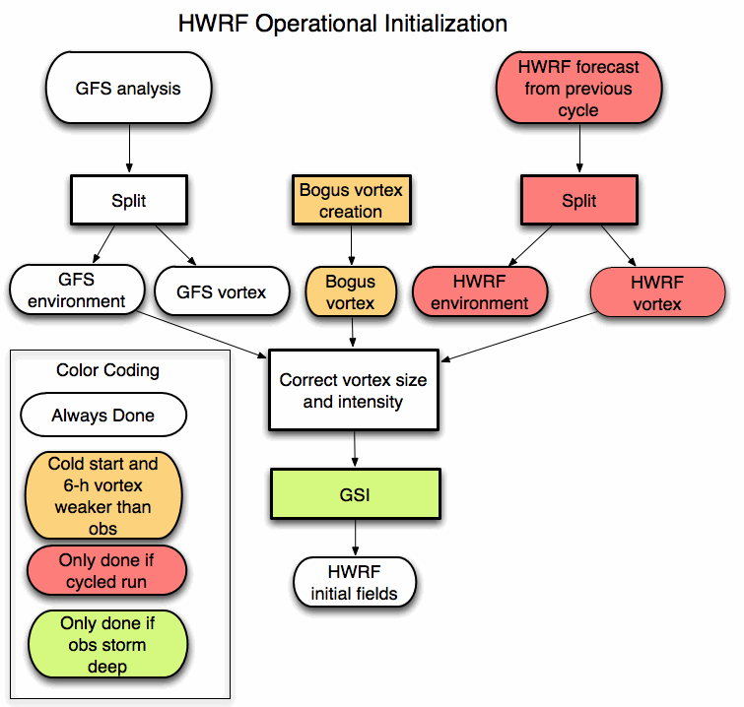
Vortex initialization and cycling processes
Credit: Q. Liu

Slide 18

Data Assimilation
T – 6 h
T
T + 126 h
Ensemble
Spin-up
DA Cycling
with EnKF
Deterministic HWRF-X Forecast from Ens. Mean
1-hour Cycles
Ensemble
Initialization from T-6h GFS-EnKF
Real-Time
Observation
Pre-Processing
Mean of Final Analysis Assumed Valid for T
Credit: A. Aksoy

Slide 19
Advances in HWRF forecast

Slide 20
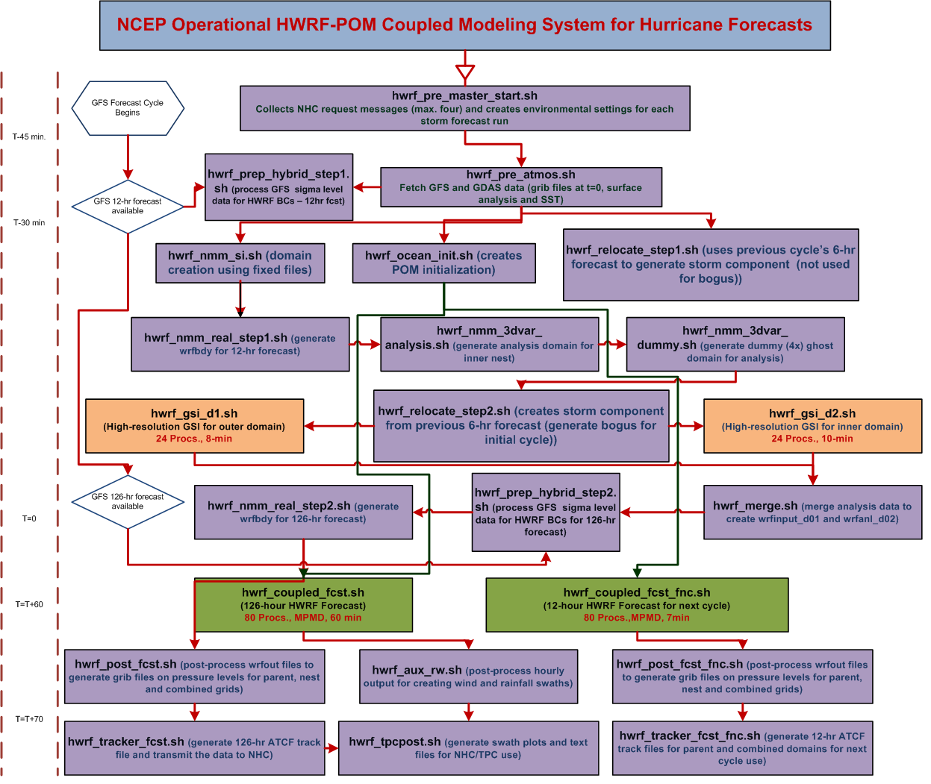
Credit: V. Tallapragada

Slide 21
Model Configuration
 | Stream 1.5 HWRF | Operational HWRF | HWRFx | GFDL
Domain | 27 KM: 77.76˚ X 77.76˚ 9 KM: 10.56˚ X 10.2˚ 3 KM: 7.6˚ X 6.4˚ | 27 KM: 77.76˚ X 77.76˚ 9 KM: 7.2˚ X 6.0˚ | 9 KM: 57.12˚ X 55.56˚ 3 KM: 5.84˚ X 5.8˚ | 36 KM: ~75˚ X ~75˚ 18 KM: ~11˚ X ~11˚ 9KM: ~5˚ X ~5˚
Vortex Initialization | 27-9 KM: Yes 3 KM: No (Downscaling) | 27-9 KM: Yes | 9KM: Yes 3KM: No (Downscaling) | 36-18-9KM: Yes
Cycling | Yes | Yes | No | No
Ocean Coupling (Ocean model: POM) | 27-9 KM: Yes 3 KM: No (Downscaling) | 27-9 KM: Yes | No | Yes
GSI | Yes | Yes | No | No
Platform | JET-Linux | IBM | JET-Linux | IBM
Physics schemes
Microphysics | Ferrier | Ferrier | Ferrier | Ferrier
Radiation (SW) | GFDL | GFDL | NCAR SW | GFDL
Radiation (LW) | GFDL | GFDL | RRTM | GFDL
Surface Scheme | GFDL (2010 implementation) | GFDL (2011 implementation) | GFDL (2009 implementation) | GFDL
PBL Scheme | GFS (Modified for HR implementation) | GFS | GFS | GFS
Cumulus Parameterization | New SAS (27-9 KM) no CP (3 KM) | New SAS | SAS (9 KM) no CP (3KM) | SAS
Land Surface | GFDL Slab | GFDL Slab | GFDL Slab | GFDL Slab

Slide 22
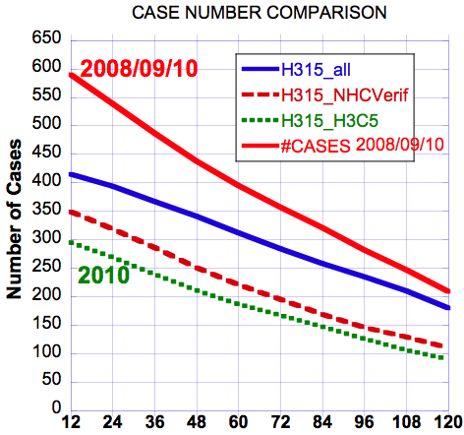
2008/09/10 & 2010 Verifications -- Sample Sizes
Notes:
H315: HWRFv3.2 2011 Stream 1.5 27-9-3km model
H3C5: HRD HWRF experimental 2010 version (HWRFx)
This is shown the homogeneous cases for each verification. H315_all: all H315 cases; H315_NHCVerif: homogeneous cases used in NHC verification package; H315_H3C5: homogeneous cases including H3C5 model forecasts

Slide 23
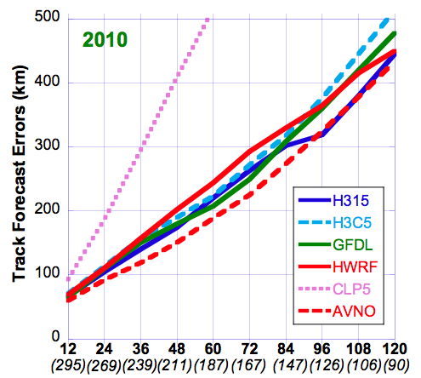
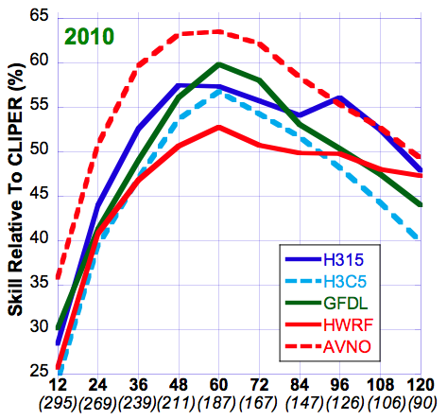
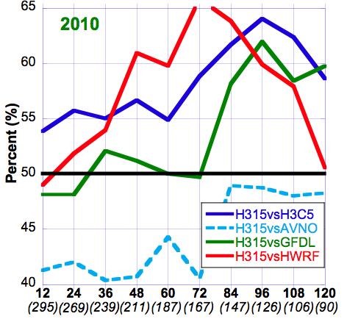
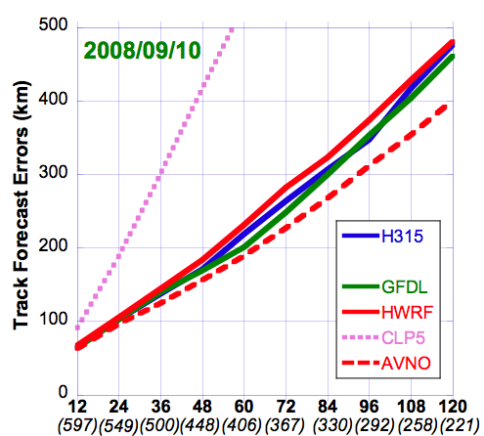
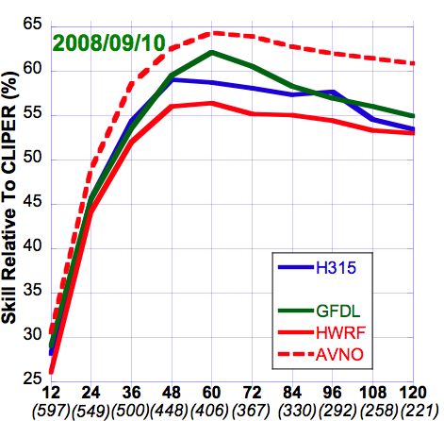
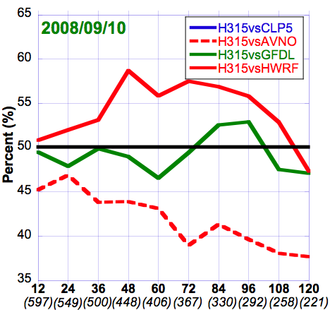
Verifications – Track Forecasts
HWRF (operational 27:9km), H3C5 (HWRFx 9:3km), H315 (27:9:3km), GFDL (operational 54:18:9km)
Cliper5(dotted), AVNO(dashed)
Absolute Errors
Skill vs CLP5
FSP
Notes:
H315: HWRFv3.2 2011 Stream 1.5 27-9-3km model
H3C5: HRD HWRF experimental 2010 version (HWRFx)
HWRF: NCEP/EMC operational HWRF 27-9km
GFDL: NCEP/EMC operational GFDL (54-18-9km). http://www.gfdl.noaa.gov/operational-hurricane-forecasting
CLP5: CLIPER5 (Climatology and Persistence model, statistical model)
AVNO: NWS Global Forecast System (GFS)
FSP: Frequency of Superior Performance. Here H315 is compared to all other models to obtain FSP (i.e. H315 vs. H3C5, H315 vs. HWRF, H315 vs. GFDL, H315 vs. CLP5, the red line didn’t show because FSP is above 65% and above the y-axis limit). 50% is the divided line that means 50% H315 is better than the compared model; 50% worse. 55% means H315 is 55% better than the compared model and vice versa.

Slide 24
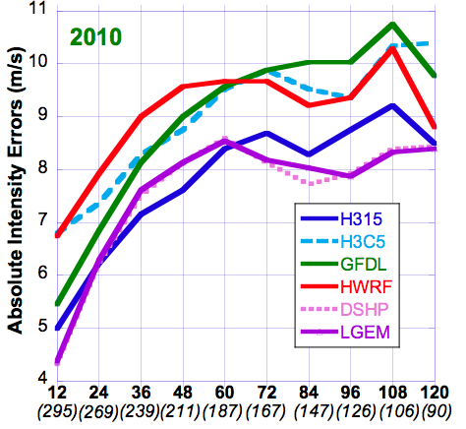
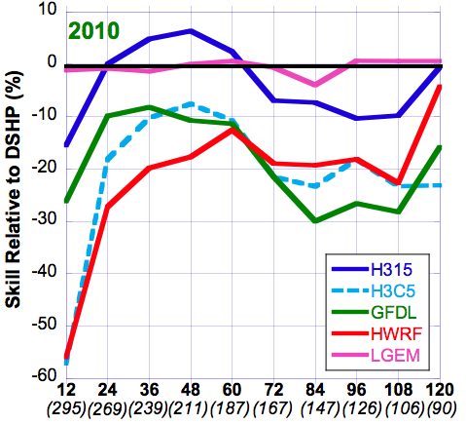
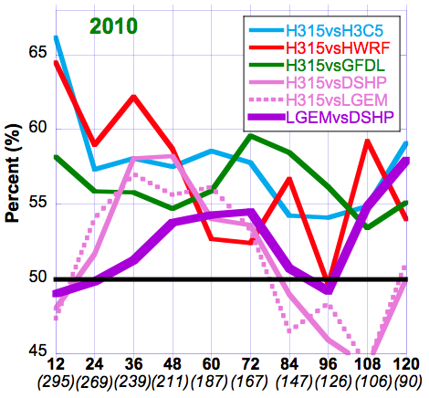
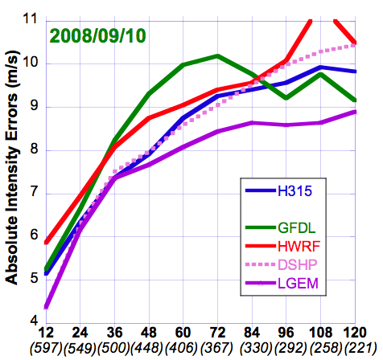
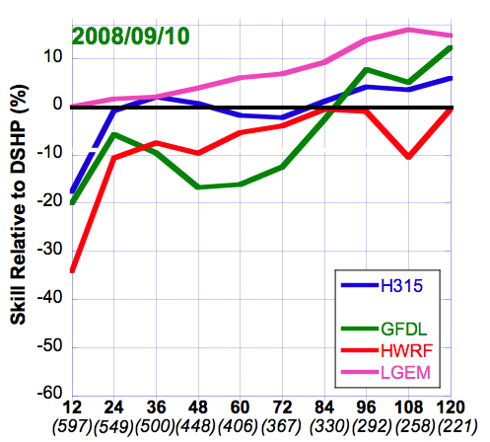
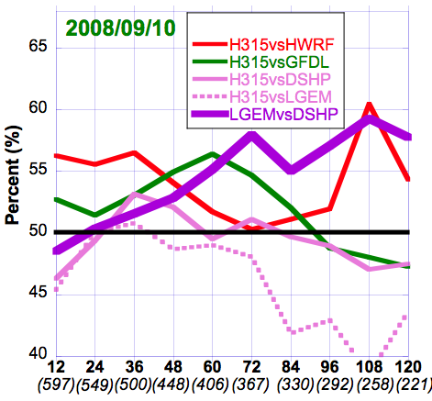
Verifications – Intensity Forecasts
HWRF (operational 27:9km), H3C5 (HWRFx 9:3km), H315 (27:9:3km), GFDL (operational 54:18:9km)
LGEM(solid), DSHP(dotted)
Absolute Errors
“Skill” vs DSHP
FSP
Notes:
DSHP: SHIPS with inland decay (Statistical-dynamical model)
LGEM: Logistic Growth Equation Model (Statistical-dynamical model)
FSP: all lines are H315 is compared to other models (H315 vs. H3C5, H315 vs. HWRF, H315 vs. GFDL, H315 vs. DSHP, H315 vs. LGEM) except thick purple line (LGEM vs. DSHP)

Slide 25
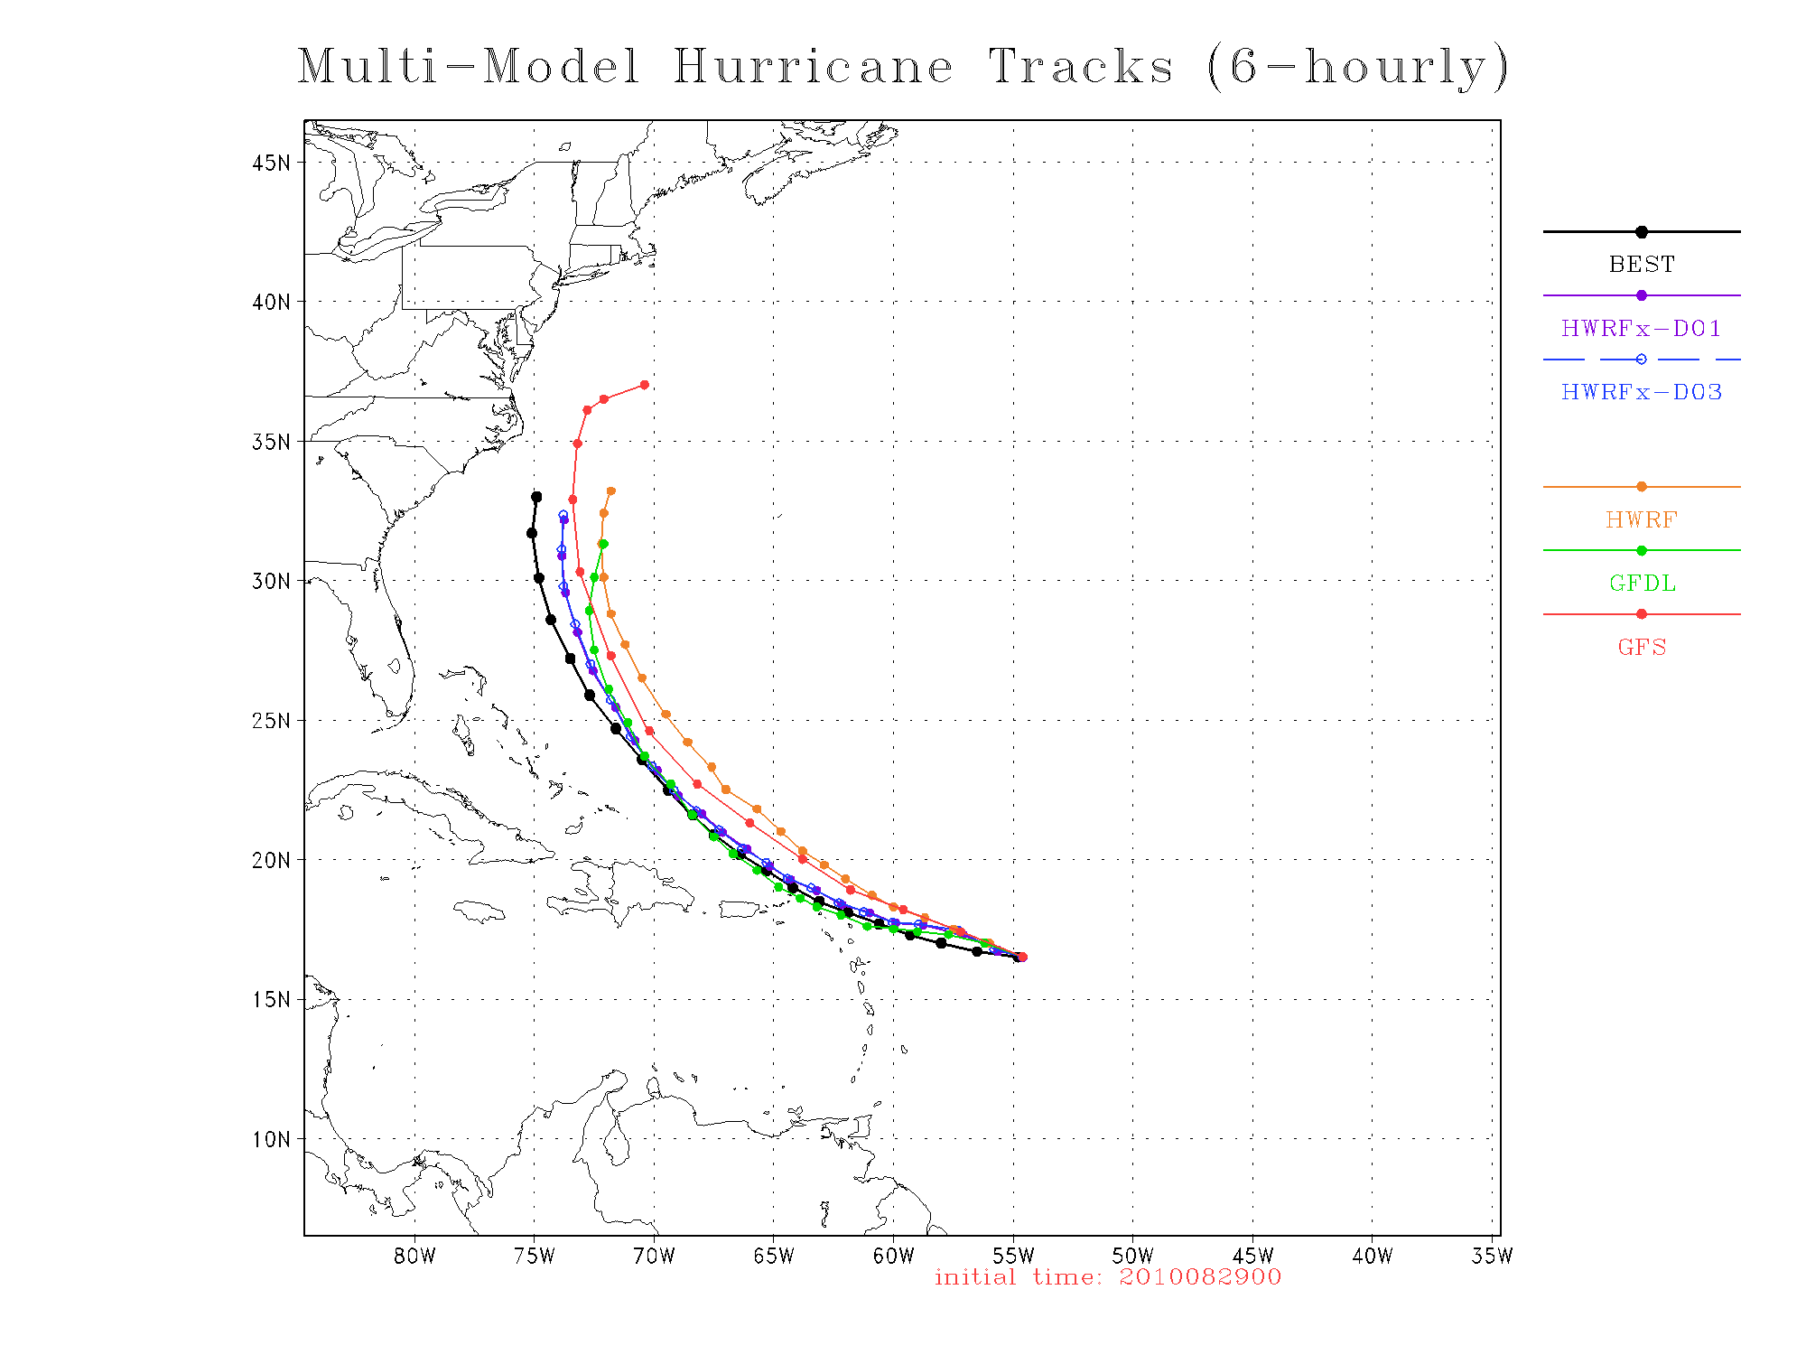

Slide 26
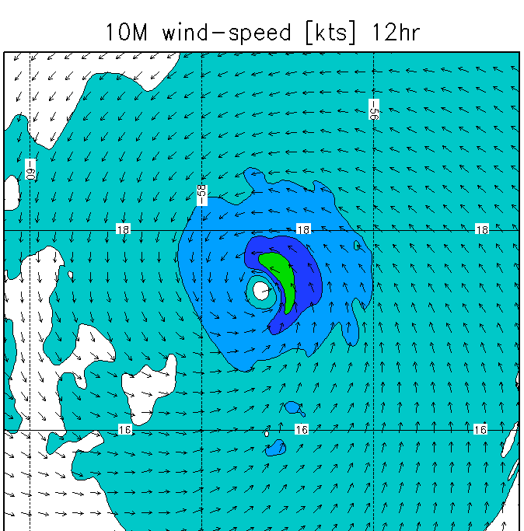
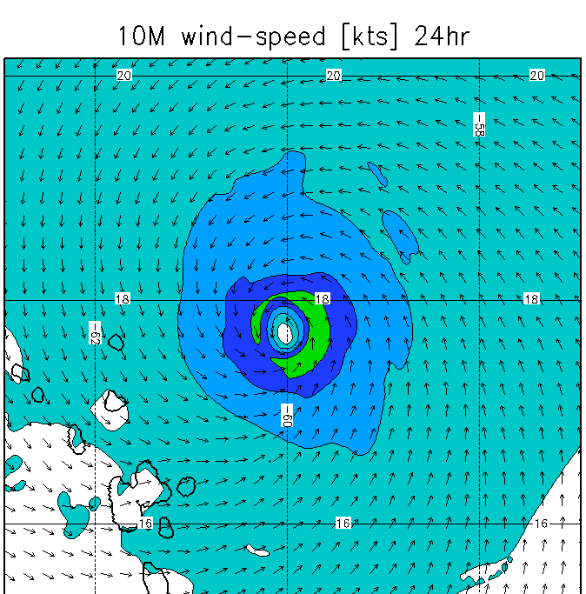
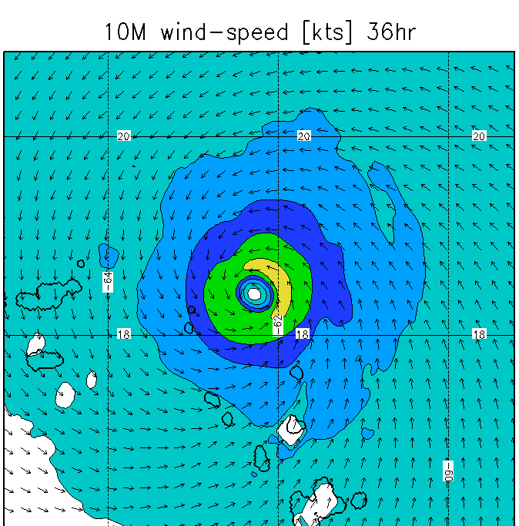
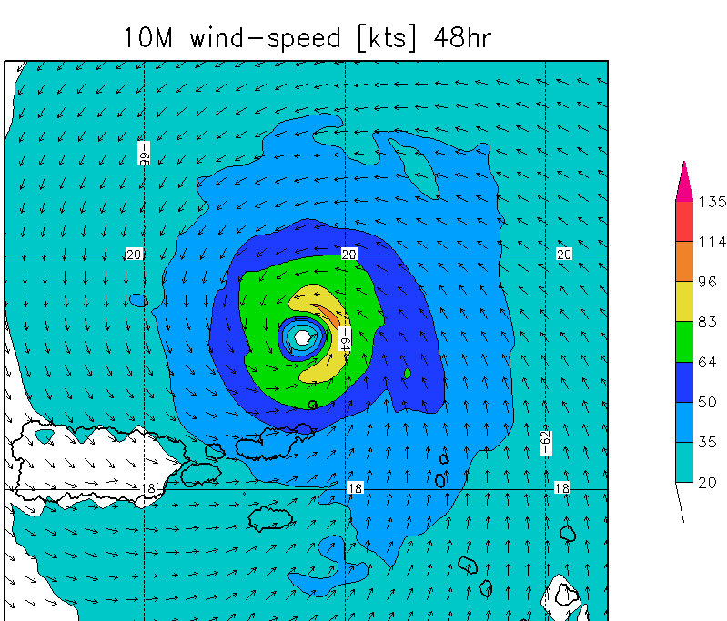
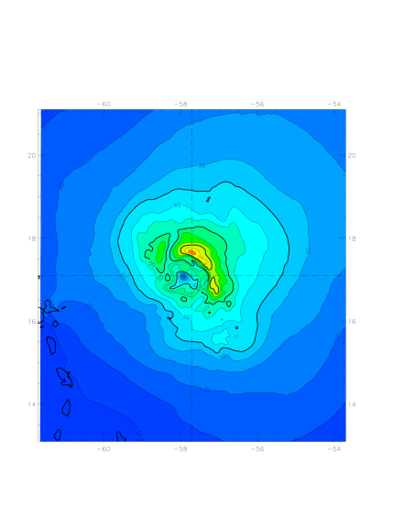
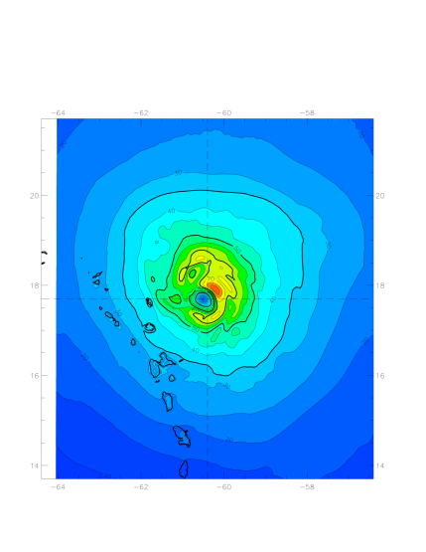
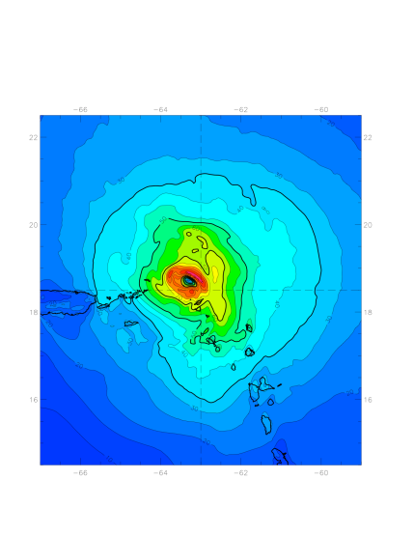
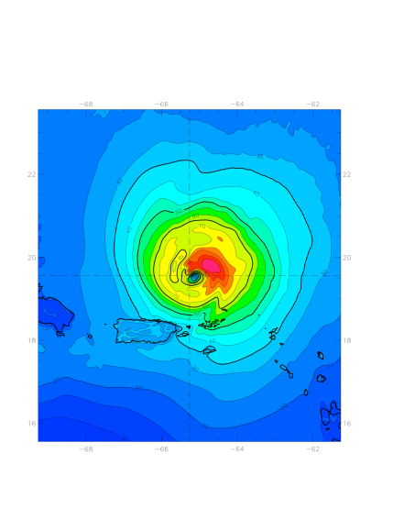
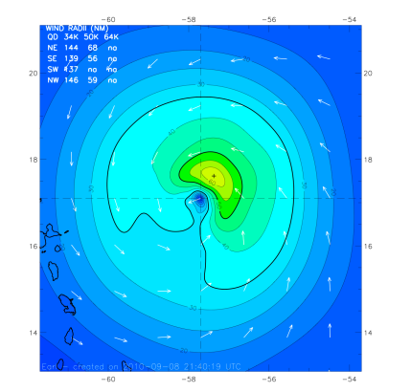
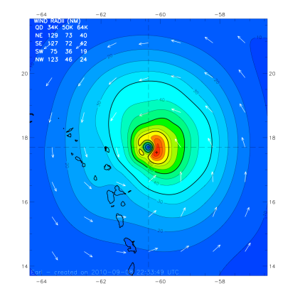
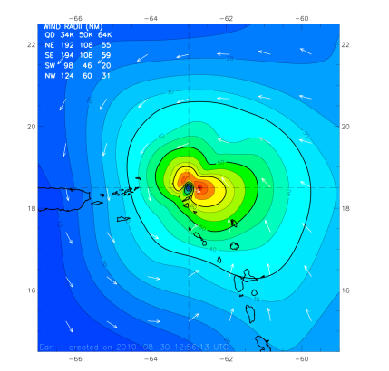
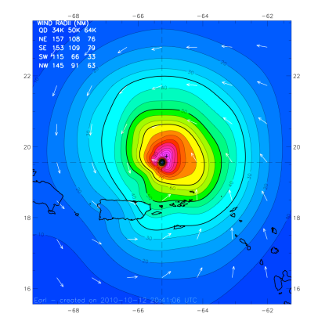
Earl forecast structure
Initial time: 2010082900
08-29 12Z
08-30 00Z
08-30 12Z
08-31 00Z
HWRF v3.2
10-m Wind
Speed
HEDAS
10-m Wind
Speed
Corresponding
H*Wind
Analysis
H*wind and HEDAS plots from R. Rogers

Slide 27
Atmospheric circulation systems
Schematic representation of conditions during the peak (Aug.–Oct.) of the above-normal 2003 Atlantic hurricane season. (Landsea et al. 2004, BAMS)
Major Circulation Systems:
Subtropical High/Ridge
200hPa Tropical Easterly Jet
700hPa AEJ
850hPa Easterly Trades
200-850hPa Vertical wind shear
Leading Climate Factors:
El Nino and Southern Oscillation
The multi-decadal signal
Madden-Julian oscillation

Slide 28
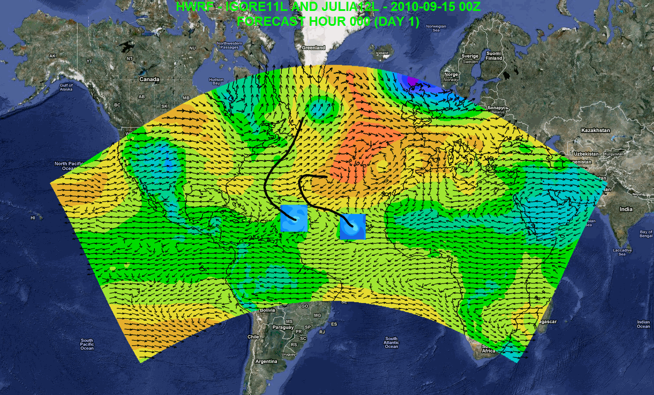
Possible Applications
Independent DA and cycling system
7-day forecast
Track forecast
Local applications
Regional ensembles/products
Daily Tropical Outlook/genesis
Website at AOML: https://storm.aoml.noaa.gov/realtime
Notes:
Independent DA system including vortex scale DA
Genesis
Track forecast
Local application
Drive local-scale model
Website at AOML: https://storm.aoml.noaa.gov/realtime

Slide 29
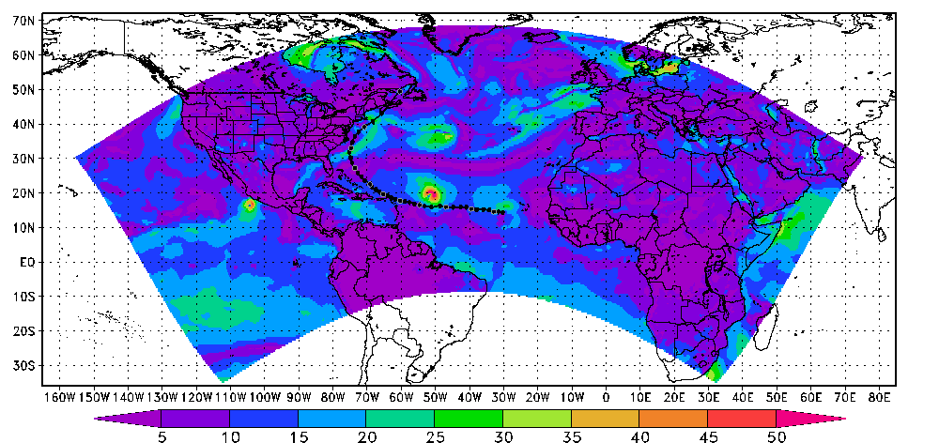
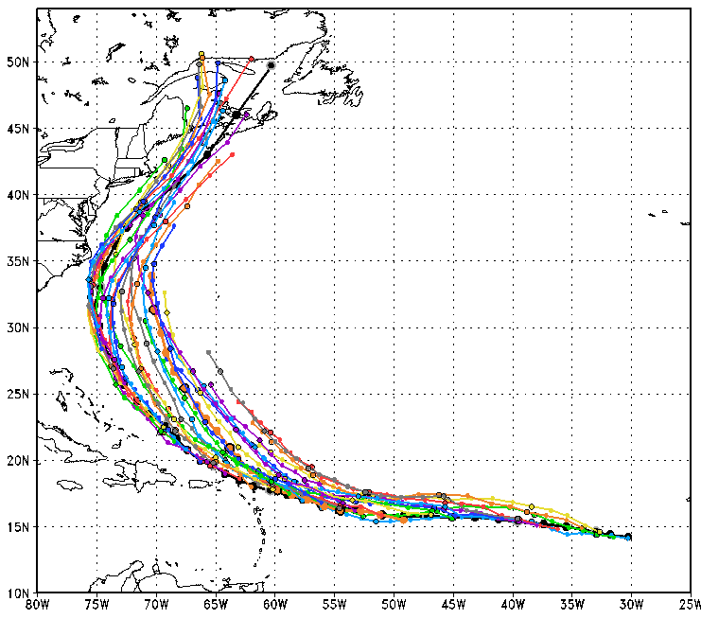
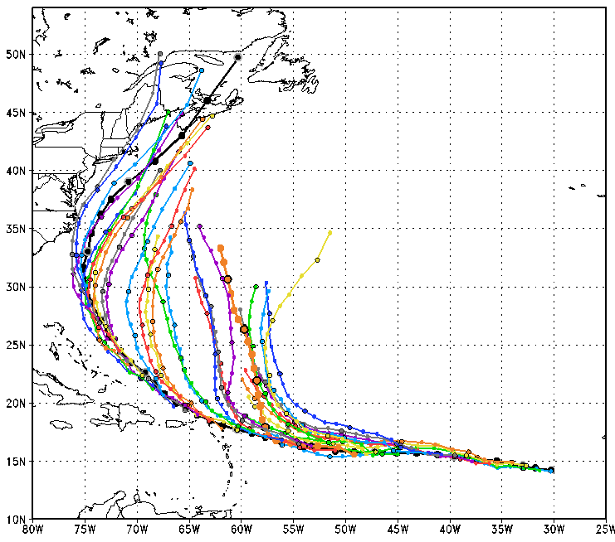
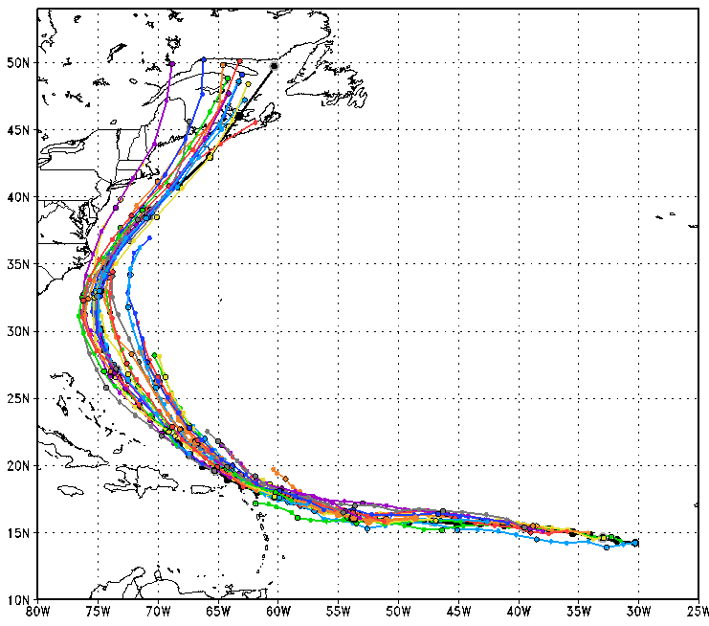
Operational forecast initialization
  GFS environmental flows
  Vortex init
  GSI DA for deep cases
Experimental forecast initialization
  HWRF environmental flows
  Vortex init
  GSI DA for deep cases
Genesis Model forecast initialization
  HWRF-cycled environmental flows
  GSI DA for all cases
Credit: K. Yeh
Notes:
HWRF track forecast is improved by 30% for 3-day fcst, and 20% for 5-day fcst, based on 33 cases of Earl (2010)

Slide 30
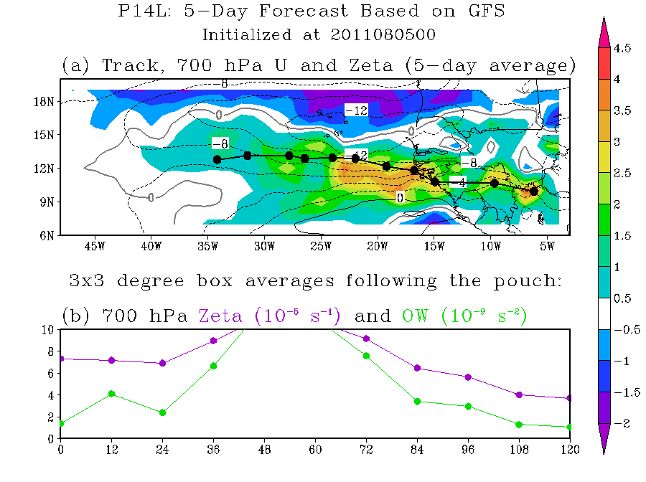
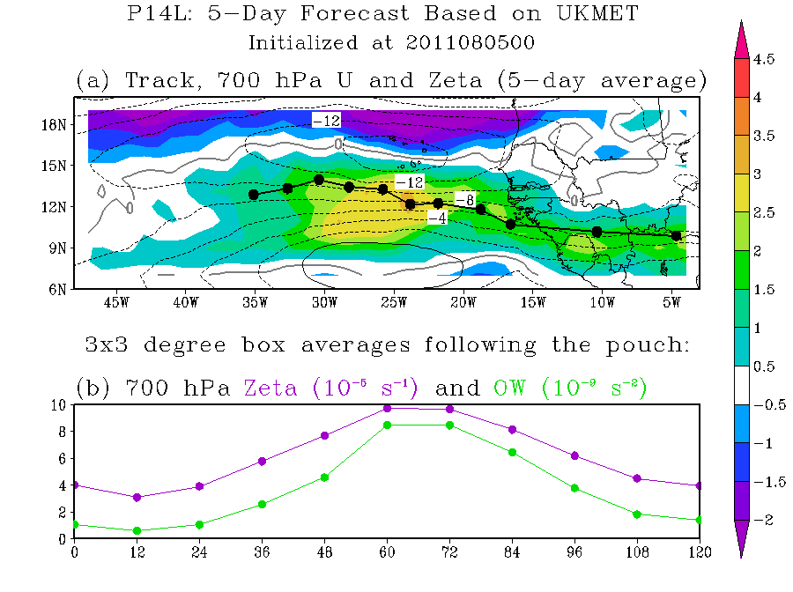


Genesis application
GFS
UKMET
HWRF-GEN can forecast the pouch coming off the W. Africa coast like global model
Faster than global model forecast
NOGAPS
HWRF-GEN
Credit: M. Boothe

