Slide 1
Composite Structure of Rapidly Deepening HWRF TCs
Wallace Hogsett and David Zelinsky
National Hurricane Center

Slide 2
Outline
Background
Data and Methodology
Horizontal composite structure
Composite hodographs
Vertical composite structure (not today)
Composite warm core structure (not today)

Slide 3
Background and Objectives
TC intensification (TS-to-HU) remains a mysterious process, particularly the roles of axisymmetric/asymmetric processes and vertical shear.
Mesoscale models provide dynamically consistent datasets, and much can be learned from analysis of their 4-D output.
In this study, we choose cases of rapidly deepening (RD) HWRF TCs, regardless of track/intensity errors, and create a composite RD TC.
Goal: Obtain hints about the general mesoscale processes that may lead to and operate during RD.

Slide 4
Composite TC - Case Selection
Criteria:
Operational HWRF nest (9km)
2011 only
≥ 20mb/24hrs
TS to HU
No land
“RD onset” marks a pressure fall acceleration.
“RD onset” f24h or after
“RD-12h” and “RD+12h” bound the RD onset
Total cases: 20
Mean intensity: 49kts at RD onset, 74kts at RD+24h (meets SHIPS RI threshold)
Above: Example time series from one case of RD, demonstrating how the relevant data points are chosen.

Slide 5
Composite TC Caveats
Caveats are too many to list, but include:
Storm size differences
Storm motion differences
Sample size
Latitude
Contamination by localized convective processes
Synoptic environment differences

Slide 6
Composite TC Structure
Consistent with an intensifying TC,
850mb RMW decreases,
P_{min} decreases and V_{max} increases,
Upper-level warmcore… warms.
More interestingly,
Storm-relative wind asymmetry occurs in northern half of circulation,
Midlevel circulation center and UL warm core are tilted NE of low-level center at RD-12h,
Composite TC appears to be sheared.
Right: 20-member HWRF “RD evolution composite” of 850-hPa storm-relative wind (shaded, kts) and MSLP (black contours at 2 hPa intervals) from (a) 12-h prior to the onset of RD, (b) at the onset of RD, and (c) 12-h after the onset of RD. 300 hPa T' (dashed red contours at 0.5 K intervals), as well as 400-hPa streamlines, are superposed. T’ is calculated with respect to the Jordan (1958) mean hurricane season sounding. Note: 300 hPa is the level of the strongest warm core.

Slide 7
Composite TC Structure
Reflectivity and vertical motion fields also suggest a northwesterly-sheared composite TC.
Precipitation and upward motion are mostly confined to the northeastern half of the storm.
The local shear is strongest in vicinity of strongest convection.
Right: As in Fig. 2, but with 850-hPa radar reflectivity (shaded, dBZ) and 850-hPa vertical motion (black contours at 0.5 hPa s⁻¹ intervals). Local 850 – 400 hPa vertical shear vectors are superposed.

Slide 8
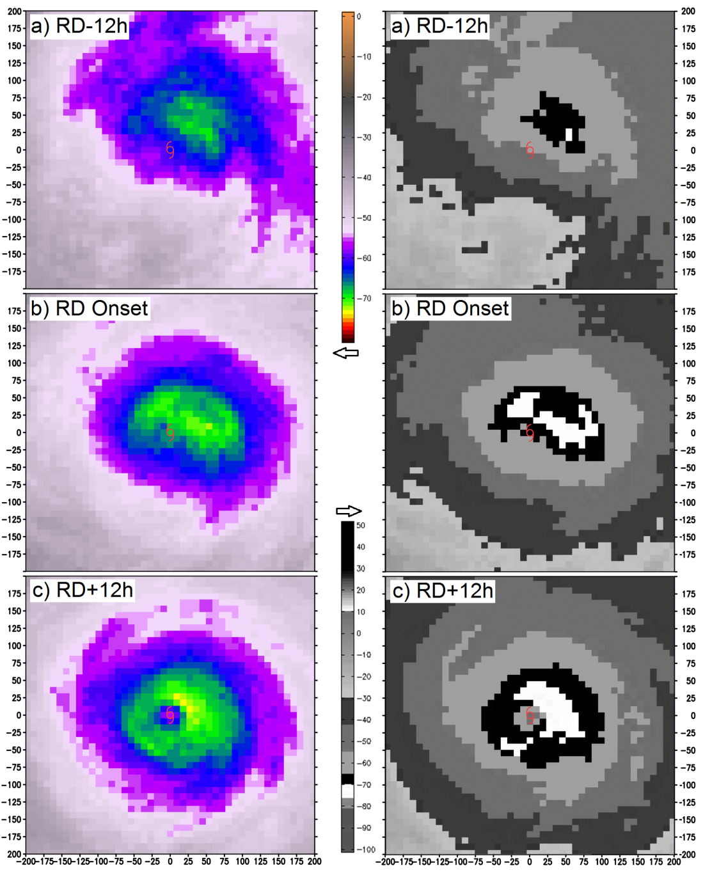
Composite HWRF Satellite Imagery
GOES Water Vapor GOES IR
From a satellite point of view, the TC also takes on a WN-1 appearance initially and evolves to near-axisymmetry by RD+12h.
The satellite presentation at RD+12h is noticeably more asymmetric than the vertical motion and precipitation fields (prev slide).
Above: As in Fig. 2, but for the simulated GOES channel 3 water vapor (left panel) with NRL WV enhancement and simulated GOES channel 4 infrared imagery (right panel) with Dvorak enhancement.

Slide 9
Composite Hodographs
Non-negligible westerly shear is present throughout the RD process, but it is confined below 200mb.
Shear is maximized in the 900-400-hPa layer.
This is consistent with the vortex structure shown previously, with a vortex tilt and convective asymmetry to left of the 900-400mb shear vector.
tilt
shear
Above right: As in Fig. 2, but for the area-averaged hodographs within the 250 x 250 km area bounded by Fig. 2. Shear magnitude between each level and 900 hPa is denoted on the right panel. The heavy black dot on each hodograph denotes the approximate storm motion (SM), calculated as a mean wind in the 950 – 400 hPa layer.

Slide 10
Clockwise-turning Hodographs
Many previous studies show that intensifying TCs are characterized by clockwise-turning inner core hodographs, similar to that shown in the composite.
Convective dynamics within this helical environment are the focus of ongoing study.
Right: clockwise-curved hodographs from (top) the current study, (middle) Hogsett and Zhang (in prep), and (bottom) Reasor and Eastin (2011). Many other examples exist.

Slide 11
Conclusions
Rapid deepening in this study appears to be a primarily asymmetric process occurring without significant deep layer vertical shear.
Composite inner core hodographs reveal 7-9kts of northwesterly shear in 900-400-hPa layer, within which the composite hodograph turns clockwise with height.
HWRF RD TCs remain asymmetric throughout RD.
The relationship between shear, tilt, and convective asymmetries appears consistent with theory and observations. E.g. the left-of-shear tilt.
Are the models able to capture this structure at t=0?
Next step: Understand how these asymmetric convective elements interact locally with vertical shear.
** Thanks to Vijay and the EMC HWRF team for archiving the operational data!

