Slide 1
Evaluation of the HRD Radar Software Analysis using Synthetic Data
Sylvie Lorsolo, John Gamache, Altuğ Aksoy

Slide 2
Goals
Evaluate HRD radar software analysis
Improve the software
Evaluate the pressure retrieval method derived from the wind analysis

Slide 3
Synthetic Data
Simulated flight:
Flight level : 3 km
Attitude : No crab angle, no pitch, roll or drift
Horizontal Resolution : ~700 m between plane position
Track: 90 deg (Due East)
Model Data:
Paloma Nature Run (Aksoy et al. 2010)
Horizontal Resolution(km): 4.5/1.5
Threshold on CWC : 7.5×10⁻⁵ g kg⁻¹
Data simulated at one single time for better comparison

Slide 4
Analysis
Parameters:
Resolution: 2km/0.5km
Interpolation Scheme: Gaussian
E-folding distance : 2 km/0.5km
Radius of influence : 4km/1km
No dBZ
Melting level height and width: 5.5 km/2 km
Smoothing

Slide 5
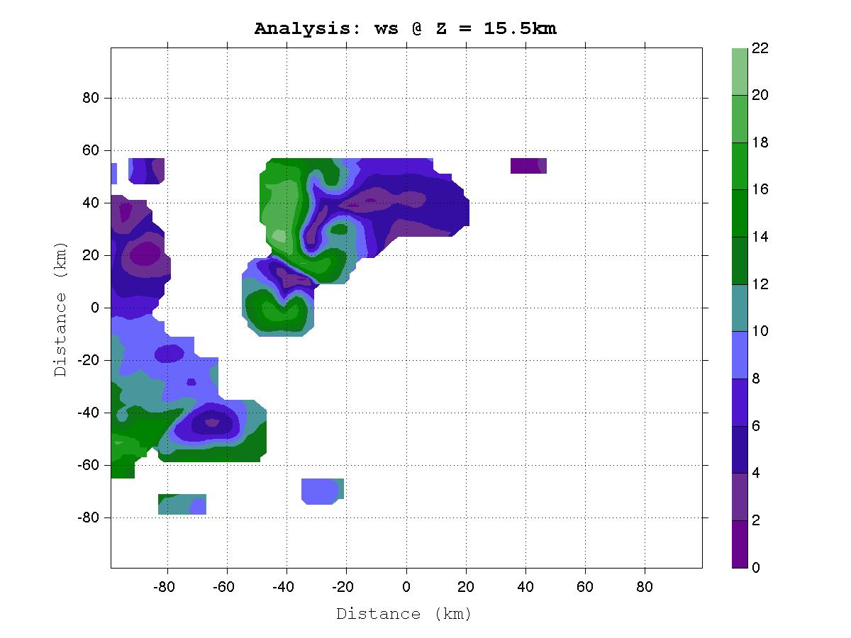
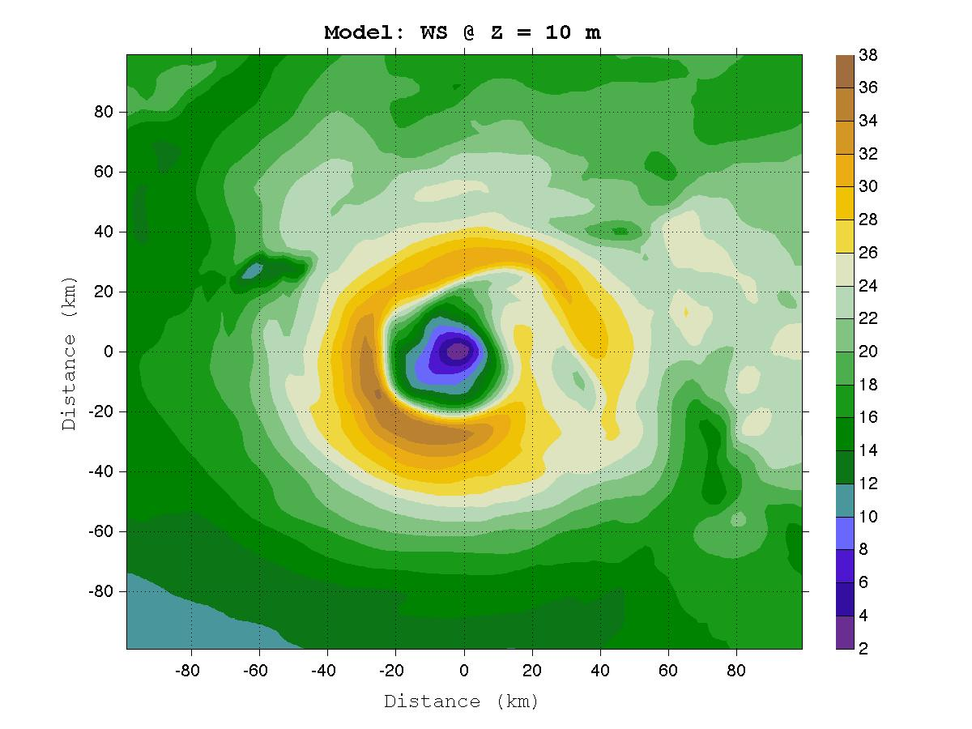
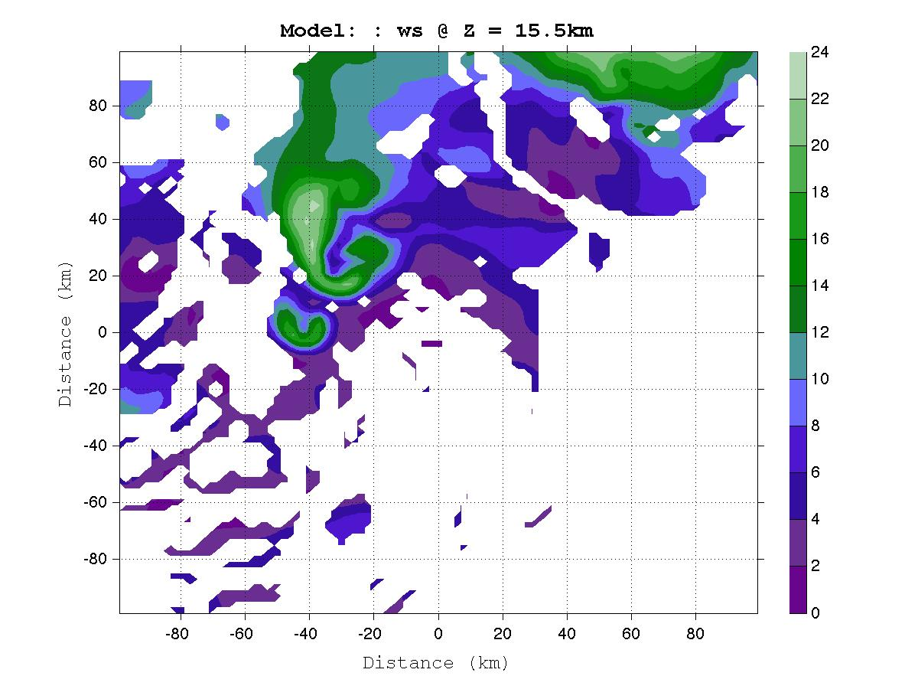
Horizontal Wind Speed

Slide 6
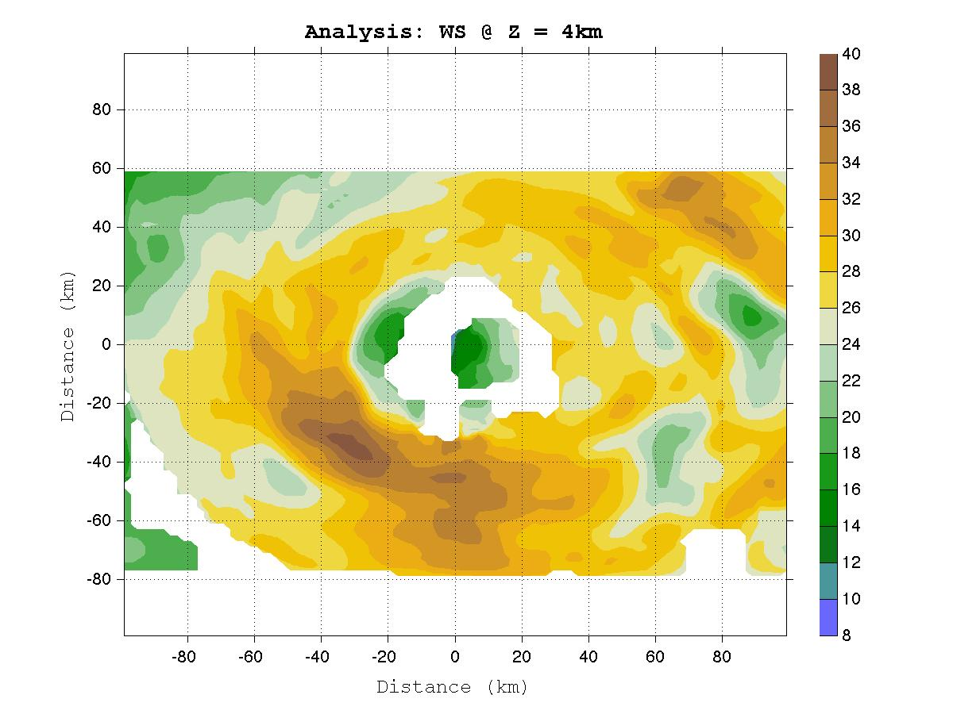
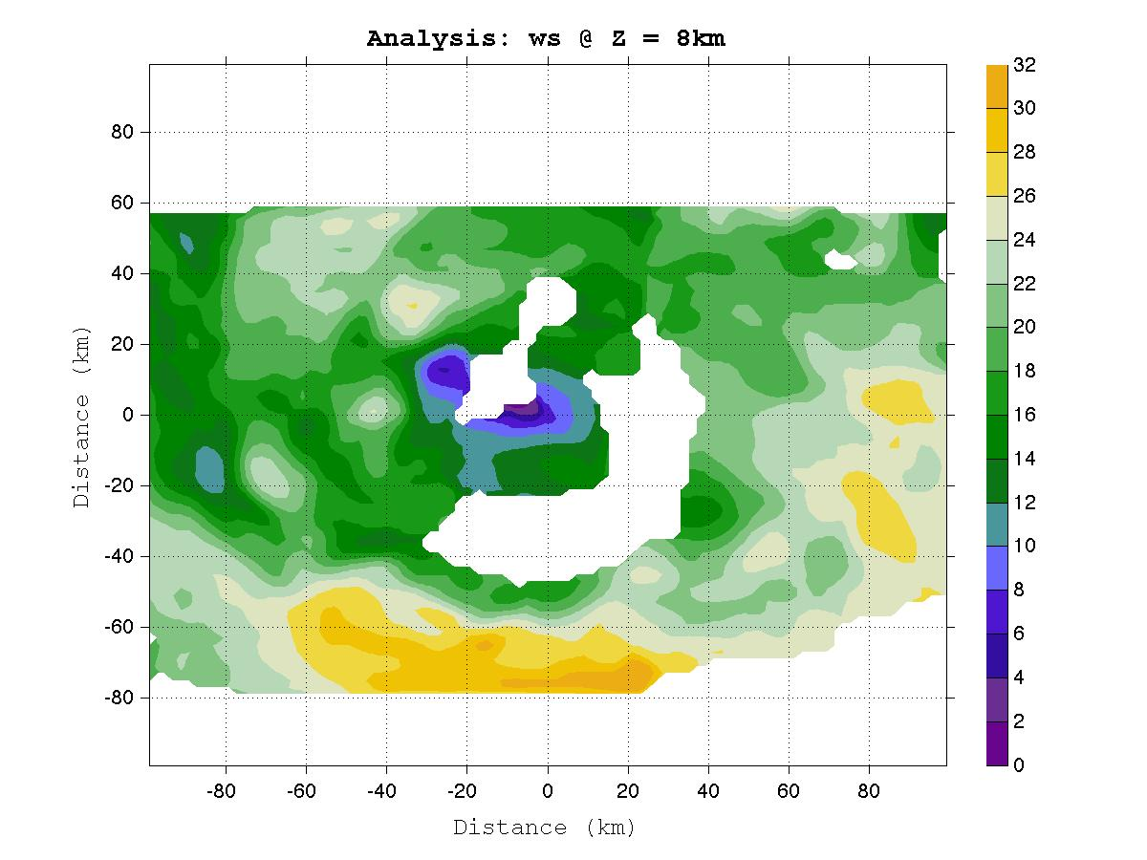
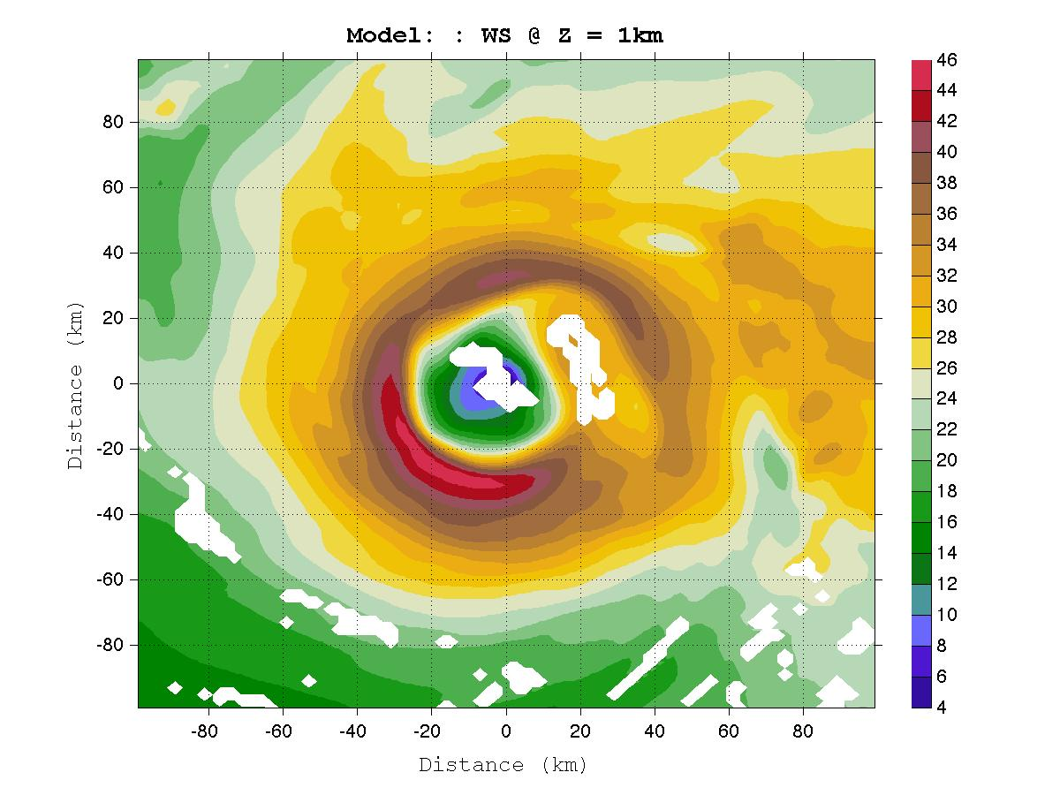
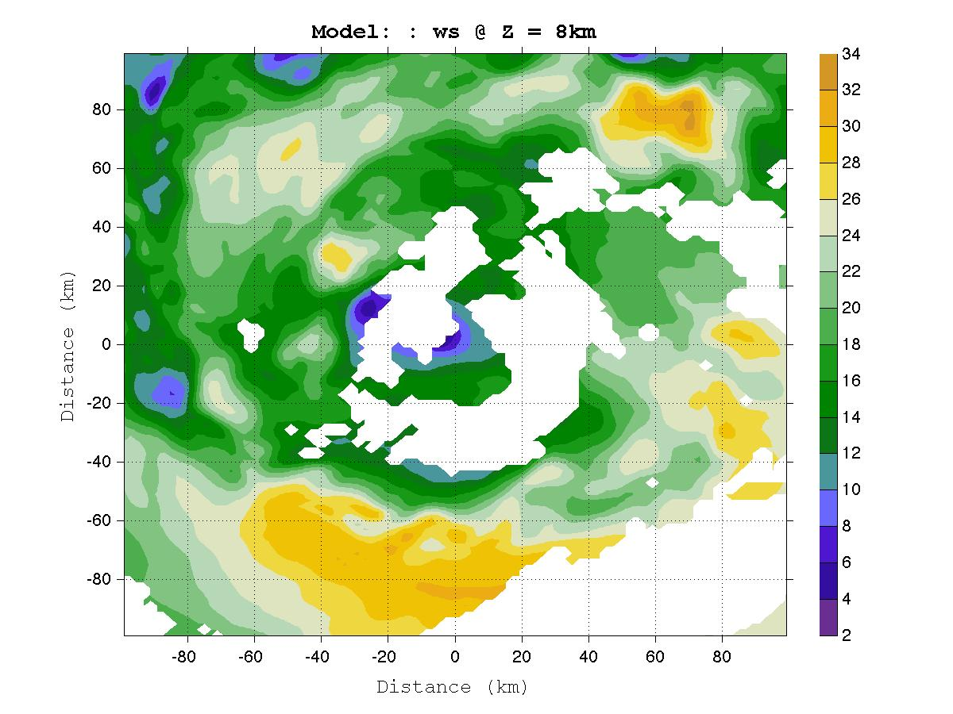
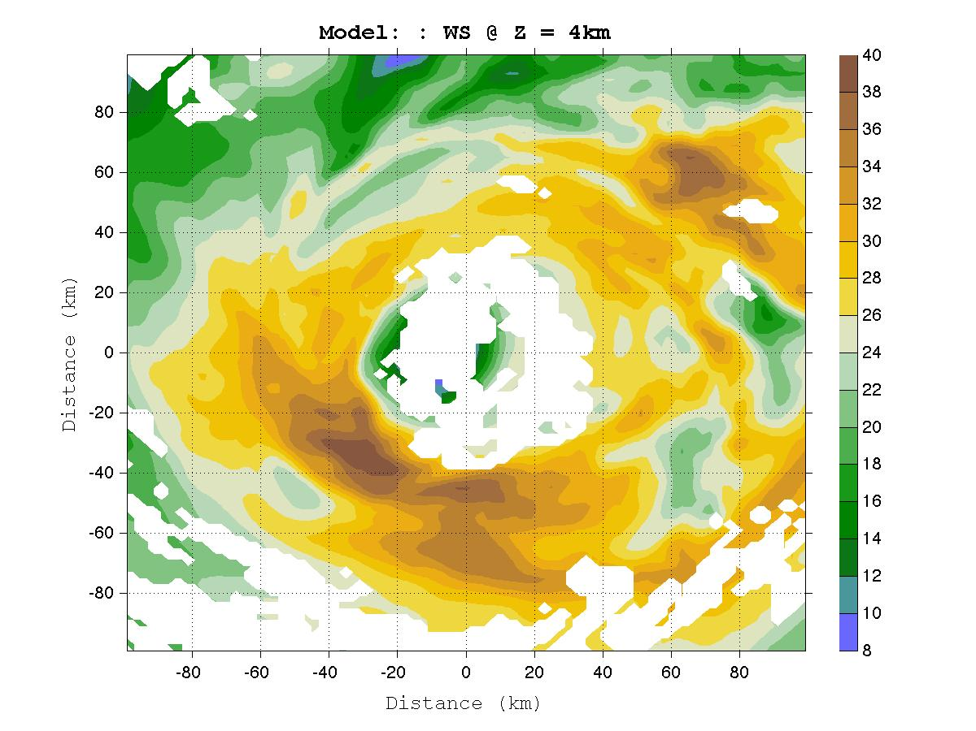
Horizontal Wind Speed

Slide 7
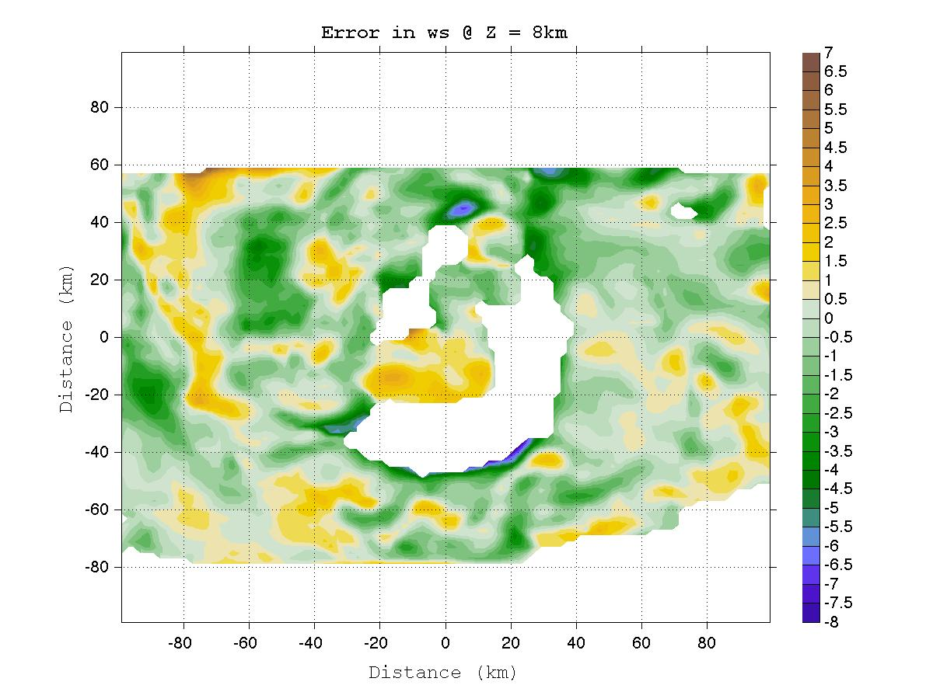
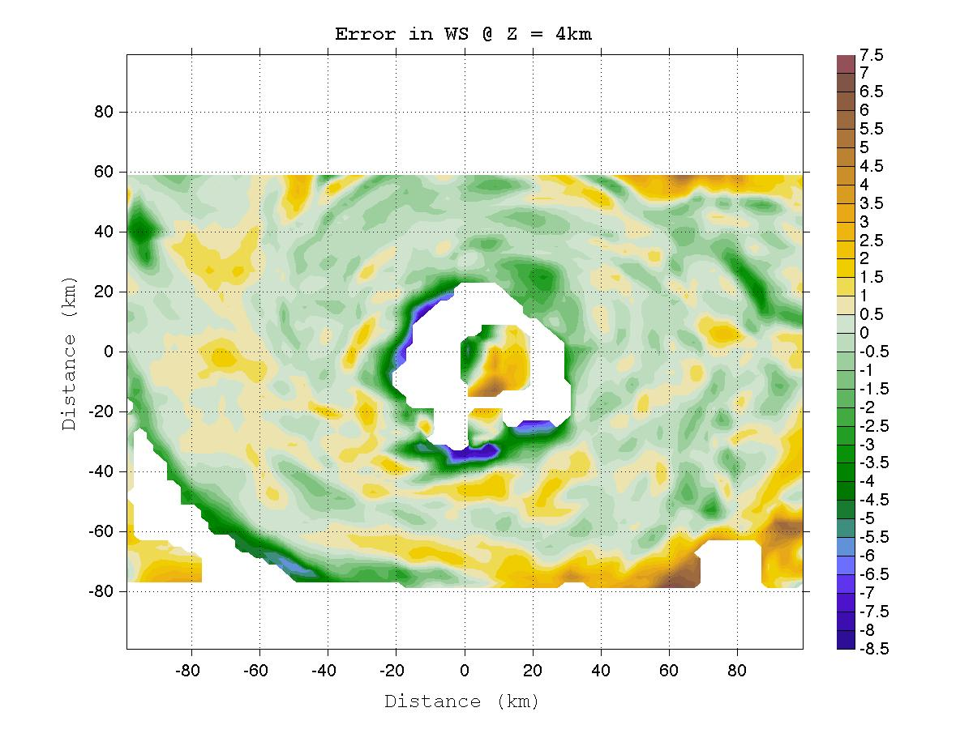
Error Field: WS_model – WS_analysis
m/s

Slide 8
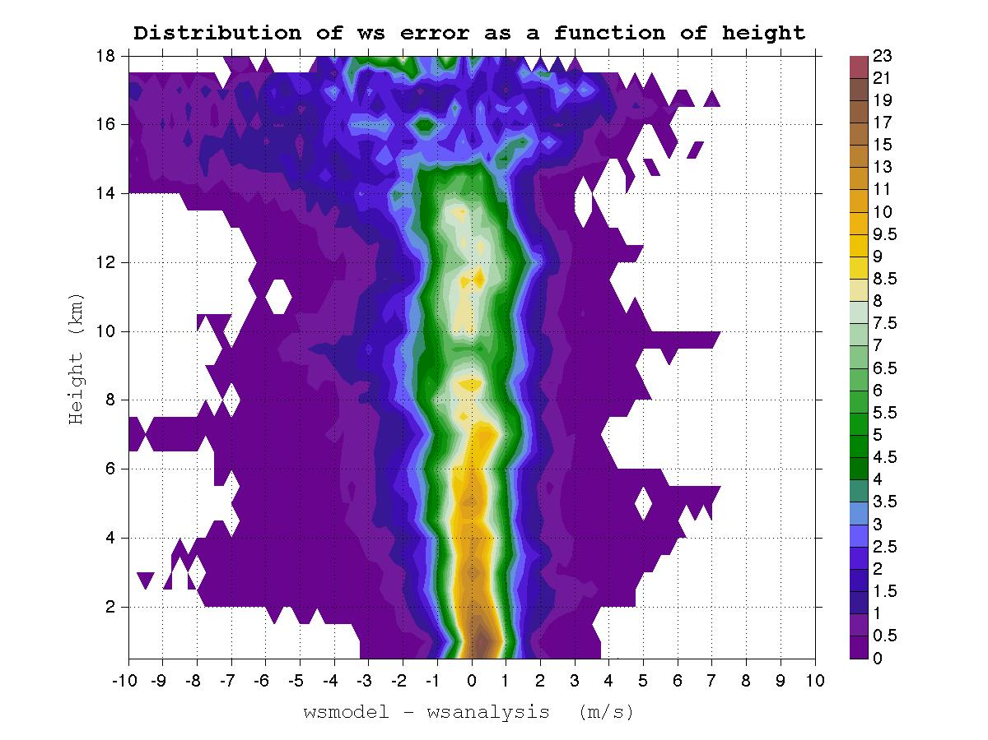
Error Distribution
%

Slide 9
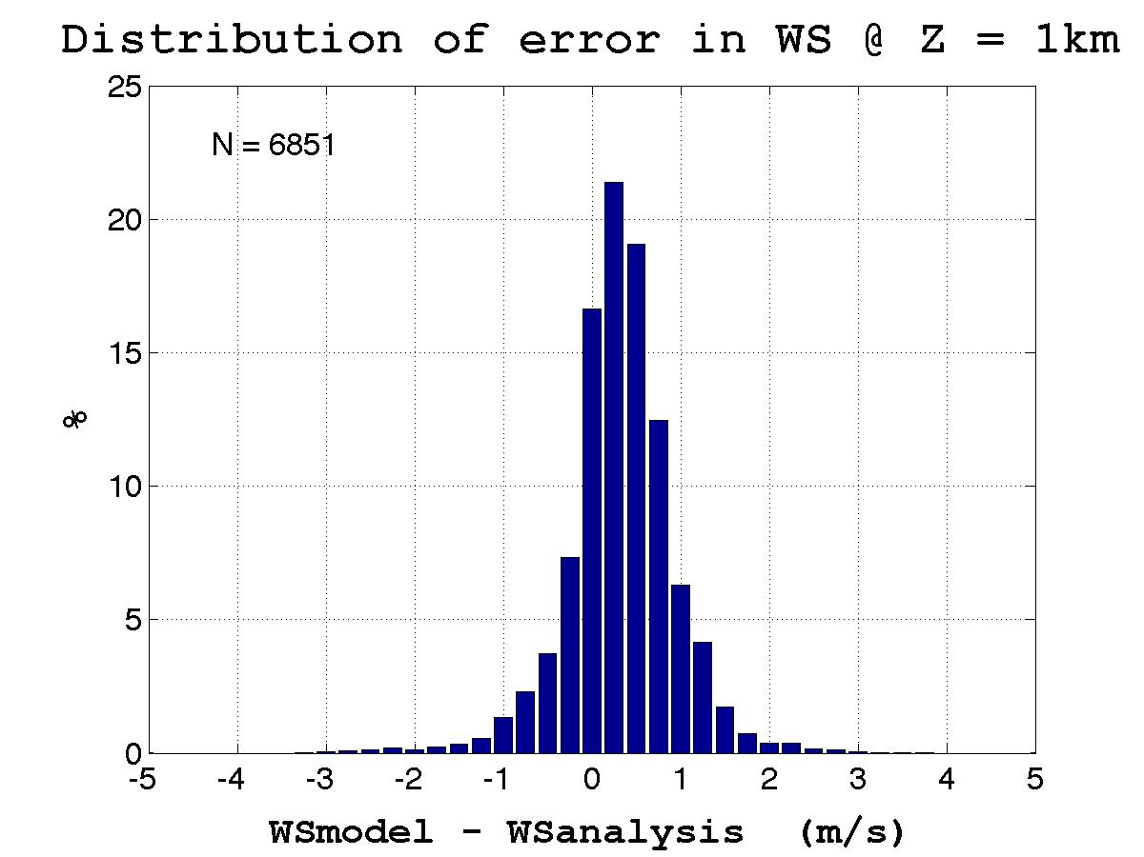
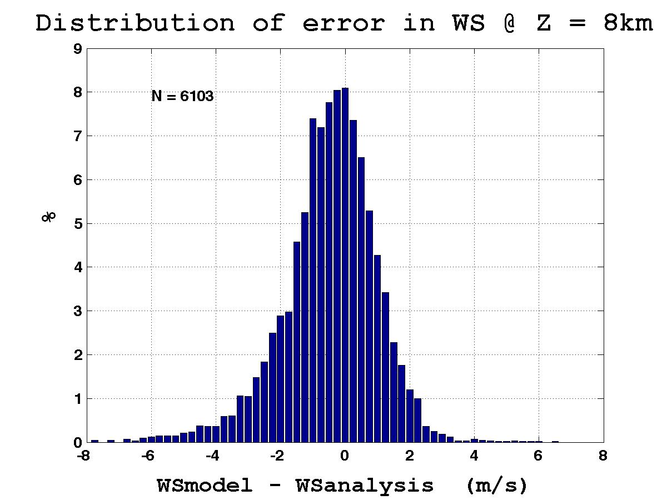
Error Distribution

Slide 10
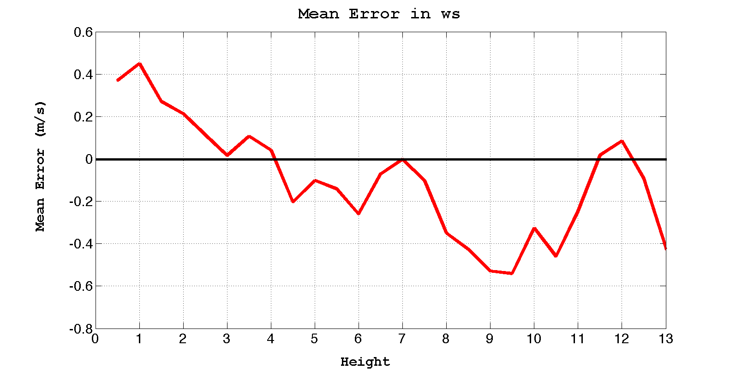
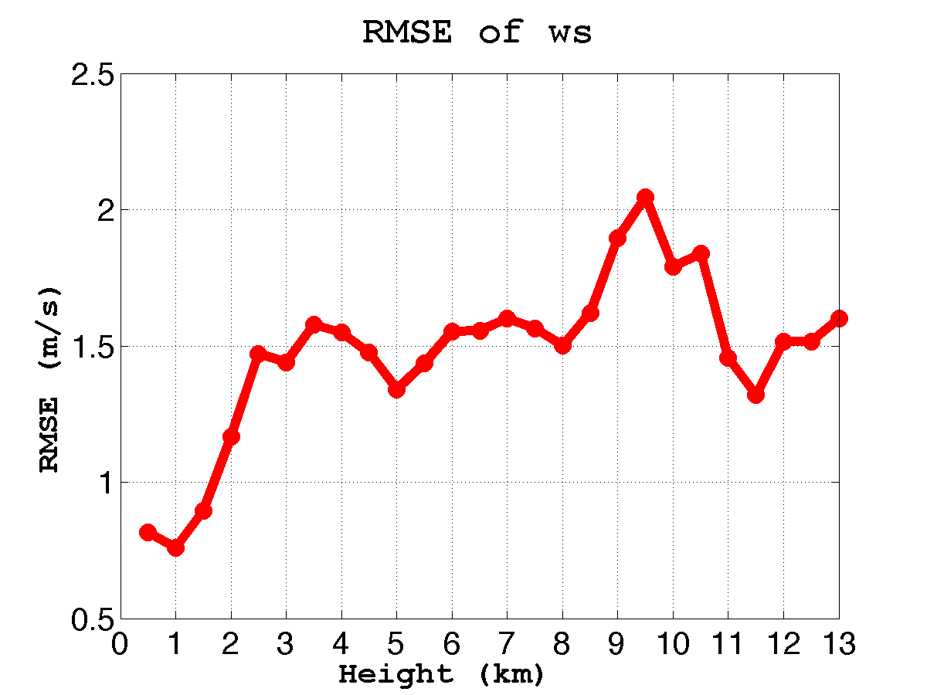
Mean Error and RMSE

Slide 11
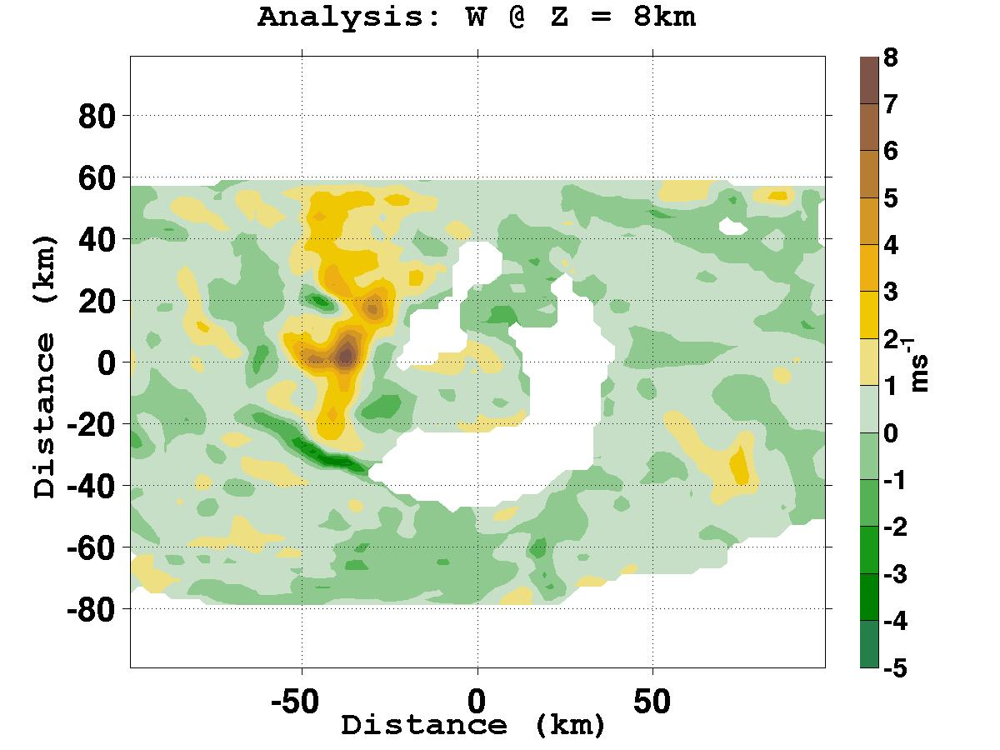
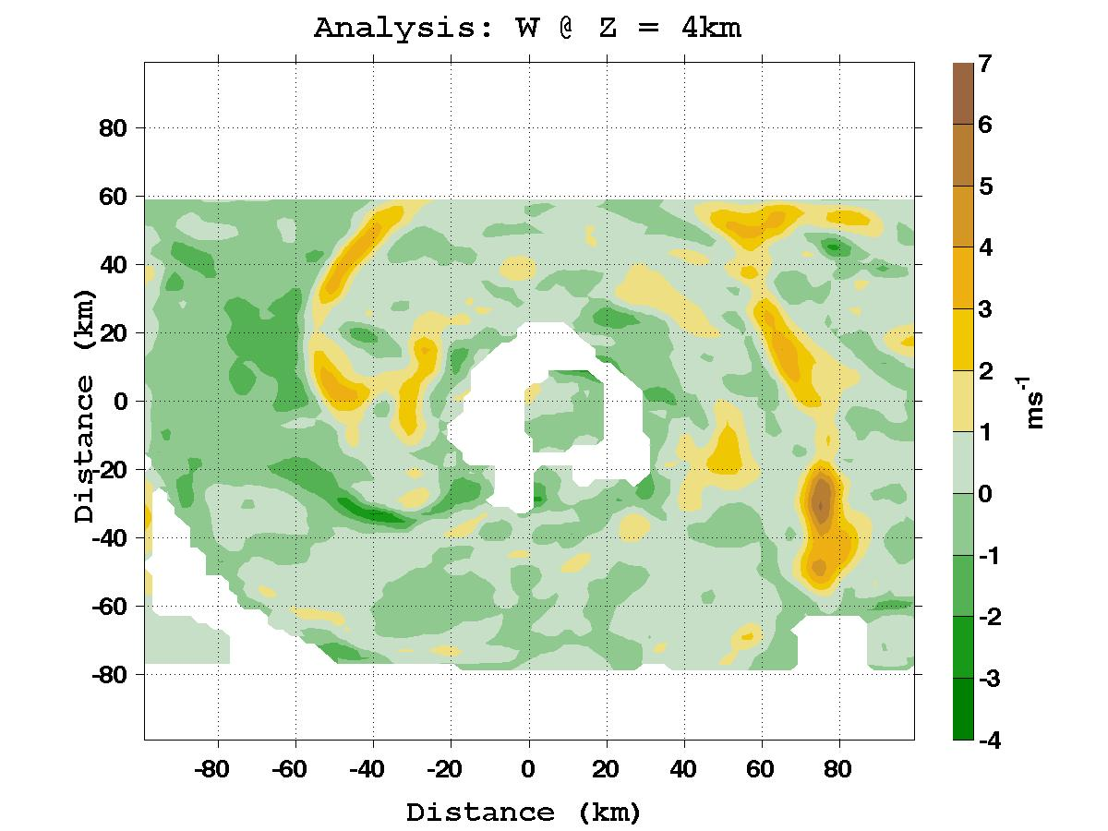
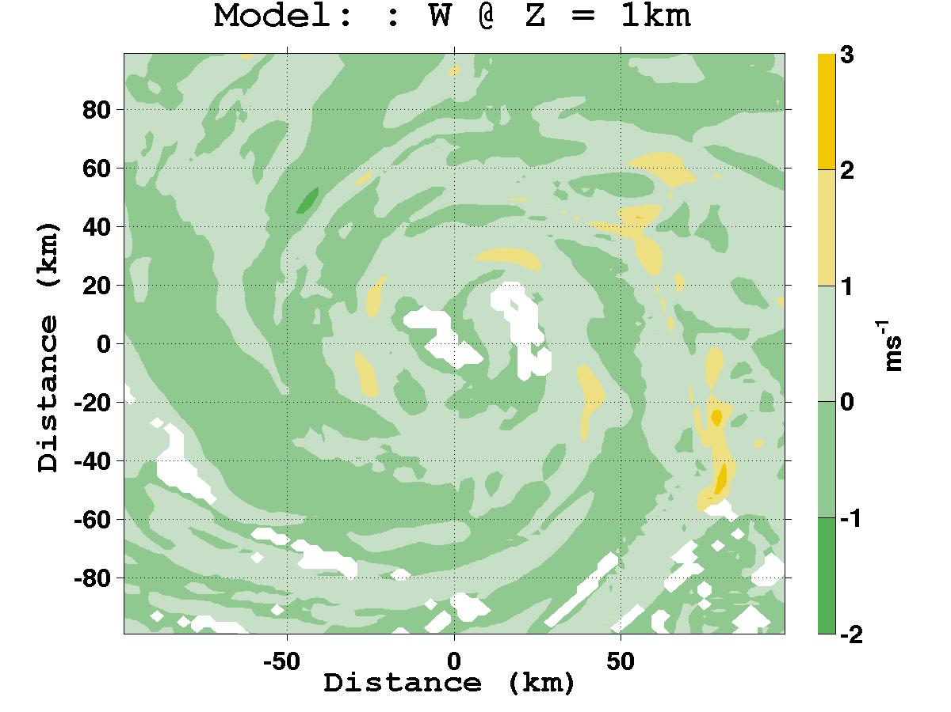
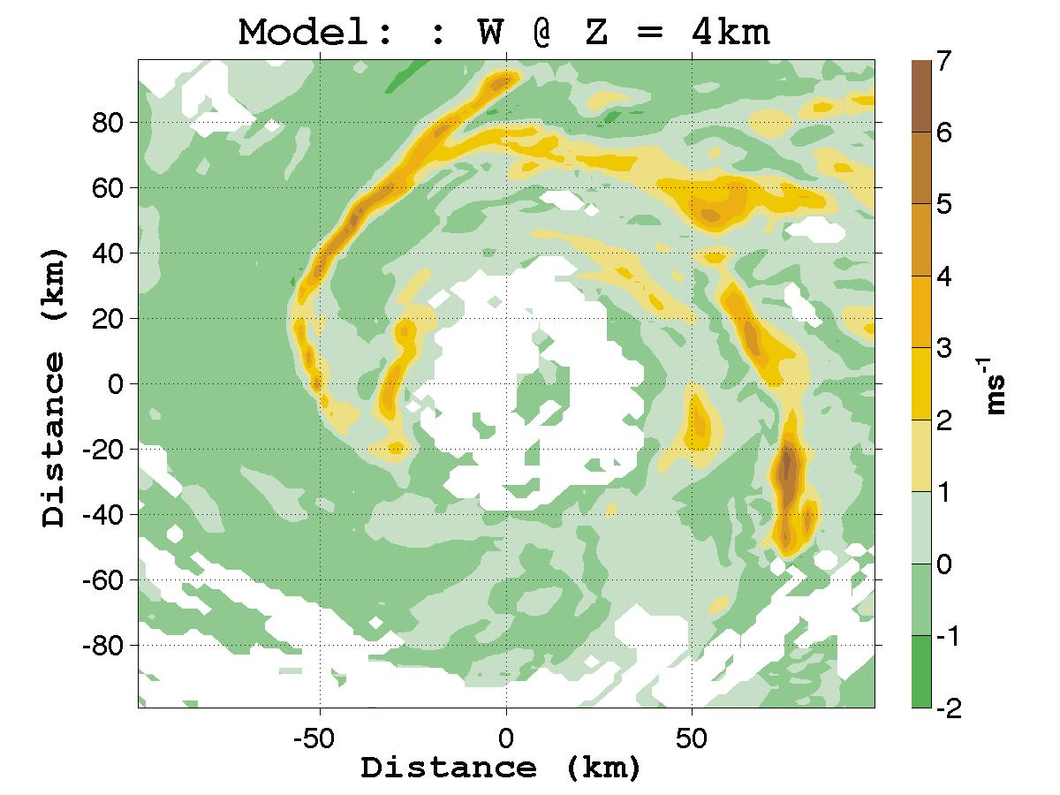
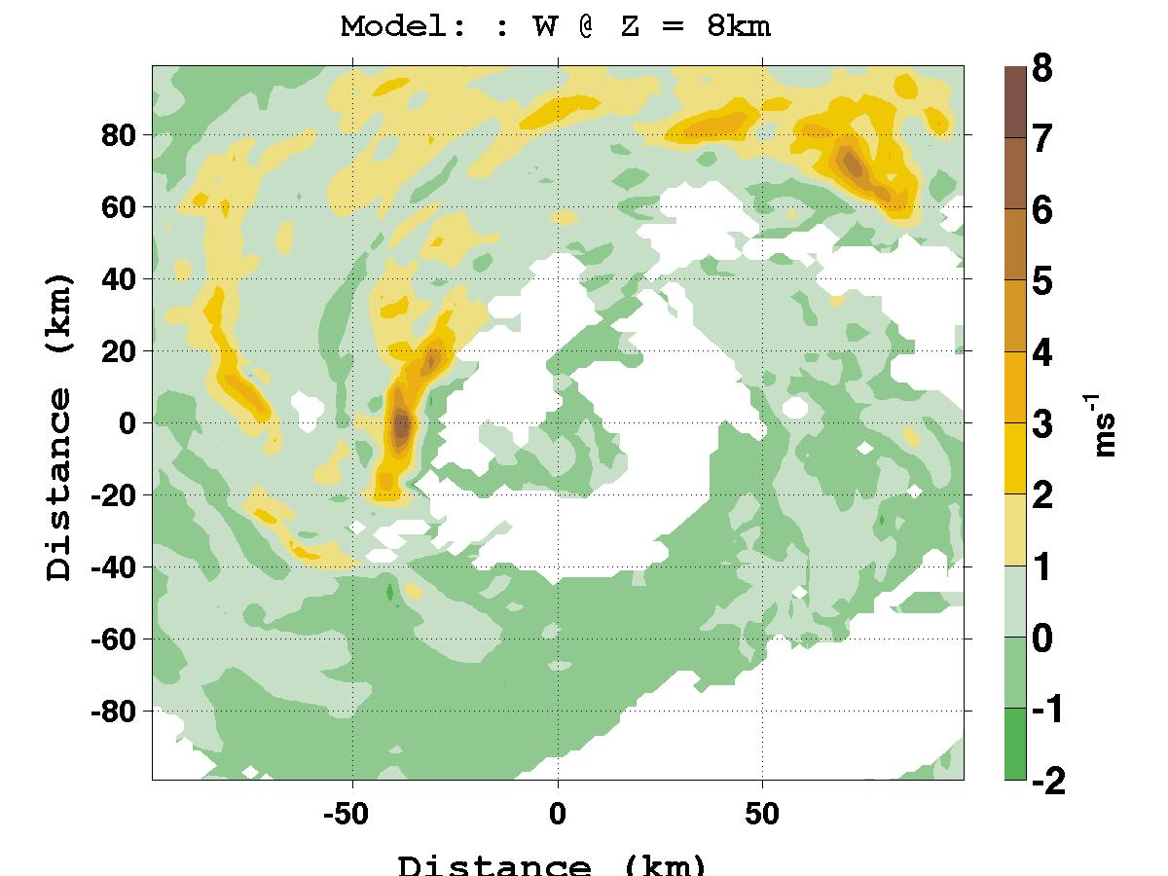
Vertical Wind Speed

Slide 12
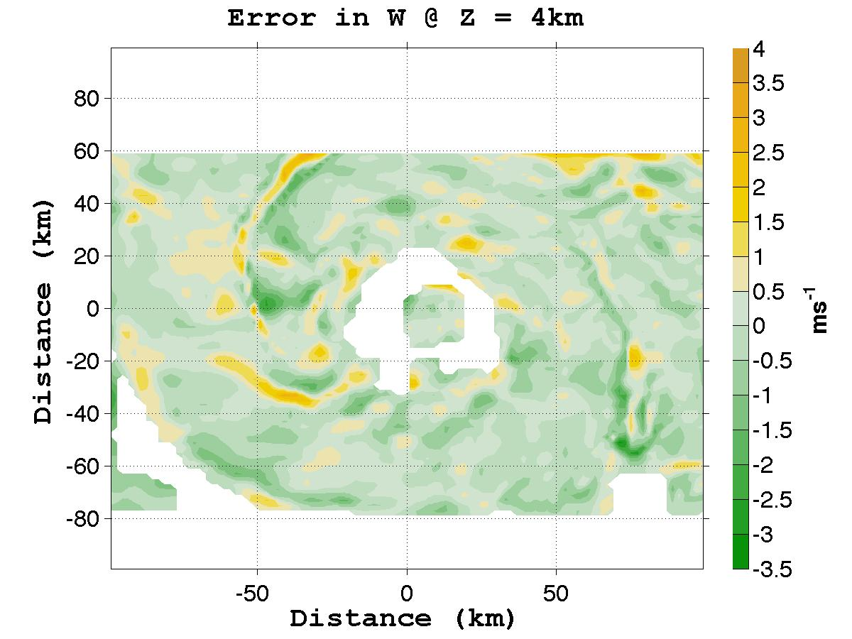
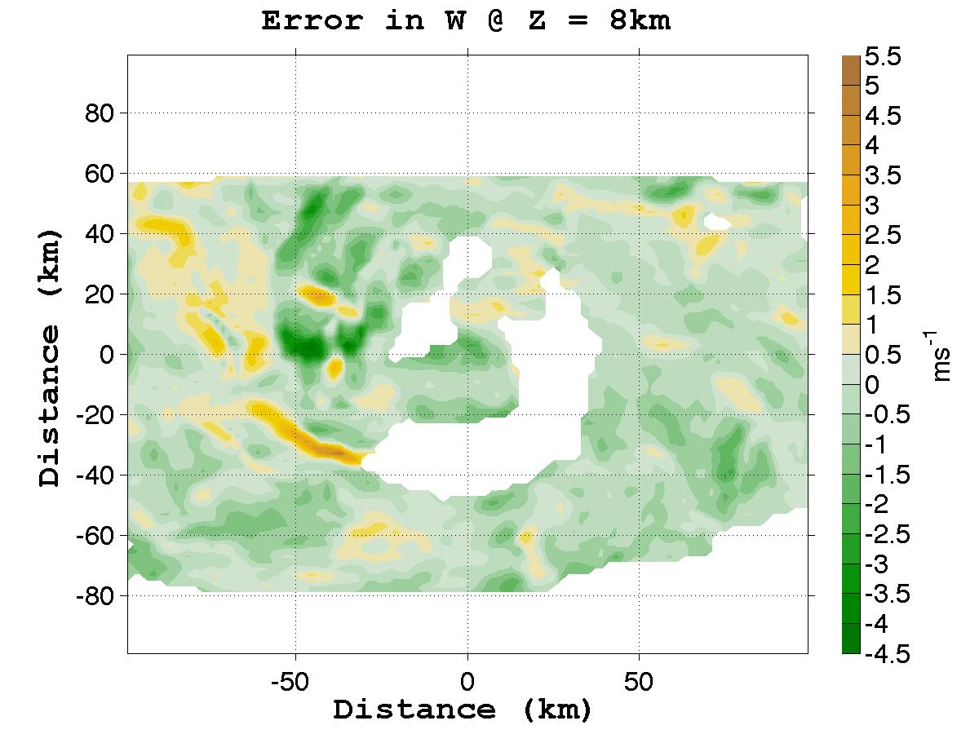
Error Field: W_model – W_analysis

Slide 13
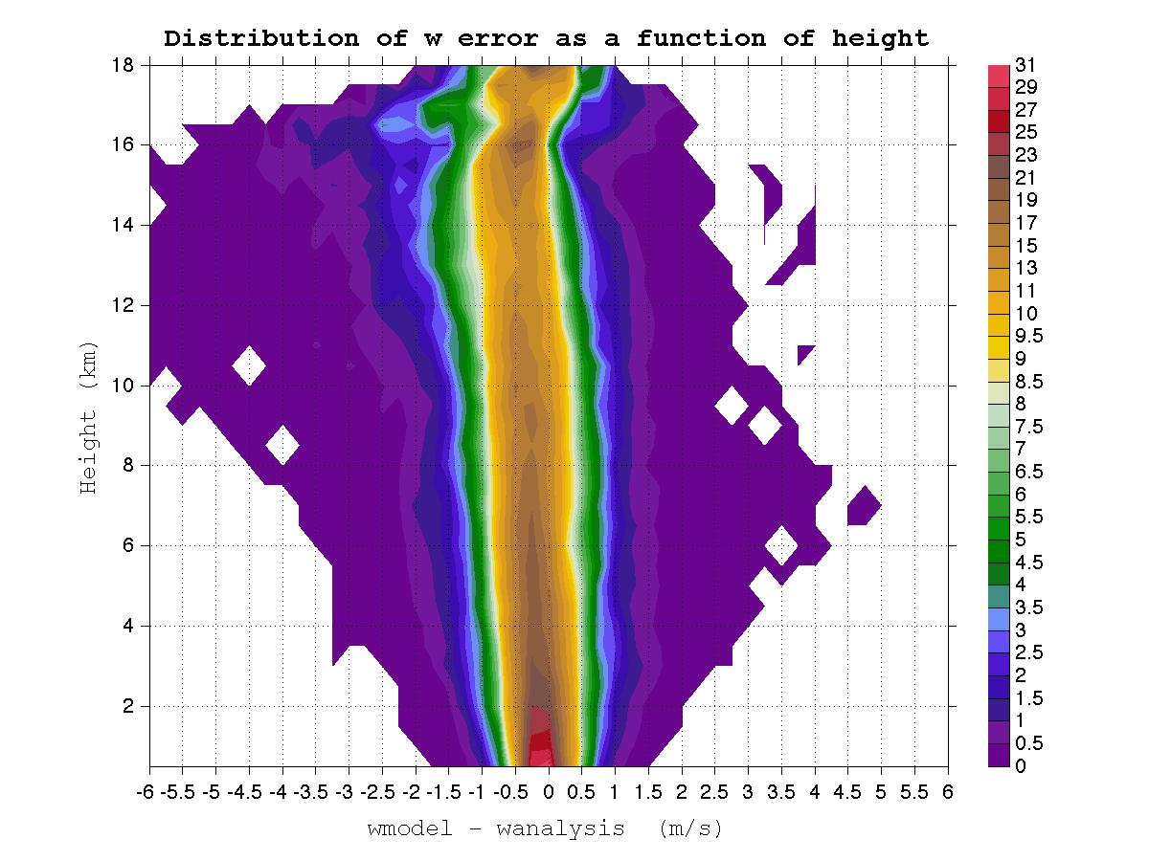
Error Distribution
%

Slide 14
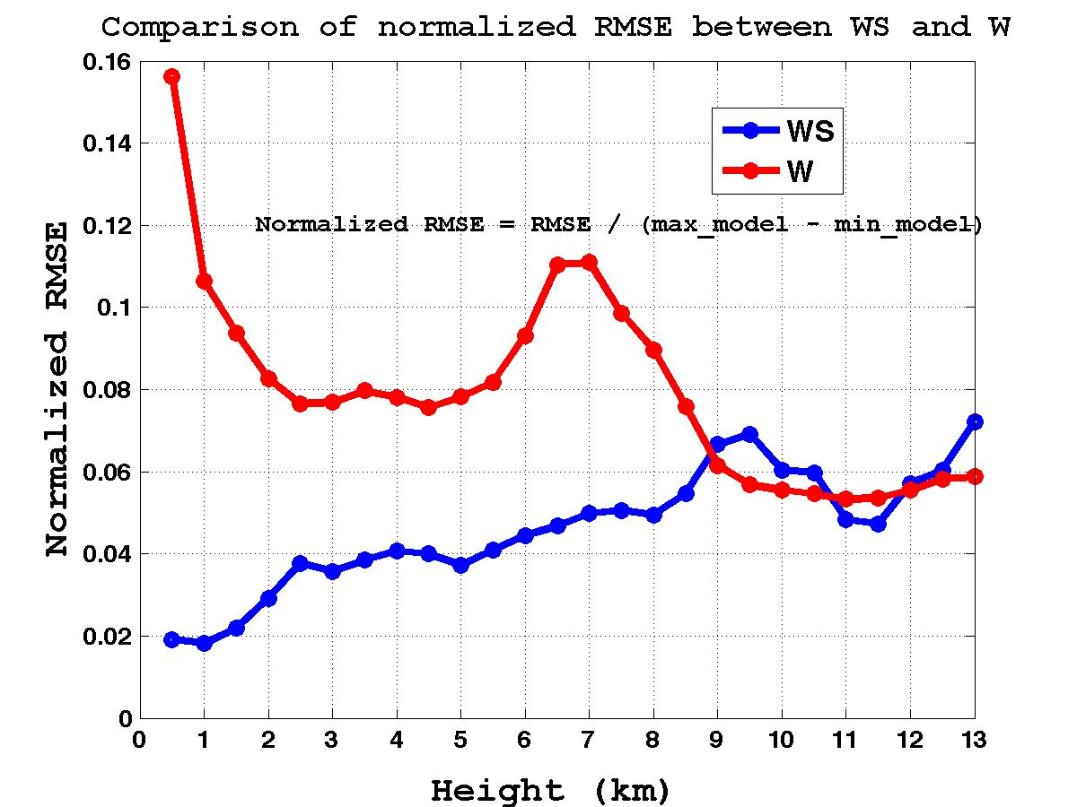
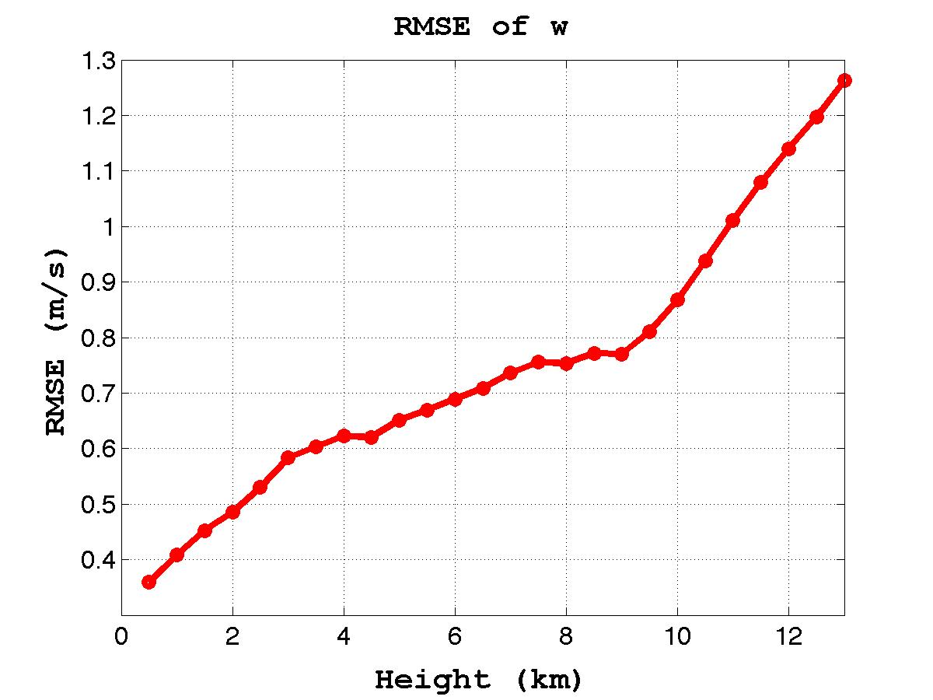
Accuracy

Slide 15
Future Work
Vertical/azimuthal structure diagnosis
Updraft/downdraft diagnosis
Gradient diagnosis
Max and min diagnosis (position, magnitude)
Sensitivity analysis to processing parameters (interpolation scheme, background weight)
U and V sensitivity to track

