Slide 1
Tropical Cyclogenesis Experiment (GenEx)
Primary IFEX Goal: 3 - Improve understanding of the physical processes important in intensity change for a TC at all stages of its lifecycle
Principal Investigator(s): Robert Rogers, Paul Reasor, and Wallace Hogsett (NHC)
Objectives
Collect observations within developing and non-developing tropical disturbances for which a “pouch” can be tracked (preferably with a model consensus), including tropospheric soundings of the disturbance environment and high-resolution measurements of 3D wind and reflectivity within the pouch;
Test existing theories for the formation of a TC surface circulation and warm core;
Provide datasets to data assimilation groups for system development in disturbance environments; evaluate HWRF performance in disturbance environments
Links to IFEX:
This experiment supports the following NOAA IFEX goals:
Goal 1: Collect observations that span the TC lifecycle in a variety of environments;
Goal 3: Improve our understanding of the physical processes important in intensity change for a TC at all stages of its lifecycle

Slide 2
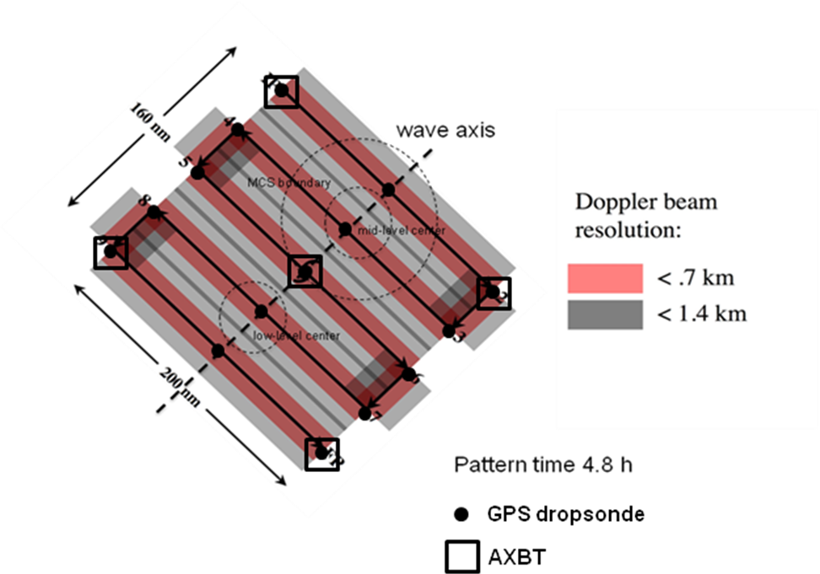
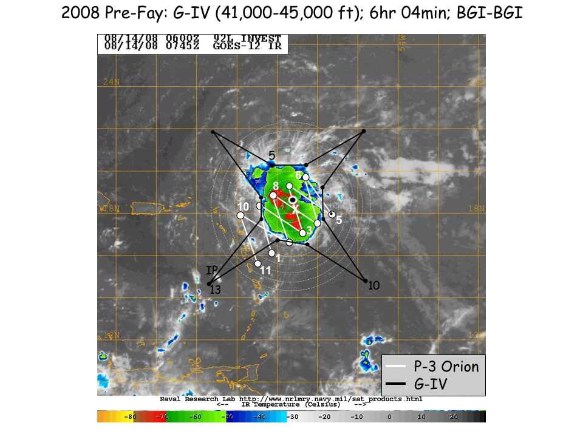
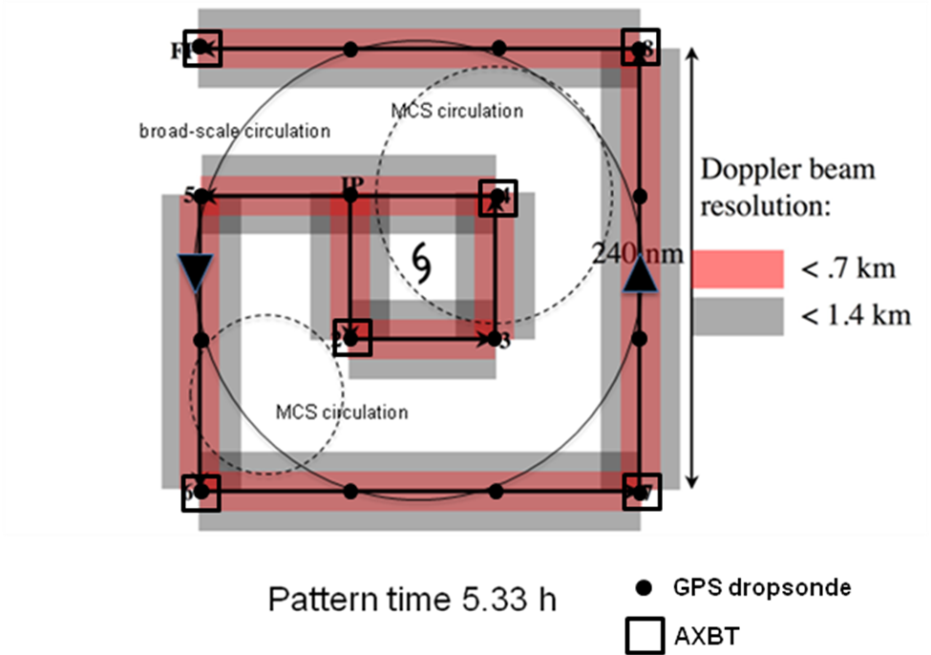
Tropical Cyclogenesis Experiment (GenEx)
Experiment Description
Objective #1: Collect observations within developing and non-developing tropical disturbances for which a “pouch” can be tracked (preferably with a model consensus), including tropospheric soundings of the disturbance environment and high-resolution measurements of 3D wind and reflectivity within the pouch
Optimal Experiment P-3 Lawnmower
Optimal Experiment P-3 Square Spiral
Coordinated G-IV with dropsonde locations
Note: When possible, NASA Global Hawk aircraft will fly coordinated (vertically-stacked) patterns with NOAA P-3

Slide 3
Objective #2: Test existing theories for the formation of a TC surface circulation and warm core
Tropical Cyclogenesis Experiment (GenEx)
Hypotheses and Questions
The “pouch” within a larger synoptic-scale wave is a preferred location for tropical cyclogenesis where horizontal deformation is weak, air is repeatedly moistened by convection, and protection from horizontal dry air intrusion and vertical shear occurs (Dunkerton et al. 2009)
Aggregation of cyclonic vortical remnants generated by convection and inward advection of convectively-enhanced vorticity by the circulation driven by aggregate heating are key processes responsible for the formation of the surface circulation and generation of the warm core (Montgomery et al. 2006)
Dry air impacts tropical cyclogenesis primarily by limiting the vertical growth of convectively-generated vorticity, and not by the production of stronger convective downdrafts per conventional wisdom (Kilroy and Smith, 30th Conference on Hurricanes and Tropical Meteorology)
Convective systems that ingest low-level flow rich in helicity preferentially produce low-level cyclonic vorticity and accelerate near-surface spin-up
What is the role of vertical wind shear during tropical disturbance development?
Can clear observational evidence of vortex mergers within a tropical disturbance be obtained?

