Slide 1
EMC TDR real time parallel experiments for Hurricane Irene

Slide 2
Data received in real-time
Time | Received | Complete | Time | Received | Complete
2011082400 | yes | yes | 2011082412 | yes | No Only last leg
2011082512 | yes | No Only first two legs | 2011082600 | no | N/A
2011082612 | no | N/A | 2011082700 | yes | not sure
2011082712 | yes | yes

Slide 3
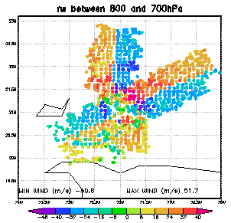
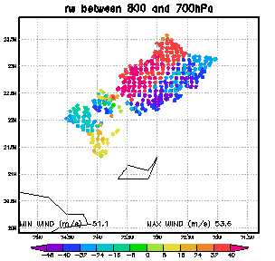
TDR radial velocity data assimilated in inner analysis domain
2011.08.24 00 UTC
2011.08.24. 12 UTC

Slide 4
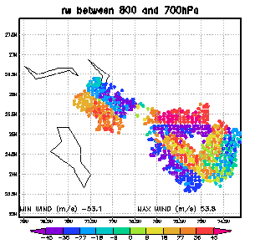
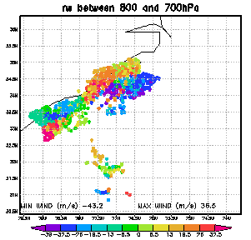
TDR radial velocity data assimilated in inner analysis domain
2011.08.25 12 UTC
2011.08.27. 00 UTC

Slide 5
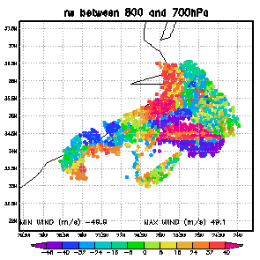
TDR radial velocity data assimilated in inner analysis domain
2011.08.27 12 UTC

Slide 6
experiment | TDRP | TDRA | TDRB | TDRC | NTDR
Assimiate TDR Vr data | yes | yes | yes | yes | no
background | Full HWRF vortex initialization | Relocate vortex only | Full HWRF vortex initialization | Relocate vortex only | Full HWRF vortex initialization
GSI FGAT | no | yes | no | yes | no
Post balance | yes | yes | no | no | no

Slide 7
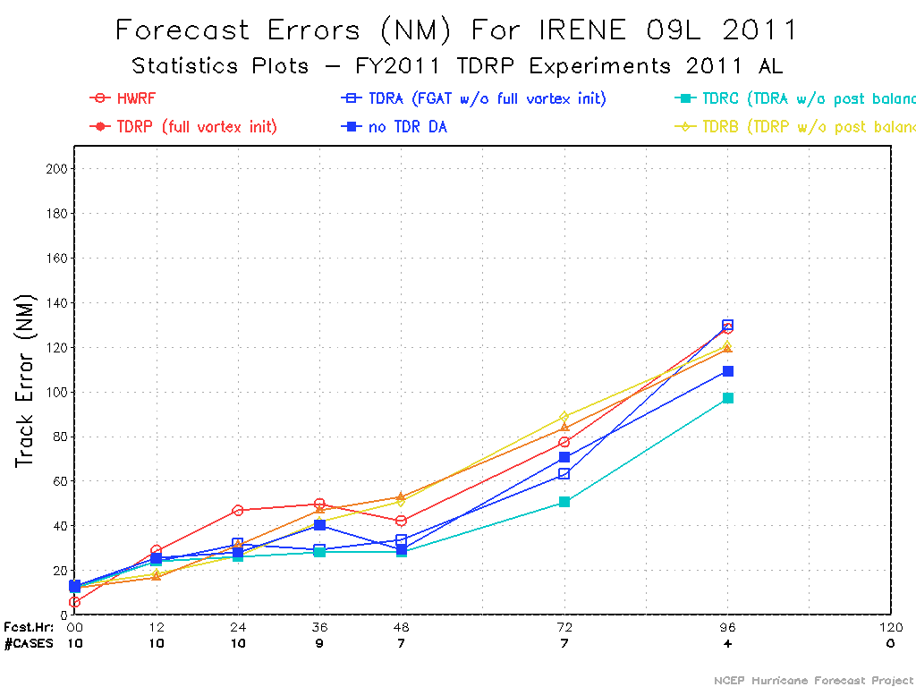
* TDRC has smaller track error than NTDR

Slide 8
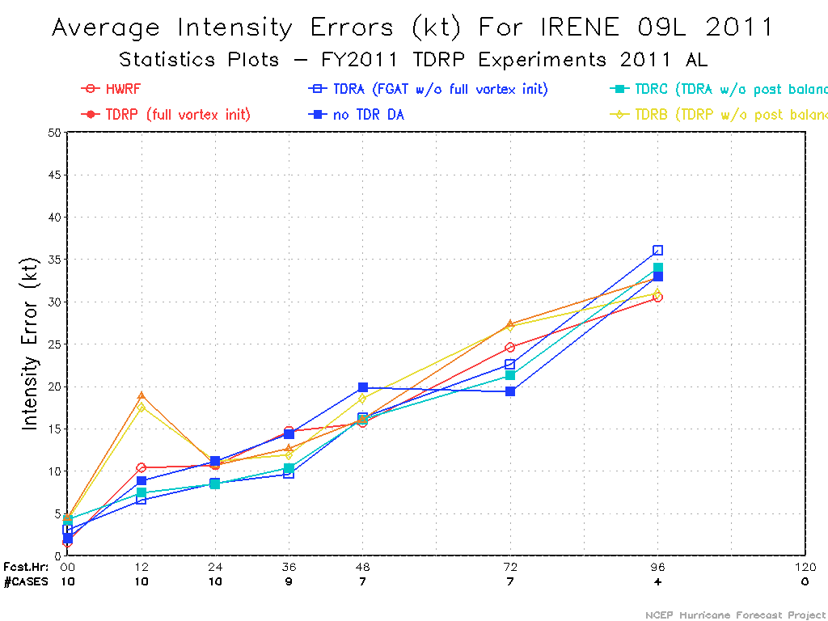
* TDRA and TDRC have smaller intensity error than NTDR before 60 hours

