Slide 1
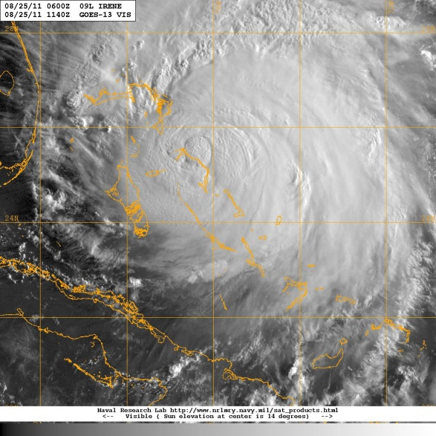
Hurricane Irene Debrief
Agenda:
-G-IV & P-3 missions
TDR performance
-Landfall Coordination
-HEDAS
-H*Wind
-Visiting Sci. Program
-Logistics –Tampa travel, hotel, etc.
-Safety
-Social Media
Blog/Twitter
VIPs and Media
Courtesy of NRL

Slide 2
J. Kaplan

Slide 3
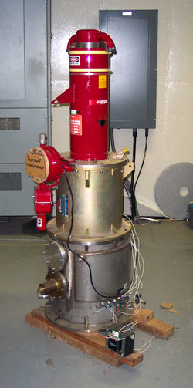
Summary of N42 20 UTC Flights into Irene
Four flights flown with a 20 UTC takeoff time
Second flight aborted before IP due to chip light indicator
Good radar data collected on three flights
Dropsondes worked well, except for last flight near land (radar interference?)
several (~10-15) drops in high-rain low-wind environments for SFMR intercomparisons
Ground-radar module done on last flight with dual-Pol radar on NC coast
MP probes generally worked well, some possible problems though
Storm deepened in terms of MSLP, but peak winds never increased much
storm increased in horizontal extent instead
highly asymmetric, shallow tangential wind maximum
core gradually decayed over course of flights, with winds expanding in radial extent and decreasing in vertical extent
Why didn’t storm intensify in presence of seemingly favorable environmental conditions?
What governs size vs. intensity growth? Vortex or environmental structure?

Slide 4
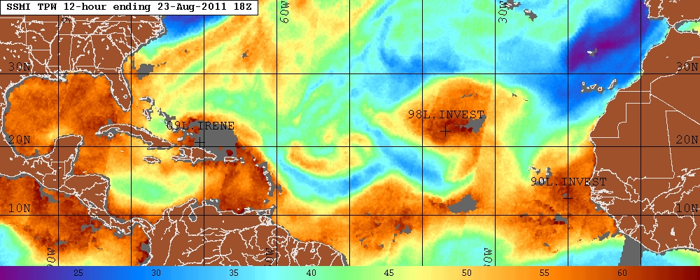
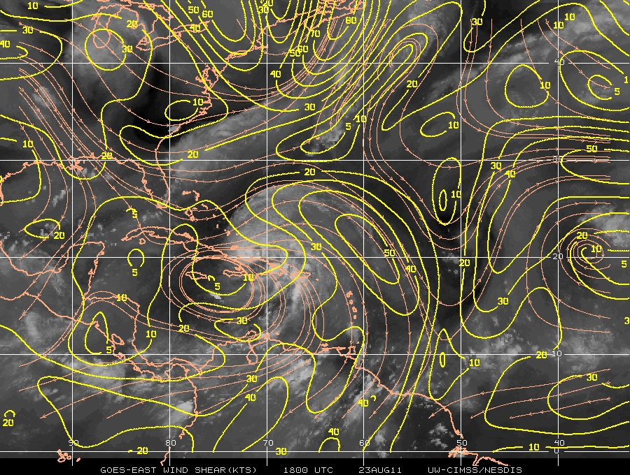
Flight 110823H1
Figure 1. SSM/I Total precipitable water (shaded, mm) valid 18 UTC 23 August.
Figure 2. CIMSS-derived 850-200 hPa shear magnitude (contour, kt) and streamlines valid 18 UTC 23 August.

Slide 5
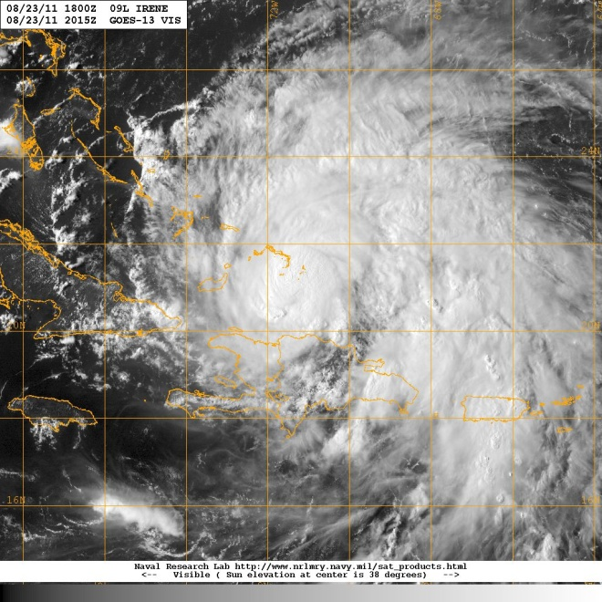
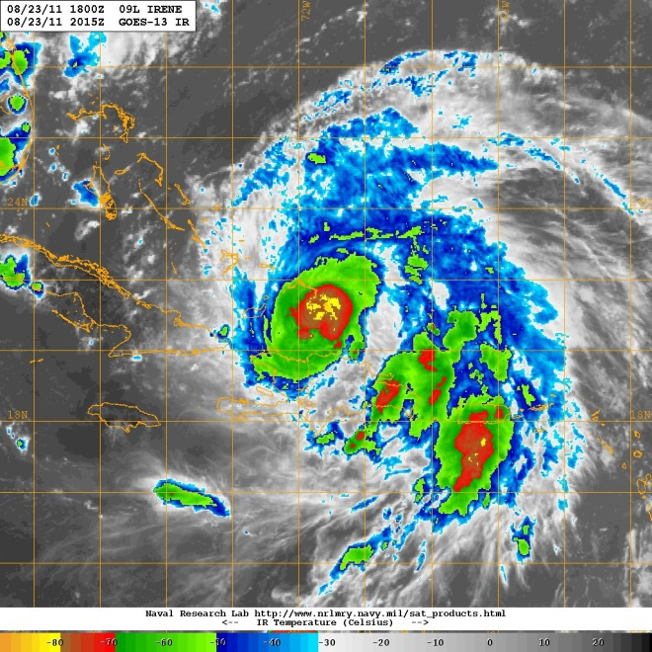
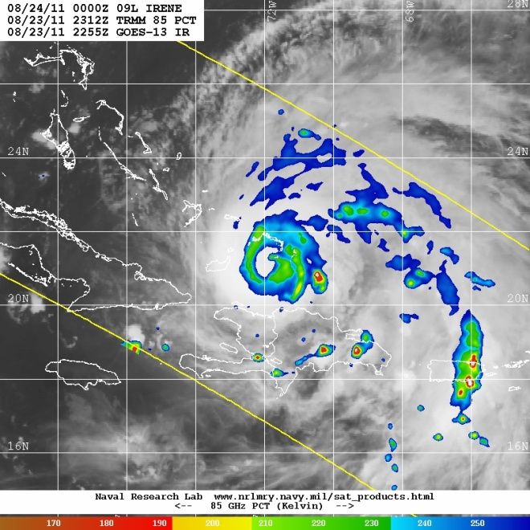
Flight 110823H1
(a)
(b)
(c)
Figure 3. (a) GOES-East 1-km visible image valid 2015 UTC 23 August; (b) GOES-East infrared image valid 2015 UTC 23 August; (c) TRMM 85 GHz PCT valid 2312 UTC 23 August.

Slide 6
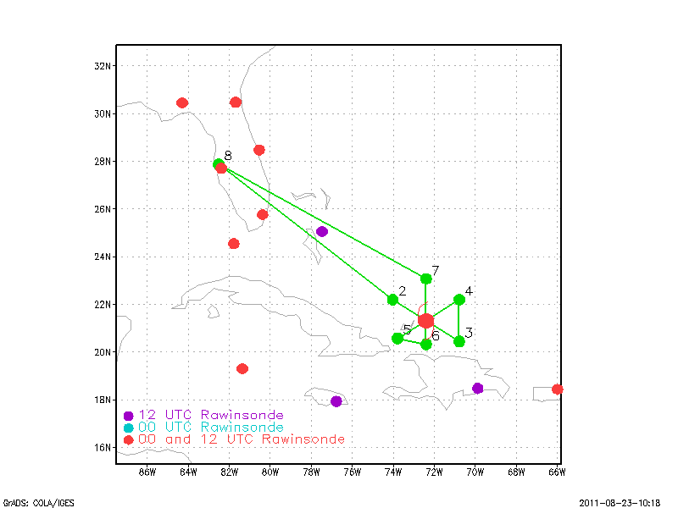
Flight 110823H1
(a)
(b)
Figure 4. (a) Proposed flight track for 110823H1; (b) Actual flight track for 110823H1. Barbs (kt) show flight-level winds.

Slide 7
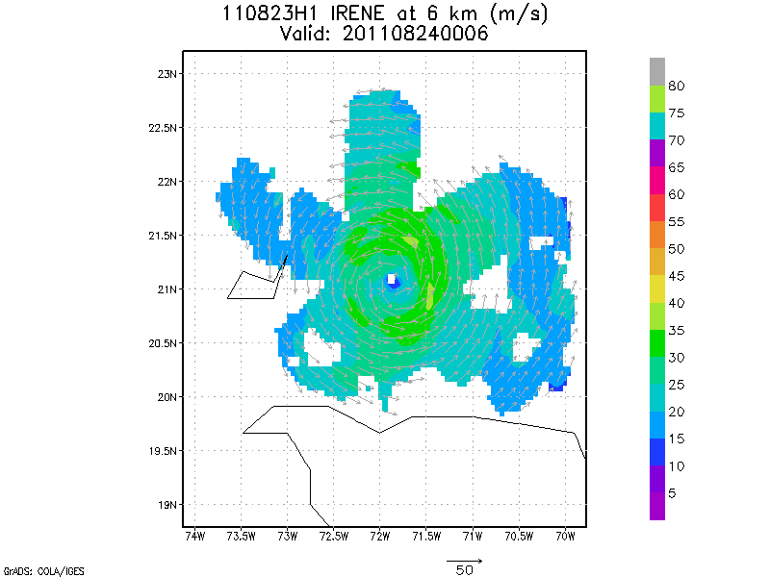
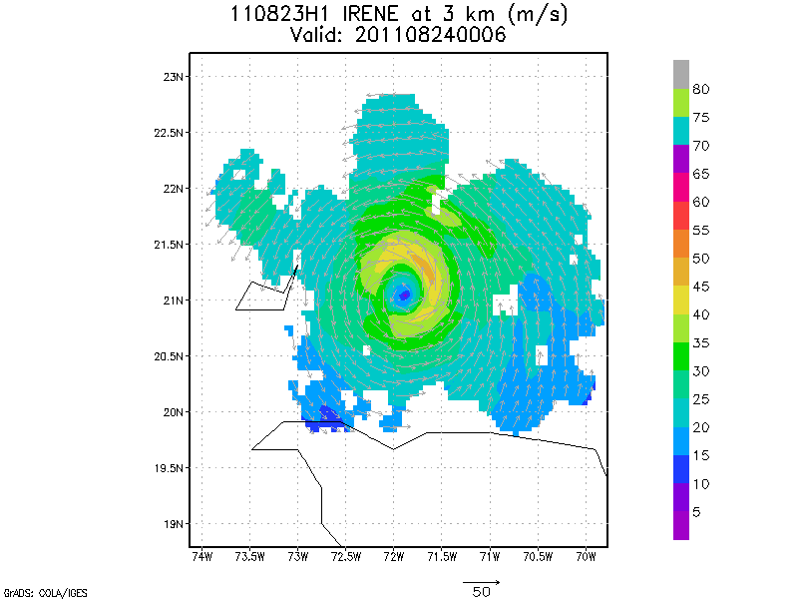
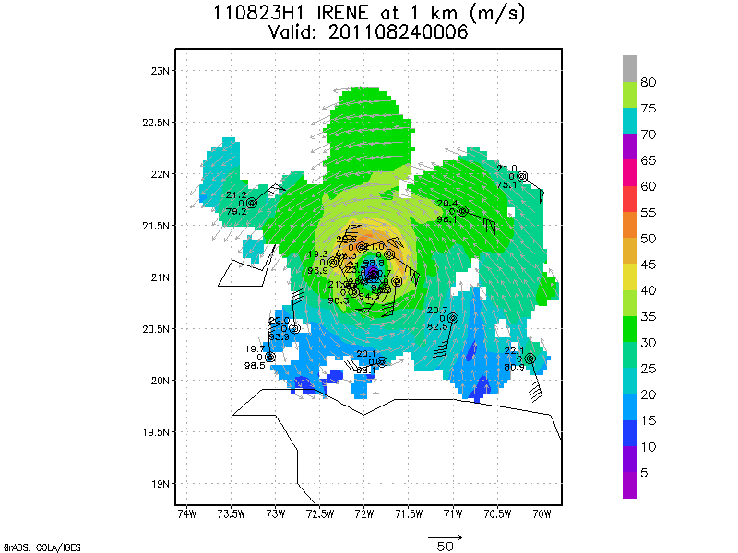
Flight 110823H1
(a)
(b)
(c)
Figure 5. (a) Doppler-derived wind speed (shaded, m/s) and vectors (m/s) at 6 km altitude for 110823H1; (b) As in (a), but for 3 km; (c) As in (a), but for 1 km. Dropsonde measurements at same level also indicated.

Slide 8
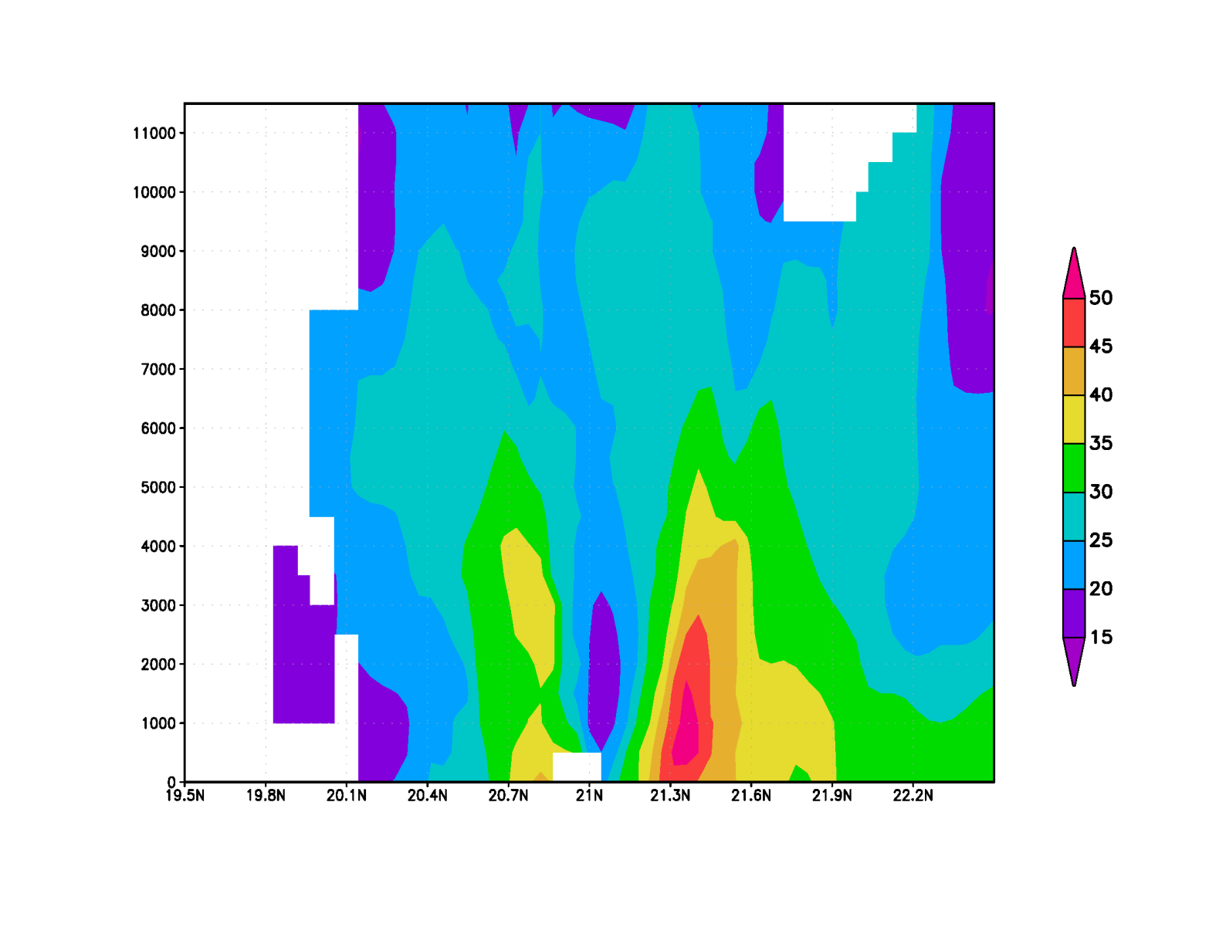
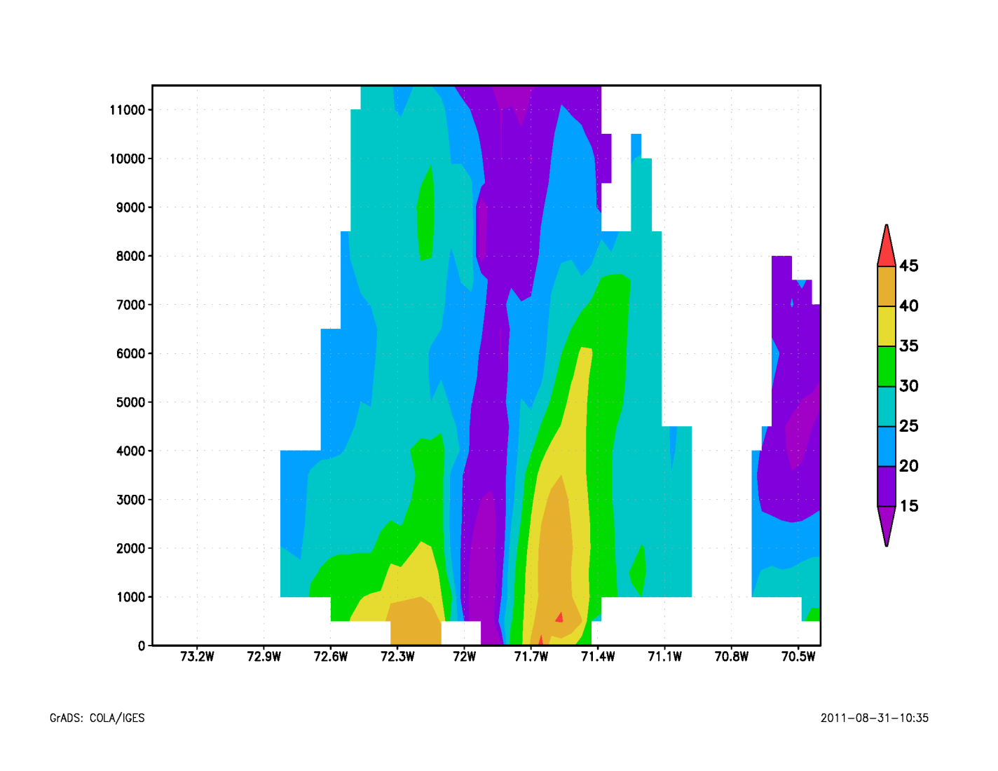
Flight 110823H1
South
(a)
North
West
(b)
East
Figure 6. (a) South-north vertical cross section of wind speed (shaded, m/s); (b) West-east vertical cross section of wind speed (shaded, m/s).

Slide 9
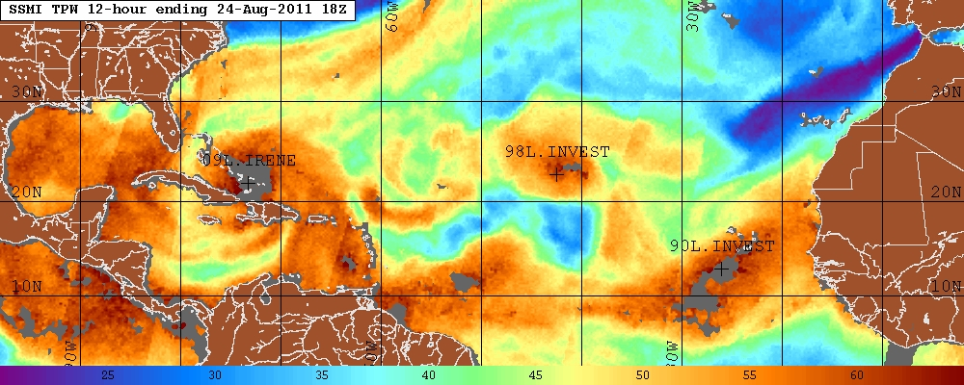
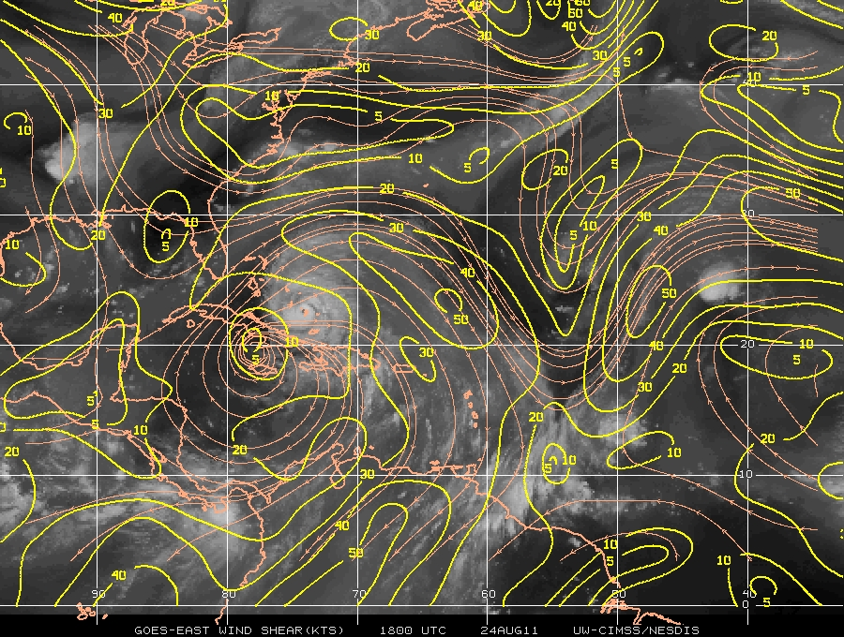
Flight 110824H1
Figure 1. SSM/I Total precipitable water (shaded, mm) valid 18 UTC 24 August.
Figure 2. CIMSS-derived 850-200 hPa shear magnitude (contour, kt) and streamlines valid 18 UTC 24 August.

Slide 10
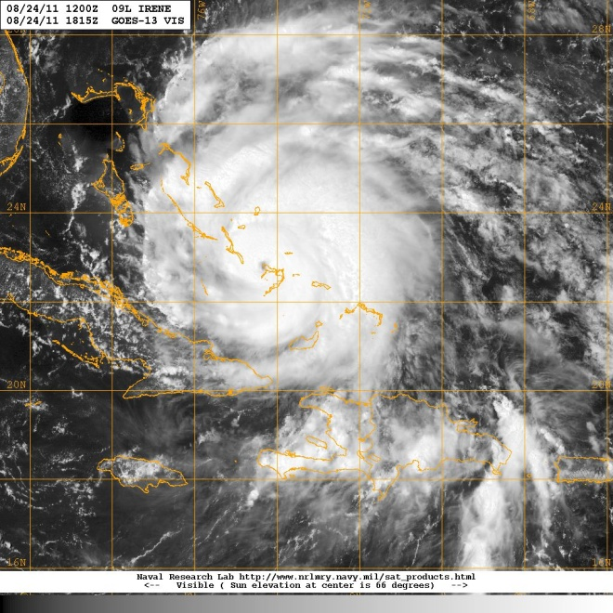
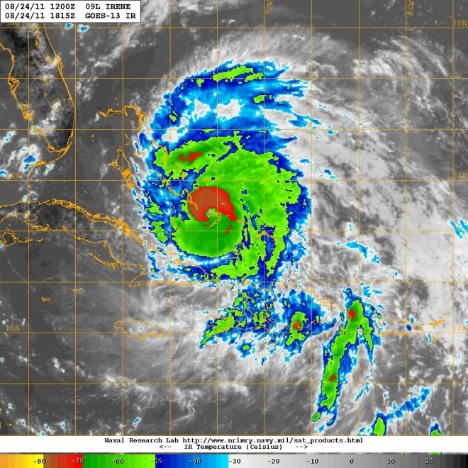
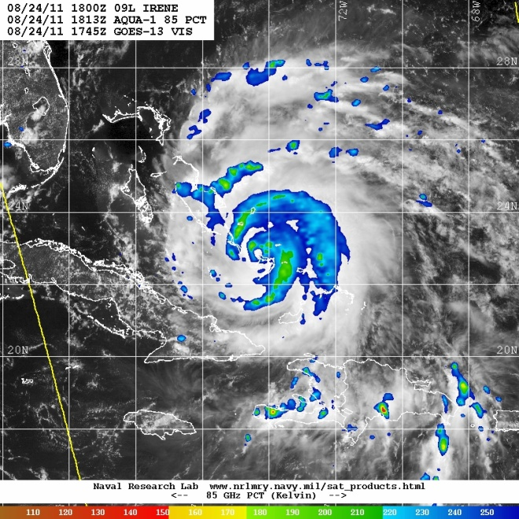
Flight 110824H1
(a)
(b)
(c)
Figure 3. (a) GOES-East 1-km visible image valid 1815 UTC 24 August; (b) GOES-East infrared image valid 1815 UTC 24 August; (c) Aqua-1 85 GHz PCT valid 1813 UTC 24 August.

Slide 11
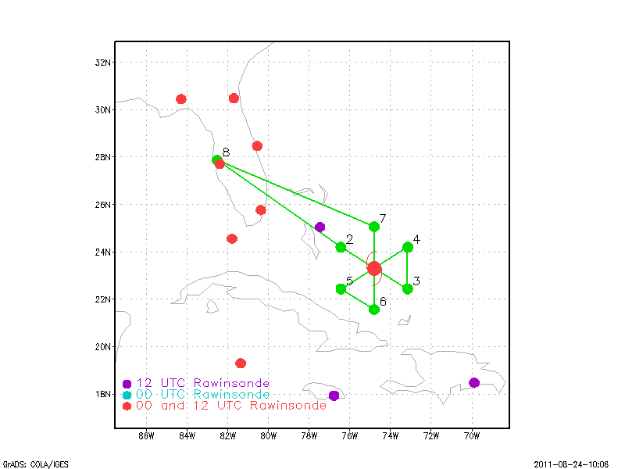
Flight 110824H1
(a)
(b)
Figure 4. (a) Proposed flight track for 110824H1; (b) Actual flight track for 110824H1. Barbs (kt) show flight-level winds.

Slide 12
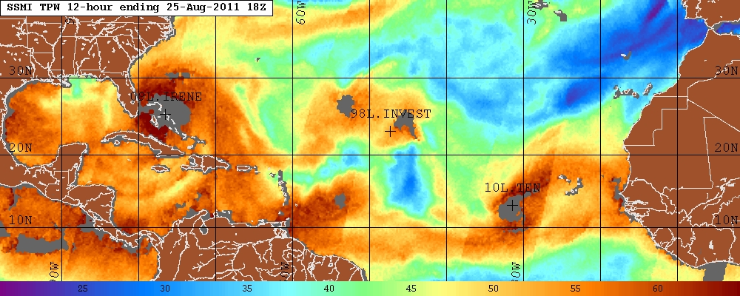
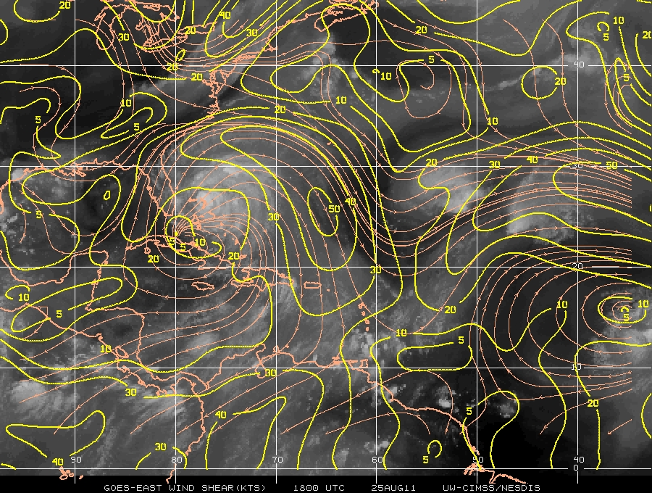
Flight 110825H1
Figure 1. SSM/I Total precipitable water (shaded, mm) valid 18 UTC 25 August.
Figure 2. CIMSS-derived 850-200 hPa shear magnitude (contour, kt) and streamlines valid 18 UTC 25 August.

Slide 13
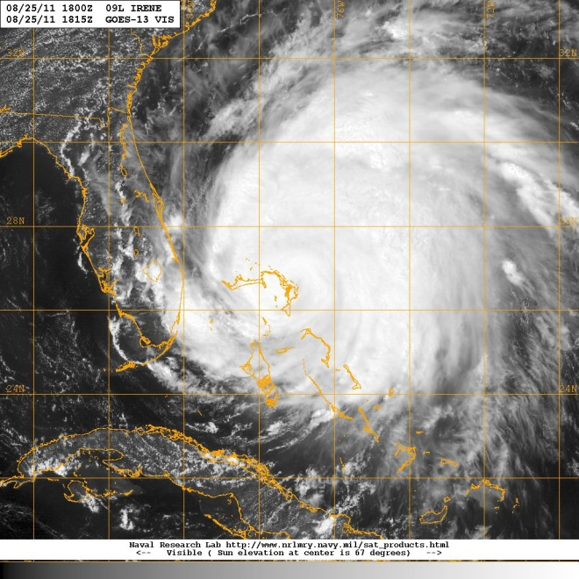
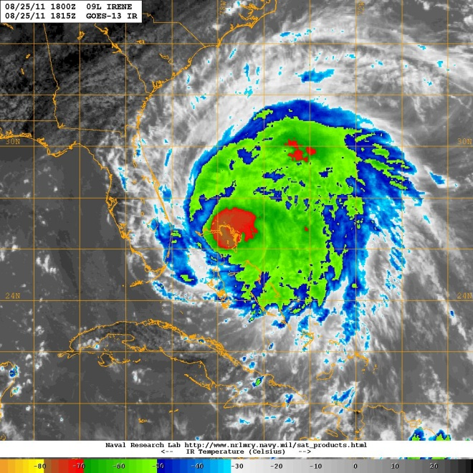
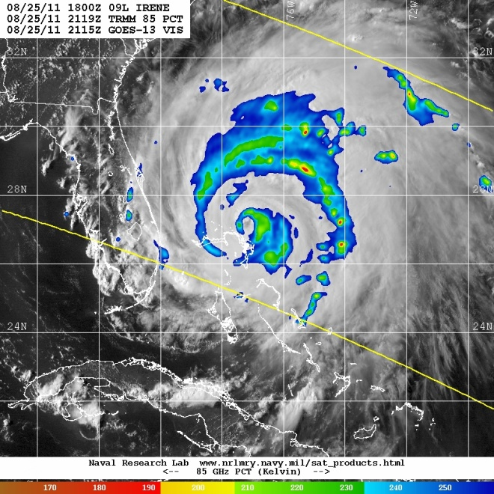
Flight 110825H1
(a)
(b)
(c)
Figure 3. (a) GOES-East 1-km visible image valid 1815 UTC 25 August; (b) GOES-East infrared image valid 1815 UTC 25 August; (c) TRMM 85 GHz PCT valid 2119 UTC 25 August.

Slide 14
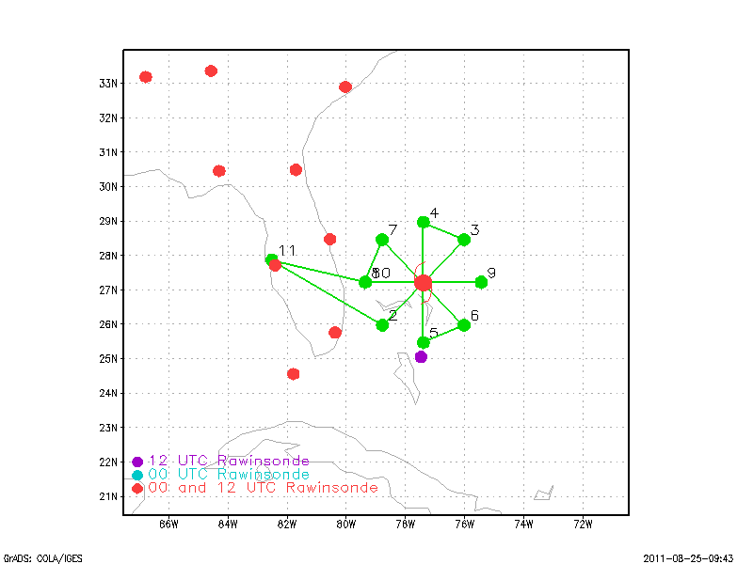
Flight 110825H1
(a)
(b)
Figure 4. (a) Proposed flight track for 110825H1; (b) Actual flight track for 110825H1. Barbs (kt) show flight-level winds.

Slide 15
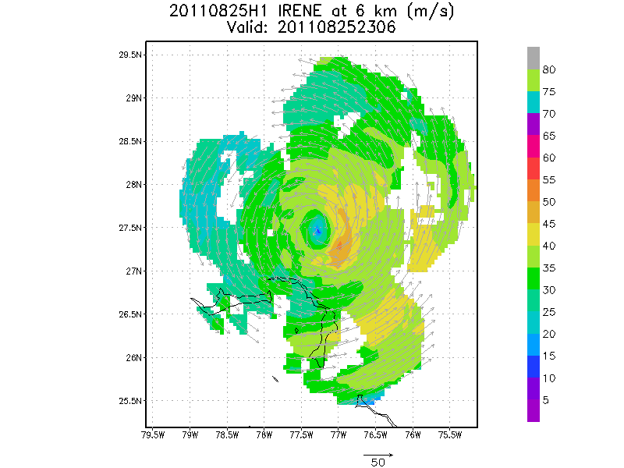
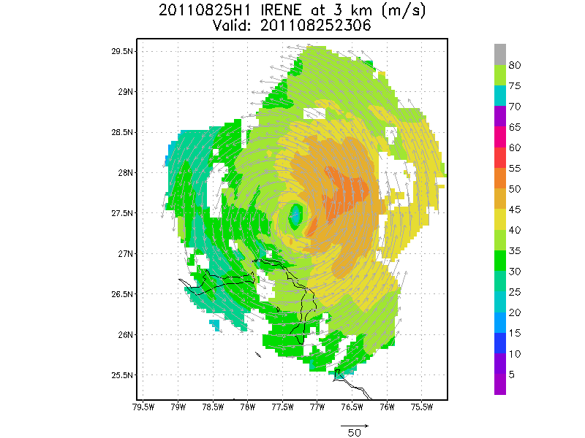
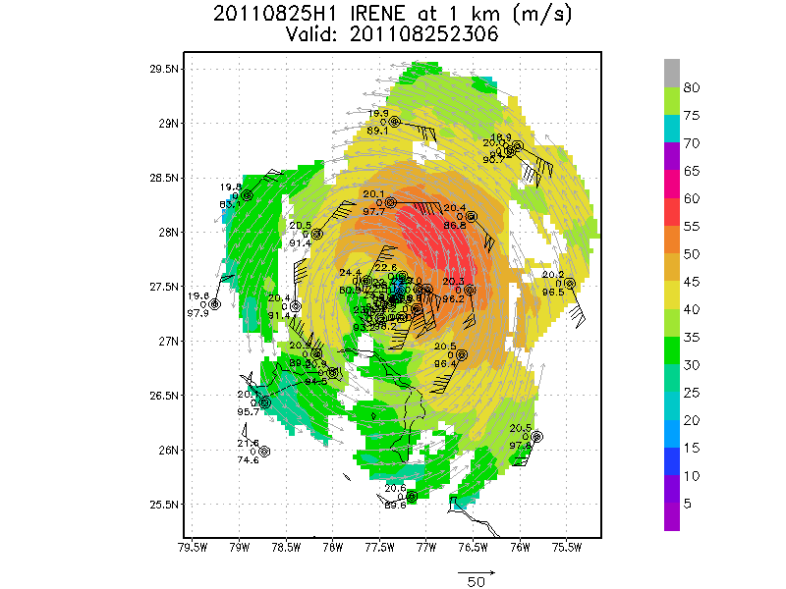
Flight 110825H1
(a)
(b)
(c)
Figure 5. (a) Doppler-derived wind speed (shaded, m/s) and vectors (m/s) at 6 km altitude for 110825H1; (b) As in (a), but for 3 km; (c) As in (a), but for 1 km. Dropsonde measurements at same level also indicated.

Slide 16
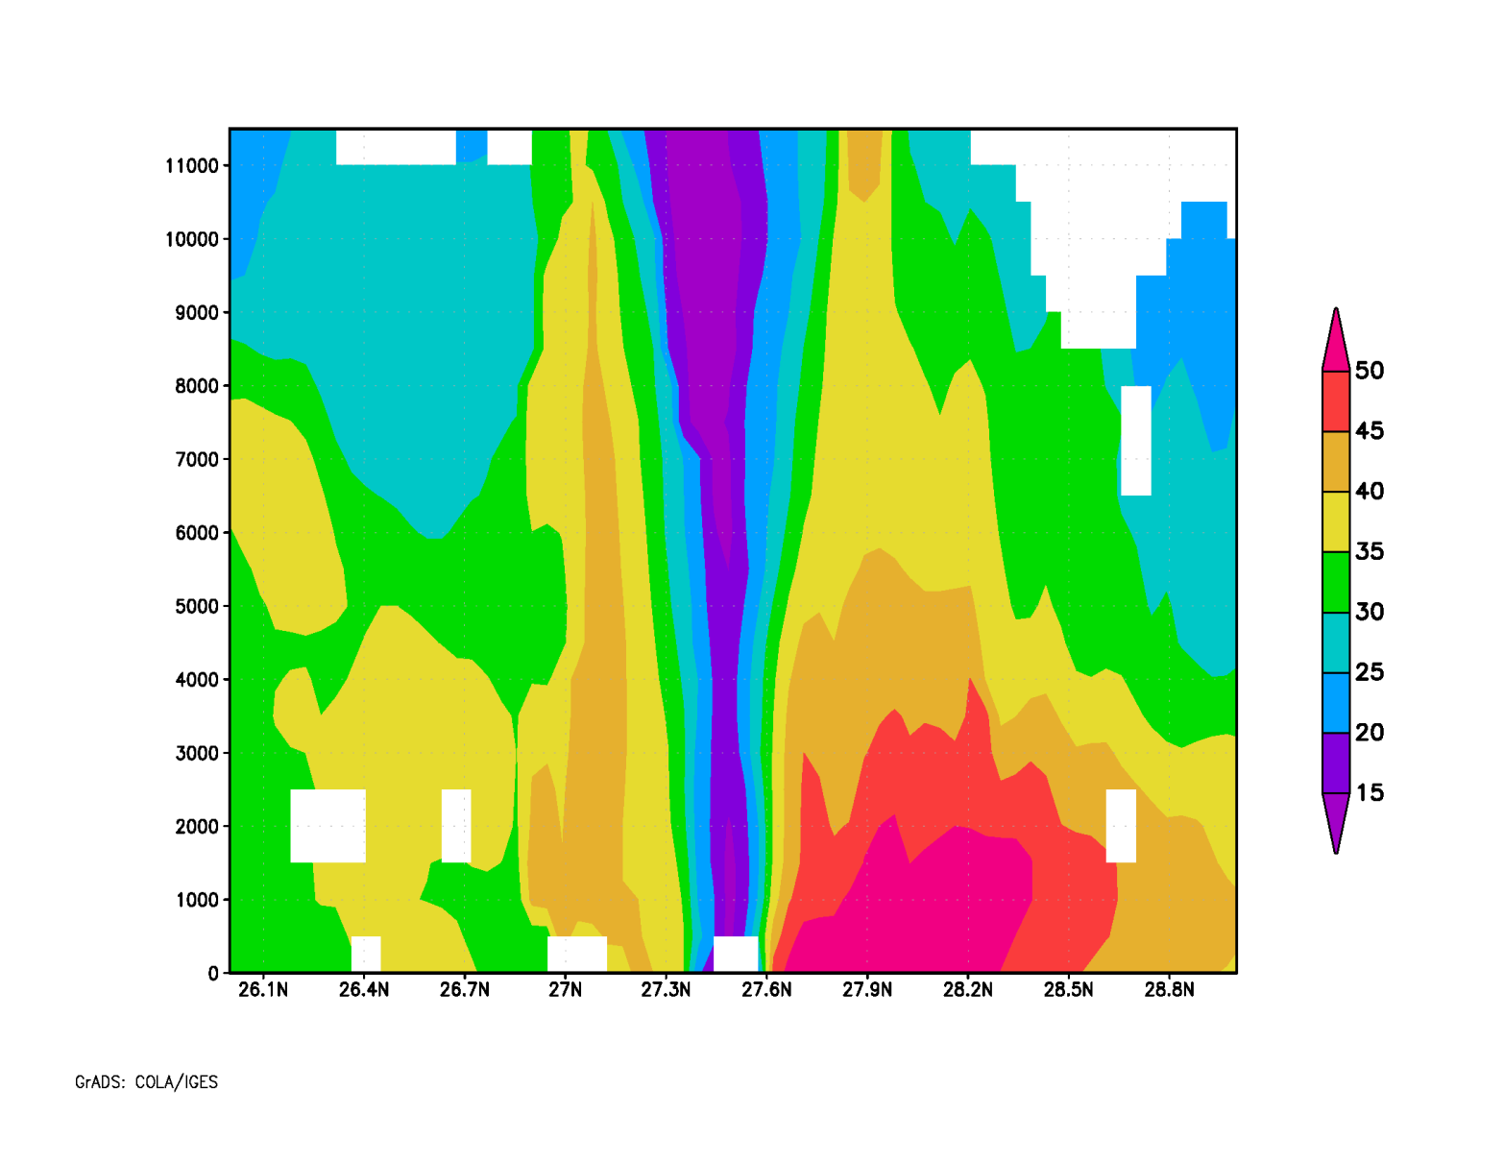
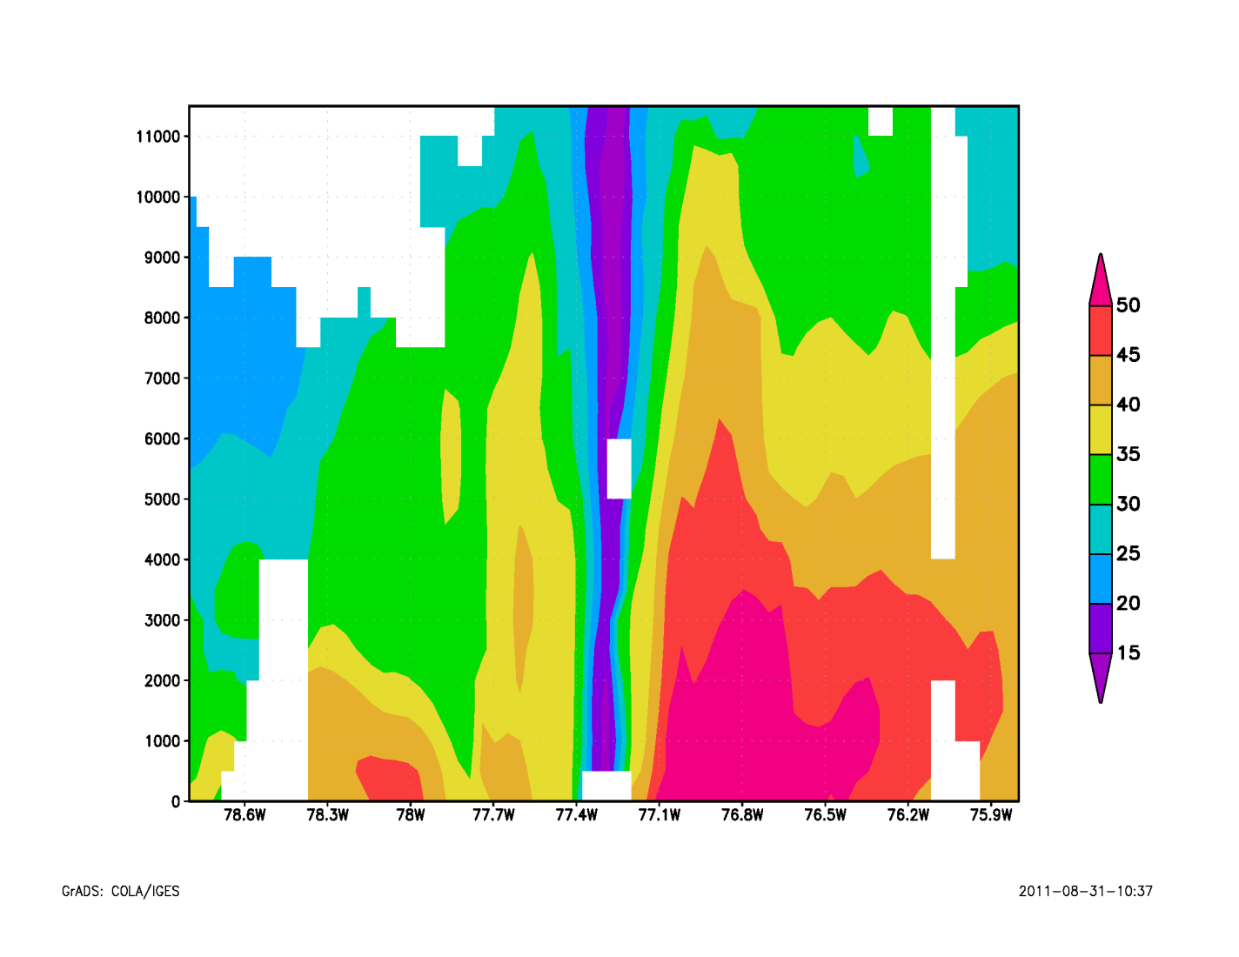
Flight 110825H1
South
(a)
North
West
(b)
East
Figure 6. (a) South-north vertical cross section of wind speed (shaded, m/s); (b) West-east vertical cross section of wind speed (shaded, m/s).

Slide 17
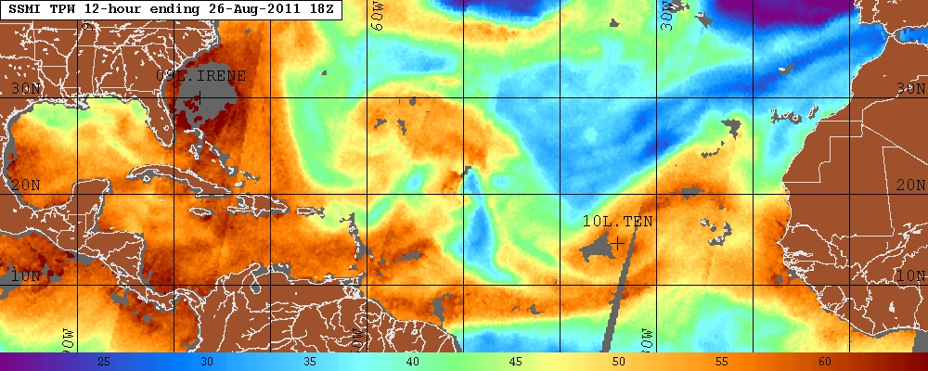
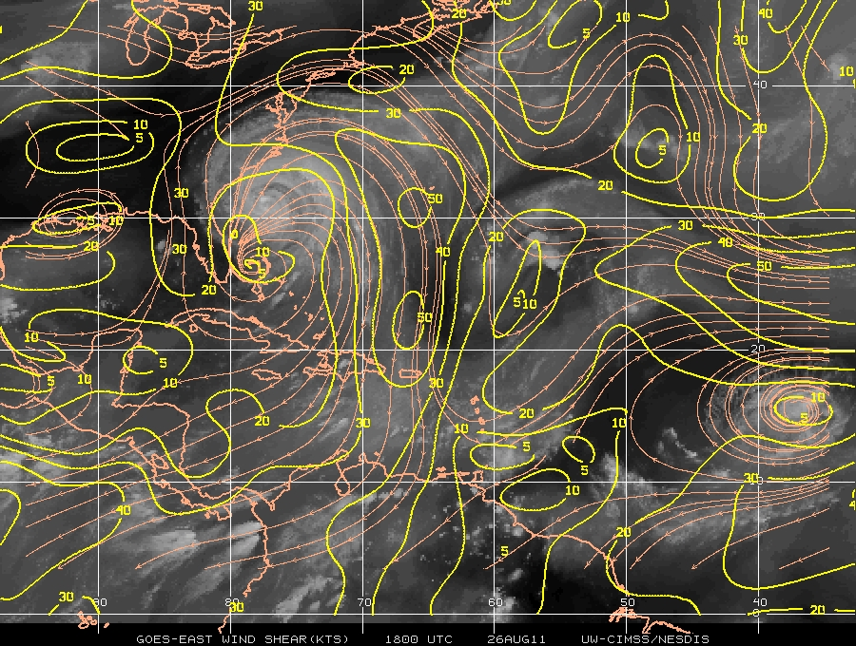
Flight 110826H1
Figure 1. SSM/I Total precipitable water (shaded, mm) valid 18 UTC 26 August.
Figure 2. CIMSS-derived 850-200 hPa shear magnitude (contour, kt) and streamlines valid 18 UTC 26 August.

Slide 18
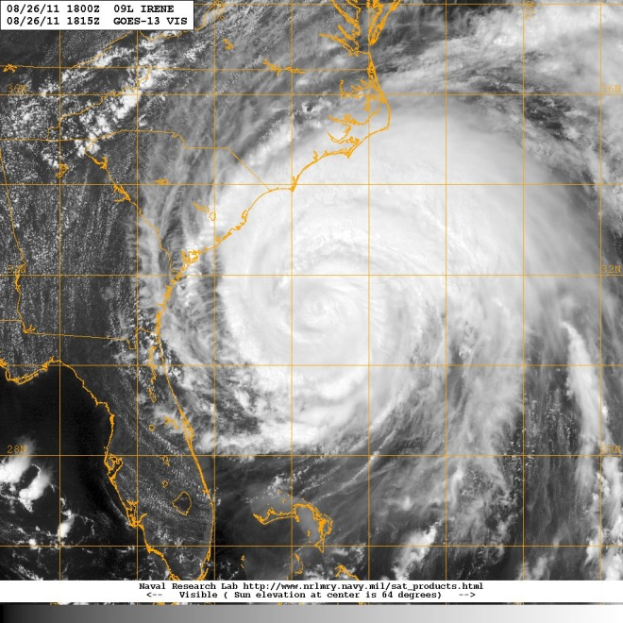
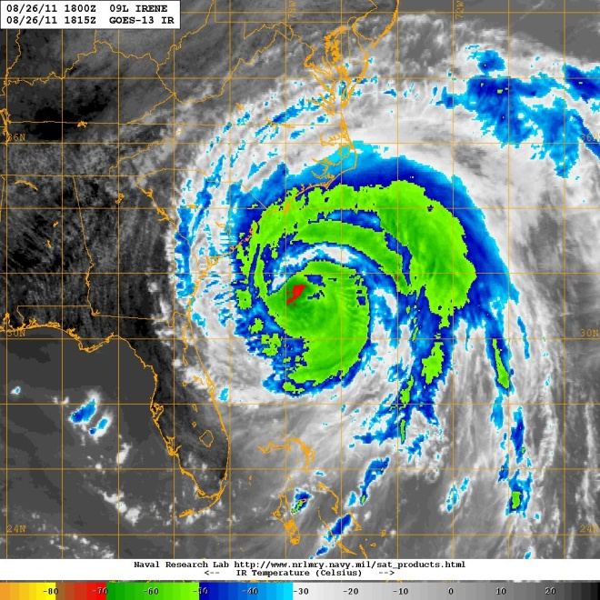
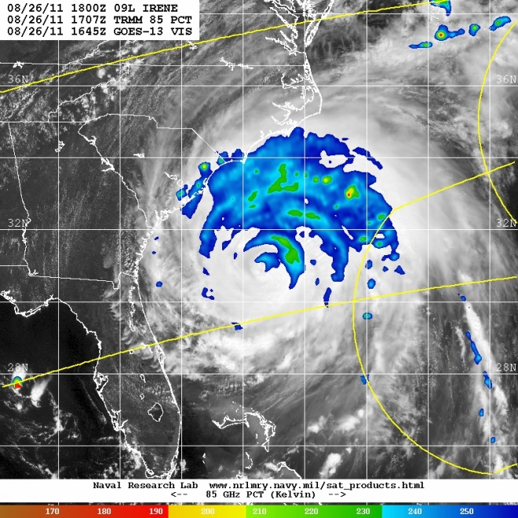
Flight 110826H1
(a)
(b)
(c)
Figure 3. (a) GOES-East 1-km visible image valid 1815 UTC 26 August; (b) GOES-East infrared image valid 1815 UTC 26 August; (c) TRMM 85 GHz PCT valid 1707 UTC 26 August.

Slide 19
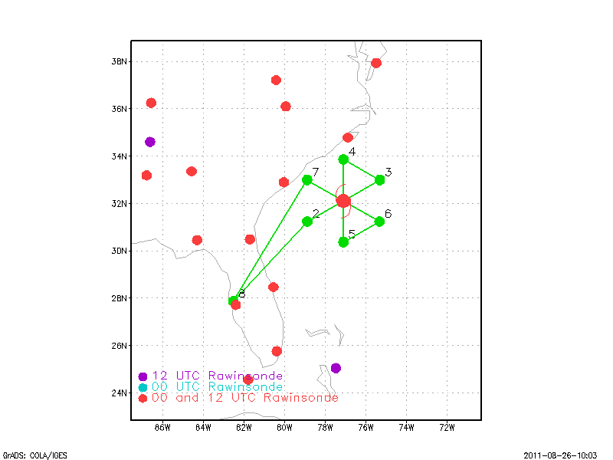
Flight 110826H1
(a)
(b)
Figure 4. (a) Proposed flight track for 110826H1; (b) Actual flight track for 110826H1. Barbs (kt) show flight-level winds.

Slide 20
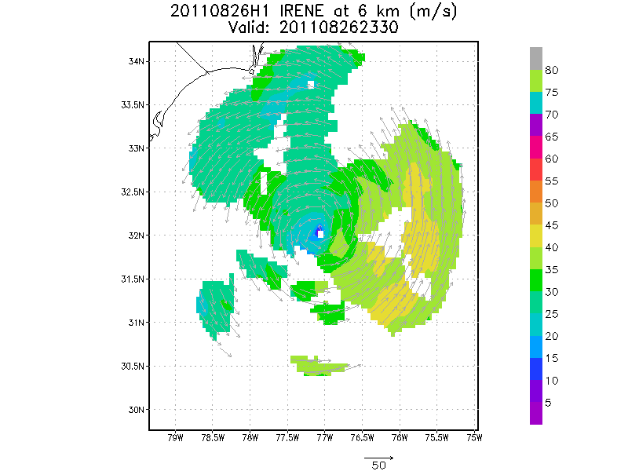
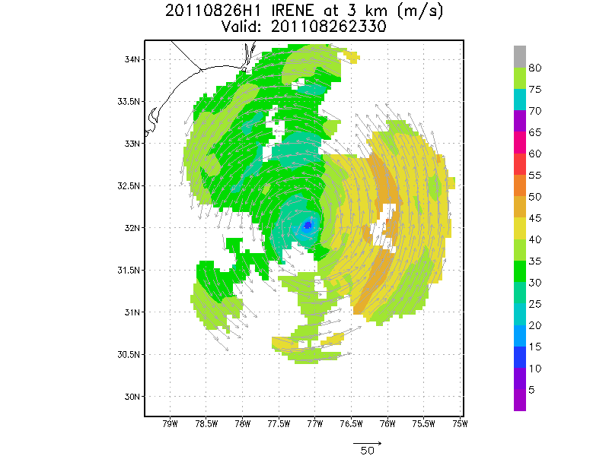
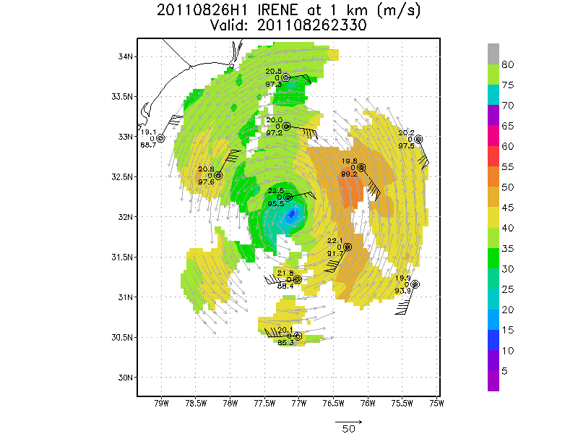
Flight 110826H1
(a)
(b)
(c)
Figure 5. (a) Doppler-derived wind speed (shaded, m/s) and vectors (m/s) at 6 km altitude for 110826H1; (b) As in (a), but for 3 km; (c) As in (a), but for 1 km. Dropsonde measurements at same level also indicated.

Slide 21
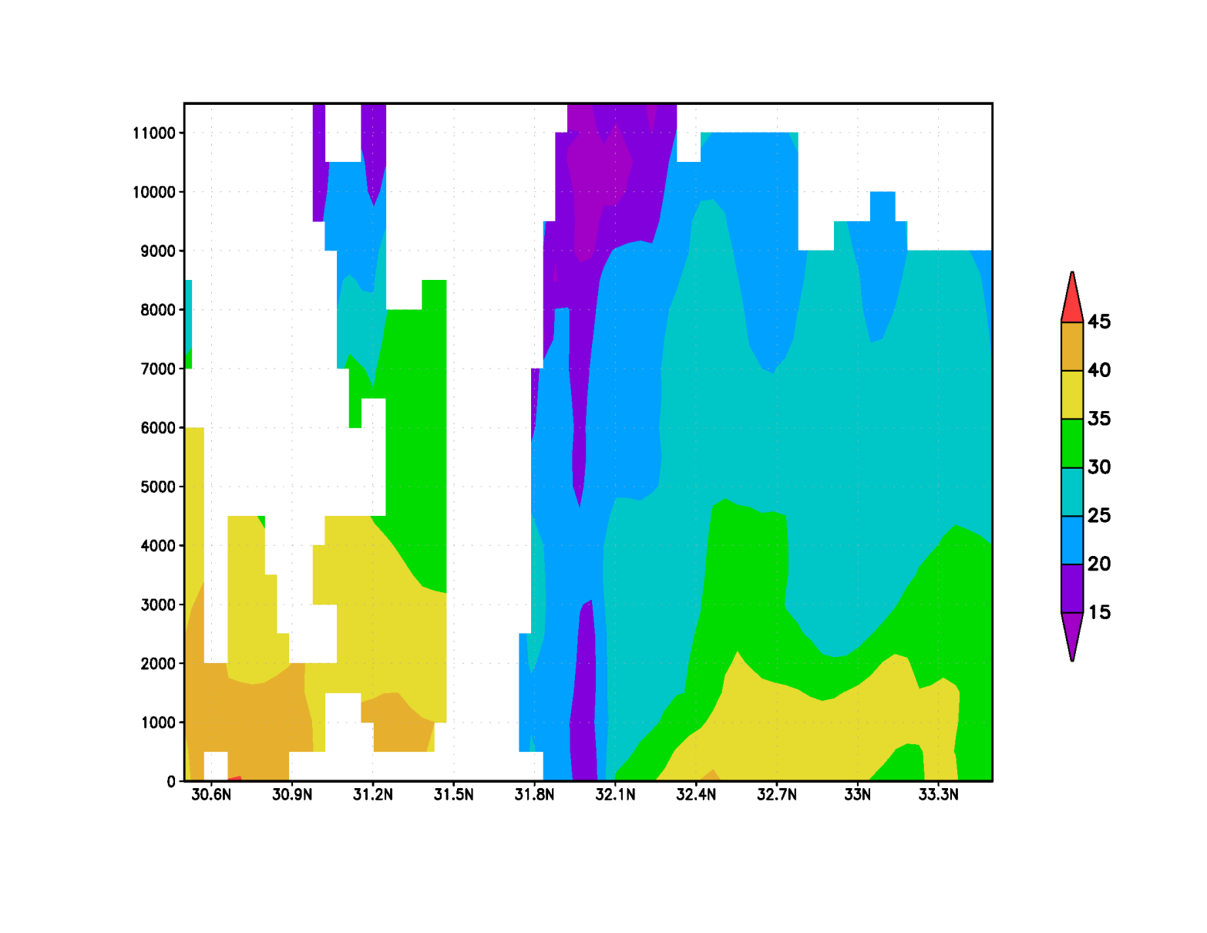
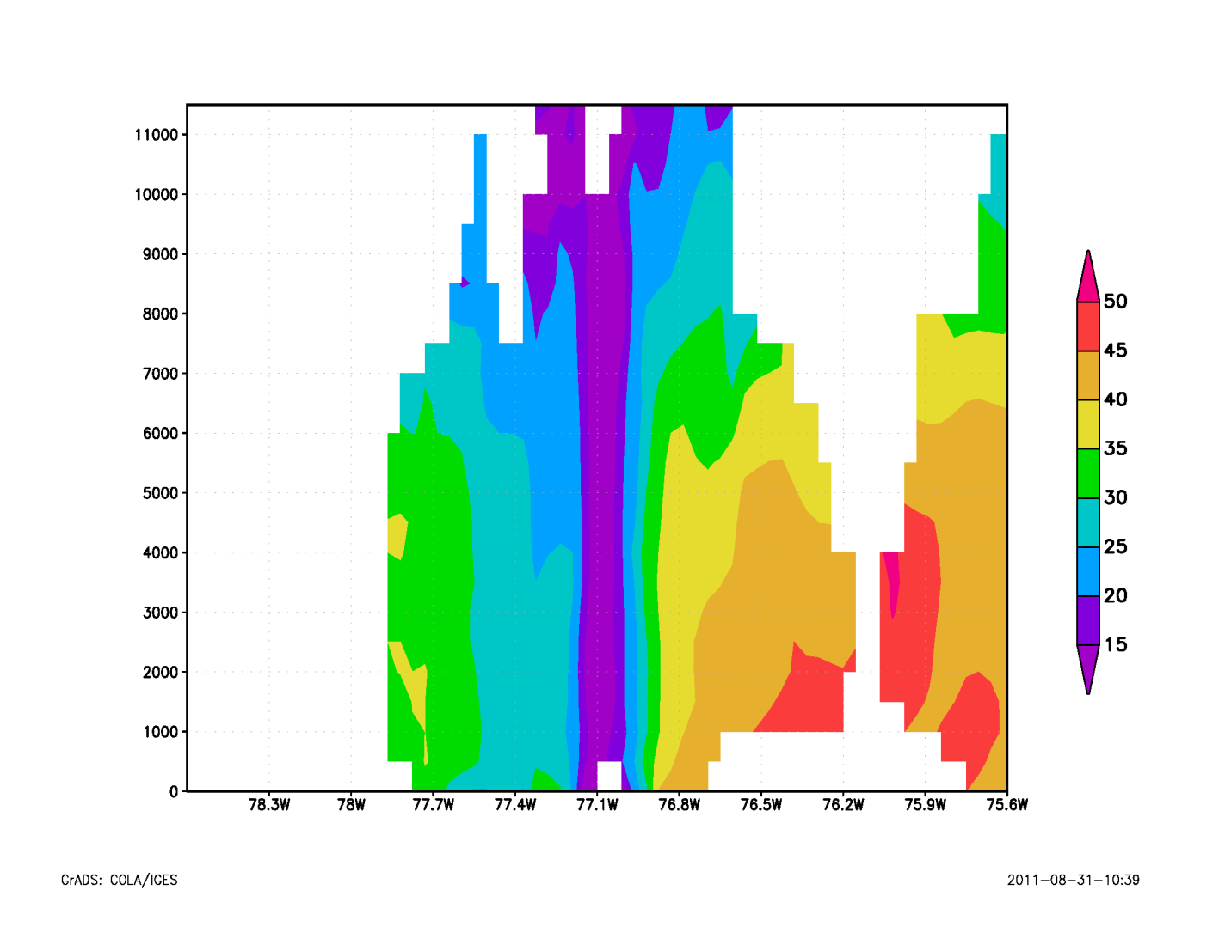
Flight 110826H1
South
(a)
North
West
(b)
East
Figure 6. (a) South-north vertical cross section of wind speed (shaded, m/s); (b) West-east vertical cross section of wind speed (shaded, m/s).

Slide 22
Hurricane Irene Debrief
20110824H1
20110825I1
20110826I1
20110827I1

Slide 23
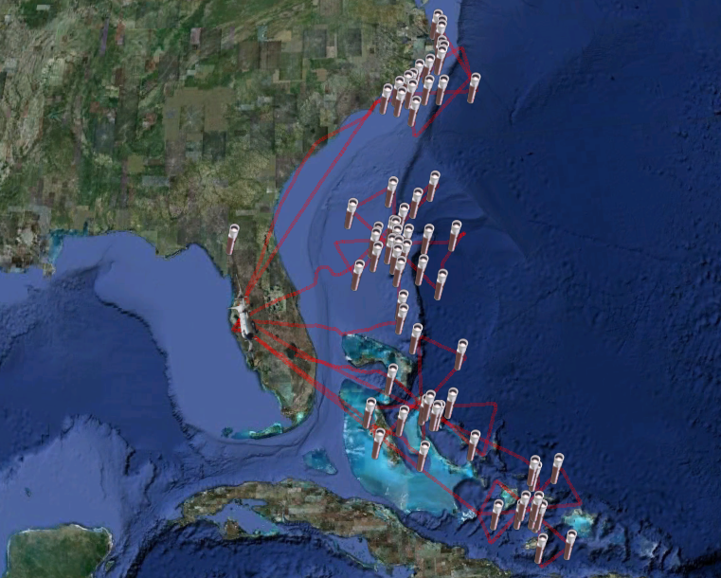
\
20110827I1
20110826I1
20110825I1
20110824H1

Slide 24
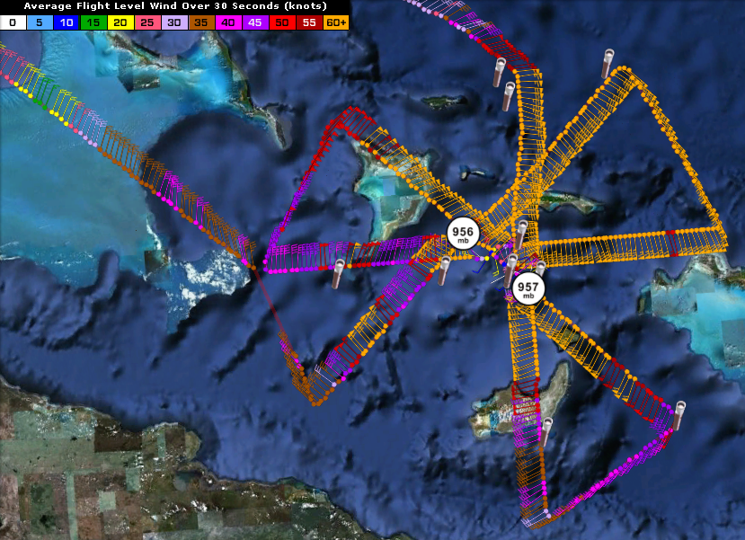
20110824H1
Summary
8.2 hours
4 passes
4 Doppler analyses
28 sondes (24 xmit)
Issues
AVAPS comms with WS
Radar comms with WS

Slide 25
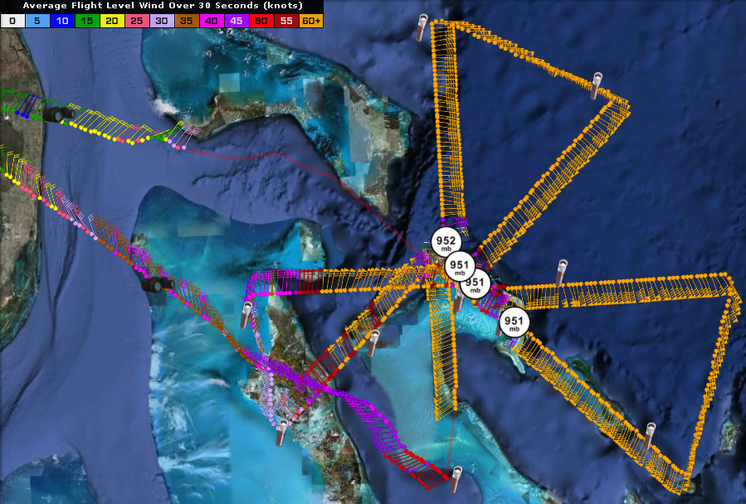
20110825I1
Summary
7.4 hours
4 passes
4 Doppler analyses
28 sondes (24 xmit)
Issues
HDOBS not getting through to NHC

Slide 26
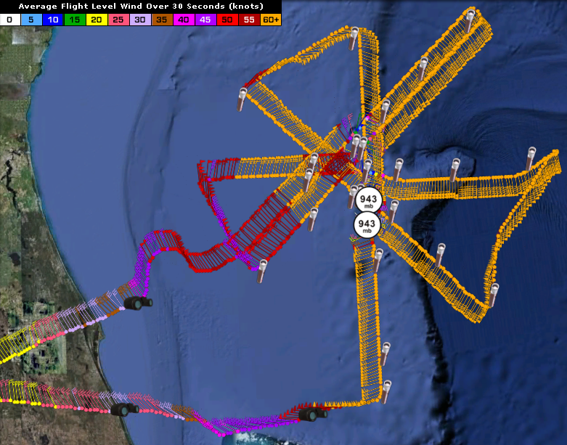
20110826I1
Summary
7.5 hours
5 Passes
4 Doppler analyses
29 Sondes (26 xmit)
Issues
TA down on final pass NE-SW

Slide 27
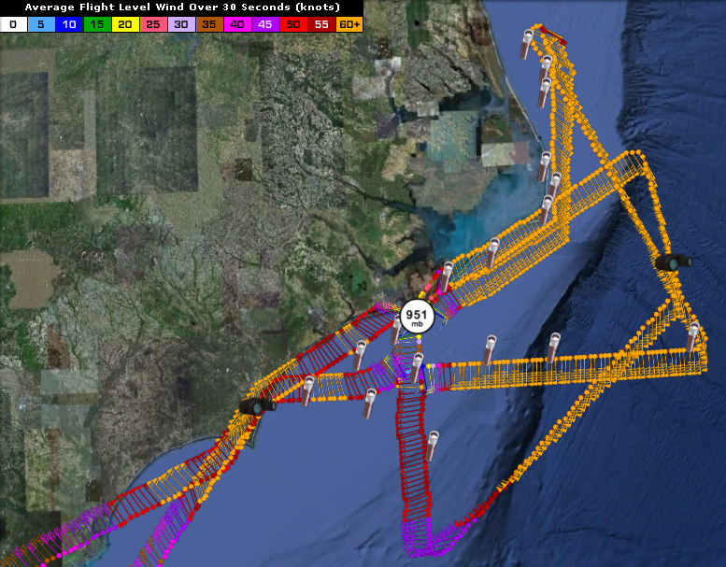
20110826I1
Summary
7.3 hours
3 passes (2 pen)
4 Doppler analyses
29 Sondes (26 xmit)
Coord. with ground-based obs.
Issues
SATCOM on ferry back to KMCF

