Slide 1
JHT RI project progress report (9/24) (Satellite portion of project)

Slide 2
Meeting Agenda
Kaplan: JHT timeline – Where do we stand?
Knaff: Progress using IR imagery for RI
Dunion: Progress using water-vapor imagery for RI
Kaplan: Satellite project to do list

Slide 3
Kaplan
Year 1 JHT timeline
August 3, 2009 – Project begins
December 2009 - Complete development of new inner-core predictors (PBL and satellite) for Atlantic RI index Jan 2010 - Finalize revised Atlantic basin inner-core version of RII
Feb 1 2010- Year 1 mid-term report due
Feb 2010 - Complete assembly of E. Pacific TPW database
March 2010 - Present year 1 results at IHC
April 1 2010- Year two renewal proposal due
June- Complete development of new E. Pacific inner-core RI predictors
June- Nov 2010- Perform real-time tests of new Atlantic inner-core RII
August 1, 2010 Year 1 funding ends progress report due

Slide 4
Progress using IR imagery for RI
Principle components for motion relative imagery calculated using the CIRA IR image archive
The first nine PCs were examined wrt to RI
12-h average PCs and their temporal standard deviations were calculated and added to the SHIPS lsdiag files for the Atlantic
Improving the Archive
Ray has added some of the missing cases from 1995 in the Atlantic.
I’m working on adding 1996 East Pacific storms.

Slide 5
Simple Stratification – land cases removed
Weights for PC1 (40%)
Potential RI Discrimination

Slide 6
Further Stratification of PC1
PC1
Standard Deviation of PC1

Slide 7
Comments
PC 1 seems to be the only significant predictor in a stand-alone manner
PC 2 & 3 deal with wave number 1 banding and suggest that convection is preferred in the back quadrants wrt motion.
PC 4 & 5 have are related to size variations of the cloud shield, but are symmetric like PC 1
All of these may/may not matter once environmental factors are accounted for.

Slide 8
TPW at NESDIS/CIRA
The Jones & Kidder (2007) overlay product is being produced at NESDIS and being collected every 6 hours locally.
The CIRA average product continues to be collected from CIRA every 6 hours for inter comparison efforts.
The CIRA average product for 2006 was supplied to J. Dunion for inter-comparison to the RSS/NRLMRY product.

Slide 9
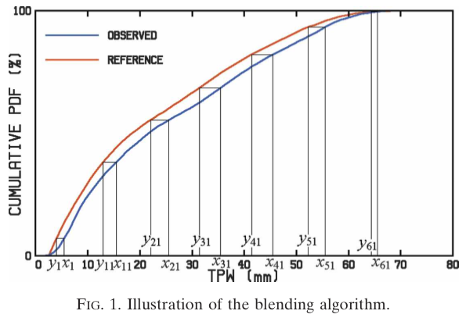
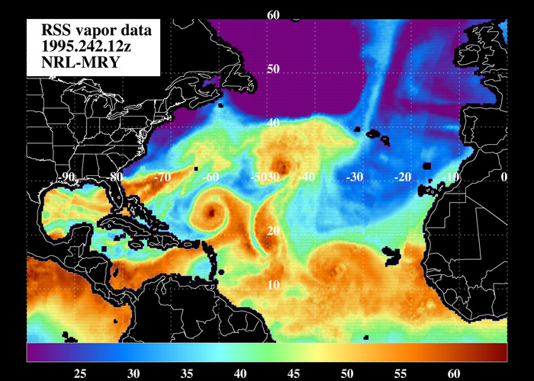
RII TPW Effort (completed tasks)
Spell out start and end dates (rounded to the whole month) for the NATL and EPAC data request to reduce the data crunching a bit
-Jason provided to Jeremy at NRL
TPW NATL test files provided to Mark D.
-no problems reading in
Received CIRA (operational) version of the TPW product
-comparisons will be made with RSS TPW dataset for blending corrections (SSM/I generally moister)
NRL has processed all NATL TPW for 1995-2008 (images and Asciis)
-given subtle changes to RSS algorithm, just use new dataset
-we can develop TPW RII training set with RSS dataset and worry about blending for June 2010 deadline

Slide 10
RII TPW Effort (todos)
Begin testing of NATL TPW dataset [Mark]
-timeline: Dec 2009
Process sample EPAC RSS TPW dataset and provide to Mark for testing [NRL]
-timeline: Nov 2010
Process EPAC RSS TPW dataset (1995-2008) [NRL]
-timeline: Feb 2010
Perform necessary blending for RSS & operational TPW datasets [Jason]
-timeline: ready for June 2010 real-time tests

Slide 11
RII TPW Effort (TPW testing ideas)
QUADRANT ANALYSES of TPW
My take on these dry air intrusions into Atlantic TCs is that the dry air has a very predictable progression as it infiltrates the storm: it begins wrapping around the NW quadrant...then into the SW quadrant...next to the SE...and occasionally into the NE quadrant. This sequence doesn't always complete itself, but the progression is very consistent. So a few ideas here
a) calculate TPW stats by quadrant
b) develop a method for looking at these quadrant TPWs that accounts for how far the dry air has wrapped around the storm (e.g. dry NW=marginal, dry NW+SW=trouble for the storm, dry NW+SW+SE=real trouble, etc.). We could define a TPW threshold (<45 mm is a good proxy for the SAL); for "dry quadrant" in this case...or just let the stats sort things out on their own
c) an annulus ~200-500 km from the storm center for calculating TPW would probably be a good starting point for trying to capture the presence of these dry air intrusions (most intrusions seem to have a width of ~50-100 km)
2) STORM SIZE VS TPW
Bigger storms can better defend against dry air intrusions while smaller systems can really get beat up quickly. I'll bet we'd find a stronger relationship between TPW and intensity change in smaller, weaker systems (e.g. TDs and TSs)
a) normalize the TPW calculations against a storm size parameter (maybe determined using BT counts in the GOES imagery over some radius from the center)
3) STORM ASYMMETRY VS TPW
Asymmetric storms are probably more vulnerable to dry air intrusions:
a) normalize the TPW calculations against a storm asymmetry parameter (I think you guys already calculate something like this in SHIPS?)
4) VERTICAL WIND SHEAR VS TPW
I think this is the big one. No doubt, dry air can be surrounding a TC for days without getting into the inner core. Turn up the shear a bit and it's a completely different story (Isabel 2003 is a great example of this). I also wonder if the shear vector might provide some information re: the potential to advect the dry air in toward the inner core
a) normalize the TPW calculations against vertical wind shear (to help hone in on the relationship, it might be interesting to test this by radii, annulus, and semicircle)
b) normalize the TPW calculations against the vertical wind shear vector (again, might be interesting to test this by radii, annulus, and semicircle).

Slide 12
Homework assignments (Who needs to do what and by when)
J. Solbrig. Complete TPW data sets for Atlantic and E. Pacific basins (1995-2008). This task is nearly complete and only minimal additional work is required. (Nov 1, 2009).
Add Atlantic/EPAC TPW data to SHIPS lsdiag file (M. DeMaria (Dec 1 2009).
Kaplan –Determine optimal satellite predictors to use in revised version of Atlantic RII and derive new version of RI index using those predictors (Jan 31, 2010).
Dunion- Compare NESDIS operational algorithm against archived TPW data from 2006-2007 to determine required offset to apply for real-time TPW use during 2010 Hurricane season. (Spring 2010)

