Slide 1
SHIPS-RII 2021 UPGRADES
JOHN KAPLAN (NOAA/AOML)
STEPHANIE STEVENSON (NHC)
MARK DEMARIA (CSU/CIRA)

Slide 2
SHIPS-RII 2021
Upgraded versions of the operational SHIPS Rapid Intensification Index (SHIPS-RII) were derived and transitioned to the NOAA’s National Weather Service for use during the 2021 Hurricane season.
Retrospective testing conducted for the 2013-2020 Hurricane Seasons demonstrated that the new 2021 SHIPS-RII models provided average absolute skill improvements of 3% (2%) in the Atlantic (eastern North Pacific) basins relative to the 2020 models.
Skill improvements of up 7% (4%) were found for some rapid intensity thresholds in the Atlantic (eastern North Pacific) basins.
Notably, improvements in model skill for the 25-kt/24-h and 30-kt/24-h rapid intensity thresholds of 4% (3%) for the Atlantic (eastern North Pacific basins) are roughly 3x (4x) the historical yearly average skill improvements for those models found by DeMaria et al. (2021).

Slide 3
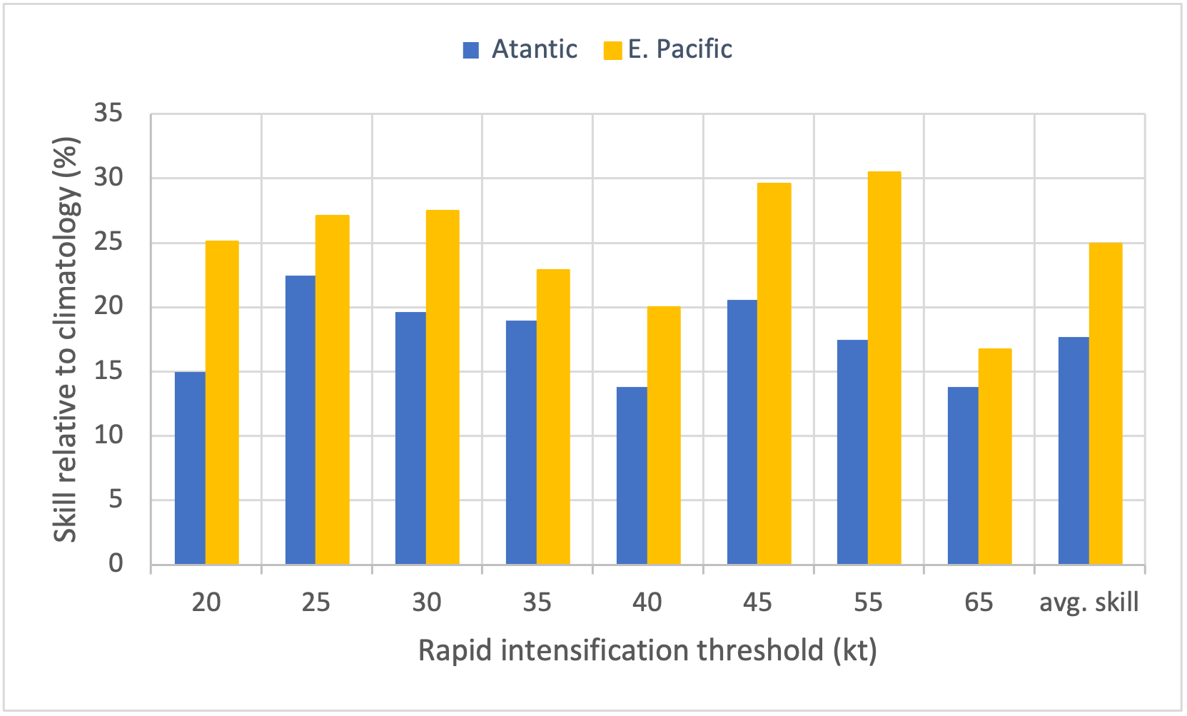
Skill of the operational 2021
SHIPS-RII models
Figure 1. Skill of the 2021 SHIPS-RII model forecasts relative to climatology for retrospective Atlantic and eastern Pacific basins forecasts for the 2013-2020 Hurricane Seasons.

Slide 4
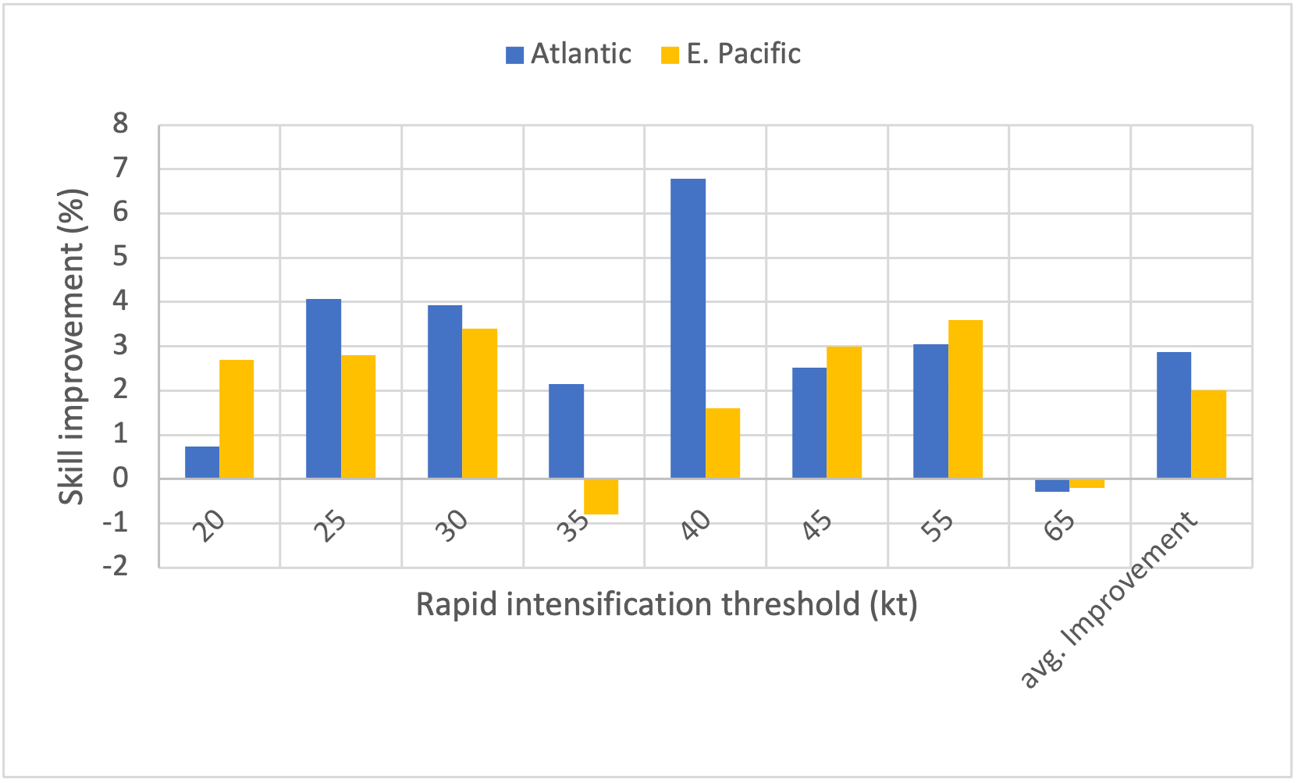
Improvements of the new operational SHIPS-RII 2021 models over the existing 2020 models
Figure 2. Absolute skill improvements (%) of the new 2021 SHIPS RII models over the previous 2020 versions for the retrospective 2013-2020 Atlantic and eastern Pacific Hurricane Season forecasts.

