Slide 1



The NOAA-HWRF Modeling System: Addressing Our Nation’s Immediate and Next Generation Tropical Cyclone Track, Structure and Intensity Prediction Problems
Sundararaman G. Gopalakrishnan (Gopal)
NOAA/AOML/HRD, Miami
Vijay Tallapragada
NOAA/NCEP/EMC, Washington DC
CAPITOL HILL PRESENTATION, 13 Sept, 2012
Acknowledgements :
Frank Marks, NOAA/AOML/HRD, Miami, FL
Robert Atlas, NOAA/AOML, Miami, FL
Bill Lapenta, NOAA/NCEP/EMC, Washington, DC
Notes:
Hurricane Bill: HWRF Equivalent of GOES-East Imager 10.7 micro m
1

Slide 2

HFIP-HWRF Tiger Team for a “Weather-Ready” Nation
NOAA/NCEP/EMC Teams
NOAA/AOML/HRD Modeling Teams
Dr.Vijay Tallapragada (Team Lead)
Dr.Young Kwon
Dr.Qingfu Liu
Dr.Zhan Zhang
Dr.Sam Trahan
Dr.Weiguo Wang
Dr.Chanh Kieu
Dr.Mingjing Tong
Dr.In-Hyuk Kwon
Dr.S. G. Gopalakrishnan (Lead)
Dr. Xuejin Zhang
Dr.Thiago Quirino
Dr.Jun Zhang
Lisa Bucci
Dr. Altug Aksoy
Stanley Goldenberg
NOAA/ESRL Modeling Teams
Dr.Jian-Wen.Bao
S.A.Michelson
DTC: code support and management
NOAA/NHC: important inputs and suggestions
2
Capacity Building for NOAA

Slide 3
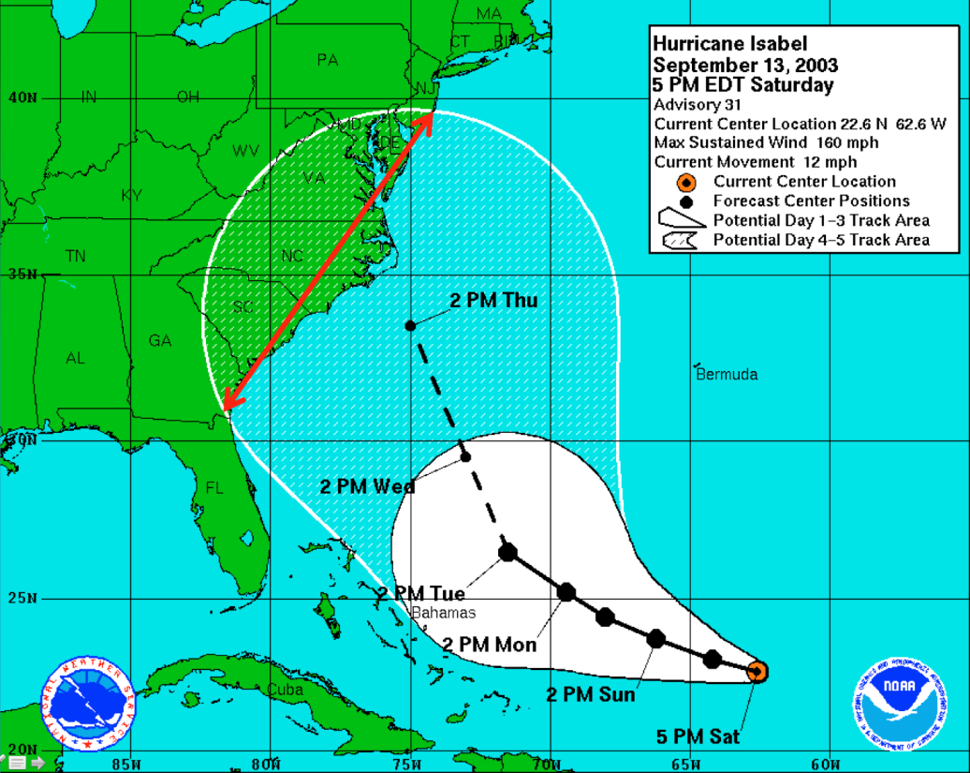
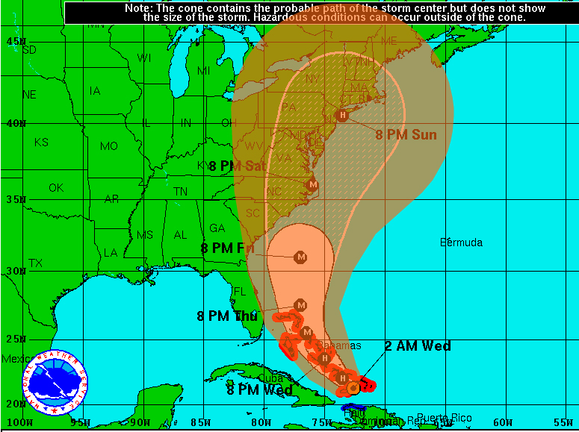
Improved Precession of Hurricane Track Forecast
Hurricane Irene forecast – a great example of track improvement
In 2003 the cone of uncertainty for the 5-day forecast for Isabel extended 878 nautical miles.
Hurricane Irene
August 24, 2011
2 AM EDT Wednesday
Advisory 15A
Center location 21.3 N 72.6 W
Max sustained wind 100 mph
Movement WNW at 9mph
With today’s advances in track forecasting, the 5-day forecast for Hurricane Irene in 2011 reduced the cone of uncertainty an estimated 54% (478 miles at 120 hours) compared to 2003.
The advances in forecasting reduced over-warning in Irene and saved the U.S. at least $384 million in evacuation costs.
Notes:
The cumulative hurricane research budget at AOML from 2003 – 2011 was less than $30 million, less than 8% of the money saved from unnecessary evacuations.
The estimate of $384 million saved results from the assumed evacuation of communities under the “red” 2003 cone, from Miami, FL to Charleston, SC - an estimated 600 miles of coastline.
The 2008 Economic Statistic for NOAA estimates an average cost of $640,000 to evacuate a mile of coastline. The actual cost of evacuation is highly variable and is dependent on coastal population and development in the evacuated area.
The 2012 cone radii will be slightly smaller than the previous year, with the greatest decease at 96 hours (4 day forecast).
Changes in Atlantic Cone of Warning radii from 2003 to 2012:
hr 49 to 36 nmi (-13)
24 hr 85 to 56 nmi (-29)
36 hr 121 to 75 nmi (-46)
48 hr 164 to 95 nmi (-69)
72 hr 232 to 141 nmi (-91)
96 hr 318 to 180 nmi (-138)
120 hr 439 to 236 nmi (-203)
3

Slide 4
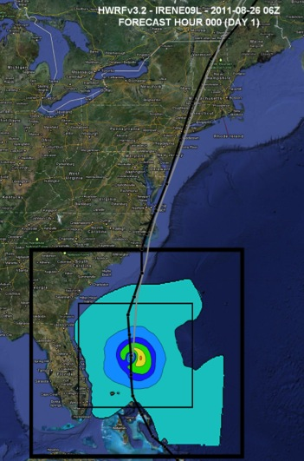
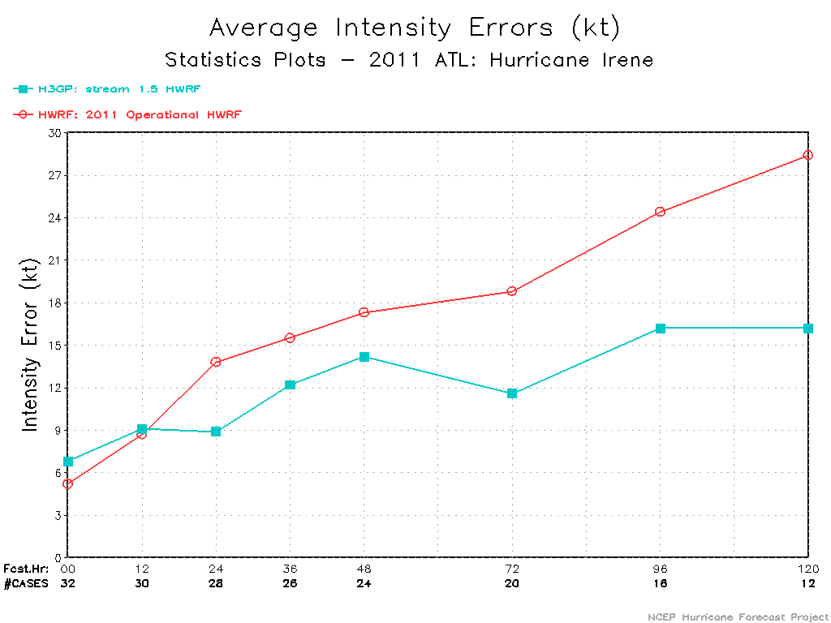
High-Fidelity HWRF for Tracks, Structure and Intensity Predictions
AOML and their partners at NCEP are creating a high resolution HWRF model to address NOAA’s immediate and future operational needs
Hurricane Irene
Intensity Verification
3km HWRF showed a 30-50% improvement over operational HWRF (statistics provided by NCEP)
A major accomplishment was the development of a third nest, at 3 km resolution, to cover the inner core and most of the surrounding circulation of the storm. This would make the HWRF model the highest resolution hurricane model ever implemented for operations in the National Weather Services”… Richard Pasch, NHC.
State-of-the art physics based on observations and Data Assimilation Packages to ingest airborne observations
NOAA-HFIP Advancements
Notes:
4

Slide 5
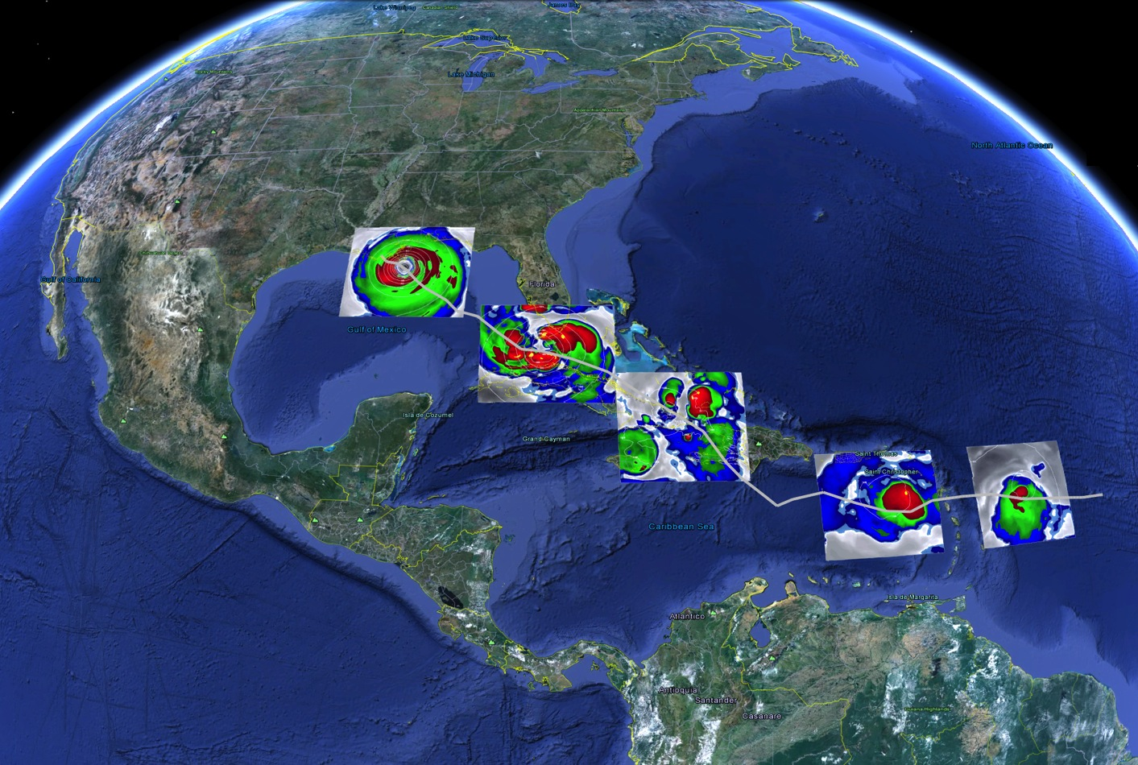

HWRF: Advancing Track and Structure Predictions
AOML/HRD – NCEP/EMC
What it takes to forecast a Tropical Cyclone (TC)
1.Higher Resolution for resolving convection & terrain
2. Model Physics valid for higher resolution
3. Improved representation of initial conditions
4. Advanced understanding of the TCs (observations)
Warmer sea surface temperatures and no shear
Vortex tilt, dry air, and size of the storm
Terrain interactions
Northerly shear and dry air impedes the development of circulation
Enhanced Water Vapor Equivalents obtained from HWRF in the Life cycle of Hurricane Isaac
NOAA-HFIP Advancements
Notes:
5

Slide 6
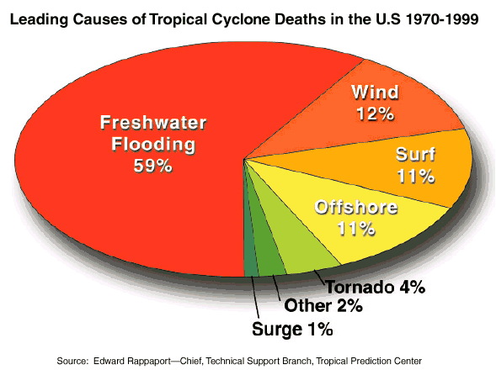
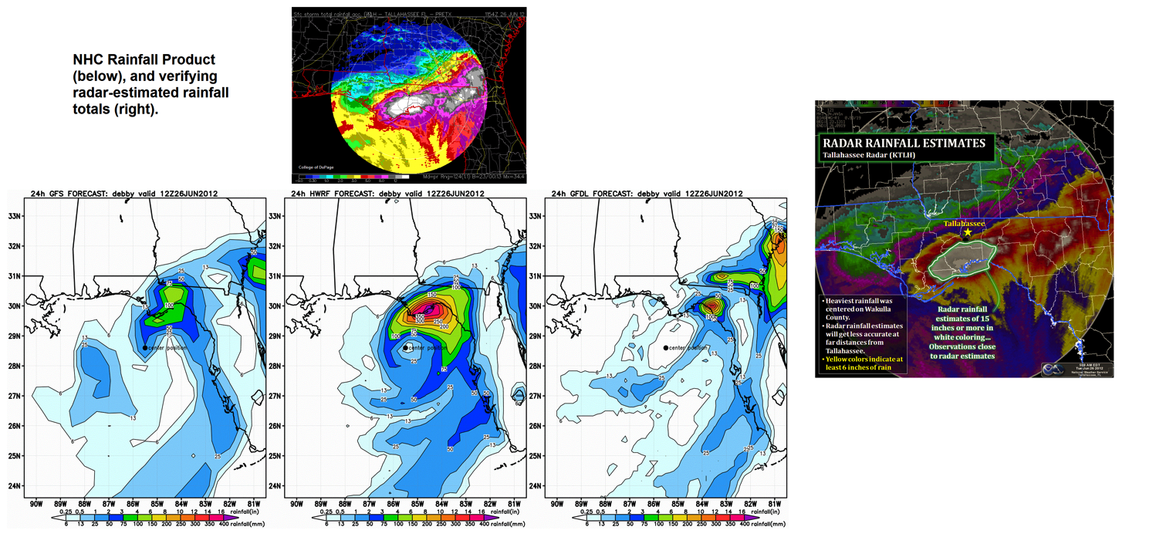
HWRF: Advancing Tropical Cyclone Rainfall Predictions
GFS
HWRF
GFDL
NOAA-HFIP Advancements
Promises
Notes:
6

Slide 7
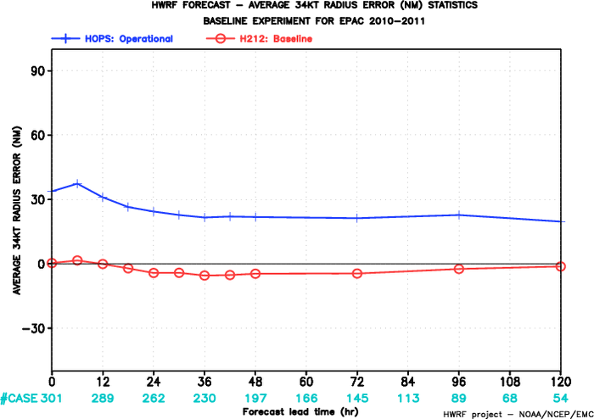
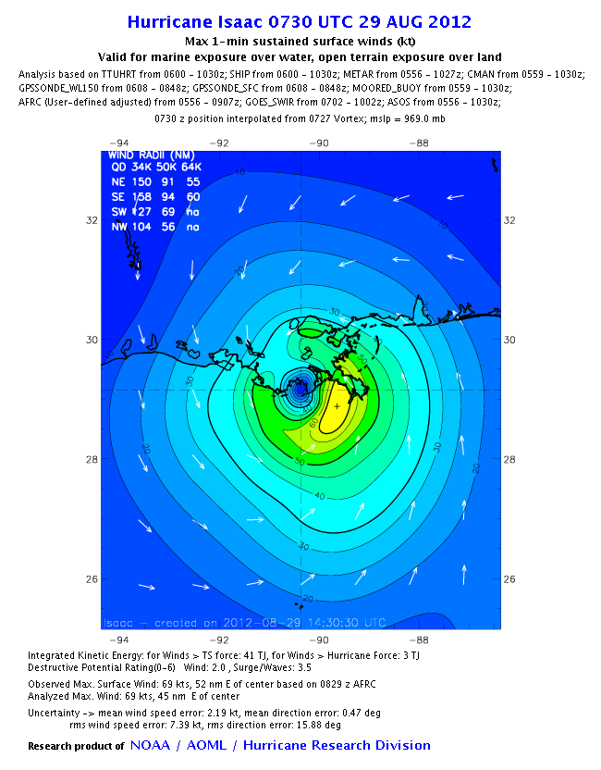
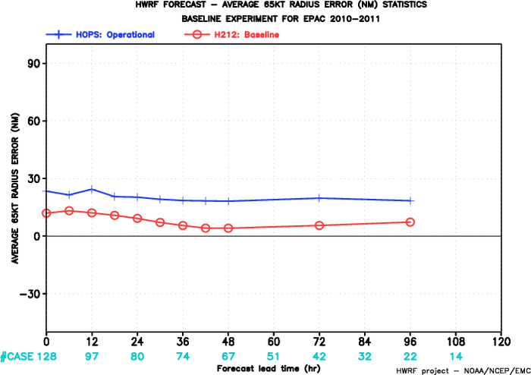
HWRF: Advancing Tropical Cyclone Size Predictions
EPAC: Mean 34-kt Radius Error
9km HWRF
Radius
Of 34 kt
winds
3km HWRF
Radius
Of Maximum
winds
EPAC: Mean 65-kt Radius Error
NOAA-H*Wind Analysis
9km HWRF
Size Matters!
(e.g. storm surge)
3km HWRF
NOAA-HFIP Advancements
Promises
Notes:
7

Slide 8


Airborne Observations For Advancing Tropical Cyclone Forecasts
NOAA Gulfstream-IV jet:
Flight altitude:
  ~45,000 ft (13700 m, 150 hPa)
Purpose
  synoptic
Instrument
    GPS dropsonde
Observation frequency
  Flight level: 1 Hz
  dropsonde: ~30 个
  interval: 150-200 km
NOAA G-IV
NOAA P-3
NOAA P-3:
Flight altitude
  ~25,000 ft (7600m, 400 hPa)
Purpose
  Inner core
Instrument
  GPS dropsonde
  AXBT, AXCP, AXCTD, Bouy
  Doppler Radar
  SFMR, DWRL etc.
Observation frequency
  dropsonde: ~30 个

Slide 9
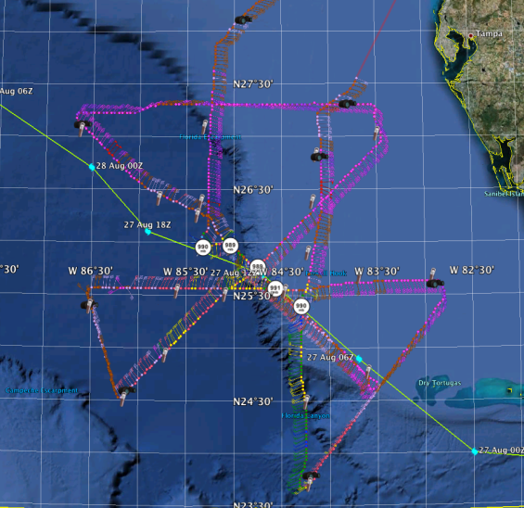
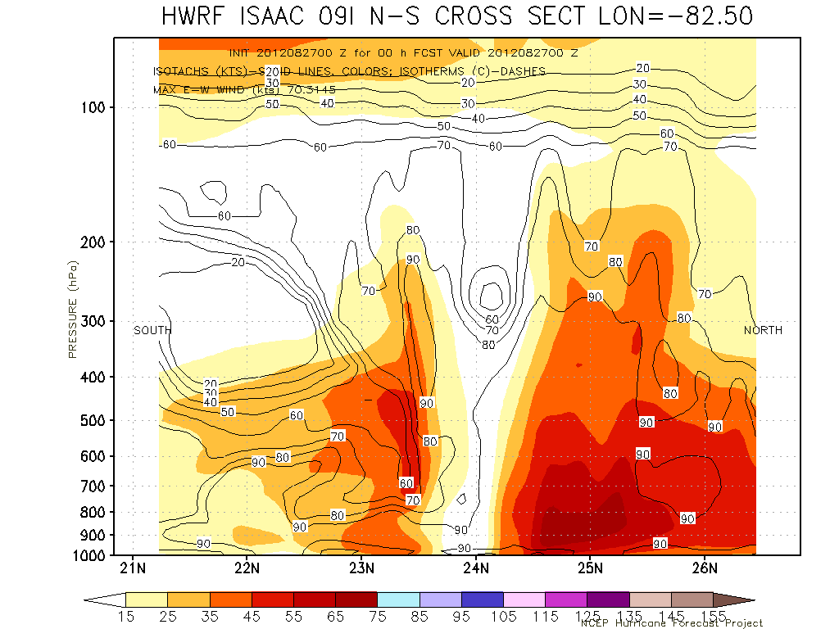
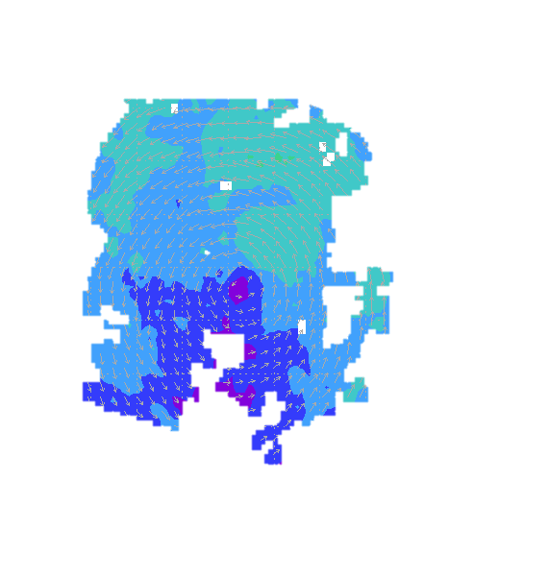
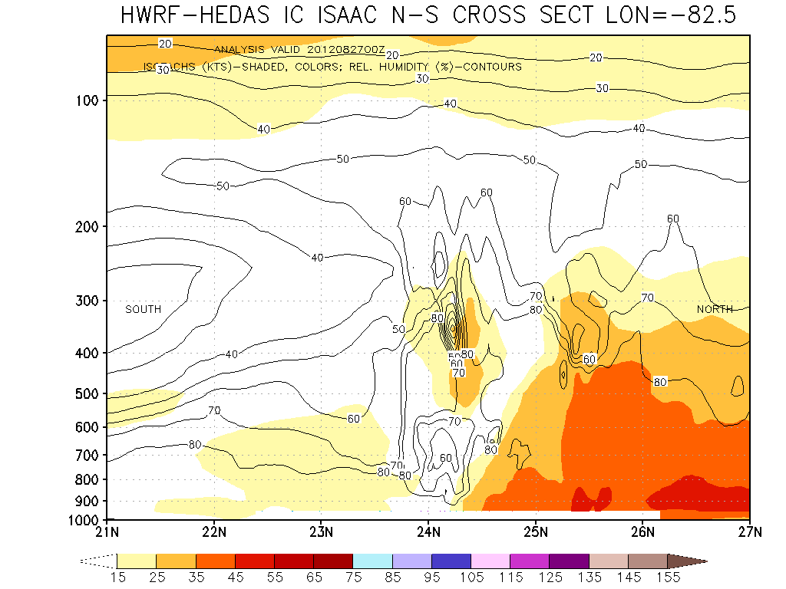
HWRF: Advancing Tropical Cyclone Intensity Predictions Using P3 Observations
The Hurricane Research Division of NOAA/AOML has developed a state-of the-art inner core data assimilation system for HWRF (HEDAS)
[Runs in real time under HFIP]
ISAAC Initial vortex (wind)
Operational HWRF (No Data Assimilation)
ISAAC (2012): Intensity Errors (kt)
Hours | 12 | 24 | 36 | 48
Operational HWRF | 13 | 16 | 26 | 26
With P3 Data | 8 | 3 | 9 | 20
Cases | 9 | 7 | 5 | 3
ISAAC Initial vortex (wind)
with assimilation of observations
Dry and
Sheared
vortex
Aksoy, A., S. Lorsolo, T. Vukicevic, K. Sellwood, S. Aberson, and F. Zhang, 2012: The HWRF Hurricane Ensemble Data Assimilation System (HEDAS) for highresolution data: The impact of airborne Doppler radar observations in an OSSE. Mon. Wea. Rev (in press).
NOAA-HFIP Advancements

Slide 10
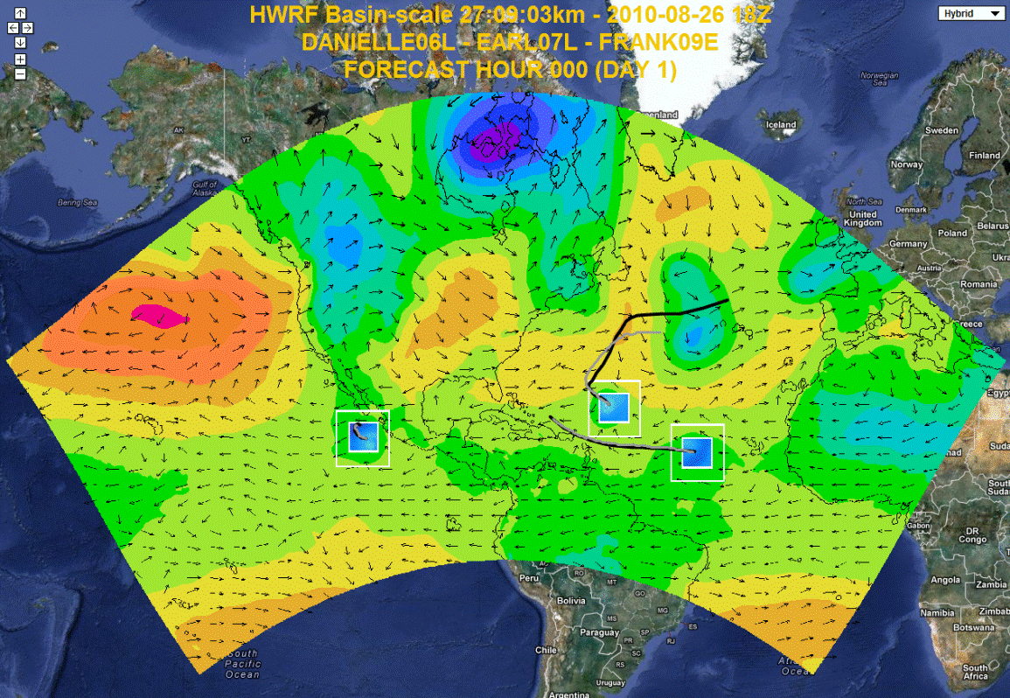
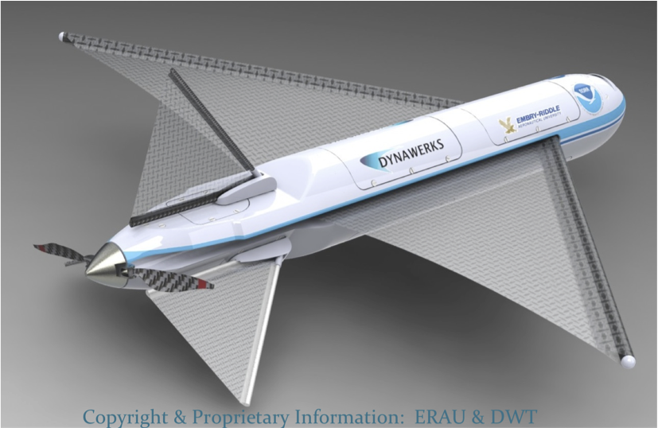
HWRF: Addressing the Next Generation Needs for a “Weather-Ready” Nation
Providing Tropical Outlooks beyond 5 days
Website at AOML: https://storm.aoml.noaa.gov/realtime
GALE Unmanned Arial System (UAS):
For Improving Initial Conditions
NOAA-HFIP Advancements
Notes:
10

Slide 11
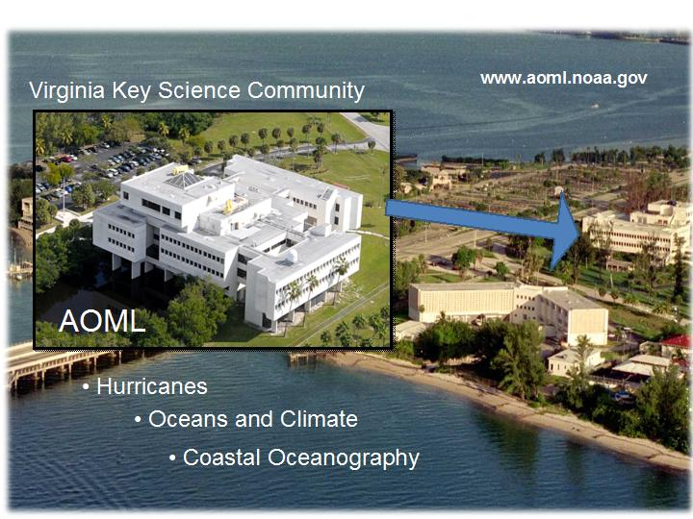
Questions ?
gopal@noaa.gov

