Slide 1
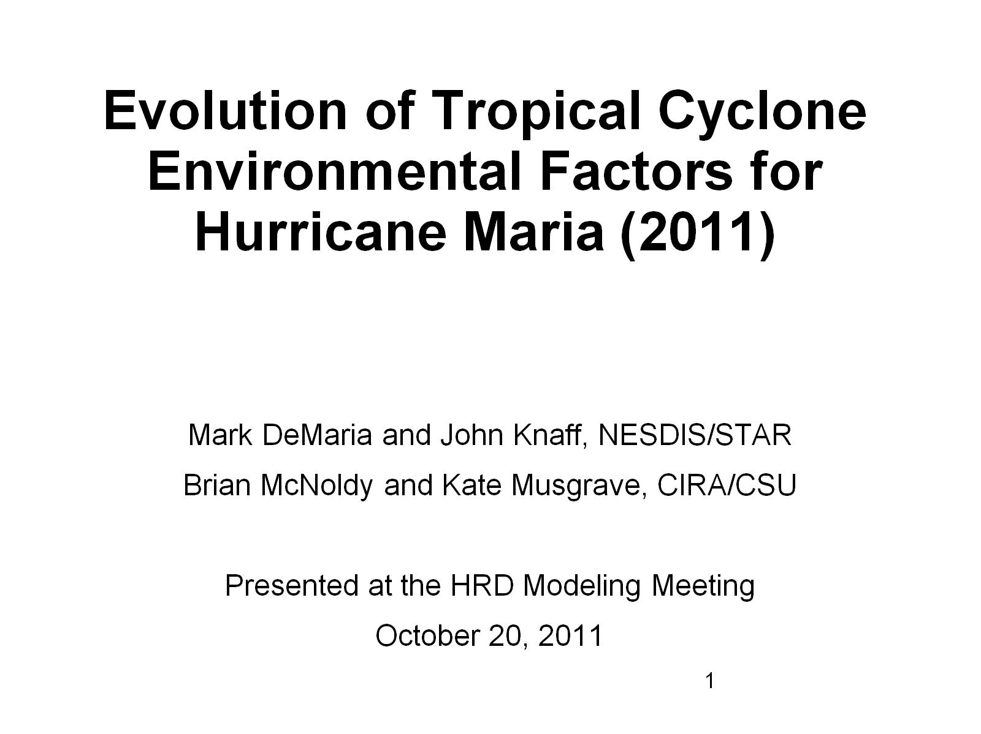
Evolution of Tropical Cyclone Environmental Factors for Hurricane Maria (2011)

Slide 2
Outline

Slide 3
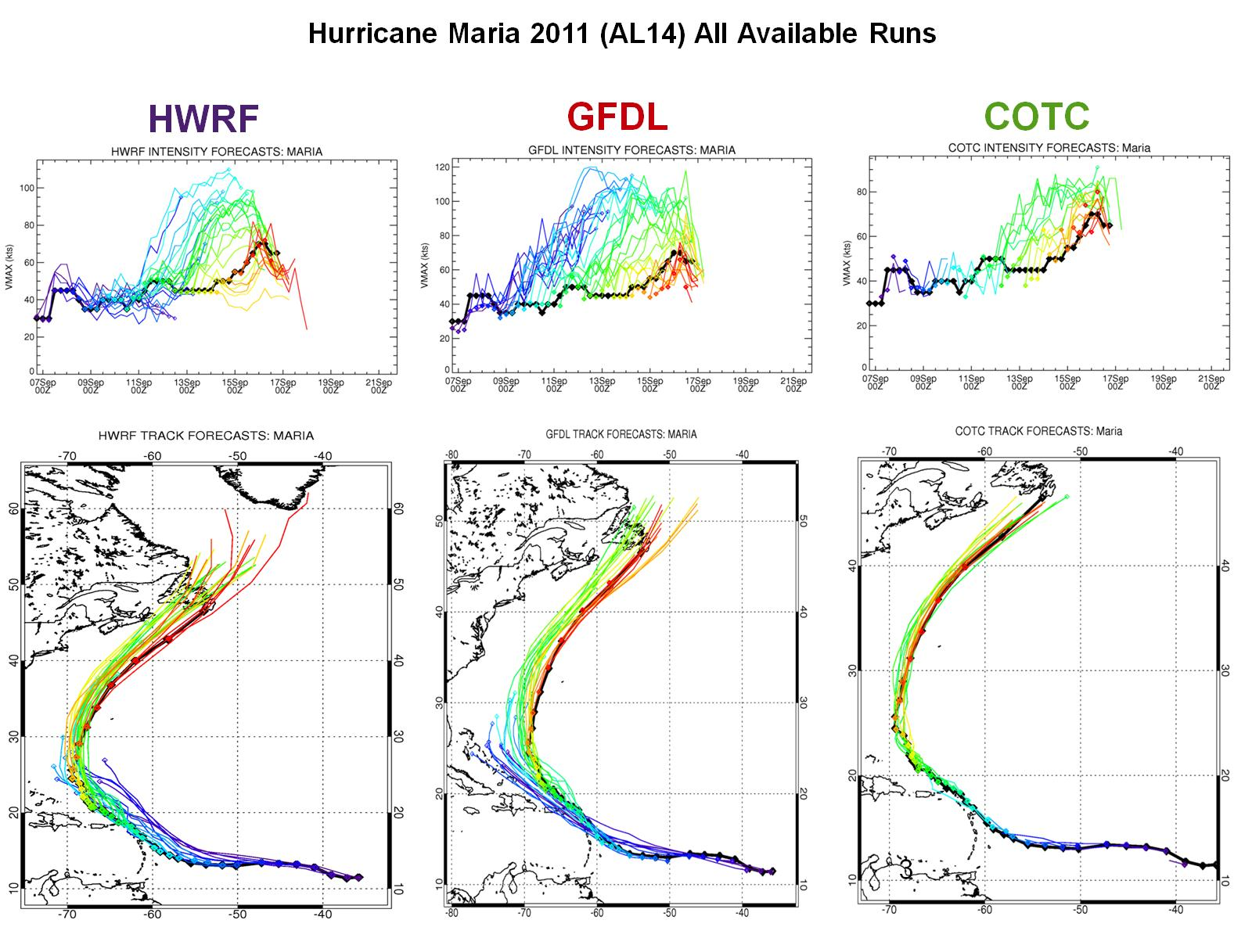

Slide 4
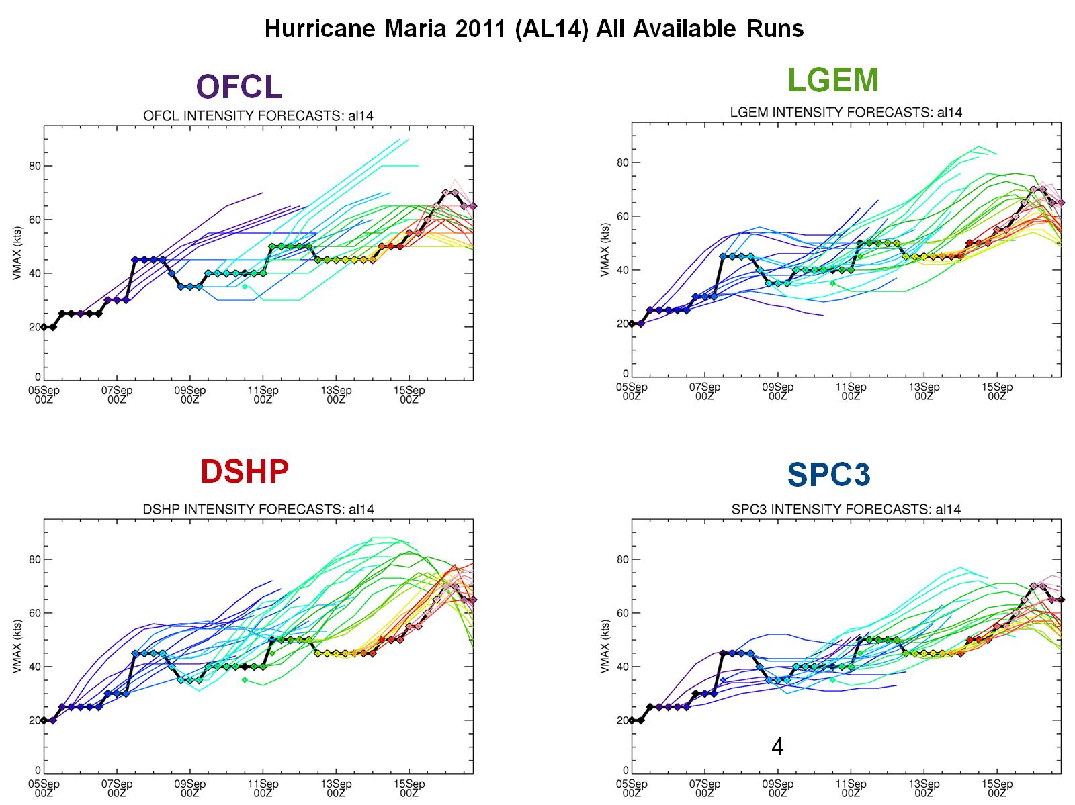

Slide 5
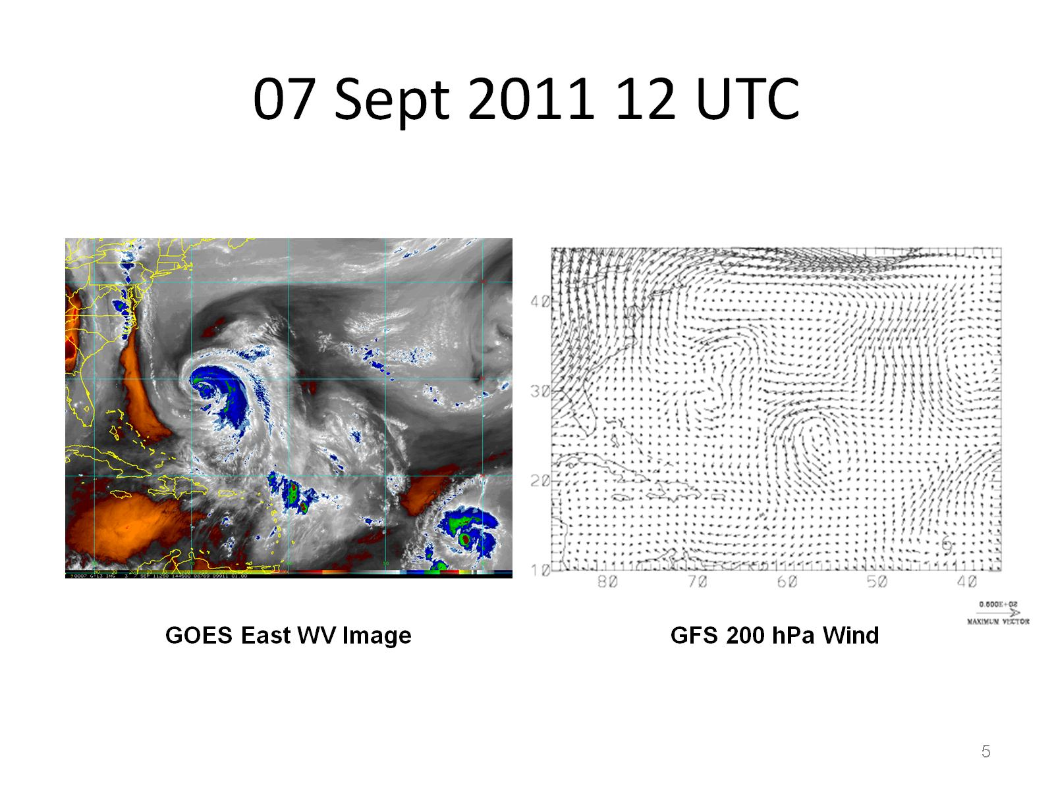
07 Sept 2011 12 UTC

Slide 6
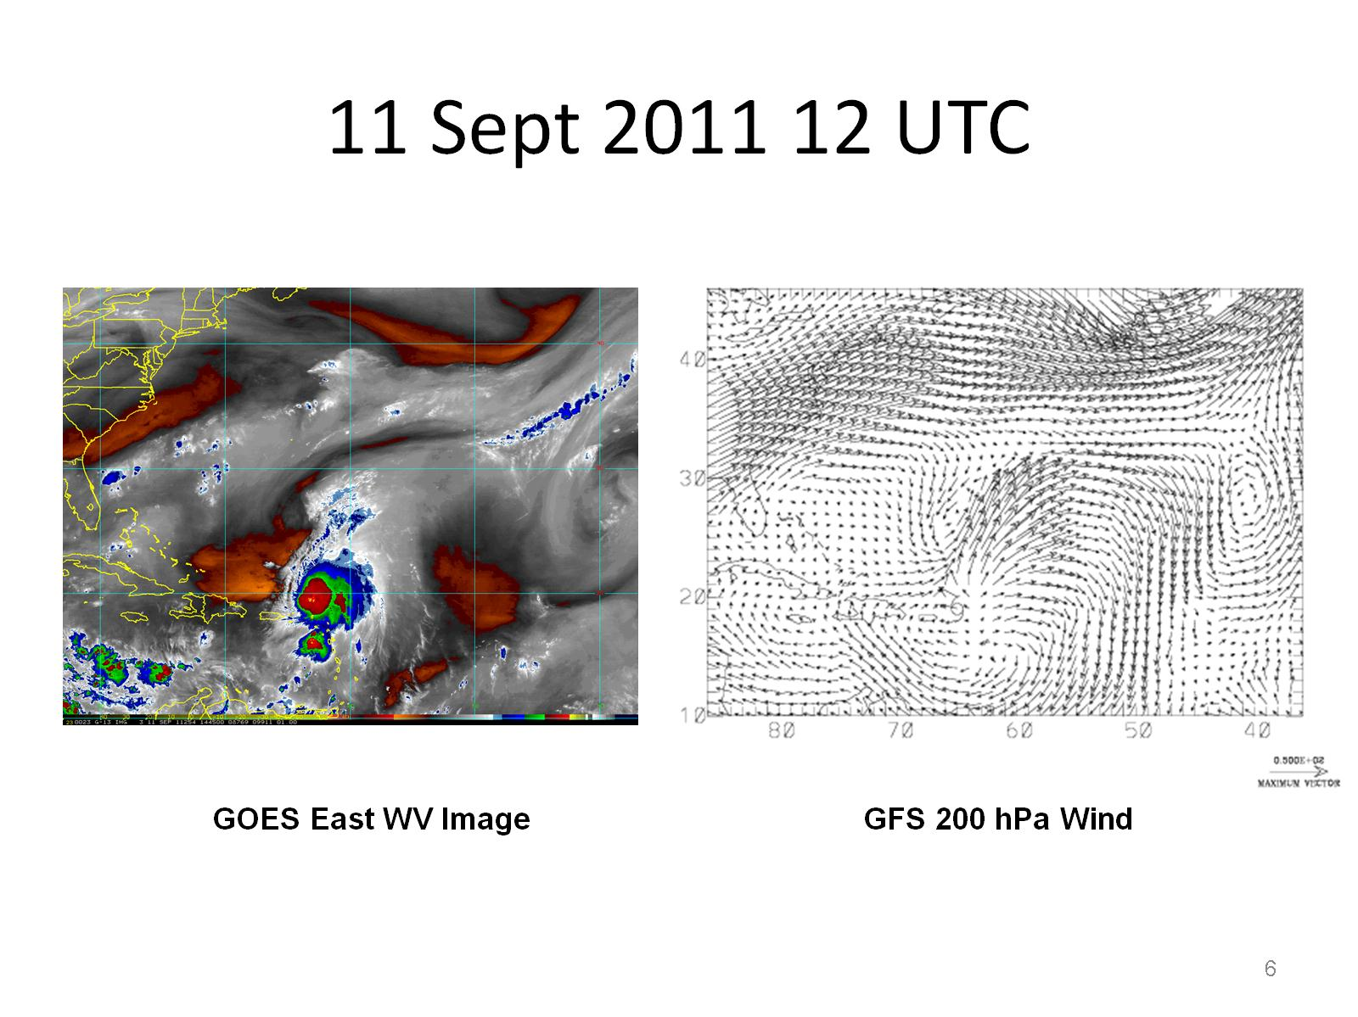
11 Sept 2011 12 UTC

Slide 7
15 Sept 2011 18 UTC

Slide 8
Evaluation of Environmental Variables

Slide 9
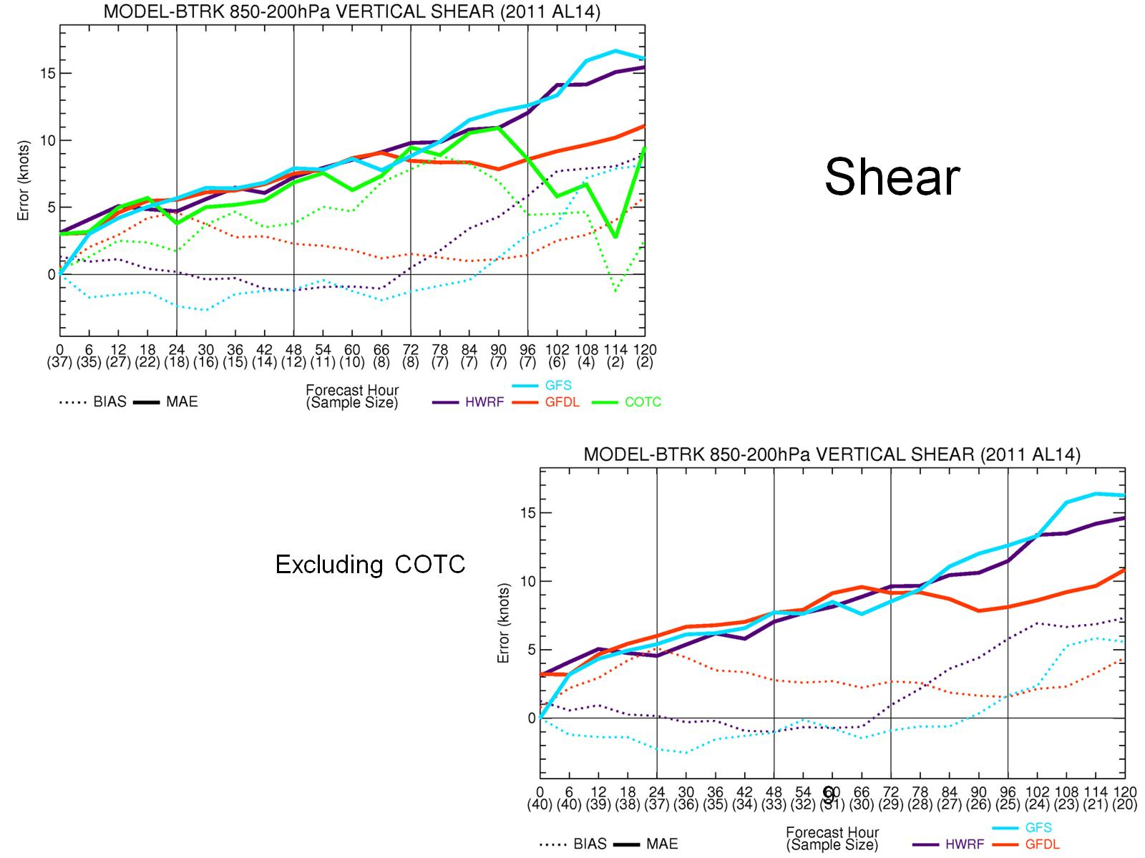

Slide 10
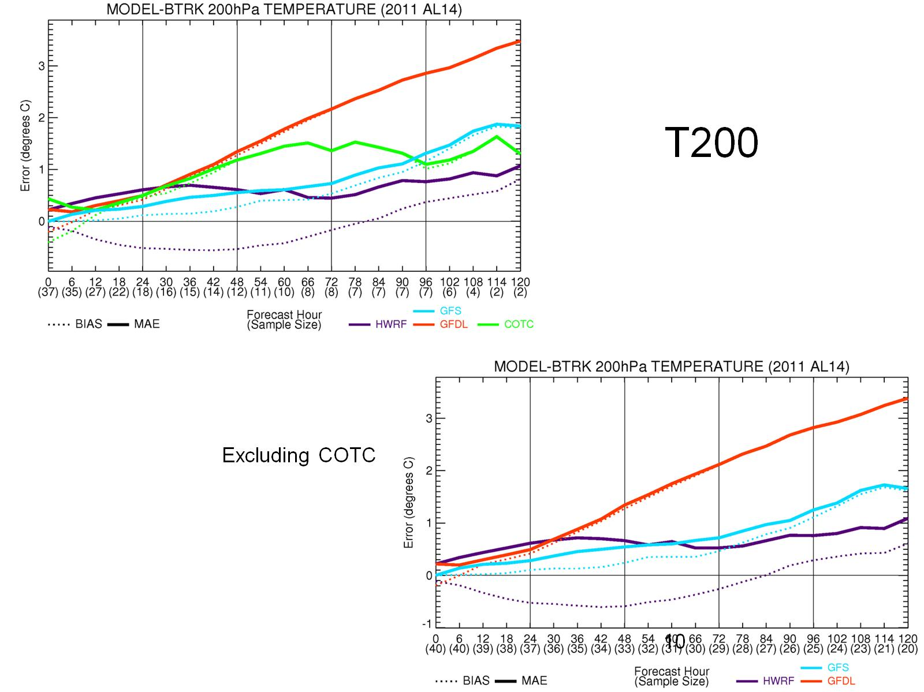

Slide 11
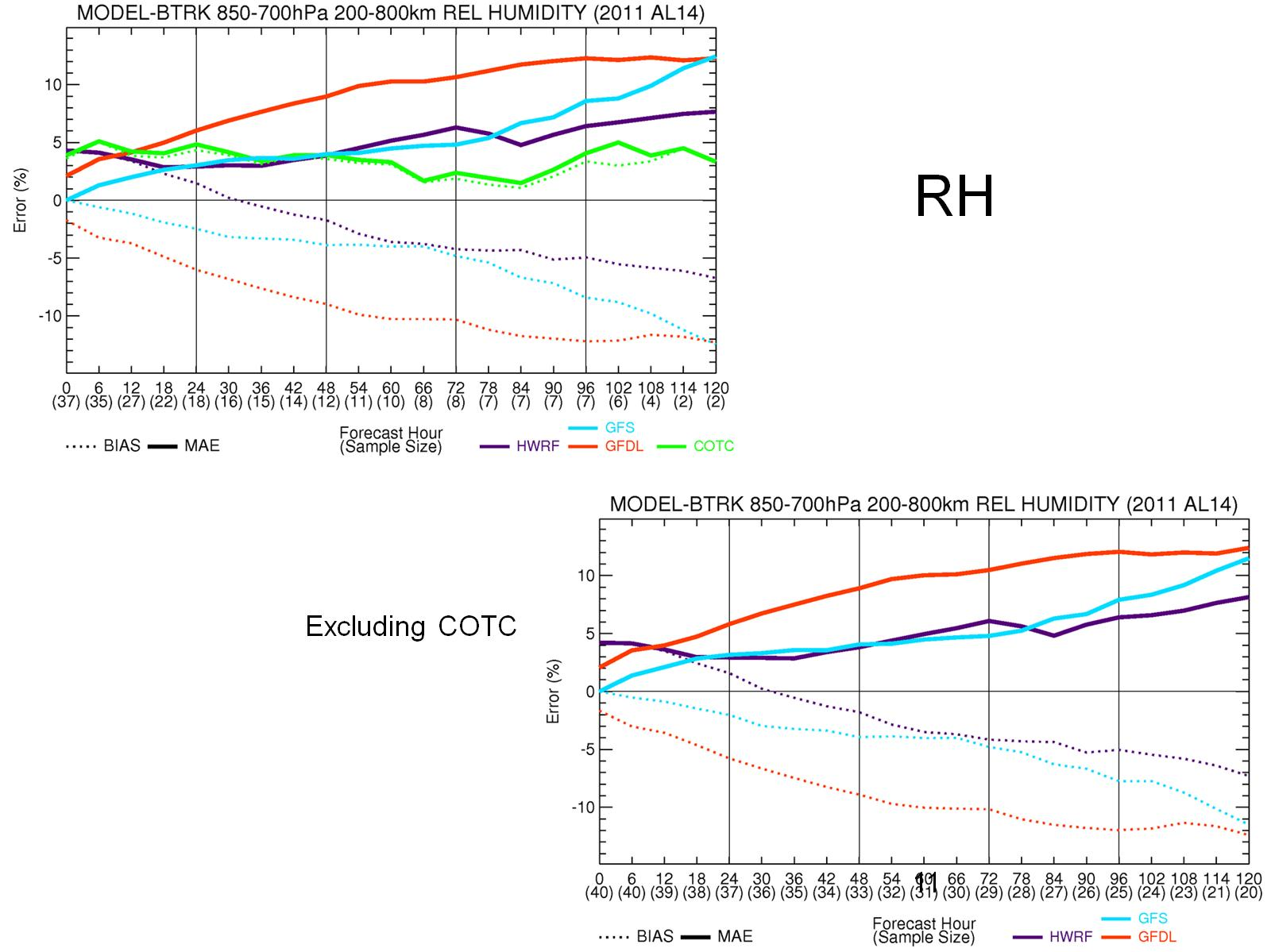

Slide 12
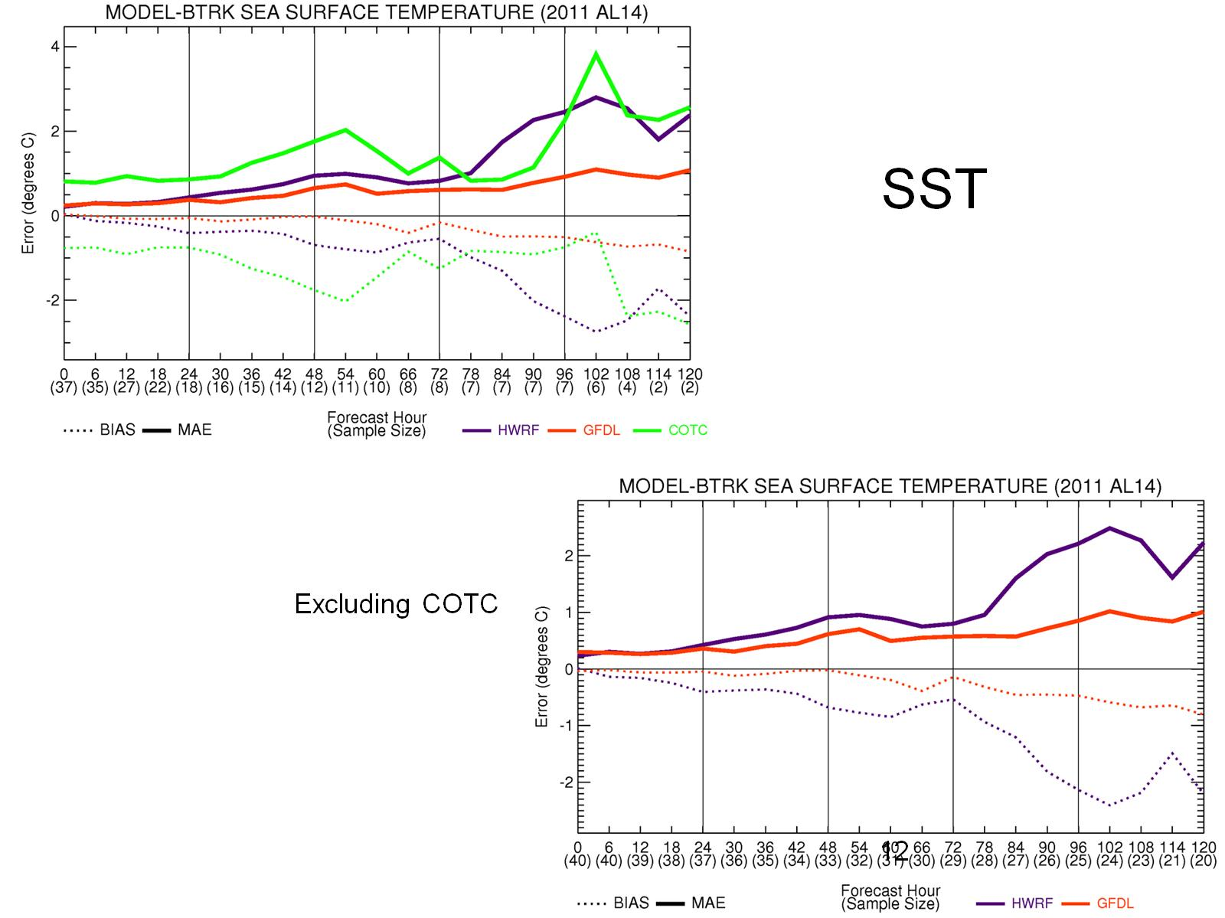

Slide 13
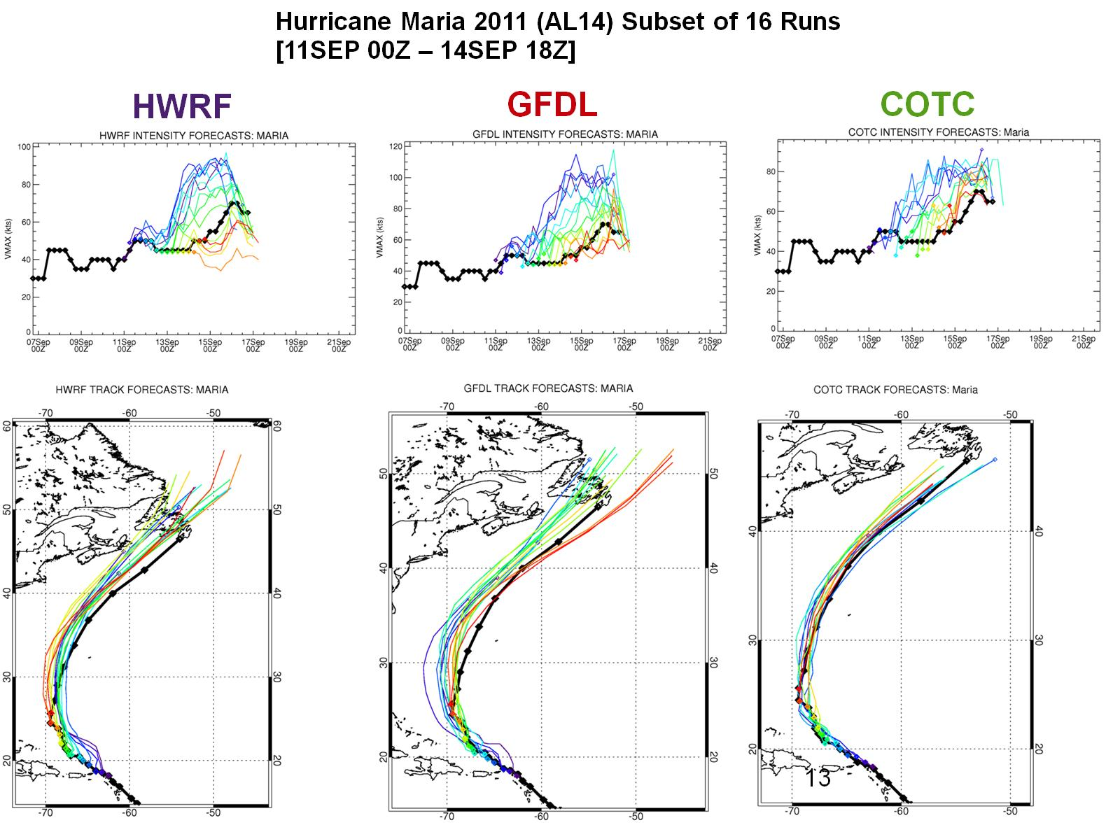

Slide 14
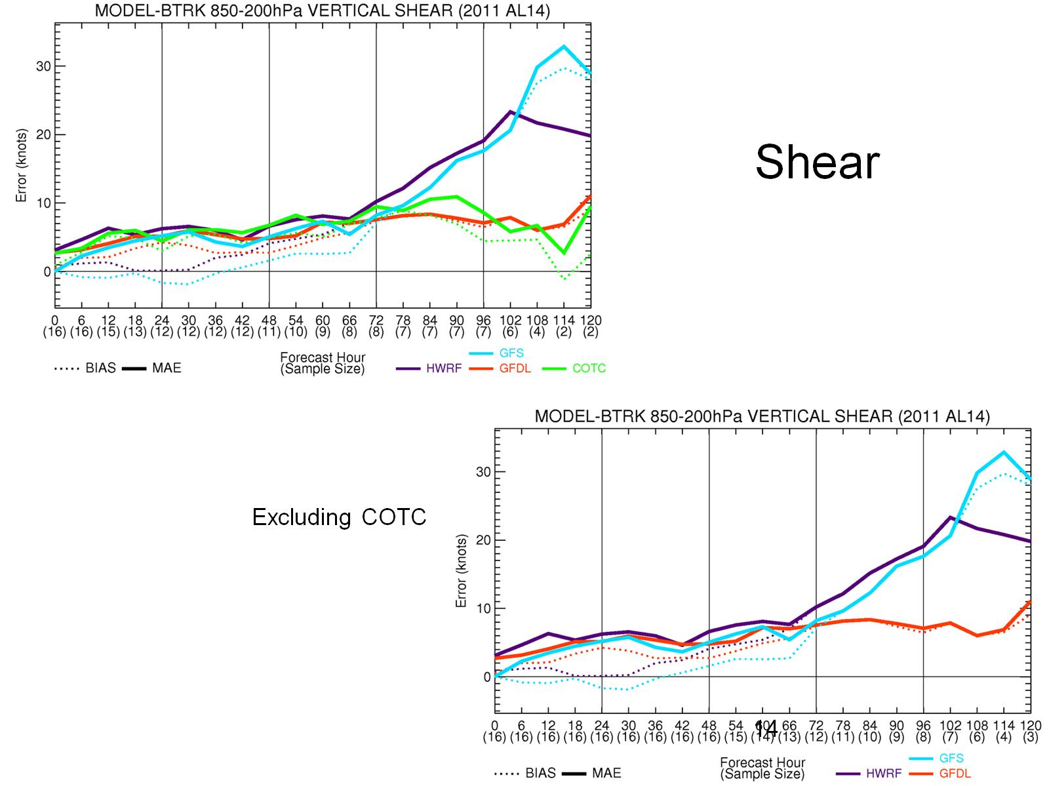

Slide 15
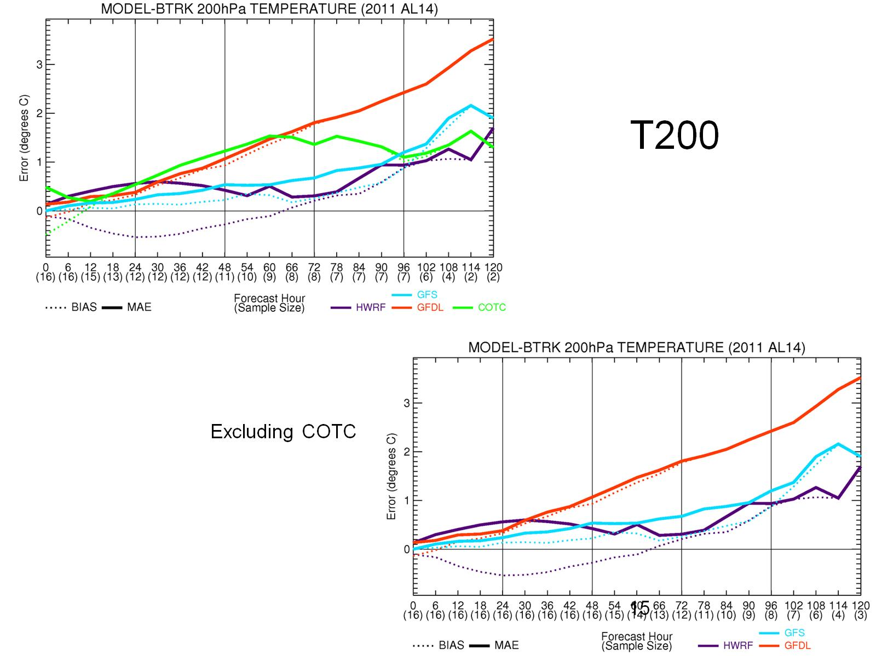

Slide 16
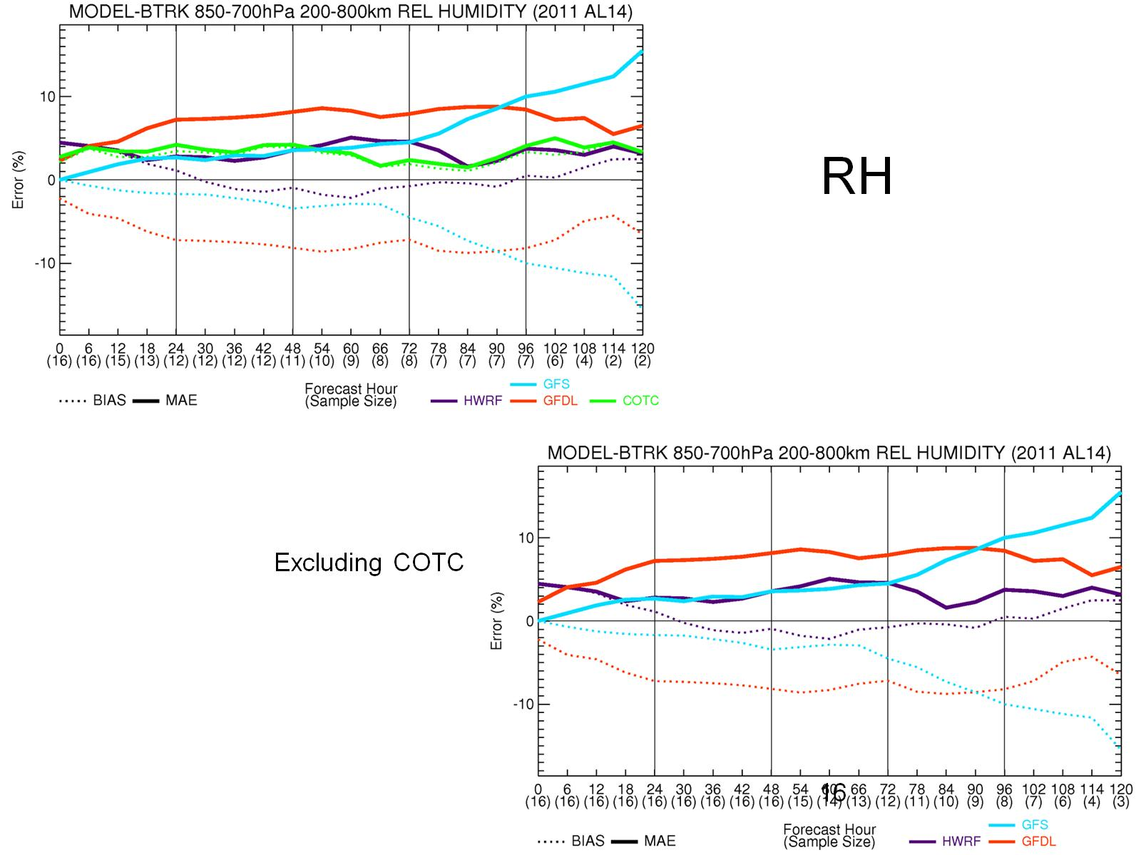

Slide 17
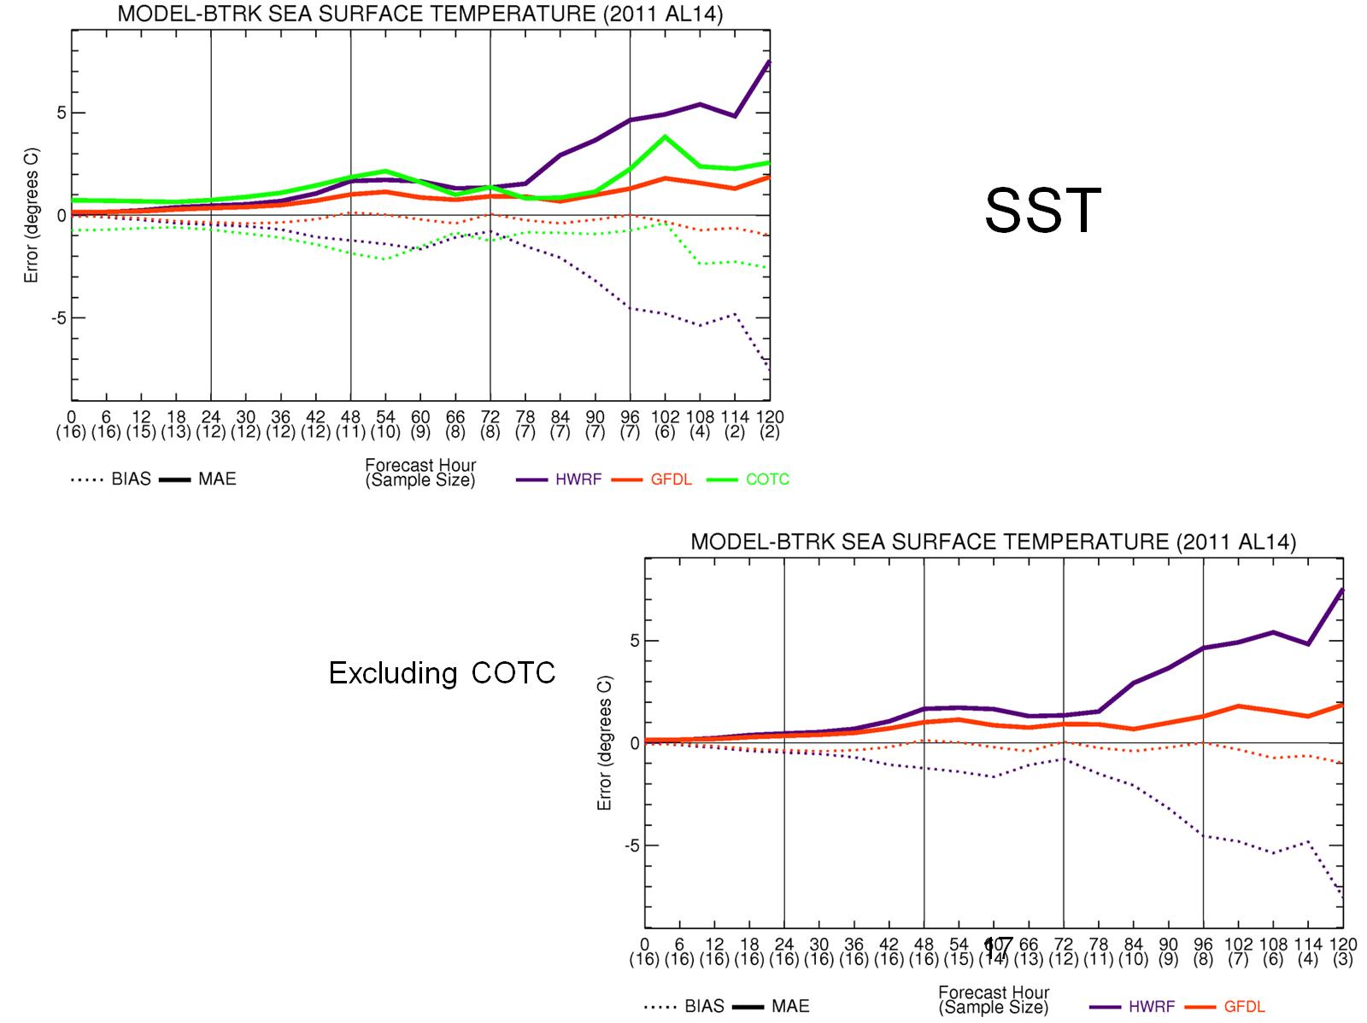

Slide 18
The Holland Wind Profile

Slide 19
Holland B for GFDL and HWRF

Slide 20
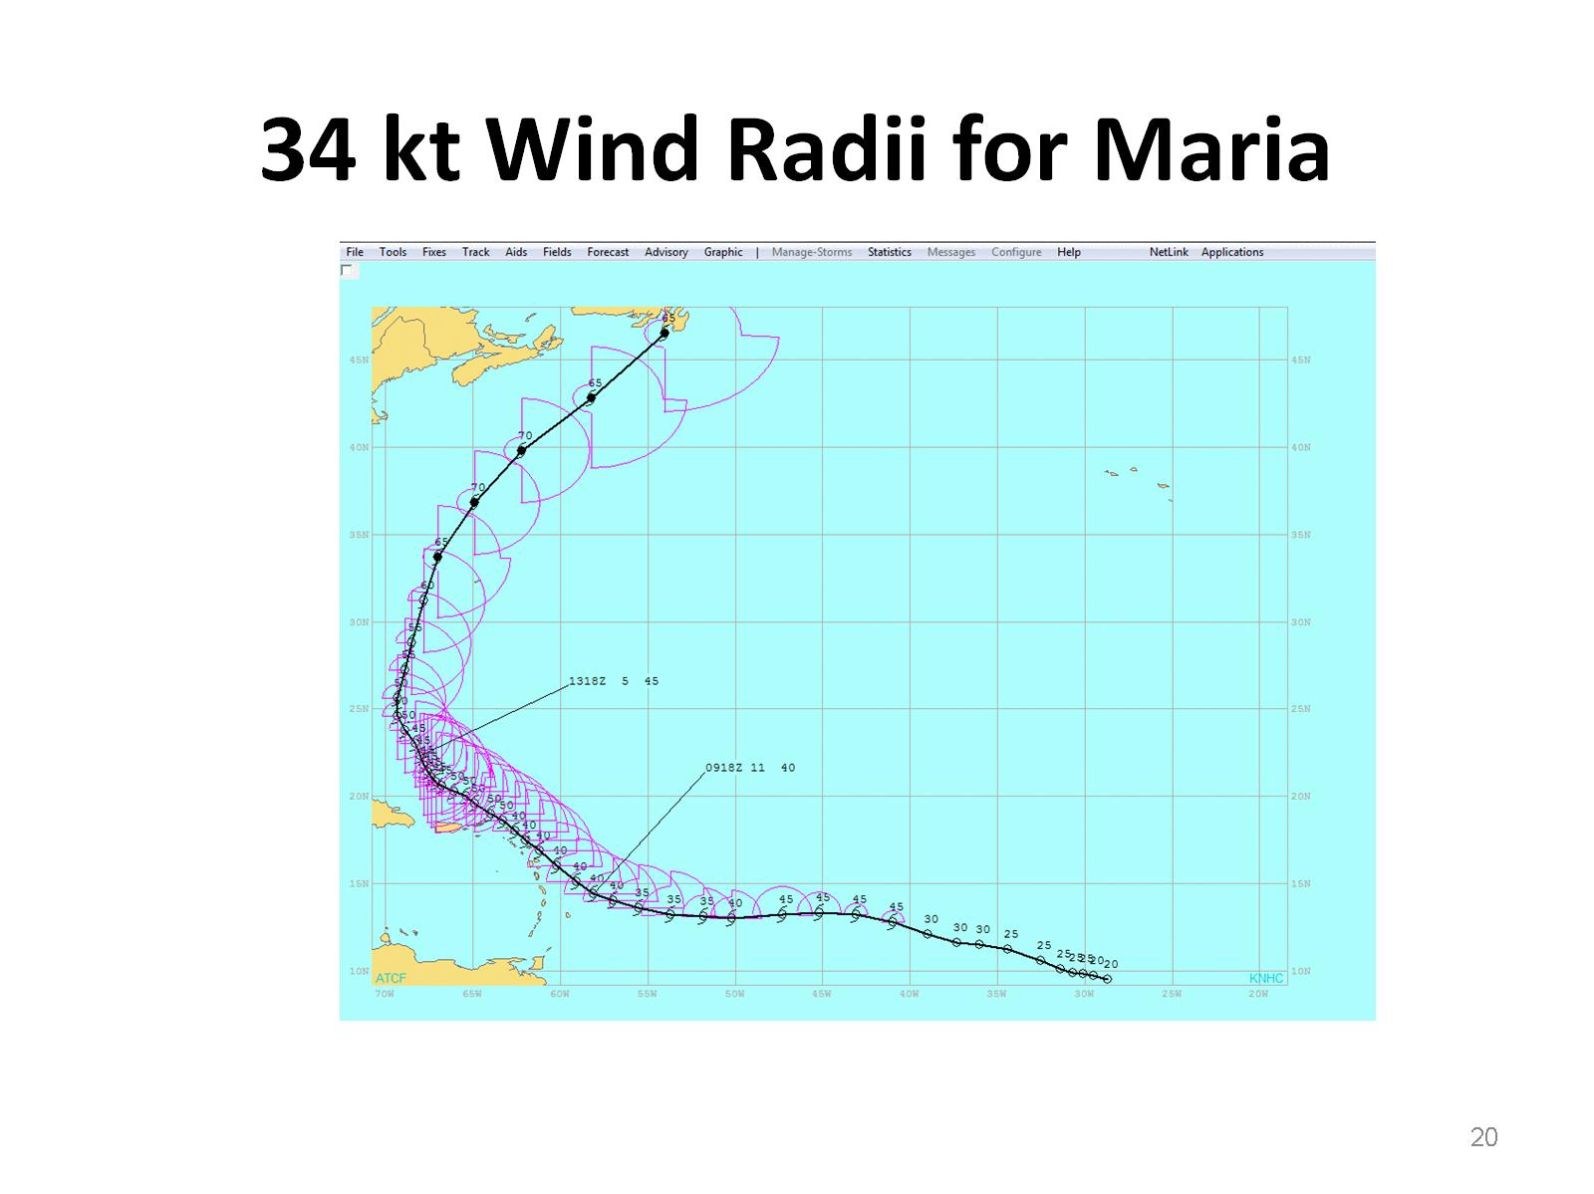
34 kt Wind Radii for Maria

Slide 21
Preliminary Results and Future Plans

