Slide 1
Stream 1.5 and Stream 2.0 Model Performance Hurricane Maria (AL142011)
Christopher Williams and Paul Kucera
NCAR/RAL
Updated 20 October 2011

Slide 2
Introduction
Intensity and track errors were computed for homogeneous sample for stream 1.5, stream 2.0 and several operational models
Restricting all the model forecasts to a homogeneous sample resulted in very small sample sizes.
So, in addition to evaluating all the models together, we did the same analysis but excluded the model(s) that have small sample sizes.
Note: Errors based on Working Best Track

Slide 3
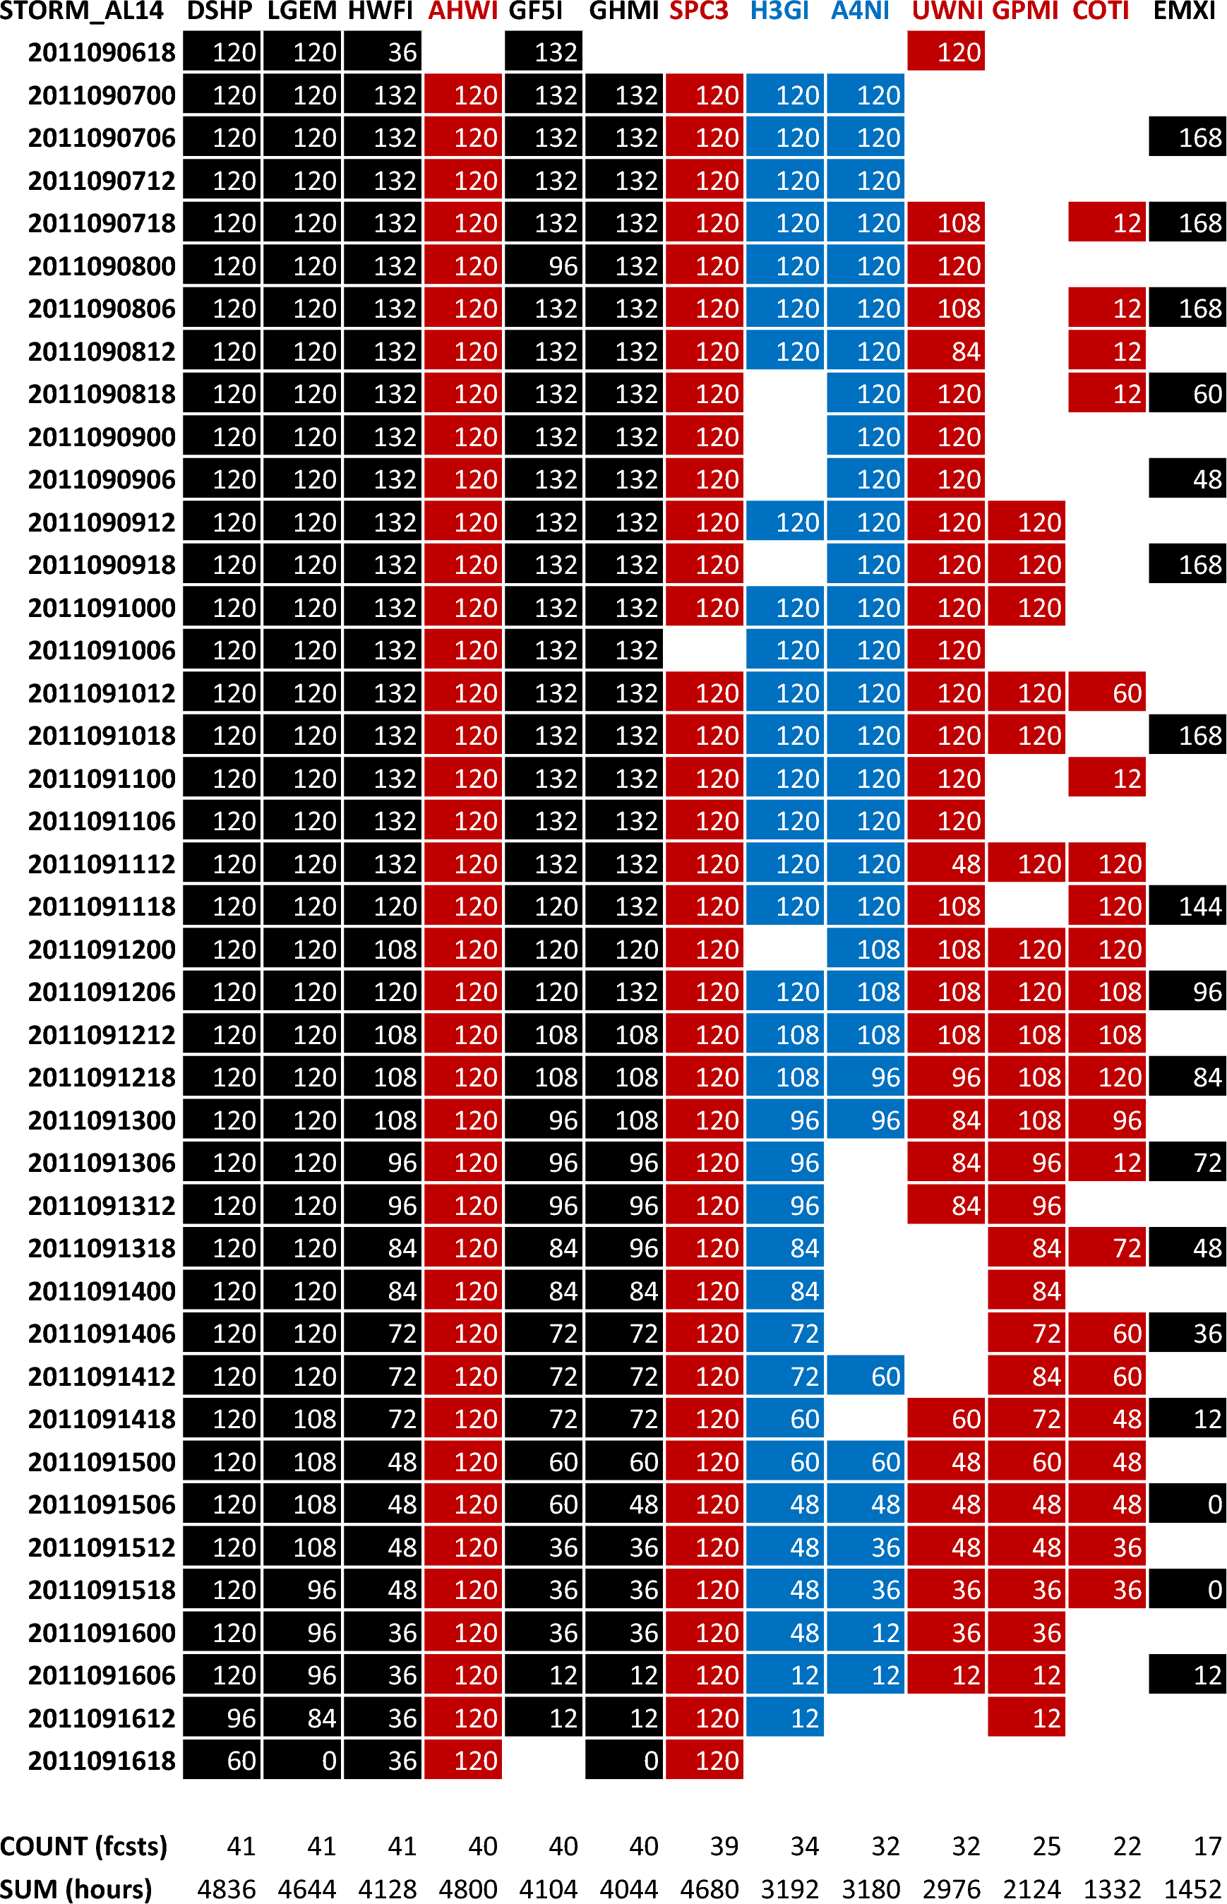
INTENSITY
The following table shows which Operational (black), Stream 1.5 (red), and Stream 2.0 (blue) forecasts are available at each forecast time when the storm is classified as either tropical or subtropical.
The values in the ATCF ID columns reflect the last forecast hour/period for each available forecast. A blank space means no forecast is available.

Slide 4
Mean Intensity Error (kt) for Homogeneous Sample (Land and Water)
0 12 24 36 48 60 72 84 96
LGEM 0.0 1.5 1.5 1.0 1.5 2.5 -1.0 -6.5 -9.0
DSHP 0.0 1.5 3.5 5.5 8.5 11.5 9.0 2.0 -1.0
GHMI 0.0 8.5 16.5 25.5 33.5 35.5 24.5 23.5 24.0
GF5I 0.0 5.5 10.0 20.5 26.0 24.0 19.0 16.0 8.0
HWFI 0.0 8.5 18.0 26.5 30.0 29.5 23.5 9.0 7.0
EMXI 0.0 1.0 0.0 -4.0 -5.5 -5.0 -10.0 -14.0 1.0
GPMI 0.0 8.0 13.5 22.5 29.5 31.5 26.0 25.5 22.0
AHWI 0.0 3.0 20.5 38.0 45.0 49.0 37.5 11.5 -1.0
COTI 0.0 11.0 19.0 21.5 22.5 25.0 17.0 8.5 7.0
UWNI 0.0 8.5 15.0 19.5 25.5 25.5 19.5 14.5 12.0
SPC3 0.0 1.5 3.0 3.0 3.5 3.0 -2.0 -10.0 -12.0
H3GI 0.0 9.0 15.5 21.0 21.0 22.0 18.0 -0.5 -12.0
A4NI 0.0 7.0 11.0 15.5 24.0 29.0 26.0 17.5 2.0
# Cases 4 2 2 2 2 2 2 2 1
All Stream 1.5 Models (Intensity) and requested baselines/models
Mean Intensity Error (kt) for Homogeneous Sample (Land and Water)
0 12 24 36 48 60 72 84 96 108 120
LGEM 0.0 1.4 4.0 2.8 3.2 4.0 2.8 -0.5 0.0 2.0 2.0
DSHP 0.0 0.4 5.7 7.7 11.0 13.3 12.7 9.0 7.2 7.5 5.0
GHMI 0.0 3.6 12.2 21.3 31.5 35.2 31.8 31.2 33.2 38.5 29.0
GF5I 0.0 1.7 8.7 15.2 19.7 23.3 20.8 17.3 14.2 12.8 26.0
HWFI 0.0 2.3 7.2 10.3 16.7 20.5 19.0 12.3 9.4 6.0 32.0
EMXI 0.0 0.7 2.5 1.2 0.2 -1.3 -5.2 -9.5 -7.6 -12.8 -25.0
AHWI 0.0 2.4 16.8 27.2 36.3 44.8 46.0 34.7 32.2 30.5 -3.0
UWNI 0.0 6.0 14.5 16.7 20.5 20.5 16.8 10.3 5.2 -1.2 12.0
SPC3 0.0 0.9 4.3 4.2 5.0 4.8 2.7 -2.3 -2.0 0.0 -6.0
H3GI 0.0 3.7 11.7 16.0 18.0 20.2 22.5 18.0 18.8 23.2 26.0
A4NI 0.0 5.1 10.3 15.5 22.0 27.0 26.3 20.5 13.6 7.8 32.0
# Cases 9 7 6 6 6 6 6 6 5 4 1
Excludes
GPMI and COTI
Mean Intensity Error (kt) for Homogeneous Sample (Land and Water)
0 12 24 36 48 60 72 84 96 108 120
LGEM -0.5 0.4 1.2 1.6 2.2 3.3 3.7 3.2 4.7 7.5 6.5
DSHP -0.5 0.9 4.8 8.3 12.0 15.0 15.5 14.6 14.5 14.3 11.7
GHMI -0.5 3.7 7.2 16.5 27.2 32.5 33.9 34.2 36.6 40.0 37.7
GF5I -0.5 2.2 6.1 14.5 19.4 24.4 25.6 22.2 21.4 26.4 32.8
HWFI -0.5 0.2 1.1 5.8 12.7 18.3 20.1 17.9 18.9 20.4 27.0
AHWI -0.5 -2.5 9.3 22.1 32.5 40.8 43.4 38.1 32.7 28.7 10.3
UWNI -0.5 7.7 14.4 19.0 24.2 25.3 22.5 17.1 15.9 13.3 18.0
SPC3 -0.5 0.0 2.0 3.2 4.2 4.6 3.7 1.7 1.9 3.6 -0.5
H3GI -0.5 2.8 8.7 15.3 18.8 21.9 24.7 23.0 23.3 26.3 26.2
A4NI -0.5 3.7 6.2 11.9 19.6 24.9 28.3 26.3 24.0 18.0 23.3
# Cases 22 22 20 18 16 15 15 15 13 10 6
Excludes
EMXI, GPMI, and COTI
Mean Intensity Error (kt) for Homogeneous Sample (Land and Water)
0 12 24 36 48 60 72 84 96 108 120
LGEM -0.3 -0.2 0.1 0.3 -0.0 0.8 2.0 2.8 3.3 4.5 3.6
DSHP -0.3 0.5 3.8 7.1 9.9 12.5 13.8 13.6 13.4 12.3 9.7
GHMI -0.3 2.4 4.2 10.9 19.0 24.7 29.5 32.2 35.6 38.9 43.2
GF5I -0.3 1.1 3.4 9.9 12.3 17.5 21.5 19.9 16.8 18.1 15.9
HWFI -0.3 -0.4 -1.0 1.7 6.0 10.6 14.0 13.9 12.2 9.2 4.3
AHWI -0.3 -4.8 7.8 21.2 27.0 33.1 37.6 37.8 36.5 32.7 25.1
SPC3 -0.6 -1.1 0.1 0.9 0.8 1.0 1.2 0.8 0.6 0.5 -0.6
H3GI -0.3 2.1 6.1 11.2 12.9 16.6 18.7 19.8 22.1 22.6 20.6
# Cases 33 32 30 28 26 24 22 20 18 15 14
Excludes
EMXI, GPMI,
COTI, UWNI, and A4NI

Slide 5
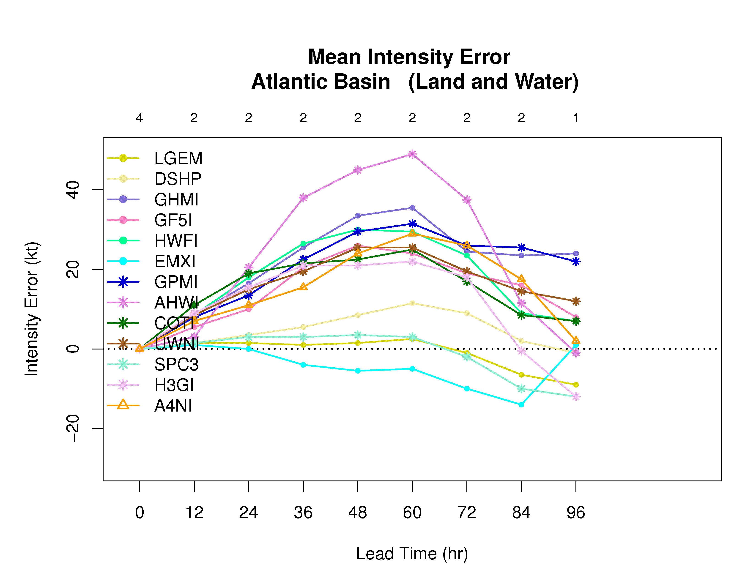
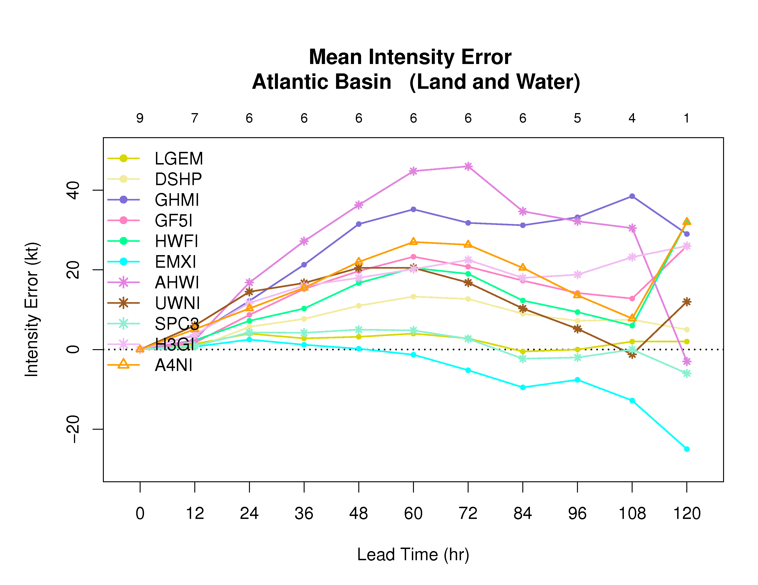
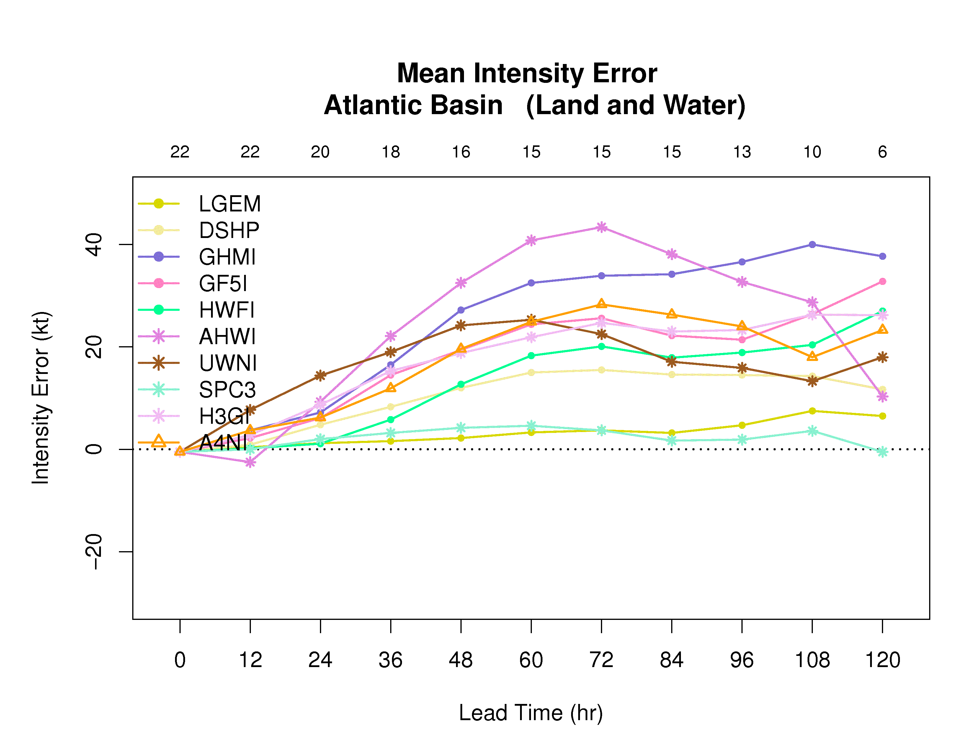
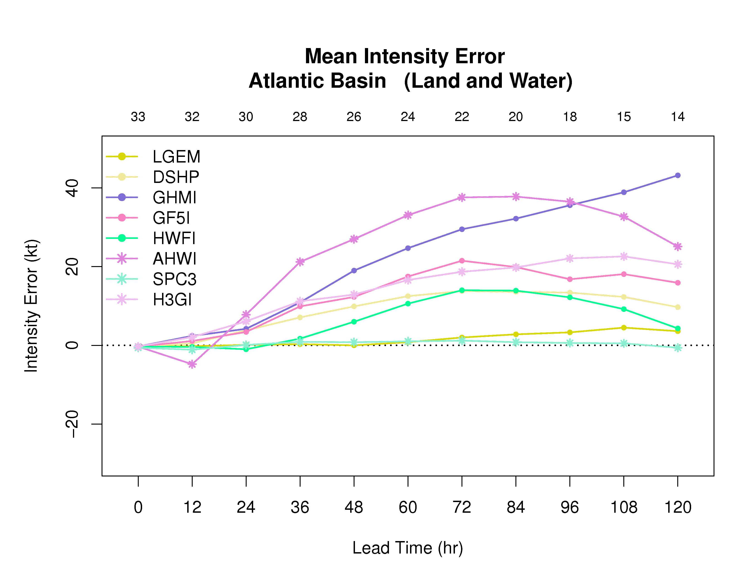
Homogeneous Comparison of Stream 1.5 and Stream 2.0 Models - Maria

Slide 6
Absolute Mean Intensity Error (kt) for Homogeneous Sample (Land and Water)
0 12 24 36 48 60 72 84 96
LGEM 0.0 3.5 3.5 6.0 3.5 6.5 9.0 8.5 9.0
DSHP 0.0 3.5 3.5 6.5 8.5 11.5 9.0 8.0 1.0
GHMI 0.0 8.5 16.5 25.5 33.5 35.5 24.5 23.5 24.0
GF5I 0.0 5.5 10.0 20.5 26.0 24.0 19.0 16.0 8.0
HWFI 0.0 8.5 18.0 26.5 30.0 29.5 23.5 14.0 7.0
EMXI 0.0 3.0 4.0 6.0 5.5 6.0 10.0 14.0 1.0
GPMI 0.0 8.0 13.5 22.5 29.5 31.5 26.0 25.5 22.0
AHWI 0.0 4.0 20.5 38.0 45.0 49.0 37.5 17.5 1.0
COTI 0.0 11.0 19.0 21.5 22.5 25.0 17.0 8.5 7.0
UWNI 0.0 8.5 15.0 19.5 25.5 25.5 19.5 14.5 12.0
SPC3 0.0 3.5 4.0 6.0 3.5 6.0 8.0 10.0 12.0
H3GI 0.0 9.0 15.5 21.0 21.0 22.0 18.0 8.5 12.0
A4NI 0.0 7.0 11.0 15.5 24.0 29.0 26.0 17.5 2.0
# Cases 4 2 2 2 2 2 2 2 1
All Stream 1.5 Models (Intensity) and requested baselines/models
Absolute Mean Intensity Error (kt) for Homogeneous Sample (Land and Water)
0 12 24 36 48 60 72 84 96 108 120
LGEM 0.0 4.9 8.0 7.5 4.5 5.3 8.8 7.2 6.0 6.0 2.0
DSHP 0.0 4.7 7.3 8.7 11.0 13.3 12.7 11.0 7.6 10.0 5.0
GHMI 0.0 5.3 12.2 21.3 31.5 35.2 31.8 31.2 33.2 38.5 29.0
GF5I 0.0 4.3 8.7 15.2 19.7 23.3 20.8 21.0 19.8 17.8 26.0
HWFI 0.0 5.7 8.2 13.0 20.0 21.2 22.0 19.7 18.2 15.0 32.0
EMXI 0.0 4.7 5.8 6.8 5.8 5.3 7.5 10.2 8.0 12.8 25.0
AHWI 0.0 4.4 16.8 27.2 36.3 44.8 46.0 36.7 32.6 32.5 3.0
UWNI 0.0 6.9 14.5 16.7 20.5 21.8 21.5 19.7 18.4 17.2 12.0
SPC3 0.0 4.9 8.0 7.8 5.0 5.8 8.3 7.0 5.6 5.0 6.0
H3GI 0.0 5.4 11.7 16.0 18.0 20.2 22.5 21.0 23.6 24.8 26.0
A4NI 0.0 6.0 10.3 15.5 22.0 27.0 26.3 23.8 19.6 15.2 32.0
# Cases 9 7 6 6 6 6 6 6 5 4 1
Excludes
GPMI and COTI
Absolute Mean Intensity Error (kt) for Homogeneous Sample (Land and Water)
0 12 24 36 48 60 72 84 96 108 120
LGEM 0.5 4.4 6.9 6.4 5.8 6.7 10.6 11.5 12.5 12.7 14.2
DSHP 0.5 4.4 7.3 9.7 12.0 15.0 15.5 16.2 16.3 16.9 13.7
GHMI 0.5 5.9 10.8 17.6 27.2 32.5 33.9 34.2 36.6 40.0 37.7
GF5I 0.5 5.4 10.8 15.1 20.3 25.7 27.6 27.9 28.9 30.6 32.8
HWFI 0.5 4.7 7.7 10.1 16.6 20.5 23.3 22.3 25.7 25.4 27.0
AHWI 0.5 6.7 12.3 22.3 32.5 40.8 43.4 39.9 38.2 31.7 19.7
UWNI 0.5 8.0 14.4 19.1 24.6 26.5 26.7 24.7 22.7 20.7 18.0
SPC3 0.5 4.1 6.9 6.1 5.3 6.3 9.2 10.0 10.8 9.4 13.2
H3GI 0.5 5.8 11.8 16.2 19.2 21.9 24.8 25.4 26.7 29.5 26.2
A4NI 0.5 4.8 7.5 11.9 20.2 25.1 28.3 27.7 26.3 27.4 24.7
# Cases 22 22 20 18 16 15 15 15 13 10 6
Excludes
EMXI, GPMI, and COTI
Absolute Mean Intensity Error (kt) for Homogeneous Sample (Land and Water)
0 12 24 36 48 60 72 84 96 108 120
LGEM 0.3 4.6 6.7 6.3 6.0 7.9 10.3 10.9 11.4 10.5 11.2
DSHP 0.3 4.3 7.0 8.6 9.9 12.7 13.8 14.8 14.9 14.1 13.1
GHMI 0.3 5.5 9.3 13.7 19.5 25.0 29.5 32.2 35.6 38.9 43.2
GF5I 0.3 5.3 9.4 11.9 14.0 18.8 22.9 24.2 22.9 22.5 21.8
HWFI 0.3 4.9 7.8 10.1 13.2 16.3 19.2 19.6 22.6 22.3 20.7
AHWI 0.3 8.0 11.0 21.4 27.2 33.8 38.9 40.0 40.5 34.7 34.1
SPC3 0.6 4.2 6.1 5.5 5.2 7.5 9.4 9.6 10.7 9.8 11.5
H3GI 0.3 5.4 9.5 13.2 15.3 16.9 20.2 22.2 24.7 24.7 26.1
# Cases 33 32 30 28 26 24 22 20 18 15 14
Excludes
EMXI, GPMI,
COTI, UWNI, and A4NI

Slide 7
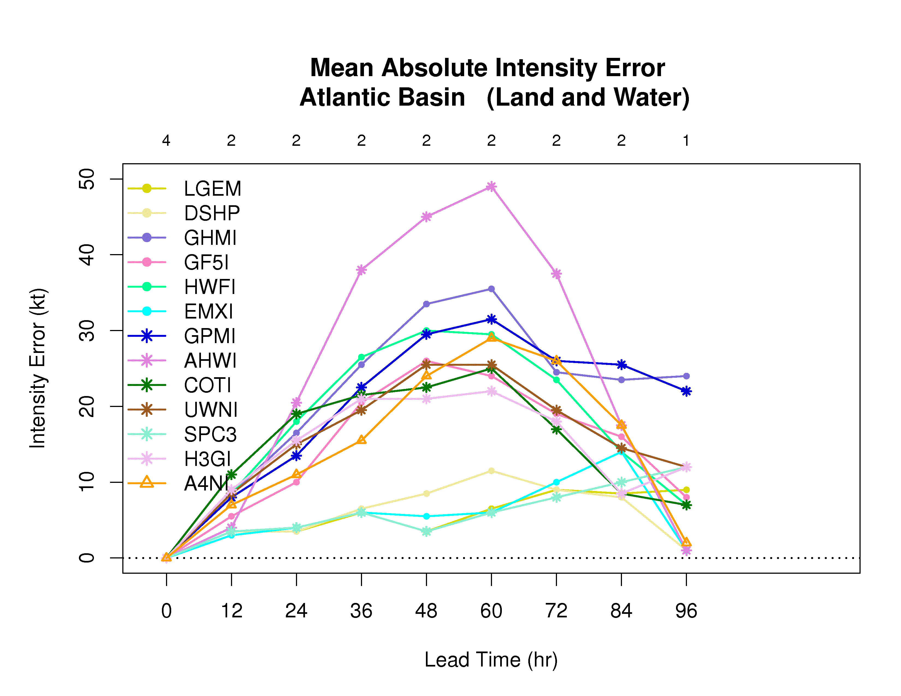
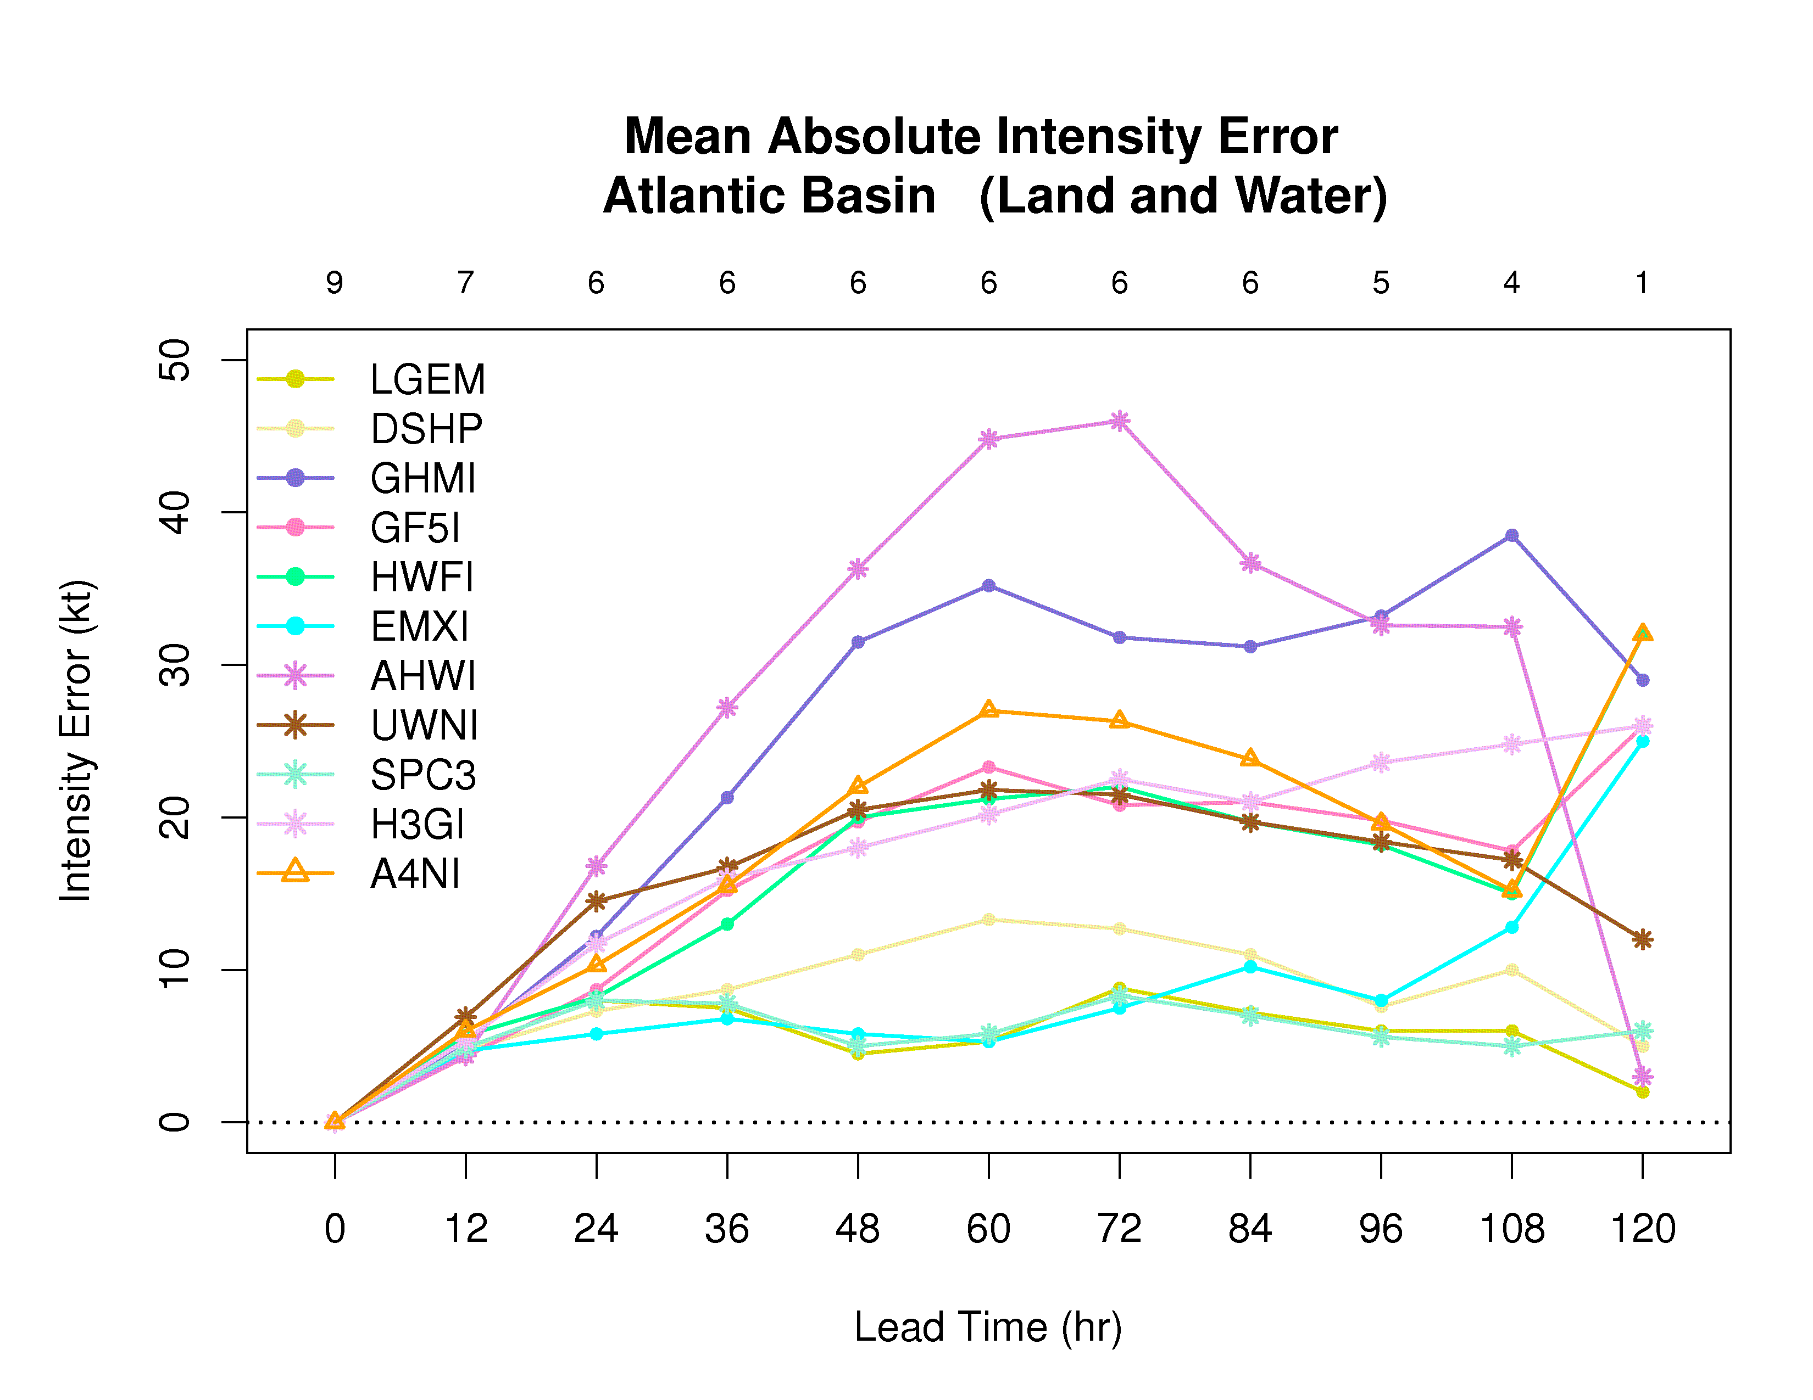
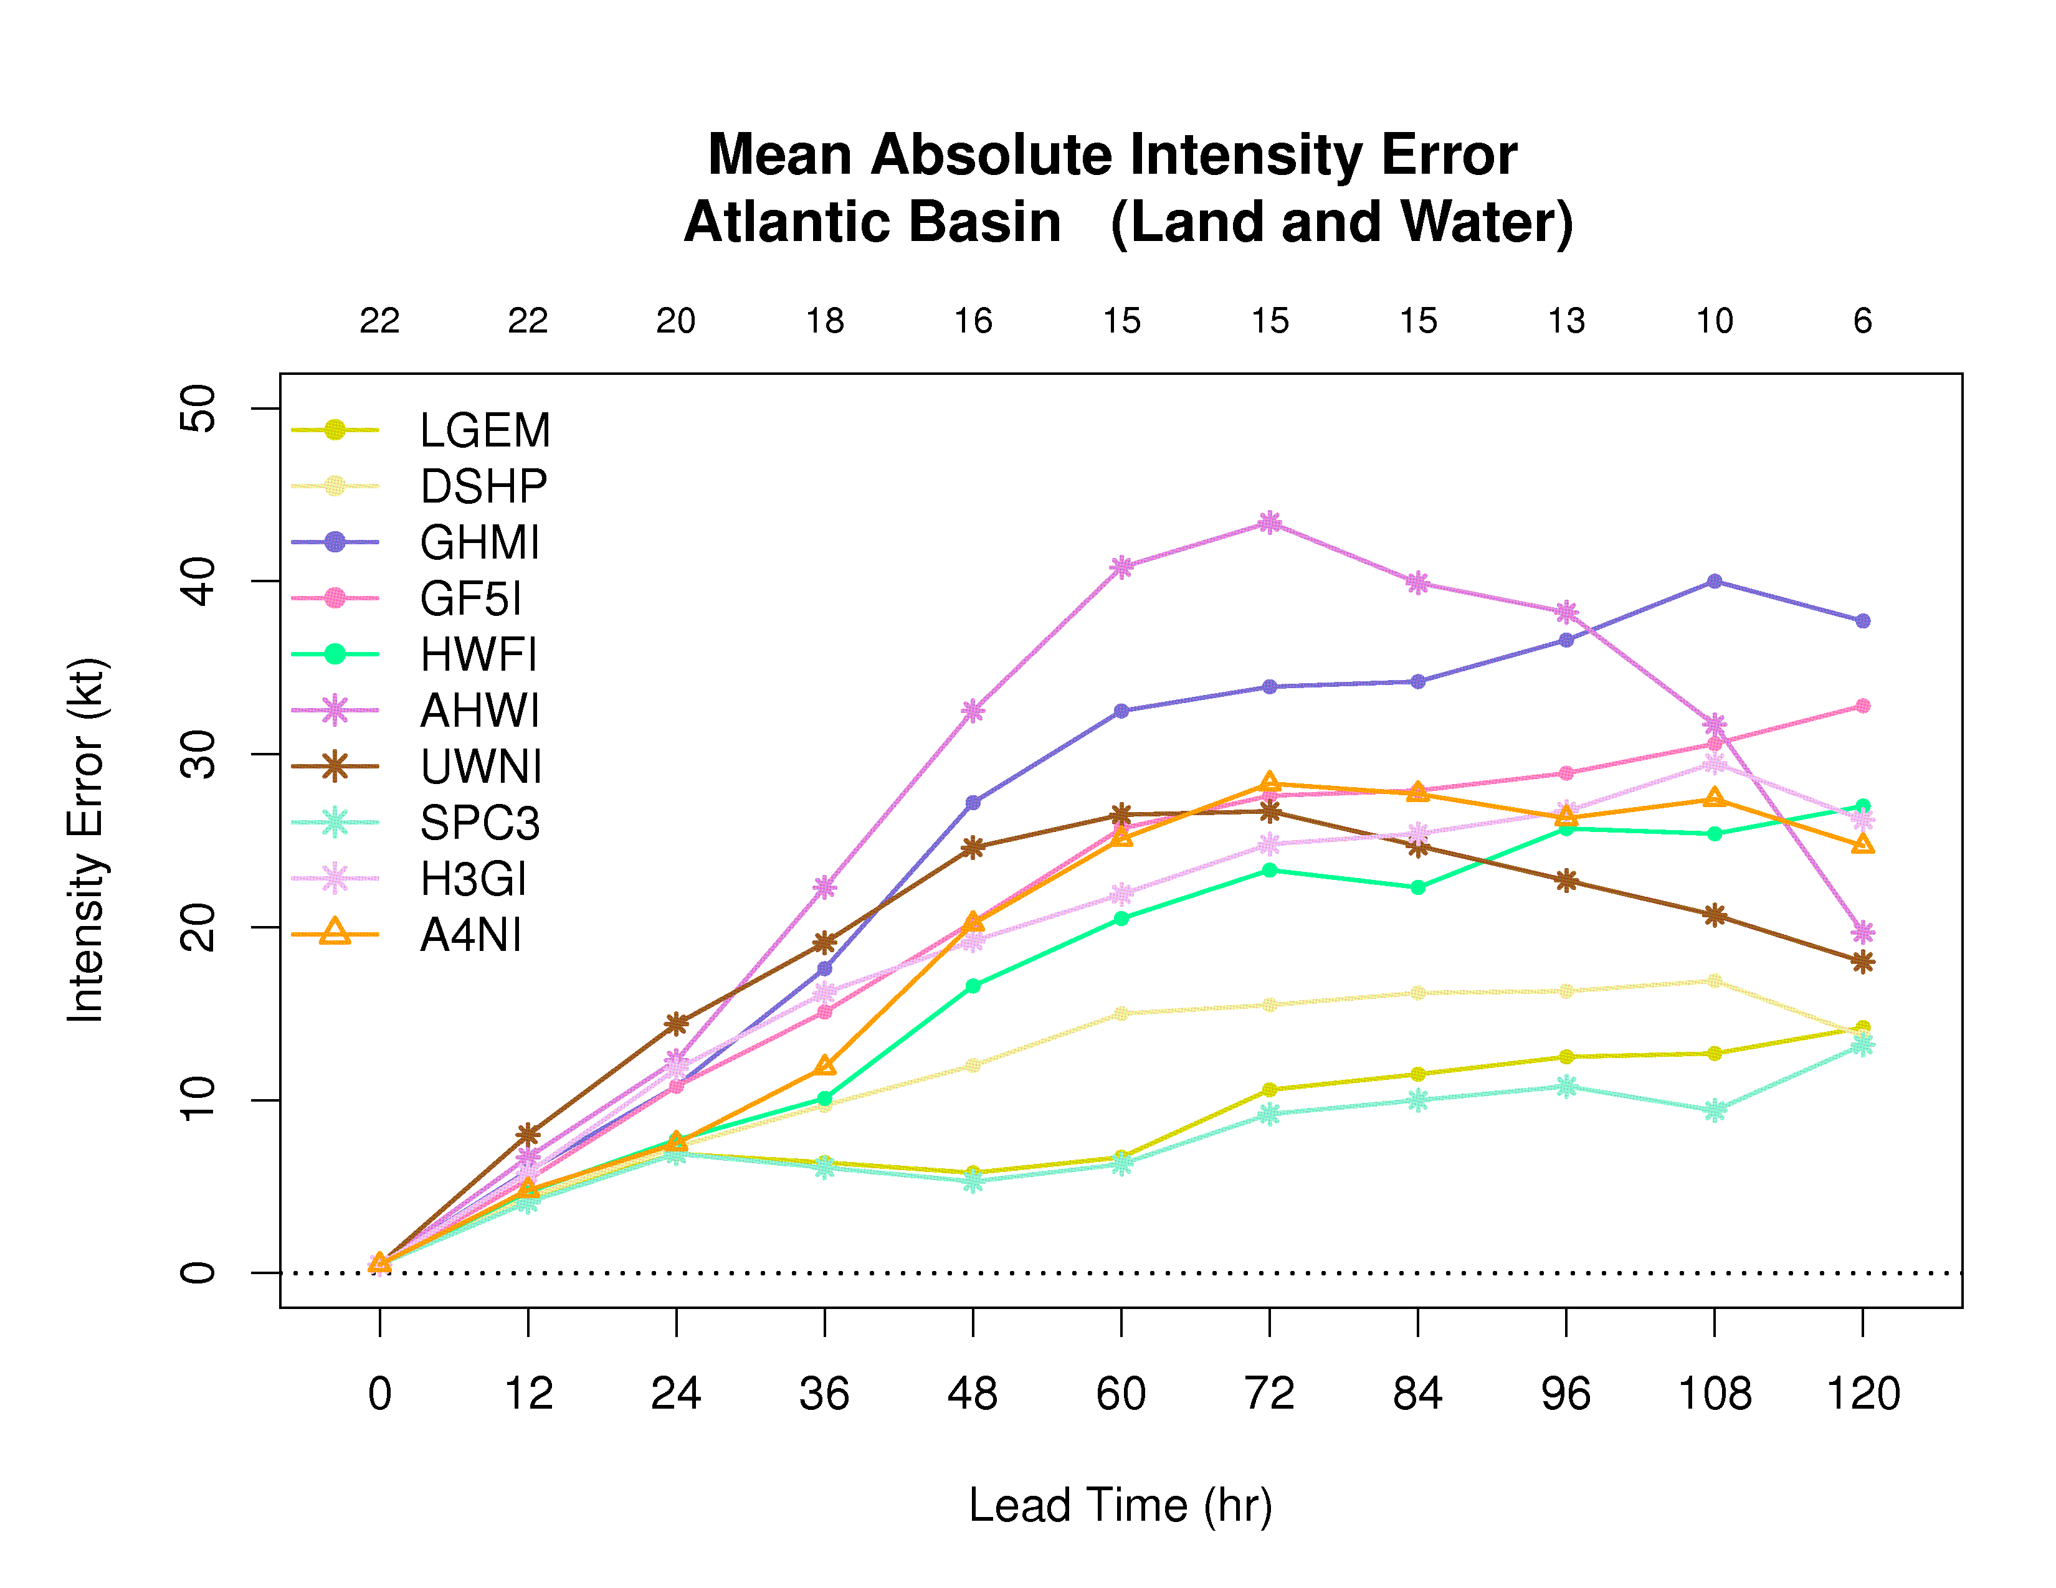
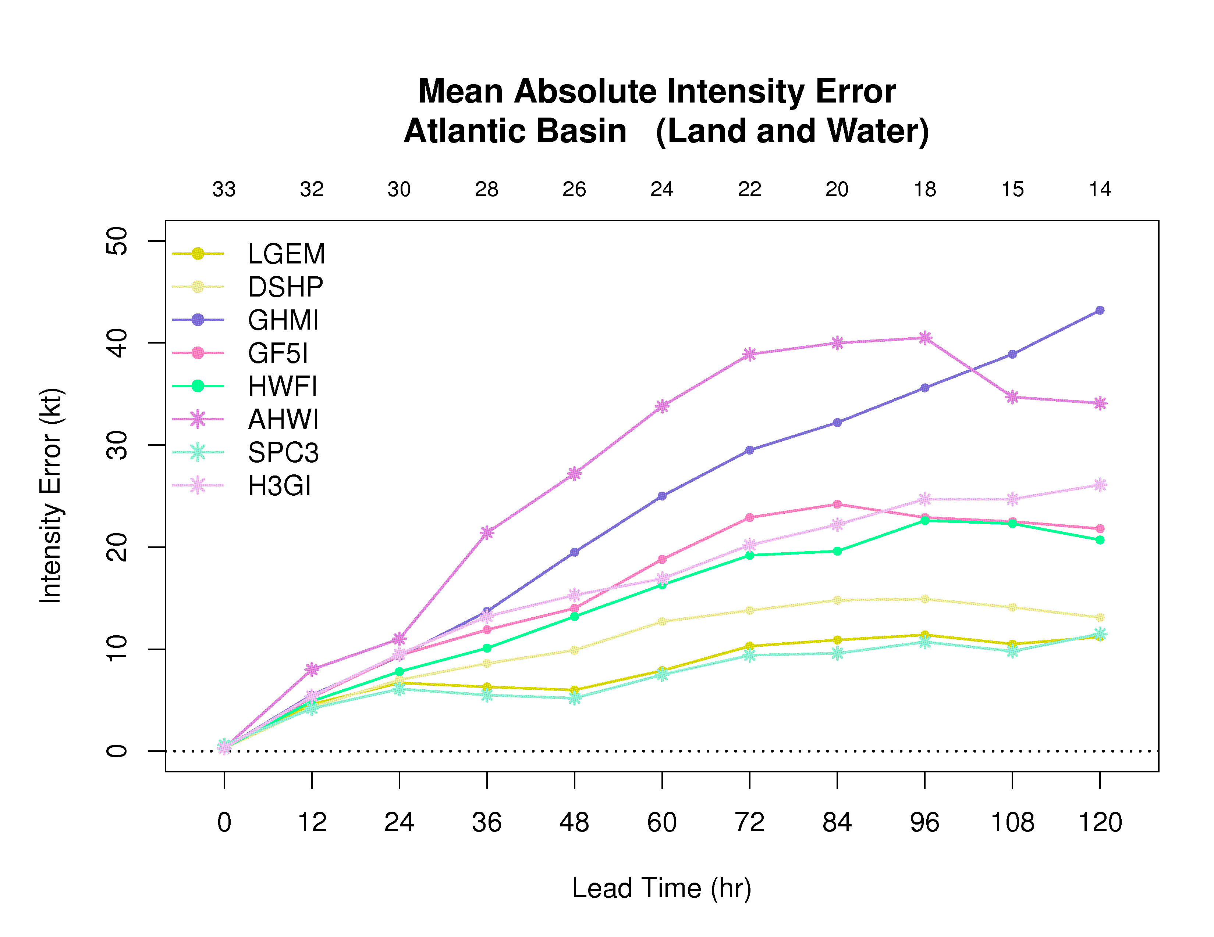
Homogeneous Comparison of Stream 1.5 and Stream 2.0 Models - Maria

Slide 8
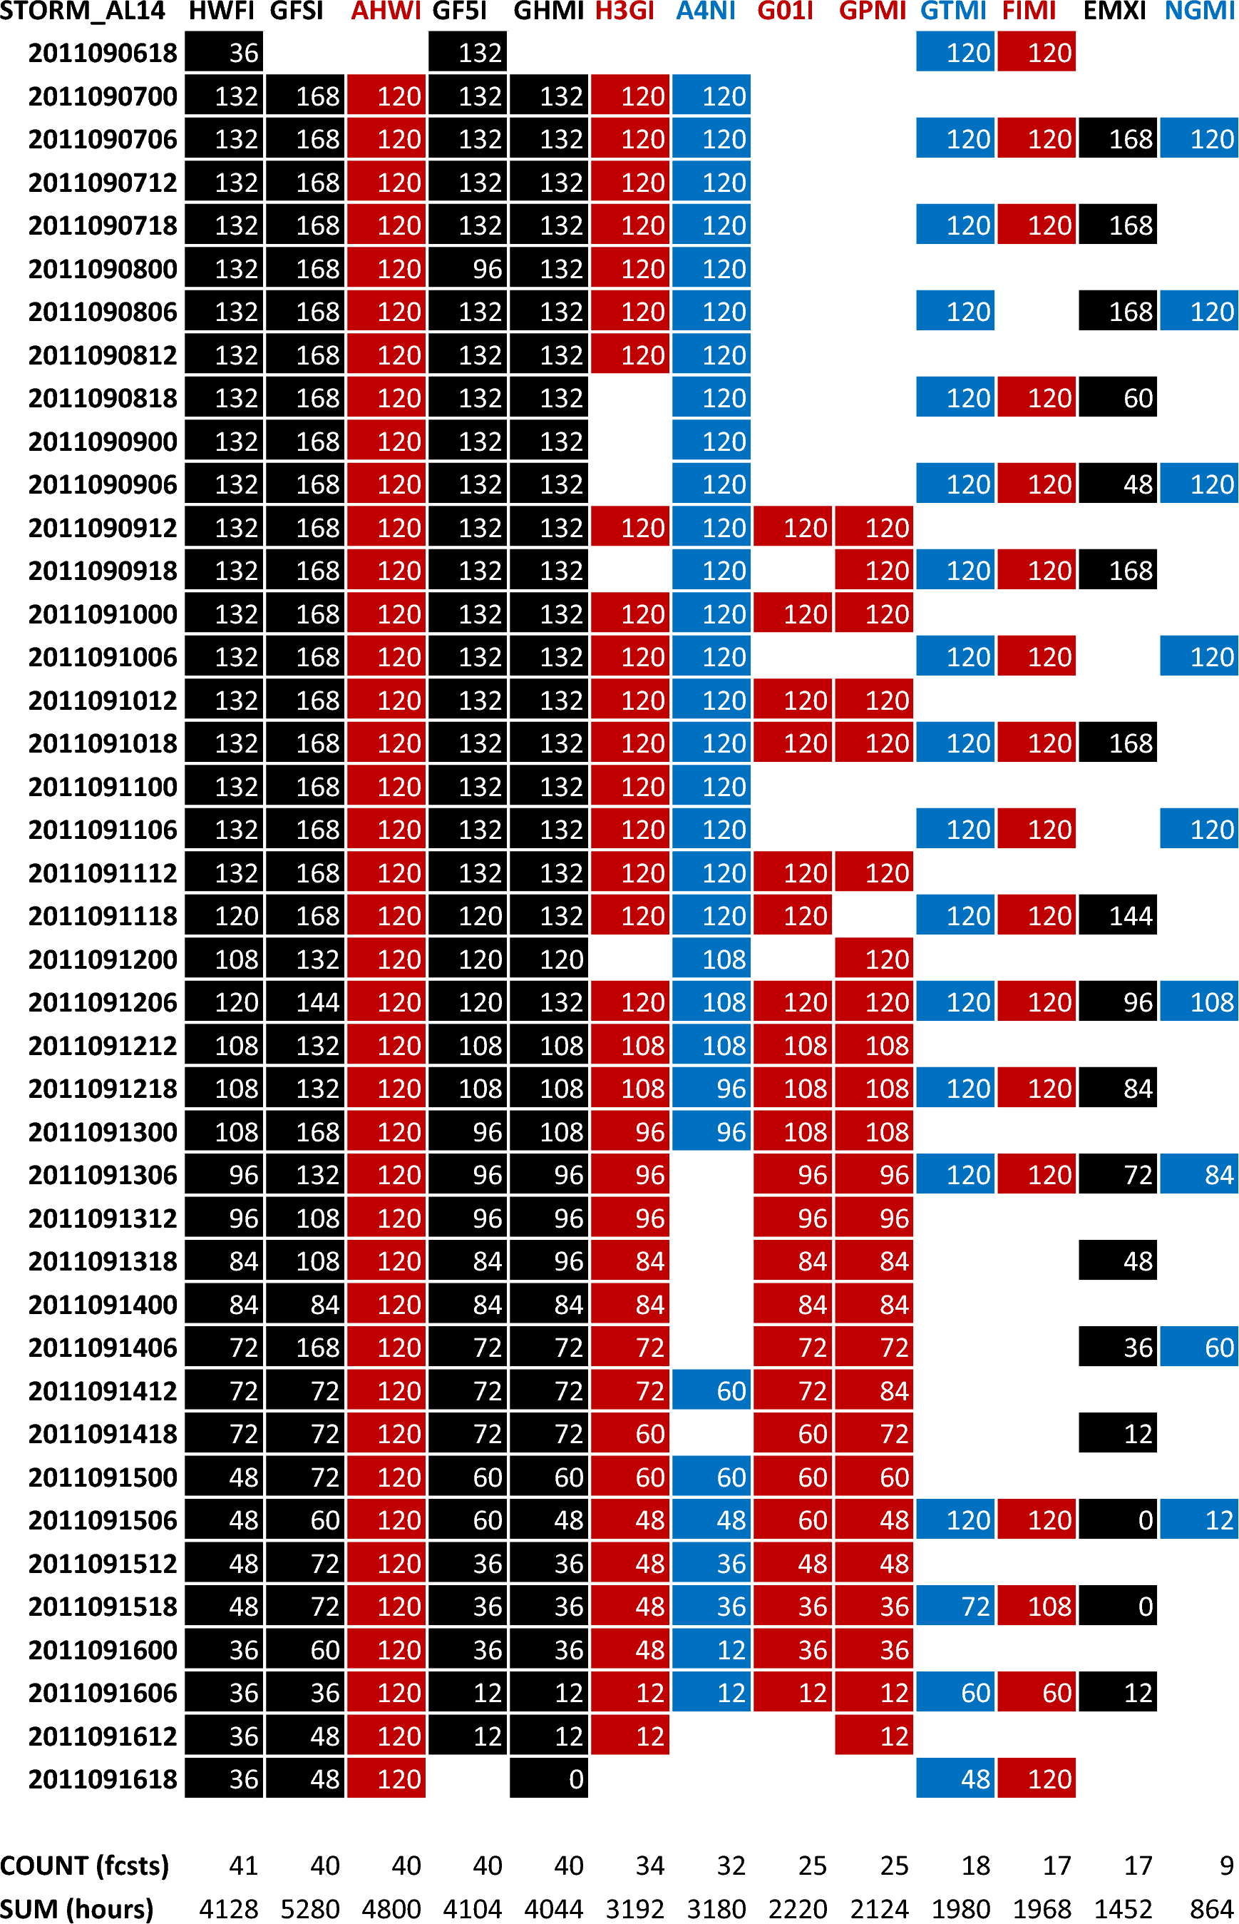
TRACK
The following table shows which Operational (black), Stream 1.5 (red), and Stream 2.0 (blue) forecasts are available at each forecast time when the storm is classified as either tropical or subtropical.
The values in the ATCF ID columns reflect the last forecast hour/period for each available forecast. A blank space means no forecast is available.

Slide 9
Mean Track Error (nm) for Homogeneous Sample (Land and Water)
0 12 24 36 48 60 72 84 96 108 120
GFSI 14.7 36.0 38.0 62.0 67.5 108.0 131.5 133.0 143.0 260.0 331.0
GHMI 14.7 41.5 52.5 91.0 113.5 163.5 193.0 183.5 219.0 415.0 504.0
GF5I 14.7 51.5 61.0 107.0 145.5 200.0 229.0 235.5 261.0 270.0 331.0
HWFI 14.7 61.5 89.0 136.0 173.0 222.5 236.0 233.0 246.5 127.0 177.0
EMXI 14.7 54.0 59.0 81.5 74.0 62.0 79.0 83.0 127.0 146.0 158.0
AHWI 14.7 65.0 112.5 194.5 255.5 309.0 343.5 374.5 382.5 221.0 200.0
FIMI 14.7 56.5 78.0 130.0 178.5 222.0 225.0 223.5 230.0 135.0 162.0
H3GI 14.7 66.5 96.5 145.5 179.5 213.5 256.0 284.5 306.5 142.0 215.0
A4NI 14.7 36.5 39.0 73.5 113.0 163.0 206.0 251.5 307.5 389.0 490.0
GTMI 14.7 56.5 71.5 110.0 136.0 172.5 190.0 193.5 183.5 109.0 158.0
NGMI 14.7 62.5 102.5 163.5 186.5 196.0 169.5 89.5 215.5 198.0 258.0
# Cases 3 2 2 2 2 2 2 2 2 1 1
Stream 1.5 Models (Track) and requested baselines/models
except GPMI and G01I
Mean Track Error (nm) for Homogeneous Sample (Land and Water)
0 12 24 36 48 60 72 84 96 108 120
GFSI 9.6 33.6 57.0 70.2 83.3 99.8 137.2 188.7 207.8 279.2 319.8
GHMI 9.6 35.9 67.0 99.0 131.5 164.7 193.2 221.3 235.2 298.2 348.2
GF5I 9.6 37.1 68.7 106.2 142.3 179.3 210.3 236.3 311.2 387.8 477.8
HWFI 9.6 48.9 88.2 129.0 171.5 211.3 249.5 282.8 300.8 332.2 405.0
EMXI 9.6 41.3 78.8 111.8 130.5 134.7 147.7 145.7 186.8 203.2 175.5
AHWI 9.6 64.7 117.5 183.3 249.5 306.7 364.7 406.8 440.4 475.8 488.0
FIMI 9.6 40.3 76.7 111.8 151.0 177.3 198.7 212.0 259.0 269.0 306.2
H3GI 9.6 42.4 83.8 124.5 161.7 197.2 243.3 284.5 301.0 289.8 336.5
A4NI 9.6 28.9 51.2 78.7 113.5 148.3 197.7 245.7 321.0 386.5 442.0
GTMI 9.6 39.0 73.0 104.5 132.3 155.2 175.7 208.3 271.4 311.2 342.8
# Cases 9 7 6 6 6 6 6 6 5 4 4
Excludes
GPMI, G01I, and NGMI
Mean Track Error (nm) for Homogeneous Sample (Land and Water)
0 12 24 36 48 60 72 84 96 108 120
GFSI 7.7 35.5 60.5 90.6 113.1 123.4 119.9 161.2 230.9 272.7 304.0
GHMI 7.7 37.9 70.2 106.7 134.5 159.2 182.8 207.0 252.8 281.0 325.6
GF5I 7.7 36.5 69.5 112.9 145.1 158.4 195.1 248.6 307.2 379.7 466.0
HWFI 7.7 40.1 85.3 122.7 157.2 196.1 228.1 278.6 355.8 405.0 445.8
GPMI 7.7 32.6 64.3 104.9 136.9 146.4 164.9 201.0 227.4 250.2 299.6
G01I 7.7 46.7 80.8 118.2 147.6 169.3 196.4 225.6 268.6 329.2 358.6
AHWI 7.7 50.1 93.0 141.7 191.3 255.1 319.3 393.9 482.0 620.7 822.0
H3GI 7.7 39.8 85.4 124.1 172.1 214.3 252.3 286.7 323.4 317.5 303.6
# Cases 22 22 20 18 16 14 12 10 8 6 5
Excludes
EMXI, FIMI,
A4NI, GTMI, and NGMI
Mean Track Error (nm) for Homogeneous Sample (Land and Water)
0 12 24 36 48 60 72 84 96 108 120
GFSI 7.5 31.4 49.0 72.7 92.0 112.9 145.0 188.4 245.9 299.7 359.2
GHMI 7.5 35.9 66.4 105.9 147.5 190.3 227.2 265.0 304.5 335.1 380.9
GF5I 7.5 38.1 66.7 101.5 138.5 180.4 221.5 267.9 322.6 378.0 430.5
HWFI 7.5 41.6 79.2 109.8 141.2 173.1 209.2 255.5 299.5 343.9 360.4
AHWI 7.5 60.6 113.2 157.1 192.7 235.9 279.8 331.0 380.1 445.2 533.8
A4NI 7.5 30.1 43.6 63.2 89.1 125.1 170.8 224.6 286.3 351.6 396.4
# Cases 32 32 30 28 26 25 25 25 24 21 19
Excludes
EMXI, GPMI, G01I,
FIMI, H3GI, GTMI, and NGMI

Slide 10
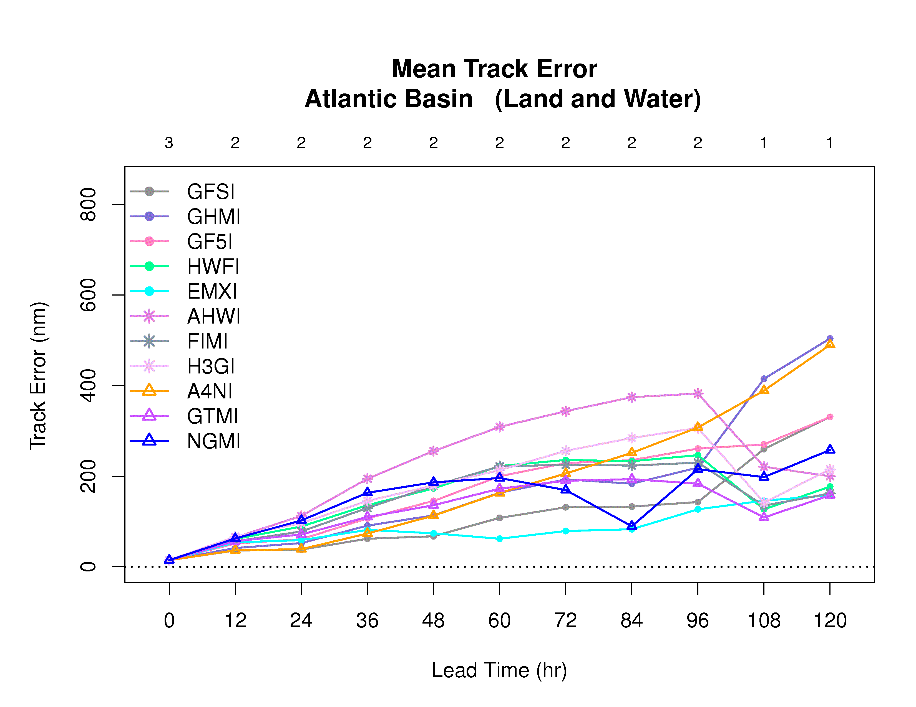
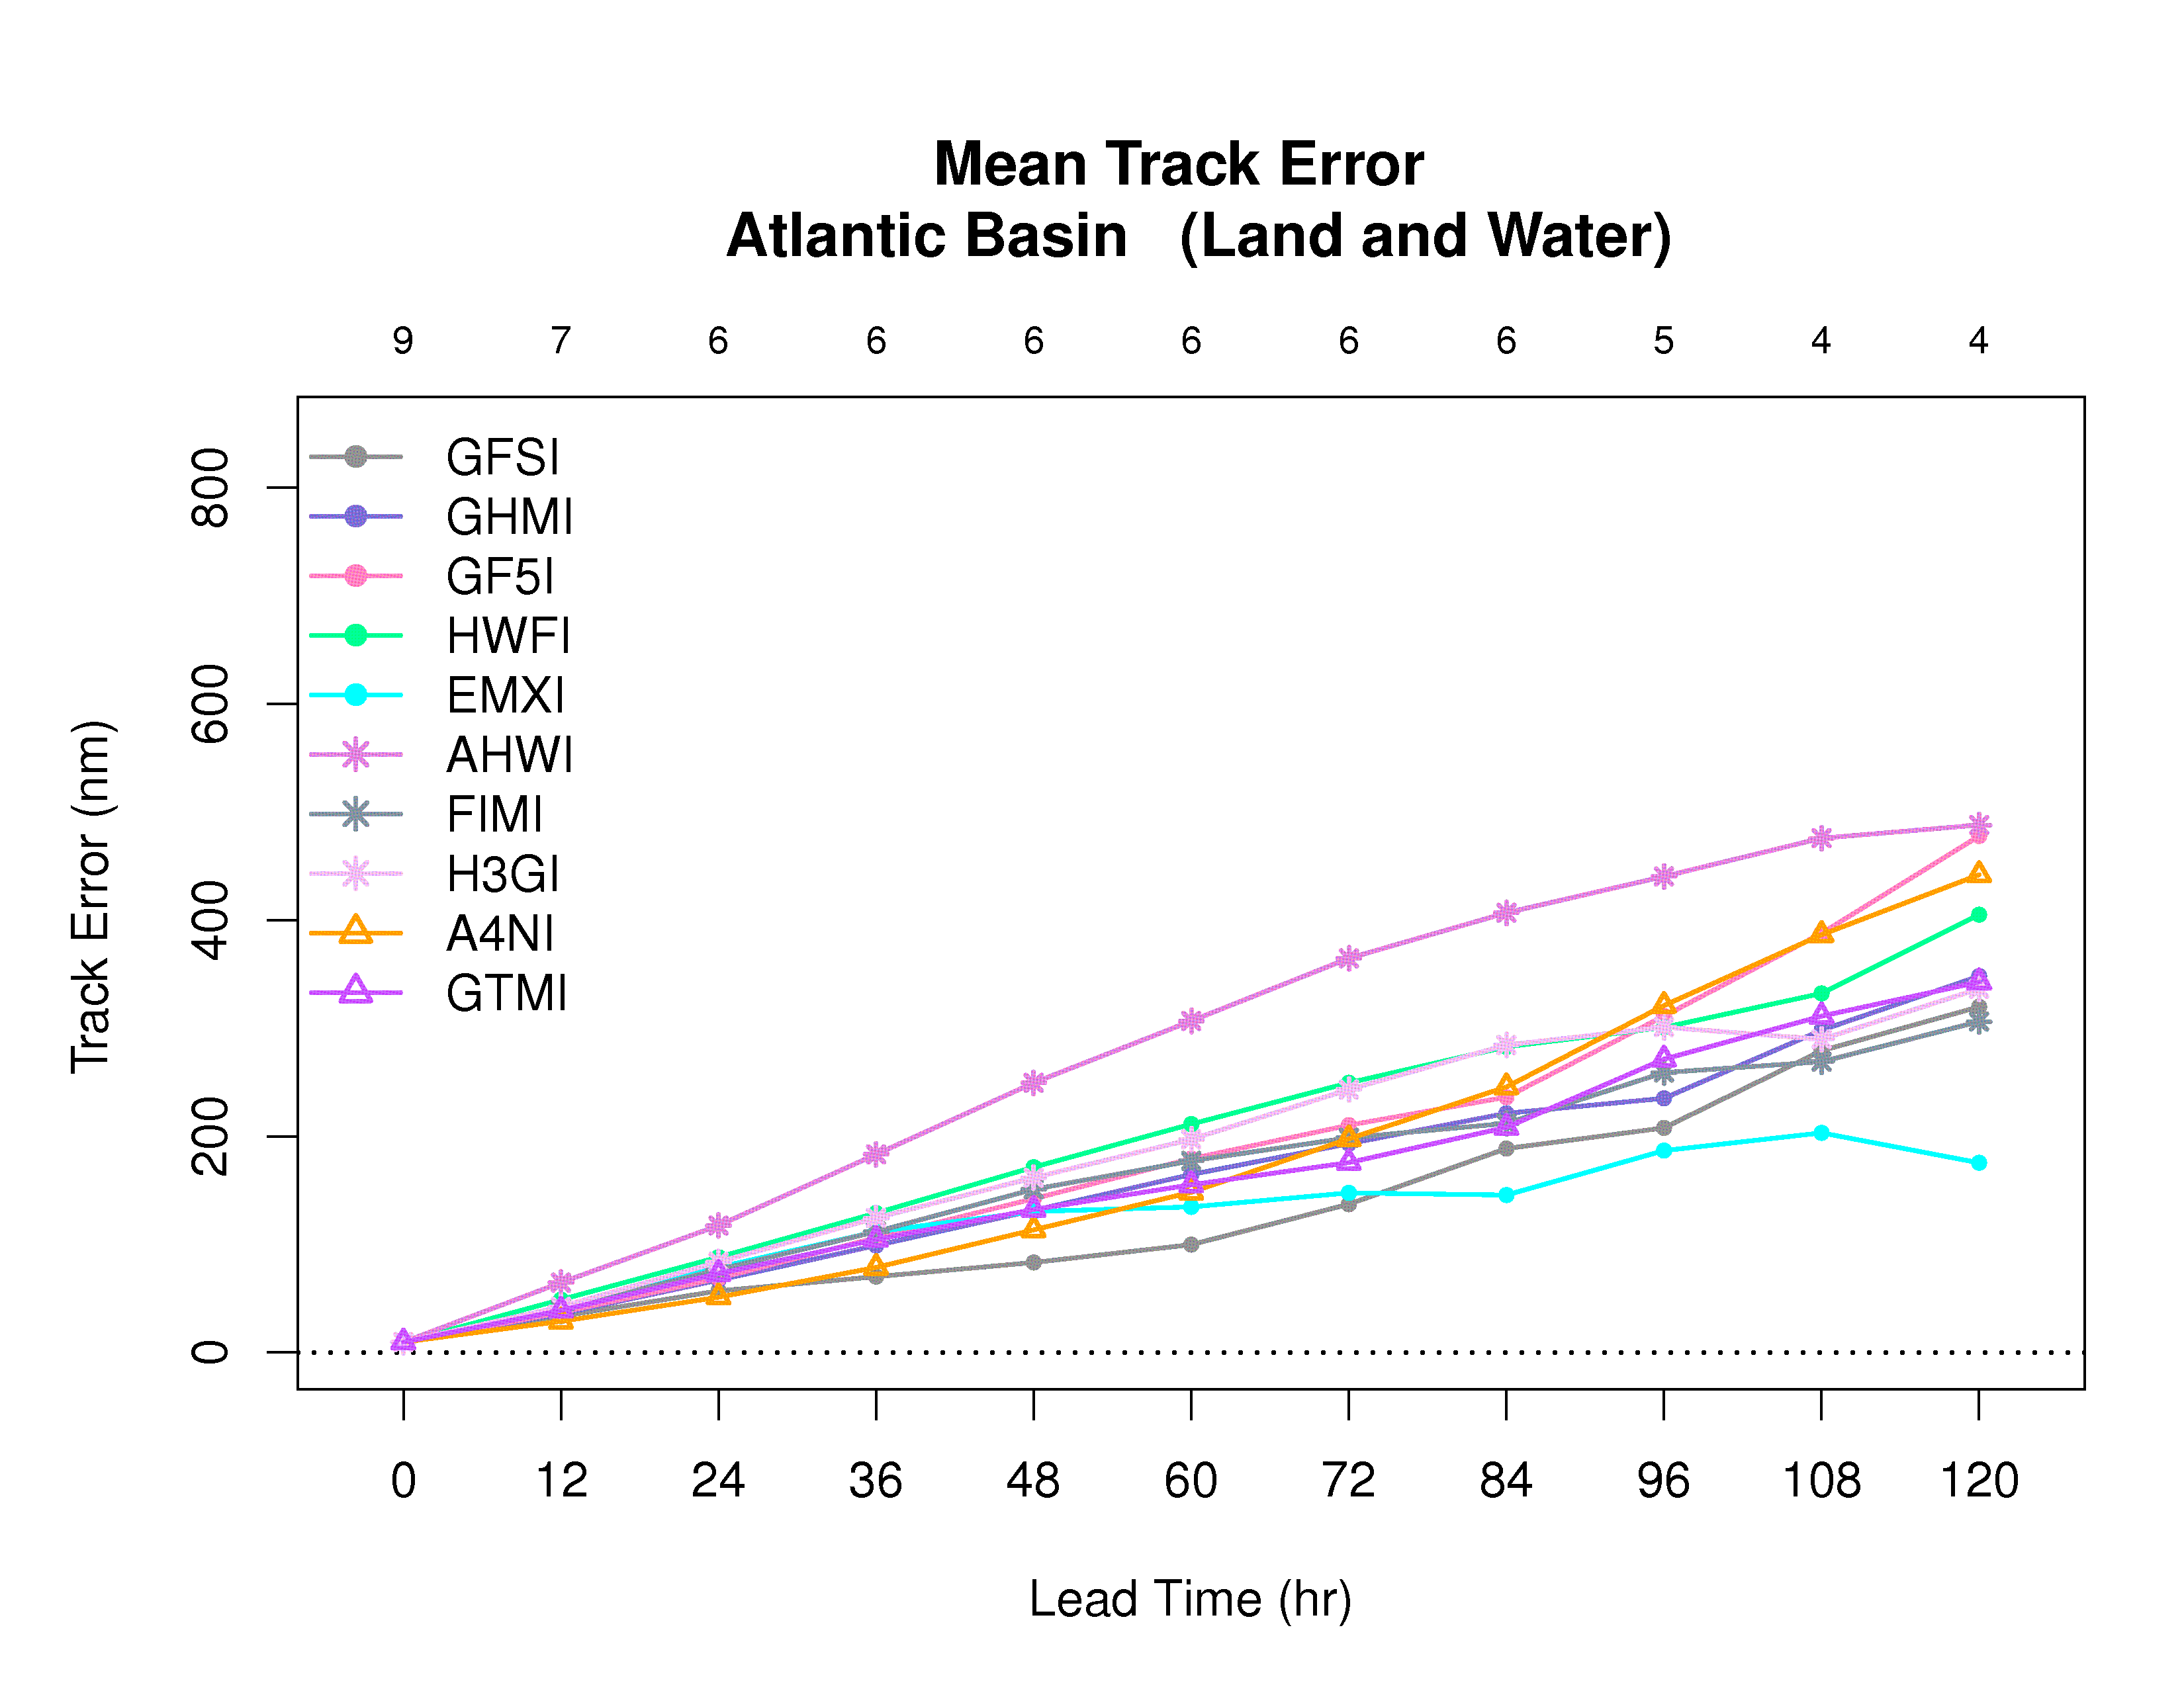
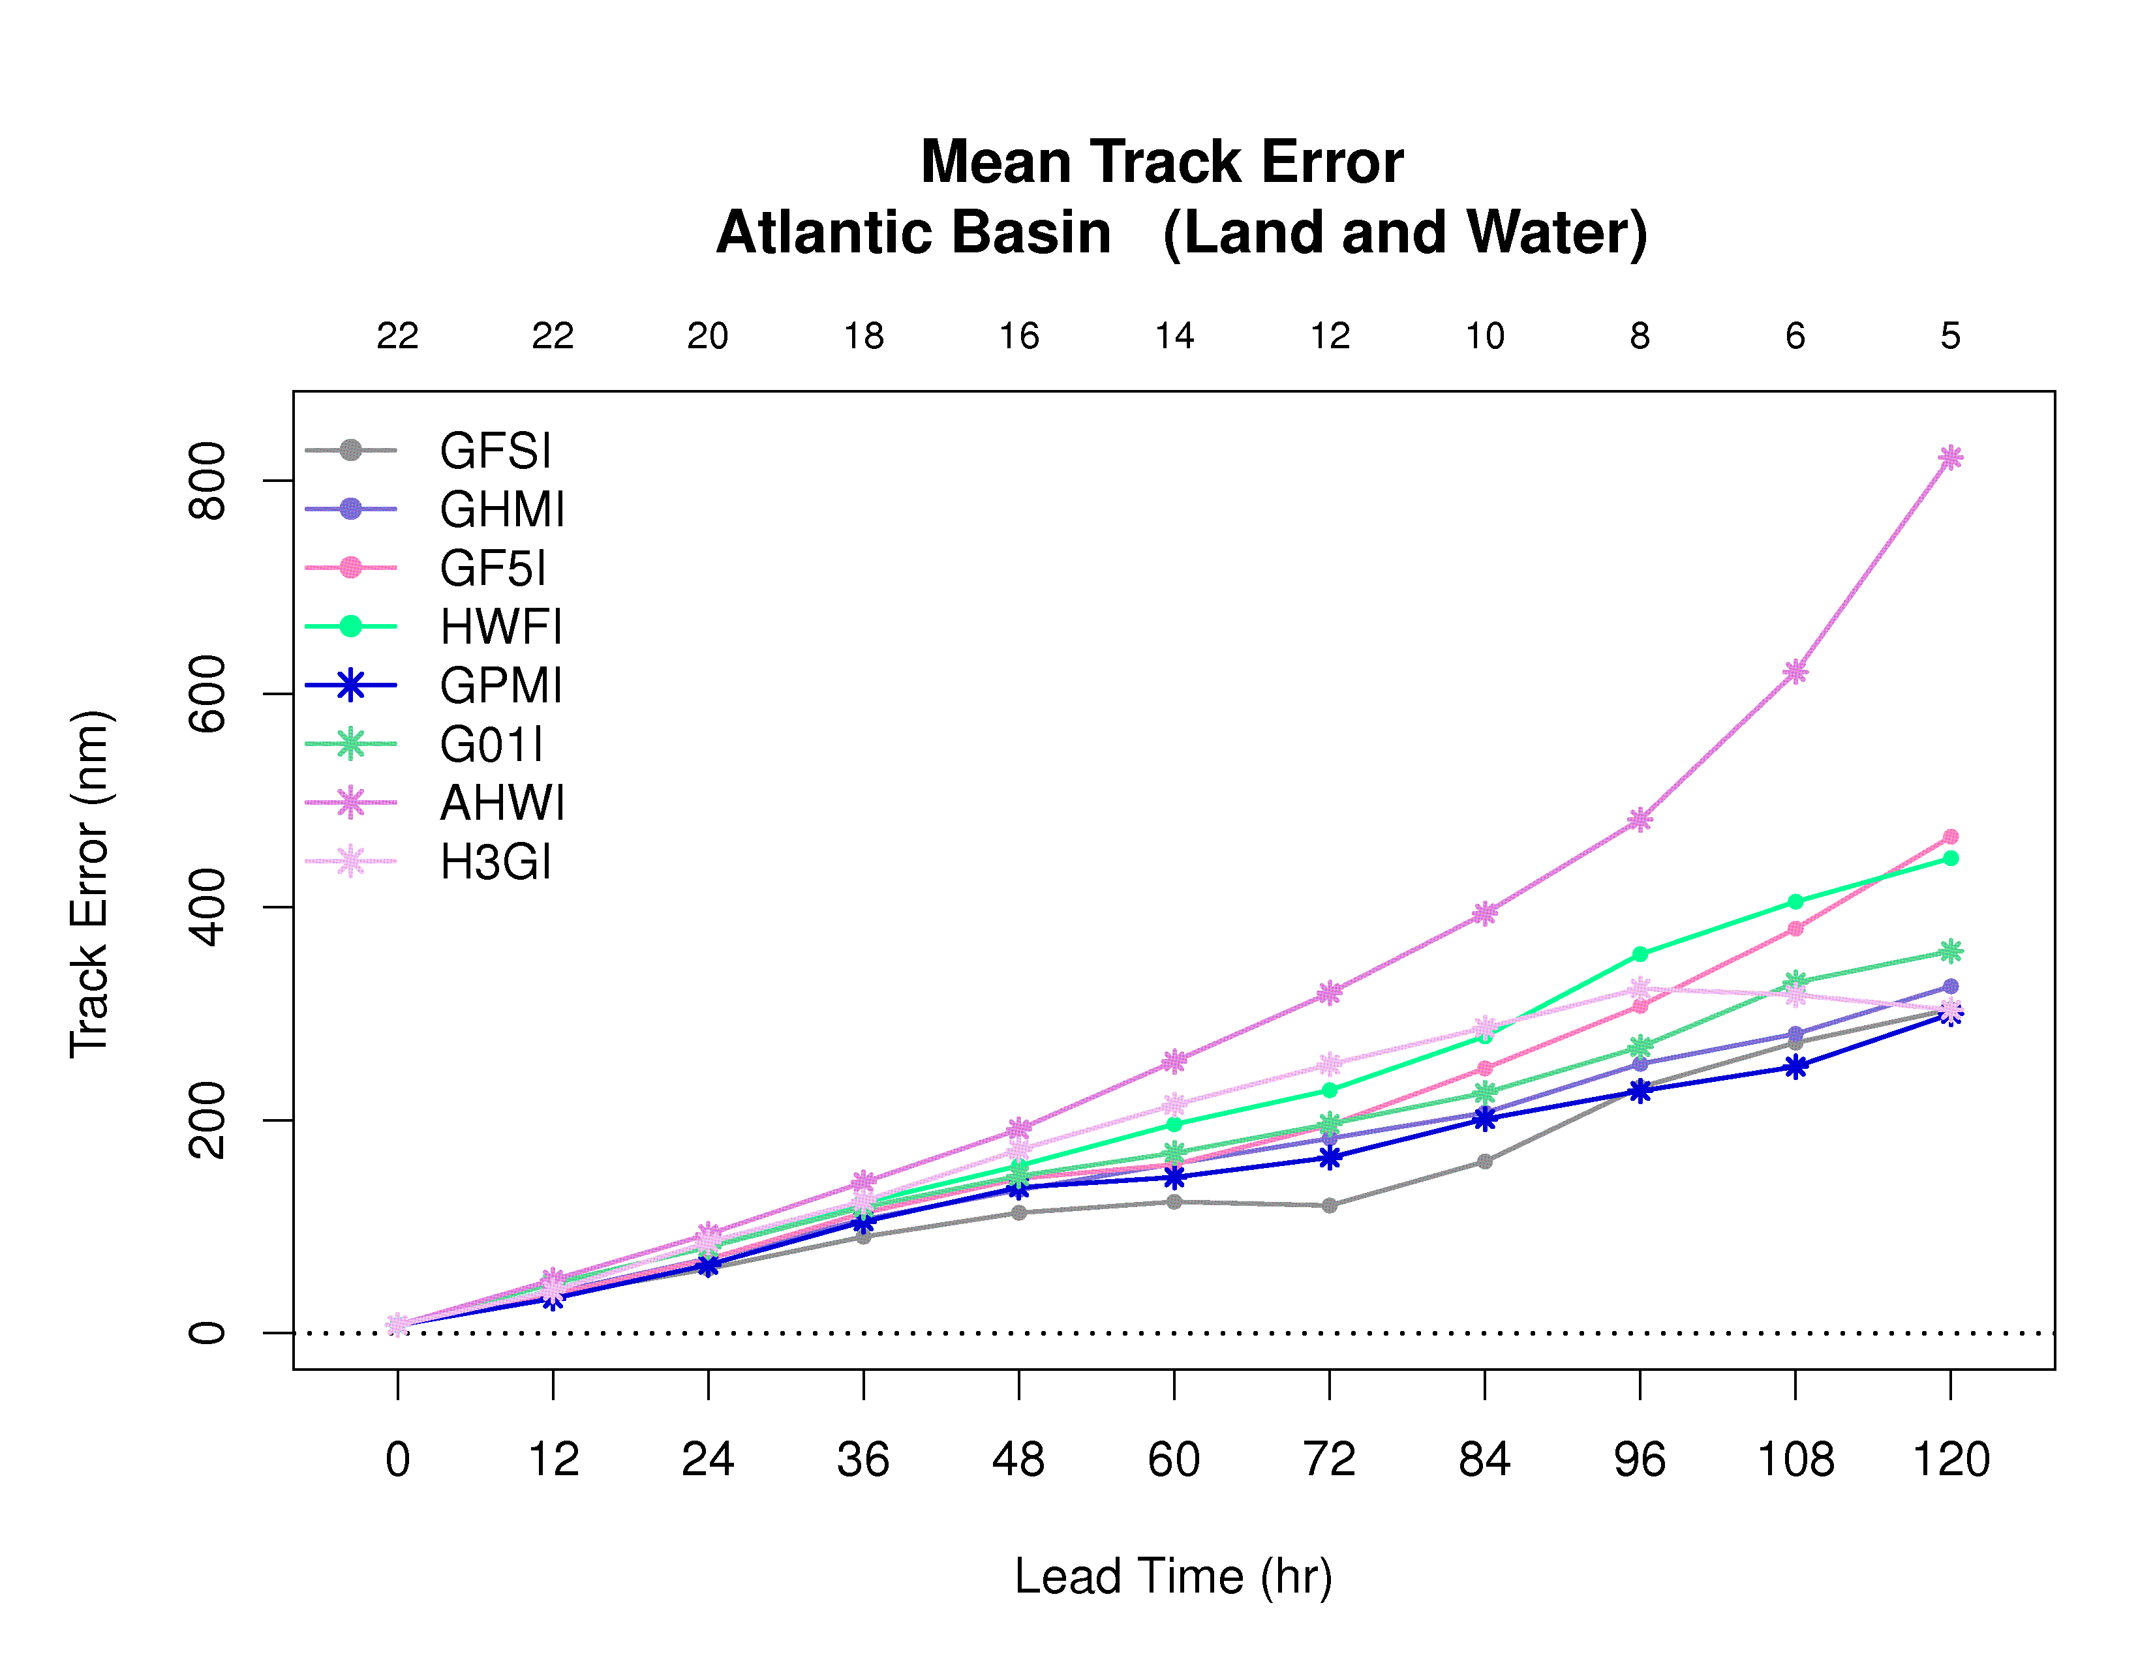
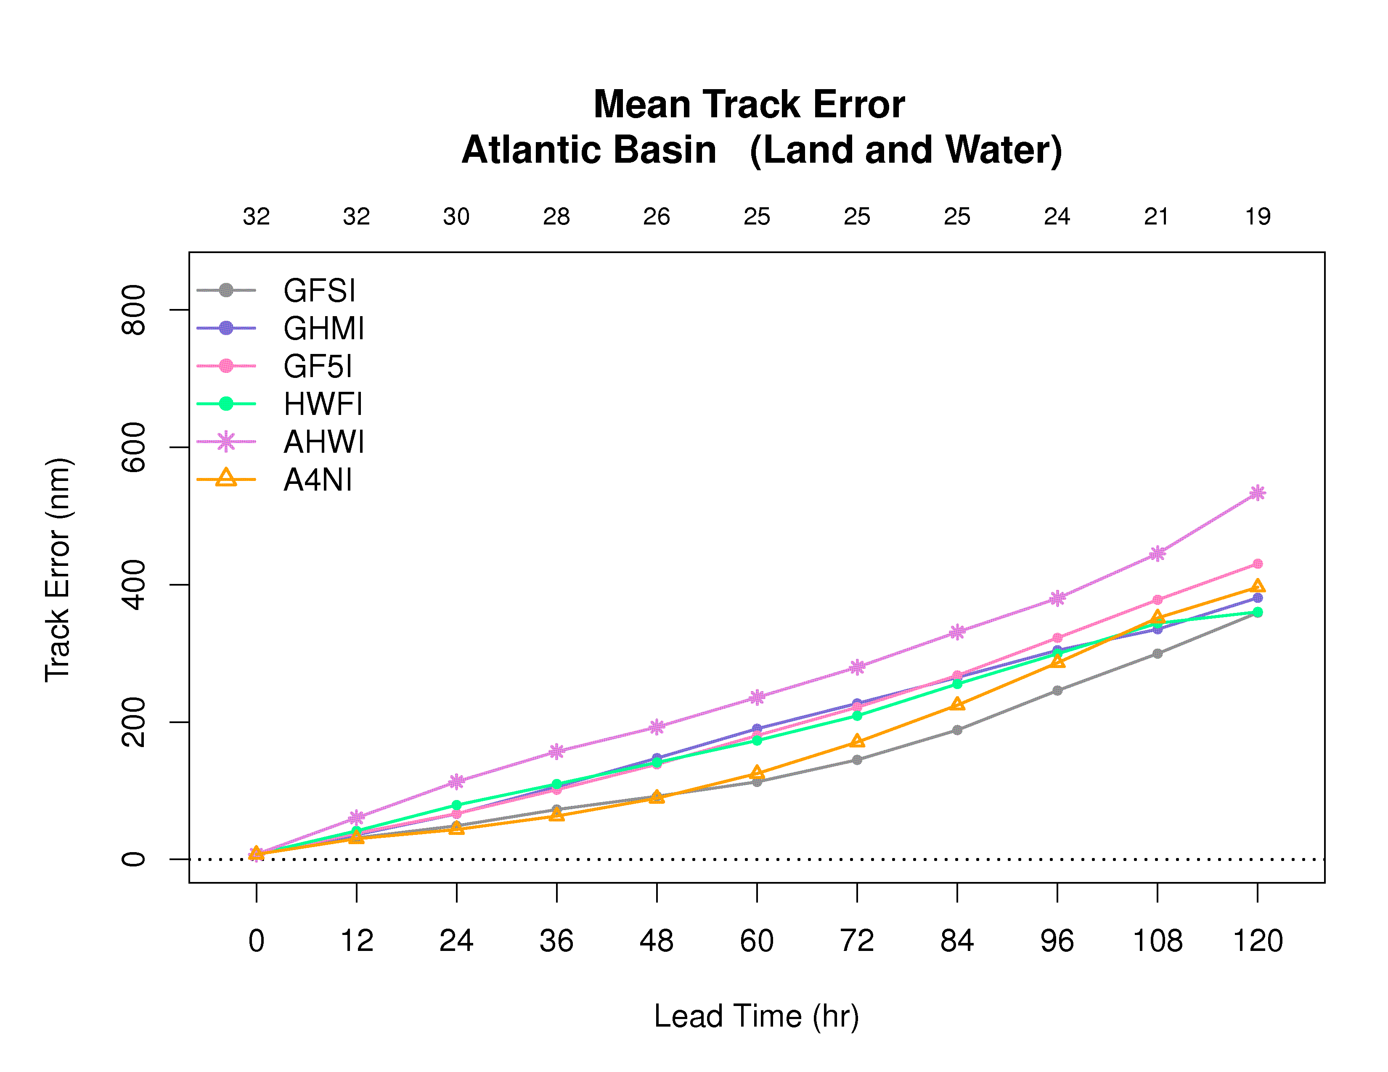
Homogeneous Comparison of Stream 1.5 and Stream 2.0 Models - Maria

