Slide 1
HWRF EMC-HRD Stream 1.5 Retrospective Forecasts
EMC HWRF team
HRD Modeling team
Presented by
Xuejin Zhang & Stanley Goldenberg

Slide 2
Model Configuration
 | Stream 1.5 HWRF | Operational HWRF | HWRFx | GFDL
Domain | 27 KM: 77.76˚ X 77.76˚ 9 KM: 10.56˚ X 10.2˚ 3 KM: 7.6˚ X 6.4˚ | 27 KM: 77.76˚ X 77.76˚ 9 KM: 7.2˚ X 6.0˚ | 9 KM: 57.12˚ X 55.56˚ 3 KM: 5.84˚ X 5.8˚ | 54 KM: ~75˚ X ~75˚ 18 KM: ~11˚ X ~11˚ 9KM: ~5˚ X ~5˚
Vortex Initialization | 27-9 KM: Yes 3 KM: No (Downscaling) | 27-9 KM: Yes | 9KM: Yes 3KM: No (Downscaling) | 54-18-9KM: Yes
Cycling | Yes | Yes | No | No
Ocean Coupling (Ocean model: POM) | 27-9 KM: Yes 3 KM: No (Downscaling) | 27-9 KM: Yes | No | Yes
GSI | Yes | Yes | No | No
Platform | JET-Linux | IBM | JET-Linux | IBM
Physics schemes
Microphysics | Ferrier | Ferrier | Ferrier | Ferrier
Radiation (SW) | GFDL | GFDL | NCAR SW | GFDL
Radiation (LW) | GFDL | GFDL | RRTM | GFDL
Surface Scheme | GFDL (2010 implementation) | GFDL (2011 implementation) | GFDL (2009 implementation) | GFDL
PBL Scheme | GFS (Modified for HR implementation) | GFS | GFS | GFS
Cumulus Parameterization | New SAS (27-9 KM) no CP (3 KM) | New SAS | SAS (9 KM) no CP (3KM) | SAS
Land Surface | GFDL Slab | GFDL Slab | GFDL Slab | GFDL Slab

Slide 3
High-Resolution HWRF Upgrades and Bug-fixes
 | Stream 1.5 HWRF | Upgrade or Bug-fix
Moving nest | New algorithm | Upgrade
Microphysics | Ferrier | Bug-fix (moving nest hydrometer initialization)
Surface scheme | GFDL | Upgrade (based on observation C_{D} & C_{H})
PBL scheme | GFS | Upgrade (based on observation K_{m})
Cumulus Parameterization | New CP (27-9 KM) No CP (3-KM) | Upgrade (Random cloud top, Convection overshoot, Max cloud base mass flux, Convection-induced pressure gradient force)
Explicit Lateral Diffusion | COAC=0.75 (27 KM) COAC=5.0 (9-3 KM) | Empirical determined by computational damping and stability criterion
Vortex initialization | New vortex initialization Downscale (3 KM) | Upgrade (Vortex cycling, surface pressure correction, Storm size correction)
Post-processor | Diapost | Upgrade (Model native grid output, multiple coordinate outputs, full ATCF output)

Slide 4
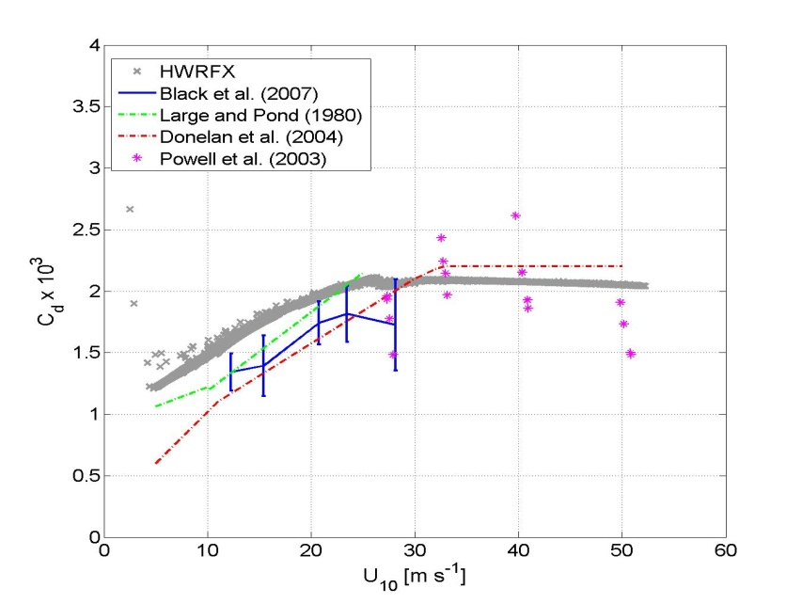
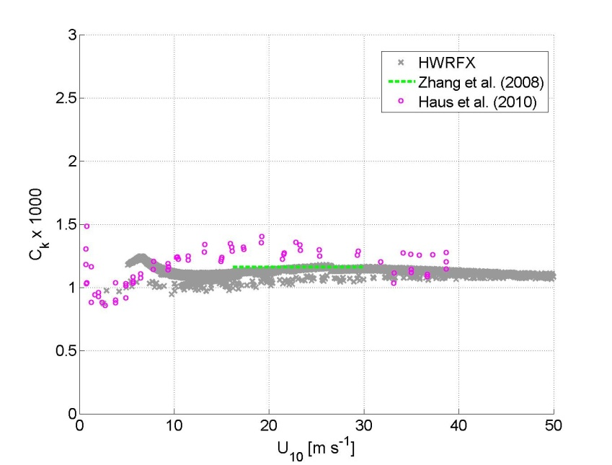
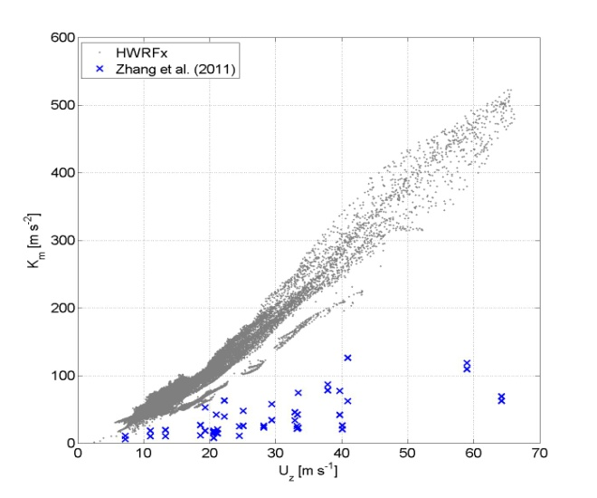
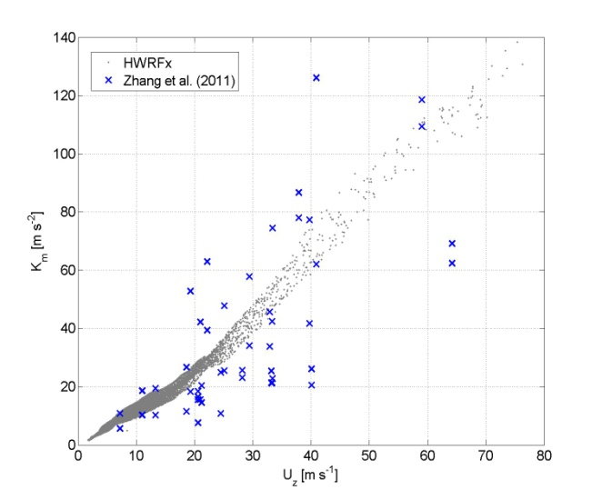
Current HWRF
Current HWRF
Current HWRF
Original GFS
Gopalakrishnan et al. 2011

Slide 5
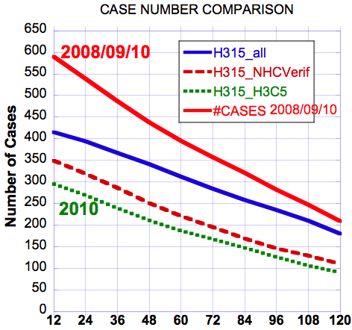
2008/09/10 & 2010 Verifications -- Sample Sizes
Notes:
H315: HWRFv3.2 2011 Stream 1.5 27-9-3km model
H3C5: HRD HWRF experimental 2010 version (HWRFx)
This is shown the homogeneous cases for each verification. H315_all: all H315 cases; H315_NHCVerif: homogeneous cases used in NHC verification package; H315_H3C5: homogeneous cases including H3C5 model forecasts

Slide 6
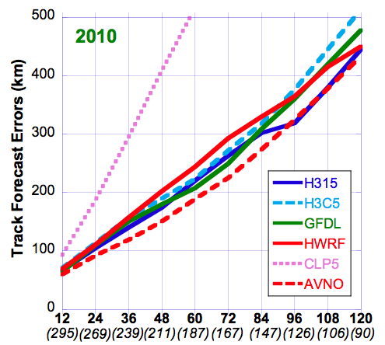
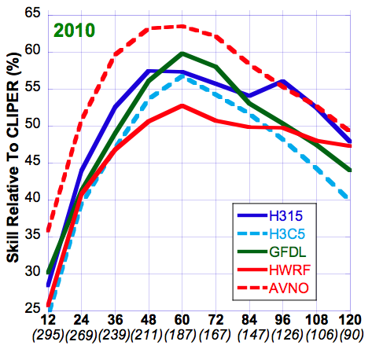
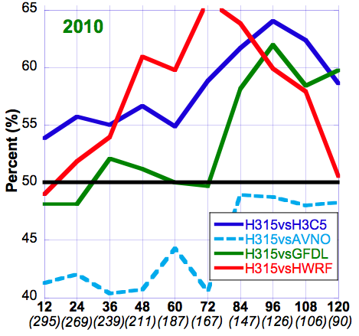
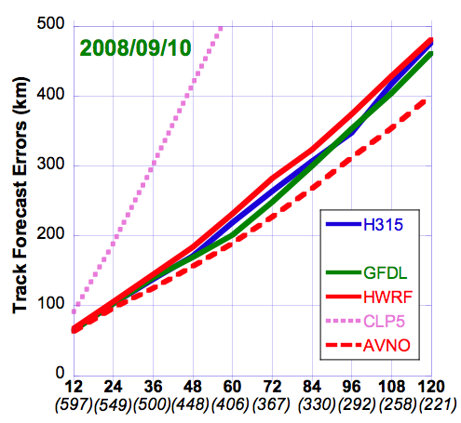
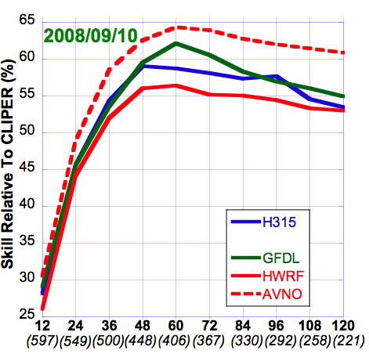
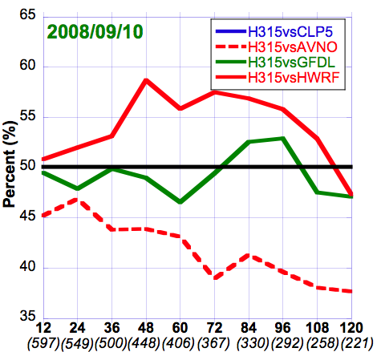
Verifications – Track Forecasts HWRF (operational 27:9km), H3C5 (HWRFx 9:3km), H315 (27:9:3km), GFDL (operational 54:18:9km)
Cliper5(dotted), AVNO(dashed)
Absolute Errors
Skill vs CLP5
FSP
Notes:
H315: HWRFv3.2 2011 Stream 1.5 27-9-3km model
H3C5: HRD HWRF experimental 2010 version (HWRFx)
HWRF: NCEP/EMC operational HWRF 27-9km
GFDL: NCEP/EMC operational GFDL (54-18-9km). http://www.gfdl.noaa.gov/operational-hurricane-forecasting
CLP5: CLIPER5 (Climatology and Persistence model, statistical model)
AVNO: NWS Global Forecast System (GFS)
FSP: Frequency of Superior Performance. Here H315 is compared to all other models to obtain FSP (i.e. H315 vs. H3C5, H315 vs. HWRF, H315 vs. GFDL, H315 vs. CLP5, the red line didn’t show because FSP is above 65% and above the y-axis limit). 50% is the divided line that means 50% H315 is better than the compared model; 50% worse. 55% means H315 is 55% better than the compared model and vice versa.

Slide 7
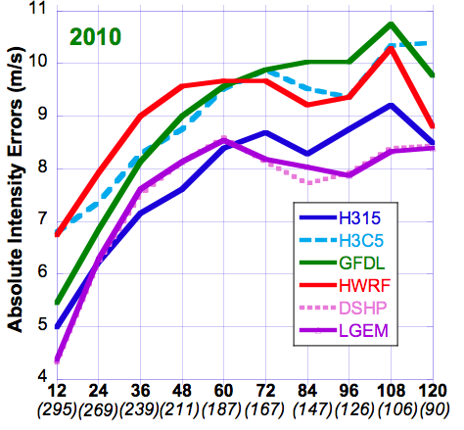
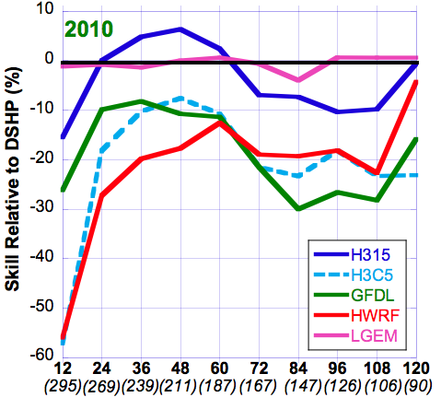
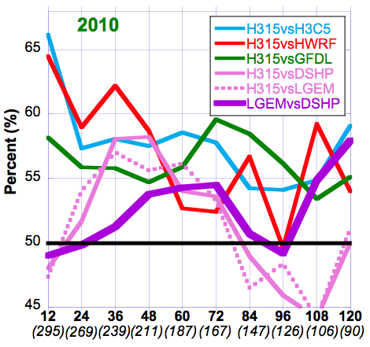
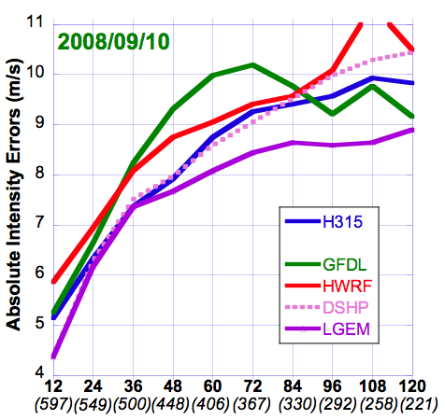
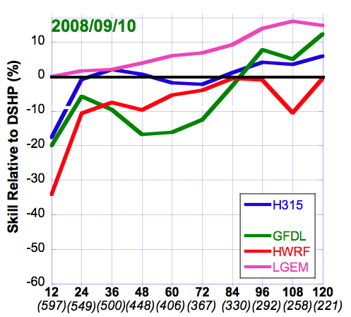
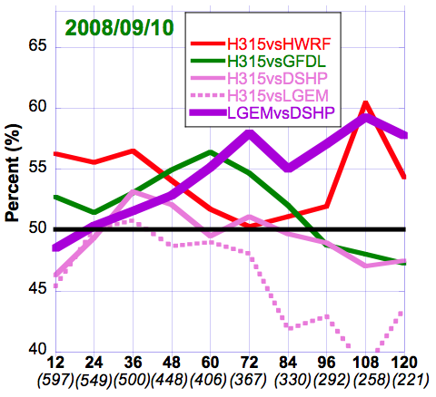
Verifications – Intensity Forecasts HWRF (operational 27:9km), H3C5 (HWRFx 9:3km), H315 (27:9:3km), GFDL (operational 54:18:9km)
LGEM(solid), DSHP(dotted)
Absolute Errors
“Skill” vs DSHP
FSP
Notes:
DSHP: SHIPS with inland decay (Statistical-dynamical model)
LGEM: Logistic Growth Equation Model (Statistical-dynamical model)
FSP: all lines are H315 is compared to other models (H315 vs. H3C5, H315 vs. HWRF, H315 vs. GFDL, H315 vs. DSHP, H315 vs. LGEM) except thick purple line (LGEM vs. DSHP)

