Slide 1
Operational Intensity Estimates from High-resolution Models
Eric Uhlhorn
HRD
Dave Nolan
UM/RSMAS

Slide 2
Hurricane intensity is determined by the maximum sustained surface wind speed, which the U.S. National Weather Service defines as:
Recent modeling studies have suggested a model resolution of (O)1 km is required for simulating the peak 1-min wind
  Nolan et al. (2009a) using a mesoscale model with completely- parameterized turbulence
  Rotunno et al. (2009) using a LES model
Results may depend on additional model parameters (e.g., horizontal and vertical mixing length/eddy viscosity coefs.)
  Skamarok
  Bryan and Rotunno
Operational numerical model intensity guidance (e.g., GFDL, HWRF) typically delivers an instantaneous peak wind
“The highest one-minute average (at an elevation of 10 meters with an unobstructed exposure) associated with a weather system at a particular point in time.” (NWS 2010).

Slide 3
Operationally-Consistent Intensity Estimates from Numerical Models
Isolating the peak wind
Converting to a maximum one-minute average
Smoothing transient fluctuations over specified interval
  6 hour forecast cycle

Slide 4
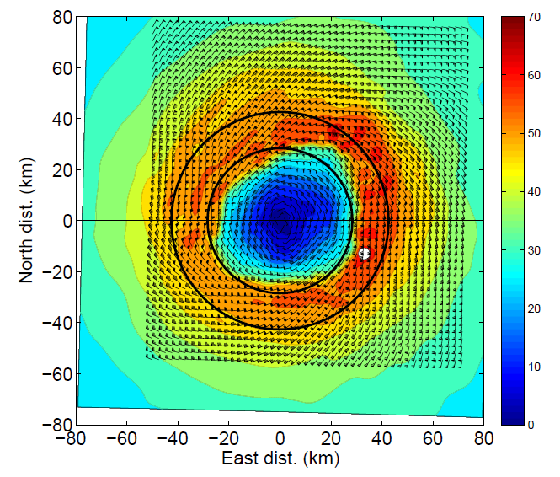
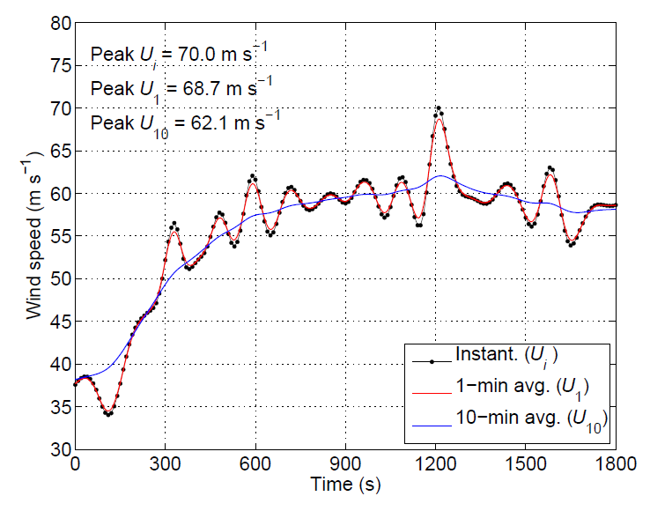
WRF-ARW Simulation of Hurricane Isabel Nolan et al. (2009a,b)
Four-day simulation (12-16 Sept. 2004)
Inner nest 1.33 km
Two 30-min periods of 10-m winds output at model time step (δt = 10 s)
  Generate simulated wind time series from high-density anemometer field
  Filter to appropriate averaging period (1 min, 10 min, etc)

Slide 5
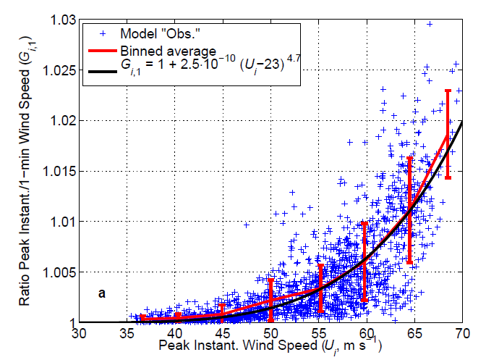
Converting from Peak Instantaneous to Peak T-min Wind Speed
Compute G_{i,T} = U_{i} / U_{T} for all anemometers in eyewall (0.8 -- 1.2 R_{max})
One data point per 30-min high-frequency model output period
Develop functional relationship between G_{i,T} = U_{i} / U_{T}
At each model output time, compute U_{T} from functional relationship

Slide 6
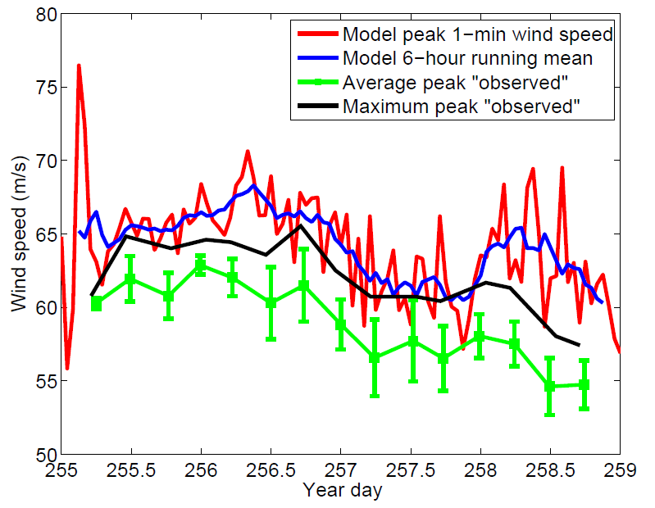
Intensity Estimate at Valid Time
Represents the expected value
NOT the actual max 1-min wind at the valid time, which is only one realization, (red curve)
Better described by a 6-hour running mean (blue curve)
More accurately, should be an ensemble average of many solutions at the valid time

