Slide 1
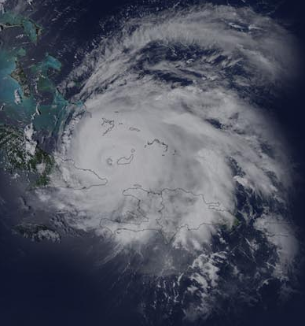
Verifying Regional Tropical Cyclone Model Forecasts using Synthetic Satellite Imagery
David A. Zelinsky
SRG, Inc., Colorado Springs, CO
and National Hurricane Center, Miami, FL
In collaboration with:
Vijay Tallapragada and Sam Trahan, EMC

Slide 2
Why verify synthetic satellite forecasts?
Traditional track/intensity verification
Limited by lack of in-situ ground truth in TCs
Does not account for storm structure
Wind radii / RMW verification also limited by a lack of data (or lack of best track)
Aircraft and buoy-based structure verification
Generally limited to looking at composite storms due to temporal and spatial limitations of observations

Slide 3
Goal
Add value to traditional verification metrics by systematically evaluating TC structure forecasts through the comparison of real and synthetic satellite data.
Now: Test a variety of verification metrics
Future: Use synthetic satellite data for pre-implementation testing and model-to-model comparisons

Slide 4
Synthetic Satellite Imagery
EMC uses the Community Radiative Transfer Model (CRTM) to generate synthetic brightness temperatures (BTs) based on variables such as water vapor, temperature, and surface properties within the HWRF model.
4 microwave channels (SSMIS)
4 IR channels (GOES)
Focus here is on microwave data
Provides more information about inner-core
structure

Slide 5
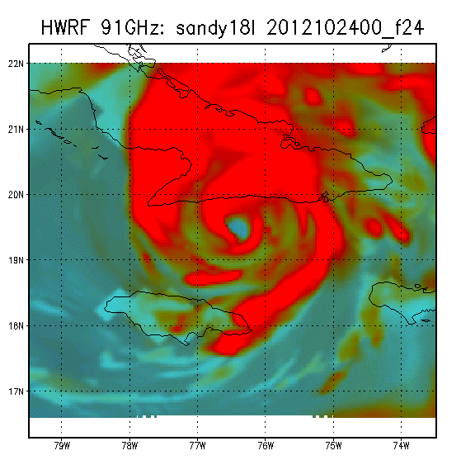

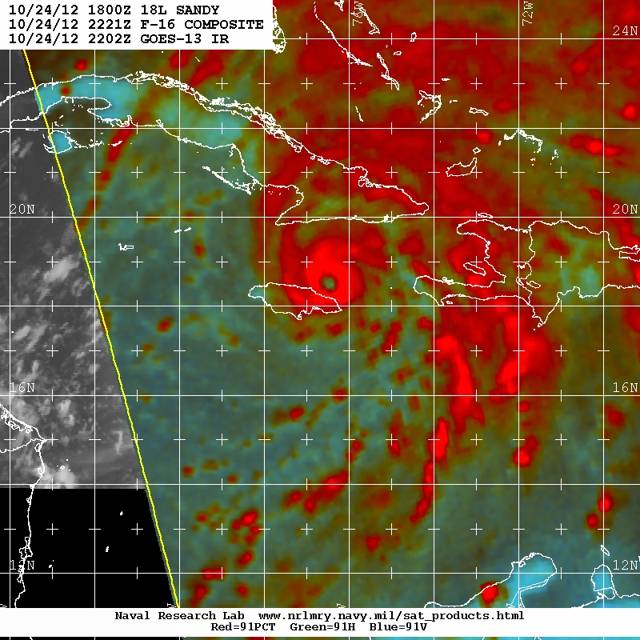
Methodology
91GHz Horizontal and Vertical BTs converted to color composites
Minimizes impact of resolution and instrument differences
91GHz selected due to relatively high resolution of real instruments
Eye quantified by assessing “completeness” of convective ring (red on color composite)
Banding quantified by fitting a Dvorak log-10 spiral
24, 48, and 72 hour forecasts verified against the closest available real image
SSMS 91GHz: 10/24/2012 2221UTC

Slide 6
Methodology
All forecasts from the 2012 operational HWRF, May-November were analyzed
“Yes” eyewall forecast defined as 6/10 of an eyewall or more
“Yes” banding forecast defined as 5/10 of a primary band or more
Only forecasts of named systems verified
Landfall cases removed

Slide 7
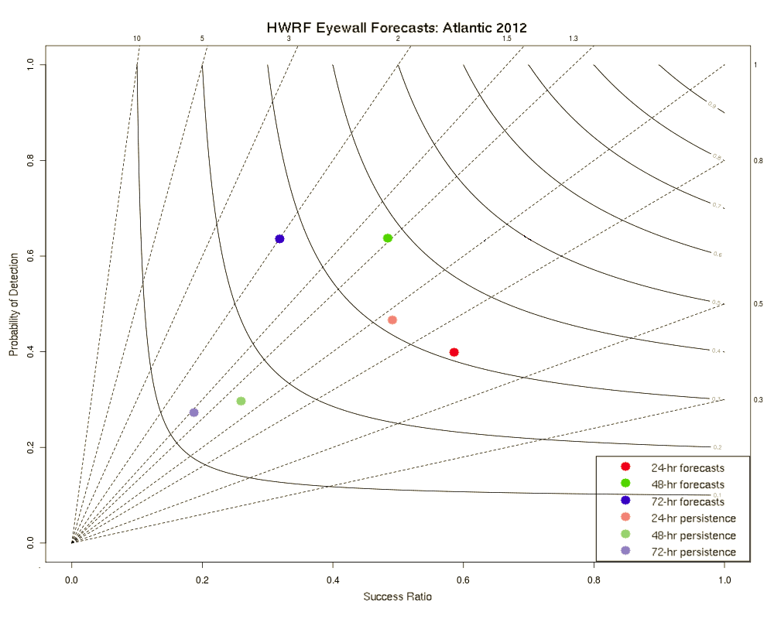
Results: Eyewall Forecasts
Atlantic
High probability of detection, however there is also a high bias beyond 24h
Overall accuracy decreases from 79% (24h) to 69% (72h)
Buoyed by large number of correct null cases
Less than 50% when correct null cases removed
24-h forecasts not much skill relative to persistence

Slide 8
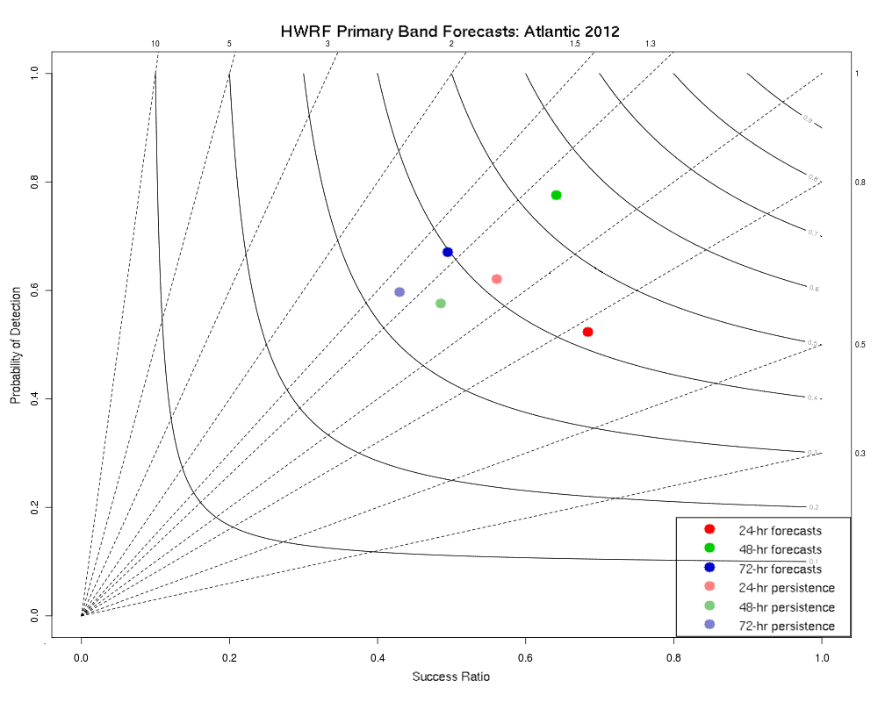
Results: Primary Band Forecasts
Atlantic
Banding forecasts generally better than eyewall forecasts
POD and Success Ratio higher for all forecast hours
Overall accuracy slightly lower
Fewer null cases
Slight high bias for 48 and 72h forecasts
24h forecasts have very little skill relative to persistence

Slide 9
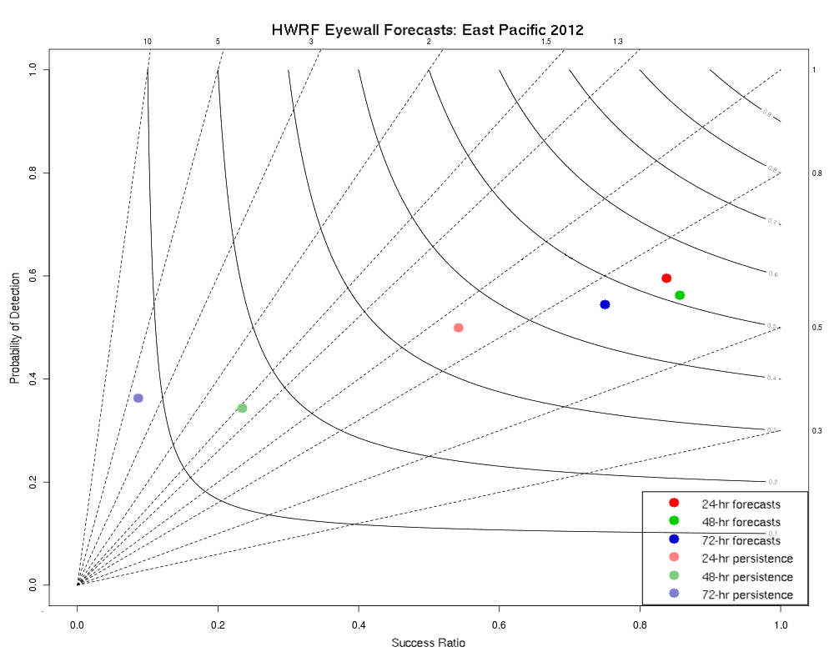
Results: Eyewall Forecasts
East Pacific
Low bias, but very few false alarms
POD 55-60%
Overall accuracy increases from 82% (24h) to 93% (72h)
About 50% when correct null cases removed
Overall persistence forecast accuracy decreases with time (68% to 51%)

Slide 10
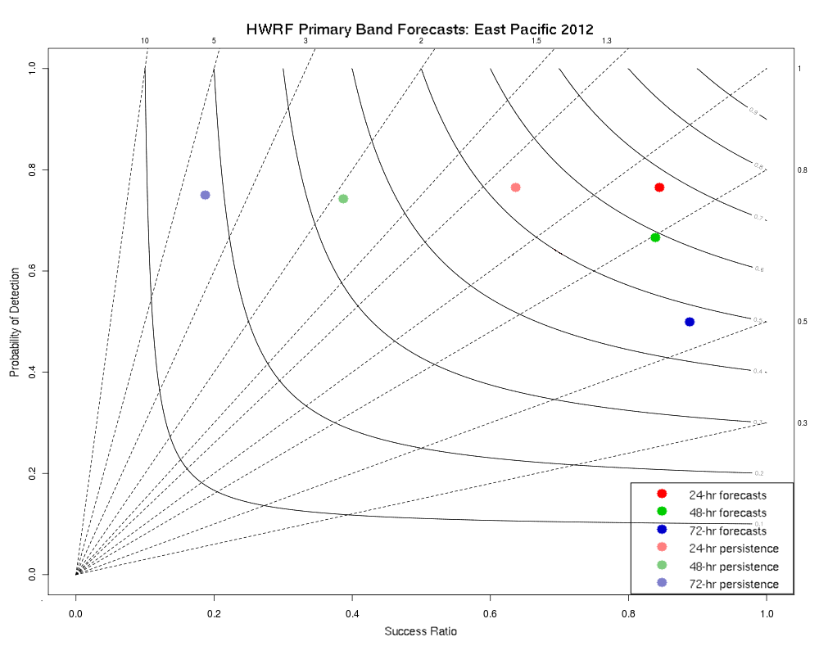
Results: Primary Band Forecasts
East Pacific
Low bias remains, but still very few false alarms
Despite fewer correct null cases, overall accuracy comparable to eyewall forecasts (84-91%)
POD at 24h and 48h higher than eyewall forecasts

Slide 11
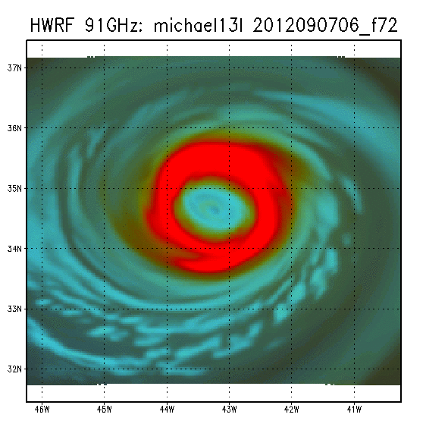
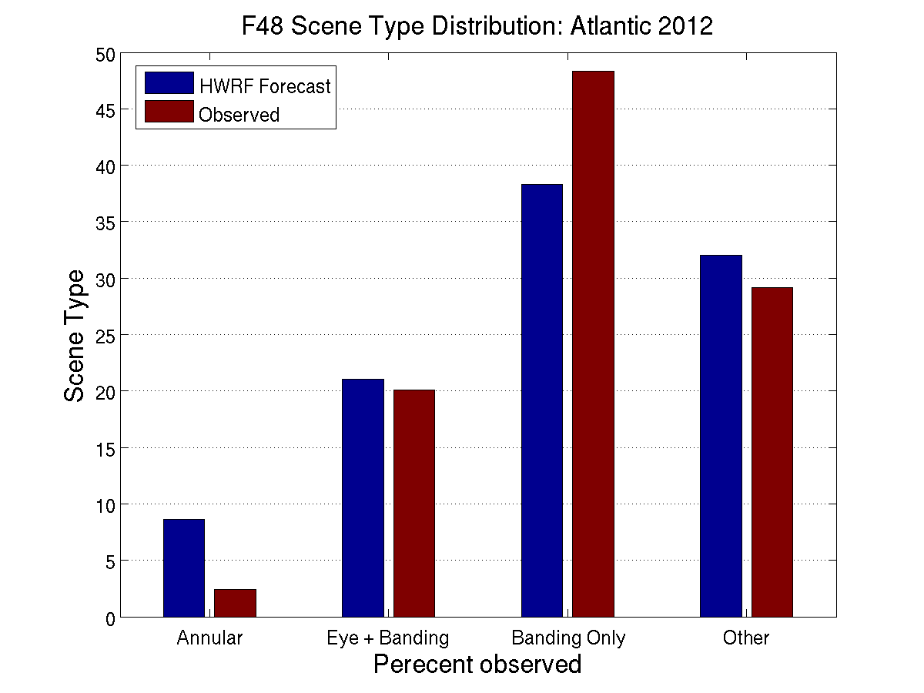
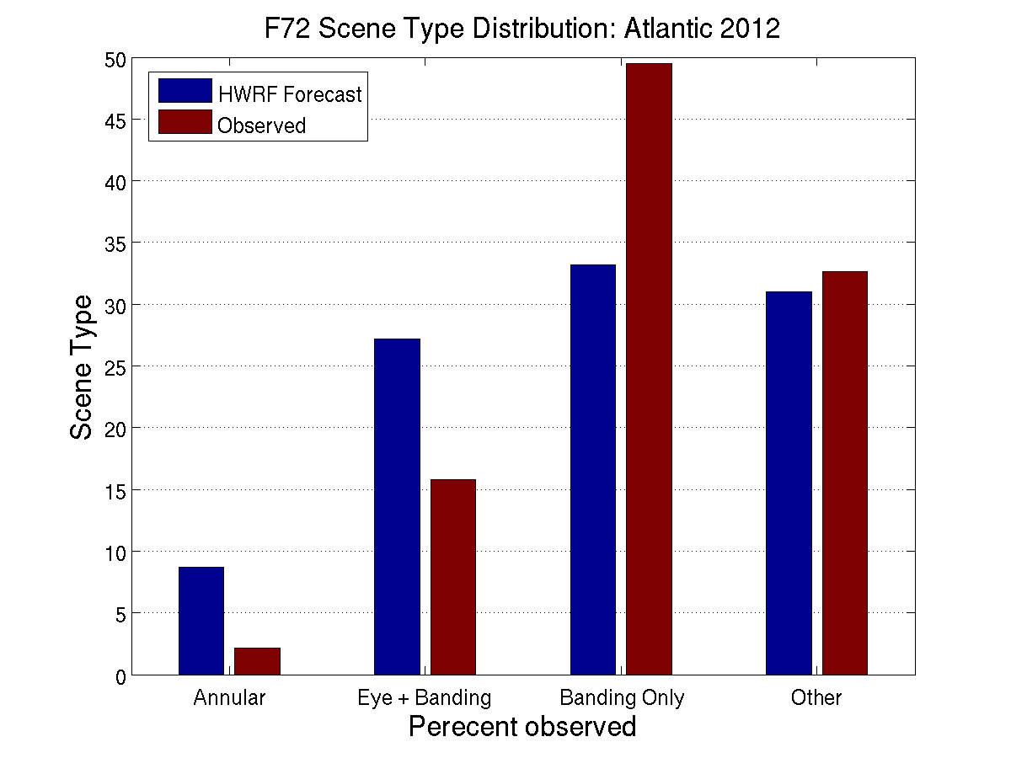
Results: Distinguishing Scene Type
How well can HWRF forecast distinguish between 4 modes:
Annular (eye with little to no banding
Eye with banding
Banding, no eye
Other (convection absent, or lacking curvature- primarily shear and remnant low cases)
Model has a tendency to forecast too many annular storms, at the expense of too few “banding only” cases
(%)
(%)

Slide 12
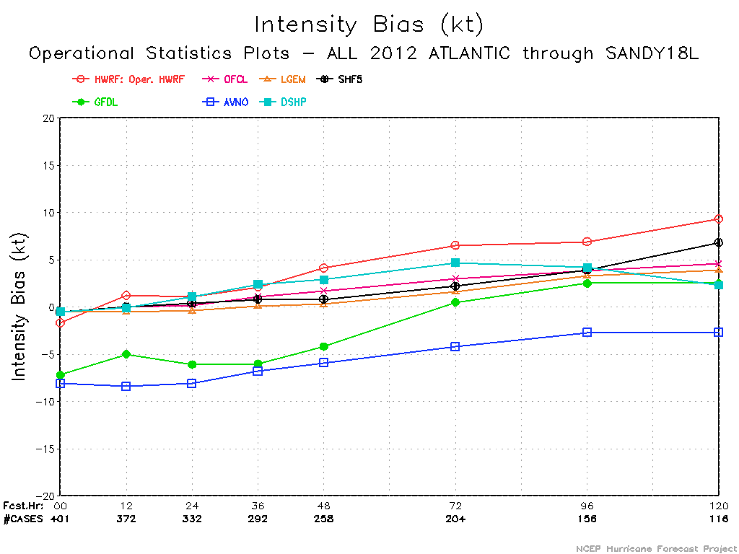
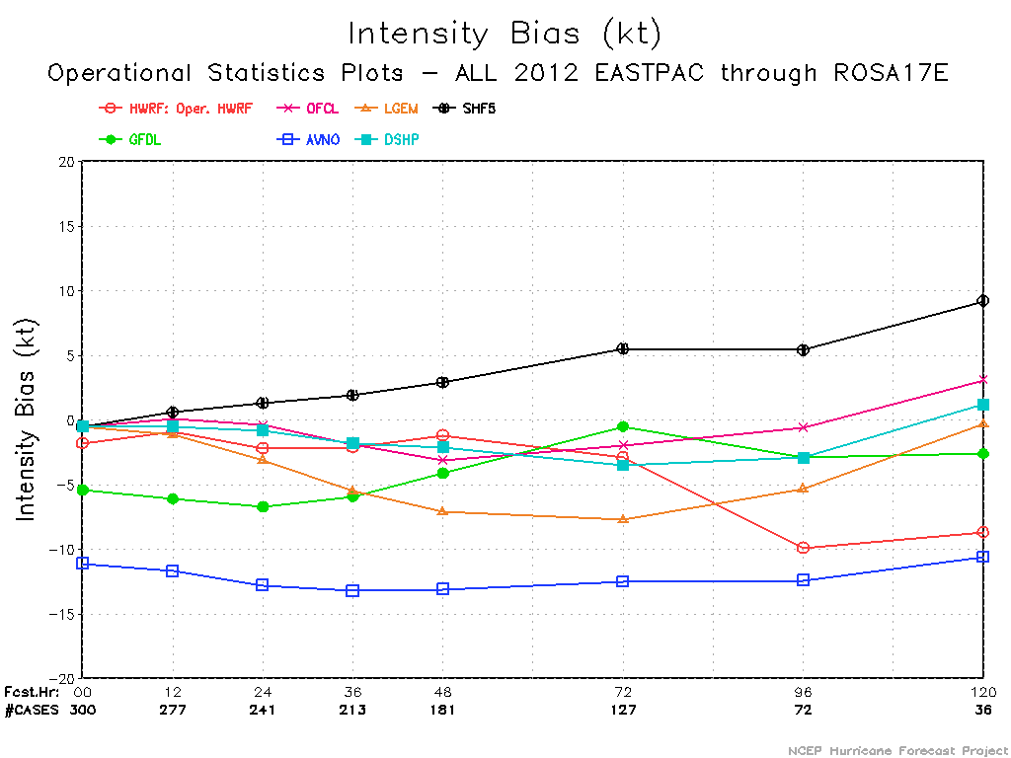
Discussion
Eyewall forecast biases match intensity biases for Atlantic and E. Pacific
Model verification courtesy of EMC

Slide 13
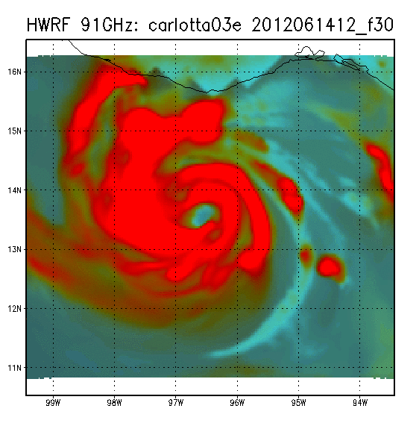
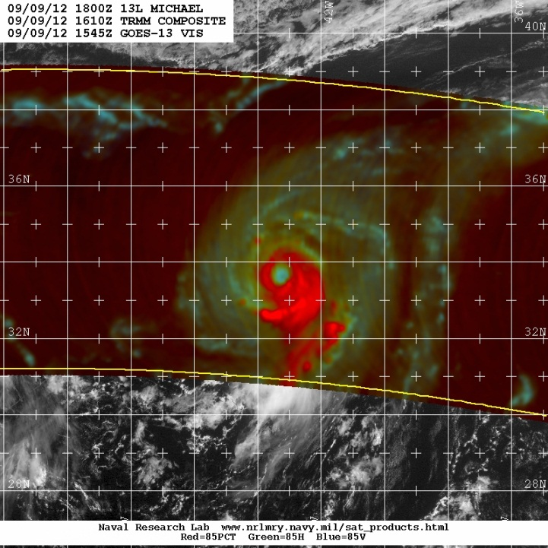
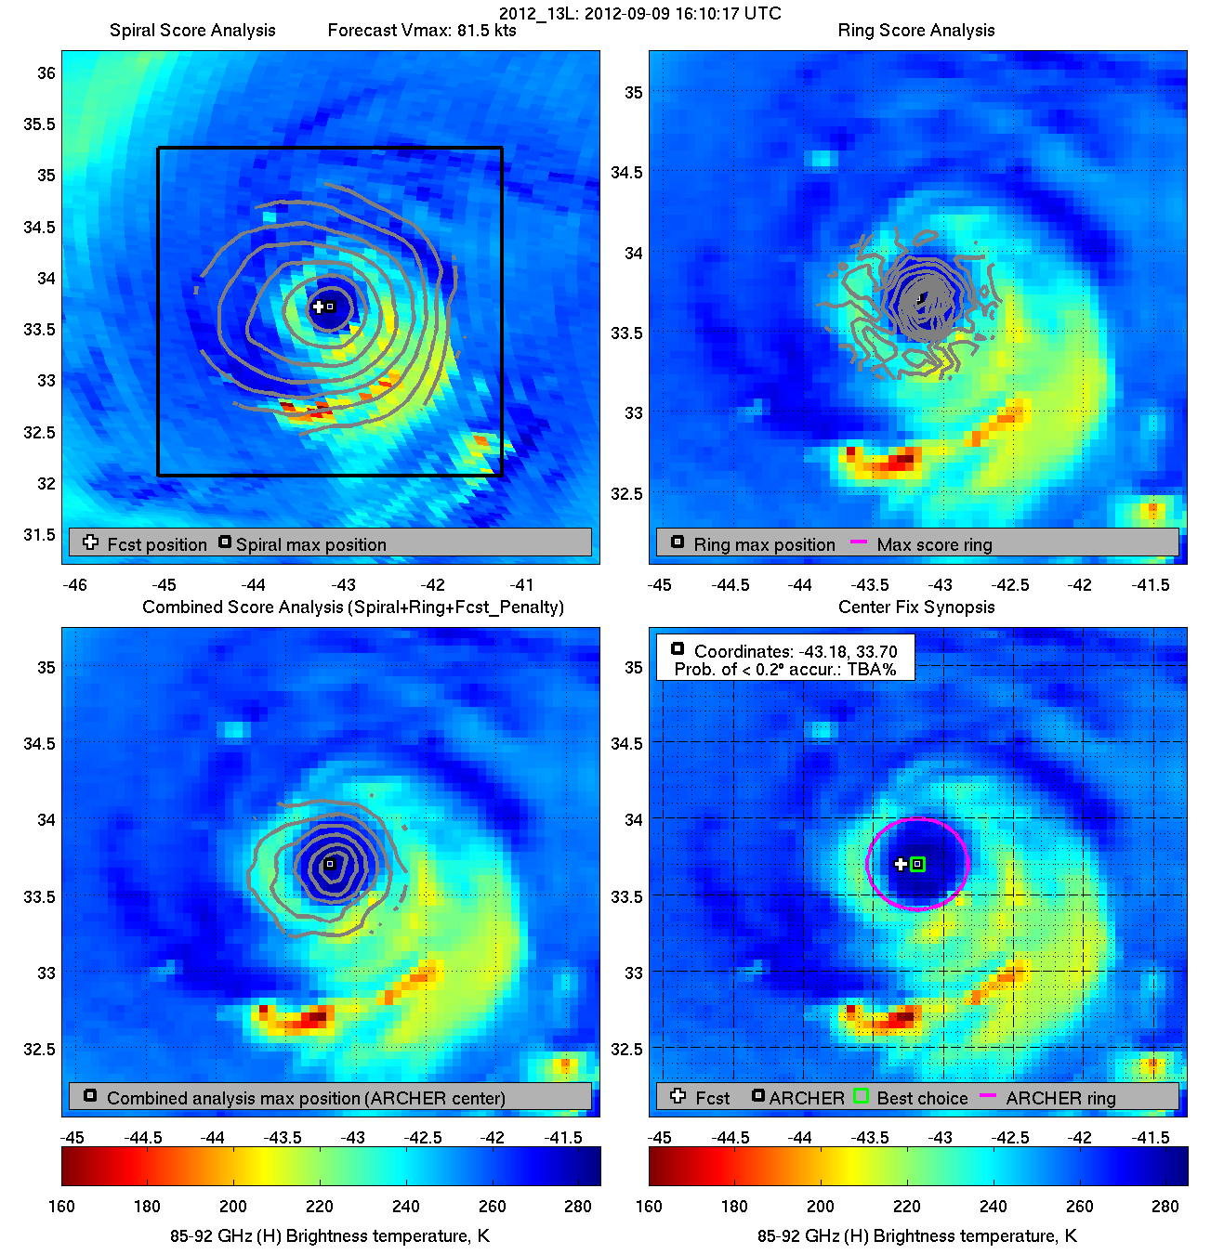
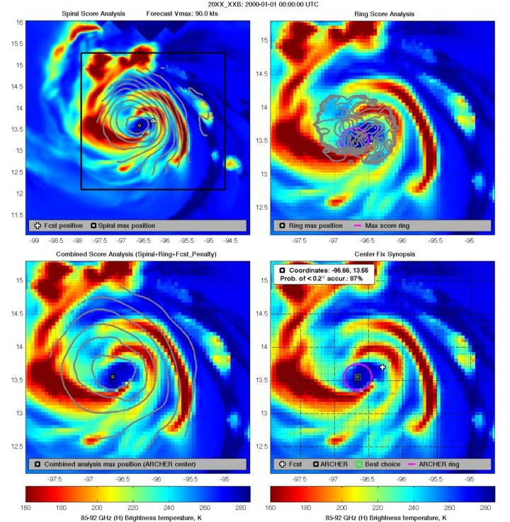
Future Work
Apply HWRF imagery to U-W CIMSS ARCHER technique
Requires applying a resolution correction first
Can also use for objective verification of eye size
Currently can not quantify banding features
ADT-based Dvorak structure analysis
13

Slide 14
Conclusions
Synthetic satellite imagery can be used to systematically evaluate TC structure forecasts
ARCHER technique will allow for the verification of large-sized samples
2012 operational HWRF results mixed
Eye forecast accuracy ~ 80%
Large number of correct nulls, accuracy much lower (sometimes lower than 50%) when those are removed
East Pacific forecasts generally better than Atlantic forecasts
Skillful (compared to persistence) at all hours, while Atlantic has no skill at 24h.
Banding forecasts generally better than eyewall forecasts
Model has tendency to forecast too many annular storms
Plan to use techniques presented here to verify the proposed 2013 operational HWRF implementation

Slide 15
Thanks to: Kim Richardson, NRL Chris Velden and Tony Wimmers, UW-CIMSS EMC HWRF Team

Slide 16
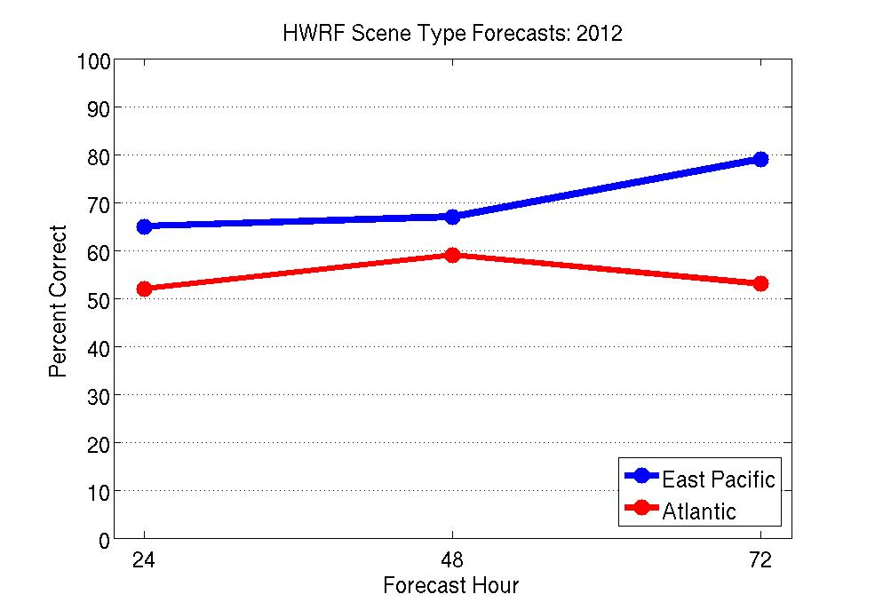
Results: Scene Type
How well can HWRF forecasts distinguish between these 4 modes:
Annular (eye with little to no banding)
Eye with banding
Banding, no eye
Other (convection absent or lacking at least 2/10 of curvature)

Slide 17
Annular Hurricanes: How often does HWRF forecast annular-like storms?
“Annular” defined here as 6/10 eyewall with 2/10 or less of a primary band
HWRF Annular/Total eyewall forecast (48h):
Atl: 18/62 (29%)
Epc : 8/21 (38%)
Observed 2012 (all analyses):
Atl: 6/68 (9%)
Epc: 8/71 (11%)
Note: if observed cases are restricted to storms that existed 48-h prior to the observed time (same subset as 48-h forecasts), Atl increases to 11%, Epc to 16%

Slide 18
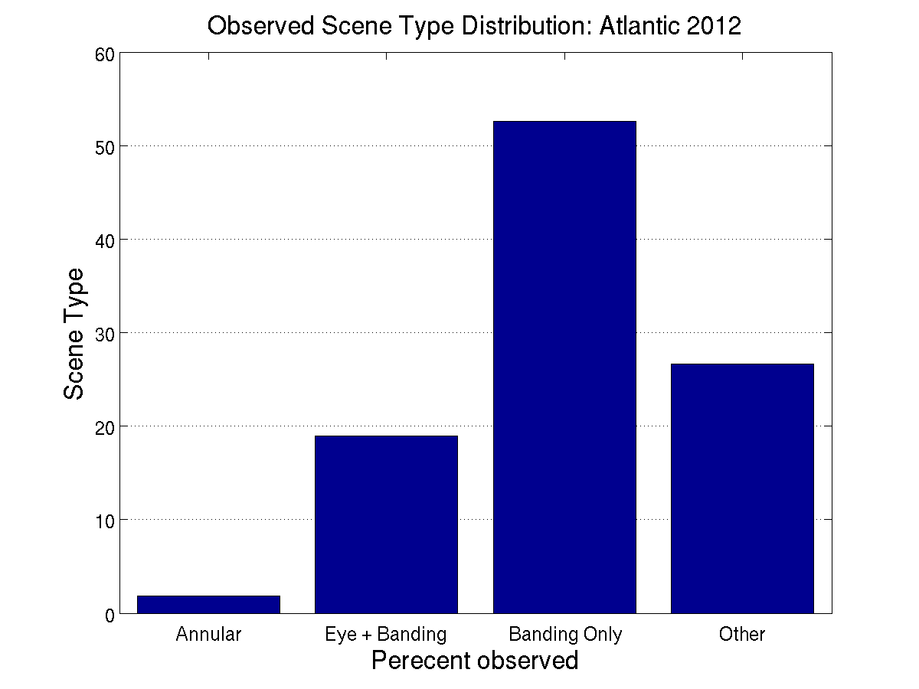
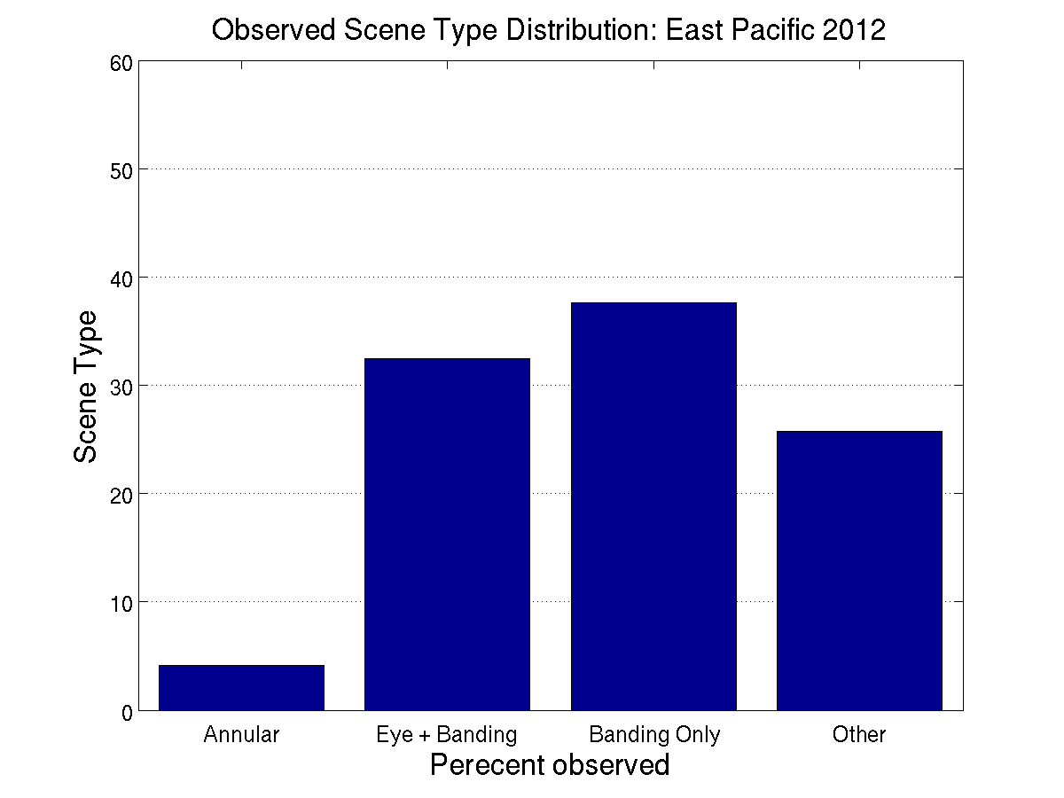
Results: Distinguishing Scene Type
Does HWRF have a realistic distribution of scene types?

Slide 19
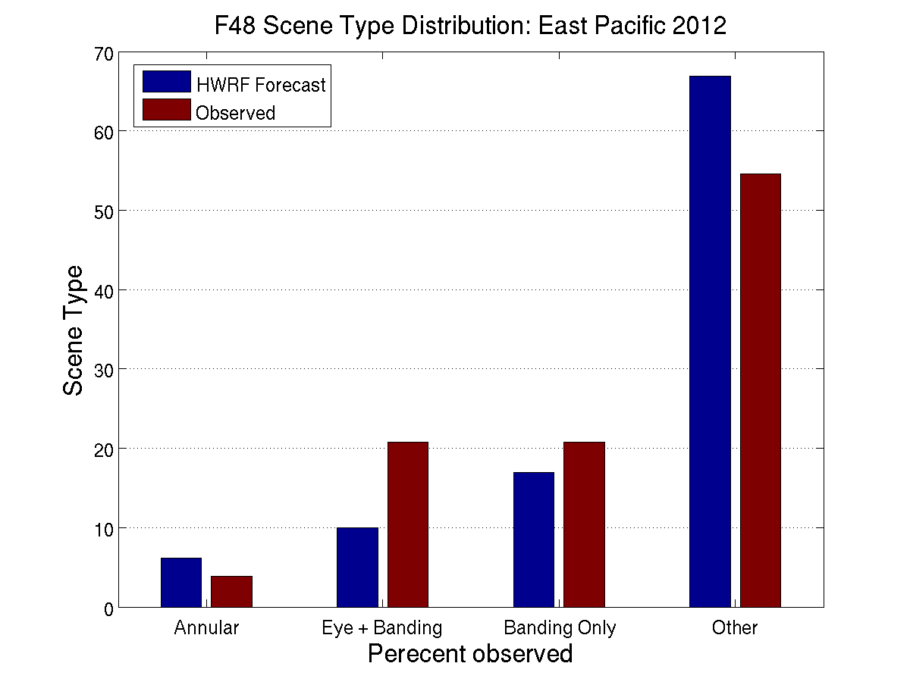
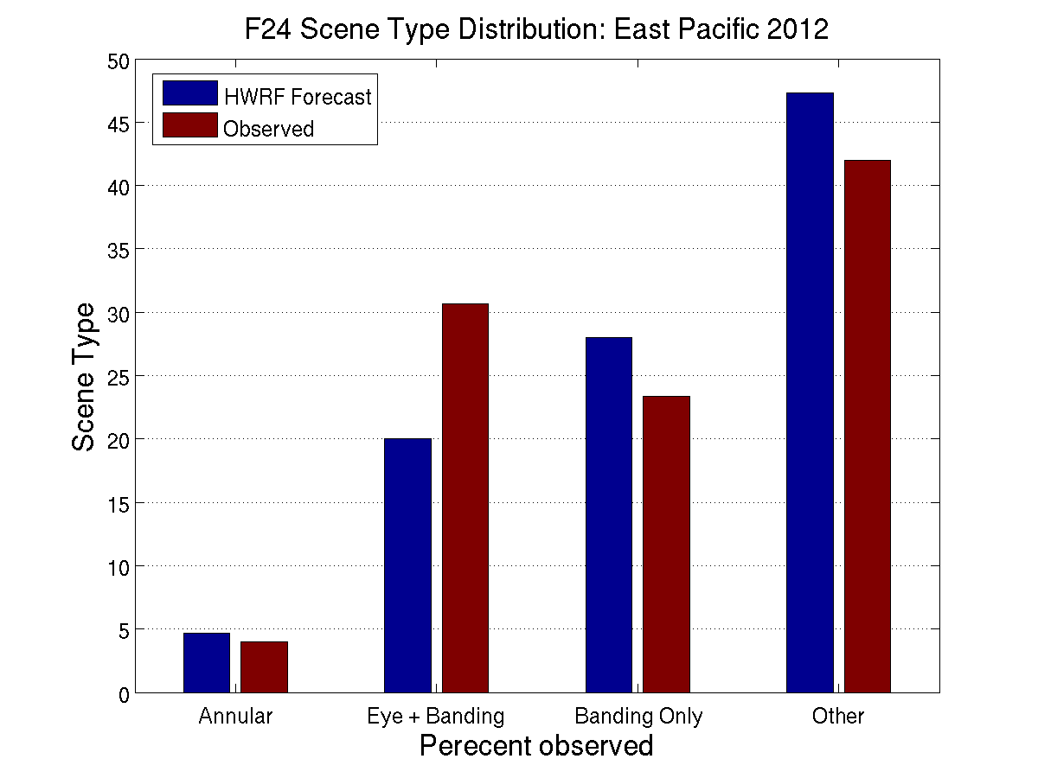
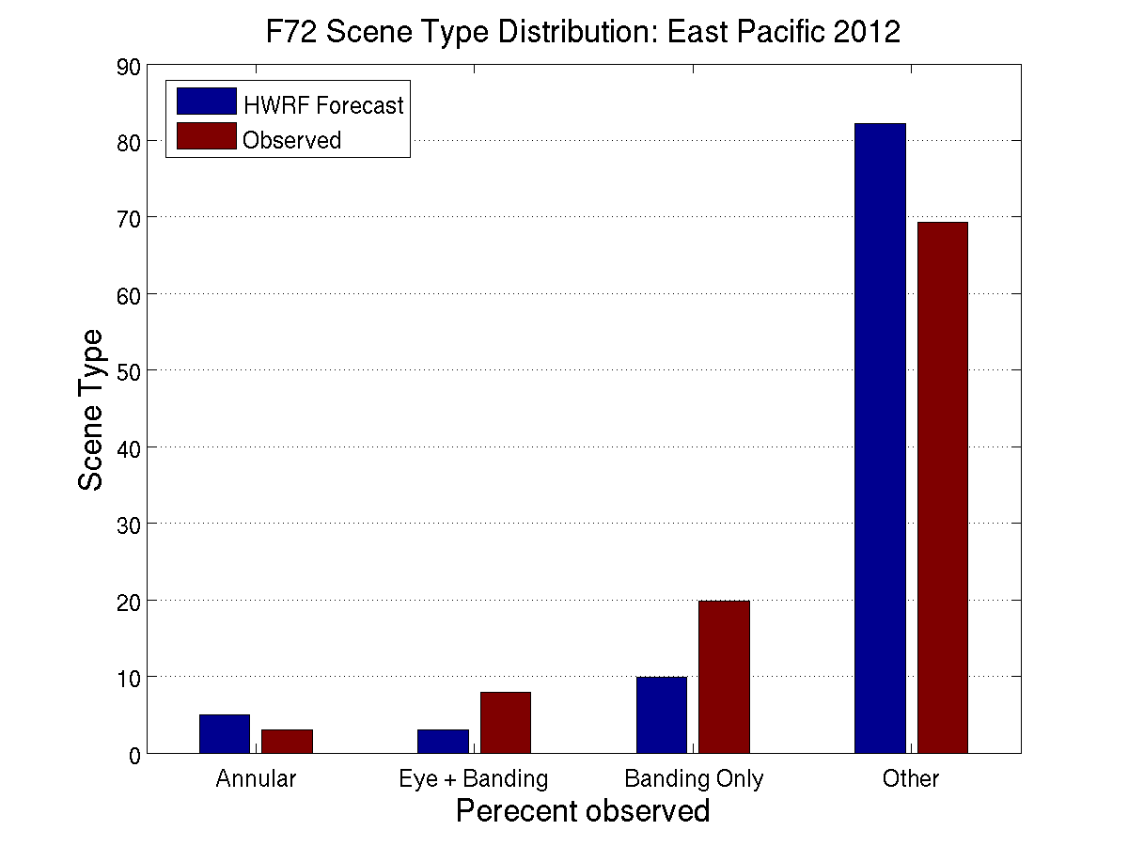
Results: Distinguishing Scene Type East Pacific
Low bias in “curvature-scenes”
Slight “other” bias suggests too many shear or remnant low forecasts
Slight high bias in annular storms
Smaller bias than Atlantic

Slide 20

U-W CIMSS ARCHER
Date/Time | Sat | Diameter (km) | Ring % | Tb diff (K)
20120909T161017 | TMI | 56.7 | 100.0% | 32.0
Top: Michael 09/09/12 TRMM 1610 Image courtesy of NRL
Right: ARCHER analysis of same pass, courtesy of UW-CIMSS

Slide 21
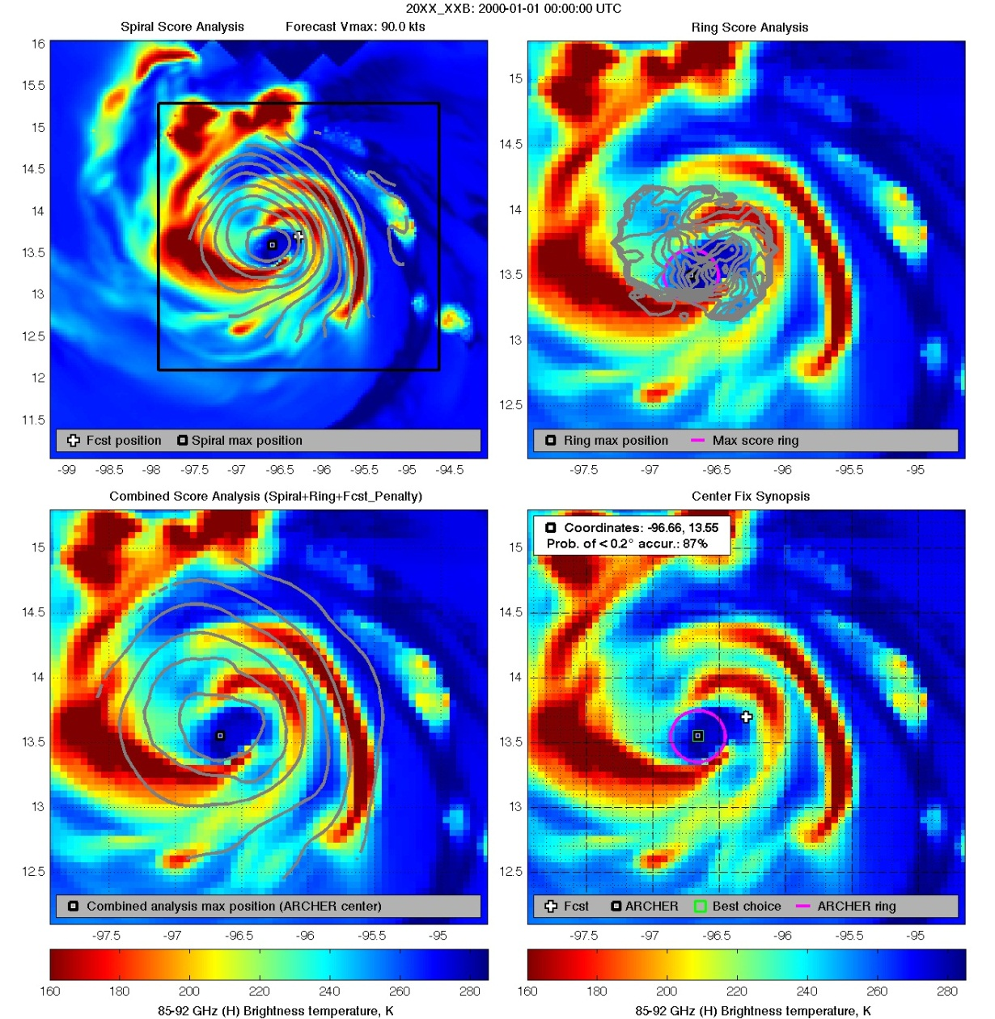
U-W CIMSS ARCHER
Early tests with HWRF
ARCHER able to locate storm center and analyze closed eyewall in sample HWRF imagery

