Slide 1

Hurricane activities at DTC
Status report by the DTC
Ligia Bernardet
HRD Modeling Meeting
February 17 2011

Slide 2
Code Management
Current public release (March 2010) corresponds to 2008/2009 HWRF operational model
Current code in HWRF Community Code repositories corresponds to 2011 operational baseline (aka, R2-final) from November 2010
This code will be released in WRF v3.3 (March 2011), will be used in the 2011 Hurricane Tutorial*
    *Only exception is that updates to the vortex initialization based on Kevin Yeh’s work will be added to vortex initialization code

Slide 3
Upcoming upgrades
After the April 2011 Tutorial, DTC will incorporate the 2011 operational capability onto the HWRF community code repositories

Slide 4
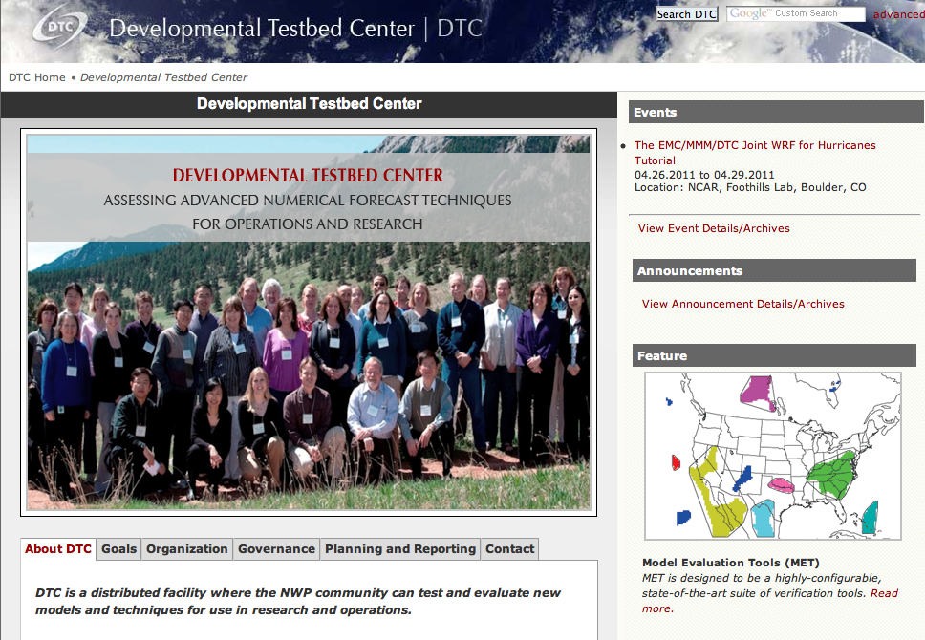
Joint EMC/MMM/DTC Tutorial
Register at
www.dtcenter.org

Slide 5
Benchmarking of Community Code
DTC developed a functionally-equivalent T&E system on tjet using GSD workflow manager
DTC ran 1000+ cases for Reference Configuration tests using the operational configuration.
Goals
  Make public the skill of current community code
  Compare skill of current community code run on jet using DTC testing environment (HNR2) against similar run by EMC (HR20) on IBM. Expect similarity over large sample.

Slide 6
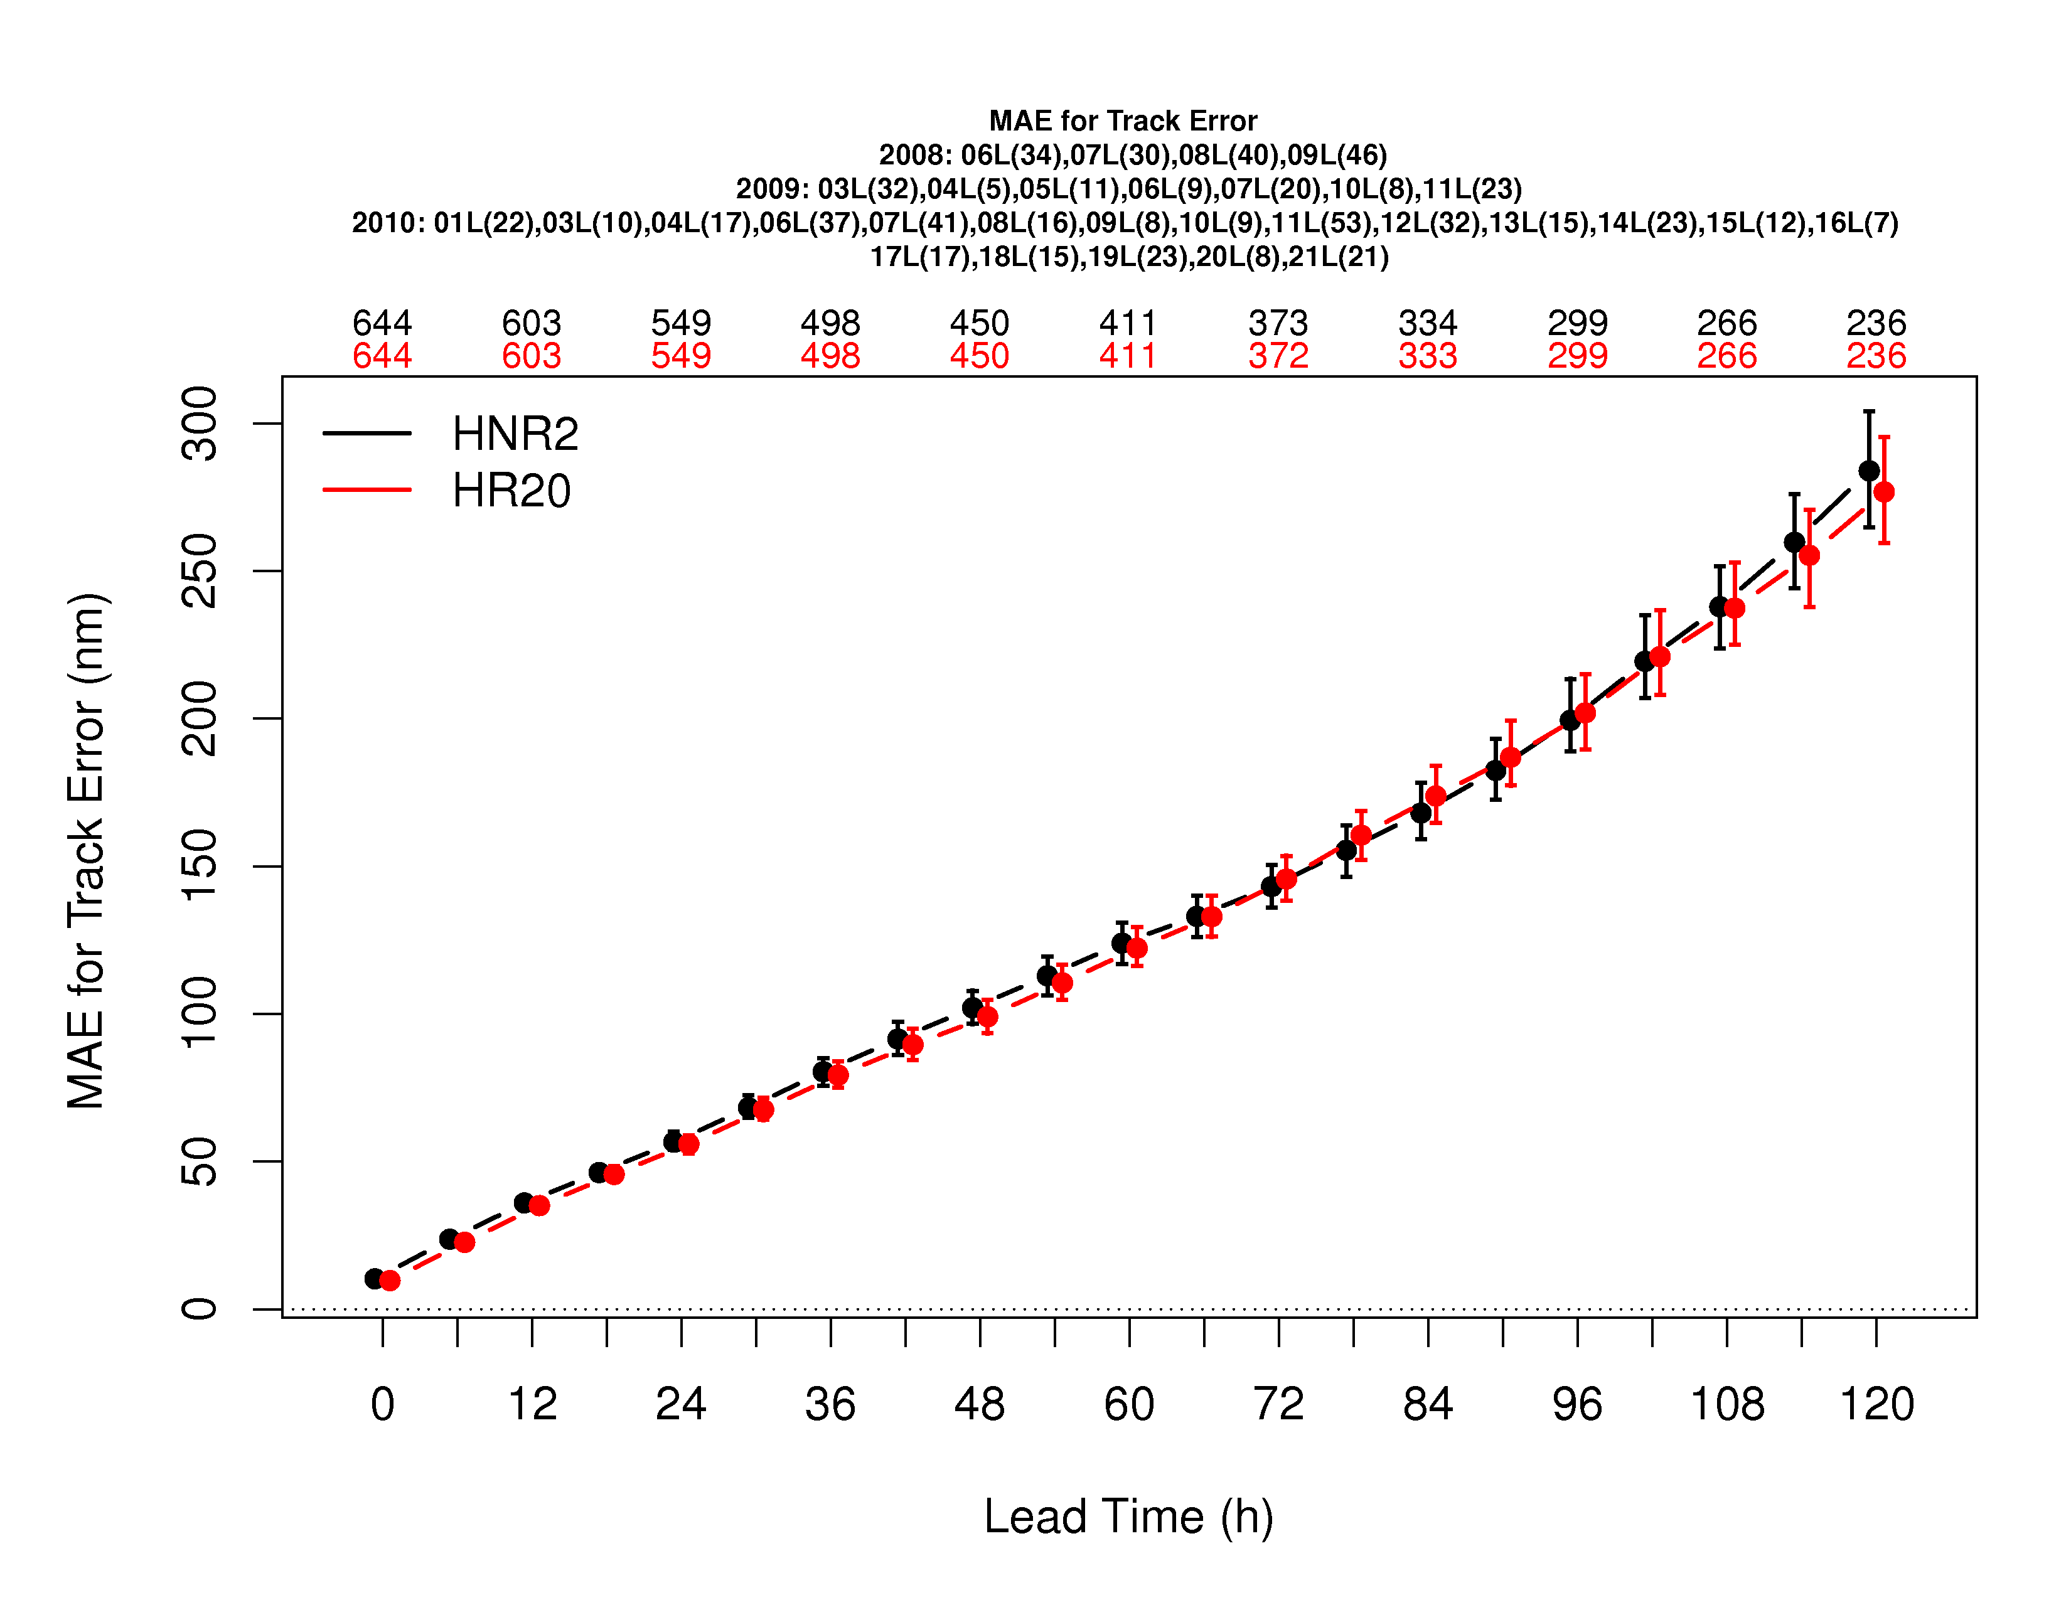
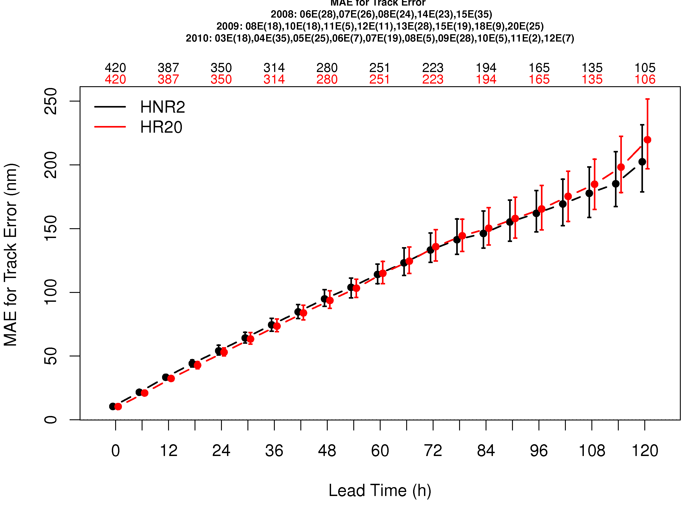
Atlantic

Slide 7
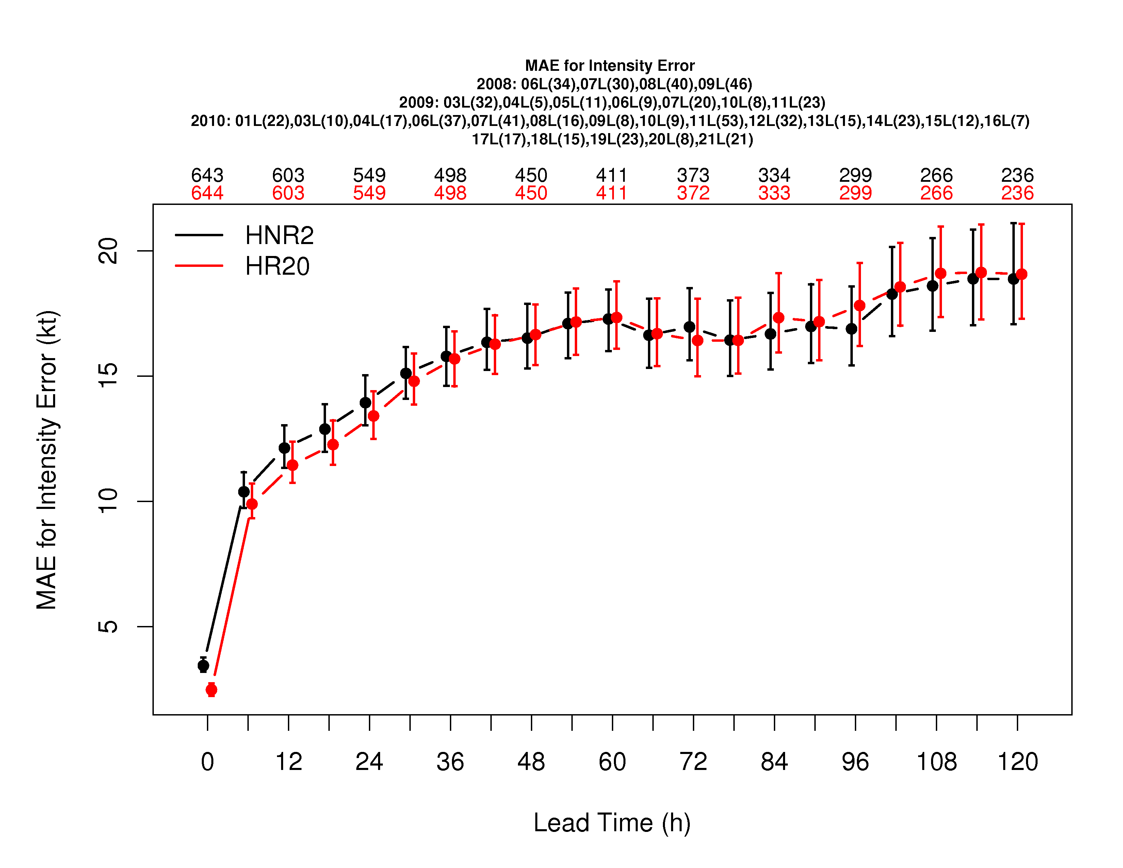
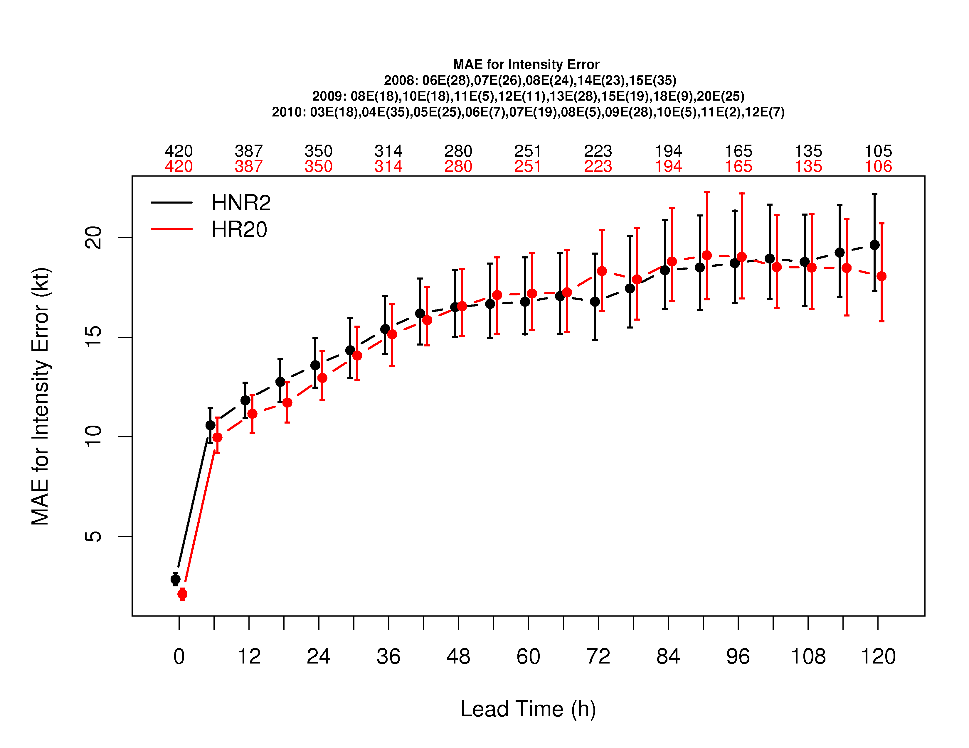
East Pacific

Slide 8
Collaboration
Community WRF v3.3 contains 3rd nest by AOML but no runs using 3 nests can be done due to hardwires to 2 nests in parts of the code
  EMC/AOML working on this and adding coupling to 3rd nest
Idealized capability not incorporated in community code
Acknowledging that development takes time…
  are we using the most efficient path to add new developments to the community code?

