Slide 1
Addressing the observed bias in HWRFx deep-layer vertical wind shear diagnostics
Aryeh Drager, Paul Reasor
HRD Model Meeting, 8/18/2011
Special thanks to Rob Rogers, Thiago Quirino, and John Kaplan

Slide 2
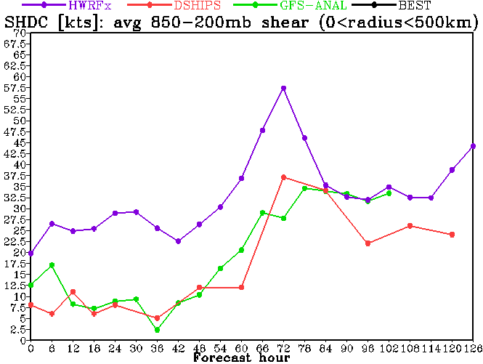
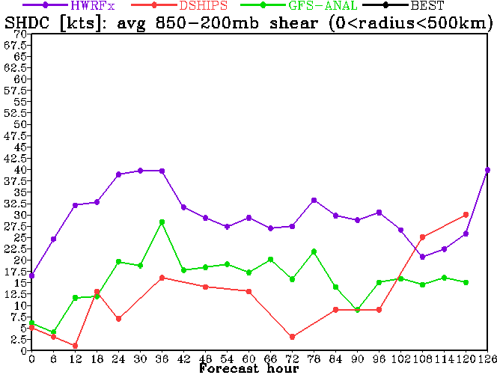
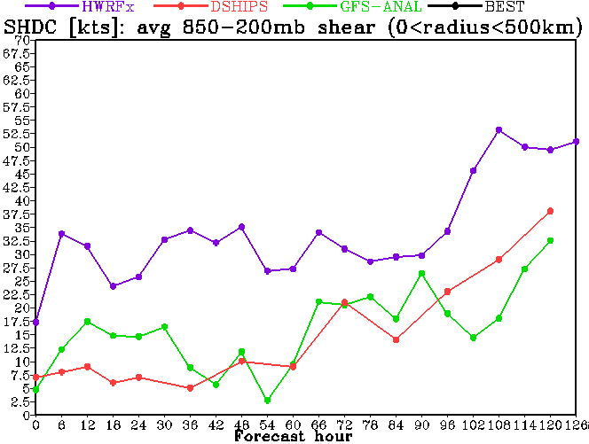
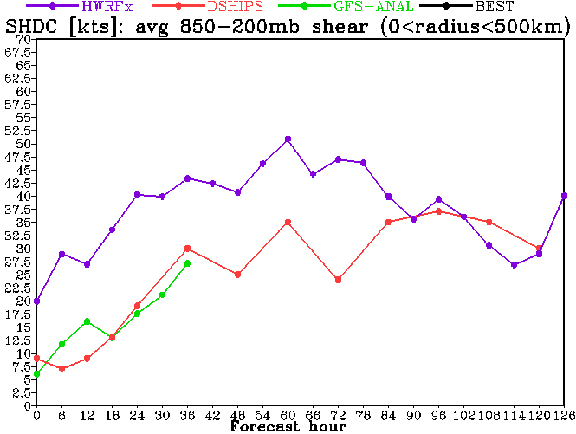
MOTIVATION: Plots of Forecast Deep-Layer Shear
Danielle (2010)
Earl (2010)
Igor (2010)
Otto (2010)

Slide 3
MOTIVATION: Plots of Forecast Deep-Layer Shear
HWRFx
GFS
DSHIPS

Slide 4
Possible Explanations
Discrepancy in how large-scale shear is calculated:
Magnitude of average shear vector vs. average of shear vector magnitude?
Accounting for vortex tilt?
Height surfaces vs. pressure surfaces?
Bias within the model itself?

Slide 5
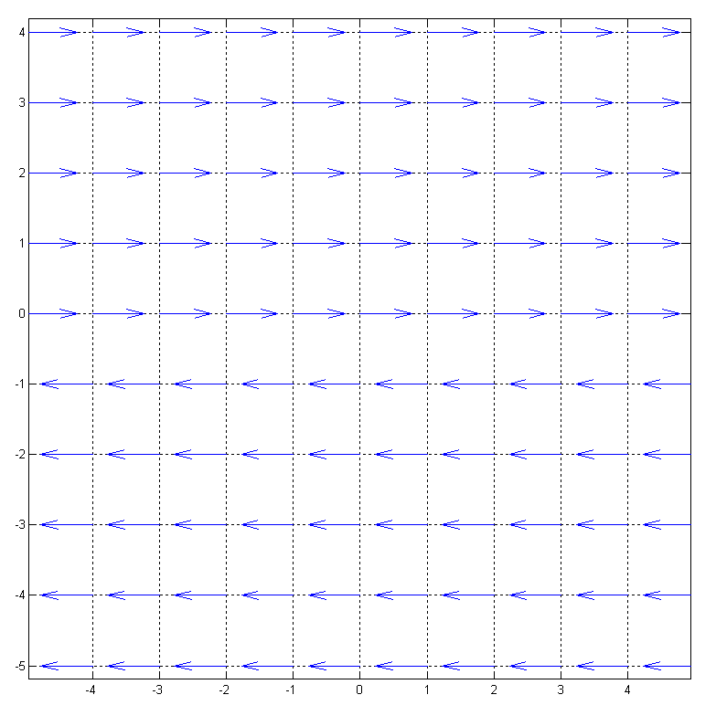
Magnitude of average shear vector vs. average of shear vector magnitude:
Simple Shear Field: (arrow magnitude = 10 kts)
Magnitude of average shear vector = 0 kts
Average shear vector magnitude = 10 kts

Slide 6
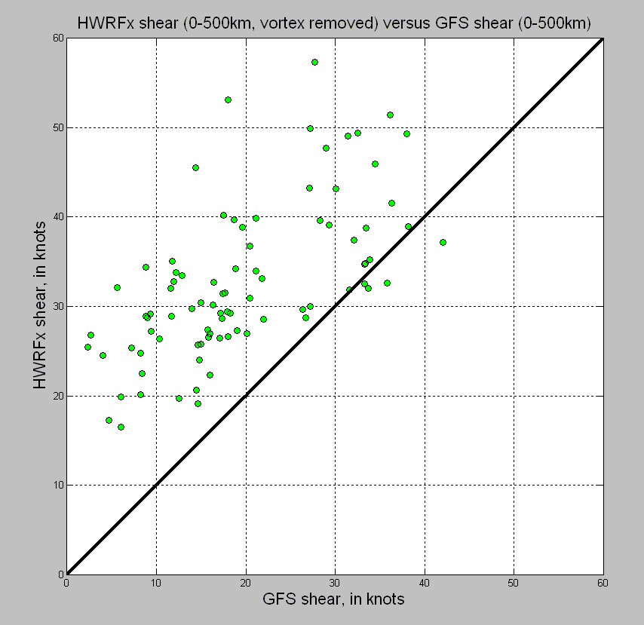

Slide 7
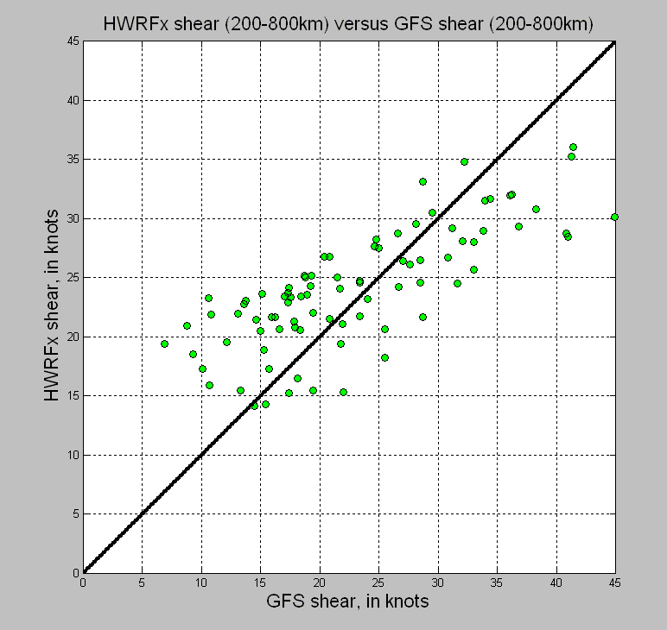

Slide 8
