Slide 1
An HWRF Model-Based Examination of Possible Land Surface Influences on the Post-Landfall Intensification of Tropical Storm Fay of 2008.
Monica Laureano
Dev Niyogi
Purdue University
Gopal, Frank, Xuejin and Vijay
HRD and EMC

Slide 2
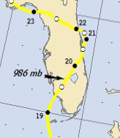
Experiment Goals
The goals of our experiments are three-fold:
  Examine the effects of different land surface parameterization schemes and various physics changes on the HWRF forecast
  Study the effect of land surface heterogeneity through idealized simulations of the presence or lack of Lake Okeechobee and the Everglades
  Rank the contribution of impact of each experiment on the model forecast to suggest possible influences that may have contributed to the post-landfall intensification of tropical storm Fay.
Experiments will test the HWRF forecast using two different land surface schemes: the GFDL Slab model and the Noah land surface model.
  GFDL Slab is currently the default LSM in HWRF, while many NCEP models use Noah LSM
Fay is modeled from 2008-8-19 00Z until 2008-08-21 00Z, then studied from the model start time through 2008-08-20 06Z to limit the investigation to the time period only land influences on Fay.

Slide 3
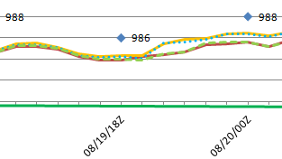
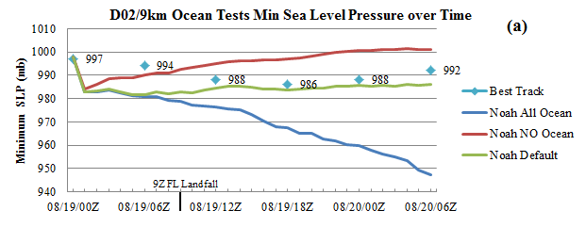
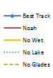
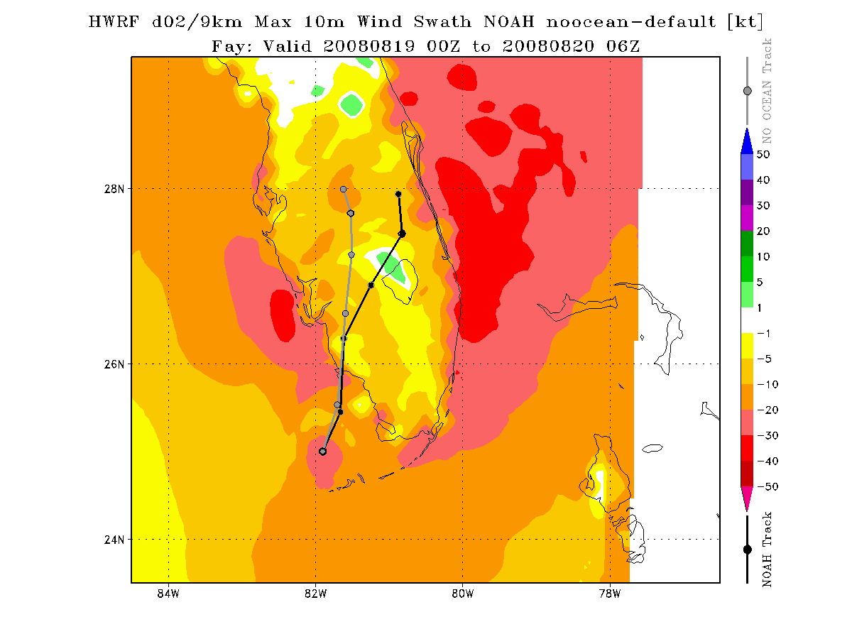
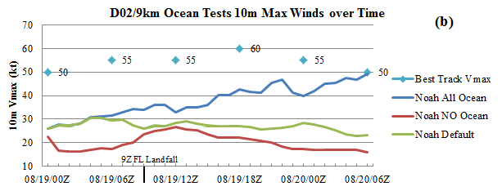
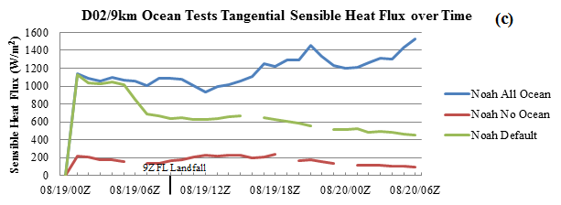
No Ocean run – overprediction from default of 10m winds over lake location
As the storm crosses over the Florida peninsula, the rainbands swirling over the ocean are still impacting the energy transfer within the core (despite being over land) by either slowing the amount of evaporation or through advection of moisture inwards.

Slide 4
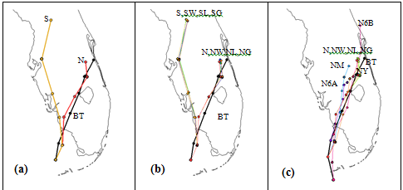
 |  | GFDL SLAB LSM |  |  |  | NOAH LSM
Time | fcst hr | S | SW | SL | SG | N | NW | NL | NG | NY | NM | N6B | N6A
08/18 18Z | -6 |  |  |  |  |  |  |  |  |  |  | 0
08/19 00Z | 0 | 0 | 0 | 0 | 0 | 0 | 0 | 0 | 0 | 0 | 0 | 25.09
08/19 06Z | 6 | 14.80 | 15.46 | 14.91 | 15.42 | 15.24 | 15.50 | 15.33 | 15.40 | 18.77 | 13.92 | 23.26 | 0
08/19 12Z | 12 | 19.68 | 18.92 | 19.23 | 19.19 | 14.79 | 14.40 | 14.20 | 14.95 | 12.46 | 5.32 | 12.39 | 45.35
08/19 18Z | 18 | 28.11 | 29.92 | 28.32 | 28.65 | 11.96 | 13.59 | 12.47 | 12.85 | 4.05 | 9.92 | 49.25 | 27.28
08/20 00Z | 24 | 147.56 | 140.46 | 143.34 | 141.81 | 6.37 | 10.83 | 11.41 | 5.19 | 21.53 | 33.08 | 75.29 | 44.58
08/20 06Z | 30 | 191.24 | 187.58 | 187.32 | 192.33 | 30.03 | 22.02 | 25.68 | 25.66 | 44.87 | 62.52 | 111.63 | 96.32
Sum FTE |  | 401.37 | 392.35 | 393.12 | 397.40 | 78.39 | 76.34 | 79.10 | 74.05 | 101.68 | 124.77 | 296.91 | 213.53

Slide 6
Rankings and Future Studies
With results so far, we have found that influences on forecasts should be ranked:
  Land surface parameterization scheme is of most importance to track forecast.
    Noah LSM seems to be performing better than GFDL Slab
  Initial boundary conditions and PBL scheme (on intensity forecast-winds and SLP)
  Land surface features and heterogeneity
    Presence of Lake Okeechobee shows a drop in pressure, but not by much.
    Presence of the Everglades does not seem very important with the Fay case, but mostly because the track was closer to the lake than the Everglades.
Further studies for landfalling systems includes investigation of TS Erin (2007) over OK with the Noah LSM using:
  The 1993 USGS Landuse dataset
  The updated high-res 2001 MODIS Landuse dataset
  NASA Land Information System (LIS) and/or High Resolution Land Data Assimilation System (HRLDAS) forcing files for the Noah LSM
Investigation of landfalling systems in the Indian Monsoon region and TS Arlene from 2005 (Niyogi’s group @ Purdue University)

