Slide 1
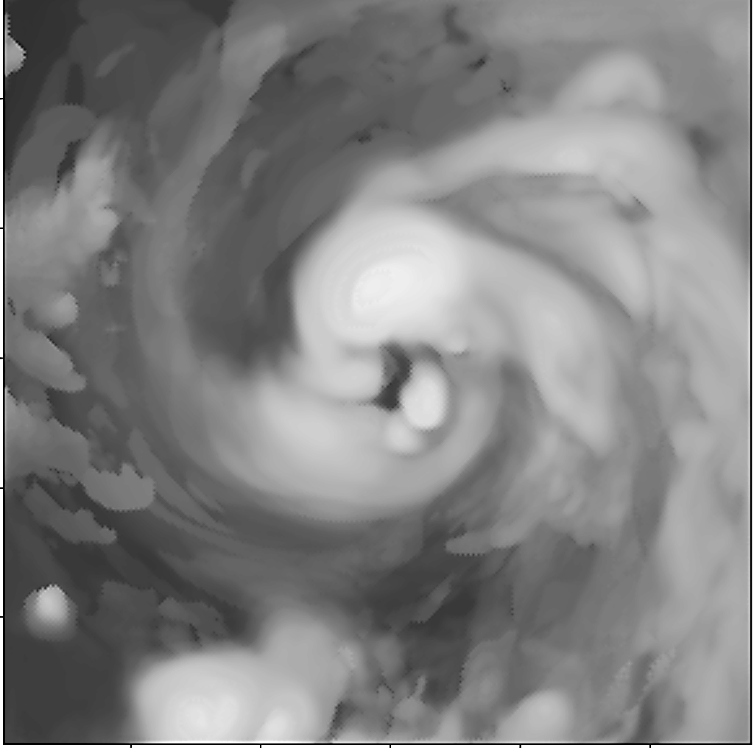
A Brief Update on the Hurricane Nest Project
Sundararaman G. Gopalakrishnan (Gopal)
NOAA/AOML/HRD, Miami, FL
Vijay Tallapragada
EMC/NCEP, College Park, MD
&
Thiago Quirino
NOAA/AOML/HRD, Miami, FL
In collaboration with
Meso-Scale Modeling Group, EMC/NCEP, College Park, MD
Acknowledgements: Frank Marks and Robert Atlas, AOML, Miami,FL
1st Quarterly HIWPP Meeting, May 13-14, Boulder, CO
1
Notes:
Hurricane Bill: HWRF Equivalent of GOES-East Imager 10.7 micro m

Slide 2
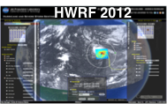
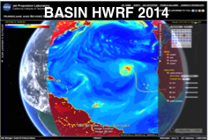
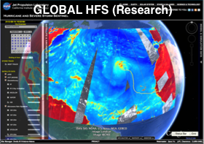
PROJECT GOALS
Create the next generation, non-hydrostatic, Hurricane Forecast system (HFS) capable of capturing better, land-TC multi-scale interactions, critical for land fall applications. This modeling system will have a very high potential to transition to operations (regional)
Proof of concept of Global tropical cyclone model with multiple moveable nests placed around all tropical systems in the world
Options to test HWRF nests in NMMB/NEMS framework with initial and boundary conditions from different hydrostatic and non-hydrostatic global models being developed in this HIWPP effort will be made available to other collaborators

Slide 3
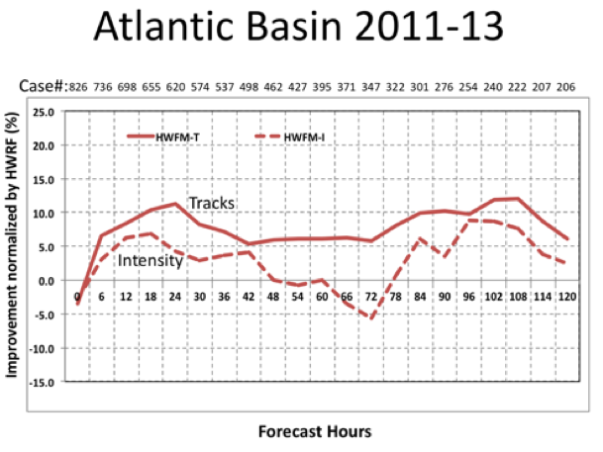
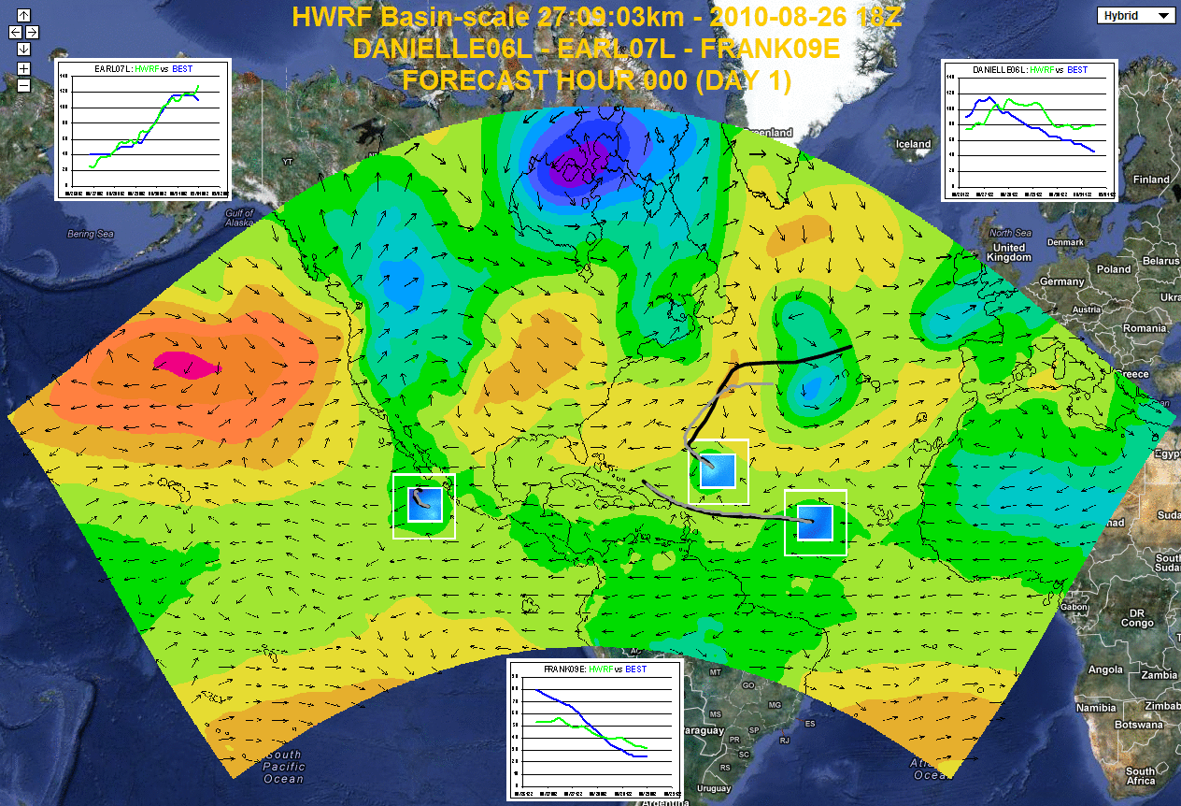
BACKGROUND INFORMATION
Available:
2013 Basin Scale HWRF (extended version of 2013 HWRF with multiple moving nests)
NMMB/NEMS global model configuration (currently runs without nesting)
NMMB regional model configuration with moving nest techniques adopted from an earlier version of HWRF system
Basin Scale HWRF: 2013 version of HWRF with multiple moving nest, with initialization, cycling and physics all consistent with operational HWRF, with 61 levels, w/o active ocean coupling. Thanks for HFIP support.
Need for transition:
(1) Local to Global Scale framework (partners) (2) NEMS Framework (3) Scalability

Slide 4
MILESTONES
Second Quarter of FY14:
Feb 2014: Complete initial training on NMMB/NEMS for staff, procure computational resources, set up development branch within the EMC subversion and identify/prioritize HWRF components for transition to NMMB/NEMS. Subversion based code management is in progress. Milestone complete.
Third Quarter of FY14:
June 2014: Transition NMMB to a research model configuration. Evaluate existing capabilities of NMMB and start to implement HWRF vortex initialization scheme in NMMB. Start implementing HWRF nest motion algorithm into NMMB. Transition to jet ongoing
Fourth Quarter of FY14:
September 2014: Configure, test and evaluate NMMB for hurricane forecast applications: mimic existing operational HWRF configuration, develop idealized/semi-idealized capability for hurricane simulations in NMMB, implement important HWRF physics schemes in NMMB and develop HWRF vortex initialization for NMMB

Slide 5
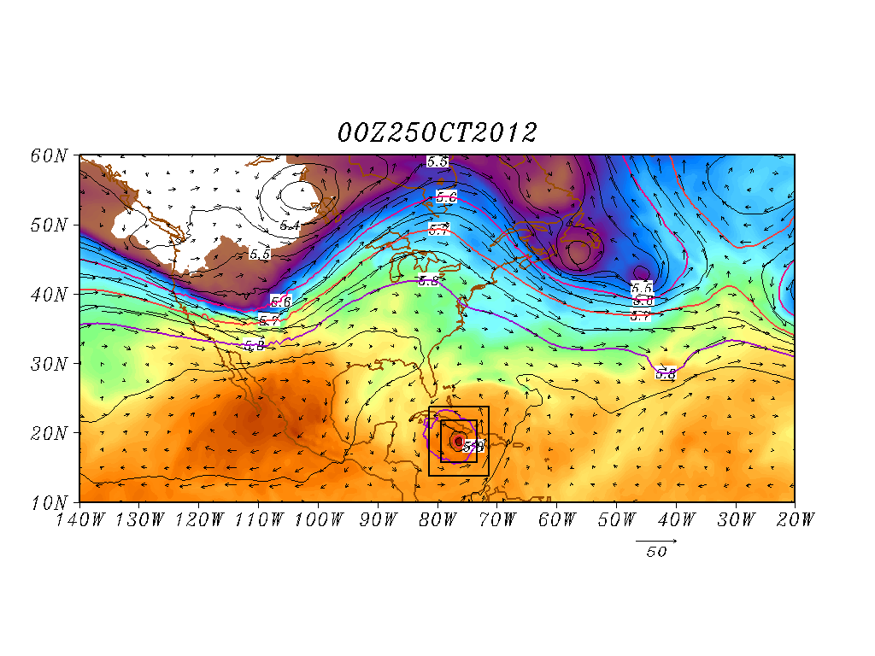
BENCHMARK CASE 1: BASELINE FROM BASIN SCALE HWRF
Case study: Hurricane Sandy 2012
Verification
H*Wind
Improved scale interactions and improved track & size forecasts (25 00Z Predictions)
108h Forecast
Shading: T at 500 hPa; Contour: GHT at 500 hPa
Vector: Flow averaged between 500 hPa and 200 hPa
- Importance of Multi-Scale (large and vortex) interactions for tracks
- Importance of size of land-falling storms
5
Notes:
The Basin scale HWRF was run real time under HFIP last season and shows a lot of promise. Example application of the basin scale HWRF for Sandy. The basin scale HWRF turned Sandy towards land (Good run) 18 hours in advance of the operational HWRF. A study is undertaken to understand the reason. Right hand side shows two runs from basin scale HWRF. 2500Z that turned towards land and 2400Z that was still turning into the Ocean (Bad run). It appears that the differences originate at the vortex scales between these two runs. Influence of steering will be different between a deeper vortex and a more shallow on (on 2500 Z)

Slide 6
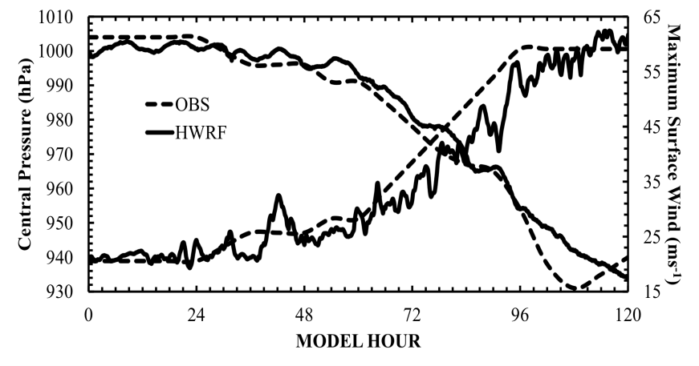
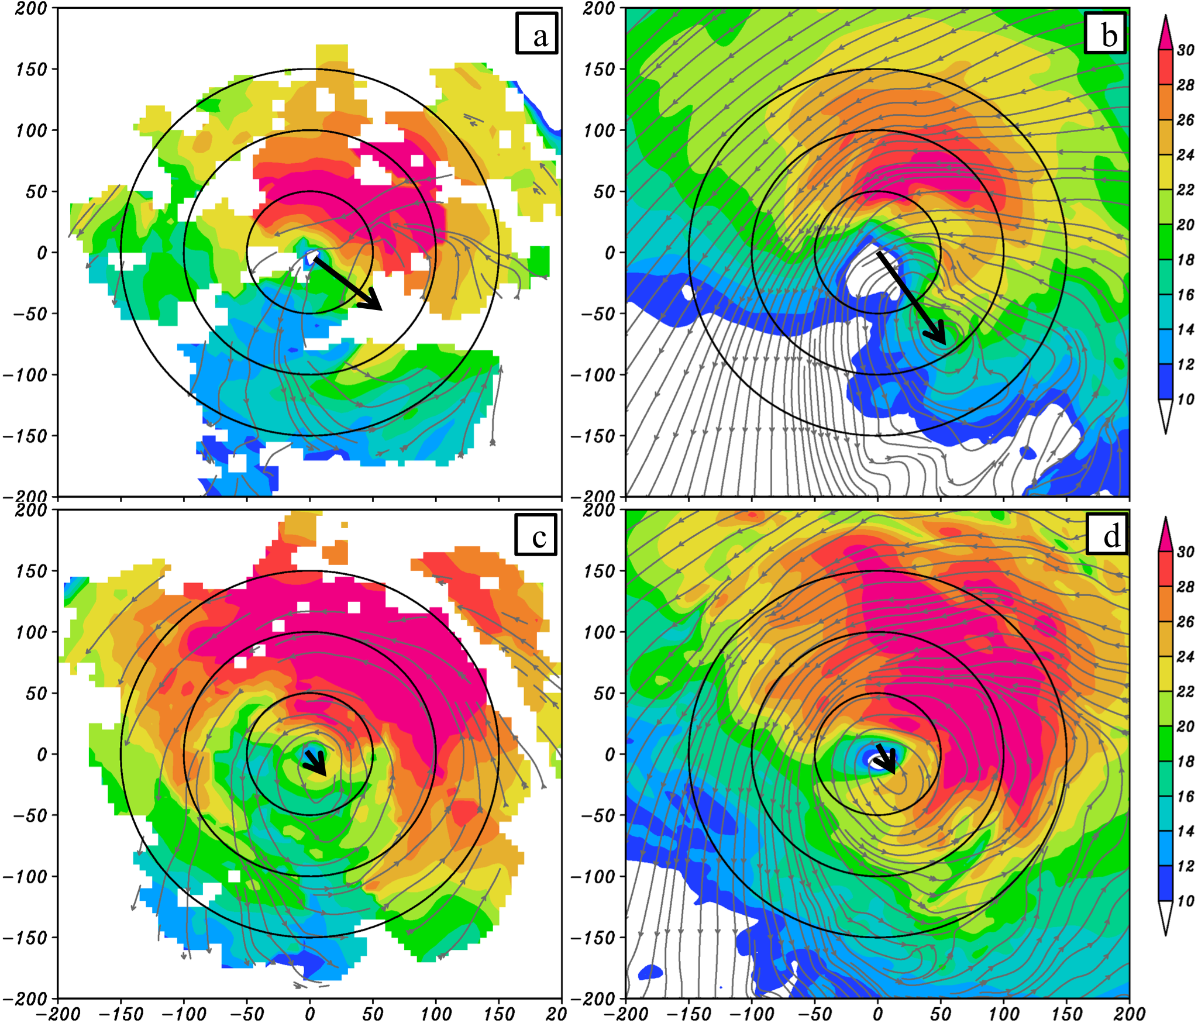
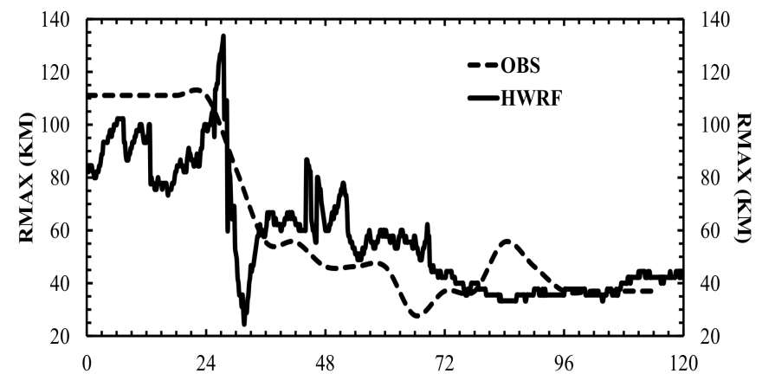
BENCHMARK CASE 2: BASELINE FROM OPERATIONAL HWRF
Vortex Scale Problem: An Example of RI case in a sheared environment
Earl 2010, 3-km HWRF
2-km Wind Structure and Vortex Tilt
Observed- Pre RI
HWRF- Pre RI
Intensity Predictions
Observed-- RI
HWRF- RI
Size Predictions
Aug 26/18 27/18 28/18 29/18 30/18 31/18
- Importance of high resolution (nesting) for RI predictions
- Importance of HWRF physics

Slide 7
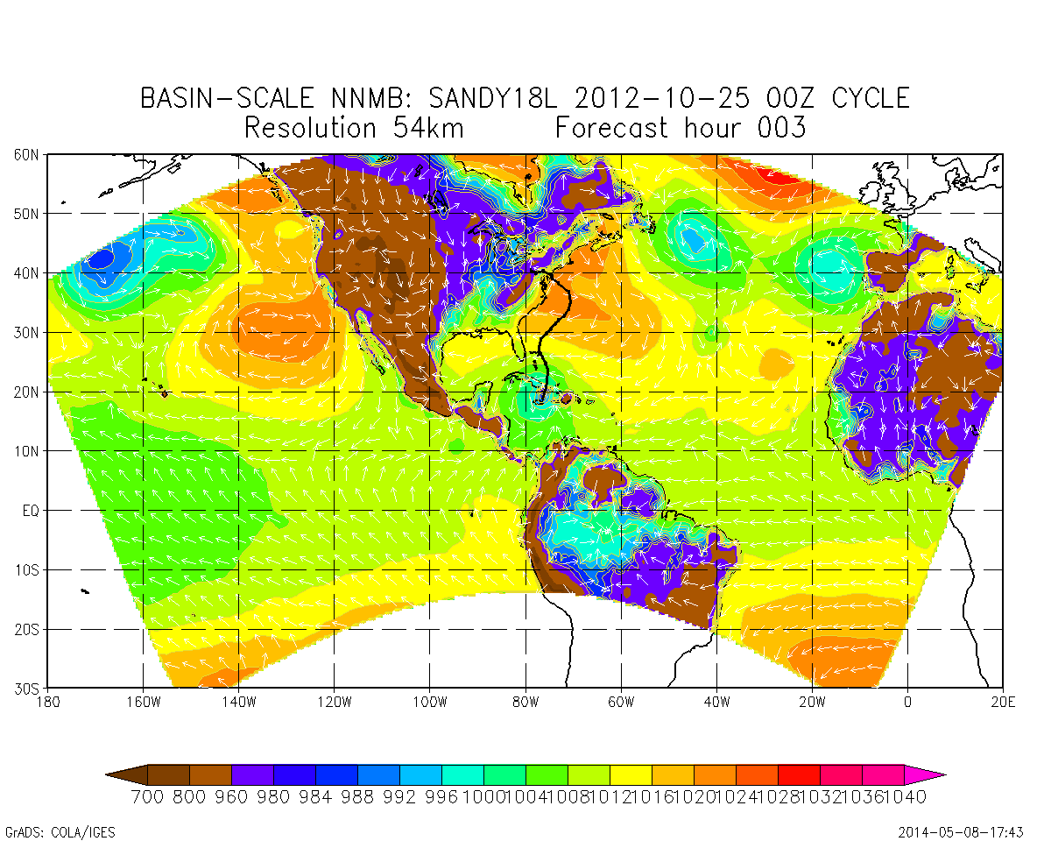
BENCHMARK CASE 1: NEMS/NMMB EVALUATION
54 km
27 km
9 km
- 576p; 7 days fcst 4 m
- 61 levels; 359x157
- GFDL radiation; MYJ;BMJ;
- Ferrier; NOAH LSM
- 576p; 7 day fcst - 13 m
- 61 levels; 716x313
- GFDL radiation; MYJ;BMJ;
- Ferrier; NOAH LSM
- 576p; 7 day fcst - 2h 10 m
- 61 levels; 1988x868
- GFDL radiation; MYJ;BMJ;
- Ferrier; NOAH LSM
- Uniform 3-km basin scale run in progress – needs more dedicated nodes (3000p)
- Uniform 3-km basin scale NEMS will be used as base line for testing 2-way interactions

Slide 8
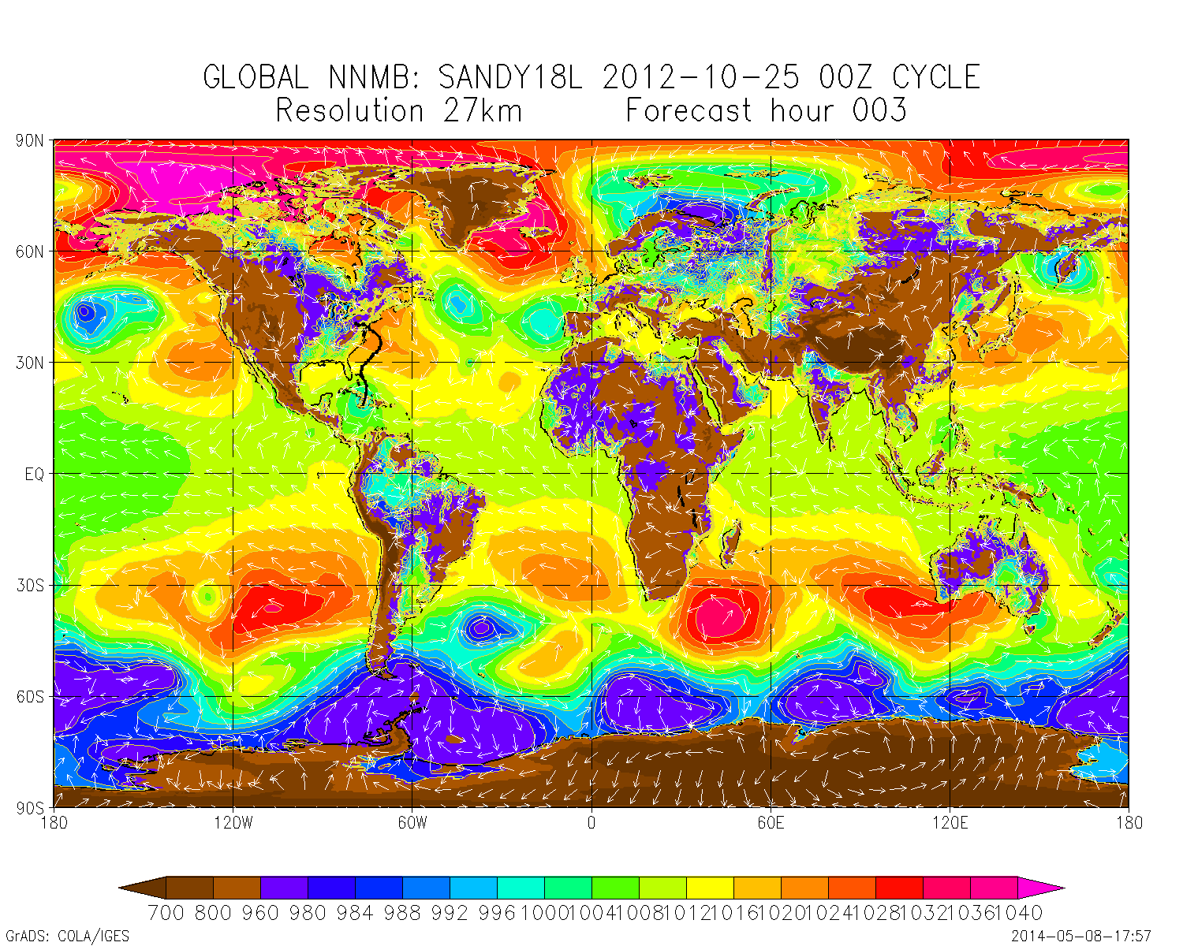
BENCHMARK CASE 1: NEMS/NMMB EVALUATION
27 km
- 576p; 7 days fcst - 3h 45m
- 61 levels; 1441x1019
- GFDL radiation; MYJ;BMJ;
- Ferrier; NOAH LSM

Slide 9
FUTURE DEVELOPMENTS AND CHALLENGES
Roadmap
Nesting Transition (Evaluation of Earl case)
Development of Idealized vortex
HWRF physics transitions
HWRF basin scale multi-nest initialization
Multi-Season Testing
Challenges
Hiring issues (nearly solved)
No dedicated computational resources as yet!

Slide 10
QUESTIONS?
AOML Program Review

