Slide 1
A Brief Update on the Hurricane Nest Project
Sundararaman G. Gopalakrishnan (Gopal)
NOAA/AOML/HRD, Miami, FL
Vijay Tallapragada
EMC/NCEP, College Park, MD
&
Thiago Quirino
NOAA/AOML/HRD, Miami, FL
In collaboration with
Meso-Scale Modeling Group, EMC/NCEP, College Park, MD
Acknowledgements
Tim Schneider, Robert Atlas, Frank Marks, Geoff DiMego and Fred Toepfer
Presented at the HIWPP Executive Oversight Board Meeting, Oct 21, 2015
Notes:
Thanks are due to motivational leadership from Tim. We never had dedicated resources for this project. In my opinion this project had two bail outs with HPC. During the developmental stages when jet was offered. Secondly for testing in Theia. Thanks are Due to Fred and Bob Atlas. Thanks are also due to Frank and Geoff. They were gracious to have some of the FTEs involved in this effort.

Slide 2
The Team
AOML Team
Thiago Quirino (Nesting)
Steven Diaz (Initialization)
Xuejin Zhang (HWRF transitions)
Javier Delgado (Software support)
Joseph Prusa (Idealized framework)
S.G.Gopalakrishnan (Analysis/Physics)
EMC Team
Thomas Black (Nesting)
Mathew Pyle (NPS)
Qingfu Liu (Initialization)
Weiguo Wang (Physics)
Sam Trahan (Vortex tracker)
Lin Zhu (Idealized framework)
Notes:
This is another project beyond HWRF that EMC and AOML/HRD have been working almost seamlessly towards creating the next generation HWRF system. Thanks are mainly due to HFIP for creating a capacity, not only in terms of manpower but also in terms of infrastructure.

Slide 3
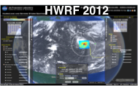
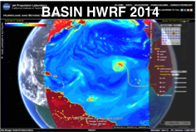
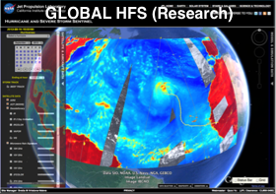
PROJECT GOALS
Create the next-generation HWRF within NEMS framework (HWRF-B) capable of better capture of multi-scale interactions, critical for land fall applications. This modeling system will have a very high potential to transition to (regional) operations
Proof-of-concept of Global tropical cyclone model with multiple moveable nests placed around all tropical systems in the world
Options to test HWRF nests in NMMB/NEMS framework with initial and boundary conditions from different hydrostatic and non-hydrostatic global models being developed in this HIWPP effort will be made available to other collaborators

Slide 4
Milestones
Project Statement: “The success of HWRF in track, intensity and structure forecasting lies not only in its nesting capability but also in its physics package, part of which was advanced at AOML using hurricane core observations and the hurricane initialization technique that was developed at NCEP. All three hurricane-specific components from HWRF (nesting, physics and vortex initialization) will be transitioned to the NMMB/NEMS framework before testing the model for providing improved tropical cyclone track and intensity forecast guidance in a multi-scale environment.”
Milestones | Completed
Configuration & Testing | Dec 2014
HWRF Physics Transitions | Sept 2014
Idealized Framework | April 2015
HWRF Vortex Tracker | Jun 2015
HWRF vortex initialization and cycling | On-going
Semi-Real Time testing | On-going
Multi-Season Testing, Verification, Rainfall Evaluation | Postponed due to lack of HPC

Slide 5
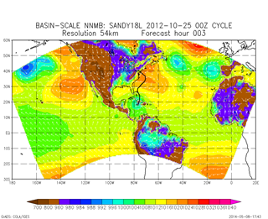
Configuration and Testing (May 2014)
Project Statement: “NMMB/NEMS is the adopted pathway for operational regional scale applications at NCEP. Extending that for multi-scale hurricane forecast applications should provide a seamless pathway towards next generation operations. The strategy to incorporate HWRF capabilities into the NMMB is consistent with recommendations made by the UCACN to consolidate the number of operational modeling systems within NOAA. Also, this project will leverage on NOAA’s success with HWRF and support from HFIP towards creating the next-generation HWRF within NEMS framework.”
54 km
27 km
9 km
- 576p; 7 days fcst 4 m
- 61 levels; 359x157
- GFDL radiation; MYJ;BMJ;
- Ferrier; NOAH LSM
- 576p; 7 day fcst - 13 m
- 61 levels; 716x313
- GFDL radiation; MYJ;BMJ;
- Ferrier; NOAH LSM
- 576p; 7 day fcst - 2h 10 m
- 61 levels; 1988x868
- GFDL radiation; MYJ;BMJ;
- Ferrier; NOAH LSM
- Uniform 3-km basin scale run in progress – needs more dedicated nodes
- Uniform 3-km basin scale HWRF-B will be used as base line for testing 2-way interactions

Slide 6
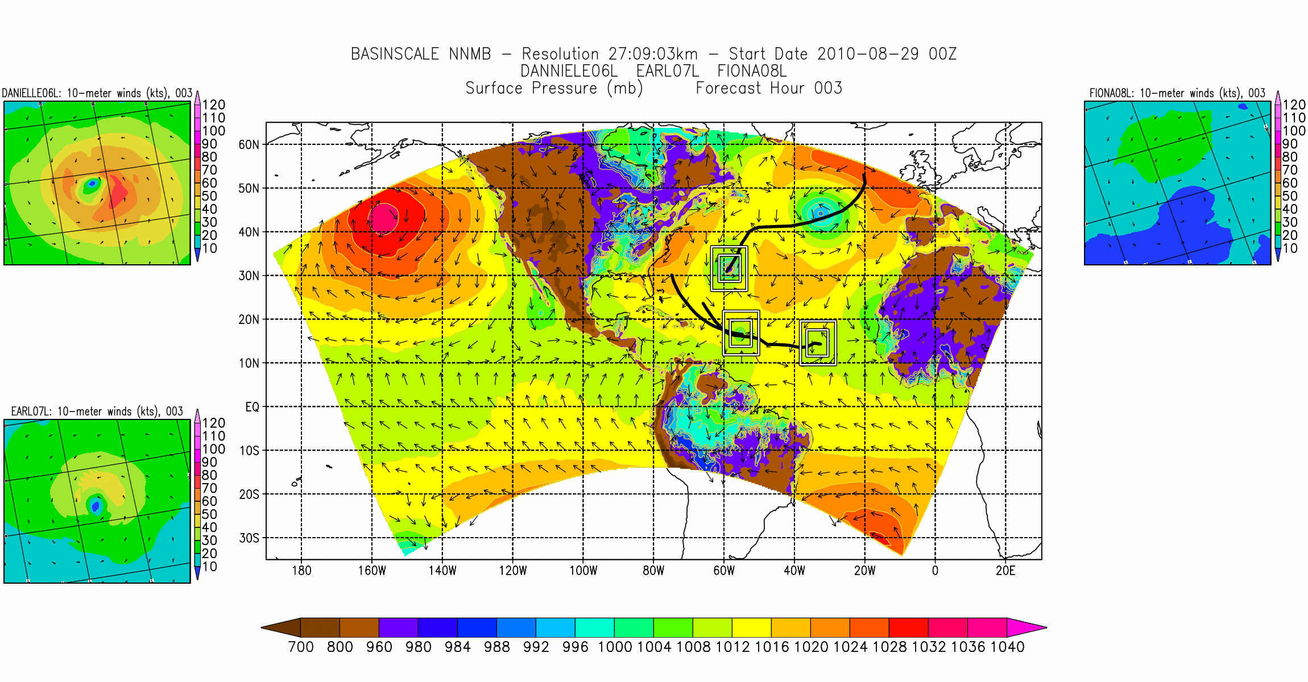
The NEMS HWRF-B system (Oct 2015)
Project Statement: “The current operational HWRF configuration is storm centric, not ideal for representing multi-scale interactions or for post land fall applications, and is greatly limited in extending forecast lead times beyond 5 days. Key for improving near land fall (size) and post land fall applications (rainfall) and for extending forecast lead times beyond 5 days lies in the creation of a multi scale model (eventually covering the entire globe) with multiple moving nests at 1-3 km resolution covering all the storms in the basin.”
NEMS Framework
NMMB dynamic core
HWRF physics
HWRF vortex tracker
HWRF Cycling
18:6:2 configuration
Fully Automated System
Advanced Diagnostics
Notes:
Such a Tropical Prediction system may be very useful for several down stream applications as well: Easy cycling, Satellite DA, Genesis and inland applications.

Slide 7
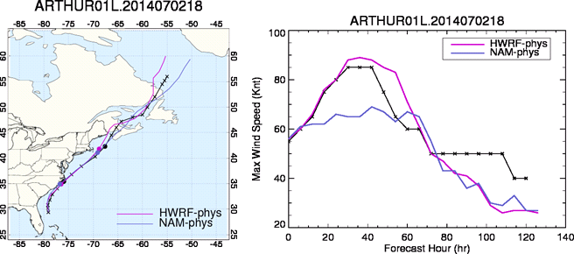
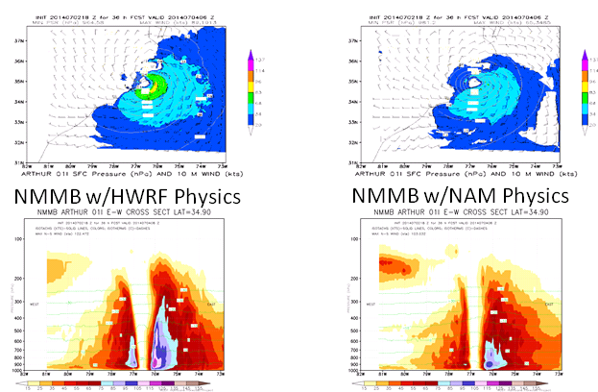
The HWRF-B system: Impact HWRF physics
HWRF –vs- NMMB physics
NMMB with HWRF physics experiment showed track, intensity, and landfall characteristics (timing and location) similar to the operational HWRF (not shown) and much closer to the observations compared to NMMB with NAM physics, although the horizontal structure of the storm is comparable between these two experiments. NMMB with NAM physics produced much weaker hurricane compared to NMMB with HWRF physics.

Slide 8
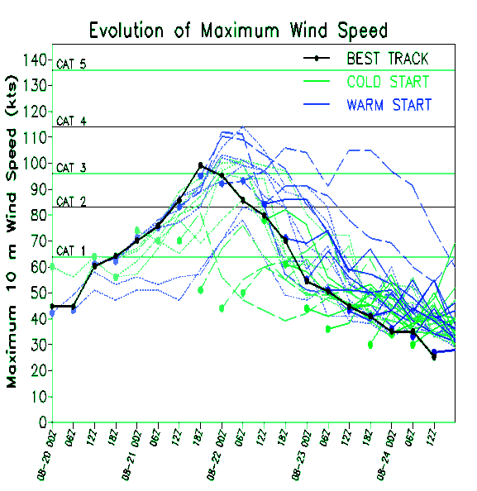
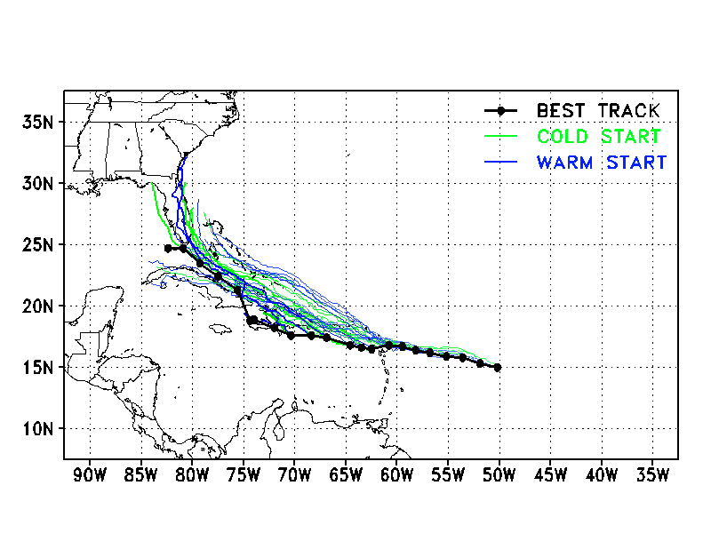
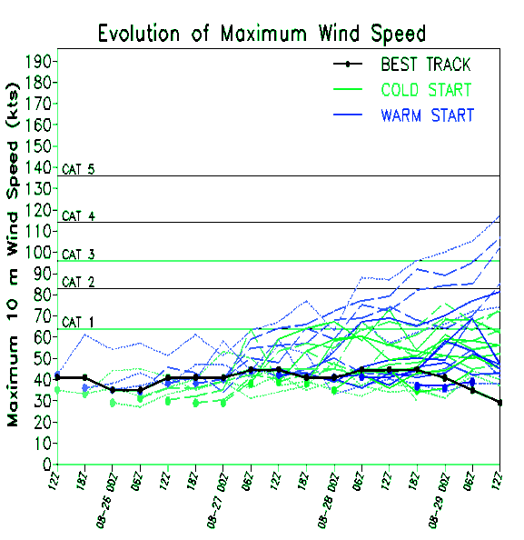
The HWRF-B system: Impact of Vortex Cycling
TRACK
INTENSITY
Vortex-cycling:
The modification/relocation of the 0-hr GFS vortex, based on the previous 6-hr HWRF-B forecast and observed conditions.
DANNY 2015
DANNY 2015
Successes
Improves initial intensity forecasts
Appears to improve track forecasts for developed storms
Opportunities
Early forecasts tend to ‘over-intensify’ long-term forecasts of weak storms, regardless of vortex-cycling
ERIKA 2015
ERIKA 2015

Slide 9
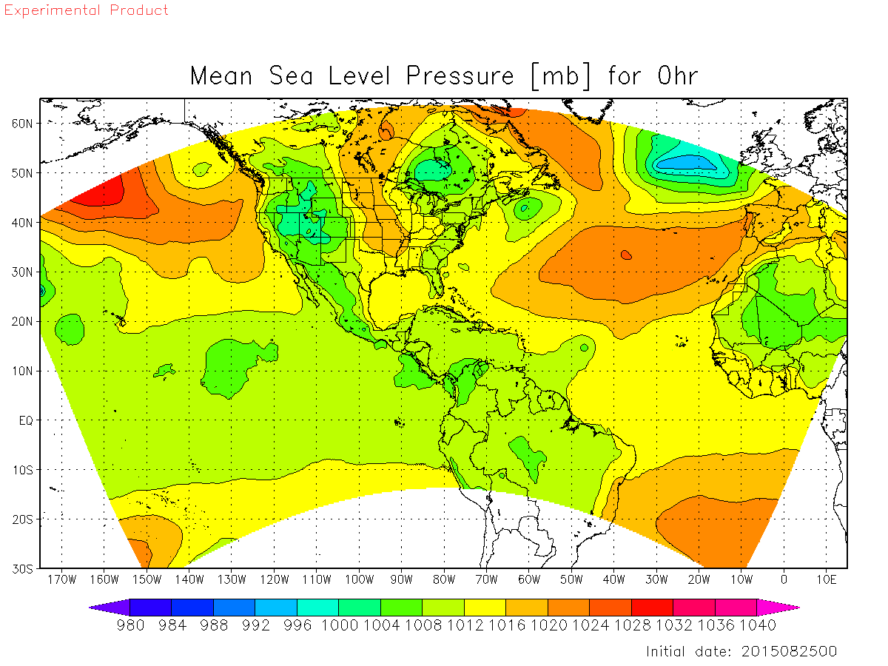
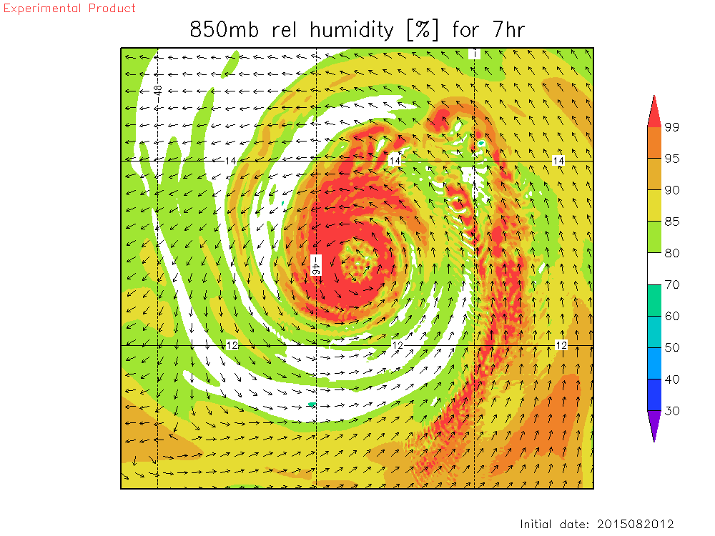
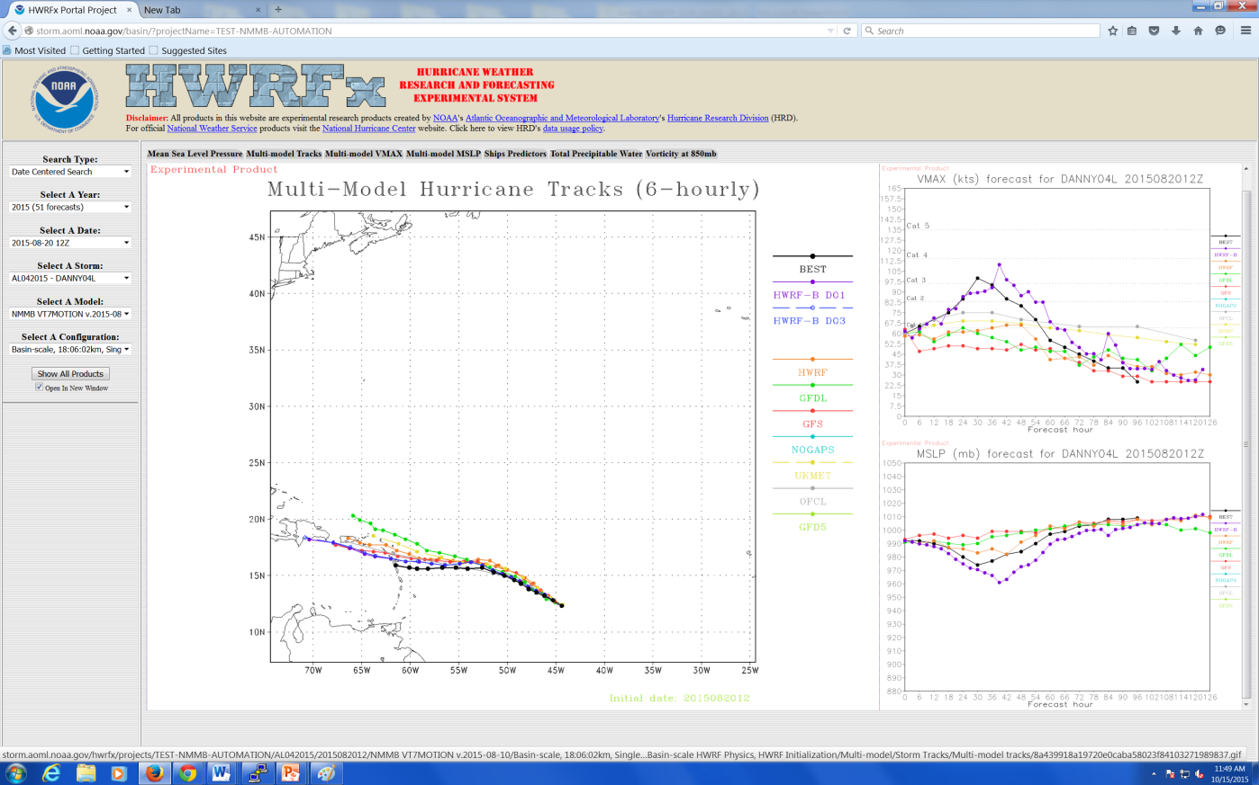
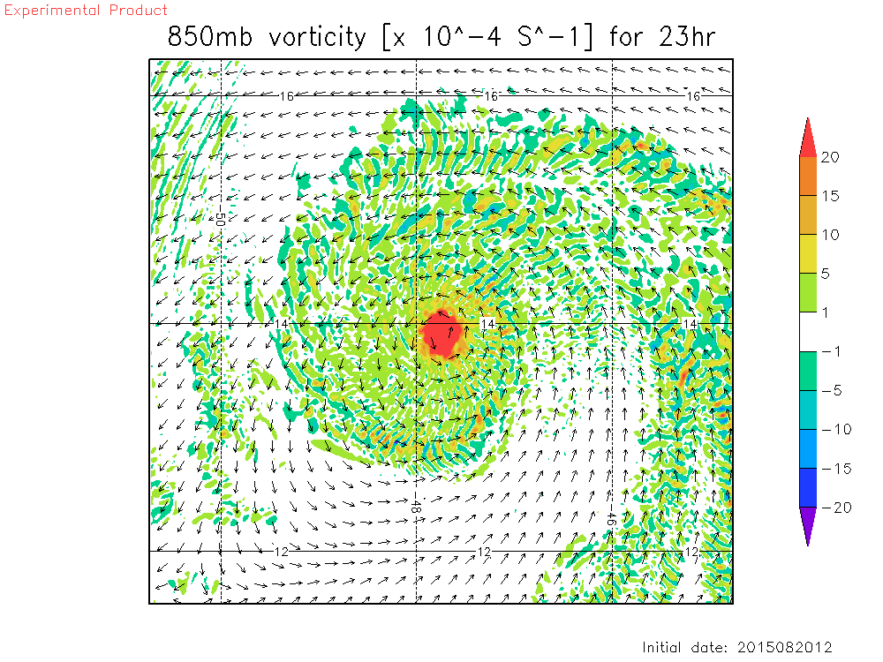
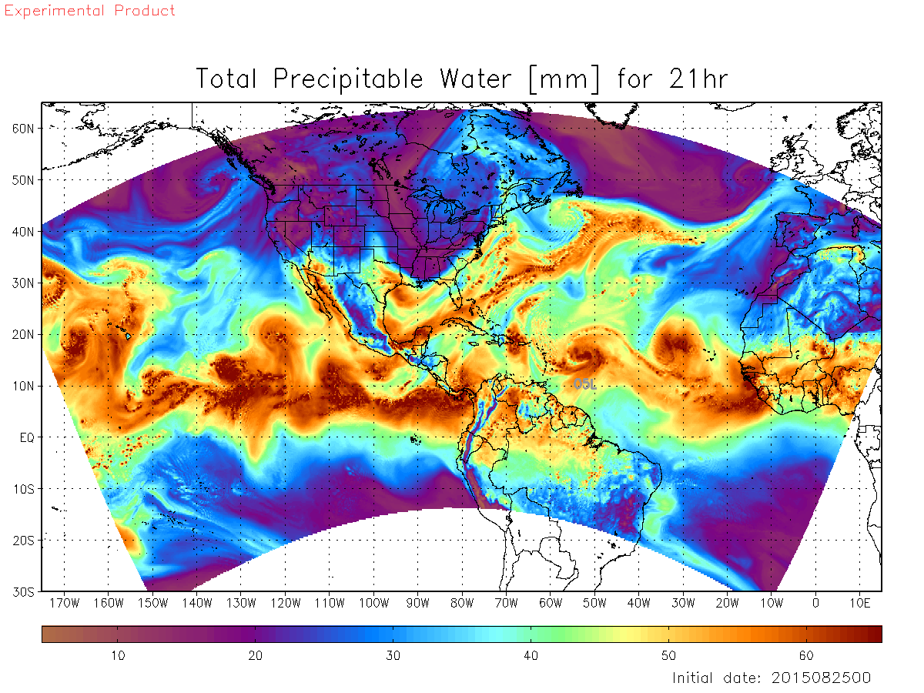
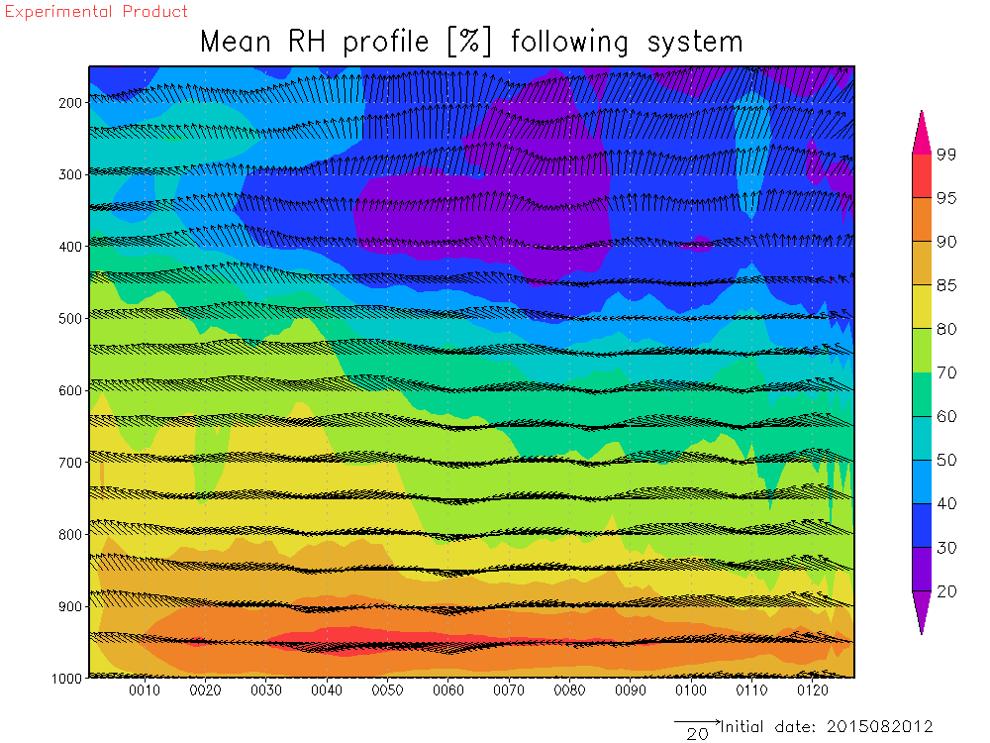
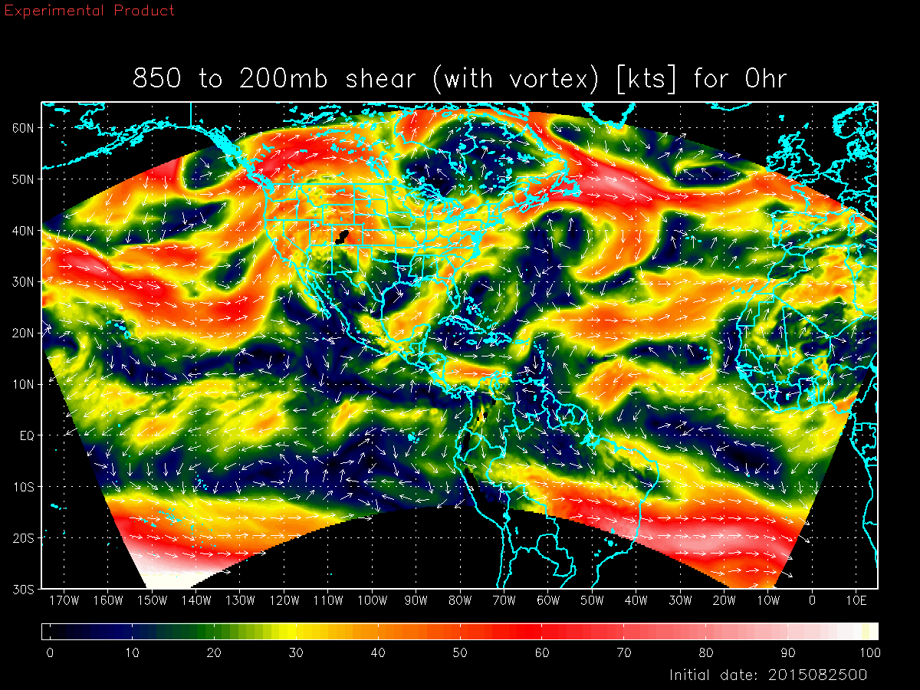
HWRF-B Experimental Web-Site/Products
http://storm.aoml.noaa.gov/hwrfb
HWRF-B Products:
Large scale (18 km): Track, Intensity, Shear, Steering, Predictors, TPW, MSLP, Winds, etc.
Vortex Scale (2 km): Warm core, Hovemoller, Vorticity, Winds, Relative Humidity, etc.
About 5000 graphics are produced per run! This capacity was available at HRD, Thanks to HFIP

Slide 10
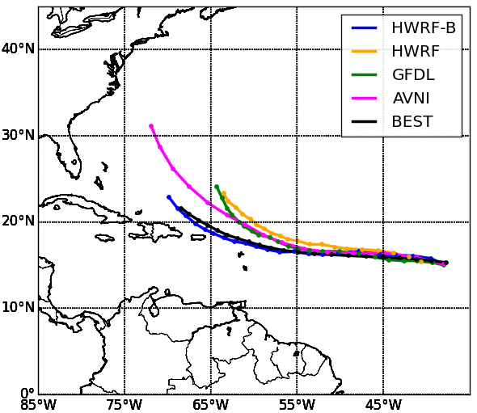
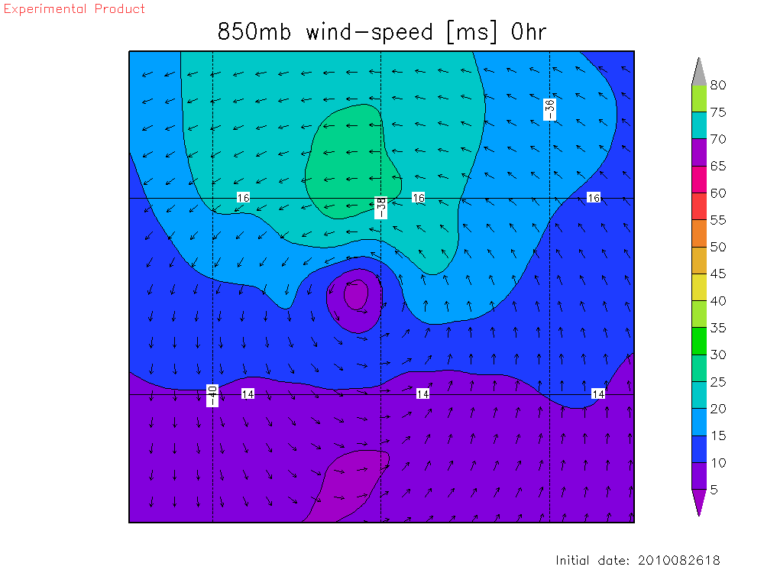
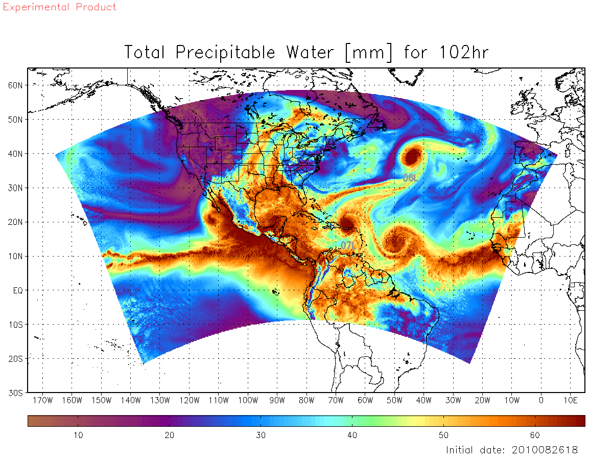
HWRF-B for Nature Run
Use of HWRF-B for OSSE Nature Run and Hurricane Research (Baseline for evaluating multi-scale interactions)
Uniform 3 km Basin Scale Simulation of Dannielle-Earl-Fiona Interactions
Earl Tracks
Earl Structure
Dannielle-Earl Shear-Vortex interactions
Dannielle-Earl-Fiona interactions

Slide 11
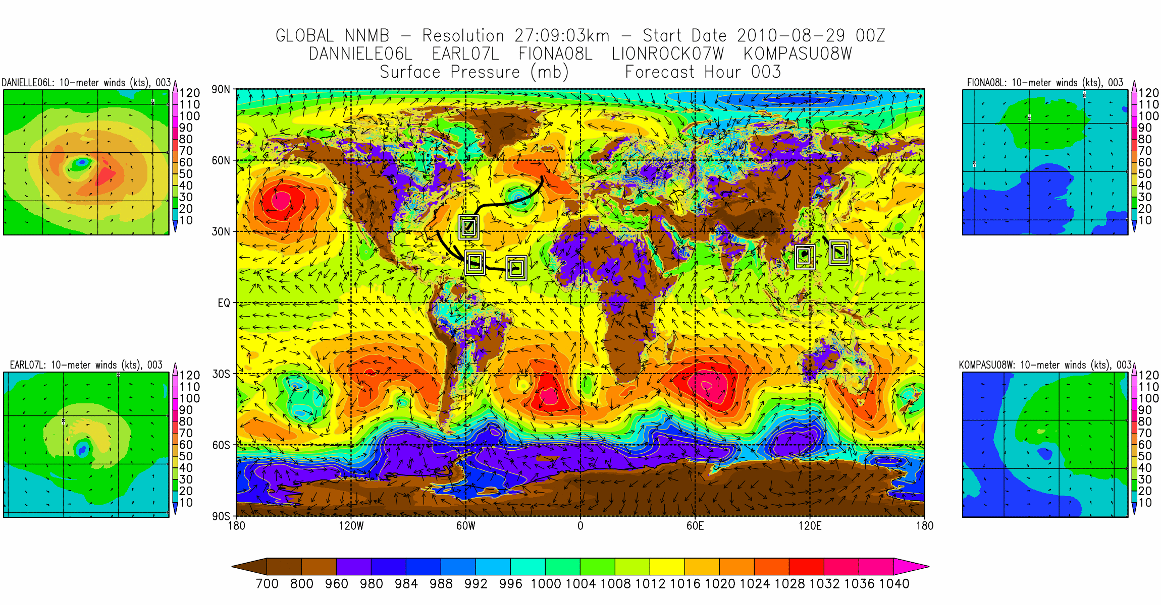
Global Nesting
This is perhaps the first of its kind! Two-Way interactive Global Moving Nest for Global Tropical Cyclones Problem
Notes:
This is only a proof of concept. We have made some 5-10 runs. But have not done any detailed analysis. However, this work has paved a way towards the creation of generalized nesting technique in NGGPS. Lot of research on the impacts on two way interactions on large scales may be required.

Slide 12
Path Forward
Summary
Basin scale NMMB in NEMS framework for Hurricanes (dubbed as HWRF-B) was successfully developed under HIWPP.
The project is at readiness level 5.
Future advancements include Ocean coupling, DA, Physics improvements and T&E
Further support from HFIP and R2O efforts is important for success of this effort.
Proof-of-concept of Global-to-local scale Hurricane Prediction System was demonstrated
Generalized nesting technique is being developed for NGGPS
Challenges
It is fair to say that this project has come a long way without dedicated HPC
Need for at least 4M core-hours/month to sustain the above developments & T&E
Need for HFIP- Phase II for next generation hurricane predictions

Slide 13
Questions ?

