Slide 1
Development of the Basin-scale HWRF Modeling System
(Briefing to EMC)
Presented by
Xuejin Zhang
Ghassan Alaka, Jr.
Stanley Goldenberg
(AOML/HRD)

Slide 2
Team
AOML/HRD (Team Lead: S. Gopalakrishnan)
  G. Alaka, R. Black, H. Chen, J. Delgado, S. Diaz, S. Goldenberg, T. Quirino, K. Sellwood, R. St. Fleur, J. Zhang, X. Zhang, and HRD colleagues
NCEP/EMC (Branch Chief: V. Tallapragada; Acting Team Lead: A. Mehra)
  B. Ferrier, Hyun-Sook Kim, B. Liu, Q. Liu, J. Michalakes, D. Sheinin, M. Tong, S. Trahan, W. Wang, Z. Zhang, and EMC/Hurricane team
DTC
  L. Bernardet, L. Carson, J. Frimel, C. Holt, K. Newman, and HWRF task team
GFDL
  T. Marchok and M. Bender
URI
  B. Thomas and I. Ginis
NPS
  M. Boothe, M. Montgomery, and B. Rutherford

Slide 3
Acknowledgement
Main contributors of analysis and slides
  G. Alaka
  S. Goldenberg
  P. Reasor
  K. Sellwood
  R. St. Fleur
  B. Thomas
  J. Zhang
  X. Zhang

Slide 4
Achievements & Challenges

Slide 5
2016 Achievements
Increased HB16 to 18-6-2 km
Operated real-time HB16 (4 cycles daily)
Synchronized HB16 forecast timing with HWRF
Redesigned basin-scale HWRF product website
Accelerated web product delivery
  Available for HFP and Map Discussions at Noon, NPS genesis team
Developed basin-scale MPI-POM and initialization
Converted research to forecast products

Slide 6
2016 Challenges
Late release of the operational HWRF system (June 6)
  Reduced time to test/optimize for real-time
Reservation not available until August 1
  Delayed start of real-time HB16 forecasts
GFS data delivery disrupted during the season
  Cold Starts/fewer TC nests/no GSI → Adverse Impacts?
Coupler development delayed (another month or so)
  No ocean coupling in HB16
HWRF help desk short of staff
Although we had many challenges this year, we were still able to achieve many of our goals. Thanks to our collaborators including JET management. We are ready for R2O transition!

Slide 7
The Model

Slide 8
Configuration
 | 2016 Operational HWRF (HWRF) | 2015 Basin-Scale HWRF (HB15) | 2016 Basin-Scale HWRF (HB16)
Domain | 18 KM: 77.625˚ X 77.49˚ 6 KM: 25.875˚ X 25.83˚ 2 KM: 8.625˚ X 8.61˚ | 27 KM: 214.92˚ X 113.58˚ 9 KM: 12.6˚ X 12.18˚ 3 KM: 7.88˚ X 7.06˚ | 18 KM: 194.13˚ X 84.105˚ 6 KM: 25.875˚ X 25.83˚ 2 KM: 8.625˚ X 8.61˚
Levels & Top | 61 levs, 2 hPa | 61 levs, 2 hPa | 61 levs, 2 hPa
Vortex Initialization/DA | Improved Vortex Initialization Hybrid TDR DA/Improved GSI DA | Improved Vortex Initialization GSI DA | Improved Vortex Initialization (Improved GSI DA)
Cycling | Vortex Cycling | Same as HWRF | Same as HWRF
Ocean Coupling | 18-6 KM: POM; 2 KM: No | Static SST | Static SST
PHYSICS SCHEMES
Microphysics | Ferrier-Aligo (High Resolution) | Ferrier | Same as HWRF
Radiation | RRTMG | GFDL | Same as HWRF
Surface | GFDL (tuned C_{D}, C_{H}) | GFDL (C_{D}, C_{H}) | Same as HWRF
PBL Scheme | 2016 GFS (High Resolution) | 2016 GFS (High Resolution) | Same as HWRF
Convection | Scale-Aware SAS | SAS, No CP (3km) | Same as HWRF
Land Surface | NOAH LSM | GFDL LSM | Same as HWRF

Slide 9
Basin-scale HWRF Features and Forecast Applications
The unique features of the basin-scale HWRF:
  Static outer domain spanning nearly ¼ of the globe
  Multiple sets of movable nests targeting multiple storms
  Independent parallel integration on outer domain and each set of movable domains
  Coarse and fine resolution two-way interactions and vortex-vortex interactions
Forecast applications:
  Basin-scale HWRF as a genesis forecast model like global model, i.e. run every cycle, even if no TCs
  Proof of concept for FV3, i.e. spawn nests in the basin-scale HWRF when TC genesis occurs (or earlier)
  Independent hybrid DA for both large-scale and vortex-scale (D01 and nests)
  Ensemble forecasts

Slide 10
The Real-time Product Website

Slide 11
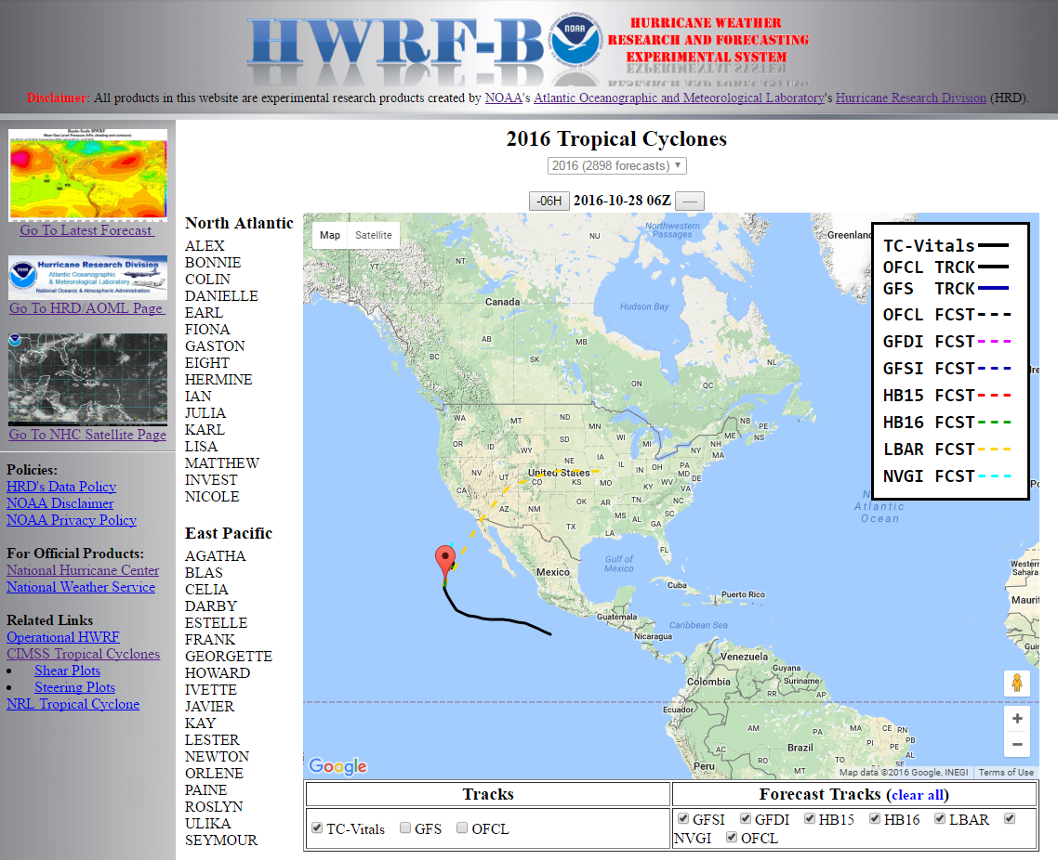
Real-time Website
(http://storm.aoml.noaa.gov)
Product delivery accelerated via new graphics package
  Timing on par with HWRF
  Used by HFP, Map Discussions, & others
  On-the-fly analysis
  Products for:
    HB16
    HB15
    GFS

Slide 12
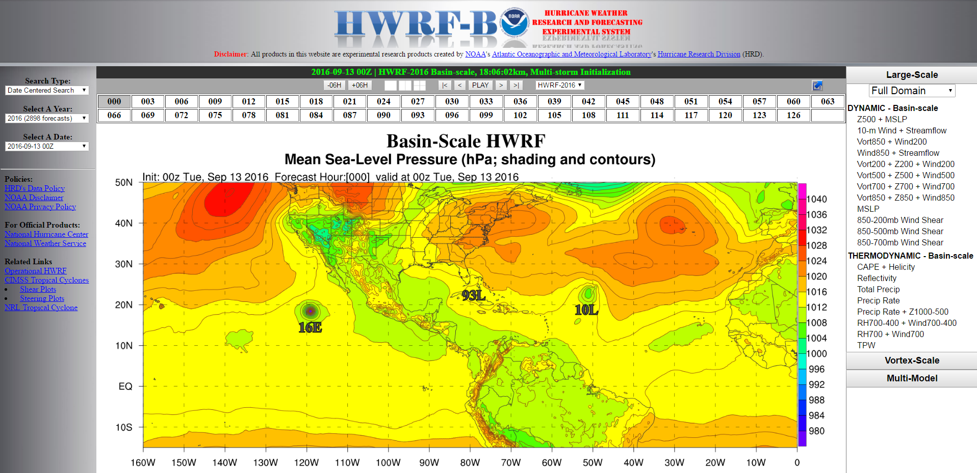
Real-time Website
Choose Forecast
Toggle Cycle
Toggle Multi-Pane
Toggle Model
Choose Product

Slide 13
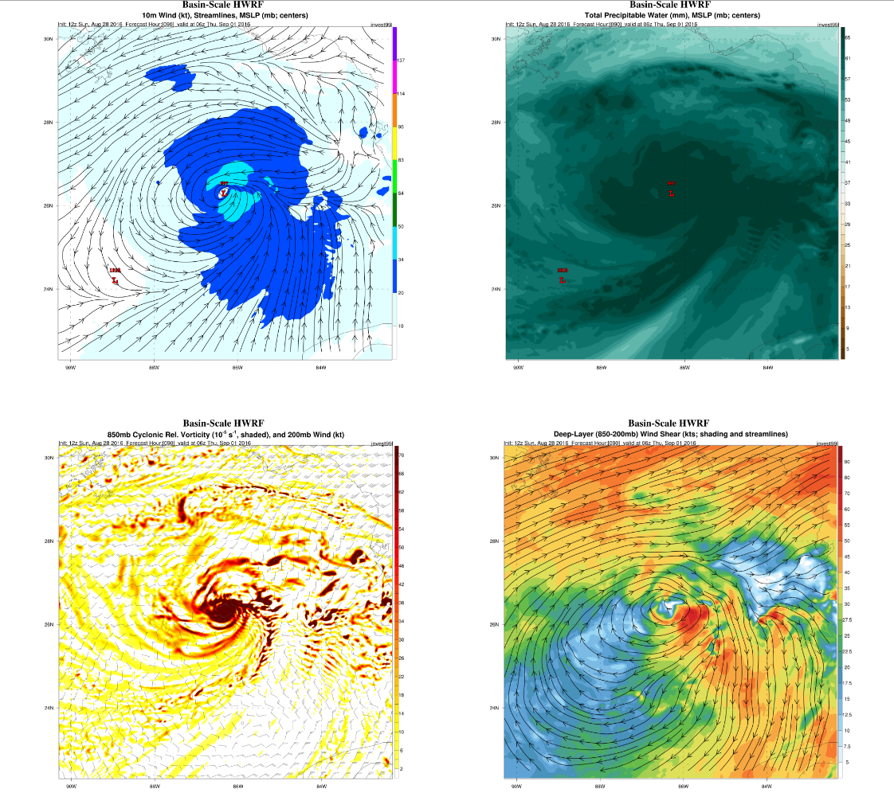
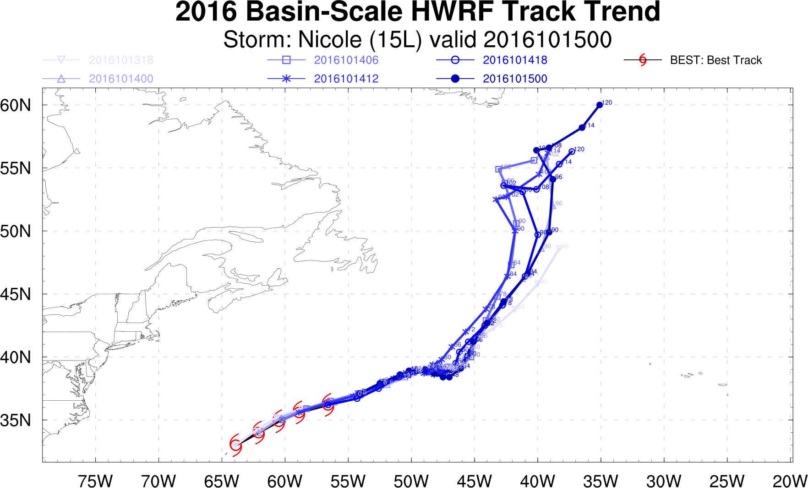
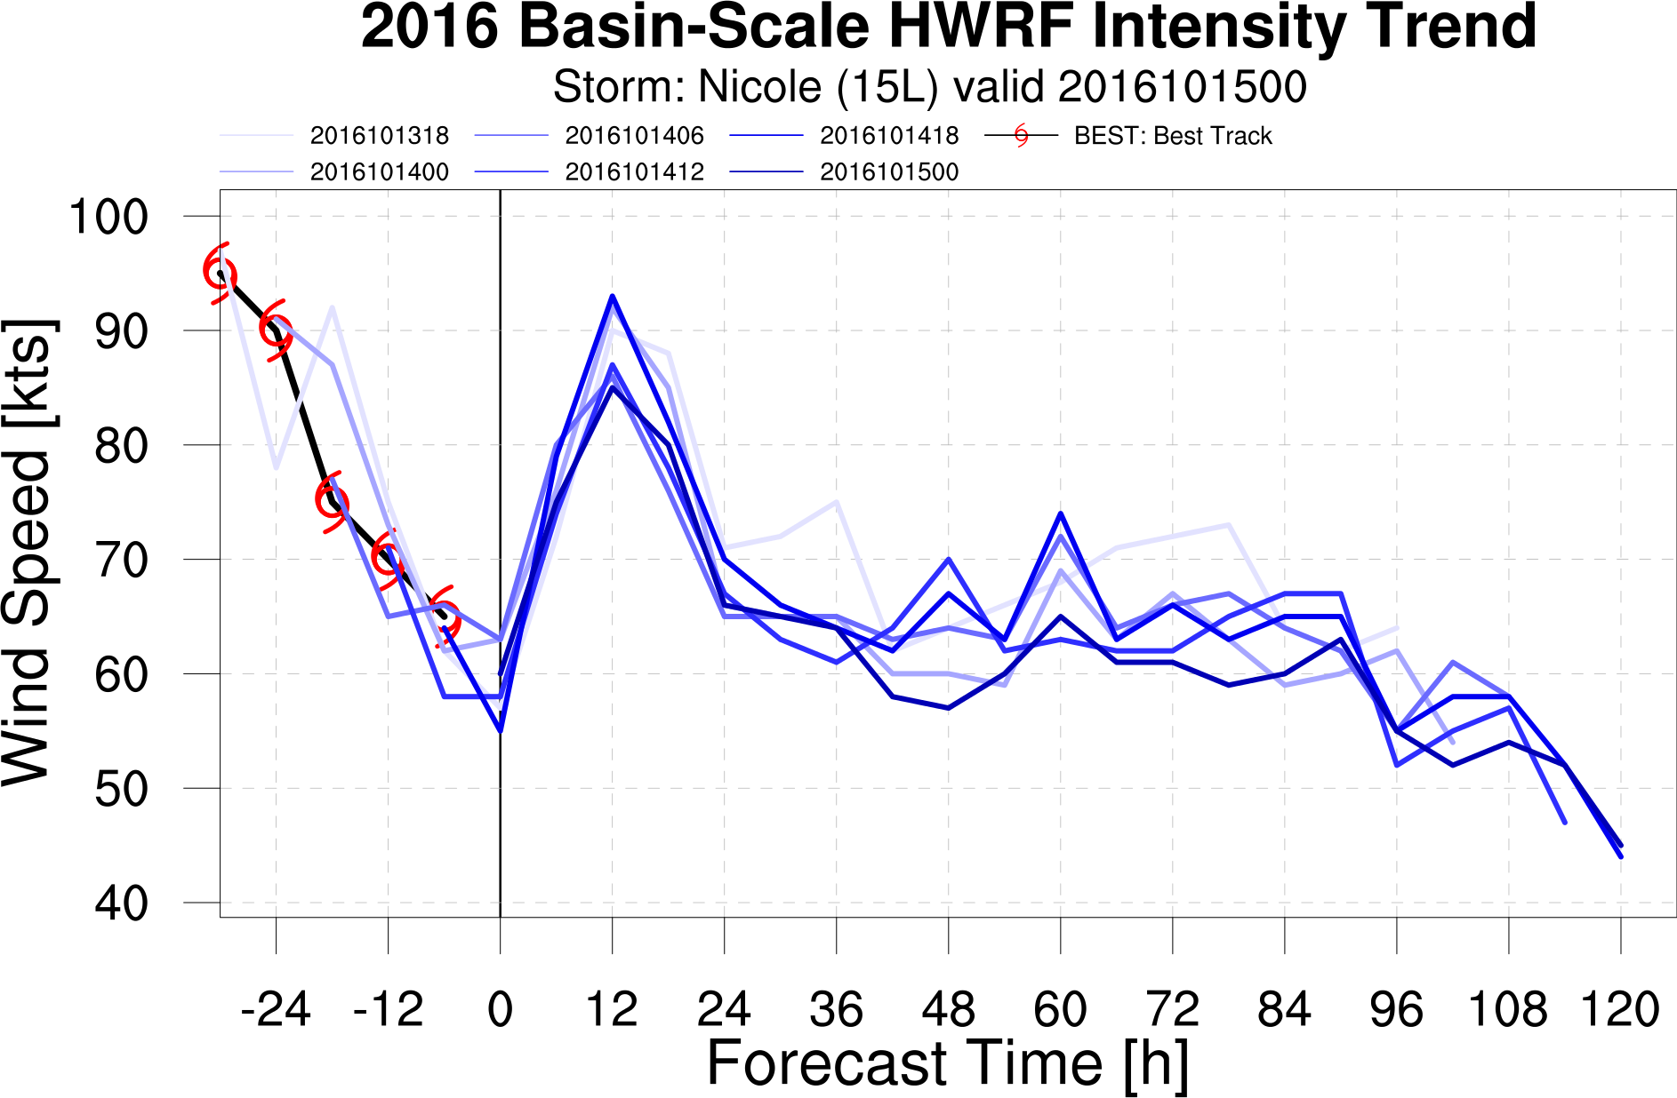
Real-time Website
Multi-Panel Vortex-Scale Graphics
Guidance

Slide 14
Results:
Track/Intensity Verification Statistics

Slide 15
SAMPLE SIZE PROBLEMS (NATL & EPAC) [HWRF = H216, i.e., HOPS]
Sample sizes on this slide are derived from SINGLE MODEL verifications
(i.e., # of cases that can be verified according to NHC rules for each model)
HOWEVER – all actual verifications are for homogeneous samples!
Reduced sample sizes for HB15 & HB16 are due to various operational time constraints: e.g., data availability, completion deadlines, limited # of nests (esp. for HB16 EPAC runs), etc.

Slide 16
TRACK SKILL (vs. HWRF) (NATL & EPAC) [HB15 used for EPAC]

Slide 17
TRACK (paired) FSP (NATL & EPAC) [HB15 used for EPAC]

Slide 18
INTENSITY ERRORS (NATL & EPAC) [HB15 used for EPAC]

Slide 19
INTENSITY SKILL (vs. HWRF) (NATL & EPAC) [HB15 used for EPAC]

Slide 20
INTENSITY SKILL (vs. HWRF) (NATL) [HB15 sample on right]
Sample w/ HB16 & HB15
Sample w/o HB16

Slide 21
INTENSITY BIAS (NATL & EPAC) [HB15 used for EPAC]

Slide 22
INTENSITY (paired) FSP (NATL & EPAC) [HB15 used for EPAC]

Slide 23
Results– Cases Study

Slide 24
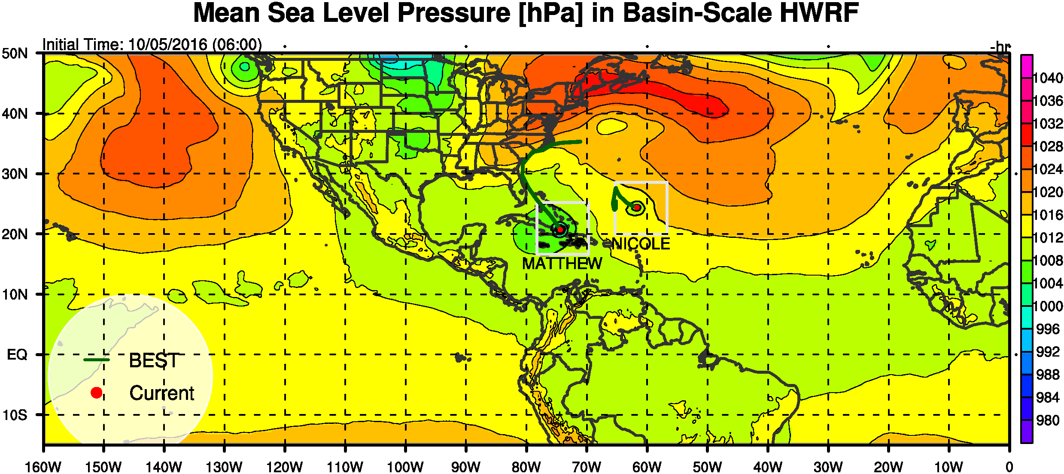
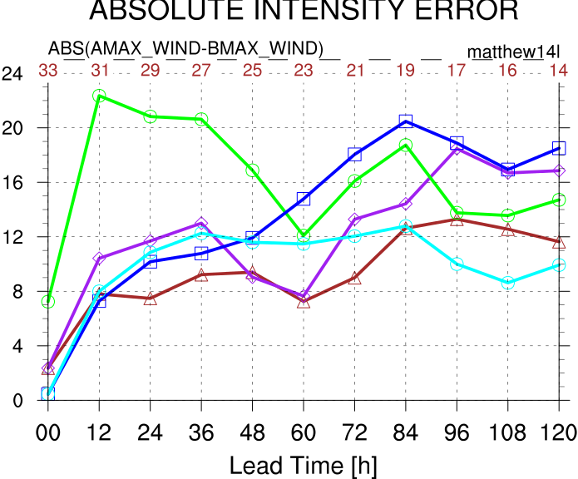
Matthew (14L) & Nicole (15L)
MATTHEW Intensity Errors
GFDL
GFS
HWRF
Basin HWRF
LGEM

Slide 25
Matthew (14L) & Nicole (15L)
Very complex track forecast, with a potential binary interaction.
HB16 correctly forecasted that Matthew would move NE.
MATTHEW Intensity Errors
GFDL
GFS
HWRF
Basin HWRF
LGEM

Slide 26
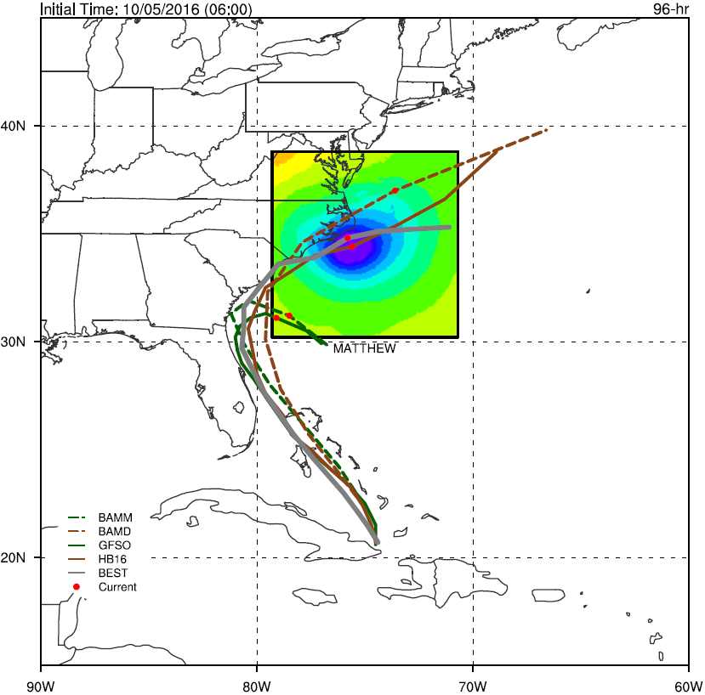
Environment & Resolution
HB16, D03, MSLP
HB16 tracks had lower errors than GFS tracks when Matthew emerged N of Cuba
HB16 tracked closer to deep layer steering flow (BAMD)
GFS tracked closer to medium layer steering flow (BAMM)
When steering flows are different for certain layers (i.e., deep, shallow), vortex structure is important for track forecasts.
Notes:
How did you determine the BAMD and BAMM? Did you use GFS forecasts to compute BAMD and BAMD? This means GFS forecast tilted vorte and sheared steering flows.

Slide 27
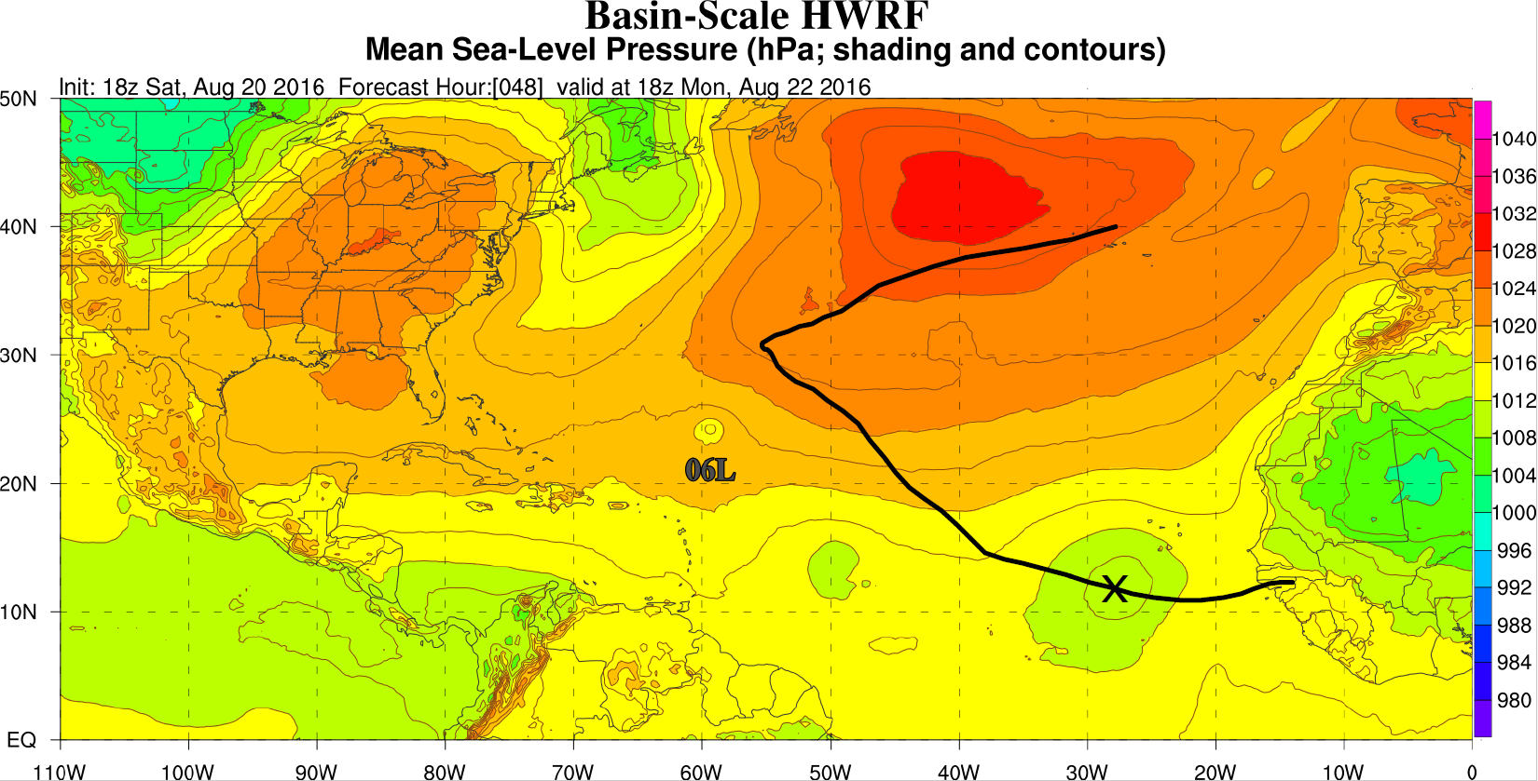
TC Genesis
GASTON (07L)
X = Genesis Location
Lead Time = 48 hrs
Best Track

Slide 28
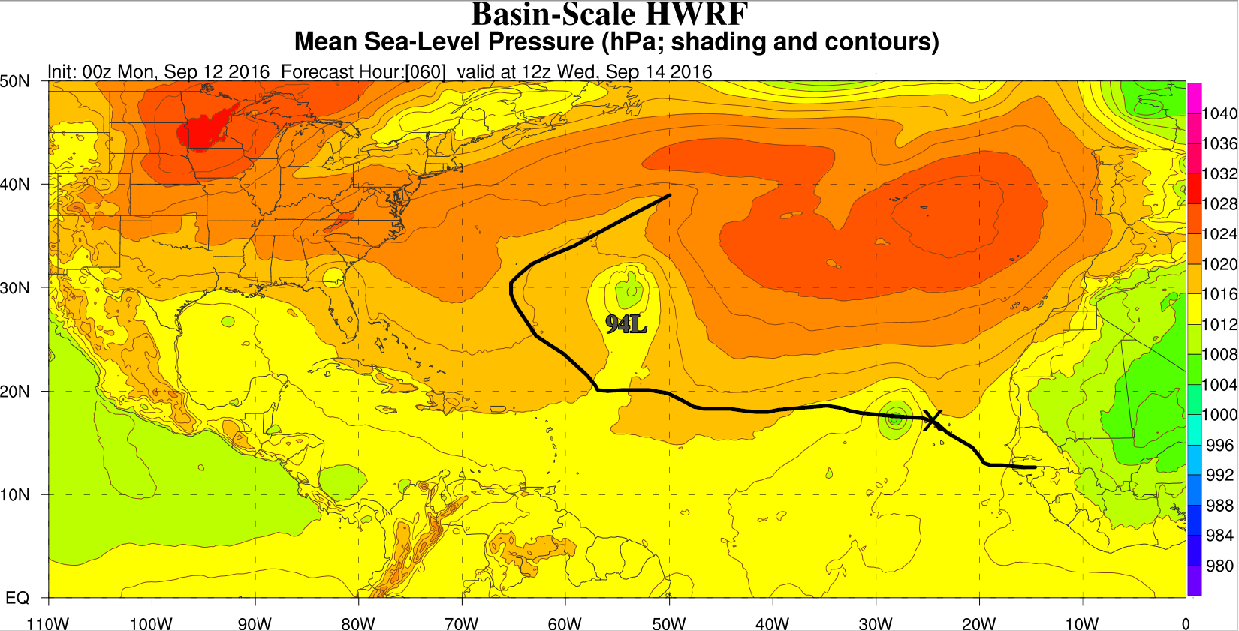
TC Genesis
Best Track
KARL (12L)
X = Genesis Location
Lead Time = 60 hrs

Slide 29
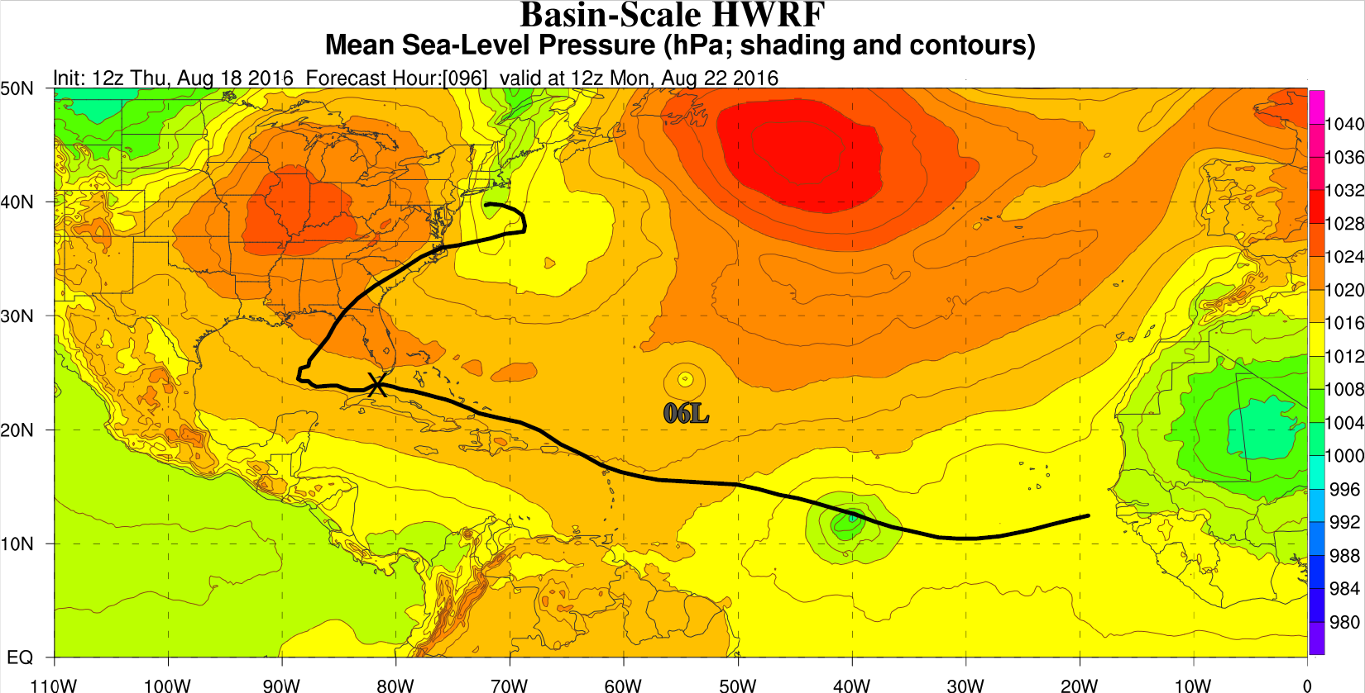
TC Genesis
Best Track
HERMINE (09L)
X = Genesis Location
GENESIS TOO EARLY
KARL (12L)
X = Genesis Location
Lead Time = 60 hrs
Best Track

Slide 30
Latest Developments

Slide 31
Status Update of POM Configuration and Initialization
New domain for basin-scale HWRF
Initialized from RTOFS
Initialization code development done
Flexible physics and initialization options
Initialization code merging into repository ongoing
Uniform prognostic code for worldwide HWRF ocean basins

Slide 32
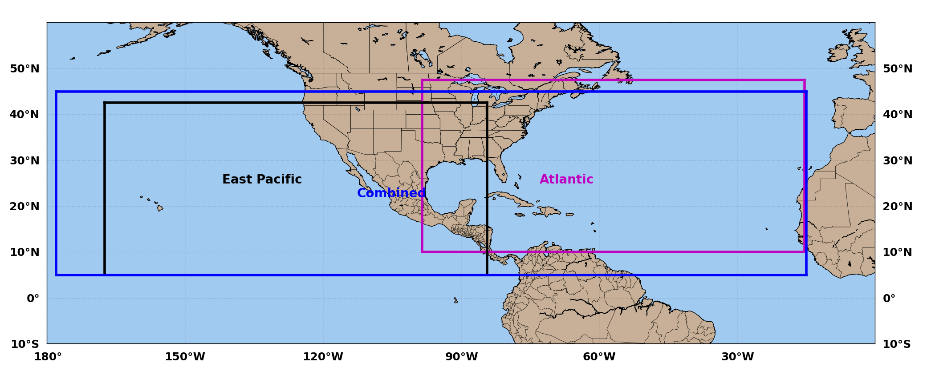
MPI-POM for Basin-scale HWRF
The POM grid that covers EPAC and ATL (178W-15W, 5-45N)

Slide 33
Status Update of Multi-storm Coupler
Based on 2015 coupler (no compatible with HWRF 2016)
One storm working and reproducible for ocean and atmosphere outputs
Need new strategy for developing multi-storm coupler

Slide 34
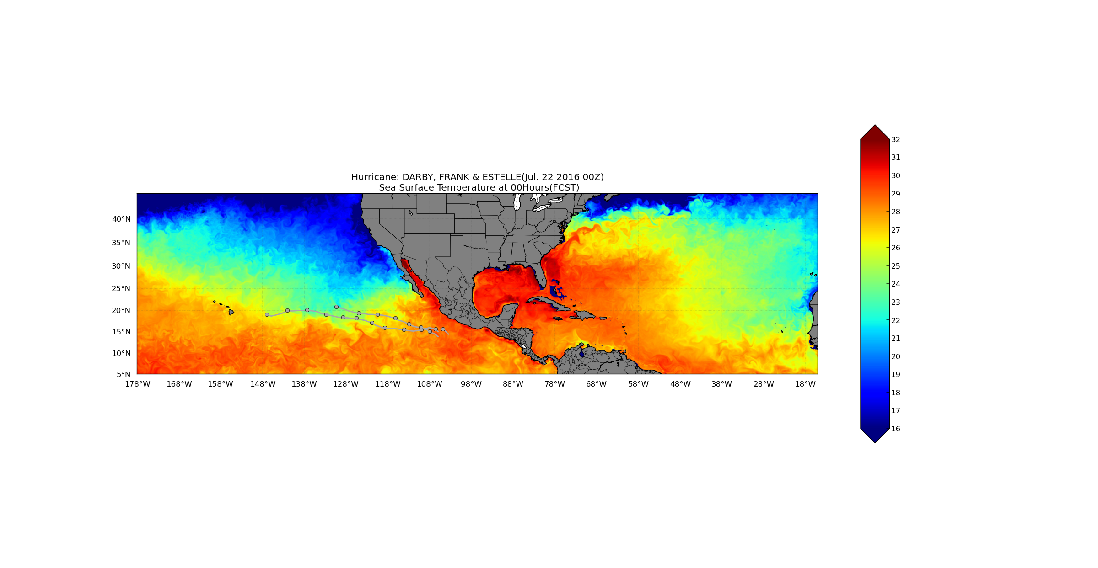
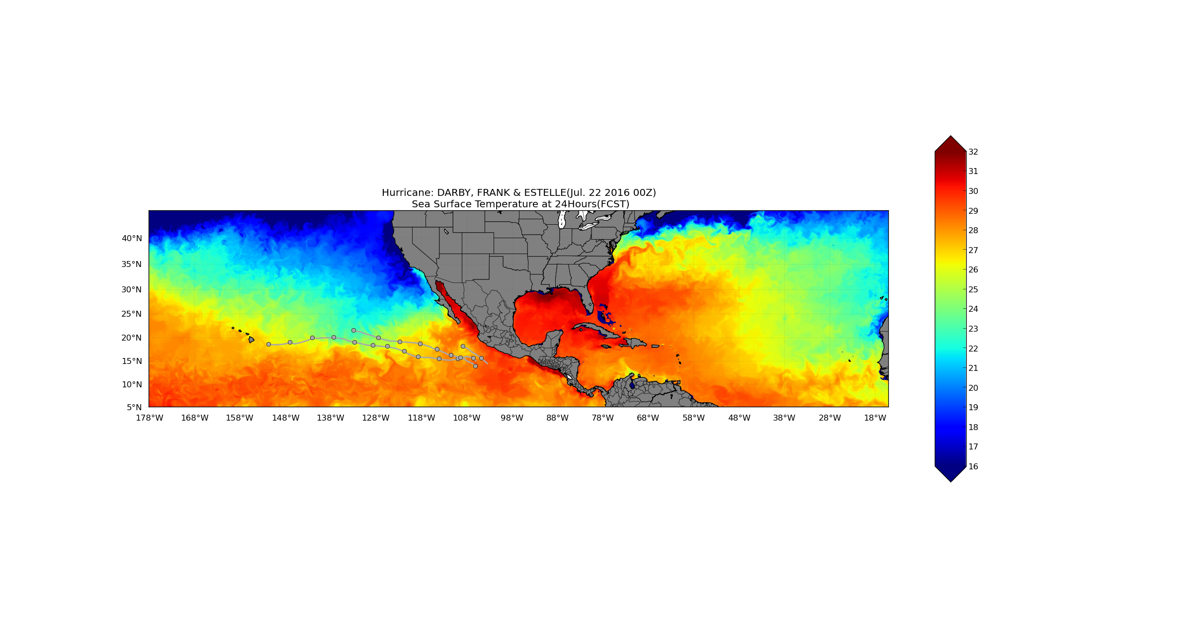
Sea Surface Temperature
Estelle
Darby
Frank
Estelle
Darby
Frank

Slide 35
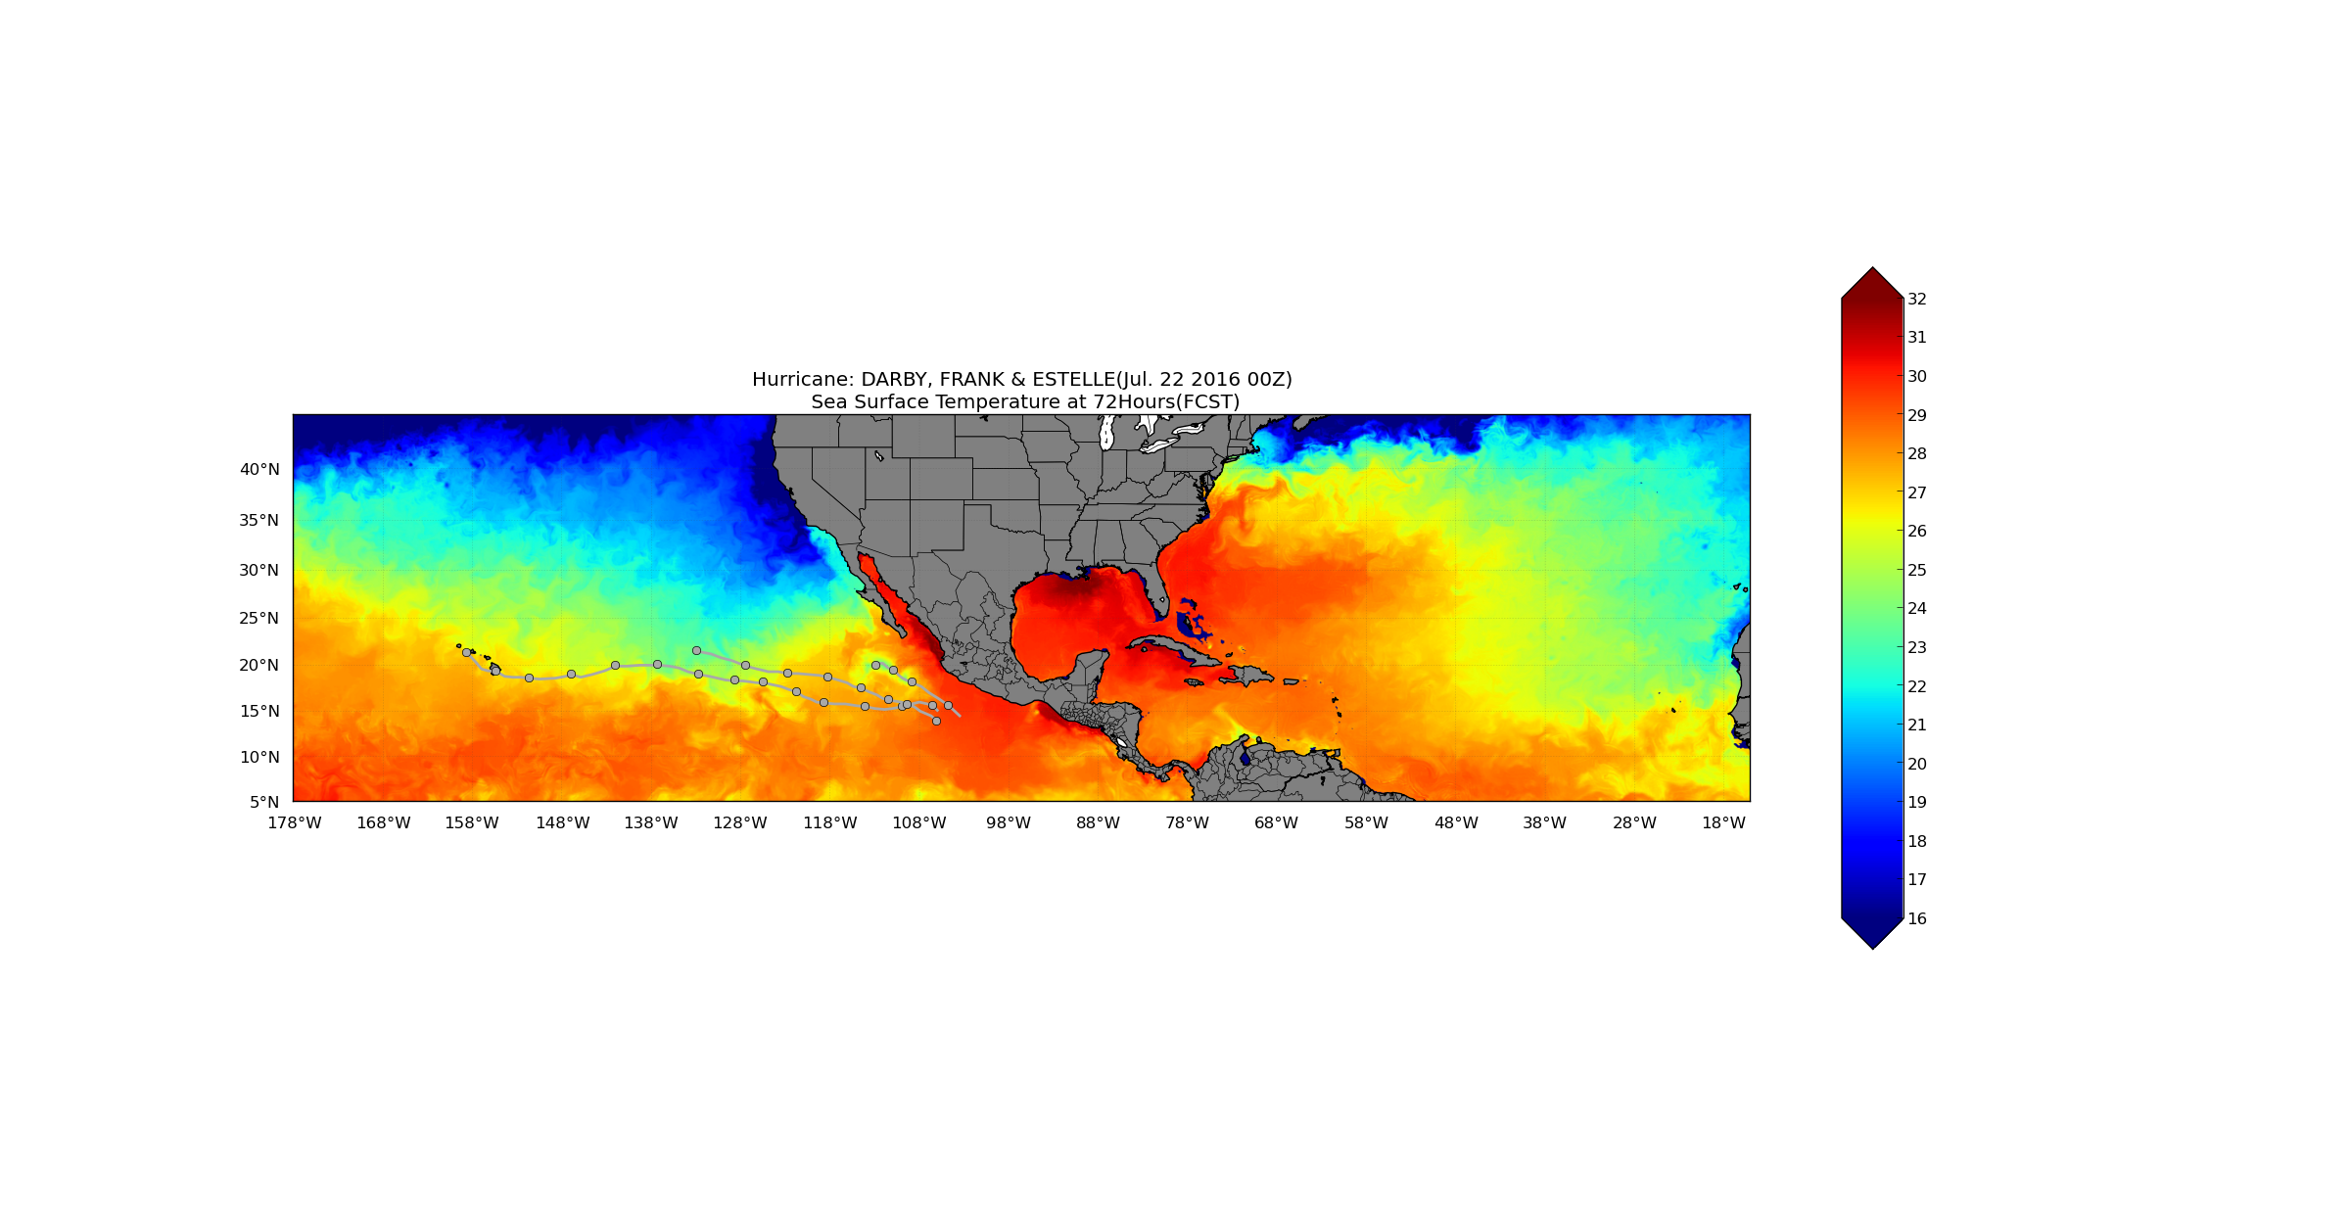

Sea Surface Temperature
Darby
Estelle
Frank
Darby
Estelle
Frank

Slide 36
March Forward
Create a new development branch (Done)
Complete multi-storm coupler (need a task plan)
Complete ocean initialization merging (ongoing)
Start full coupled system retrospective forecasts for multiple seasons (complete uncoupled then coupled, need resource)
Test on operational machine configuration and scalability (TBD)
Form an operational/implementation transition plan (need a task plan)

Slide 37
Research to Forecast Products

Slide 38
Research to Forecast Products
Observation and model comparison
  Model vortex validation with TDR observations
Wind speed analysis
  Horizontal wind speed
  Azimuthal mean wind speed
  35, 50 and 64 kt wind contours
Boundary layer analysis
  Azimuthal mean structure as a function of RMW
  Tangential, radial and vertical wind speed
  Boundary Layer Height
Shear relative wind fields
  Radial wind speed or inflow
  Boundary layer height
Applicable to both Operational HWRF & Basin-Scale HWRF

Slide 39
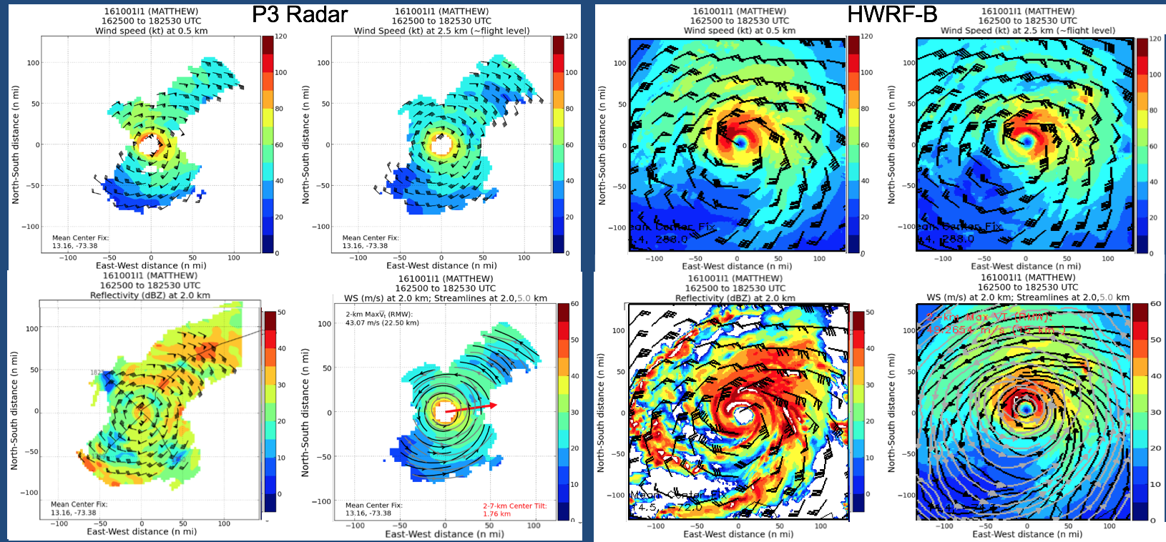
Observation and Model Validation

Slide 40
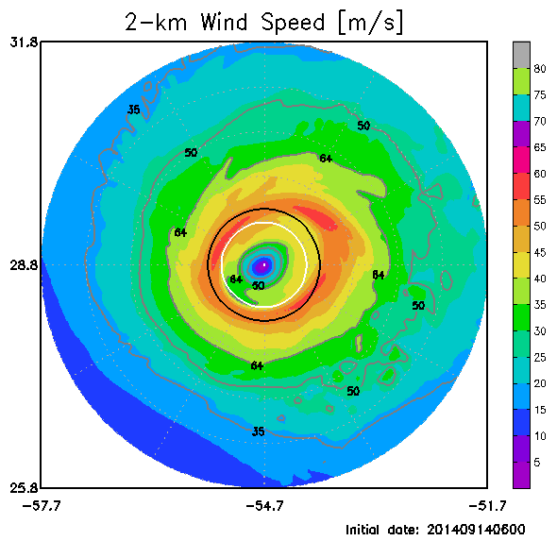
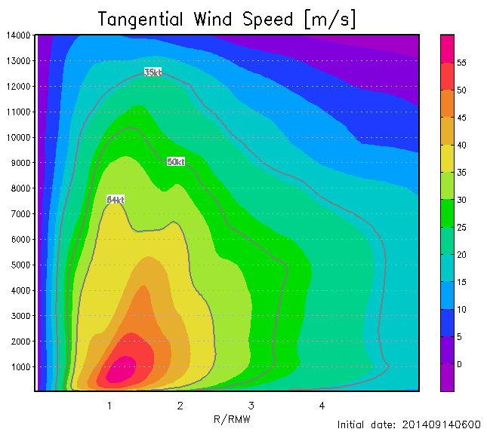
Wind Speed Analysis

Slide 41
Boundary Layer Analysis
Tangential Wind
Radial Wind
HWRF
Normalized by maximum values
Observation
Notes:
Gray line is the height of inflow layer depth defined as the height of 10% maximum inflow. The white line is the height of the maximum tangential wind speed.

Slide 42
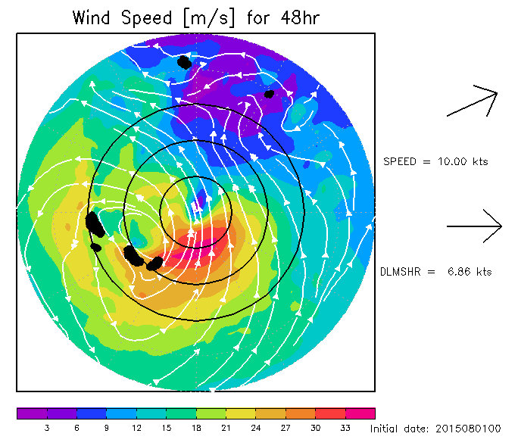
Shear Relative Wind Fields

