Slide 1
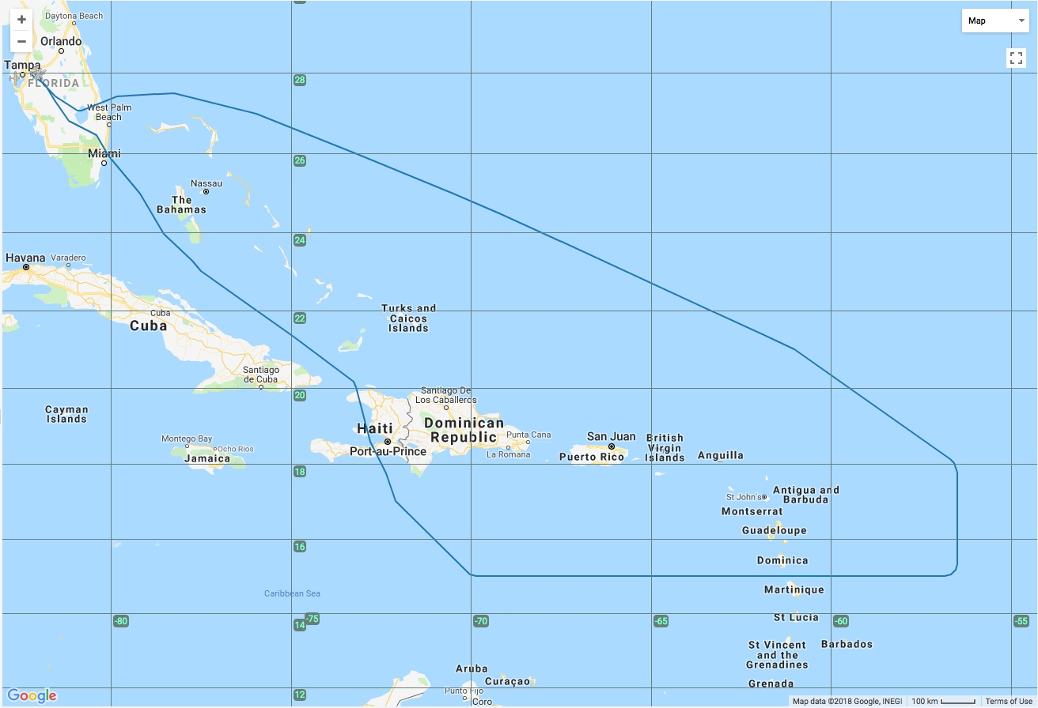
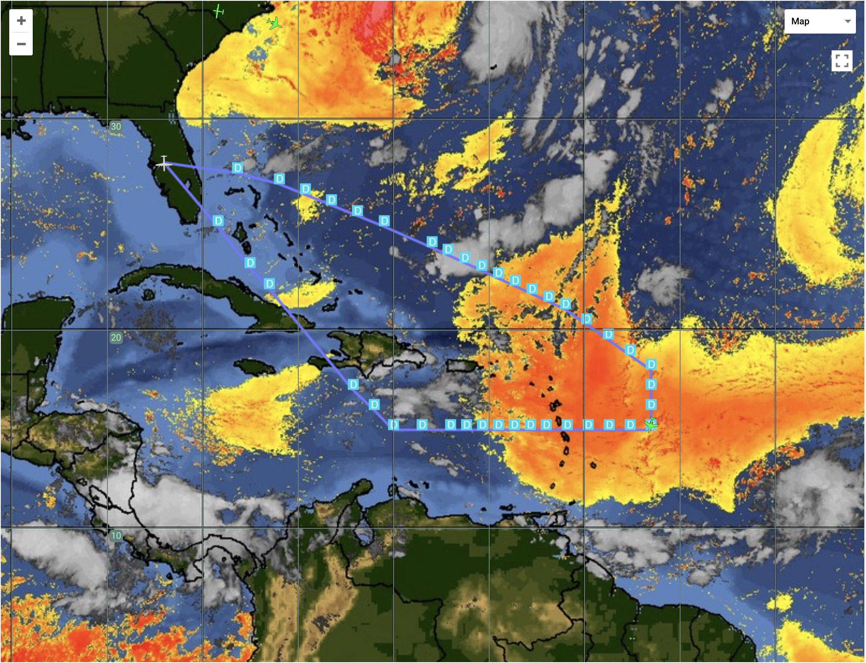
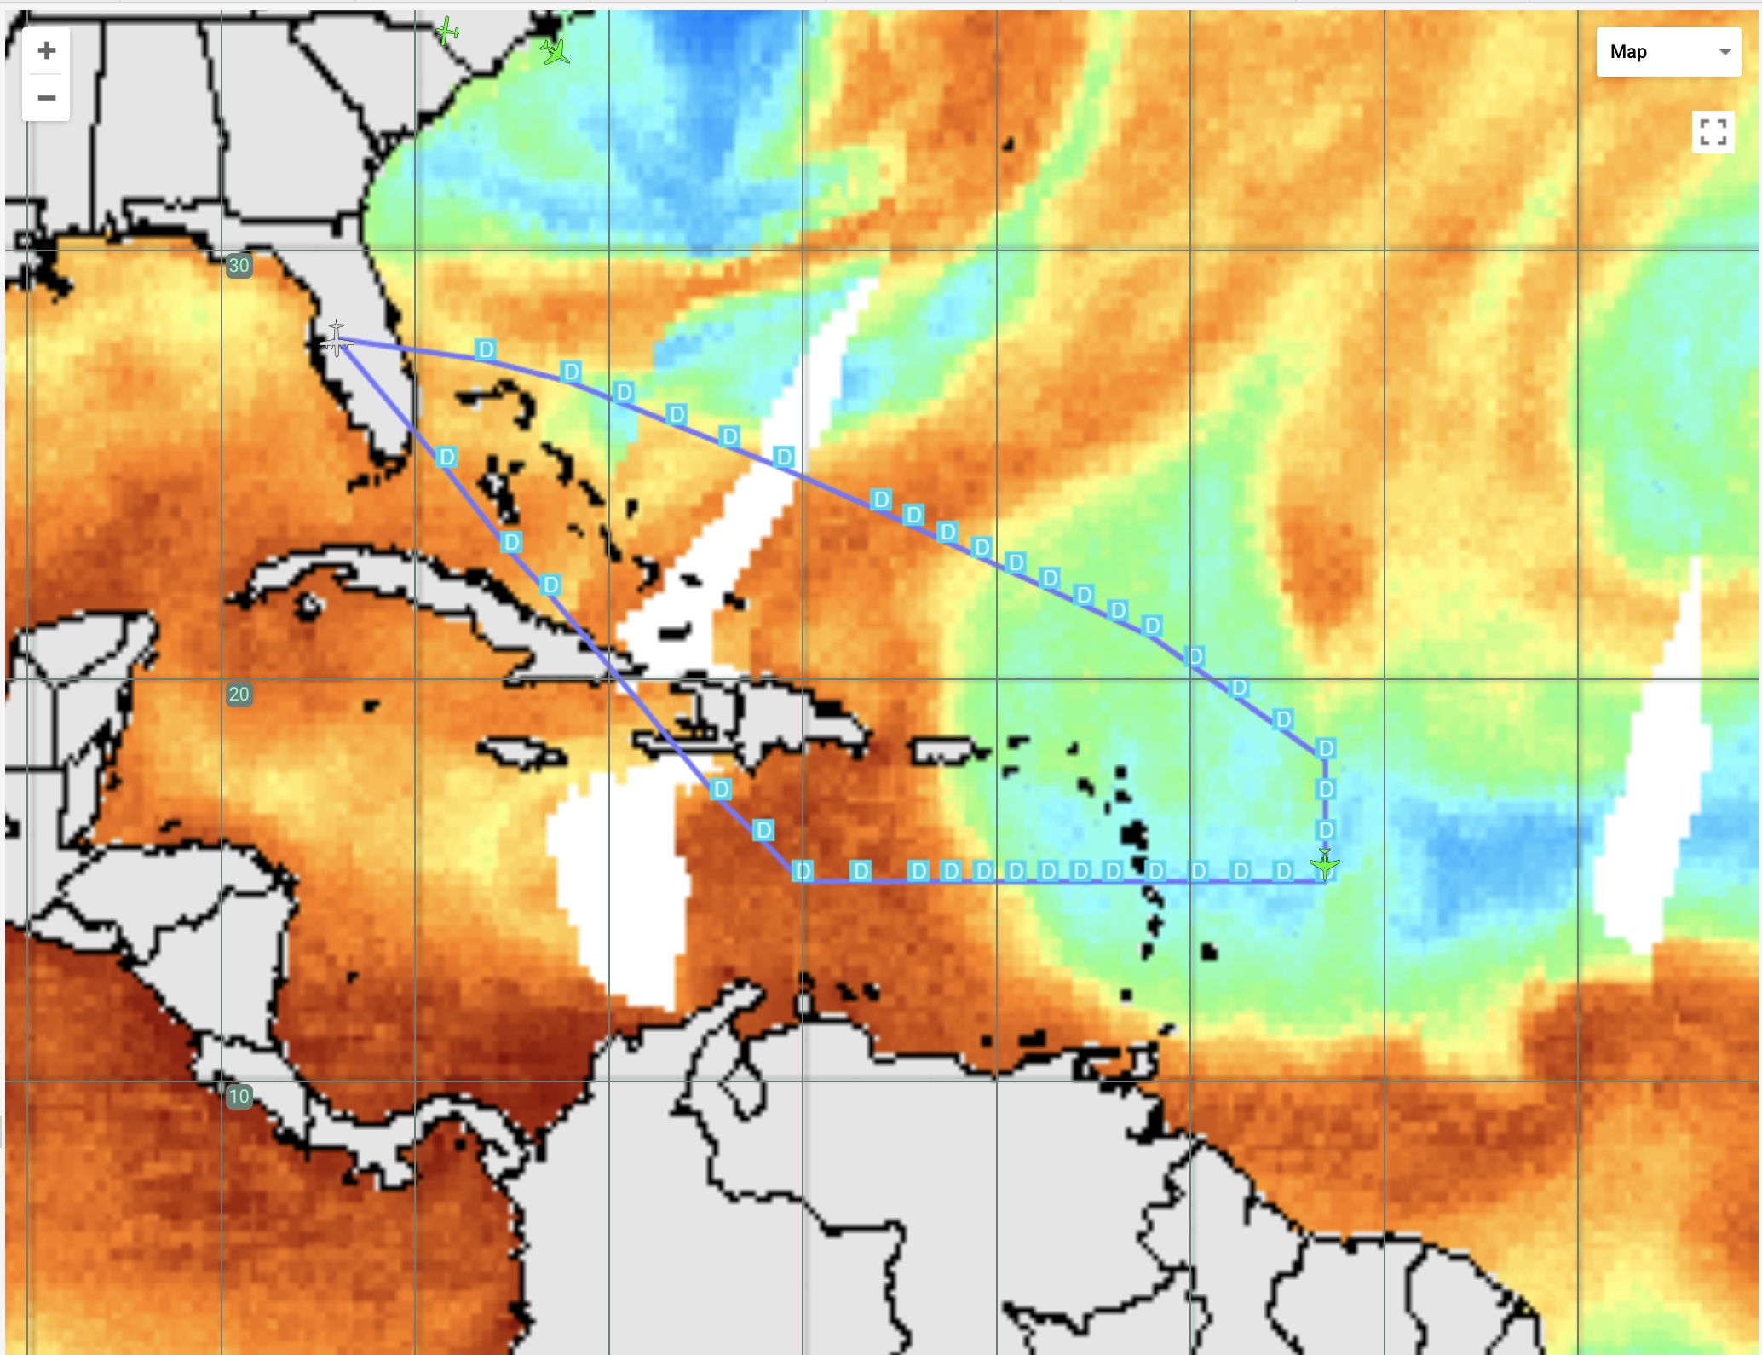
2018 NOAA/AOML/HRD Hurricane Field Program
Intensity Forecast Experiment (IFEX)
HRD-NESDIS G-IV SAL Mission Debrief
20180920N1
8.5 hr mission - flight-level 41-45 kft - 42 GPS dropsondes
On-Board LPS/Dropsondes: Jon Zawislak; Ground-based LPS: Jason Dunion
G-IV Track & Dropsonde Points - GOES-E SAL Split Window Imagery
G-IV Track & Dropsonde Points – MIMIC Total Precipitable Water

Slide 2
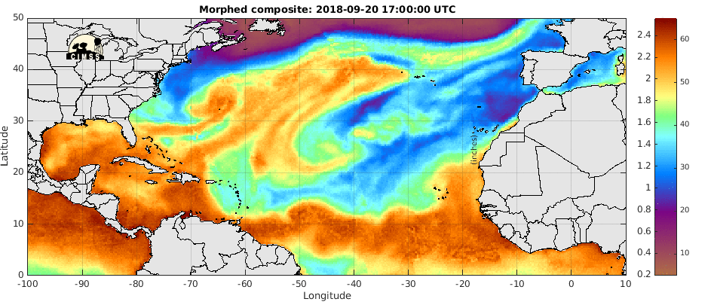
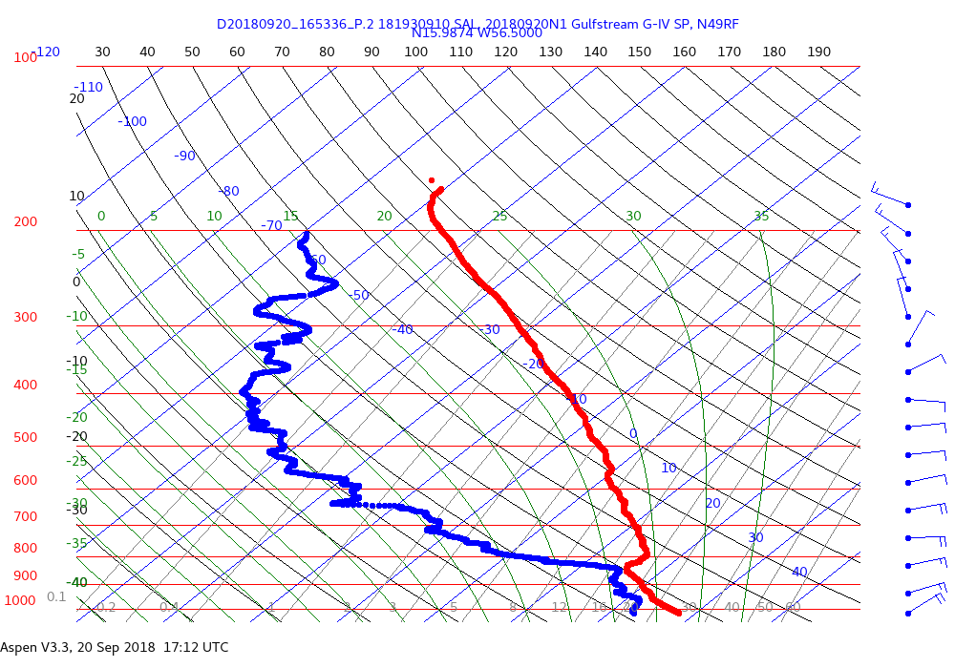
2018 NOAA/AOML/HRD Hurricane Field Program
Intensity Forecast Experiment (IFEX)
HRD-NESDIS G-IV SAL Mission Debrief
20180920N1
Environments Sampled
MLDAI
MLDAI/
Subsidence
MLDAI
MT
19% RH
SAL
SAL
AEW
SAL
Invest
AL97
MT: Moist Tropical
SAL: Saharan Air Layer
MLDAI: Mid-Latitude Dry Air Intrusion
AEW: African Easterly Wave

Slide 3
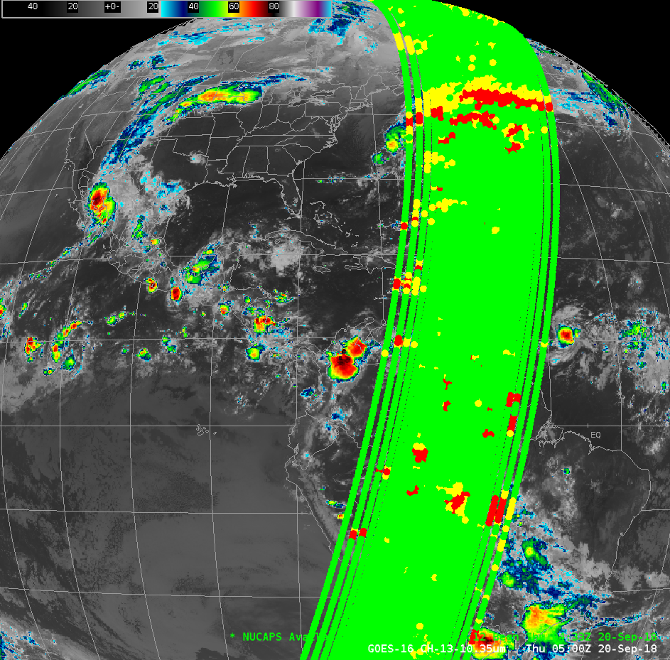
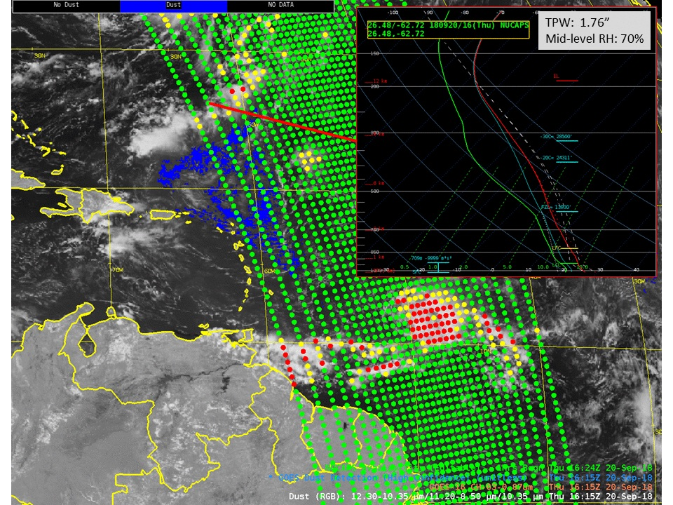
2018 NOAA/AOML/HRD Hurricane Field Program
Intensity Forecast Experiment (IFEX)
HRD-NESDIS G-IV SAL Mission Debrief
20180920N1
NOAA NESDIS Unique Combined Atmospheric Processing System (NUCAPS)
Atmospheric soundings derived from the CrIS (IR) and ATMS (MW) instruments flying on the Suomi-NPP & NOAA-20 satellites
CrIS: 1305 IR channels (3.9-15 μm); ATMS: 22 MW channels (23-183 GHz)
NUCAPS soundings: 324,000 soundings per day; 20-30 min latency
NUCAPS retrievals: temperature, water vapor, cloud fraction, cloud top pressure, trace gases, dust, volcanic emissions
GOES-16 IR – Suomi NPP Morning Overpass
NUCAPS Profile: ~1600 UTC 20 Sep 2018

Slide 4
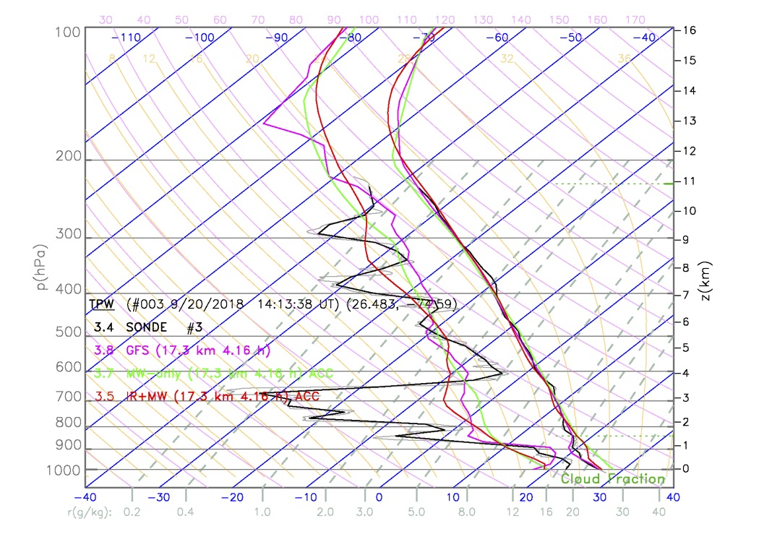
2018 NOAA/AOML/HRD Hurricane Field Program
Intensity Forecast Experiment (IFEX)
HRD-NESDIS G-IV SAL Mission Debrief
20180920N1
G-IV Drop #3 (140518 UTC)
Environments: Mid-latitude dry air intrusion
Dropsonde-NUCAPS temporal & spatial separation: 9 min, 2.2 km
G-IV track - MIMIC TPW Imagery
G-IV GPS Dropsonde - GFS - NUCAPS
700 hPa RH
Dropsonde: 5.5%
NUCAPS: ~35%
GFS: ~40%
Drop #3

Slide 5
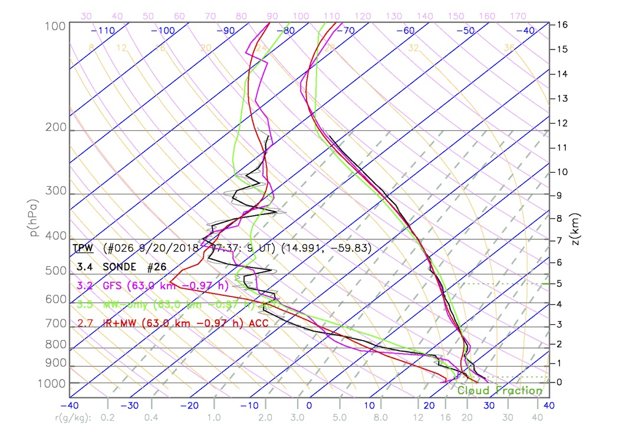
2018 NOAA/AOML/HRD Hurricane Field Program
Intensity Forecast Experiment (IFEX)
HRD-NESDIS G-IV SAL Mission Debrief
20180920N1
G-IV Drop #26 (172822 UTC)
Environments: Saharan Air Layer, mid/upper-level subsidence
Dropsonde-NUCAPS temporal & spatial separation: 9 min, 2.0 km
G-IV track - MIMIC TPW Imagery
G-IV GPS Dropsonde - GFS - NUCAPS
600 hPa RH
Dropsonde: 8.5%
NUCAPS: ~8%
GFS: ~10%
SAL
Drop #26

Slide 6
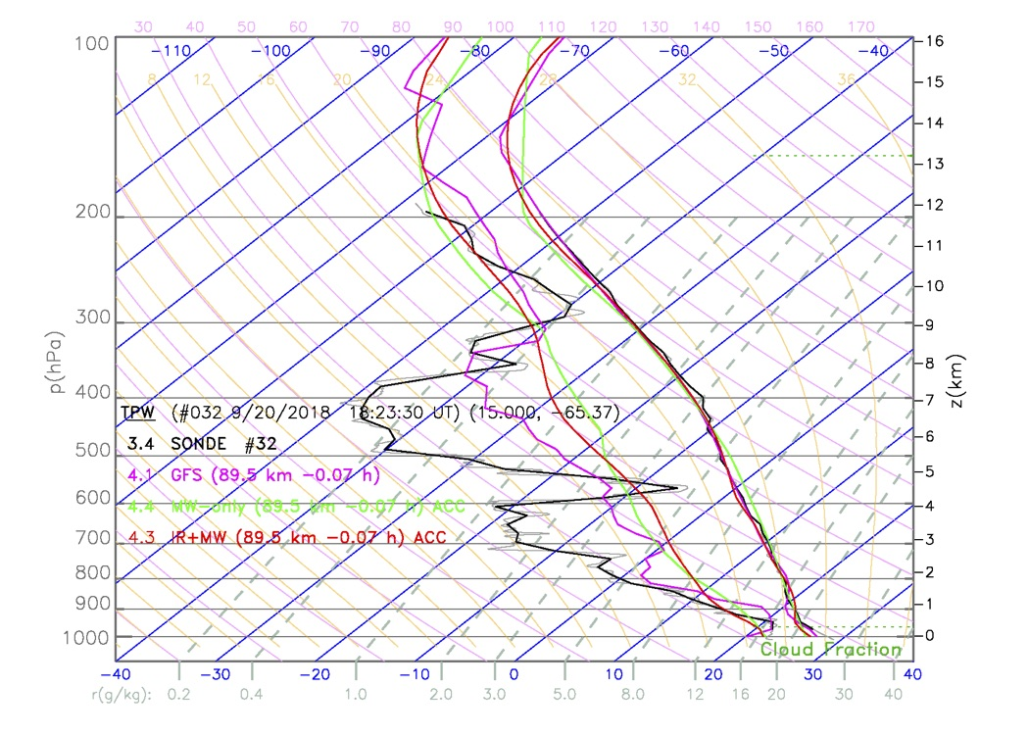
2018 NOAA/AOML/HRD Hurricane Field Program
Intensity Forecast Experiment (IFEX)
HRD-NESDIS G-IV SAL Mission Debrief
20180920N1
G-IV Drop #32 (181448 UTC)
Environments: Saharan Air Layer leading edge, mid/upper-level subsidence
Dropsonde-NUCAPS temporal & spatial separation: 9 min, 2.4 km
G-IV track - MIMIC TPW Imagery
G-IV GPS Dropsonde - GFS - NUCAPS
700 hPa RH
Dropsonde: 14.5%
NUCAPS: ~55%
GFS: ~50%
Drop #32
SAL

Slide 7
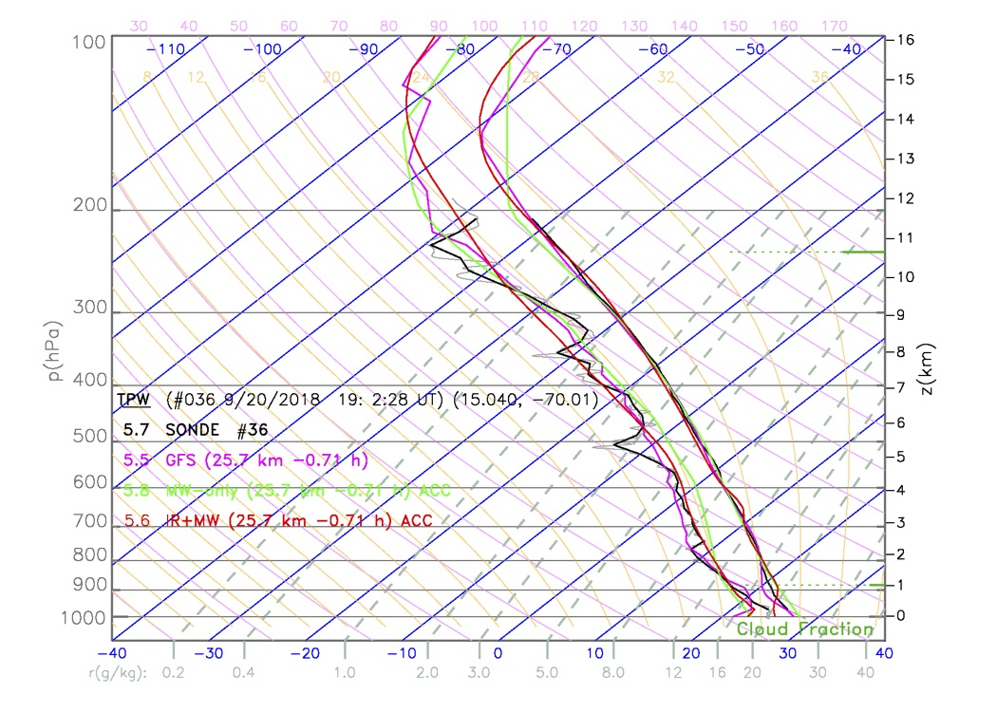
2018 NOAA/AOML/HRD Hurricane Field Program
Intensity Forecast Experiment (IFEX)
HRD-NESDIS G-IV SAL Mission Debrief
20180920N1
G-IV Drop #36 (185359 UTC)
Environments: tropical wave axis (moist tropical)
Dropsonde-NUCAPS temporal & spatial separation: 8 min, 1.2 km
G-IV track - MIMIC TPW Imagery
G-IV GPS Dropsonde - GFS - NUCAPS
700 hPa RH
Dropsonde: 68.9%
NUCAPS: ~70%
GFS: ~66%
Drop #36

Slide 8
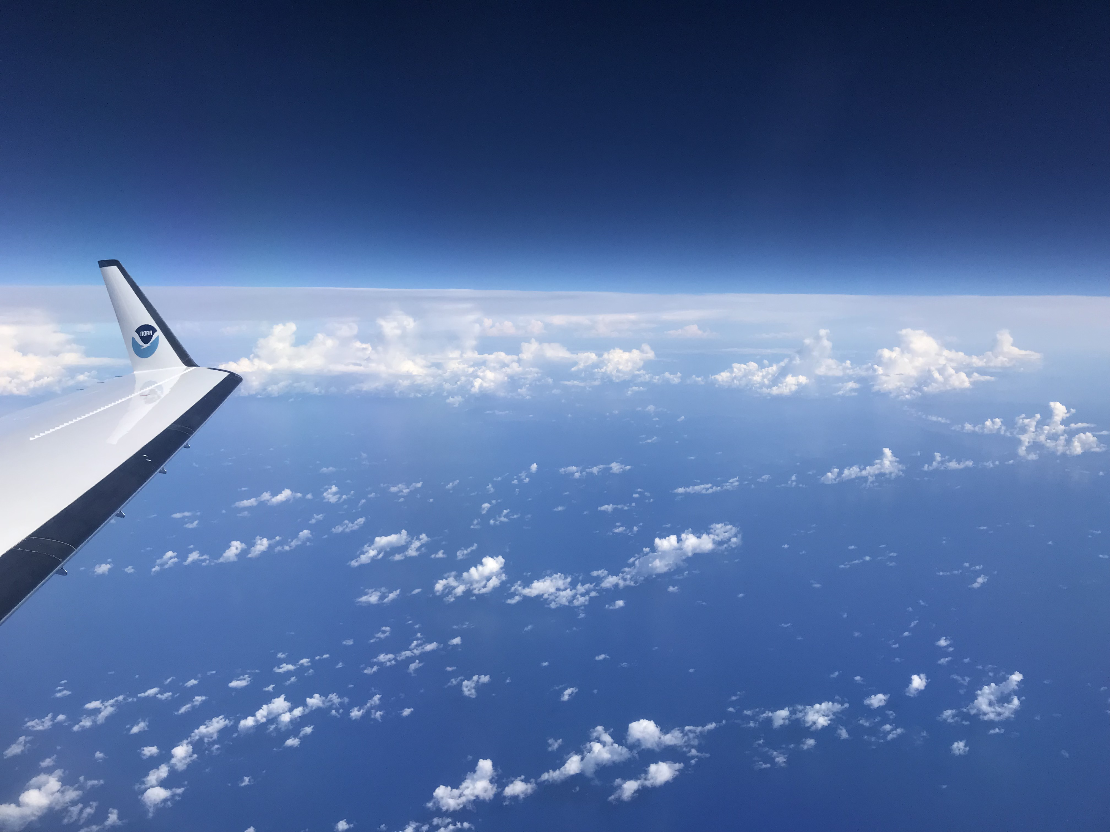
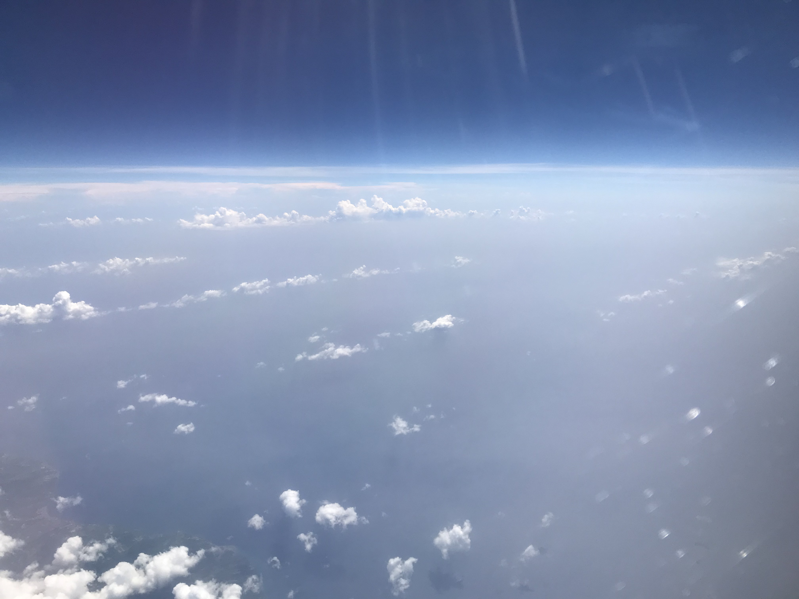
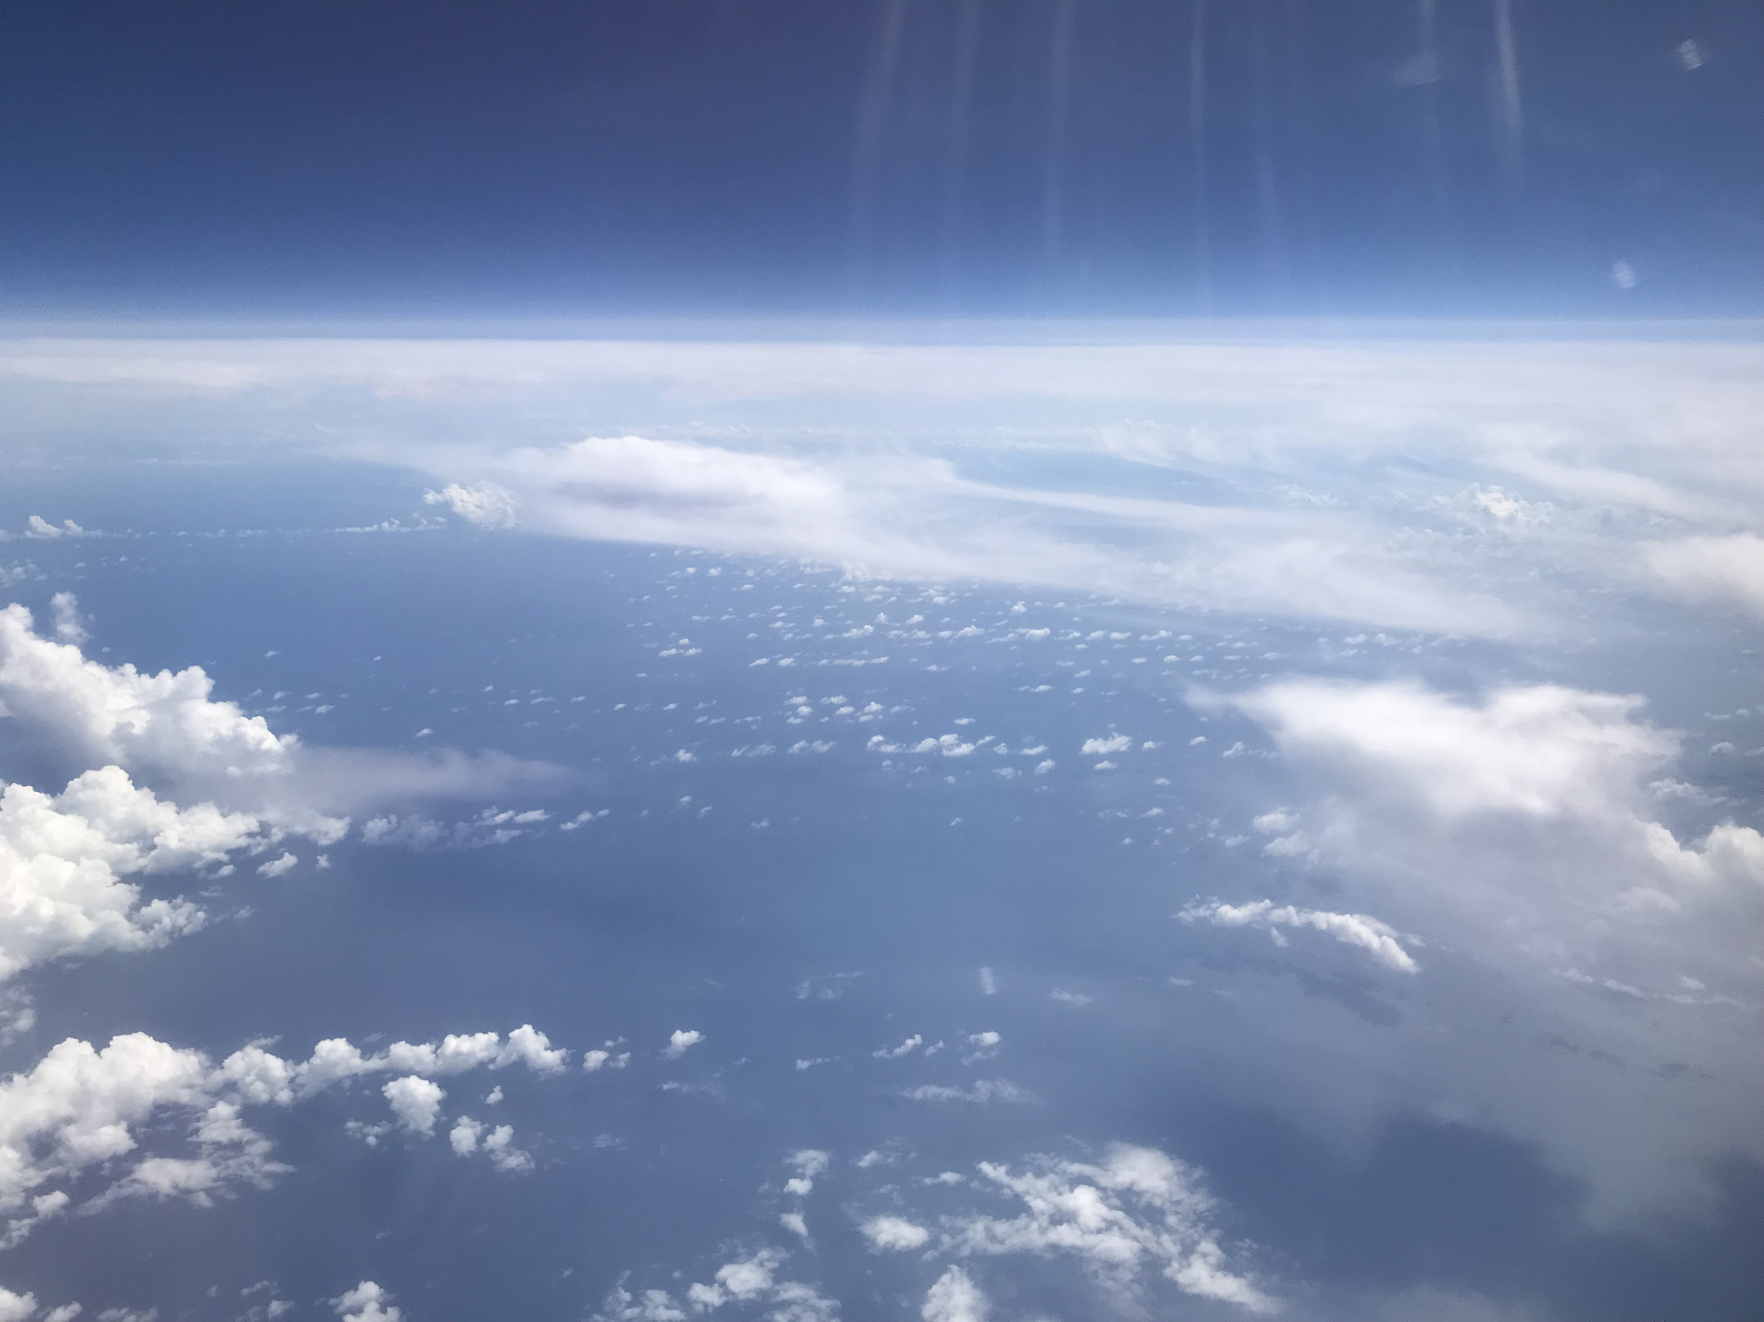
2018 NOAA/AOML/HRD Hurricane Field Program
Intensity Forecast Experiment (IFEX)
HRD-NESDIS G-IV SAL Mission Debrief
20180920N1
MT: Moist Tropical
SAL: Saharan Air Layer
MLDAI: Mid-Latitude Dry Air Intrusion
AEW: African Easterly Wave
MLDAI
MLDAI
MT
SAL
AEW
SAL
Invest
AL97

Slide 9
2018 NOAA/AOML/HRD Hurricane Field Program
Intensity Forecast Experiment (IFEX)
HRD-NESDIS G-IV SAL Mission Debrief
20180920N1
Objectives
Validate NESDIS NUCAPS sounding profiles with G-IV GPS dropsondes >> focus on SAL & MLDAI environments
Assess NUCAPS performance in high gradient areas >> e.g., moist tropical-SAL (or mid-latitude dry air intrusion) boundaries
Assess NUCAPS performance in SAL/MLDAI environments that are capped by moist layers (particularly challenging)
Repeat assessments for various models (e.g., HRWF, Basin-Scale HWRF, GFS)
HRD-NESDIS Coordination
G-IV take-off time: 1300 UTC/0900 LT
optimize GPS dropsonde SAL sampling and coincident satellite overpasses (Suomi-NPP and NOAA-20)
Expendables
42 GPS dropsondes (40 + 2 back-ups)
Issues
None
2019 Plans
Possible HRD-NESDIS/JPSS SAL missions pending NESDIS dropsonde purchase
Possible inclusion of the Saharan Air Layer Experiment (SALEX) in the HRD HFP

