Slide 1
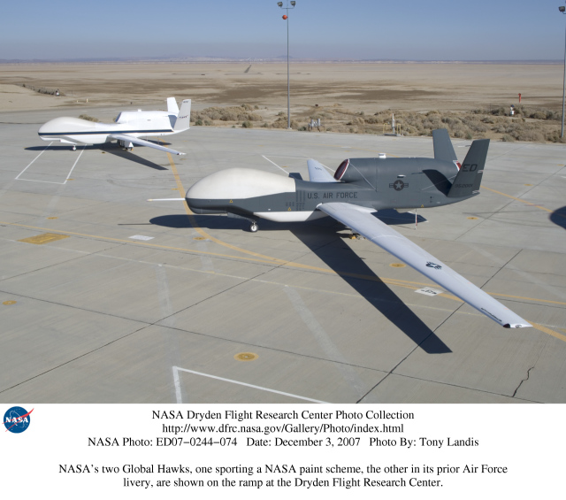

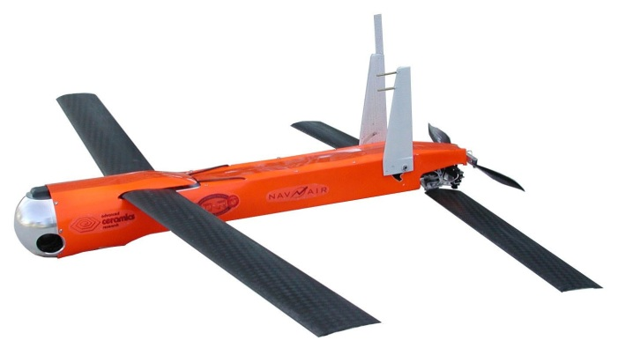
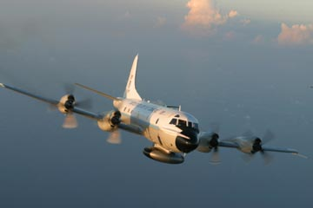
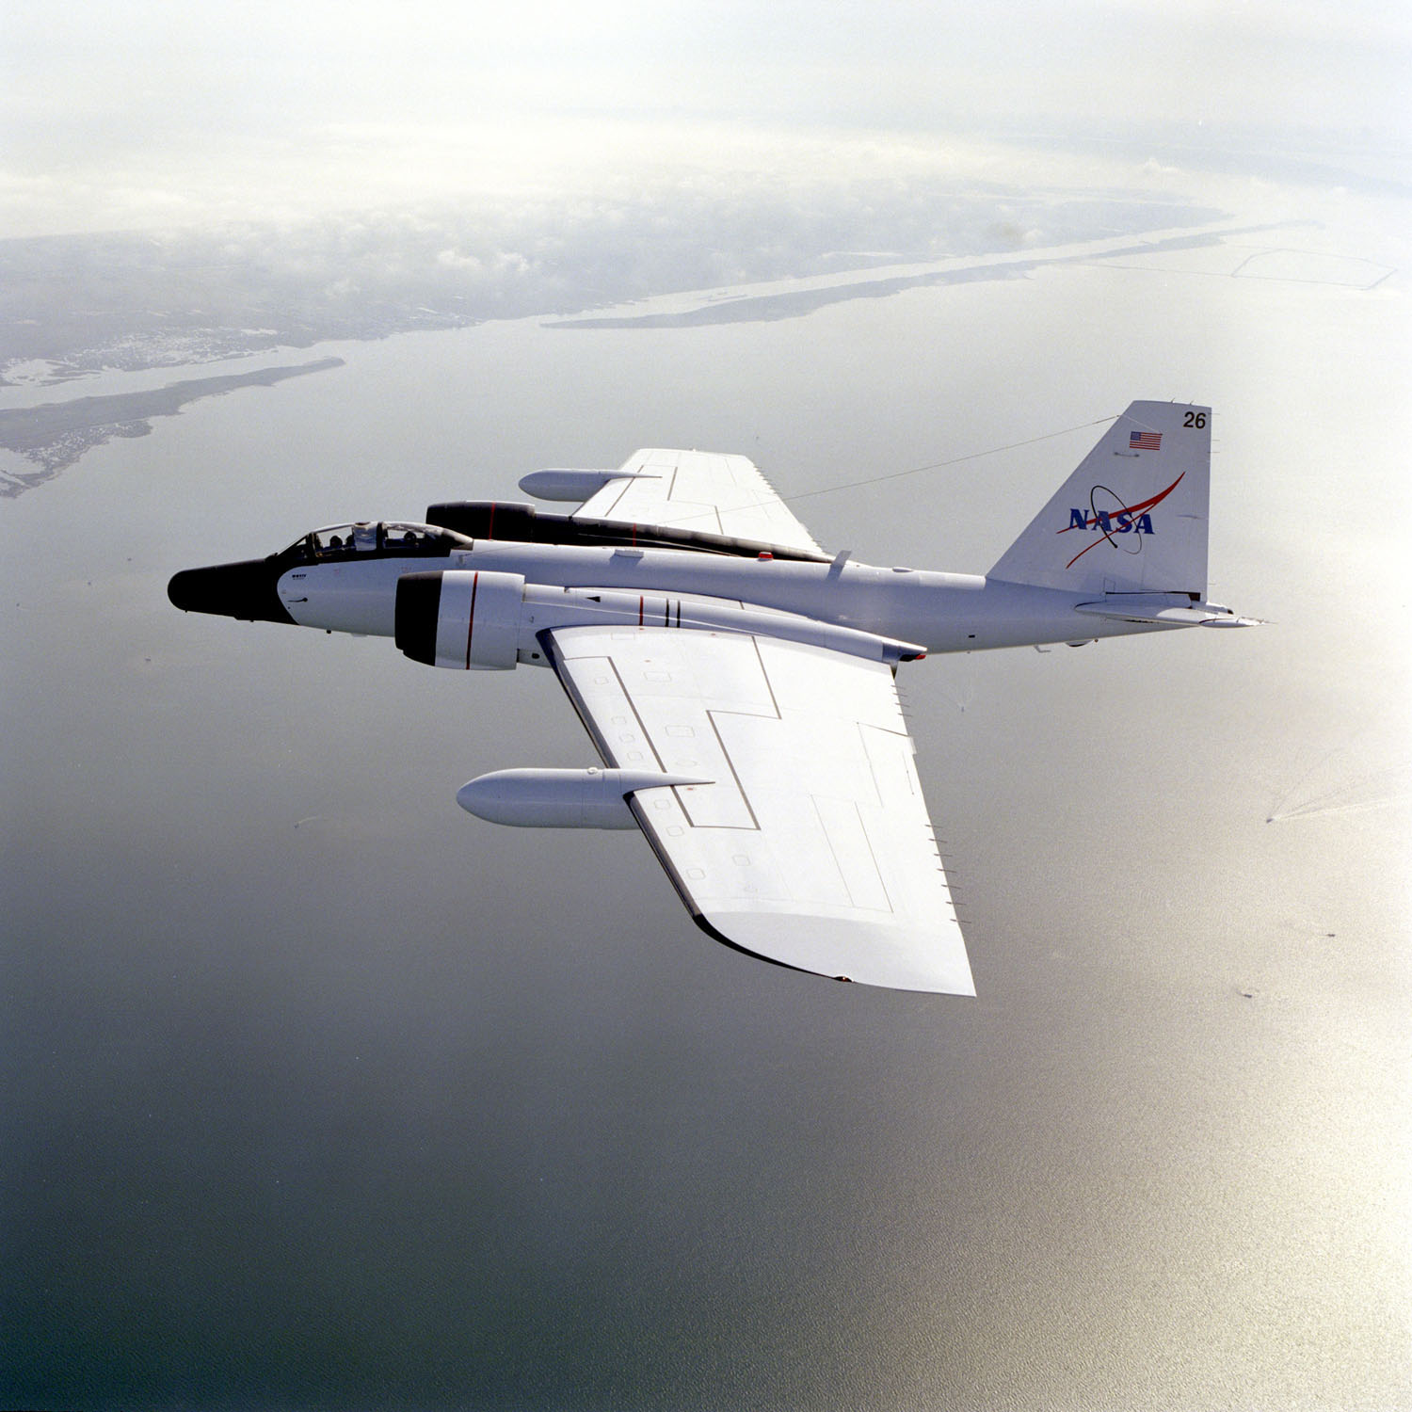
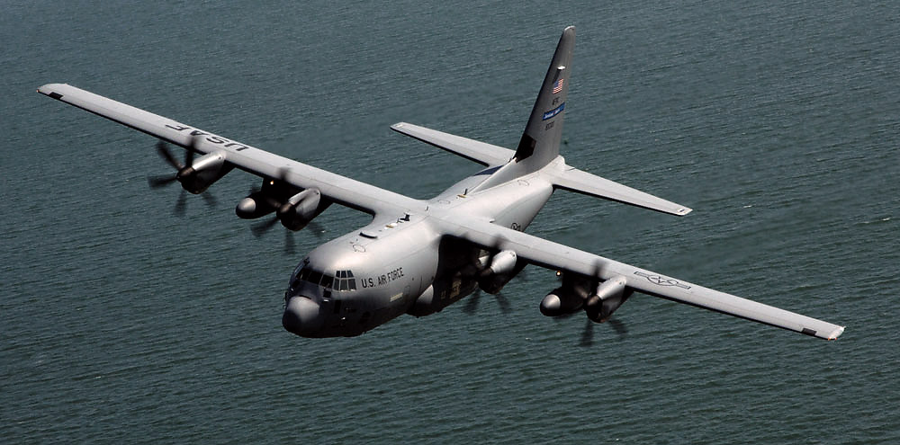
Global Hawk and G-IV Plans, Resources, and Opportunities for 2104
Jason P. Dunion
University of Miami – NOAA/AOML/Hurricane Research Division
Global Hawk and G-IV Plans, Resources, and Opportunities for 2014
Jason P. Dunion
University of Miami – NOAA/AOML/Hurricane Research Division
Strategic Use of Observations to Reduce Model Physics Uncertainty
NOAA/ESRL Boulder, CO; 07-08 August 2014

Slide 2
NOAA G-IV Jet
Scientific Objectives & Missions
Overarching Goal:
Optimizing Observations to Better Evaluate and Improve NOAA’s Hurricane Weather Research and Forecasting Operational Model
Investigating TC environmental processes by observing the TC’s surrounding large scale environment
Specific G-IV Experiments (with concurrent P-3 flights)
Rapid Intensity Experiment
Saharan Air Layer Experiment - Arc Cloud Module
TC Diurnal Cycle Experiment
Tropical Cyclone in Shear Experiment
G-IV Tail Doppler Wind Radar Experiment

Slide 3
NOAA G-IV Jet
NOAA G-IV | NOAA G-IV
Cruising Speed | 400 kt
Flight-Level | 41-45K ft, 12.5-14 km
Duration | 8-8.5 hr, 2850-3025 nm
Operating Storm Radius | ~60-270 nm, ~100-500 km
Data | Flight-Level, C-Band Wx Radar, GPS dropsondes, SFMR, TDR

Slide 4
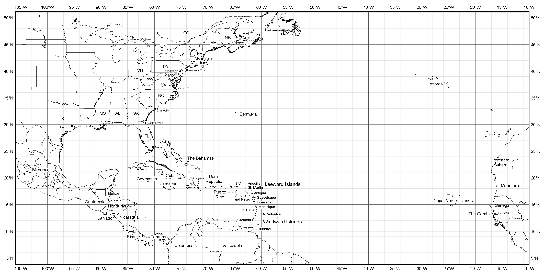
NOAA G-IV Operating Range
x
x
x
x

Slide 5
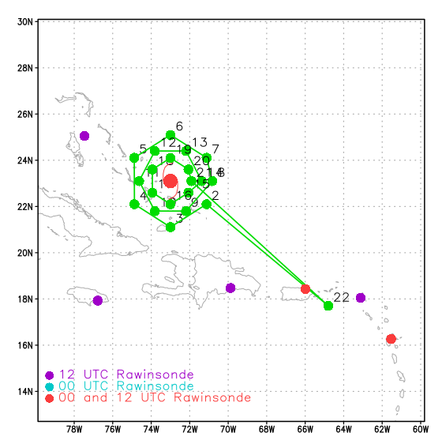
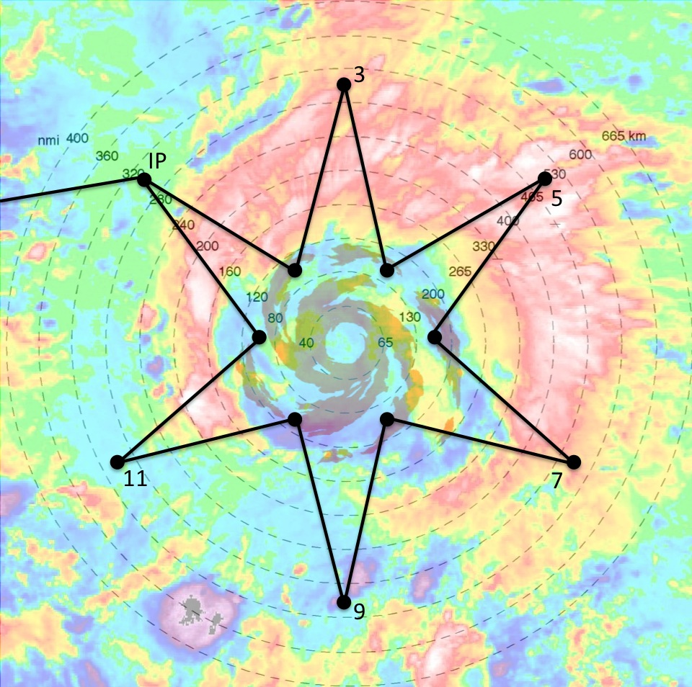
NOAA G-IV Jet: Flight Patterns
Circumnavigation Pattern
Star Pattern
~800-900 km
Operating Area: R=~60-120 nm
Advantage: good inner core radar coverage
Disadvantage: limited environmental & radial gradient sampling
Operating Area: R=~80-220 nm
Advantages: good environmental & radial gradient sampling
Disadvantage: limited inner core radar coverage

Slide 6

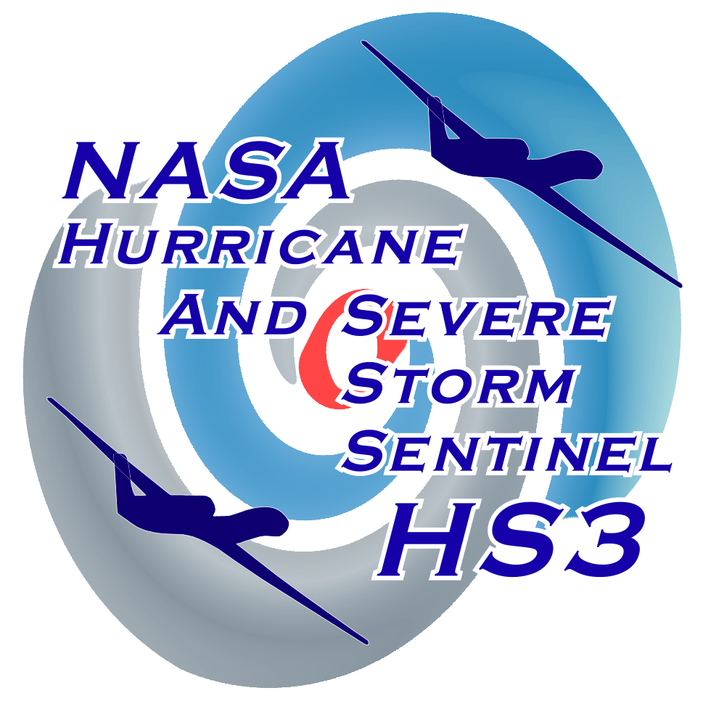
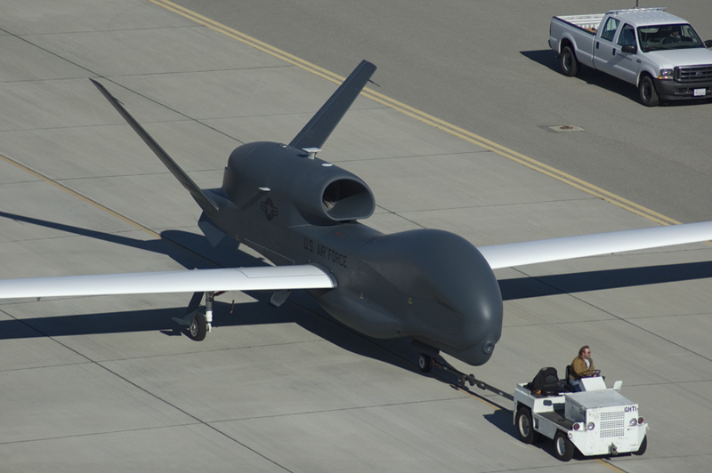
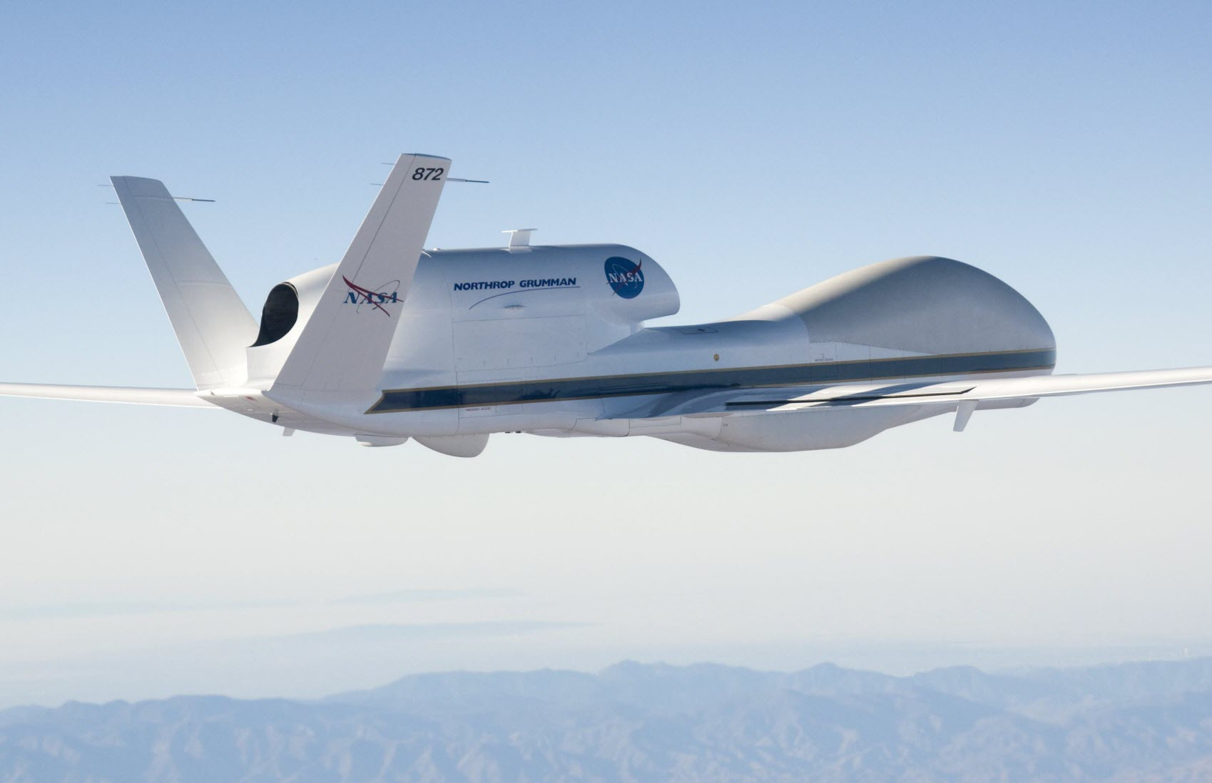
Hurricane and Severe Storm Sentinel
Overall Science Objective
To provide measurements to address key science questions related to storm formation and intensity change, including whether it is primarily a function of the storm environment or storm internal processes

Slide 7
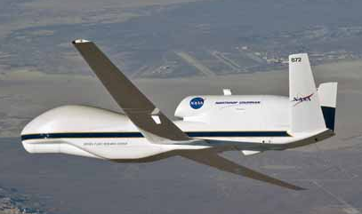
NASA’s Global Hawk Unmanned Airborne System
Global Hawk | Specification
Endurance | >30 hours
Range | >11,000 nm
Service Ceiling | 65,000 ft
Airspeed (55K+ ft) | 335 kt
Payload | 1,000-1,500 lb
Length | 44 ft
Wingspan | 116 ft
FY2014 FHs | 300
GPS dropsondes | 500+
Mission turn around time | 2 hr
Max back to backs | 3-4
Cruise Climb from 56-65K ft
(max takeoff weight)

Slide 8
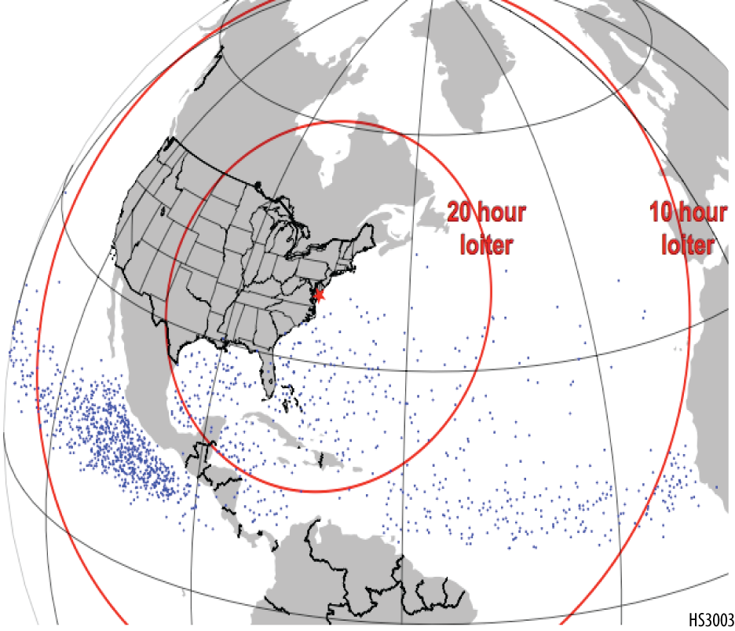
HS3 Mission Overview
• Two GH aircraft, one equipped for the storm environment (AV-6), one for over-storm flights (AV-1)
• Deployments of GHs from the Wallops Flight Facility in VA
• 5-week deployment 2014 (beginning 26 Aug)
• 2014: last of a 3-year NASA mission
Dots indicate genesis locations. Range rings assume 30-h flights.

Slide 9
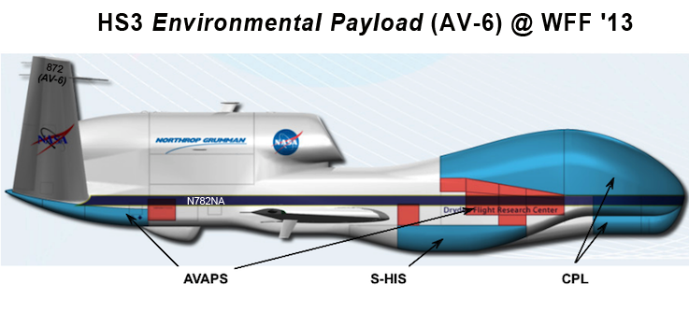
Environmental Payload (AV-6)

Slide 10
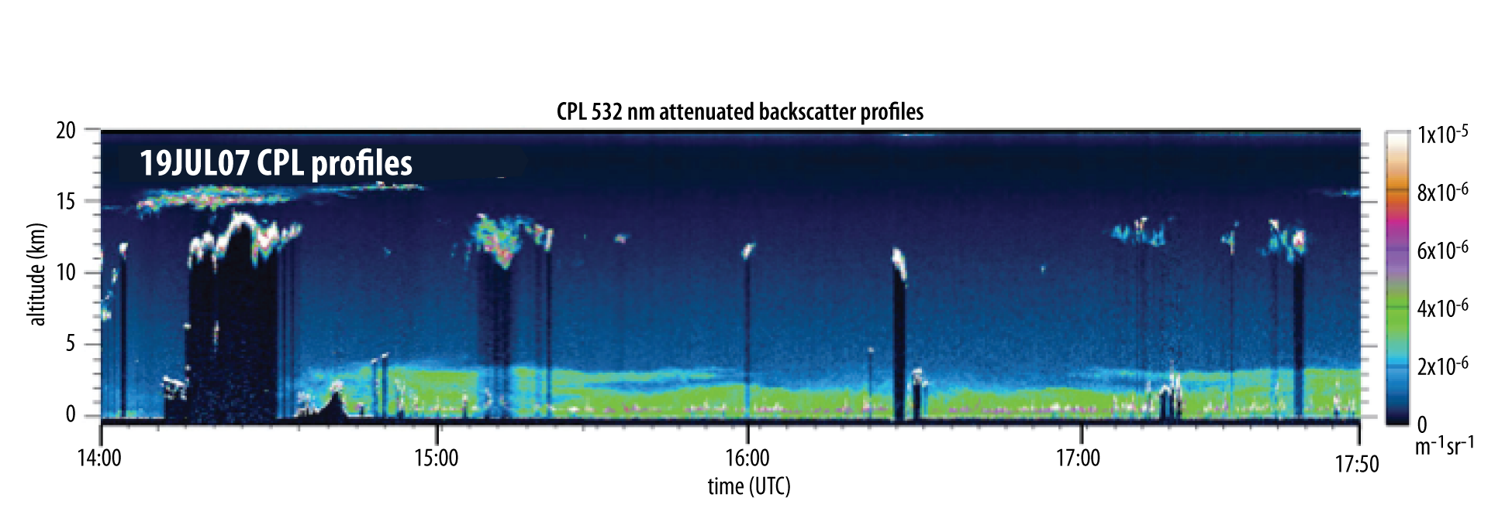
Instruments: Cloud Physics Lidar
  Cloud/aerosol lidar (CALIPSO simulator)
  Instrument PI: Matt McGill, NASA/GSFC
  Data: Profiles of atten. backscatter, cloud/aerosol boundaries, optical depth, extinction, depolarization
Horiz., vertical resolution=200 m, 30 m

Slide 11
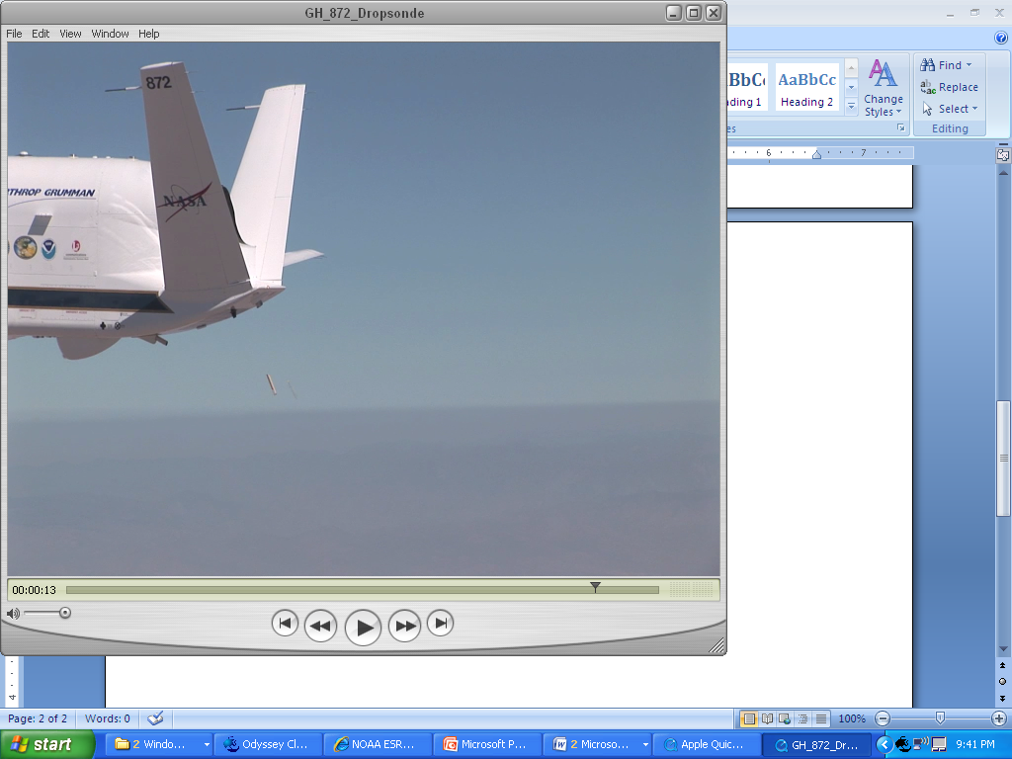
Instruments: GPS Dropsondes (AVAPS)
  Instrument PI: Gary Wick, NOAA
  Data: High-resolution vertical profiles of temperature, humidity, pressure, winds
  70-88 drops per flight
  New design has flown on GH

Slide 12
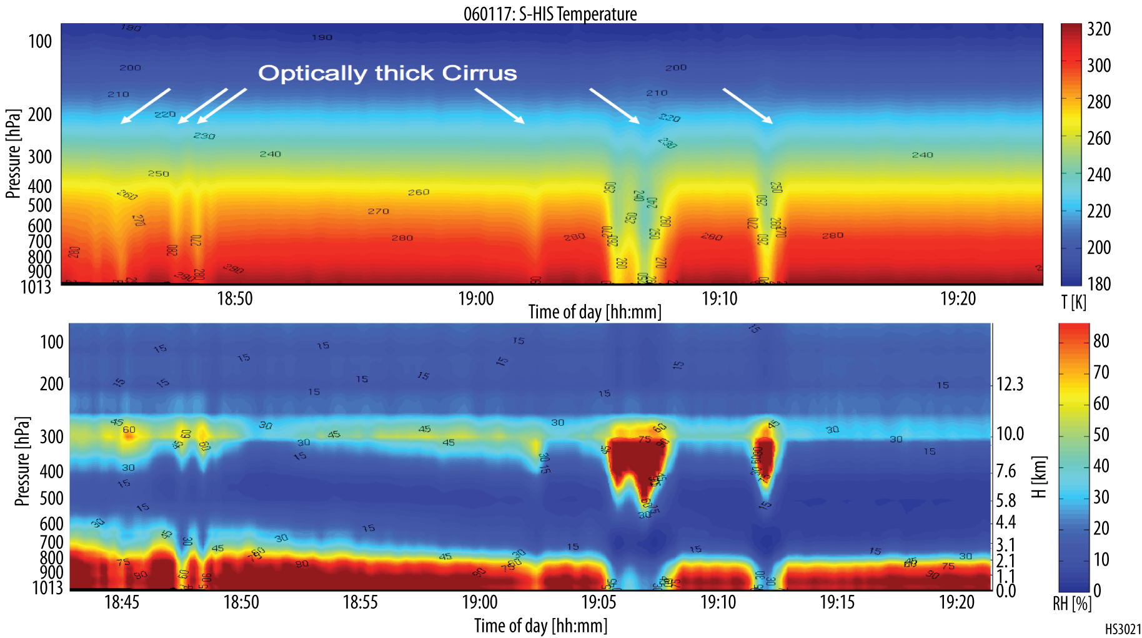
Instruments: Scanning High-resolution Interferometer Sounder
  Instrument PI: Hank Revercomb, Univ. Wisconsin
  Data: IR TB spectra; Cloud-top temperature, height; sfc skin temperature; profiles of temperature and water vapor in clear-sky conditions
  Horiz., vertical resolution=2 km, 1-3 km

Slide 13
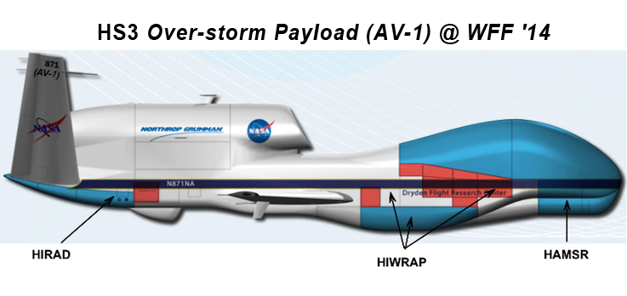
Over-Storm Payload (AV-1)

Slide 14
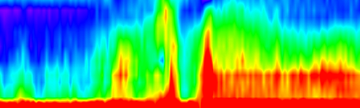
Instruments: High-Altitude MMIC
Sounding Radiometer (HAMSR)
  Instrument PI: Bjorn Lambrigtsen, JPL
  Data: Calibrated brightness temperature; vertical profiles of temperature (19 channels) and water vapor (7 channels) and liquid water; precipitation structure
  Horiz., vertical resolution=2km, 1-3 km
3D reflectivity, Hurricane Emily (2005)
15 km
14 km
13 km
12 km
11 km
10 km
9 km
8 km
7 km
6 km
5 km
4 km
3 km
2 km

Slide 15
Instruments: High-altitude Imaging Wind and Rain Airborne Profiler (HIWRAP)
  Instrument PI: Gerald Heymsfield, NASA/GSFC
  Dual frequency (Ka and Ku), Dual beam radar/scatterometer
  Data: Calibrated reflectivity, Doppler velocity, 3D reflectivity and horizontal winds, ocean surface winds in precipitation free areas
  Horiz., vertical resolution=
    1 km, 200 m for dBZ,
    Doppler velocity
    1 km, 500 m for horiz. winds
    2 km for surface winds

Slide 16
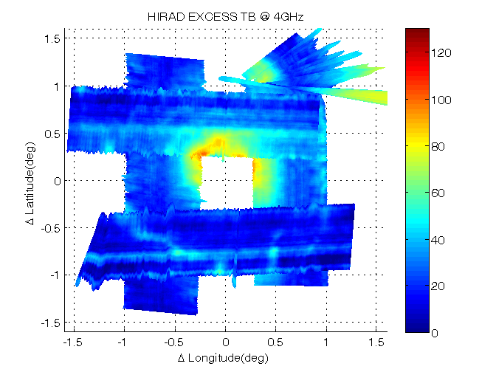
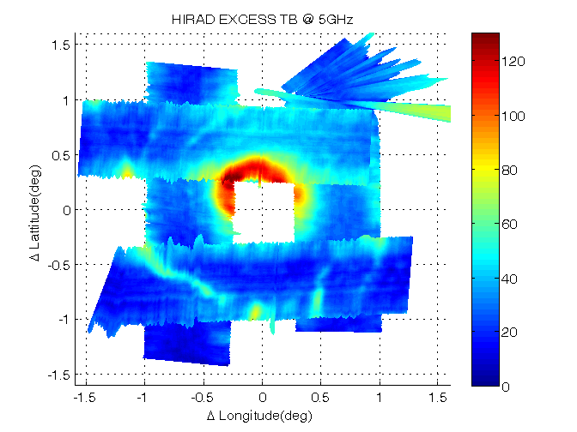
Instruments: Hurricane Imaging Radiometer (HIRAD)
  Instrument PI: Tim Miller, NASA/MSFC
  Data: Surface wind speed, rain rate, and temperature; brightness temperature fields at 4 frequencies
  Technology similar to NOAA’s SFMR, but scans cross track instead of just nadir
  Horiz. resolution=~1.5-2.5 km
2010 Hurricane Earl GRIP

Slide 17
2014-2016 NOAA UAS Program
Sensing Hazards with Operational Unmanned Technology (SHOUT)
Scientific Objectives
Adaptive aircraft sampling strategies for improving real-time TC track and intensity forecasts
Employ output from a real-time ensemble data assimilation and forecasting system to estimate optimal targeting locations for TC track and intensity;
TC Upper-Level Warm Core Evolution and Links to Intensity Change
Quantify the evolution of the TC warm core, including its structure and vertical extent in the context of TC intensity change and tropical cyclogenesis;

Slide 18
Scientific Objectives (cont’d)
The TC Diurnal Cycle and Thermodynamic/Outflow Variability of the TC Cirrus Canopy
use a combination of aircraft and satellite assets to document the 3-D structure and evolution of upper-tropospheric environmental outflow.
TC Boundary Layer Structure and its Relationship to TC Upper-Level Structure and Intensity Change
characterize and better understand the physical processes of the hurricane boundary layer and their interactions with the vortex evolution and environmental factors before and during hurricane intensification

Slide 19
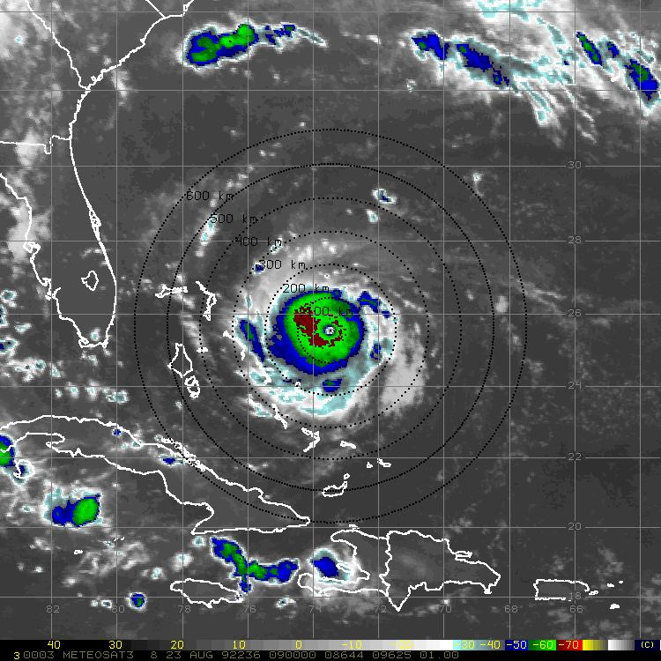
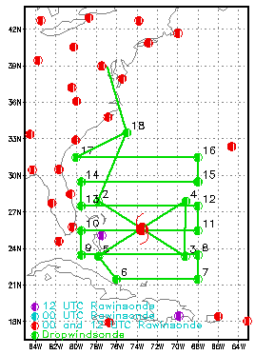
Global Hawk Flight Track Options
Intense, Compact Size (box + rotated figure-4)
IP
17
15
13
11
3
9
5
7

Slide 20
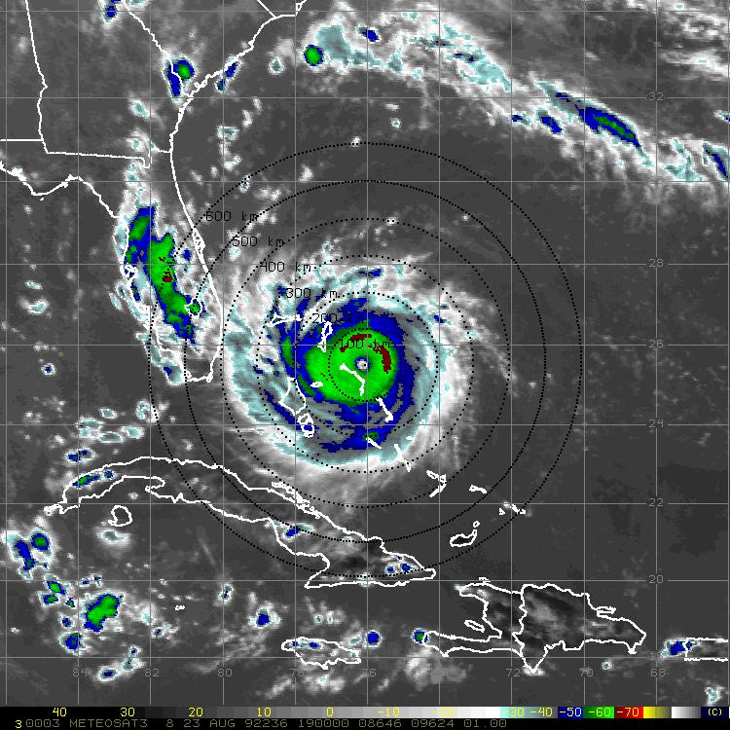
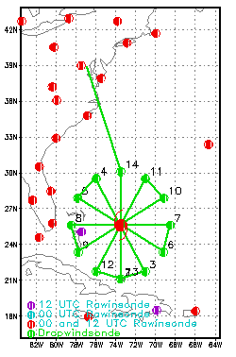
Global Hawk Flight Track Options
Intense, Compact Size (rotated figure-4)
IP
14
11
5
7
9
3
13

Slide 21
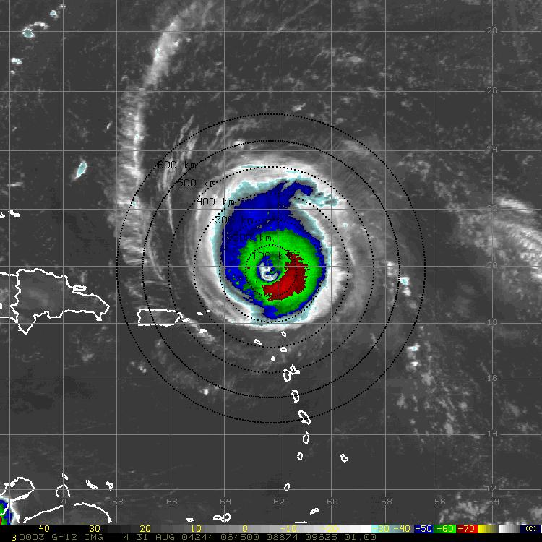
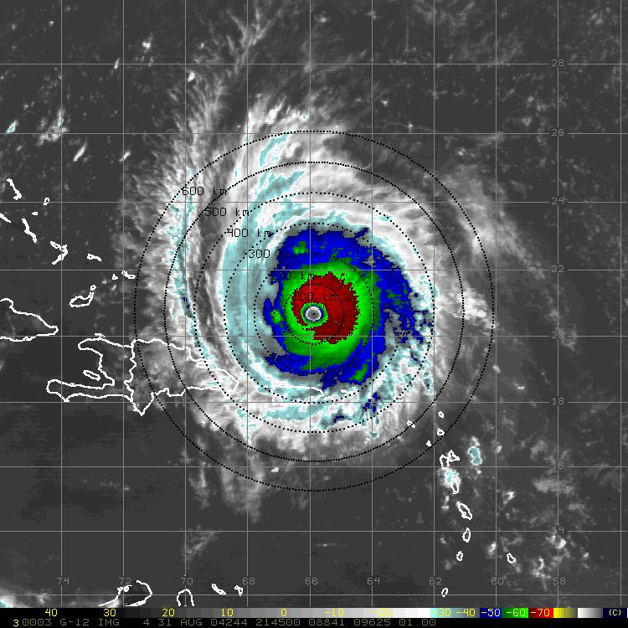
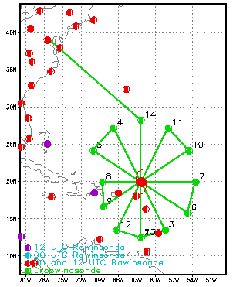
Global Hawk Flight Track Options
Intense, Moderate Size (rotated figure-4)
IP
14
11
5
7
9
3
13

Slide 22
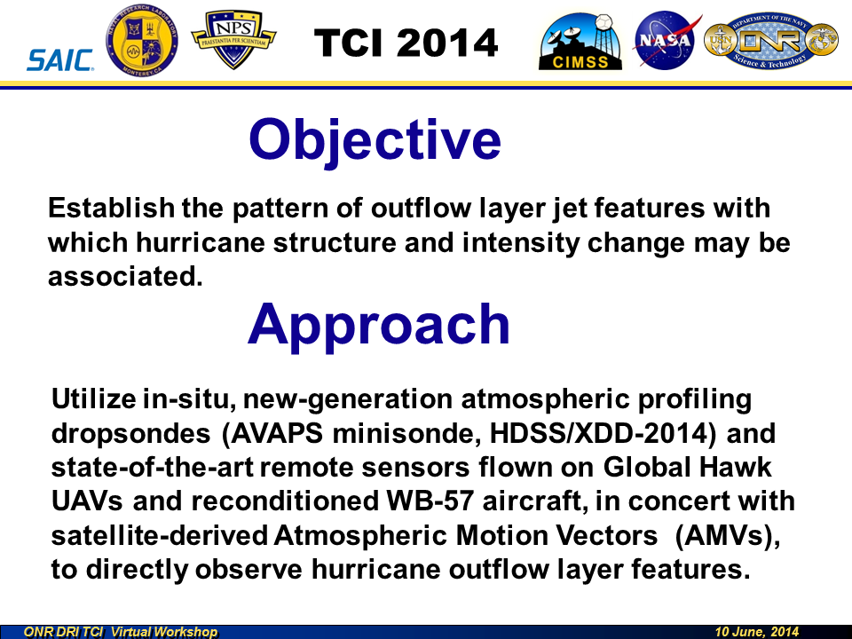

Slide 23
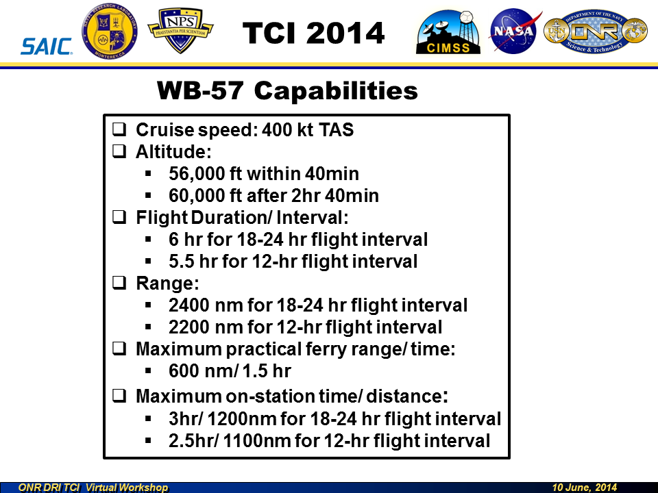

Slide 24
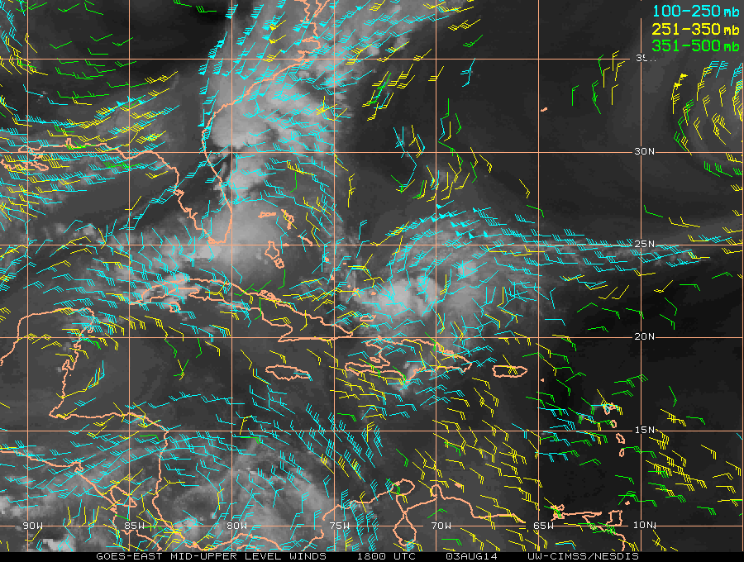
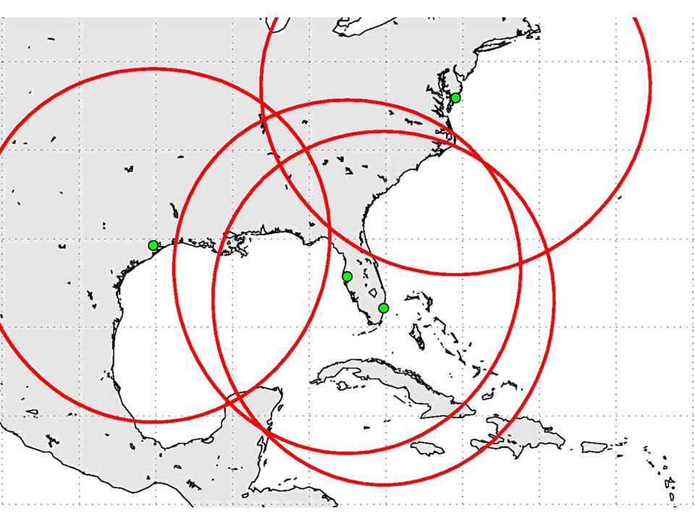
WB-57
TC Outflow Pattern
600 km Range Rings (2-3 hr on station)
>
>
>
>
Notes:
600 nm range rings = ~2-2.5 hr on station

Slide 25
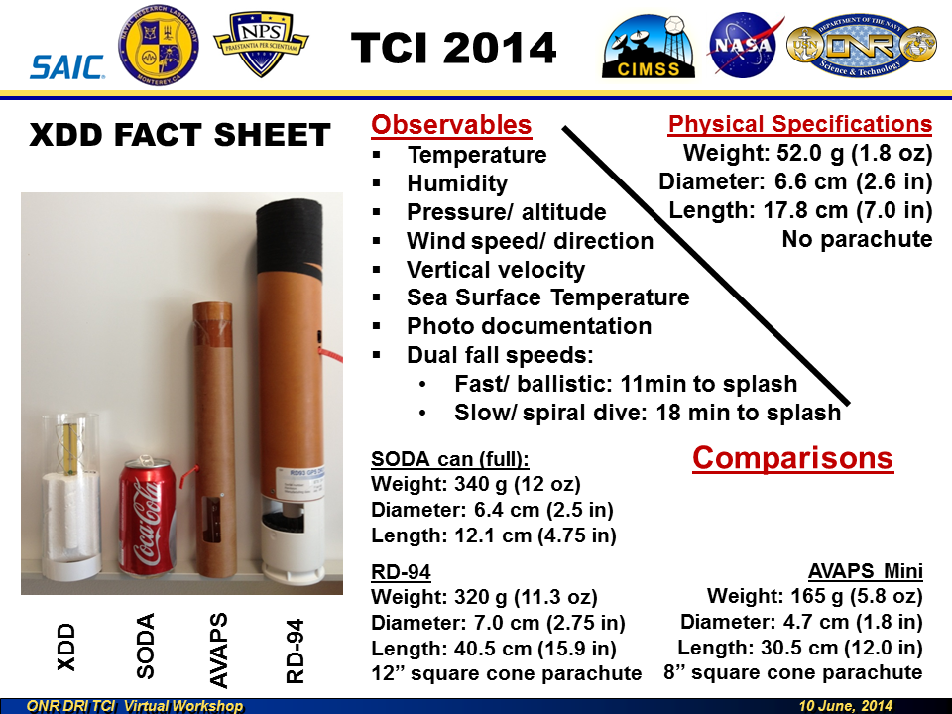
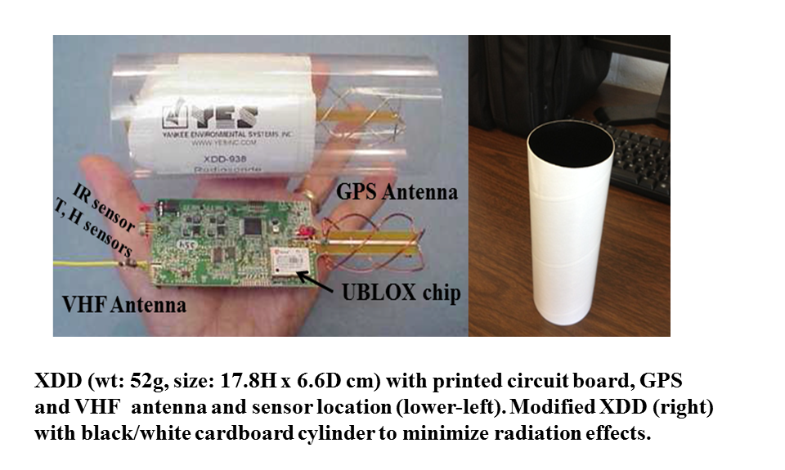

Slide 26
North Atlantic Hurricane Field Programs
…a look ahead
2014 –NOAA HFP, NOAA UAS, NASA HS3, & ONR TCI
NOAA HFP: June-Dec
NOAA UAS/NASA HS3: 26 Aug - 29 Sept (2 GHs; NASA Wallops, VA)
ONR TCI: Aug-Sept (G-IV); Sept-Oct (WB-57)
2015 – NOAA HFP, NOAA UAS, & ONR TCI
NOAA HFP: June-Dec
NOAA UAS Sept – Nov (likely 1 GH, possibly 2; based from NASA Armstrong, CA)
Single deployment location >> flexibility for potential targets- Atlantic, EPAC, Pacific, Arctic
NOAA UAS: 10-16 potential flights

