Slide 1
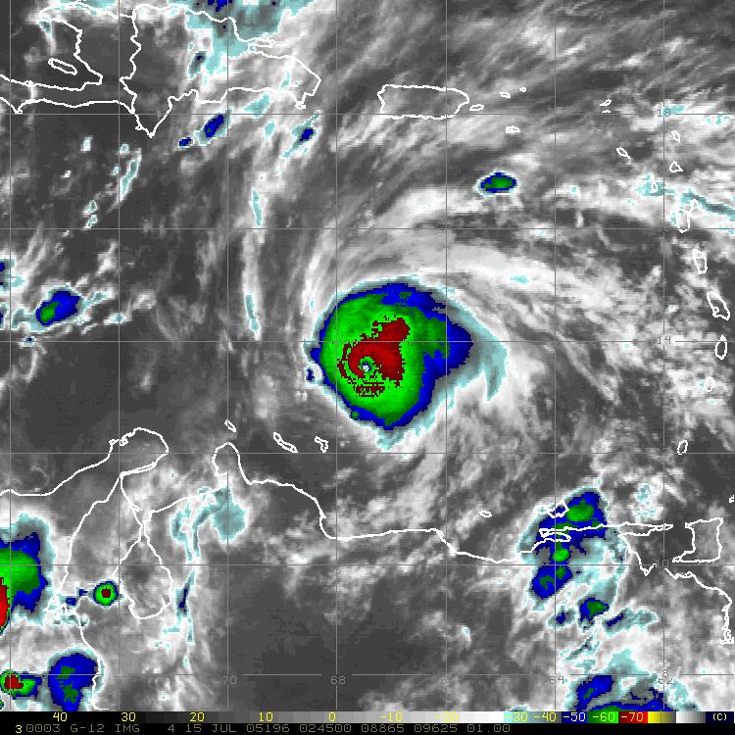
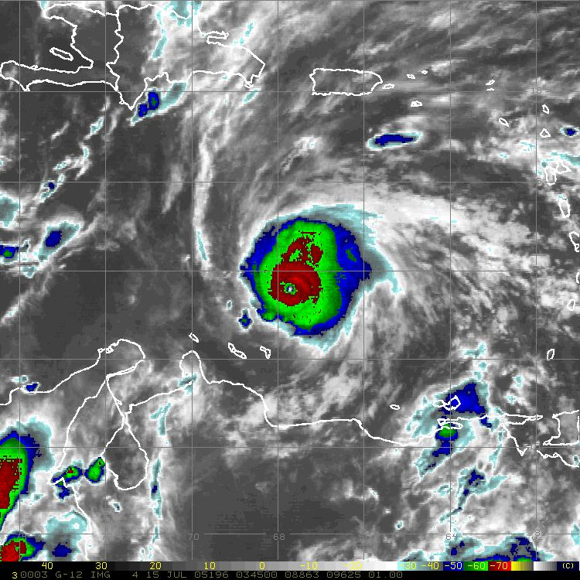
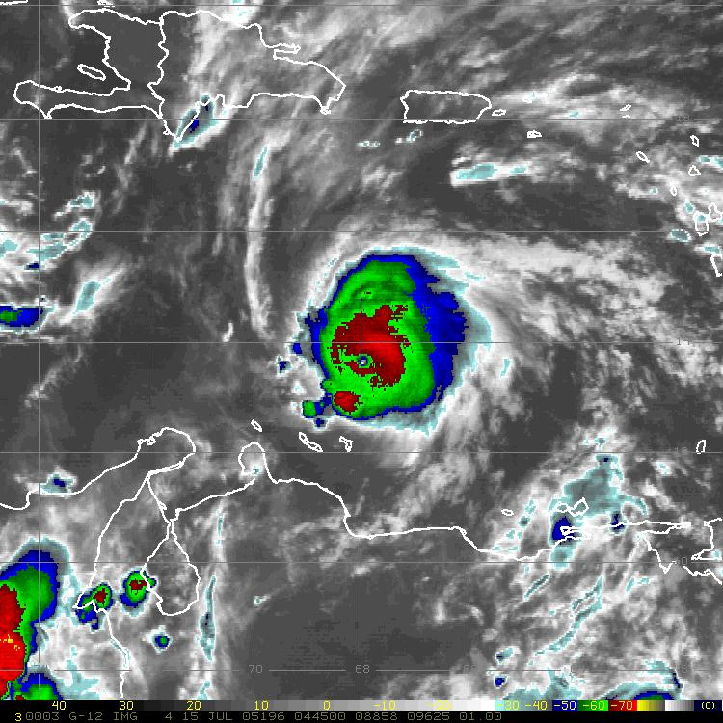
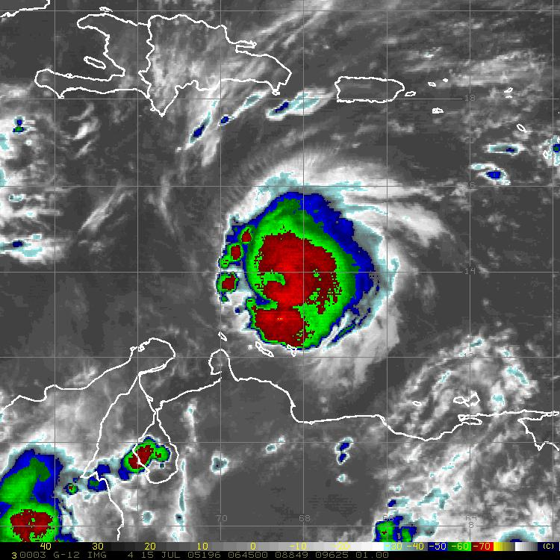
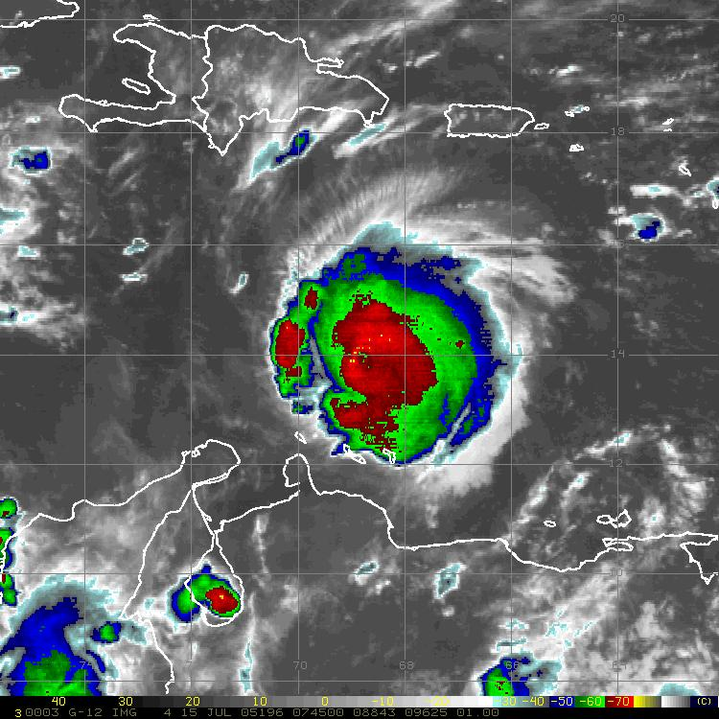
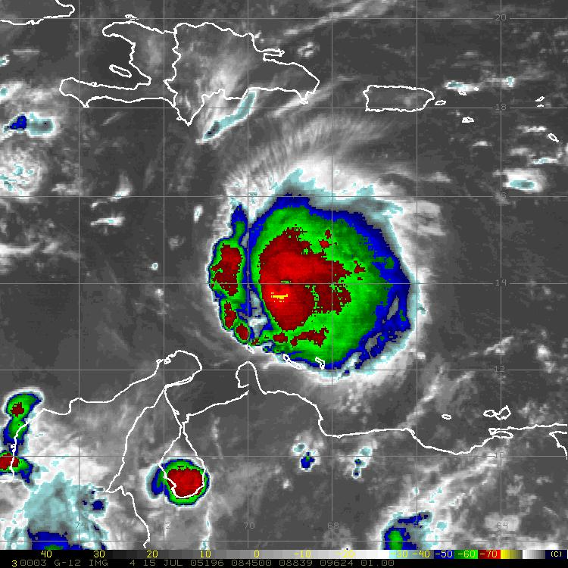
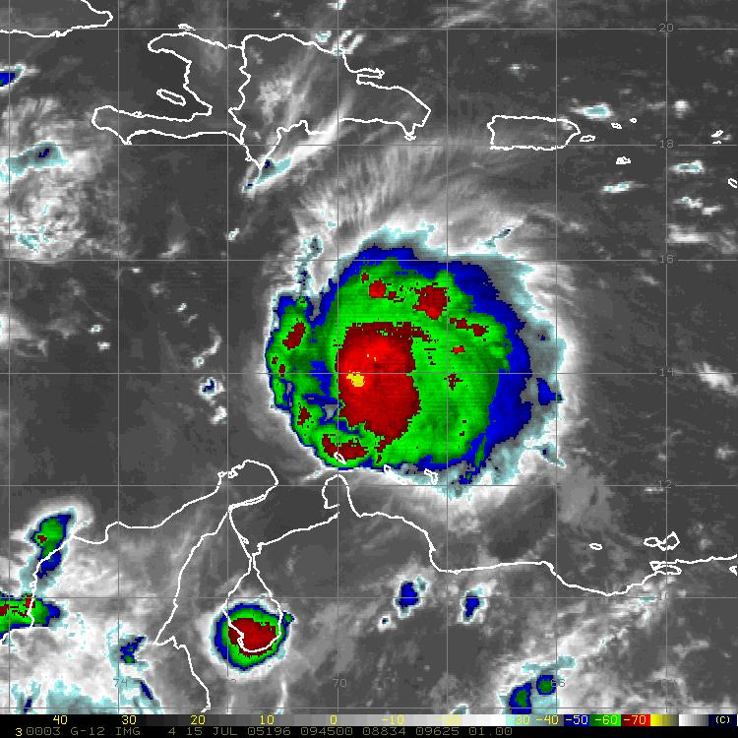
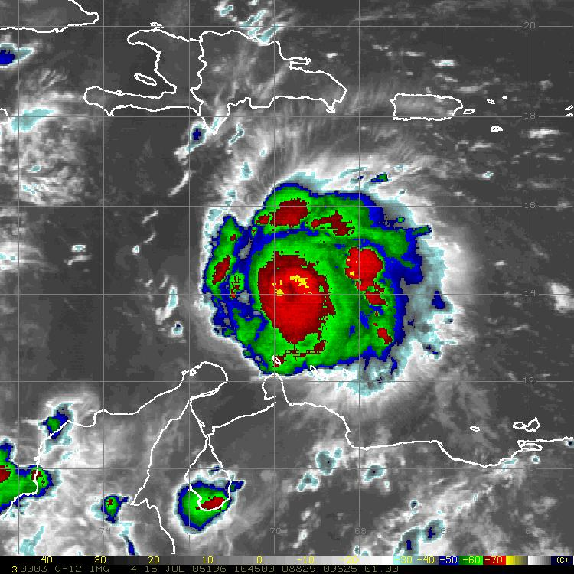
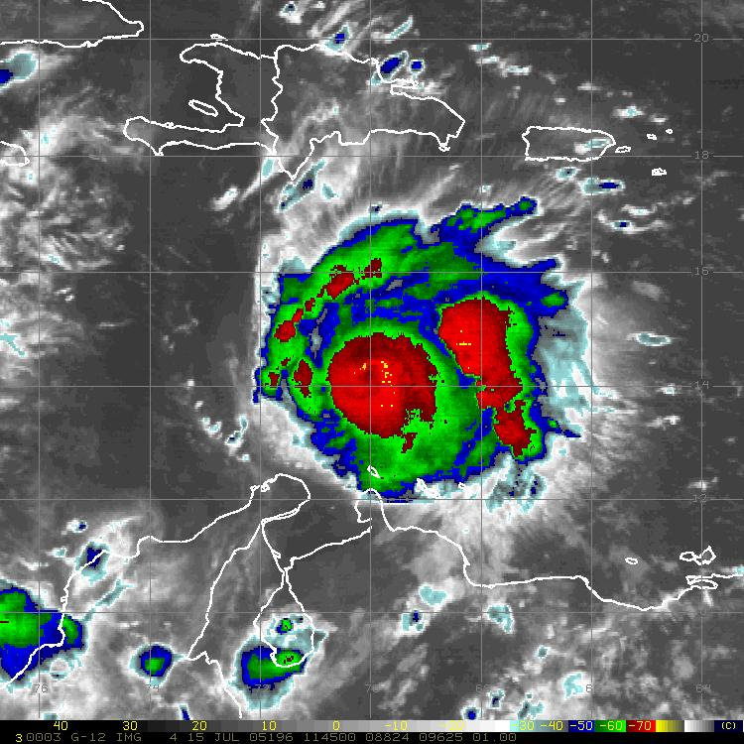
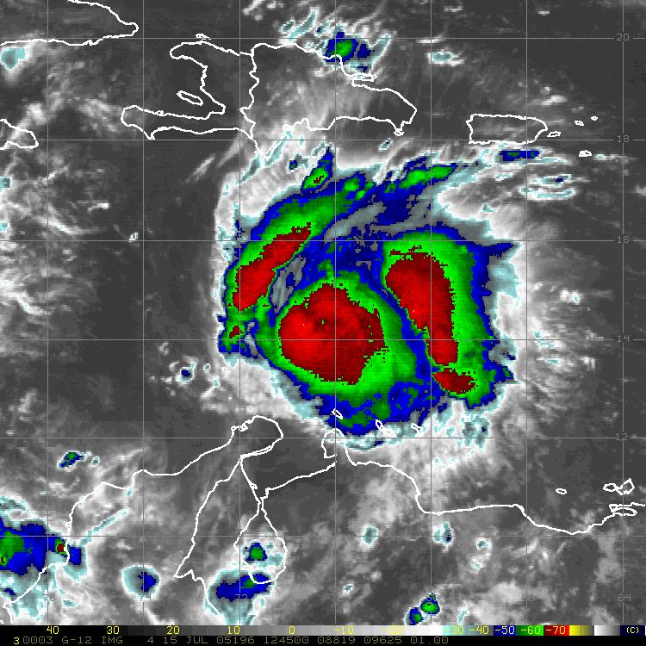
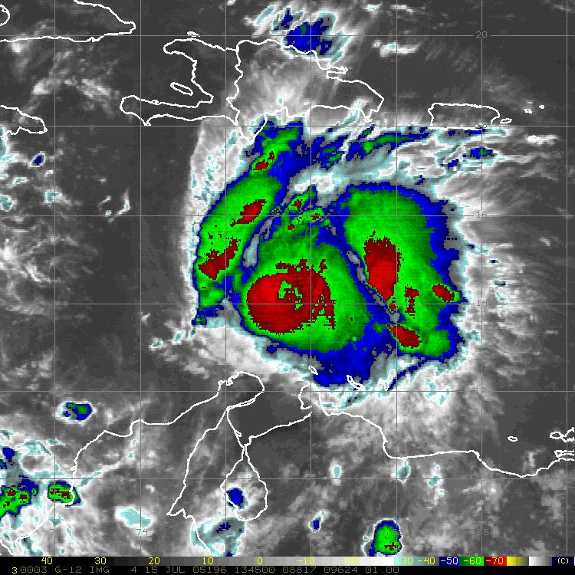
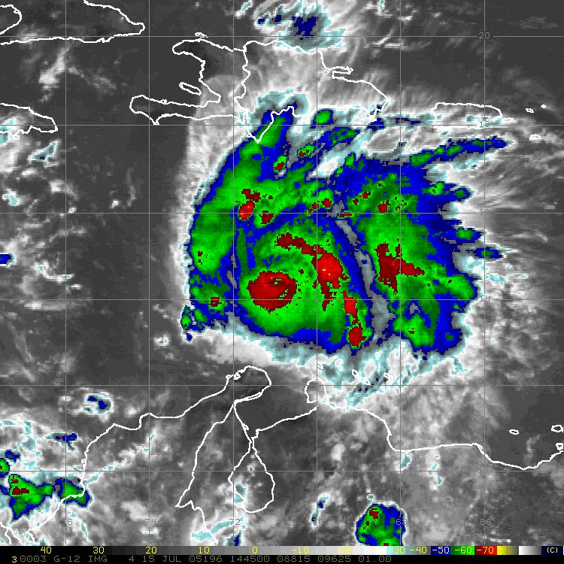
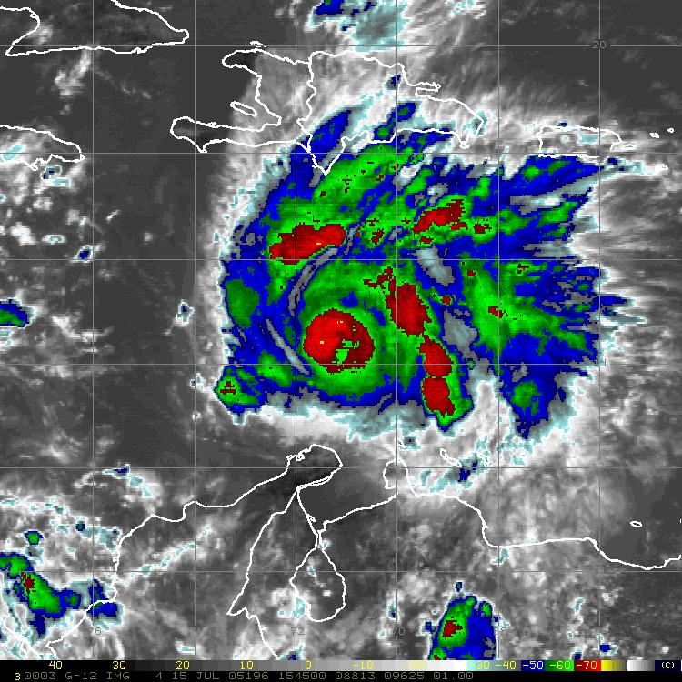
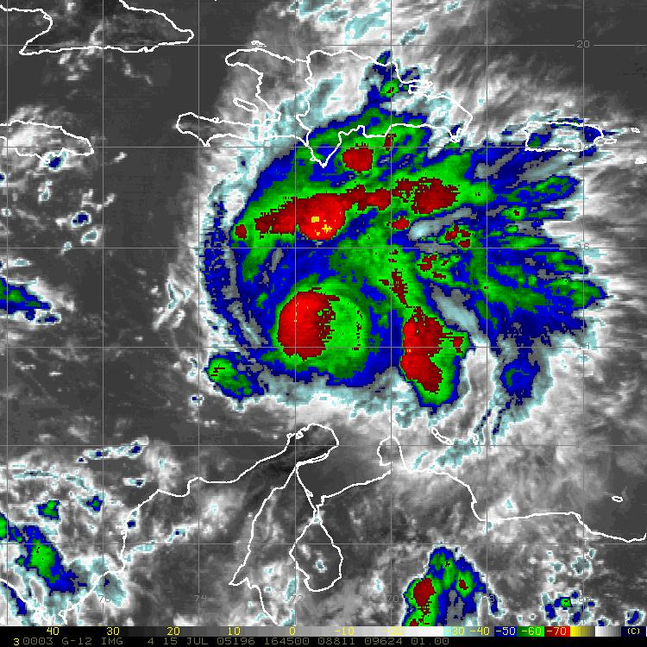
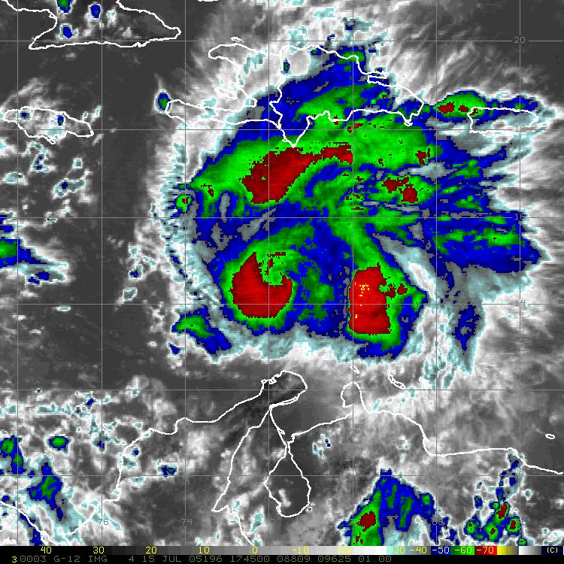
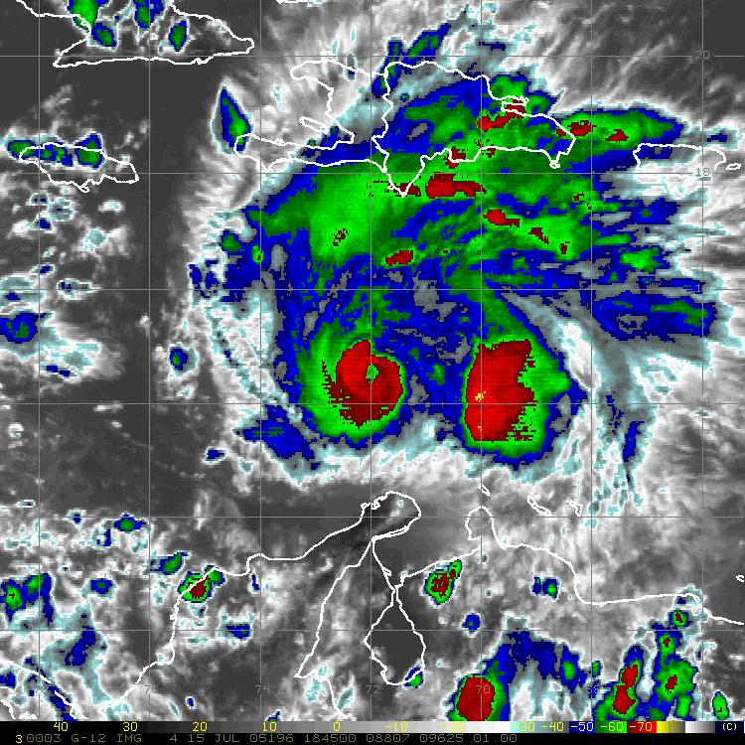
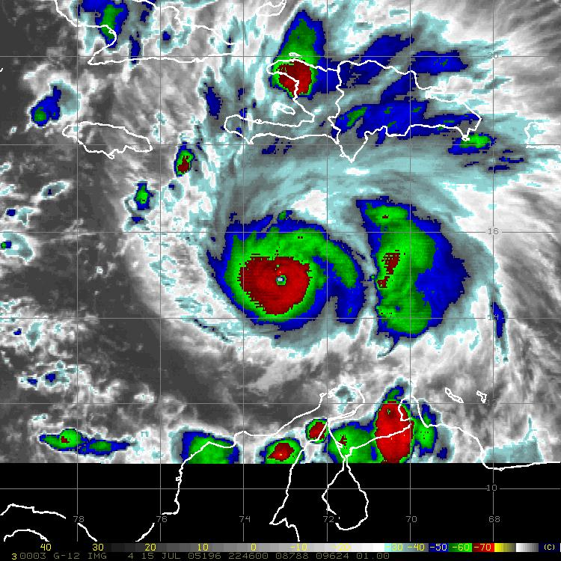
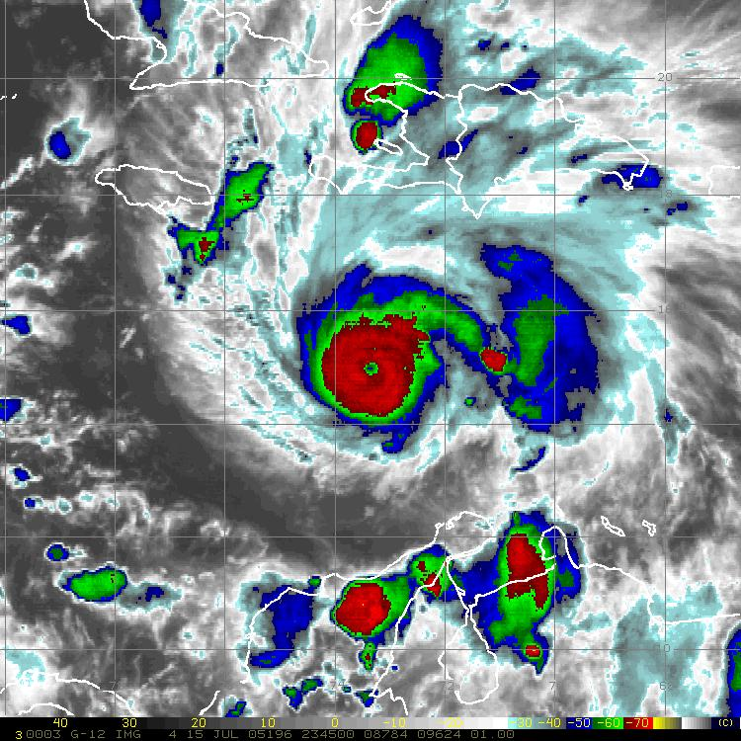
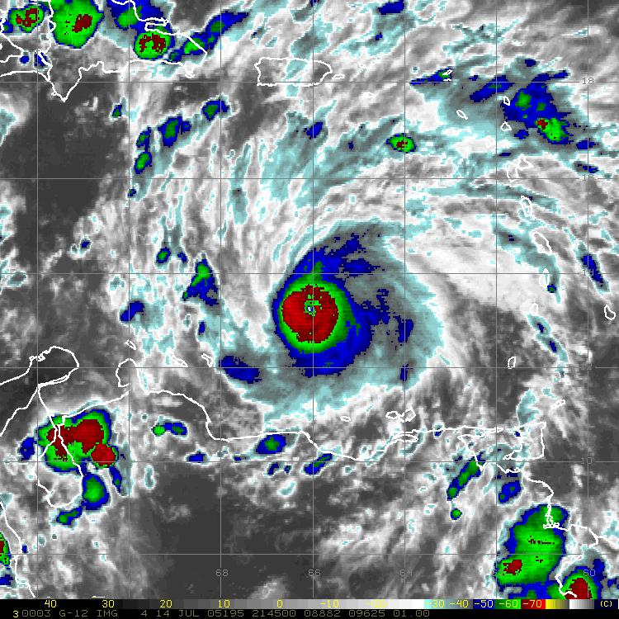
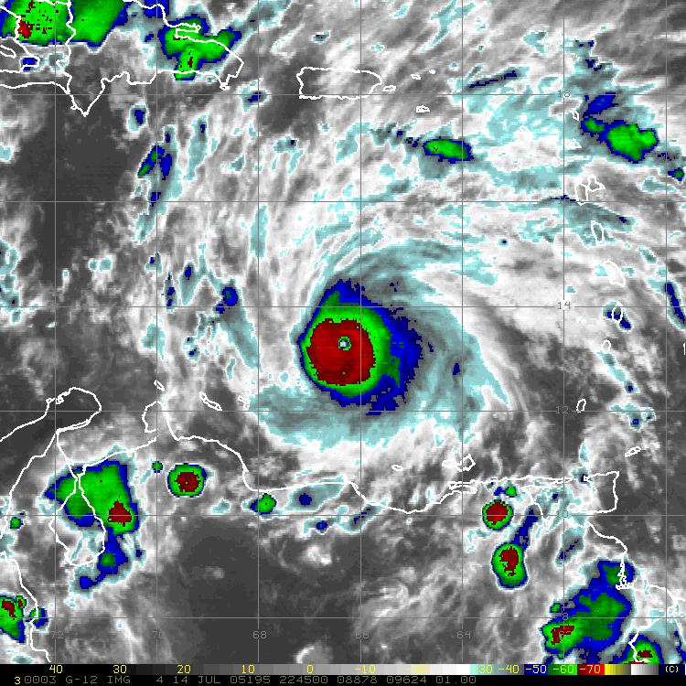
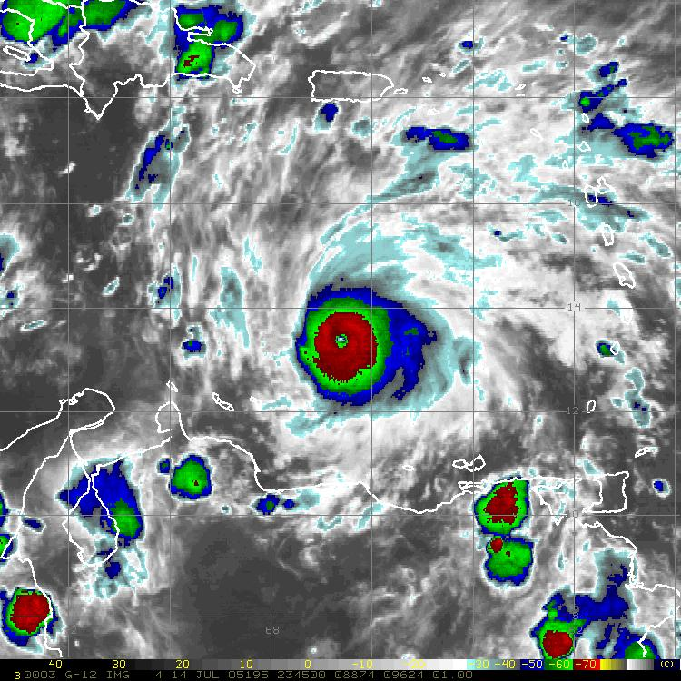
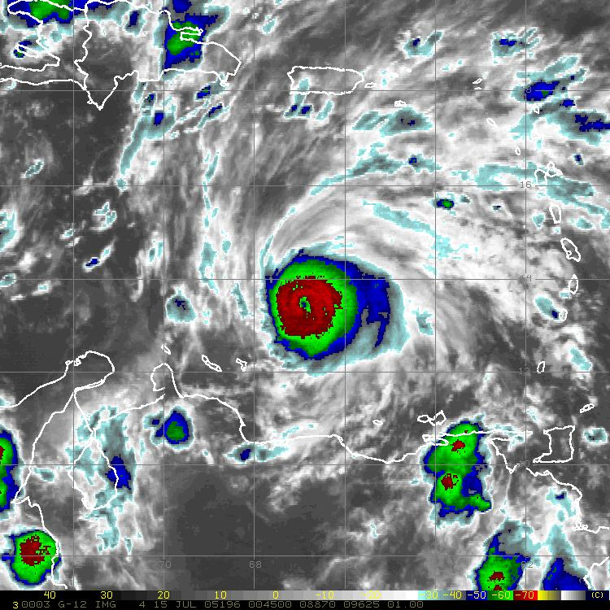
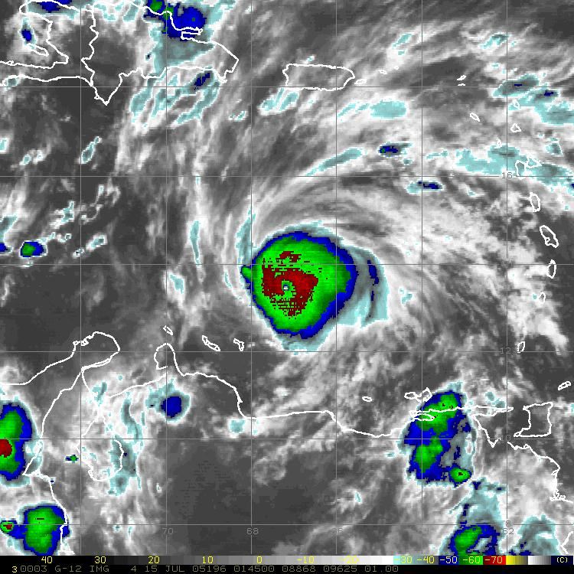
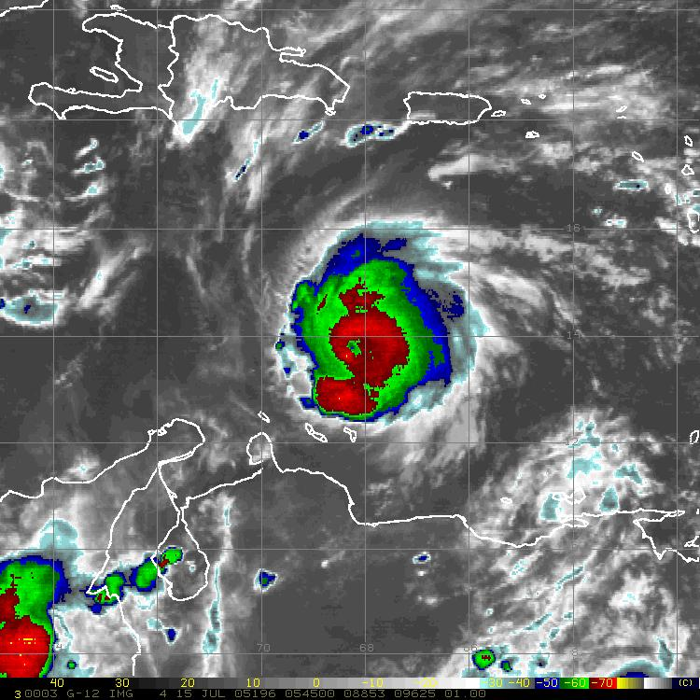
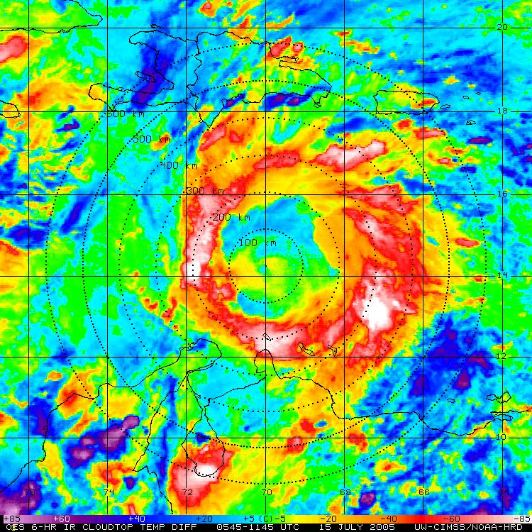
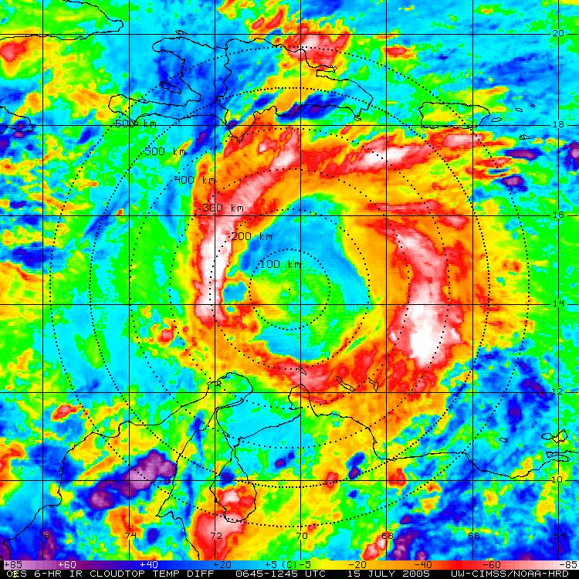
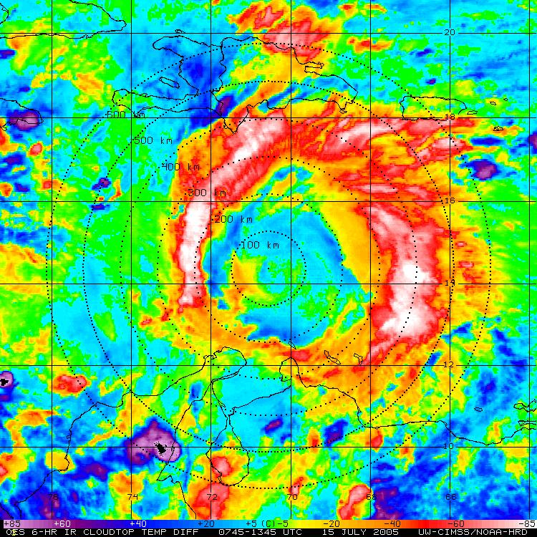
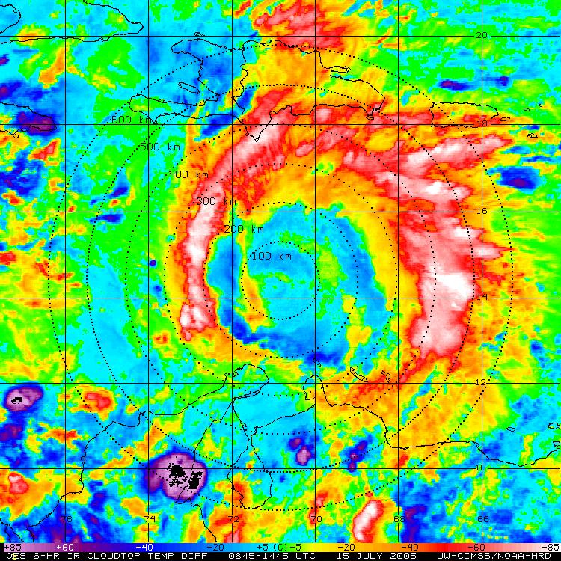
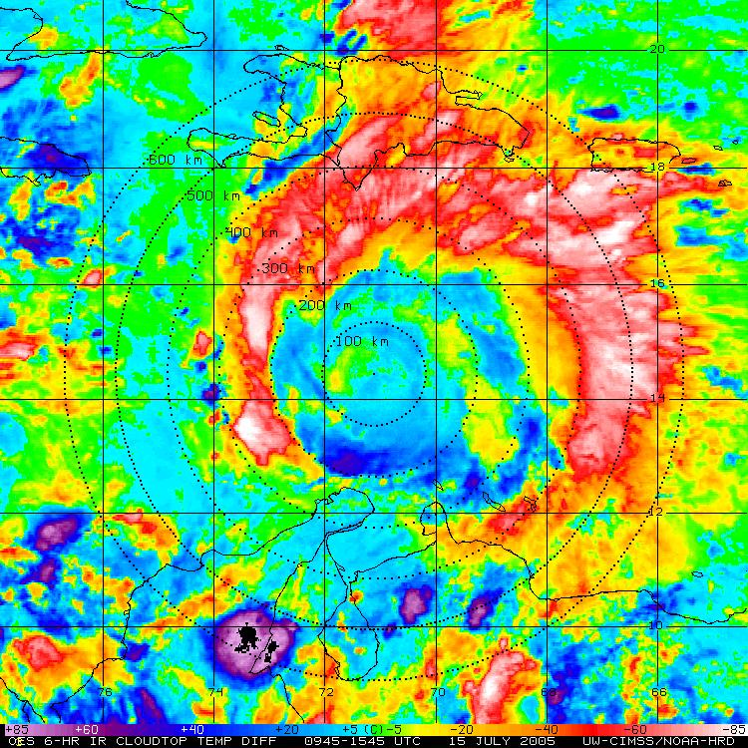
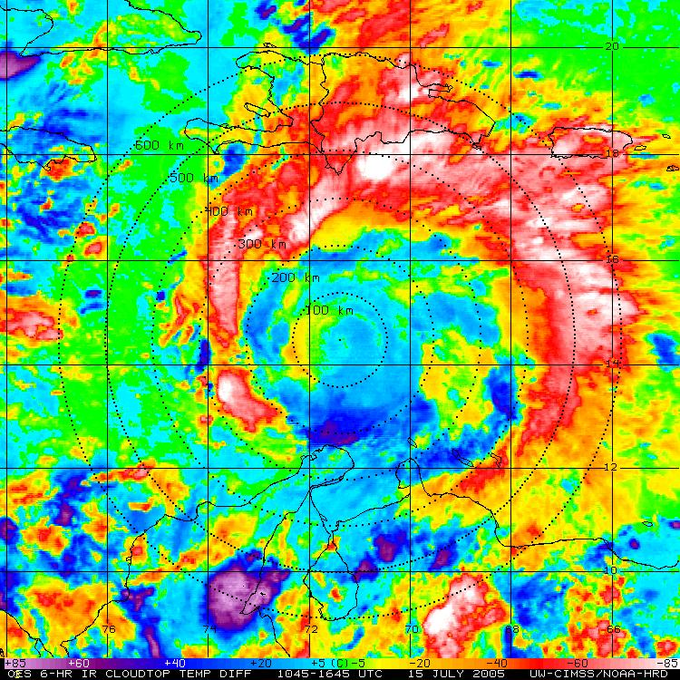
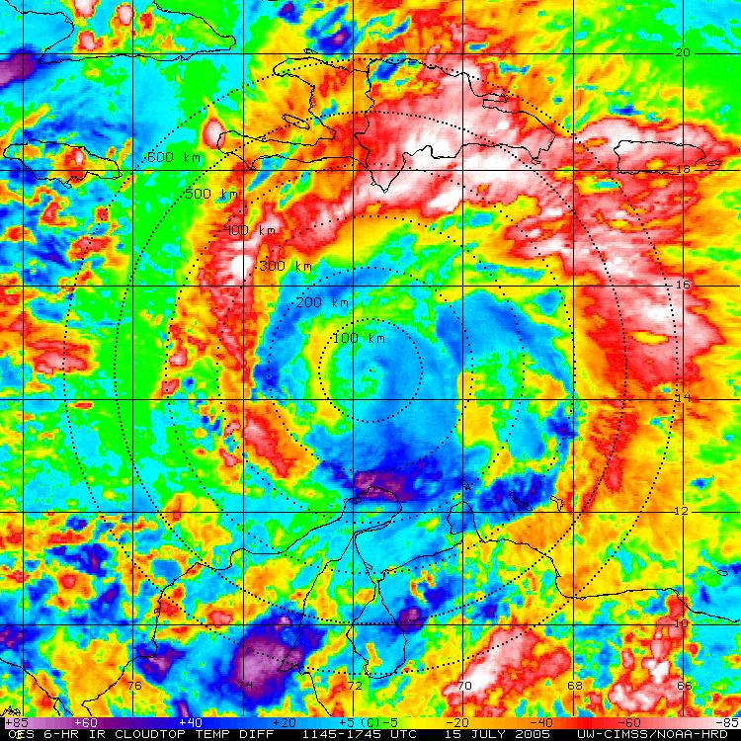
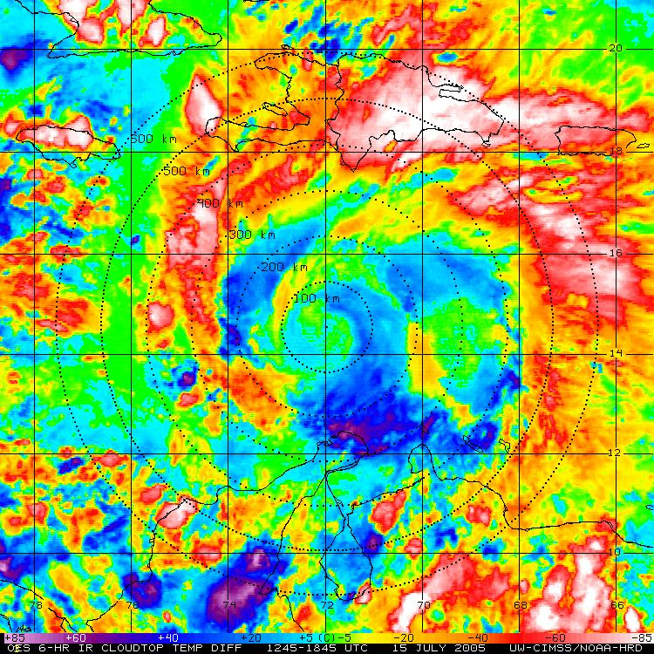
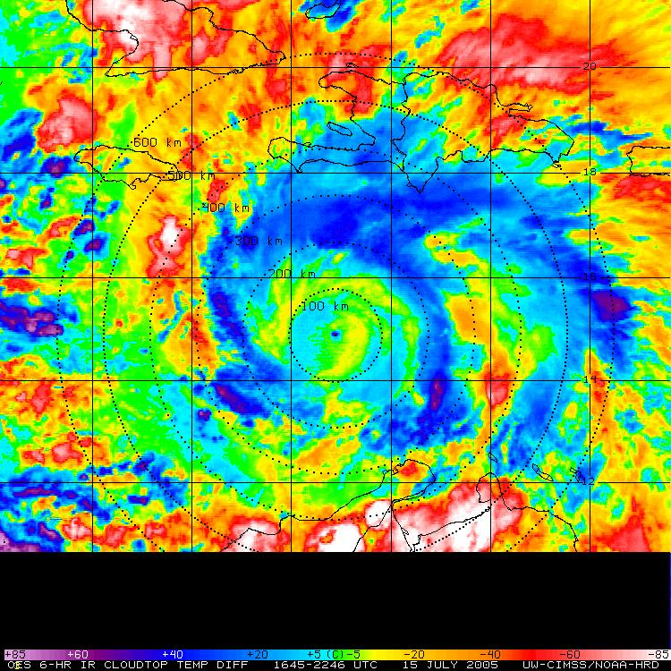
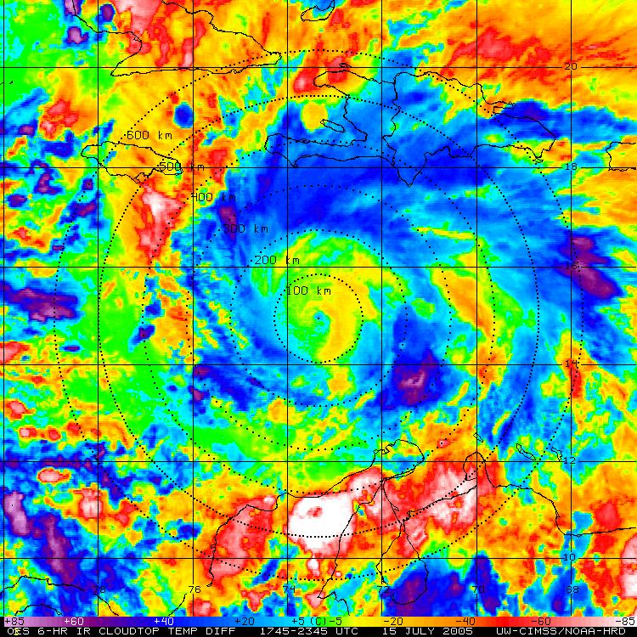
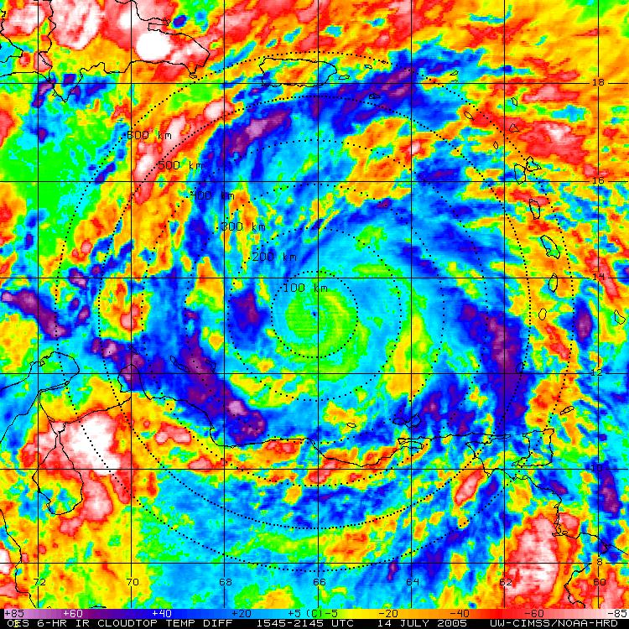
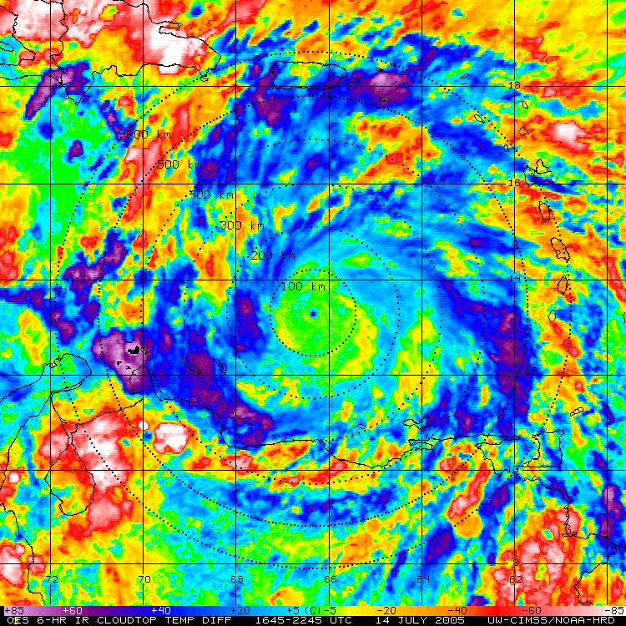
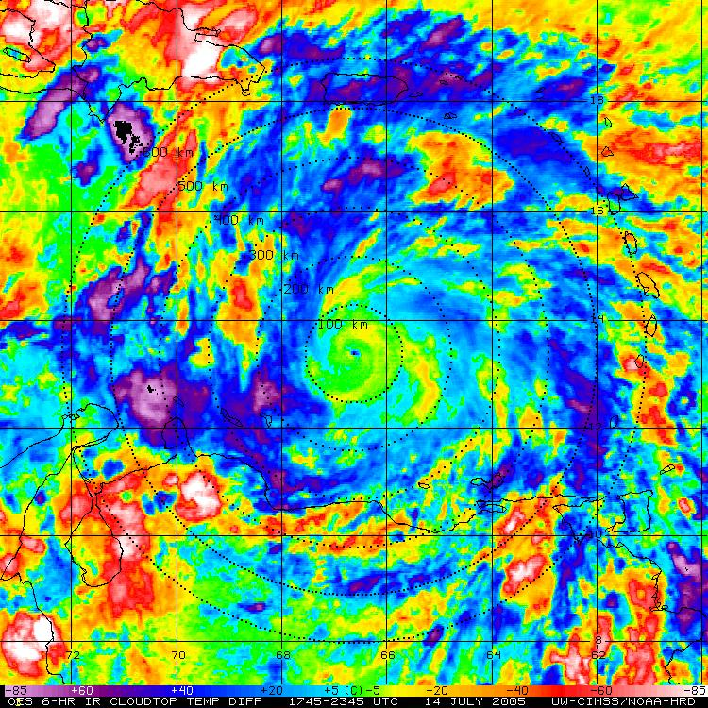
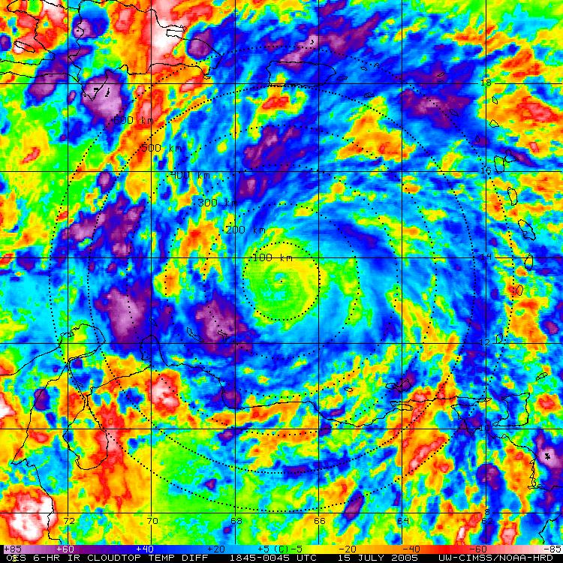
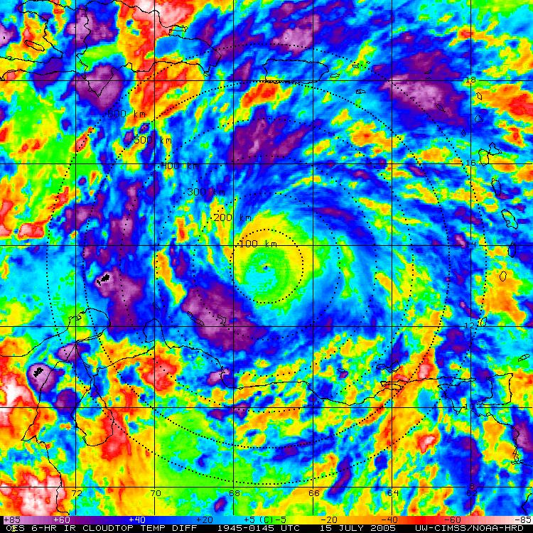
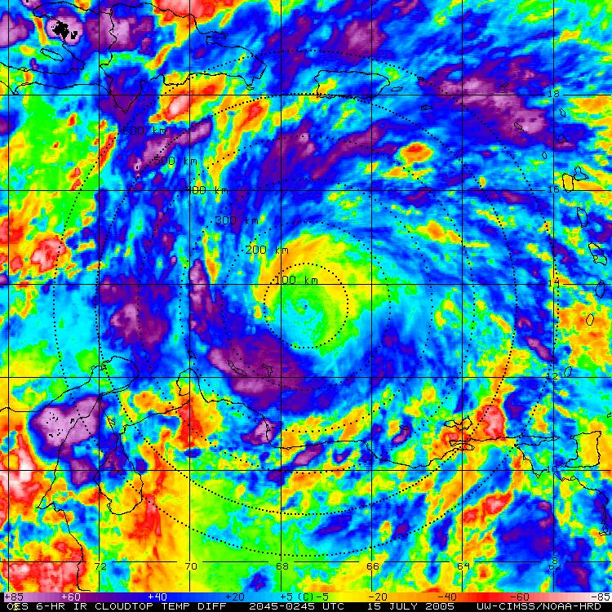
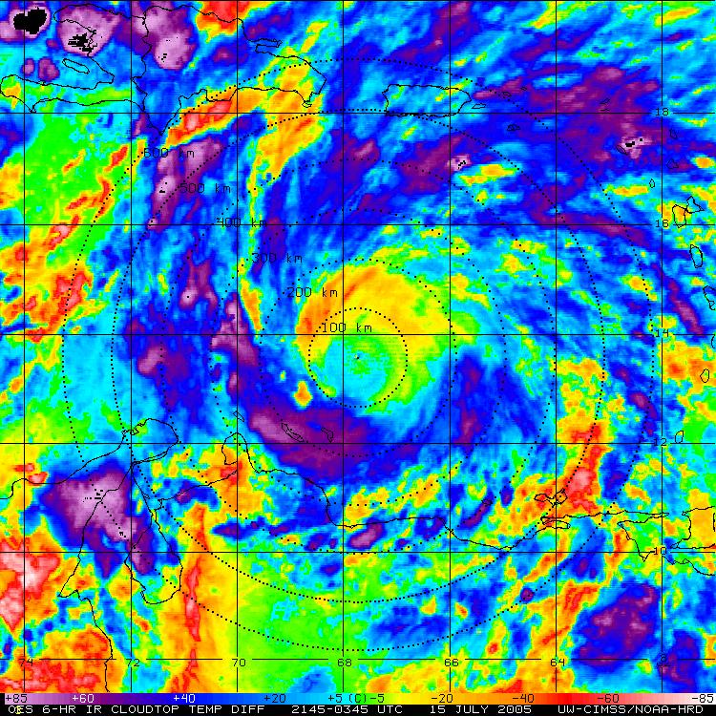
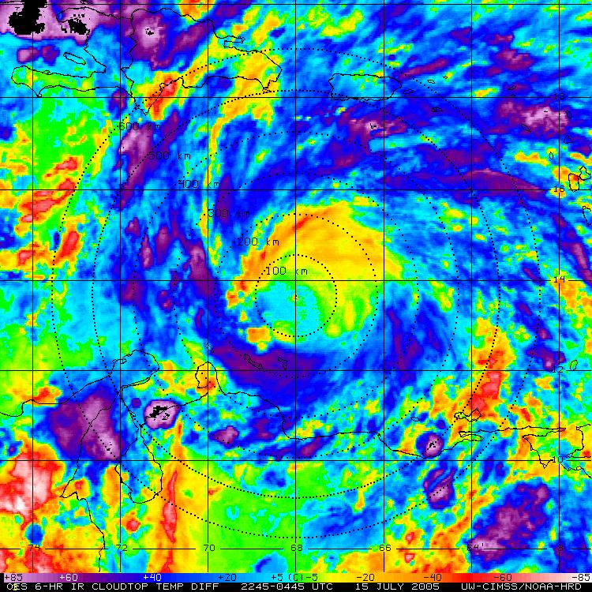
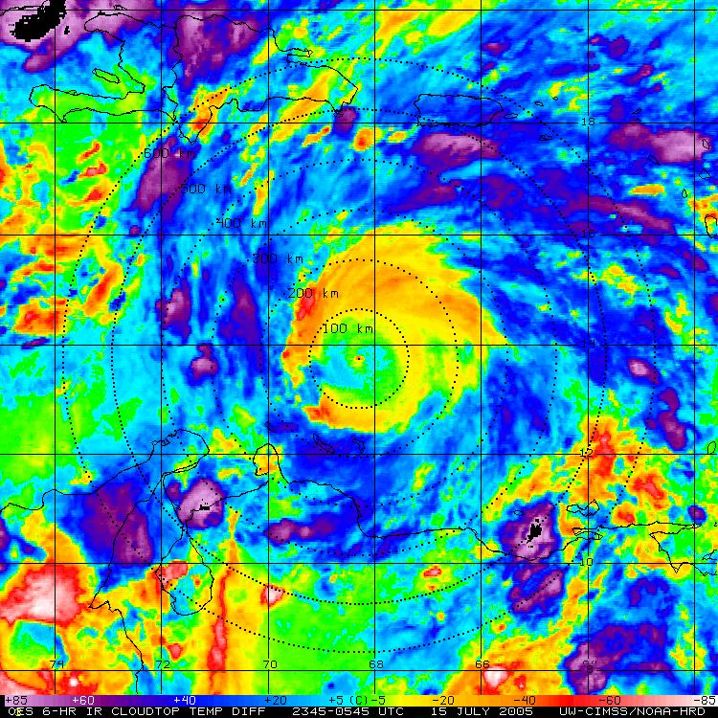
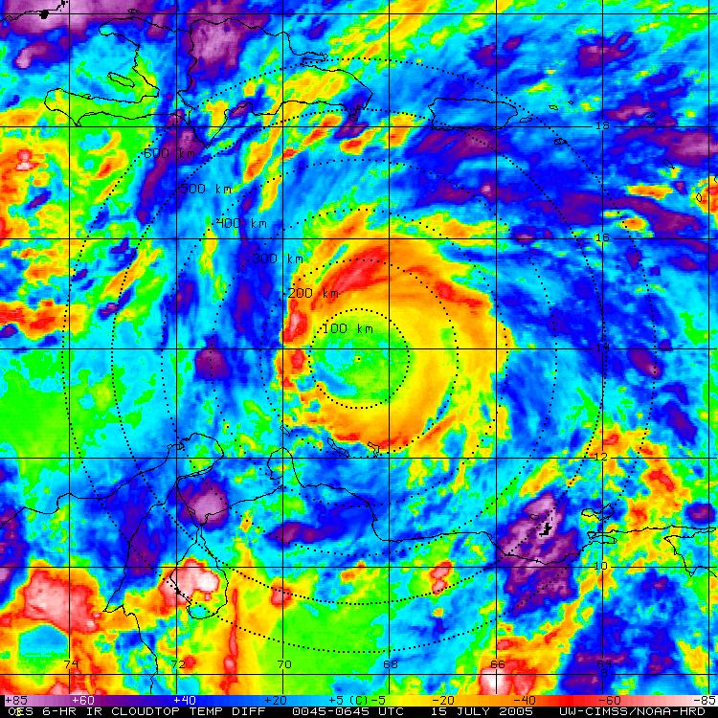
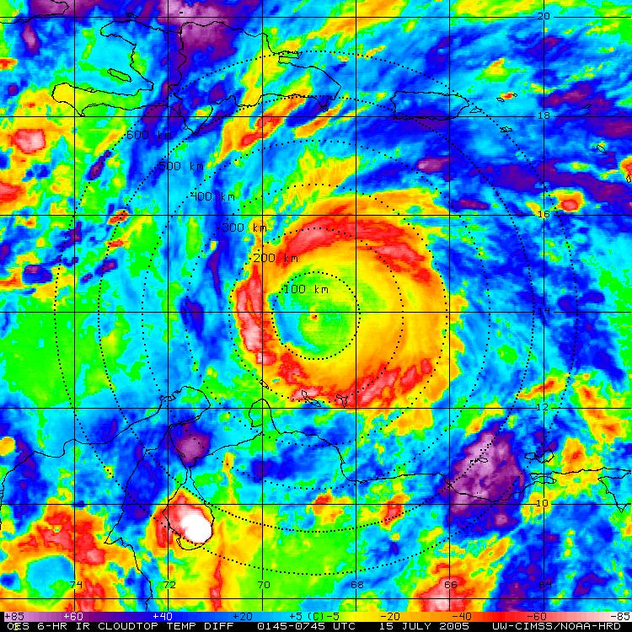
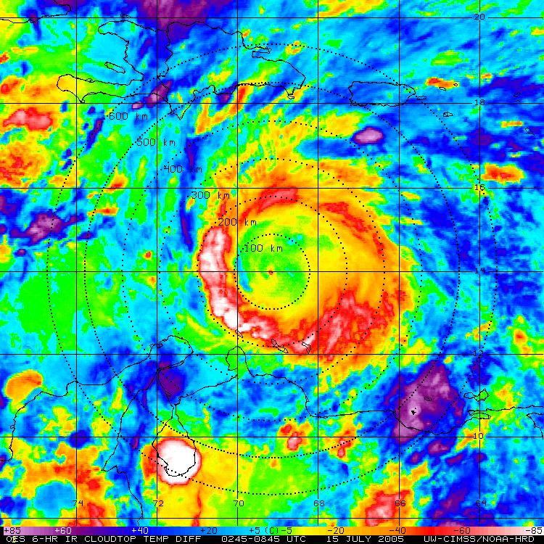
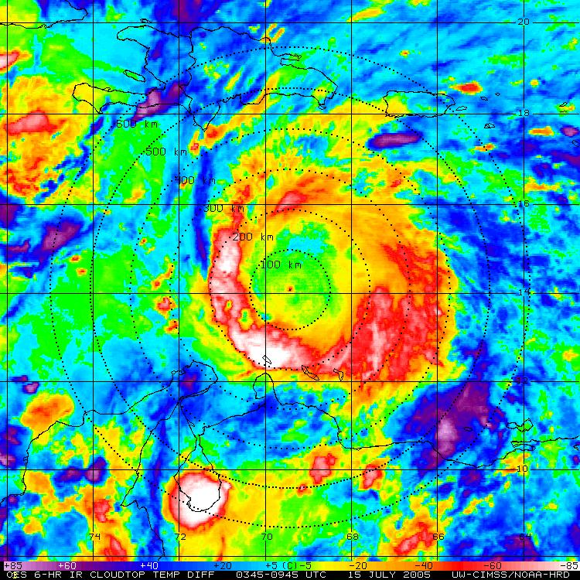
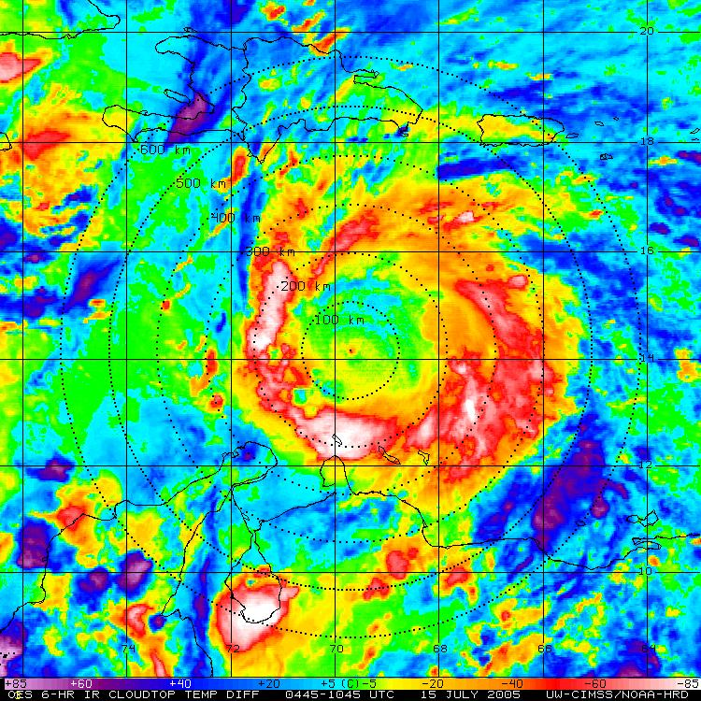
Hurricane Emily: 14-15 July 2005
GOES IR (storm relative)
GOES BT Diff (storm relative)
Notes:
Click “next”
IR imagery on the left animates: hourly storm centered GOES IR showing 2005 Hurricane Emily
Notice how the storm suddenly expands as it passes south of Hispaniola (that’s the diurnal pulse)…also notice that the storm looks a bit ragged/asymmetric as it goes through this expansion
Click “next” again
Now the 6-hour brightness temp difference imagery on the right animates: greens to yellows to pinks indicate a 6-hr trend of cooling cloudtops…blues to purples indicate warming trends
Watch for a cool ring (greens to yellows to pinks) to develop in the inner ~150 km and then steadily propagate/move out radially outward over time (with marked warming behind the pulse >> that’s the signature signal of the TC diurnal cycle)

Slide 2
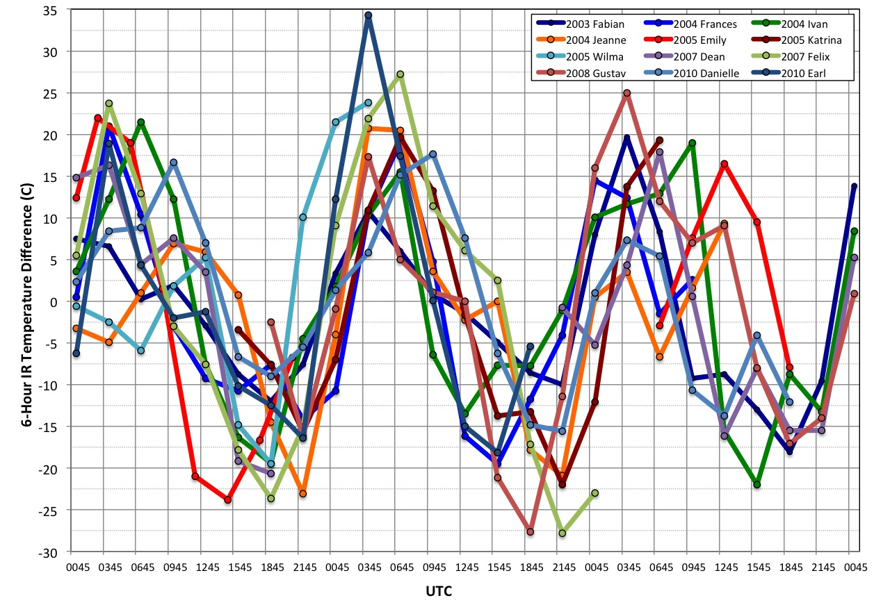
GOES 6-HOUR IR Temperature Differences
Azimuthal Mean (R=400km)
Notes:
This plot is a 3-day snapshot of 12 North Atlantic major hurricanes from 2003-2010- we’re looking at 6-hr IR brightness temp trends at R=400 km
Basically, I wanted to detect the diurnal pulses as they passes R=400 km (i.e. peak neg values indicate when the diurnal pulse passed R=400km (notice the warming trend after the pulses pass)
These storms are all within ~30 deg longitude of each other…so it’s ok to use UTC…had they been storms from vastly different time zones, we’d have to look at this in LST
Notice the rythmic diurnal cycle signature of cooling (neg y-axis values) as the pulses pass by

Slide 3
TC Diurnal Cycle
2001-2010; 31 Major Hurricanes
Notes:
Similar to the previous plot, this shows a 31 composite of all major NATL hurricanes from 2001-2010 (relative to LST)
notice that a clear signal is not present at R=100 km, becomes more discernable at R=200 km, and is very clear at R=400km
Click “next”: same plot, but for R=400-600 km >> notice the trend in the timing of the passage of the diurnal pulse (min in BTs) is a bit later as you go from R=400 to 500 to 600 km (confirmation that this thing is propagating radially away form the storm)

