Slide 1

Sensing Hazards with Operational Unmanned Technology (SHOUT)
Mission Readiness Review
DATE

Slide 2
Agenda
AGENDA
Opening/Introducton Remarks Phil Kenul/Gary Wick
Management & Logistics Phil Kenul
Tropical Outlook Jason Dunion
Mission & Science Overview Gary Wick
Flight Patterns & Modules Jason Dunion
Data Management & Analysis JC Coffey
GH Operations Jon Neuhaus
Actions Phil Kenul

Slide 3
INTRODUCTION
Name : SHOUT (Sensing Hazards with Operational Unmanned Technology)
When: 16 August – 30 Sepember 2015 (with up to a 2 week extension-Flight ops nominally 25 August-27 September)
Where: NASA Wallops Island Flight Facility, Virginia
  Demonstrate and test UAS concept of operations that could be used to mitigate the risk of diminished high impact weather forecasts and warnings in the case of polar-orbiting satellite

Slide 4
Overview: SHOUT Science Objectives
Objective 1 - Quantify the significance of unmanned observations to high impact weather prediction through data impact studies using Observing System Experiments (OSE) based on unmanned observations collected during prototype operational field missions and Observing System Simulation Experiments (OSSE) based on expected unmanned observing capabilities.
Objective 2 - Quantify the cost and operational benefit of unmanned observing technology for high impact weather prediction through detailed analysis of life-cycle operational costs and constraints versus scientific benefit.

Slide 5
SHOUT
Project Management & Logistics
Philip Kenul
Project Manager

Slide 6
SHOUT Mission Management
Robbie Hood, Director UAS Program, NOAA OAR
Gary Wick, PI, Mission Scientist, NOAA ESRL
Jason Dunion, Deputy PI, Deputy Mission Scientist, NOAA HRD
Philip Kenul, Project Manager, NOAA OAR, Trivector Services
JC Coffey, Deputy Project Manager, NOAA OAR, CNT
Quincy Allison, Deputy Program Manager, Ames Research Center
Frank Cutler, GH Project Manager, AFRC
Jon Neuhaus, GH Deputy Project Manager, AFRC
Mark Buschbacker, GH Payload Manager, AFRC
Ron Walsh, SHOUT Wallops PM, WFF
Denise Lawless, SHOUT Wallops Deputy PM

Slide 7
SHOUT Management
Program Manager : Robbie Hood/UASPO
Overall Directions & Planning
Mission Systems Engineer
Deputy PM: JC Coffey/UASPO
Mission Requirements
Project Manager: Philip Kenul/UASPO
Budget & Schedule, Mission Operations &
Deployment Operations
Principal Investigator : Gary Wick/ESRL;
Mission Science: Jason Dunion AOML-HRD
Science Requirements – Mission Planning
Flight Planning & Analysis
Aircraft Manager
Frank Cutler/AFRC
GH Management
Payload Manager
Mark Buschbache r
Modifications/Integration
Data Management
JC Coffey & ESRL-GSD
Data Archival /Access
WFF Manager
Ron Walsh/WFF
Facilities & Infrastructure
AV-6
Dropsondes
Hock (NCAR)
HIWRAP
Heymsfield (GSFC)
HAMSR
Lambrigtsen (JPL)
LIP
Blakeslee (MSFC)

Slide 8
FINANCIALS

Slide 9

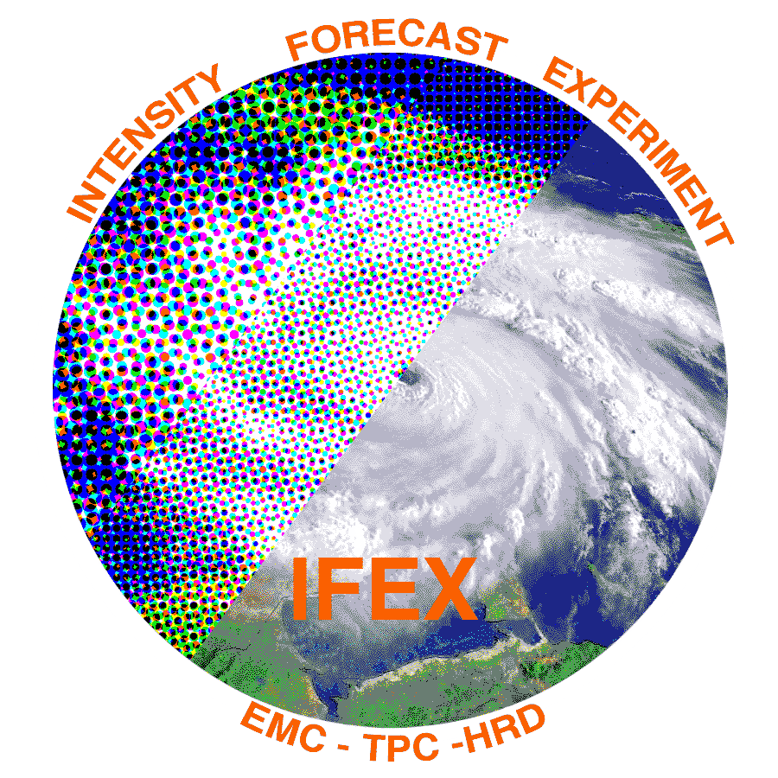

Interagency Cooperation
NASA / NOAA / USAF
2015 Hurricane Research
Tri-Agency Communications Plan

Slide 10
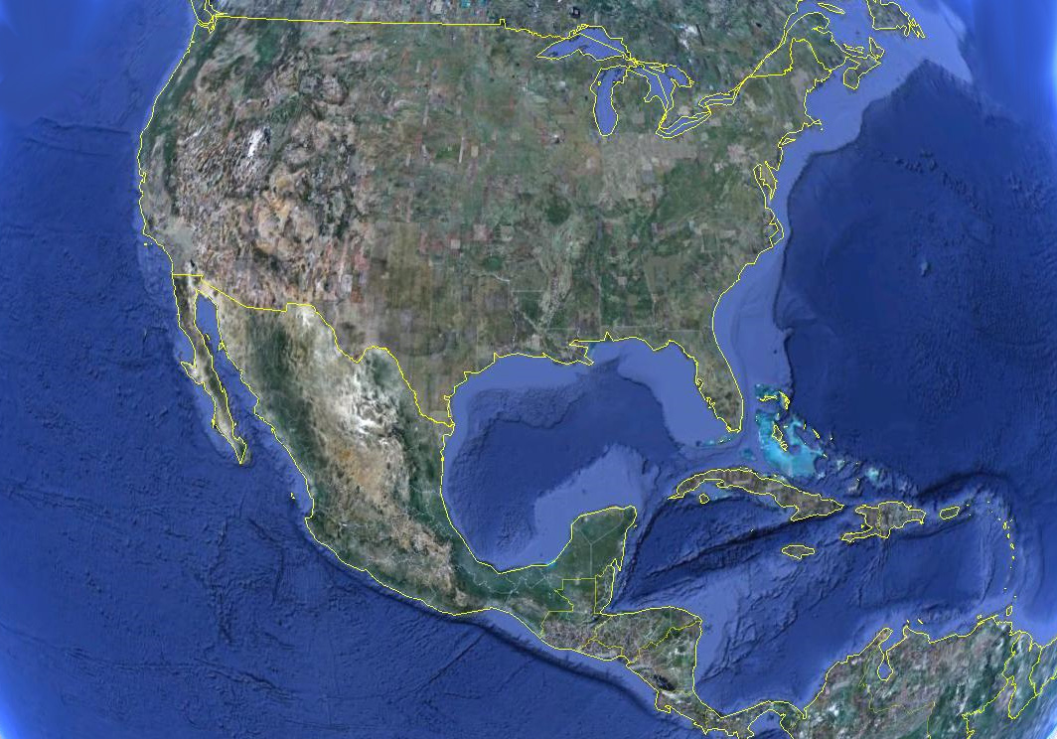
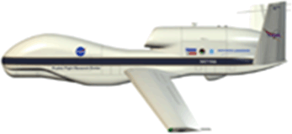
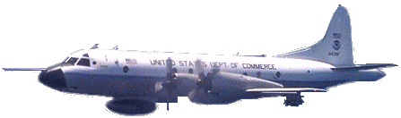

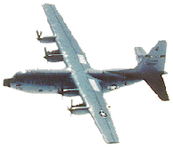
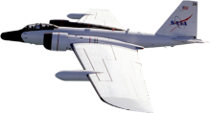
SHOUT Air Force/ONR /NOAA Coordination to improve tropical storms observations
Operation Base Locations
*
NASA
WFF
BDA
AFRC/53rd WRS
Keesler AFB
NASA JSC
Ellington Field
NOAA/AOC
MacDill AFB
STX
TBPB

Slide 11
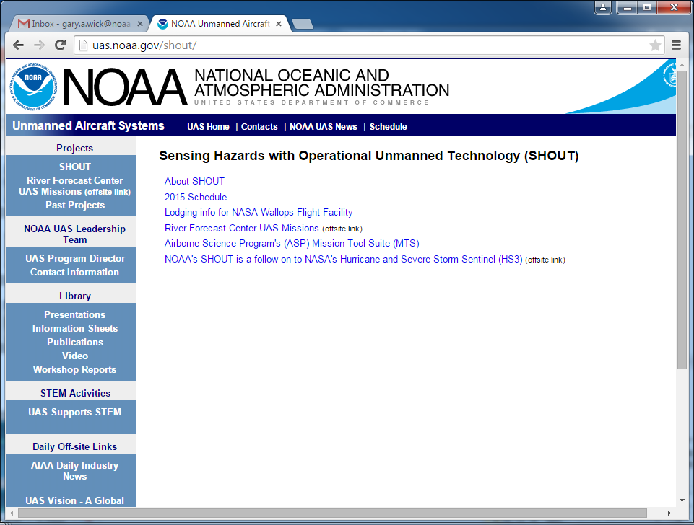
http://uas.noaa.gov/shout

Slide 12
Lodging and Badging
Room blocks established at per diem
  Comfort Suites
  Best Western
  Fairfield Inn
  Call hotels directly; mention NOAA/NASA SHOUT
Eagle’s Nest
  PIV badges and CAC card holders only
Badging at both AFRC and WFF managed via ESPO database
  Groups populated
  Please enter travel plans ASAP-Need specific on site dates
  Multiple visit capability at both sites

Slide 13
COMSEC
COMSEC procedures in effect at both sites
WFF training from last year valid for two years
Sharing WFF hangar with Navy
  No additional COMSEC required during while NAVY Ops are conducted.

Slide 14
SHOUT Risks for 2015
Reliability – AV-6 will be used. AV-1 is being retired (?).
IAA’s: Delays in cost estimates for GSFC under AFRC IAA may impact timely approvals/Funds transfer. MSFC IAA Pending.
Instrumentation – All Instrument payloads previously flown and required minor effort. No major problems are currently apparent.
  LIP Delay Nose Probe install
  HIWARP/AVAPs delayed arrival at AFRC (7/20/15)
Flight Ops Restrictions – Standard issues with clearances approvals, VACAPES conflicts.
Quiet Atlantic Basin/Redeploy –Lost time to project will reduce productivity if Atlantic basin quiet. Costs of redeploy should be minimal and fund adequate.

Slide 15
Operations
Deployment Decision
  KDP 1 on July 28/29 Go/NO GO to WFF
Redeployment to AFRC
  KDP 2 on September 7
  Approx 6-7 days to move operations

Slide 16
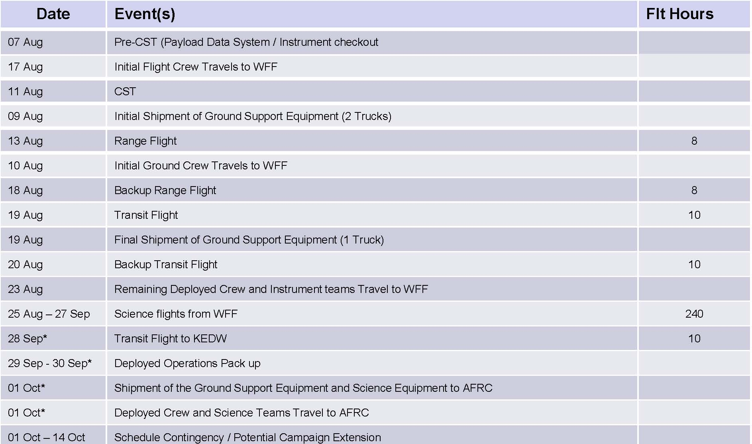
Timeline and Deployment Plan

Slide 17
NOAA SHOUT’15 GH Project Schedule
AFRC / WFF
Final 2Jul’15
Neuhaus
June 2015
Sunday | Monday | Tuesday | Wednesday | Thursday | Friday | Saturday
 | 1 | 2 | 3 | 4 | 5 RDO | 6
7 | 8 | 9 | 10 | 11 | 12 | 13
14 | 15 | 16 | 17 | 18 | 19 RDO | 20
21 | 22 | 23 | 24 | 25 | 26 | 27
28 | 29 | 30
872 Flight Ready
Pilot Prof Flt
Lessons Learn
Table Top
Pilot Prof Flt
ORR Slide Review
AFRC ORR

Slide 18
NOAA SHOUT’15 GH Project Schedule
AFRC / WFF
July 2015
Sunday | Monday | Tuesday | Wednesday | Thursday | Friday | Saturday
 |  |  | 1 | 2 RDO | 3 HOLIDAY | 4
5 | 6 | 7 | 8 | 9 | 10 | 11
12 | 13 | 14 | 15 | 16 | 17 RDO | 18
19 | 20 | 21 | 22 | 23 | 24 | 25
26 | 27 | 28 | 29KDP1 | 30 | 31 RDO | 1
GH Crew – Prep Aircraft and Hangar for SHOUT -- Install AVAPS Mount, Z-61
LIP Instrument
Arrives AFRC
HIWRAP AVAPS
Inst’s Arrive AFRC
LIP Team Arrives
LIP Unpack, Test
SIL* Bench Tests
LIP install on A/C
LIP install on A/C
LIP OA Harnessing / Cleanup
HIWRAP/AVAPS Teams Arrives
HIWRAP / AVAPS Unpack, Test
SIL* Bench Tests
HIWRAP / AVAPS installation on A/C
HWRAP/AVAPS
OA Harnessing / Cleanup
Wt & Bal
HAMSR Arrives, SIL* Bench
HAMSR Install on A/C
Hangar IT Testing
Hangar IT Testing
Fuel A/C
*Note: “SIL Bench Tests” includes Wt., SIL Power Tests, and Data-IT Tests

Slide 19
NOAA SHOUT’15 GH Project Schedule
AFRC / WFF
August 2015
Sunday | Monday | Tuesday | Wednesday | Thursday | Friday | Saturday
2 | 3 | 4 | 5 | 6 | 7 | 8
9 | 10 | 11 | 12 | 13 | 14 RDO | 15
16 | 17 | 18 | 19 | 20 | 21 | 22
23 | 24 | 25 | 26 | 27 | 28 RDO | 29
30 | 31
Initial Data-IT & Instr. Teams- WFF
Lessons Learn
Table Top
Tech Brief
Pre-CST
Instr. Outdoor SATCOM Testing (w/GHOC-E manned)
Initial GH Flt. Crew to WFF
Inst. & A/C Preflights
CST
CST Backup
Pacific Ku Sat Support Starts
2 trucks leave for WFF
Inst. & A/C Preflight
Range Flt
(6 hrs)
Instrument
Access
Atlantic Ku Sat Support Starts
Inst. & A/C Preflight
1 trucks to WFF
Instrument Access
Initial GH OM Crew to WFF
Inst. & A/C Preflight
Transit Flt. to WAL
Range Flt
(Backup)
Transit Flt.
(Backup)
Remaining GH Crew, GH Team & Inst. P.I.’s to WAL
Inst. & A/C Preflight
Science Flight Ops
Science Flight Period

Slide 20
NOAA SHOUT’15 GH Project Schedule
AFRC / WFF
September 2015
Sunday | Monday | Tuesday | Wednesday | Thursday | Friday | Saturday
 |  | 1 | 2 | 3 | 4 | 5
6 | 7KDP-2 HOLIDAY | 8 | 9 | 10 | 11 RDO | 12
13 | 14 | 15 | 16 | 17 | 18 | 19
20 | 21 | 22 | 23 | 24 | 25 RDO | 26
27 | 28 | 29 | 30
Science Flight Period
Science Flight Period
Earliest decision point to RTB
Science Flight Period
*Earliest date to begin Pacific Ops
Pacific Option - Science Flight Period
Science Flight Period
Pacific Option - Science Flight Period
Science
Transit Flt. to EDW
Inst. Removal & Packing
Pacific Option - Science
GH Team & Inst. P.I.’s AFRC
*Note: The first Pacific science flight after returning from Wallops is estimated to be 5 to 8 days following return.

Slide 21
NOAA SHOUT’15 GH Project Schedule
AFRC / WFF
October 2015
Sunday | Monday | Tuesday | Wednesday | Thursday | Friday | Saturday
 |  |  |  | 1 | 2 | 3
4 | 5 | 6 | 7 | 8 | 9 RDO | 10
11 | 12 | 13 | 14 | 15 | 16 | 17
18 | 19 | 20 | 21 | 22 | 23 RDO | 24
25 | 26 | 27 | 28 | 29 | 30 | 31
Schedule Contingency
Trucks leave WFF for AFRC
Schedule Contingency
Both Atlantic and Pacific Ku Sat Support Ends
Schedule Contingency

Slide 22
SHOUT PAYLOADS
Investigator | Instrument | Acronym | Primary Measurement
Bjorn Lambrigsten, JPL | HAMSR | High-Altitude MMIC Sounding Radiometer | Profiles of temperature, humidity in non-raining areas; precipitation profiles
Gerry Heymsfield, GSFC | HIWRAP | High-alt. Imaging Wind and Rain Airborne Profiler | 3-D precipitation, winds; sfc winds in non-raining areas
Gary Wick, NOAA | AVAPS | Advanced Vertical Atmospheric Profiling System (dropsonde) | High-resolution profiles of temperature, humidity, and winds
Richard Blakeslee, MSFC | LIP | Lightning Instrument Package | Electric field components, aircraft self-charge, and air conductivity
Notes:
Check spelling

Slide 23
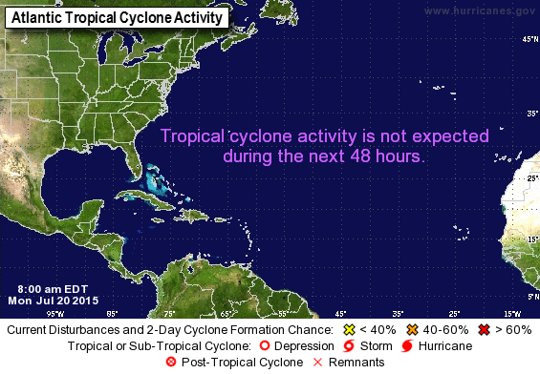
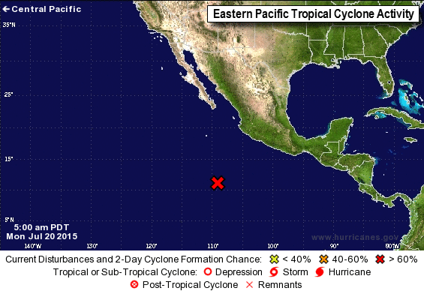
Current Tropical Outlook
North Atlantic & Eastern North Pacific
Jason D. Modified
This will need to be updated the day before the MRR

Slide 24
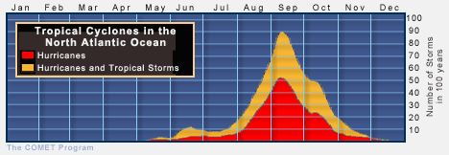
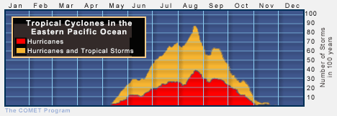
Number of Tropical Cyclones per 100 Years
NOAA SHOUT Science Operations: 25 Aug – 27 Sep 2015
North
Atlantic
NOAA
SHOUT
Eastern
North Pacific
Jason D. Modified
NOAA
SHOUT

Slide 25
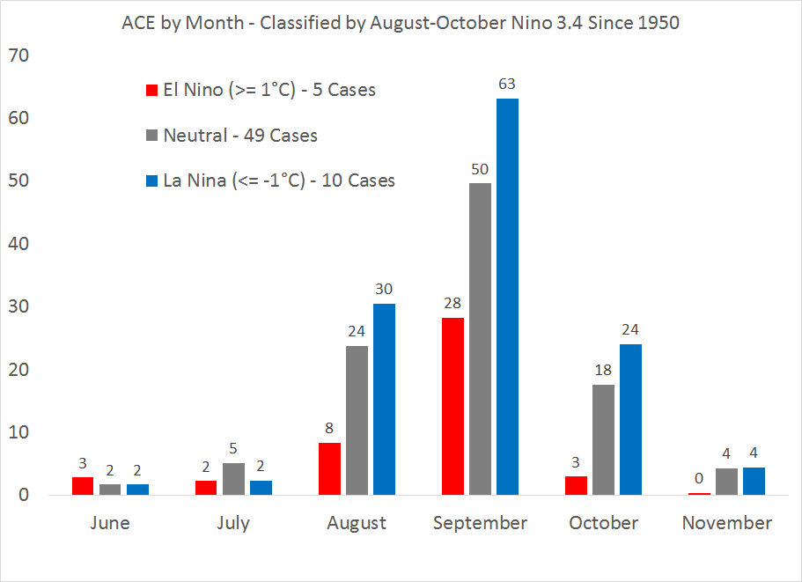
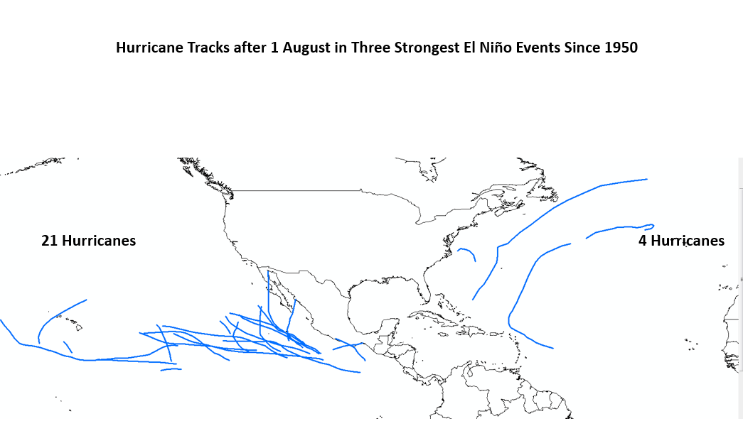
2015 Tropical Outlook
Tropical cyclone Accumulated Cyclone Energy (ACE)
& occurrence of hurricanes after August 1st
Jason D. Modified
El Nino Years
The eastern North Pacific hurricane season is significantly more active overall
The North Atlantic hurricane season is significantly less active overall
North Atlantic tropical cyclone activity drops significantly after September

Slide 26
SHOUT Science Team Readiness
Gary Wick/ Jason Dunion
Mission Scientist’s (MS) roles & responsibilities document prepared (Section 5 SHOUT MOP)
Familiarization/clarification of flight rules, flight scheduling, flight restrictions (Section 3 SHOUT MOP)
GH flight modules compiled and documented (Section 3 SHOUT MOP)
2015 Shout Dry Run
  Aug 10-19, 2015
  Exercise 2015 Wx brief schedule
  Exercising real-time use of adaptive sampling software for targeting GH dropsonde observations
  Exercising of flight planning software, Mission Tools Suite
Data Management Plan submitted
Jason D. Modified

Slide 27
2015 NOAA SHOUT
Mission Science Schedule
Dry Run: 10-19 August
Dry Run:
1 SHOUT mission scientist assigned each day
1200 EDT HRD map discussion (weekdays)
TCI 1530 EDT map discussions (weekend)
Run GH targeting software in real-time
Prepare Global Hawk boxes (day+2) & tracks (day+1)
Daily 1100 EDT coordination with pilots
Jason D. Modified

Slide 28
2015 NOAA SHOUT
Mission Science Schedule
Science Operations: 25 Aug – 27 Sep
Science Operations:
0730 EDT: daily cage meeting (shift-1 mission scientists & pilots)
0830 EDT: daily SHOUT coordination call
Wallops local weather (NASA Wallops-led)
MS shift-1: lead with a 5-10 min weather update)
Discussion of flight plans and strategies
1000 EDT: Coordination call with NOAA IFEX & ONR TCI
1100 EDT: Coordination with pilots
1200 EDT: HRD map discussion (weekdays only)
1530 EDT: ONR TCI map discussion (weekends only)
Jason D. Modified

Slide 29
2015 NOAA SHOUT
Mission Science Schedule
Science Operations: 25 Aug – 27 Sep
Science Operations:
Run HWRF ensemble targeting software in real-time
Prepare Global Hawk flight boxes (day+2) & tracks (day+1)
Mission Science Shifts
MS shift 1: 0400-1300 EDT (2-3 SHOUT)
MS shift 2: 1200-2100 EDT (2 SHOUT + 1 TCI)
MS shift 3: 2000-0500 EDT (2-3 SHOUT)
Jason D. Modified

Slide 30
2015 NOAA SHOUT
Mission Science Schedule
Extended Science Operations: 28 Sep – 14 Oct
Extended Science Operations:
Same schedule as Science Operations Period
Activated if a potentially high-impact tropical cyclone is imminent and resources are available to support operations
Jason D. Modified

Slide 31
2015 NOAA SHOUT
Mission Science Scheduling
DELETE SLIDE
Mission Science:
Mission Science Shifts
MS shift 1: 0400-1300 EDT (2 SHOUT)
MS shift 2: 1200-2100 EDT (2 SHOUT + 1 TCI)
MS shift 3: 2000-0500 EDT (2 SHOUT)
TCI will have a presence at Wallops and provide 1 mission scientist during shift 2 (Science Ops period)
Please reply to Doodle poll email send by J. Dunion
Provide your total window of availability
Jason will coordinate your actual time commitment
Detailed MS schedule >> 1-2 weeks

Slide 32
DAILY MEETING SCHEDULE
TIME EDT | 0600 EDT | 0700 EDT | 730 | 800 | 830 | 900 | 930 | 1000 | 1030 | 1100 | 1130 | 1200 | 1230 | 1300 | 1330 | 1400 | 1430 | 1500 | 1530 | 1600
TIME PDT | 0300 PDT | 0400 PDT | 430 | 500 | 530 | 600 | 630 | 700 | 730 | 800 | 830 | 900 | 930 | 1000 | 1030 | 1100 | 1130 | 1200 | 1230 | 1300
TIME GMT | 1000 GMT | 1100 GMT | 1130 | 1200 | 1230 | 1300 | 1330 | 1400 | 1430 | 1500 | 1530 | 1600 | 1630 | 1700 | 1730 | 1800 | 1830 | 1900 | 1930 | 2000
FORECAST PREPARATION
GLOBALHAWK STATUS (Cage MTG)
GLOBALHAWK INSTRUMENT STATUS
GLOBALHAWK FLIGHT PLAN/DROP PREP
WEATHER AND PLANNING DISCUSSION
POD PREP/SUBMIT TO AOC/CARCAH
NOAA HRD GO/NO GO TELECON
INTERAGENCY TELECON
FLIGHT CREW ALERT /FLIGHT PLAN SUBMIT
NOAA HRD WX BRIEF (WEEKDAY)
NOAA/TCI WX BRIEF (WKENDS/HOLIDAYS)
SHOUT POD

Slide 33
Pilot /Mission Science
Communications
One shift to be flown from AFRC
Flight plan changes anticipated
Initial contact through Mission Director
Sufficient advance notice needed
  Half hour notice required to refile flight plans
  Coordinates for waypoints and dropsonde locations
  Formatting important

Slide 34

2015 SHOUT
Flight Patterns & Modules
Jason Dunion

Slide 35
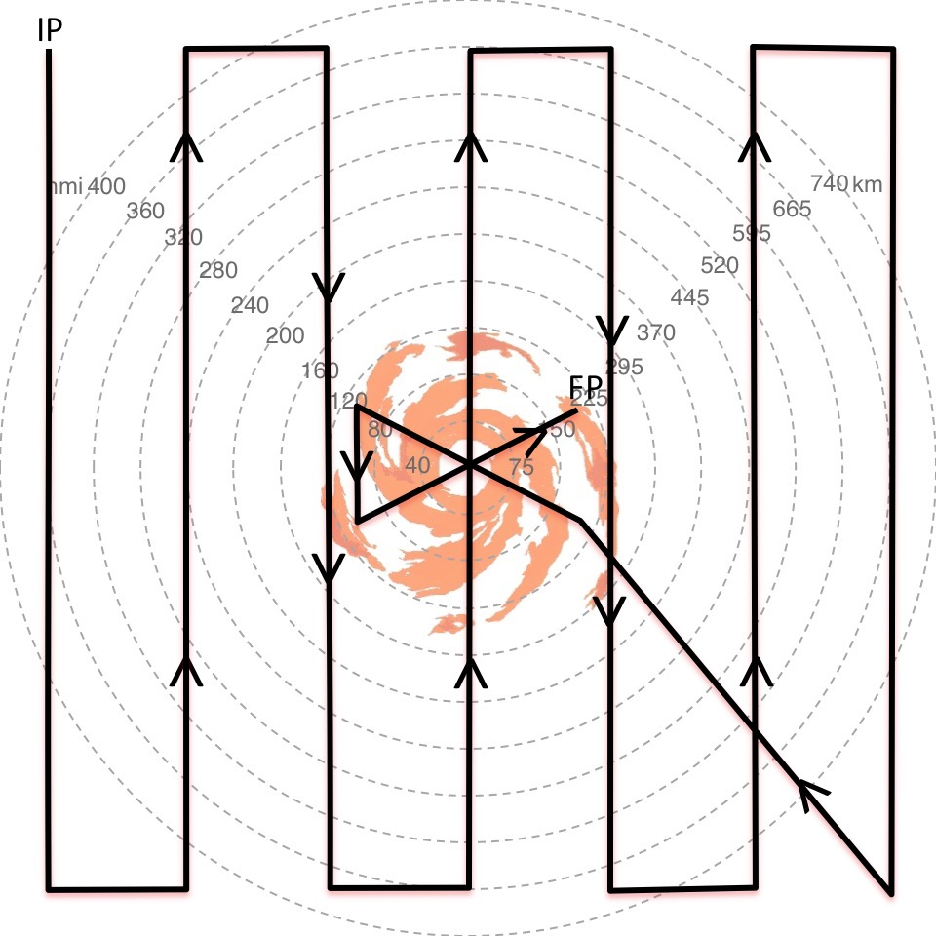
Global Hawk Sample Flight Modules
Lawn Mower (~2 deg spacing)
On-Station Time
~19.75 hr
R=0 to R=~665 km
12x12 degree box
Advantages
Far Field sampling
Simpler navigation
Jason D. Modified
Disadvantages
Radial/Azimuthal sampling
Long pattern
Limited Inner core snapshots
Radial gradients
HAMSR & HIWRAP >> inner core

Slide 36
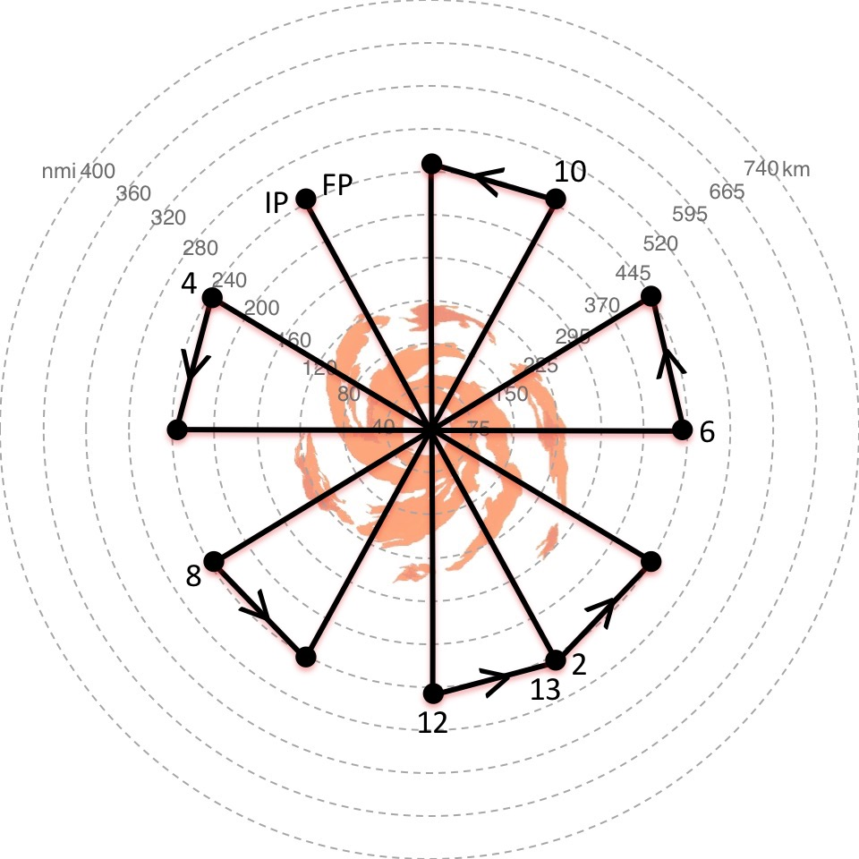
Global Hawk Sample Flight Modules
Rotated Butterfly (30 deg)
On-Station Time
~12.5 hr
R=0 to R=~450 km
Advantages
Radial/Azimuthal sampling
Radial gradients
~ 8 center crossings
Inner core & envir sampling
HAMSR & HIWRAP >> inner core
Jason D. Modified
Disadvantages
Not ideal for inner core snapshots
Far field sampling limited
Navigating center crossings

Slide 37
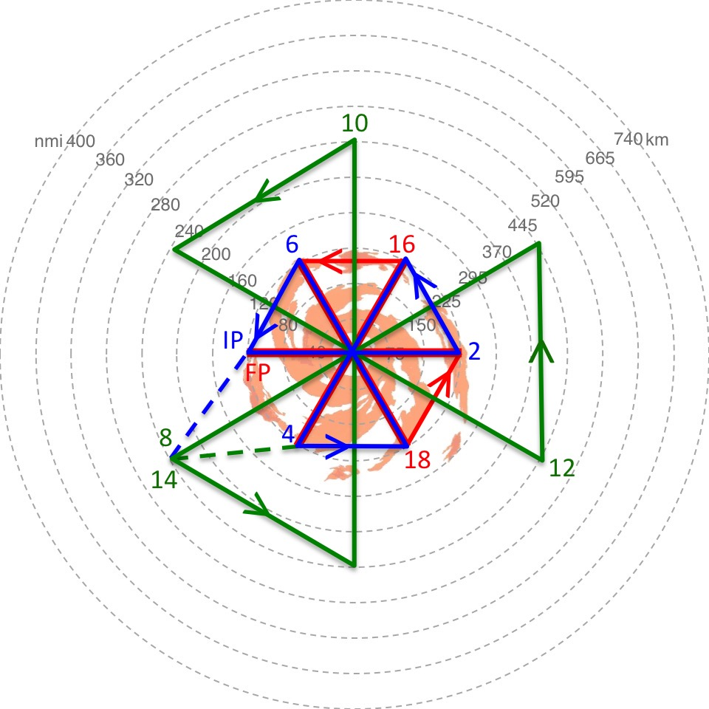
Global Hawk Sample Flight Modules
Butterfly (small-large-small)
On-Station Time
~14.0 hr (3.25 hr/6.5/3.0 hr)
R=0 to R=~450 km
Advantages
Radial/Azimuthal sampling
2 Inner core snapshots
Radial gradients
9 center crossings
Inner core & environ sampling
HAMSR & HIWRAP >> inner core
Jason D. Modified
Disadvantages
Far field sampling limited
Navigating center crossings

Slide 38
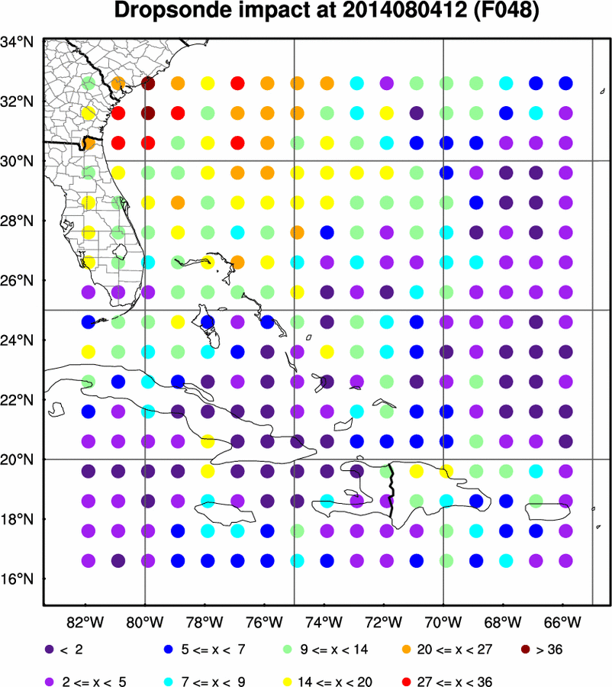
Global Hawk Flight Modules
Adaptive GPS Dropsonde Sampling
Real-time targeting products (based on 80 member HWRF ensemble);
Valid for a Global Hawk mission on 04 August 12 UTC (designed to optimize the 06 August 12 UTC track forecast);
Warmer colors: denote target regions where GPS dropsonde observations could help reduce HWRF track uncertainty;
2014 Hurricane Bertha
Jason D. Modified
Notes:
Hypothetical reduction in primary variability axis distance at 1200 UTC 6 August due to assimilating a dropsonde at each point. The warmer the color, the greater the impact. Figure is storm-centered (the x denotes the predicted center of Bertha at the time).

Slide 39
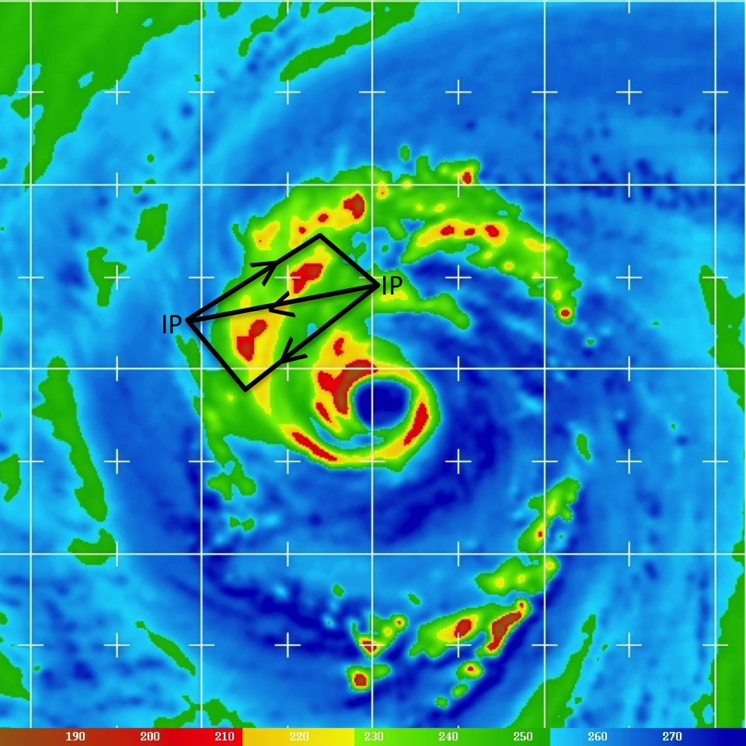
Global Hawk Sample Flight Modules
Convective Module
~45-60 minute deviation from the main flight pattern: sample convective targets in the tropical cyclone inner core and spiral bands;
Sampling by GPS dropsondes, HAMSR microwave sounder, and HIWRAP dual frequency Doppler radar;
Requires close coordination between mission scientists and Global Hawk pilots;
Jason D. Added
Notes:
Hypothetical reduction in primary variability axis distance at 1200 UTC 6 August due to assimilating a dropsonde at each point. The warmer the color, the greater the impact. Figure is storm-centered (the x denotes the predicted center of Bertha at the time).

Slide 40
2015 SHOUT
Flight Planning Tool: HRD tkmap
Jason Dunion

Slide 41
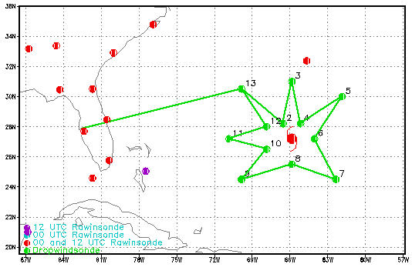
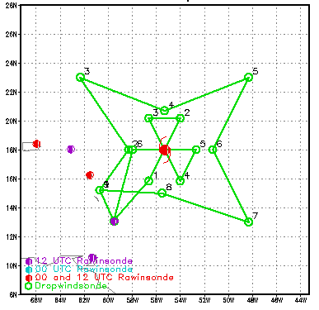
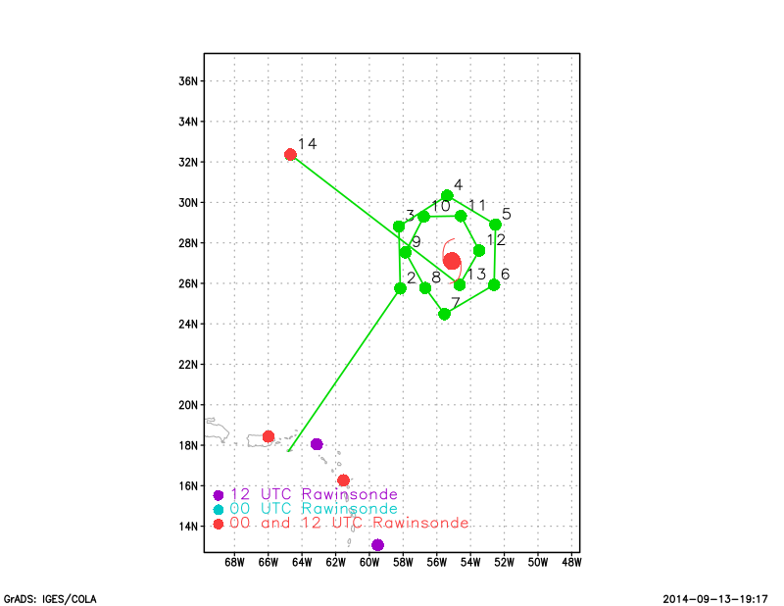
2015 NOAA SHOUT
HRD tkmap track software
Used by NOAA HRD for P-3 and G-IV aircraft flight planning for 15+ years;
Runs quickly (few seconds);
Generates aircraft track and GPS dropsonde coordinate files and track graphics;
Output can be quickly uploaded to NASA’s Airborne Science Mission Tools Suite (MTS) >> flight planning and situational awareness;
Jason D. Modified

Slide 42
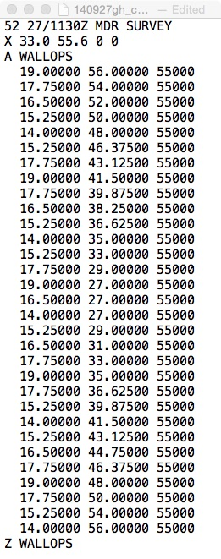
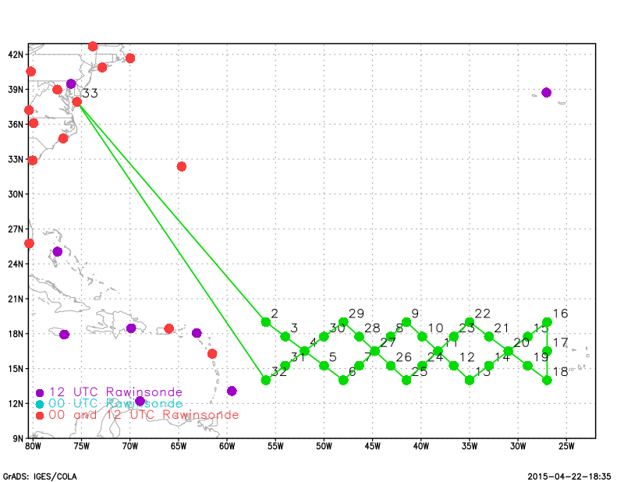
2015 NOAA SHOUT
HRD tkmap track software
Input File (text)
Lat-Lon Points
Track & dropsonde image (png)
Jason D. Modified

Slide 43
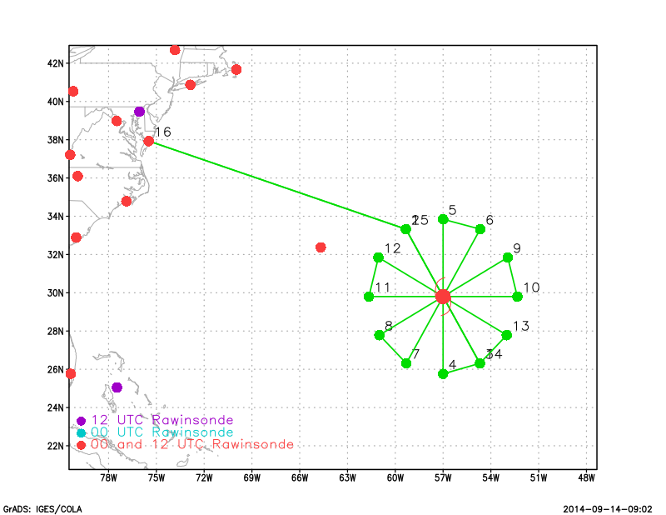
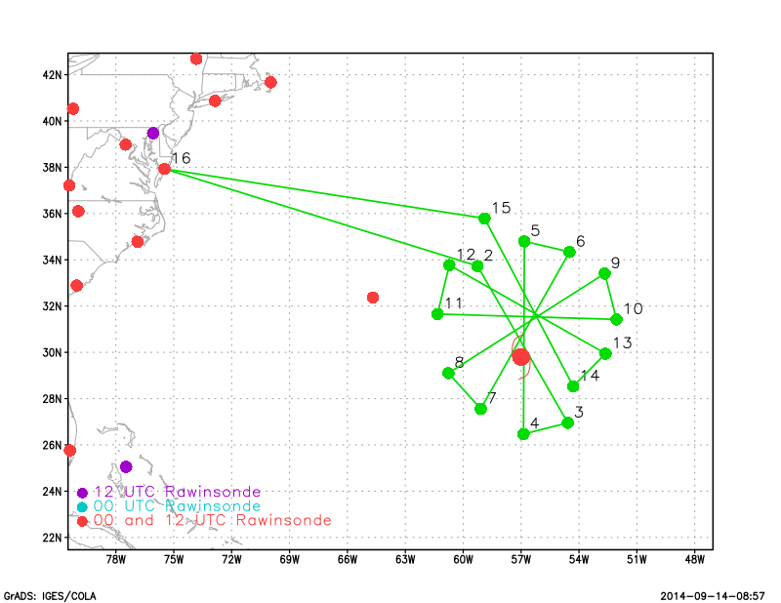
2015 NOAA SHOUT
HRD tkmap track software
Track & dropsonde image (png)
Input File (text)
(motion: 10kt@10deg)
Input File (text)
(no motion)
Dropsonde File (text)
Waypoints File (text)
Jason D. Modified

Slide 44
Data Analysis and Management
STATUS
JC COFFEY

Slide 45
Data Management and Archival
Formal SHOUT data management plan exists
Team at NOAA ESRL/GSD leading data management
  Integration with NOAA Meteorological Assimilation Data Ingest System (MADIS)
Official NOAA data center to be final archive
  National Centers for Environmental Information
  Products to archive?
  Data to enable model evaluation and validation
Collaboration planned with ONR TCI field catalog from EOL

Slide 46
Data
ARC
Navigation Data
Instrument Status
Video
PI
Science Instrument data
Real-time (during flight)
Quick Looks/derived products (after flight)
ESPO HS3 Website
Catalog (Satellite data during the period of deployment)
Mission Tools Suite
Displaying Navigation and Video
Displaying Instrument data for strip chart plotting
Displaying some Real-time data and Quick Looks on Map
Bookmarks to Real-time data and Quick Looks
Bookmark to Catalog

Slide 47

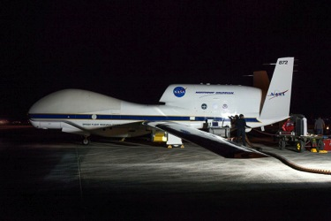
Global Hawk Flight Operation
Jon Neuhaus

Slide 48

GHOC East at Wallops Flight Facility, Virginia-Readiness
Notes:
48

Slide 49
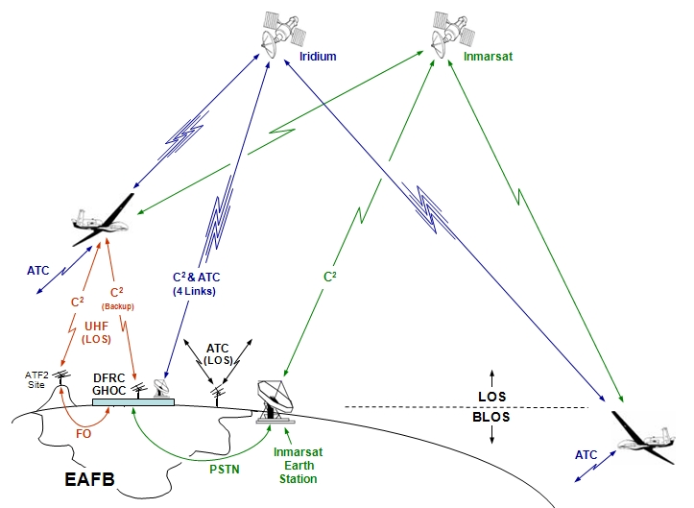
Aircraft Flight Control and Air Traffic Control Communications Architecture
Iridium Provides Global Coverage
Encrypted Links are Used for Aircraft Command and Control
Notes:
49

Slide 50
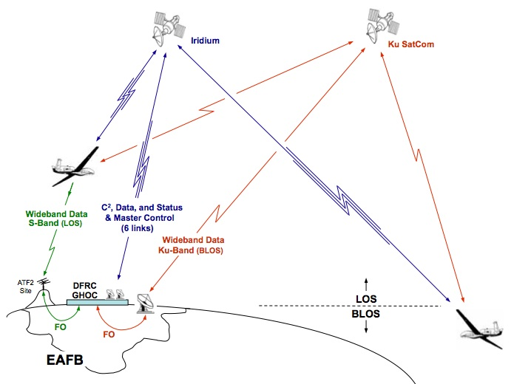
Payload Communications Architecture
Iridium Provides Global Coverage
50
Notes:
50

Slide 51
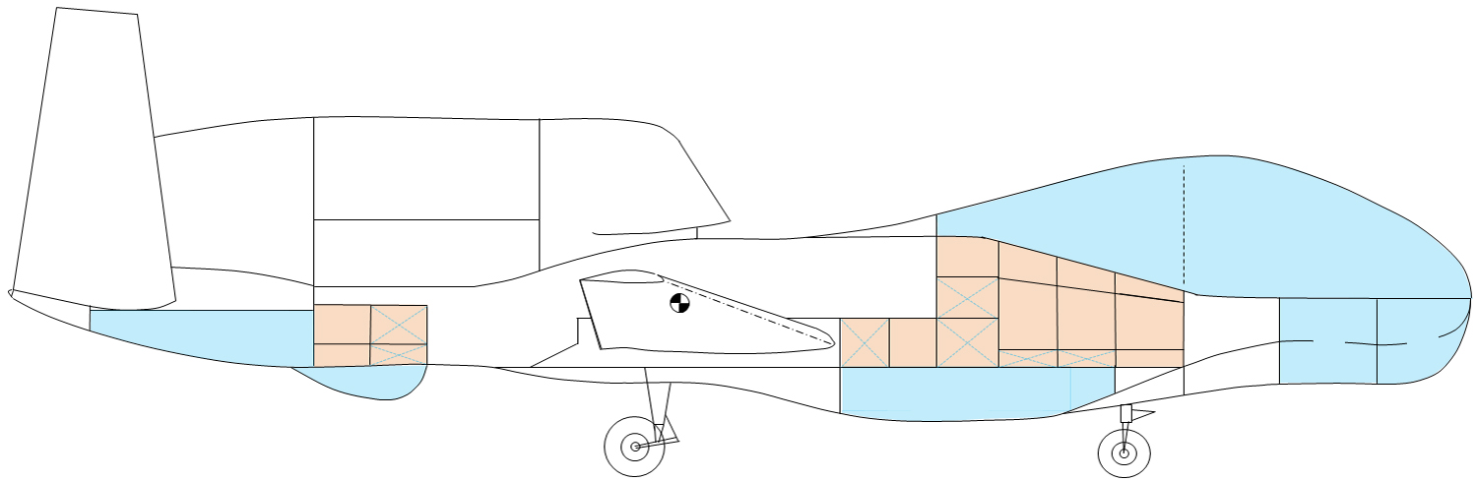
Platform Overview, APCS
Airborne Payload C³ System (APCS)
Components and Antenna Locations
GPS Antenna
Ku Antenna
Iridium Antennas (6)
Link Module
NASDAT
Zone 7
Zone 61
46
16
14
12
22
3
1
51
Zone 25
MPCS

Slide 52
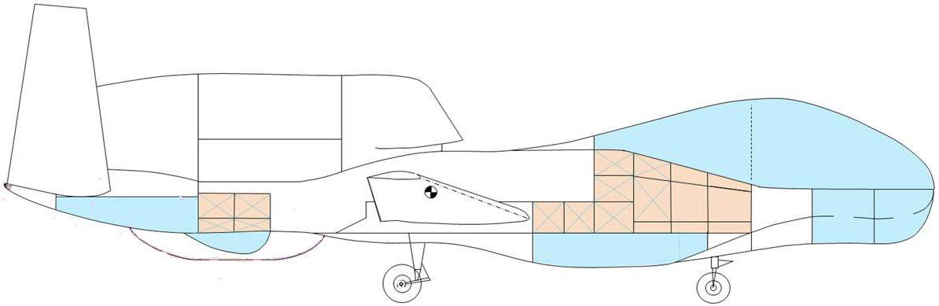
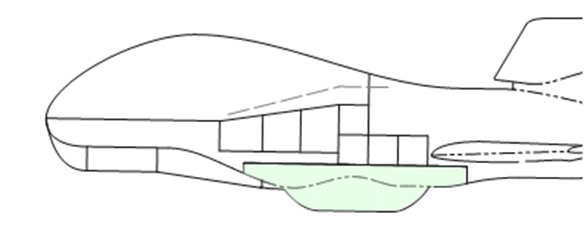

SHOUT 2015 - Payloads
872
(AV-6)
LIP
LIP (left side)
DropSonde
Data
LIP (rt. side)
Low-light
Camera
7
61
46
22
16
13( (L)
14 (R)
12
LIP
3
25
DropSonde
Dispensor
Storm
Scope
HDVis
Camera
GHIS
(Accel)
Daylight
Camera
HAMSR
LIP
HIWRAP
AVAPS
HAMSR
HIWRAP
LIP
Airborne Vertical Atmospheric Profiling System
High Altitude MMIC Sounding Radiometer
High Altitude Imaging Wind and Rain Profiler
Lightning (and Electric Field Meas.) Instrument Package

Slide 53
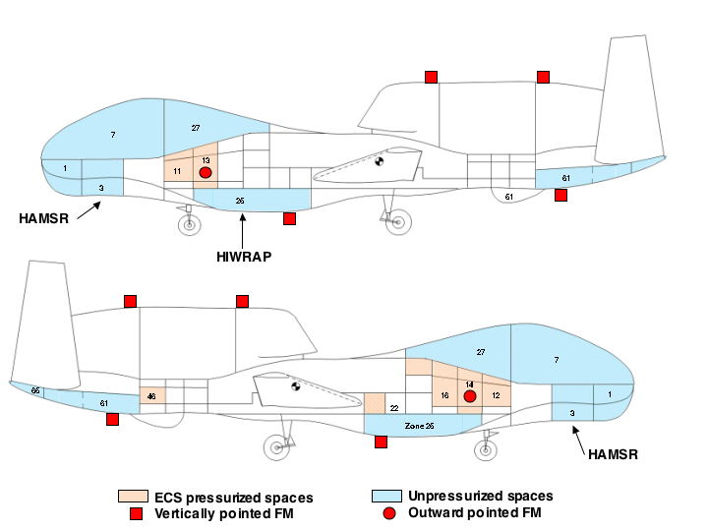
LIP Instrument Layout on Global Hawk
Fwd Up
Aft Up
Aft Down
Fwd Down
Aft Down Field Mill will be moved for SHOUT
Conductivity probe not fully integrated for GRIP
/Conductivity Probe
Notes:
This slide shows how the LIP sensors were distributed about the Global Hawk during GRIP.
The primary change that we will have to make in SHOUT is to move the Aft Downward looking field mill slightly forward since its GRIP location is now occupied by the AVAPS antenna.

Slide 54
SHOUT 2015 Schedule & Ops Tempo
Single Air Vehicle NASA 872 (AV-6)
Notional Schedule
Ops Tempo
Approx 268 Flight Hours (approx. 10-12 flights)
Flight duration: max 26hrs (weather forecast dependent)
Approximately 1 flight every 2-3 days
Surges: Back to back missions, up to 6 days (24 hr turns)
1 full duty day notification for flight coordination package (2-3 day “heads up”)
*Possible 1 week extension for high impact storm event *
N872NA (AV-6)
8/11/2015 | Combined Systems Test
8/13/2015 | AFRC range flight
8/19/2015 | Transit flight to WFF
8/25/2015 | Open science flight window
9/27/2015 | Close science flight window
9/28/2015 | Transit flight to AFRC

Slide 55
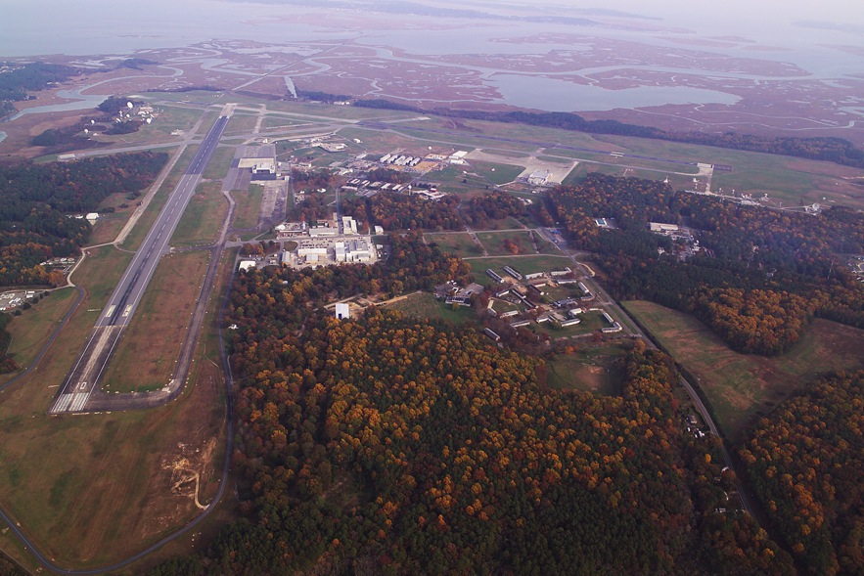
NASA Wallops Flight Facility (WFF)

Slide 56
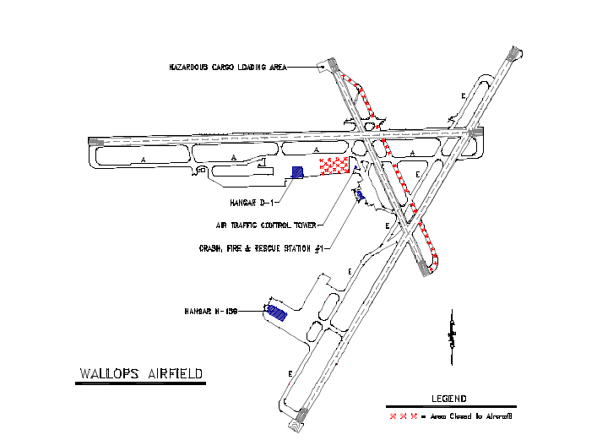
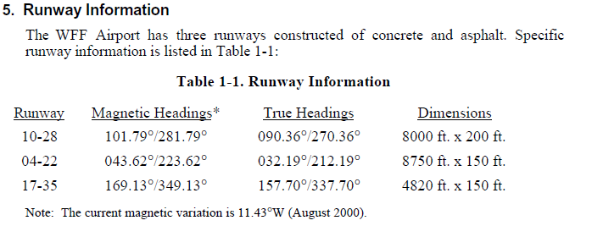
WFF Runways
10/28 8000 ft x 200 ft
04/22 8750 ft x 150 ft

Slide 57
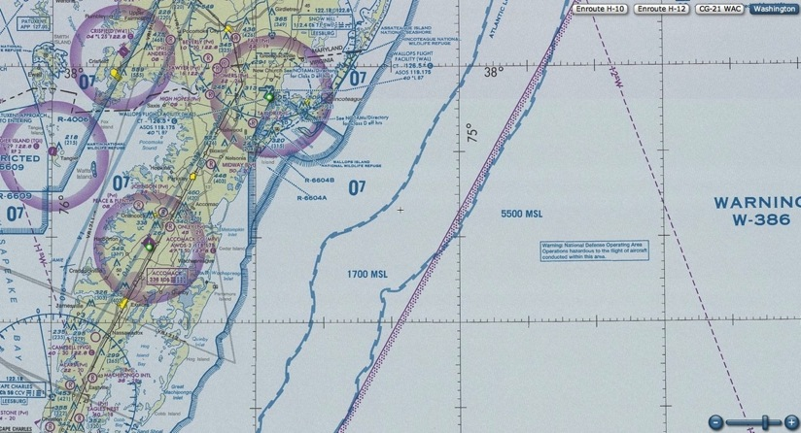
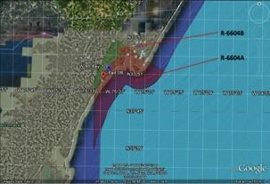
WFF Airspace
  KWFF Class D: 5nm radius from center of airfield, surface – 2500ft AGL
  R-6604 A & B: surface to unlimited – scheduled through WFF
  W-386: surface to unlimited – scheduled through FACSFAC VACAPES (DOD)
W-386
WFF Class D
R-6604B
R-6604A
W-386

Slide 58
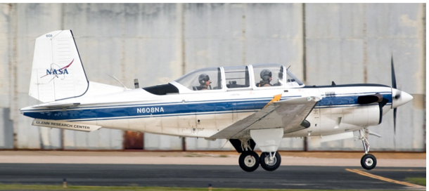
WFF Equivalent Sense and Avoid
Proposed Equivalent Sense and Avoid Mitigation at WFF
Departures and approaches will mitigate the sense and avoid requirement with a combination of ground observers and chase aircraft.
Ground Observer (Trapper)
  Within 3nm of KWAL and below 3,000 ft
  On airfield in contact with GH Pilot
Chase aircraft with pilot and dedicated observer (2 aircrew)
  Flight outside of SUA and visual range

Slide 59
WFF Flight Departures
  Mission Planning:
  NGC Mission Plan – uses common routing in NAS when possible.
  FASFAC VACAPES - Test Track C/D sub-area developed for NASA Global Hawk in W-386
  Departures:
  Conditions: Day/Night, VMC only
  Operating control tower and visual observer required for all departures
  Chase required to be on standby during departure in case of RTB (2-3 hrs)
  R6604 required exclusive used surface to 10,000 MSL
  Test Track required exclusive use 5,000 MSL to FL450, east W-386 above FL450
  Lost Link Logic has aircraft returning to departure runway
  All departures meet the office of NASA Range Safety population avoidance criteria

Slide 60
WFF Flight Operations Summary
  Approaches:
  Conditions: Day/Night, VMC+ only
  Operating control tower and chase aircraft required for all approaches & runways
  Chase aircraft will join GH in W-386 in the lower orbit in the VACAPES Test Track Area ‘Charlie’
  Lost Link Logic has aircraft returning to runway 28
  All approaches meet the office of NASA Range Safety population avoidance criteria

Slide 61
Emergencies
  Emergencies:
  If an emergency RTB back to WFF is declared by the PIC, ATC will provide emergency handling to reduce loss of life and property. PIC will follow emergency procedures checklist. (Non-emergency RTB’s will loiter in Atlantic until tower can open.)
  An emergency landing could occur at night and/or during IMC conditions at WFF or other emergency landing fields.
  Control tower will be staffed for emergency RTB.
  Other emergency landing fields: NAS Pax River, KSC, Cherry Point MAS, Beaufort MAS, NS Mayport, NAS Key West
  AFRC pilots may conduct an emergency landing at WFF in the event that WFF pilots are in crew rest.
  The definition of an emergency is a distress or an urgency condition.

Slide 62
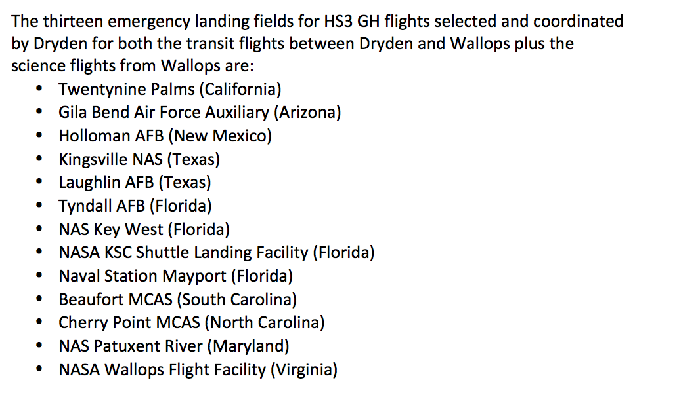
SHOUT Emergency Landing Sites

Slide 63
Chase Operations Summary
  Requirements:
  The chase must remain at a safe distance from the aircraft to ensure collision avoidance should a malfunction occur, and must remain close enough to the aircraft to provide visual detection of any conflicting aircraft and advise the PIC of the situation.
  The chase aircraft pilot and observer will not concurrently perform either observer or UAS pilot duties along with chase pilot duties. The chase must maintain direct voice communication with the UAS pilot.
  For approaches, the chase aircraft will rendezvous with Global Hawk in W-386 between 7,000 and 15,000 MSL. The chase will follow Global Hawk through Class E, into Class D airspace and be prepared to continue chase for a go-around contingency.
  Minimum meteorology requirements for Global Hawk operations with chase is VFR. VFR in Class D airspace are 3 statute miles visibility and 1000-foot ceiling. Minimum meteorology requirements for remaining VMC in Class D and Class E airspace (below 10,000 MSL) are 3 statute miles and ability to maintain the follow distance from clouds: 500 feet below, 1,000 feet above, and 2,000 feet horizontal.
  Backup chase capability is highly desirable in case primary chase is unable to fly due to unscheduled maintenance issue. Landing without chase will require Global Hawk pilot to declare an emergency to land.

Slide 64
SHOUT Science Atlantic Region Overview
SHOUT ATLANTIC Operations Area

Slide 65
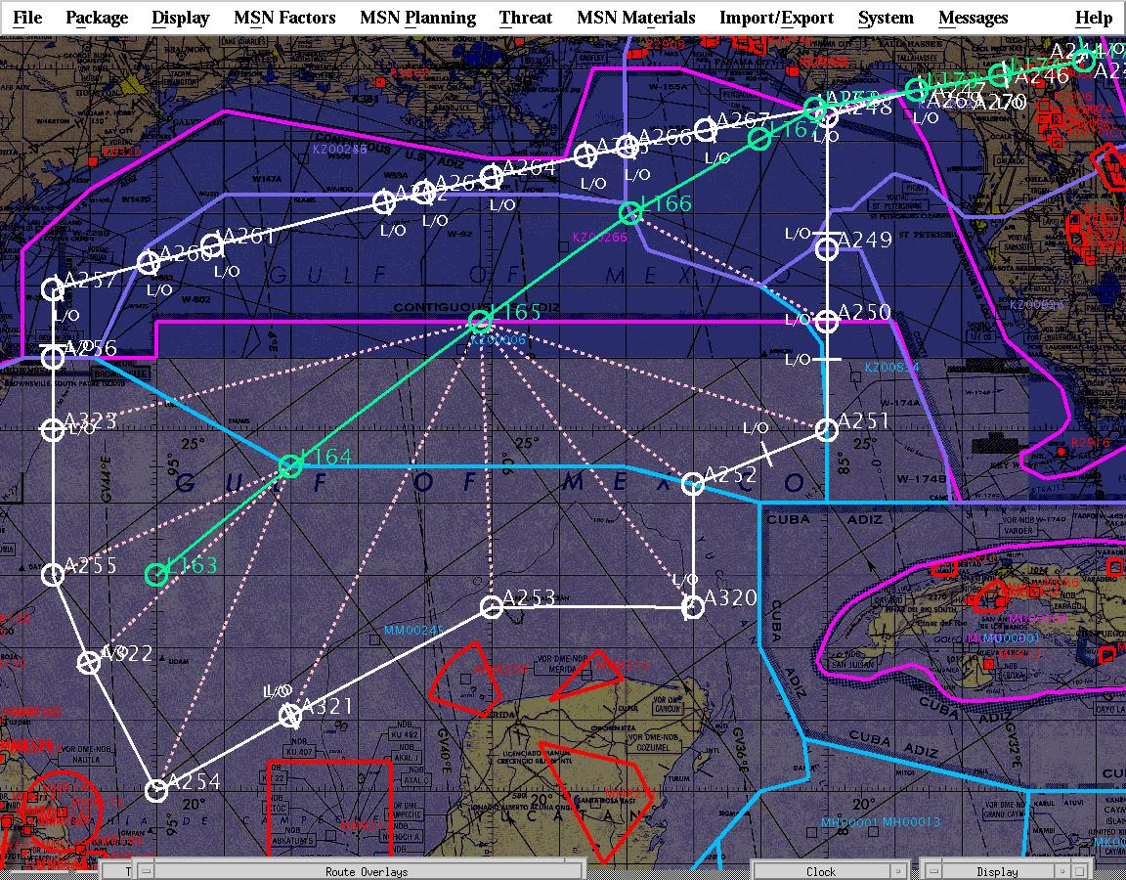
Gulf Science Route
ADIZ
Miami FIR
Houston FIR
C1/C2 Route
Mexico FIR
Gulf of Mexico Route

Slide 66
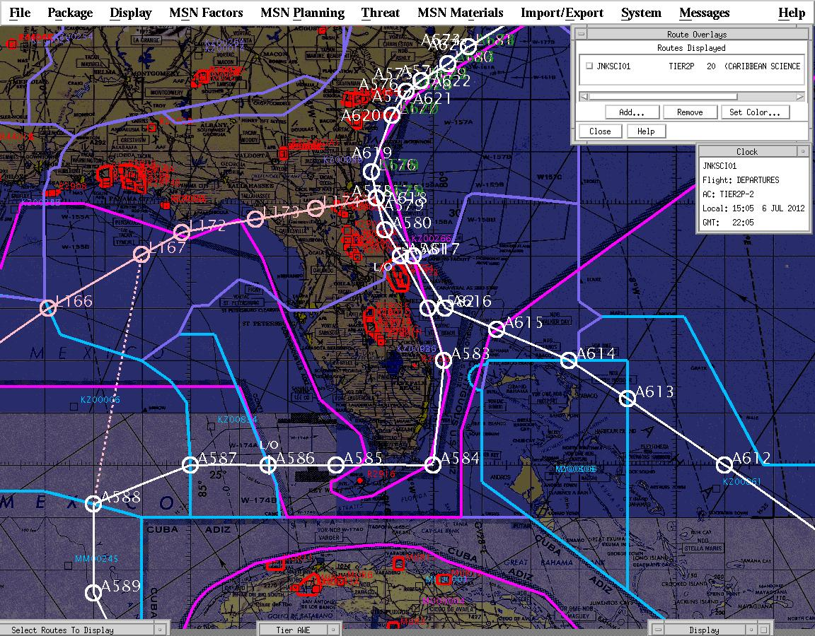
Caribbean Route

Slide 67
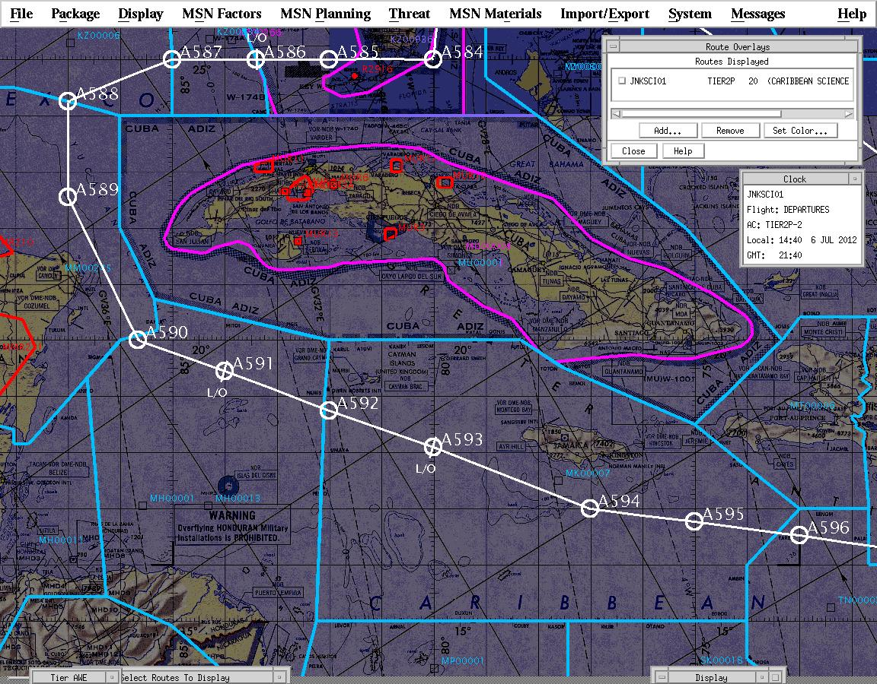
Caribbean Route

Slide 68
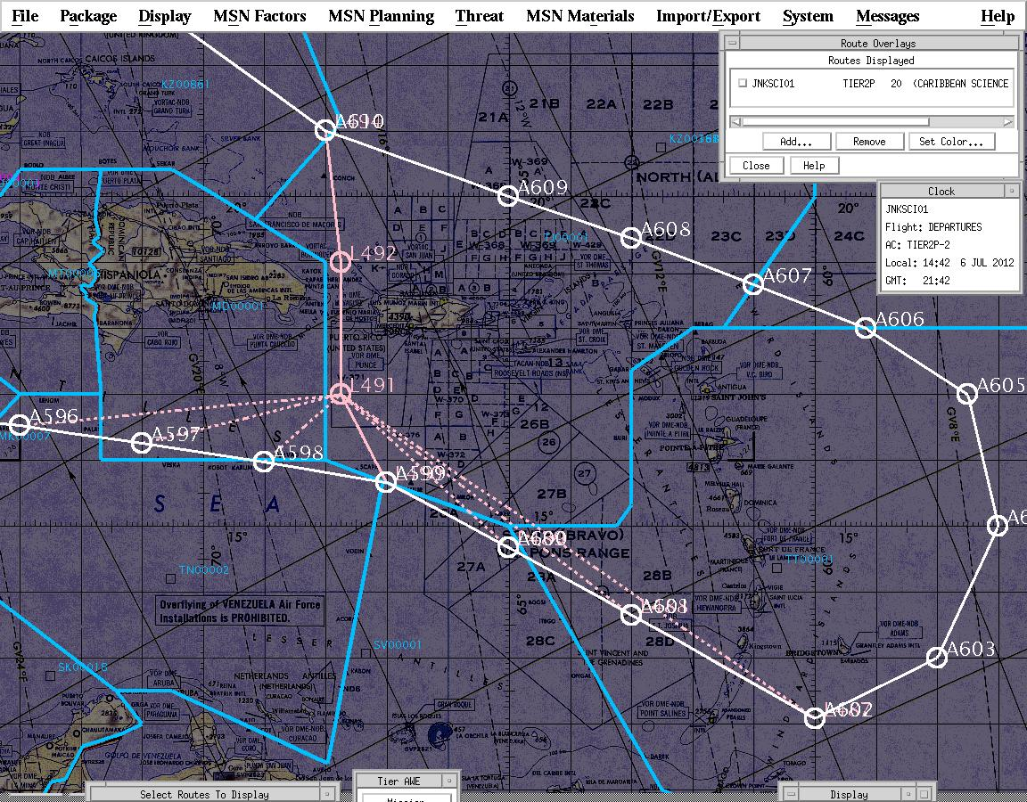
Caribbean Route

Slide 69
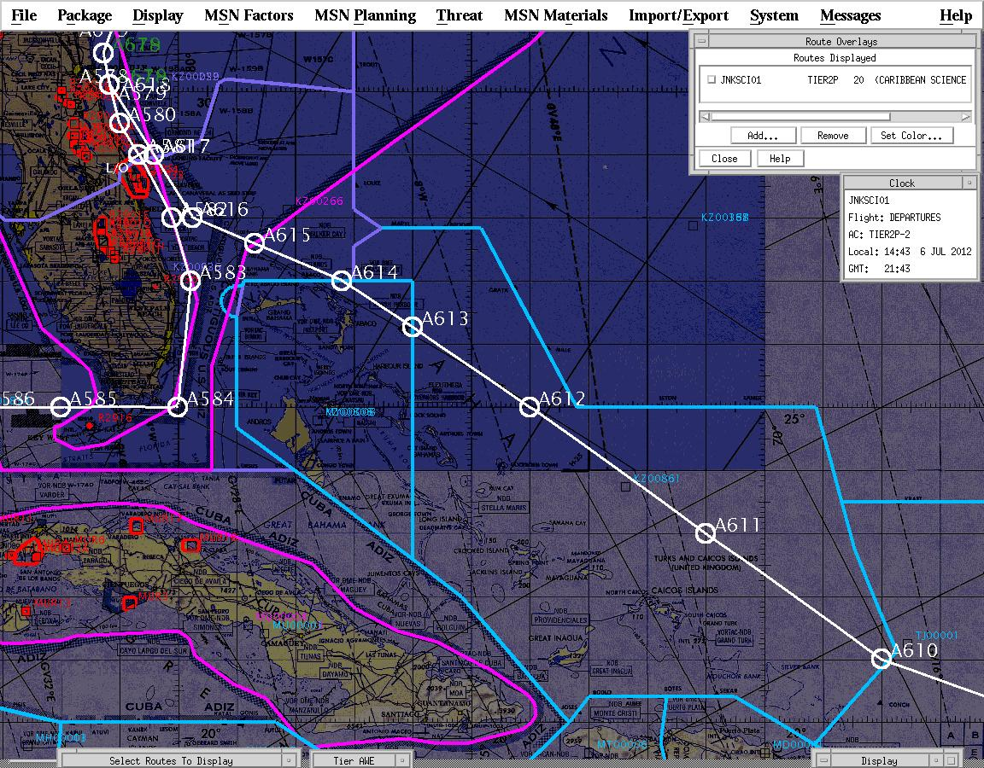
Caribbean Route

Slide 70
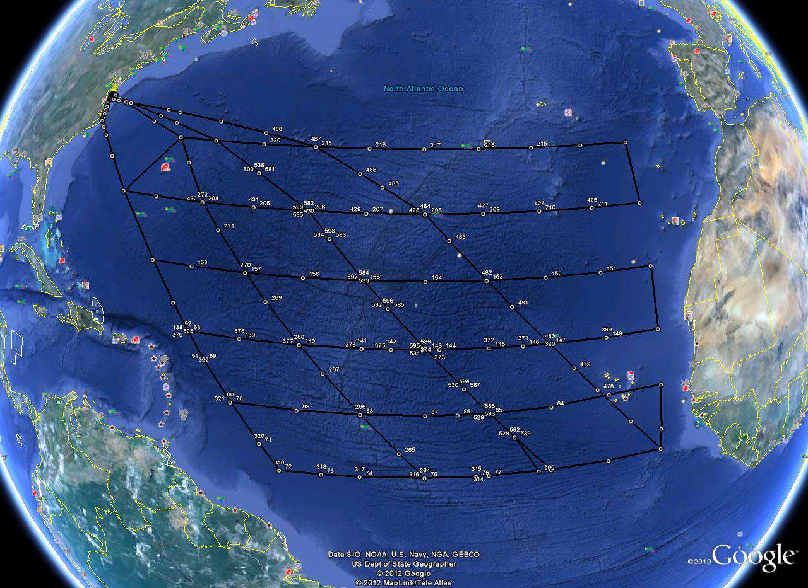
All Atlantic Routes
35N
30N
Rte C
30N 20W
25N
20N
Rte B
20N 20W
15N
10N
Rte A
10N 20W
RTE F
10N 40W
Rte D
10N 30W
Rte E
Atlantic Route

Slide 71
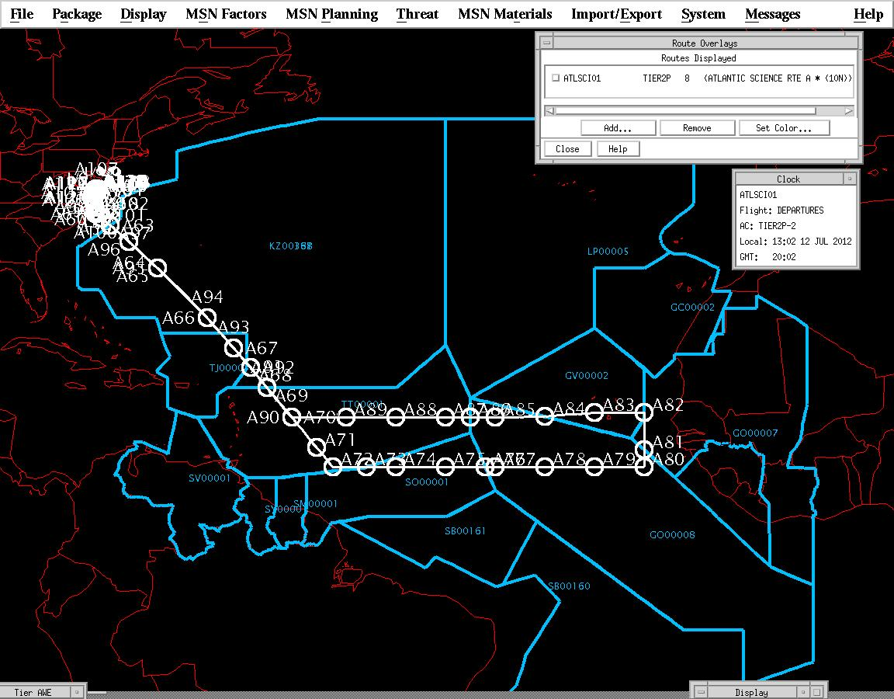
Atlantic Route A

Slide 72
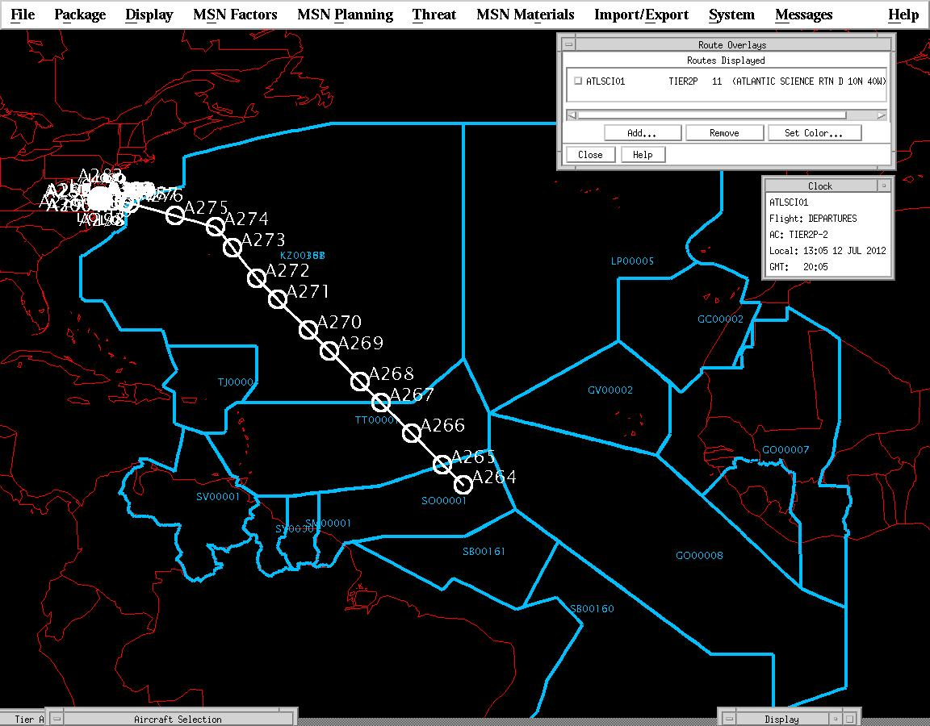
Atlantic Route D

Slide 73
Dropsonde System
Agreements between agencies in 2015 Interagency Hurricane Operations Plan (IHOP).
NOTAM published.
Max of 88 dropsondes.
Need to talk to ATC real time (phone) for traffic deconfliction.
Multiple levels of system inhibits to ‘safe’ system.
Pilot in command final release authority.
Extensive mission rules have been agreed upon by all weather aircraft based on dropsonde drift analysis.
Flights scheduled in Tropical POD produced by Chief, Aerial Reconnaissance Coordination (CARCAH), All Hurricanes - National Hurricane Center.

Slide 74
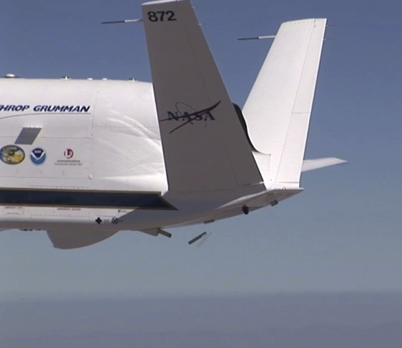
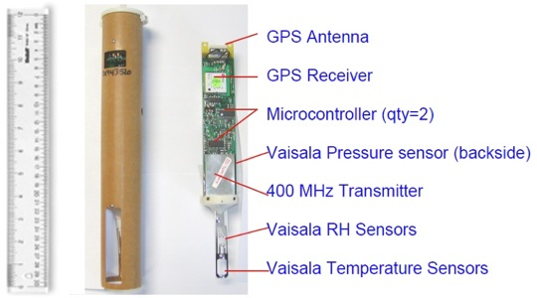
Miniature In-situ Sounder Technology
(MIST) Dropsonde System

Slide 75
SHOUT Example AV-6 Flight Tracks - Gulf
Over-storm aircraft
Approx. 17 hr pattern
Figure 4 flight pattern
Follows storm direction

Slide 76
SHOUT Example Flight Tracks – Western Atlantic
Track is for storm similar to Hurricane Isabel in 2003
Storm threatens US
Dropsonde releases

Slide 77
SHOUT Example Flight Tracks – Central Atlantic
Lawnmower pattern
Tropical disturbance that could eventually become a hurricane
Dropsonde releases

Slide 78
Flight Coordination – Timeline
T-2 Day
  Flight route determined by science
  Mission Region transmitted to FAA by COB
T-1 Day
  NOTAM for Dropsondes transmitted
  Aviation weather briefing
  ‘T-1’ Crew Briefing, if required
  Aircraft and GHOC preflights
T-0 Day
Takeoff -3 hrs
  Aviation weather briefing
  File DD1801 flight plan
Takeoff -2 hrs
  ‘T-0’ Crew Breifing
  Personnel man GHOC
T-1 hr - Engine start

Slide 79
Mission Plans
    Route Planning
    Science to post route coordinates to MTS
    Pilots to retrieve coordinates data from MTS
    Pilots to insert coordinates into the Portable Flight Planning System (PFPS)
    PFPS used to generate aircraft flight tracks
    Flight Crew Notification of Route
Nominally, 1.5 duty day notification for flight coordination package (by 1100 local time 1.5 days prior to mission)
      The requirement is for boundaries of the flight region and inbound and outbound routes to be identified.
      More detailed plan submitted up to 24 hrs before flight.
FAA notification required one business day prior to flight
  For Saturday, Sunday and Monday flights, that means that flight plans must be submitted to flight crew by Thursday @ 1100 Local.
Can make changes to filed plan on day of flight (process to be defined but will require direct communication with the flight crew)
    Remember that access to foreign owned FIRS could be an issue on short notice changes
79

Slide 80

Mission Rules & Go-No go

Slide 81
Mission Rules
Only authorized personnel are permitted in the Flight Operations Room of the GCS.
  - During critical phases of flight, access to the aircraft command and control side of the GCS is restricted to essential personnel only (i.e. Mission Director, Pilots, GCS Operator, RSO, Senior Ops Rep and personnel undergoing training for any of these positions).
  - Critical phases of flight are defined as flight within R-2515, any test points, any in-flight or ground emergency situation, flight below 10,000 ft or critical mission maneuvers (i.e. vertical maneuvering).
Weather Limits:
  Ground
    Winds: < 15 kts (cross), 30 kts (head), 25 kts (tail)
    No lightning within 5 nm
    Min. RVR - 1 mile
    No standing water reported on the runways
  In flight:
    Do not approach thunderstorms within 25 nm
    No overflight of cumulus tops higher than FL500
    No flight into forecast or reported icing conditions
    No flight into forecast or reported moderate or severe turbulence

Slide 82
Mission Rules
Aircraft systems:
  Do not switch UHF LOS between LCPs during taxi .
  If GHOC/GHMOF transitions to auxiliary power while AV is taxiing:
      “STOP TAXI’ command will be issued
      “TAXI” command will not be reissued until GHOC/GHMOF returned to primary power
  If GHOC/GHMOF transitions to auxiliary power while AV is in flight, an RTB will be initiated
C1 Contingency timer may be set to 5 minutes or less while the air vehicle is in autonomous mode, and no greater than 1 minute while in override mode within R-2515 and R-2508. C1 Contingency timer will be set IAW COA requirements when outside the Restricted and Warning Area. In override mode, the pilot will maintain an appropriate margin to ensure that if a C1 were to occur, the aircraft would not cross an airspace boundary.
Failure of MPCS, control functions or extended loss of APCS safety-of-flight (SOF) parameters will result in an RTB. Extended loss of APCS SOF parameters for any instrument will result in removal of power for that instrument.
Aircraft to be operated within the temperature limits defined in the Global hawk Flight Manual
  Standardly available JP5 fuel to be used (not extreme cold tested fuel)

Slide 83
SHOUT Aircraft De-Confliction Plan
Communications plan includes chat details and aircraft satellite/ground phone number of all participants
Daily coordination email sent to all pilots on email list from each ops organization regarding planned flights (list serve)
Science leads to inform flight crew of other aircraft plans during flights
Dropsondes will be coordinated with ARTCC but the responsibility for dropsondes launches lies with the PIC
Dropsonde mission rule complete

Slide 84
Aviation Safety
A flight plan will be filed with the FAA for all flights per the COA
Flight on the programmed Mission plan (black line) shall be utilized except where flight safety or science mission interests dictate a need to alter the flt path
  Such changes will be made in accordance with the COA
  Experience is that ‘go to’ diverts were flown 80% of the time
Pilot situational awareness will be enhanced with systems installed on the a/c and used during GRIP
  Low-light nose camera image display
  (updated for AV6)
  Storm scope display
  GHIS II accelerometer

Slide 85

GH SHOUT Mission
Confirmation of Notification Sheet
Green – Rec’d response (Conf. of Notification), via email or Dip Note
Bold Black – Post Receipt of Action Request

Slide 86
GH SHOUT Mission
Confirmation of Notification Sheet
Dominican Republic
Ecuador | 6/26/15
El Salvador | 6/18/15
French Guiana - FR
Grenada | 6/15/15 – via Dip Note 26
Guadeloupe - FR
Guatemala | 6/22/15 - via Authorization Docs.
Guyana | 7/1/15
Haiti – State CDO POC
Honduras | 7/8/15 – via Dip Note 217
Jamaica | 7/9/15
Martinique - FR
Mexico
Montserrat - UK | 6/12/15
The Netherlands | 6/16/15
Nicaragua | 6/23/15 – via Dip Note 231/2015
Panama | 6/16/15 – clearance # TA5082
Saint Barthelemy - FR
Saint Kitts & Nevis - EB
Saint Lucia - EB

Slide 87
GH SHOUT Mission
Confirmation of Notification Sheet
Saint Martin - FR
Saint Pierre & Miquelon - FR
Saint Vincent & The Grenadines - EB
Sint Maarten | 6/16/15
Suriname | 6/9/15- via Dip Note 083/15
Trinidad & Tobago | 7/1/15
Turks and Caicos - UK | 6/12/15
Cape Verde | 6/23/15
Cote D'Ivoire – Africa – State CDO POC
The Gambia – Africa – State CDO POC
Guinea-Bissau – Africa – State CDO POC
Mauritania | 6/29/15
Senegal – Africa – State CDO POC
Canary Islands - Spain | 6/16/15 – via Dip Note 470
Madeira Islands - Portugal | 6/9/15 – via Dip Note 134-15
Azores - Portugal | 6/9/15 – via Dip Note 134-15
Kiribati | 7/11/15
Tahiti- FR
Pitcairn Islands - UK | 6/12/15
Western Sahara – Africa – State CDO POC

Slide 88




Slide 89

Integration Status for AV-6
Global Hawk hangar and experimenter work area.

Slide 90

SHOUT WFF/AFRC KU SAT Update
GHOC-E, KU are operational

Slide 91
Wallops Facilities Status
Ron Walsh

Slide 92
SHOUT Deployment Status to WFF
• Facility
- lab
- phone and IT infrastructure
- trailer power and IT
• Chase plane
• Full support
• Documentation & Reviews

Slide 93

WFF Aircraft Office – Mission Readiness
G |  | WFF Weather Office & Meteorologists
G |  | WFF Airport & Airport Tower Controllers
G |  | WFF SureTrak radar display in GHMOF
G |  | WFF video and photo coverage
G |  | WFF IT & phone infrastructure
G |  | WFF Portable Trunk Radios
G |  | WFF commercial power & diesel backup
Y |  | WFF Chase aircraft
 |  | Y |  | T-34C (primary) [arrival scheduled for 8/27 1200 EDT]
 |  | G |  | King Air (backup)
 |  | G |  | Air Crew
 |  | Y |  | Chase Practice Flight with a simulated GH
Y |  | WFF Safety
 |  | G |  | Final flight routes from Dryden (transit and science)
 |  | Y |  | GH Emitter info from Dryden for HERP & Spectrum Mgmt
 |  | 8/27 |  | WFF Ground Safety Plan (GSP) [95% complete]
 |  | 8/27 |  | WFF Flight Safety Plan (FSP) [95% complete]
G |  | WFF Security
 |  | G |  | WFF Visitor Badging (complete through 8/30 arrivals)
 |  | G |  | Distributed building keys for N-159 after hours access
8/27 |  | WFF Mission Operations Directive (MOD) [in signature loop]
Y |  | WFF Special Use Airspace (SUA)
 |  | G |  | NASA R-6604
 |  | G |  | VACAPES above 45,000'
 |  | Y |  | VACAPES Test Track "C" (LOA with VACAPES/PAX/DFRC/WFF)
8/28 |  | WFF Authority to Proceed with HS3 Flight Operations

Slide 94


Hangar D-1 1st Floor
AVAPS/LIP
Shared Office
N106
N108
N104
HIWRAP/HAMSR
N110
114
Ground Crew
d
Shared
Break Room
AV-6
Conference
Room
10 Benches
S115

Slide 95


Work benches are ready to go under the tail of the P3!
DFRC GH &
ESPO Personnel
DFRC Payload &
Data Support Personnel
PI – A/C Network

Slide 96
Safety & Security Issues have been addressed
Orientation Package – complete; distributed
Security – 24/7 access
All Hands briefings - recorded
Badging – FN badging issue in work
Safety equipment in N159
Medical – Health Unit, Hearing protection, insect repellant
Evacuation Plan - complete

Slide 97
Miscellaneous

Slide 98
Communications Structure Set up
Mission Information and notifications will be sent to the SHOUT List serve
Daily meeting schedule
WebEx/Telecon for most meetings
Local contact info for all team members as back up to poor cell service
Brick radios can be checked out during mission for critical personnel
A daily plan of the day will be:
  posted on the SHOUT website & emailed to the SHOUT list serve
  On the WFF Operations Schedule Recording 757-824-1176#2?????
Mission Tool Suite

Slide 99
Mission Tools has been upgraded and is being used for the dry run and CST JD UPDATING
Flight reports/science reports
Instructions and Documentation (i.e. Flt Planning A/C Summary)
Tools & links
Schedules & Shift summaries

Slide 100
SHOUT
Public Affairs, Education, Outreach
Limited Media/Public Affairs
Visitor Day (VIP)
AUVSI Visit

Slide 101
In Summary
• Reviews: ORR complete
Tech Reviews 8/3/15
Lessons Learned 8/4/15
• Instruments – Status
• Aircraft – no major issues
• Facilities – WFF delays due to funding delay
• Coordination with other agencies - ready
• Documentation:
Minor
WWF Frequency clearances - pending
LOA NASA, VACAPES & PAX River – pending
Transit Delay
Range Flight -
Hangar Fire Waiver – pending
COA - pending
RTF – pending
WFF – ATP ACTIONS
Requesting ATP

