Slide 1


NOAA SHOUT
Plans for the Global Hawk UAS During
the 2015 Atlantic Hurricane Season
Jason Dunion¹, Robbie Hood², Gary Wick², & Michael Black³
1 University of Miami/CIMAS – NOAA/AOML/HRD – University at Albany/SUNY
2 NOAA UAS Program
3 NOAA/AOML/HRD
NOAA National Hurricane Center: May 18, 2015

Slide 2
Discussion
1) Bad joke from Landsea (2:00-2:01 pm)
2) NOAA SHOUT Objectives & Deployment
3) NASA-NOAA Global Hawk (AV-6)
Aircraft capabilities
Instrument platforms (AVAPS, HAMSR, HIWRAP, LIP)
4) Adaptive Sampling Strategies (GPS Dropsondes)
2014 Hurricanes Bertha & Edouard
5) Global Hawk Flight Patterns and Modules
6) 2015 Field Program Collaborations
NOAA SHOUT: Global Hawk (AV-6)
NOAA IFEX: 1 P-3 Orion; G-IV jet
ONR TC Intensity (TCI): NASA WB-57

Slide 3
SHOUT Objectives
Overall Goal
Objective 1
Objective 2
Demonstrate and test prototype UAS concept of operations that could be used to mitigate the risk of diminished high impact weather forecasts and warnings in the case of polar-orbiting satellite observing gaps
Conduct data impact studies
Observing System Experiments (OSE) using data from UAS field missions
Observing System Simulation Experiments (OSSE) using simulated UAS data
Investigate processes in the TC inner core (e.g. warm core), boundary layer, diurnal cycle, and upper-level environment (e.g. cirrus canopy) that impact intensity change
Objective 3
Evaluate cost and operational benefit through detailed analysis of life-cycle operational costs and constraints
Utilize adaptive aircraft sampling strategies for improving real-time TC track and intensity forecasts (80 member HWRF ensemble)

Slide 4
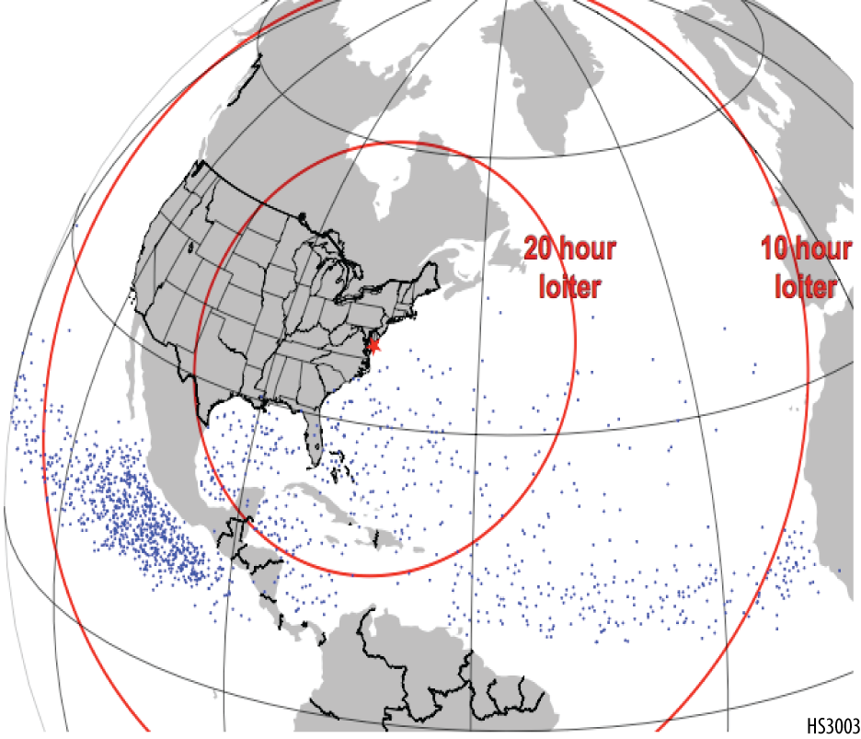
SHOUT 2015 Deployment
Atlantic Hurricane focus
Single Global Hawk (AV-6) deployed at NASA Wallops Flight Facility
Potential to shift west coast if no activity
NASA Armstrong (~90 mi north of Los Angeles)
Dry Run: 10-19 August
5 week deployment period
25 Aug - 27 Sept
10 science flights
Tempo to support 2-3 flights/wk
~24-hr duration flights
Possible extended Science ops
28 Sep – 14 Oct

Slide 5

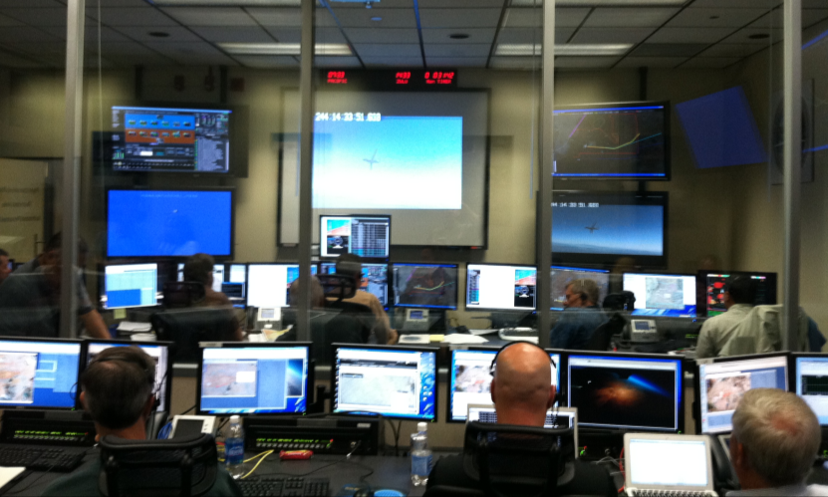
Global Hawk (AV-6) Capabilities
Flight Level: ~55-60,000 ft
Duration: ~24 hr
Flight Frequency
-1x per 48 hr (every other day)
-3 consecutive flights
-7 day max >> hard down
Range: 11,000 nm
Payload: 1,500+ lbs
Mission Science Support
-3 shifts per mission (2-3 MSs per shift)
Global Hawk Operations Center (GHOC)

Slide 6

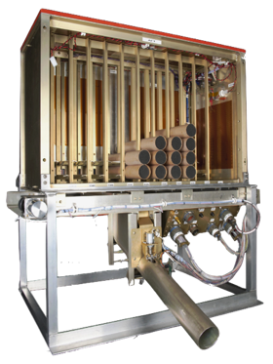
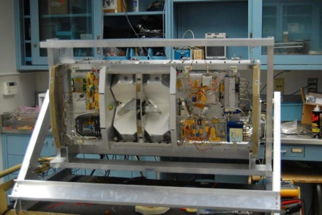
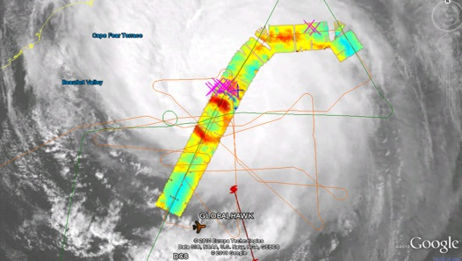
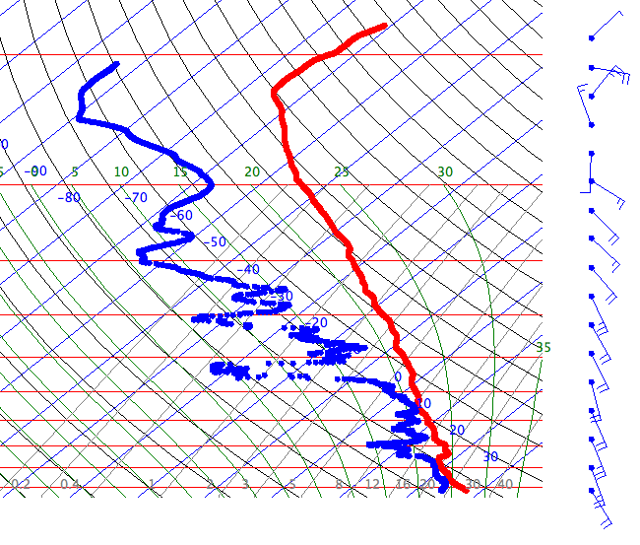
2015 NOAA SHOUT Global Hawk (AV-6) Instrumentation
Airborne Vertical Atmospheric Profiling System (AVAPS)
High Altitude Monolithic Microwave Integrated Circuit (MMIC) Sounding Radiometer (HAMSR)
2010 Karl
PI: Terry Hock, NCAR / Gary Wick, NOAA
Measurements:
Temperature, pressure, wind, & humidity vertical profiles;
88 dropsondes per flight;
Resolution:
4 Hz (winds); 2 Hz (PTH);
~2.5 m (winds), ~5 m (PTH);
PI: Dr. Bjorn Lambrigtsen, JPL
Measurements:
Microwave AMSU-like sounder;
25 spectral channels in 3 bands;(50-60 GHz, 118 GHz, and 183 GHz);
3-D distribution of temperature, water vapor, & cloud liquid water;
Resolution:
2 km vertical; 2 km horizontal (nadir)
40 km wide swath
~16-20km
Notes:
HAMSR: 2010 NASA GRIP (Hurricane Karl overliflight)

Slide 7
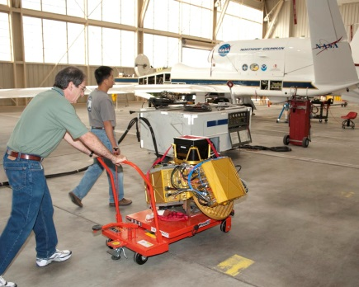
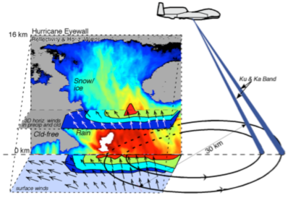
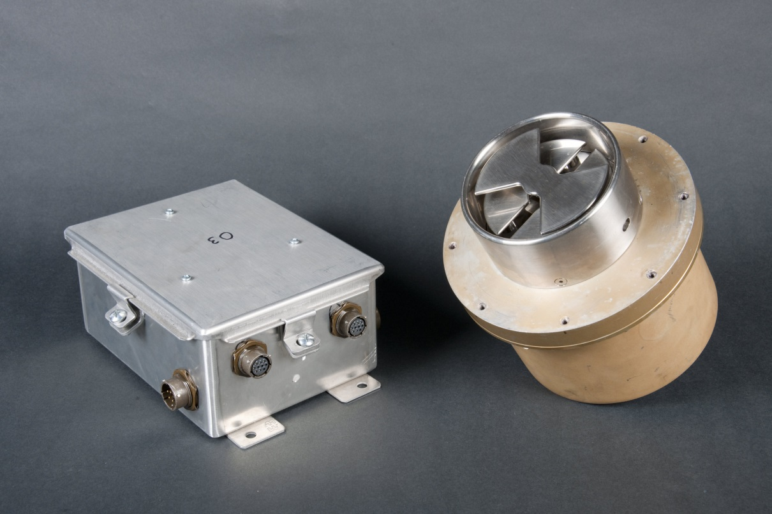
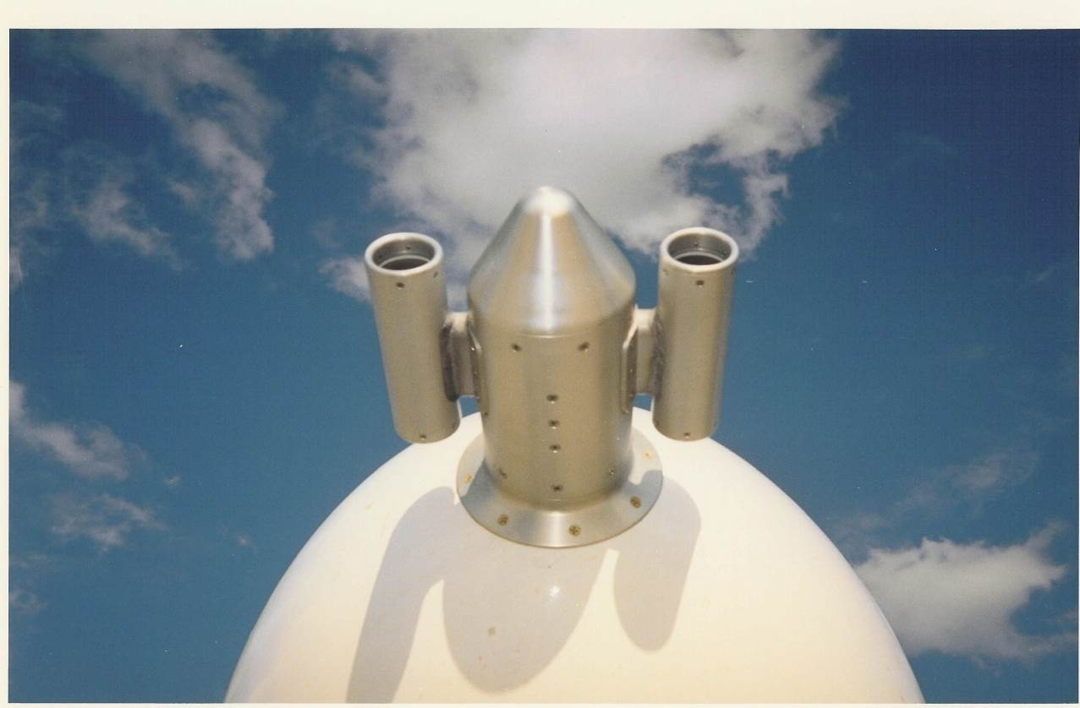
2015 NOAA SHOUT Global Hawk (AV-6) Instrumentation
High-Altitude Imaging Wind and Rain Airborne Profiler (HIWRAP)
Lightning Instrument Package (LIP)
Embedded
Linux System (5X)
Electric Field Mill (6X)
Conductivity Probe (ER-2)
PI: Dr. Gerald Heymsfield, NASA GSFC
Measurements:
Dual-frequency (Ka- & Ku-band), dual beam, conical scanning Doppler radar;
3-D winds, ocean vector winds, and precip;
Resolution:
60 m vertical, 1 km horizontal;
PI: Richard Blakeslee, NASA
Measurements:
Electric Field Mills (6), conductivity probes;
Lightning statistics, storm electric currents & charge structure;
Vector components of the electric field;
Aircraft charge & air conductivity;
Notes:
HAMSR: 2010 NASA GRIP (Hurricane Karl overlflight)

Slide 8
AVAPS (GPS Dropsondes)

Slide 9
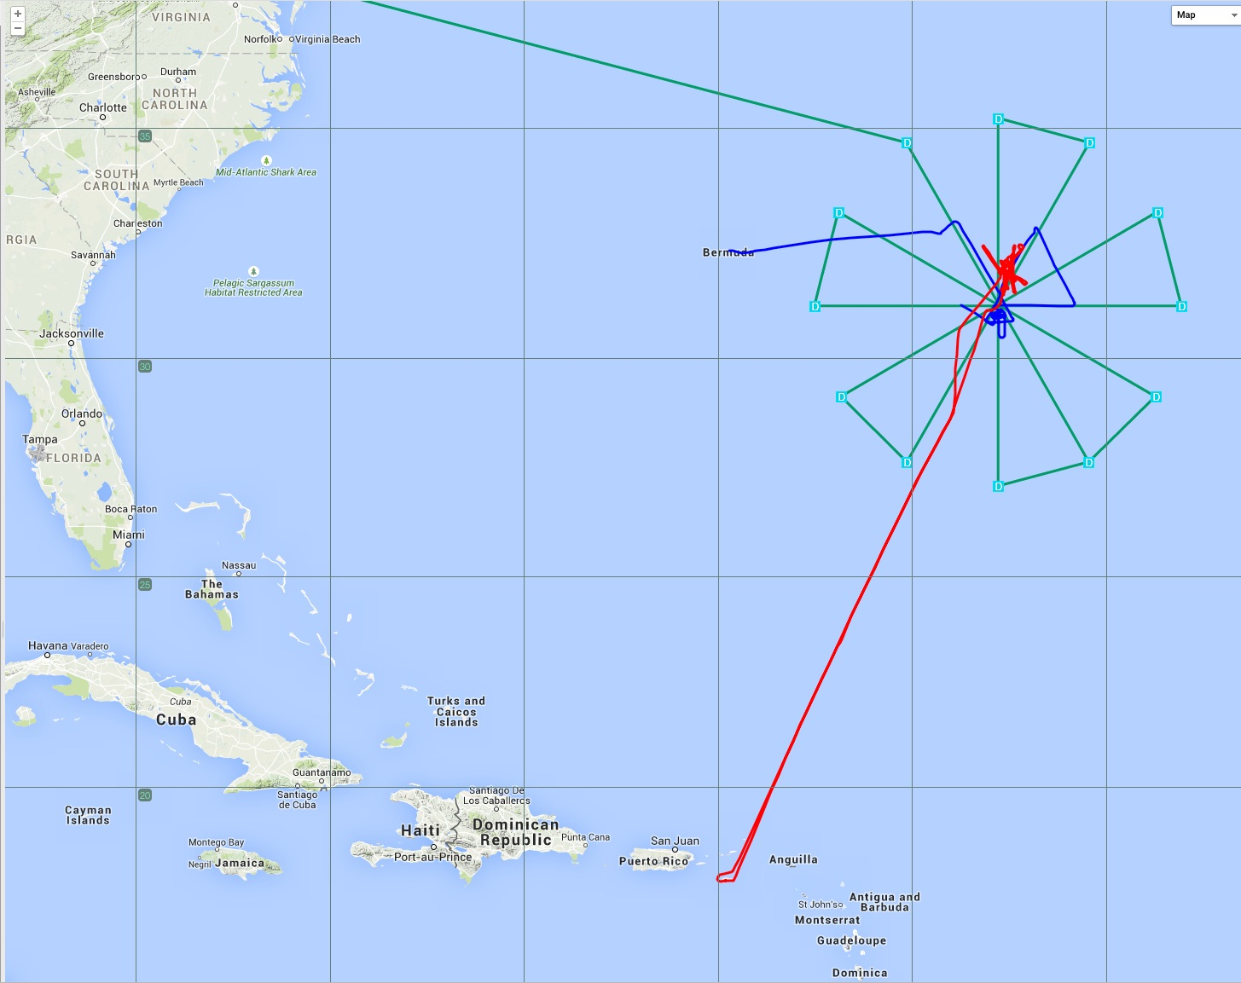
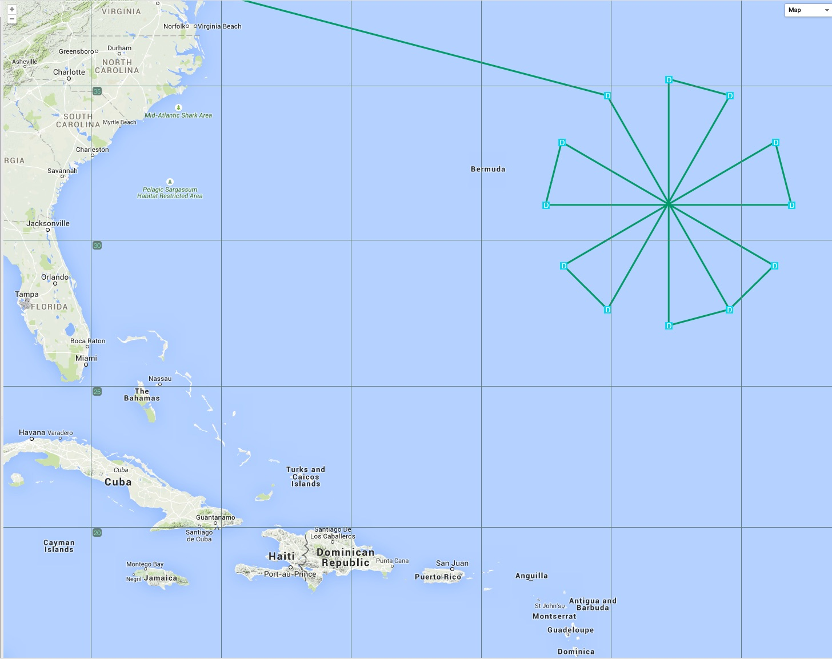
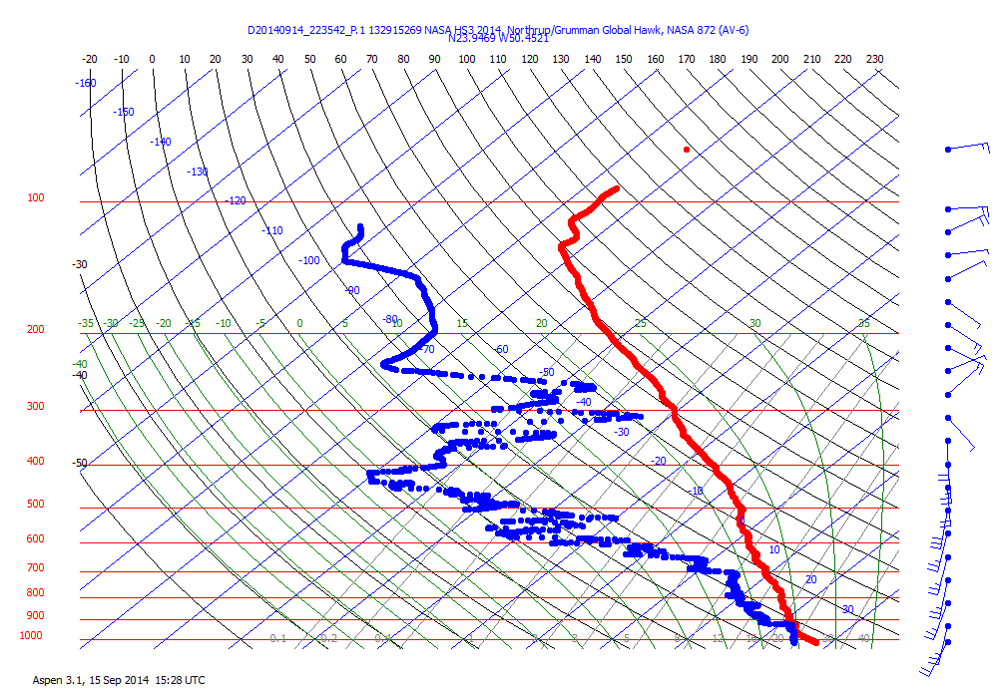
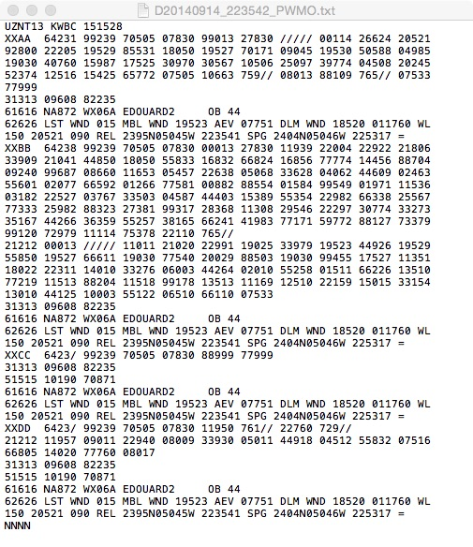
AVAPS GPS Dropsondes
Hurricane Edouard: 16 Sep 2014
NASA’s Mission Tools Suite (MTS)
NOAA P3 (N42)
NOAA P3 (N43)
Global Hawk (AV-6)

Slide 10
HAMSR

Slide 11
HAMSR Realtime Data
HAMSR has quick-look imagery and processed data files available with ~5 minutes latency
Raw files can be pulled from outward facing server at NASA Armstrong
Real-time swath imagery display in MTS, available as KMZ files
Storm centric gridded plots included in KML display
Plots placed as overlays over North America
Allows visualization of full dataset avoiding problem of track overlays in swath display
TC center positions and times for each eye overpass added as placemarks
HAMSR operator records TC center coordinates after each eye overpass using real-time imagery
Clicking on placemark provides pop-up display with plots and text information for that overpass
Provides experimental intensity estimate based on HAMSR 55 GHz TB anomaly
Complete L1B and L2 netCDF files available in realtime
L1B: Calibrated, geolocated brightness temperature for 25 channels
L2: Retrieved products; Tz, Qz, PWV, CLW, dBz

Slide 12
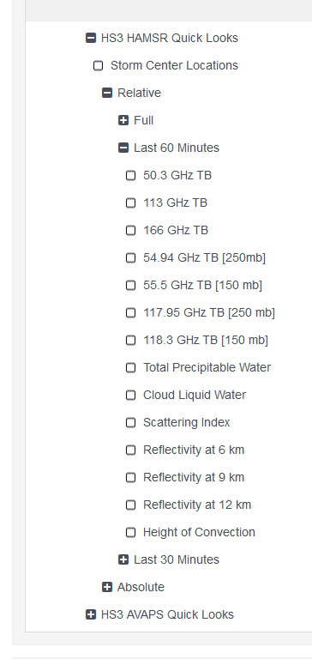
HAMSR KML Swath Imagery
HAMSR provides KML files to MTS and JPL Portal for display
Display swath products (e.g. TB imagery, derived products)
User chooses between complete flight, past 60 minutes or past 30 minutes and relative or absolute color scale

Slide 13
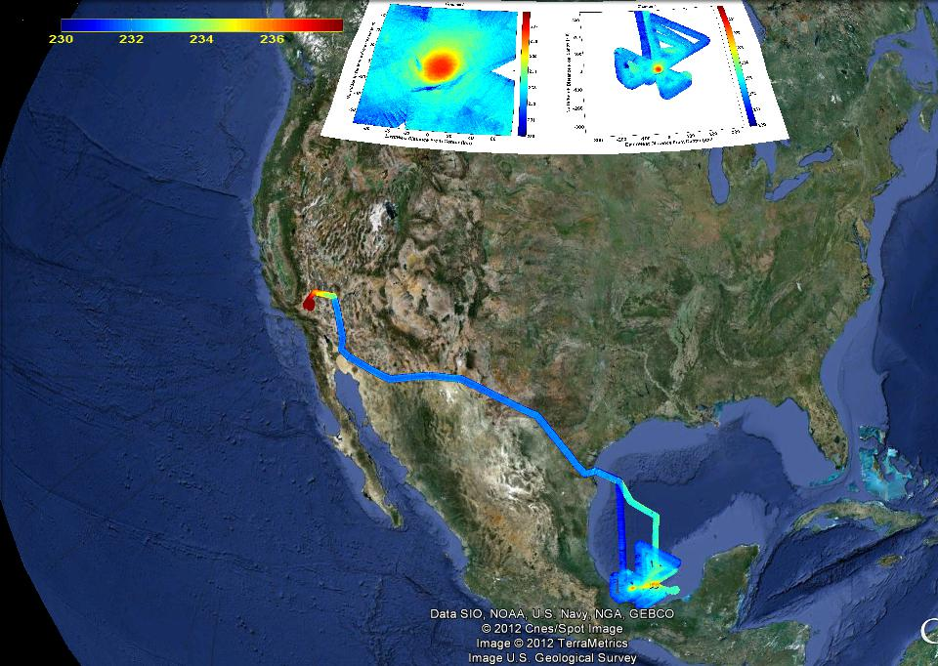
Example: 55 GHz TB imagery
350km storm relative gridded image of selected field
75km storm relative gridded image of selected field
Swath data along flight path of selected field

Slide 14
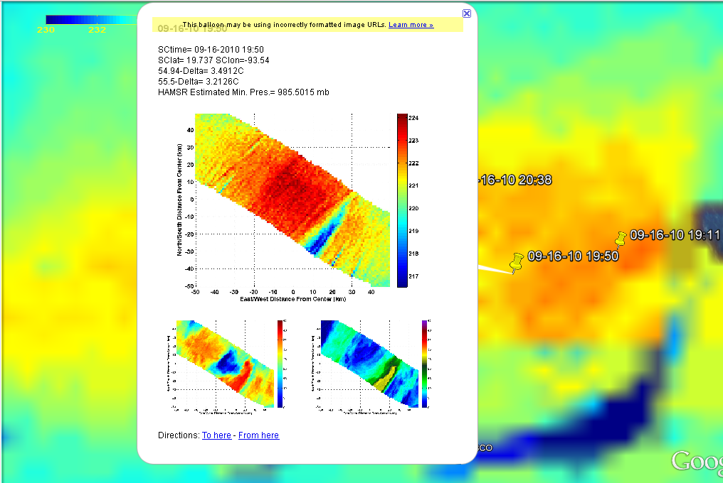
Example TC center placemark popup
Information about overpass shown as text
Time, Lat, Lon
54.94 [250mb] and 55.5 [150mb] TB anomaly
Experimental minimum central pressure derived from warm anomaly
Clicking on placemark brings up gridded images for that overpass
55.5 GHz TB, 8 km and 12 km reflectivity shown in this example

Slide 15
HIWRAP

Slide 16
HIWRAP products
Hurricane Gonzalo
10/15/15 2015-2124Z
B
High-resolution reflectivity structure (Ku, Ka bands)
Three-dimensional winds of precipitation features (~2 km horizontal resolution)
Local solver: Coplane dual-Doppler analysis
(Didlake et al. 2015, JAMC)
Global solver: Variational optimization analysis
(Guimond et al. 2014, JAOT)
Mean horizontal wind profile at nadir using Velocity Azimuth Display analysis
Currently being developed for real-time processing
(Tian et al. 2015, in review JAMC)
Ka band reflectivity
dBZ
2 km altitude
A
Distance (km)
A
B

Slide 17
HIWRAP products
Hurricane Gonzalo
10/15/15 2015-2124Z
High-resolution reflectivity structure (Ku, Ka bands)
Three-dimensional winds of precipitation features (~2 km horizontal resolution)
Local solver: Coplane dual-Doppler analysis
(Didlake et al. 2015, JAMC)
Global solver: Variational optimization analysis
(Guimond et al. 2014, JAOT)
Mean horizontal wind profile at nadir using Velocity Azimuth Display analysis
Currently being developed for real-time processing
(Tian et al. 2015, in review JAMC)
B
dBZ
2 km altitude
C
Distance (km)
Vertical velocity (m/s)
B
C

Slide 18
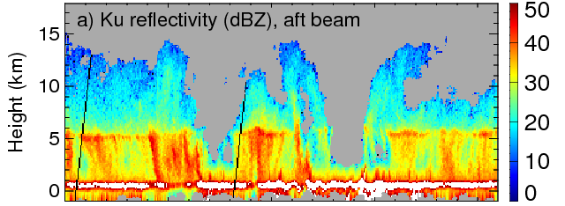
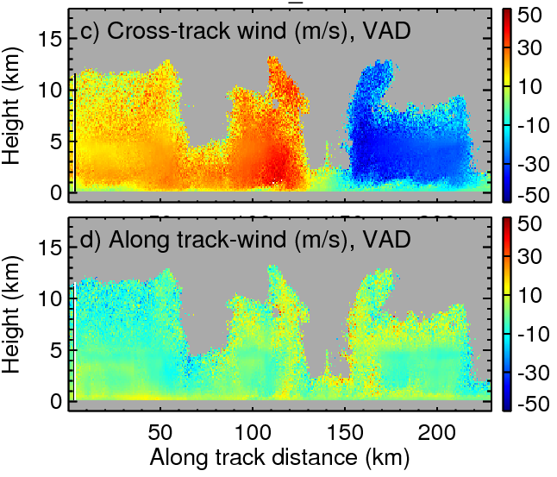
HIWRAP products
Hurricane Karl
9/17/10 0331-0413Z
High-resolution reflectivity structure (Ku, Ka bands)
Three-dimensional winds of precipitation features (~2 km horizontal resolution)
Local solver: Coplane dual-Doppler analysis
(Didlake et al. 2015, JAMC)
Global solver: Variational optimization analysis
(Guimond et al. 2014, JAOT)
Mean horizontal wind profile at nadir using Velocity Azimuth Display analysis
Currently being developed for real-time processing
(Tian et al. 2015, in review JAMC)

Slide 19
Lightning Instrument Package (LIP)

Slide 20
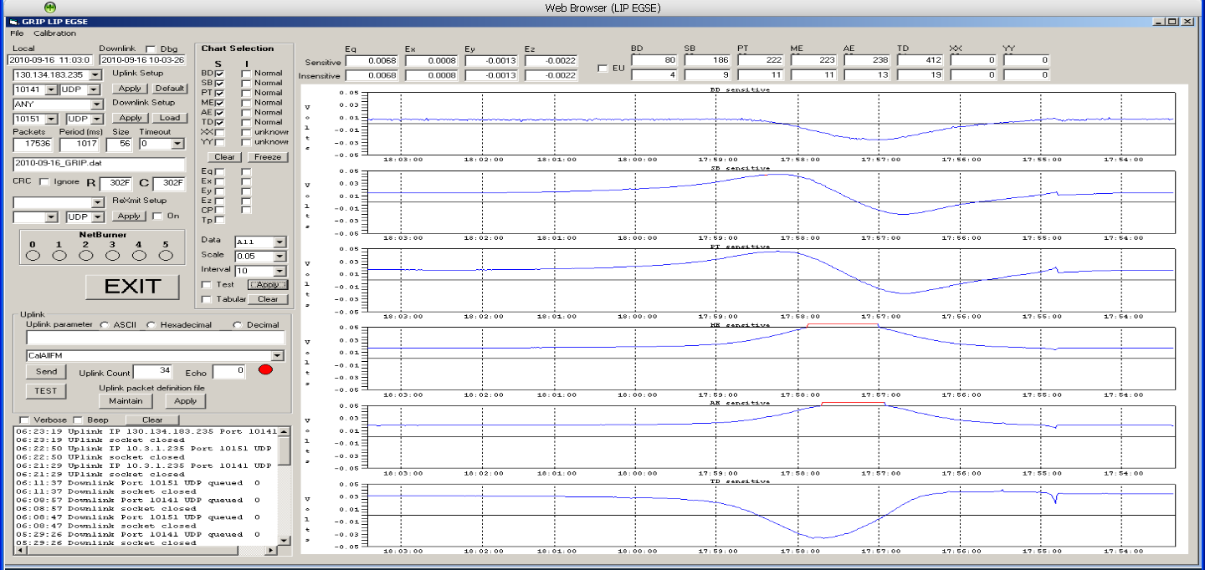
Lightning Instrument Package (LIP)
NASA GRIP Field Campaign
Real time command/control and display application for LIP

Slide 21
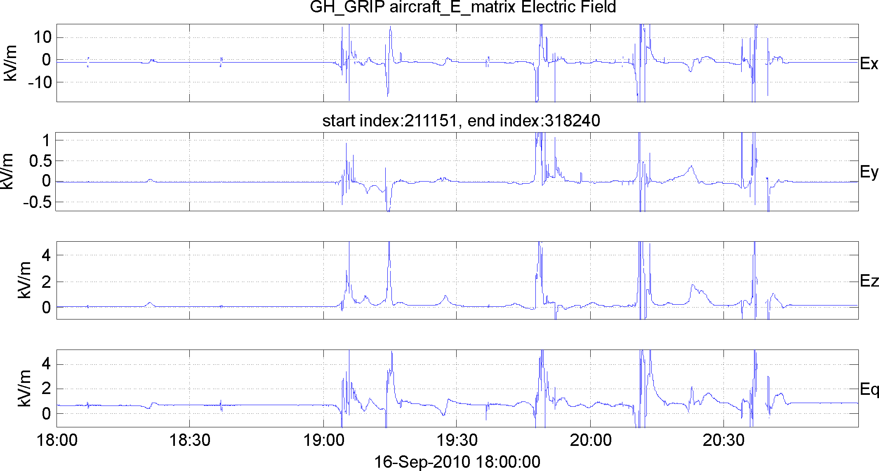
LIP: Data and Preliminary Example of Observations
Hurricane Karl: 16 Sep 2010
Global Hawk electric field observations
Multiple passes of the TC inner core
Periods with convective burst activity
*note: over 60 electrified storm clouds overflown during this 28 hour mission
Notes:
Jason, something like this can be done to produce quick look files to quickly located electrified storms. The sharp transitions correspond to lightning.

Slide 22
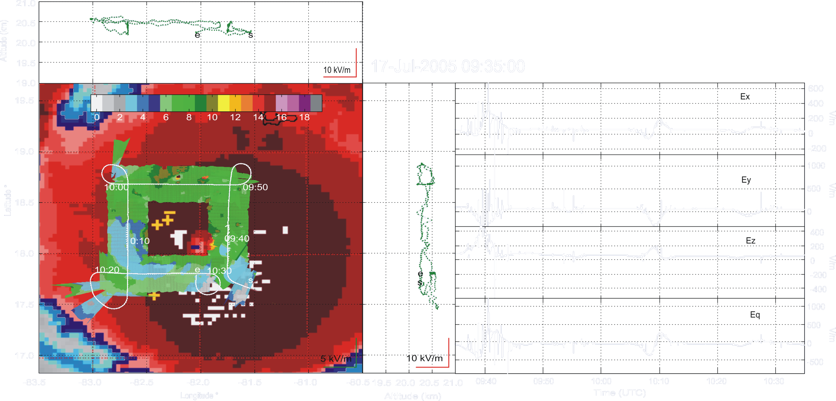
Hurricane Emily: 17 July 2005
Box pattern flow around core.
Green swath corresponds to 85 GHz channel of the Advanced Precipitation Radiometer (AMPR)
Fields in excess of 1 kV/m at closest approach to eyewall convection
Notes:
Box pattern flown around the core.
Near core, high fields again
Note frequent lightning signatures (upwards of 10 per minute)
Every time I look at the data, I see smaller & smaller lightning flashes. Rate keeps going up.
2-3/min of “big stuff”. But lots of smaller flashes.

Slide 23
2015 SHOUT
Adaptive Aircraft Sampling
GPS Dropsondes

Slide 24
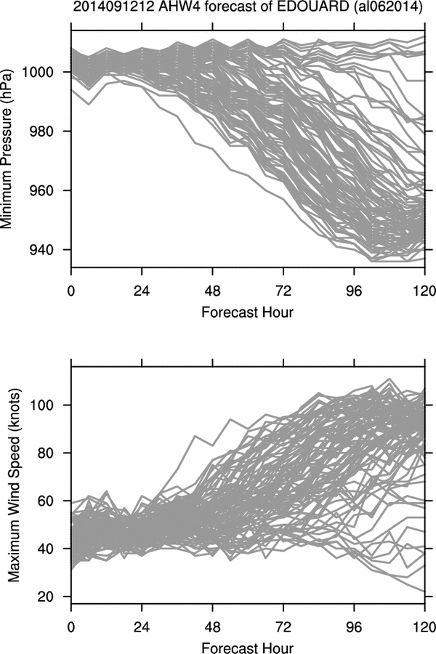
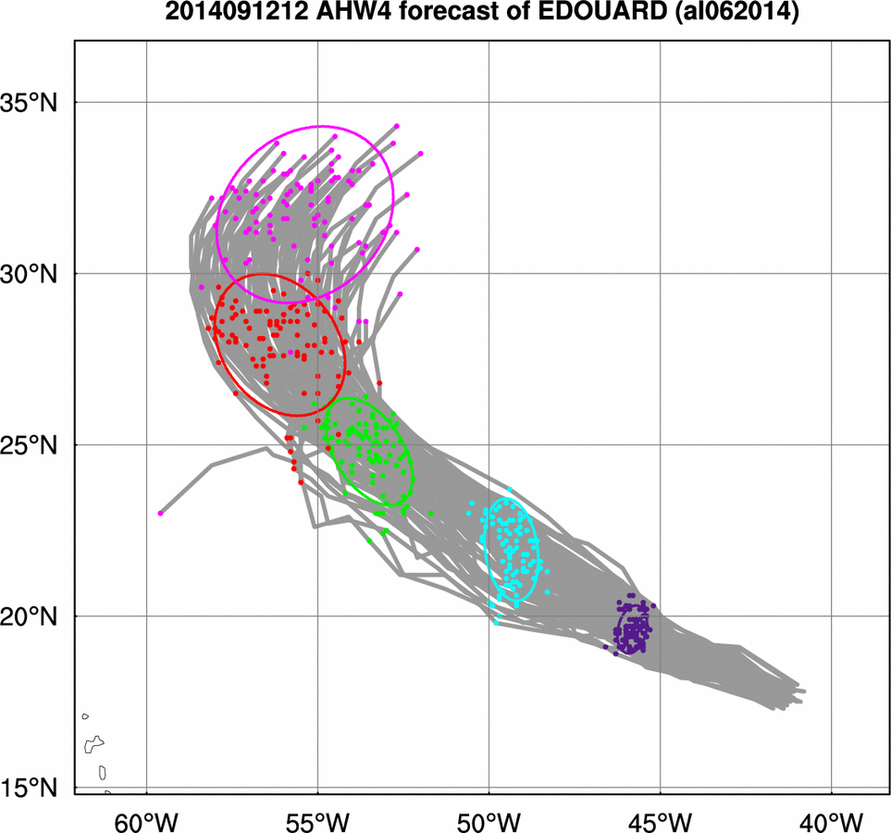
2014 Hurricane Edouard
WRF Ensemble Members (Track & Intensity)
120-hr
Ensemble Members
96-hr
72-hr
48-hr
24-hr
Ensemble Members
Notes:
Edouard Forecasts initialized 1200 UTC 12 September. Each gray line is an ensemble member. Dots show 24 h positions.

Slide 25
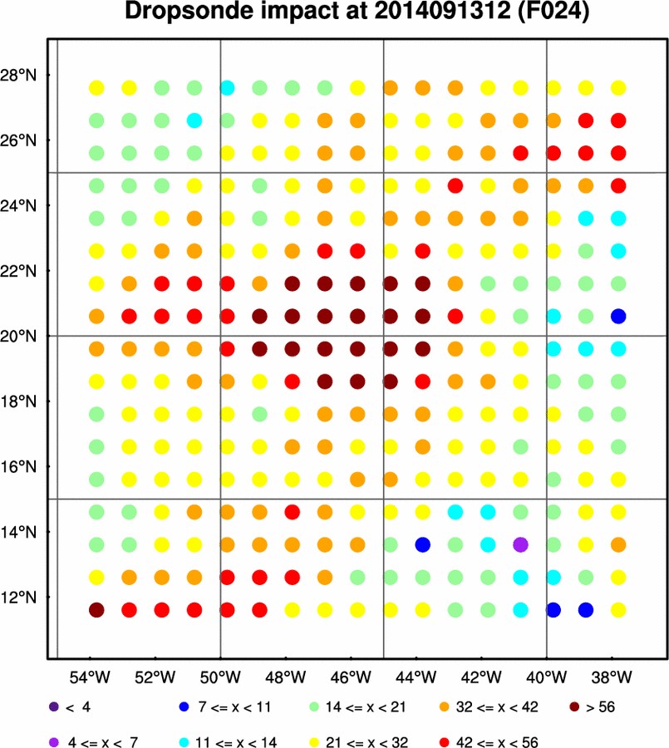
Adaptive Dropsonde Sampling
2014 Hurricane Edouard
Real-time targeting products
80 member HWRF ensemble
Edouard: hypothetical reduction in ensemble intensity variability
t=0 planning: 12 Sept 12 UTC
flight: 13 Sep 12 UTC
forecast impact: 15 Sep 12 UTC
Warmer colors >> target regions
Target >> northern semicircle of Edouard (downshear)
19kt
SHIPS shear
Notes:
intensity forecasts are sensitive to amount of downshear convection
units are percentage reduction, so warmer colors are larger
Obs should be taken in NW quadrant 0-300 km from the center
SHIPS shear: 19kt@199 deg

Slide 26
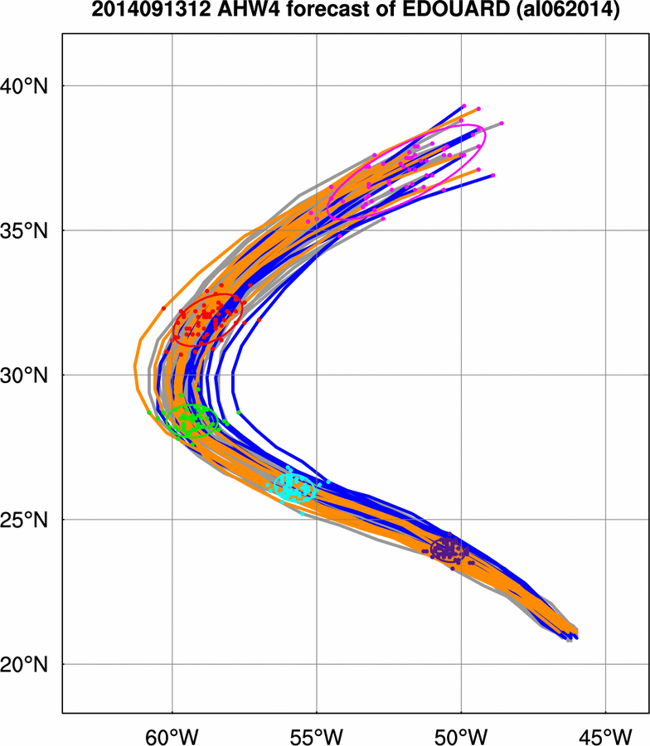
2014 Hurricane Edouard
WRF Ensemble Track Forecasts (initialized 13 Sep 1200 UTC)
10 Strongest members (0-72 hr)
10 Weakest members (0-72 hr)
120-hr
96-hr
Metric
along-track dx (96 hr)
72-hr
48-hr
24-hr
Notes:
These are Edouard track forecasts initialized 1200 UTC 13 September. Metric is going to be along-track distance at 96 h (red dots and ellipse).
Blue=10 weakest 1st 72 hr
Orange=10 strongest 1st 72 hr

Slide 27
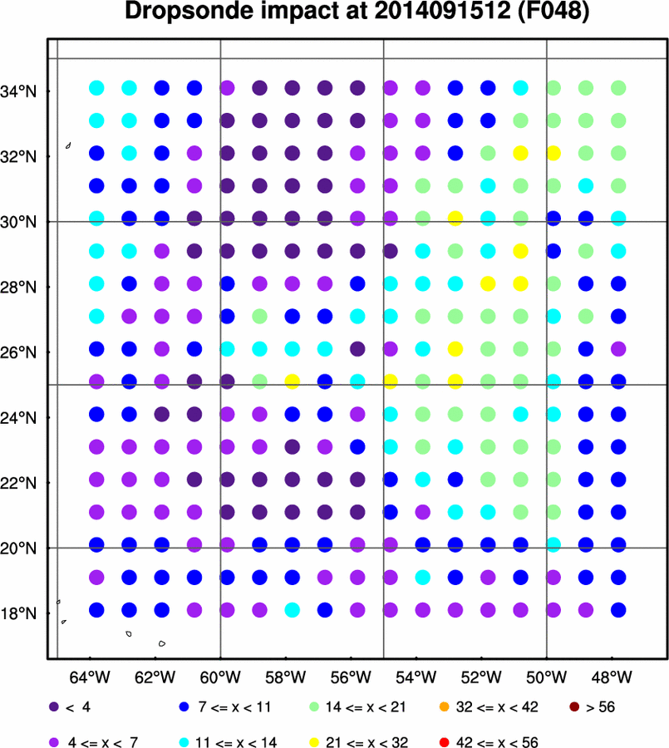
Adaptive Dropsonde Sampling
2014 Hurricane Edouard
Real-time targeting products
80 member HWRF ensemble
Edouard: hypothetical reduction in ensemble along- track variability (~SW-NW)
t=0 planning: 15 Sept 12 UTC
flight: 15 Sep 12 UTC
forecast impact: 17 Sep 12 UTC
Warmer colors >> target regions
Target >> east semicircle (~0-600 km): meridional steering flow
Notes:
Left shows hypothetical impact of assimilating a drop at that location at 1200 UTC 15 Sept. on along-track distance (distance to the NE) forecast valid 1200 UTC 17 Sept. This is type of plot that would be available two days before a flight takeoff. The units are percentage reduction, so warmer colors are larger. Right panel shows sensitivity of the along-track distance at 1200 UTC 17 September to the 1200 UTC 15 September meridional steering flow. This figure suggests that a storm ends up more to the NE when there is higher meridional wind on the eastern side of the TC. As a consequence, it is not surprising that the location for observations is on the eastern side of the storm.
All dot plots are Zonal, meridional, T , q throughout column

Slide 28
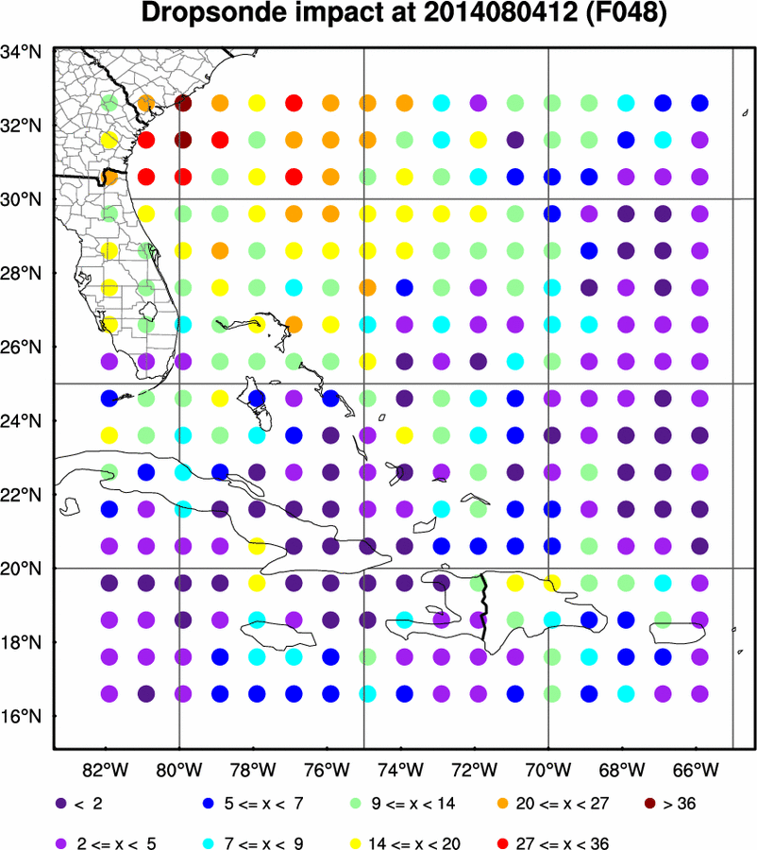
Adaptive Dropsonde Sampling
2014 Hurricane Bertha
Real-time targeting products
80 member HWRF ensemble
Bertha: hypothetical reduction in ensemble track variability
t=0 planning: 04 Aug 12 UTC
flight: 04 Aug 12 UTC
forecast impact: 06 Aug 12 UTC
Warmer colors >> target regions
Target >> far field NW of Bertha (build into GH ferry)
Notes:
Hypothetical reduction in primary variability axis distance at 1200 UTC 6 August due to assimilating a dropsonde at each point. The warmer the color, the greater the impact. Figure is storm-centered (the x denotes the predicted center of Bertha at the time).

Slide 29
2015 SHOUT
Flight Patterns & Modules
NOAA SHOUT TCI Science Team Meeting: May 7, 2015

Slide 30
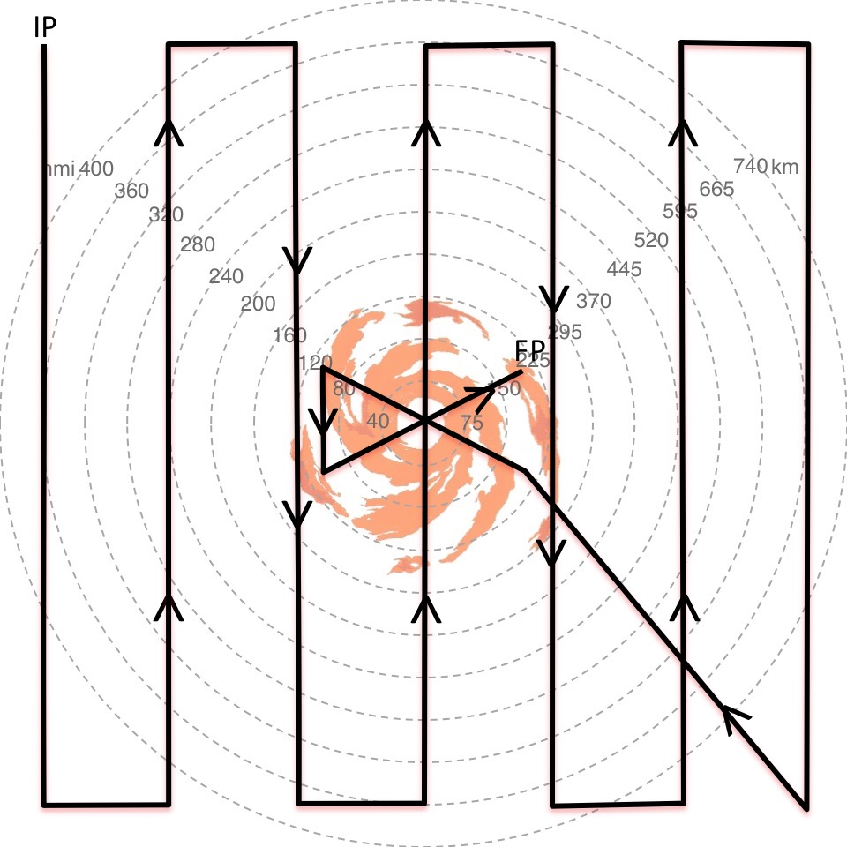
Global Hawk Flight Modules
Lawn Mower (~2 deg spacing)
On-Station Time
~19.75 hr
R=0 to R=~665 km
12x12 degree box
Advantages
Far Field sampling
Simpler navigation
Disadvantages
Radial/Azimuthal sampling
Long pattern
Limited Inner core snapshots
Radial gradients
HAMSR & HIWRAP >> inner core

Slide 31
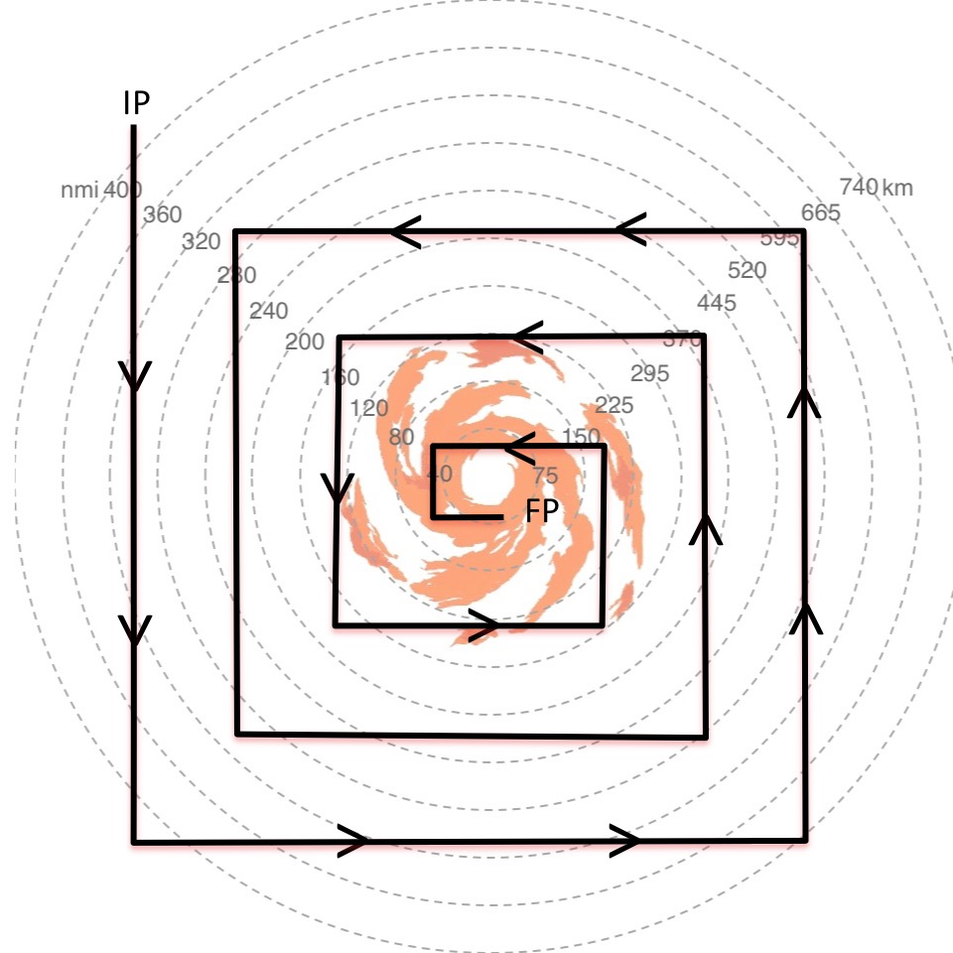
Global Hawk Flight Modules
Square Spiral (10x10 box; 1.5 deg legs)
On-Station Time
~13.5 hr
R=0 to R=~555 km
Advantages
Inner core & envir sampling
Uniform sampling
Calculating budgets
Simpler navigation
Disadvantages
Radial sampling/gradients
Limited Inner core snapshots
HAMSR & HIWRAP >> limited inner core
HIWRAP >> tight inner core turns

Slide 32
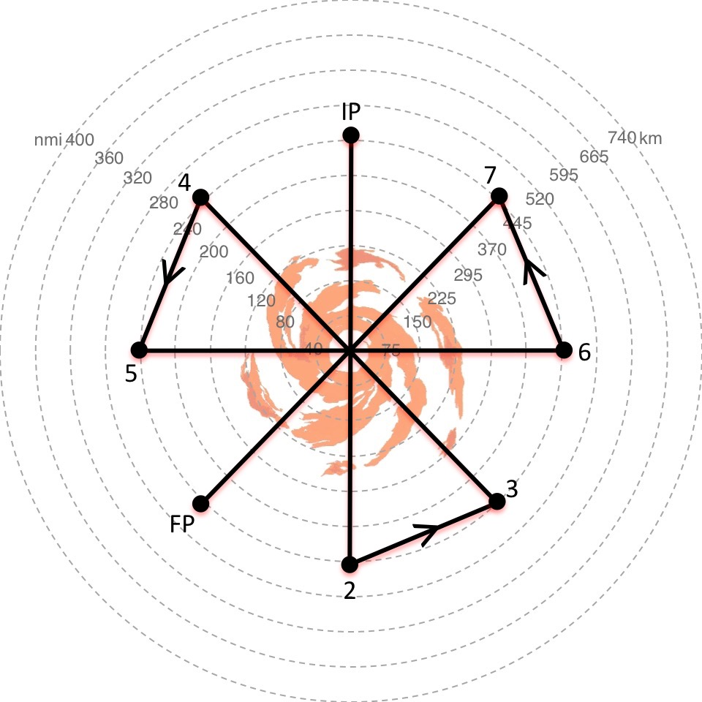
Global Hawk Flight Modules
Figure-4
On-Station Time
~7.5 hr
R=0 to R=~450 km
Advantages
For limited on-station scenarios
Radial gradients
Inner core & envir sampling
HAMSR & HIWRAP >> inner core
Better for inner core snapshots
Disadvantages
Far field sampling limited
Navigating center crossings

Slide 33
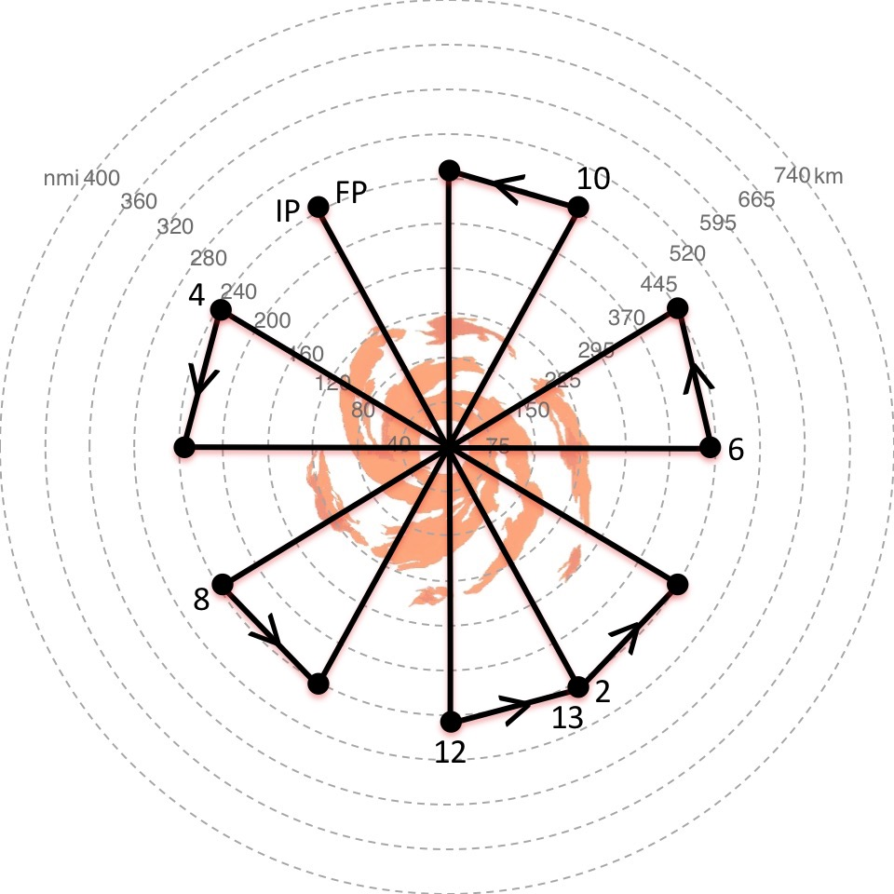
Global Hawk Flight Modules
Rotated Butterfly (30 deg)
On-Station Time
~12.5 hr
R=0 to R=~450 km
Advantages
Radial/Azimuthal sampling
Radial gradients
~ 8 center crossings
Inner core & envir sampling
HAMSR & HIWRAP >> inner core
Disadvantages
Not ideal for inner core snapshots
Far field sampling limited
Navigating center crossings

Slide 34
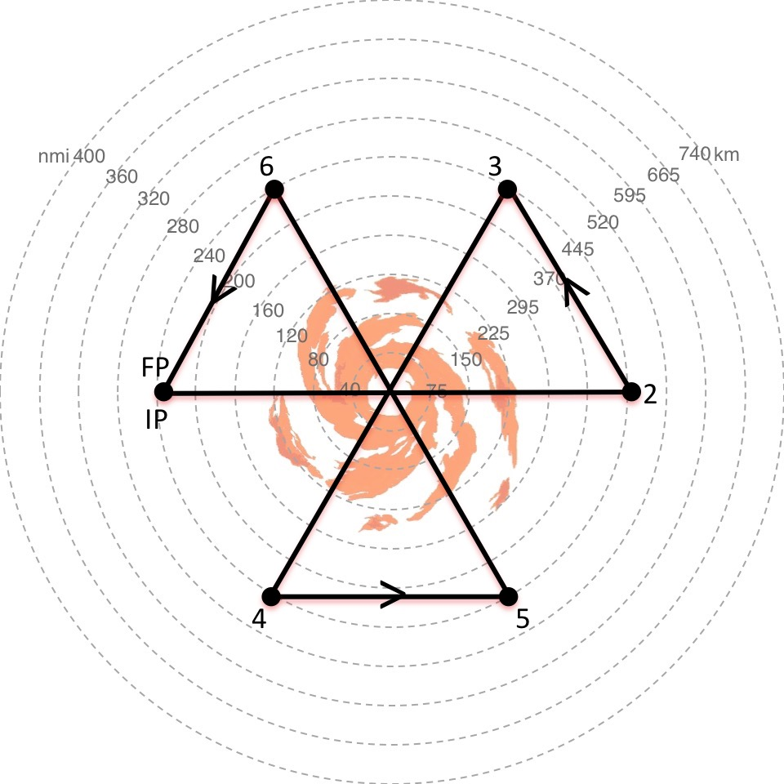
Global Hawk Flight Modules
Butterfly
On-Station Time
~6.75 hr
R=0 to R=~450 km
Advantages
For limited on-station scenarios
Radial gradients
Inner core & envir sampling
HAMSR & HIWRAP >> inner core
Disadvantages
Not ideal for inner core snapshots
Inner Core sampling limited
Far field sampling limited
Navigating center crossings

Slide 35
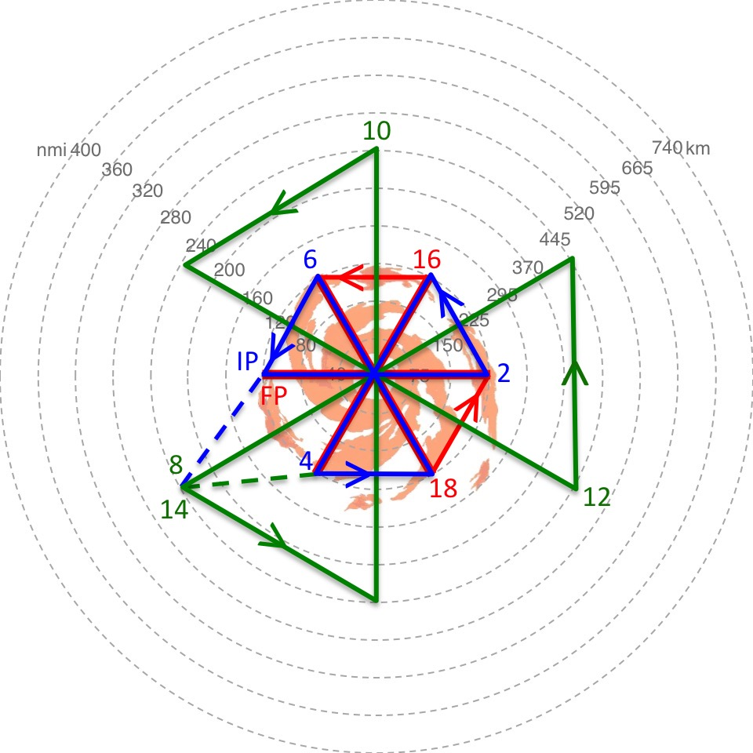
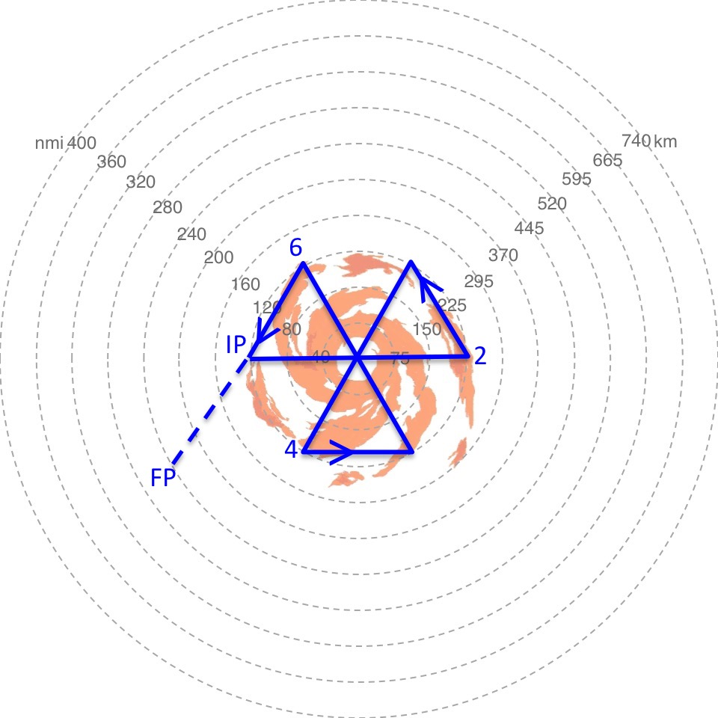
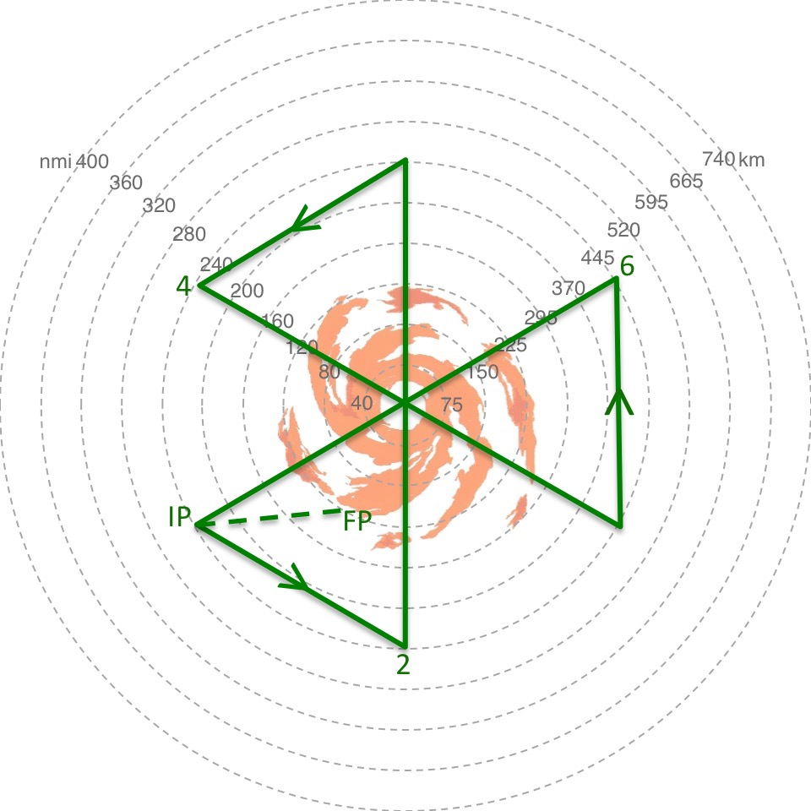
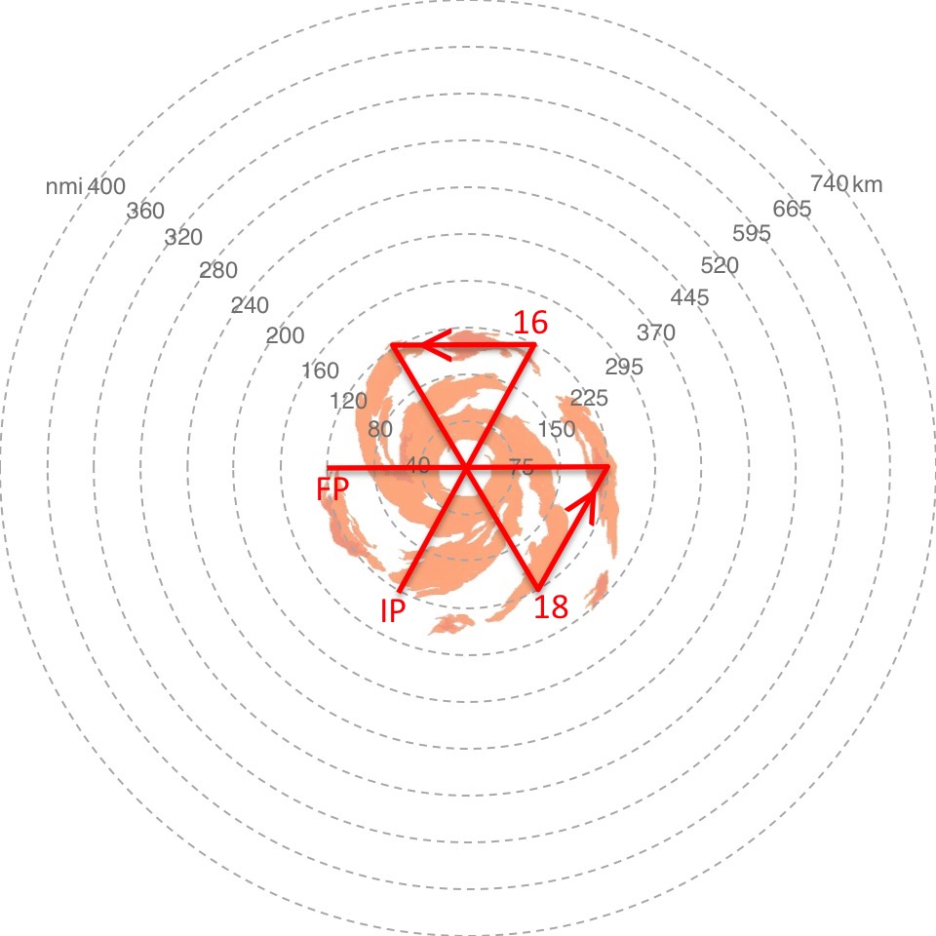
Global Hawk Flight Modules
Butterfly (small-large-small)
On-Station Time
~14.0 hr (3.25 hr/6.5/3.0 hr)
R=0 to R=~450 km
Advantages
Radial/Azimuthal sampling
2 Inner core snapshots
Radial gradients
9 center crossings
Inner core & environ sampling
HAMSR & HIWRAP >> inner core
Disadvantages
Far field sampling limited
Navigating center crossings

Slide 36
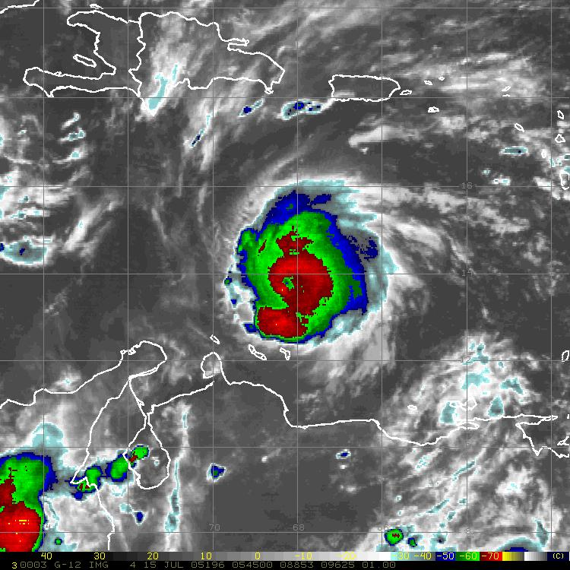
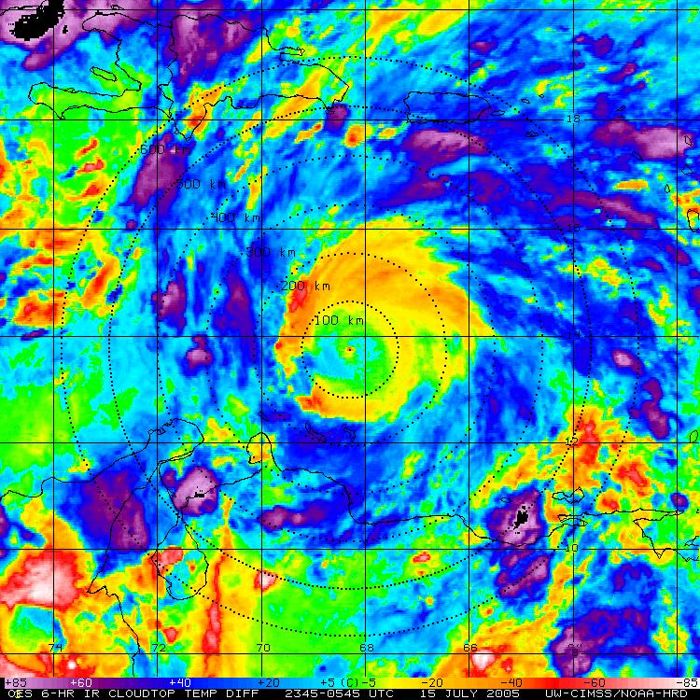
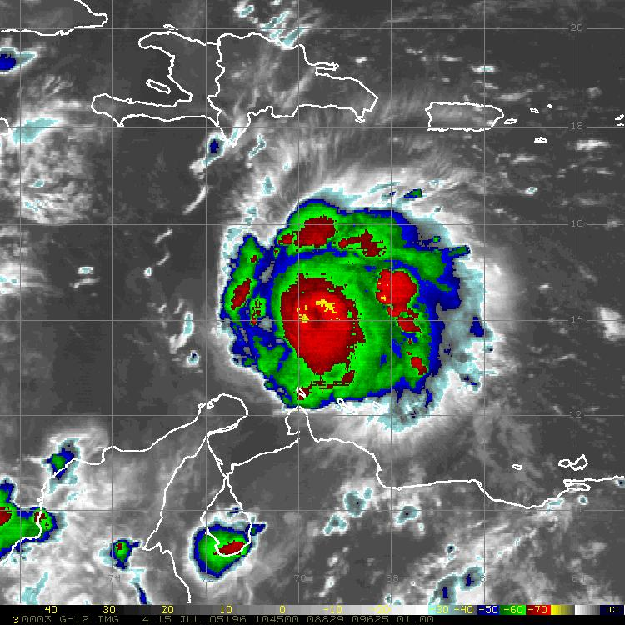
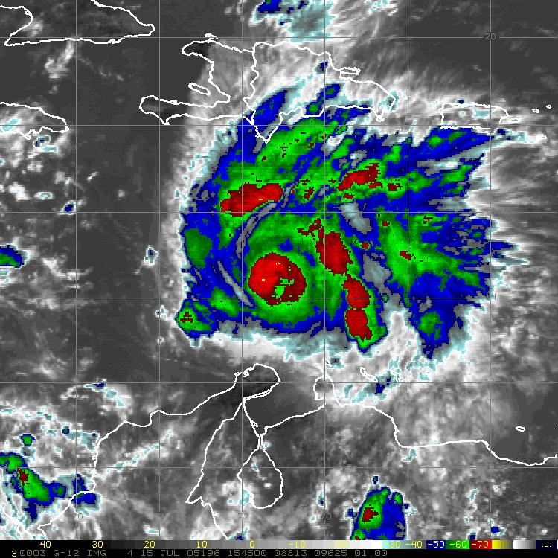
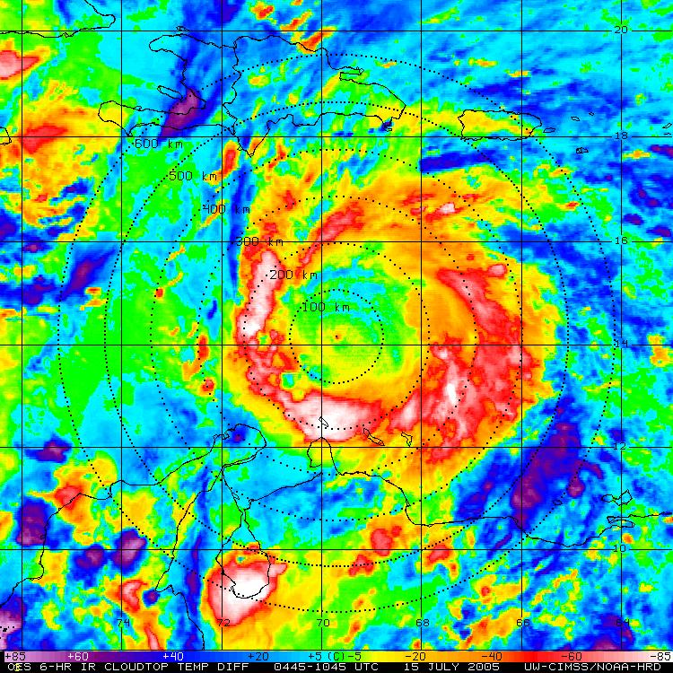
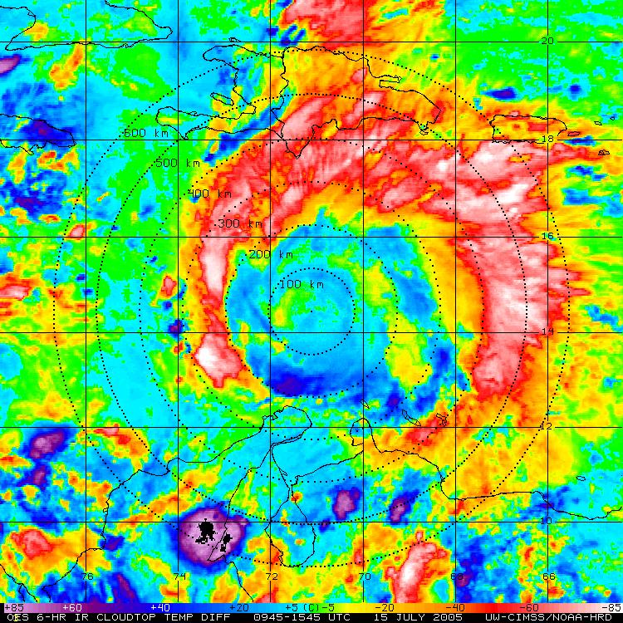
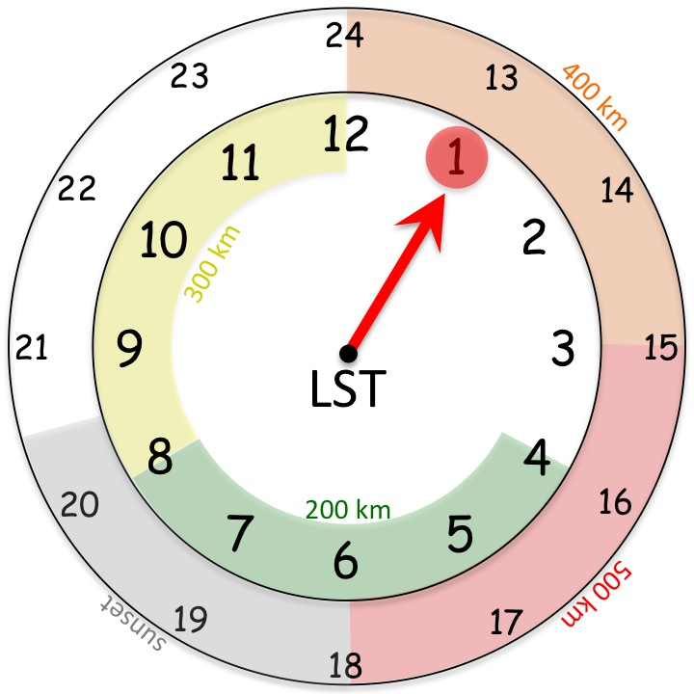
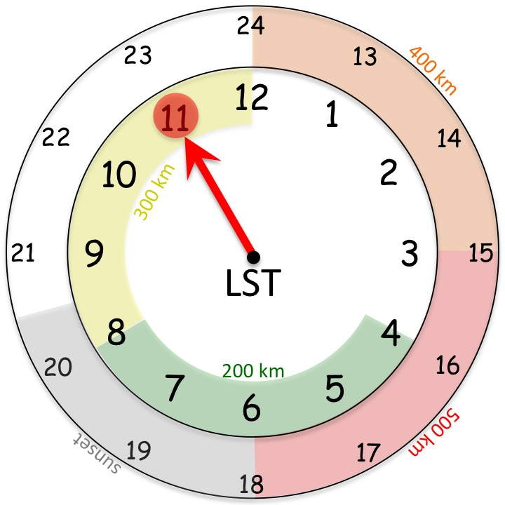
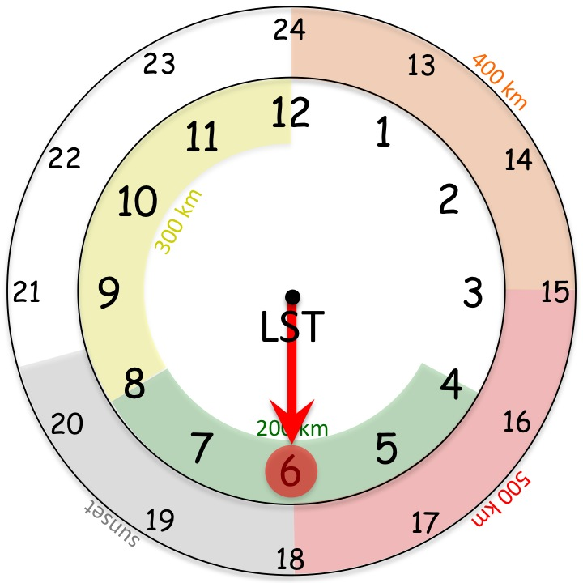
Global Hawk Flight Modules
TC Diurnal Cycle
GOES IR
TC Diurnal Cycle

Slide 37
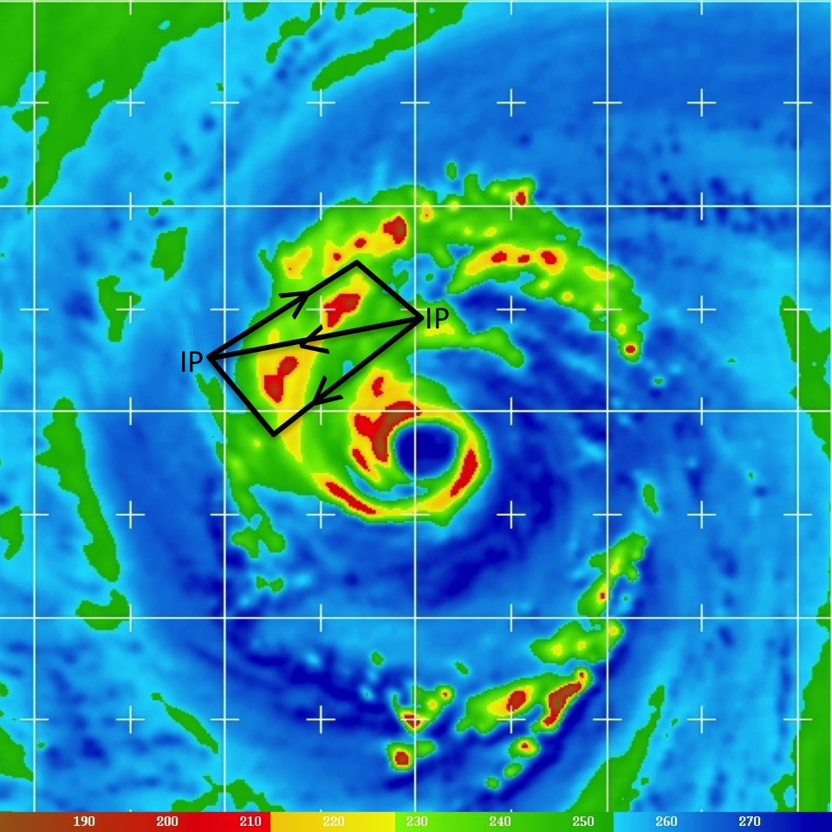
Global Hawk Flight Modules
Convective Module
GOES IR

Slide 38
Conclusions
1) NOAA SHOUT Objectives
Demonstrate & evaluate UAS operational benefits
Improve TC track & intensity forecasts
Improve impacts & understanding (OSEs, OSSEs, obs)
2) NOAA SHOUT 2015 Deployment
Single Global Hawk (AV-6)
Science period: 25 Aug – 27 Sep
Instruments: GPS dropsondes, HAMSR, HIWRAP, LIP
3) Real-time Global Hawk data
What products are NHC forecasters interested in?
What is the best means to deliver those products?

Slide 39




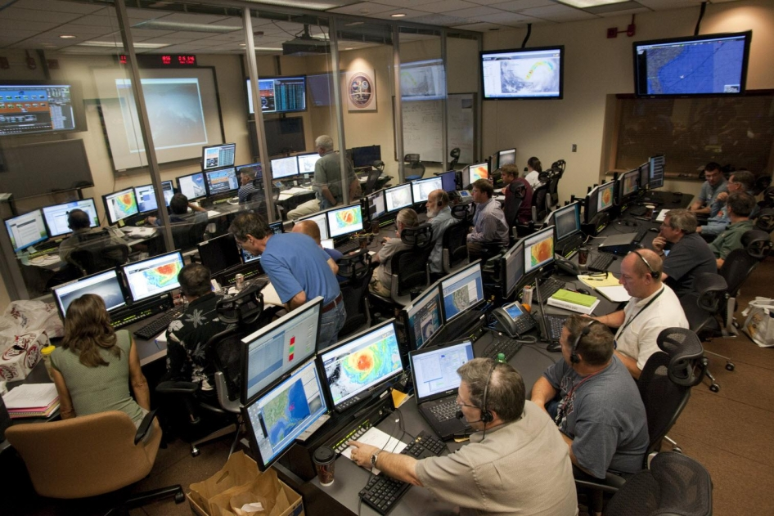
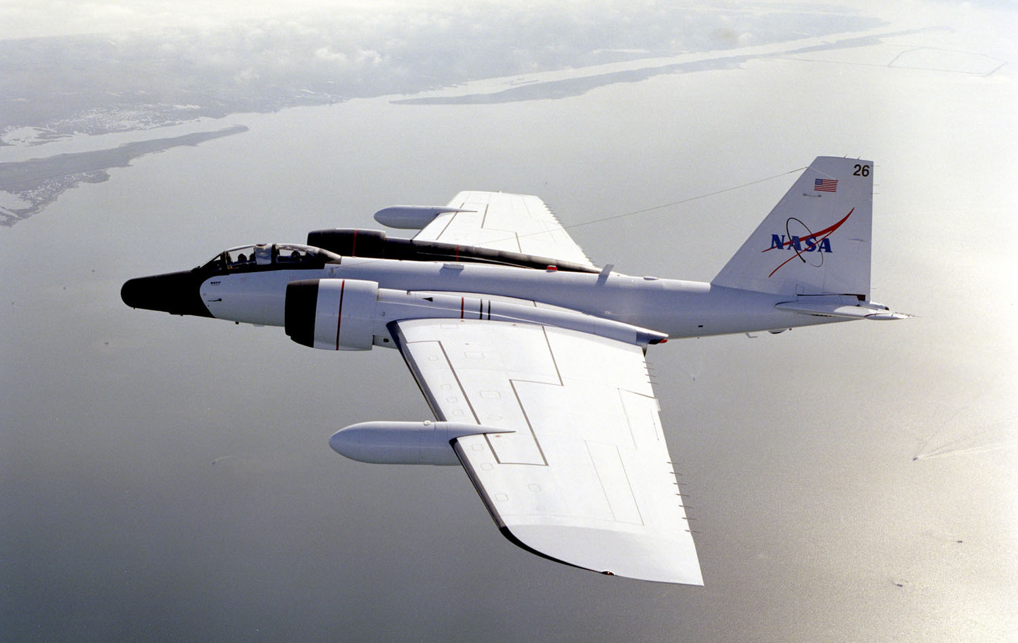
2015 Hurricane Field Programs
NOAA, Air Force, Office of Naval Research
Notes:
Clockwise from 12:00: AF C-130, Global Hawk at Wallops, Global Hawk Operations Center at Wallops, NASA WB-57 (ONR outflow project), NASA GH, NOAA P-3 and G-IV

