Slide 1
Interesting Observations from the P-3 Lower-Fuselage Radar
Jason P. Dunion
University of Miami – NOAA/AOML/Hurricane Research Division

Slide 2
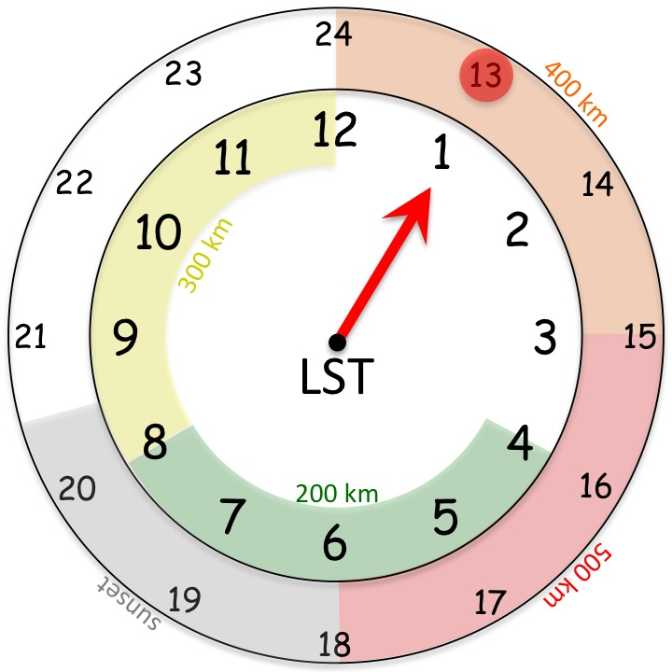
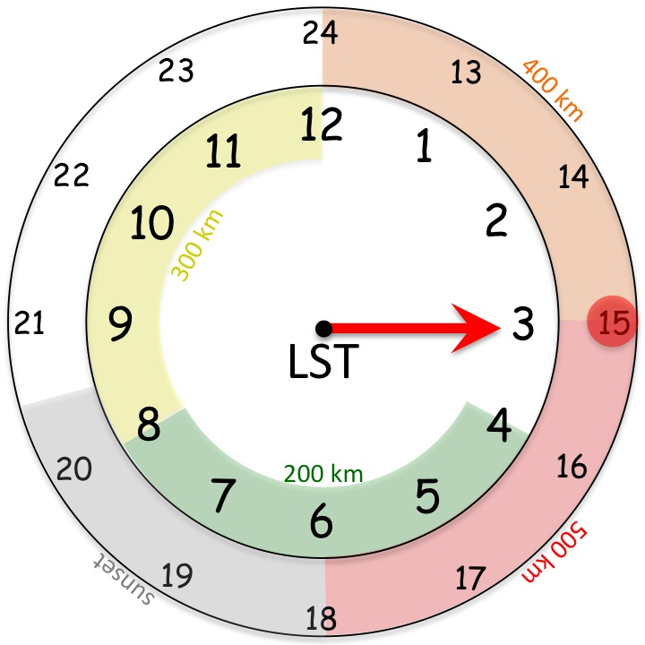
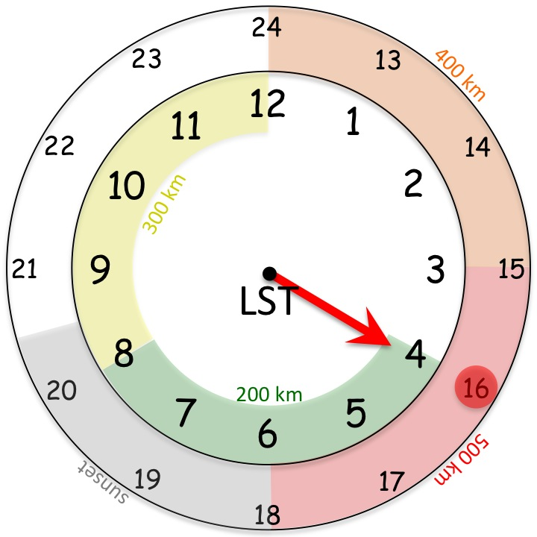
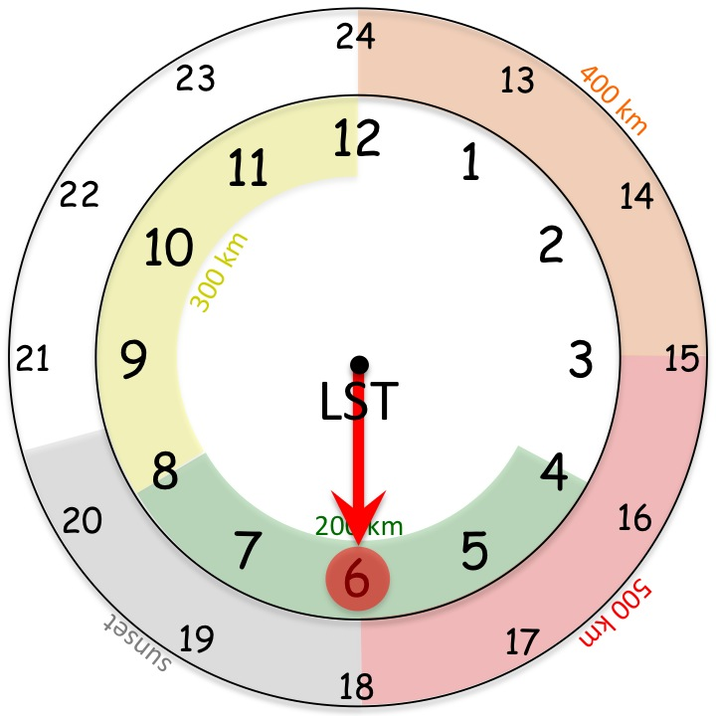
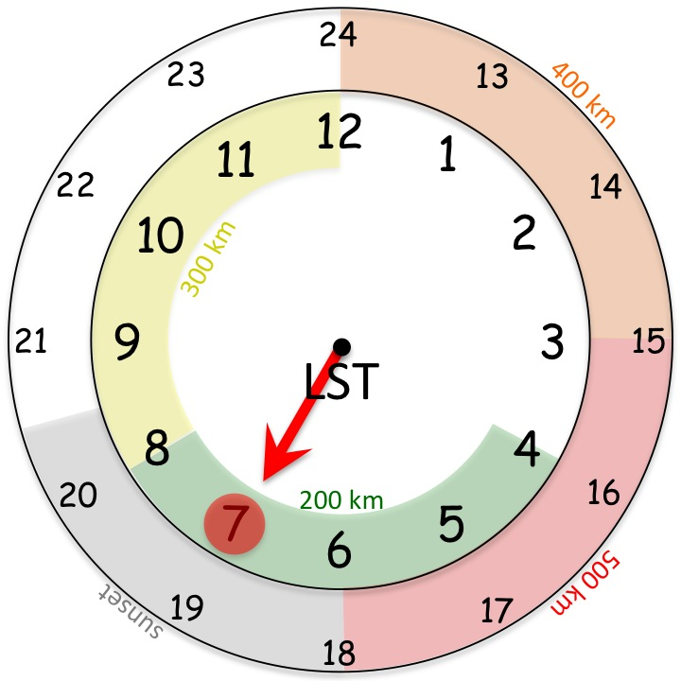
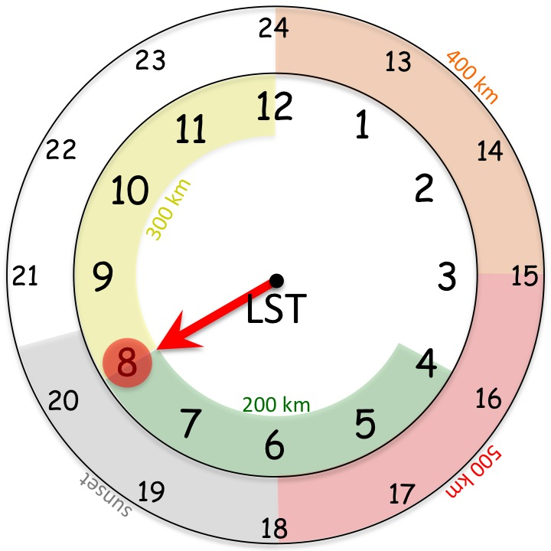
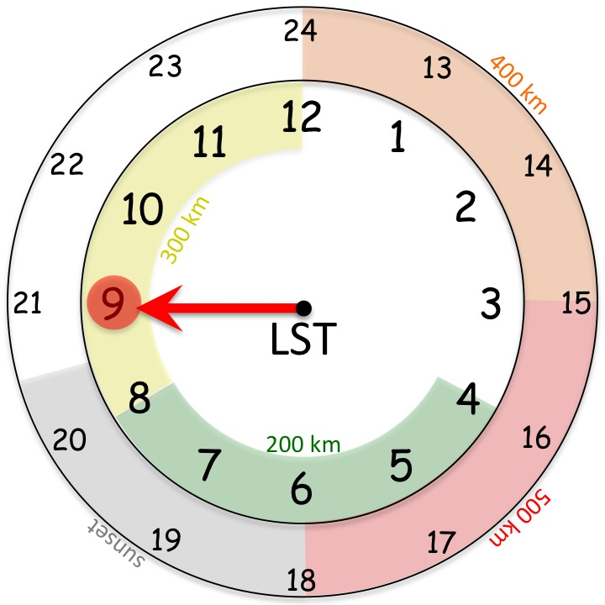
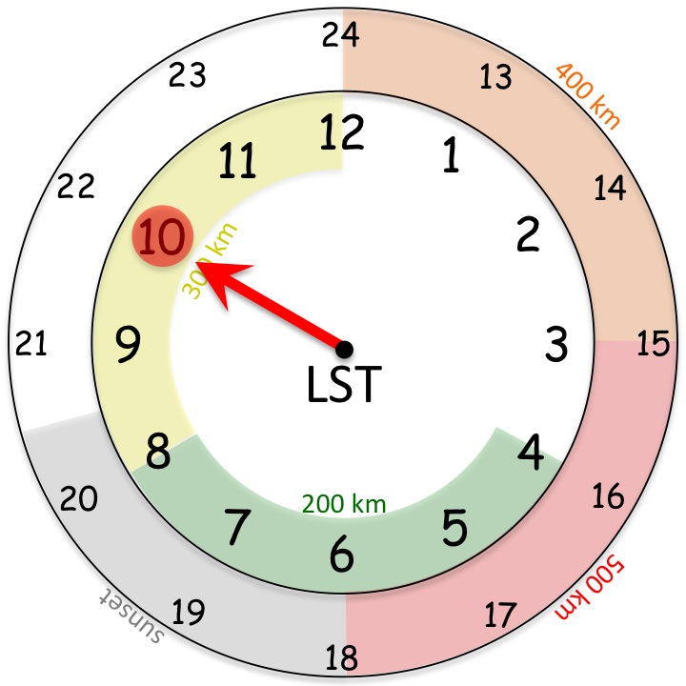
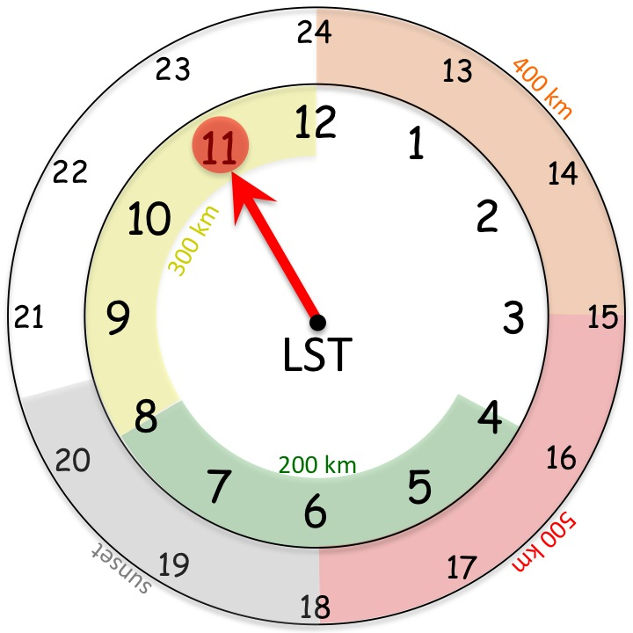
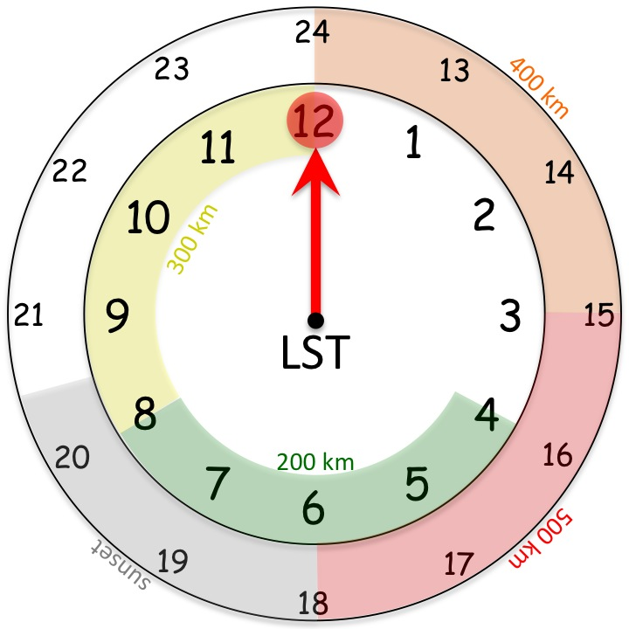
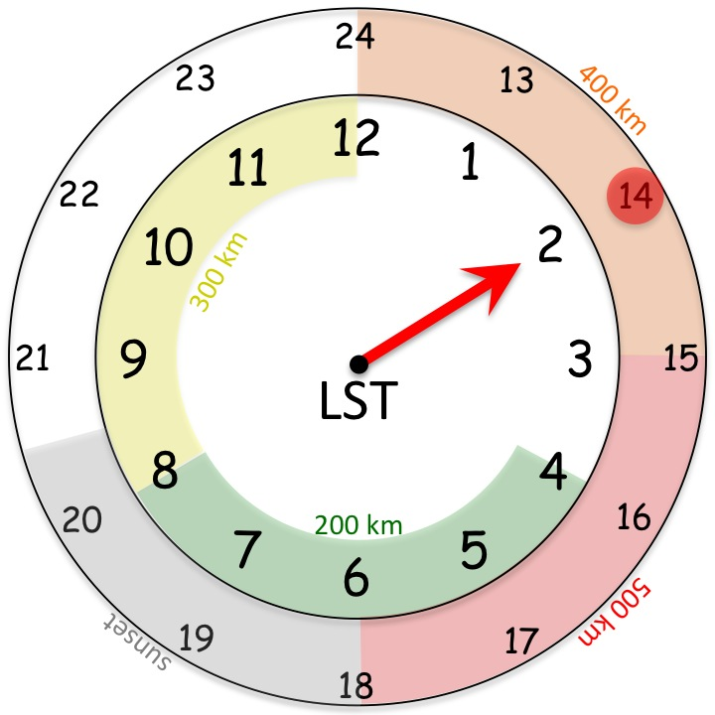
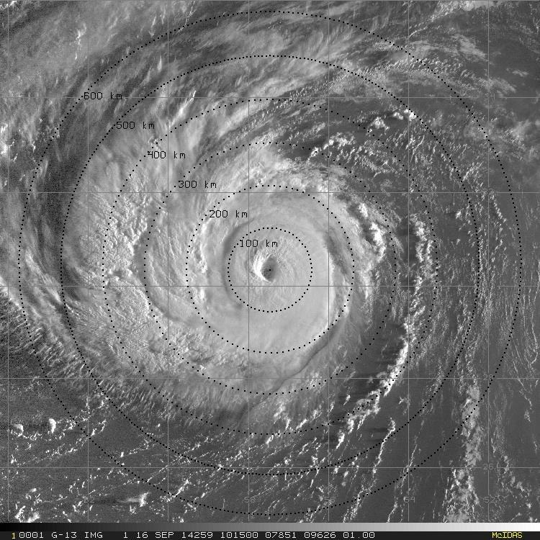
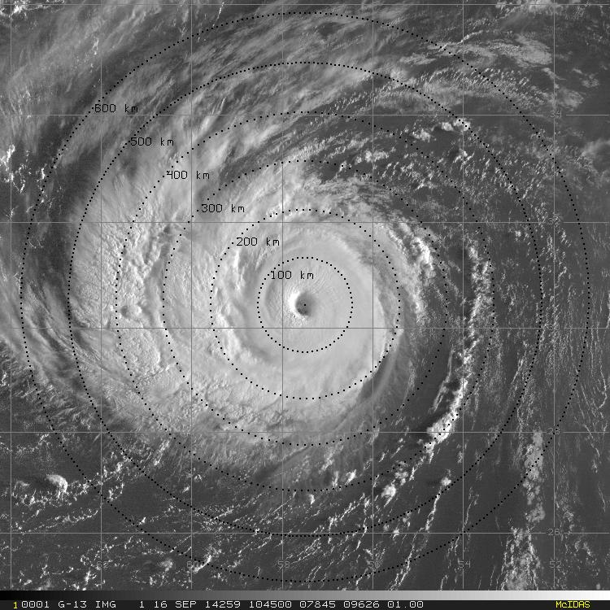
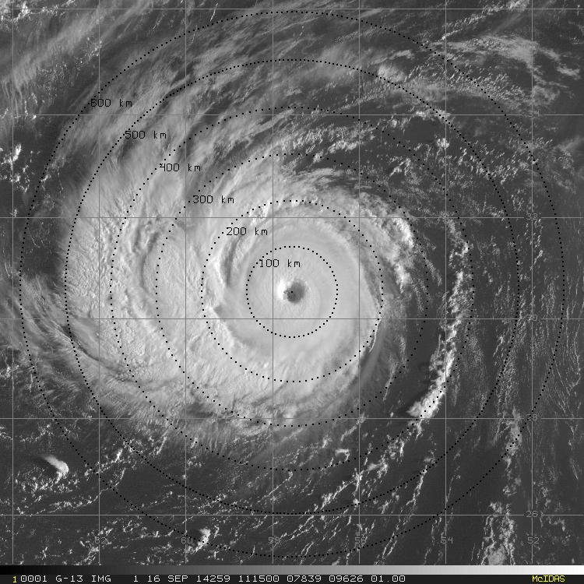
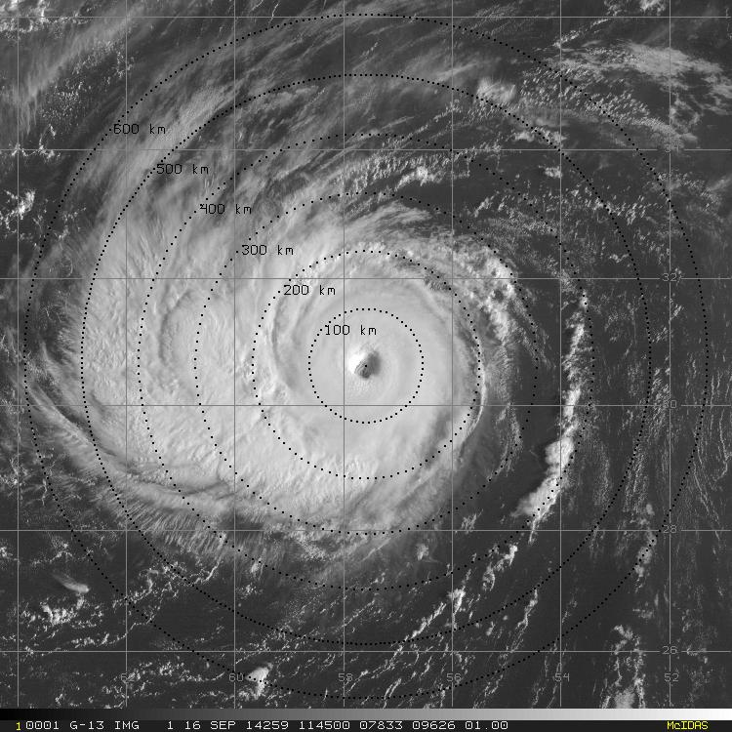
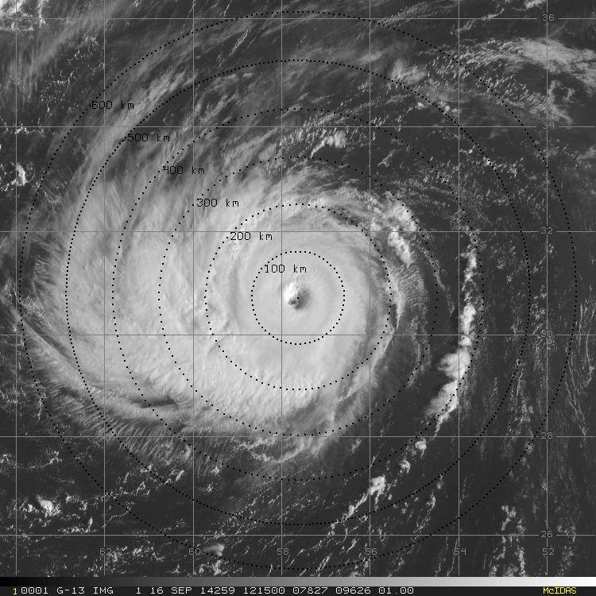
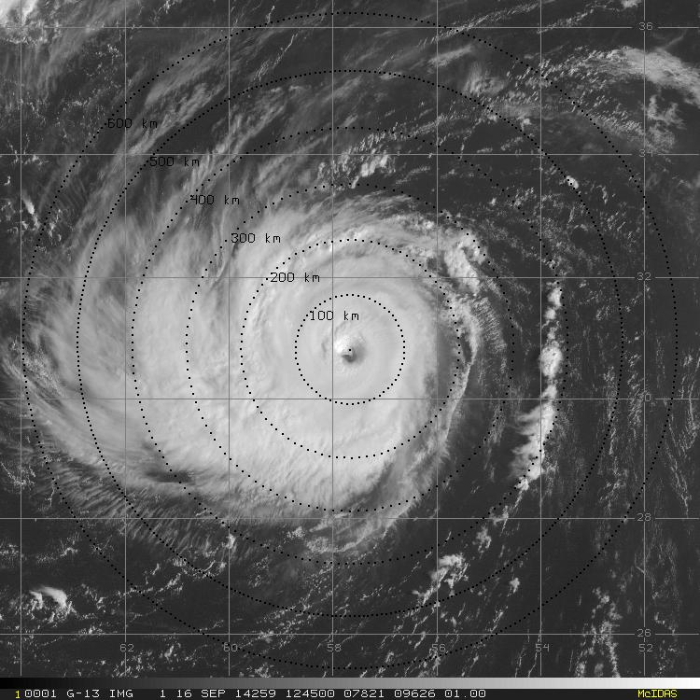
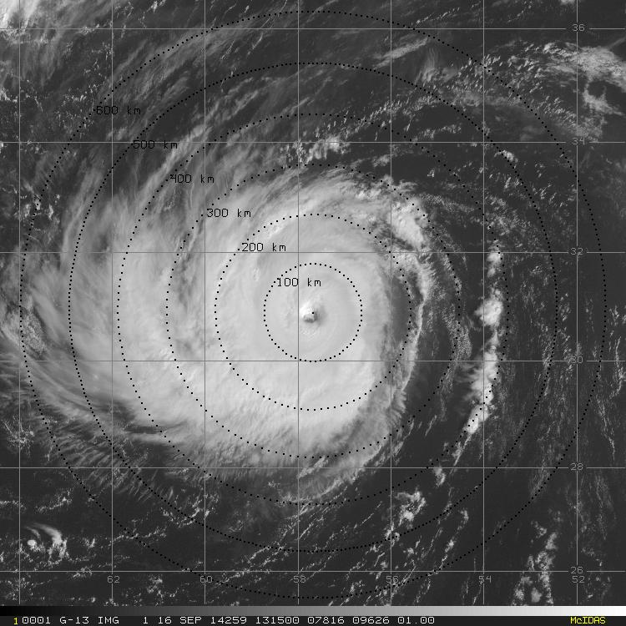
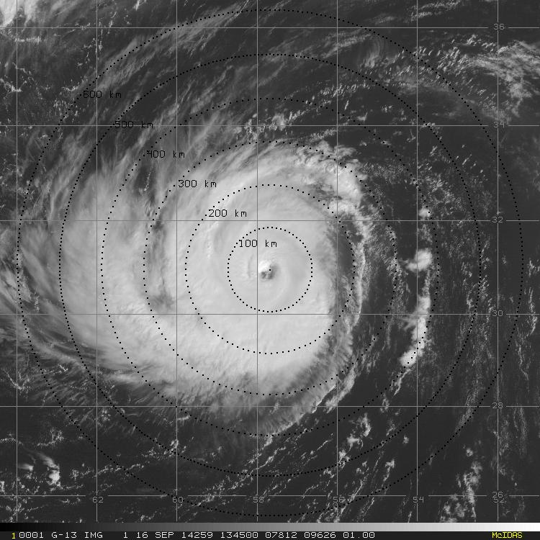
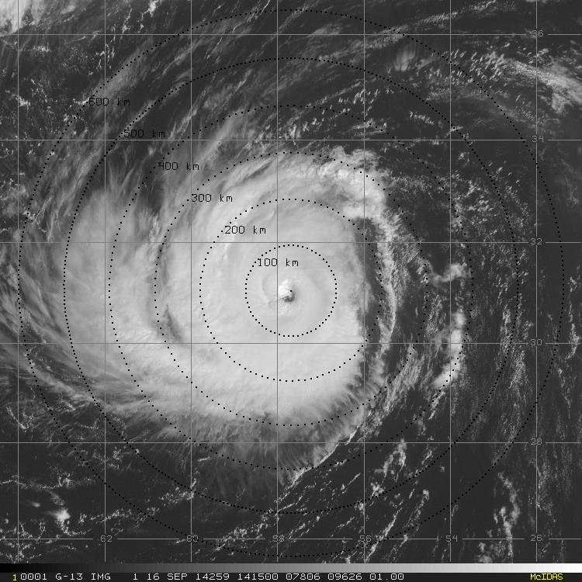
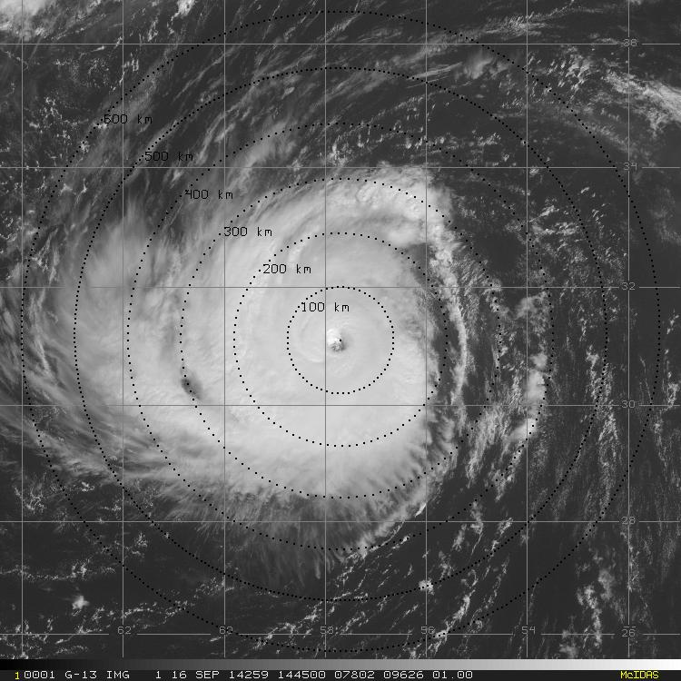
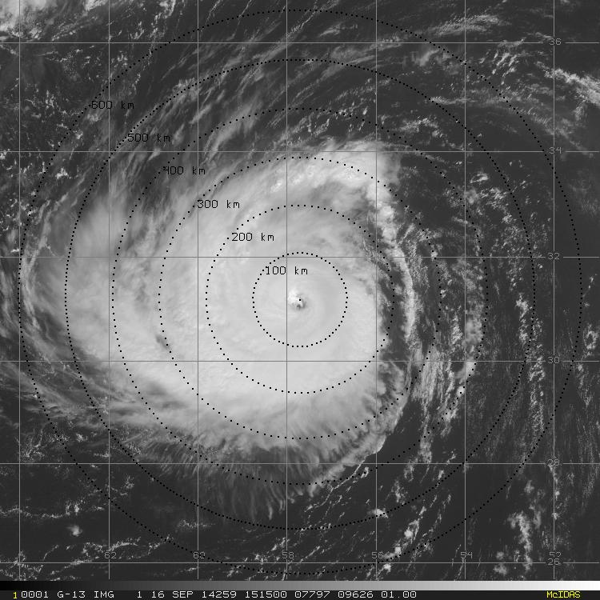
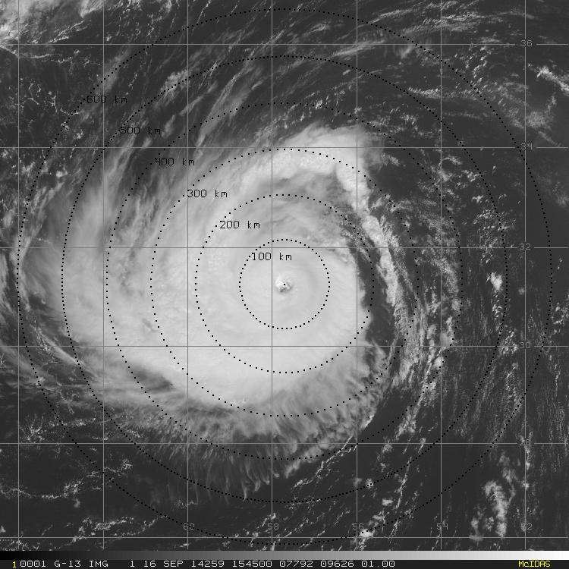
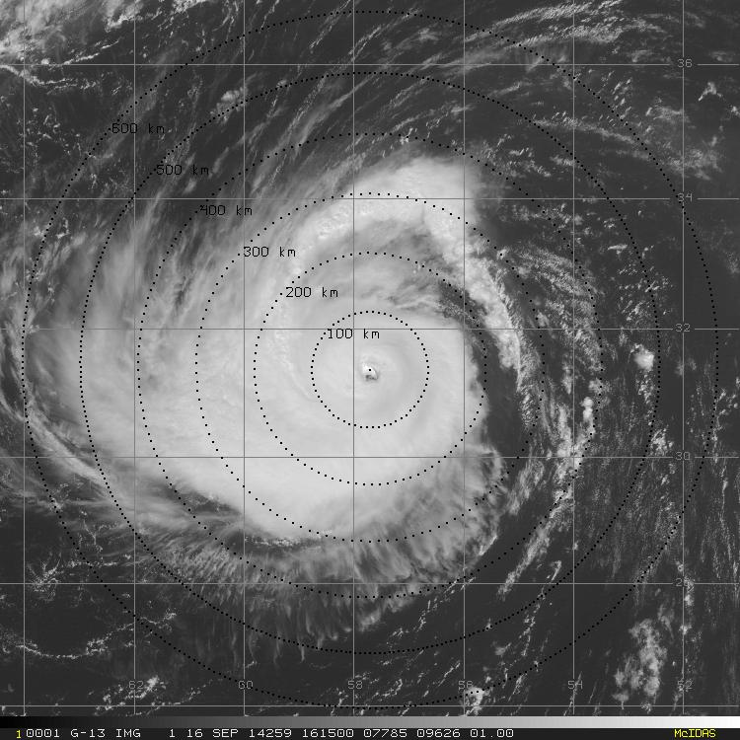
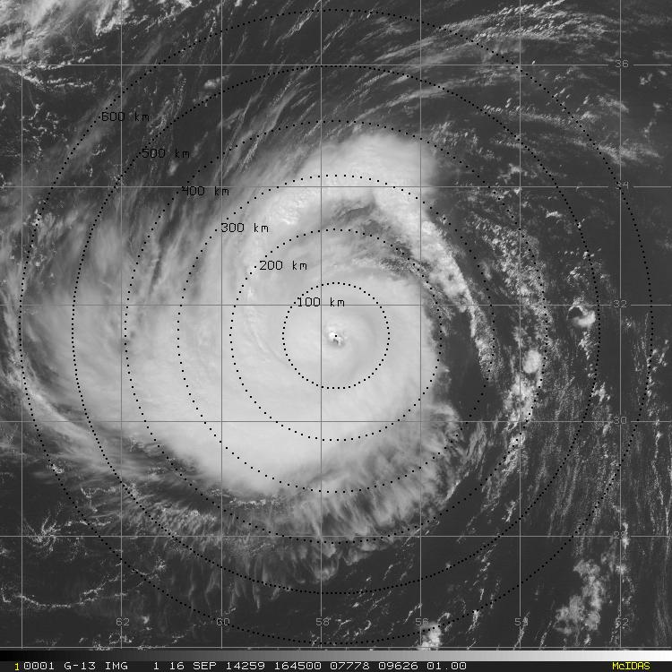
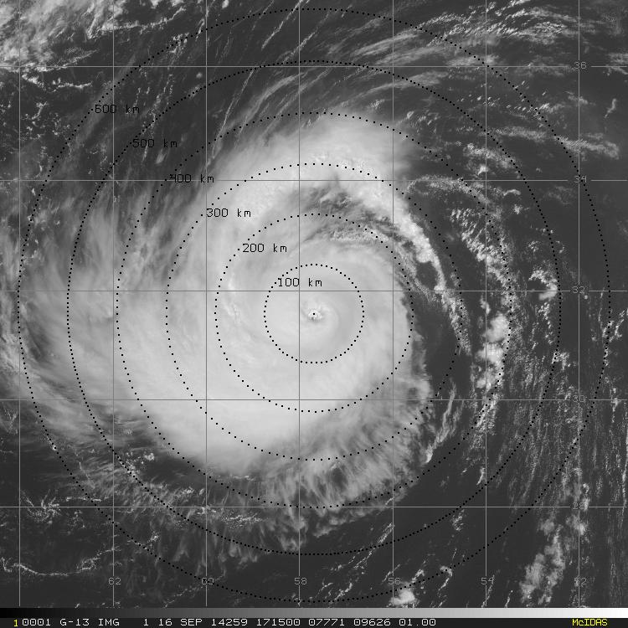
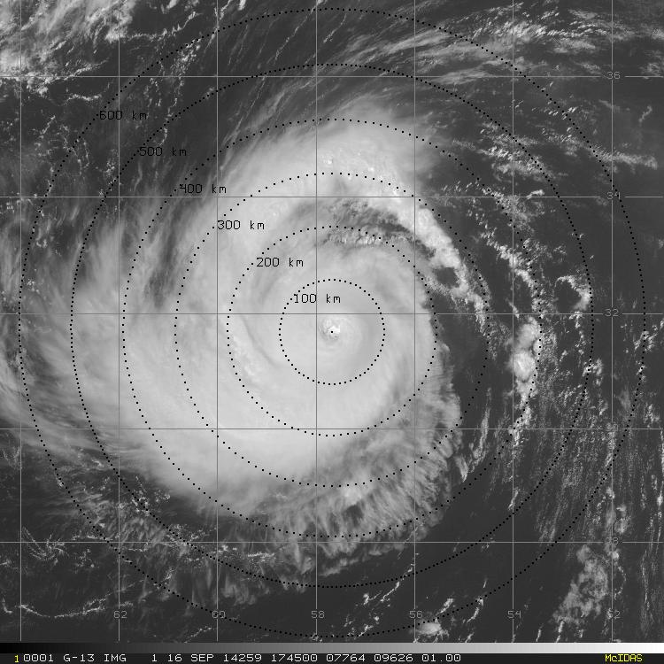
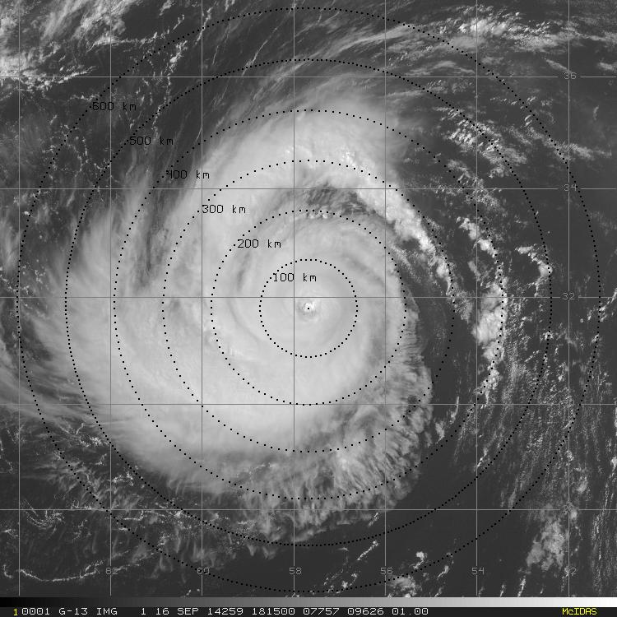
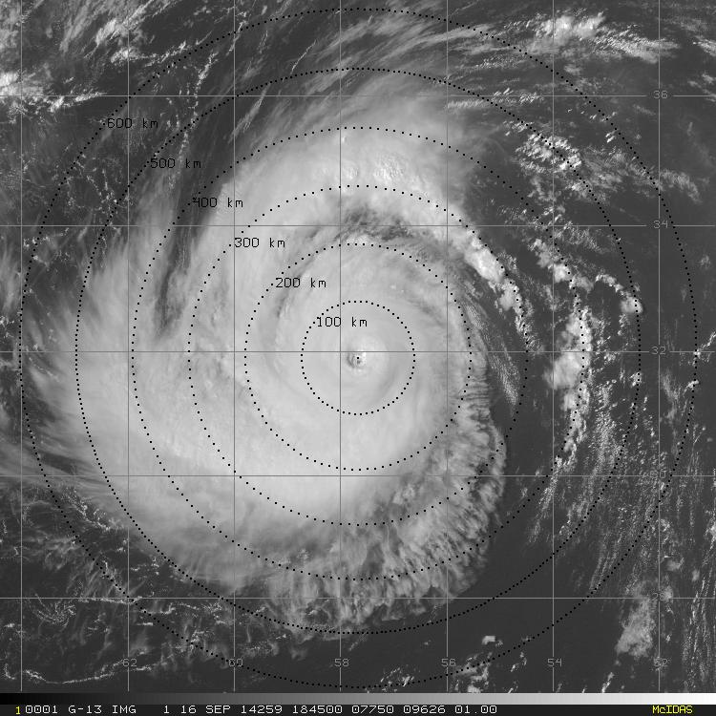
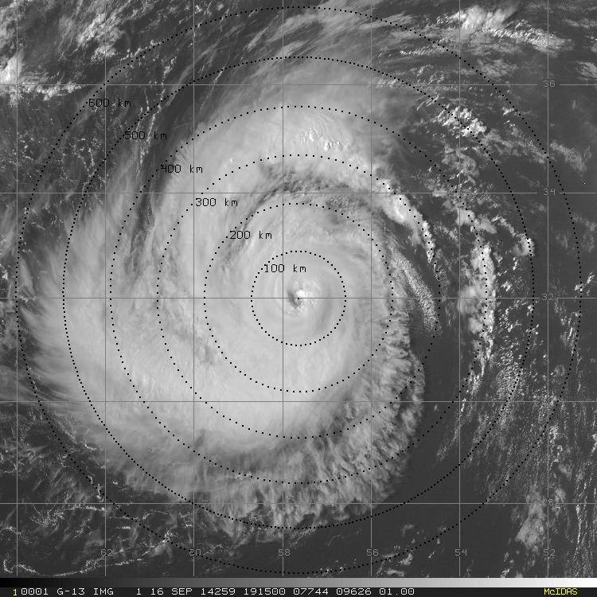
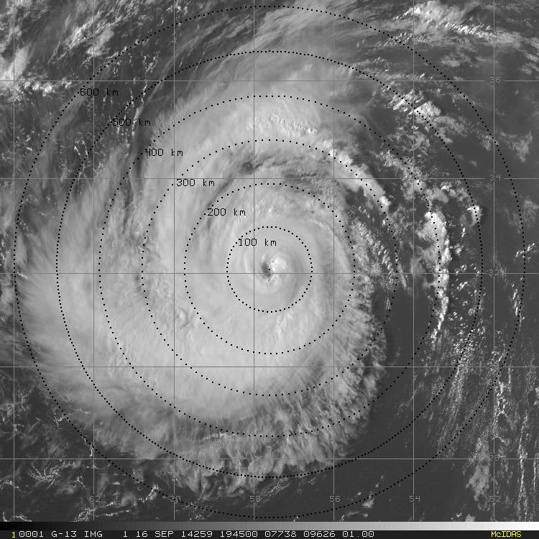
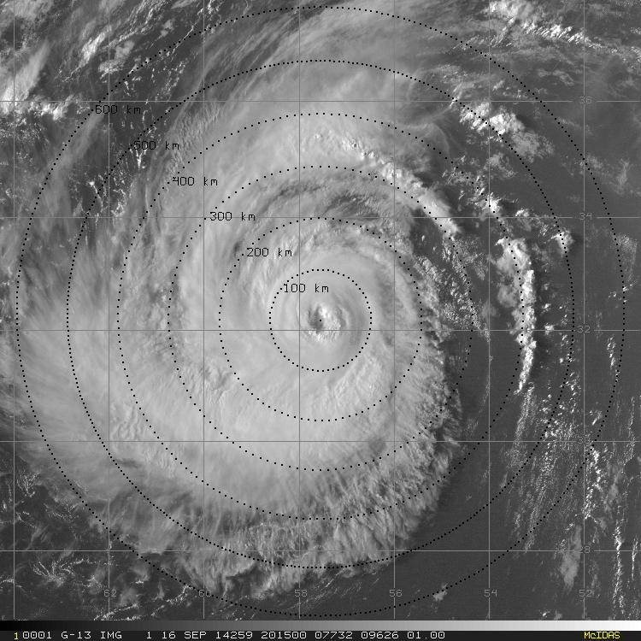
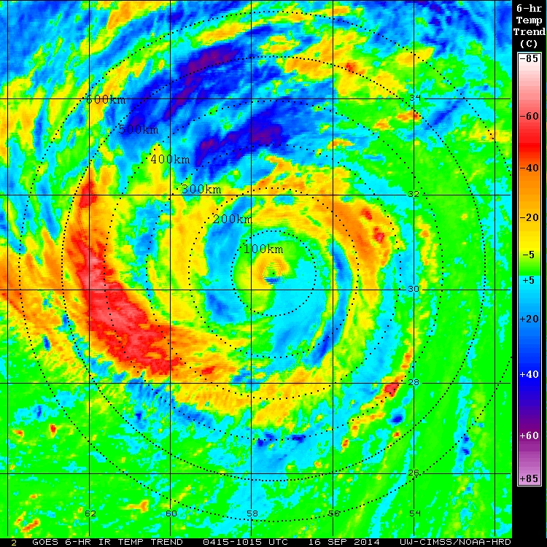
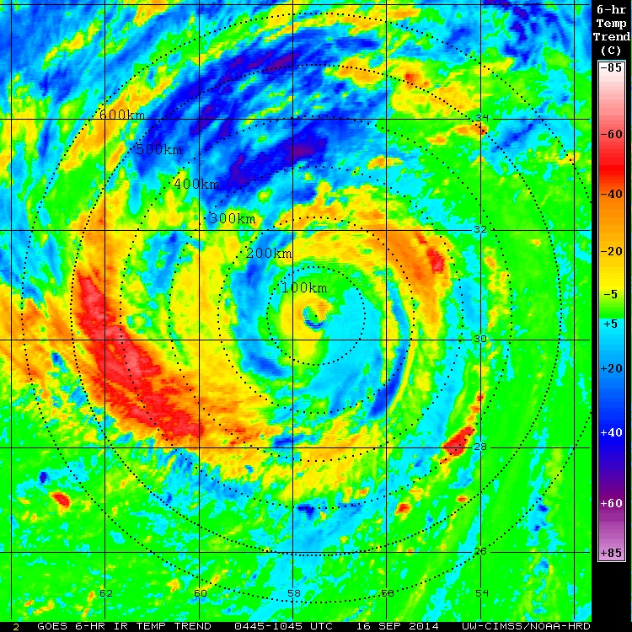
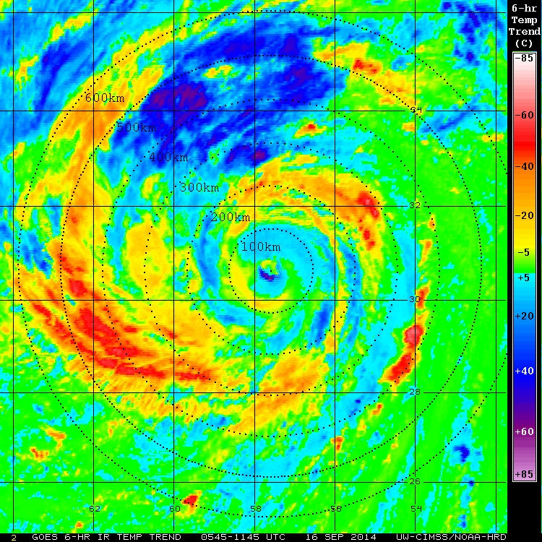
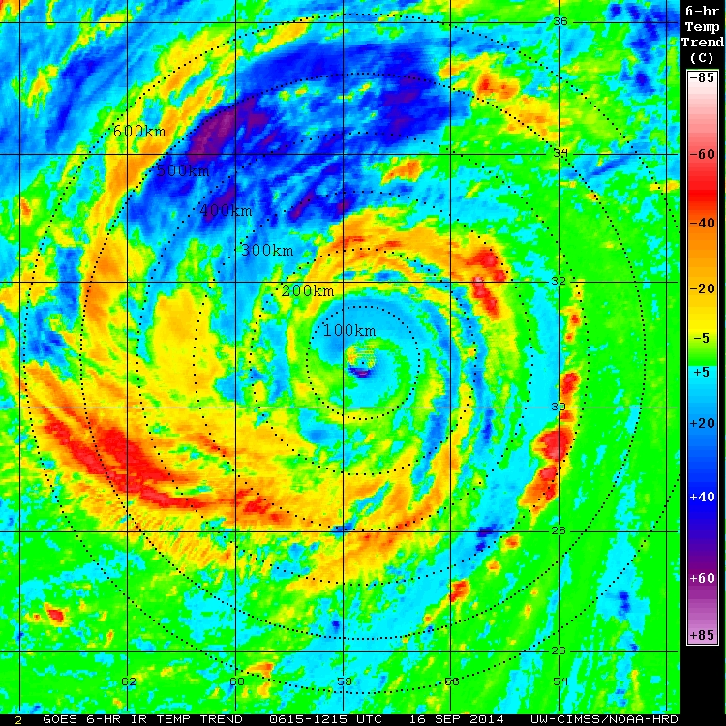
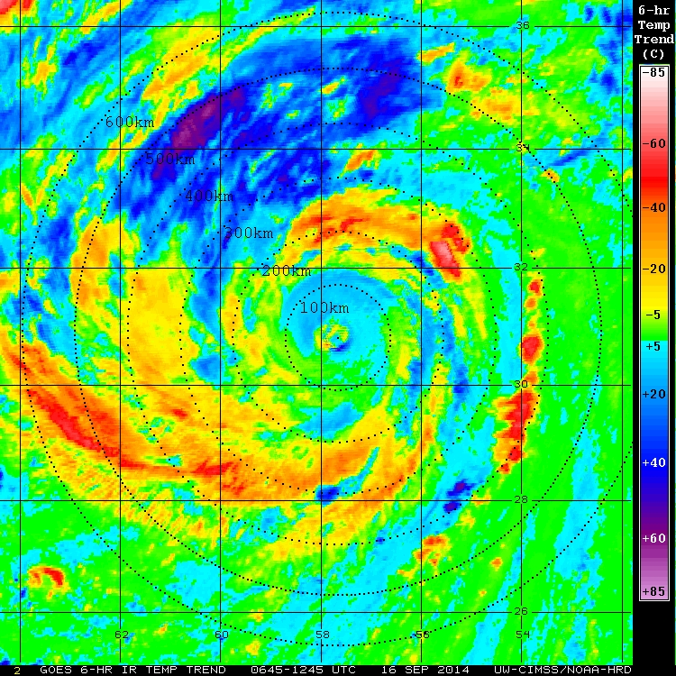
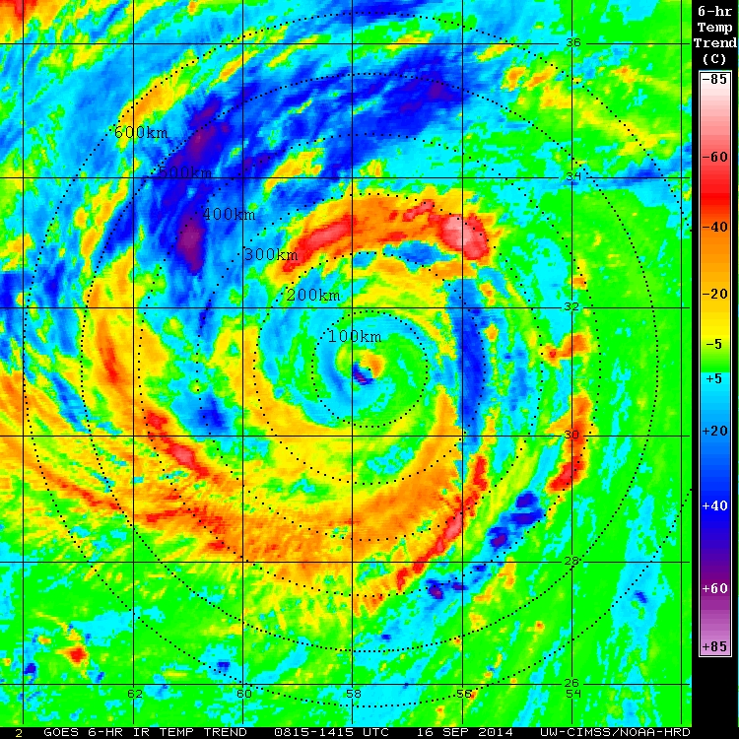
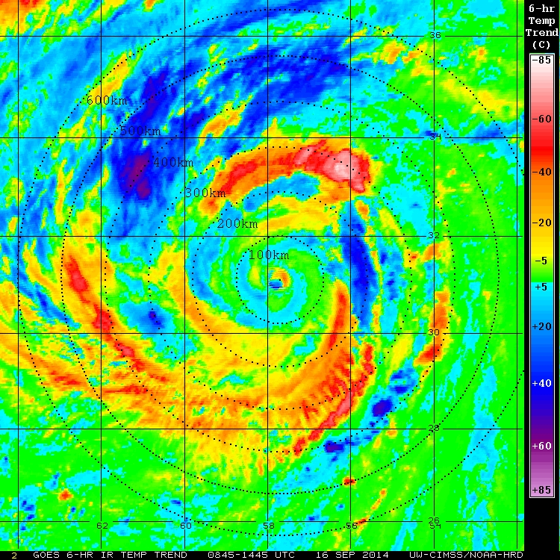
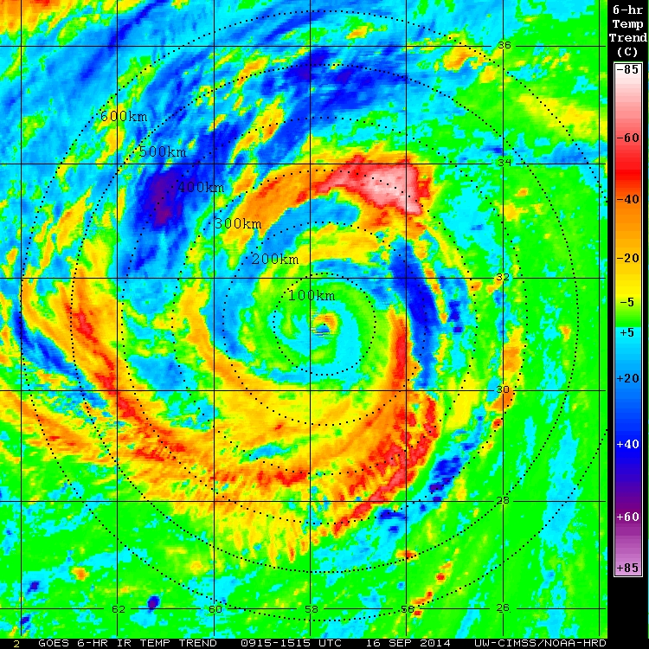
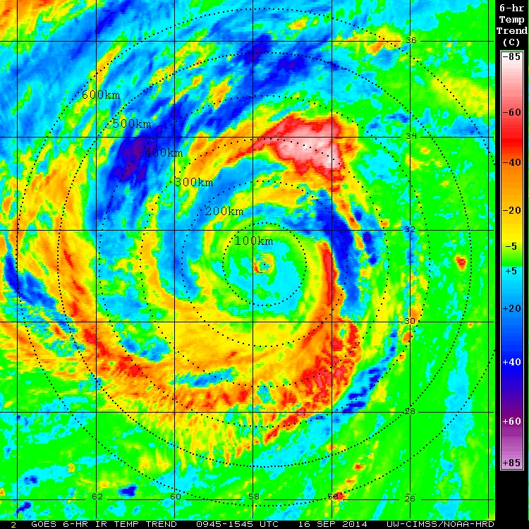
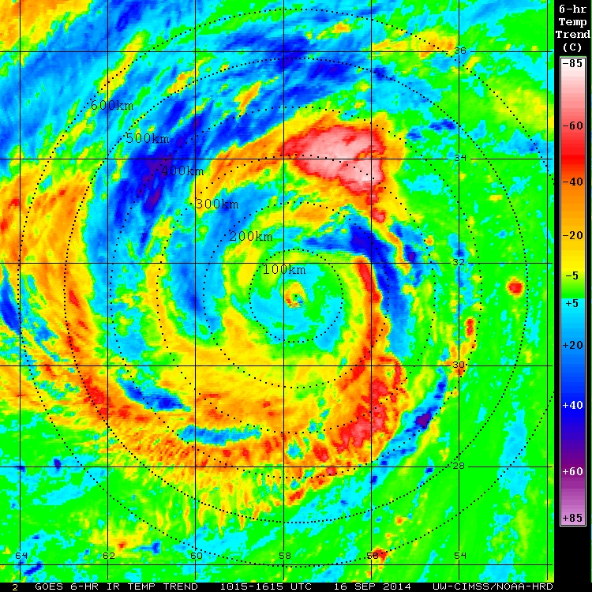
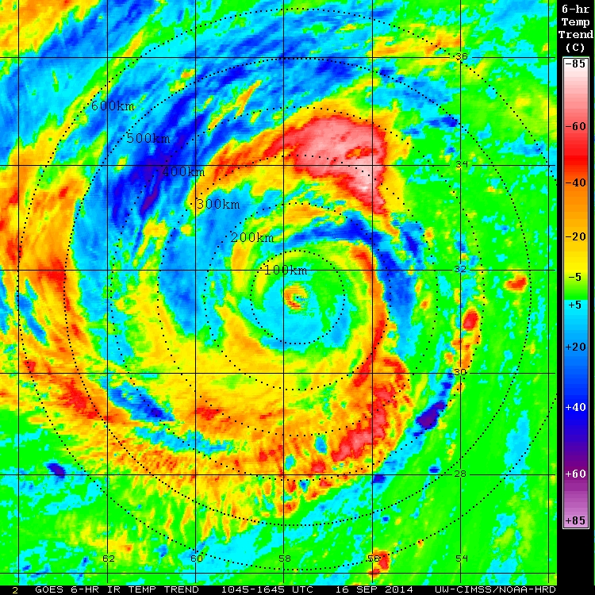
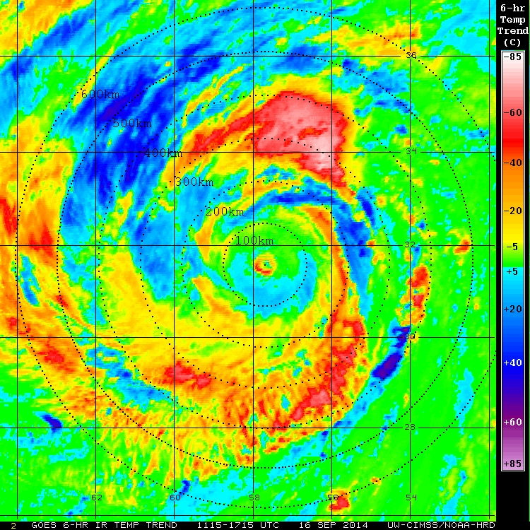
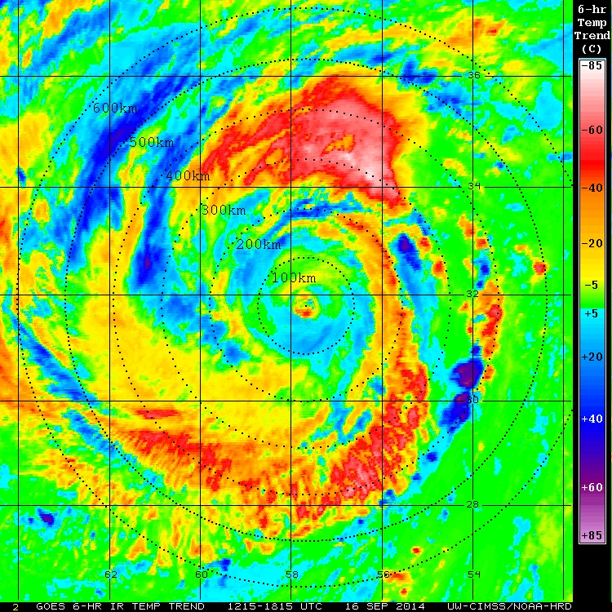
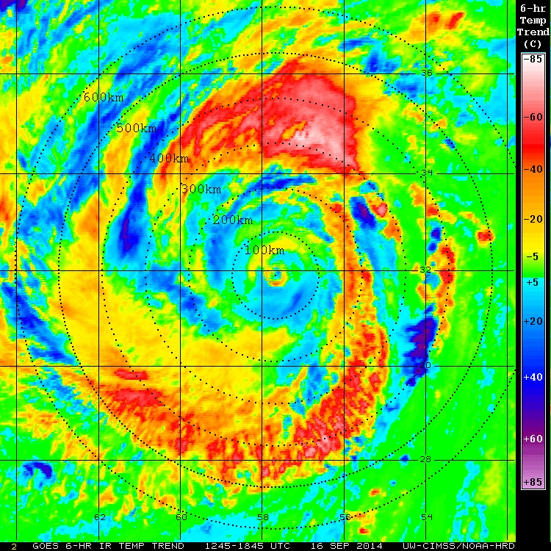
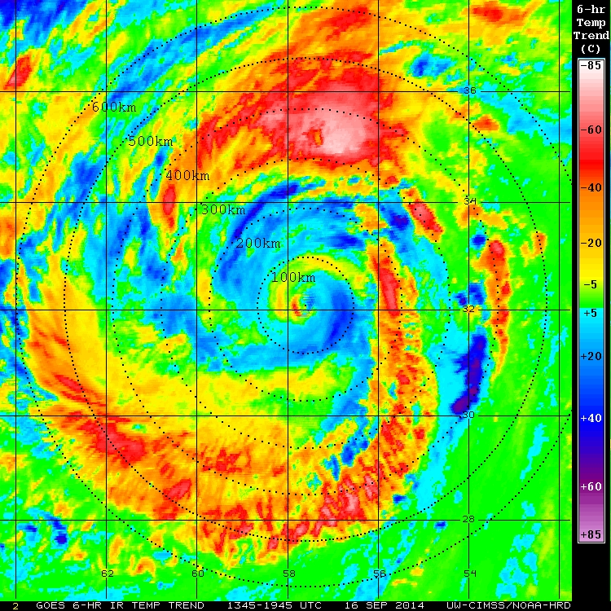
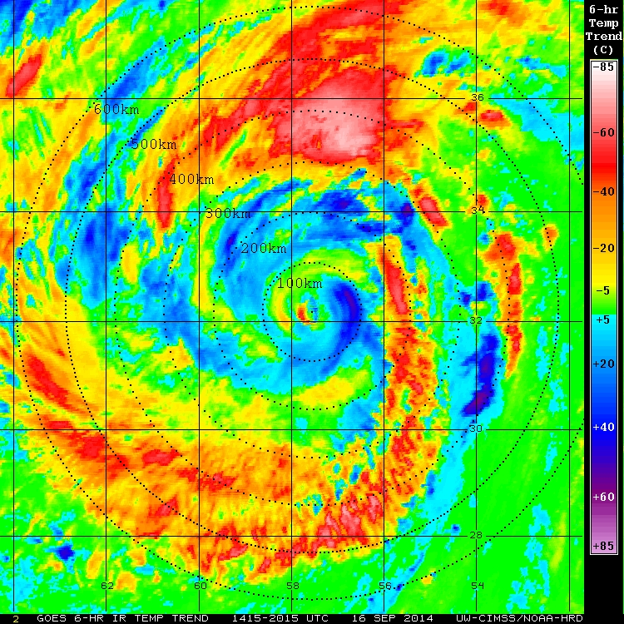
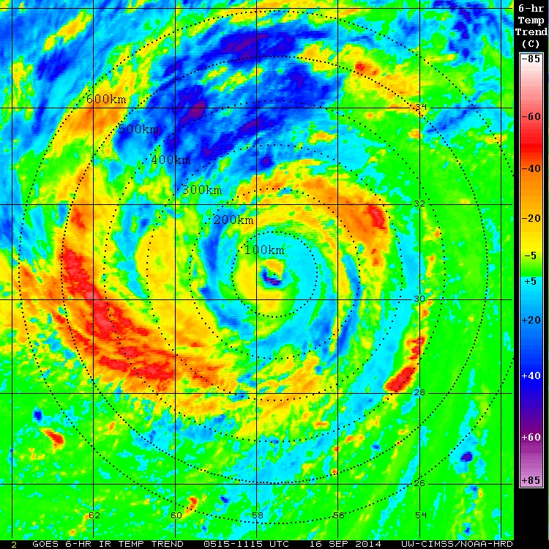
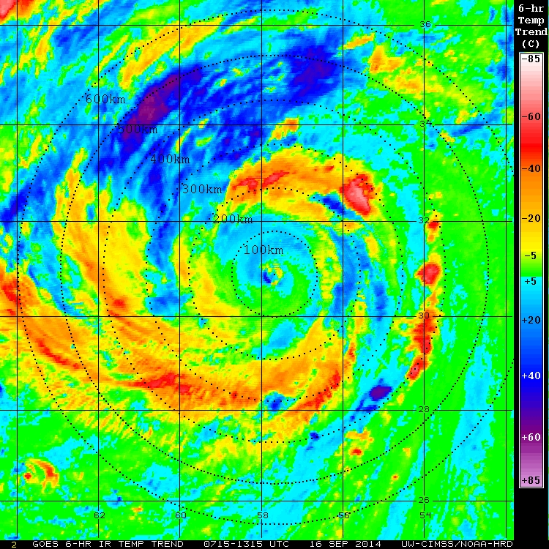
Edouard 16 Sep 2014 TC Diurnal Cycle (Dunion et al. 2014)
GOES Visible
GOES IR 6-hr Temp Trend
GOES Infrared
Notes:
SHIPs shear: 06z: 15kt 123 deg
SHIPs shear: 12z: 17kt 119 deg
SHIPs shear: 18z: 15kt 109 deg

Slide 3
Edouard 16 Sep 2014 TC Diurnal Cycle
What did we just see?
A predictable feature that is limited to the cirrus canopy
A predictable feature that affects a deep layer of the TC
Dunion’s fancy artwork
GOES IR 6-hr Temp Trend
37 GHz Composite Imagery

Slide 4
Edouard 16 Sep 2014 NOAA P-3 (42) LF Radar 1322-1821 UTC
180km
120km
60km
360 km
30nm
65nm
100nm
360 km

Slide 5
Edouard 16 Sep 2014 NOAA P-3 (42) LF Radar 1322-1821 UTC
300km
200km
100km
660 km
55nm
110nm
160nm
660 km

Slide 6
Hurricane Edouard 16 Sep 2014 TC Diurnal Cycle (1345 to 1845 UTC)
GOES IR 6-hr Temp Trend
GOES Visible/NOAA P-3 LF Radar
VWS: 19 kt

Slide 7
Hurricane Earl 30 Aug 2010 TC Diurnal Cycle (0645, 1245, & 1845 UTC)
GOES IR 6-hr Temp Trend
GOES IR

Slide 8
Earl 30 Aug 2010 NOAA P-3 (42) LF Radar 0957-1447 UTC
300km
200km
100km
660 km
55nm
110nm
160nm
660 km

Slide 9
Hurricane Earl 30 Aug 2010 TC Diurnal Cycle (1245 UTC, 0845 LST)
GOES IR 6-hr Temp Trend
GOES Visible/NOAA P-3 LF Radar

Slide 10
TC Diurnal Cycle Simulated & Observed Diurnal Pulses
NR Hurricane 1 (Nolan et al. 2013)
700 hPa Vertical Wind (m/s): 1300 LST
P-3 LF Radar
2014 Hurricane Edouard: 1300 LST
300km
200km
100km
100km
200km
55nm
300km
110nm
160nm
Take-aways:
More & more evidence that diurnal pulses move through a deep layer of the atmosphere
We may need to rethink what a TC outer band really is
P-3 LF radar: producing 660x660 km domains routinely sure would be nice

