Slide 1
Utilizing NASA Reconnaissance Assets to Investigate Hurricane Upper-Level Warm Core Evolution, Inner Core Pulsing, and Near-Environment
Moisture Interactions
Jason P. Dunion¹, Christopher S. Velden², Lance F. Bosart³, Derrick C. Herndon²,
Bjorn Lambrigsten⁴, Charles Helms³, Sarah Monette², and John Sears²
1 University of Miami/CIMAS – NOAA/AOML/HRD
2 UW-CIMSS
3 SUNY Albany
4 Jet Propulsion Laboratory
Funding Support: NASA HSRP (Grant # NNX12AK63G)

Slide 2
Discussion Outline
1) Real-Time Mission Support
2) Satellite Products (Real-time & Experimental)
3) TC Phase Space Composites
4) RGB air mass Imagery
5) TC Diurnal Cycle (2013 Gabrielle)
6) Conclusions

Slide 3
2013 Real-Time Mission Support
Satellite Data and Product Support
CIMSS Satellite Imagery (e.g. SAL, pseudo natural color)
CIMSS AMVs (Vis, IR, WV)
Tropical Overshooting Tops (TOTs) [poster session]
Cloud-Top Height Analyses (pressure alt)
GOES-14 1-min rapid scan coordination (Ingrid)
Mission Support (Wallops & Remote)
Forecasting: Chip Helms (SUNY), Derrick Herndon (CIMSS), John Sears (CIMSS), Sarah Monette (CIMSS)
Mission Scientist: Velden
Global Hawk GPS Dropsonde Processing: Dunion
NOAA Coordination: Dunion

Slide 4
Satellite Products
Real-time and Experimental

Slide 5
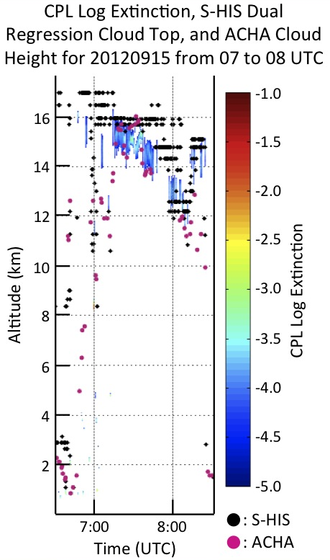
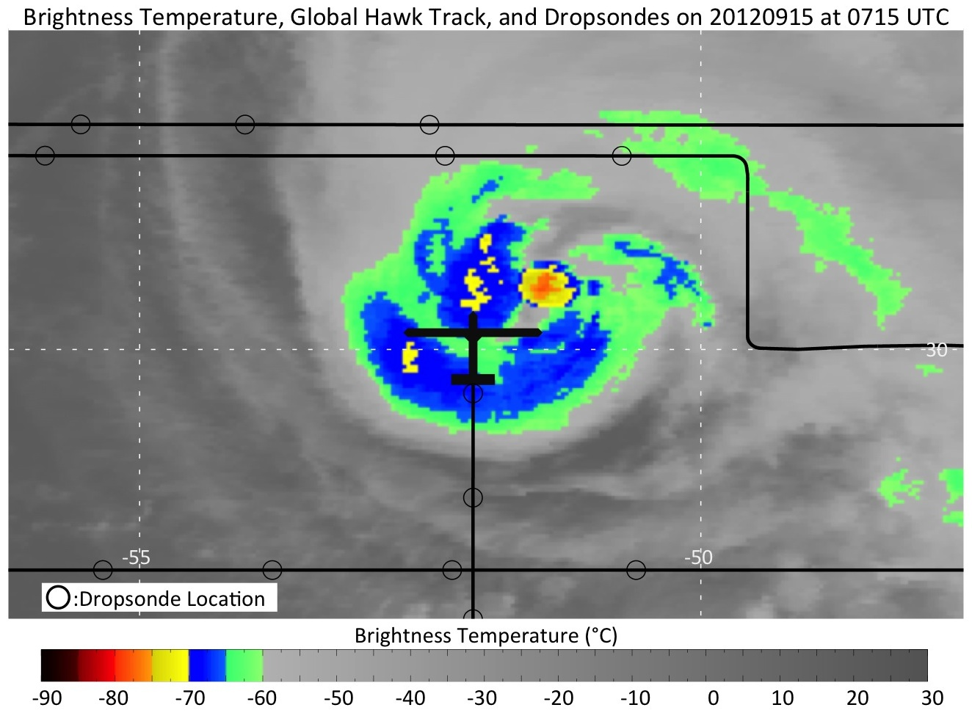
Validation of Satellite-Derived Cloud Top Heights in Tropical Cyclones using HS3 Observations
• Goal: Utilize HS3 TC over-flight measurements >> assess the quality of cloud heights derived from the NESDIS ACHA algorithm
• Compare ACHA estimates with collocated CPL and S-HIS measurements
PIs: Christopher Velden and Sarah Monette – Univ. Wisconsin-CIMSS
Notes:
Summary of our work on assessing the latest cloud height algorithm from NESDIS, called ACHA (ABI Cloud Height Algorithm).
In these slides we just show the components of validation that utilize the GH CPL and S-HIS. The plot at the right is a good example of CT measurements from an over-flight of Nadine on Sept 15th, 2012.
The takeaway (discussed on next slide) is that the ACHA estimates are in general a bit lower than the SHIS and CPL indicate, but become comparable in the cold and deeper clouds.

Slide 6
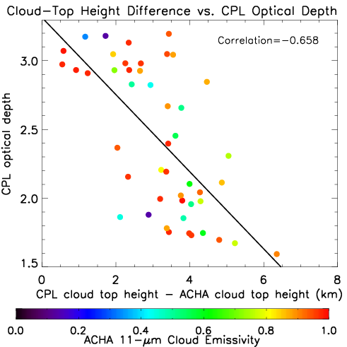
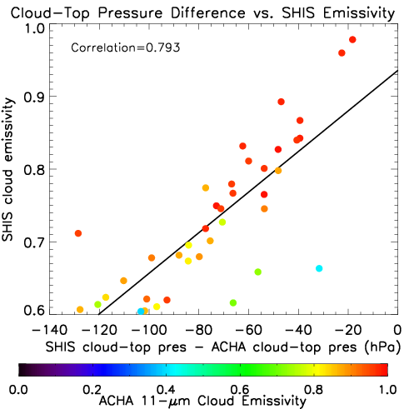
Validation of Satellite-Derived Cloud Top Heights in Tropical Cyclones using HS3 Observations
• CPL optical depth >> explaind 43.3% of the variability between CPL vs ACHA cloud-top heights (>14 km)
S-HIS emissivity >> explains 62.9% of the variability between S-HIS vs ACHA cloud-top pressures (>140 hPa)
Intercomparisons- CPL, S-HIS (& CALIOP), and dropsondes:
ACHA cloud-top heights >> generally biased low (resolvability issues);
Best matches >> cold active and opaque cloud regions associated with TCs;
Notes:
Comparisons of collocated CPL (top graph) and SHIS (bottom) with ACHA, as scaled by the difference between the CT estimates (or differences).
The colors indicate ACHA-estimated emissivities of the cloud targets being height assigned.
What this shows is we can characterize the differences (ACHA always lower, but to varying degrees) based on properties provided by the GH instruments.
SHIS emissivity explains a bit more than the CPL OD, but they both point to the ACHA heights being a function of these cloud properties.
In cold convective opaque CTs, the ACHA method performs pretty well, and so this is why we trust it in GH mission directives, along with the other things like OTs and lightning, of course.

Slide 7
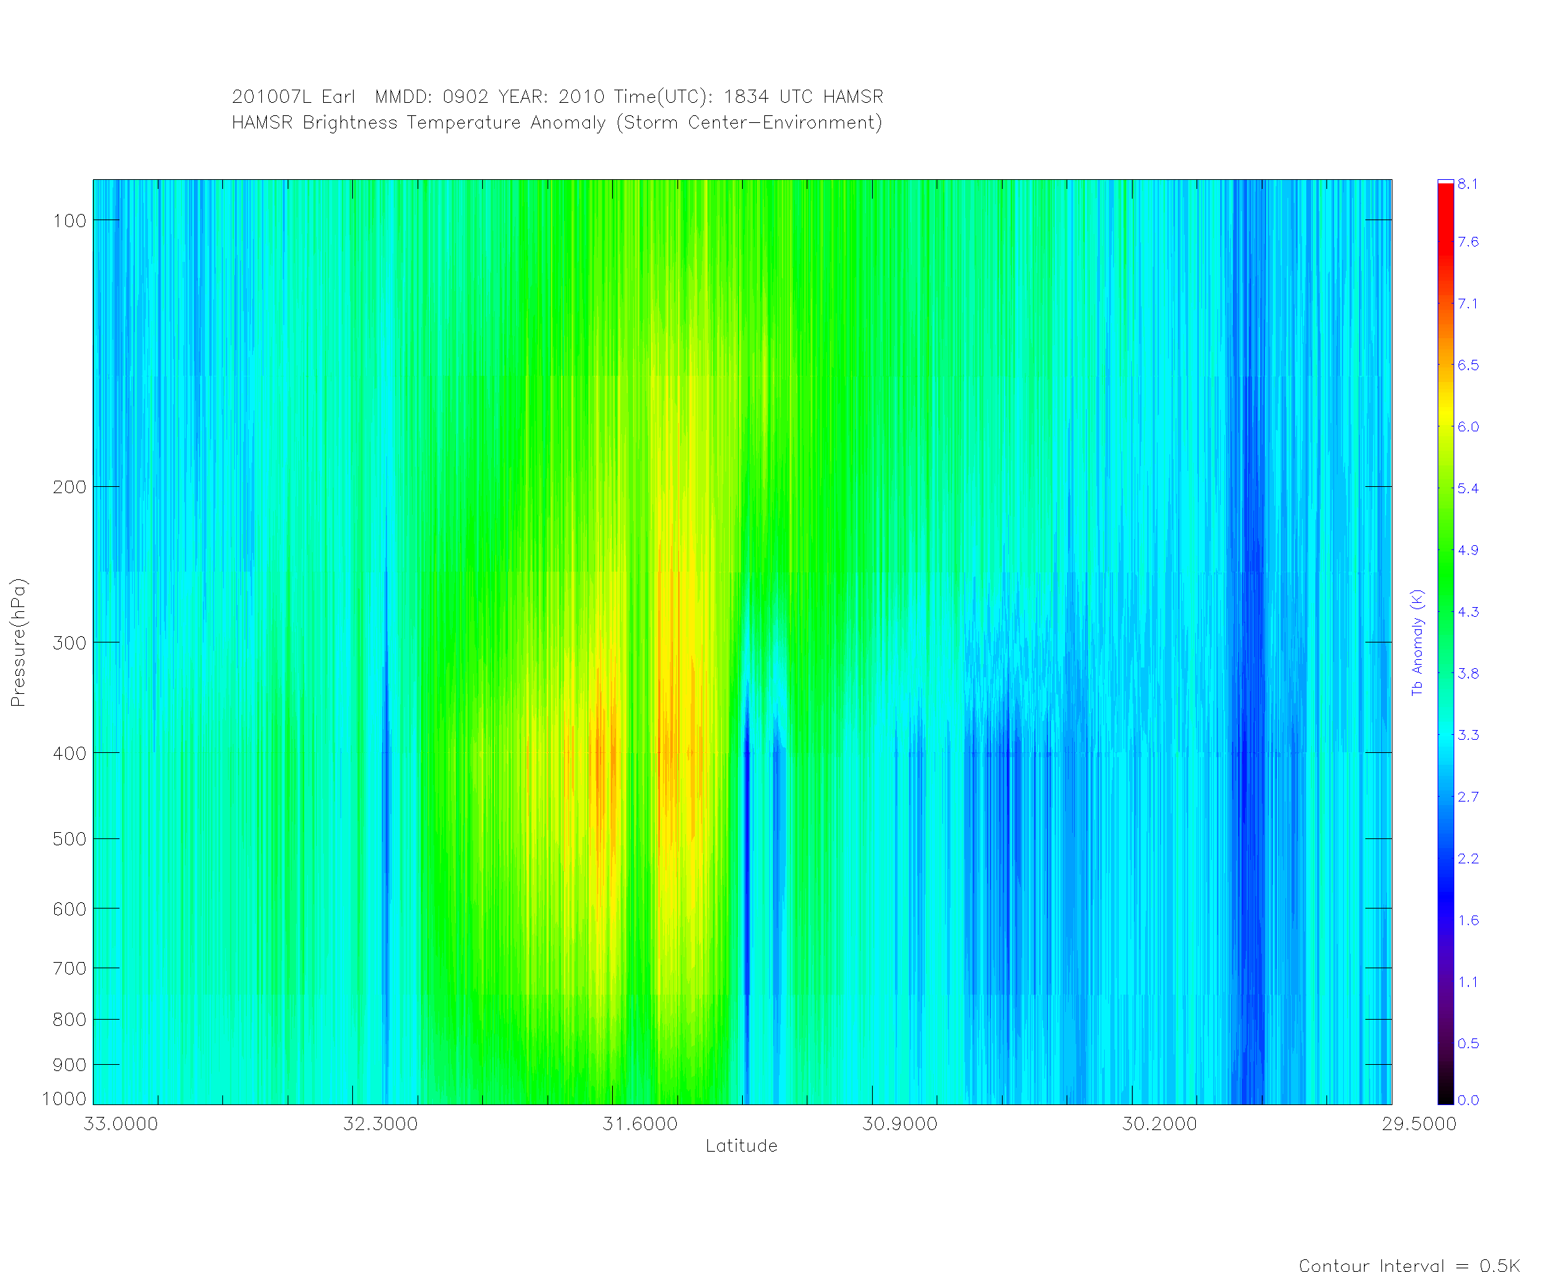
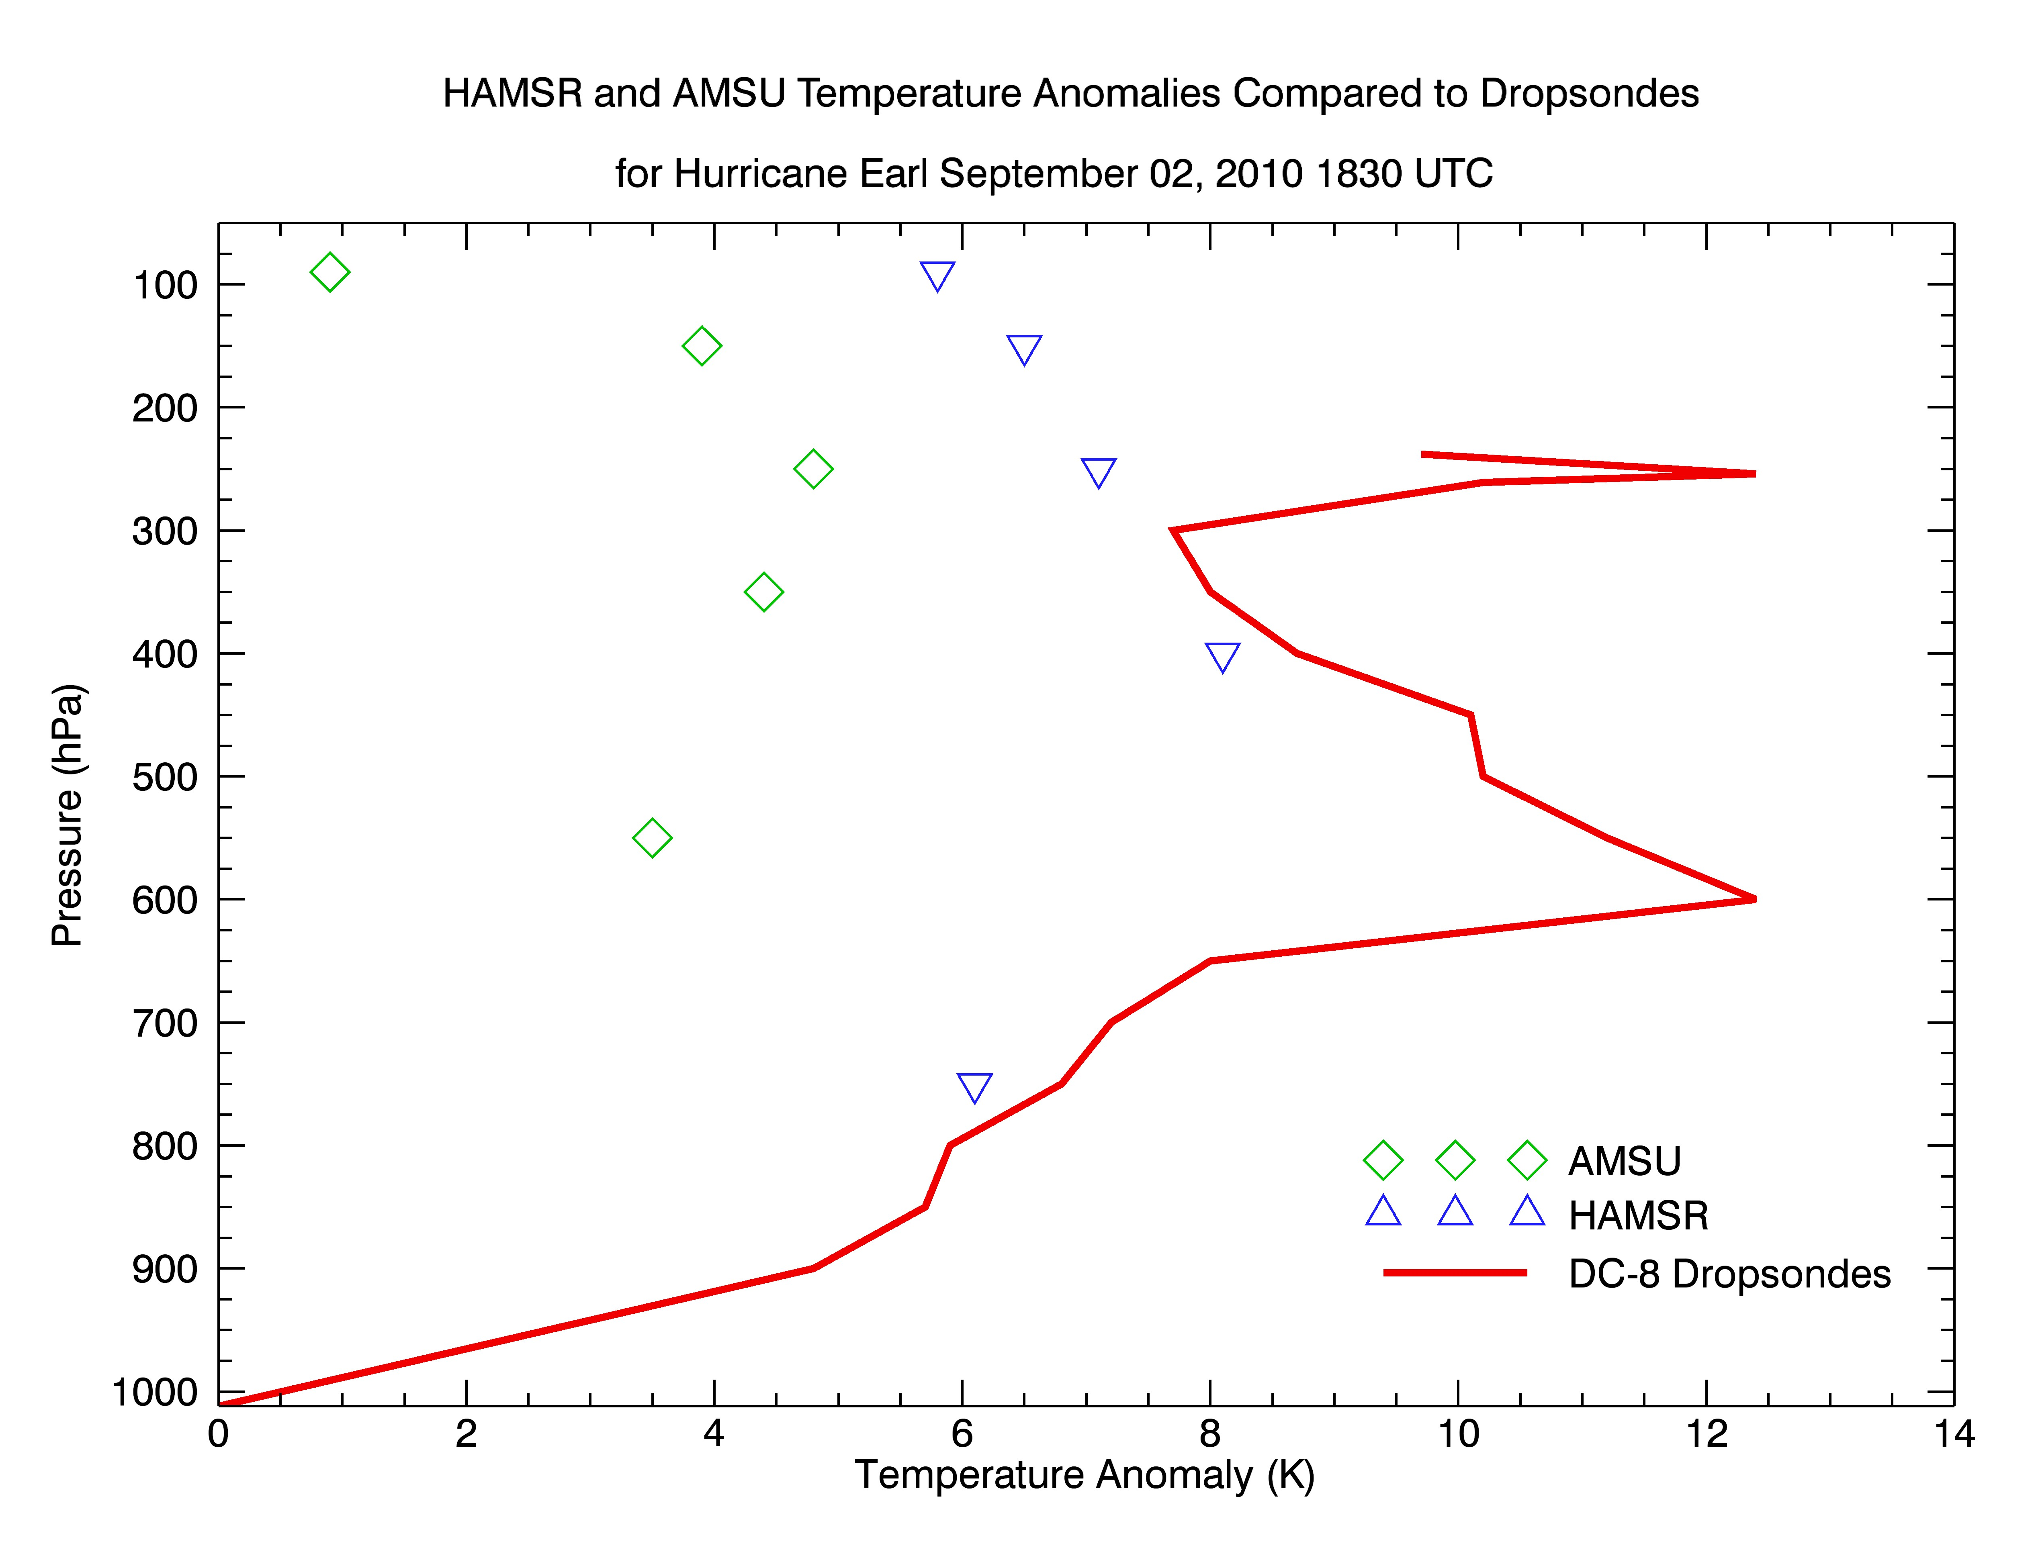
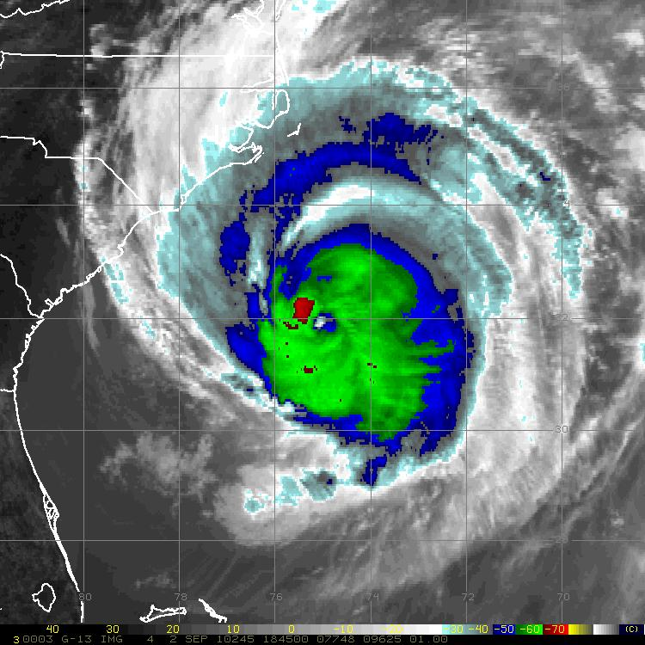
Monitoring the Warm Core Anomaly Evolution
Goal: Use GH HAMSR over-flights to calibrate satellite estimates
2013: No Viable Cases; 2010: Hurricane Earl (GRIP)
HAMSR x-section (Global Hawk)
GOES IR (02 Sep 2010 1845 UTC)
A
B
A
B
Notes:
2013, no viable HAMSR cases
2010 Earl >> good case >> strong TC, fairly large eye >> AMSU got a decent look (also looked at coincident DC-8 GPS dropsondes)
Jason,
Derrick took a look at the one GH flight from 2013 that flew near a TC core, and unfortunately it did not fly close enough to the storm center to capture the warm core. So we have nothing to work with from 2013. So he went back to the GRIP data and looked at Earl (previously we had looked at Karl). The nice thing about Earl is that it was a strong TC and the eye was fairly large at this point so AMSU got a decent look (versus small storm/eye for Karl). He then pulled the DC8 drops for the time when the DC8 was flying with the GH. An x-sect of HAMSR in the first slide shows it capturing a good portion of the warm core. The second slide shows a comparison of the anomalies derived from dropsonde, HAMSR and AMSU. The anomaly magnitudes should not match up exactly because resolution issues obviously come into play and especially knock down the magnitude of the AMSU. There is a hint of a double warm core structure emerging above 300 hPa in the dropsonde profile, but the DC-8 was flying at 260 hPa so unfortunately we cant see what is likely the dominant warm core above this.
This example is ideally what we would like to get more cases of, *IF* the GH will start overflying cores again. We could also add SSMIS and ATMS sounder anomaly estimates to the comparisons.
Let us know if you can shape this into your presentation for the HS3 meeting, and if you need anything further.
Chris/Derrick
***********
Note that the DC-8 data stops at 263 mb. The eye drop was at 238 mb but the earlier drops I used for the environment did not go that high. I dug down farther and noted that aircraft gained some altitude after burning fuel so I can get the environment up to that 238 mb level. This is important because the satellite sounders show the warm core peaking around the 250 mb then dropping off above. I will update the last image and re-send. The double warm core peak in the dropsonde data is interesting since we see this in model simulations fairly frequently. It appears in the classic Inez analysis and HWRF simulations (attached screen shot of talk by Channh Kieu at AMS in San Diego). Recent papers have tried to explain the upper core using the argument of stratospheric entrainment due to a high level inflow layer. I am not aware of any observational evidence of this.
Derrick

Slide 8
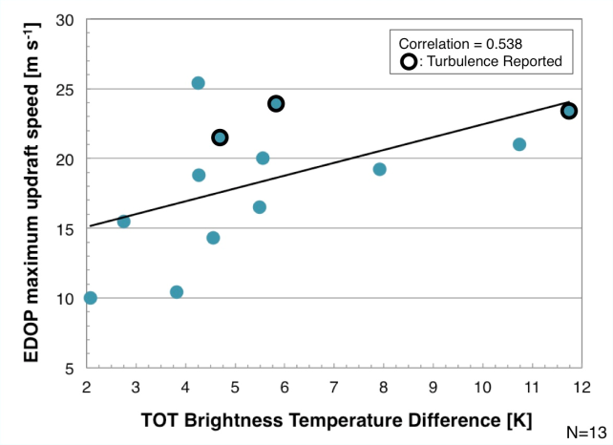
Can Satellite-Derived TOTs be utilized as a proxy for potential strong updrafts?
TOT BT Difference (i.e. TOT “strength”) vs ER-2 Doppler Radar updraft speeds in TCs
“Moderate Correlation”
see Heymsfield et al. (2010) & Velden et al. poster on Thursday
Sources of variance : timing & location differences of aircraft vs satellite
TOTs >> can discriminate tropical convection with strong updrafts to a certain degree
Optimal approach: “TOTS + Cloud-Top Height” … predicting turbulence still a challenge

Slide 9
Phase Space Compositing
Pre-Genesis Systems

Slide 10
Using a Phase Space to Composite Pre-genesis Systems
Select a subset of cases with similar structure
More homogenous subsets >> greater detail in composites
Position in phase space >> current state of important, highly variable structures
Composite all cases located in a given phase space volume
Retain detail (like case studies)
Representative results (like composite studies)
Compare system evolution >> more vs less “TC-like”
e.g. vertical alignment, warm-core, symmetry
Alternative to developing vs. non-developing

Slide 11
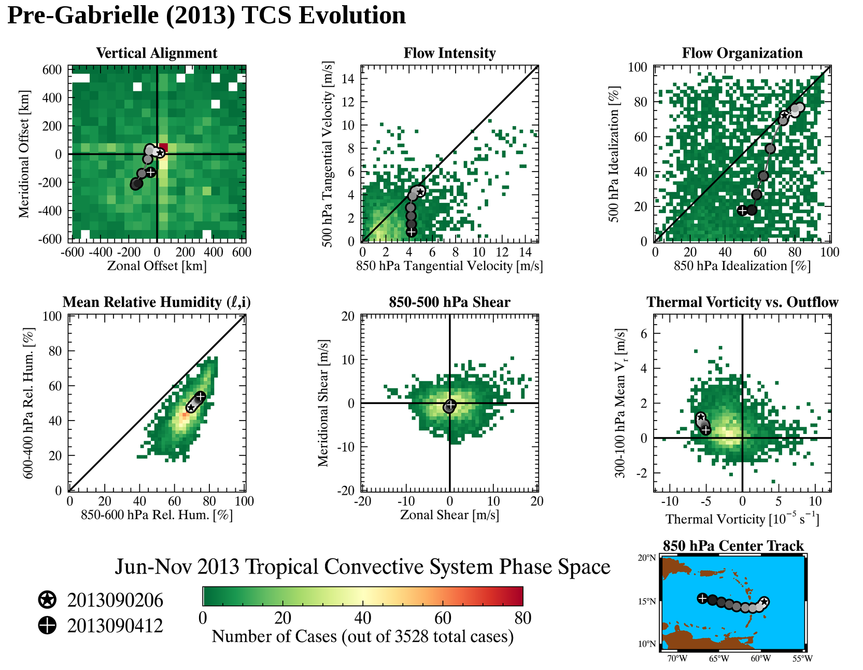
Structure of the vortex at 850 and 500 hPa
A
A
Z
A
Z
Z
Z
Z
A
A
A
Z
Near-system Environment
Relation to Upper Levels
Z
A
Pre-Gabrielle (2013)
Data Source: CFSR
Notes:
-2D histogram color shading is distribution of pre-genesis and nondeveloping systems tracked in climate forecast system reanalysis during 2013 Atlantic hurricane season (green=low counts, red=high counts)
-Shaded circles are the trajectory of pre-Gabrielle (2013) system
Vertical alignment: distance from 850 to 500 hPa center
Flow intensity: area-averaged tangential velocity (333km radius area)
Flow organization: measure of how circular the flow is. Area-averaged ratio of tangential velocity and wind speed (333km radius area)
Mean RH: volume averaged moisture (333km radius area 850-600 hPa for low levels, 600-400 hPa for midlevels)
Shear: Shallow layer shear calculated as azimuthal average at 500 km radius
Thermal vorticity: area-averaged curl of 850-200 hPa vertical wind shear (333km radius area), cold core vs warm core
Outflow: 90th percentile of radial velocity at 500 km radius over 300-100 hPa layer

Slide 12
2010
2013
Number of Cases
Notes:
Hi Chip,
Got it. The 850-600 hPa and 600-400 hPa %RH comparison between 2010-2013 is interesting. The shape of the respective envelops reveals many more “dry middle - moist lower” events in 2013 relative to 2010. It’s like the atmosphere conducted a “dry-by” shooting in 2013.
Lance

Slide 13
Looking Ahead
Finalize phase space variables
Process additional data sets (ECMWF, GFS, CMC, ERA-Interim reanalysis, etc.)
Composites >> based on phase space location
Compare systems which are becoming more vs less TC-like (e.g. upright, warm-core, axisymmetric)
Prototype real-time phase space using GFS (?) in time for HS3 2014 deployment?

Slide 14
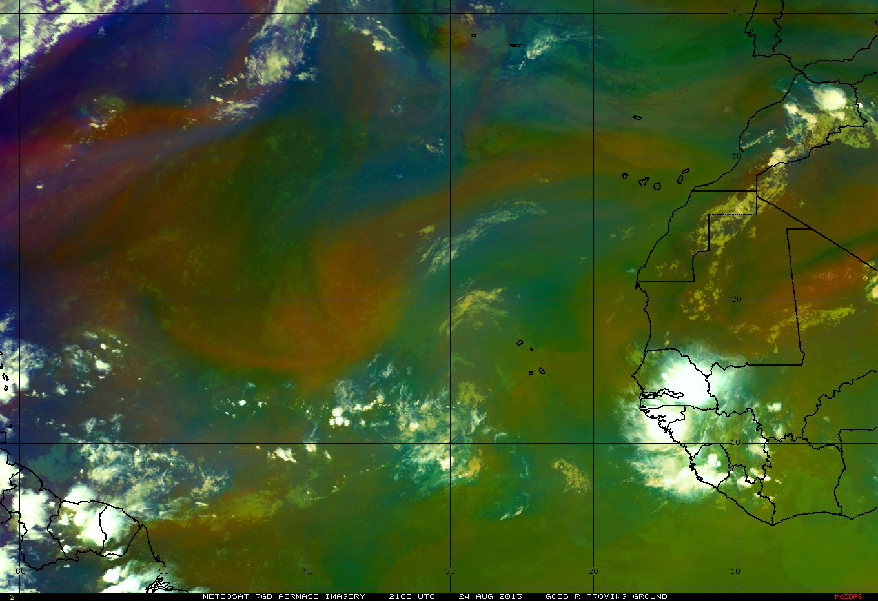
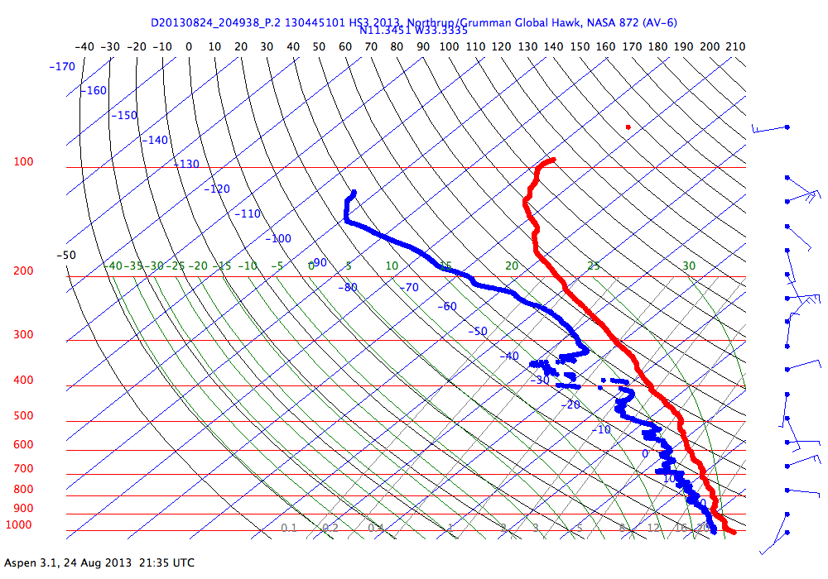
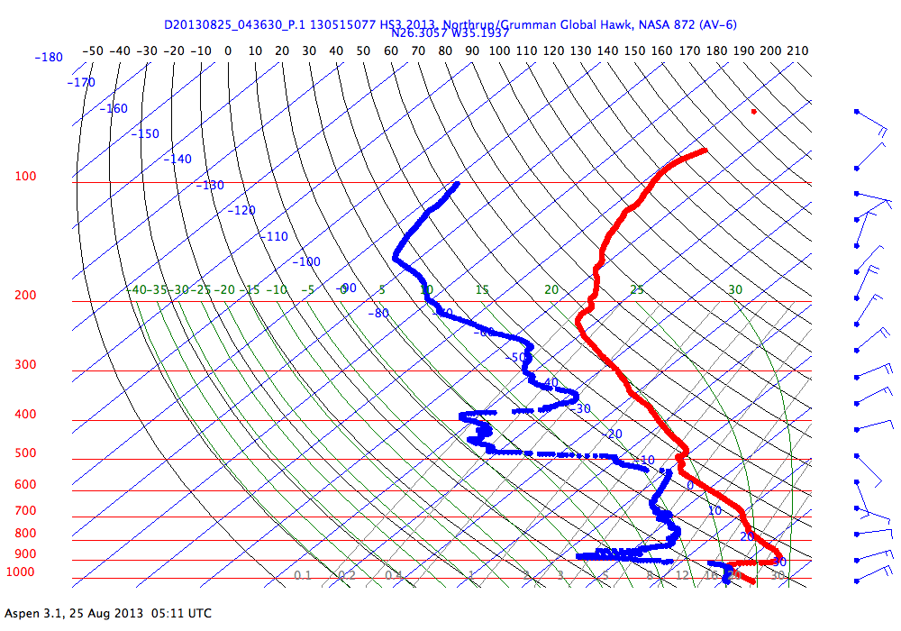
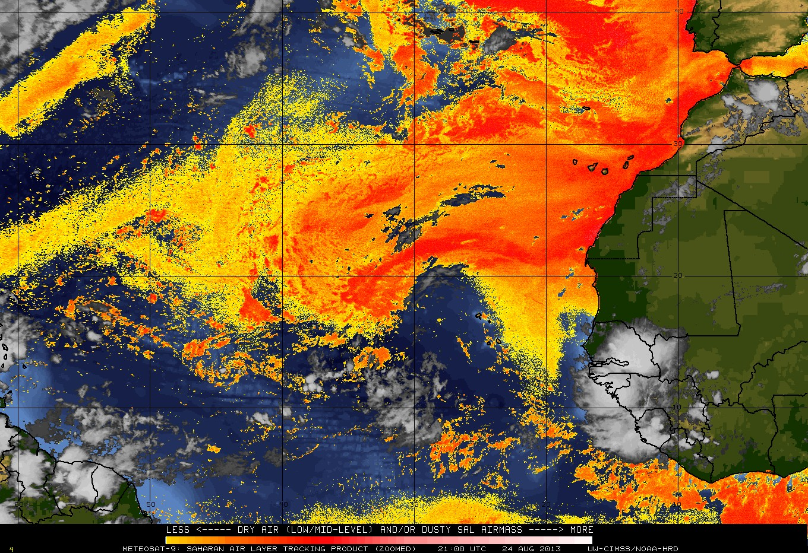
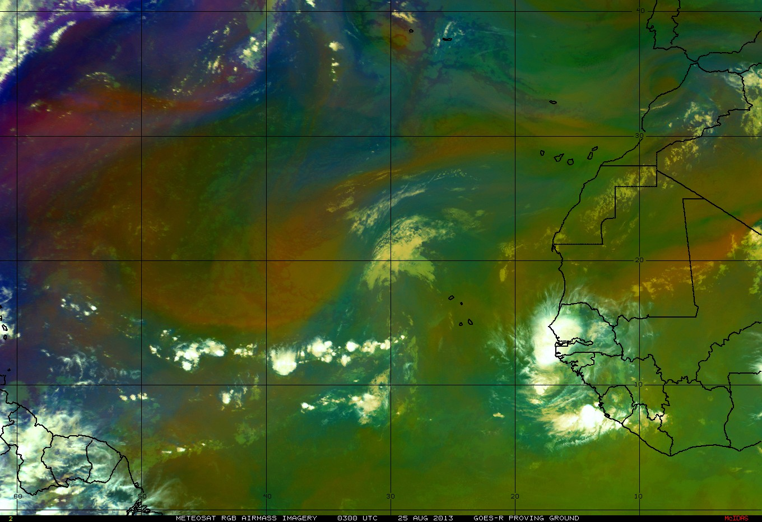
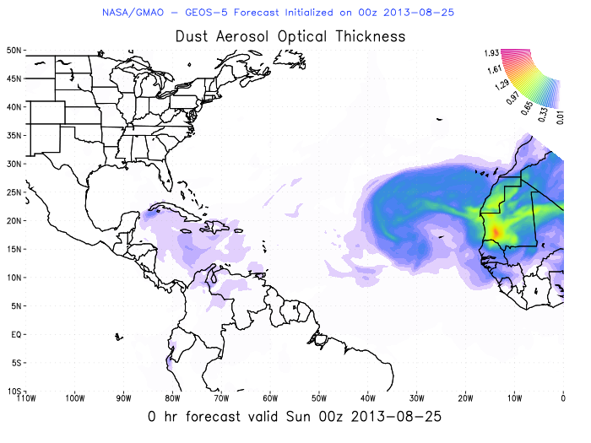
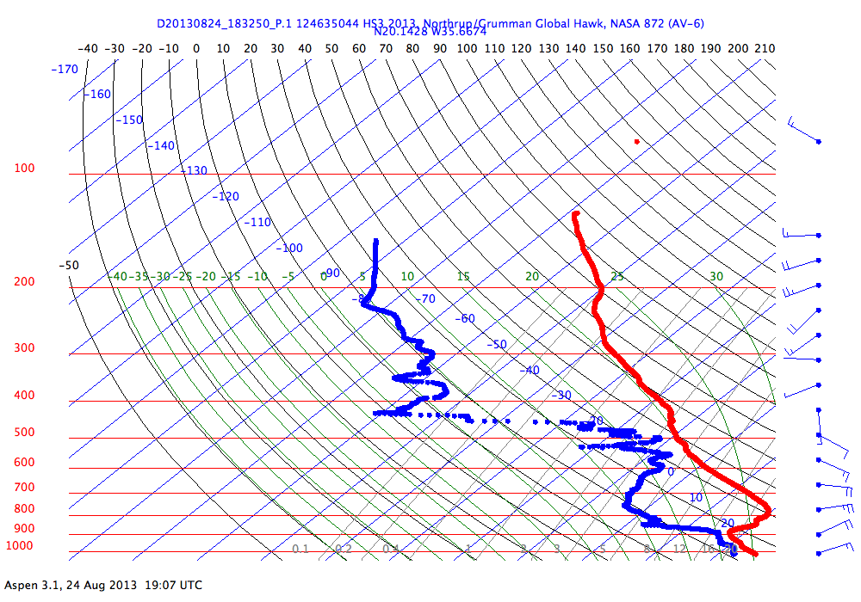
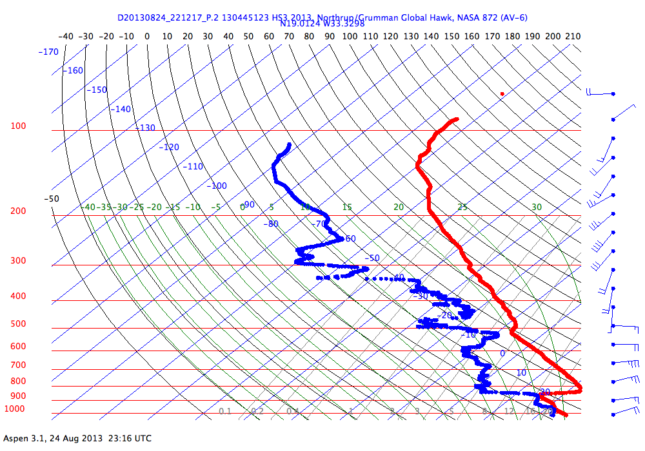
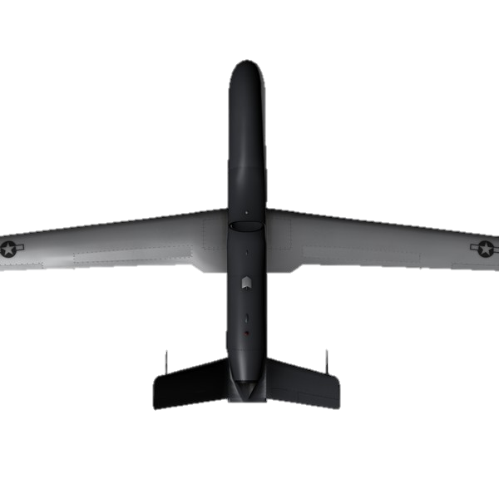
Red-Blue-Green (RGB) Air Mass Satellite Imagery
Channels: 6.2/7.3/9.7/10.8/12 μm; Uses: Tracking Different Air Masses
TINV: 7.3 C (850 mb)
RH: 23-33% (600-800 mb)
E Jet: 38 kt (665 mb)
TINV: 6.5 C (920 mb)
RH: 10-40% (550-900 mb)
E Jet: N/A
TINV: N/A
RH: 60-85% (550-850 mb)
E Jet: N/A; 16 kt (665 mb)
TINV: 7.5 C (850 mb)
RH: 20-40% (550-875 mb)
E Jet: 38 kt (820 mb)
High Clouds
Tropical Airmass
high trop
low ozone
Tropical Airmass
Warm
Dry mid-levels
Polar Airmass
Low trop
High ozone
Polar Airmass+
Low trop
High ozone
PV Anomaly
Jet Steak
Tropical below
Warm/Dry

Slide 15
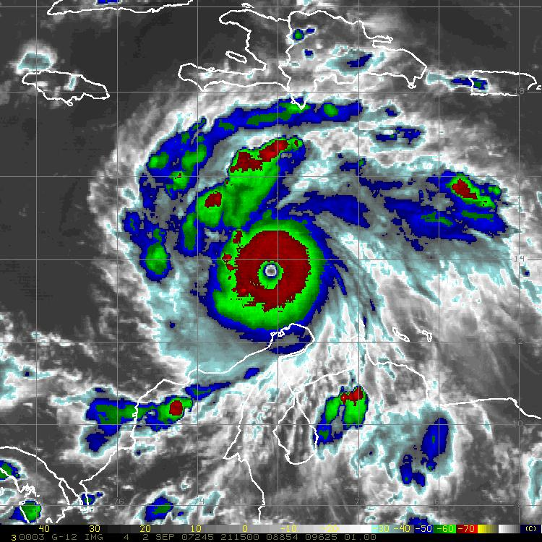
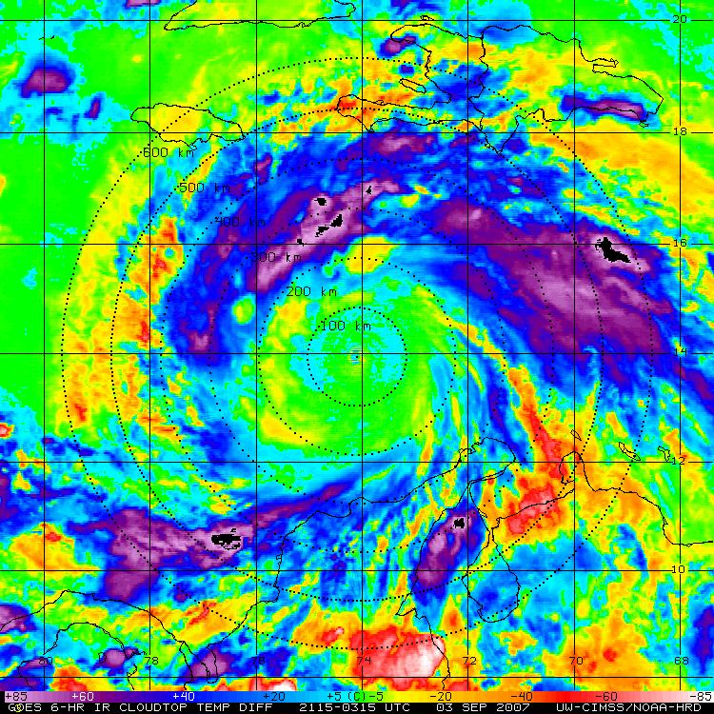
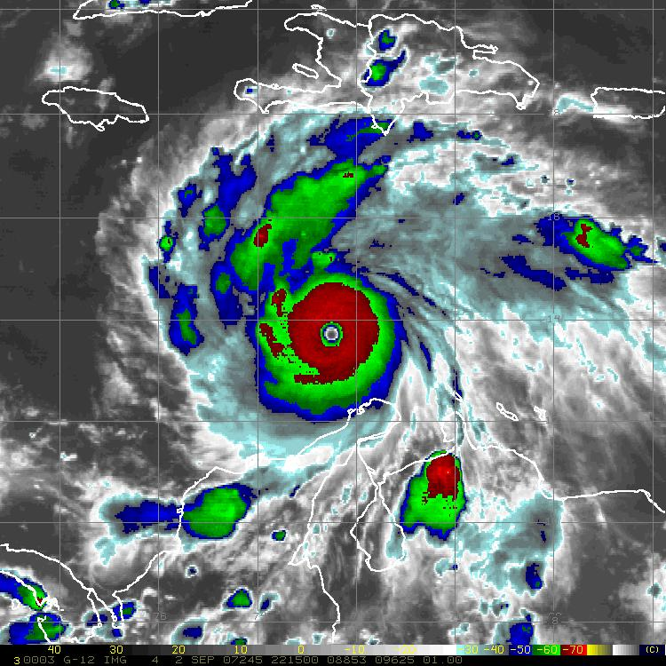
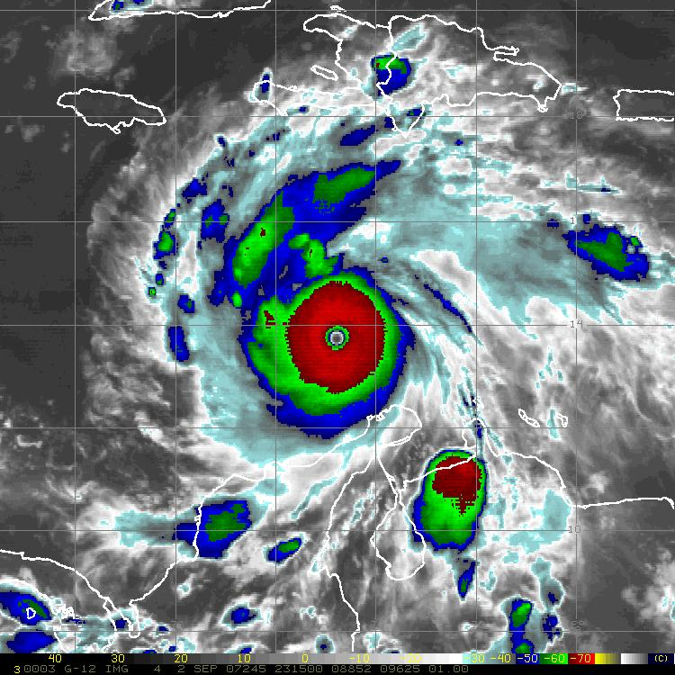
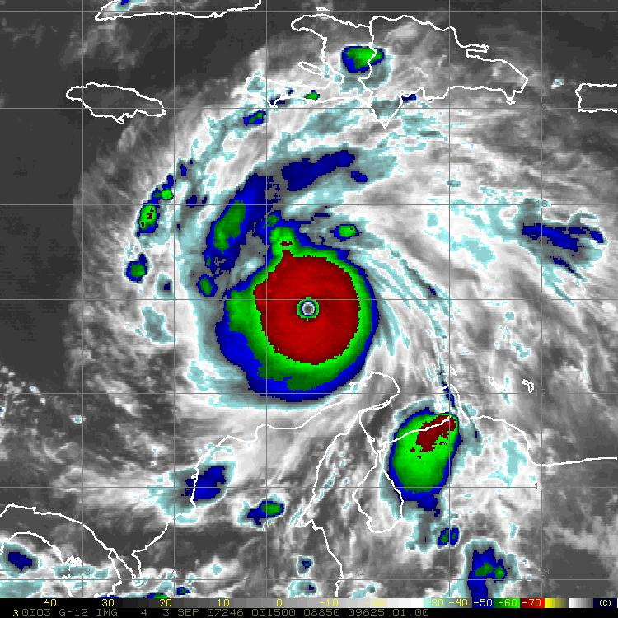
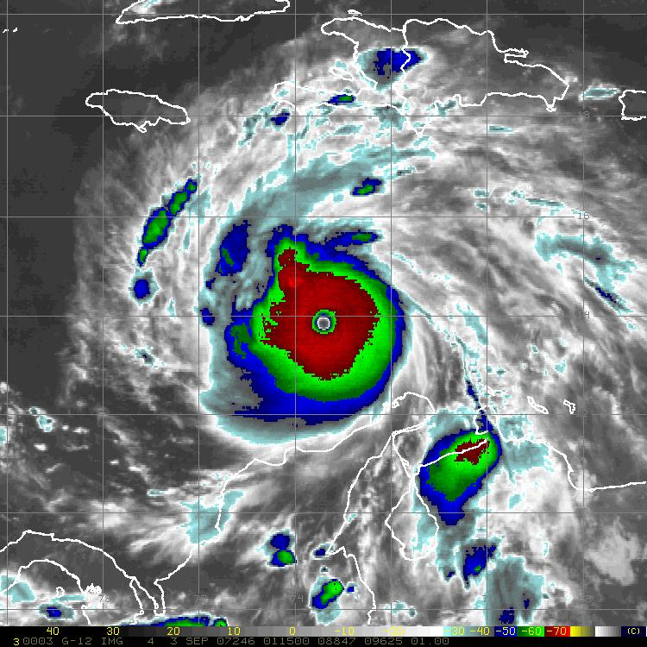
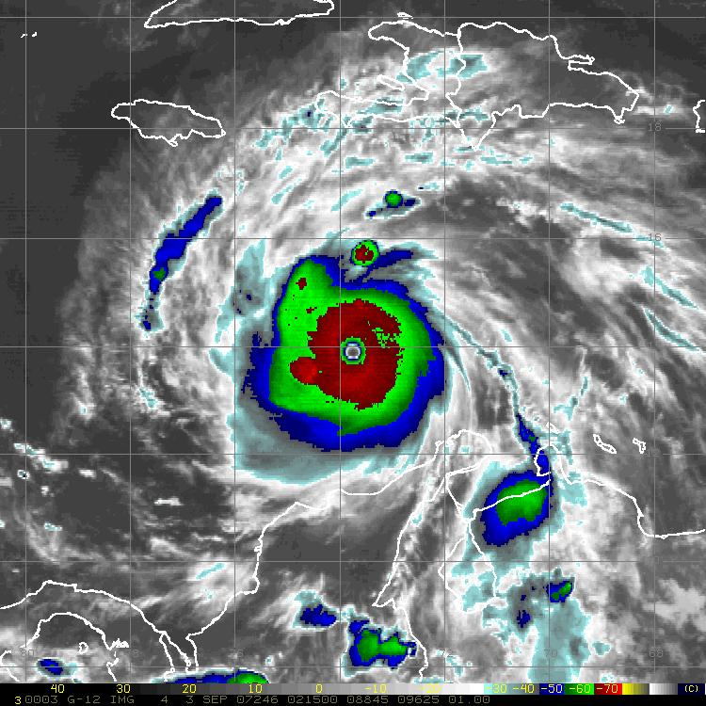
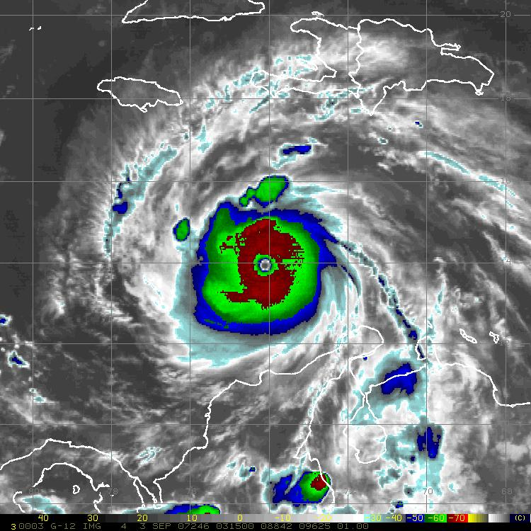
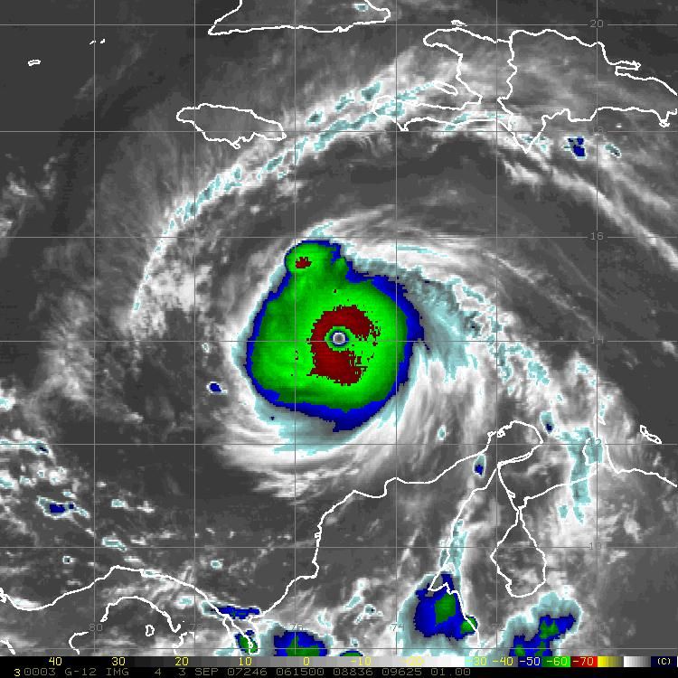
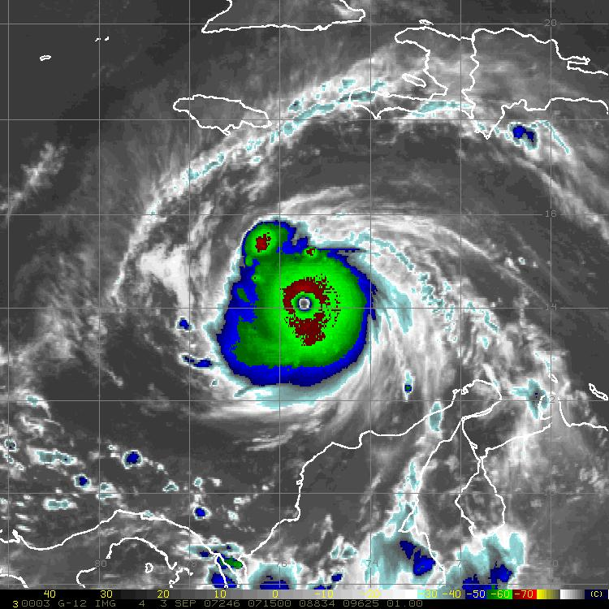
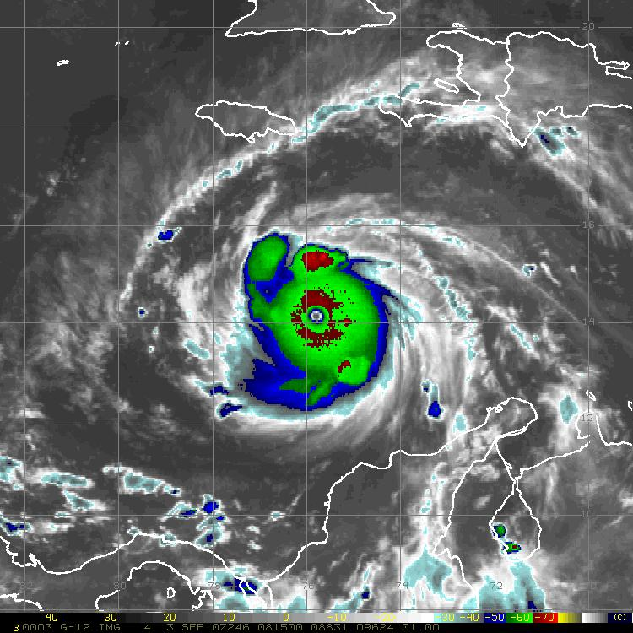
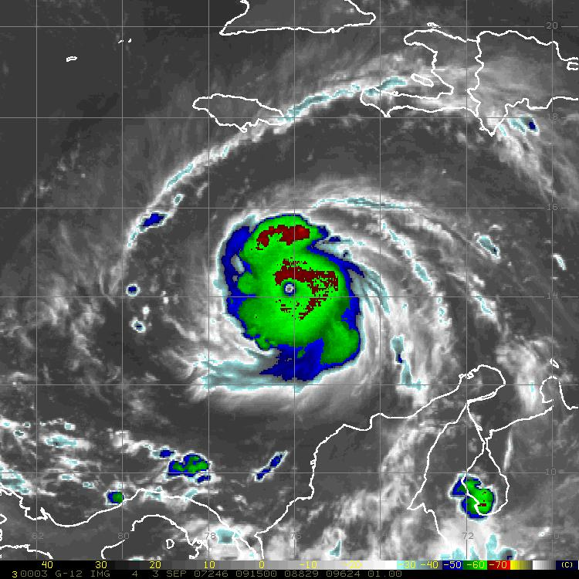
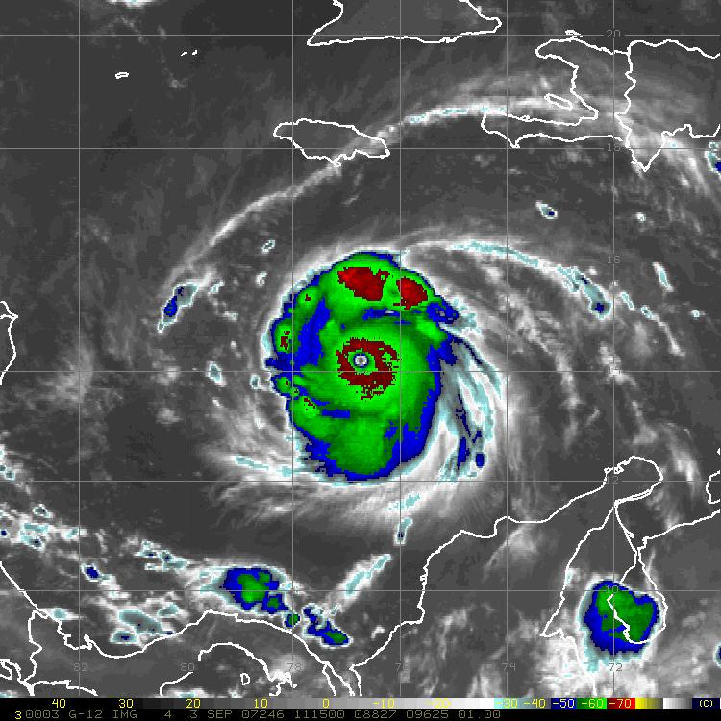
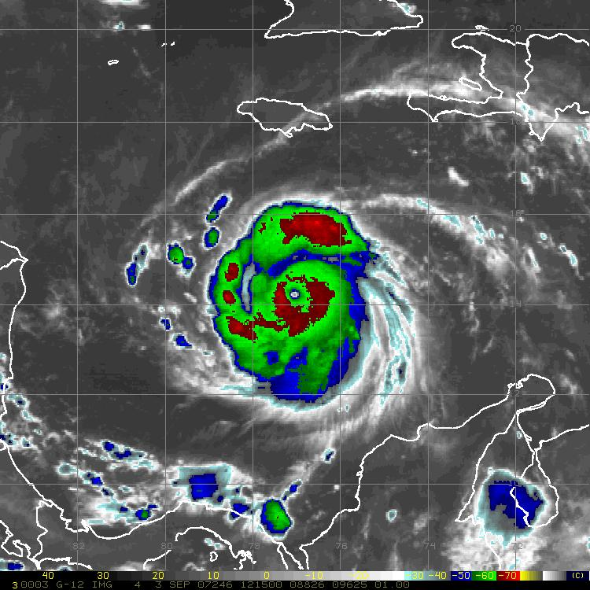
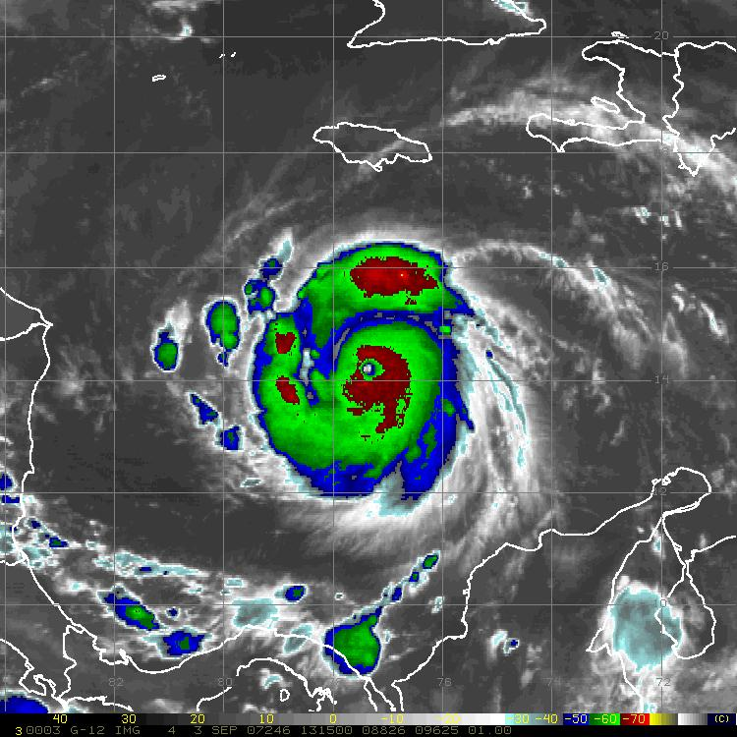
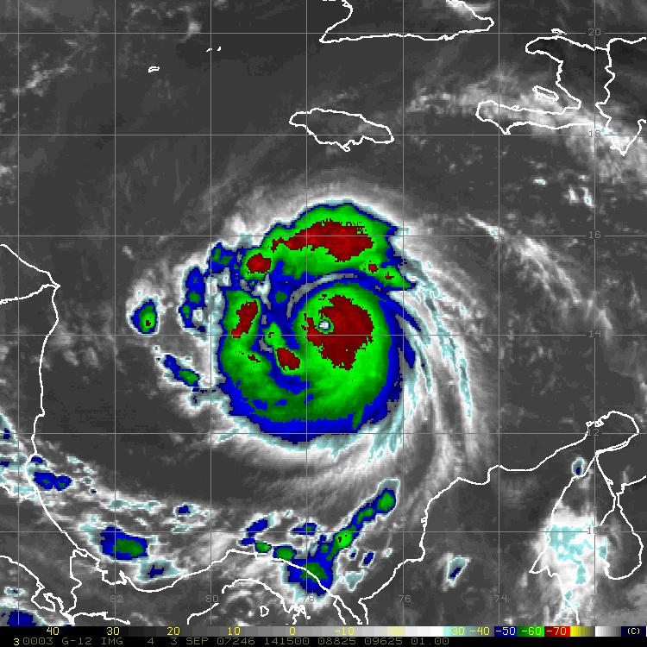
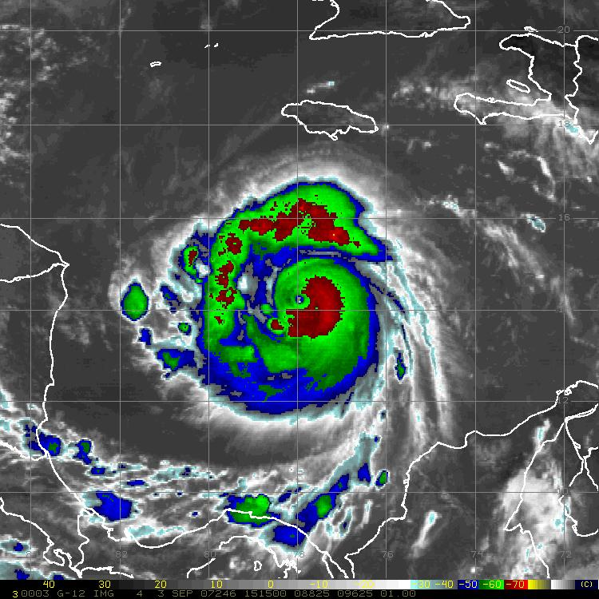
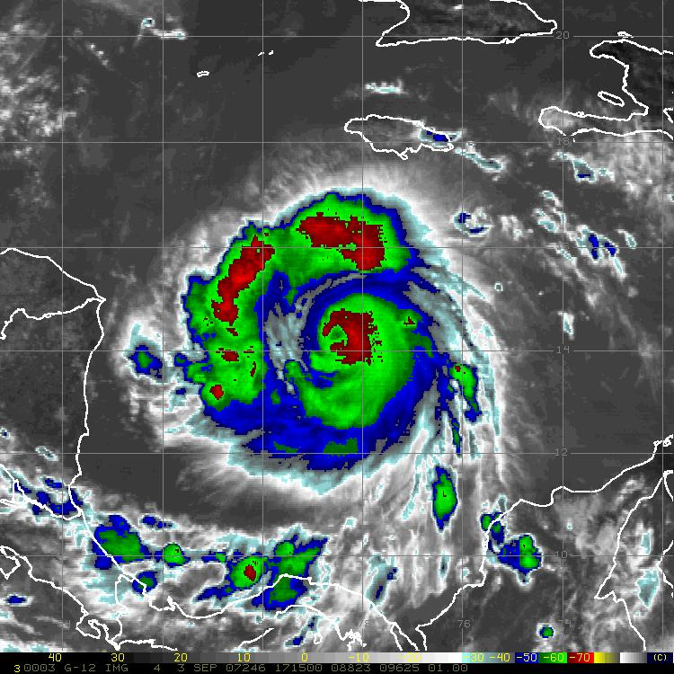
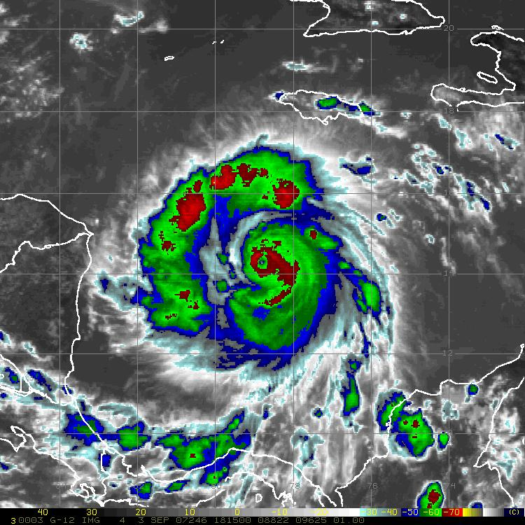
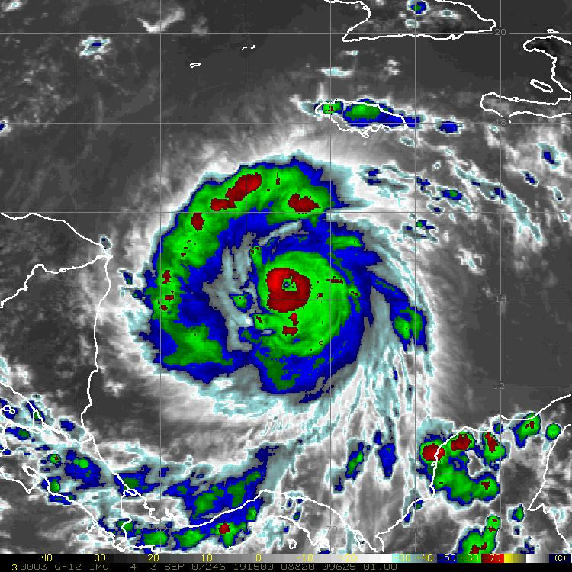
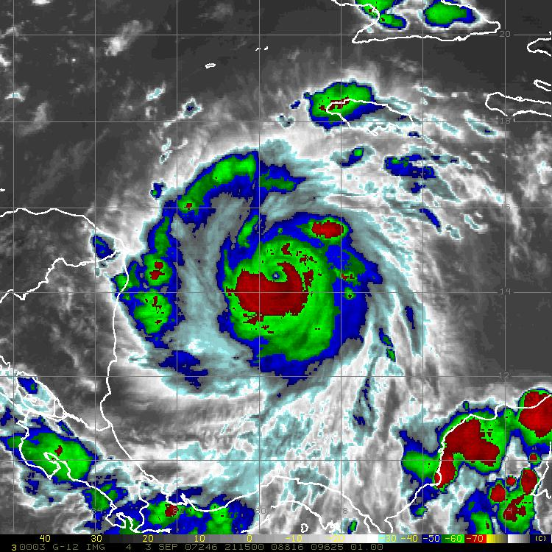
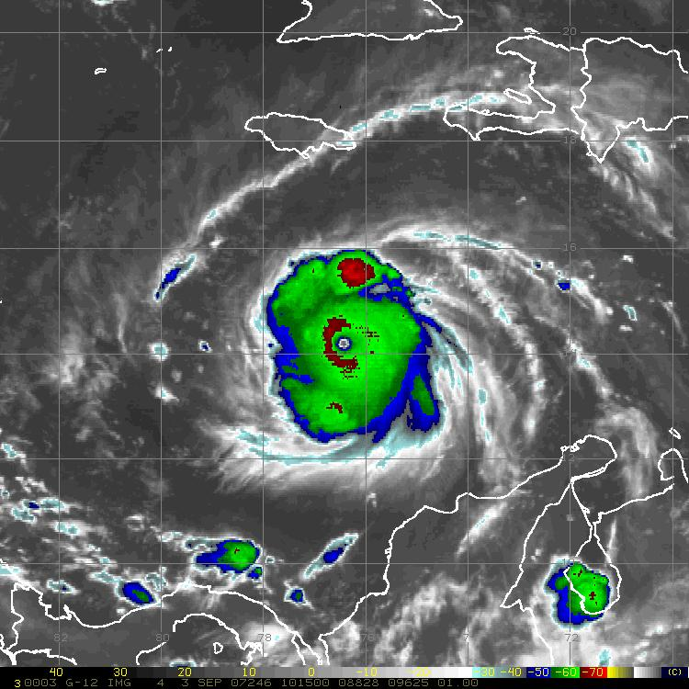
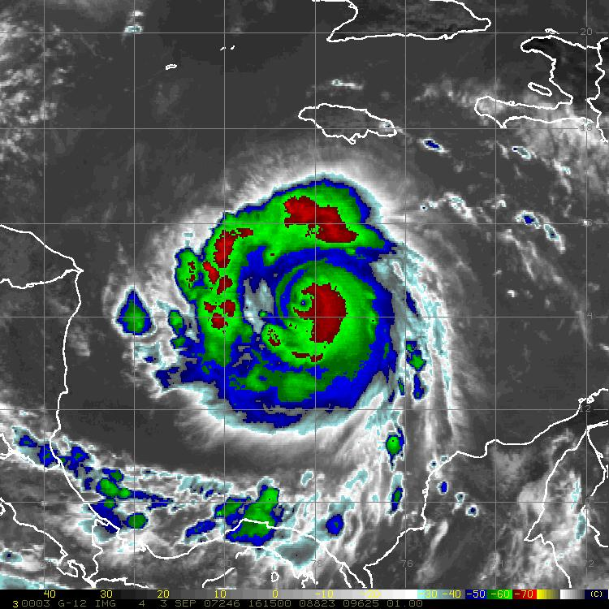
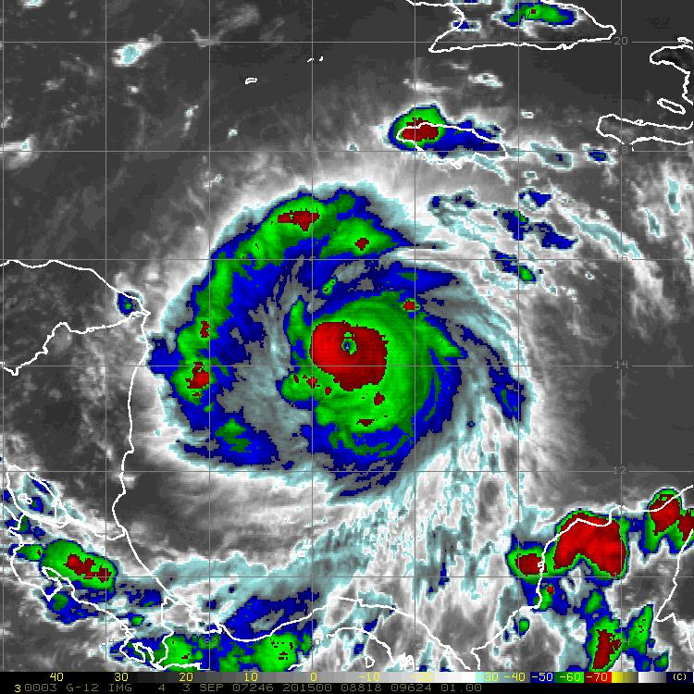
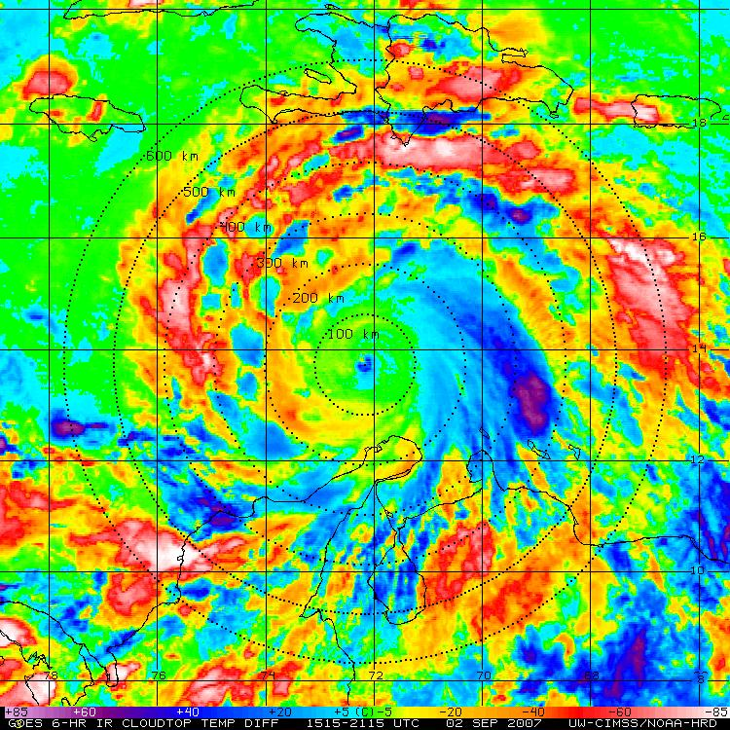
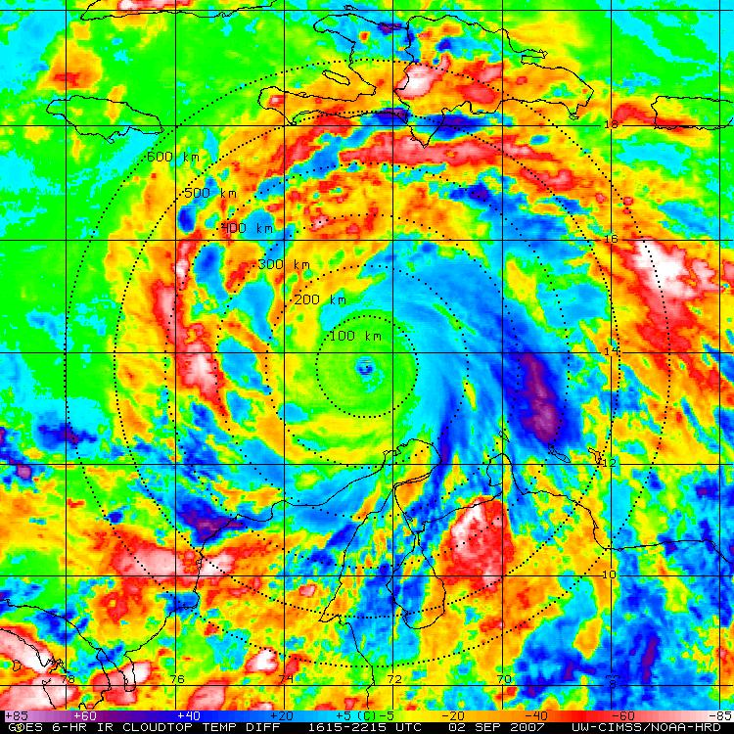
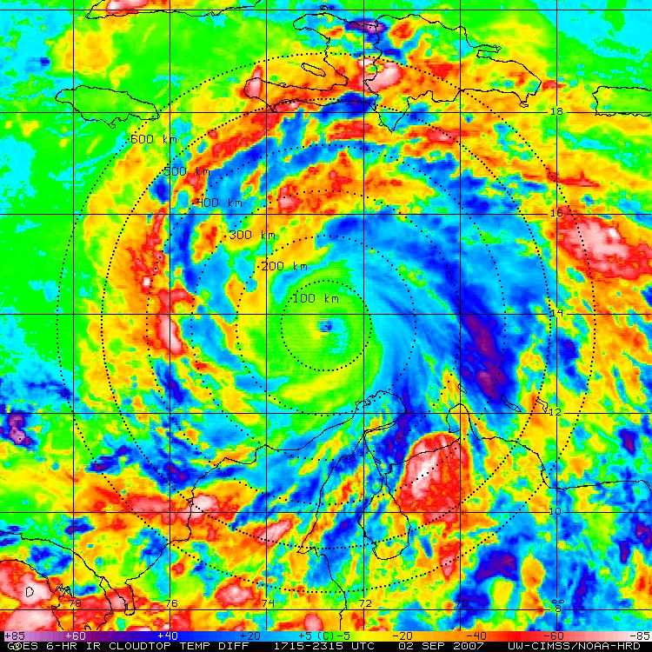
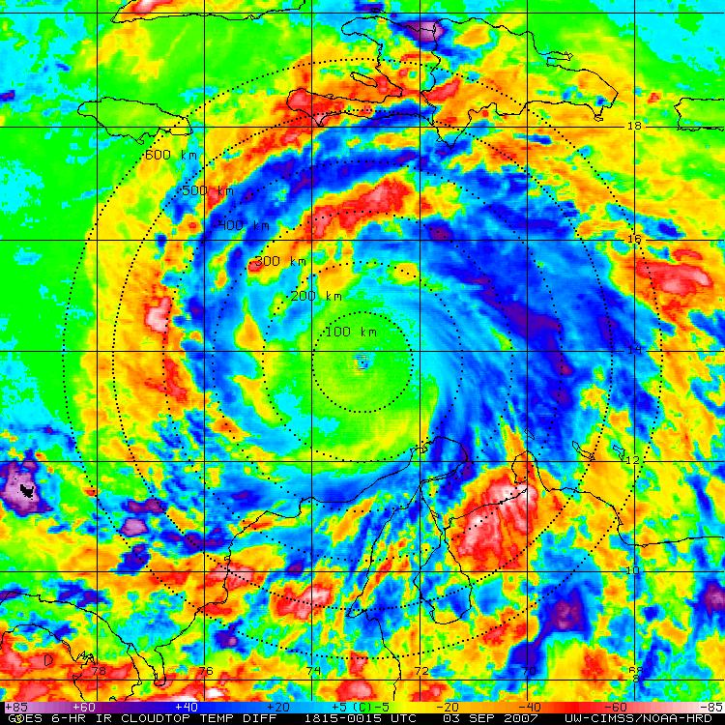
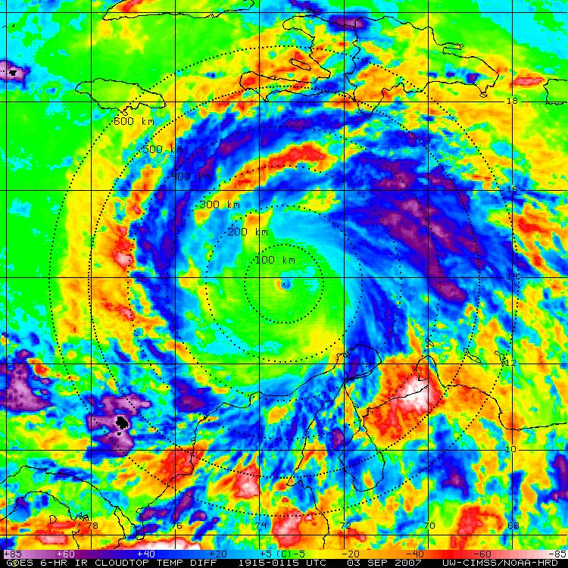
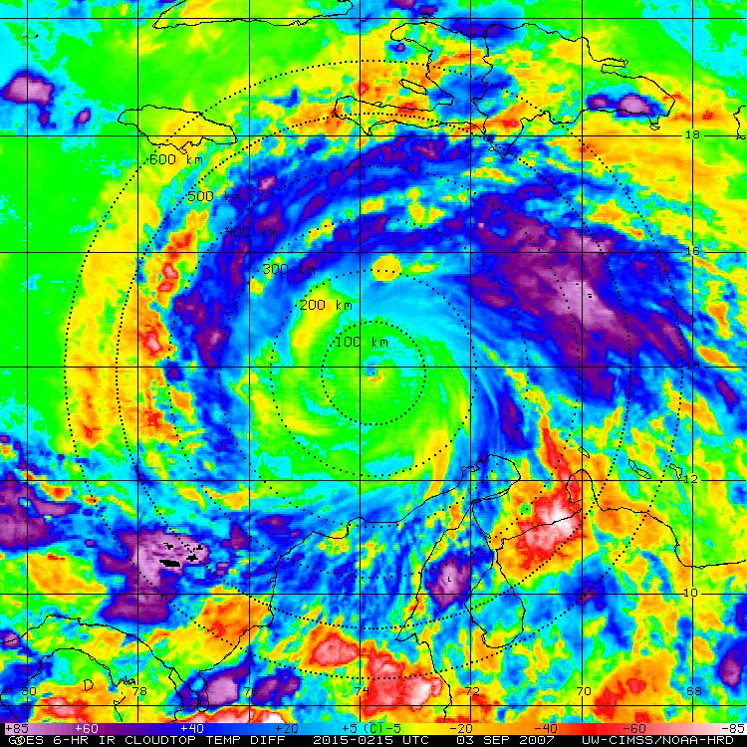
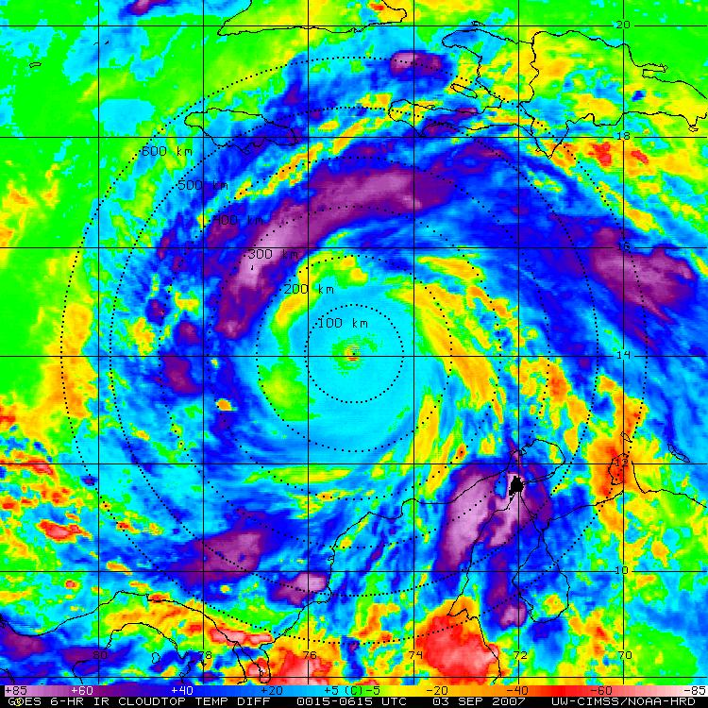
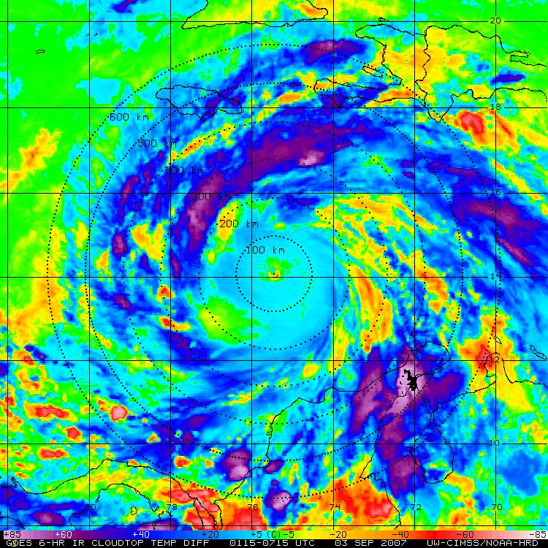
TC Diurnal Cycle
Hurricane Felix: 02-03 Sept 2007
GOES IR (storm relative)
GOES 6-hr Temp Trend (storm relative)

Slide 16
TC Diurnal Cycle
Think Globally, Act Locally

Slide 17
African Easterly Wave
15-16 August 2013
MSG IR (storm relative)
GOES IR 6-hr BT trend (storm relative)

Slide 18
TD Gabrielle: 04-05 Sept 2013
Surface
500 mb
MSG IR (storm relative)
850 mb
MSG IR 6-hr BT trend (storm relative)
05 Sep 12z
05 Sep 00 z

Slide 19
Suomi-NPP Satellite: VIIRS Instrument
South Texas Severe Thunderstorm Event
70 mph Wind Gusts; 1.75” Hail
Day-Night Band
Infrared (11.45 μm)
Notes:
IR= ~0.75 km resolution
Moonlight or airglow (excitation of air molecules by UV radiation)

Slide 20
Conclusions
2013 Real-Time Mission Support
Satellite imagery/products, GPS dropsonde processing, forecasting, mission science;
Satellite Products (Real-Time & Experimental)
TOTs, cloud-top heights, warm core anomaly evaluation
Phase Space Composites
Compositing pre-genesis systems
RGB Air Mass Imagery
Air mass identification tool (real-time)
TC Diurnal Cycle
TC diurnal pulses >> possible links to TC structure
http://tropic.ssec.wisc.edu/real-time/tc_diurnal_cycle/tc_diurnal_cycle.php

Slide 21
TD Gabrielle: 04-05 Sept 2013
Sunset and the TC CDO
Global Hawk GPS Dropsondes, NASA CPL
1918 m (813 hPa)
Notes:
CDO top = ~48,000 ft >> G-IV only gets up to ~45,000 ft toward end of mission

Slide 22
TD Gabrielle: 04-05 Sept 2013
Sunset and the TC CDO
Global Hawk GPS Dropsondes, NASA CPL
14810 m (136 hPa)
CDO Level (CPL)
Notes:
CDO top = ~48,000 ft >> G-IV only gets up to ~45,000 ft toward end of mission

Slide 23
TD Gabrielle: 04-05 Sept 2013
Sunset and the TC CDO
Global Hawk GPS Dropsondes, NASA CPL
Sunset + CDO
Sunset + No CDO
~3.5 C
CDO Top (CPL)
~1.5 C

