Slide 1
The Saharan Air Layer and Extreme Weather
What is the Saharan Air Layer?
The Saharan Air Layer (SAL) is a mass of very dry, dusty air that forms over the Sahara Desert during the late spring, summer, and early fall and moves over the tropical North Atlantic every 3-5 days. SAL outbreaks usually occupy a 2-2.5 mile thick layer of the atmosphere with base that is elevated about 1 mile above the surface. The warmth, dryness, and strong winds associated with the SAL have been shown to suppress tropical cyclone formation and intensification.
SAL activity usually ramps up in mid-June, peaks from late June to mid-August, and begins to rapidly subside after mid-August. During peak period, individual SAL outbreaks reach farther to the west (as far west as Florida, Central America and even Texas) and cover vast areas of the Atlantic (sometimes as large as the lower 48 United States).

Slide 2
The Saharan Air Layer and Extreme Weather
The Saharan Air Layer Affects our Weather and Climate
The Saharan Air Layer (SAL) has unique properties of warmth, dry air, and strong winds that can have significant moderating impacts on tropical cyclone formation and intensification. There are three characteristics of these Saharan dust outbreaks that can affect tropical cyclones, tropical disturbances, and the general climatology of the Atlantic tropical atmopshere:
Extremely Dry Air
African Easterly Jet
Warm Temperatures

Slide 3
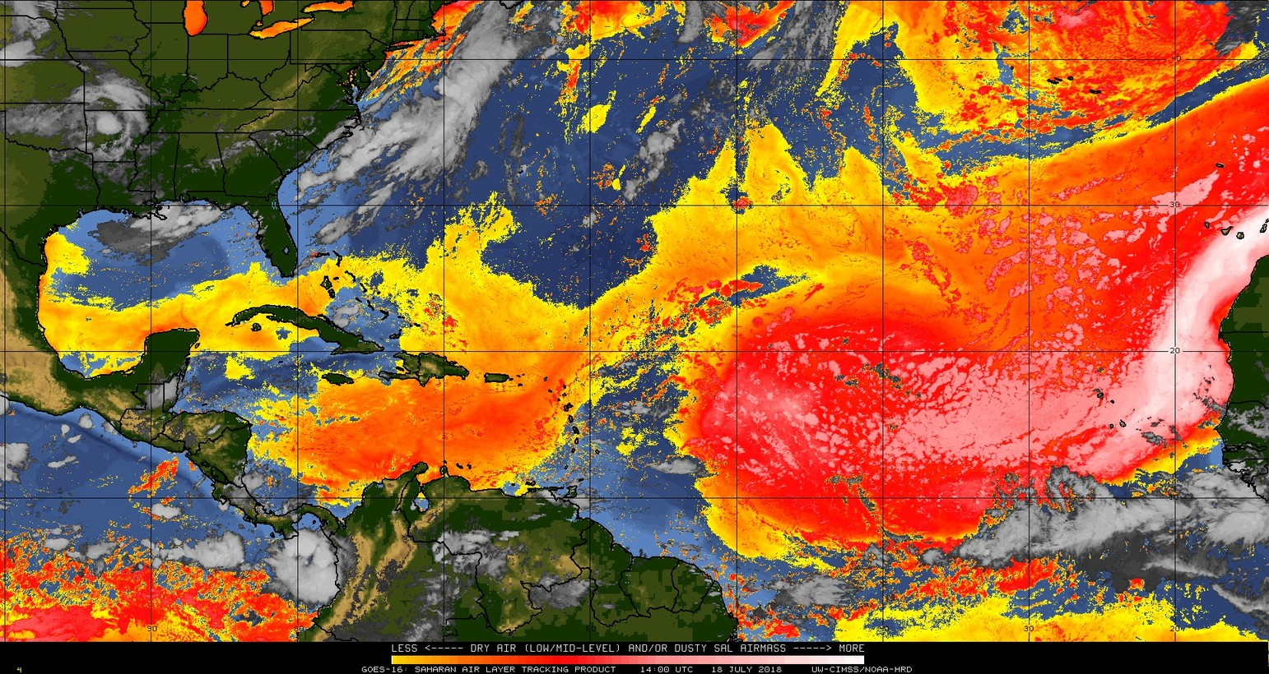
The Saharan Air Layer and Extreme Weather
Extremely Dry Air
First, the SAL’s dry, dusty air has about 50% less moisture than the typical tropical atmosphere. This extremely dry air can weaken a tropical cyclone or tropical disturbance by promoting downdrafts around the storm.

Slide 4
The Saharan Air Layer and Extreme Weather
African Easterly Jet
Second, strong winds in the SAL (25-55 mph or 10-25 m s⁻¹) can substantially increase the vertical wind shear in and around the storm environment. This “mid-level jet” of enhanced winds, typically found at a height of 6,500-14,500 ft (2000-4500 m), can cause tilting of the tropical cyclone vortex with height and can disrupt the storm’s internal heat engine.
Depicting the SAL jet is not easy, but this image from COMET is “an ok start”. It’s low res and I know we can do better…I’ve keep up the search or try to just make one.
Image courtesy of the COMET Program

Slide 5
The Saharan Air Layer and Extreme Weather
Warm Temperatures
Third, the SAL’s warmth acts to stabilize the atmosphere, which can suppress the formation of clouds. This stabilizing effect is produced when the SAL’s warm, buoyant air rides above relatively cooler, denser air. The SAL’s suspended mineral dust also absorbs sunlight, which helps maintain its warmth as it crosses the Atlantic Ocean.
Read more about the project in the selections below or click next to start over.

Slide 6
Who We Are
Our main goal is to study all aspects of the Saharan Air Layer (SAL), including its thermodynamic and kinematic structure, vertical extent, mineral dust impacts, and affect on the climatology of the North Atlantic atmosphere. This allows us to integrate new SAL observations collected from aircraft-deployed GPs dropsondes into models in order to improve forecasts and advance our knowledge of the SAL’s impact on extreme weather and climate in the Atlantic Basin.
A special thank you to our external partners, Chris Velden (UW-CIMSS), Jeff Hawkins (NRL-Monterey, retired), and Joseph Prospero (University of Miami/CIMAS, retired).
Dunion: Principal Investigator
Aberson, Dorst, Marks, Kaplan, Alaka, and Rogers: Project members

Slide 7
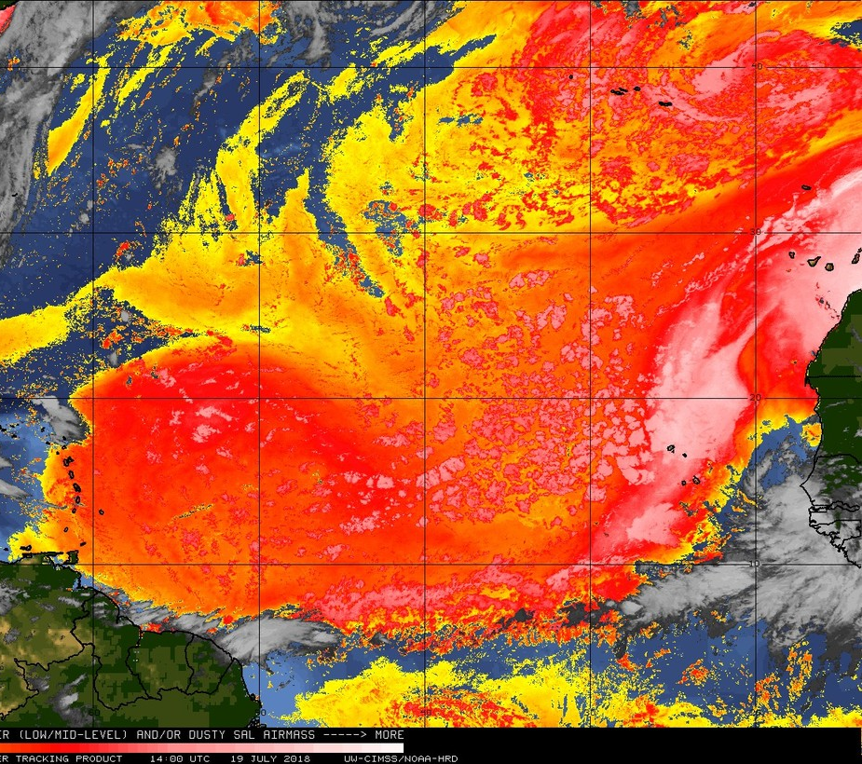
What We Do
The Saharan Air Layer project conducts experiments using NOAA’s P-3 Orions and G-IV high altitude jet as described in HRD’s Hurricane Field Program Plan. Our Saharan Air Layer monitoring is conducted using a combination of NOAA’s Geostationary Operational Environmental Satellites (GOES), the Meteosat Second Generation (MSG) satellites, as well as the the NOAA-20, Suomi-NPSS, Special Sensor Microwave Imager/Sounder (SSMIS), Global Change Observation Mission (GCOM), Global Precipitation Measurement (GPM), and Coriolis polar orbiting satellites.

Slide 8
Advancing Saharan Air Layer Science
✓
2001
Developed Satellite Imagery for Monitoring the SAL
Developed automated geostationary satellite imagery (GOES-EAST and Meteosat) to track the SAL continuously. This product used split window infrared (IR) imagery and was first made available in real-time on the UW-CIMSS tropical cyclone website in 2001:
http://tropic.ssec.wisc.edu/real-time/sal/
✓
2005
Pioneered the Saharan Air Layer Experiment (SALEX)
Conducted first-ever SALEX aircraft missions during the 2005 Atlantic hurricane season that used the NOAA G-IV high altitude jet to investigate interactions between the SAL and Tropical Storm Irene (07-08 Aug) and an African easterly Wave (27-28 Sep):
07 Aug 2005 (G-IV jet): TS Irene
08 Aug 2005 (G-IV jet): TS Irene
27 Sep 2005 (G-IV jet): African easterly wave
28 Sep 2005 (G-IV jet): African easterly wave
✓
2005
GPS Moisture Data Assimilation
Successfully submitted a proposal to the NOAA Joint Hurricane Testbed (JHT) program to examine the impacts of assimilating moisture information from GPS dropsondes launched from the NOAA G-IV jet in operational parallel runs of the NOAA Global Forecast System (GFS) model and assess the the impact of of this data on GFS initial/forecast humidity fields and its forecasts of TC track and intensity. Results from this 2005-2007 JHT project led to a decision by the NOAA National Centers for Environmental Prediction (NCEP) to begin routinely assimilating humidity data from GPS dropsondes into the operational version of the GFS model beginning on 22 Aug 2006.

Slide 9
Advancing Saharan Air Layer Science
✓
2006, 2015
SALEX Aircraft Missions
Conducted SALEX missions during the 2006 Atlantic hurricane season that used the NOAA P-3 Orions and G-IV high altitude jet to investigate interactions between the SAL and Tropical Storm Debby and Hurricane Helene. These NOAA missions were coordinated with the NASA African Monsoon Multidisciplinary Analyses (NAMMA) field campaign based in the Cape Verde Islands. P-3 and G-IV SALEX missions were also conducted in 2015 to investigate interactions between the SAL and Tropical Storm Erika.
25 Aug 2006 (G-IV jet): TS Debby
26 Aug 2006 (G-IV jet): TS Debby
15 Sep 2006 (G-IV jet): TS Helene
16 Sep 2006 (G-IV jet): Hurricane Helene
18 Sep 2006 (P-3 Orion & G-IV jet): Hurricane Helene
20 Sep 2006 (P-3 Orion & G-IV jet): Hurricane Helene
25 Aug 2015 (P-3 Orion & G-IV jet): TS Erika
26 Aug 2015 (P-3 Orion): TS Erika
✓
2011
A Revision of the Climatology of the Tropical Atlantic Atmosphere
Developed a 1995-2002 database of GOES satellite imagery, aerosol analyses, and Caribbean rawinsonde observations to create a revised set of atmospheric soundings for the tropical North Atlantic. These new soundings, partly based on knowledge of the SAL, represent a new benchmark for describing the climatological state of the tropical atmosphere during the hurricane season:
https://journals.ametsoc.org/doi/10.1175/2010JCLI3496.1
✓
2018
GOES-R Proving Ground: Developed New Satellite Products For SAL Monitoring With NOAA’s Next Generation Satellites
Developed several new satellite products to track the SAL continuously using NOAA’s next generation GOES-16 satellite. These products inluce split window infrared (IR), mid-level water vapor, and multi-spectral pseudo natural color satellite imagery and are available in real-time on the UW-CIMSS tropical cyclone website:
http://tropic.ssec.wisc.edu/real-time/sal/

Slide 10
Project Goals
Assess Impacts From Observations
Continue to assess the impact of GPS dropsonde observations from NOAA’s P-3 Orions and G-IV jet on the NOAA GFS and HWRF models. Specific goals will include assessing the impact of humidity and wind data on GFS and HWRF initial/forecast humidity fields and their forecasts of TC track, intensity and structure
Publications & References

Slide 11
Project Goals
Additional Missions
Conduct additional Saharan Air Layer Experiment (SALEX) missions during future NOAA HRD hurricane field programs that utilize the NOAA P-3 Orions and G-IV high altitude jet. These research missions will incorporate adaptive sampling strategies using model ensembles and will be deigned to address the main objectives described above.
Publications & References

Slide 12
Project Goals
Develop a New Sounding
Remove- this has already been completed
Publications & References

Slide 13
Project Goals
Improved Humidity Parameter
Remove- this has already been completed
Publications & References

Slide 14
Publications & References
Dunion, J.P., 2011: Re-Writing the Climatology of the Tropical North Atlantic and Caribbean Sea Atmosphere. J. Climate. 24, 893-908.
Dunion, J.P., and C.S. Marron, 2008: A Reexamination of the Jordan mean tropical sounding based on awareness of the Saharan Air Layer: Results from 2002. J. Climate. 21, 5242-5253.
Dunion, J.P., and S.D. Aberson, 2007: Assimilating moisture information from Global Positioning System (GPS) dropwindsondes into the NOAA Global Forecast System, 61st Annual Interdepartmental Hurricane Conference, New Orleans, LA, Office of Fed. Coord. For Meteor. Services and Supporting Research, NOAA.
Dunion, J.P., J.D. Hawkins, and C.S. Velden, 2006: Hunting for Saharan Air with the NOAA G-IV Jet. AMS 27th Conference on Hurricanes and Tropical Meteorology, Monterey, CA, American Meteorological Society.
Dunion, J.P., and S.D. Aberson, 2006: Assimilating moisture information from Global Positioning System (GPS) dropwindsondes into the NOAA Global Forecast System, 60th Annual Interdepartmental Hurricane Conference, Mobile, AL, Office of Fed. Coord. For Meteor. Services and Supporting Research, NOAA.
Dunion, J.P., and C.S. Velden, 2004: The impact of the Saharan Air Layer on Atlantic tropical cyclone activity. Bull. Amer. Meteor. Soc., 85 no. 3, 353-365.
Ismail, S., R.A. Ferrare, E.V. Browell, S.A. Kooi, J.P. Dunion, G. Heymsfield, A. Notari, C.F. Butler, S. Burton, M. Fenn, T.N. Krishnamurti, M. Biswas, G. Chen, and B. Anderson, 2010: LASE measurements of water vapor, aerosol, and cloud distributions in Saharan Air Layers and tropical disturbances. J. Atmos. Sci, 67 no. 4, 1026-1047.
Jones, T., D. Cecil, and J.P. Dunion, 2007: The environmental and inner core conditions governing the intensity of Hurricane Erin (2001). Wea. Forecast. 22, 708-725.
Evan, A.T., J.P. Dunion, J.A. Foley, A.K. Heidinger, and C.S. Velden, 2006: New evidence for a relationship between Atlantic tropical cyclone activity and African dust outbreaks. Geophys. Res. Lett., L19813, doi:10.1029/2006GL026408.
Zipser, E.J., C.H. Twohy, S. Tsay, K. L. Thornhill, S. Tanelli, R. Ross, T.N. Krishnamurti, Q. Ji, G. Jenkins, S. Ismail, N. C. Hsu, R. Hood, G. M. Heymsfield, A. Heymsfield, J. Halverson, H. M. Goodman, R. Ferrare, J. P. Dunion, M. Douglas, R. Cifelli1, G. Chen, E. V. Browell, and B. Anderson, 2009: The Saharan Air Layer and the fate of African easterly waves-NASA’s AMMA 2006 field study of tropical cyclogenesis. Bull. Amer. Meteor. Soc., 90, 1137-1156.

