Slide 1
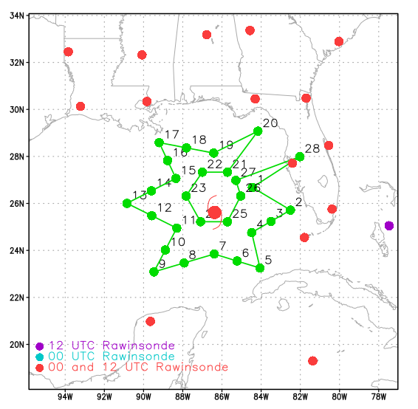
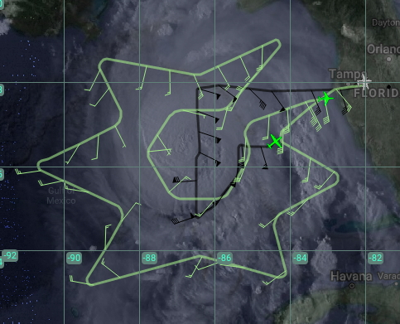
2018 NOAA/AOML/HRD Hurricane Field Program
Intensity Forecast Experiment (IFEX)
AL14/Michael Debrief
20181009N2
G-IV Flight Track (actual)
T/O: 1730 UTC (1330 L), Lakeland
Landing: 2245 UTC (1845 L), Lakeland
Planned Flight Time: ~5.5 hr
AOC/HRD Crew:
Flight Director: R. Henning
Dropsondes: J. Parrish
LPS/Dropsondes: J. Kaplan
Ground-based LPS: J. Dunion
Objectives:
AIPEX Experiment (Potential RI)
Objective #1: sample environment (R~120-240 nm)
Objective #2: circumnavigation of near-core (R~75 nm)
Focused sampling in western semicircle (vertical wind shear and dry air)
Star Pattern with 75 nm circumnav
27 Dropsondes (green dots)
G-IV Flight Track (actual - MTS)

Slide 2
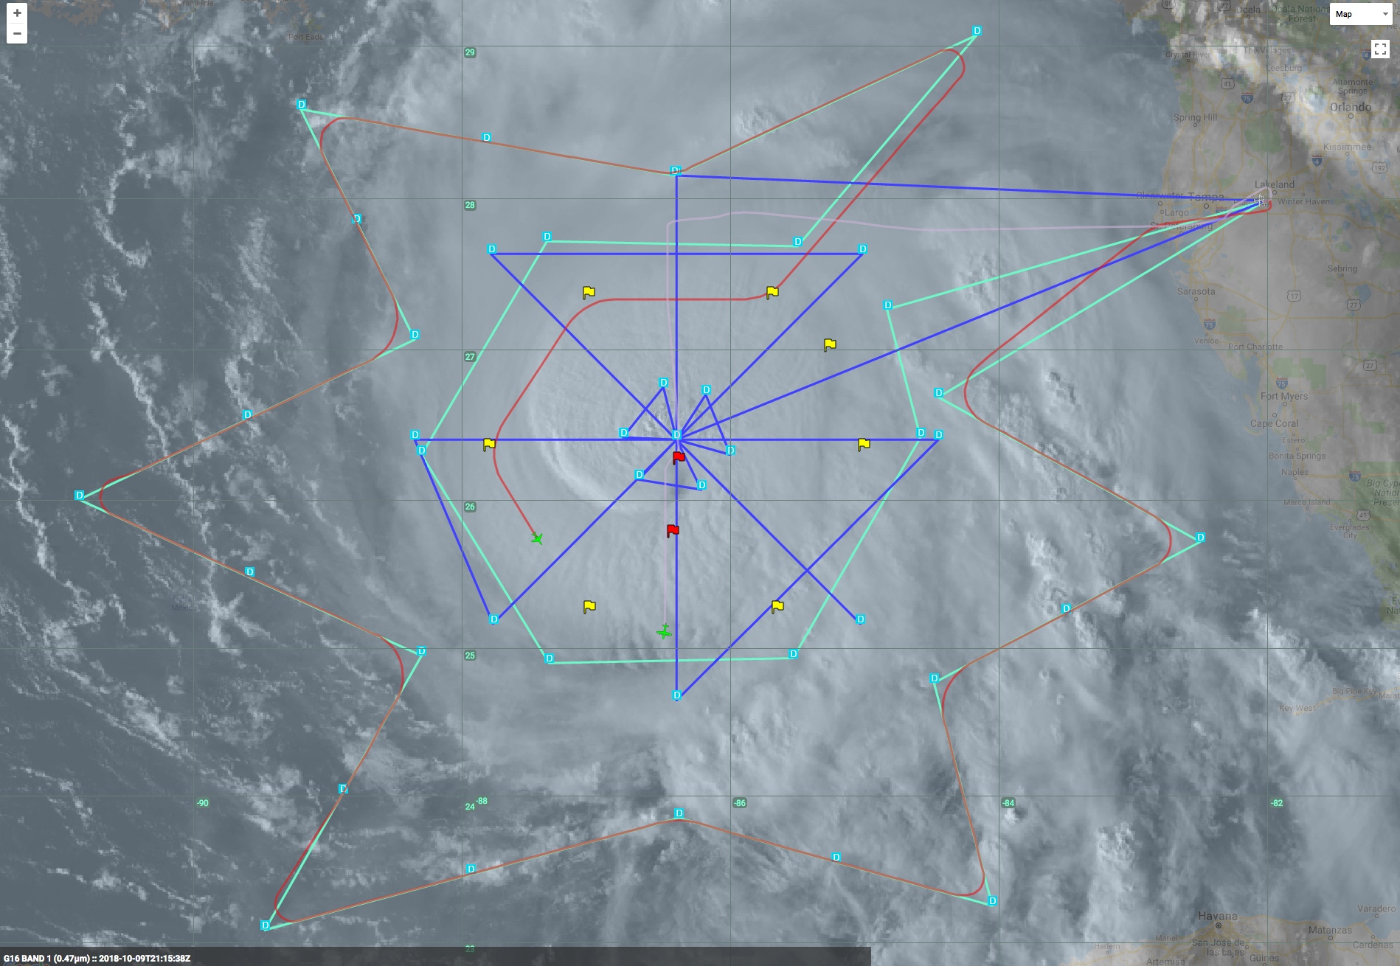
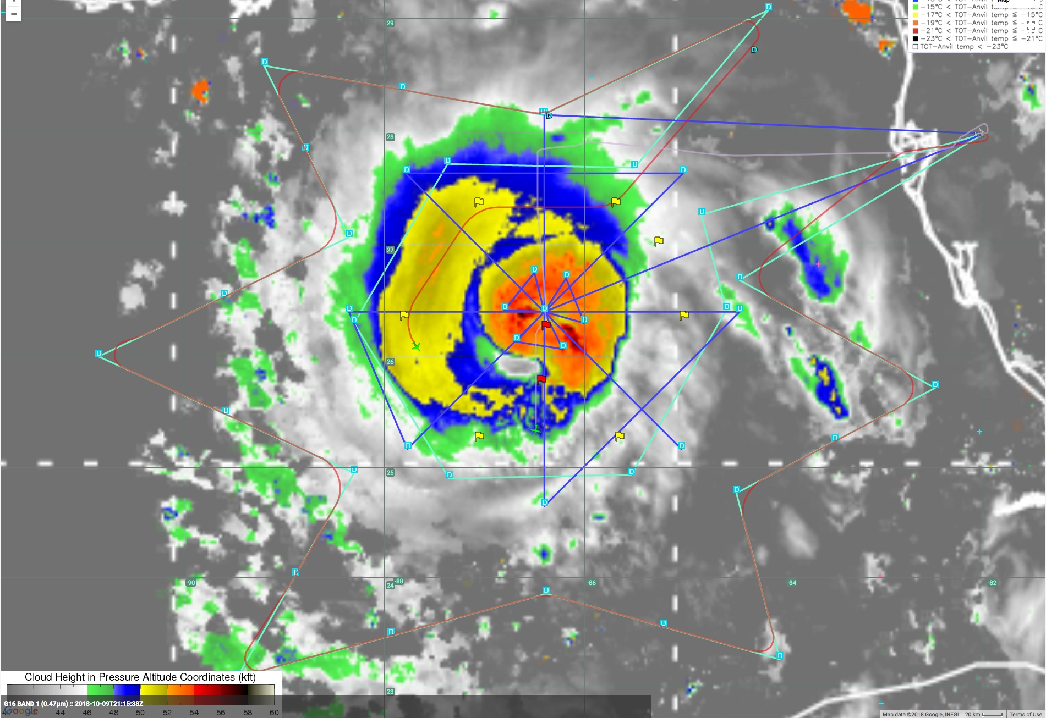
2018 NOAA/AOML/HRD Hurricane Field Program
Intensity Forecast Experiment (IFEX)
AL14/Michael Debrief
G-IV Track Changes >> inner core circumnavigation changed from R100 to R75
Objectives
Collect wind and thermodynamic observations in the periphery of the inner core
Collect near inner core GPS dropsonde data above the P-3 dropsonde level (~7,500 ft)
Optimize TDR data collection
Situational Awareness (MTS): CIMSS cloud top heights (CTHs), lightning, and tropical overshooting tops (TOTs)
G-IV Planned
G-IV Actual
P3 Planned
CTHs: 48-53 Kft
Lightning: none
TOTs: none

Slide 3
Storm Statistics based upon NHC best track data
2018 NOAA/AOML/HRD Hurricane Field Program
Intensity Forecast Experiment (IFEX)
AL14/Michael Debrief
Intensity
10/09 18 UTC P=960 mb, Vmax=105 kt
10/10 18 UTC P=919 mb ,Vmax= 135 kt (Approximate time of Landfall)
Based upon 1989-2017 Atlantic basin best track data:
30 kt/24-h increase equates to ~93 percentile in terms of wind increase
41 mb drop /24-h equates to ~99.4 percentile in terms of pressure decrease
SHIPS analyzed conditions for 24-h period from 10/9 18 UTC - 10/10 18 UTC
Shear (850-200 mb): T=0 h: 283 deg./12 kt T=24-h: 194 deg. /9 kt Sample Avg=15.7 kt
SST: T=0 h: 29.3 C T=24 h: 28.5 C Sample Avg=27.6 C
RH (500-700 mb): T=0 h: 65% T=24-h: 64% Sample Avg=54%
Storm Speed: T=0 h: 10 kt T=24 h: 15 kt Sample Avg=10.6 kt
OHC: T=0 h: 41 KJ/cm² T=24-h: 28 KJ/cm² Sample Avg=31 KJ/cm²
RI probability: 30-kt/24-h 22% (3x climatology)
Notes:
-Winds may not have had time to repsond to pressure drop
-winds are from NHC’s working Best track
-Mention that shear and moisture were quite asymmetric

Slide 4
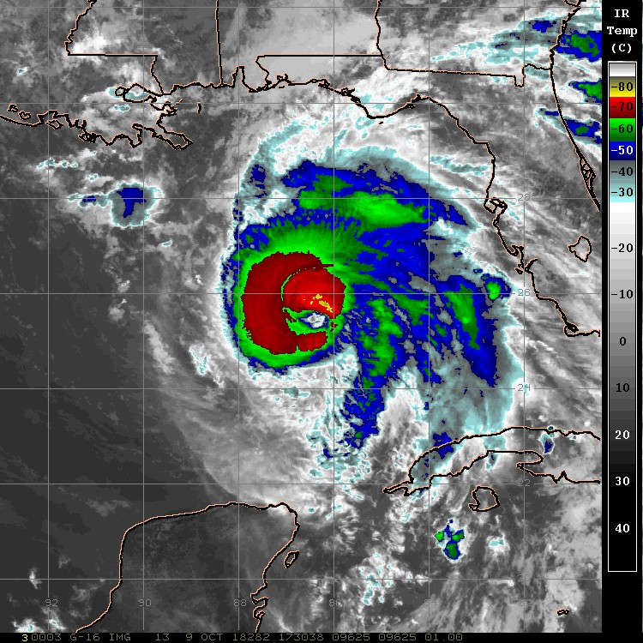
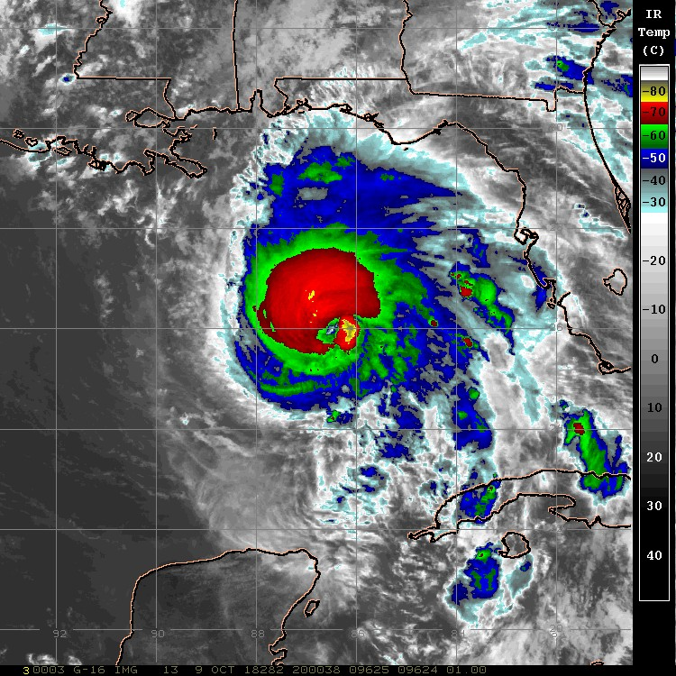
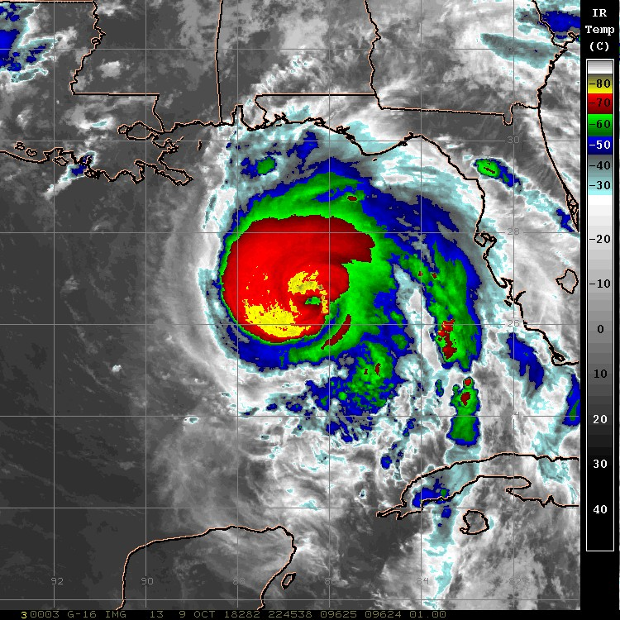
2018 NOAA/AOML/HRD Hurricane Field Program
Intensity Forecast Experiment (IFEX)
AL14/Michael Debrief
GOES-16 IR (10.3 um) Satellite Imagery
G-IV take-off (1730 UTC)
G-IV mid-flight (2000 UTC)
G-IV landing (2245 UTC)

Slide 5
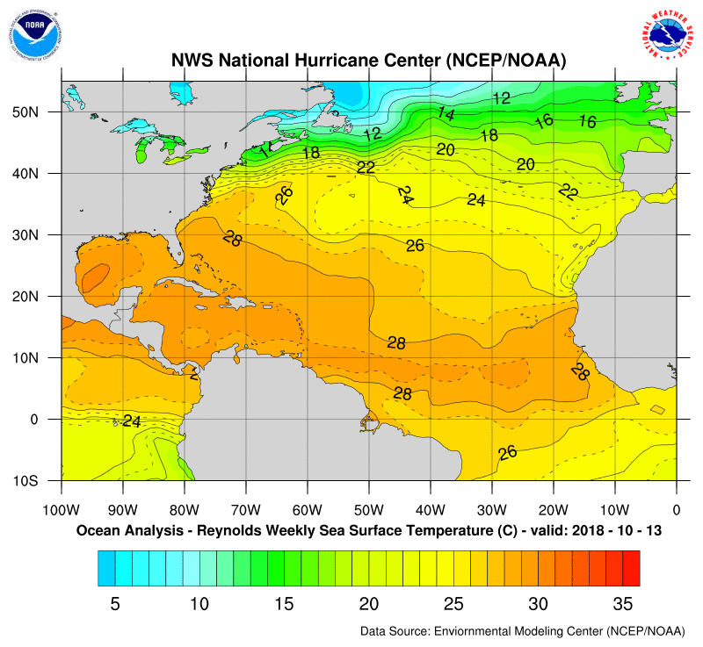
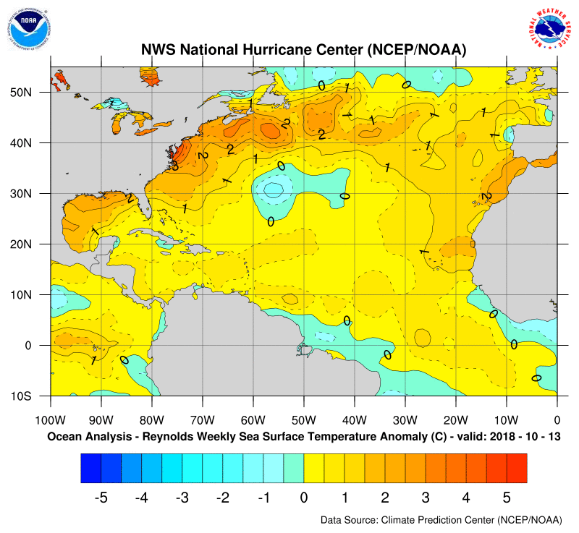
2018 NOAA/AOML/HRD Hurricane Field Program
Intensity Forecast Experiment (IFEX)
AL14/Michael Debrief
SST ANALYSIS Valid 10/13/2018
OBSERVED
ANOMALY

Slide 6
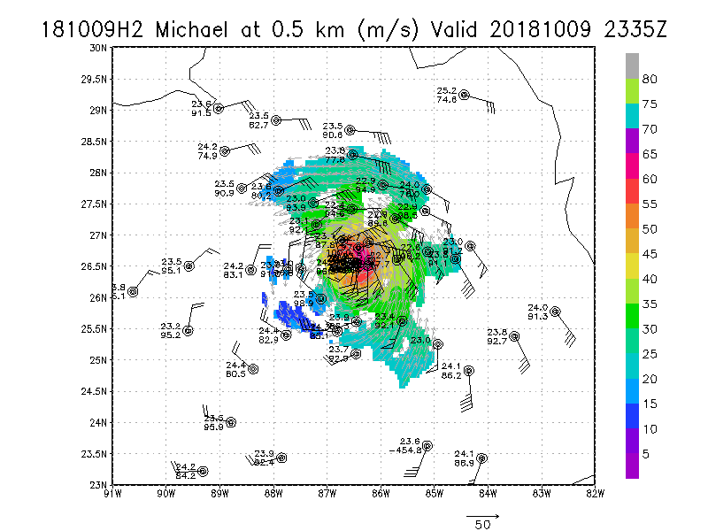
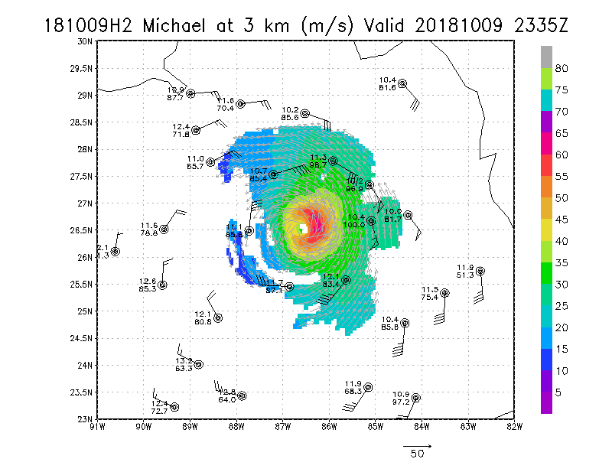
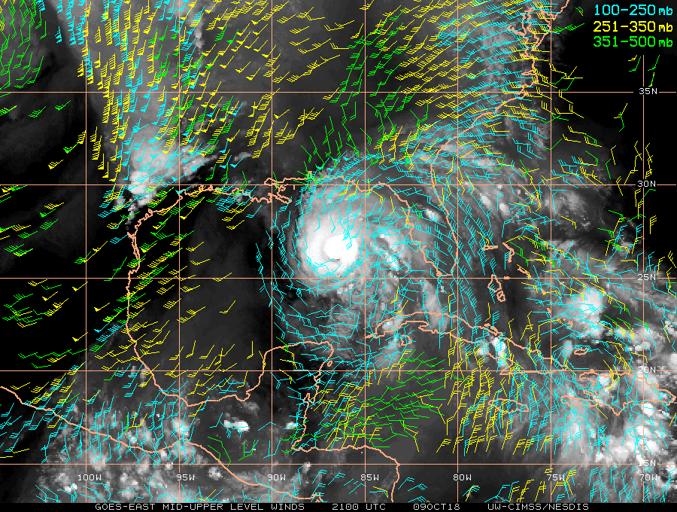
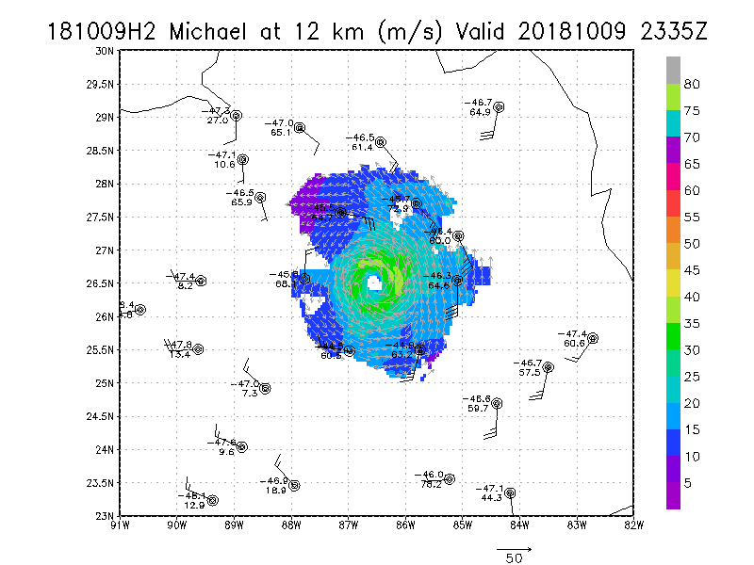
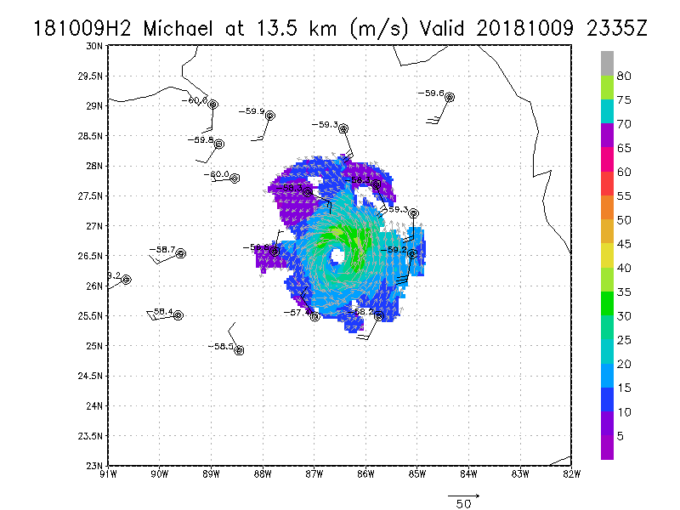
*G-IV and P-3 data plots (courtesy of S. Aberson)
2018 NOAA/AOML/HRD Hurricane Field Program
Intensity Forecast Experiment (IFEX)
AL14/Michael Debrief
GOES-16 Water Vapor Winds (100-500 mb)
Notes:
55-60 m/s at 0.5 km
Wind field is quite asymmetric (especially in the lower levels)
SW flow is undercutting the outflow layer (G-IV shows ~2 deg closer than WV winds suggest)
G-IV data up to 14 km on the inner ring after the aircraft had climbed

Slide 7
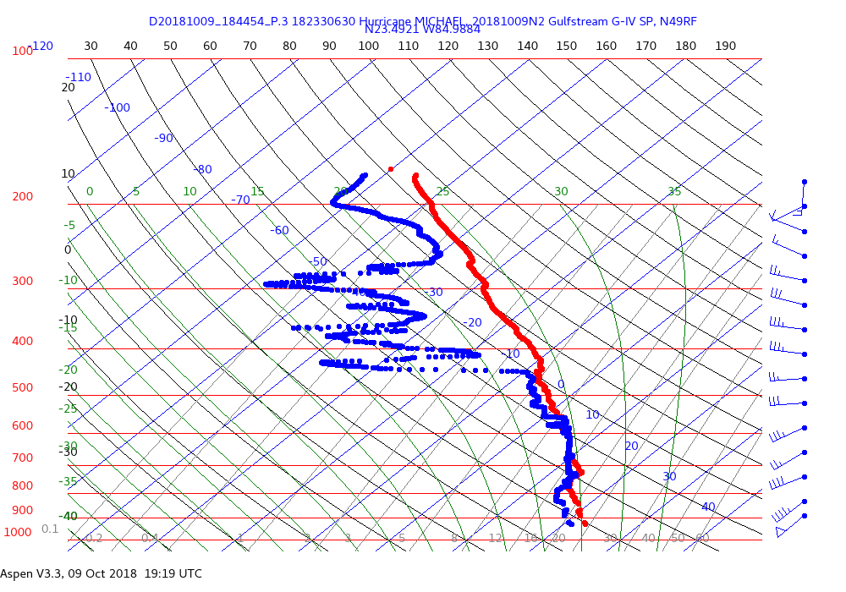
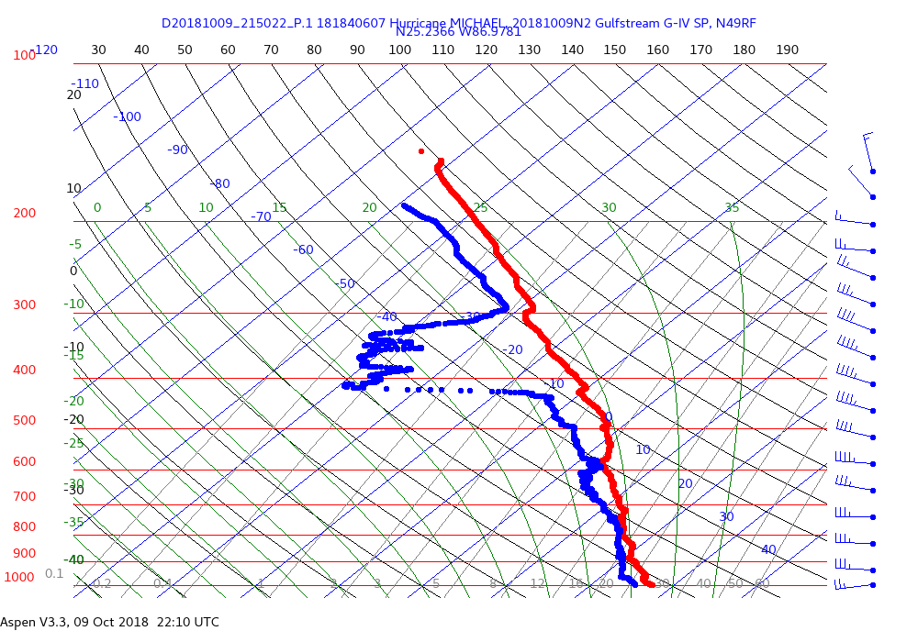
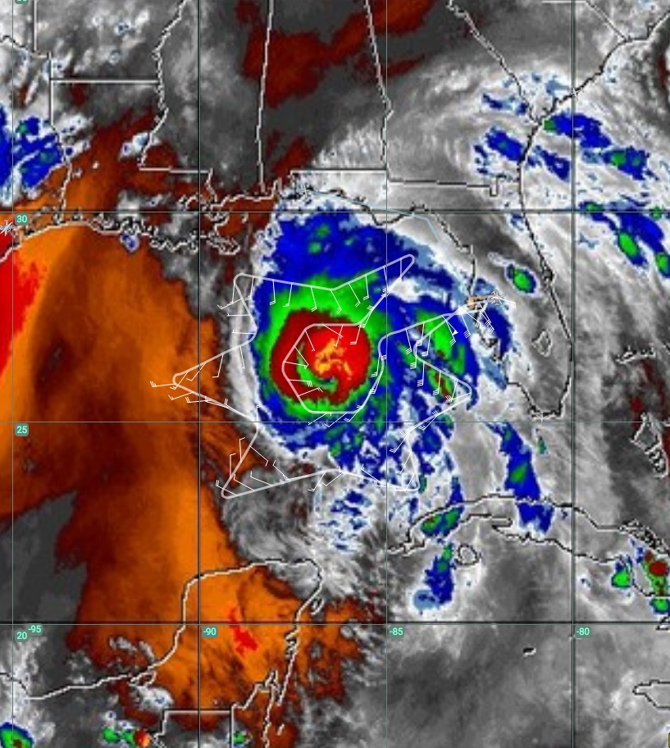
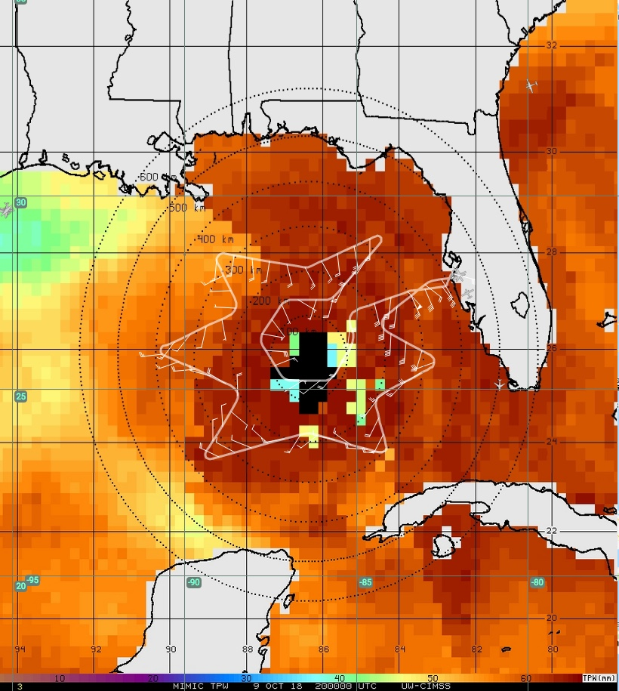
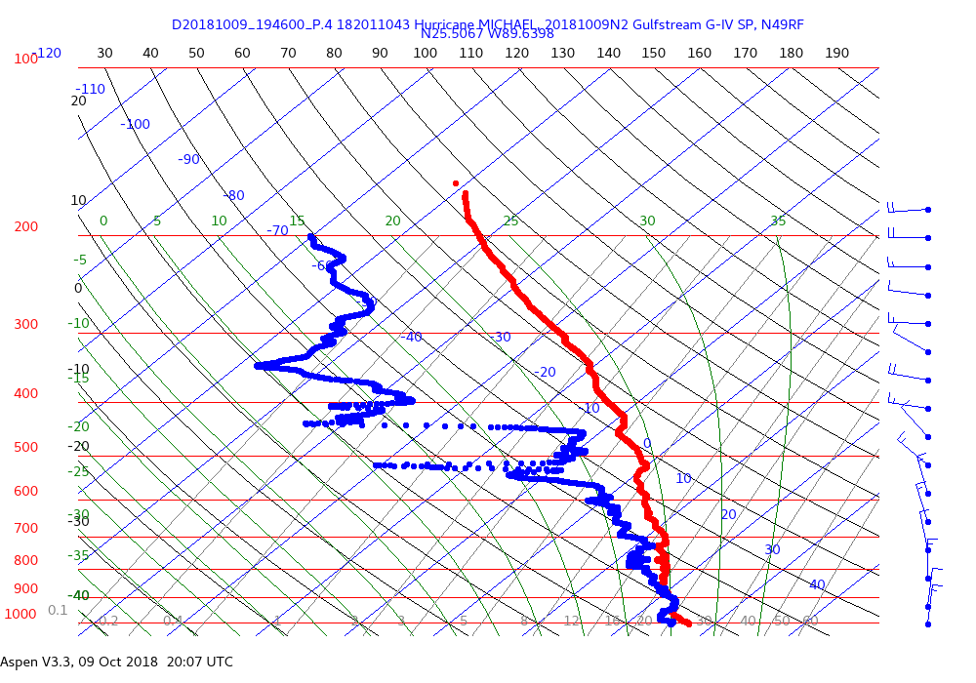
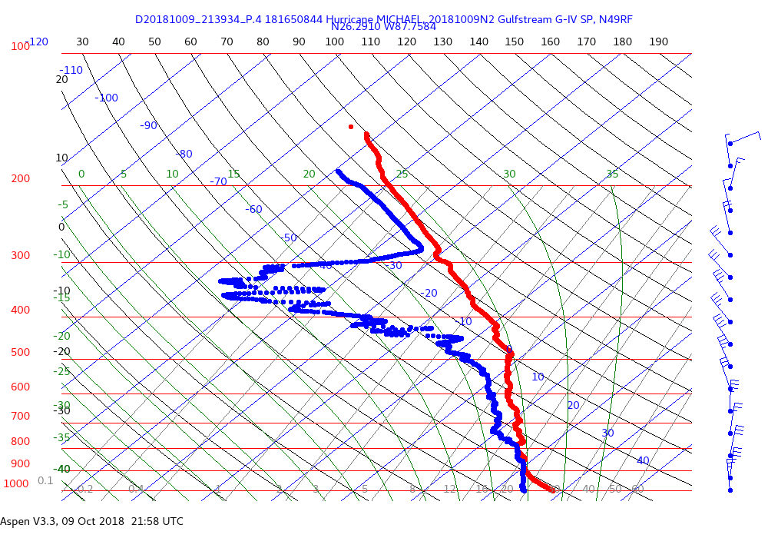
2018 NOAA/AOML/HRD Hurricane Field Program
Intensity Forecast Experiment (IFEX)
AL14/Michael Debrief
Outer
Inner
Drop #24
UW-CIMSS MIMIC TPW
Drop #6
GOES-East Mid-Level Water Vapor (6.9 um)
South
90-95% of the TPW signal
23
Drop #12
Drop #23
12
24
6
West
G-16 mid-level WV
channel weighting function

Slide 8
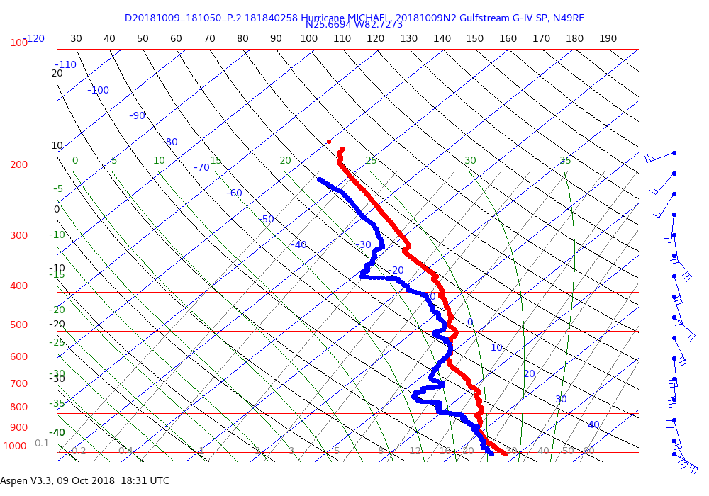
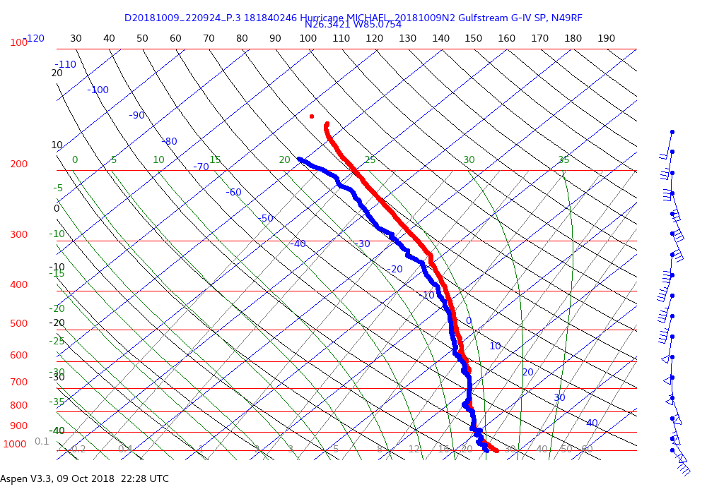
2018 NOAA/AOML/HRD Hurricane Field Program
Intensity Forecast Experiment (IFEX)
AL14/Michael Debrief
East Side of Michael
UW-CIMSS MIMIC TPW
GOES-East Mid-Level Water Vapor (6.9 um)
Outer
Inner
Drop #2
Drop #26
26
2
Notes:
SHIPS moisture predictor >> moisture averaging: moister than average, but E VERY moist, W quite dry

Slide 9
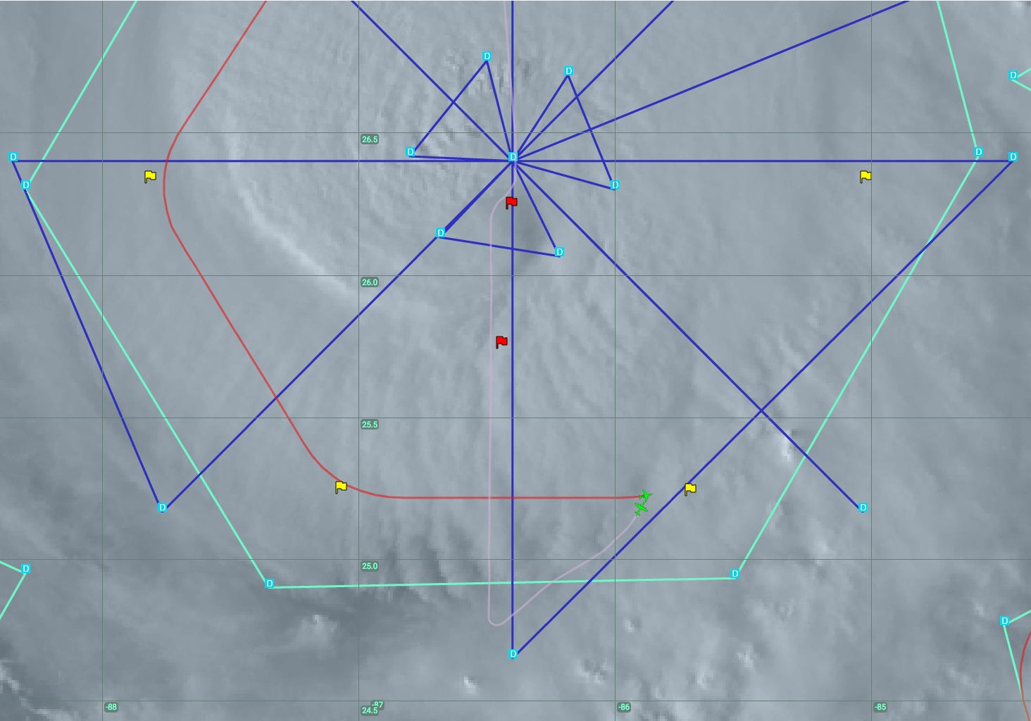
2018 NOAA/AOML/HRD Hurricane Field Program
Intensity Forecast Experiment (IFEX)
AL14/Michael Debrief
20181009N2
Expendables
28 GPS dropsondes: 27 + 1 back-up (no winds)
27 GPS dropsondes transmitted to the GTS
Issues
Only forward scanning TDR antenna was functional
No TDR data were transmitted in real-time
G-IV flight level data still not considered reliable
Situational awareness on the G-IV is very limited (bandwidth)
Fully “Planned” P-3/G-IV Coordination
Summary and Questions
Objective: AIPEX (potential RI) mission to collect dropsonde and Doppler data both just outside and within the inner-core of Hurricane Michael
Upper-level environment appeared to be restricting convection somewhat on the W and S side of Michael early in the flight.
However, by the end of the mission the convection seemed to have blossomed in that region.
Was the increase of convection on the west/south side of Michael simply the result of the upper-levels becoming more favorable during the flight or did the upper-level flow provide some dynamical forcing that aided in the spin-up/subsequent RI of Michael?
Many thanks to the entire AOC crew (especially Rich and Jack) for making the mission run so smoothly

