Slide 1
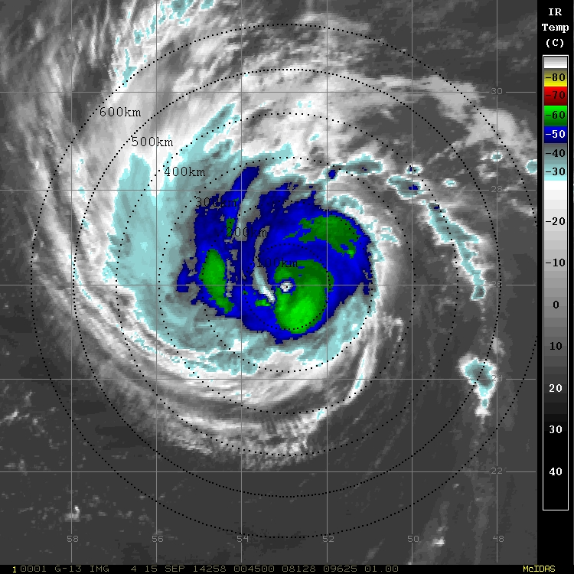
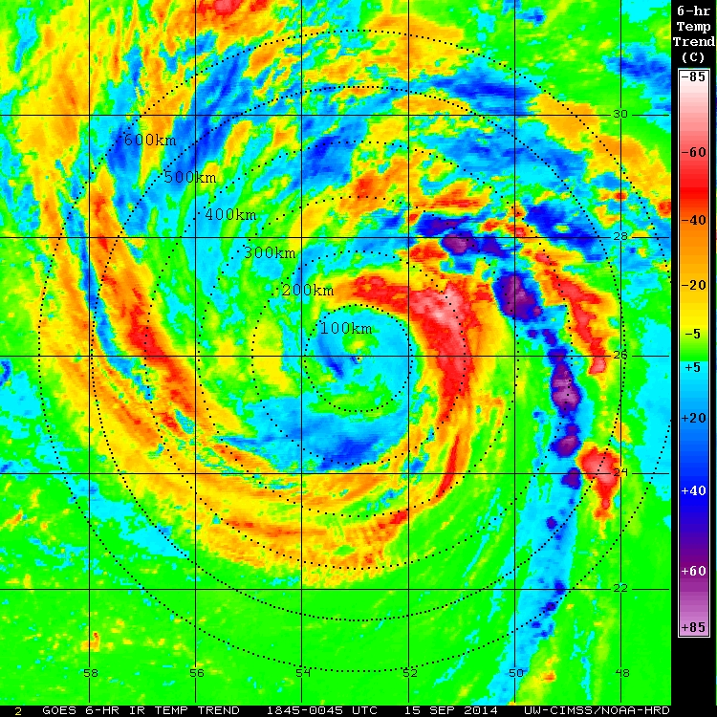
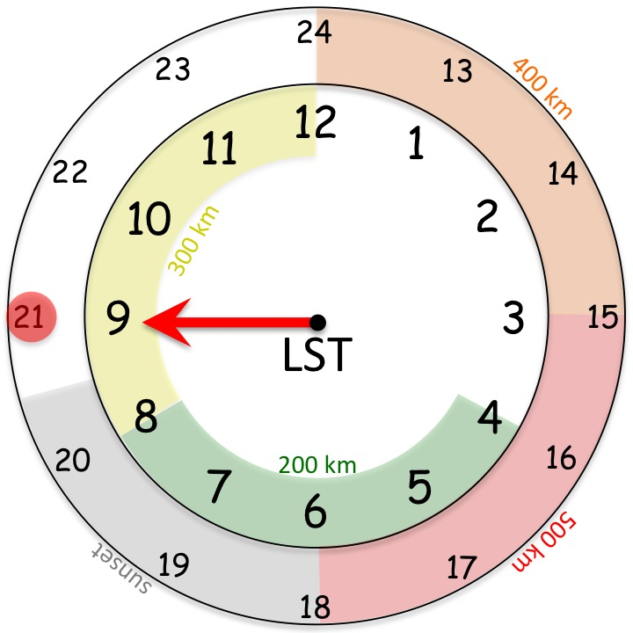
15 Sep 2014
0100 UTC

Slide 2
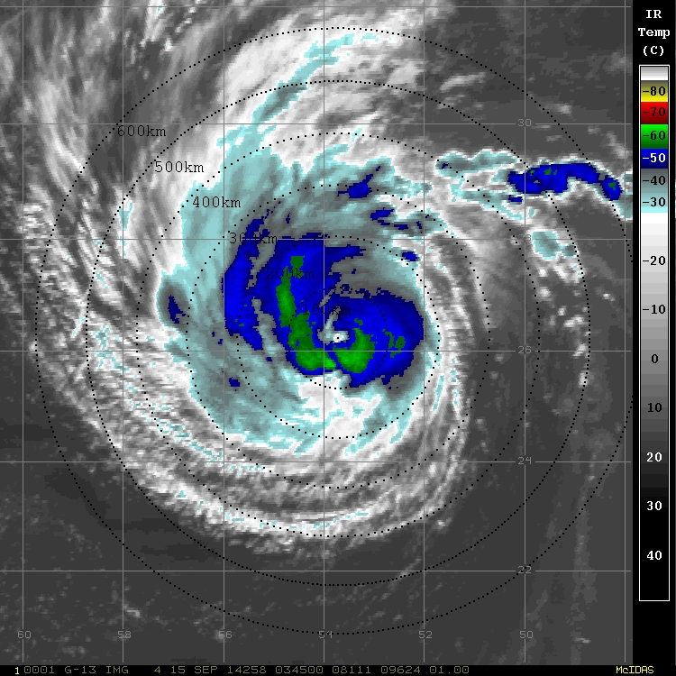
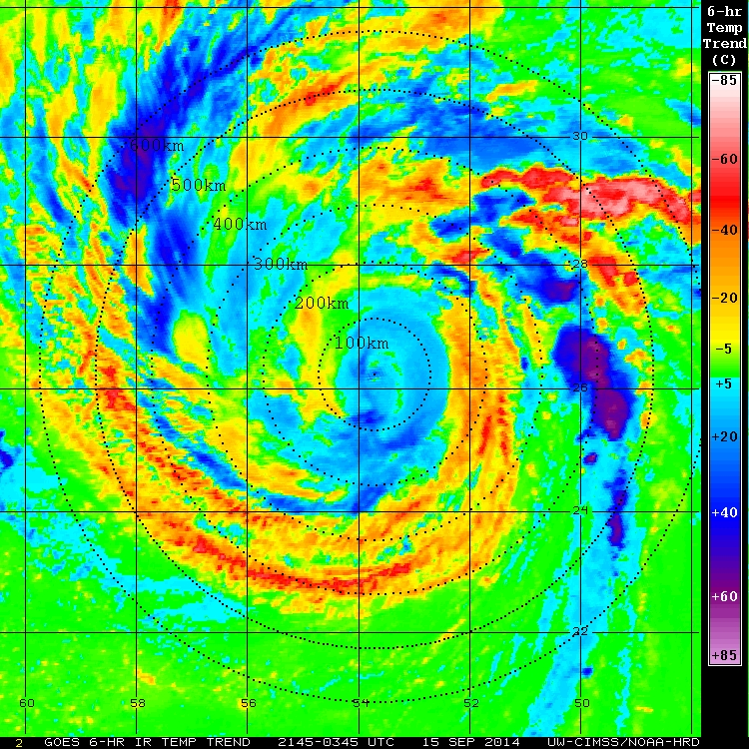
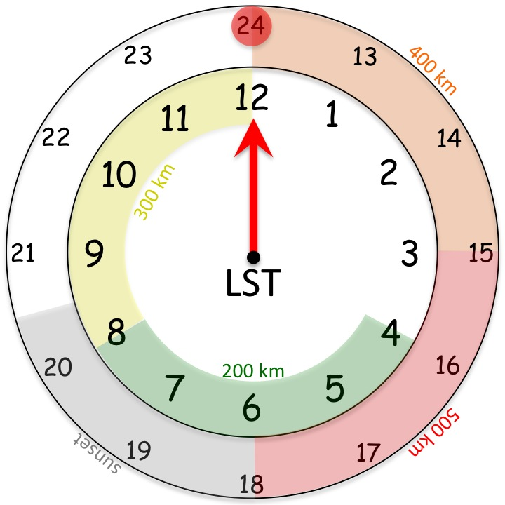
15 Sep 2014
0400 UTC

Slide 3
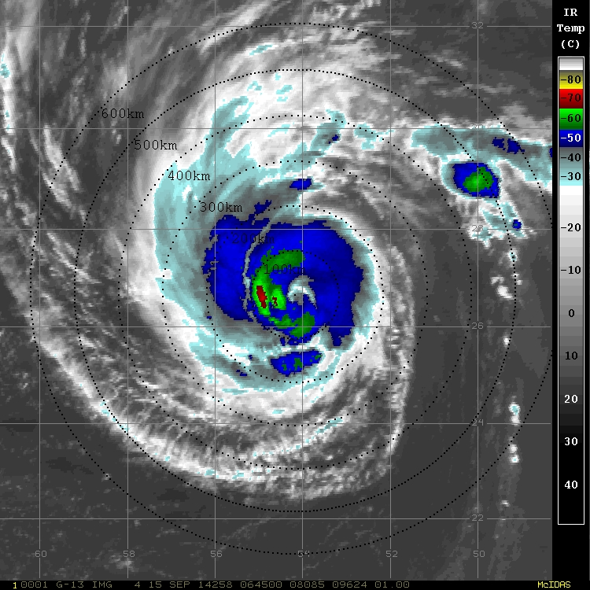
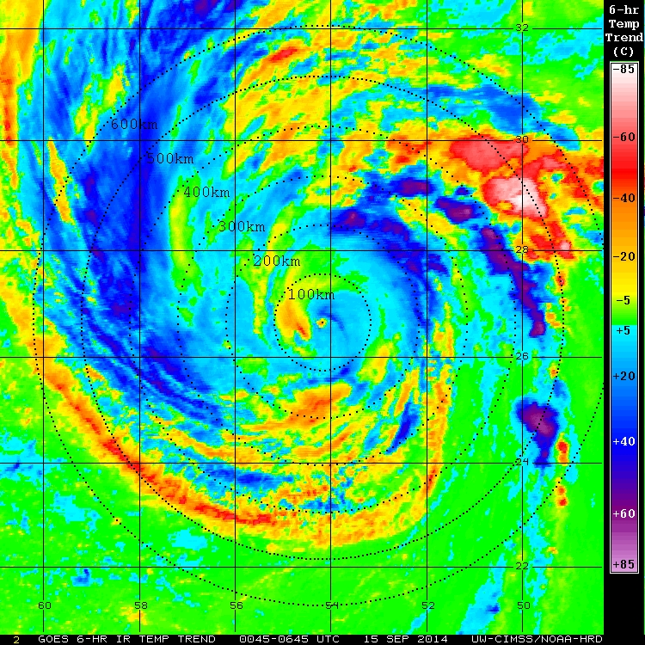
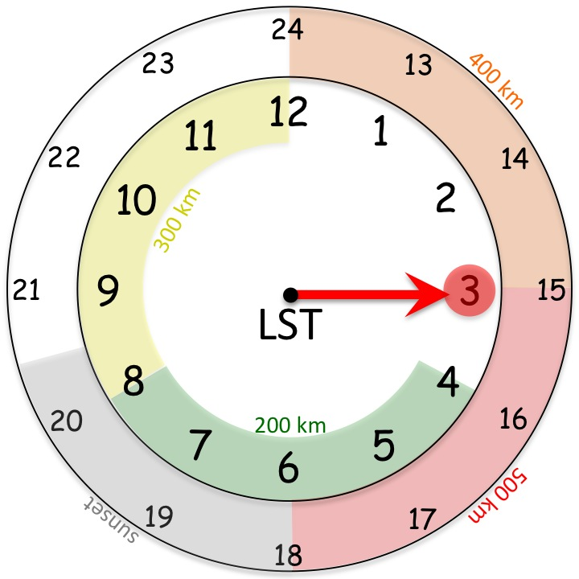
15 Sep 2014
0700 UTC

Slide 4
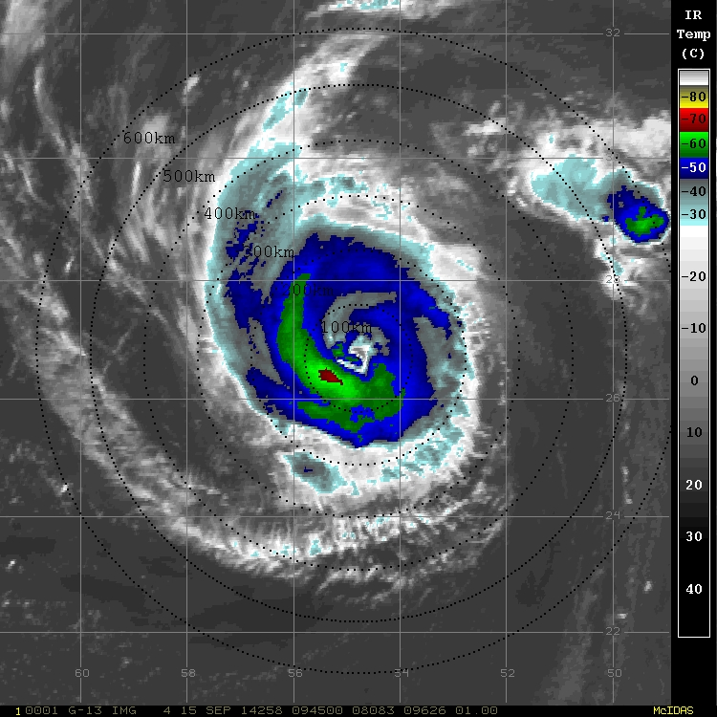
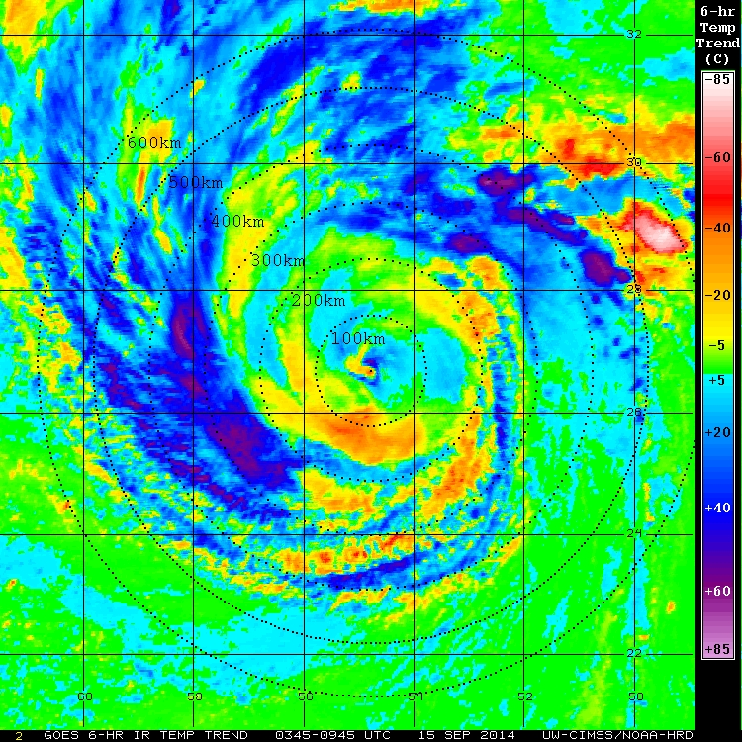
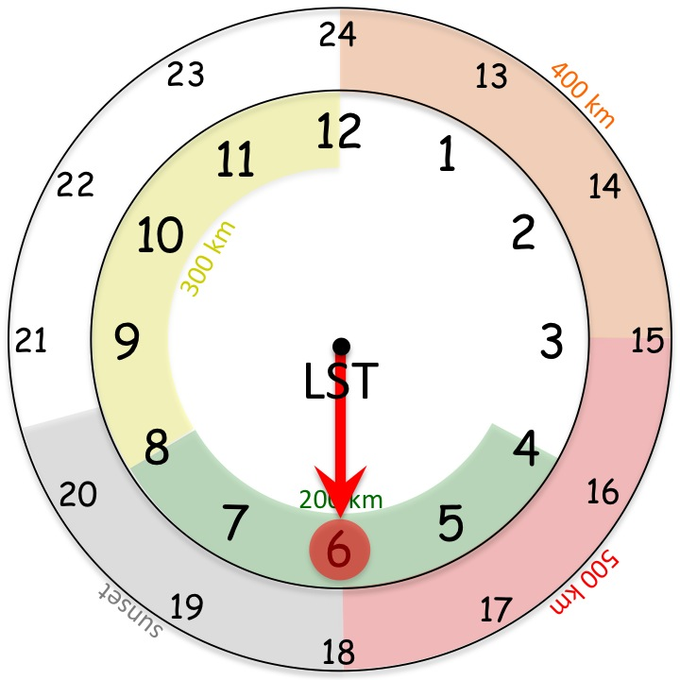
15 Sep 2014
1000 UTC

Slide 5
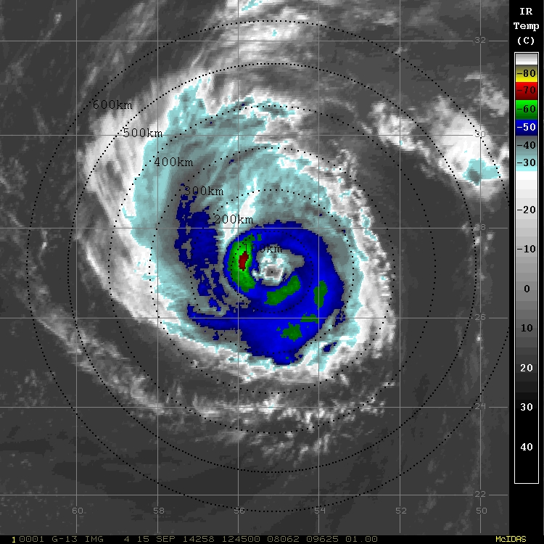
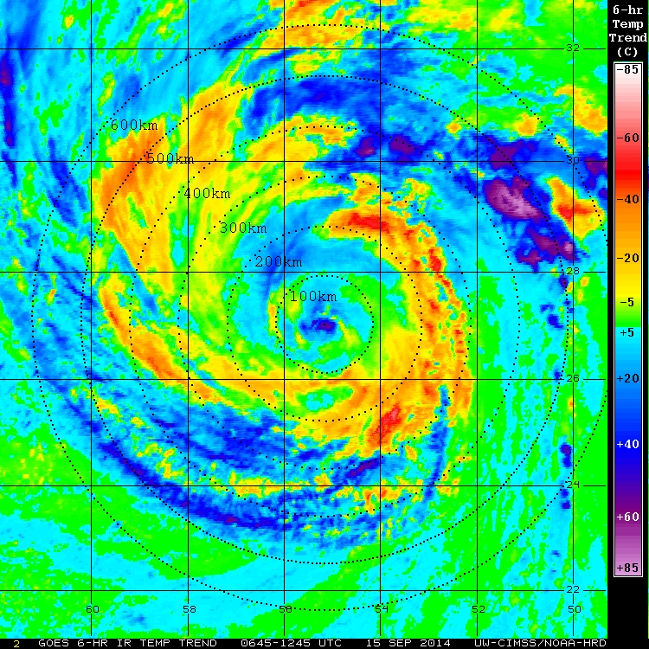
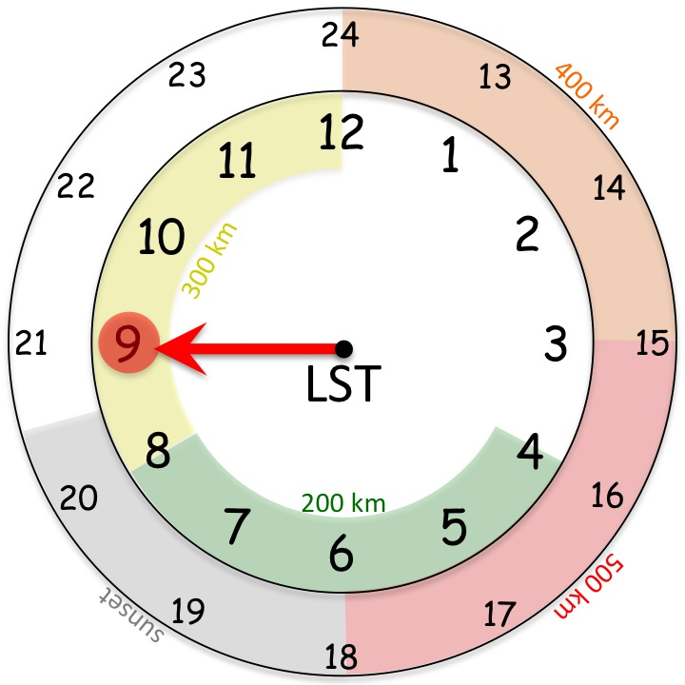
15 Sep 2014
1300 UTC

Slide 6
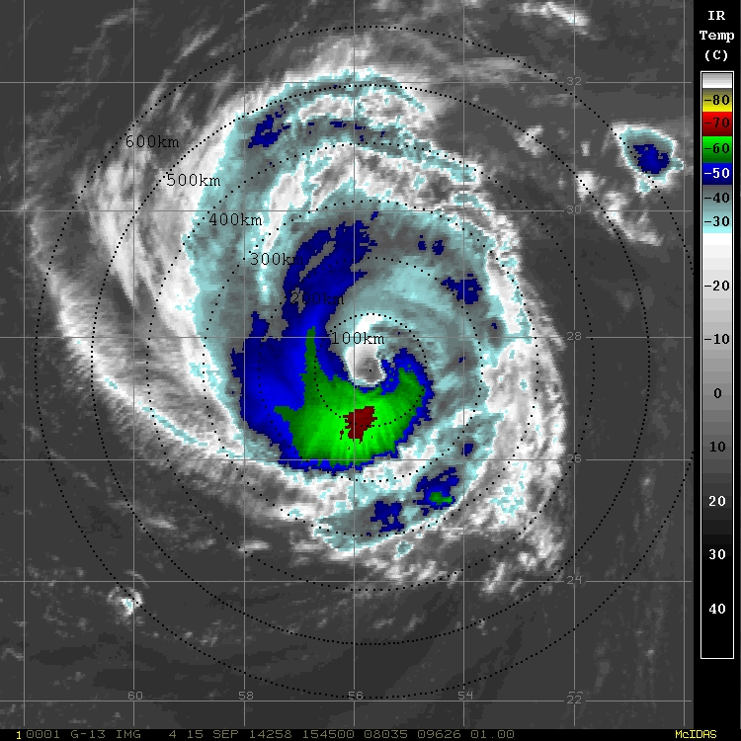
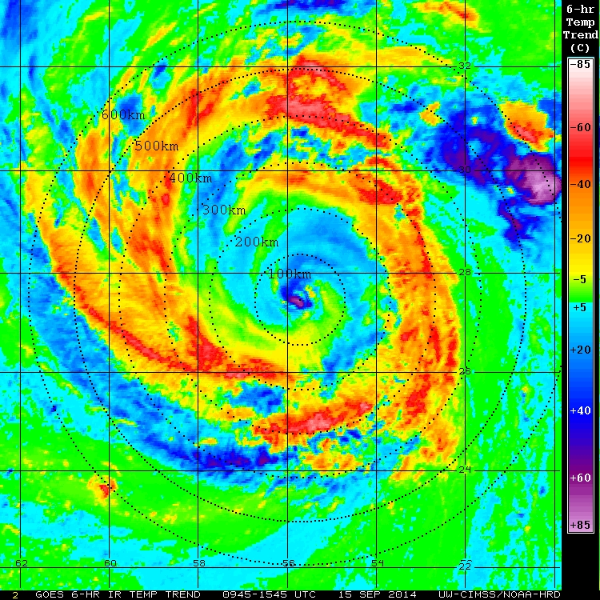
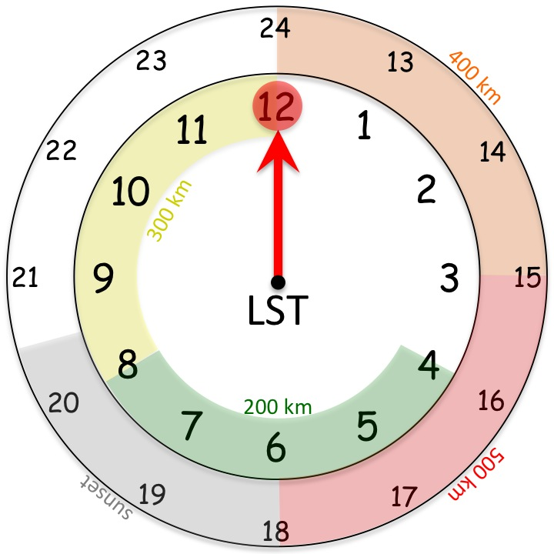
15 Sep 2014
1600 UTC

Slide 7
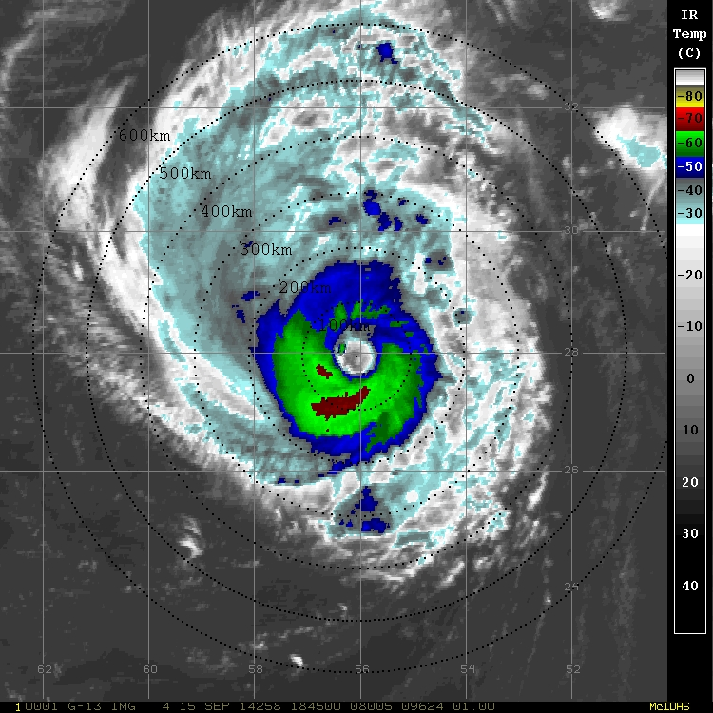
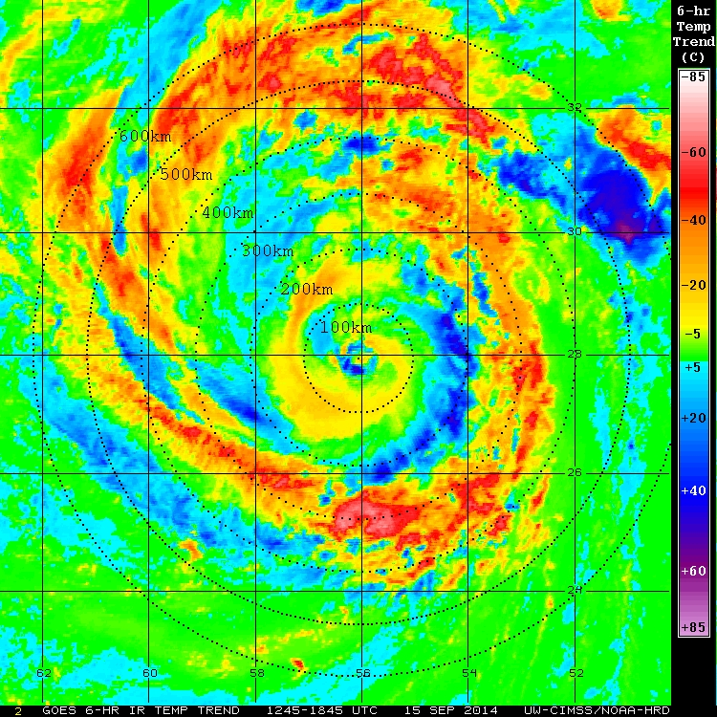
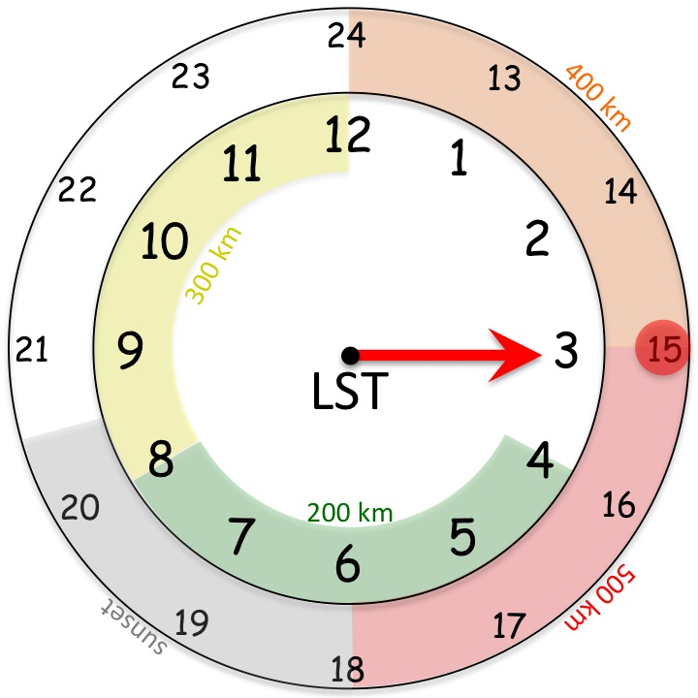
15 Sep 2014
1900 UTC

Slide 8
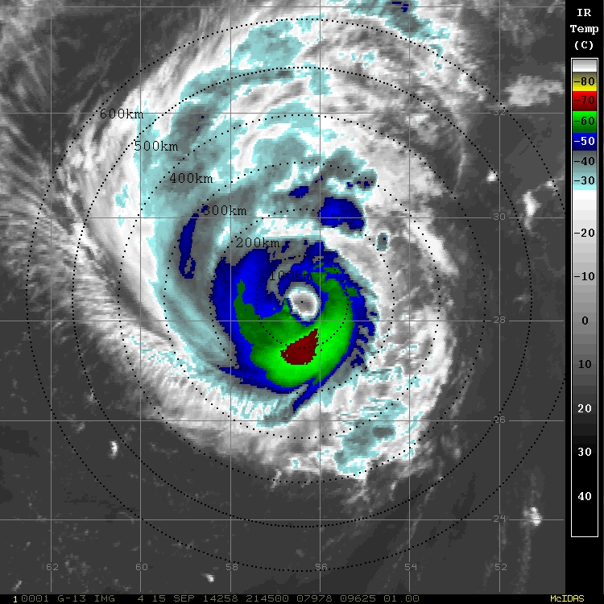
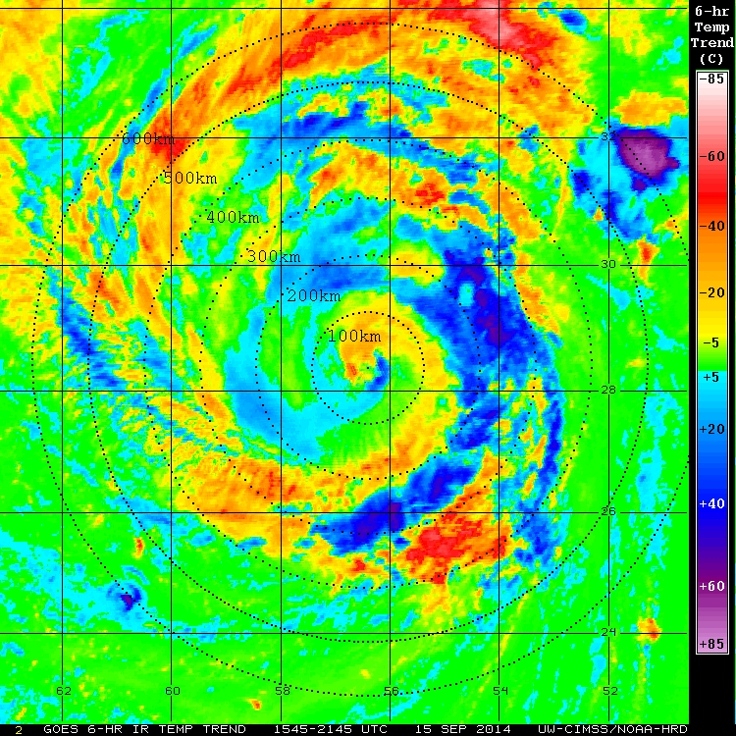
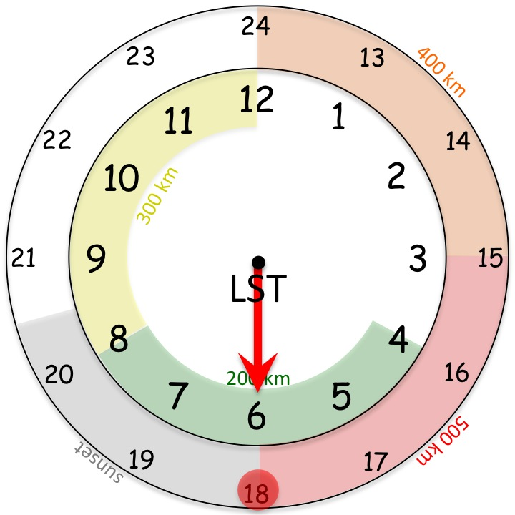
15 Sep 2014
2200 UTC

Slide 10
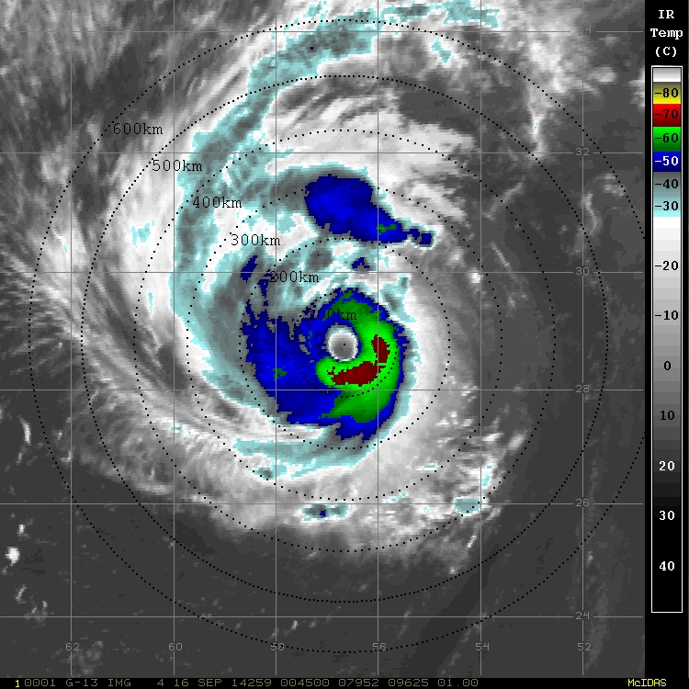
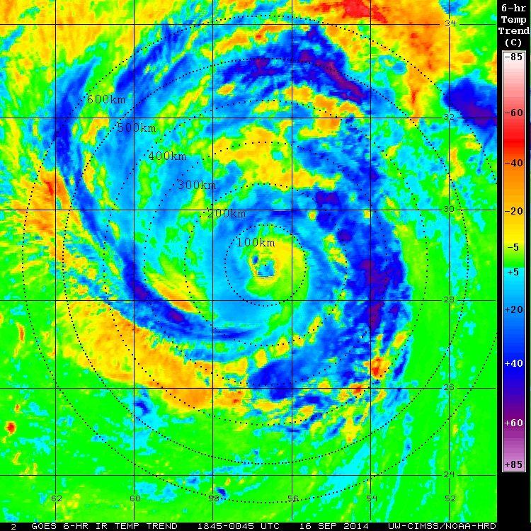
16 Sep 2014
0100 UTC

Slide 11
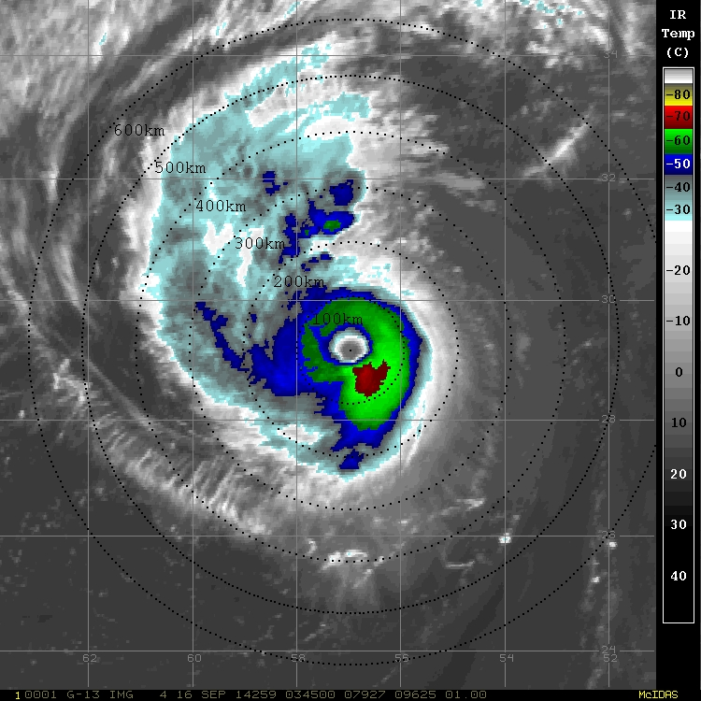
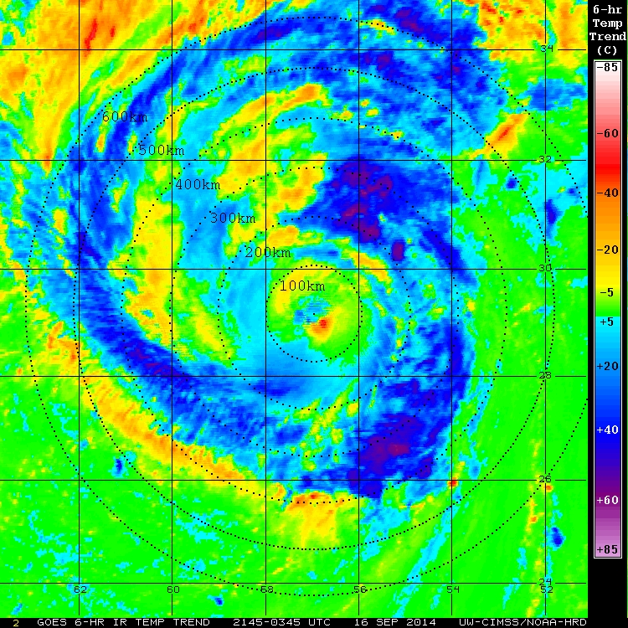
16 Sep 2014
0400 UTC

Slide 12
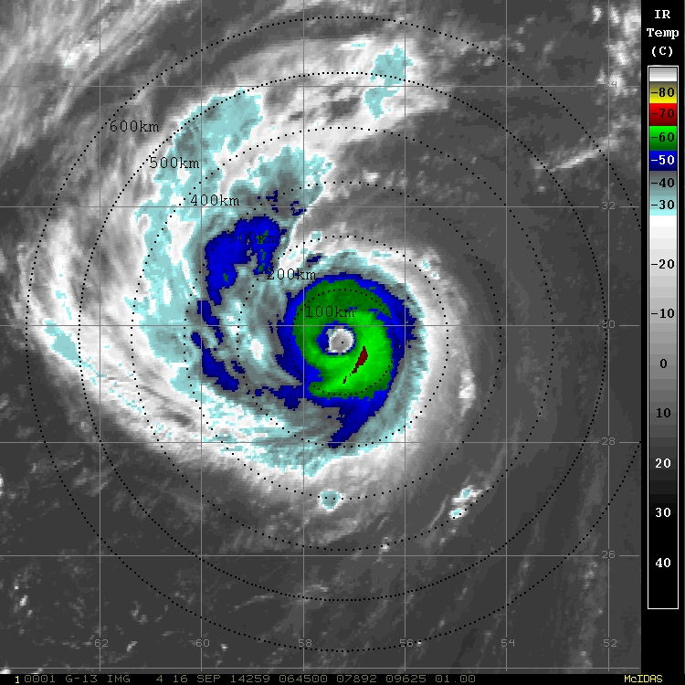
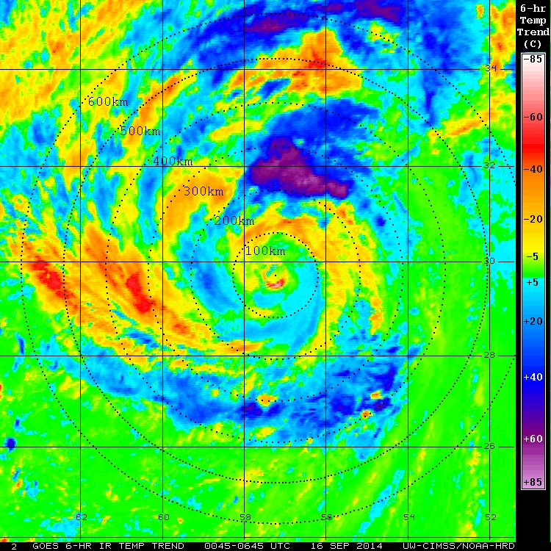
16 Sep 2014
0700 UTC

Slide 13
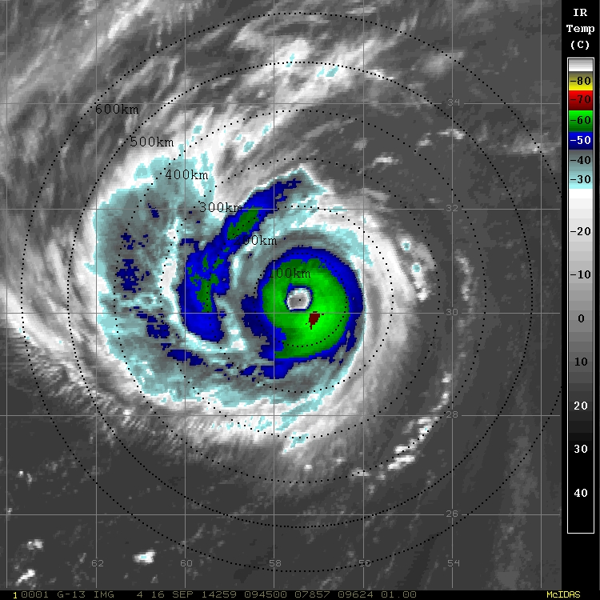
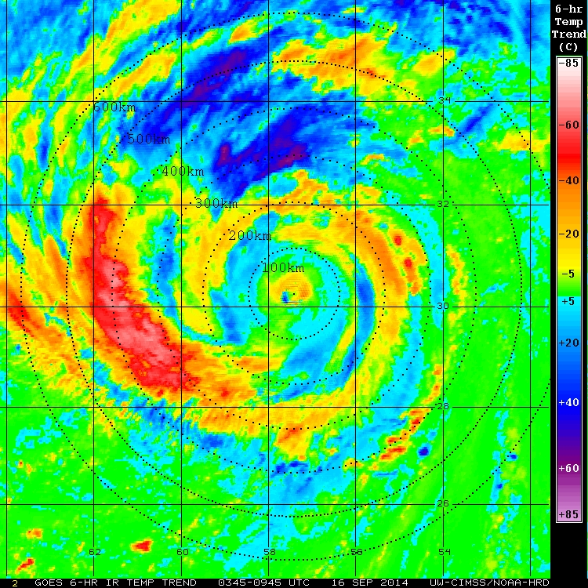
16 Sep 2014
1000 UTC

Slide 14
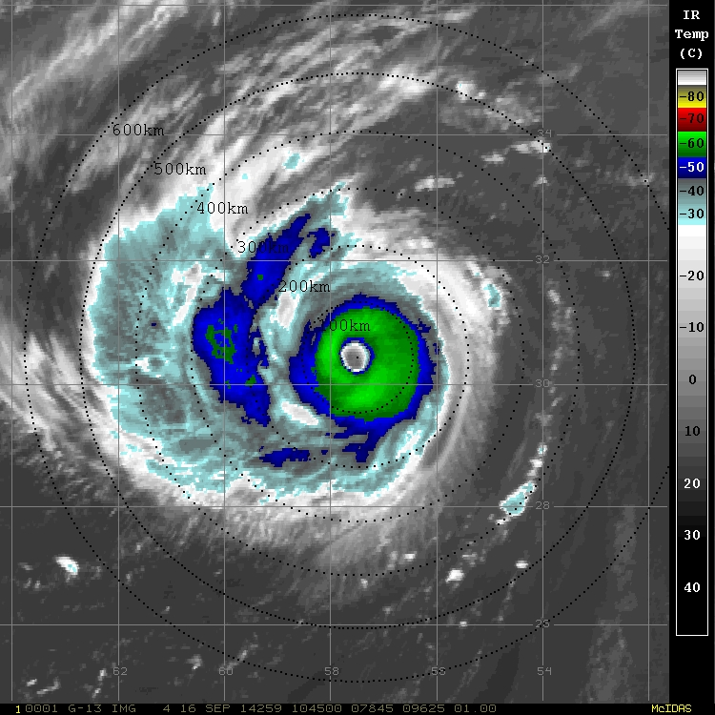
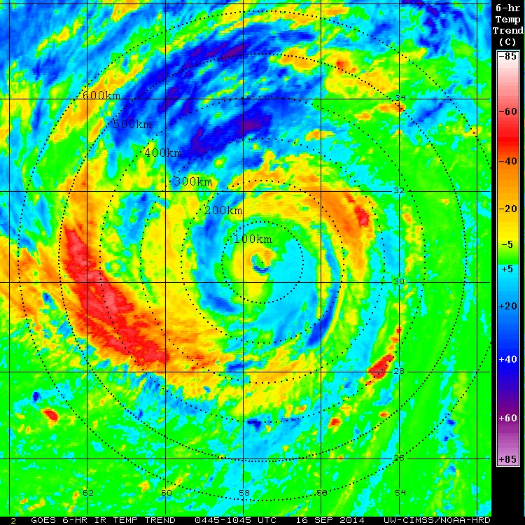
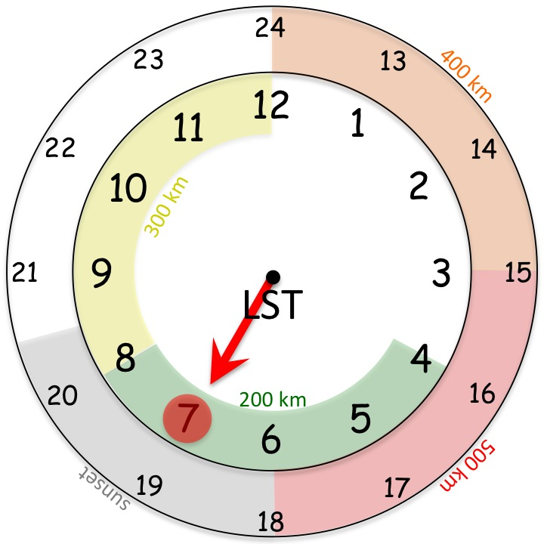
16 Sep 2014
1100 UTC

Slide 15
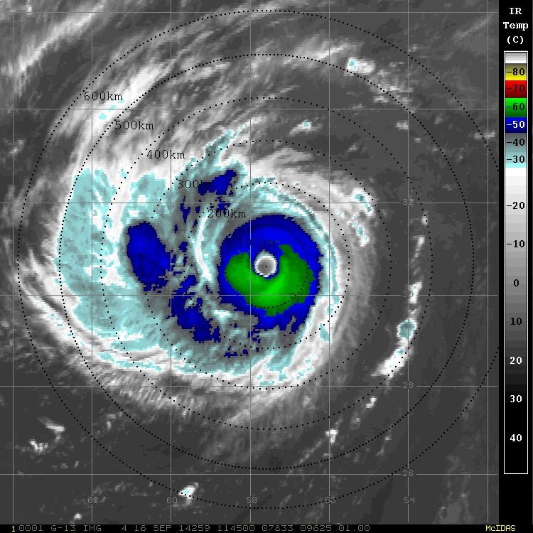
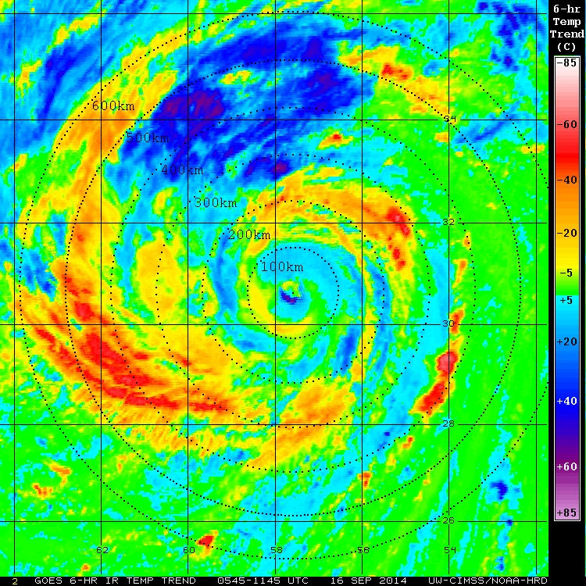
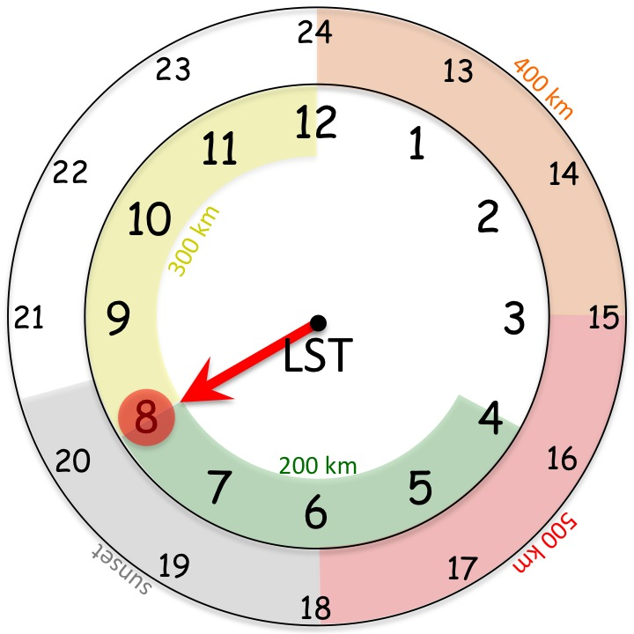
16 Sep 2014
1200 UTC

Slide 16
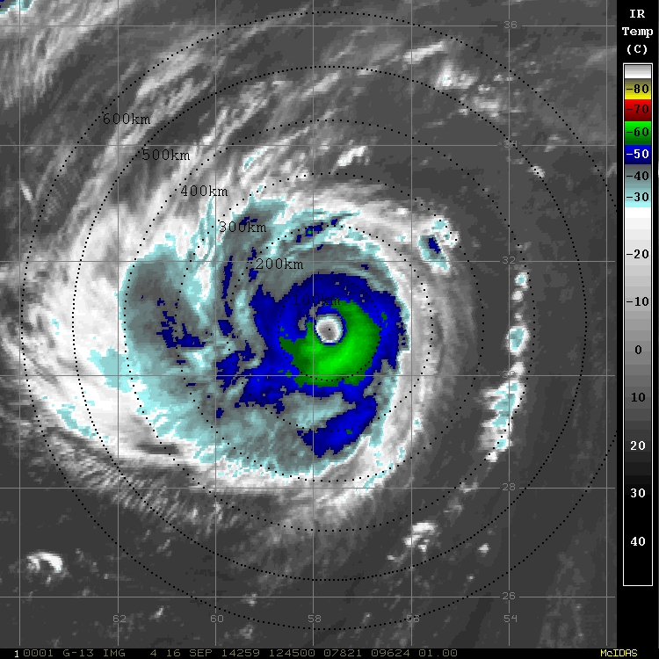
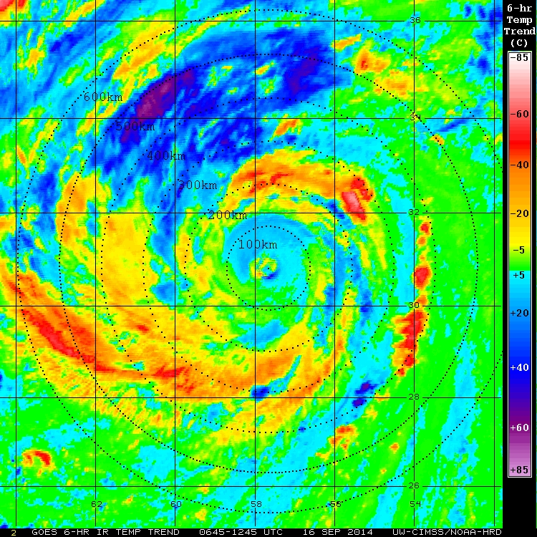
16 Sep 2014
1300 UTC

Slide 17
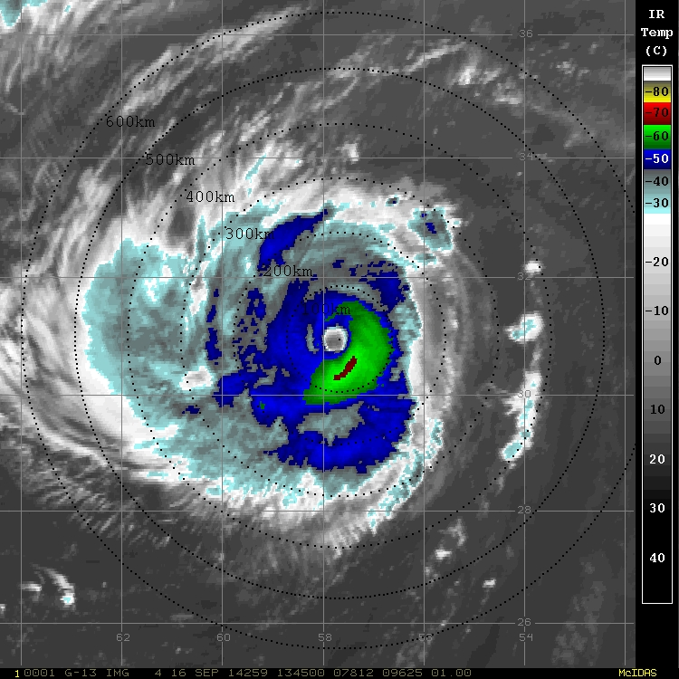
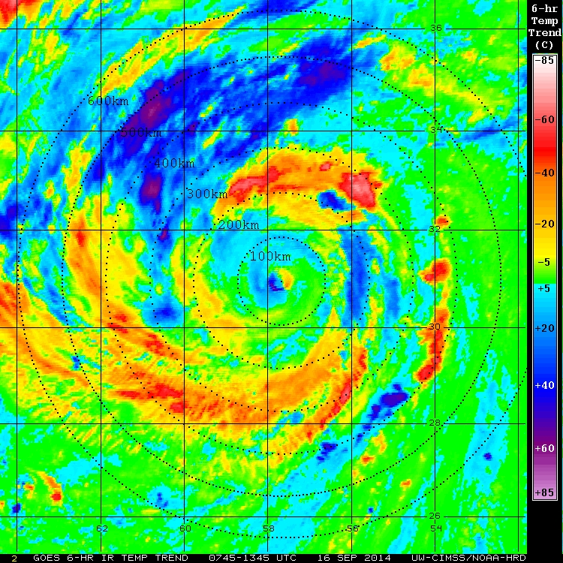
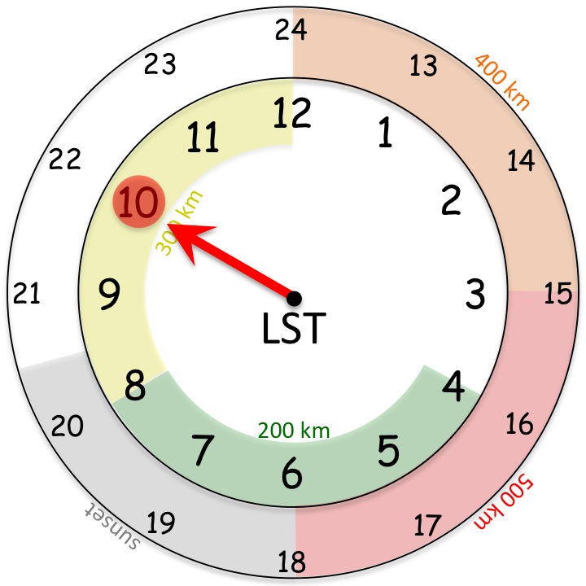
16 Sep 2014
1400 UTC

Slide 18
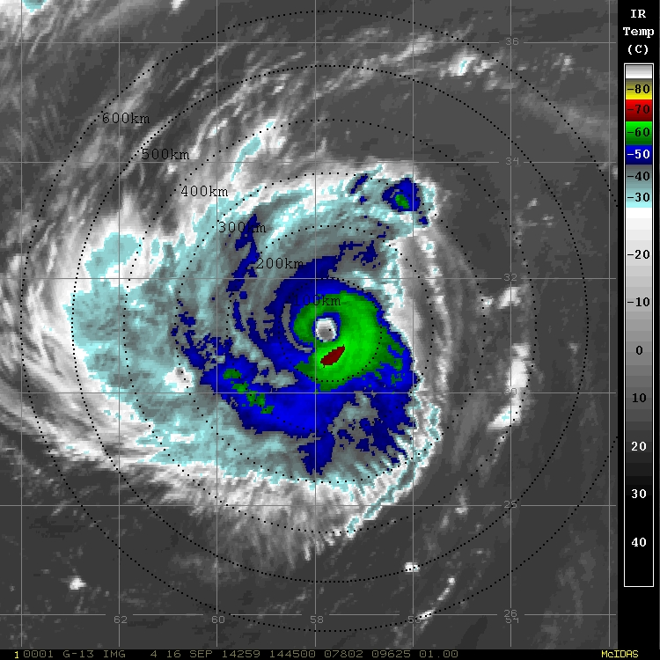
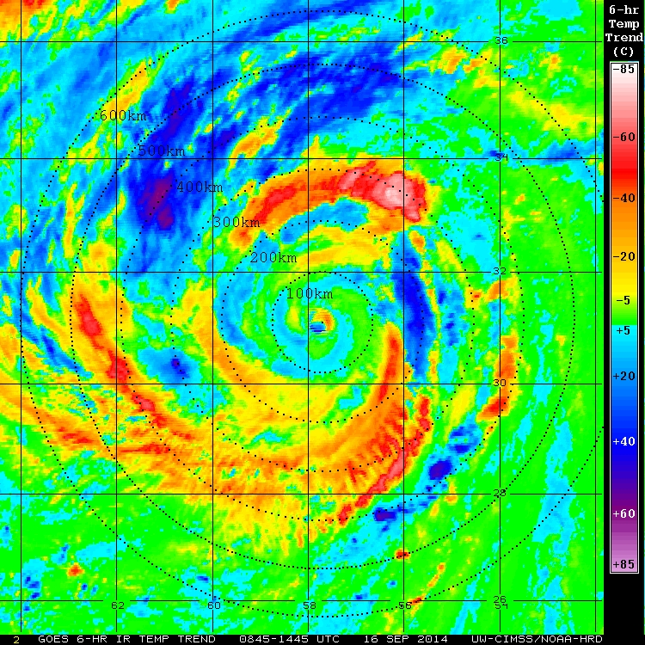
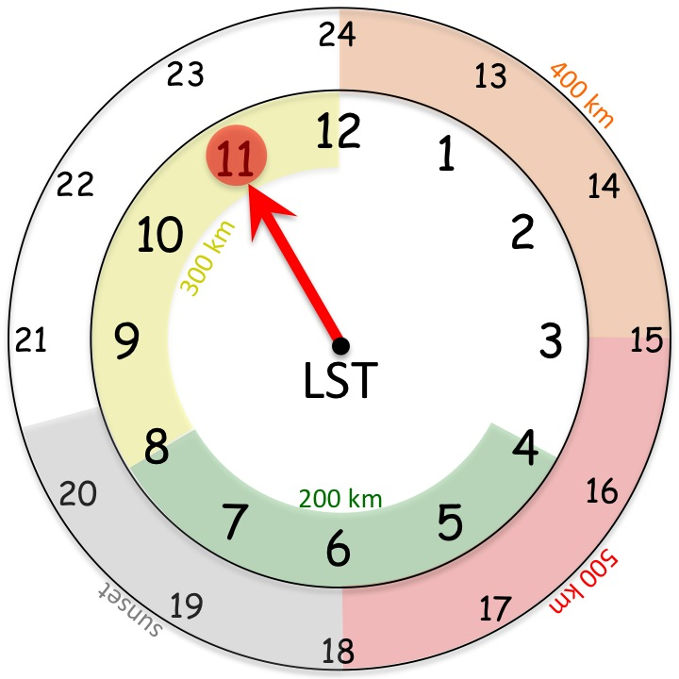
16 Sep 2014
1500 UTC

Slide 19
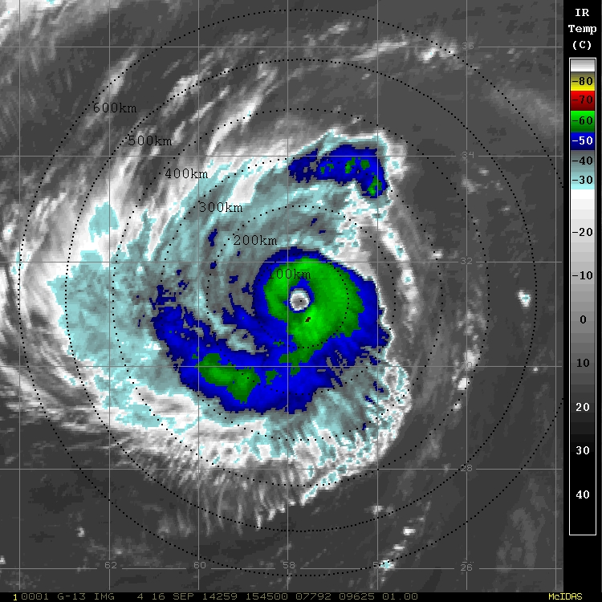
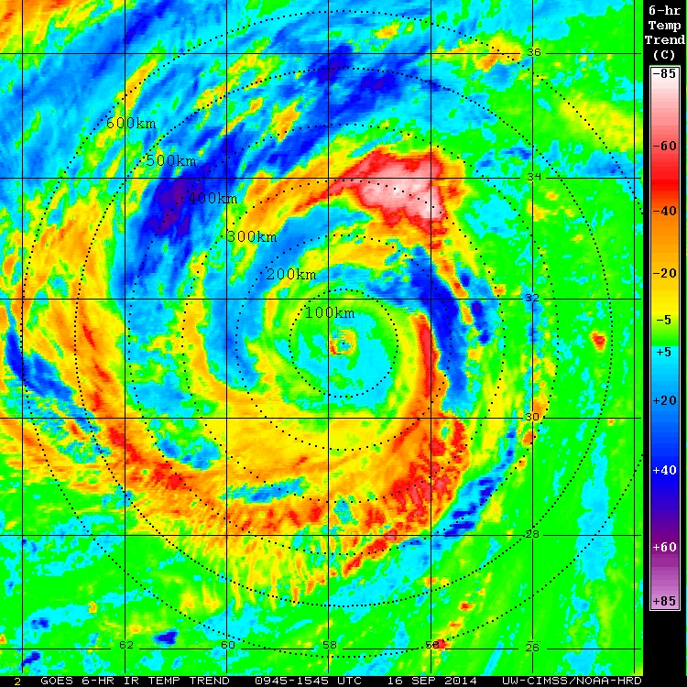
16 Sep 2014
1600 UTC

Slide 20
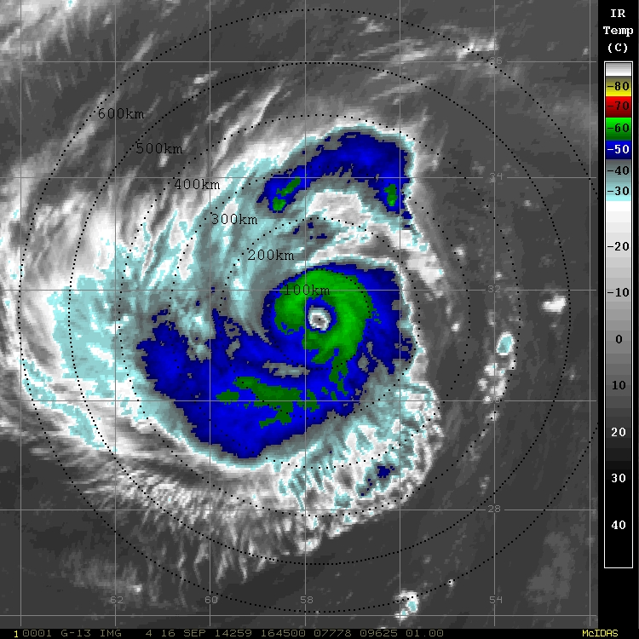
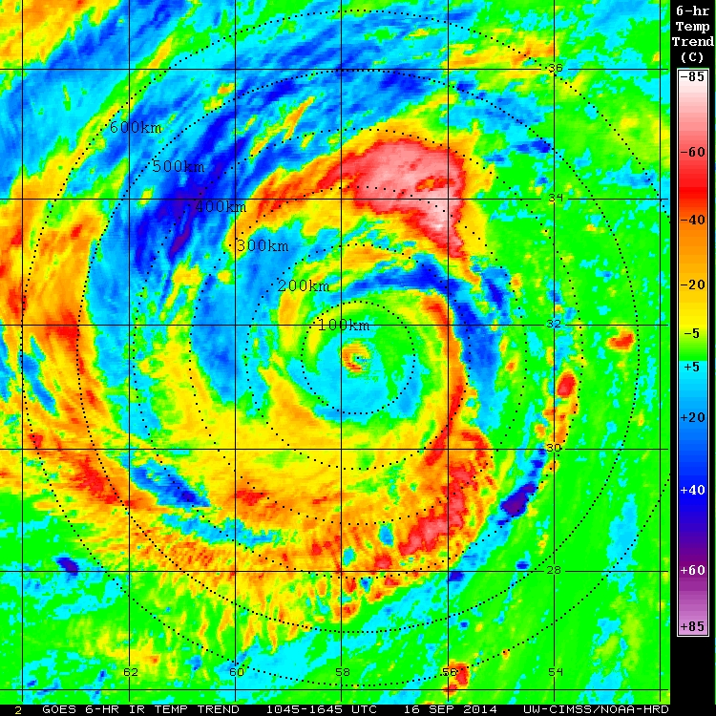
16 Sep 2014
1700 UTC

Slide 21
16 Sep 2014
1800 UTC

Slide 22
16 Sep 2014
1900 UTC

Slide 23
16 Sep 2014
2000 UTC

Slide 24
16 Sep 2014
2100 UTC

Slide 25
16 Sep 2014
2200 UTC

Slide 27
17 Sep 2014
0100 UTC

Slide 28
17 Sep 2014
0200 UTC

Slide 29
17 Sep 2014
0300 UTC

Slide 30
17 Sep 2014
0400 UTC

Slide 31
17 Sep 2014
0500 UTC

Slide 32
17 Sep 2014
0600 UTC

Slide 33
17 Sep 2014
0700 UTC

Slide 34
17 Sep 2014
0800 UTC

Slide 35
17 Sep 2014
0900 UTC

Slide 36
17 Sep 2014
1000 UTC

Slide 37
17 Sep 2014
1100 UTC

Slide 38
17 Sep 2014
1200 UTC

Slide 39
17 Sep 2014
1300 UTC

Slide 40
17 Sep 2014
1400 UTC

Slide 41
17 Sep 2014
1500 UTC

Slide 42
17 Sep 2014
1600 UTC

Slide 43
17 Sep 2014
1700 UTC

Slide 44
17 Sep 2014
1800 UTC

Slide 45
17 Sep 2014
1900 UTC

Slide 46
17 Sep 2014
2000 UTC

Slide 47
17 Sep 2014
2100 UTC

Slide 48
17 Sep 2014
2200 UTC

