Slide 1


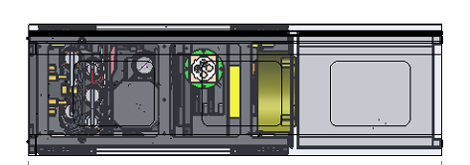
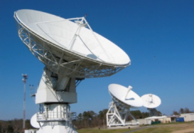

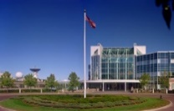
TROPICS Mission Implementation
RF Link
Science Community
Terrestrial Link
TROPICS Science Team
Coverage Swath
= NEN Sites & Coverage
NASA Distributed Active Archive Center
= MOC @ Bus Vendor Site (TBD)
= SOC @ MIT LL
= DPC @ University of Wisconsin
Space Vehicle
Ground
Data Processing Center (U. Wisconsin)
BUS
(Commercially Procured)
Payload
(MIT LL)
Ground Network
(NEN Baseline)
Mission
Operations
(Bus Vendor Baseline)
Science and Payload Operations Center (MIT LL)
NEN = NASA Near-Earth Network
MOC = Mission Operations Center
SOC = Science Operations Center
DPC = Data Processing Center

Slide 2
TROPICS Latency is Dominated by the Ground Station Network
RF Link
TROPICS is a research mission, and optimization of data latency is therefore done on as “best effort”
TROPICS will rely on two ground stations (occasionally three or four) to downlink science mission data
This results in about 6-hr average latency to the user community
Terrestrial Link
Coverage Swath
= NEN Sites & Coverage
= MOC @ Bus Vendor Site (TBD)
= SOC @ MIT LL
= DPC @ University of Wisconsin
Ground
Ground Network
(NEN Baseline)
NEN = NASA Near-Earth Network
MOC = Mission Operations Center
SOC = Science Operations Center
DPC = Data Processing Center

Slide 3
Other Ground Elements Add Some Latency, But Are Not Drivers
Science Community
TROPICS will use a proven model for data networking and processing
It is highly desirable to maintain a single distribution point for simplicity
TROPICS Science Team
NASA Distributed Active Archive Center
Ground
Data Processing Center (U. Wisconsin)
Mission
Operations
(Bus Vendor Baseline)
Science and Payload Operations Center (MIT LL)
NEN = NASA Near-Earth Network
MOC = Mission Operations Center
SOC = Science Operations Center
DPC = Data Processing Center

Slide 4
Complicating Factors
(For TROPICS)
Heterogeneous addition of ground stations is usually not a good solution, because of the overhead involved in folding these into the network and mission operations
“Second-order” effects are not negligible
  On the spacecraft side, there are usually implications on power, thermal, radio reliability, ground and mission ops interactions, etc.
  Conservative designs help here, and we are trying to do this where feasible/practical

Slide 5
Thoughts and Possible
Discussion Points
What is the right mix of NASA/government ground assets and those from a rapidly emerging commercial base (KSAT, Spaceflight Networks, Atlas, Globalstar, Iridium NEXT, etc.)?
How might we facilitate the sharing and homogenization of key government ground assets (NEN, NOAA ground stations, DoD ground stations, etc.)?
How can we leverage “university class” capabilities (MC3, Morehead State, etc.)
How do we think about scalability of the various assets given a potential move toward constellations?
Are there enabling technologies to consider (“Big LEO comm”, laser comm, etc.)?

