Slide 1
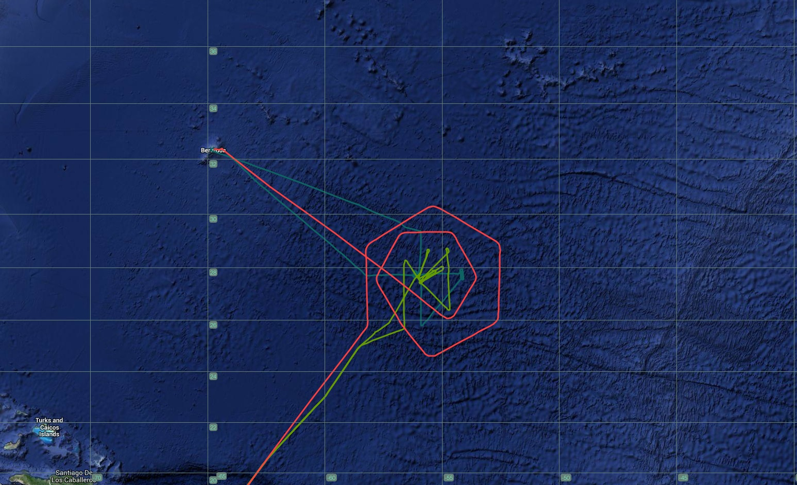
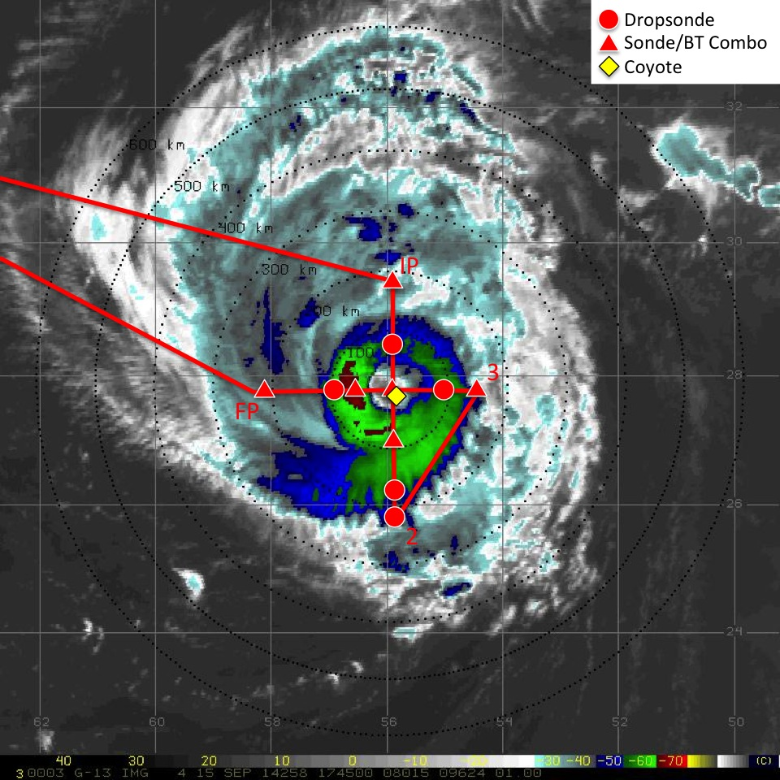
20140815H1
Hurricane Edouard
Model Evaluation Experiment
NOAA-42
NOAA-43
NOAA-49
Take-off 1408 UTC (Bermuda); Landing 2054 UTC (Bermuda)
14 GPS dropsondes; 8 AXBTs
Coyote (#1) launched during final E-W pass through eye
1 Radar Analysis (E-W final pass)

Slide 2
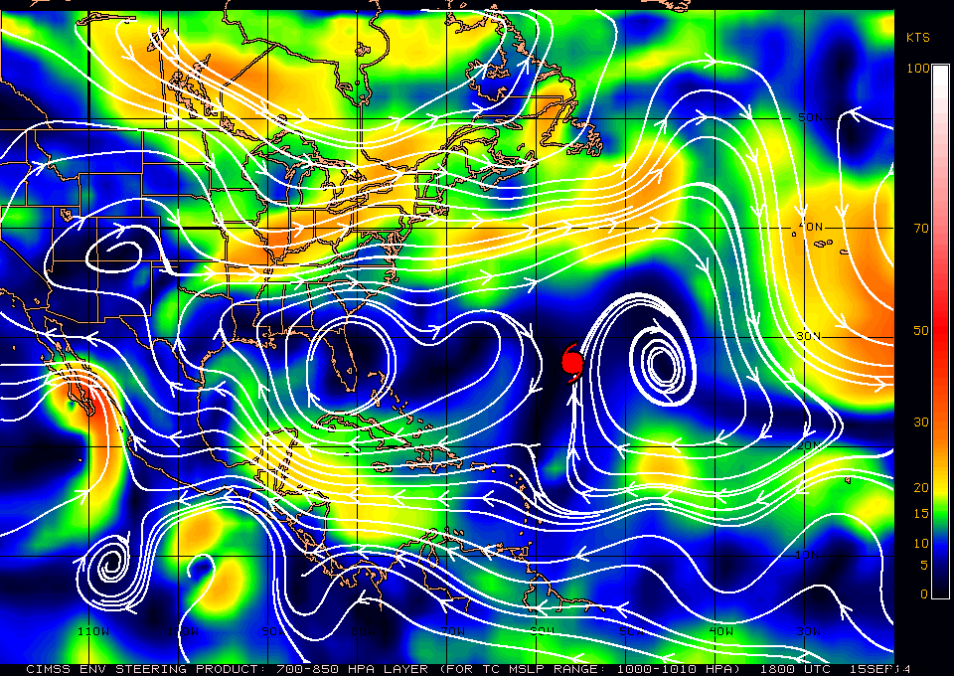
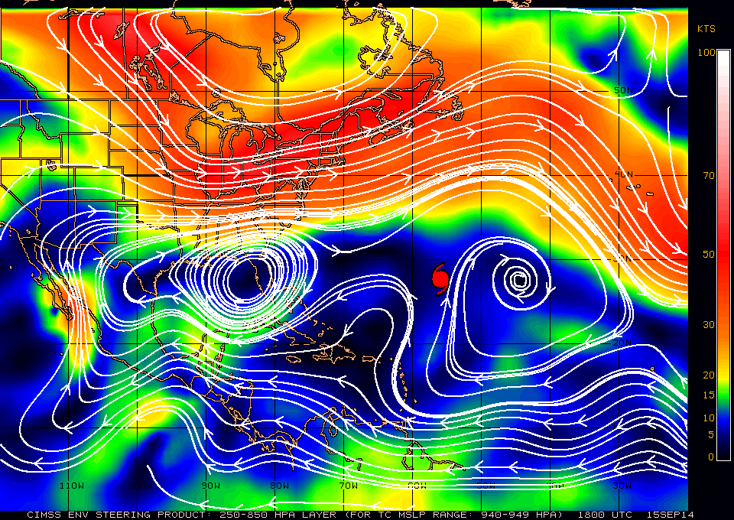
Hurricane Edouard: 15 Sept 2014:
CIMSS Deep Layer Mean Steering

Slide 3
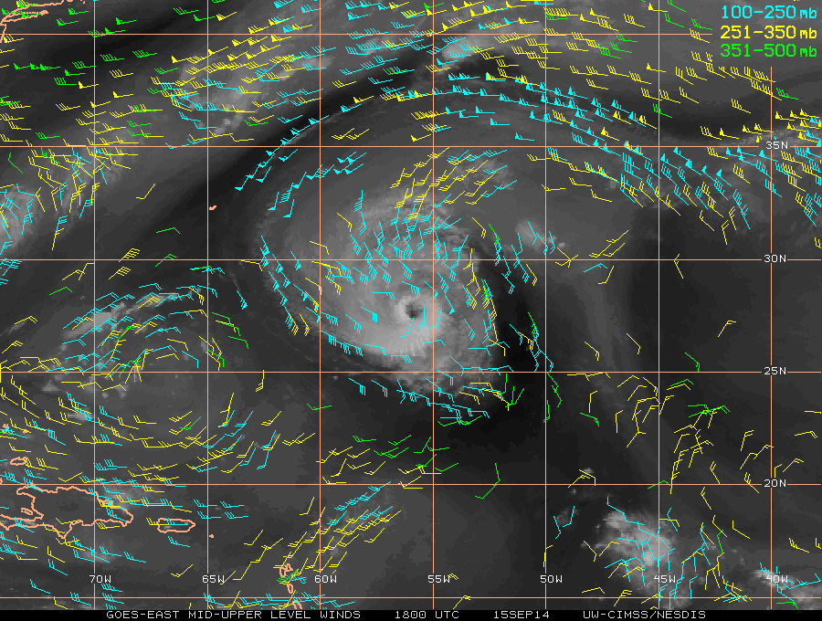
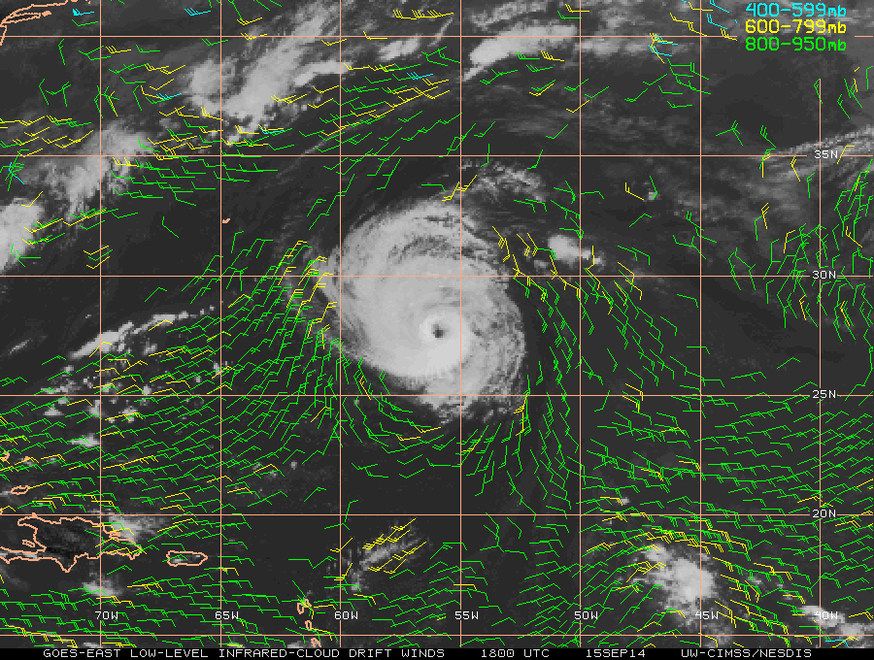
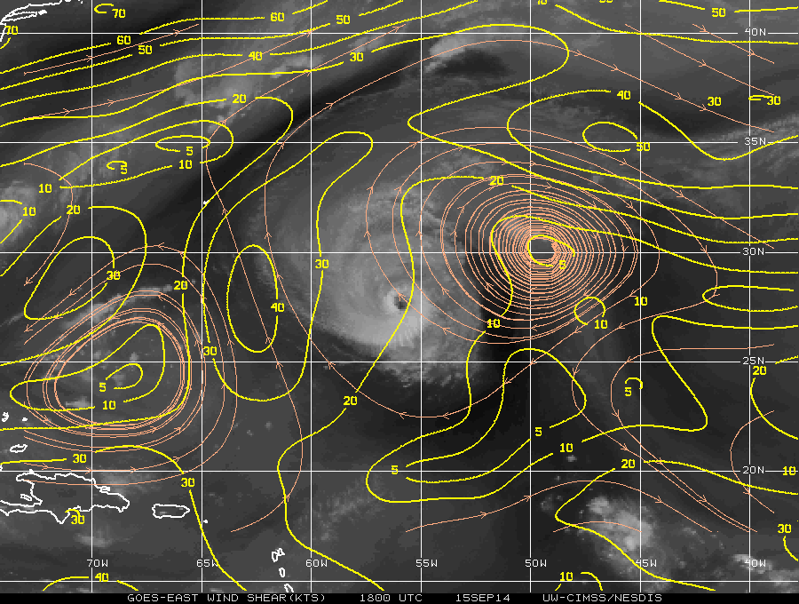
Hurricane Edouard: 15 Sept 2014:
CIMSS AMVs and Vertical Shear

Slide 4
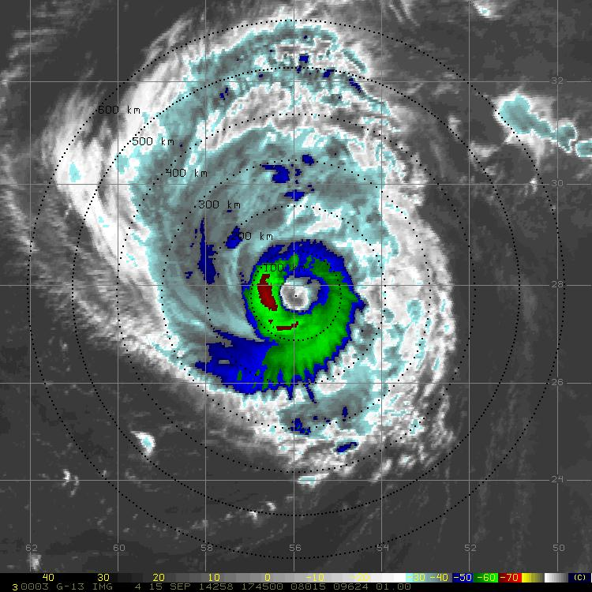
Hurricane Edouard: 15 Sept 2014:
Radar Cross-Section

Slide 5
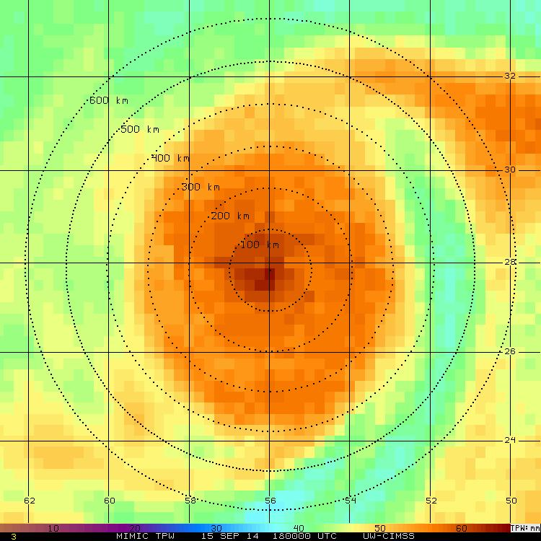
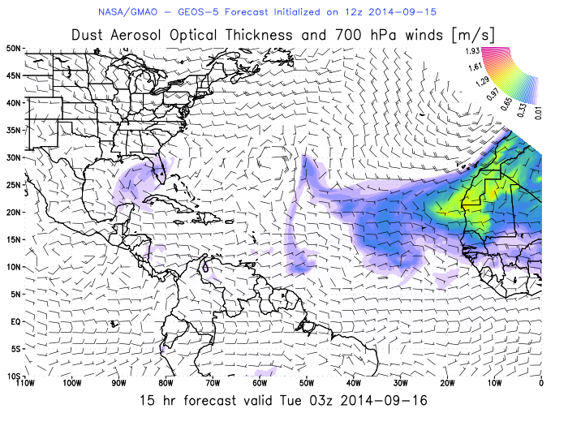
Hurricane Edouard: 15 Sept 2014
GOES Infrared
CIMSS MIMIC TPW
X

Slide 6
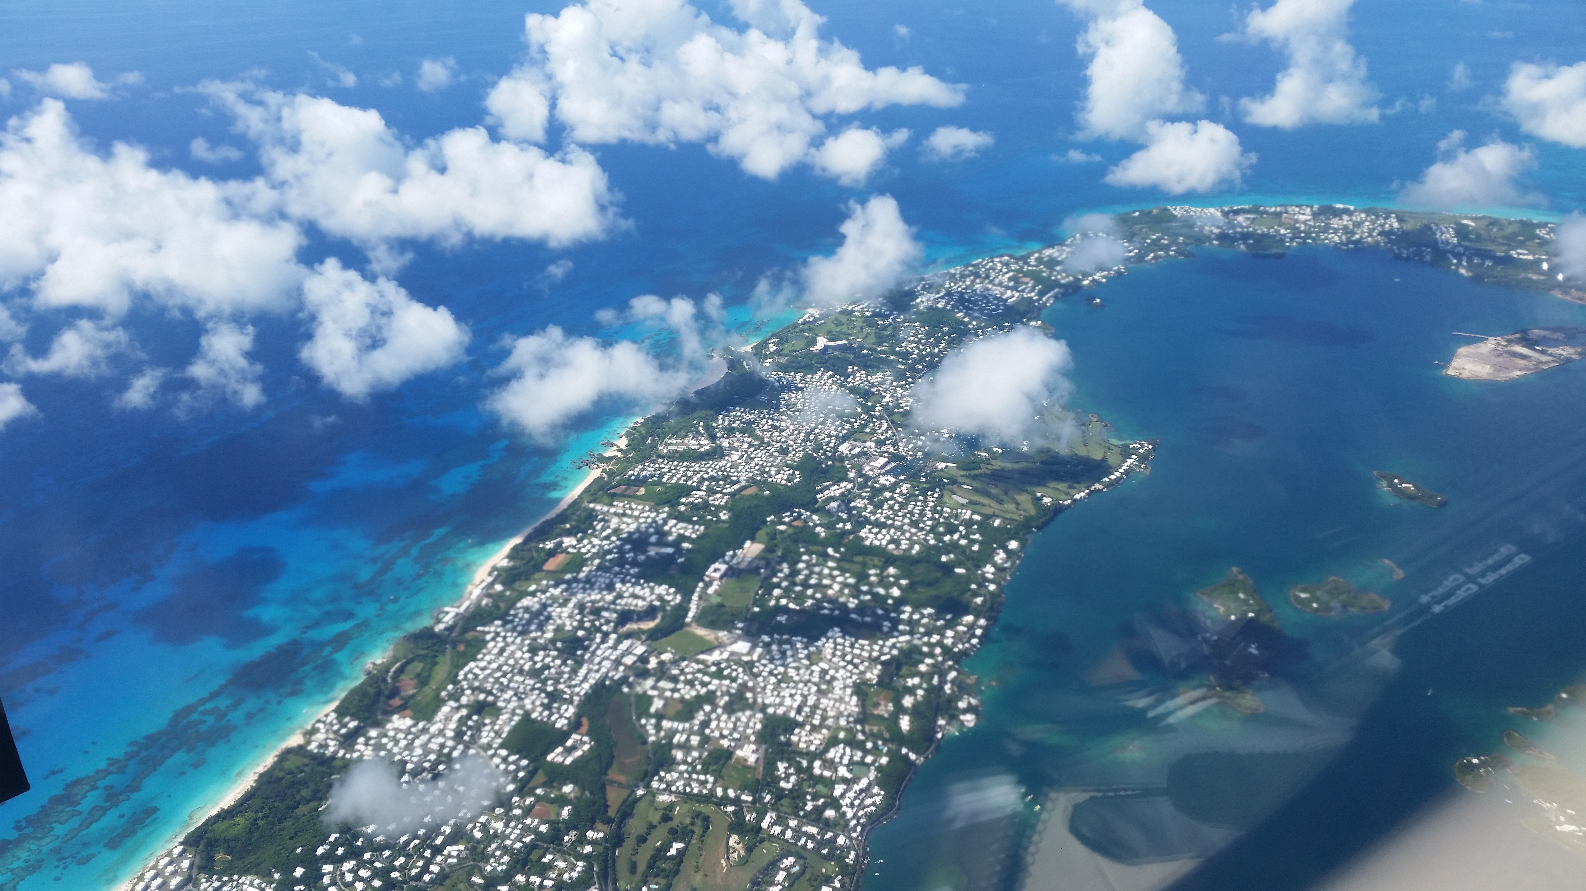
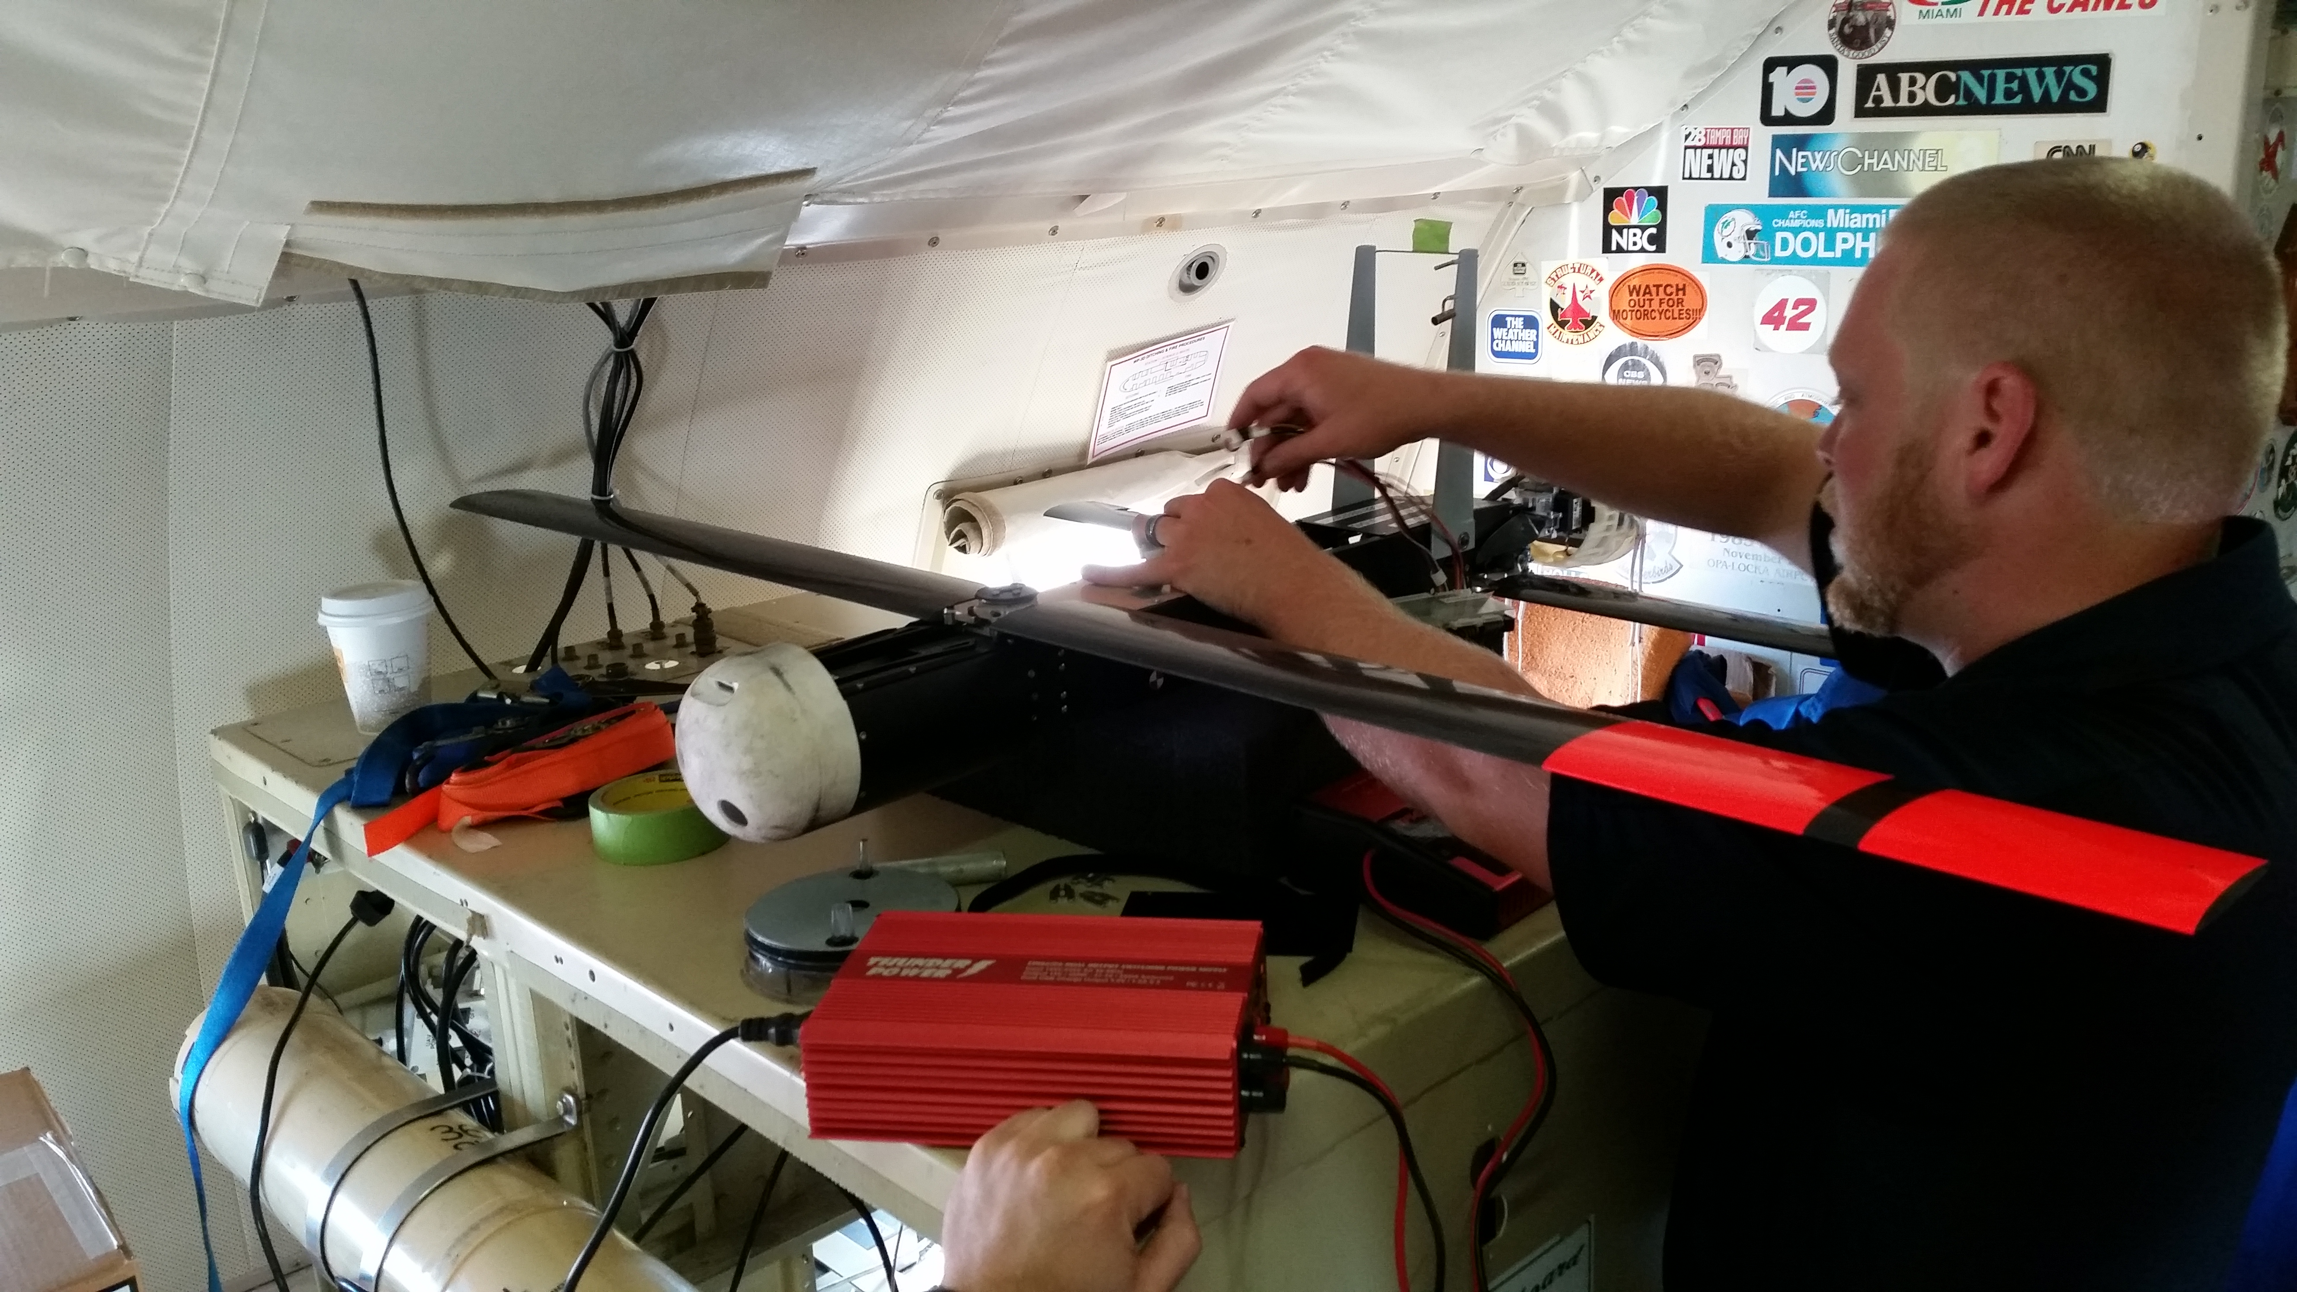
Summary
Coordination with NOAA-43 was poor
-NOAA-43 was delayed inbound E-W for Coyote eye launch
Radar software hung up during the 1st pass and was not transmitted in real-time
-John G. is troubleshooting
Coyote (#1) lost comms and never recovered

