Slide 1
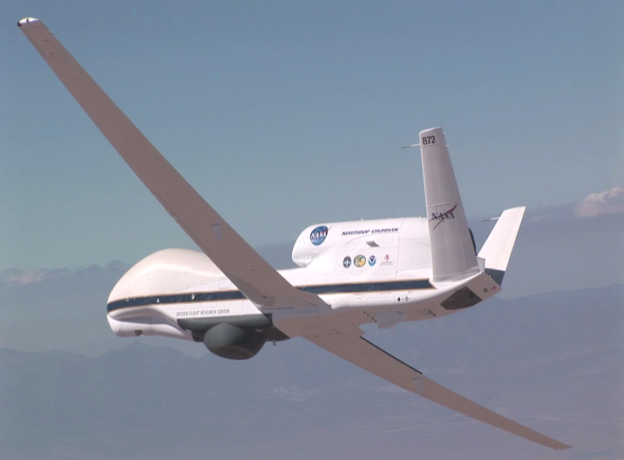
Tropical Cyclone Research Utilizing the
Global Hawk Unmanned Aircraft
Jason P. Dunion¹, Robbie Hood², Michael Black³, Gary Wick⁴
1 University of Miami – NOAA/AOML/HRD – University at Albany/SUNY
2 NOAA UAS Program
3 NOAA/AOML/HRD
4 NOAA/ESRL

Slide 2
Discussion
1) Global Hawk Capabilities
2) 2010: NASA The Genesis and Rapid Intensification Processes (GRIP)
3) 2012-2014: NASA Hurricane and Severe Storm Sentinel (HS3)
4) 2015: NOAA Sensing Hazards with Operational Unmanned Technology (SHOUT)

Slide 3
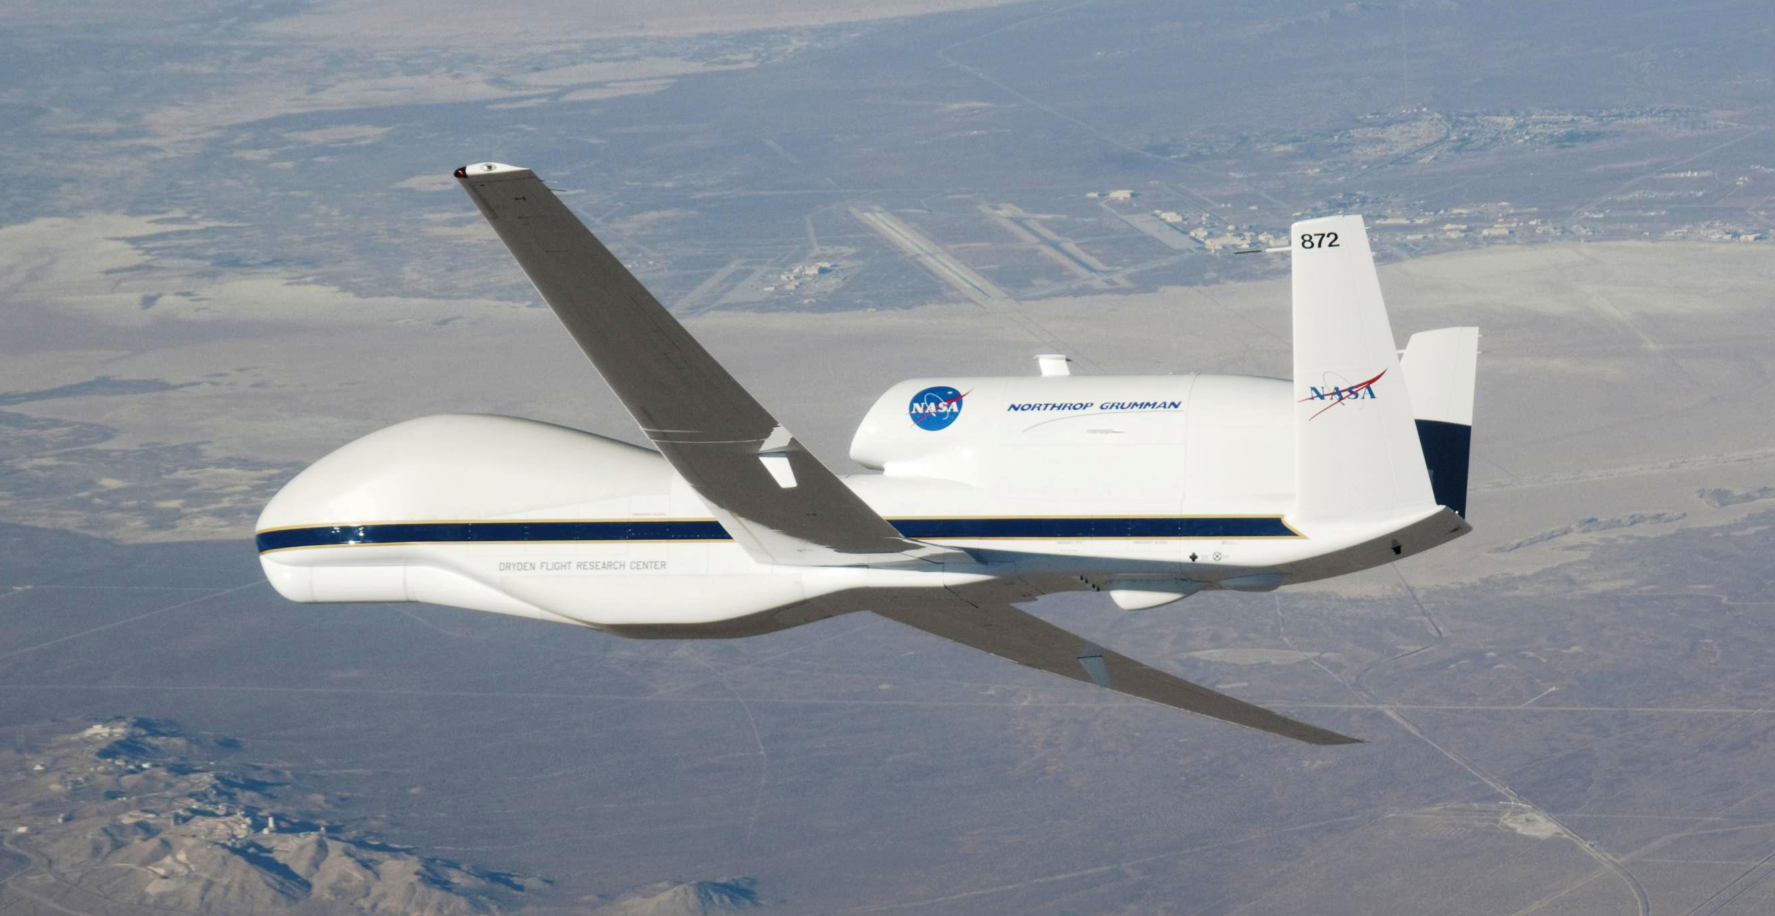
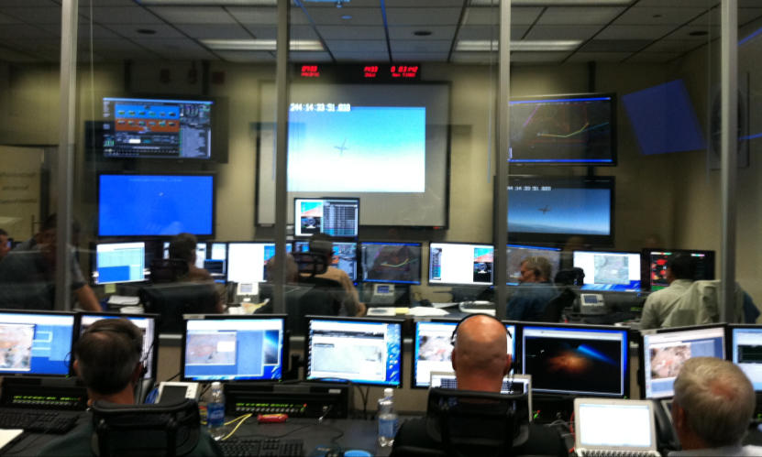
Global Hawk Capabilities
Flight Level: ~55-60,000 ft
Duration: ~24 hr
Range: 11,000 nm
Payload: 1,500+ lbs
Deployment Site: NASA Wallops Flight Facility (Wallops Island, VA)

Slide 4
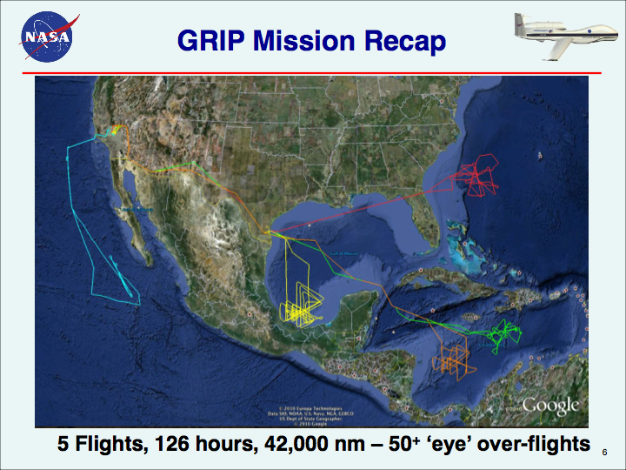
Hurricane Earl
Hurricane Karl
TD Frank
TS Mathew
Pre-Karl

Slide 5
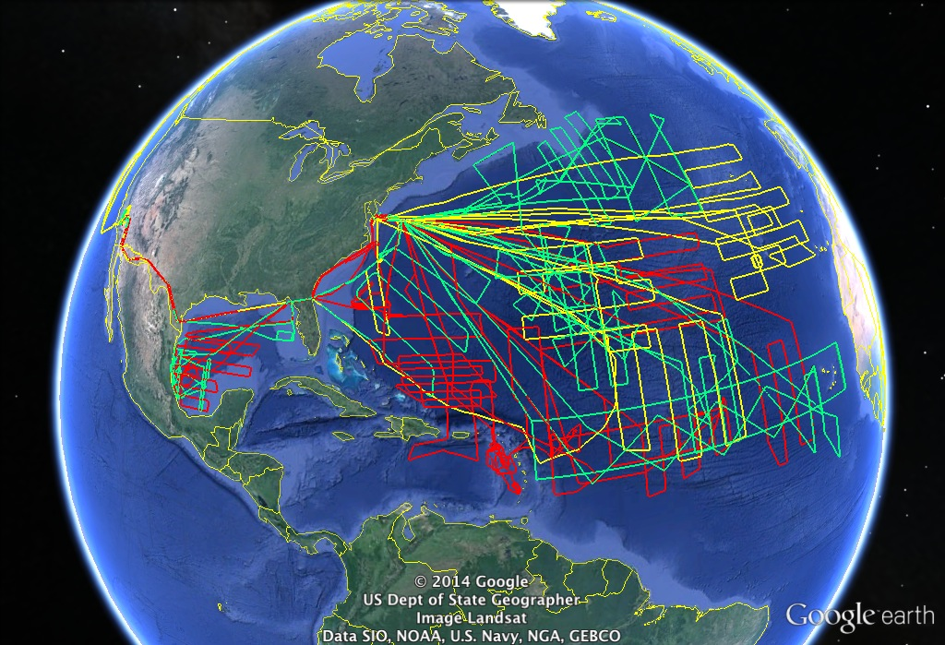
NASA Hurricane and Severe Storm Sentinel (HS3): 2012-2014
6 flights in 2012 into Leslie and Nadine
Range capabilities clearly demonstrated
337 soundings obtained
Data processed and transmitted in near-real time
Graphic courtesy NASA

Slide 6
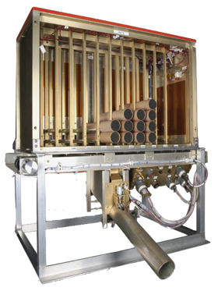
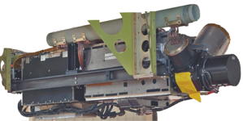
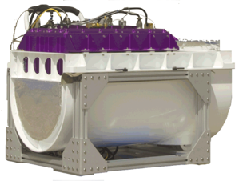
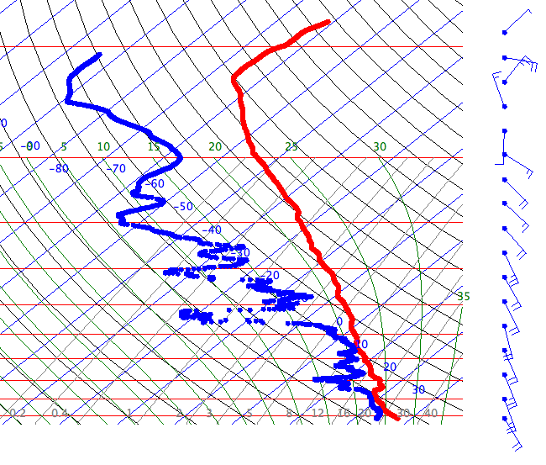
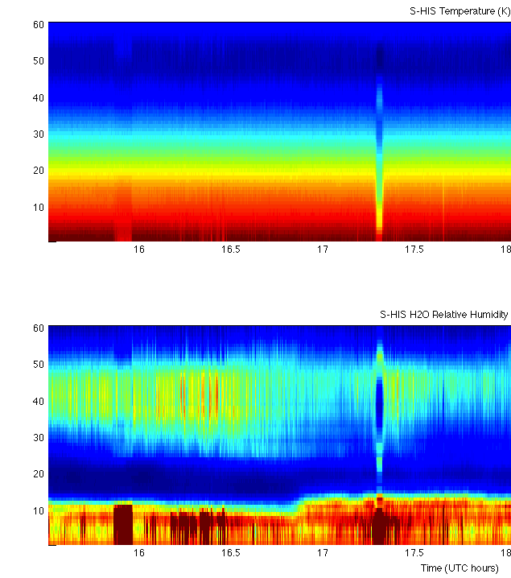
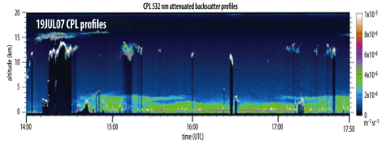
Instruments on the Environmental Global Hawk
Airborne Vertical Atmospheric Profiling System (AVAPS)
Scanning High Resolution Infrared Sounder (S-HIS)
Cloud Physics Lidar (CPL)
PI: Dr. Hank Revercomb
University of Wisconsin
Measurements: Upwelling thermal radiation at high spectral resolution between 3.3 and 18 microns, temperature, water vapor vertical profiles (2-km nadir res; 40 km ground swath);
PI: Dr. Matt McGill
NASA Goddard Space Flight Center
Measurements: Cloud and aerosol structure and depth (backscatter lidar: 1064, 532 ,and 355 nm; horizontal res: ~200 m; vertical res: 30 m)
PI: Dr. Gary Wick, NOAA, NCAR
Measurements: Temperature, Pressure, wind, humidity vertical profiles; 88 sondes per flight
~80-115 hPa
Temperature
_{T (K)}
_{Turn}
Relative Humidity
_{RH (%)}
Source: Scott Braun, NASA/GSFC

Slide 7
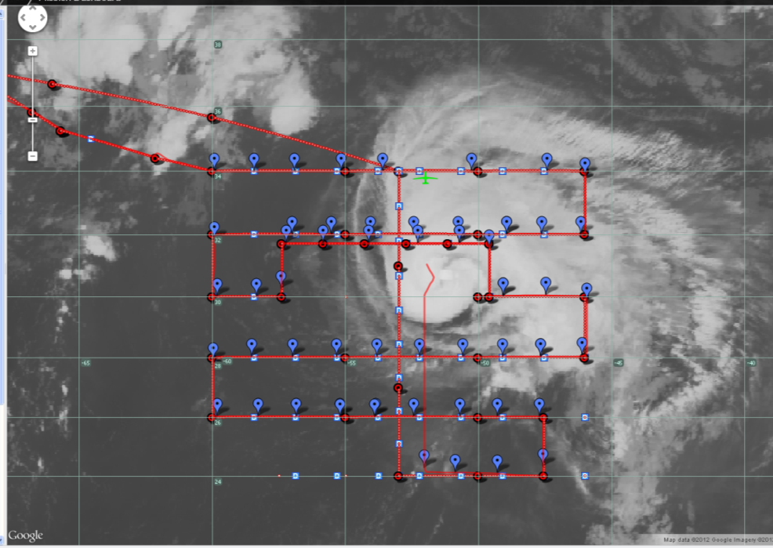
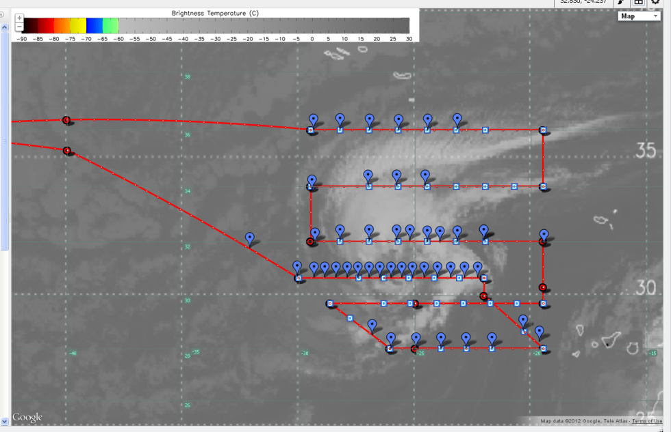
HS3 2012 Sample Results
5 science flights to date
Nadine flight 22-23 September 2012
Nadine flight and rapid launch sequence 14 September 2012
BASED ON THE IMPROVED SATELLITE APPEARANCE AND TROPICAL CLASSIFICATIONS OF 2.5 AND 3.0 FROM SAB AND TAFB... NADINE IS CLASSIFIED AS A TROPICAL STORM ONCE AGAIN. DROPSONDE DATA FROM AN ONGOING NASA GLOBAL HAWK MISSION SUGGESTS THAT THE MAXIMUM WINDS ARE NEAR 50 KT. A DROPWINDSONDE NEAR THE CENTER AROUND 1030 UTC MEASURED A PRESSURE OF 989.9 MB WITH STRONG WINDS...SO THE ESTIMATED MINIMUM CENTRAL PRESSURE IS 986 MB.
TROPICAL STORM NADINE
DISCUSSION NUMBER 44
NWS NATIONAL HURRICANE CENTER
1100 AM AST SUN SEP 23 2012

Slide 8
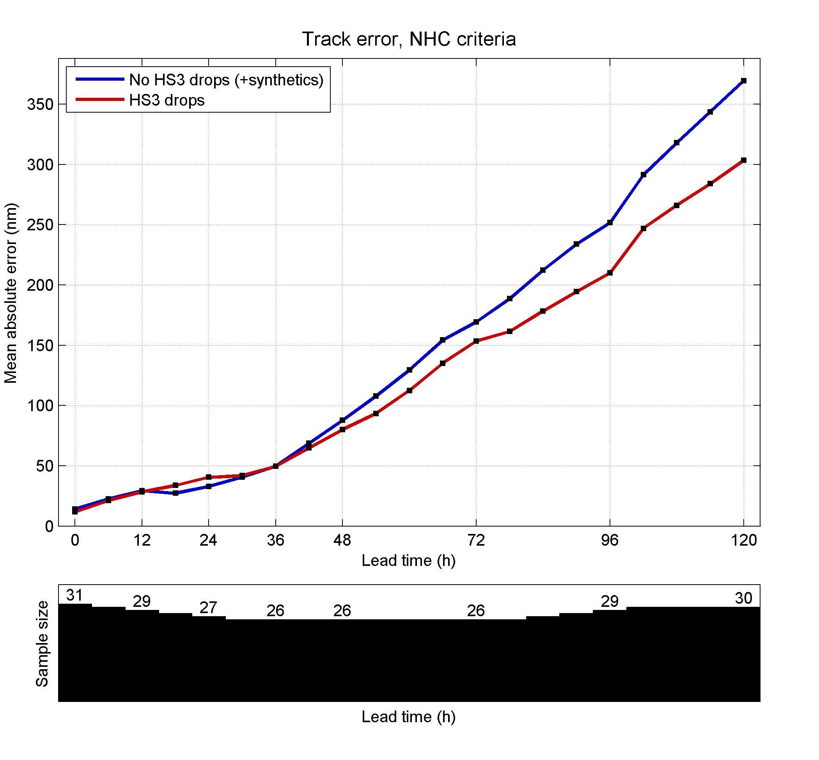
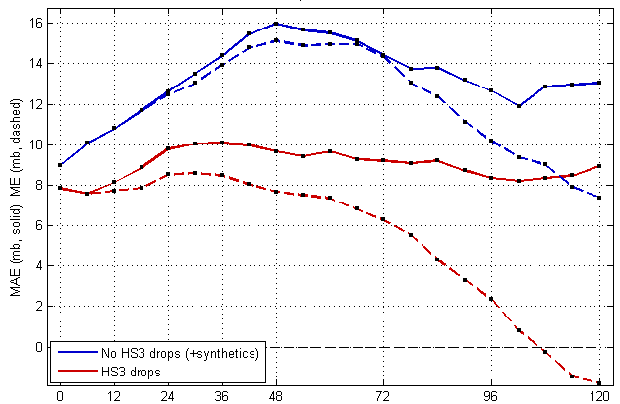
Impact of HS3 Dropsondes for Navy COAMPS-TC Hurricane Nadine Predictions
Track Error (nm)
Intensity: Max. Wind Error (kts)
No drops
No drops
HS3 drops
HS3 drops
Bias (dash)
Intensity: Min. SLP Error (hPa)
No drops
Dropsonde impact experiments performed for 19-28 Sep. (3 flights)
Red: with HS3 drops
Blue: No drops with synthetics
COAMPS-TC Intensity and Track skill are improved greatly through assimilation of HS3 Drops.
HS3 drops
Bias (dash)
Slide courtesy of James Doyle / NRL

Slide 9
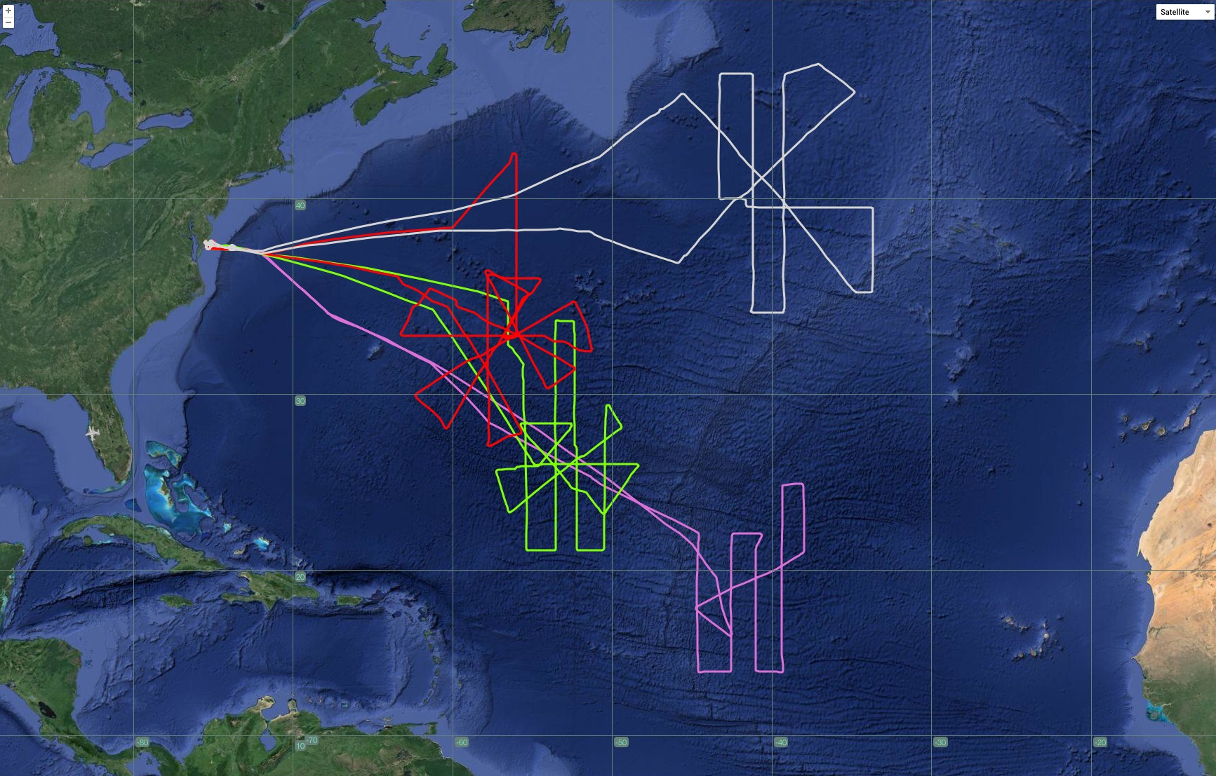
HS3 Flights Over 2014 Edouard
Four flights over the life cycle of Edouard
Rapid weakening to
weak tropical storm
Sept. 18-19
Steady strong Cat 2
Sept. 16-17
Rapid intensification
to strong Cat 2
Sept. 14-15
Tropical Storm
Sept. 11-12
Source: Scott Braun, NASA/GSFC

Slide 10
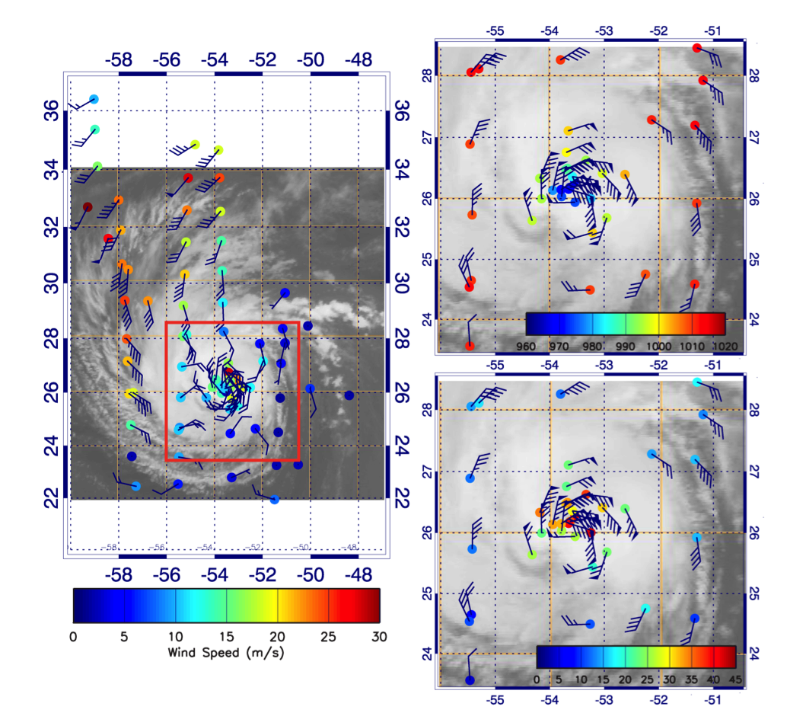
Edouard Rapidly Intensifies 14-15 Sep
Sea-level pressure
Maximum winds increase from 60 to 90 kt from 09 UTC Sept. 14 to 09 UTC Sept. 15
Strong outflow jet to northwest may have aided intensification
Wind speed at 200 hPa
967 hPa
Surface wind speed
40 m s⁻¹
Source: Scott Braun, NASA/GSFC
Notes:
Data from the second flight when Edouard underwent significant intensification. The plot on the level shows wind speed and wind barbs at 200 hPa, showing a strong outflow jet to the NW of the storm. The plots on the right show sea-level pressure (top) and surface wind speed (bottom). Minimum measured SLP is 967 hPa with a 40 m/s wind at 40 m, suggesting that the minimum pressure might be several hPa lower. Maximum measured sfc wind speeds are ~40 m/s, but the sparse sampling suggests that the maximum winds could be higher.

Slide 11
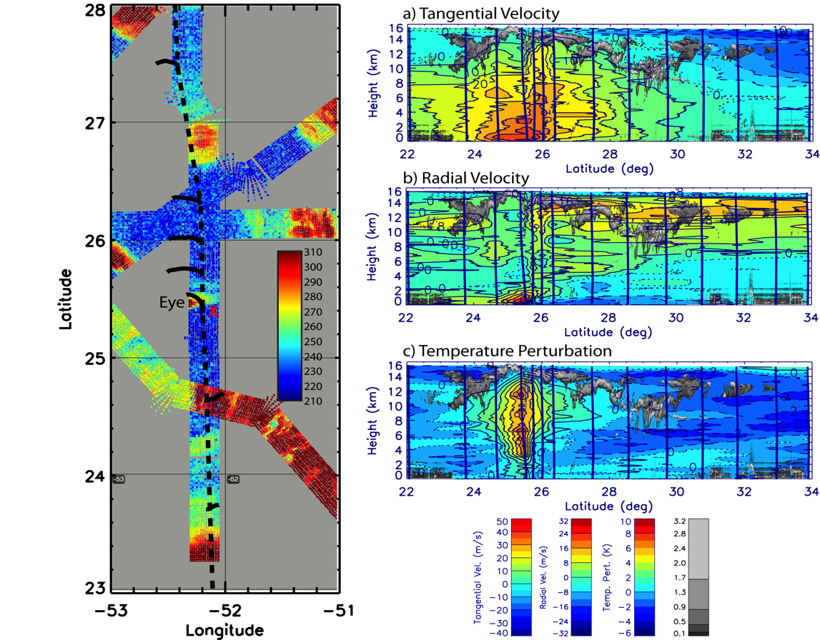
Storm Structure Along the First Overpass of Edouard (Sept. 14-15)
(Left) S-HIS brightness temperature—Blue indicates high clouds, red low clouds. Short curved lined segments indicate dropsonde trajectories.
Vertical cross sections show tangential and radial velocities and temperature perturbation. CPL clouds are overlaid in gray shading.
Source: Scott Braun, NASA/GSFC
Notes:
Left figure shows S-HIS brightness temperature with blue areas being higher thick clouds, red being low clouds or the surface. S-HIS (and CPL) suggest that we flew on the eastern edge of the eye rather than a direct overflight. Small black curved lines indicate trajectories of dropsondes and the sonde close to the center suggests that the small area of red indicated is the eye. The dropsondes were used to make cross sections of the indicated fields (vertical lines indicate locations of dropsondes). CPL data is overlaid in gray shading. Since we did not get a drop directly in the eye, the tangential winds do not show a minimum at low-mid levels associated with the eye. There is strong inflow on the north side of the storm, weak outflow on the south side. The dominant outflow is also to the north. A temperature perturbation (perturbation from the mean of sondes >200 km from the center) shows a deep layer of warming of ~8K.

Slide 12
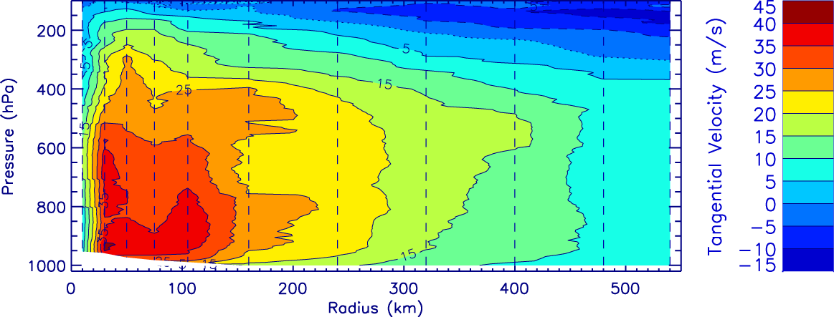
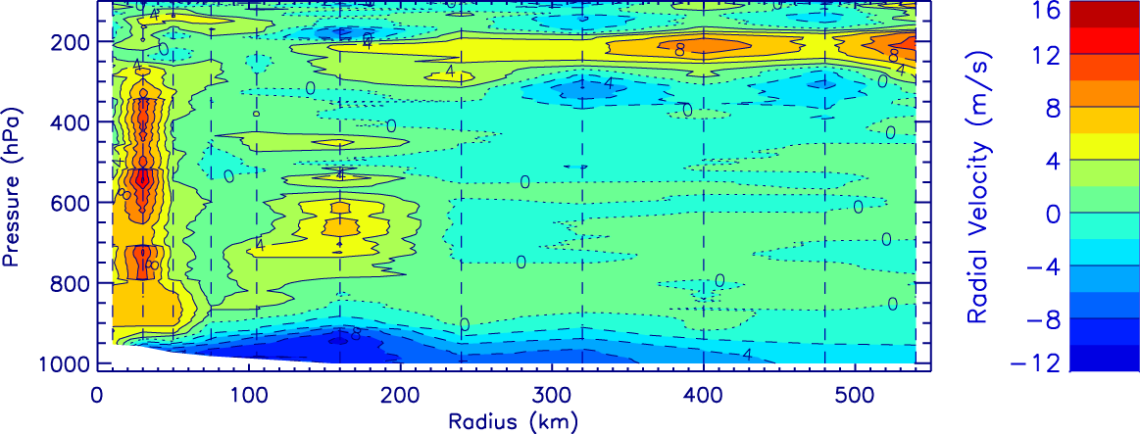
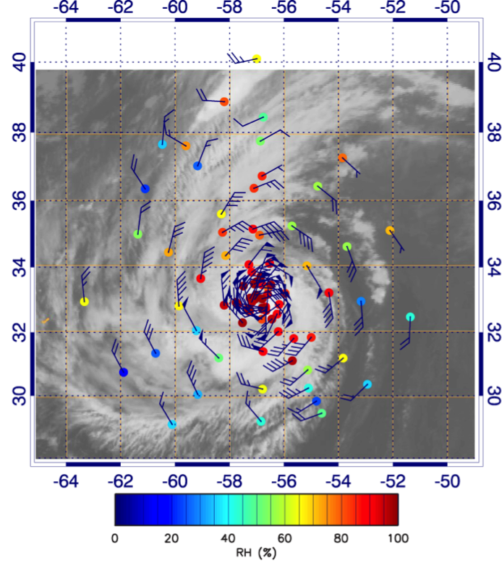
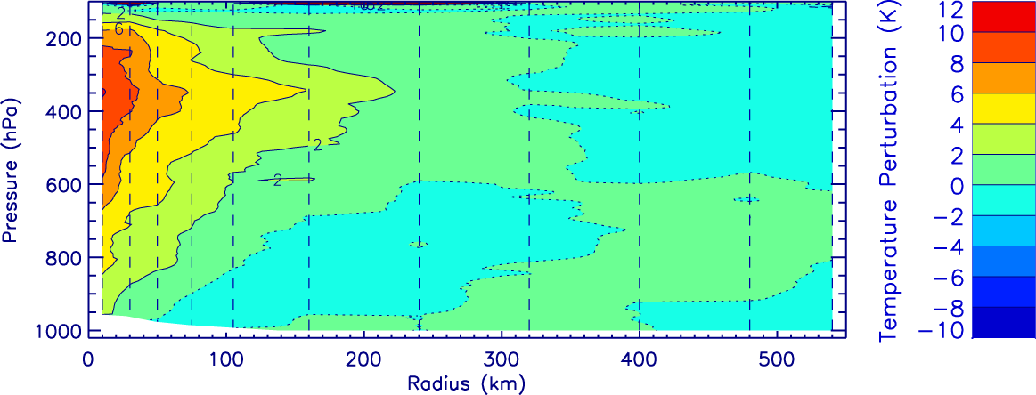
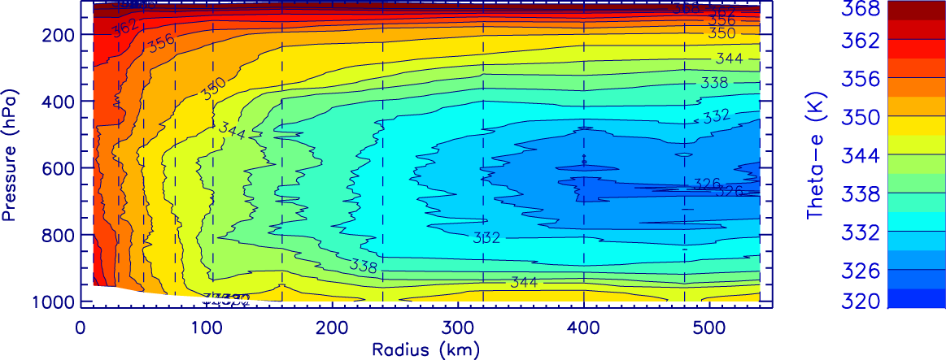
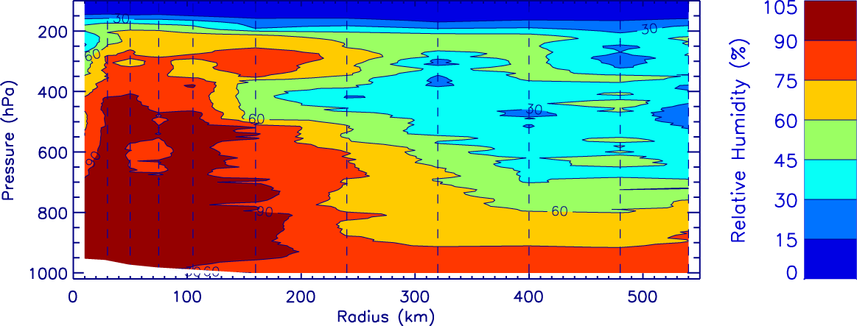
Composite Structure at Peak Intensity
Tangential Velocity
Hurricane Edouard on September 16-17
Relative Humidity at 700 hPa
Radial Velocity
Temperature Perturbation
Equiv. Pot. Temp.
Relative Humidity
Source: Scott Braun, NASA/GSFC
Notes:
Data from the third Edouard flight when the storm was fairly steady at its maximum intensity. The distribution of sondes is shown to the left and is fairly evenly distributed about the center. RH data shows dry air in the storm environment, but no indication that it was getting into the protected core of the storm. The dropsondes were composited into radial bins with closer spacing in the core, wider spacing at larger radii (see vertical lines). The azimuthal mean fields of the indicated variables are shown. The tangential wind field suggests a secondary wind maximum near 100 km with mid-level outflow and a high altitude outflow region. Strong outflow is seen near the eyewall and may be the main contributor to the high-level outflow. The temperature perturbation (from the mean outside 200 km) peaks at 350 hPa. Temperature perturbation is with respect to the mean of all sondes at radii > 200km.
Contour labels are shown for most cross sections, but difficult to show for the radial velocities. There, the contour interval is 2 m/s, with positive (negative) contours indicated by solid (dashed) lines. The dotted line is the 0 contour.

Slide 13
2015 NOAA SHOUT
Overall Goal
Demonstrate and test prototype UAS concept of operations that could be used to mitigate the risk of diminished high impact weather forecasts and warnings in the case of polar-orbiting satellite observing gaps
Objectives
Conduct data impact studies (track & intensity)
Observing System Experiments (OSE) using data from UAS field missions
Observing System Simulation Experiments (OSSE) using simulated UAS data
Investigate processes in the TC inner core, boundary layer, and upper-level environment that impact intensity change

Slide 14
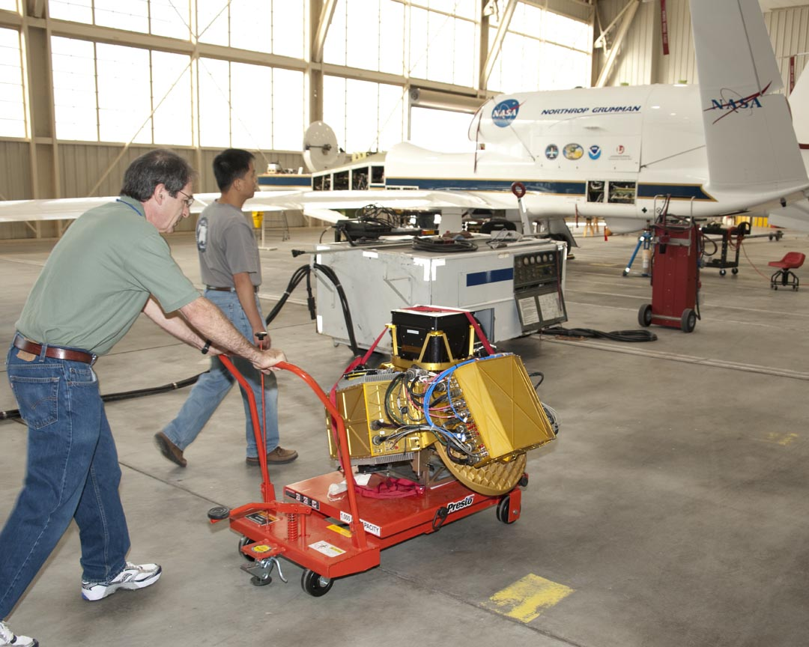
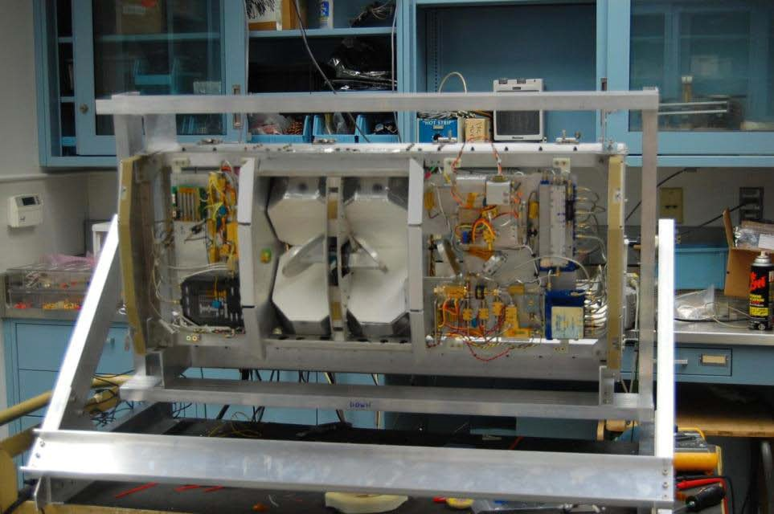
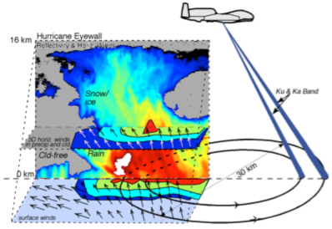
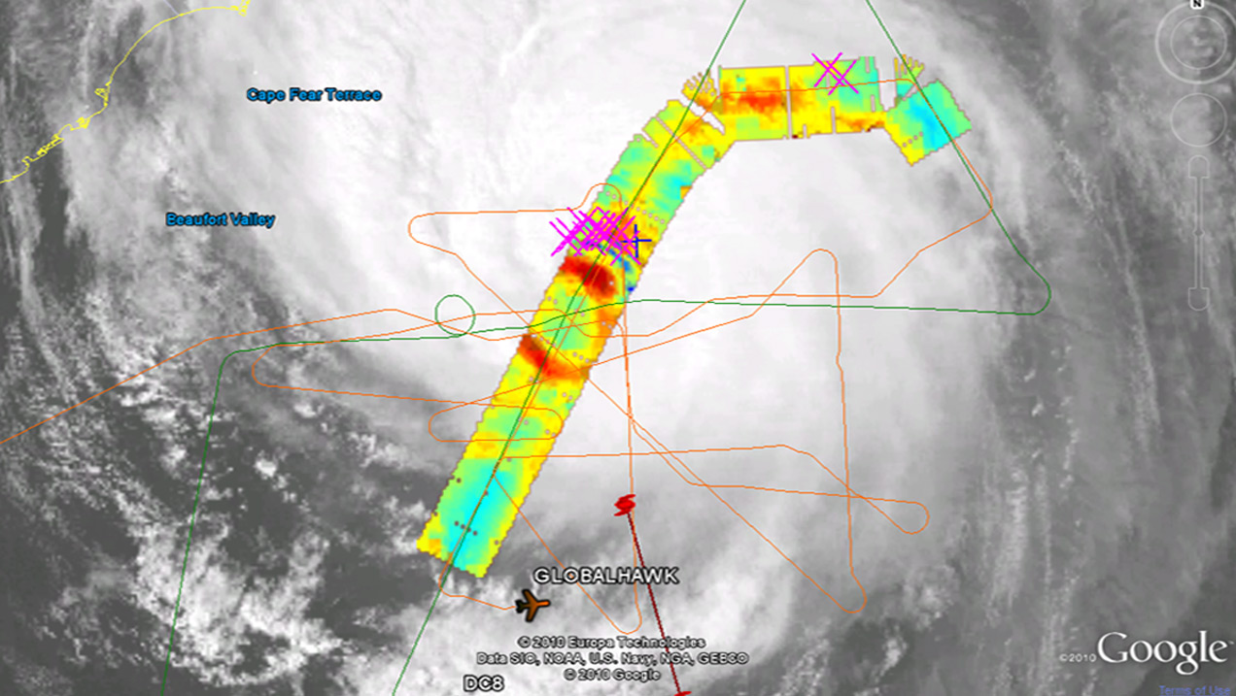
2015 NOAA SHOUT Potential Global Hawk Instrumentation
Airborne Vertical Atmospheric Profiling System (AVAPS)
High Altitude Monolithic Microwave Integrated Circuit (MMIC) Sounding Radiometer (HAMSR)
High-Altitude Imaging Wind and Rain Airborne Profiler (HIWRAP)
PI: Dr. Bjorn Lambrigtsen, Jet Propulsion Laboratory
Measurements: Microwave radiometer sounder operating at 25 spectral channels in 3 bands (50-60 GHz, 118 GHz, and 183 GHz): 3-D distribution of temperature, water vapor, and cloud liquid water; Resolution: 2 km vertical, 2 km horizontal (nadir), 40 km wide swath
PI: Dr. Gerald Heymsfield, NASA GSFC
Measurements: Dual-frequency (Ka- and Ku-band), dual beam, conical scanning Doppler radar: 3-D winds, ocean vector winds, and precipitation;
Resolution: 60 m vertical, 1 km horizontal;
PI: Dr. Gary Wick, NOAA, NCAR
Measurements: Temperature, pressure, wind, humidity vertical profiles; 88 sondes per flight;
Resolution: ~2.5 m (winds), ~5 m (PTH)
~80-115 hPa

Slide 15
Global Hawk Mission Highlights
NASA GRIP (2010)
-5 missions (Frank, Earl, Karl, & Mathew)
NASA HS3 (2012-2014)
-2012: 6 missions (Leslie & Nadine)
-2013: 9 missions (Gabrielle,Humberto,Ingrid,AEW,SAL)
-2014: 10 missions (Cristobal, Dolly, Edouard, MDR)
NOAA SHOUT (2015)
-5 week Wallops deployment (late Aug through Sep)
-Probable instrumentation: AVAPS, HAMSR, & HIWRAP
-Focus on improving TC track & intensity forecasts
-Flight plans >> optimize forecast impact

