Slide 1
NOAA SHOUT
Plans for the Global Hawk UAS During
the 2016 Atlantic Hurricane Season
NOAA HRD Observations Group Meeting: Feb 18, 2016

Slide 2
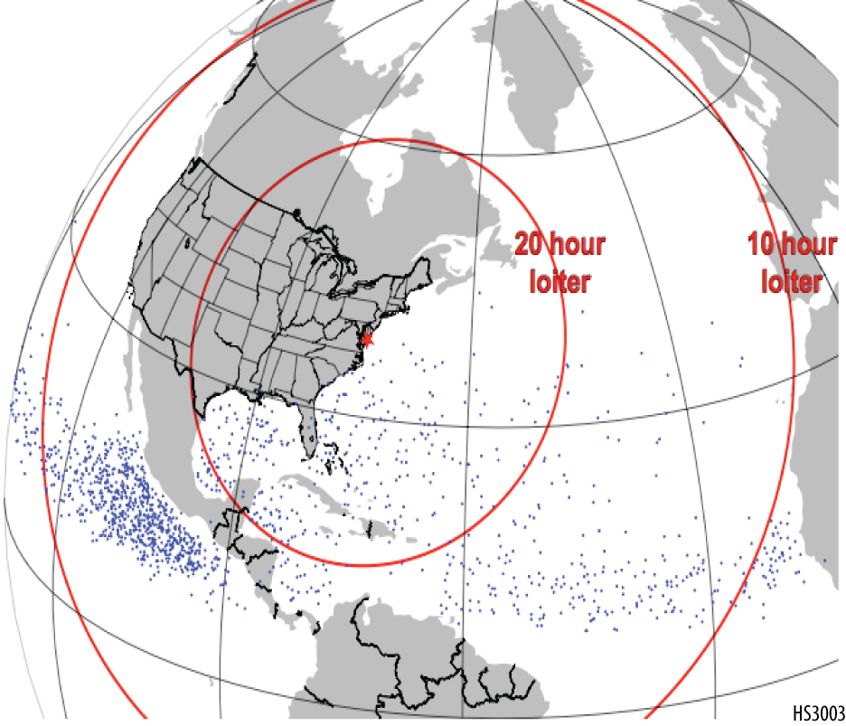
SHOUT 2016 Deployment
Atlantic hurricane focus
Single Global Hawk (AV-6) deployed at NASA Wallops Flight Facility
Possible rapid response mission(s) before campaign
NASA Armstrong (~90 mi NNE of Los Angeles)
July/August timeframe
Dry Run: early/mid August
4-5 week deployment period
~end of August through September
10 science flights
Tempo to support 2-3 flights/wk
~24-hr duration flights

Slide 3
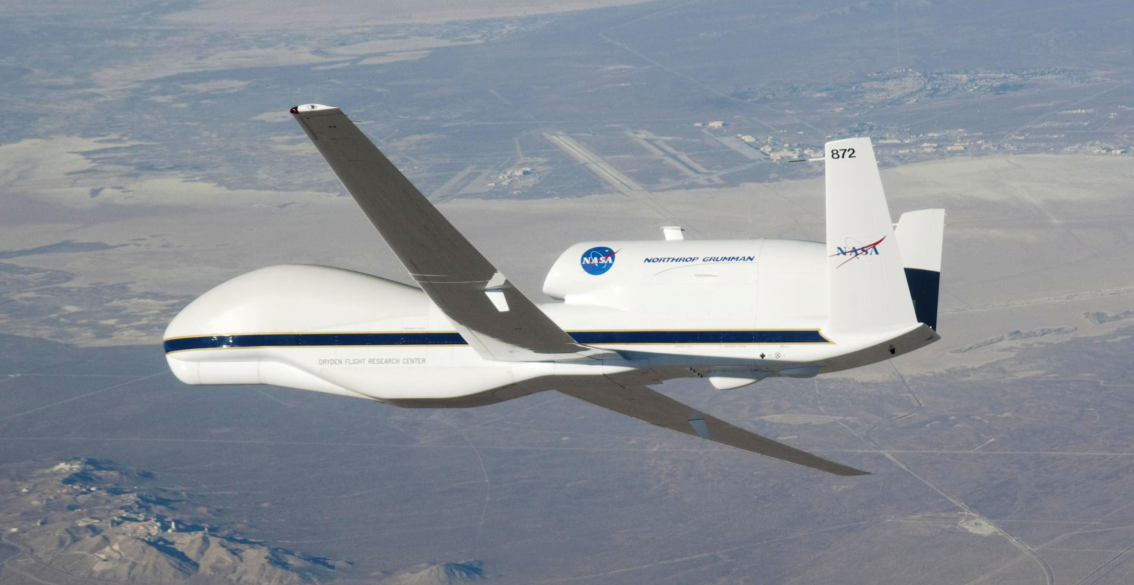
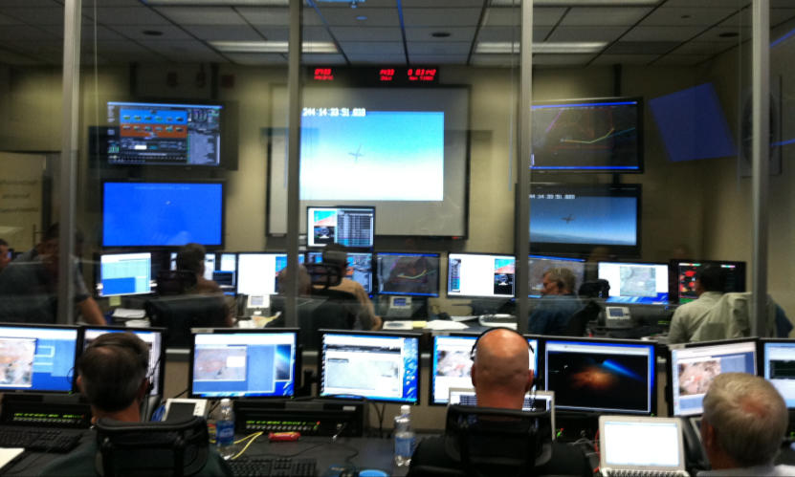
Global Hawk (AV-6) Capabilities
Flight Level: ~55-60,000 ft
Duration: ~24 hr
Flight Frequency
-1x per 48 hr (every other day)
-3 consecutive flights
-7 day max >> hard down
Range: ~8-10,000 nm
Payload: 1,500+ lbs
Mission Science Support
-3 shifts per mission (2-3 mission scientists per shift)
Global Hawk Operations Center (GHOC)

Slide 4
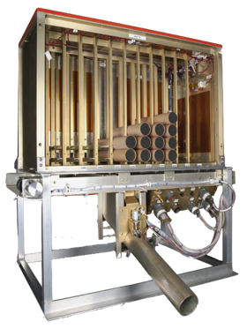
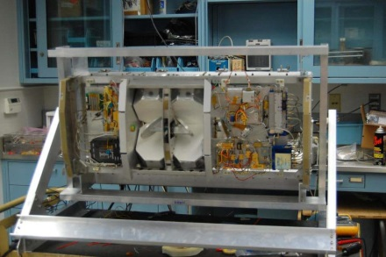
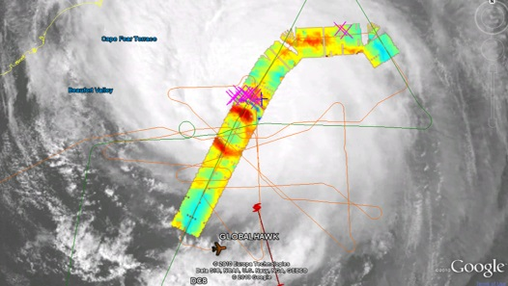
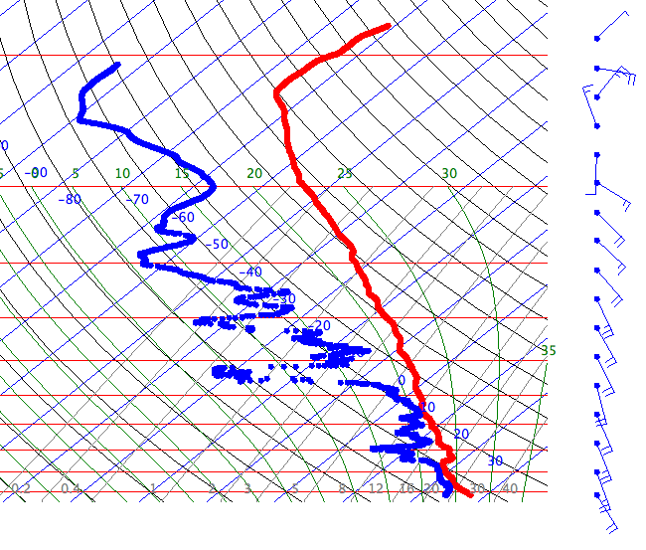
2016 NOAA SHOUT Global Hawk (AV-6) Instrumentation
Airborne Vertical Atmospheric Profiling System (AVAPS)
High Altitude Monolithic Microwave Integrated Circuit (MMIC) Sounding Radiometer (HAMSR)
2010 Karl
PI: Terry Hock, NCAR / Gary Wick, NOAA
Measurements:
Temperature, pressure, wind, & humidity vertical profiles;
88 dropsondes per flight;
Resolution:
4 Hz (winds); 2 Hz (PTH);
~2.5 m (winds), ~5 m (PTH);
PI: Dr. Bjorn Lambrigtsen, JPL
Measurements:
Microwave AMSU-like sounder;
25 spectral channels in 3 bands; (50-60 GHz, 118 GHz, and 183 GHz);
3-D distribution of temperature, water vapor, & cloud liquid water;
Resolution:
2 km vertical; 2 km horizontal (nadir);
40 km wide swath;
~16-20km
Notes:
HAMSR: 2010 NASA GRIP (Hurricane Karl overliflight)

Slide 5
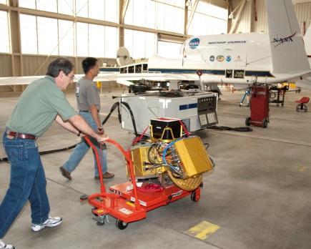
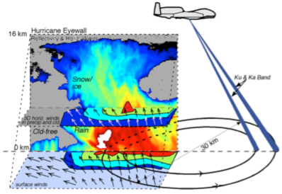
2016 NOAA SHOUT Global Hawk (AV-6) Instrumentation
High-Altitude Imaging Wind and Rain Airborne Profiler (HIWRAP)
PI: Dr. Gerald Heymsfield, NASA GSFC
Measurements:
Dual-frequency (Ka- & Ku-band), dual beam, conical scanning Doppler radar;
3-D winds, ocean vector winds, and precip;
Resolution:
60 m vertical, 1 km horizontal;
Notes:
HAMSR: 2010 NASA GRIP (Hurricane Karl overlflight)

