Slide 1
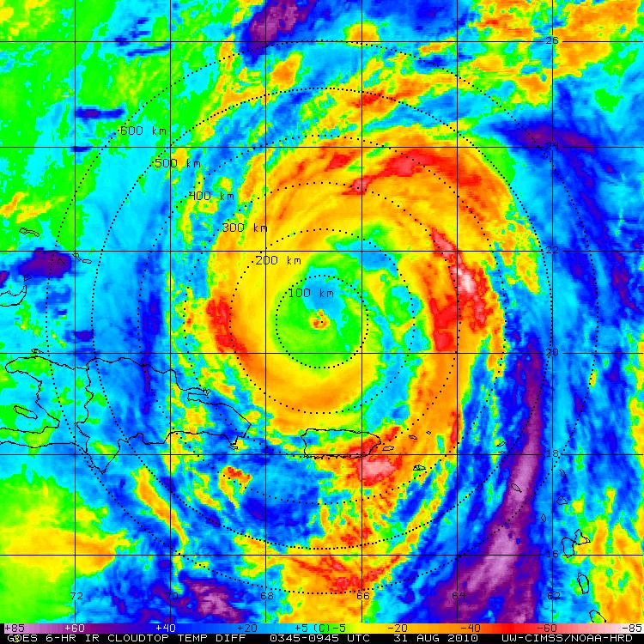
Diurnal Pulsing of Tropical Cyclones: An Overlooked Yet Fundamental TC Process?
Jason Dunion
University of Miami/CIMAS – NOAA/AOML/HRD – SUNY/Albany

Slide 2
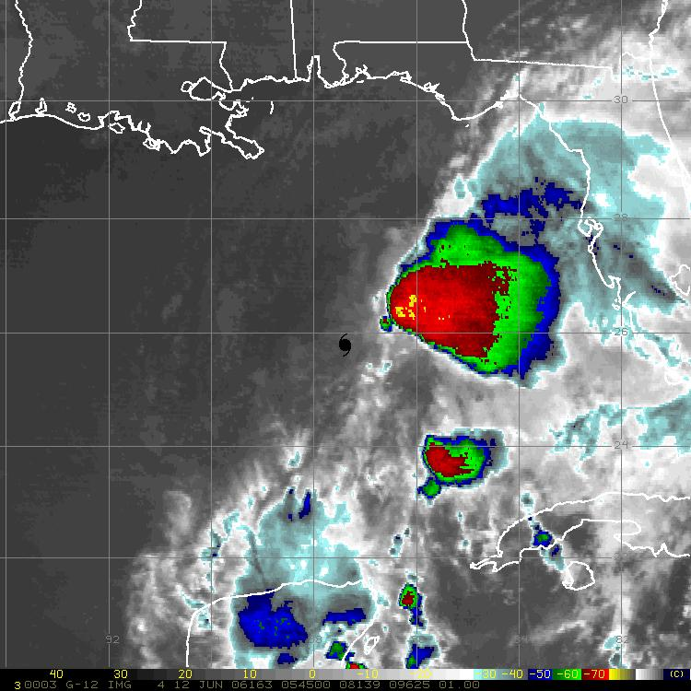
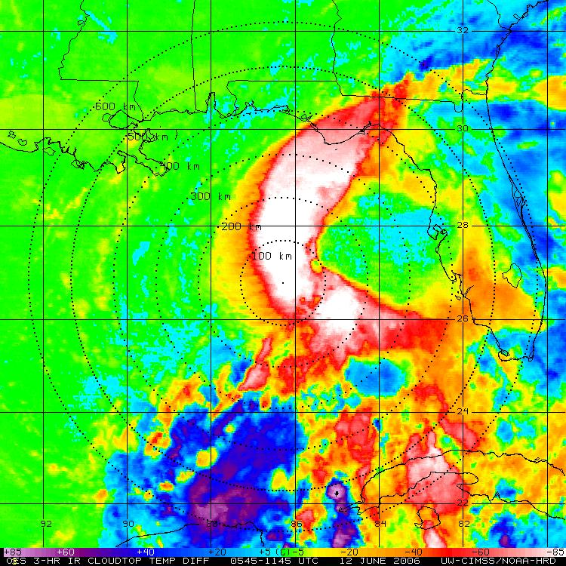
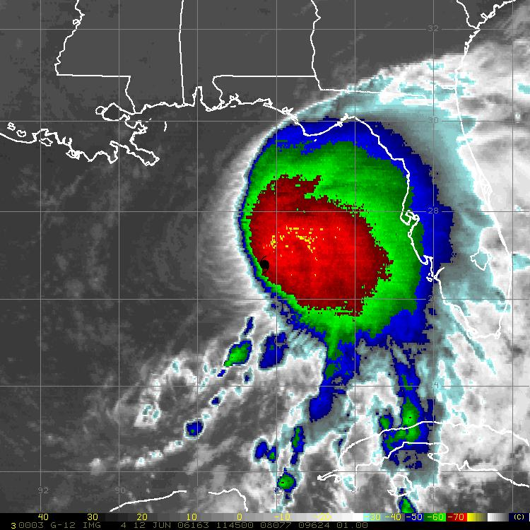
2006 Tropical Storm Alberto
GOES 6-hr BT Temp Difference

Slide 3
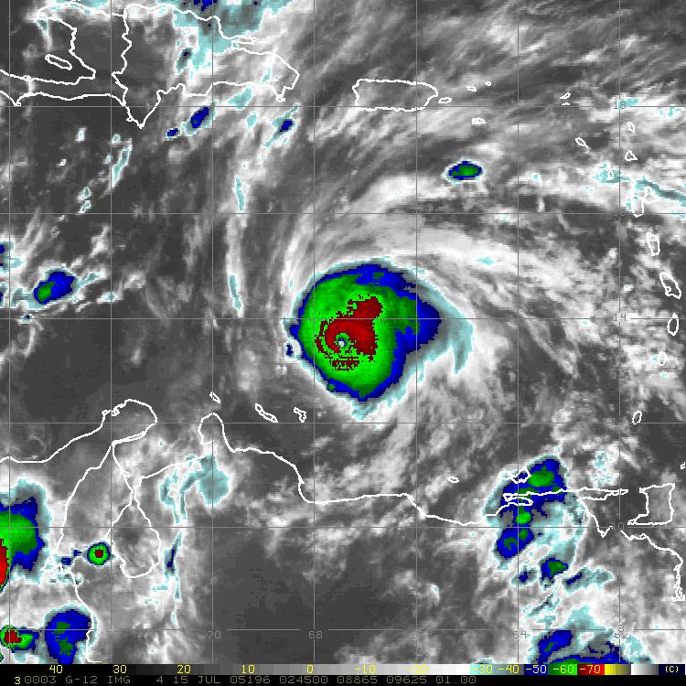
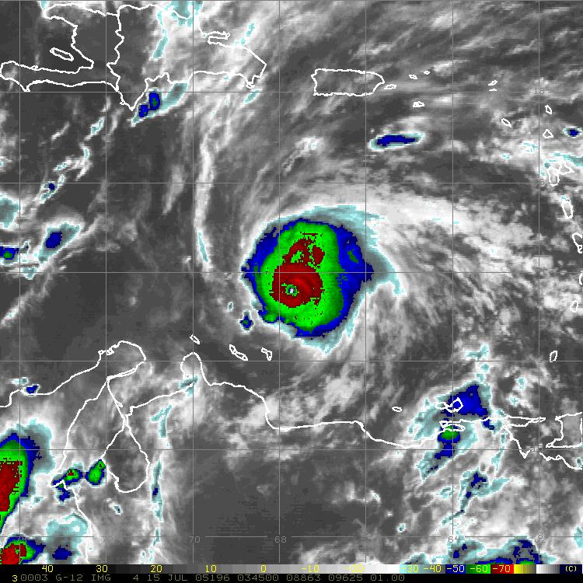
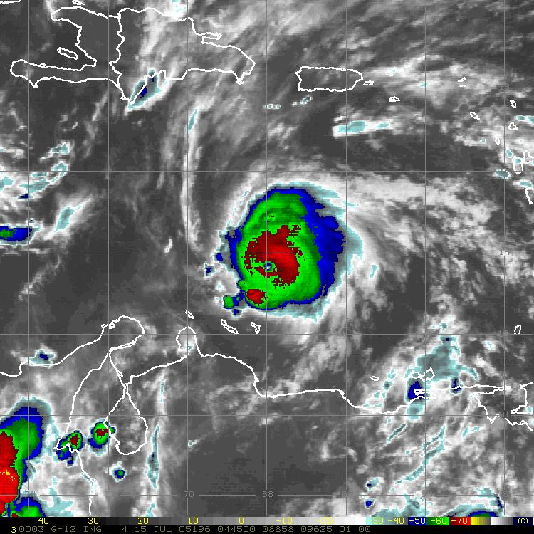
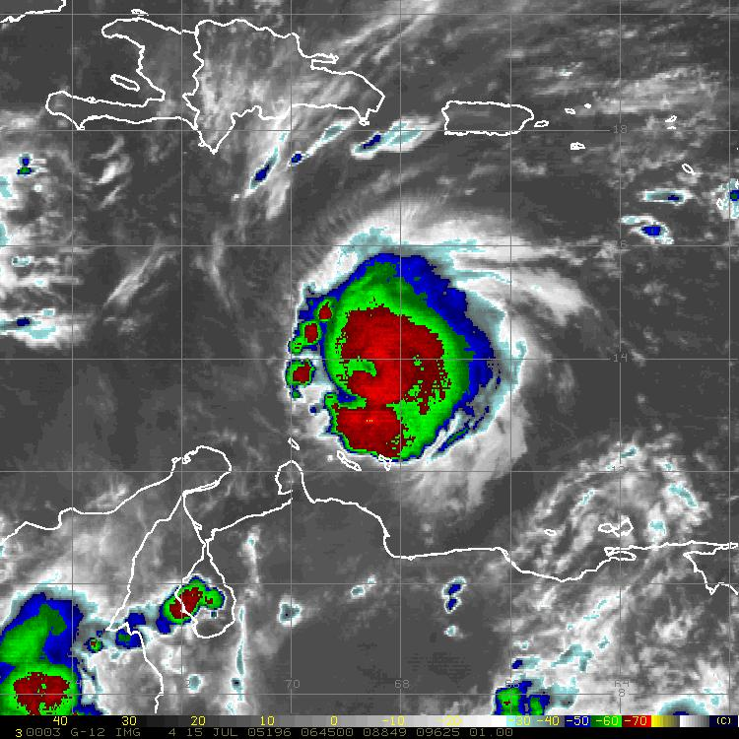
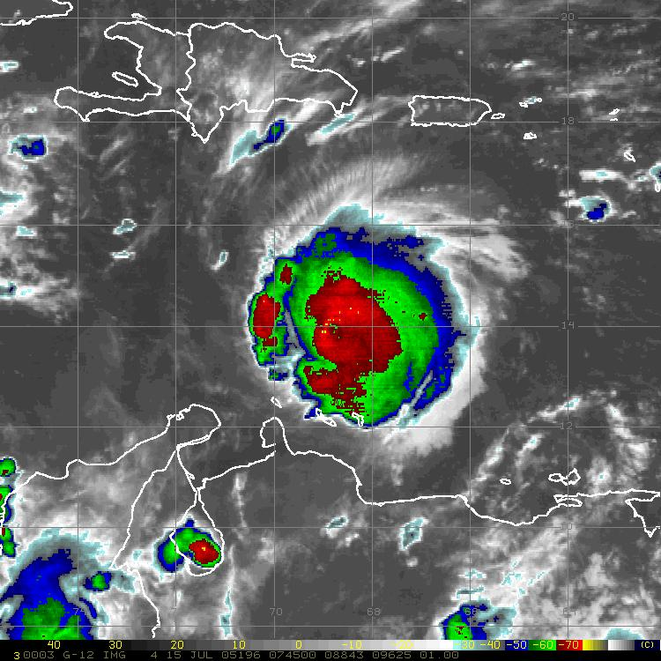
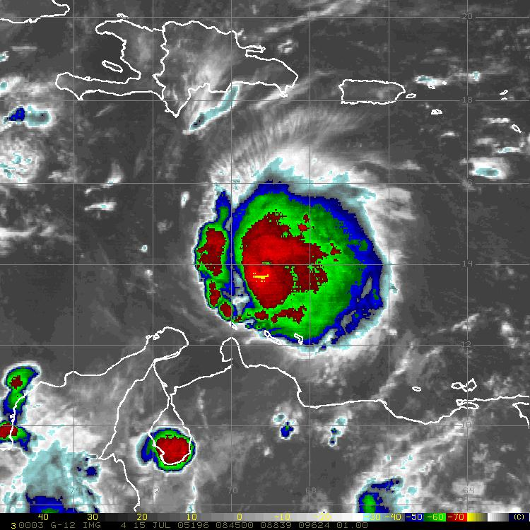
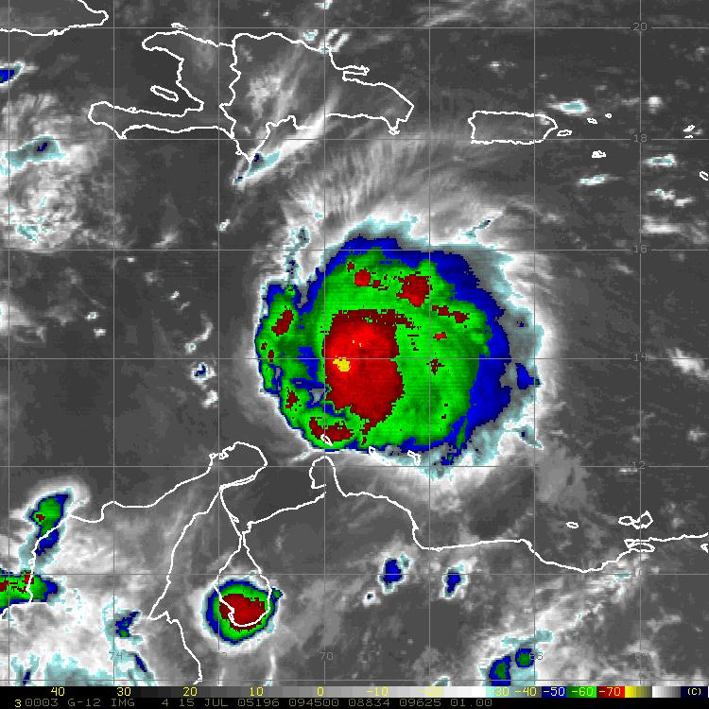
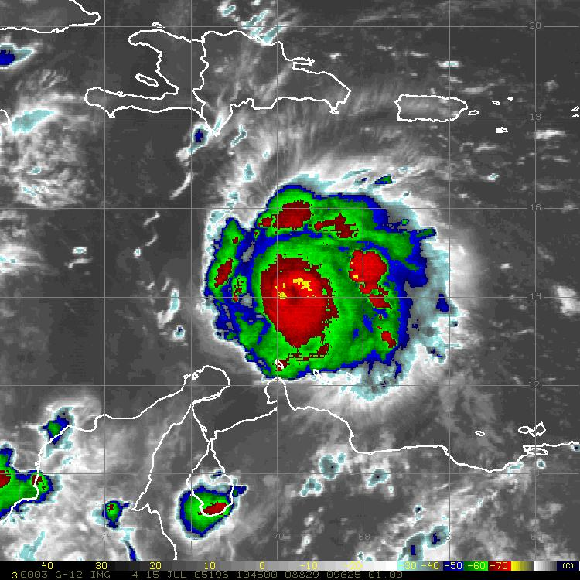
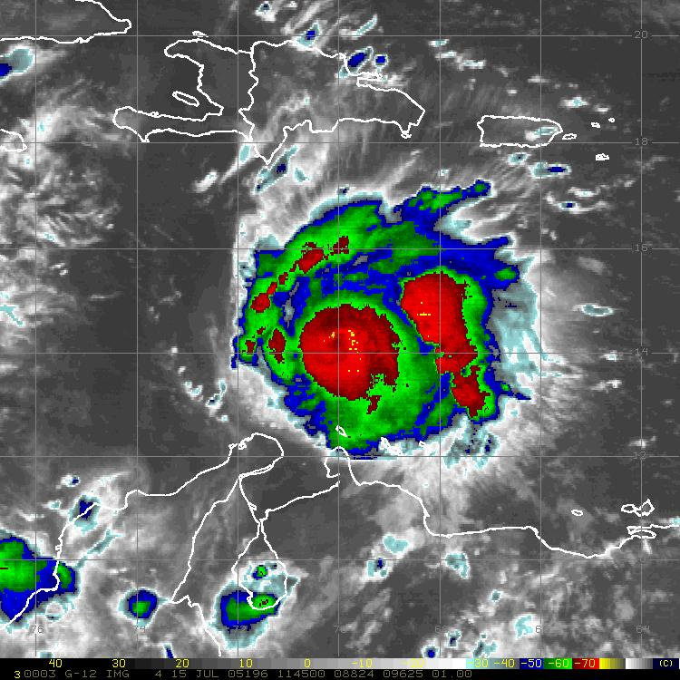
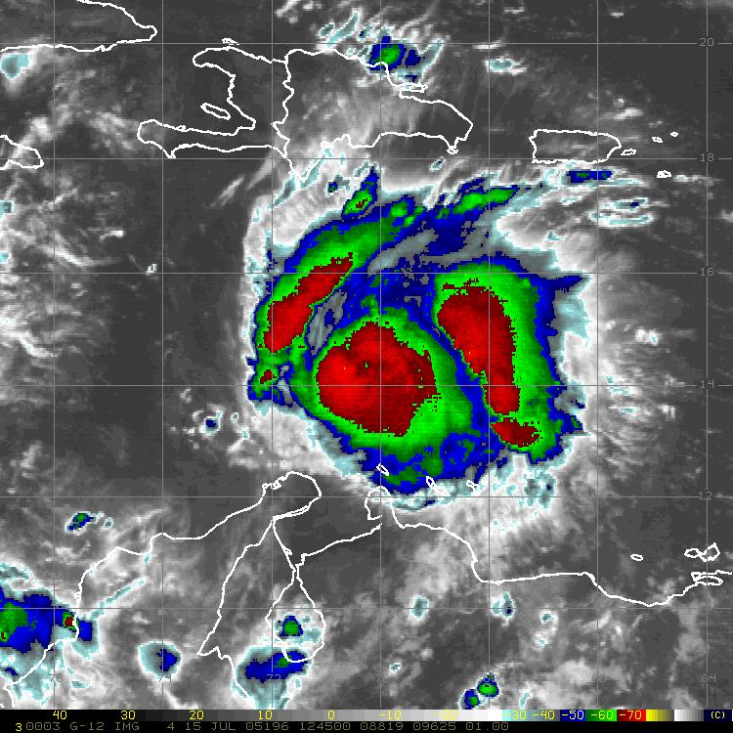
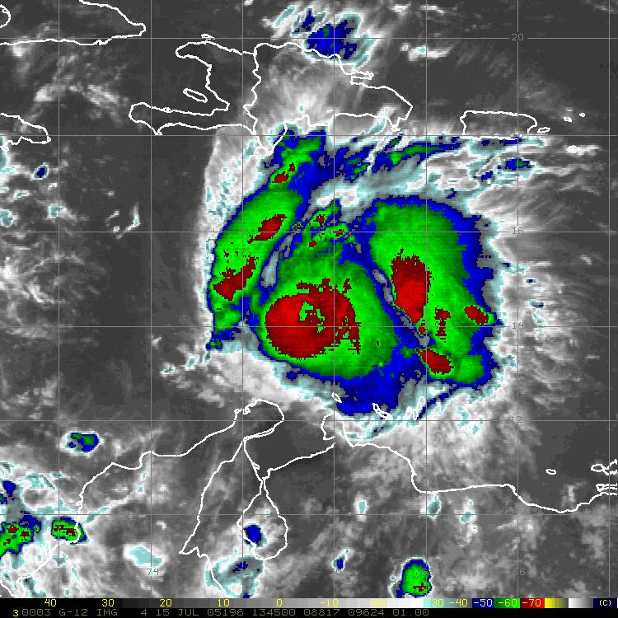
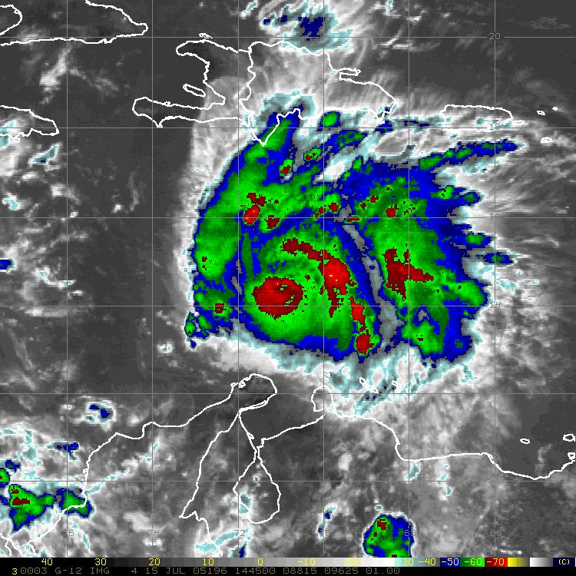
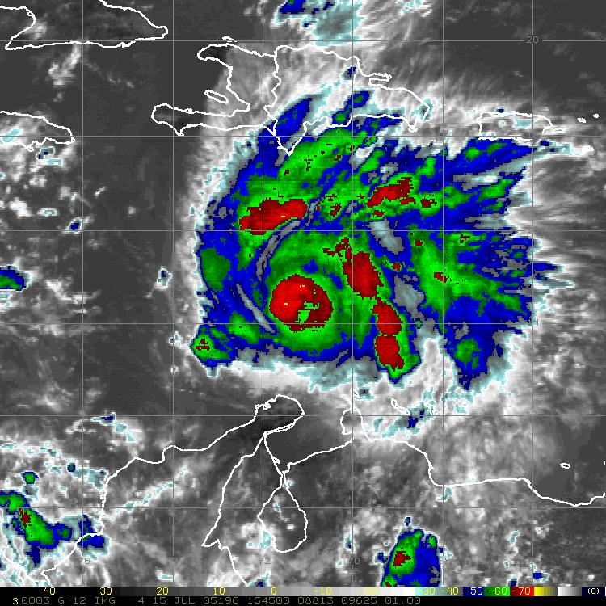
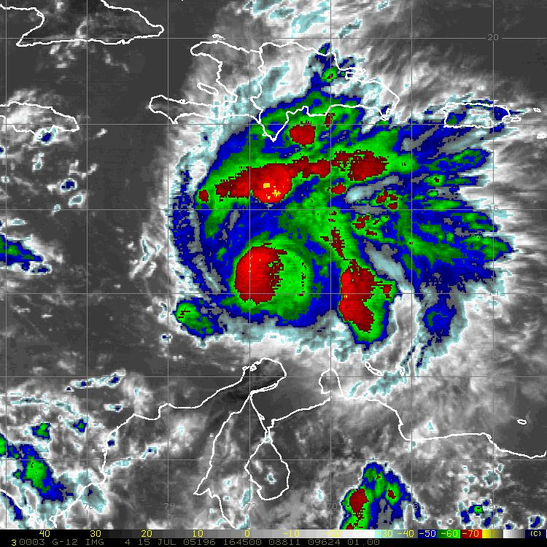
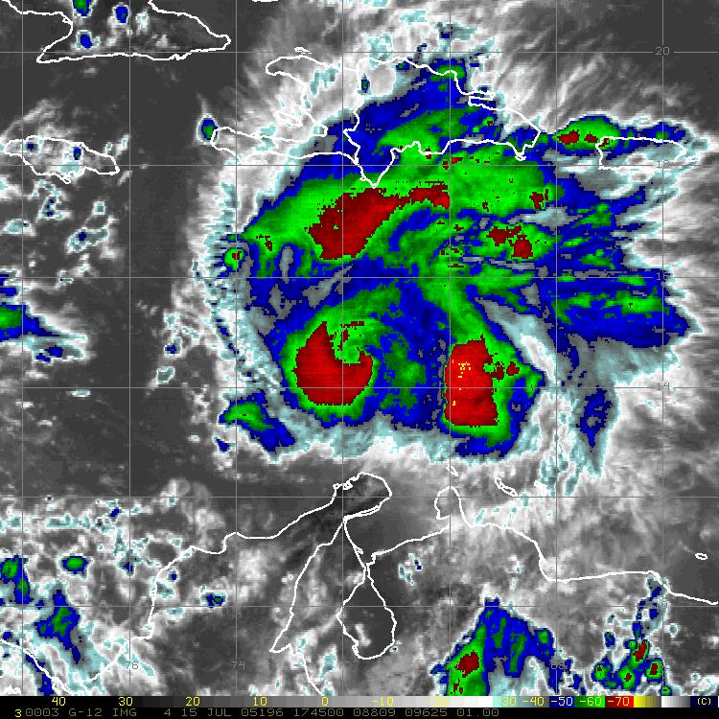
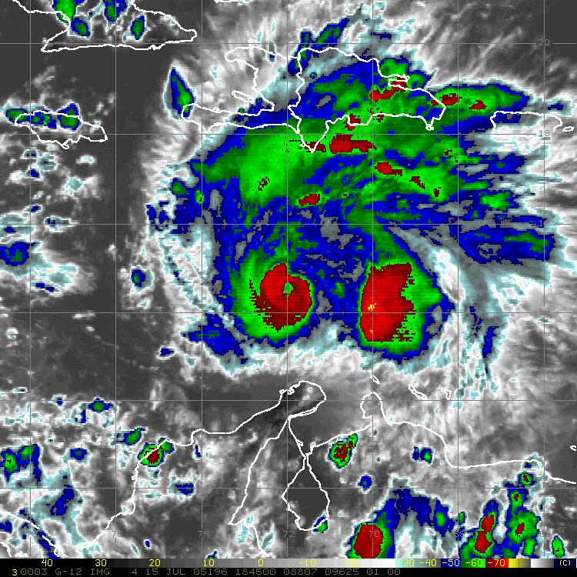
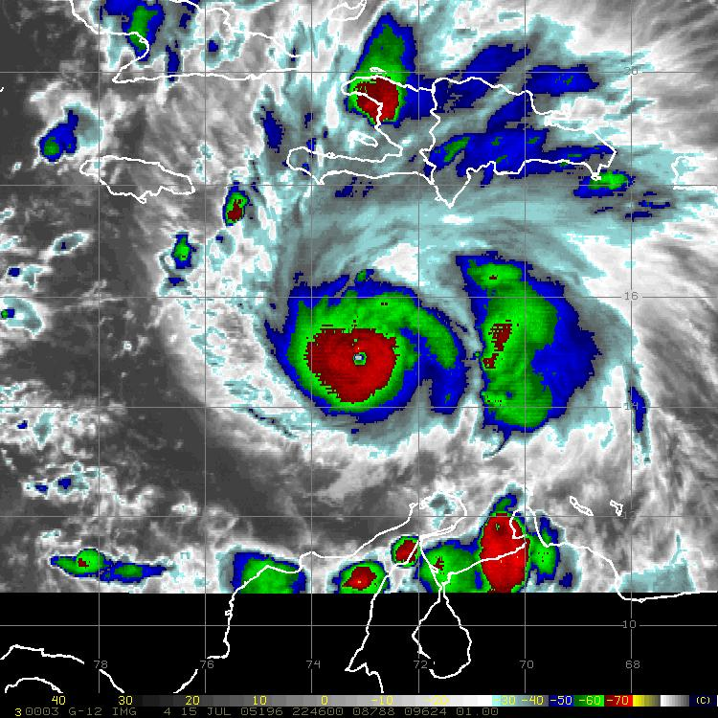
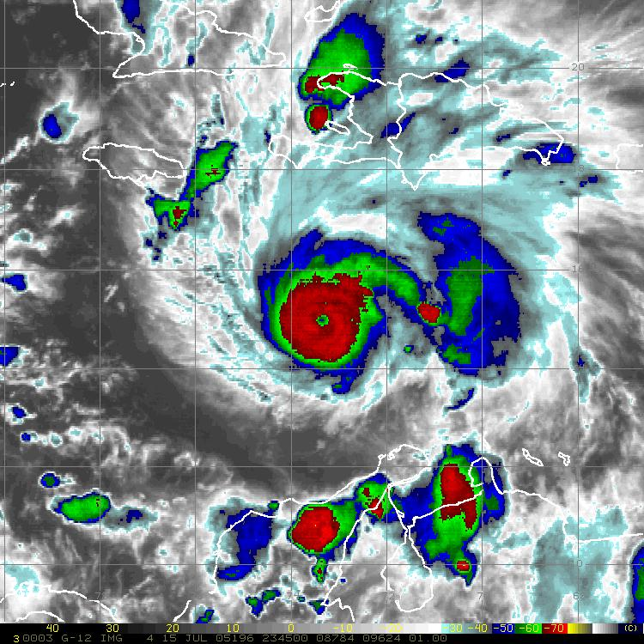
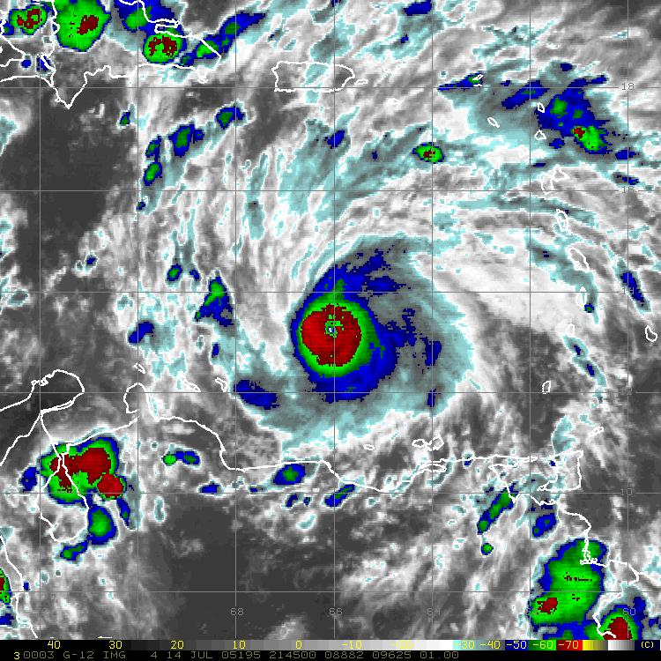
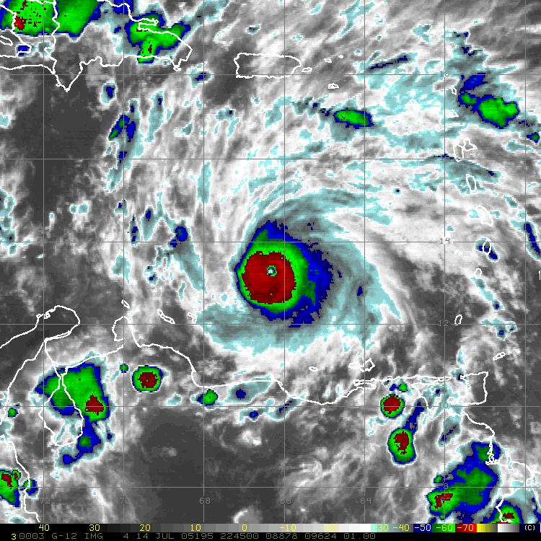
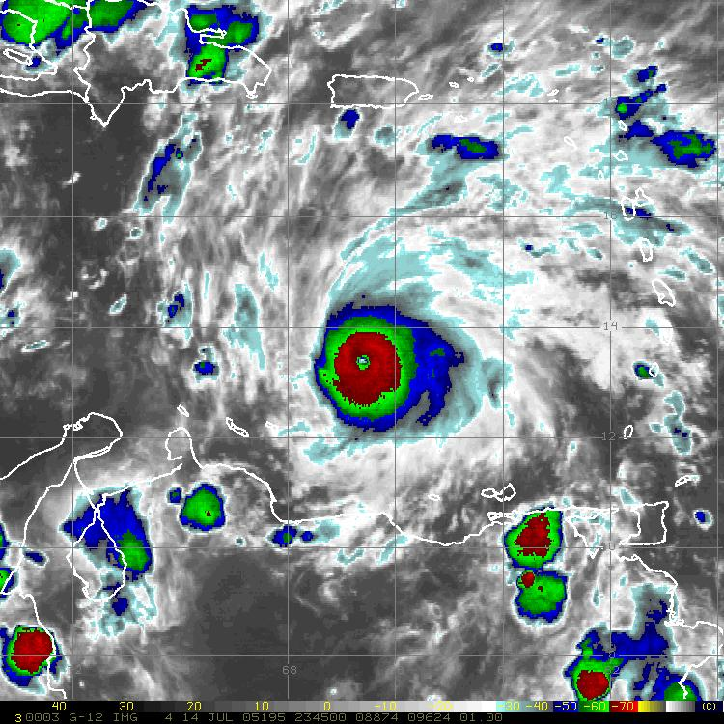
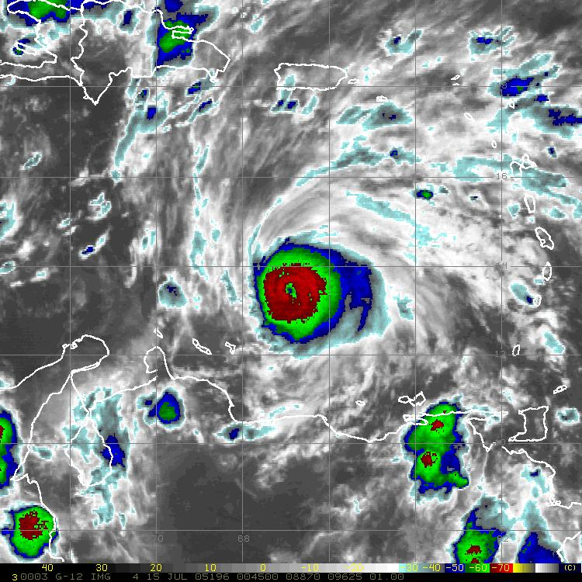
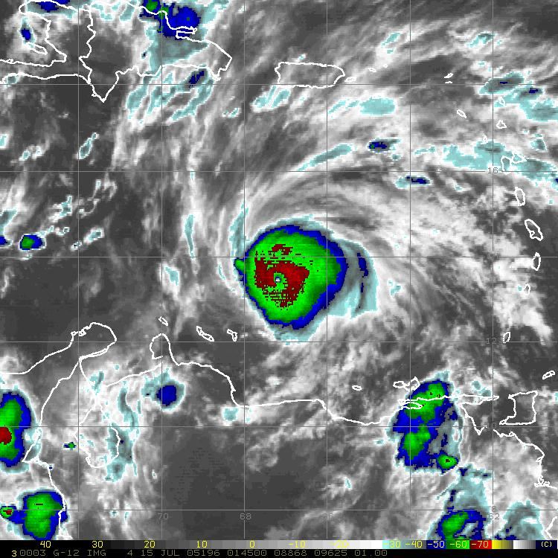
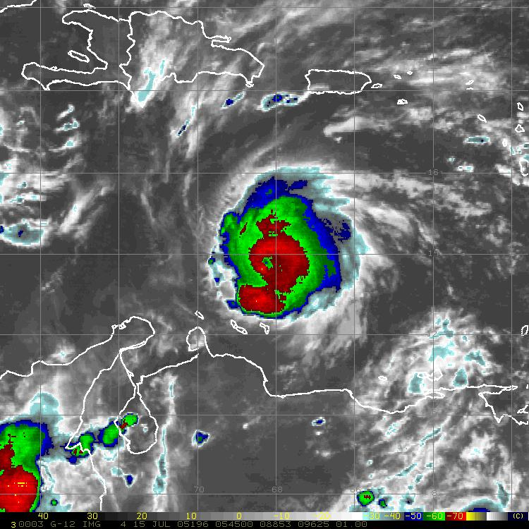
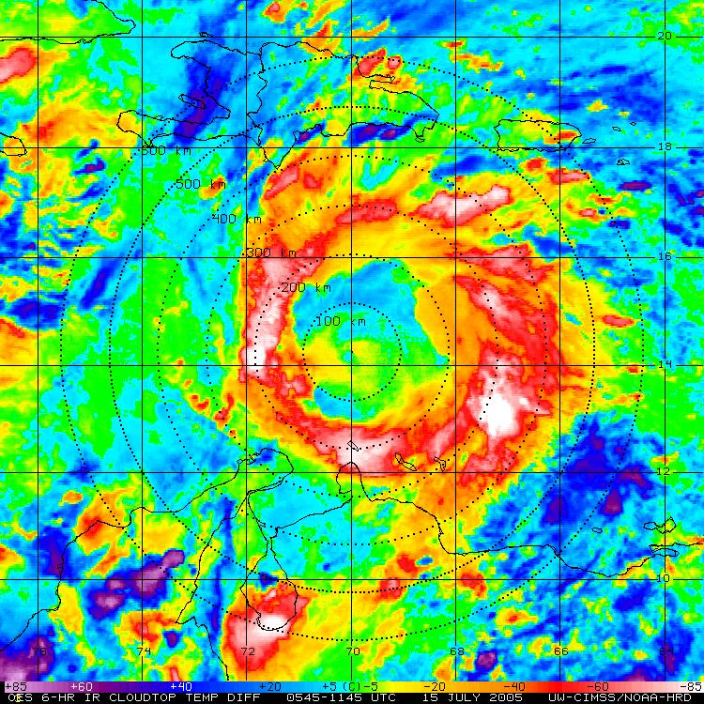
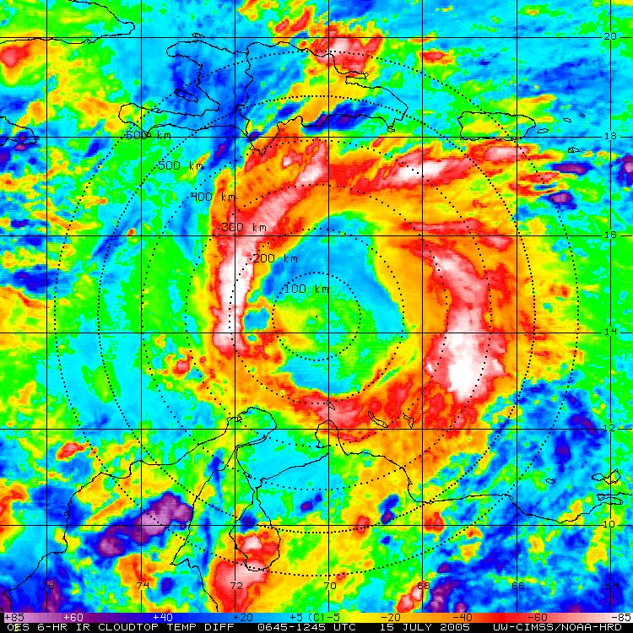
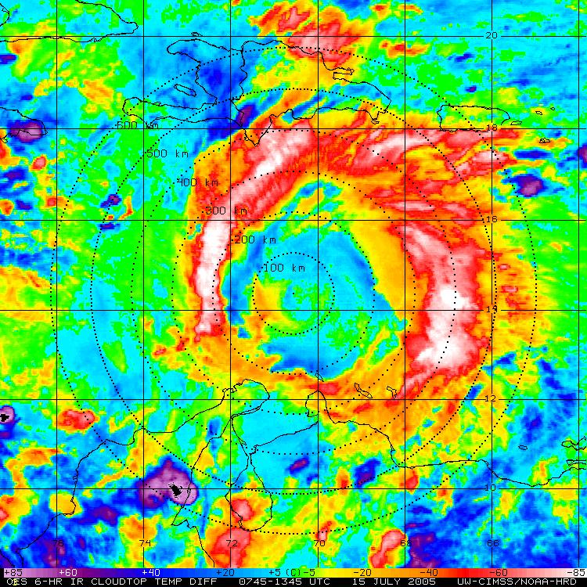
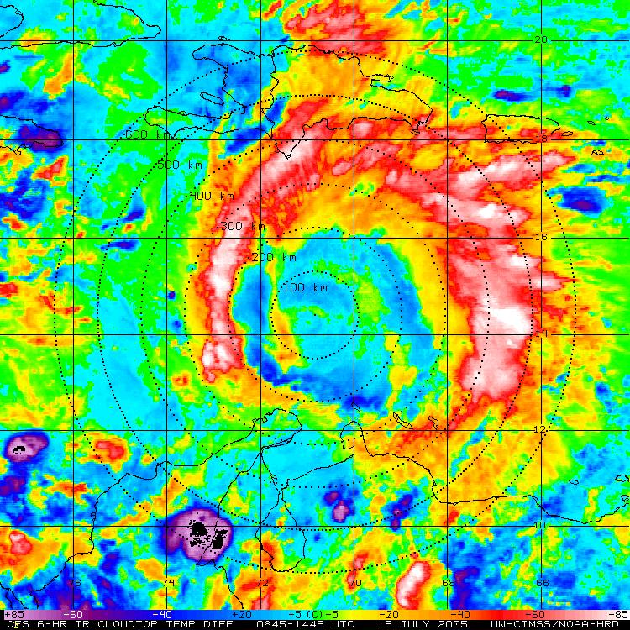
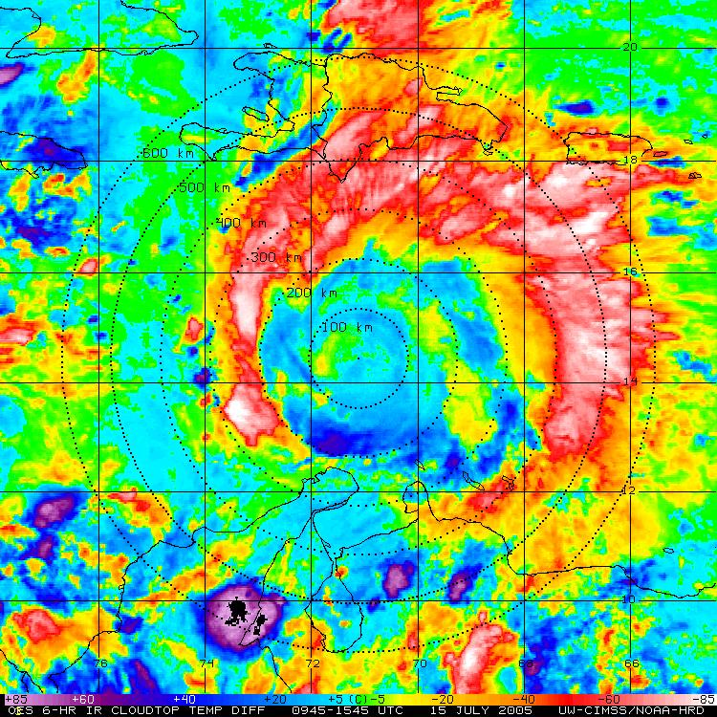
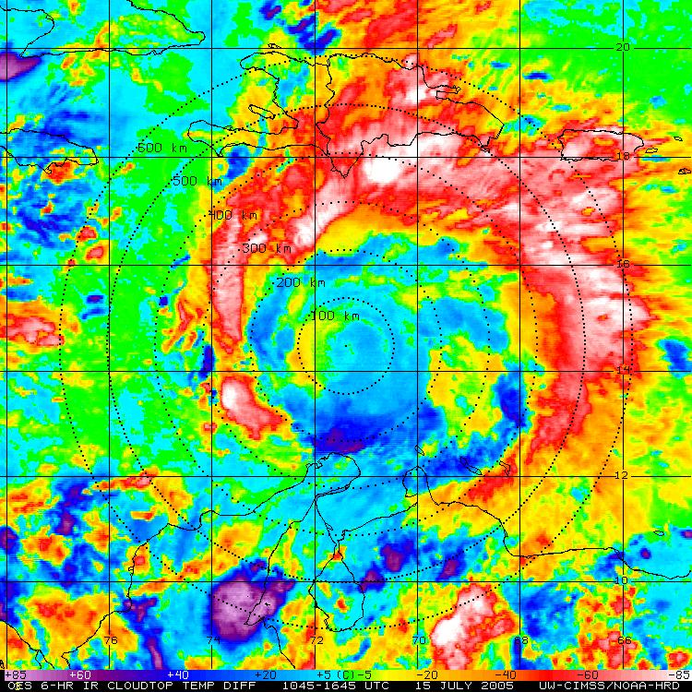
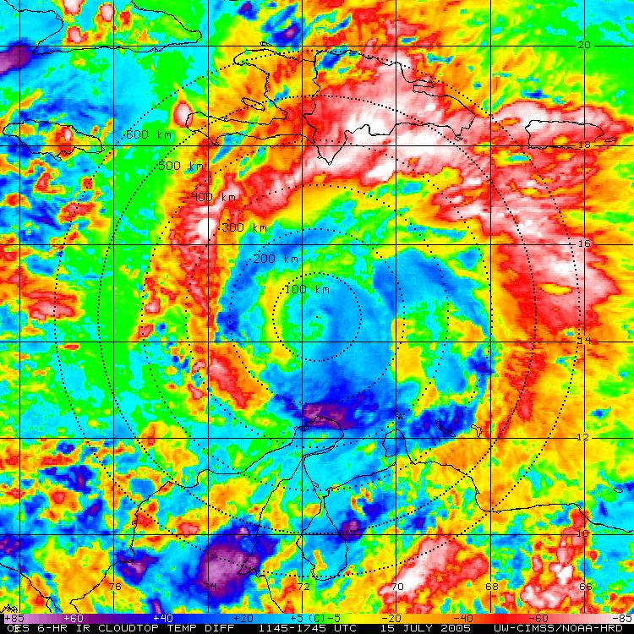
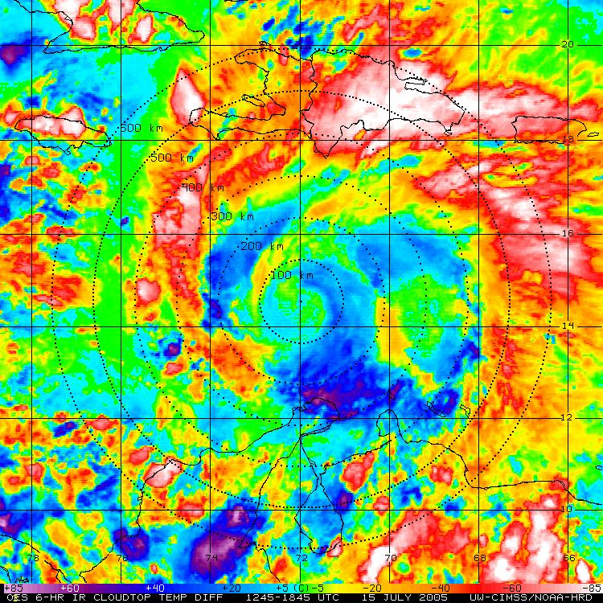
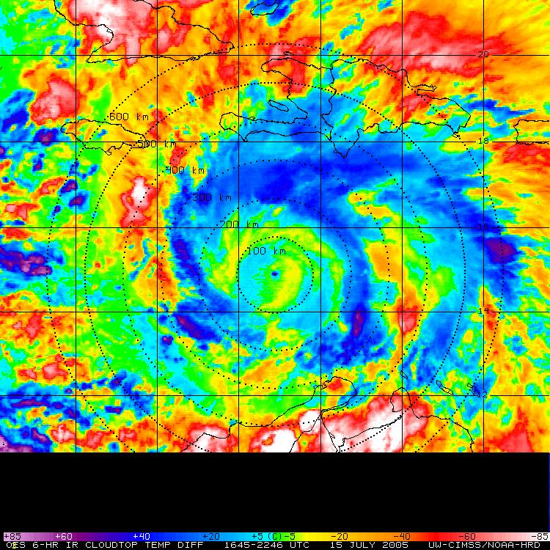
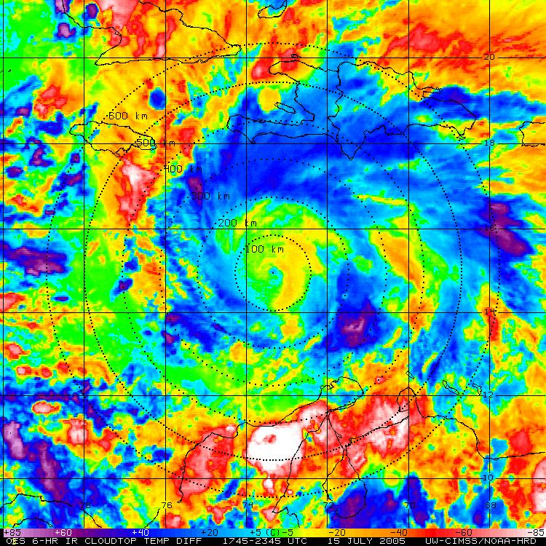
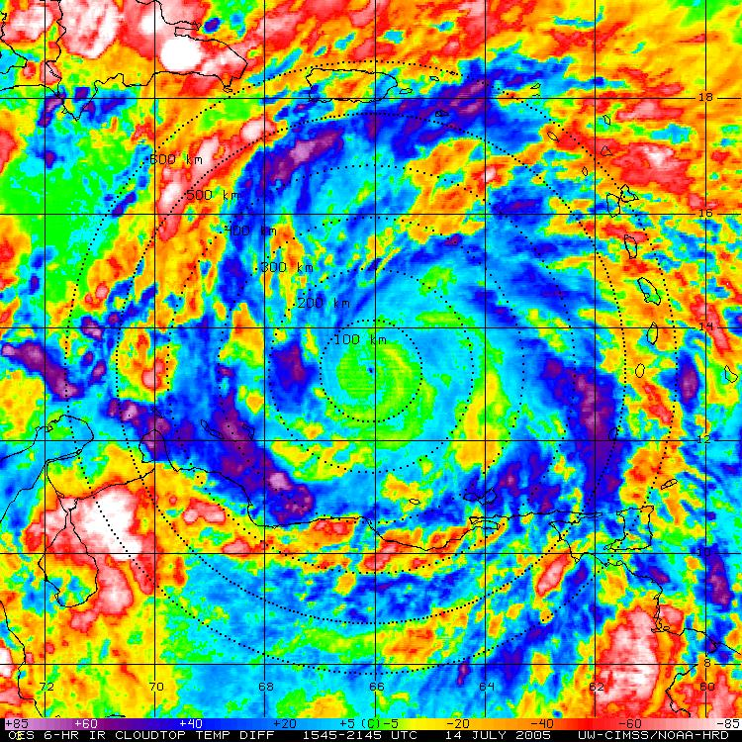
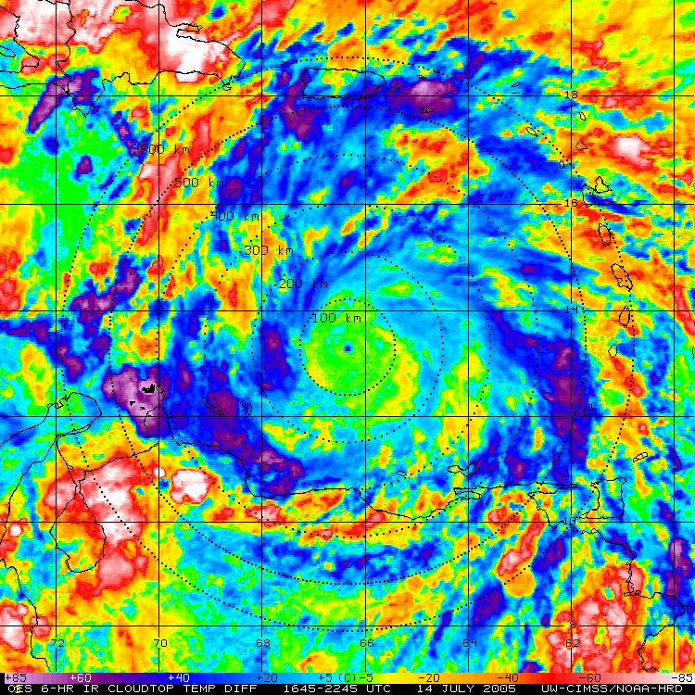
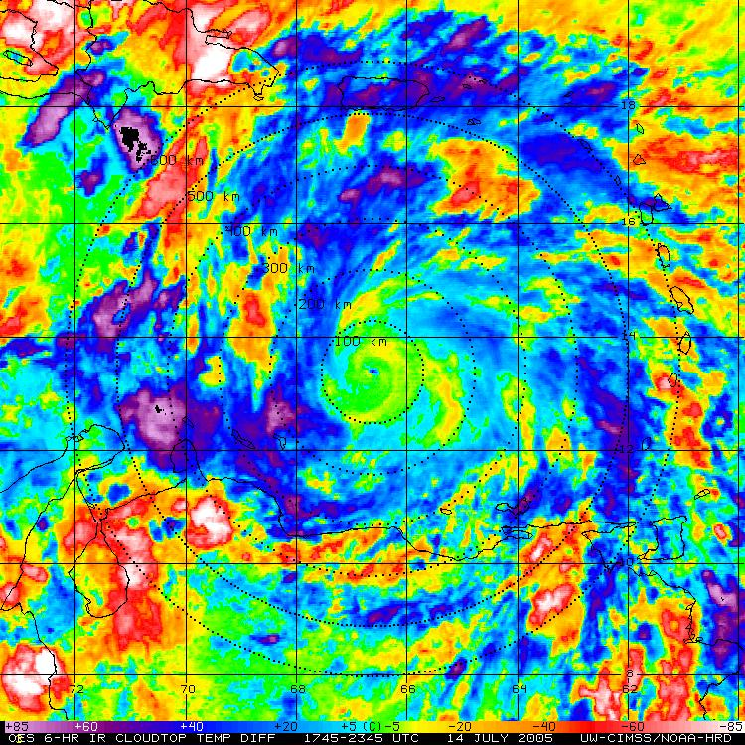
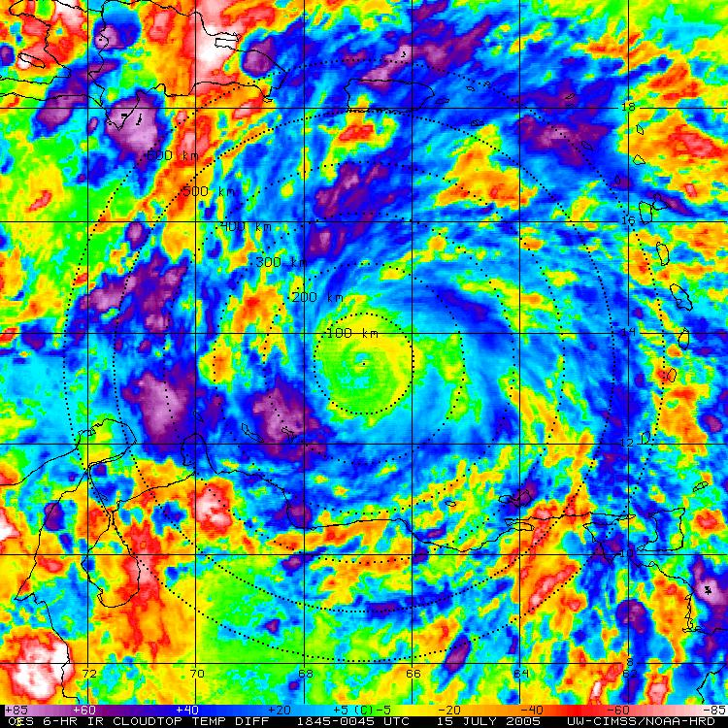
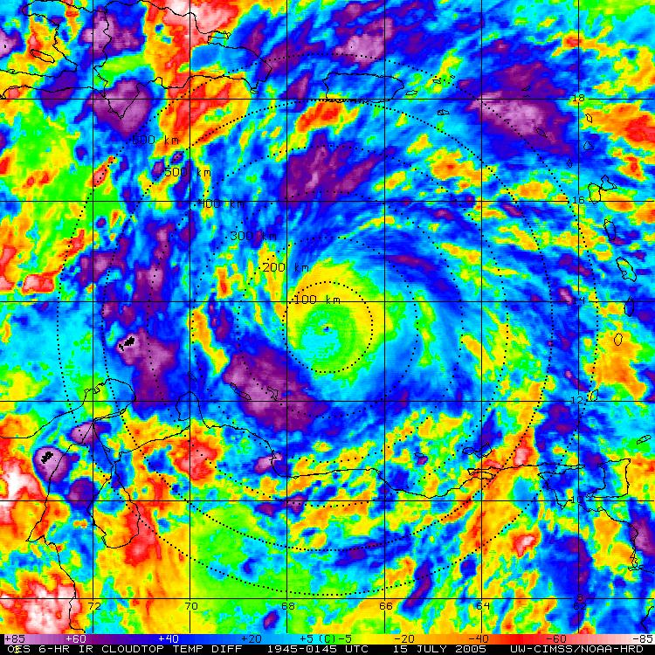
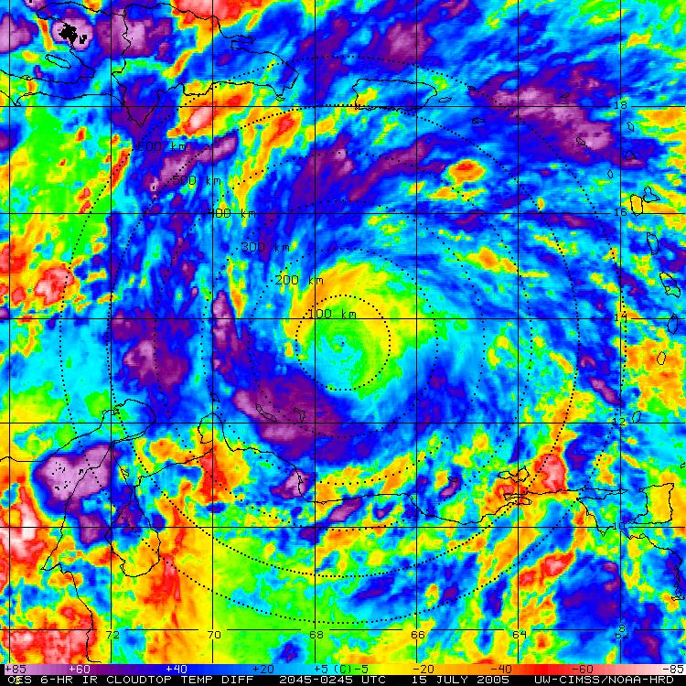
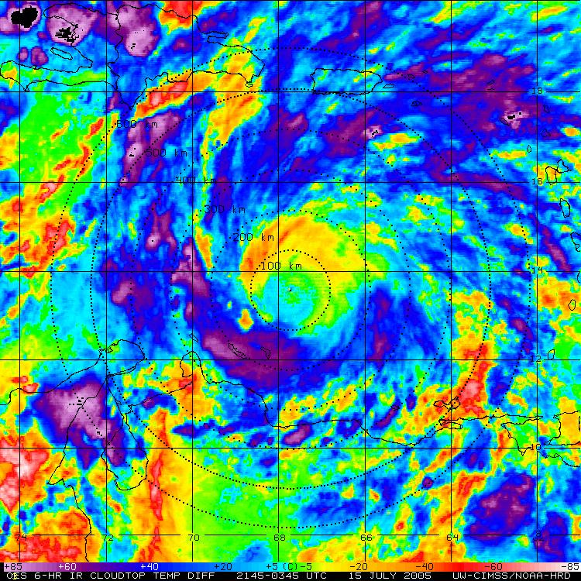
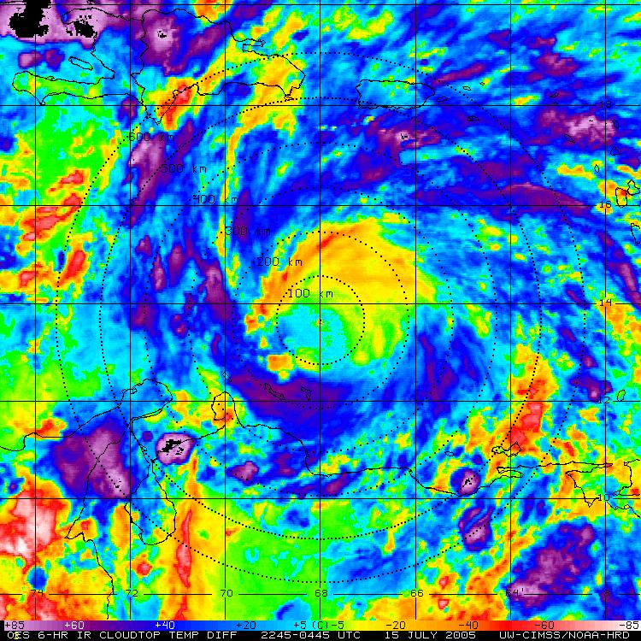
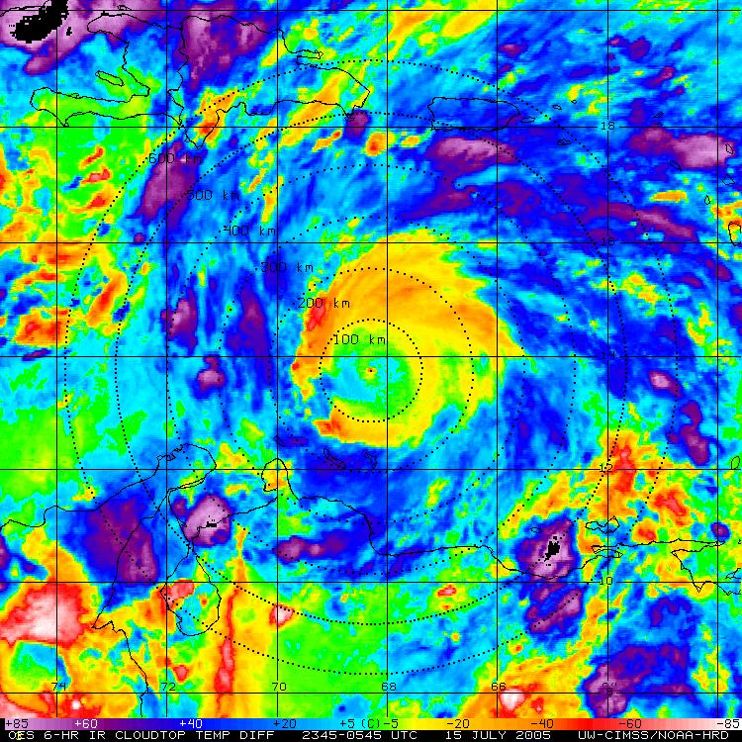
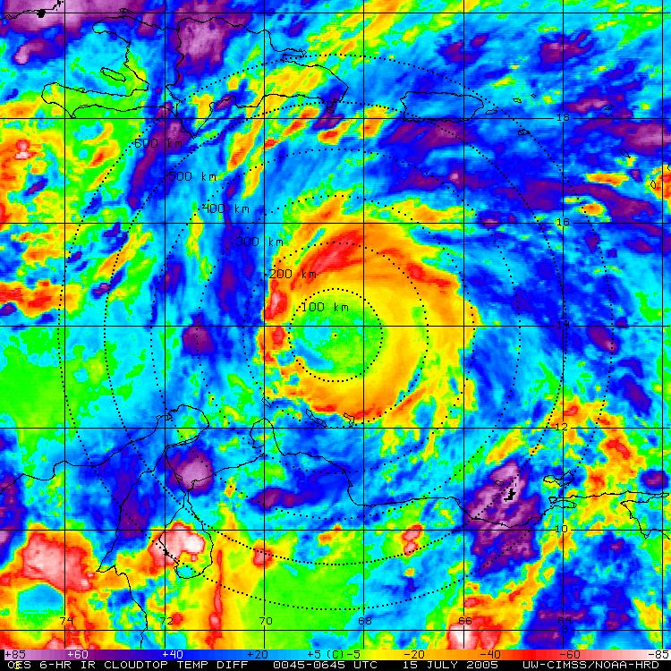
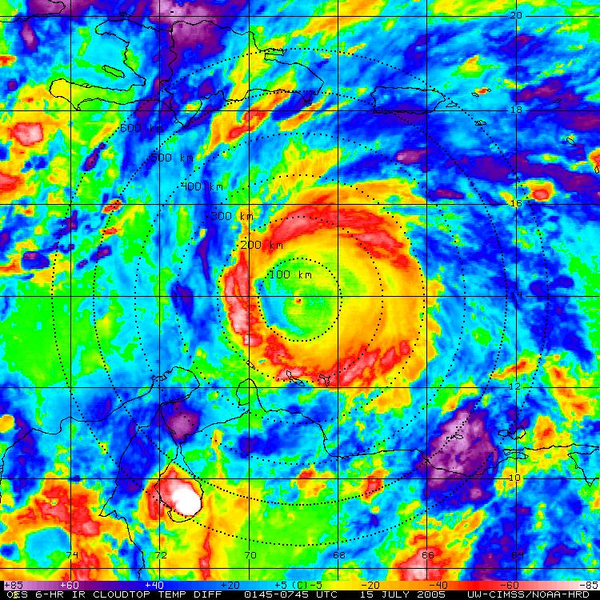
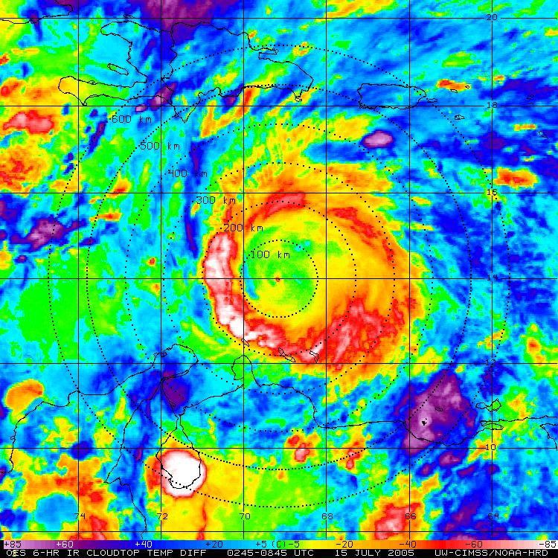


Hurricane Emily: 14-15 July 2005
GOES IR (storm relative)
GOES BT Diff (storm relative)

Slide 4












































Hurricane Felix: 02-03 Sept 2007
GOES IR (storm relative)
GOES BT Diff (storm relative)

Slide 5



























Hurricane Earl: 30-31 August 2010
GOES IR (storm relative)
GOES BT Diff (storm relative)

Slide 6





GOES IR BT Differences: Azimuthal Mean (400km)
“Cool Rings” (~12-15 UTC)

Slide 7













Diurnal TC Pulsing: A Global Phenomenon
4 AM LST
Andrew
Georges
Ivan
Emily
Katrina
Helene
Daniel
Dean
Felix
Flossie
Danielle
Earl
Opal
Megi
Bianca
Notes:
4am LST

Slide 8













Diurnal TC Pulsing: A Global Phenomenon
10 AM LST
Andrew
Georges
Ivan
Emily
Katrina
Helene
Daniel
Dean
Felix
Flossie
Danielle
Earl
Opal
Megi
Bianca
Notes:
10 am LST

Slide 9













Diurnal TC Pulsing: A Global Phenomenon
8 PM LST
Andrew
Georges
Ivan
Emily
Katrina
Helene
Daniel
Dean
Felix
Flossie
Danielle
Earl
Opal
Megi
Bianca
Notes:
8pm LST

Slide 10
15 July 0300 UTC
ZCZC MIATCDAT5 ALL
TTAA00 KNHC DDHHMM
HURRICANE EMILY DISCUSSION NUMBER 17
NWS TPC/NATIONAL HURRICANE CENTER MIAMI FL
11 PM EDT THU JUL 14 2005
EMILY CONTINUES TO INTENSIFY. DVORAK DATA T NUMBERS AT 00Z WERE 6.0 FROM ALL AGENCIES...CORRESPONDING TO AN INTENSITY ESTIMATE OF 115 KT…
15 July 1500 UTC
ZCZC MIATCDAT5 ALL
TTAA00 KNHC DDHHMM
HURRICANE EMILY DISCUSSION NUMBER 19
NWS TPC/NATIONAL HURRICANE CENTER MIAMI FL
11 AM EDT FRI JUL 15 2005
AN AIR FORCE PLANE CURRENTLY OBSERVING THE STRUCTURE OF EMILY HAS REPORTED CONCENTRIC EYEWALLS OF 8 AND 25 N MI RESPECTIVELY. THIS SUGGESTS THAT EMILY MAY BE GOING THROUGH AN EYEWALL REPLACEMENT CYCLE...WHICH WOULD RESULT IN FLUCTUATIONS IN INTENSITY. BECAUSE THE LAST TIME THE RECON MEASURED WINDS TO SUPPORT CATEGORY FOUR HURRICANE WAS EARLY THIS MORNING…THERE IS NO EYE OBSERVED ON SATELLITE IMAGERY...AND THE CLOUD PATTERN HAS DETERIORATED…
2005 Emily
GOES IR (storm relative)
GOES BT Diff (storm relative)

Slide 11










17 July 0900 UTC
ZCZC MIATCDAT5 ALL
TTAA00 KNHC DDHHMM
HURRICANE EMILY DISCUSSION NUMBER 26
NWS TPC/NATIONAL HURRICANE CENTER MIAMI FL
5 AM EDT SUN JUL 17 2005
AT 0324Z...THE AIR FORCE RESERVE UNIT HURRICANE HUNTER AIRCRAFT REPORTED FLIGHT-LEVEL WINDS OF 153 KT. THE STANDARD ADJUSTMENT OF THIS VALUE TO THE SURFACE WOULD YIELD 138 KT...OR JUST ABOVE THE CATEGORY FIVE THRESHOLD.
17 July 1500 UTC
ZCZC MIATCDAT5 ALL
TTAA00 KNHC DDHHMM
HURRICANE EMILY DISCUSSION NUMBER 27
NWS TPC/NATIONAL HURRICANE CENTER MIAMI FL
11 AM EDT SUN JUL 17 2005
SATELLITE IMAGERY AND REPORTS FROM AN AIR FORCE RESERVE HURRICANE HUNTER AIRCRAFT INDICATE THAT EMILY HAS WEAKENED SLIGHTLY OVER THE PAST 12 HR. THE EYE HAS BECOME LESS DISTINCT IN SATELLITE IMAGERY AND THE OVERALL CLOUD PATTERN HAS BECOME A LITTLE RAGGED…IT IS UNCLEAR WHETHER THE WEAKENING THAT HAS OCCURRED IS DUE TO AN INTERNAL CYCLE OR EXTERNAL FORCING. A RECENT SSM/I OVERPASS DOES NOT SHOW CONCENTRIC EYEWALLS...AND WHILE CIRRUS OUTFLOW HAS DIMINISHED OVER THE SOUTHERN SEMICIRCLE THERE ARE NO OBVIOUS SIGNS OF SHEAR AT THIS TIME.
2005 Emily
GOES IR (storm relative)
GOES BT Diff (storm relative)

Slide 12

GOES IR BT-Difference Cool Rings…what’s going on?
Pre-Sunset
Gravity waves dispersed
<
>
Sunset
<
>
Gravity waves reflected: cooling cloud tops (>stability); ~10 m/s propagation?

Slide 13


Hurricane Katia: 06-07 September 2011
110906N1
110907N1

Slide 14






Hurricane Katia: 06 September 2011
IP
5
FP
10

Slide 15





Hurricane Katia: 06 September 2011
IP
5
FP
10

Slide 16
























































































































Hurricane Andrew: 21-23 August 1992
GOES IR (storm relative)
GOES BT Diff (storm relative)

Slide 17

Hurricane Andrew: 21-25 August 1992
South FL Landfall

Slide 18

































Hurricane Andrew: 23-24 August 1992
GOES IR (storm relative)
GOES BT Diff (storm relative)

Slide 19

Hurricane Andrew: 21-25 August 1992
South FL Landfall

Slide 20
ZCZC MIAWRKAD4 LOC
TTAA00 KNHC DDHHMM
...FOR INTERGOVERNMENTAL USE ONLY…
HURRICANE ANDREW DISCUSSION NUMBER 30
NATIONAL WEATHER SERVICE MIAMI FL
5 PM EDT SUN AUG 23 1992 (23 Aug 2100z)
THE LAST RECON REPORTED 923 MB...WHICH SUGGESTS THE DEEPENING HAS SLOWED OR MAYBE STOPPED FOR THE TIME BEING. THE 8 NMI DIAMETER EYE WILL LIKELY BE HARD TO MAINTAIN AND WE SHOULD EXPECT TO SEE SOME FLUCTUATIONS IN INTENSITY BEFORE LANDFALL ON THE FLORIDA SOUTHEAST COAST.
ZCZC MIATCDAT4
TTAA00 KNHC 240321 COR
...FOR INTERGOVERNMENTAL USE ONLY...
HURRICANE ANDREW DISCUSSION NUMBER 31
NATIONAL WEATHER SERVICE MIAMI FL
11 PM EDT SUN AUG 23 1992 (24 Sep 0300z)
THERE ARE NO SIGNIFIGANT CHANGES TO REPORT IN EITHER THE TRACK OR INTENSITY OF ANDREW. HOWEVER...MINOR STRUCTURAL EVOLUTION IS UNDERWAY IN THE CORE REGION WITH RECON CONTINUING TO REPORT A CONCENTRIC EYEWALL STRUCTURE. THIS DEVELOPMENT COINCIDES WITH A SLIGHT DECREASE IN THE STRENGTH OF THE INTERIOR EYEWALL...AND SO THE INTENSITY HAS BEEN LOWERED A LITTLE...TO 120 KT.
1992 Andrew

