Slide 1
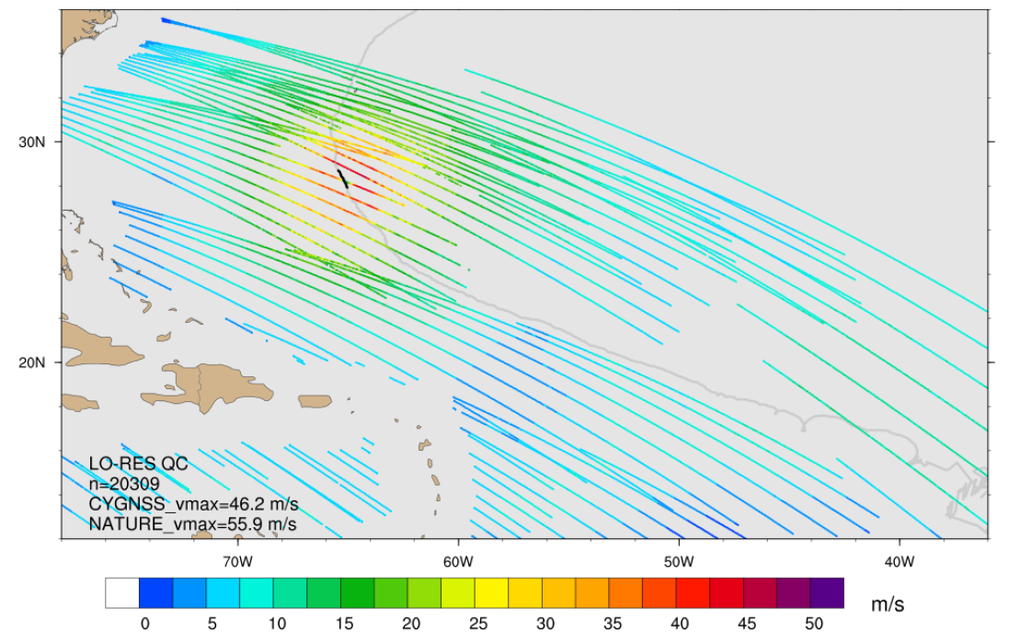
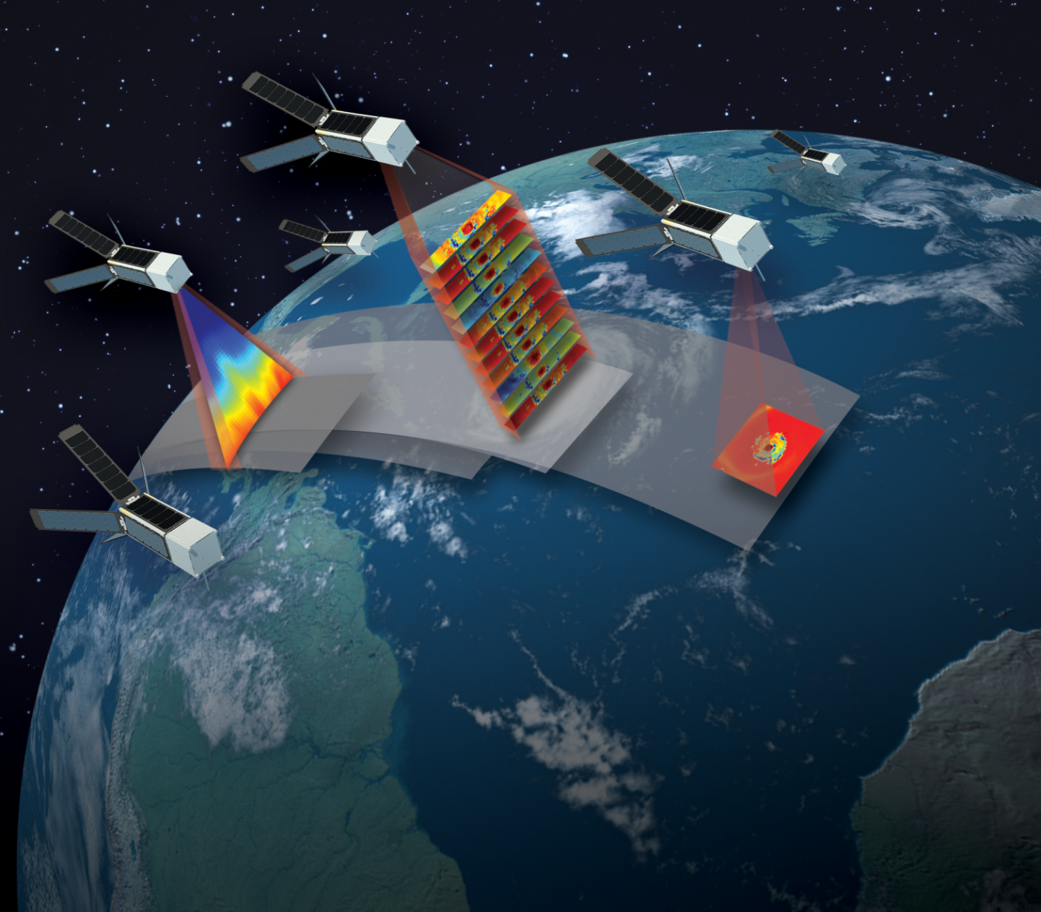
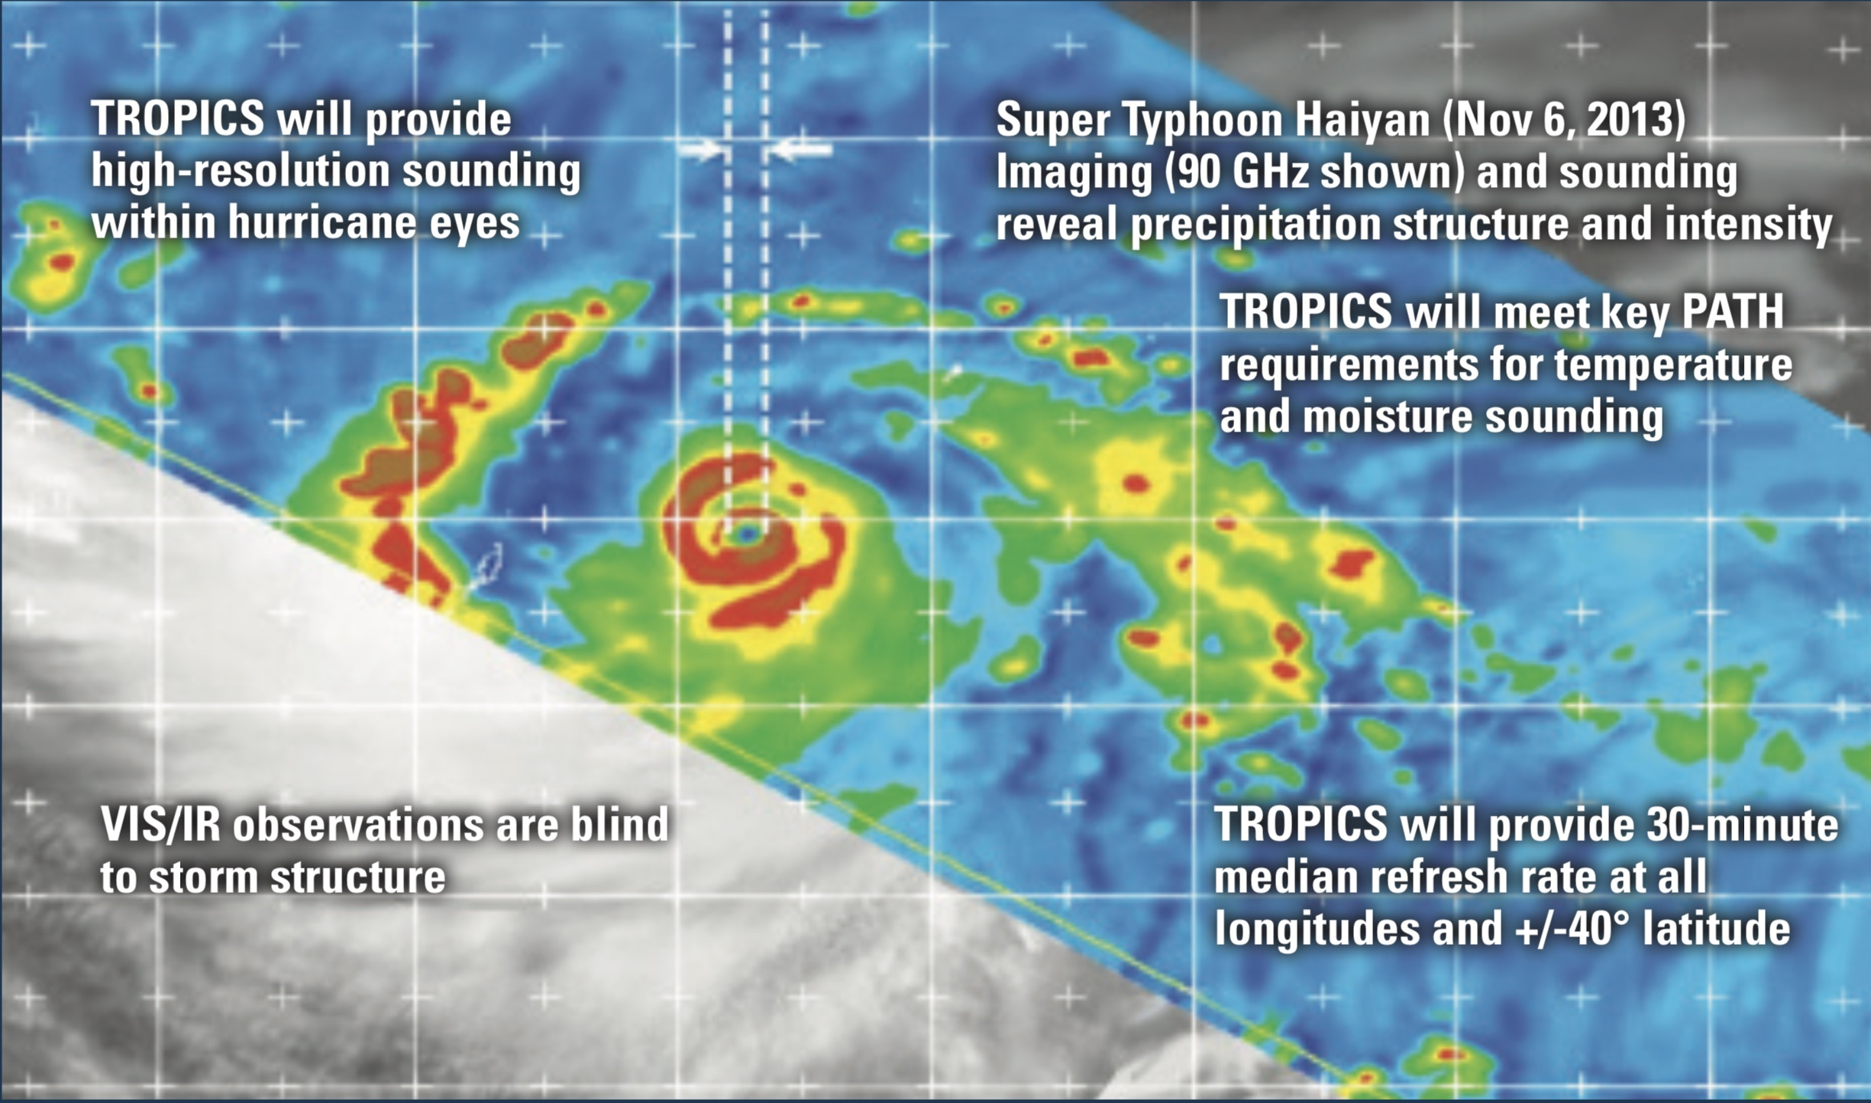
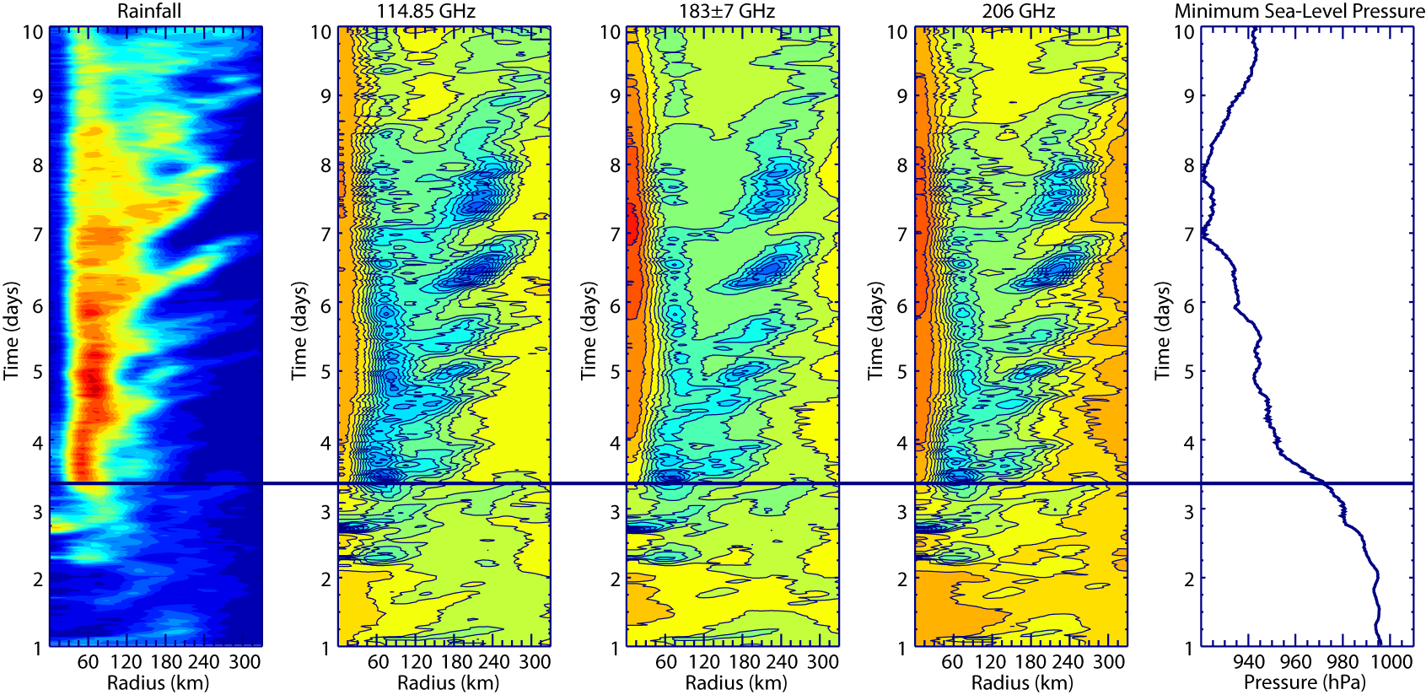
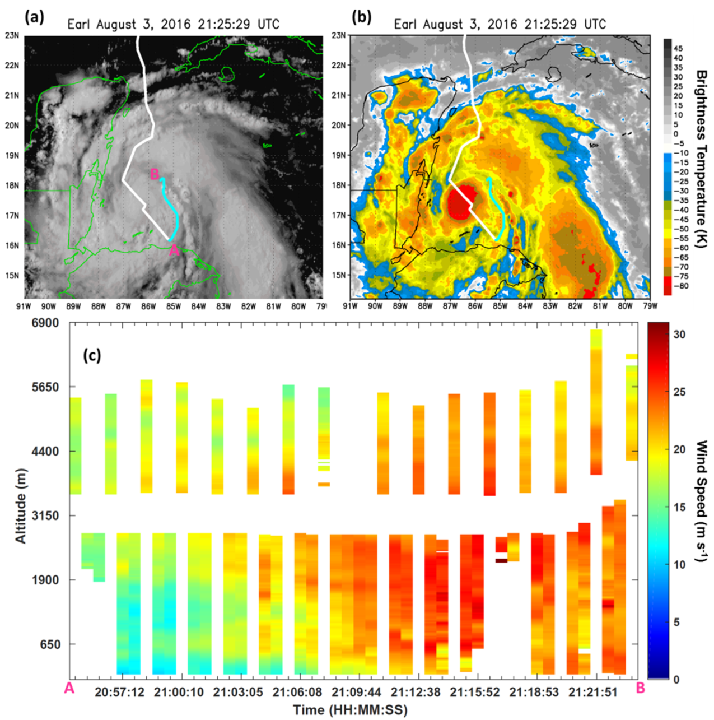
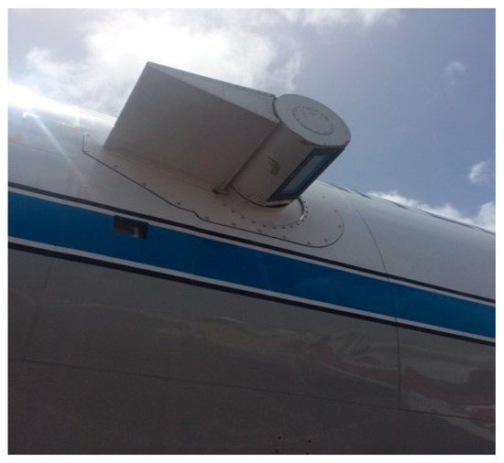
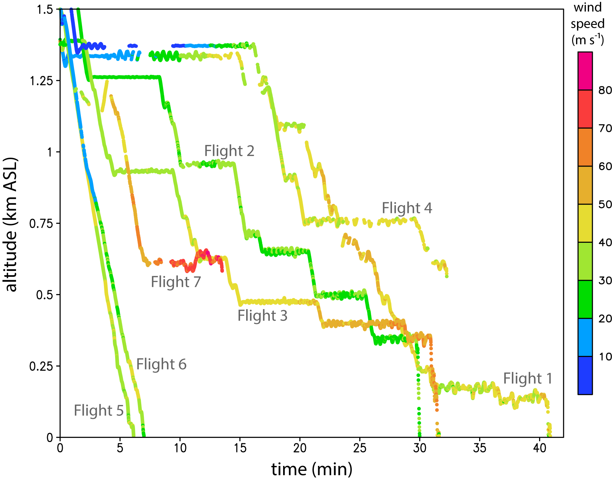
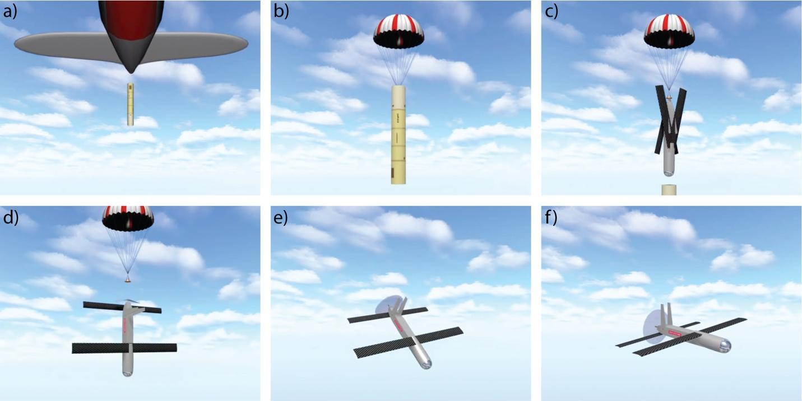
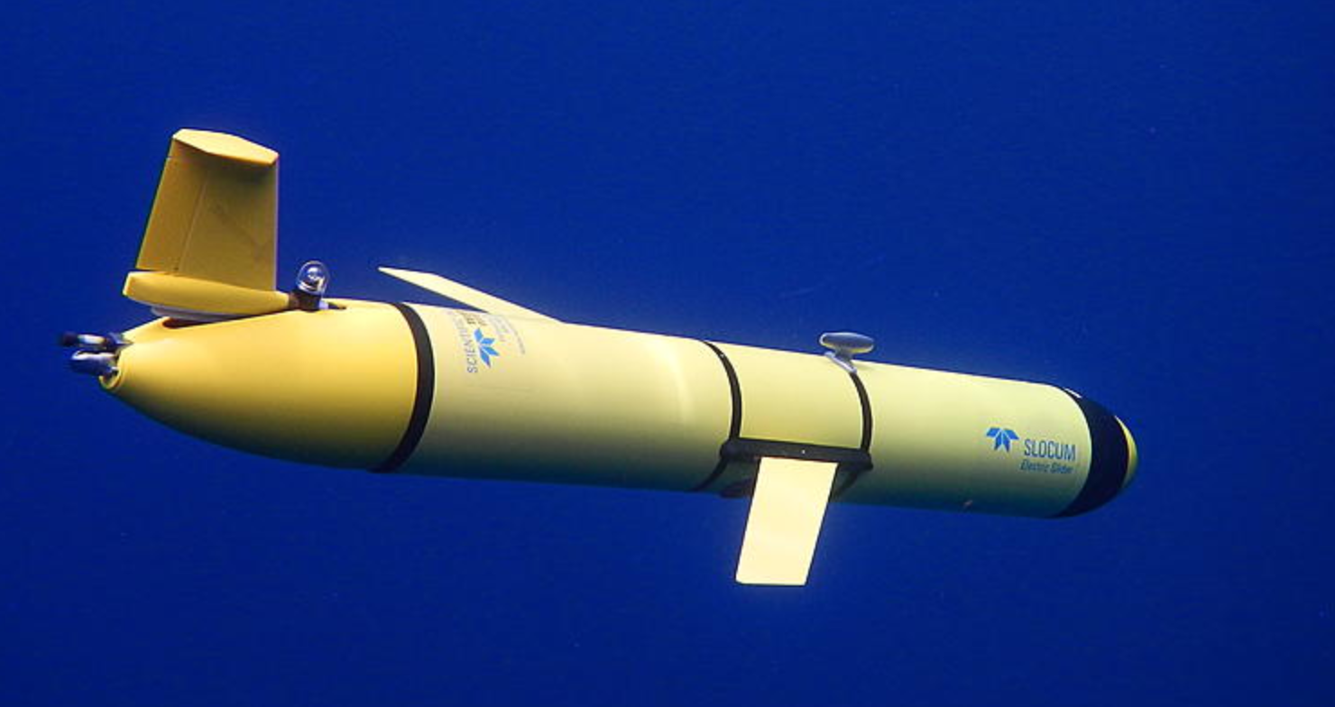
CYclone Global Navigation Satellite System
What is it?
How has this technology improved TC understanding and forecasts?
How will we use this technology in the future?
CYGNSS is a constellation of 8 micro-satellites with extensive spatial coverage of the global tropical latitudes.
Words
More words
Seriously help me
What does it measure?
Initial studies show an improvement in short term (0-48h) intensity forecasts
Data provides enhanced estimates of storm size and surface integrated kinetic energy (IKE).
Adding directional information to the CYGNSS wind speeds using the variational dimension analysis method improves storm structure and forecast further.
An example of the spatial coverage of CYGNSS wind speed retrievals over a 6-hour window. The thin gray line traces the center of the TC, while the black segment highlights the TC’s position during this period. Credit: B. McNoldy
The CYGNSS satellites measure signals from existing GPS satellites and signals reflected off the Earth’s surface. These two pieces of information are used in an algorithm to estimate surface wind speed.
Time-Resolved Observations of Precipitation structure and storm Intensity with a Constellation of Smallsats (TROPICS)
What is it?
How will this technology improve TC understanding and forecast?
TROPICS is a future (scheduled launch in 2022) constellation of 6 CubeSats with frequent, dense coverage of microwave observations over the global tropical latitudes.
What does it measure?
By providing rapid-refresh moisture, temperature, and precipitation measurements over the tropics.
An unprecedented combination of horizontal and temporal resolution of tropical cyclone life cycles.
Key data to resolve the structural evolution of TC rapid intensification.
TROPICS will measure temperature, moisture, and precipitation using a 12-channel microwave sensor:
Temperature: 8 channels from 91-118 GHz
Water Vapor : 5 channels from 91-205 GHz
Artist rendition of MicroMAS-2 constellation. Orbital configuration has a with 30-minute median revisit rate.
Science Team is led by Dr. William Blackwell (MIT Lincoln Laboratory) and is a collaboration between NASA, NOAA, U. of Miami, and U. Wisconsin scientists.
New Tropical Cyclone
Observing Technologies
Doppler Wind Lidar (DWL)
How has this technology improved our understanding of TCs?
What is it?
DWL is complementary to other wind-observing instruments (ie. Radars, SFMR), particularly in sheared storms with an asymmetric distribution of precipitation .
Continuous high vertical resolution (50 m) offers more detailed look at the storm boundary layer.
The DWL is an instrument flown on the NOAA WP-3D that uses a low powered 1.6-μm laser.
What does it measure?
What is next?
The light along the beam measures the movement of aerosols. Wind profiles are created from the combinations of multiple beams. The DWL measures wind along the flight path in precipitation-free regions of tropical systems.
Transmission of retrieved wind profile data to ground servers in real-time
Data impact studies using regional operational and experimental numerical models
DWL bi-axial scanner points above or below aircraft
(a) Visible (b) IR satellite imagery of Hurricane Earl with flight track overlaid (white) and downwind leg (cyan). (c) DWL wind speed profiles collected during the downwind leg.
Collect new observations in data sparse regions of tropical cyclones
Small Unmanned Aircraft Systems (sUAS)
What is it?
How has this technology improved our understanding of TCs?
sUAS is an expendable platform released from the NOAA WP-3D and flies near the ocean surface (below 1.5 km).
Increased observational coverage of the TC boundary layer especially in the eyewall and the inflow layer
Measurements used to estimate turbulence characteristics within the hurricane eyewall
Comparison to numerical model output reveals potential areas for improvement within the boundary layer parameterization scheme
What does it measure?
Summary of all wind speed data collected during Coyote sUAS flights in 2017–2018 (colored dots, m s-1) as a function of time and height above sea level (ASL). Flights 1–4 and 7 were typical “stepped descent” flight patterns, while flights 5–6 were “glider” flights.
Coyote sUAS launch sequence. a) Coyote released in sonobuoy canister from P-3. b) Parachute slows descent. c) Canister falls away and wings/stabilizers deploy. d) Parachute detaches. e) Motor starts and Coyote levels out. f) Coyote attains level flight and begins operations. Images were captured from a video provided courtesy of Raytheon Corporation.
Temperature, humidity, pressure and sea surface temperature
High spatial and temporal (5Hz) resolution horizontal and vertical winds
How will we use this technology in the future?
Direct calculation of surface heat, moisture, and momentum fluxes to eliminate use of exchange coefficients
Provide observations to operational models for assimilation in real time
Modify numerical model physical parameterization schemes and estimations based on sUAS observations and future composite analyses
Test improved sUAS platforms that increase flight longevity, utilize upgraded autopilot capabilities, and extend data transmission radii
Infrared Dropsondes
What is it?
Ocean Gliders
What is it?
What does it measure?
An infrared sensor attached to GPS dropsondes that provides sea surface temperature in addition to temperature, moisture, winds, and pressure.
It is an autonomous underwater vehicle that uses small changes in buoyancy with wings to propel itself by converting vertical motion into horizontal motion.
Temperature
Salinity
Dissolved Oxygen
Chlorophyll Concentration
Chromophoric Dissolved Organic Matter
Schematic of modified GPS dropsonde
How does this technology improve TC understanding and forecast?
How has this technology improved our understanding of TCs?
Provides insight to ocean cooling under the storm caused by upwelling
Information needed to calculate bulk fluxes
Can be used in the future for coupled model assimilation, verification, and validation
AXBT vs IR sonde SST for 16 pairs of Hurricane Edouard (2014) collocated measurements in lower rain conditions. The dashed black line shows the ‘perfect’ 1:1 ratio, and the solid black line shows best-fit linear regression (equation shown). The correlation coefficient squared (R²) is also given.
Image of underwater vehicle with wings deployed.
Find out more about gliders at the AOML website: https://www.aoml.noaa.gov/phod/goos/gliders
Glider data helps reduce errors of simulated ocean conditions used to initialize the ocean-atmosphere forecast models
Ocean observations helped to significantly reduce the error of Hurricane Gonzalo (2014) intensity forecast

