Slide 1
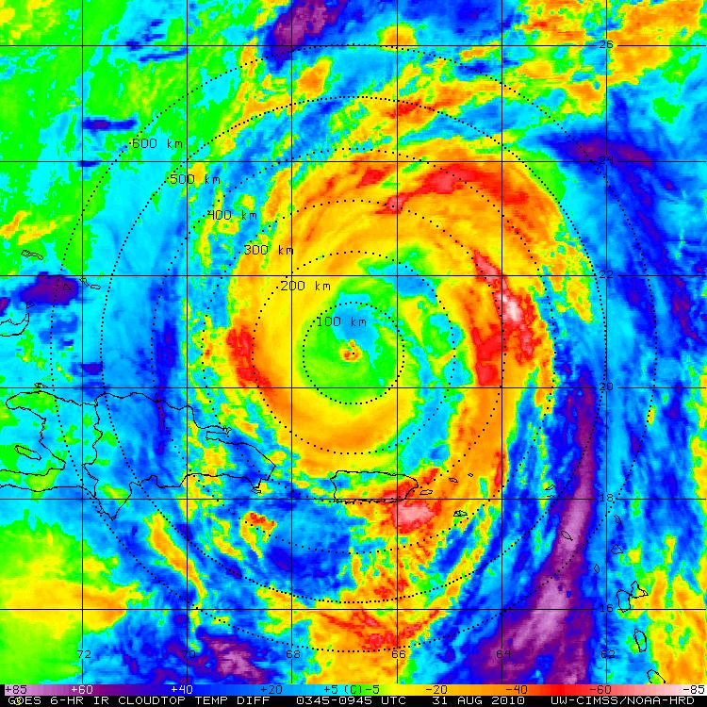
Diurnal Pulsing of Tropical Cyclones: An Overlooked Yet Fundamental TC Process?
Jason Dunion¹, Chris Thorncroft², Chris Velden³, Kerry Emanuel⁴, & David Nolan⁵
1 University of Miami/CIMAS – NOAA/AOML/HRD – SUNY/Albany
2 SUNY/Albany
3 University of Wisconsin-UW/CIMSS
4 MIT
5 University of Miami/RSMAS

Slide 2
Discussion Outline
Motivation:
-Understand & describe the notion of TC diurnal pulsing
-Fundamental process?
-Implications for TCs?
TC Diurnal Pulsing:
1) Sample North Atlantic Cases
2) A “Big Ben” TC process?
4) What are they?
5) Implications: Intensity and Dvorak
6) Modeling
Conclusions & Future Work

Slide 3
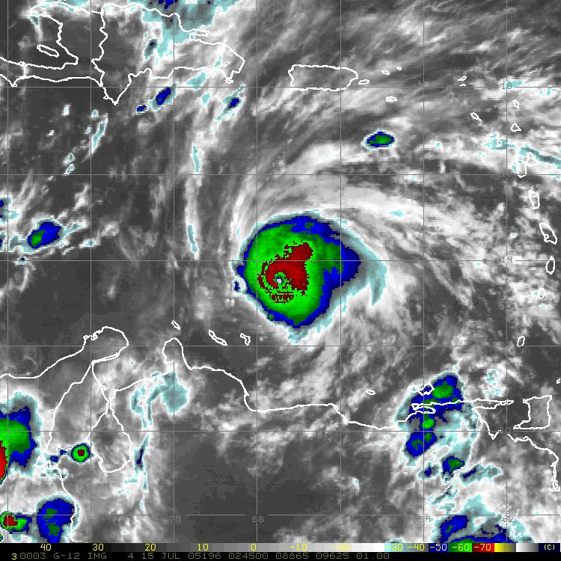
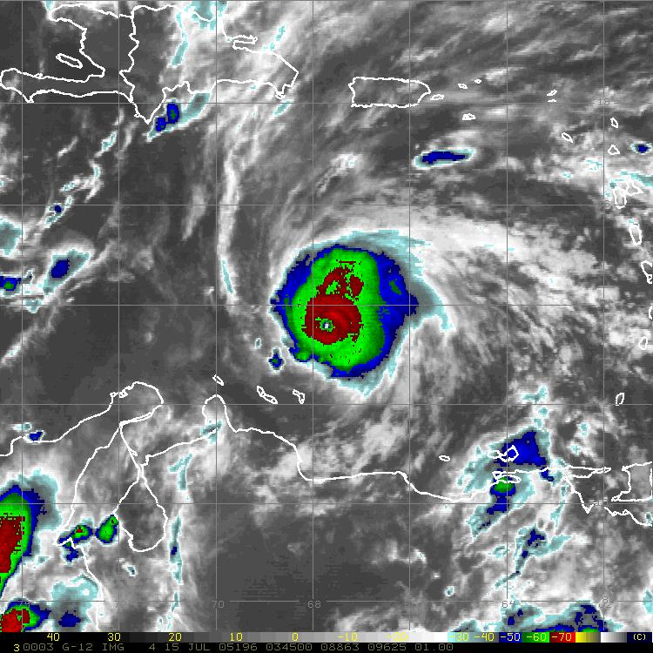
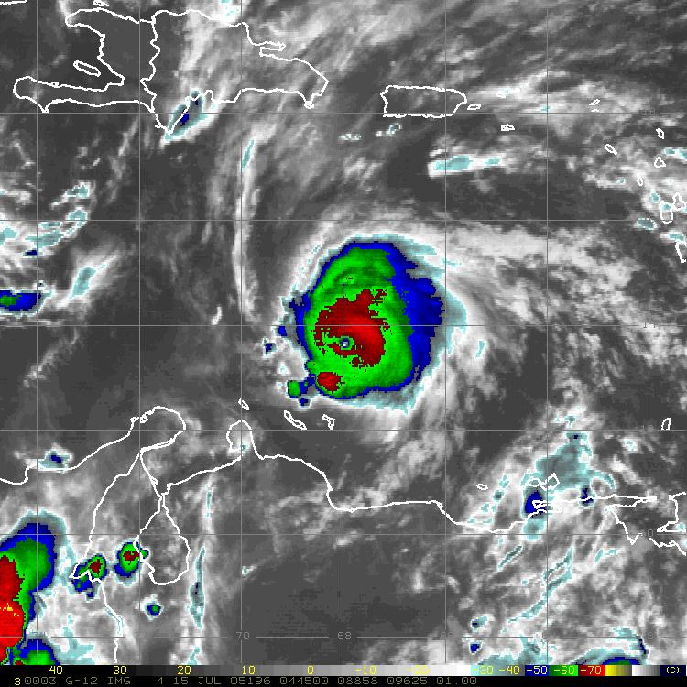
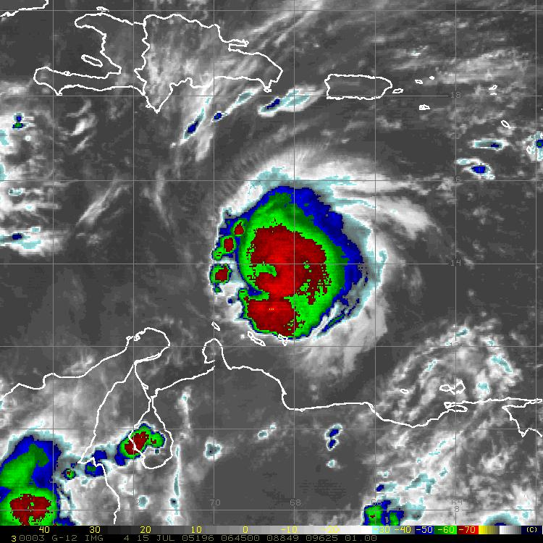
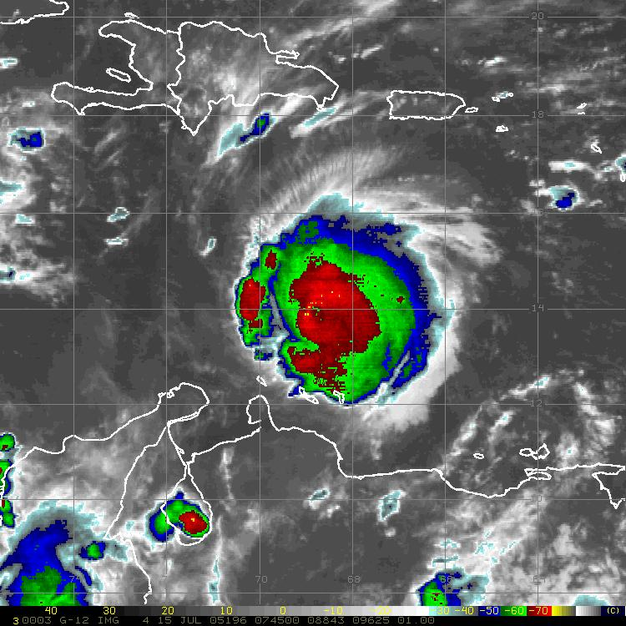
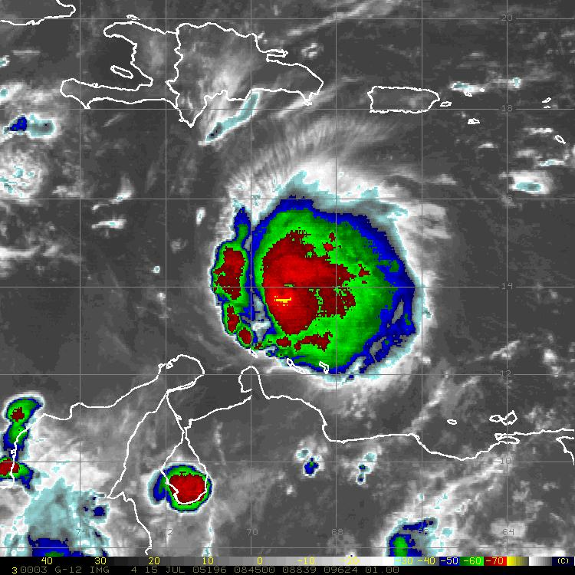
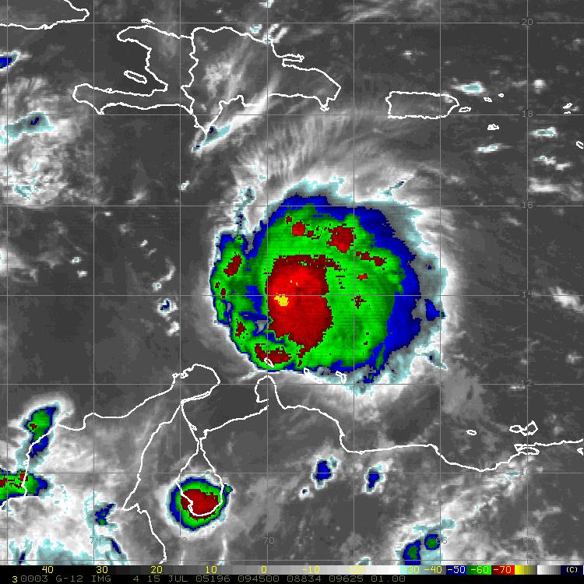
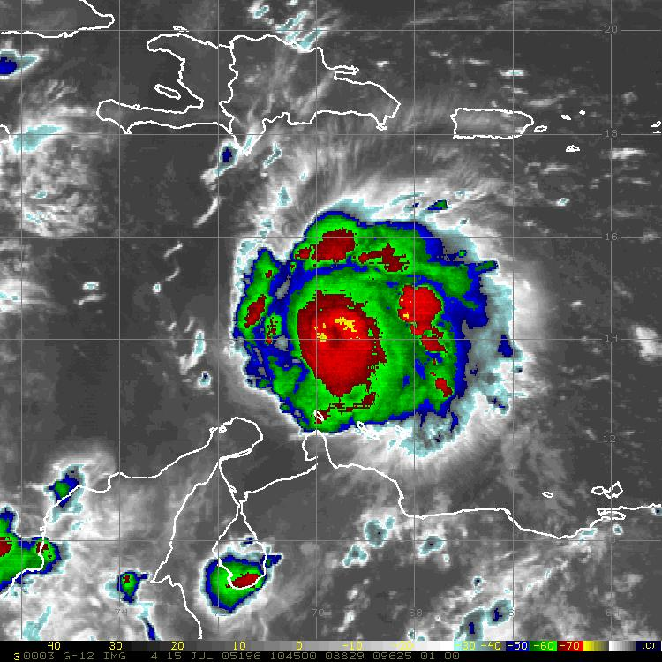
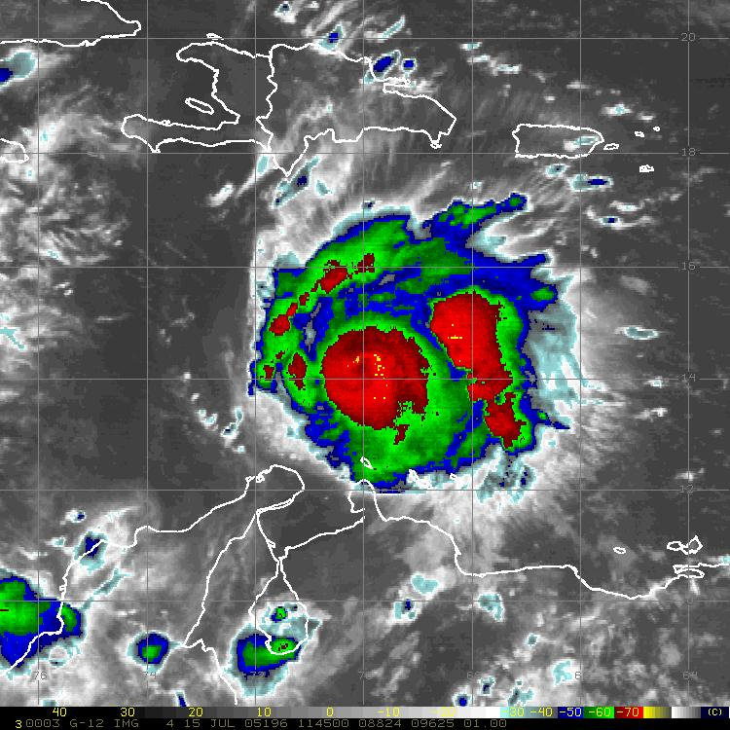
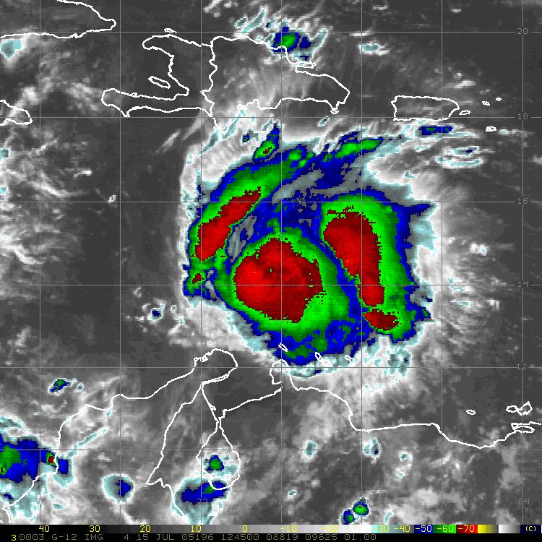
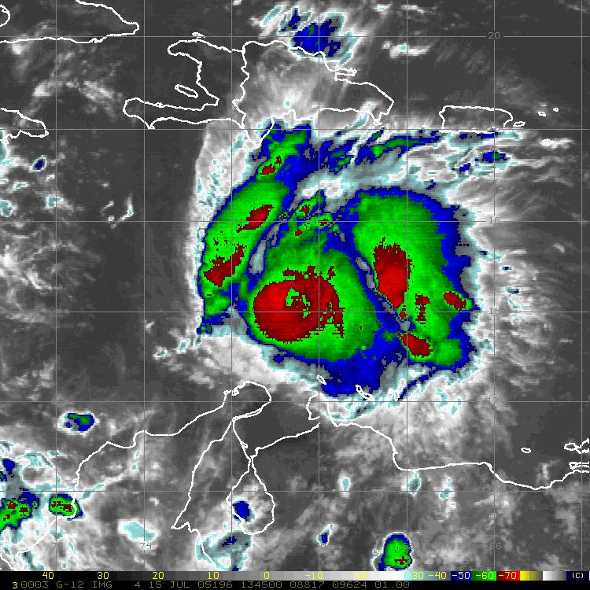
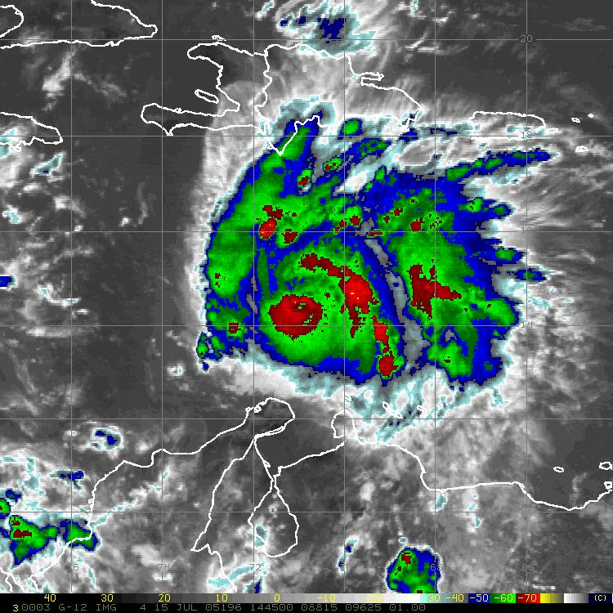
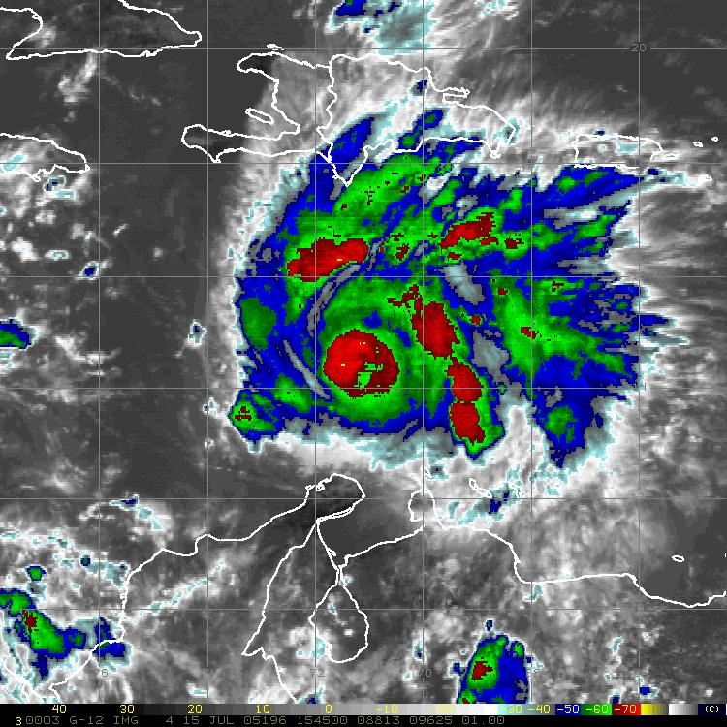
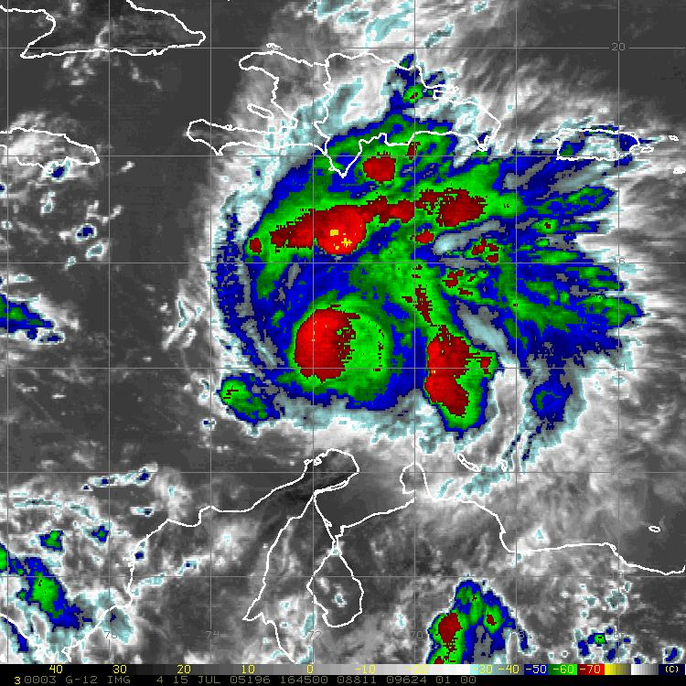
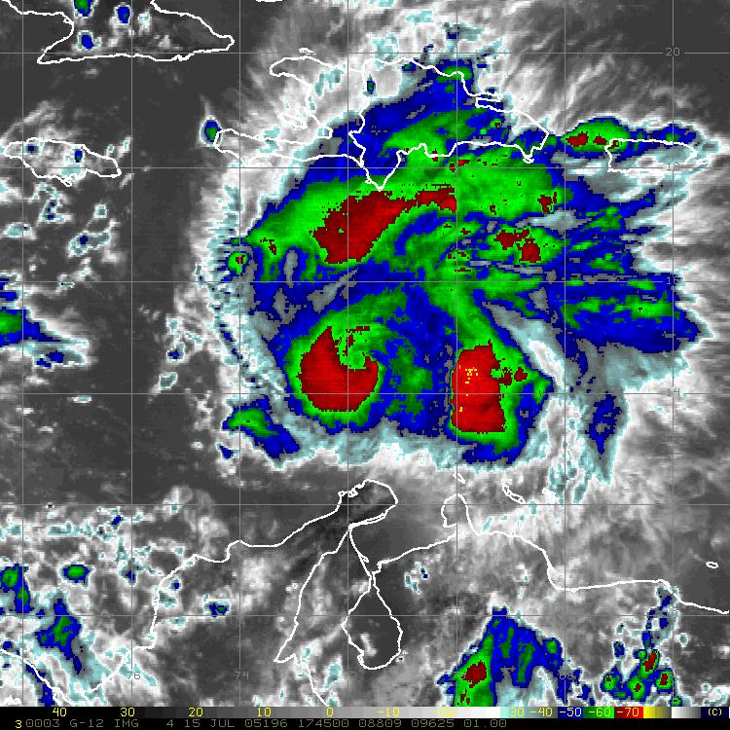
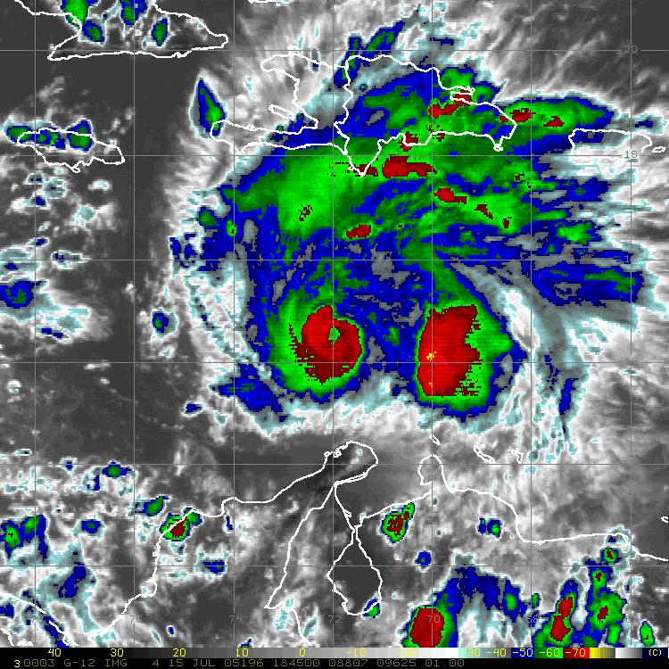
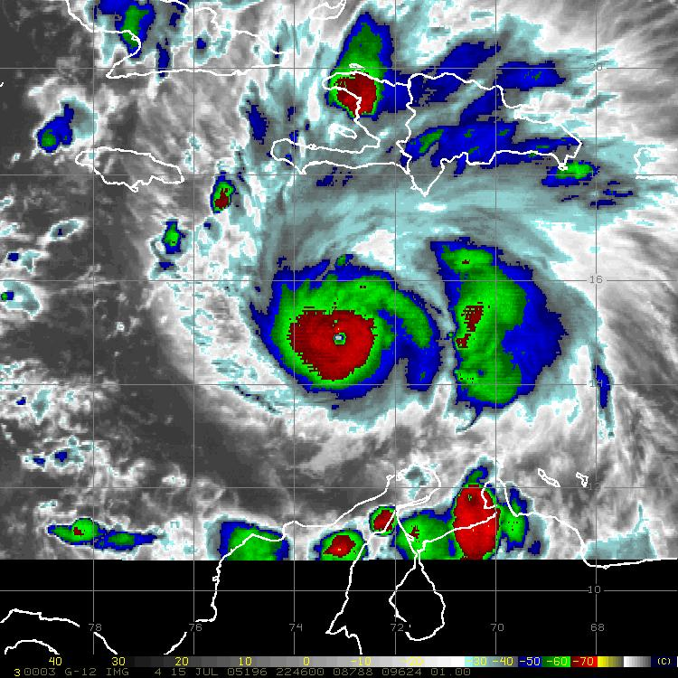
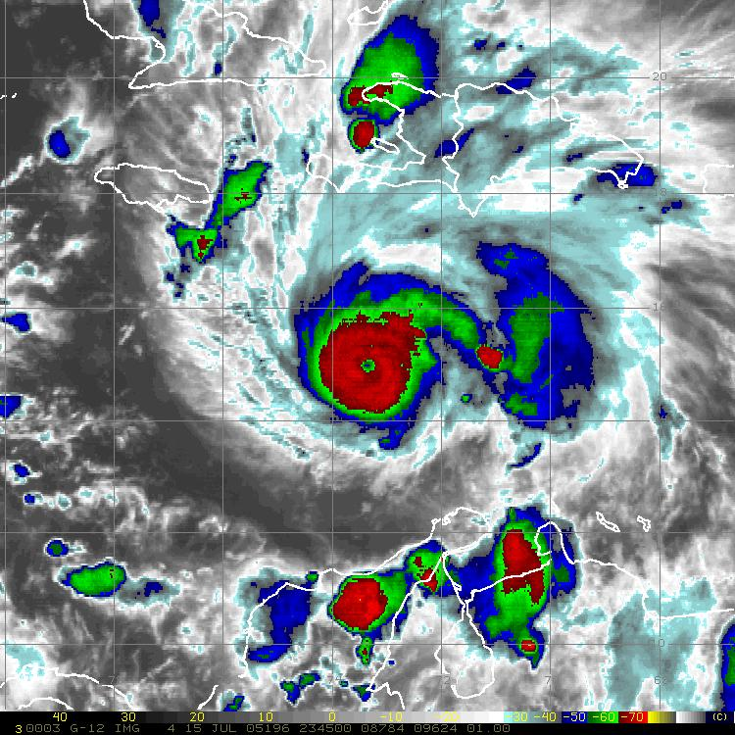
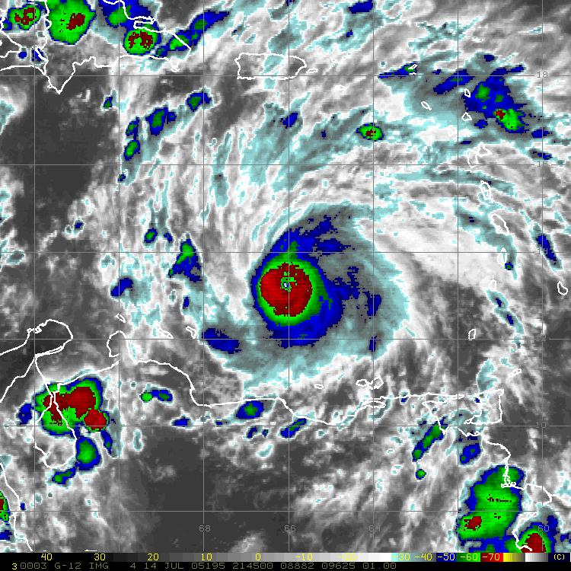
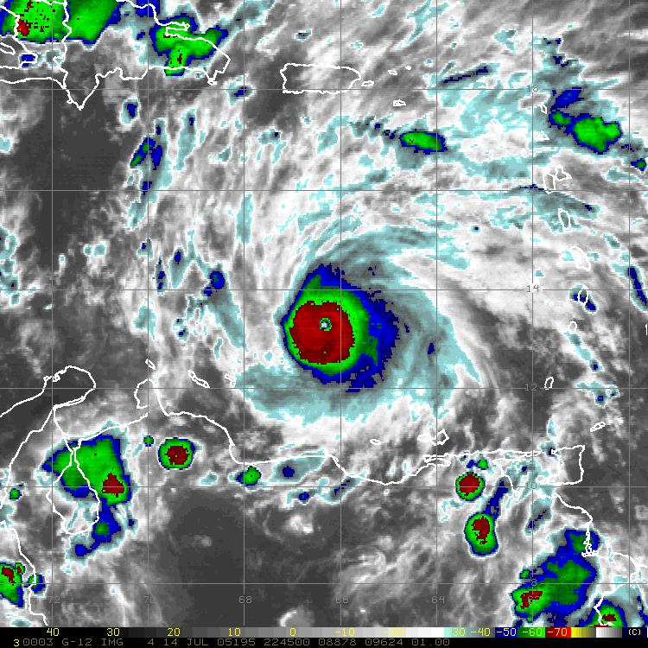
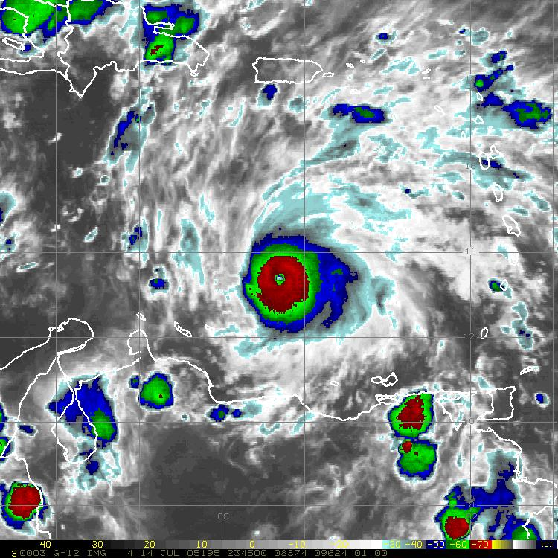
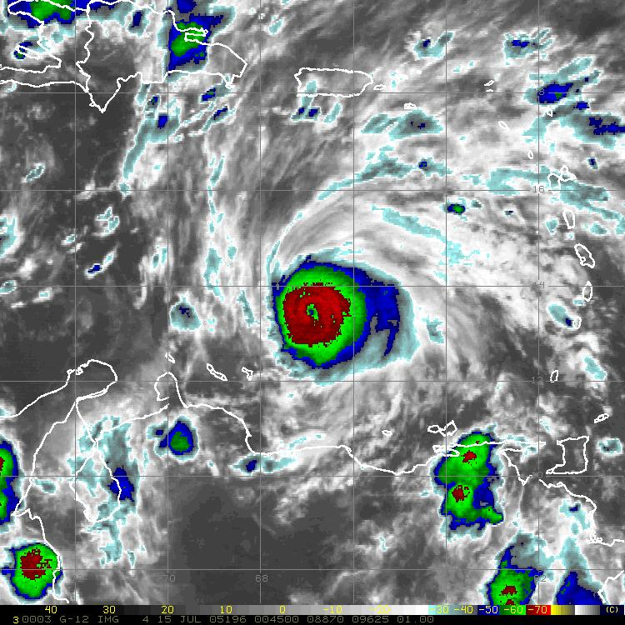
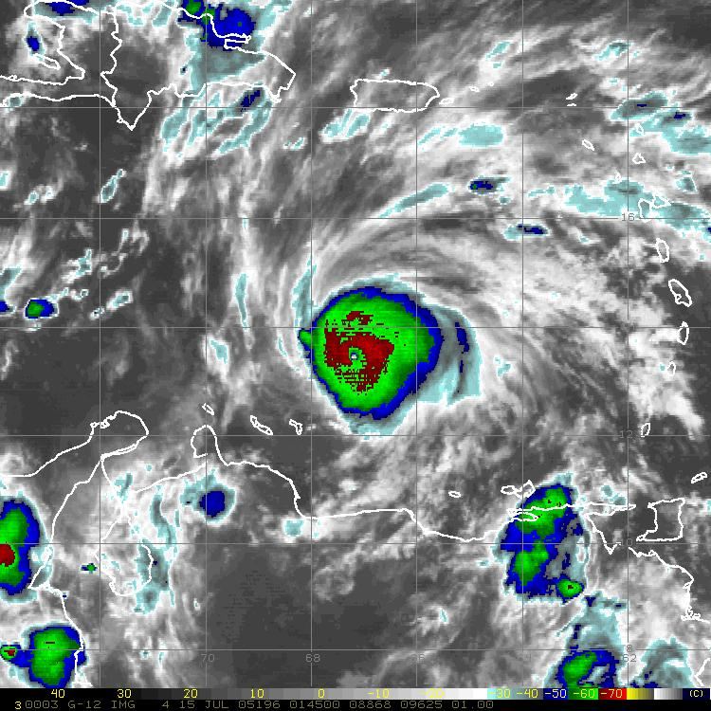
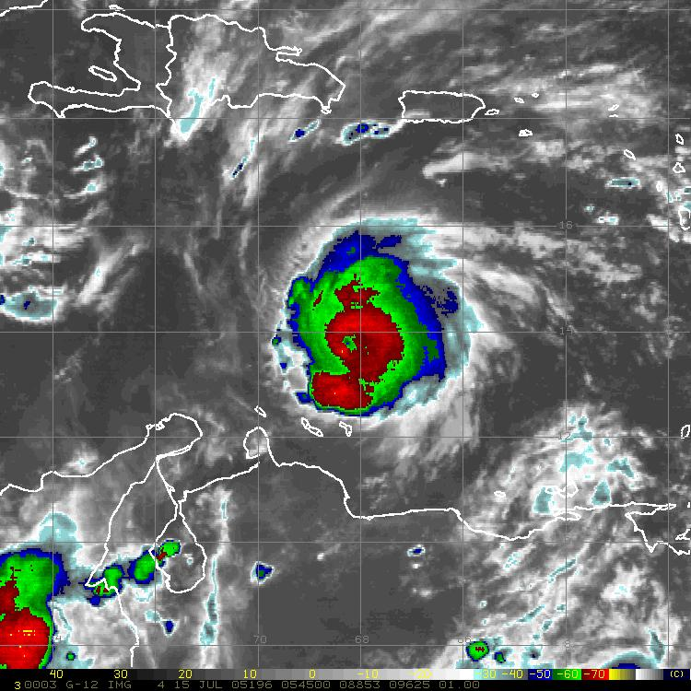
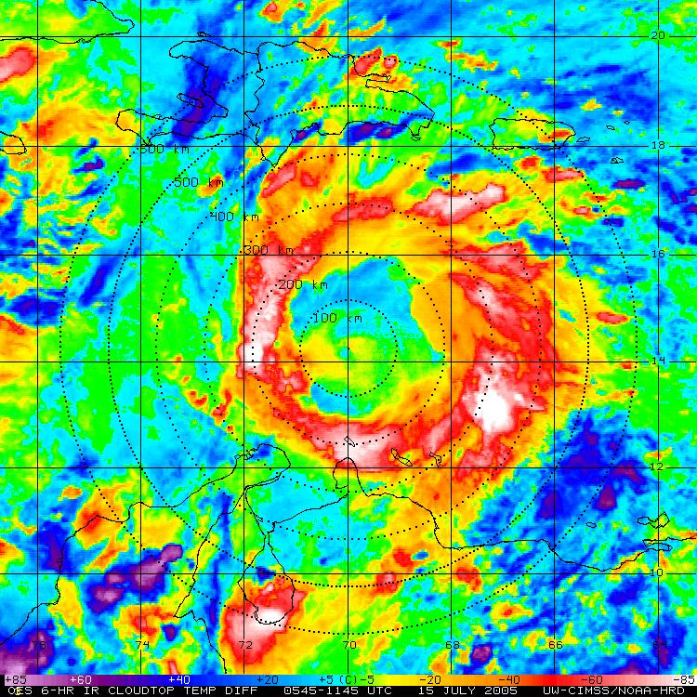
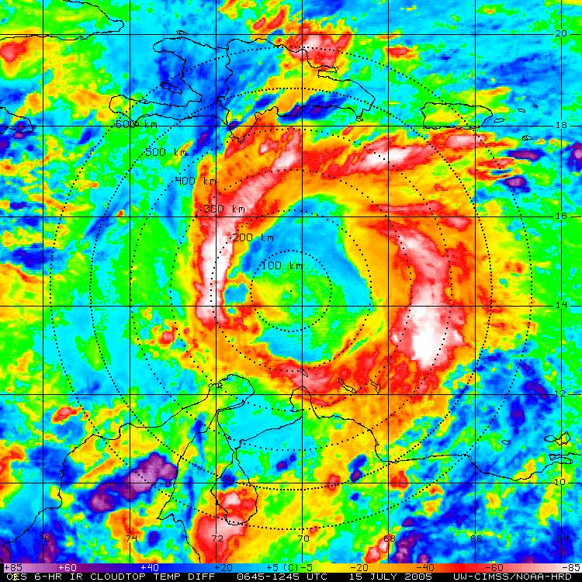
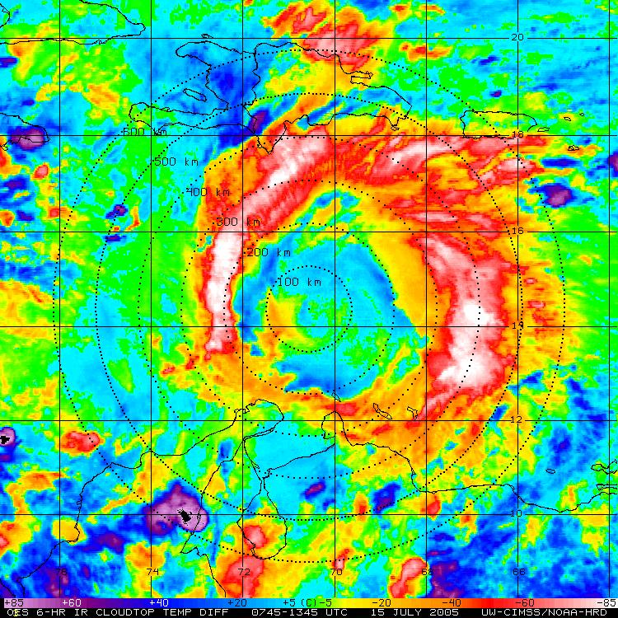
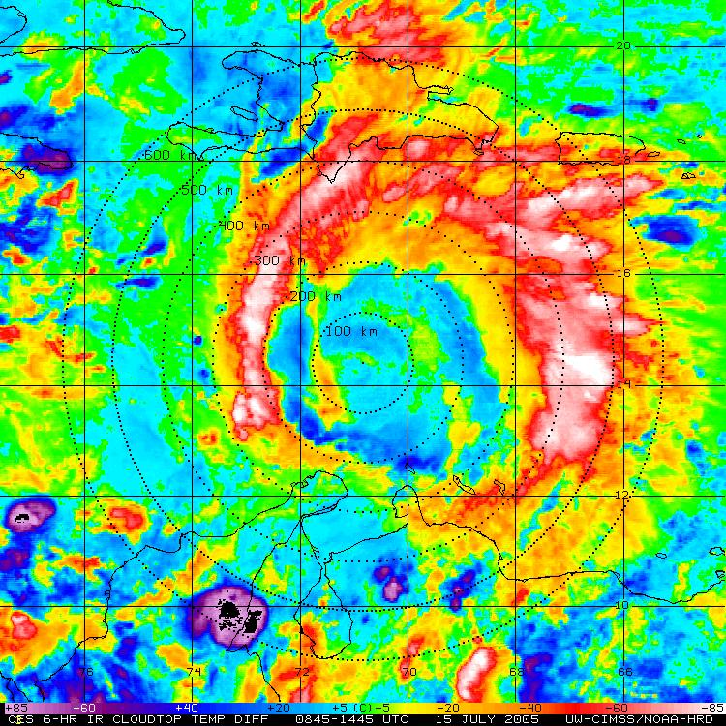
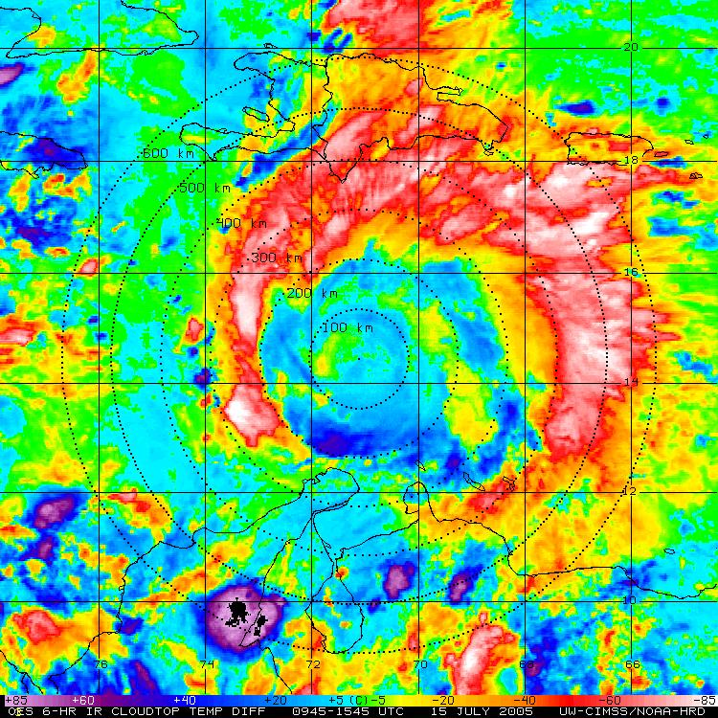
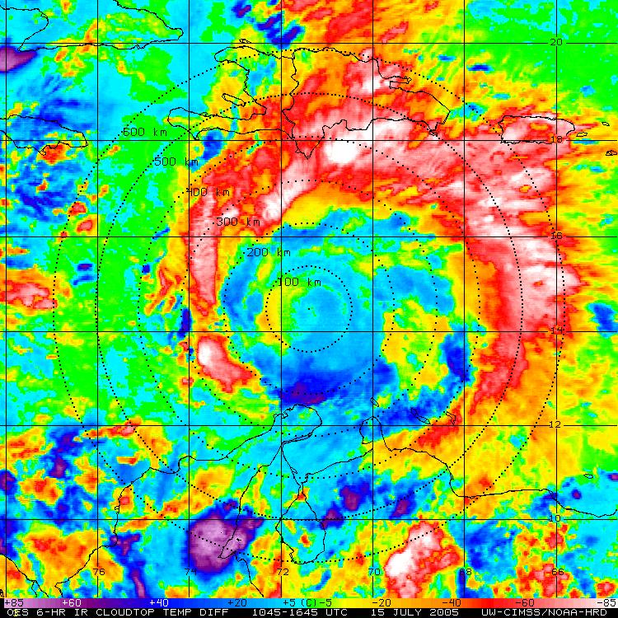
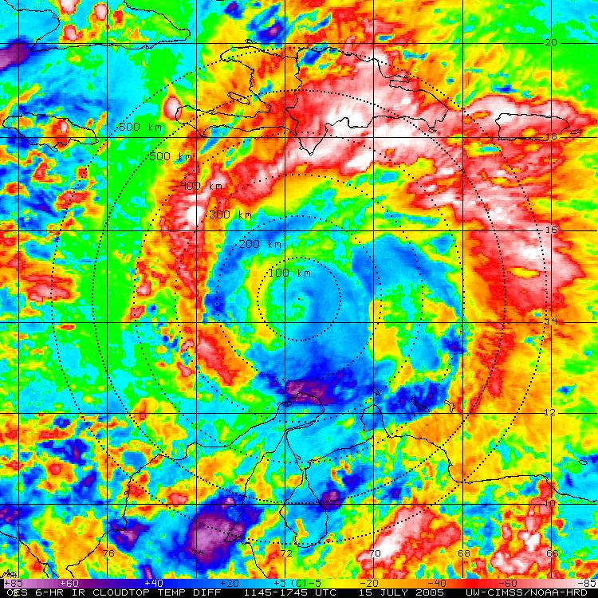
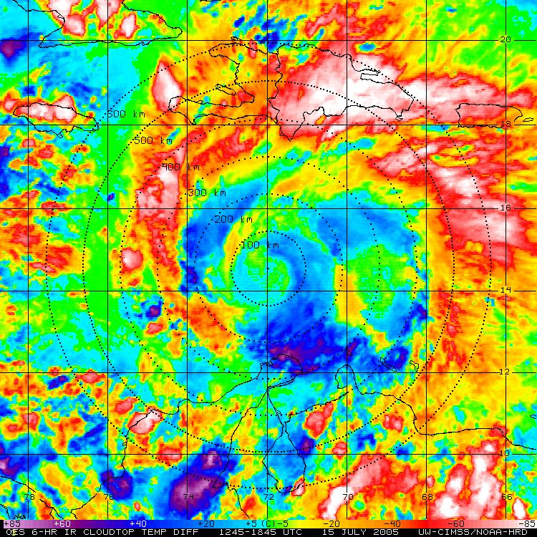
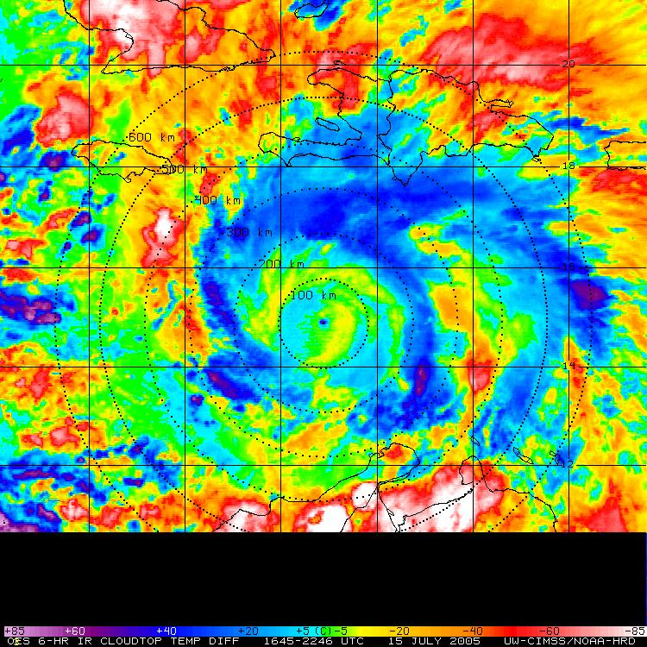
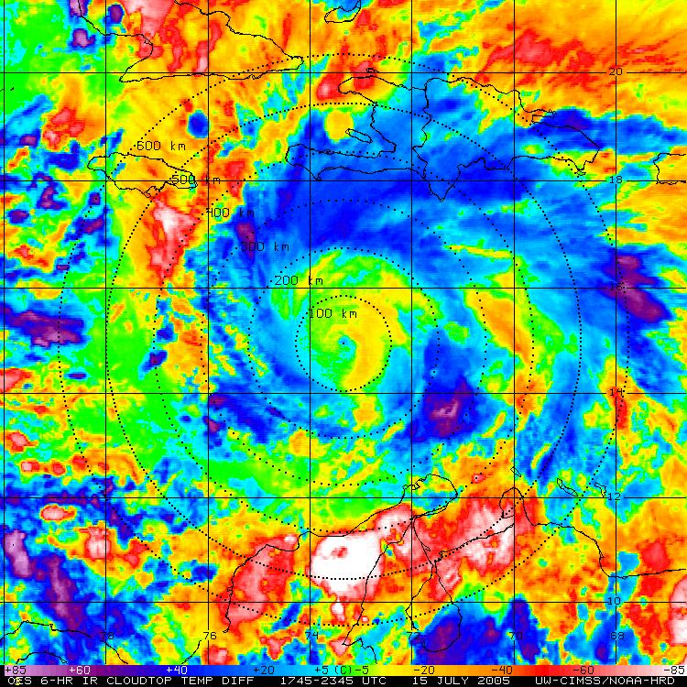
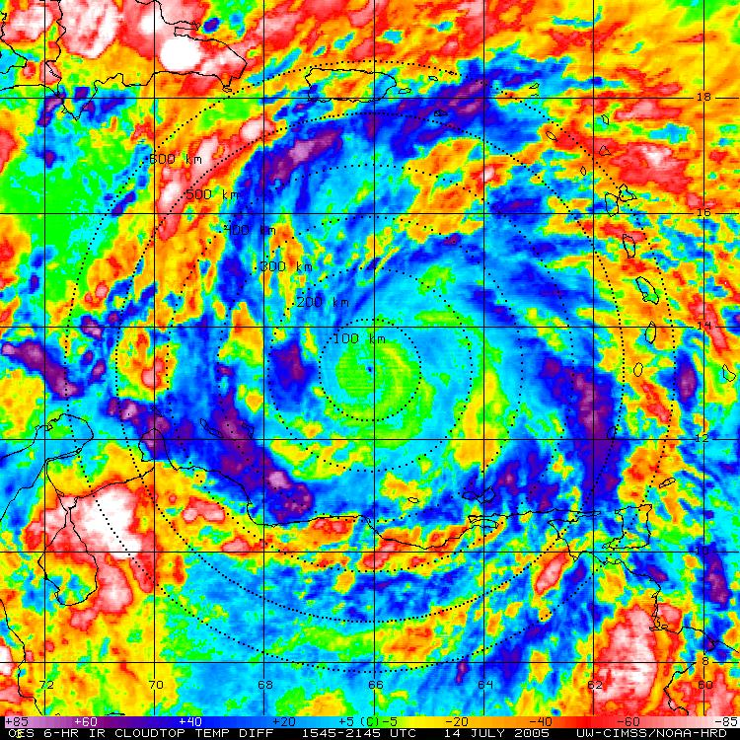
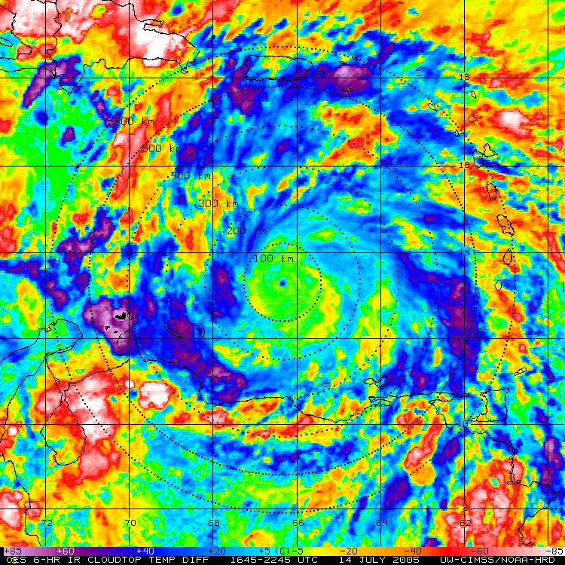
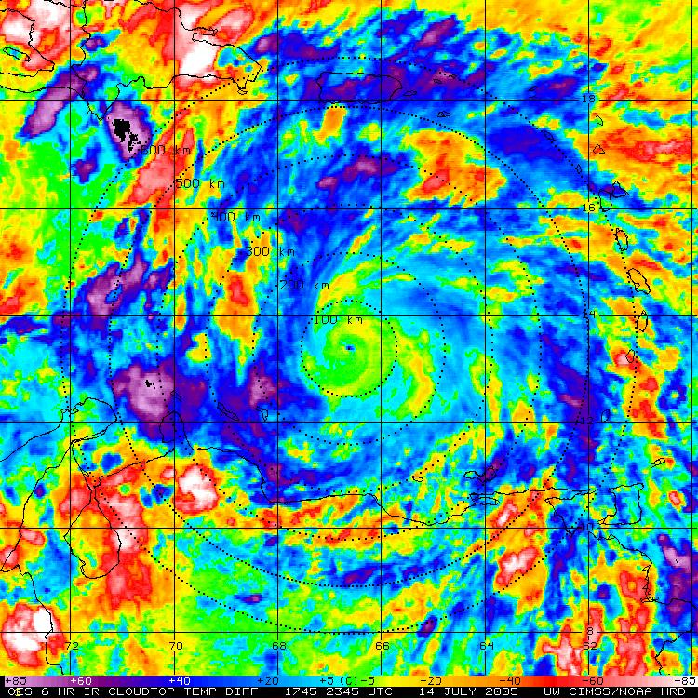
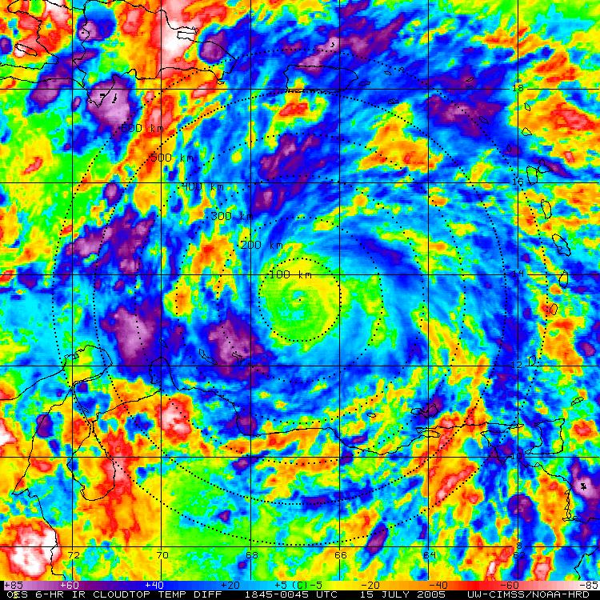
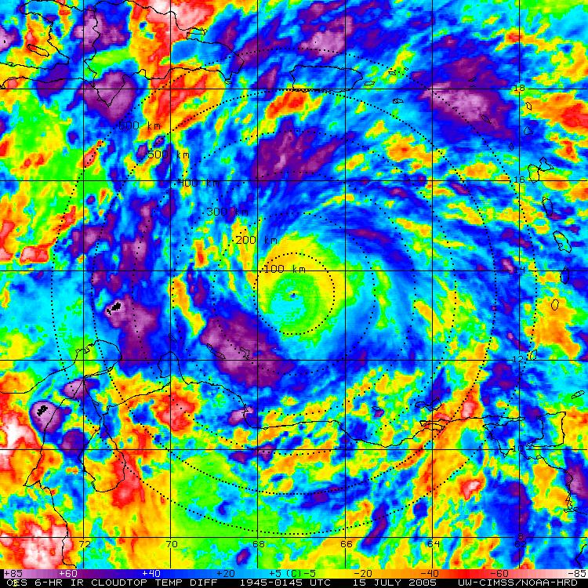
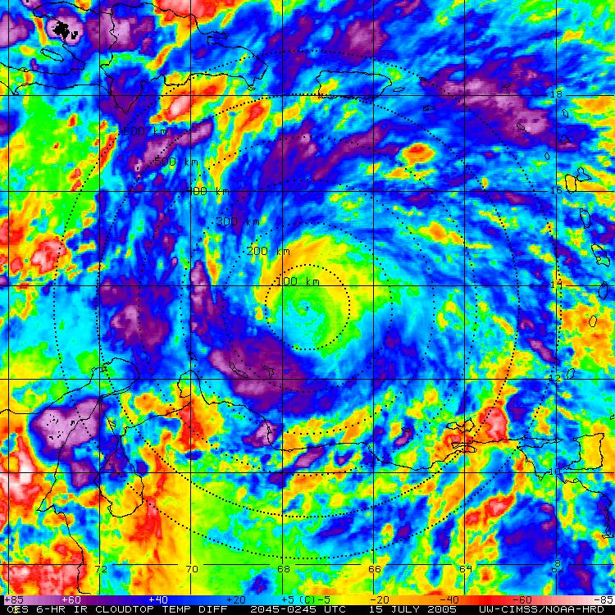
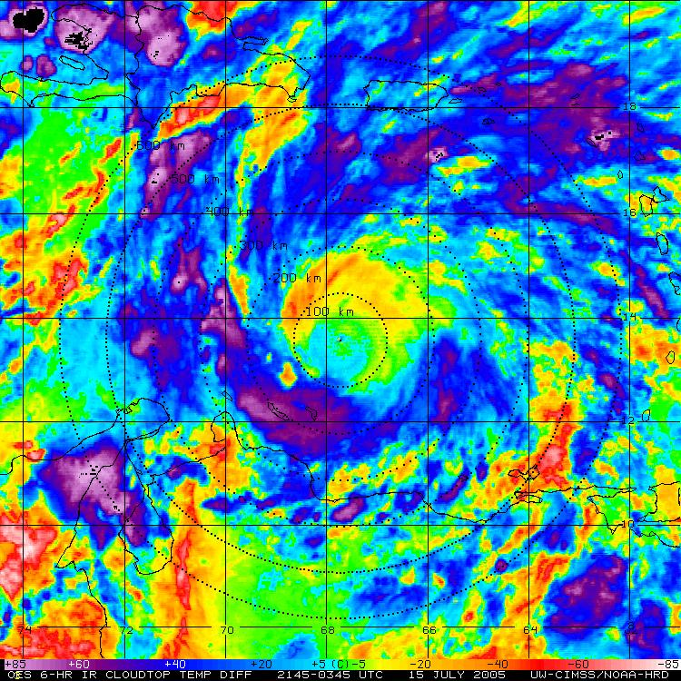
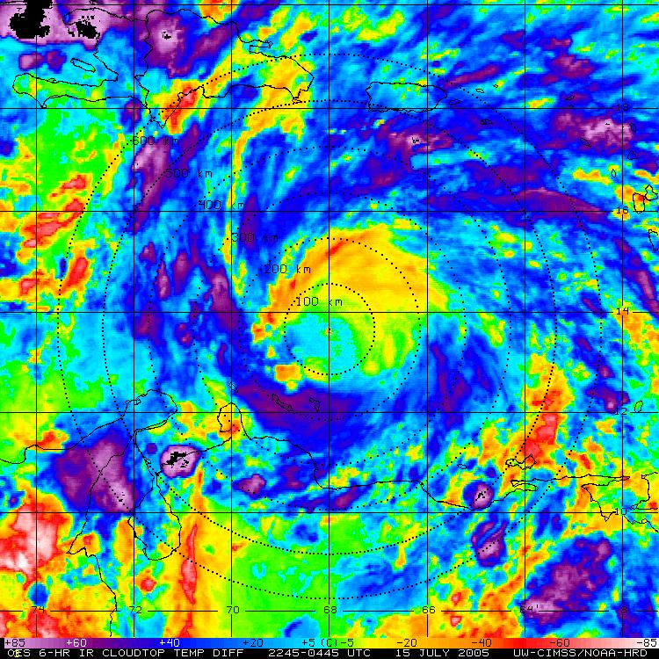
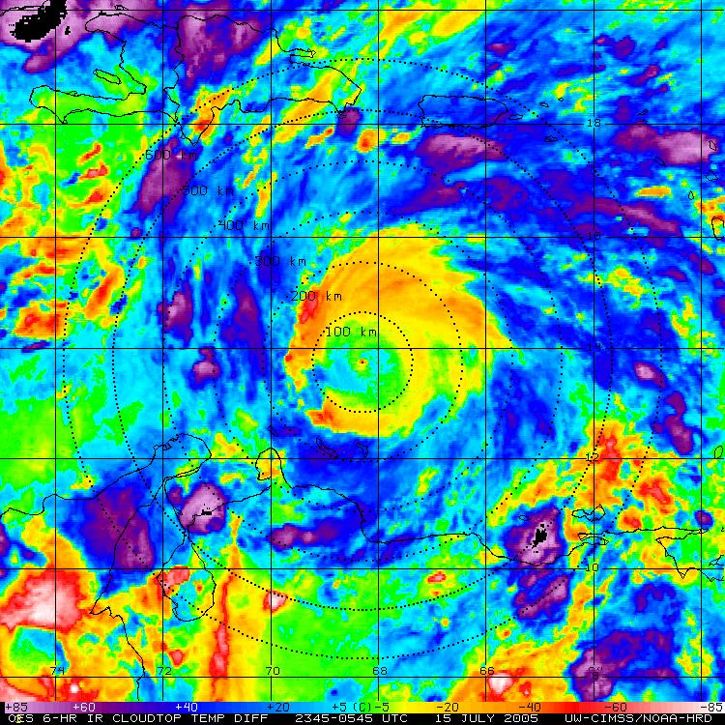
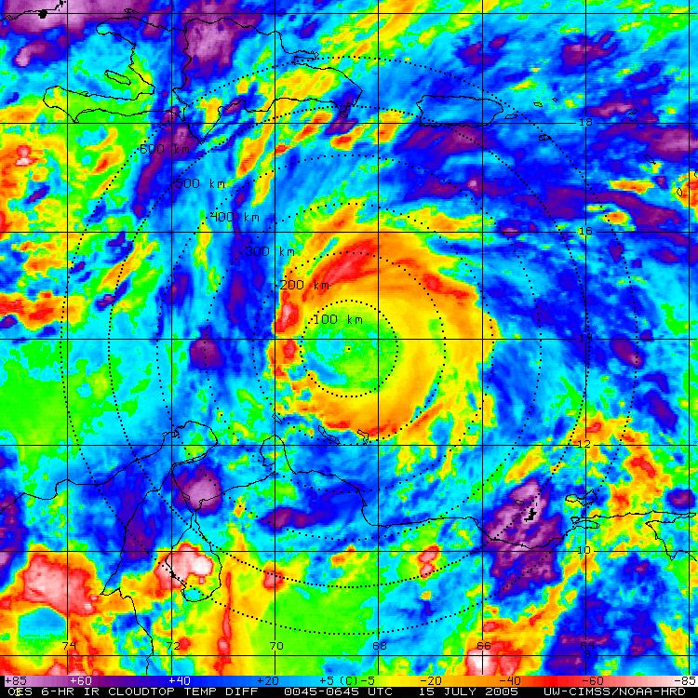
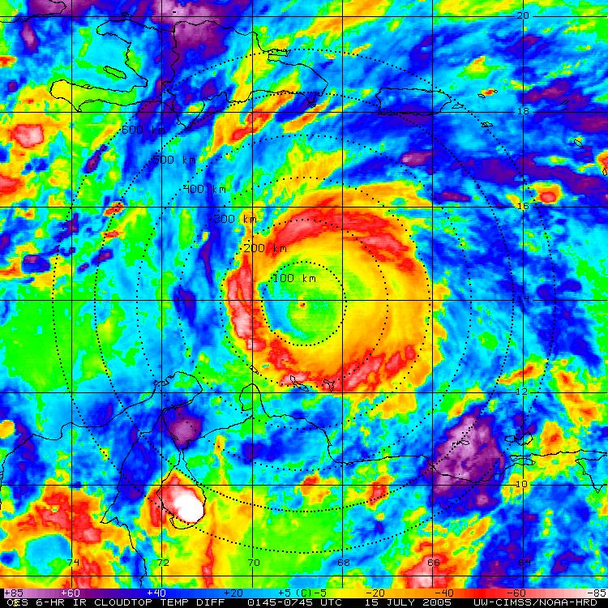
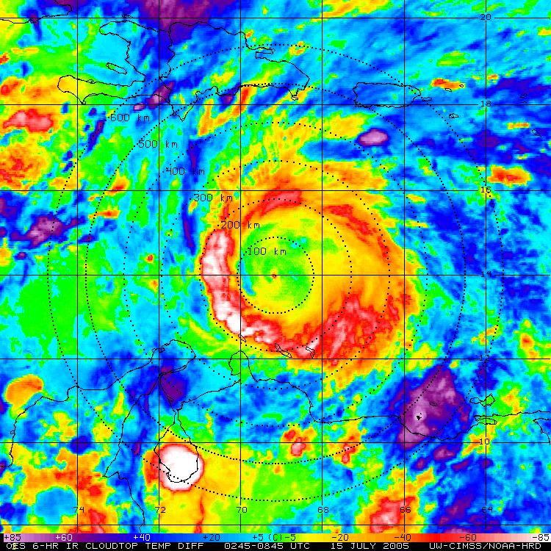
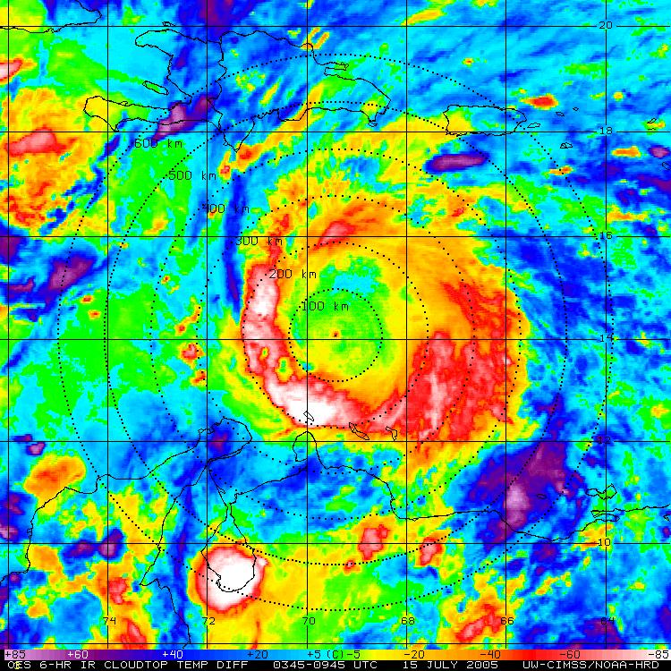
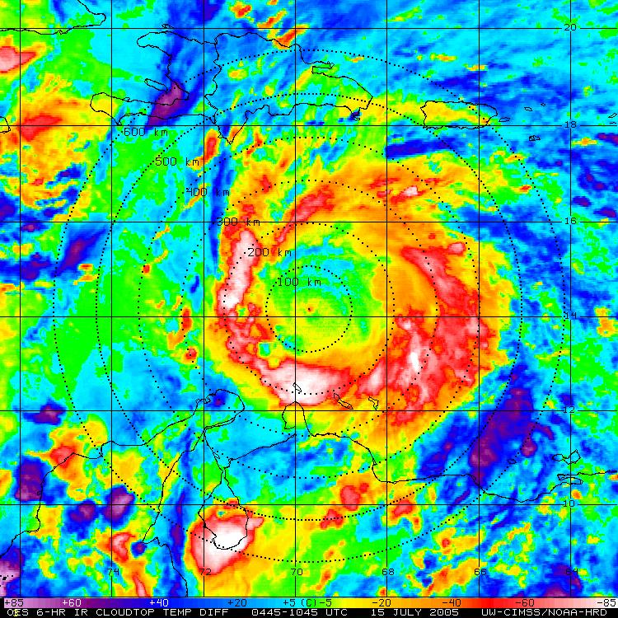
Hurricane Emily: 14-15 July 2005
GOES IR (storm relative)
GOES BT Diff (storm relative)
Notes:
Cat 3 to Cat 4

Slide 4
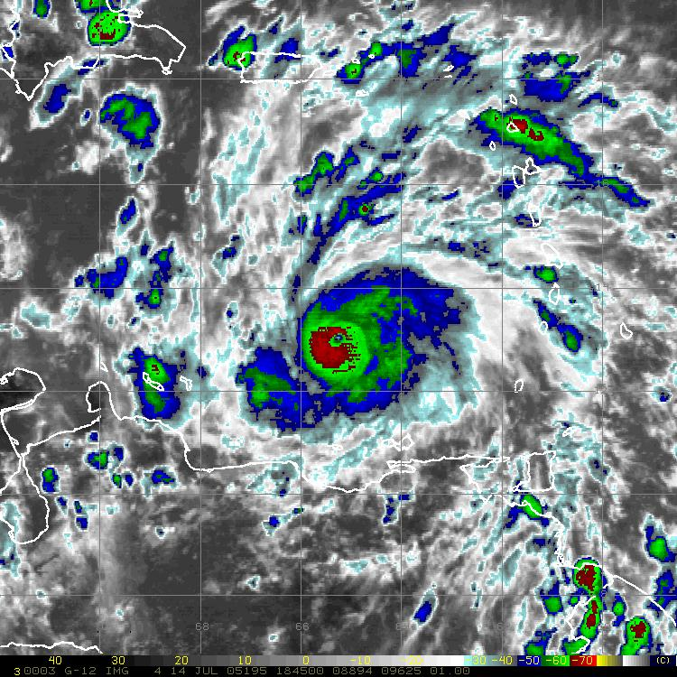











Hurricane Emily: 15 July 2005
GOES IR
GOES IR
BT-Diff
37 GHz
85/89 GHz

Slide 5












































Hurricane Felix: 02-03 Sept 2007
GOES IR (storm relative)
GOES BT Diff (storm relative)
Notes:
Cat 5

Slide 6




GOES IR BT Differences: Azimuthal Mean (400km)
“Cool Rings” (~15-18 UTC)
*also see Kossin 2002

Slide 7








Hurricane Emily: 15 July 2005
GOES IR (storm relative)
GOES BT Diff (storm relative)

Slide 8






















Hurricane Earl: 30 August 2010
GOES IR (storm relative)
GOES BT Diff (storm relative)
Notes:
Cat 4

Slide 9





















Hurricane Emily: 19 July 2005
GOES IR (storm relative)
GOES BT Diff (storm relative)

Slide 10


Hurricane Emily: 19-20 July 2005
Mexico Landfall

Slide 11






Diurnal TC Pulsing: A Global Phenomenon
4am LST
10am LST
8pm LST
Andrew
1992
Emily
2005
Katrina
2005
Notes:
4am LST

Slide 12









Diurnal TC Pulsing: A Global Phenomenon
4am LST
10am LST
8pm LST
Daniel
2006
Megi
2010
Bianca
2011
Notes:
4am LST

Slide 13

GOES IR BT-Difference Cool Rings…what’s going on?
Pre-Sunset
Gravity waves dispersed
<
>
Sunset
<
>
Gravity waves reflected: cooling cloud tops (>stability); ~10 m/s propagation?
Notes:
Krueger & Zulauf 2005
Fovell 2010

Slide 14



TC Diurnal Pulsing: Can We See it in the Models?
Axisymmetric hurricane model
Rotunno and Emanuel 1988
WRF/ECMWF Hurricane Nature Run
Dave Nolan, Univ. of Miami

Slide 15


















TC Diurnal Pulsing: Can We See it in the Models?

Slide 16
Conclusions & Future Work
Diurnal Pulsing
-What is it?: possibly a fundamental (and predictable) diurnal process
-Mechanism: gravity waves?..remarkable symmetry; flight-level turbulence
-harmonic oscillation?…anvil expansion?...inertial stability changes?
-Where?: global (hurricanes, typhoons, cyclones, MCSs, AEWs)
TC Implications:
-Timing Trends
favorable >> “wee hours” (sunset to 6am LST)
unfavorable >> larger radii (6am to late afternoon LST)
-Structure: Dvorak implications? (quantify with CIMSS ADT)
Continuing the “Diurnal Hunt”
-experimental real-time diurnal pulsing product on CIMSS TC page
-sampling with the NOAA P-3s, G-IV & NASA Aircraft
-numerical modeling of TC pulsing (timing, structure, etc.)

