Slide 1
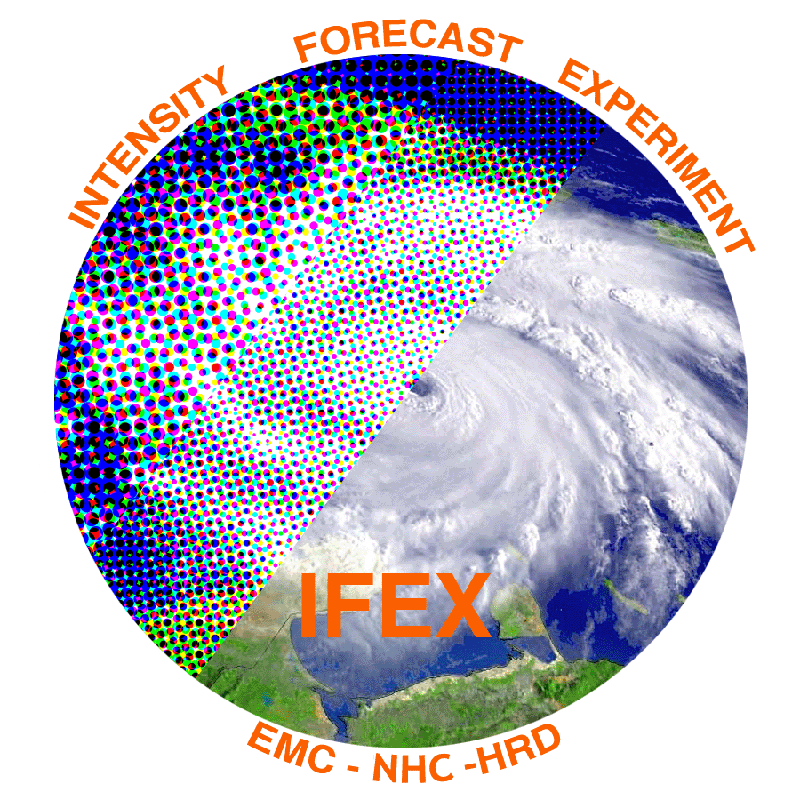
NOAA/AOML/HRD Hurricane Field Program
Advancing the Prediction of Hurricanes Experiment (APHEX)
TCORF / 75th IHC
2021 HFP Leadership
HFP Director, Jason Dunion¹
HFP Deputy Director, Jon Zawislak¹
2020 HFP Director, Lisa Bucci²
¹ NOAA/AOML/Hurricane Research Division
² University of Miami/CIMAS - NOAA/AOML/Hurricane Research Division
TCORF/IHC, March 3, 2021

Slide 2
NOAA/AOML/HRD Hurricane Field Program
Advancing the Prediction of Hurricanes Experiment (APHEX)
HFP-APHEX Overview
APHEX is motivated by the priorities of the “next generation” 5-year HFIP Strategic Plan (2019-2024):
Reduce forecast guidance errors: track and intensity
Produce 7-day forecast guidance as good as the current 5-day
Improve RI prediction
Improve guidance on pre-formation disturbances, including genesis timing
Improve hazard guidance (surge, rain, tornadoes) and risk communication
Our flight strategies and instruments will need to evolve to keep ourselves at the forefront of advancing our understanding and prediction of TCs
real-time analysis
assimilation of observations
observations to guide model improvements
Collaborations inside and outside of NOAA, across operational partners and research laboratories will be critical
Consider the new G550 and potential justification for P-3 replacements in the future
Effective use of limited aircraft assets

Slide 3
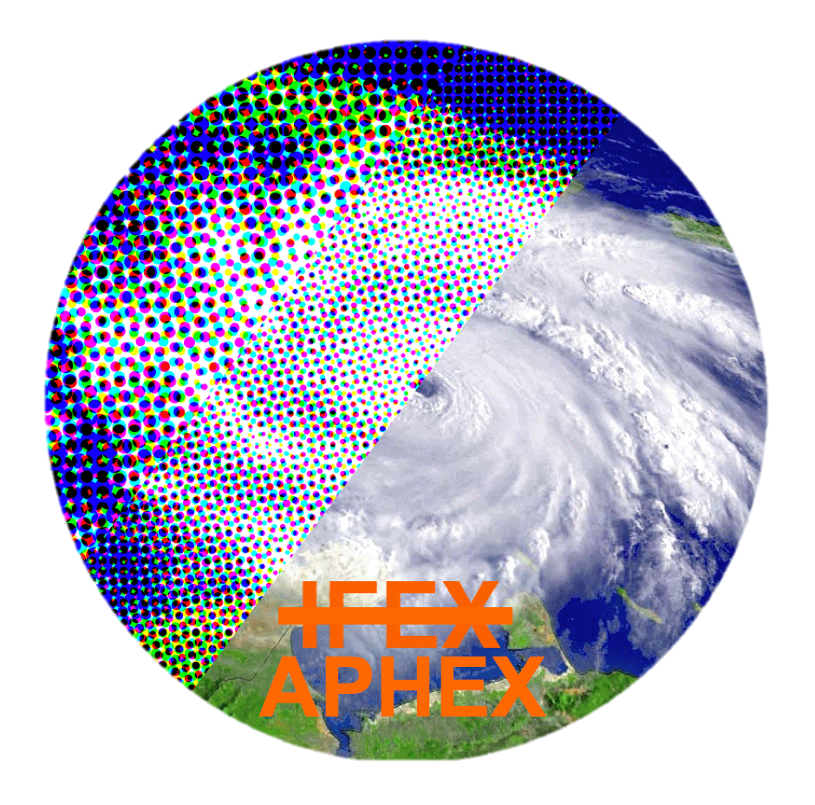
Advancing the Prediction of Hurricanes EXperiment (APHEX)
Intensity Forecasting EXperiment (IFEX)*
Goal 1: Collect observations that span the TC life cycle in a variety of environments for model initialization and evaluation
Goal 2: Develop and refine measurement strategies and technologies that provide improved real-time monitoring of TC intensity, structure, and environment
Goal 3: Improve the understanding of physical processes important in intensity change for a TC at all stages of its life cycle
Advancing the Prediction of Hurricanes EXperiment (APHEX)
Goal 1: Collect observations that span the TC life cycle in a variety of environments for model initialization and evaluation
Goal 2: Develop and refine measurement strategies and technologies that provide improved real-time analysis of TC intensity, structure, and environment, and hazard assessment
Goal 3: Improve the understanding of physical processes that affect TC formation, intensity change, structure, and associated hazards
* Intensity forecasting at the inception of IFEX is now a narrow scope within a broad expanse of forecast challenges and knowledge gaps that must be addressed at all stages of the TC life cycle, though especially in the genesis and early stages

Slide 4
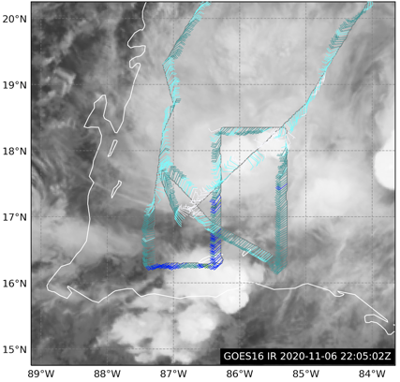
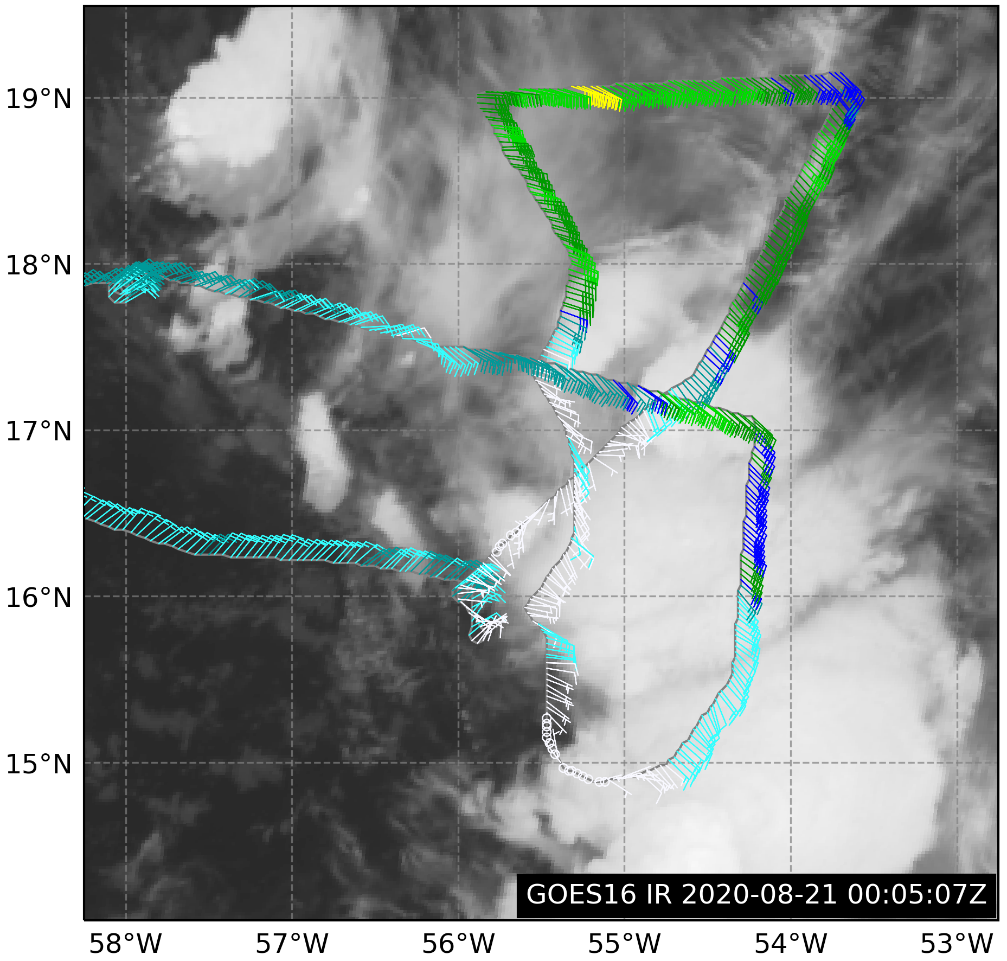
Advancing the Prediction of Hurricanes EXperiment (APHEX)
Genesis Stage
Reformation of Eta: 6 Nov 2020
TD13 (Laura): 21 Aug 2020
No dedicated genesis research missions in 2020
Piggybacking on operational invest missions
EMC mission into Eta: reemerged off the coast of Honduras and redeveloped
Pattern in Eta proved useful >> combination of lawnmower (envir survey) with Fig. 4 (vortex and precipitation contributing to formation)
Genesis remains a priority in 2021 (APHEX-PREFORM experiment)
Notes:
Survey to explore – switch strategy to vortex focused …good to have both in our back pocket >> maximize sampling of the storm environment

Slide 5
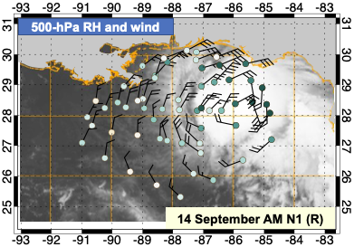
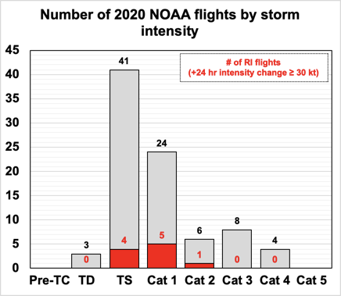
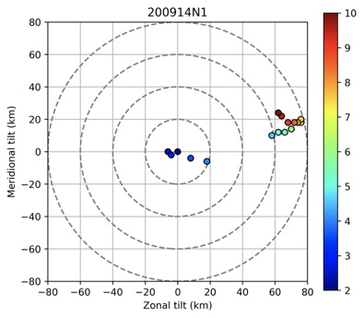
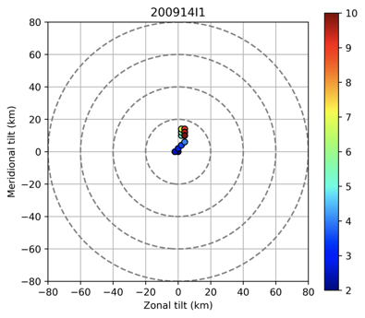
Advancing the Prediction of Hurricanes EXperiment (APHEX)
Early Stage
Hurricane Sally 14 Sep
High-density G-IV dropsondes
(NOAA-ONR collaboration)
Accomplished excellent early-stage sampling in 2020 (75% of all missions)
Hurricane Sally 14 Sep
Radar-derived vortex center locations with height (shading)
G-IV: ~0600-1330z
P-3: ~1400-2100z
Courtesy: Jon Zawislak (UM/CIMAS – NOAA/AOML/HRD)
Courtesy: Jon Zawislak (UM/CIMAS – NOAA/AOML/HRD)
Courtesy: Michael Fischer(UM/CIMAS – NOAA/AOML/HRD)
Notes:
Maximizing sampling
Sally = Early Stage storm challenges for capturing structure in moderately sheared storms
Sally on 14 Sep AM to Pm >> 60 to 100 mph (TS to Cat 2)
Good distributions with TS and Cat 1 in 2020

Slide 6
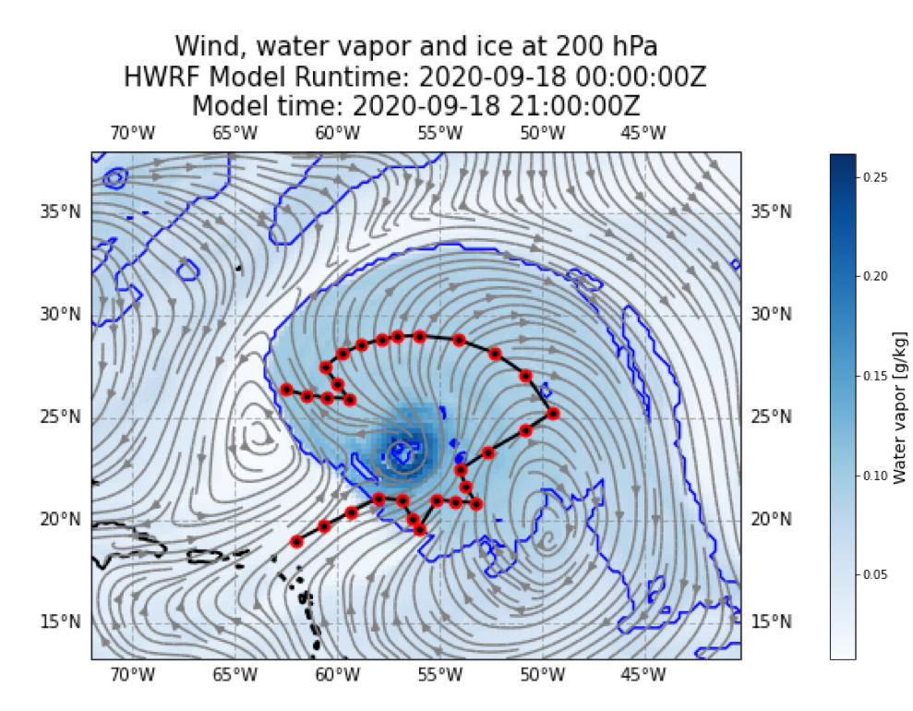
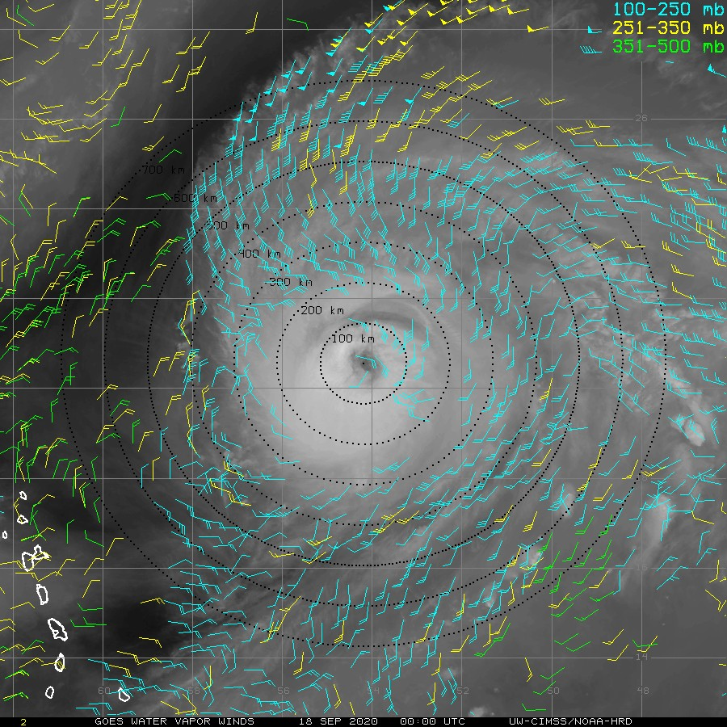
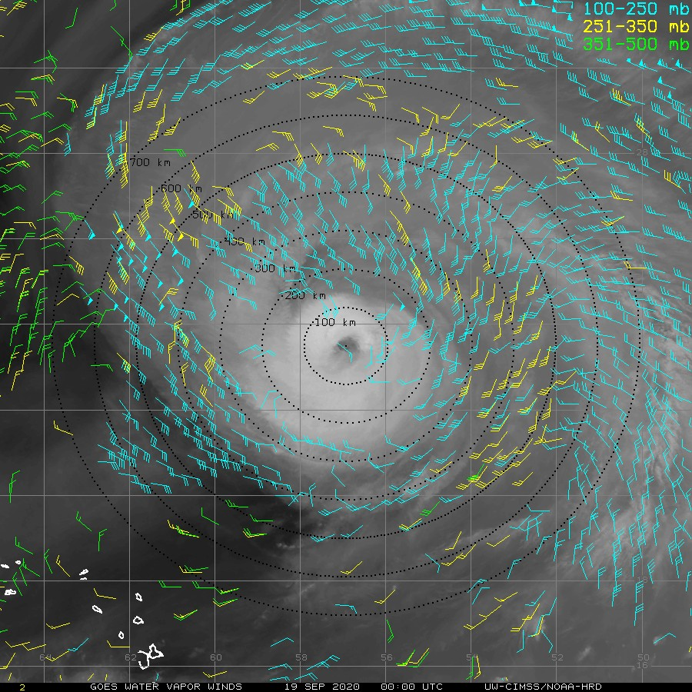
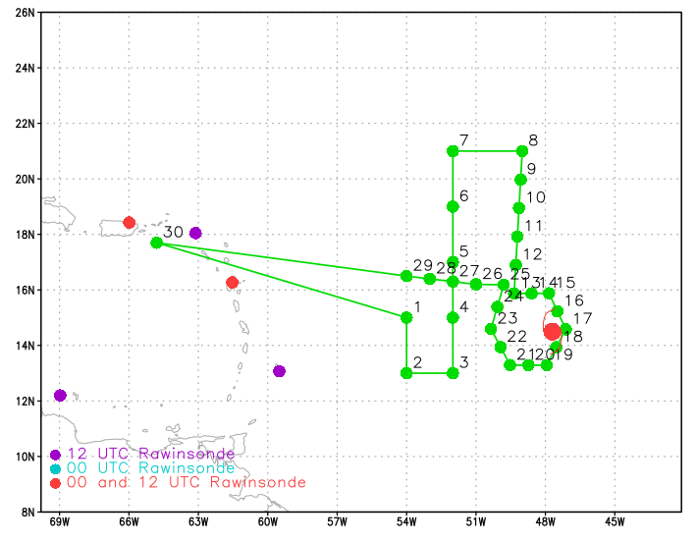
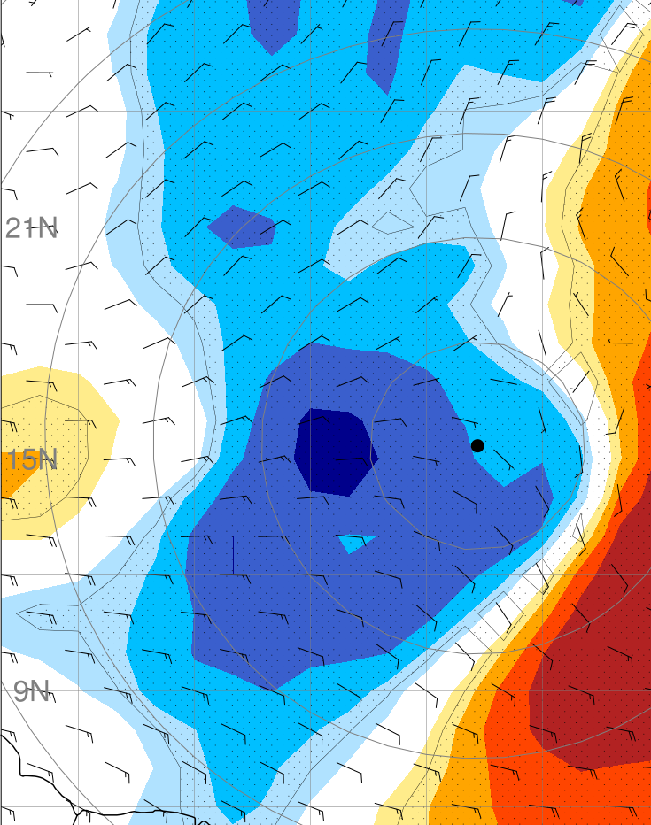
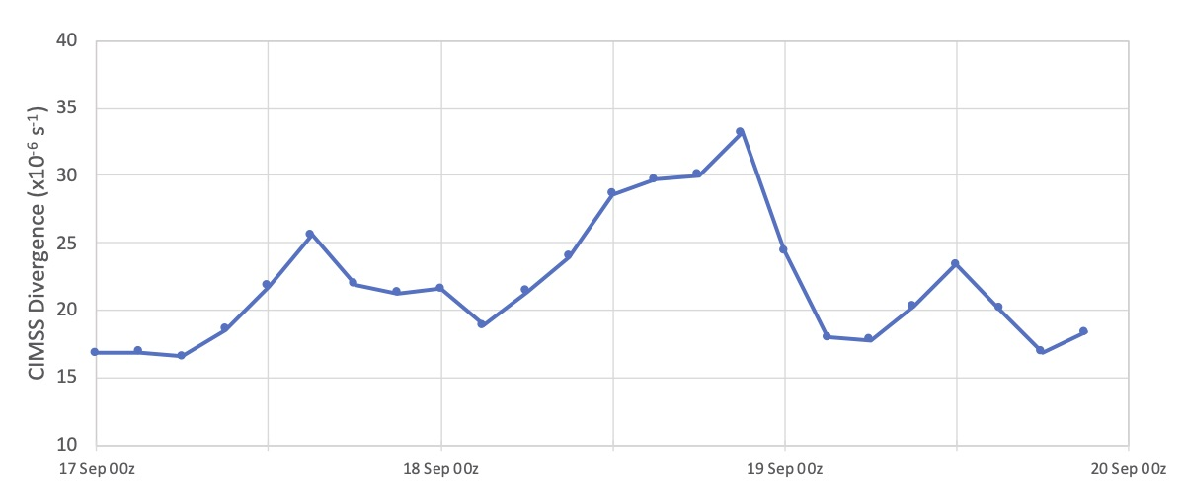
Advancing the Prediction of Hurricanes EXperiment (APHEX)
Mature Stage
UW-CIMSS Water Vapor AMVs
Hurricane Teddy: 18 Sep 00z – 19 Sep 00z
G-IV TC Diurnal Cycle Experiment Mission
HWRF 21-h forecast of Teddy’s expanding cirrus canopy (valid 18 Sep 21 UTC)
G-IV Flight Track
GPS Dropsondes
Courtesy: Morgan O’Neill (Stamford University)
Radially expanding cirrus canopy due to the TC diurnal cycle
Warm & cool shading >> targets for dropsondes to improve track forecasts
CIMSS 150-300 hPa Divergence (R= 0-500 km)
G-IV Synoptic Flow Mission (15 Sep)
Ensemble-based sensitivity targeting (ECMWF)
TC diurnal cycle >> afternoon peaks in UL DVG
G-IV
Mission
00 LT
00 LT
00 LT
Courtesy: Jason Dunion (UM/CIMAS – NOAA/AOML/HRD)
Courtesy: Ryan Torn (University at Albany/SUNY)
00 LT

Slide 7
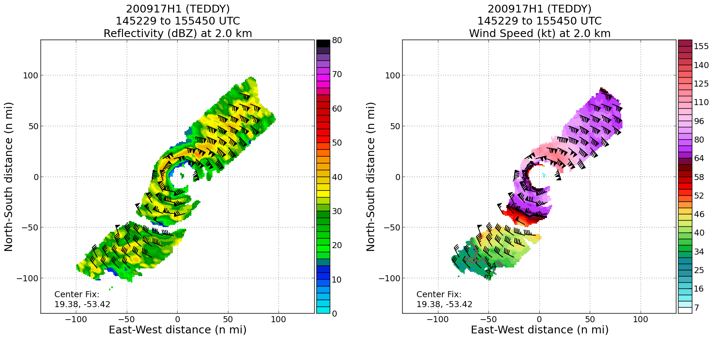
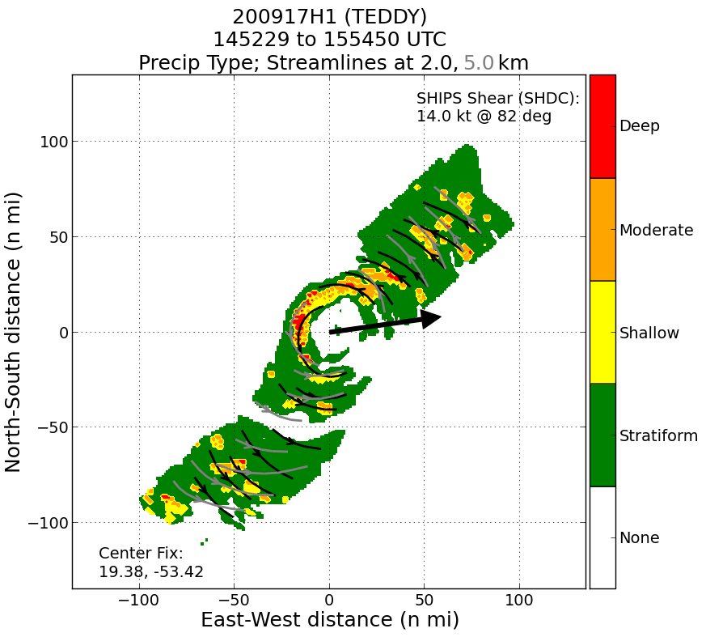
Advancing the Prediction of Hurricanes EXperiment (APHEX)
Mature Stage
TDR data >> NHC capturing RI (Teddy)
Real-time TDR analysis & transmission to EMC, vis. in AWIPS-II
Real-time Analyses
New in 2020:
Analyses for each swath, and precipitation type classification
TDR data from sequence of P-3 passes (over ~3 hr) in rapidly intensifying Hurricane Delta
*NHC forecasters used AWIPS-II to monitor Delta’s small inner core and significant RI from pass to pass
Notes:
R2O shown from top panels to lower panels

Slide 8
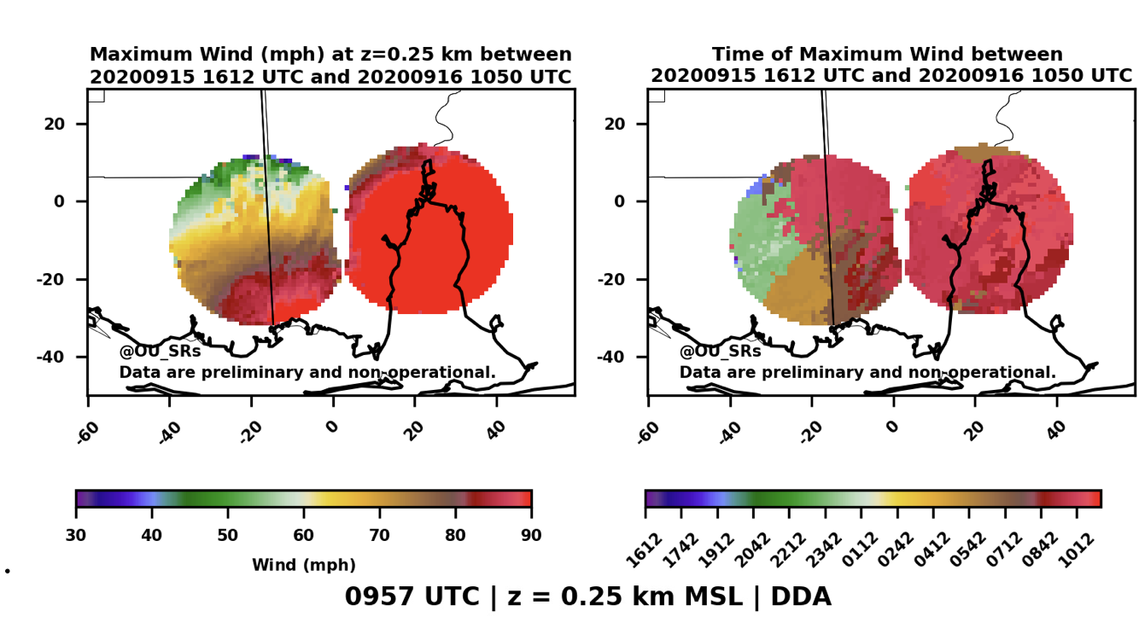
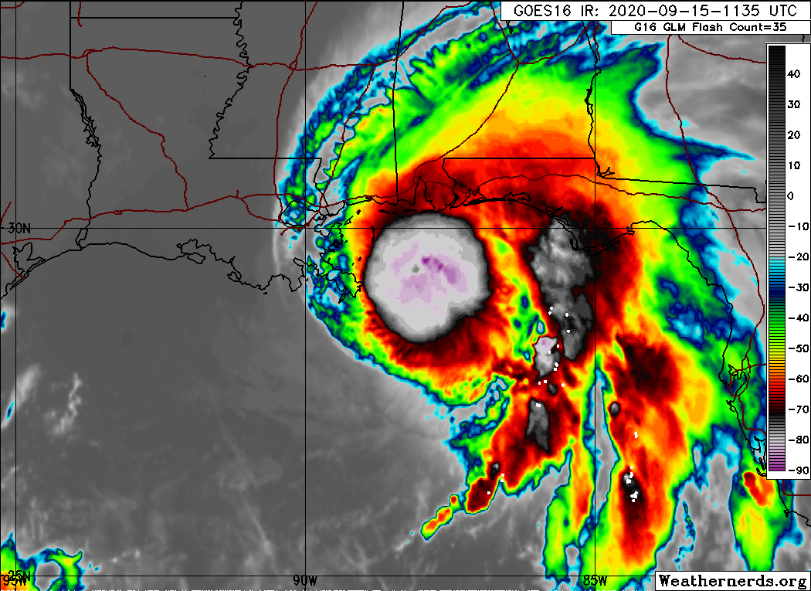
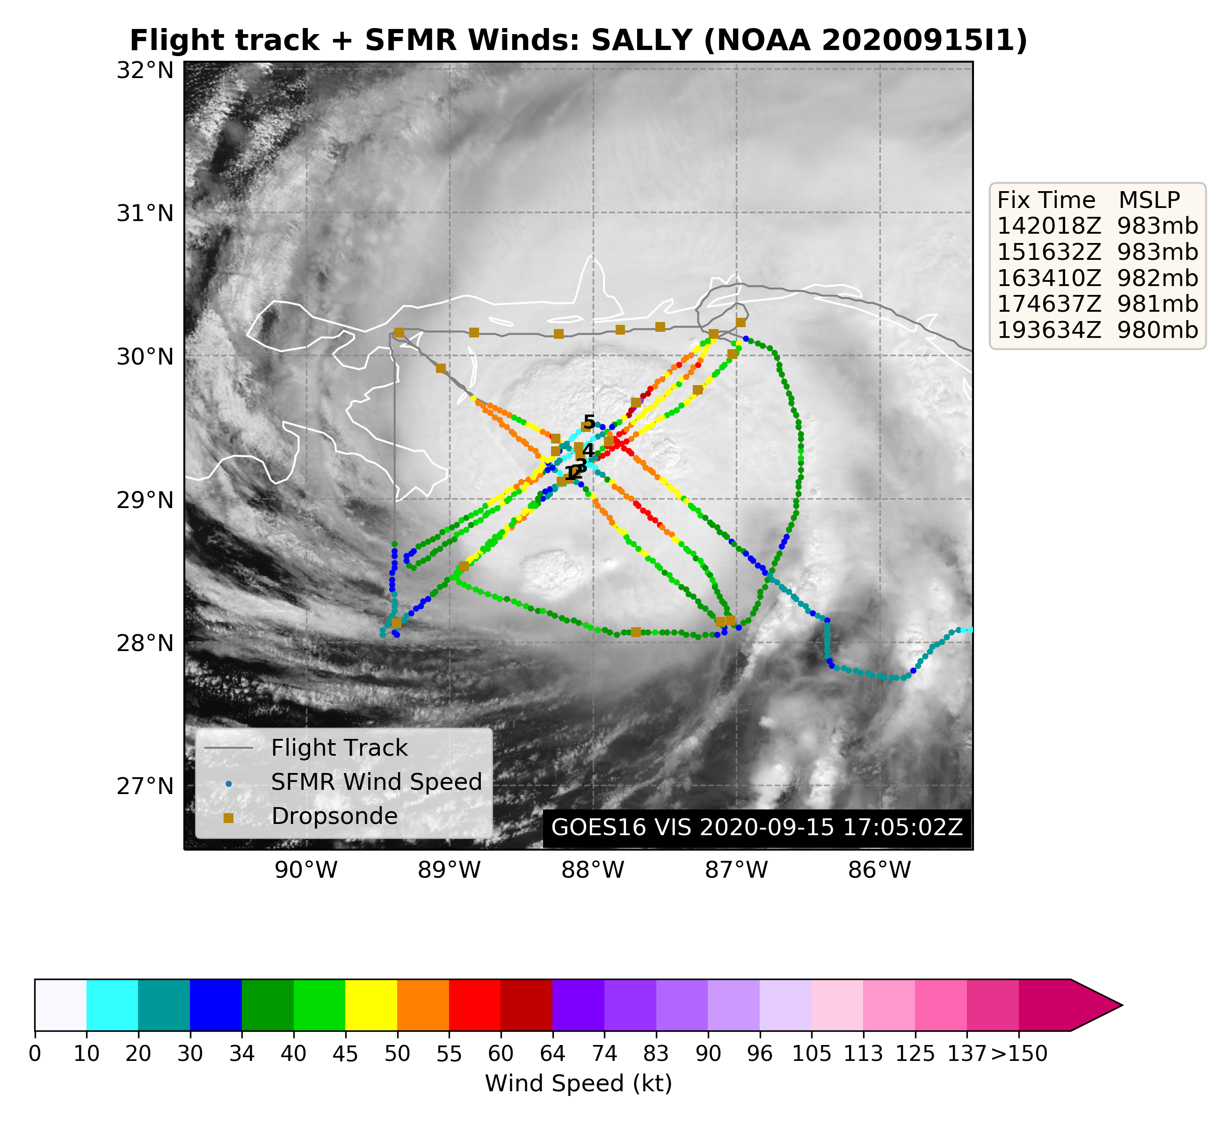
Advancing the Prediction of Hurricanes EXperiment (APHEX)
End Stage
Hurricane Sally (15 Sep): GOES-16 11 micron infrared
NOAA-OU CIMMS SMART Radars
P-3 6-sonde
sequence

Slide 9
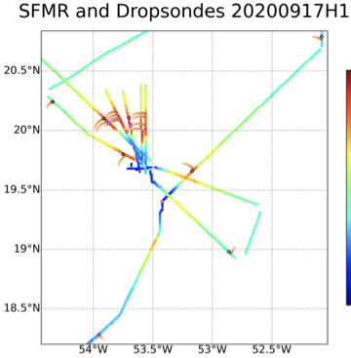
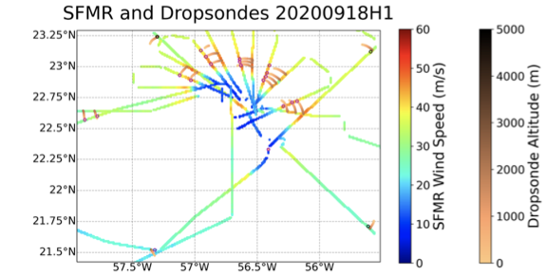
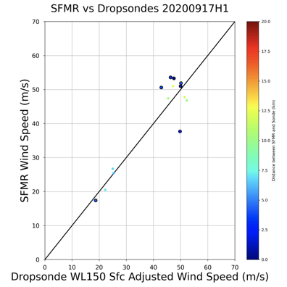
Advancing the Prediction of Hurricanes EXperiment (APHEX)
Stepped Frequency Microwave Radiometer (SFMR)
Hurricane Teddy: Overflight of dropsonde splash position to validate SFMR
Science Goal: Validate SFMR surface wind measurements, particularly in high winds
Dropsonde
Launch
Comparing drop windspeeds to SFMR
200917H1
Science Objectives
obtain
Dropsonde
Splash
200917H1
200918H1
Courtesy: Heather Holbach (FSU/NGI – NOAA/AOML/HRD)
Notes:
Drop >> go to center >> and back along the splash location to maximize comparisons (time and space)
Ocean winds collaboration

Slide 10
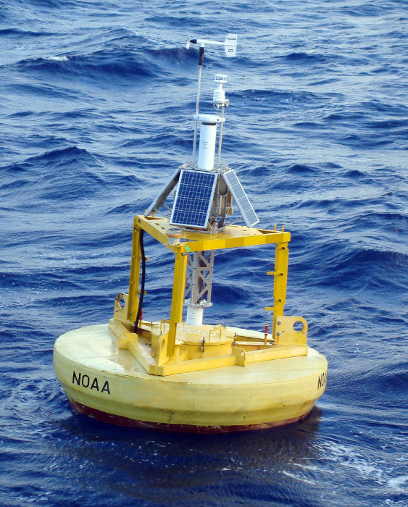
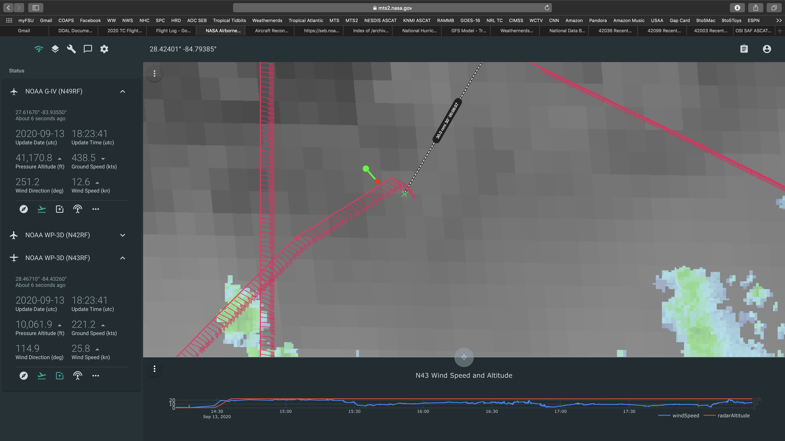
Advancing the Prediction of Hurricanes EXperiment (APHEX)
Wide Swath Radar Altimeter (WSRA)
NOAA buoy 42036, 13 Sep 2020 (Hurricane Sally, NE Gulf of Mexico)
NASA Airborne Mission Tools Suite (MTS)
tracking NOAA P-3 mission 20200913I1
Science Objectives
Validate various WSRA products (e.g., significant wave height and directional wave spectra)
Perform a 90-deg aircraft turn to ensure there is not a dependence on the angle between the aircraft heading and propagation direction of the dominant wave
Buoy 42036
P-3 Flight Pattern
Approach buoy 42036, ~5 min straight and level
Deploy a dropsonde over 42036, turn 90 deg
Fly straight and level ~2.5 min
NOAA P-3 (N-43)

Slide 11
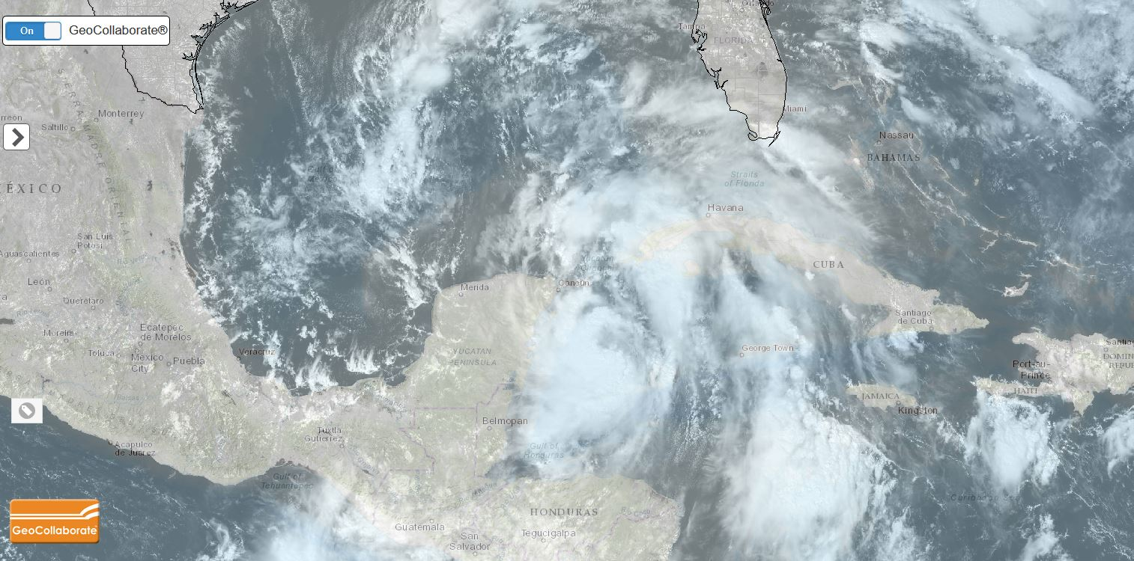
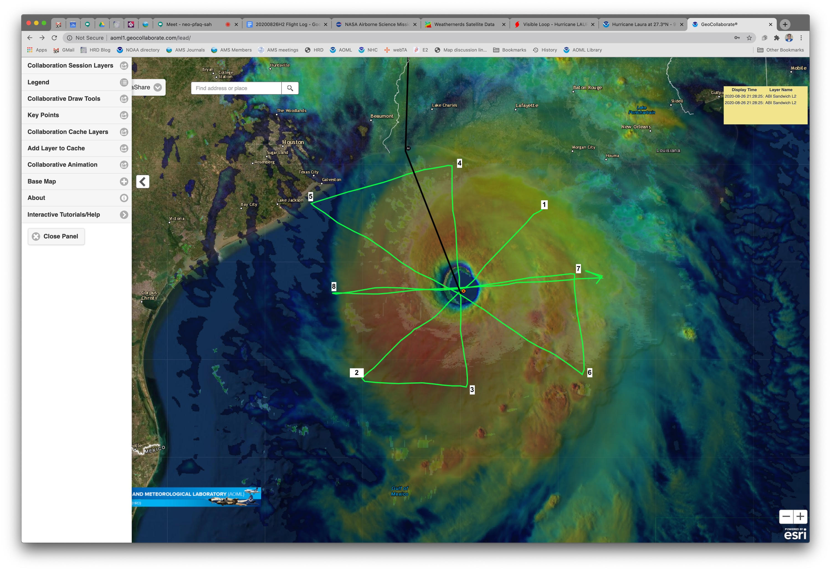
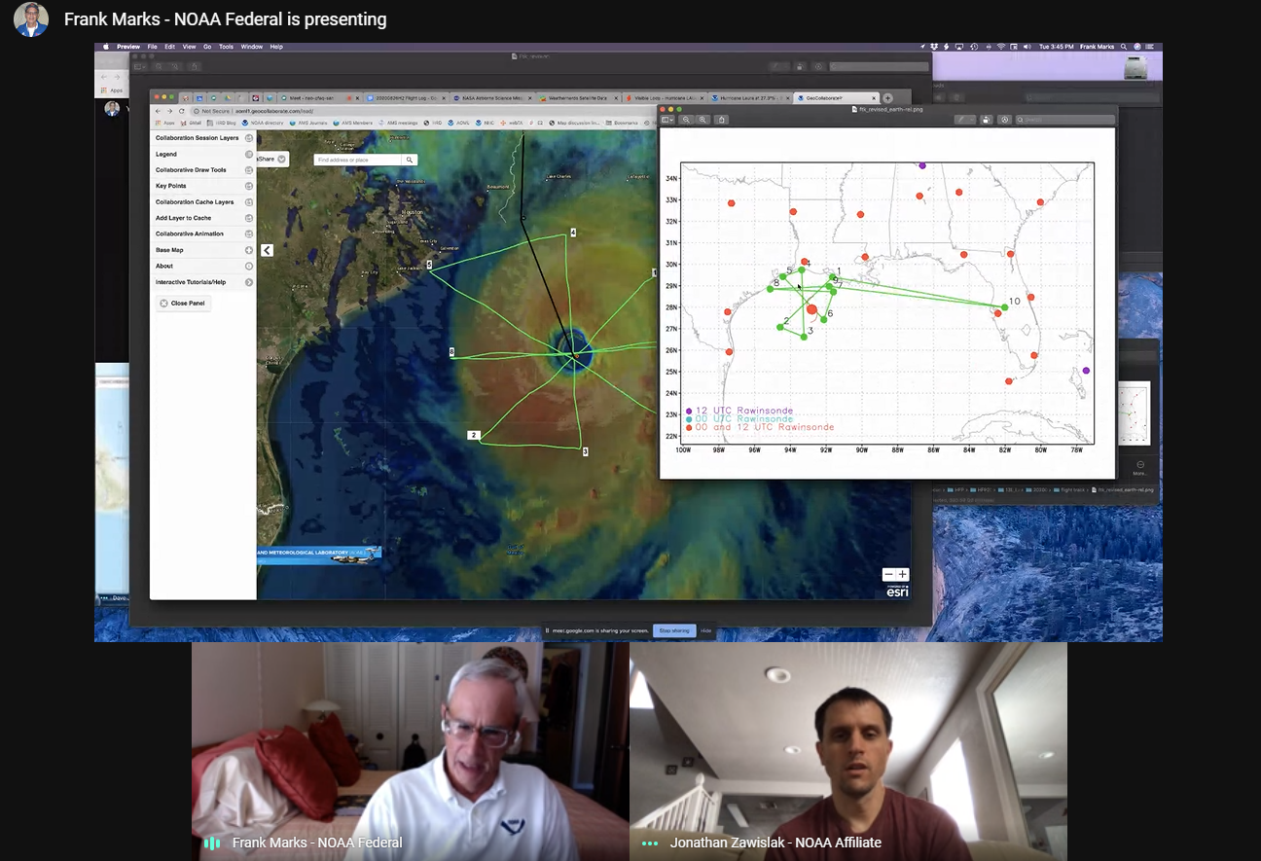
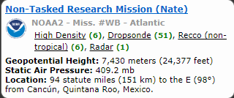
Use Case: NOAA HURRICANE RESEARCH DIVISION
Improving Science and Knowledge Sharing through GeoCollaborate
Encourage information sharing that goes beyond text chats and incudes actual data exchange, interactive drawing, key information points and a dashboard for aircraft position and plotting of data collected [Adapt & Communicate]
LEAD
FOLLOW
Final Flight Plan based on GeoCollaborate Live Interaction
GeoCollaborate +
Google Meet Combined
Notes:
From Dave Jones: the Leader basically controls the map of the followers. It goes beyond screen sharing and snapshots. If the leader zooms into an area all followers will zoom in in real-time…no matter what platform is being used. For example…a leader can display a GOES-16 meso sector over the storm…then all followers will also display the GOES-16 image on their devises/computers. If the leader zooms into a particular area of interest all followers web maps will zoom into that area as well. The leader can also highlight parts of the satellite image by issuing a geospatial message and all followers will get the geospatial message and can independently click on their web maps to see the message as a layer.

Slide 12
2021 NOAA/AOML/HRD Hurricane Field Program
Advancing the Prediction of Hurricanes Experiment (APHEX)
2021 APHEX Collaborations
Main science & observing objectives >> similar to 2020; continue to prioritize collaborative programs:
ONR TCRI
NASA CPEX-AW
sUAS (Altius-600)
Satellite Validation (NESDIS/JPSS, ADM-Aeolus, NASA TROPICS)
High priority >> sample genesis and early stages of storms, with a focus on those experiencing wind shear with the potential to intensify
P-3 instrumentation: Compact rotational Raman Lidar (CRL, aerosol, water vapor, T), WSRA (SWH, ocean directional wave spectra), testing NOAA CSL’s Doppler Wind Lidar (DWL, 3-D winds)
Explore new deployment sites to maximize research and operational objectives (e.g., Aruba and Cabo Verde)
Continue to adapt how HRD contributes to mission execution, especially in this pandemic environment
12
Notes:
Mention continuing daily schedule

Slide 13
2021 NOAA/AOML/HRD Hurricane Field Program
Advancing the Prediction of Hurricanes Experiment (APHEX)
2021 APHEX Collaborations
Office of Naval Research: Rapid Intensification of Tropical Cyclones (TCRI)
Participating Aircraft: NOAA 42, 43, 49
Collaborating Agencies: NOAA APHEX, ONR
2021 Campaign Period: 1 July - 30 September
Objective: Understand environment and storm structural evolution as it relates to rapid intensification processes
NASA’s Convective Processes Experiment - Aerosols and Winds (CPEX-AW)
Participating Aircraft: NOAA 42, 43, 49, NASA DC-8 (Cape Verde)
Collaborating Agencies: NOAA APHEX, NASA
2021 Campaign Period: 1 July - 15 August
Objective: Validate the NASA-European Space Agency ADM-Aeolus spaceborne wind lidar and sample meteorological phenomena that dominate in the East Atlantic / West Africa

Slide 14
Questions?

