Slide 1
Examining Temperature and Humidity Profiles in the
Tropical Cyclone Environment
Motivation
Dunion (2011) described 3 unique soundings that can affect TCs in the tropical North Atlantic: moist tropical (MT), Saharan Air Layer (SAL), and mid-latitude dry air intrusions (MLDAIs).
These soundings pose various challenges to forecast models and satellite retrieval algorithms.
Hypotheses
MT soundings are relatively well-represented in satellite retrievals (e.g. AIRS) and global forecast models
SAL soundings have unique thermodynamics >> poorer representation in satellite retrievals (e.g. AIRS) and global forecast models
AIRS and global forecast models can significantly overestimate the moisture in the SAL
AIRS and global forecast models tend to underestimate the SAL’s warmth and temperature inversion strength
Satellite retrievals (e.g. AIRS) may tend to underestimate the moisture below the base of the SAL (~800-850 hPa). The sharp moisture discontinuity that exists near the SAL base may pose a challenge to satellite retrieval algorithms.

Slide 2
Examining Temperature and Humidity Profiles in the
Tropical Cyclone Environment
Goals
Assess how effectively AIRS represents the temperature and moisture profiles of MT, SAL, and MLDAI soundings around TCs
Assess how effectively global forecast models represent the temperature and moisture profiles of MT, SAL, and MLDAI soundings around TCs
Perform OSEs using AIRS and GPS dropsonde data >> investigate how AIRS data affects the modeled representation of MT, SAL, and MLDAI soundings in TC environments
Perform OSSEs using AIRS data >> AIRS impact on model analyses & forecasts of MT, SAL, and MLDAI soundings in the tropical wave and/or TC environment…and how this, in turn, affects forecasts of TC genesis and/or TC intensity/structure/track.

Slide 3
Saharan Air Layer Experiment (SALEX)
Tropical Storm Irene G-IV Mission: 08 August 2005
G-IV GPS Droponde
AIRS L2 V6 Standard Retrieval Product
(28 pressure levels)
Temporal: +/- 3 hr
Spatial: ≤50 km
AIRS Retr Qual Flags : 0/512/1536/3584
Notes:
Note that this is an older study (AIRS v4), but could provide the framework for an updated, expanded study to assess the capability of AIRS and global models (e.g. GFS and ECMWF) to represent various sounding tyoes in the peripheral TC environment
Comparisons were made between AIRS and GPS dropsondes launched during a G-IV SAL mission and GFS analyses. AIRS profiles had to be within +/- 50km and +/-3.75 hr of the GPS dropsonde data from the G-IV
The satellite image shows 2005 Irene with the G-IV track overlaid
Click next >> AIRS granules 165 provided an excellent opportunity to compare GPS dropsonde and AIRS profiles

Slide 4
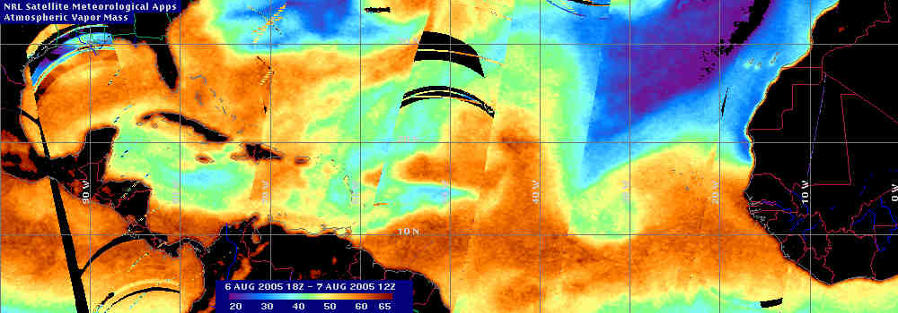
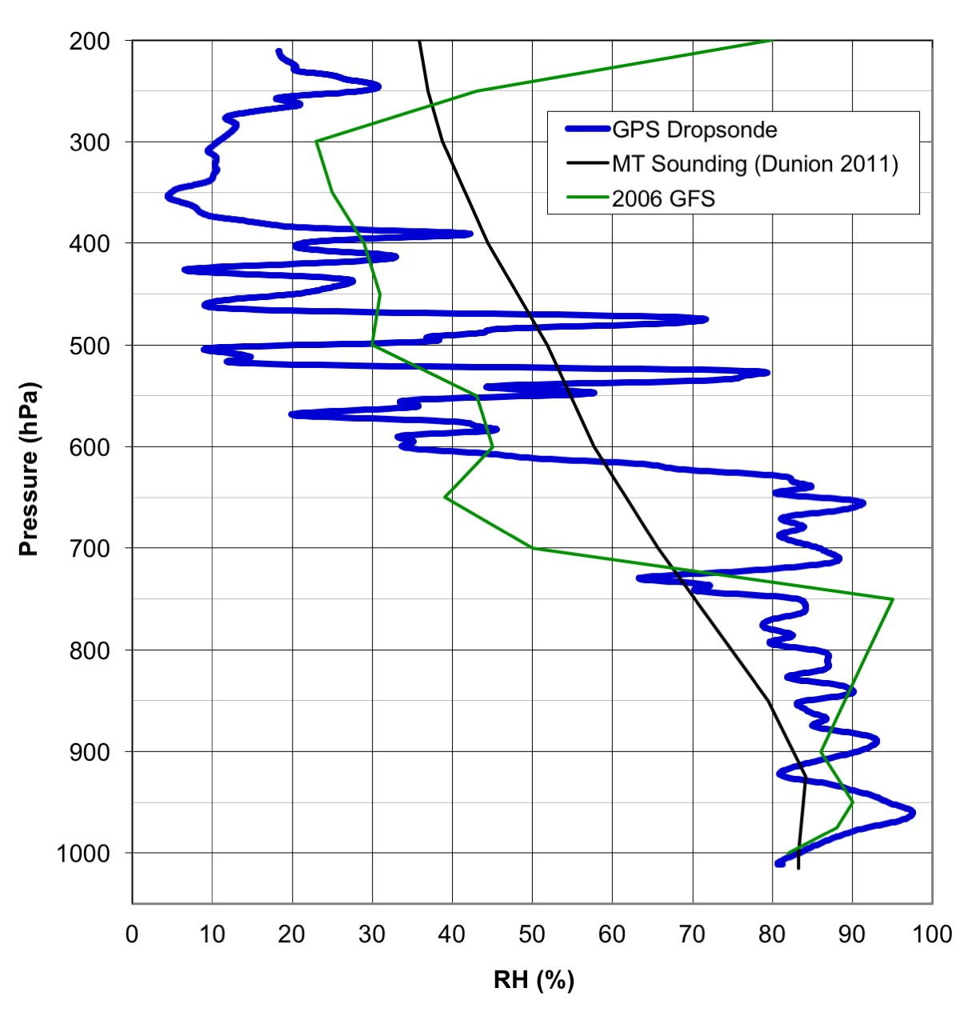
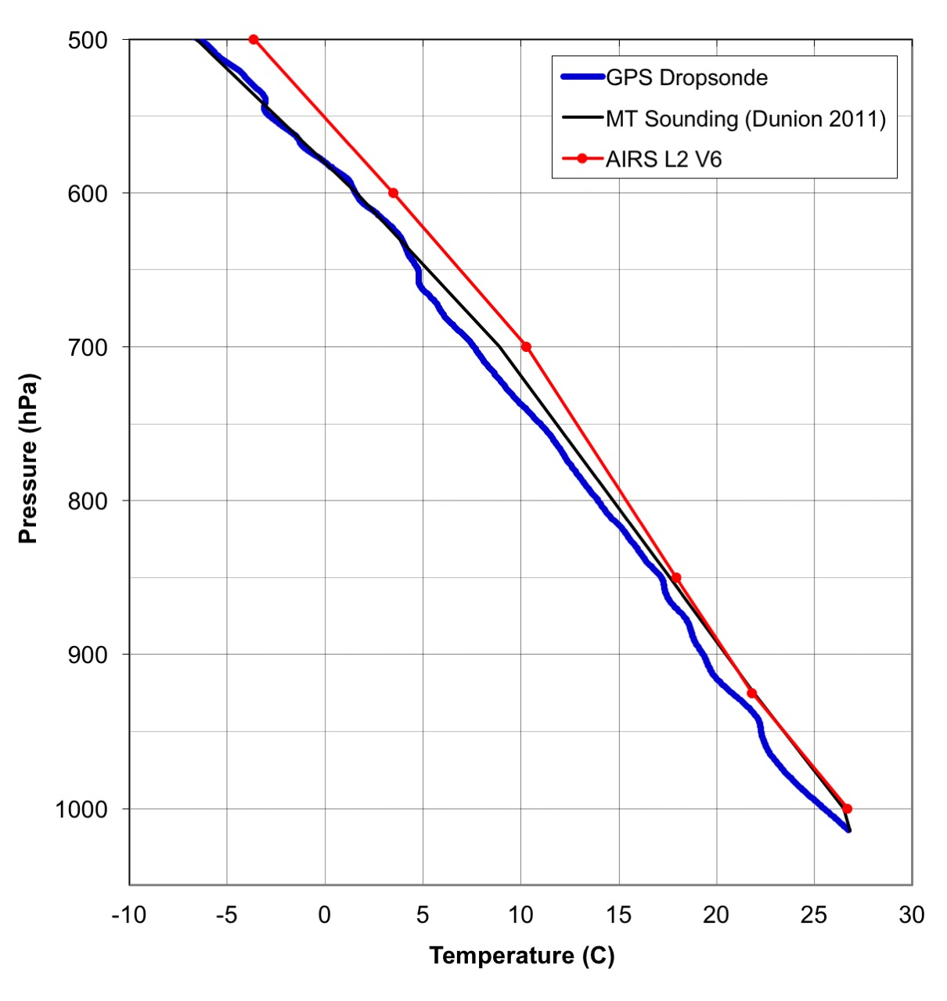
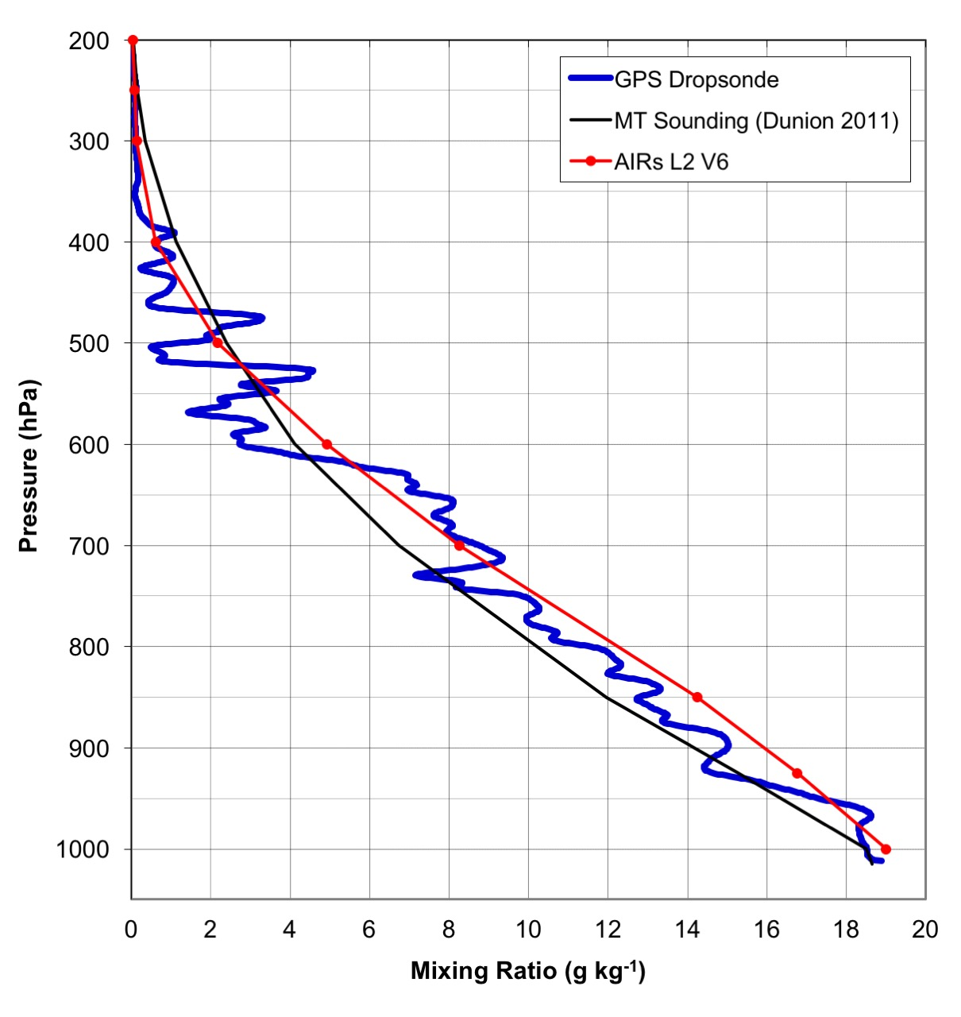
Saharan Air Layer Experiment (SALEX)
G-IV Mission 08 Aug 2005: Moist Tropical Sounding (>45 mm TPW)
Mid-Latitude
Dry Air Intrusion 1
Mid-Latitude
Dry Air Intrusion 2
SAL 2
5
10
15
SAL 3
SAL 1
1
Irene
20
Tropical Wave
25
Notes:
Methods described in Dunion 2011 were used to track moist tropical vs SAL vs mid-latitude dry air intrusions. Here, <=45 mm TPW in the microwave imagery helps delineate dry SAL or MLDAI from MT air masses (>45 mm TPW).
Left profile: drop #23 (red circle) launched SSW of Irene in a MT environment. Dropsonde (blue curve), Dunion MT sounding (black curve), and 2006 GFS analysis (green curve). This is clearly a MT profile.
Middle profile: T from the GPS dropsonde (blue curve), MT sounding (black curve), and collocated AIRS granule (red curve). The 3 profiles match fairly closely…AIRS is generally warm biased by 0.5-2 deg through the profile
Right profile: mixing ratio from the GPS dropsonde (blue curve), MT sounding (black curve), and collocated AIRS granule (red curve). Again, the 3 profiles match fairly closely and AIRS performs quite well.
Take-away: AIRS and GFS did a reasonably job representing this MT sounding. Similar results are seen in other MT environments.

Slide 5
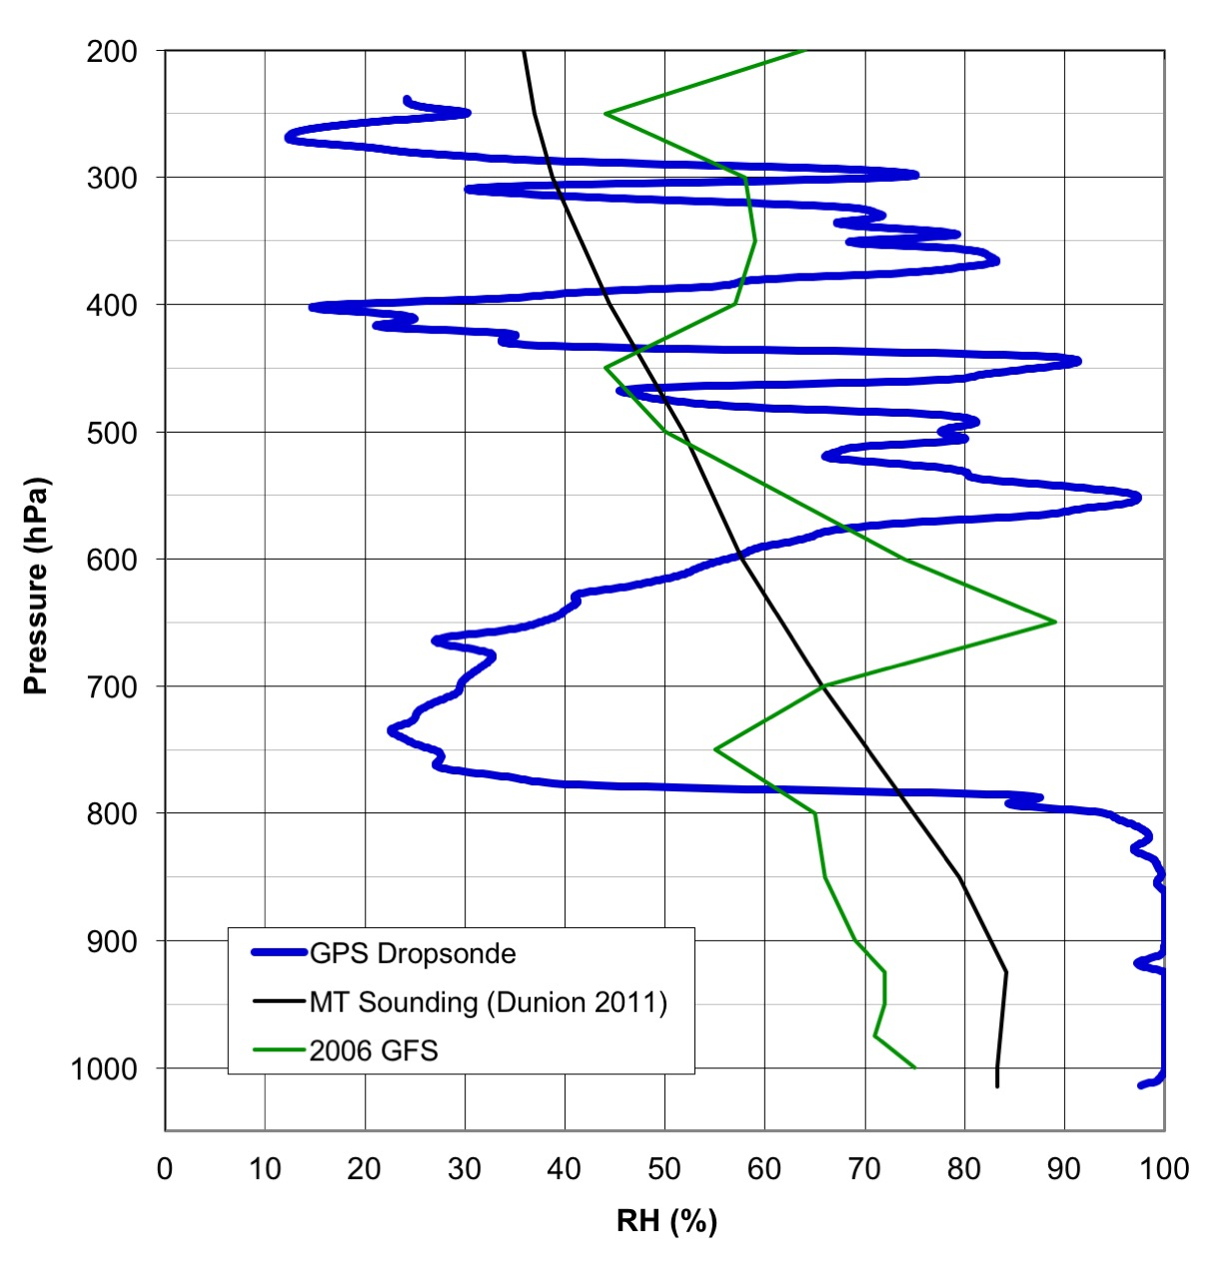
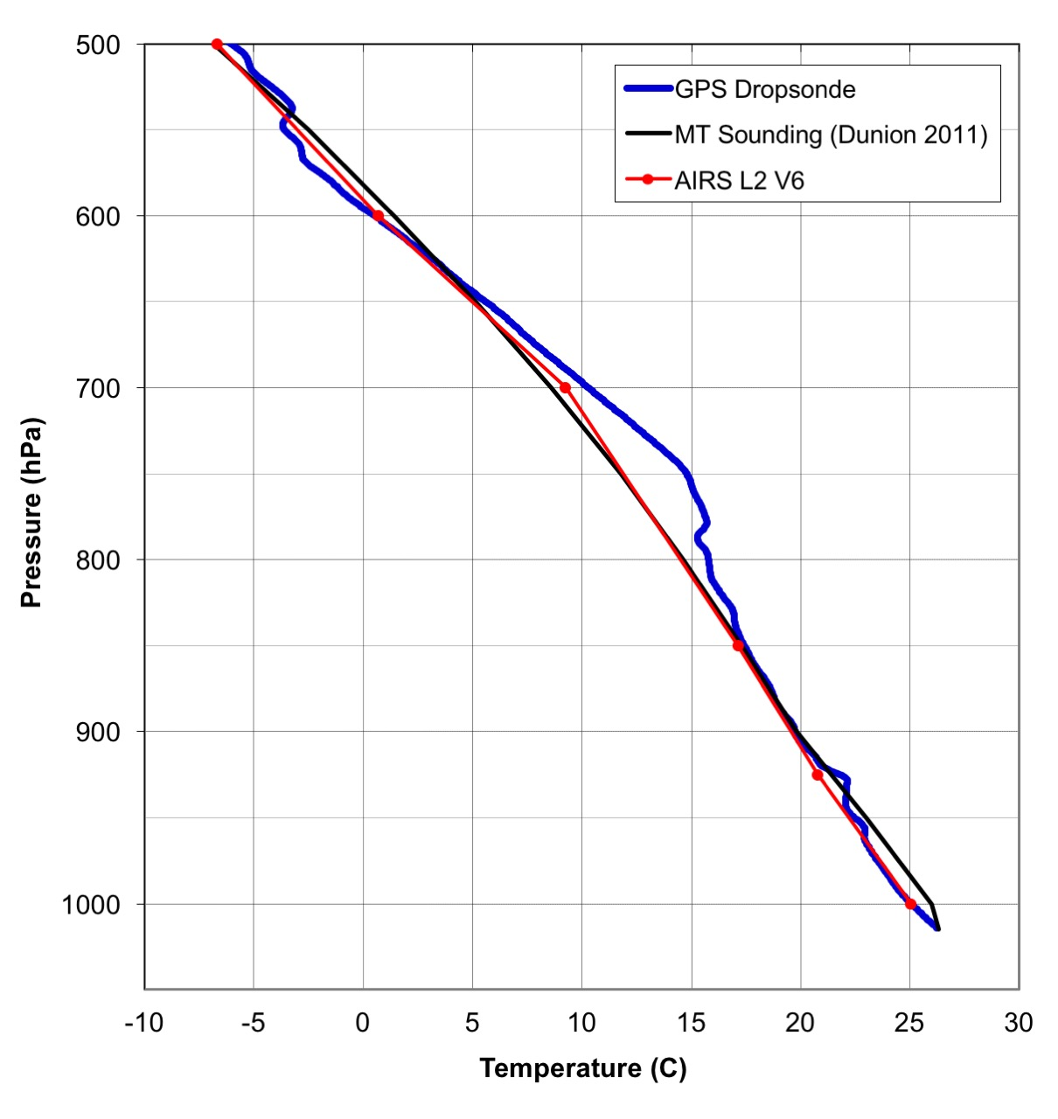
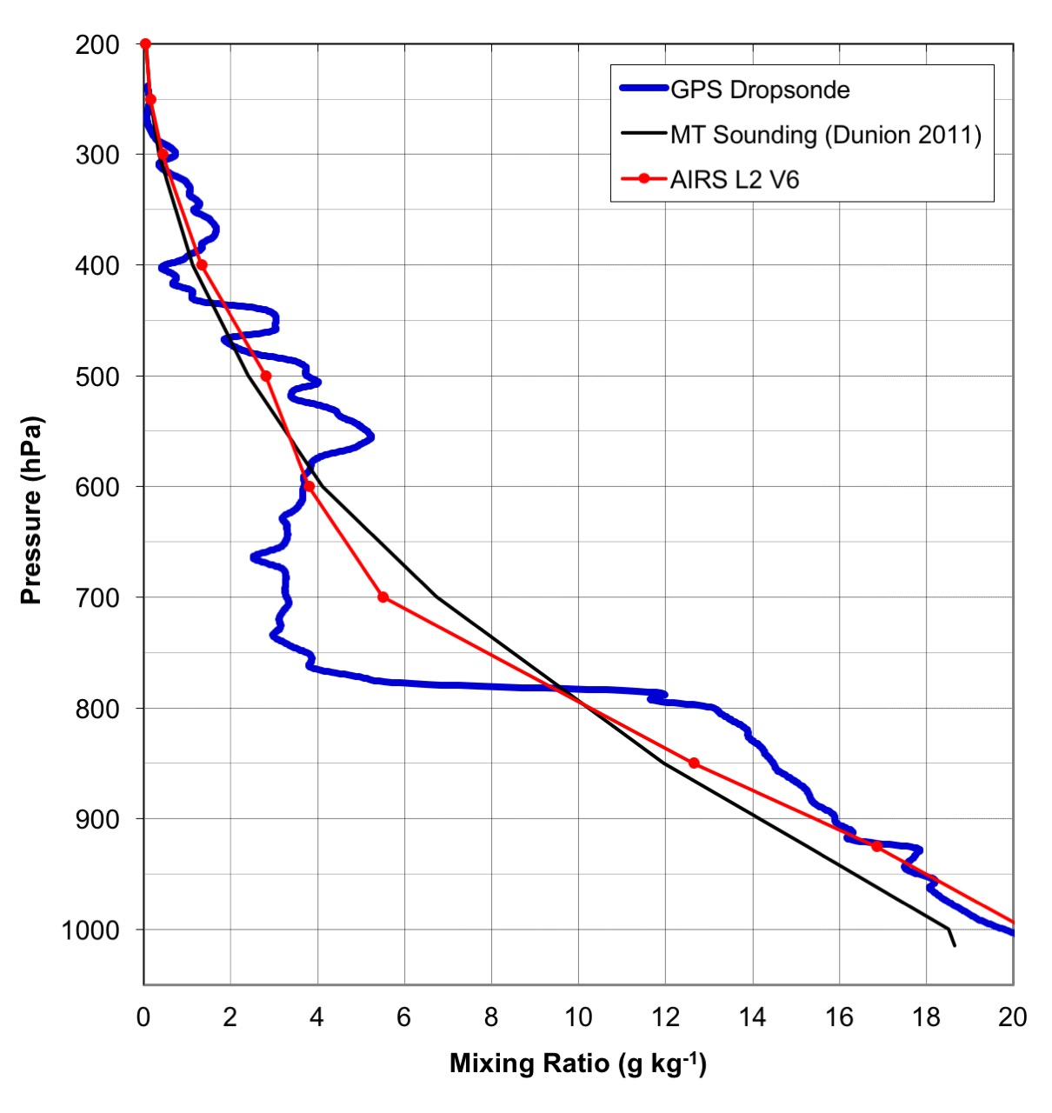
Saharan Air Layer Experiment (SALEX)
G-IV Mission 08 Aug 2005: SAL Sounding ((>45 mm TPW)
Mid-Latitude
Dry Air Intrusion 1
SAL 2
5
10
15
SAL 3
SAL 1
1
Irene
20
Tropical Wave
25
Temp
Inversion
SAL
SAL
SAL
Notes:
Methods described in Dunion 2011 were used to track moist tropical vs SAL vs mid-latitude dry air intrusions. Here, <=45 mm TPW in the microwave imagery helps delineate dry SAL or MLDAI from MT air masses (>45 mm TPW).
Left profile: (drop #20, red circle) SE of TS Irene and on the Wedge of a SAL outbreak. Dropsonde (blue curve), Dunion MT sounding (black curve), and the 2006 operational GFS analysis (green curve). The SAL’s low-to mid-level dry air shows up as a dry layer from ~550-800 hPa in the dropsonde sounding.
Middle profile: temperature from the GPS dropsonde (blue curve), MTl sounding (black curve), and collocated AIRS granule (red curve). The base of the SAL’s low-level temperature inversion is at ~800 hPa
Right profile: mixing ratio from the GPS dropsonde (blue curveMT sounding (black curve), and collocated AIRS granule (red curve)
Take-away #1: SAL profiles are difficult to capture in both models and satellite retrievals (e.g. AIRS).
Take-away #2: GFS overestimates the SAL moisture by ~30-60% RH.
Take-away #3: AIRS and GFS underestimate the SAL’s warmth and temperature inversion strength by ~2-3 C. Important to capture these inversions >> can greatly enhance Convective Inhibition (Dunion 2011)
Take-away #4: given the AIRS retrieval vertical resolution, the AIRS temperature looks quite good >> the SAL inversion tends to be at ~800-850 mb, unfortunatly, often right in between the 700 and 850 mb mandatory levels
Take-away #5: AIRS overestimates the SAL’s moisture from ~600-800 hPa by ~1.5-2.5 g/kg >> that’s fairly significant
Take-away #6: AIRS underestimates the moisture just below the SAL base (~800 hPa in this sounding). Perhaps the extremely sharp moisture discontinuity at the SAL base poses a challenge to the retrieval.
Take-away #7: similar T and moisture trends are seen in other SAL environments

