Slide 1
Observations of the TC Warm Core & Diurnal Cycle during Hurricane Edouard
Jason P. Dunion¹, Chris Velden², & Derrick Herndon²
1 University of Miami – NOAA/AOML/Hurricane Research Division – University at Albany/SUNY
2 UW-CIMSS
NASA HS3-HSRP Science Meeting, May 5 – 7, 2015
NASA Research Park, Moffett Field, CA

Slide 2
Discussion
Hurricane Edouard’s Warm Core
14 & 16 September analyses
2) Hurricane Edouard’s TC Diurnal Cycle
Edouard vs climatology
37 GHz microwave observations
P-3 LF radar observations
P-3 and GH GPS dropsonde observations

Slide 3
TC Warm Core
Hurricane Edouard: 14 & 16 Sep 2014

Slide 4
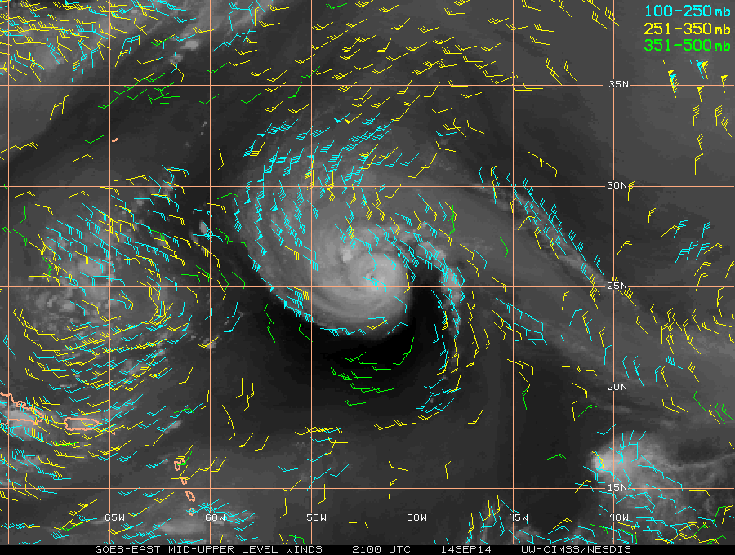
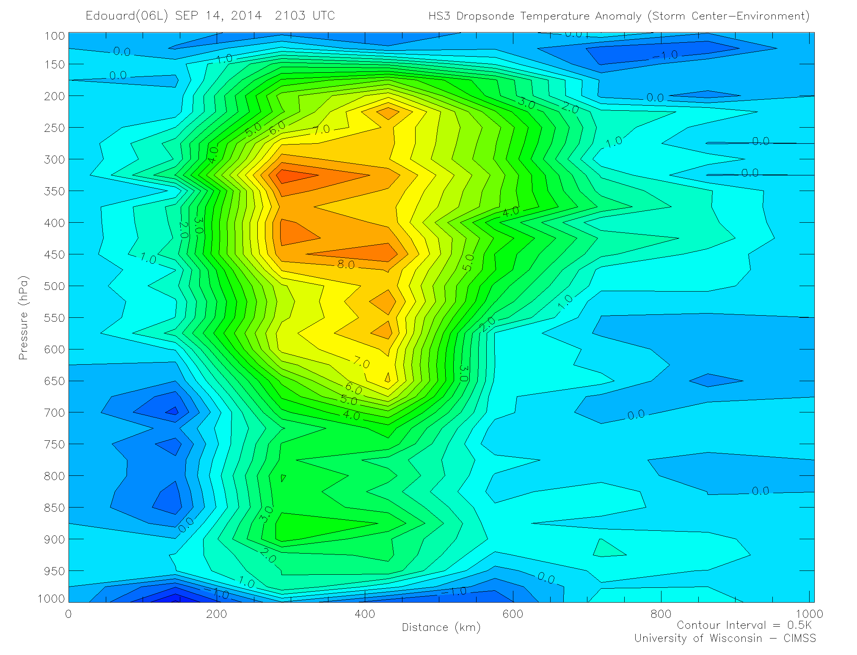
Hurricane Edouard: Observed Warm Core Structure
GH Dropsondes and AMSU Satellite
September 14, 2014 ~21 UTC
Global Hawk Transect
Combine dropsonde data from the
endpoints (A and B) of GH transect during Hurricane Edouard with coincident NWP model (GDAS) temperature soundings at 8 points outside of TC circulation, to estimate
a mean T_env.
X GDAS Sounding Locations
X
X
X
B
X
X
A
X
X
X
Compute the temperature anomaly using
that T_env at each transect dropsonde location.
Display as a cross section along GH transect.
A
B

Slide 5
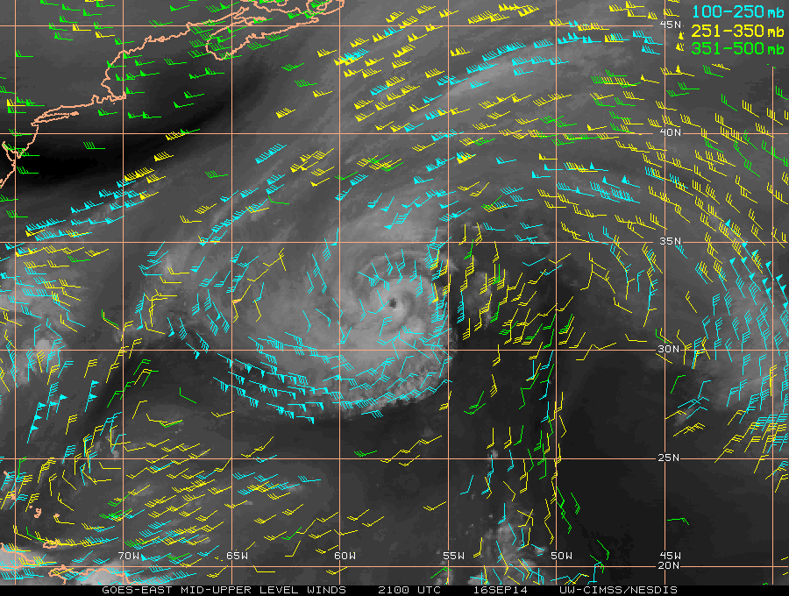
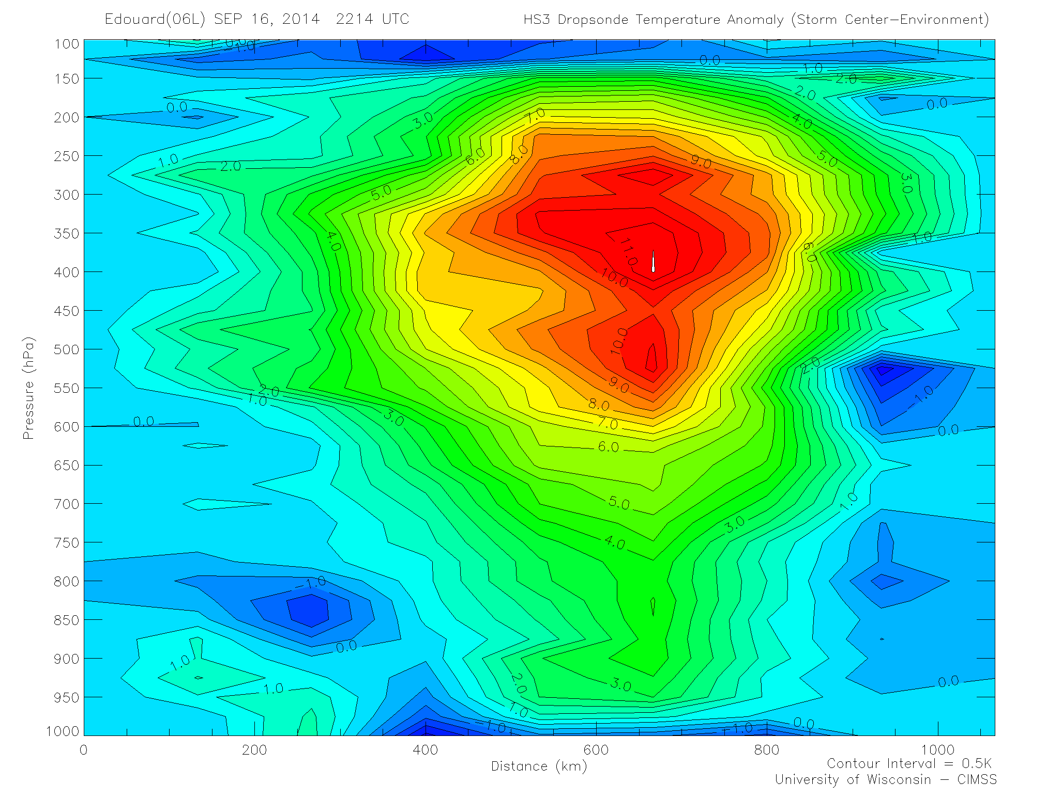
Hurricane Edouard: Observed Warm Core Structure
GH Dropsondes and AMSU Satellite
September 16, 2014 ~22 UTC
Global Hawk Transect
Combine dropsonde data from the
endpoints (A and B) of GH transect during Hurricane Edouard with coincident NWP model (GDAS) temperature soundings at 8 points outside of TC circulation, to estimate
a mean T_env.
X GDAS Sounding Locations
X
X
X
B
X
X
A
X
X
X
Compute the temperature anomaly using
that T_env at each transect dropsonde location.
Display as a cross section along GH transect.
A
B

Slide 6
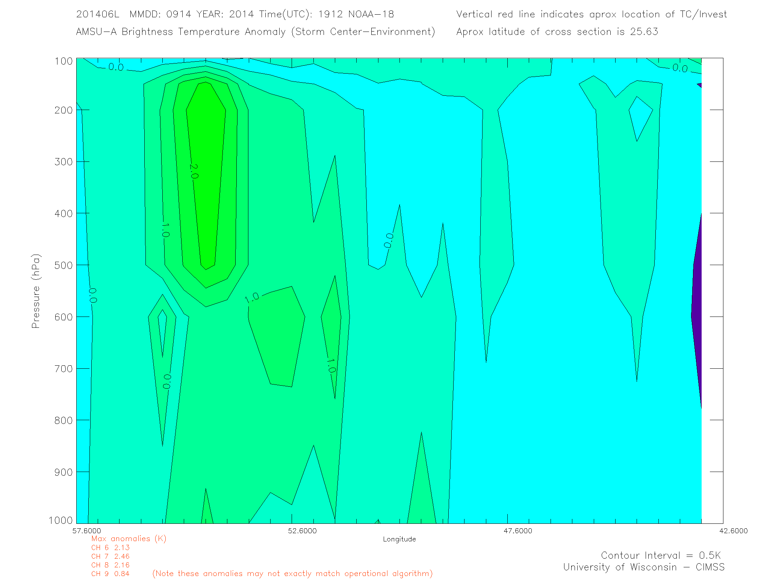
Comparison of TC Edouard’s observed warm core structure from GH dropsondes with satellite AMSU
September 14 ~21 UTC
September 14 ~19 UTC
GH Dropsonde Temperature Anomaly
(Max ~ 9.0 C)
AMSU N-18 Temperature Anomaly
(Max ~ 2.5C)

Slide 7
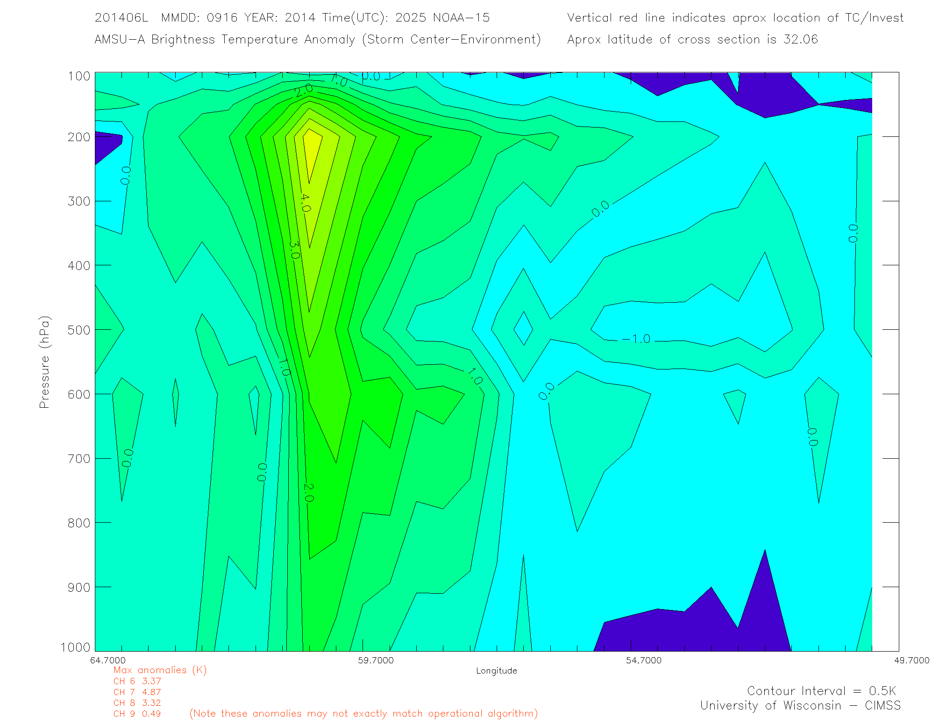
Comparison of TC Edouard’s observed warm core structure from GH dropsondes with satellite AMSU
September 16 ~22 UTC
September 16 ~20 UTC
GH Dropsonde Temperature Anomaly
(Max ~11.5C)
AMSU N-15 Temperature Anomaly
(Max ~4.5C)

Slide 8
TC Diurnal Cycle
Hurricane Edouard: 16 Sep 2014

Slide 9
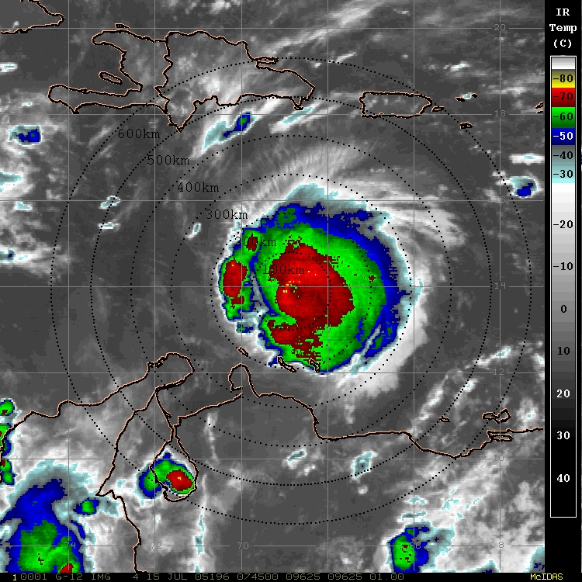
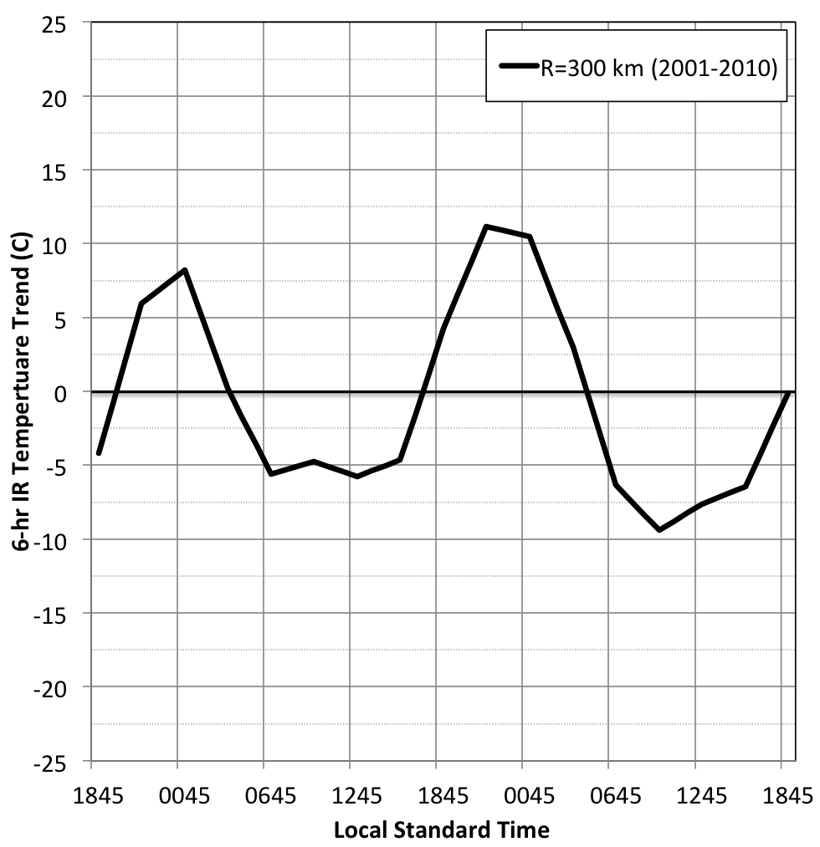
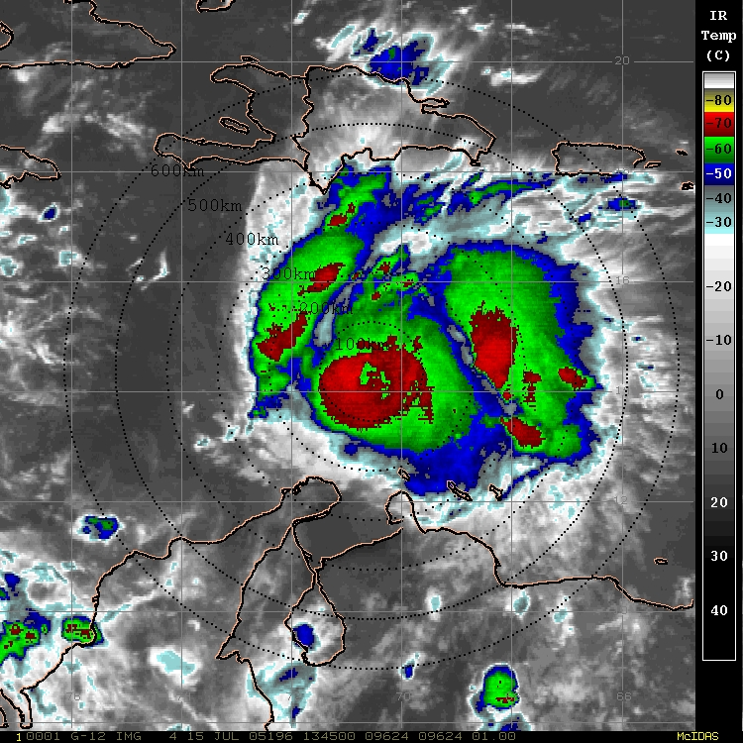
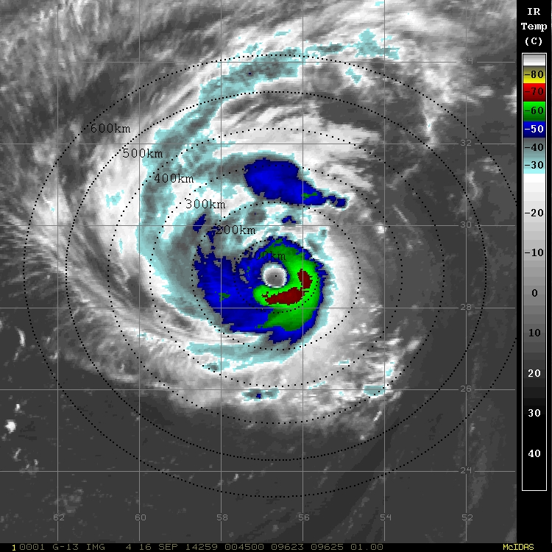
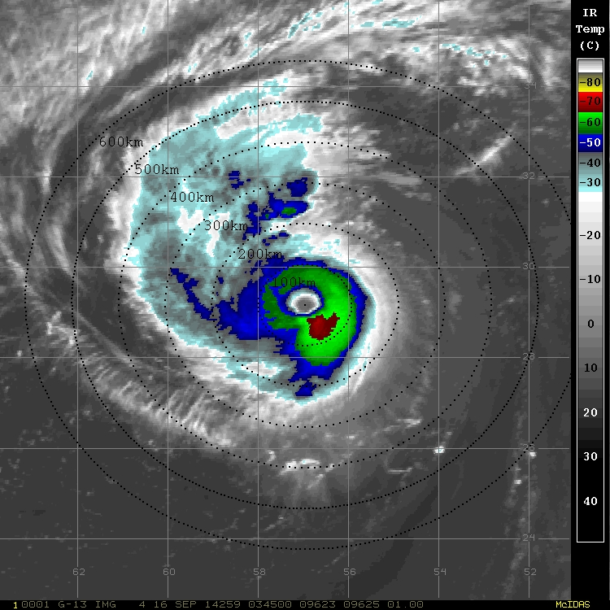
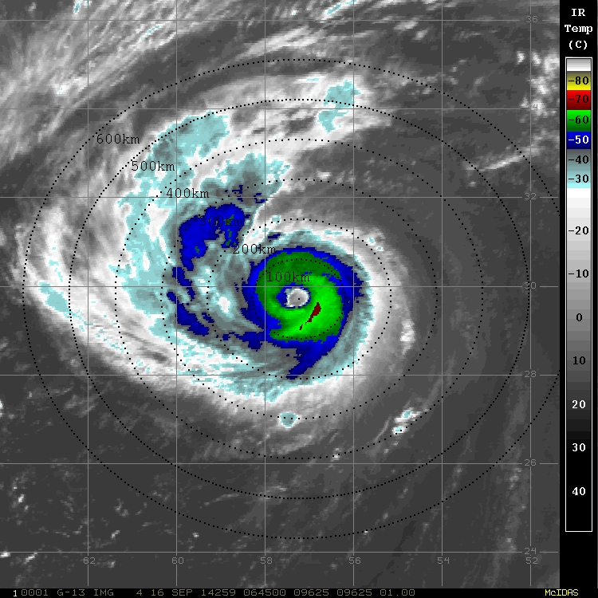
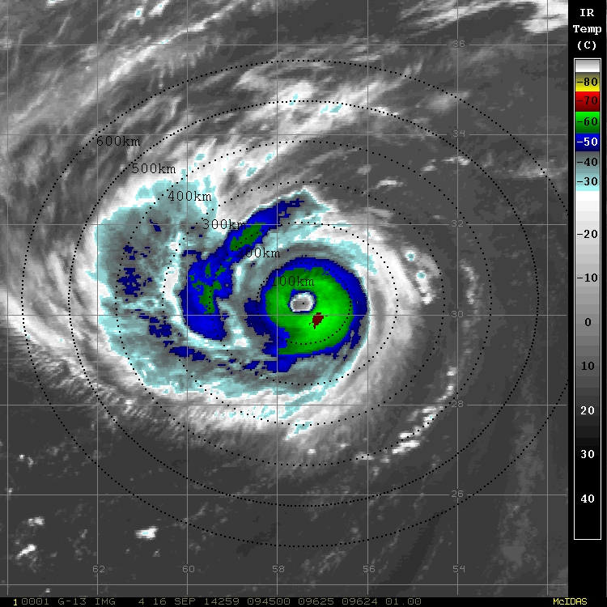
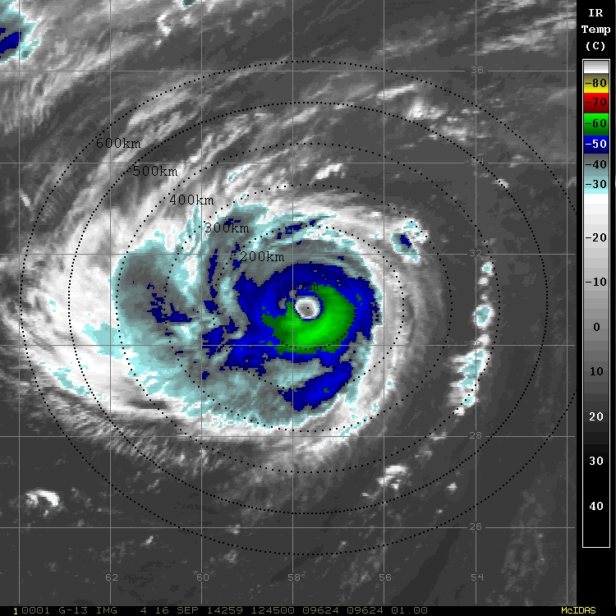
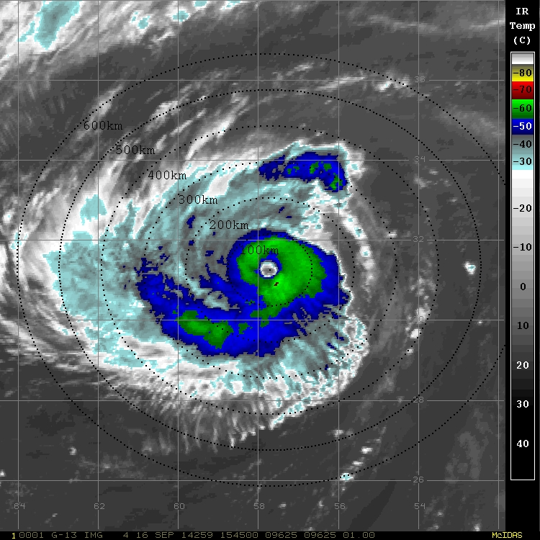
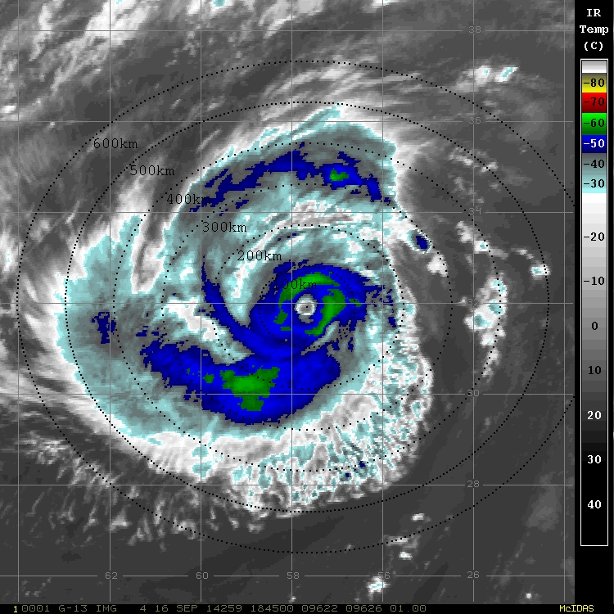
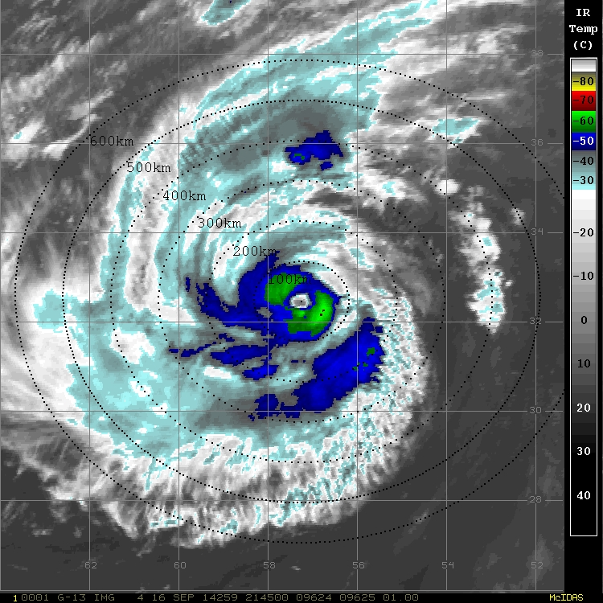
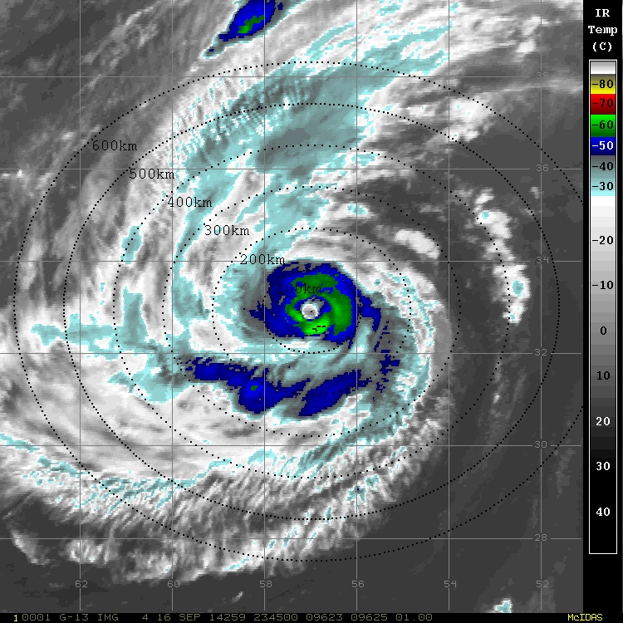
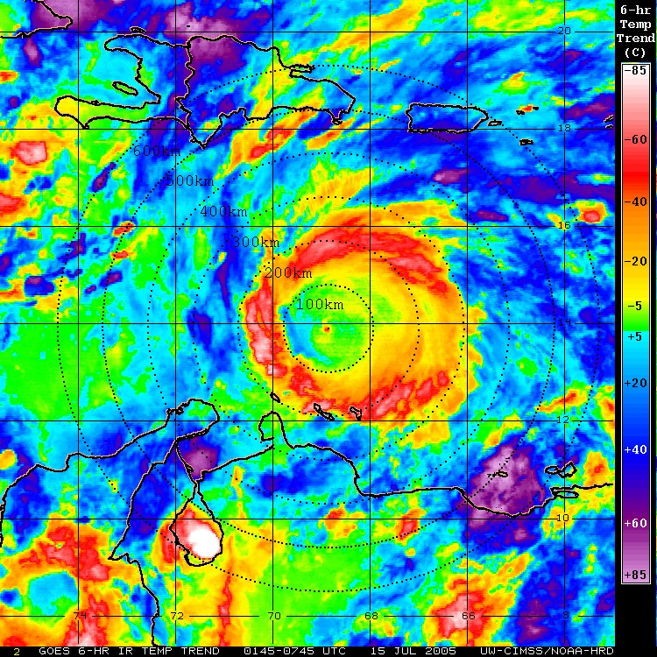
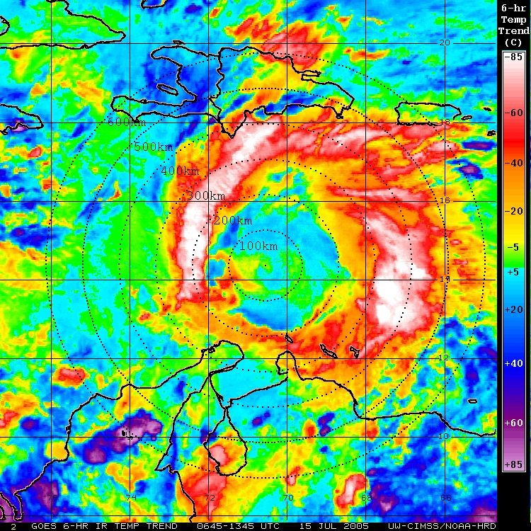
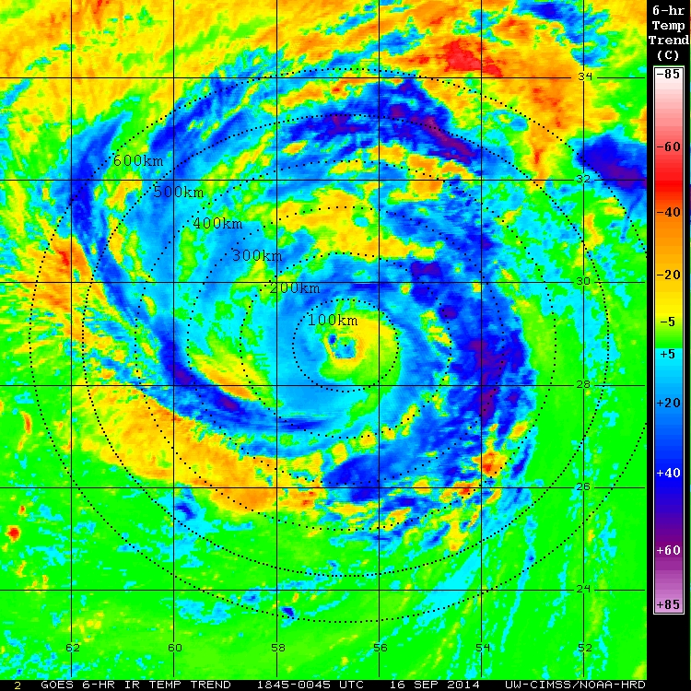
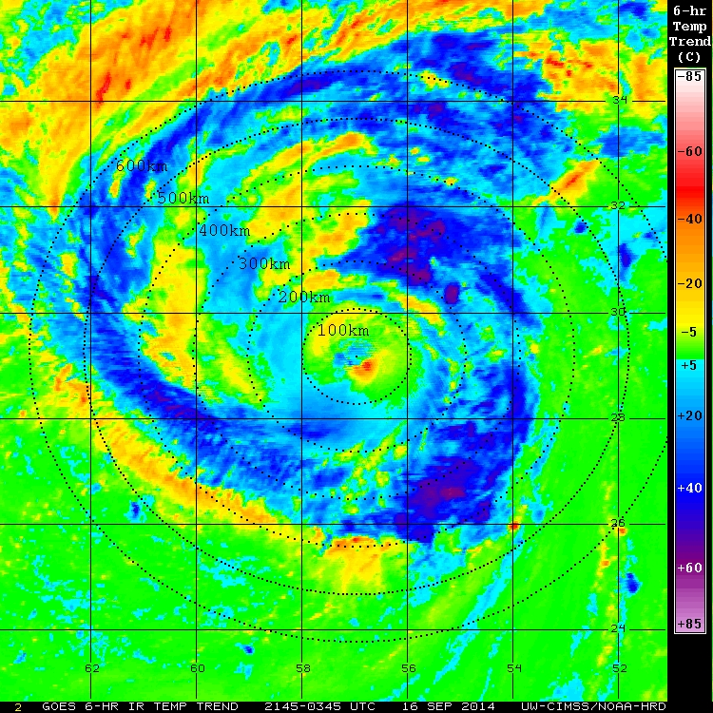
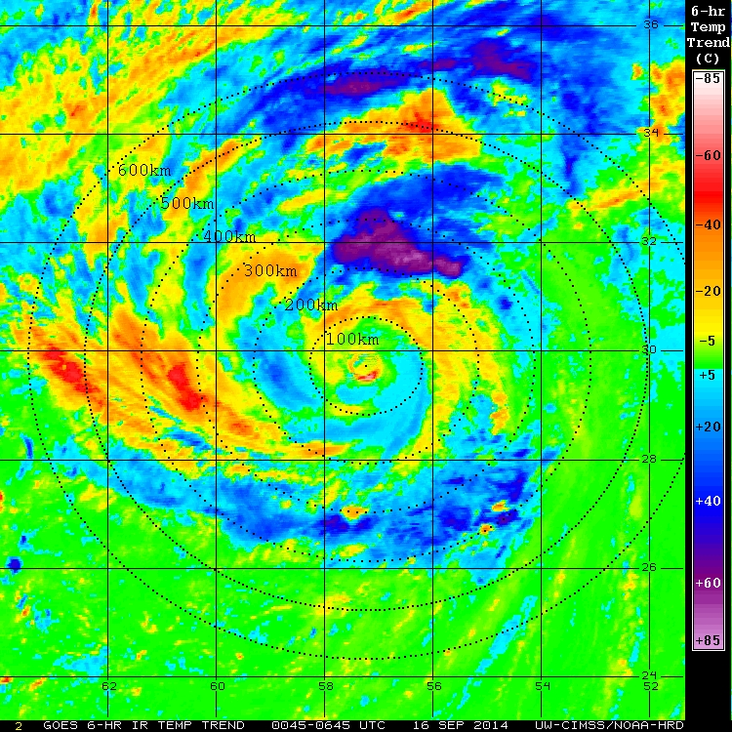
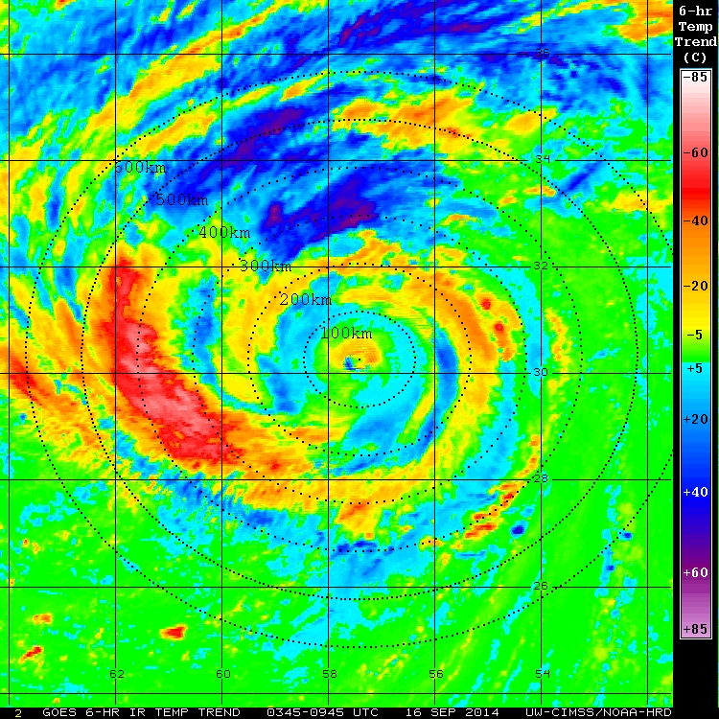
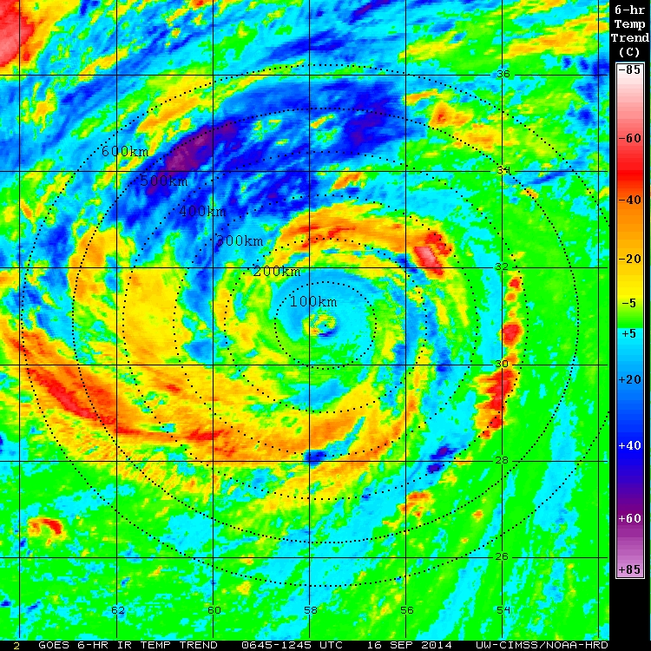
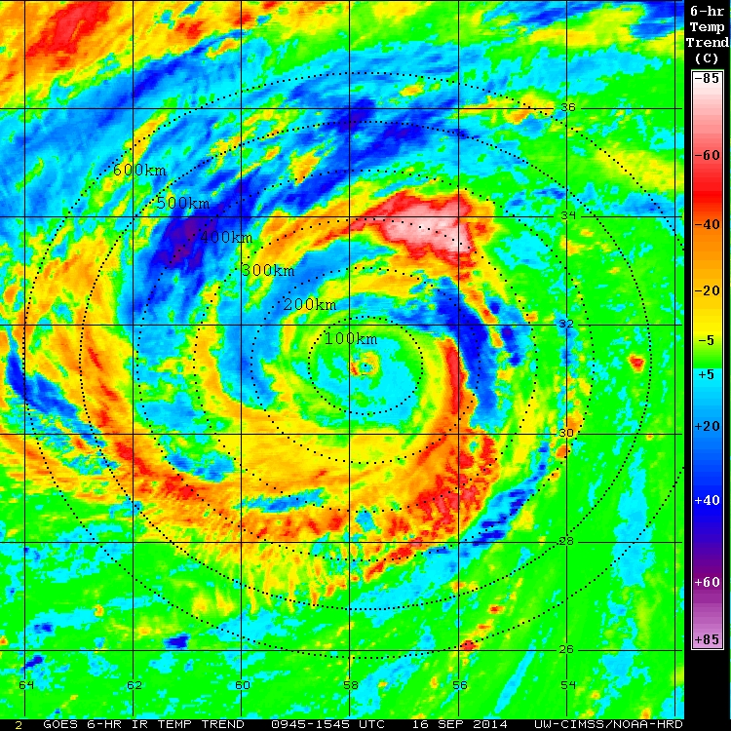
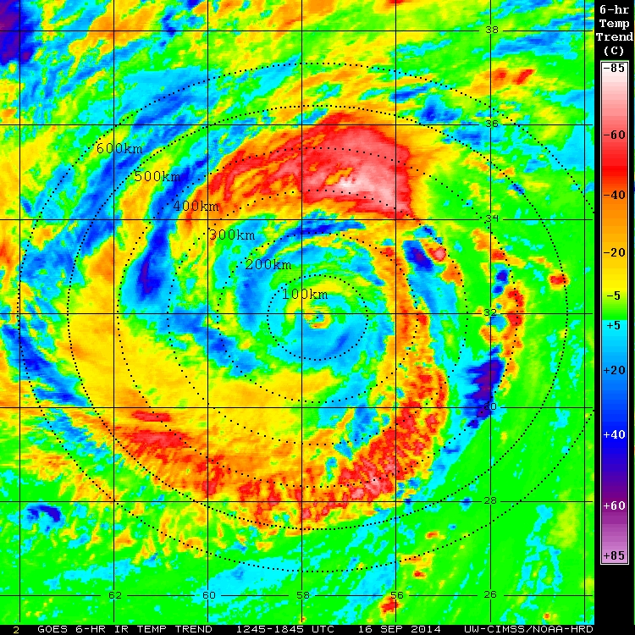
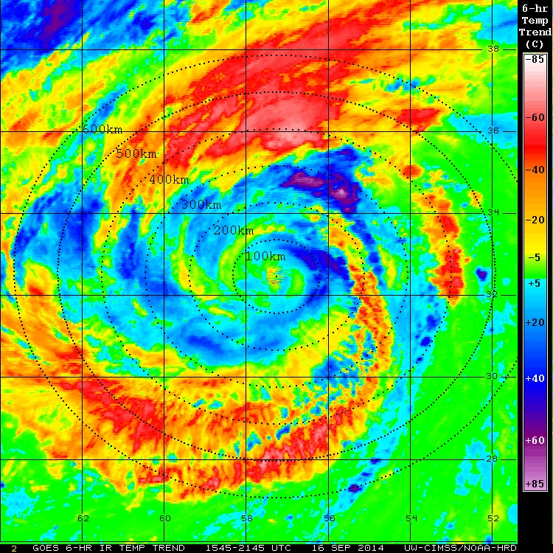
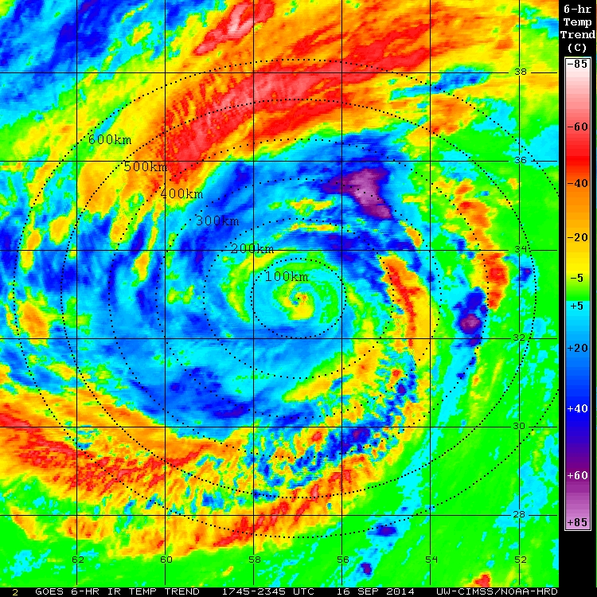
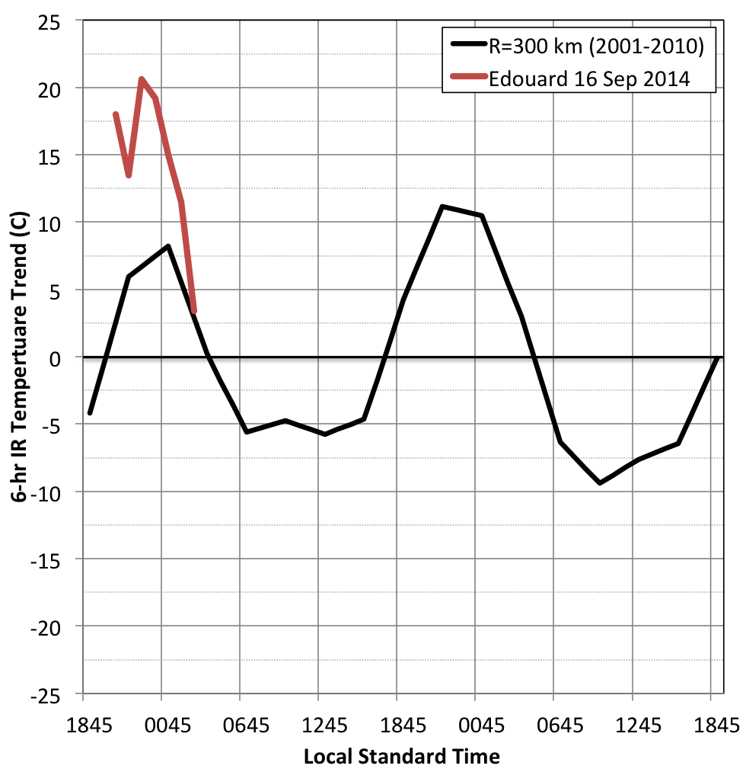
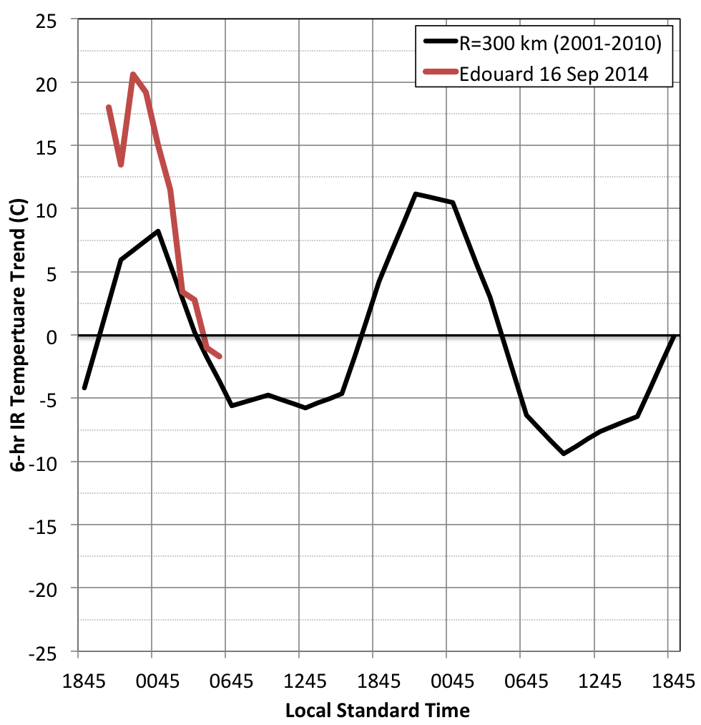
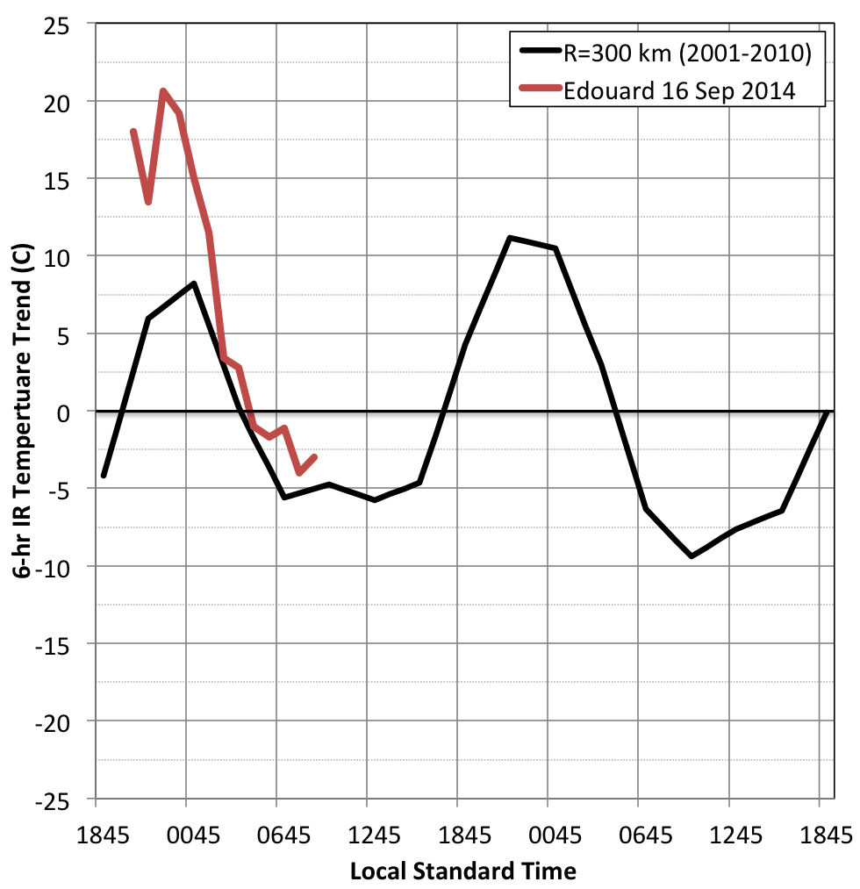
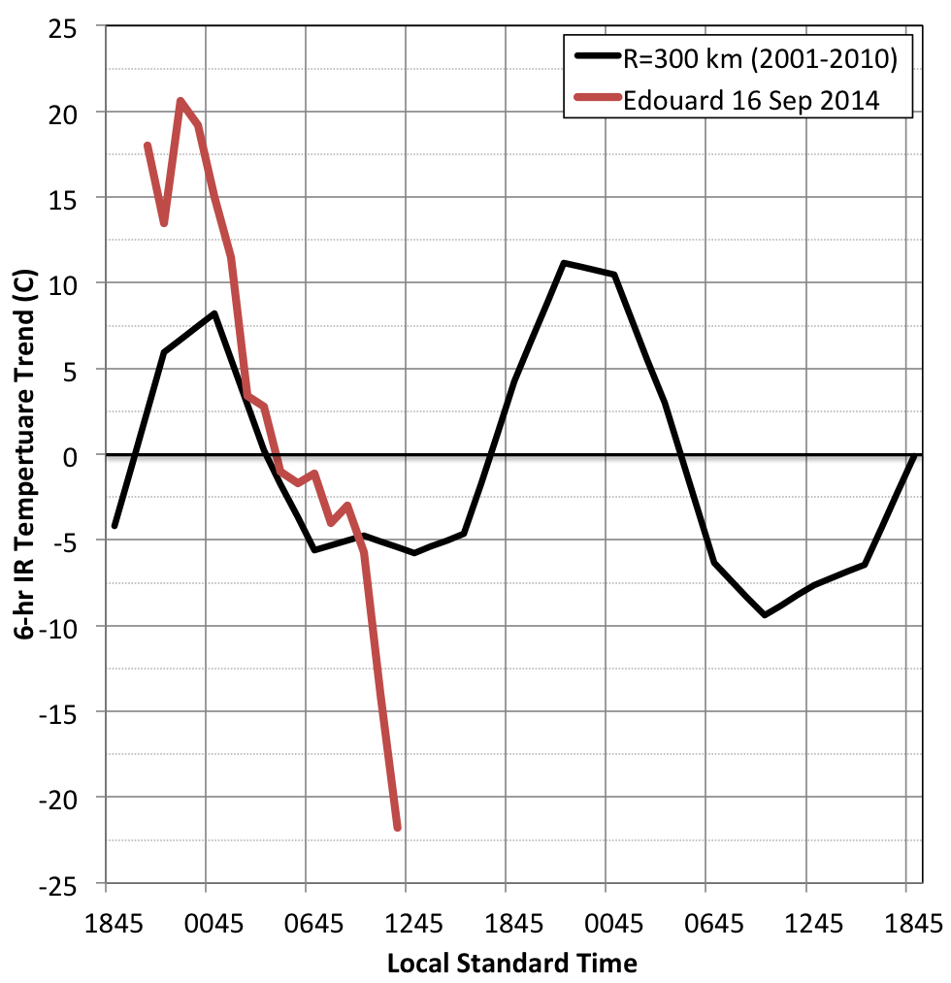
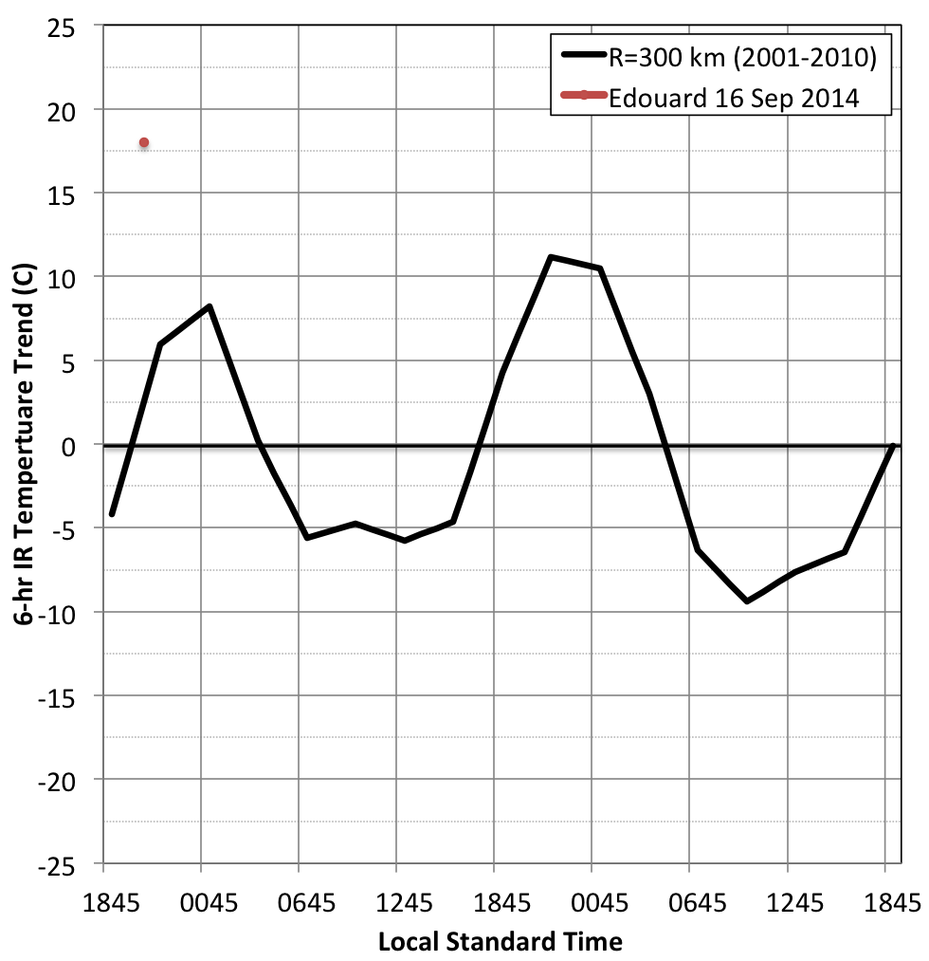
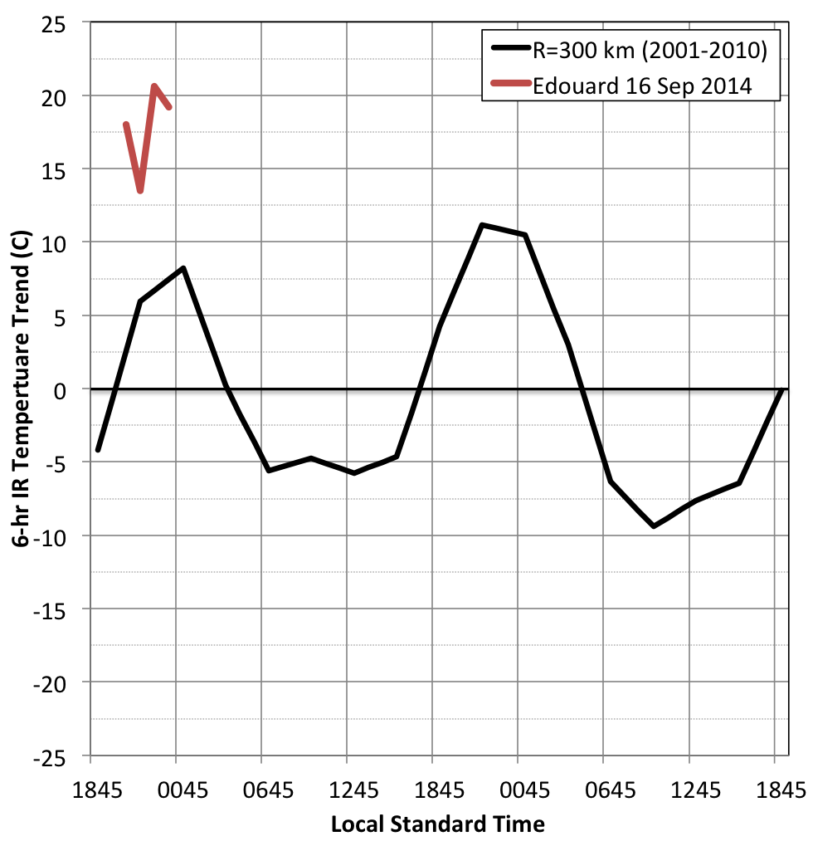
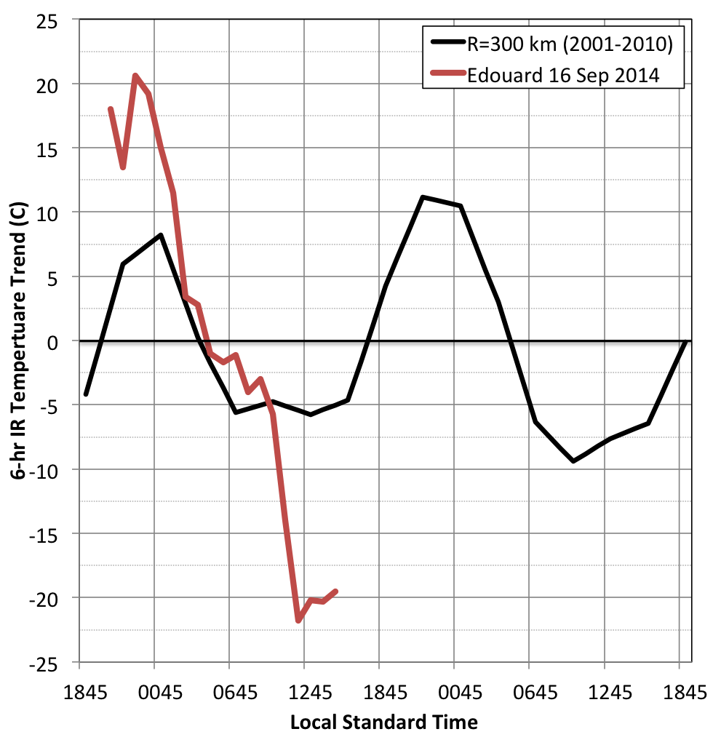
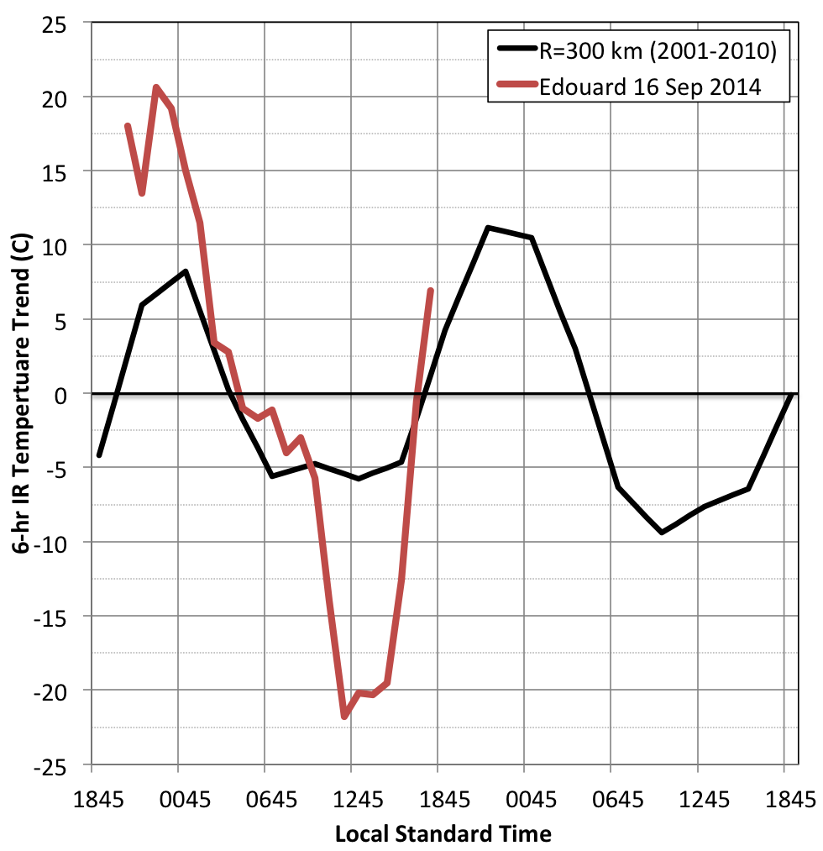
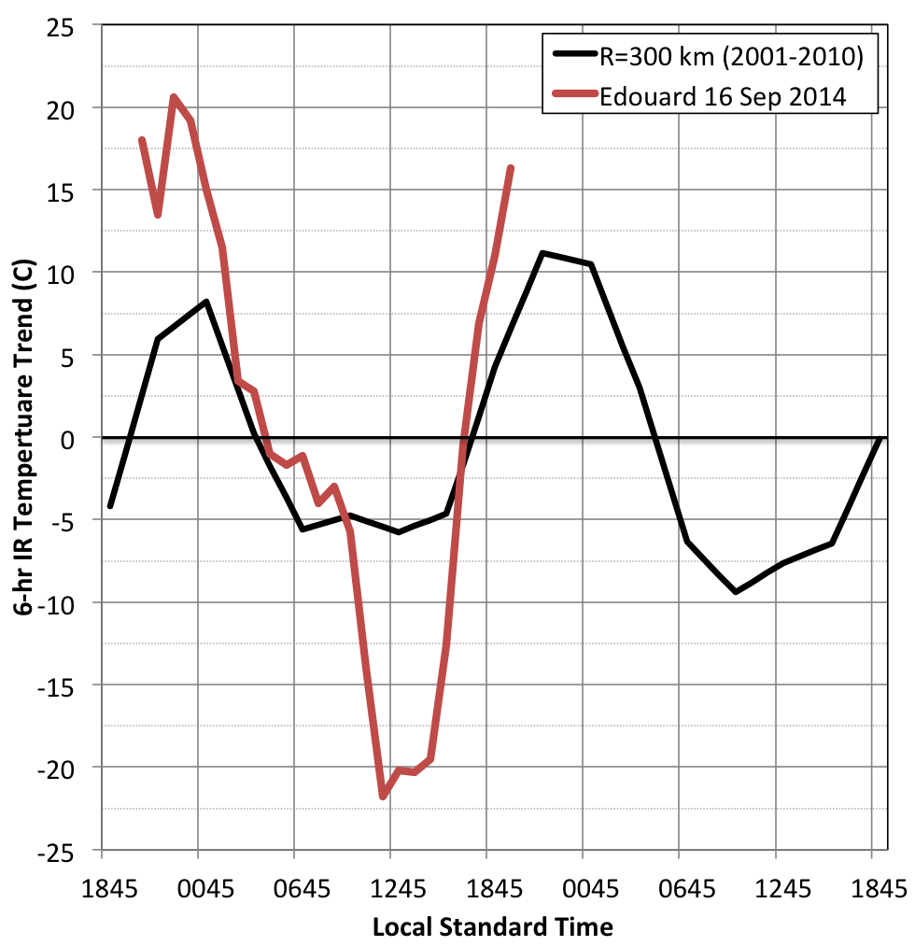
Edouard 16 Sep 2014 TC Diurnal Cycle
GOES
Enhanced IR
GOES IR 6-hr
Temperature Trend
GOES IR 6-hr
Temp Trend (R=300km)

Slide 10
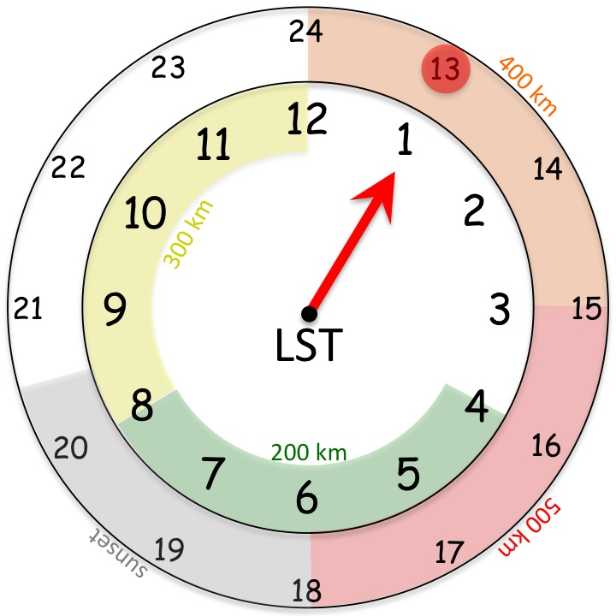
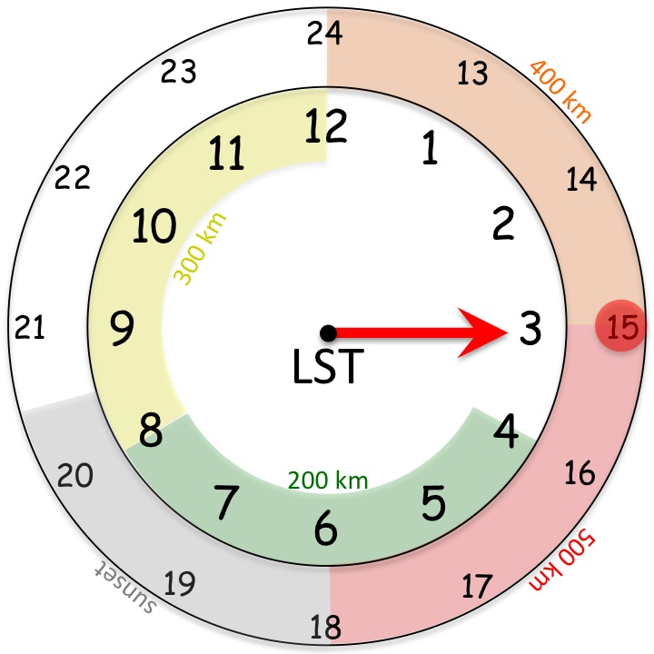
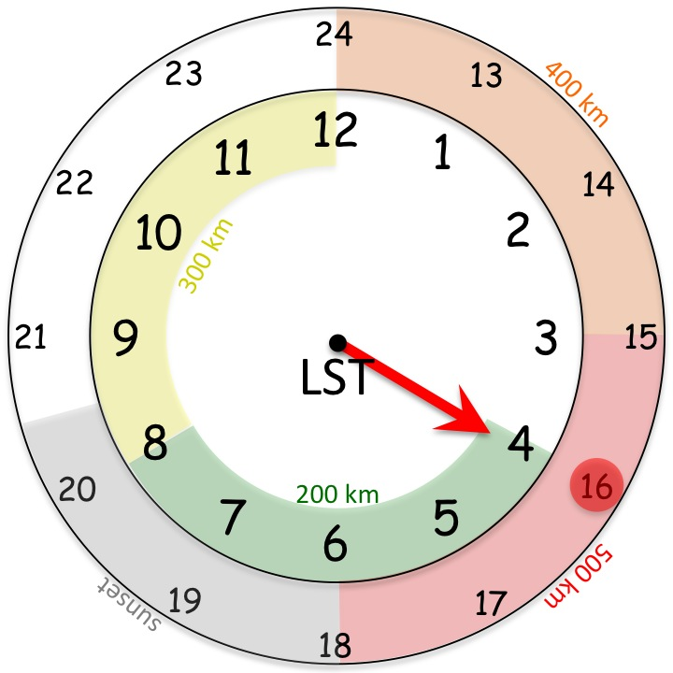
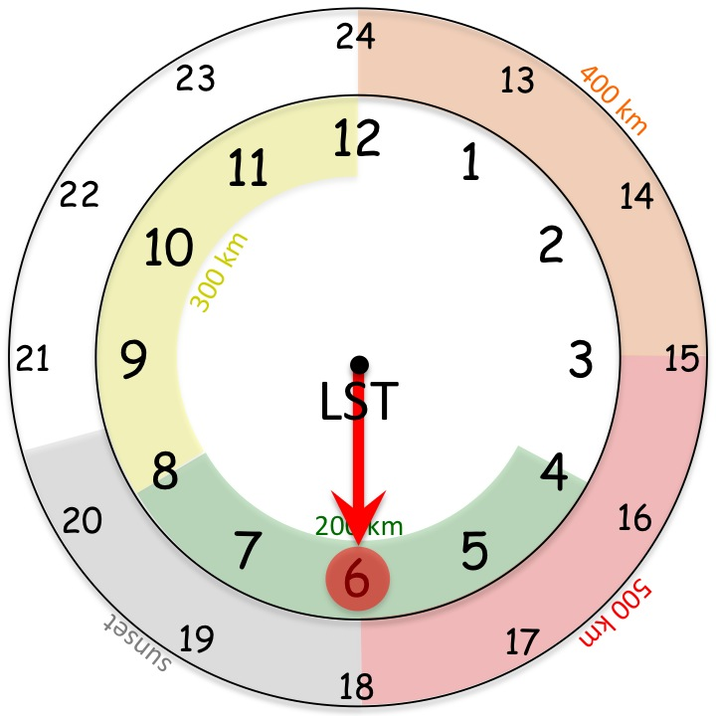
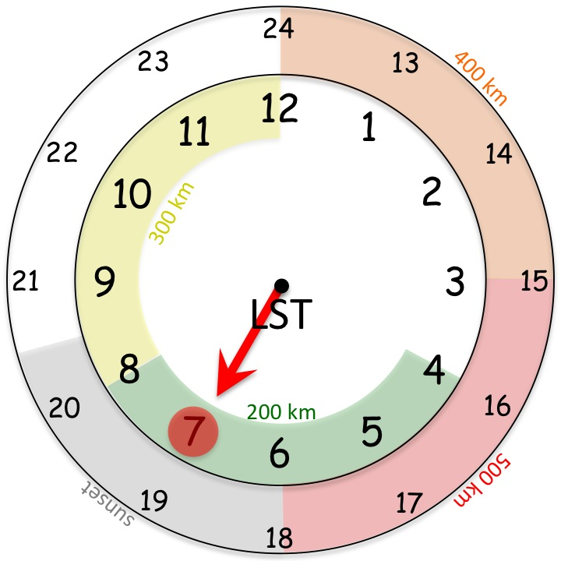
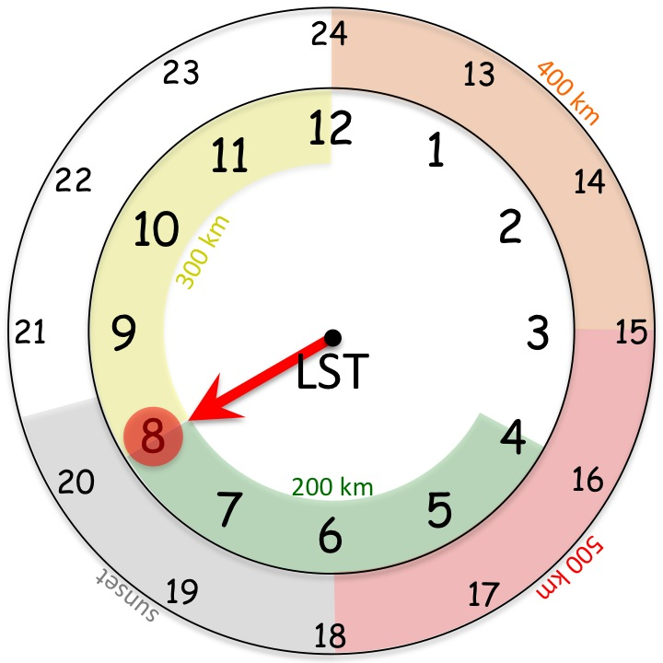
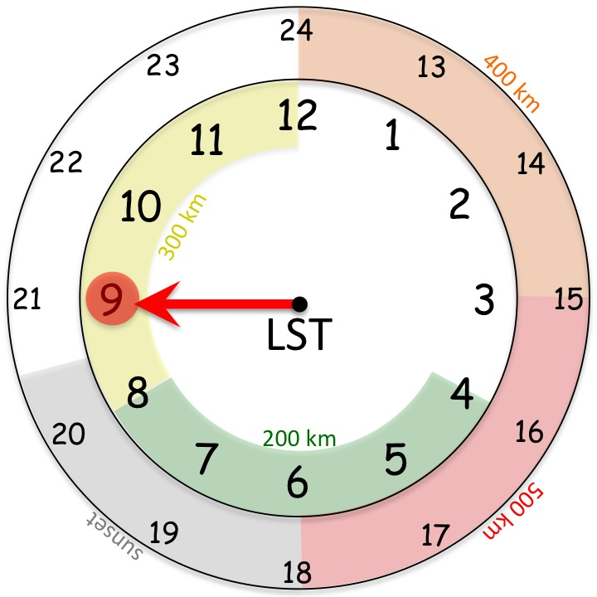
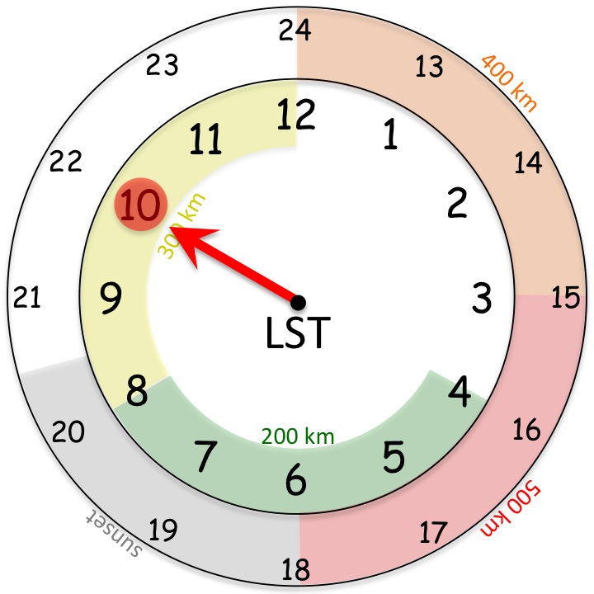
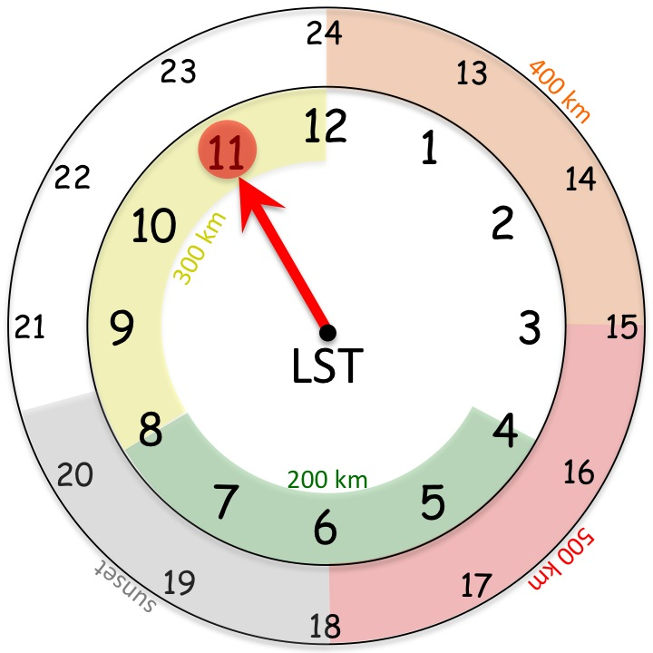
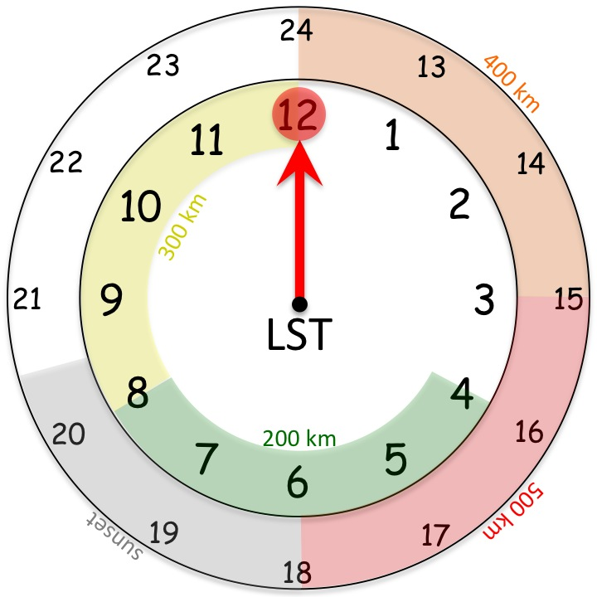
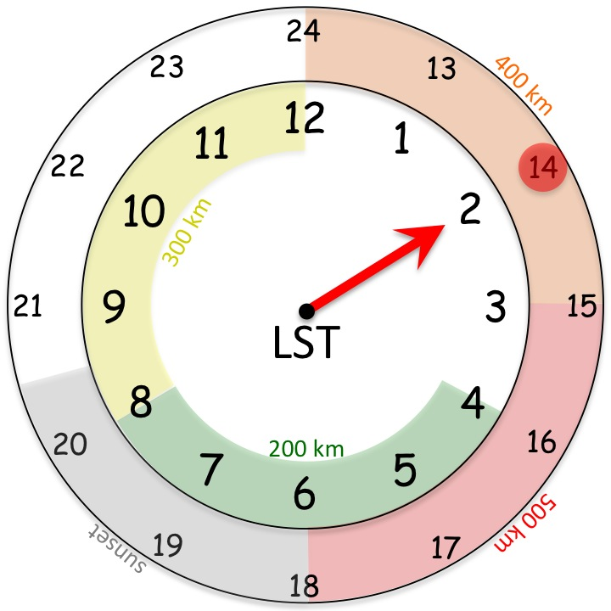
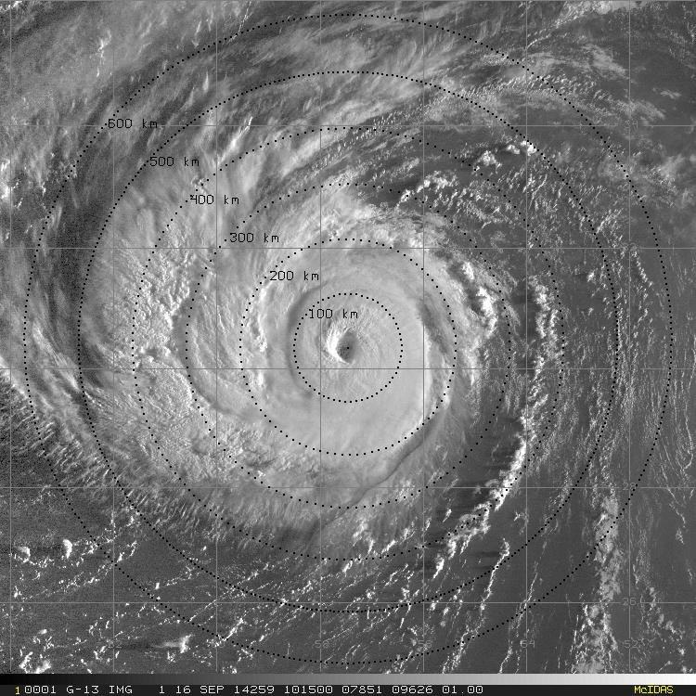
Edouard 16 Sep 2014 TC Diurnal Cycle
GOES Visible
GOES IR 6-hr Temp Trend
GOES Infrared
Notes:
SHIPs shear: 06z: 15kt 123 deg
SHIPs shear: 12z: 17kt 119 deg
SHIPs shear: 18z: 15kt 109 deg

Slide 11
Edouard 16 Sep 2014 TC Diurnal Cycle
What did we just see?
A predictable feature that is limited to the cirrus canopy
A predictable feature that affects a deep layer of the TC
Dunion’s fancy artwork
GOES IR 6-hr Temp Trend
37 GHz Composite Imagery

Slide 12
Edouard 16 Sep 2014 NOAA P-3 (42) LF Radar 1322-1821 UTC
180km
120km
60km
360 km
30nm
65nm
100nm
360 km

Slide 13
Edouard 16 Sep 2014 NOAA P-3 (42) LF Radar 1322-1821 UTC
300km
200km
100km
660 km
55nm
110nm
160nm
660 km

Slide 14
Hurricane Edouard 16 Sep 2014 TC Diurnal Cycle (1345 to 1845 UTC)
GOES IR 6-hr Temp Trend
GOES Visible/NOAA P-3 LF Radar
VWS: 19 kt

Slide 15
Hurricane Edouard 16 Sep 2014 TC Diurnal Cycle (1345 & 1845 UTC)
GOES IR 6-hr Temp Trend
GOES Visible/NOAA P-3 LF Radar

Slide 16
Hurricane Edouard 16 Sep 2014 TC Diurnal Cycle

Slide 17
Edouard 16 Sep 2014 (NOAA-42) NOAA P-3 (N42) GPS dropsonde observations
GOES Visible: 1545 UTC
GOES IR 6-hr Temp Trend: 1545 UTC
P-3 (N42) GPS Dropsonde: 160514 UTC
78% RH (80%)
79% RH (84%)
65% RH (83%)
Notes:
NOAA P-3 (N42) GPS dropsonde times (W-CTR-E-NW-CTR-S-CTR-NW): 1357/1405/1519/1553/1605/1626/0703/1745/1752 UTC

Slide 18
Edouard 16 Sep 2014 (NOAA-42) GH and NOAA P-3 (N42) GPS dropsonde observations
GOES Visible: 1645 UTC
GOES IR 6-hr Temp Trend: 1645 UTC
P-3 (N42) GPS Dropsonde: 162613 UTC
GH GPS Dropsonde: 163550 UTC
GH GPS Dropsonde: 162419 UTC
97% RH (84%)
7% RH (52%)
34% RH (58%)
71% RH (83%)
42% RH (84%)
Notes:
NOAA P-3 (N42) GPS dropsonde times (W-CTR-E-NW-CTR-S-CTR-NW): 1357/1405/1519/1553/1605/1626/0703/1745/1752 UTC

Slide 19
Edouard 16 Sep 2014 (NOAA-42) NOAA P-3 (N42) GPS dropsonde observations
GOES Visible: 1745 UTC
GOES IR 6-hr Temp Trend: 1745 UTC
P-3 (N42) GPS Dropsonde: 174519 UTC
52% RH (80%)
73% RH (84%)
Notes:
NOAA P-3 (N42) GPS dropsonde times (W-CTR-E-NW-CTR-S-CTR-NW): 1357/1405/1519/1553/1605/1626/0703/1745/1752 UTC

Slide 20
Operational HWRF Real-Time Runs 16 September 2014 (00-21 UTC)
Radial Wind (GH dropsondes)
Hurricane Nature Run (Nolan 2013)
Operational HWRF

Slide 21
Edouard 16 Sep 2014
Global Hawk GPS dropsonde analyses
GOES IR 6-hr Temp Trend
GOES Visible/NOAA P-3 LF Radar
Notes:
17 Sep 2014 00z: 35 deg@15kt
SHIPs shear: 06z: 15kt 123 deg
SHIPs shear: 12z: 17kt 119 deg
SHIPs shear: 18z: 15kt 109 deg

Slide 22
CIMSS Real-Time Product Support Cloud Top Heights, Tropical Overshooting Tops, Lightning

Slide 23
Conclusions
TC Warm Core: Edouard: 14 & 16 Sep
TEnv >> GH dropsonde endpoints + GDAS
Robust TEnv>> GH >> clear the outer band region
Marked growth of the warm core >> 14-16 Sep
GH analyses >> calibrate AMSU warm core retrievals
AMSU warm core anomalies >> low bias (resolution) >> ~1/3
TC Diurnal Cycle: Edouard (16 Sep)
Focus >> how does it manifest in the TC environment?
Edouard >> “on the clock”
Arc clouds >> linked to diurnal pulse
37 GHz & P3 Lf Radar >> diurnal pulse detected?
P3 & GH dropsondes>>low/mid-level dry air, downdrafts

