Slide 1


NOAA SHOUT
Hurricane Matthew Global Hawk Missions
Jason Dunion
University of Miami/CIMAS – NOAA/AOML/HRD – University at Albany/SUNY
HRD Hurricane Matthew Debrief: October 20, 2016

Slide 2
2016 NOAA SHOUT
Global Hawk Missions: Hurricane Matthew (AFRC-AFRC)
20161005GH: 05-06 Oct (24h 44m)
20161007GH: 07-08 Oct (24h 06m)
20161009GH: 09-10 Oct (24h 47m)
Global Hawk data collection
HAMSR: microwave AMSU-like sounder
HIWRAP: Dual-freq (Ka- & Ku-band), dual beam, conical scanning Doppler radar
GPS dropsondes (162 obs sent to the GTS)
HRD Real-Time QC processing: Stan G., Kathryn S., & John K.
2016 HRD Real-Time QC processing team: Stan G., Kathryn S., & John K., Hui C., Brittany D., & Neal D. (629 obs sent to the GTS)

Slide 3
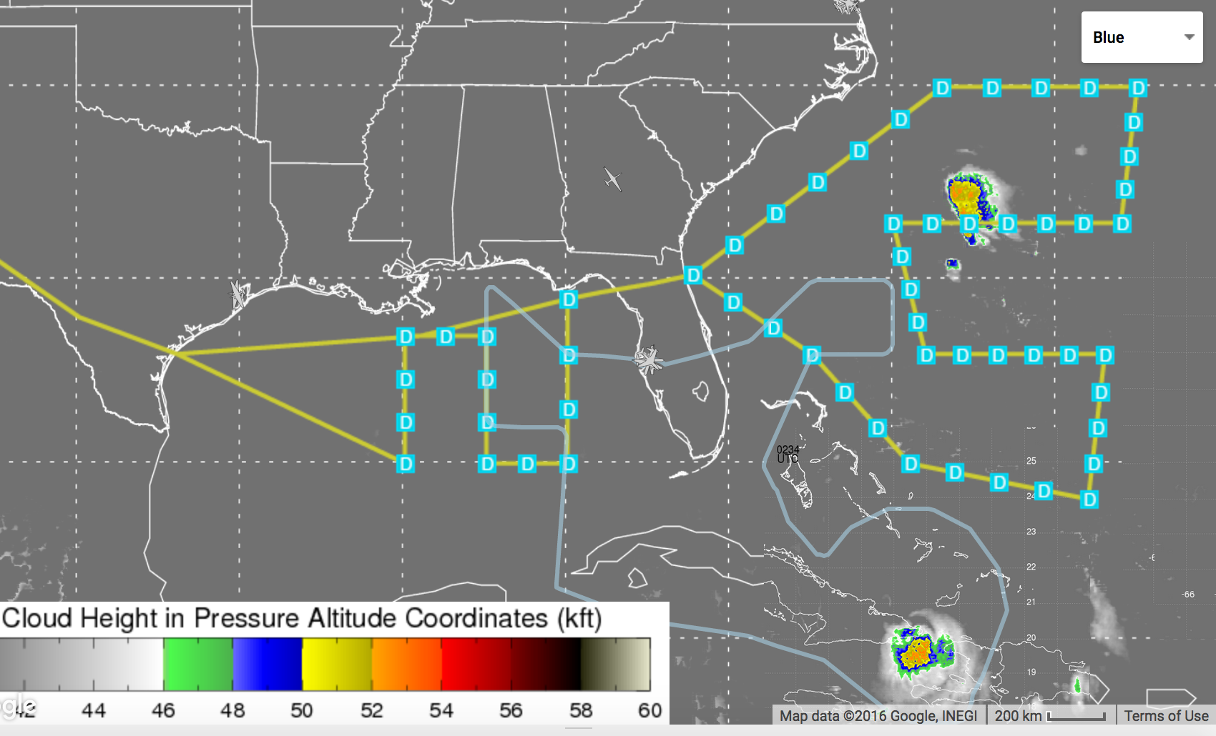
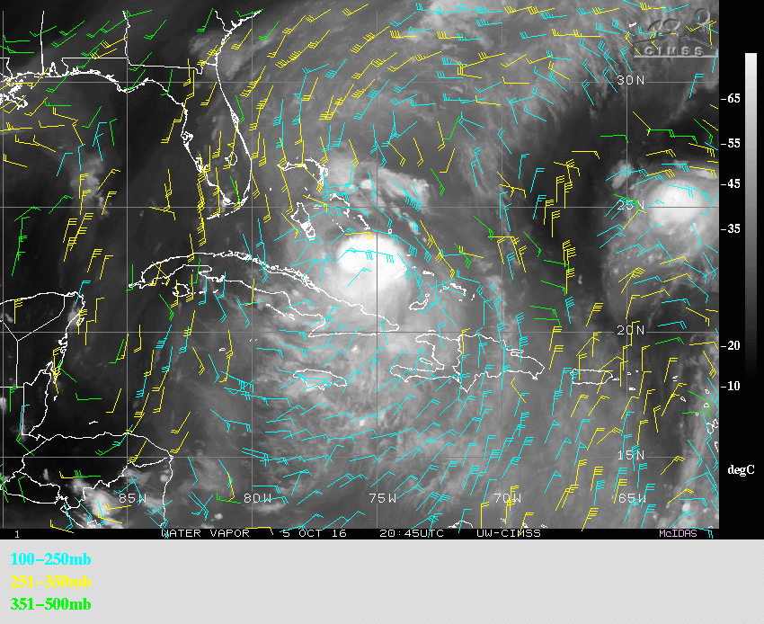
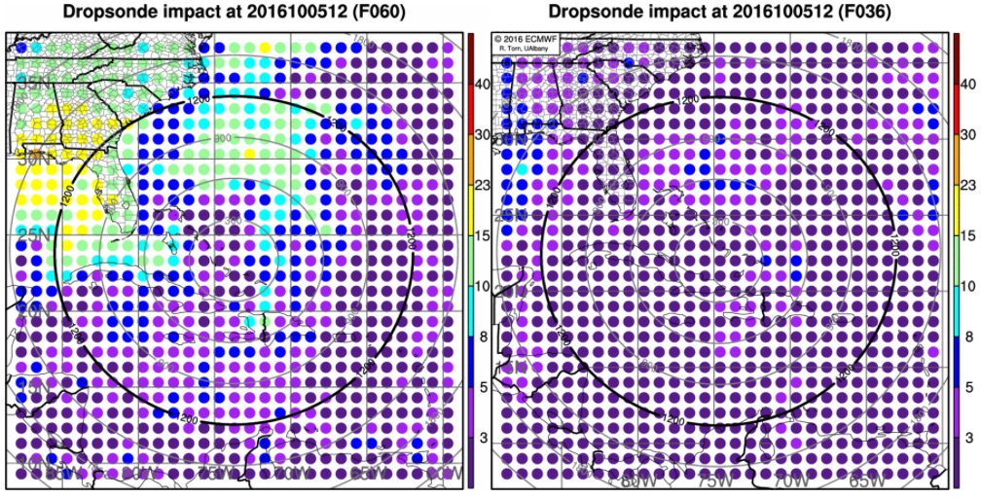
2016 NOAA SHOUT: Matthew (05-06 Oct 2016)
Mission Highlights
NASA AFRC to NASA AFRC; take-off: 0256 UTC; landing: 0340 UTC
Objectives: sample HWRF/ECMWF model sensitive regions: GMex (upper-level trough) & U.S. SE coast (ST ridge); sample outflow north of Matthew
Global Hawk track
24h 44m mission
61 GPS dropsondes
HWRF
ECMWF
Sensitivity targets for reducing uncertainty amongst the model ensemble members
CIMSS GOES water vapor AMVs showing outflow around the northern semicircle of Matthew

Slide 4
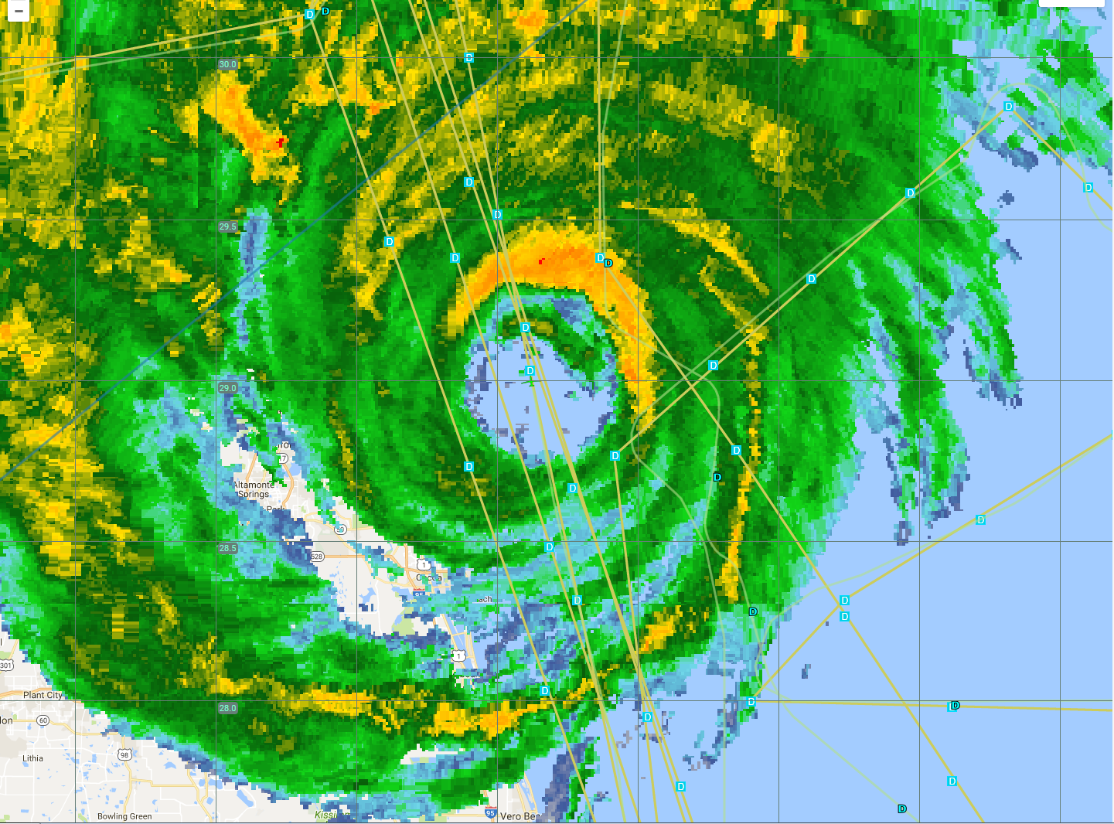
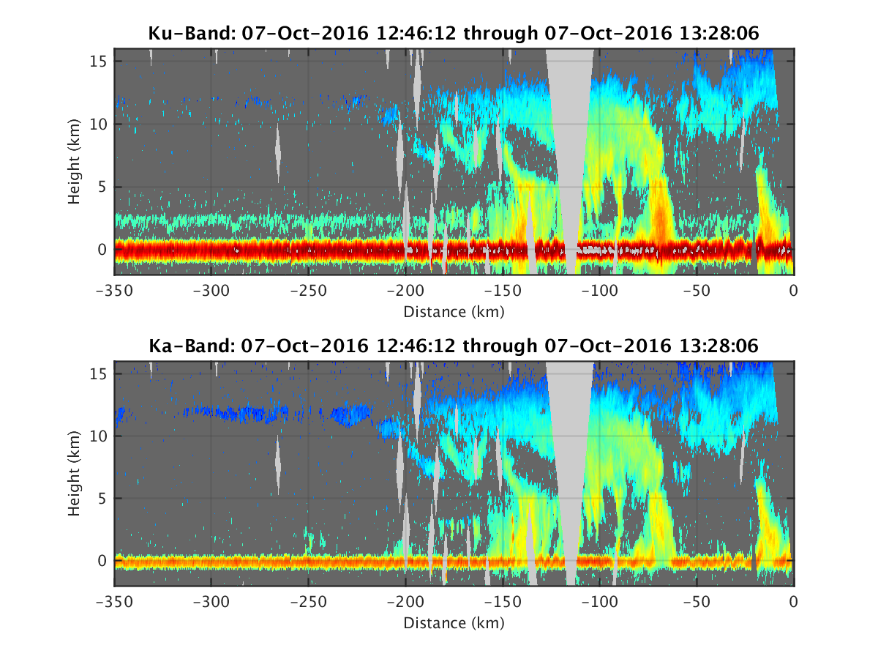
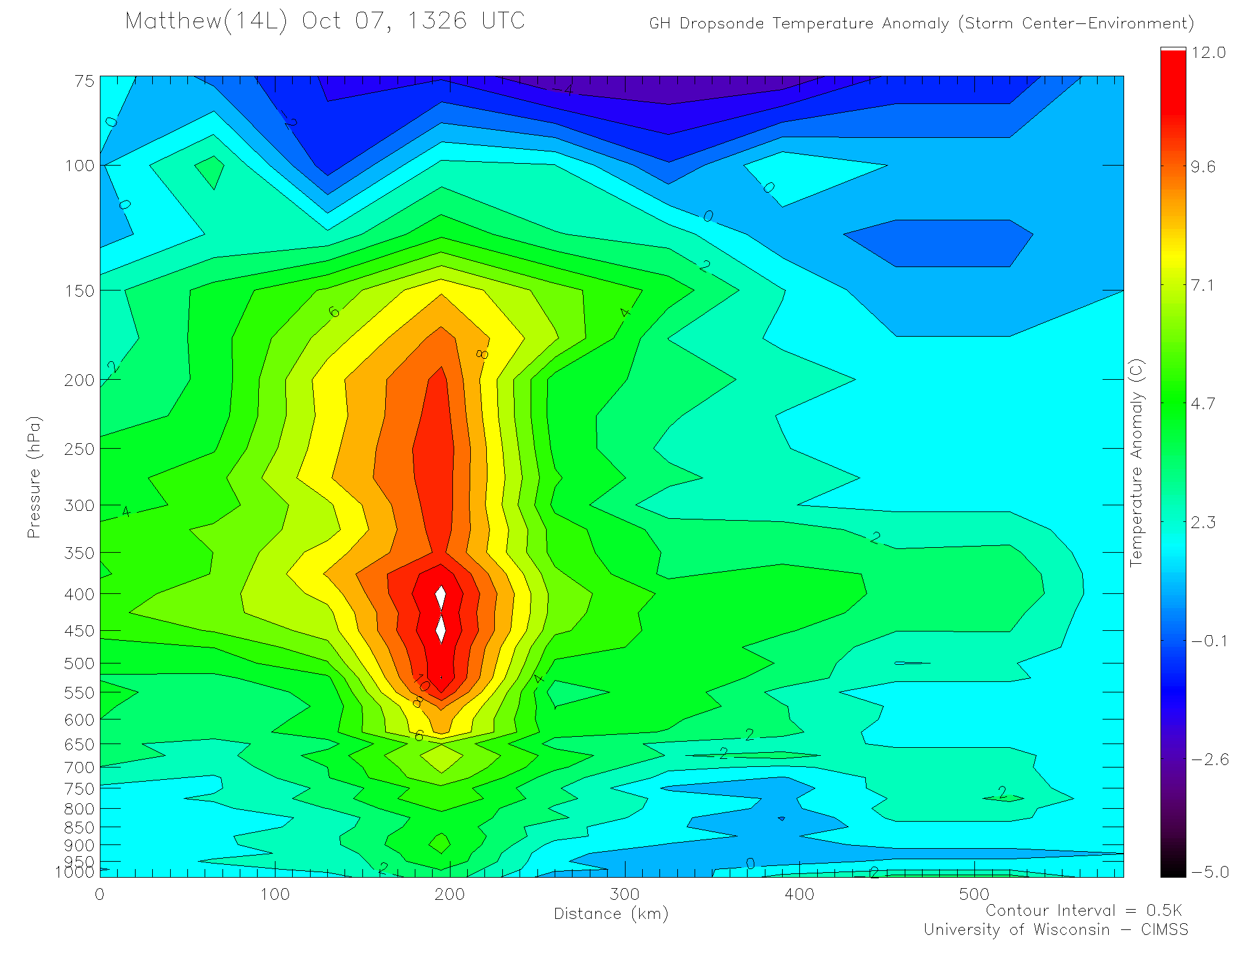
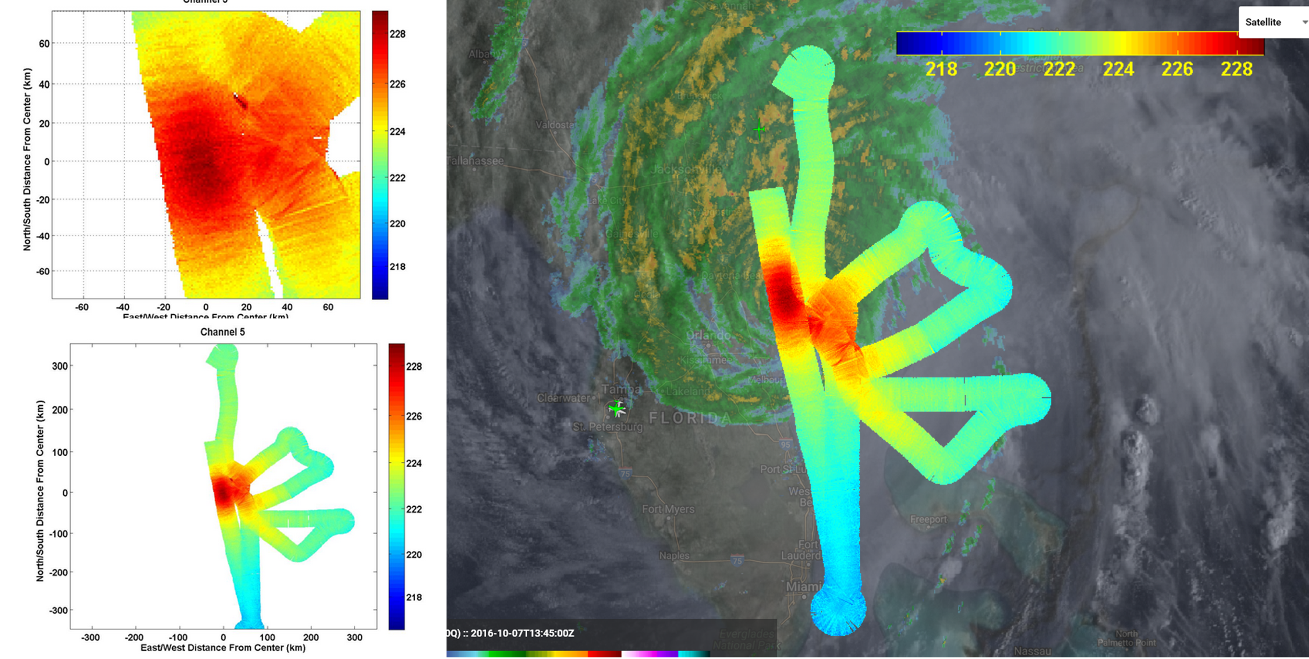
2016 NOAA SHOUT: Matthew (07-08 Oct 2016)
Mission Highlights
NASA AFRC to NASA AFRC; take-off: 0224 UTC; landing: 0230 UTC
Objectives: sample the inner core of Matthew & upper-level outflow
Global Hawk track
24h 06m mission
39 GPS dropsondes
Center Drop
1326z
944.5 hPa
5 kt @ 175
eye
TC warm core analyses derived from (left) GH dropsondes and RAOBs and (center, right) HAMSR Channel 5 (54.4 GHz; weighting function ~150 hPa).
HIWRAP x-section:
center crossing (1246-1328 UTC)

Slide 5
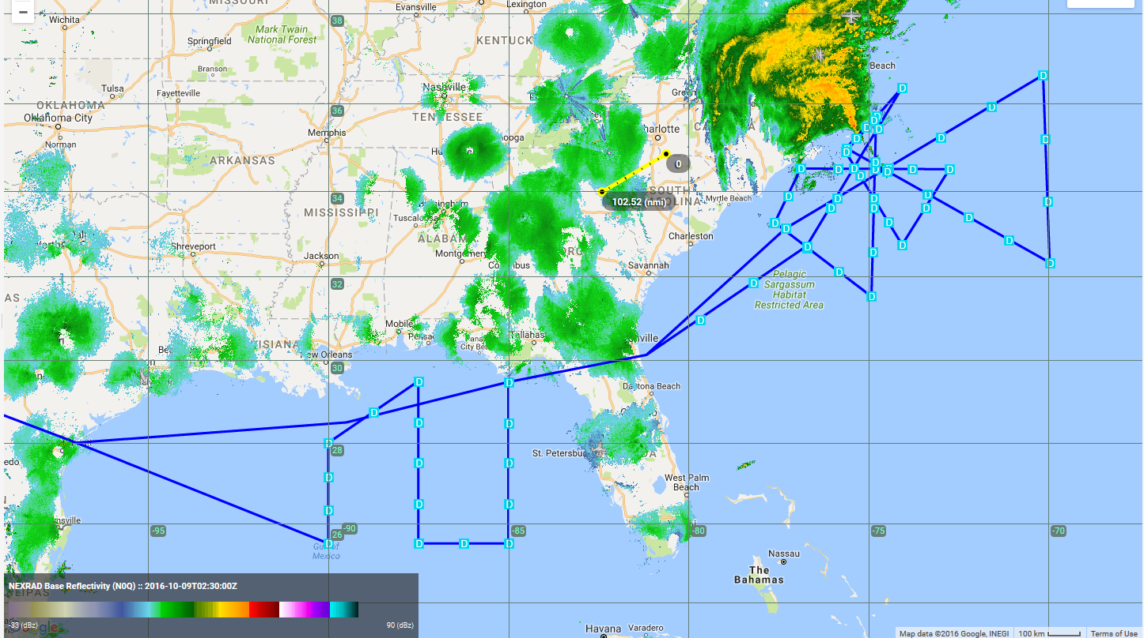
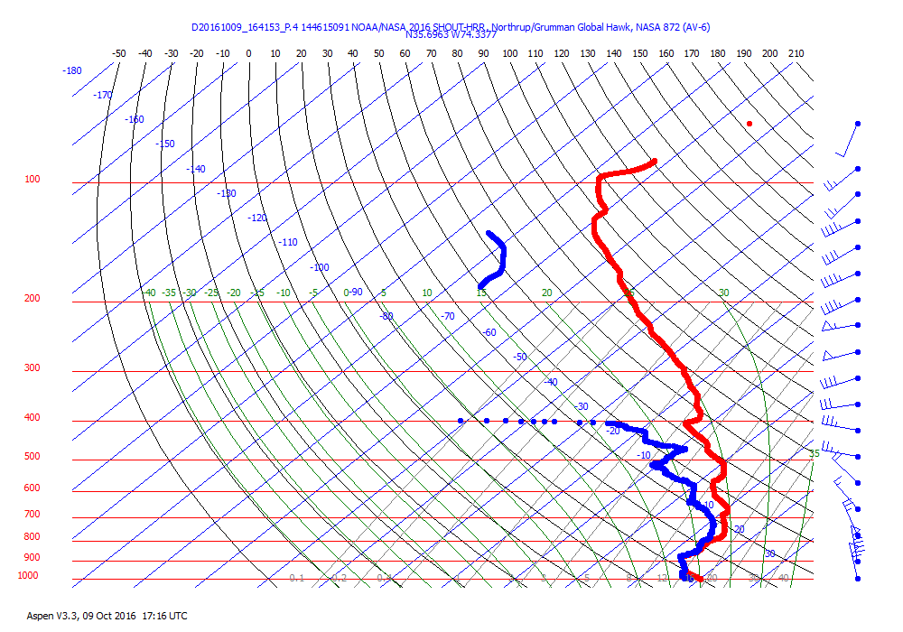
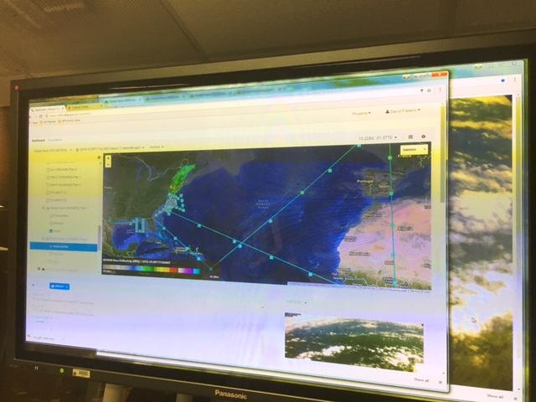

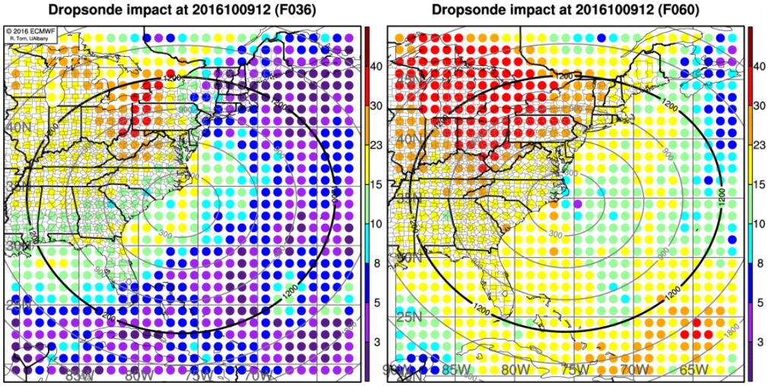
2016 NOAA SHOUT: Matthew (09-10 Oct 2016)
Mission Highlights
NASA AFRC to NASA AFRC; take-off: 0300 UTC; landing: 0347 UTC
Objectives: Sample Matthew & model sensitivity areas (HWRF and ECMWF) E of and near the storm environment, and in the GMex (SE advance of E coast trough).
NHC declared post-tropical at 0900 UTC (GPS sondes >> maintain H-force winds)
1 last track adjustment: 62h 56m
Global Hawk track
24h 47m mission
62 GPS dropsondes
1641 UTC
68 kt sfc wind
HWRF
ECMWF
Sensitivity targets for reducing uncertainty amongst the model ensemble members
Global Hawk HDVIS camera: near the center of Matthew (1910 UTC)

Slide 6
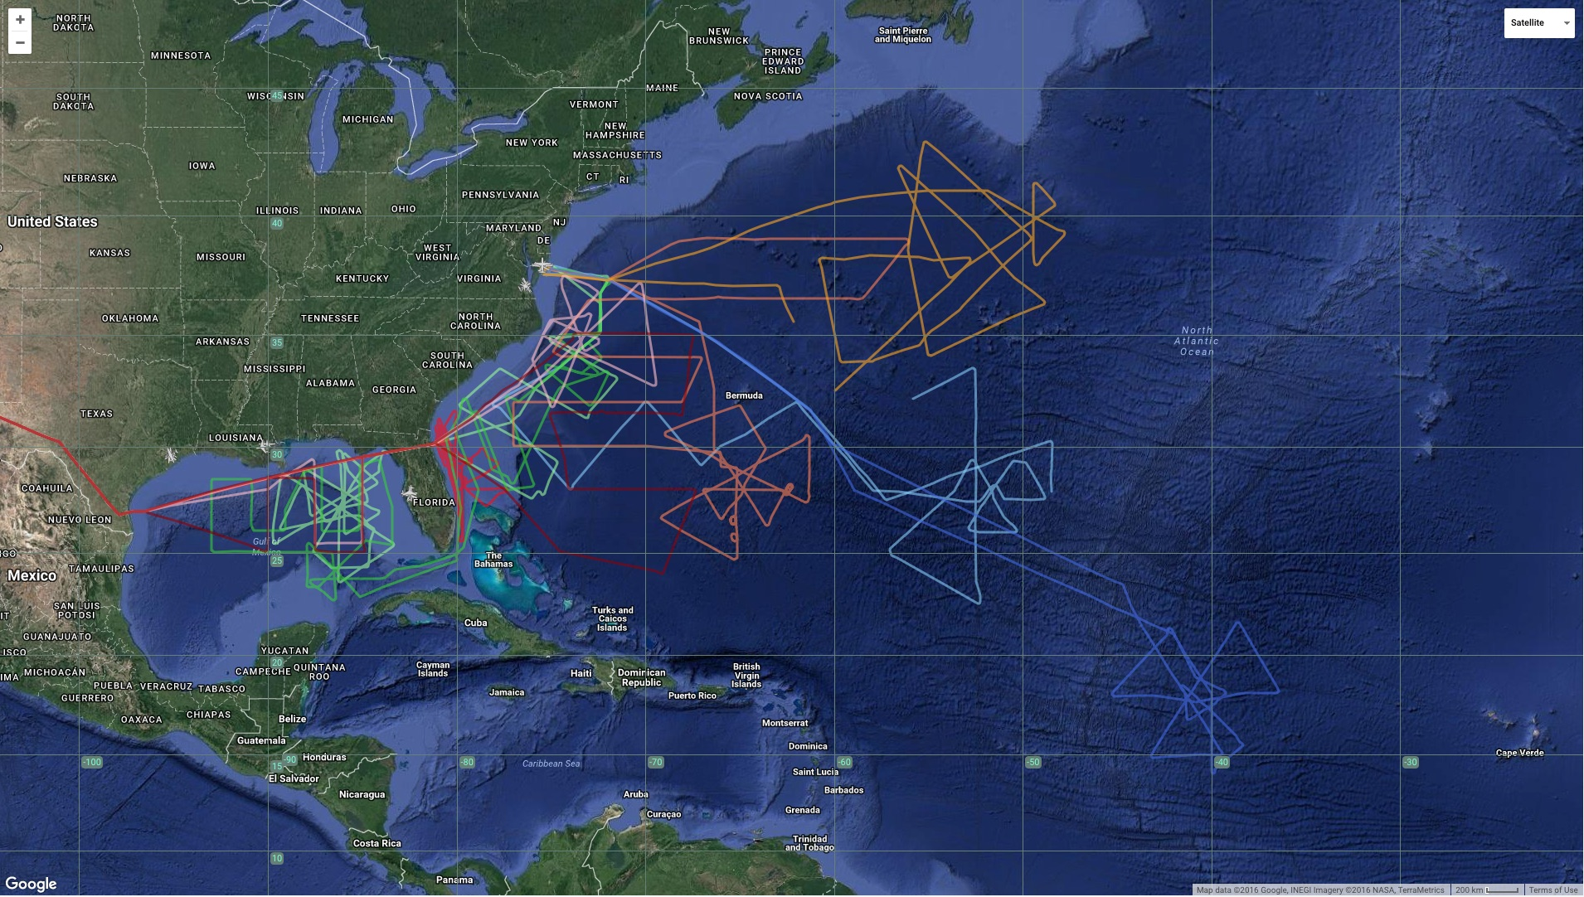
SHOUT 2016 Deployment
Mission summaries, dropsonde logs, AVAPs data (available 1-2 weeks)
ftp://ftp.aoml.noaa.gov/pub/hrd/data/global_hawk/shout2016/
HAMSR data (not yet available)
https://microwavescience.jpl.nasa.gov/instruments/hamsr/
HIWRAP data (not yet available)
http://har.gsfc.nasa.gov/index.php?section=13
Gaston (2)
Hermine (2)
Karl (2)
Matthew (3)

