Slide 1
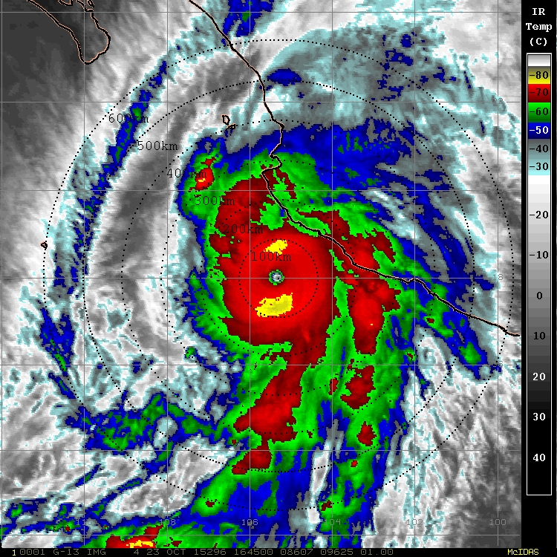
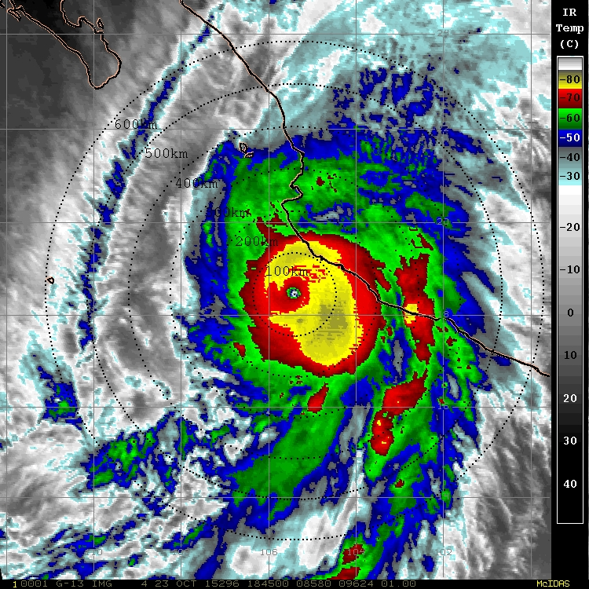
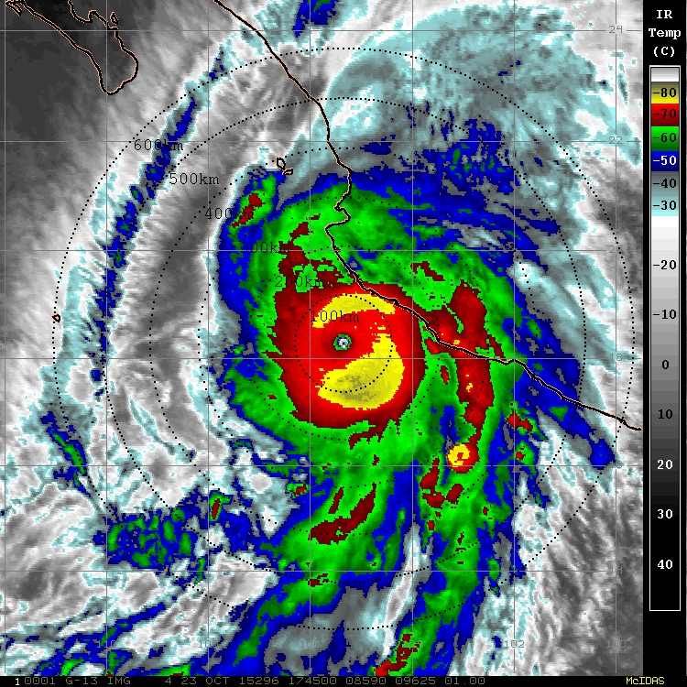
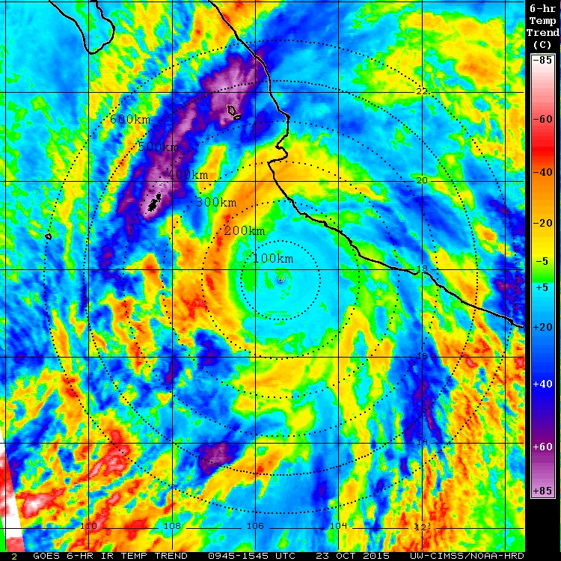
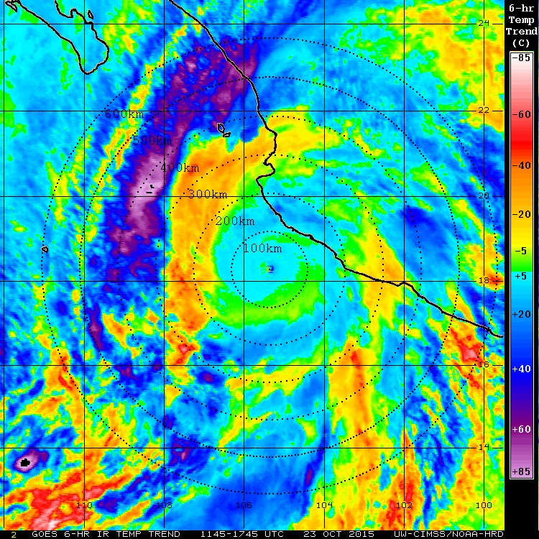
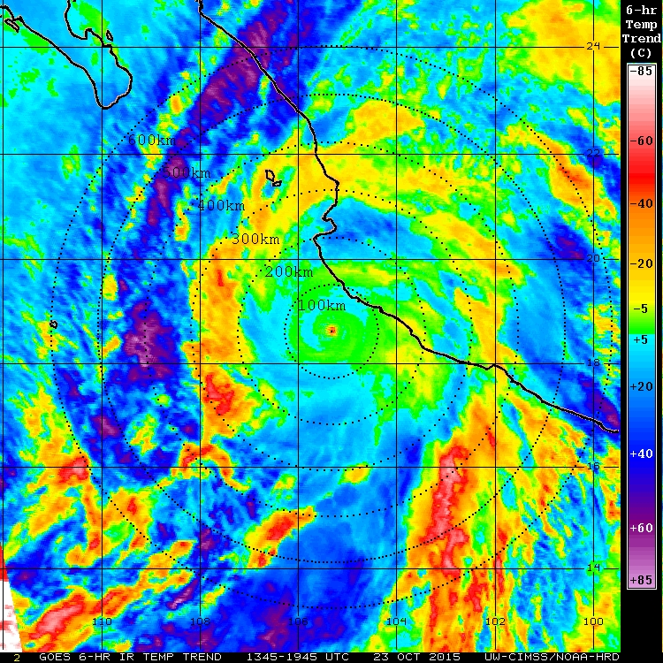
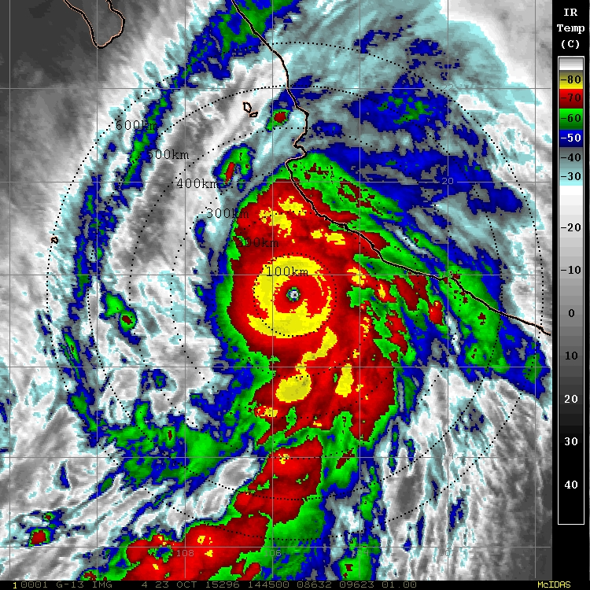
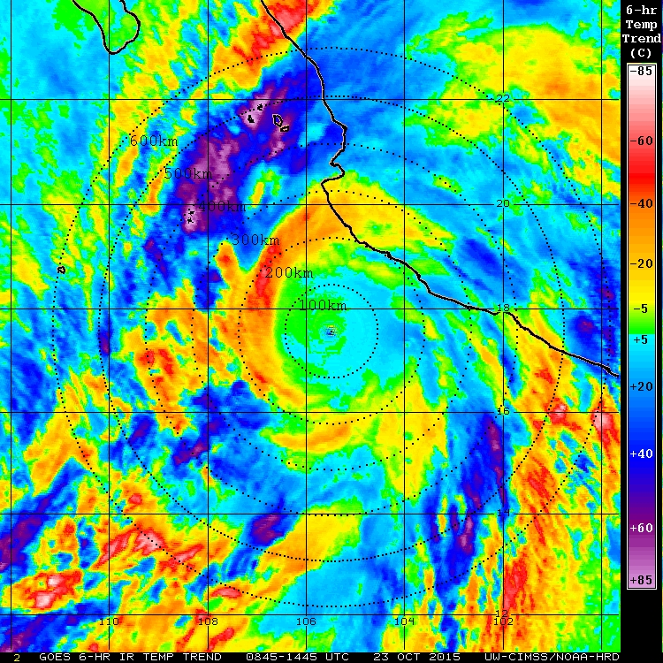
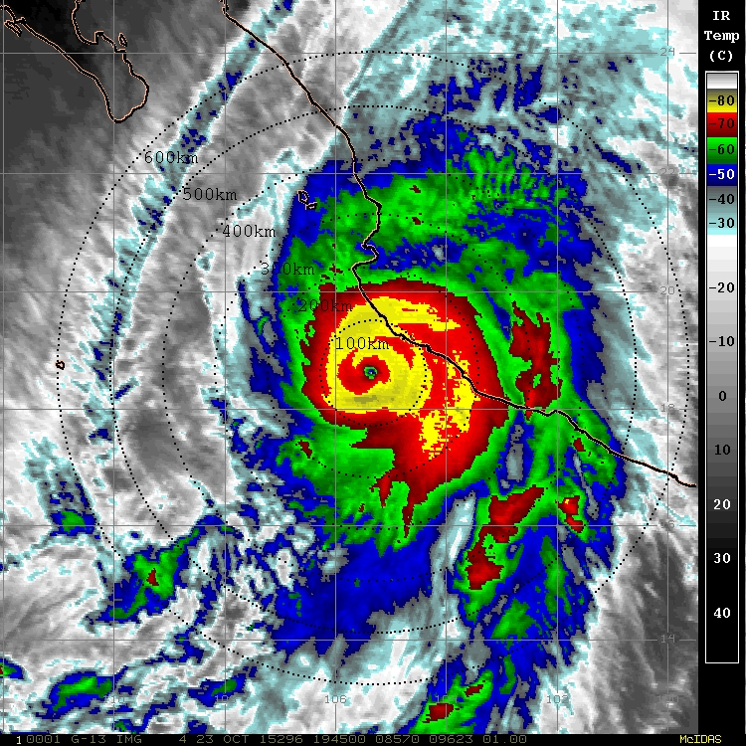
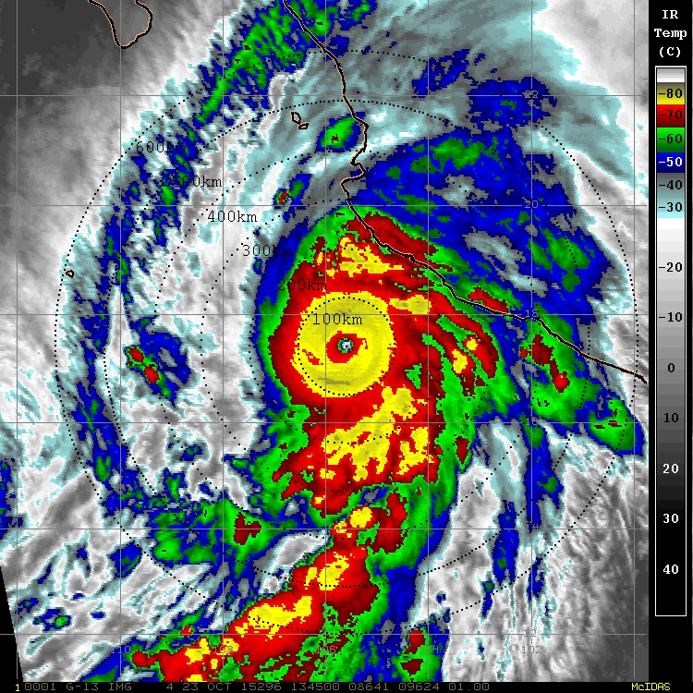
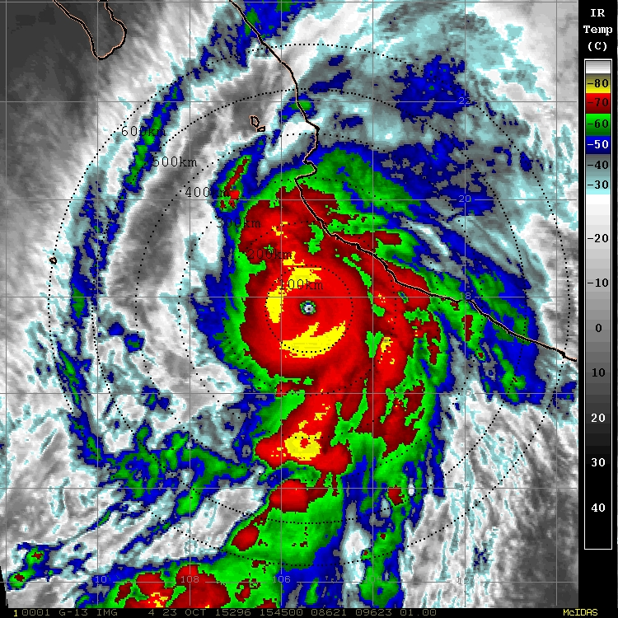
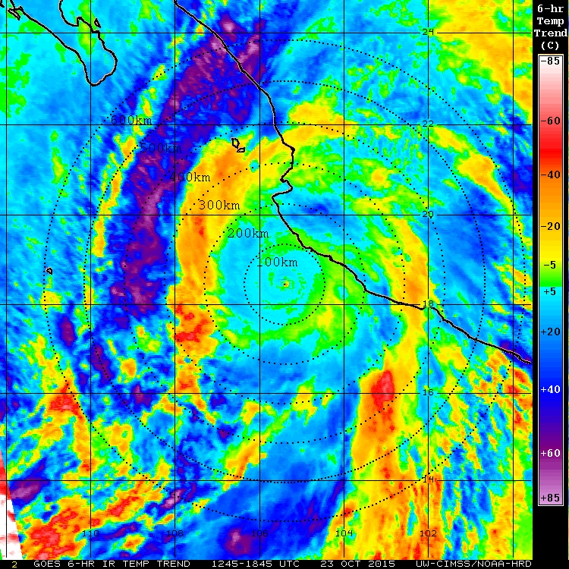
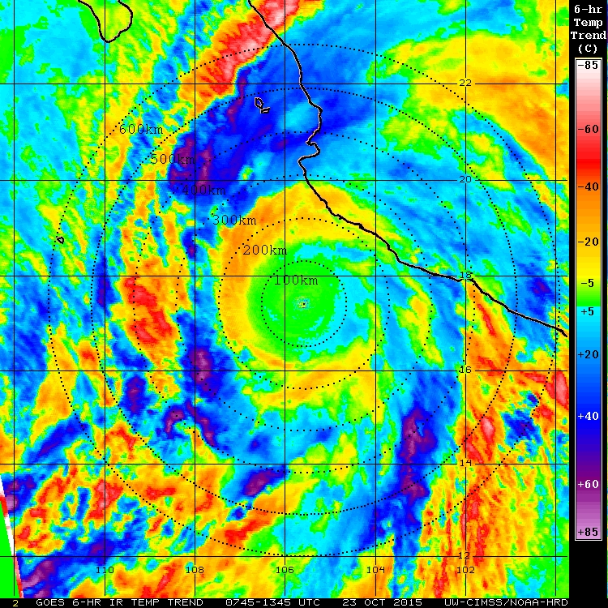
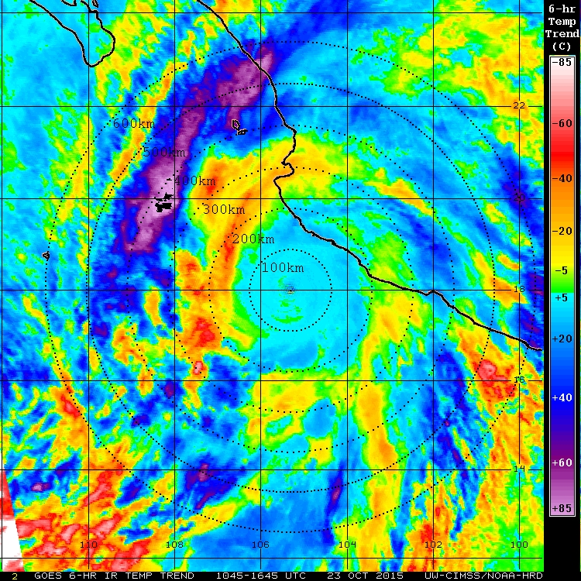
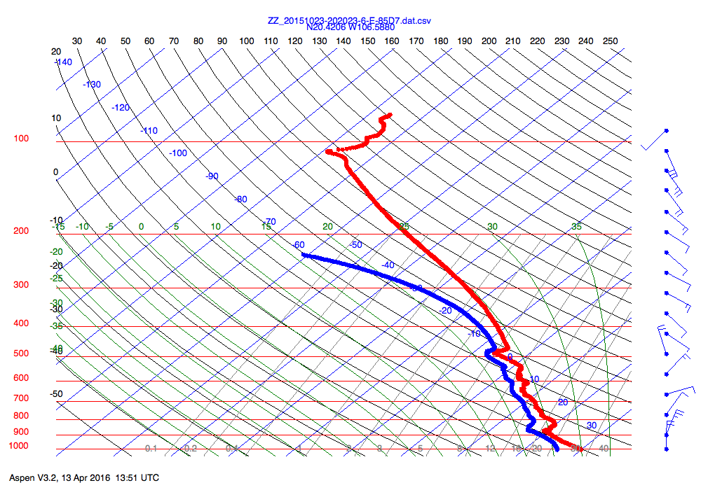
Hurricane Patricia: TC Diurnal Cycle
ONR TCI WB-57 mission: 23 Oct 2015
Objective: Investigate the relationship between TC diurnal pulses &
TC outflow, thermodynamics, vertical wind shear, and static stability
GOES Infrared
GOES IR 6-hr Temp Trend
HDSS Skew-T
Enhanced outflow above ~500 hPa
Inversion layer (1.4ºC)
23 kt VWS (across TINV)
~dry adiabatic sublayer
saturated WRT ice above
Hypothesis: TC Diurnal pulses and associated radial surges of winds and the cirrus canopy support the unique wind and thermodynamic profiles shown here.
J. Dunion and G. Tripoli, ONR TCI science team
Notes:
Click next: the GOES IR (left) and GOES IR 6-hr brightness temp trend imagery will play (hourly 6-hr loop from 1345-1945z)…loops slowly butonly takes a few seconds
Note the yellow to red ring in the differencing imagery (that’s a diurnal pulse that’s propagating away from the storm…right on the diurnal clock)
Click next: this shows a HDSS sonde (202023 UTC) dropped along the diurnal pulse ~275 km NW of the center (black circle on the IR differencing image)
Take-Away #1: there are a few consistent things that seem to show up near the diurnal pulses (all seen in this sounding): a) enhanced mid to upper-level outflow, b) an interesting mid-level temperature inversion (possibly sublimation-induced)
Take-away #2: we know that diurnal pulses are associated with surges of outward radial winds and surges in mid to upper-level ice (CDO expands) >> these characteristics of the diurnal pulse may help set up these unique soundings.
Take-away #3: We’re starting to look at soundings that sampled diurnal pulses in other storms and are seeing similar soundings (e.g. mid to upper-level enhanced outflow, TINV, strong VWS across the TINV).

