Slide 1
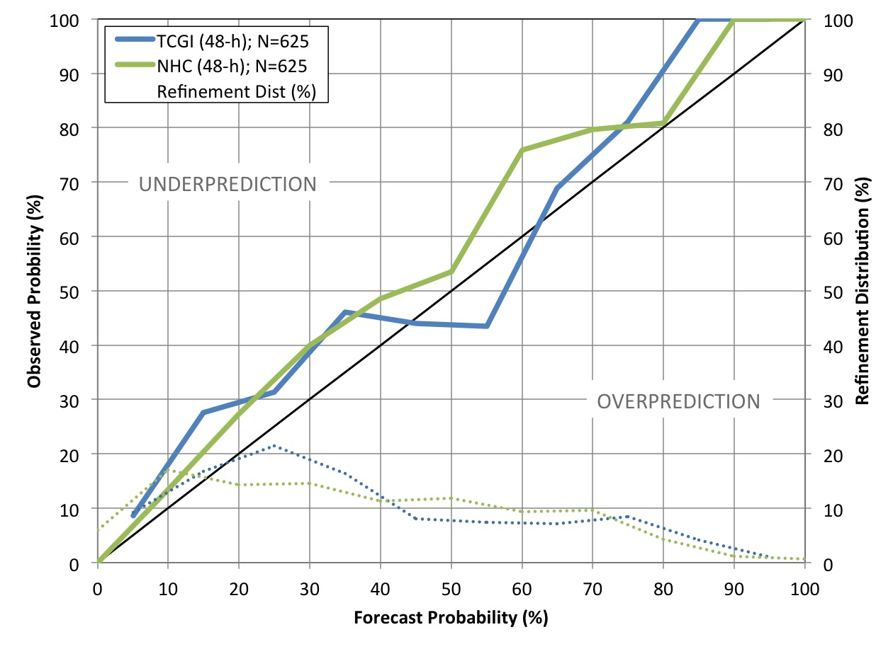
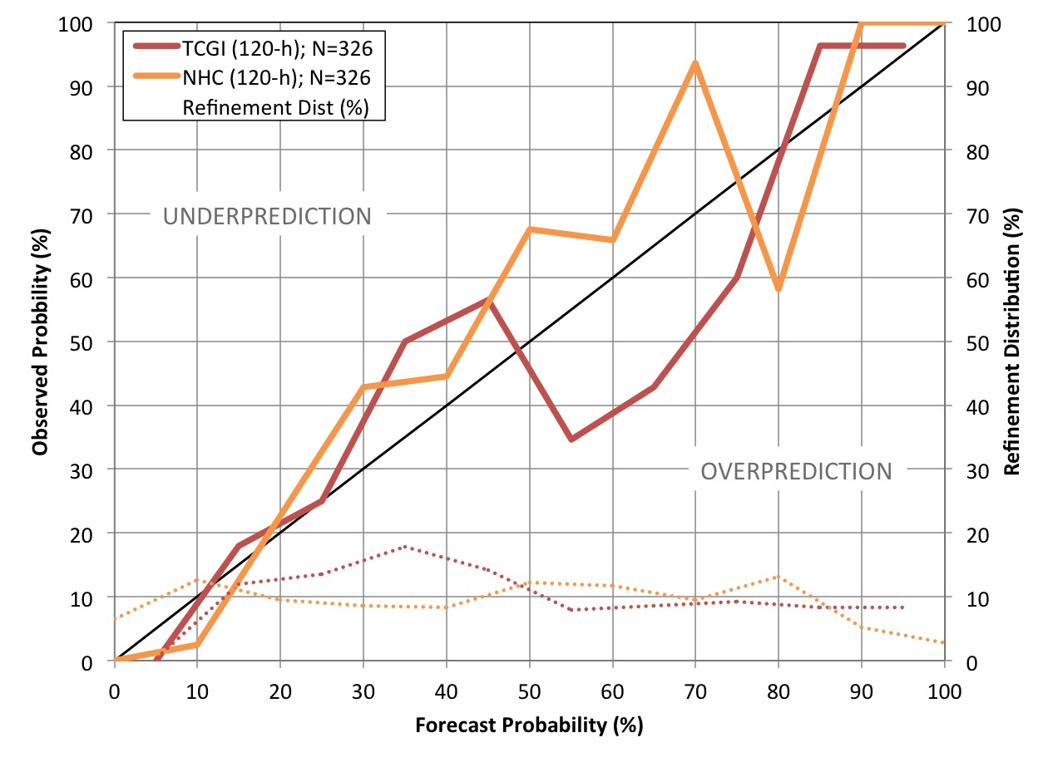
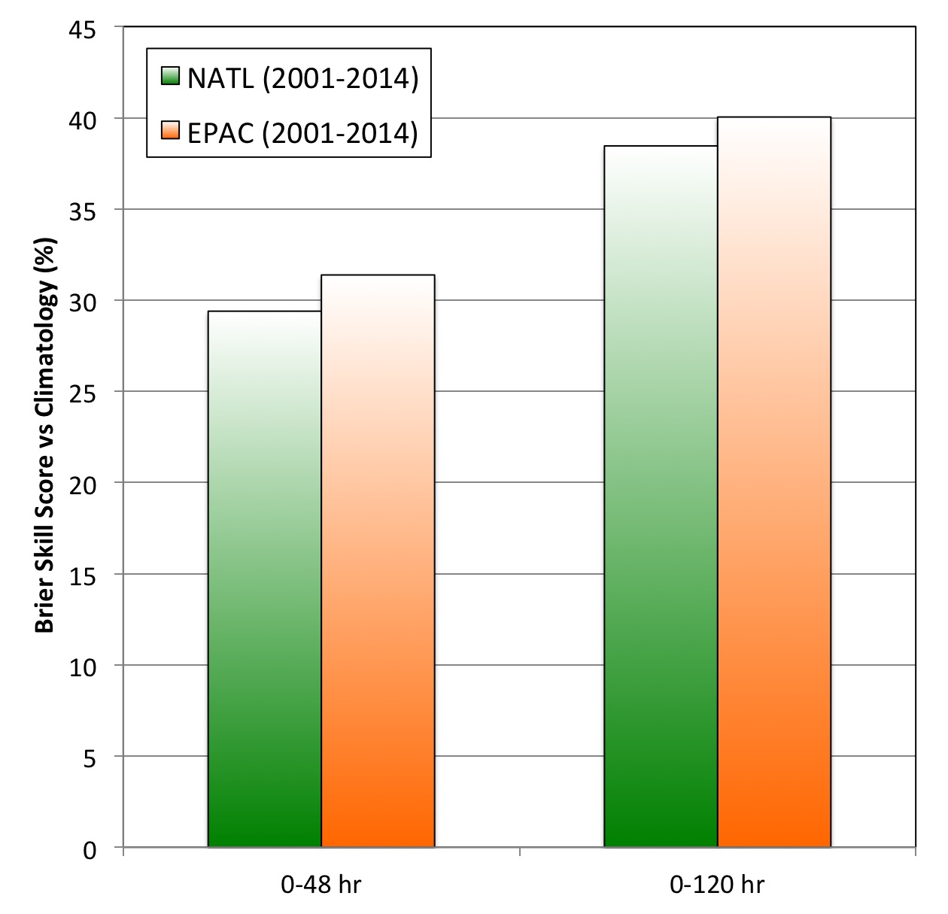
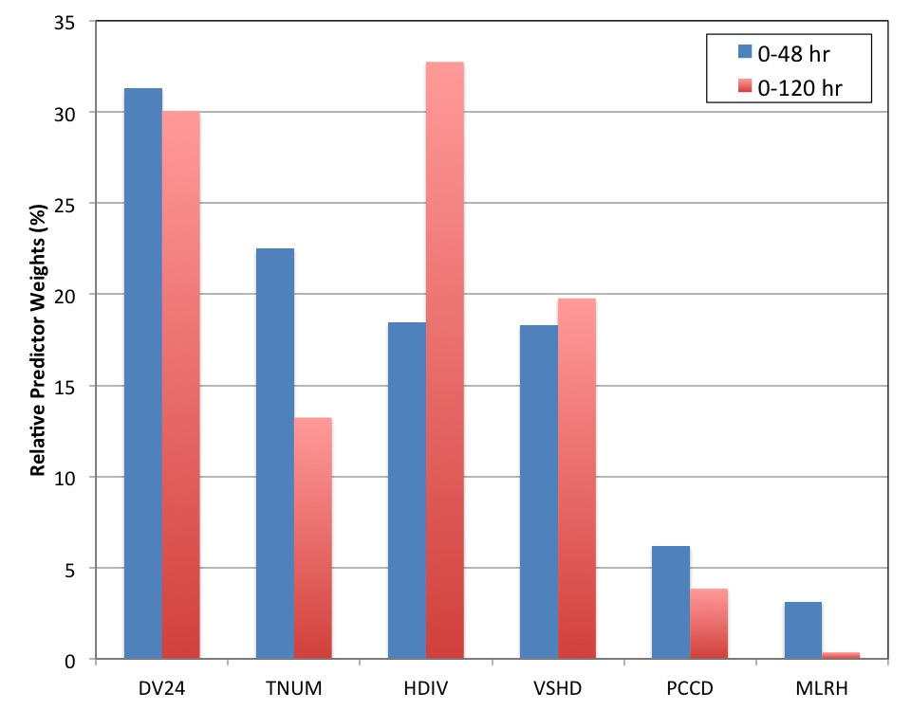
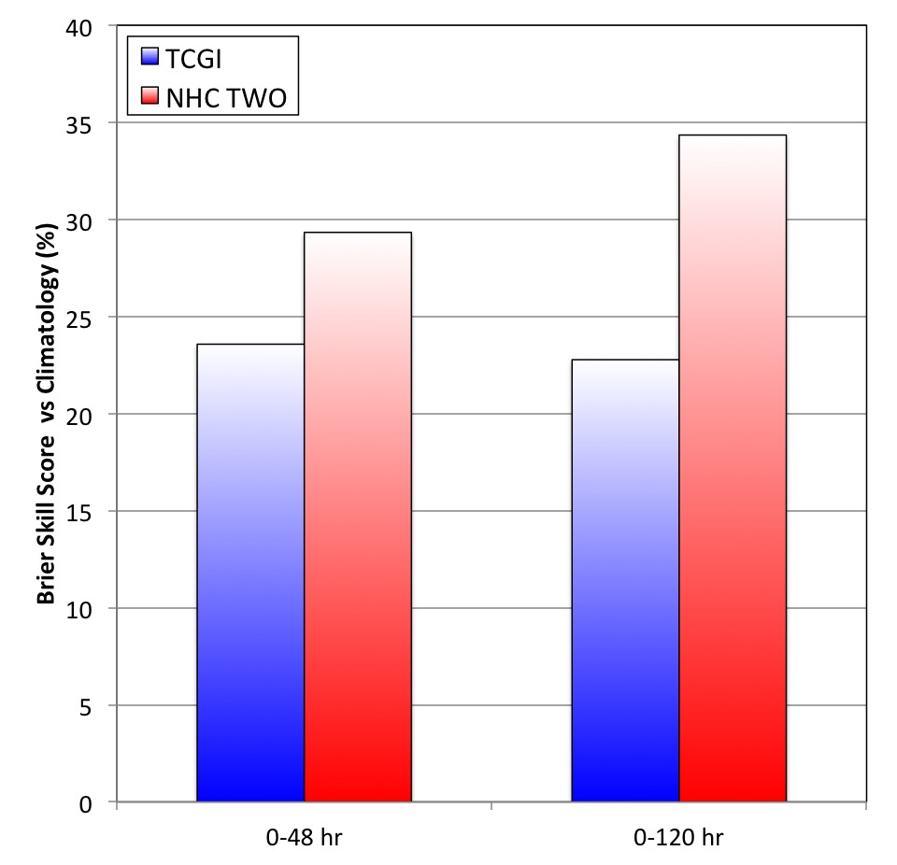
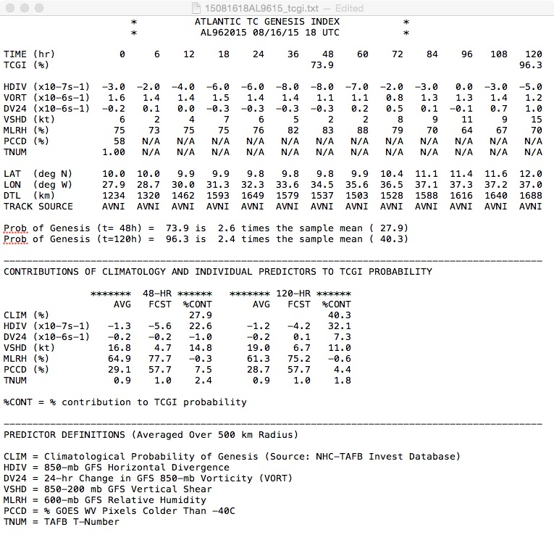
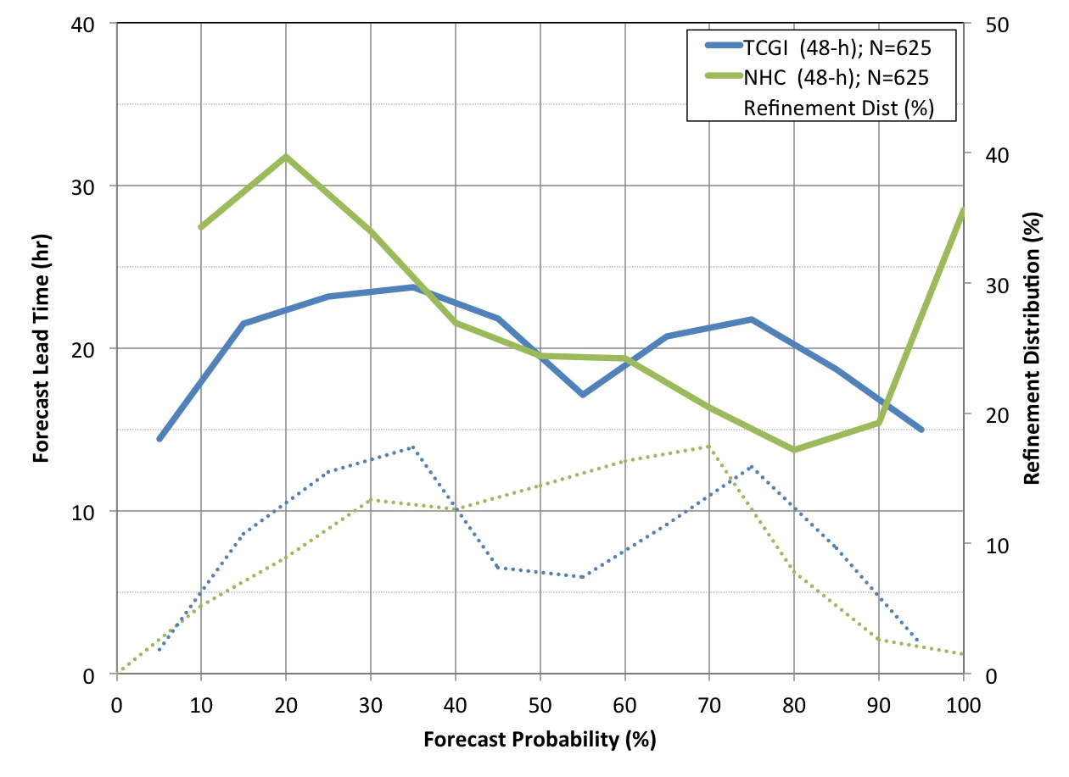
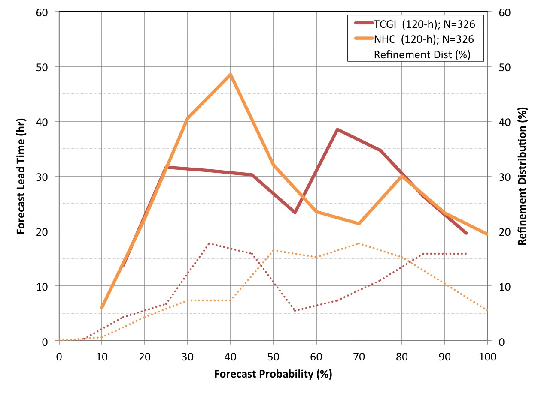
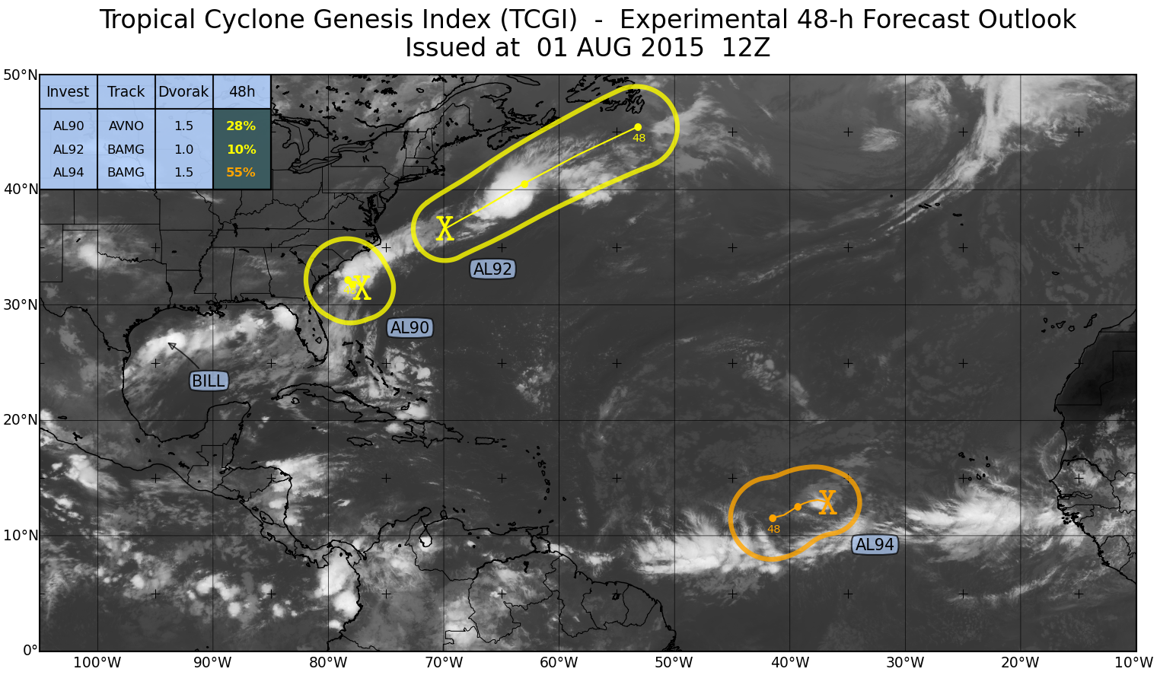
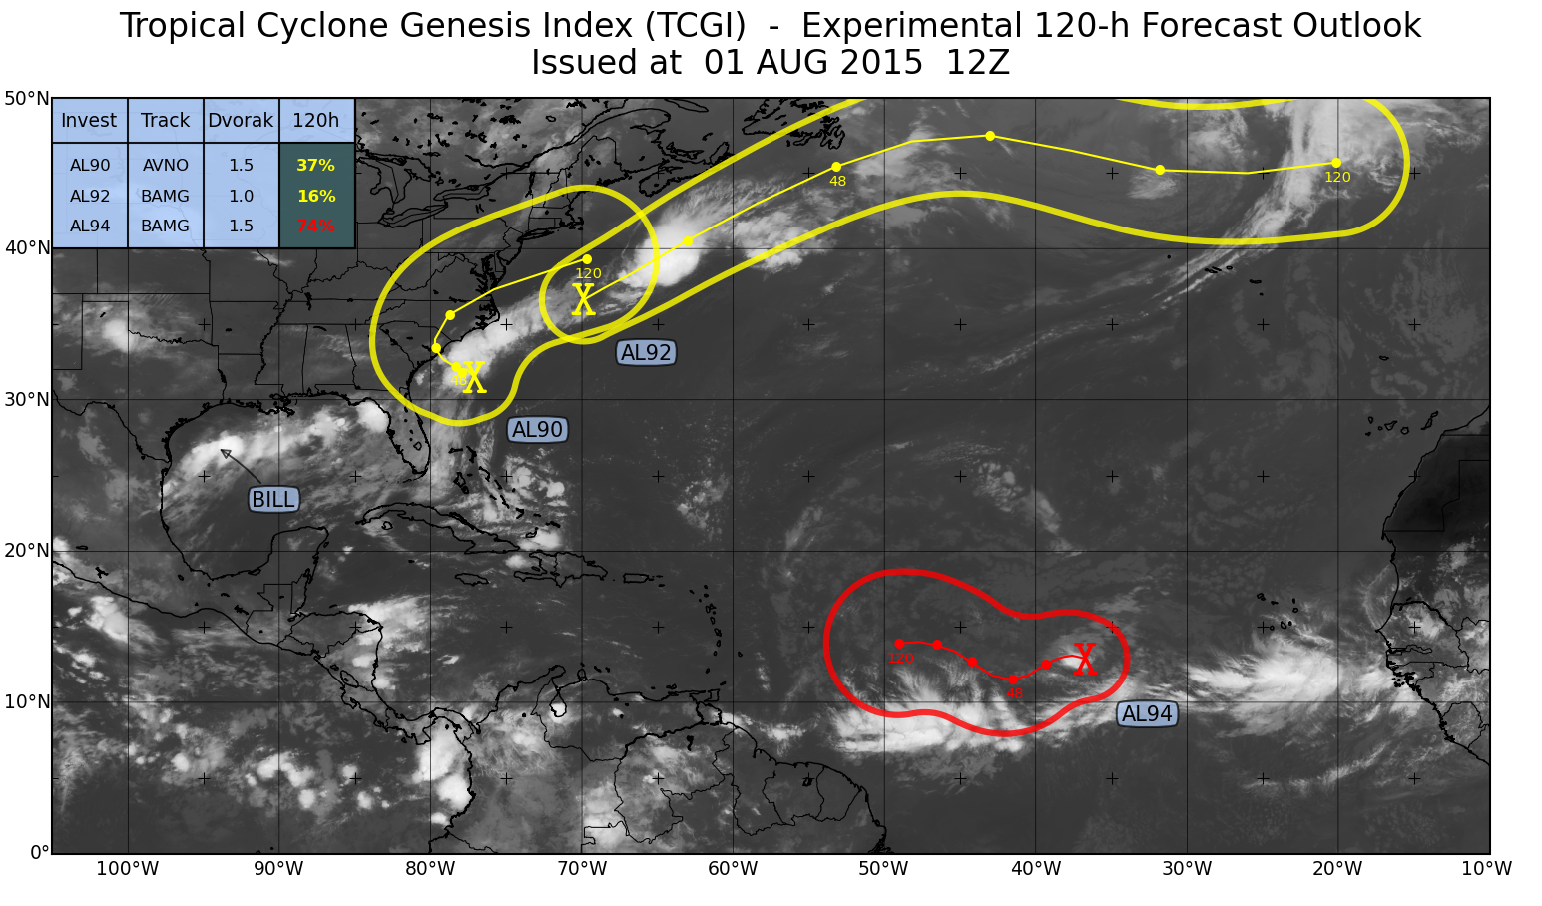
The Tropical Cyclone Genesis Index (TCGI)
Jason P. Dunion Andrea B. Schumacher John Kaplan Joshua Cossuth Kate D. Musgrave Paul Leighton
Univ. of Miami/CIMAS- NOAA/AOML/HRD Colorado State University-CIRA NOAA/AOML/HRD NRL-Monterey Colorado State University-CIRA NOAA/AOML/HRD
1) TCGI Background
2) TCGI Verification (North Atlantic)
3) TCGI: Ongoing & Planned Improvements
Motivation & Objectives
Reliability Diagrams
Expand TCGI Database
The NOAA National Hurricane Center (NHC) issues over 500 Tropical Weather Outlook (TWO) genesis forecasts for the North Atlantic each year…yet, there is limited objective guidance to support this effort;
TCGI was successfully transitioned to operations at NHC in October 2014 and provides real-time, objective, disturbance-centric guidance for identifying the probability of TC genesis in the North Atlantic (0-48 hr & 0-120 hr);
48-hr forecasts (2011-2015)
120-hr forecasts (2013-2015)
The TCGI North Atlantic tropical disturbance database was recently expanded to include the years 2001-2014;
A new eastern/central North Pacific disturbance database was also developed (2001-2014) and will be used to create a new EPAC/CPAC version of TCGI;
Cross-validated Brier Skill (NATL & EPAC/CPAC)
TCGI Predictors
Cross-validated TCGI Brier Skill using the recently updated (2001-2014) North Atlantic and newly developed EPAC/CPAC tropical disturbance databases. Skill was measured against the climatological probability of TC genesis in each basin and this preliminary test used the current operational TCGI predictors for both basins.
TCGI North Atlantic predictors (relative weights)
Reliability diagrams for the real-time version of TCGI and a homogeneous sample of NHC TWO genesis forecasts. The solid lines indicate the relationship between the 48-hr & 120-hr forecasts and verifying genesis percentages, with perfect reliability indicated by the diagonal black lines. The dashed lines indicate how the forecasts were distributed among the possible forecast values.
TCGI Predictors and Relative Weights:
DV24^{2,3}: 24-hr vorticity change (GFS model);
TNUM¹: Dvorak T-Number (NHC TAFB);
HDIV^{2,3}: 850 hPa horizontal divergence (GFS model)
VSHD^{2,3}: 200-850 hPa vertical shear (GFS model)
PCCD^{1,3}: % GOES water vapor pixels <-40ºC
MLRH^{2,3}: 600 hPa relative humidity (GFS model)
1 time zero predictor only
2 calculated continuously along the entire forecast track
3 averaged over radius=500 km
Brier Skill (vs Climatology)
48-hr (2011-2013) & 120-hr (2013-2015) forecasts
Additional TCGI Improvements
Brier Skill for the real-time version of TCGI and a homogenous sample of NHC TWO genesis forecasts. Skill was measured against the climatological probability of TC genesis from the new 2001-2014 North Atlantic tropical disturbance database.
Develop an ECMWF-based Atlantic version of TCGI;
Develop a new Pacific version of TCGI that provides TC genesis forecasts in the EPAC & CPAC from ~75ºW to the dateline;
Test variable TCGI predictor search box sizes for 0-48 (e.g. 0-200 km or 0-300 km) and 0-120 hr (e.g. 0-500 km);
Test 600-800/925-1000 hPa RH and theta-e excess predictors;
Test 850 hPa GFS (or ECMWF) relative vorticity, 850 hPa vorticity x DVG, and 850 hPa moisture convergence predictors;
Test UW/CIMSS tropical overshooting tops (TOTs) and WWLN lightning density predictors;
Real-time TCGI Output
Real-time link: http://rammb.cira.colostate.edu/realtime_data/nhc/tcgi/
TCGI forecast for 2015 pre-Hurricane Danny (36 hours before genesis)
TCGI genesis forecast (48-hr & 120-hr)
Forecast Lead Time (Genesis Cases)
Predictor values (along forecast track)
48-hr forecasts (2011-2015)
120-hr forecasts (2013-2015)
Experimental Graphical TCGI
Invest position & forecast track source
TCGI forecasts relative to climatology
Predictor contributions (48-hr & 120-hr)
Forecast lead times (hours before genesis) for the real-time version of TCGI and a homogenous sample of NHC TWO genesis forecasts. The solid lines indicate the relationship between the 48-hr & 120-hr forecast probability and the forecast lead-time. The dashed lines indicate how the forecasts were distributed among the possible forecast values.
Experimental (left) 48-hr and (right) 120-hr graphical versions of TCGI. The ellipses are defined by the TCGI-generated track forecast and are colored according to the forecast probability. The legend in the upper-left corner depicts the active tropical disturbances and includes information on track source, initial Dvorak T-number, and TCGI genesis forecast probabilities.
TCGI predictor descriptions
This material is based upon work supported by U.S. Weather Research Program within the NOAA/OAR Office of Weather and Air Quality under Grant No. NA15OAR4590201

