Slide 1
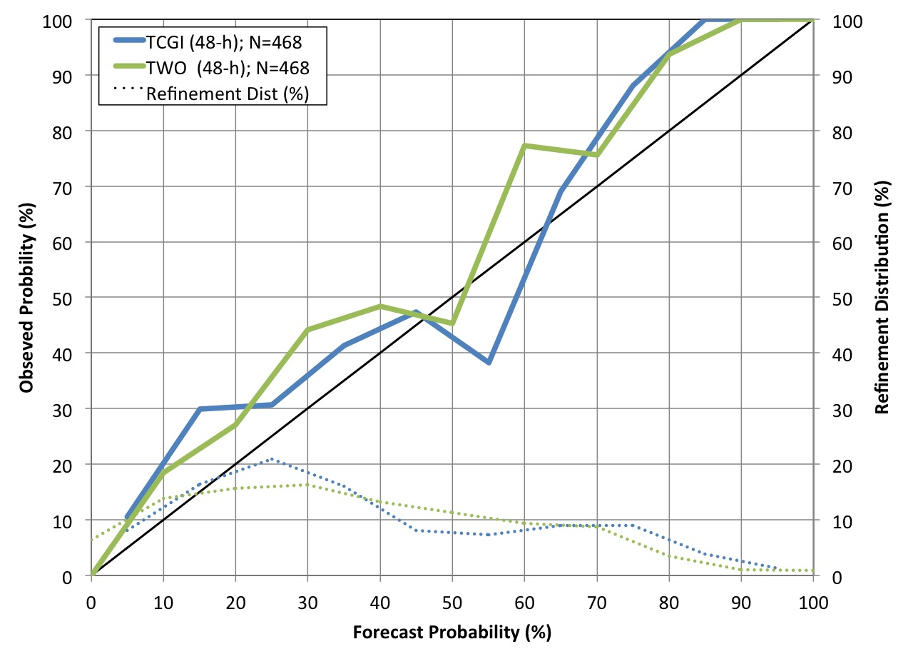
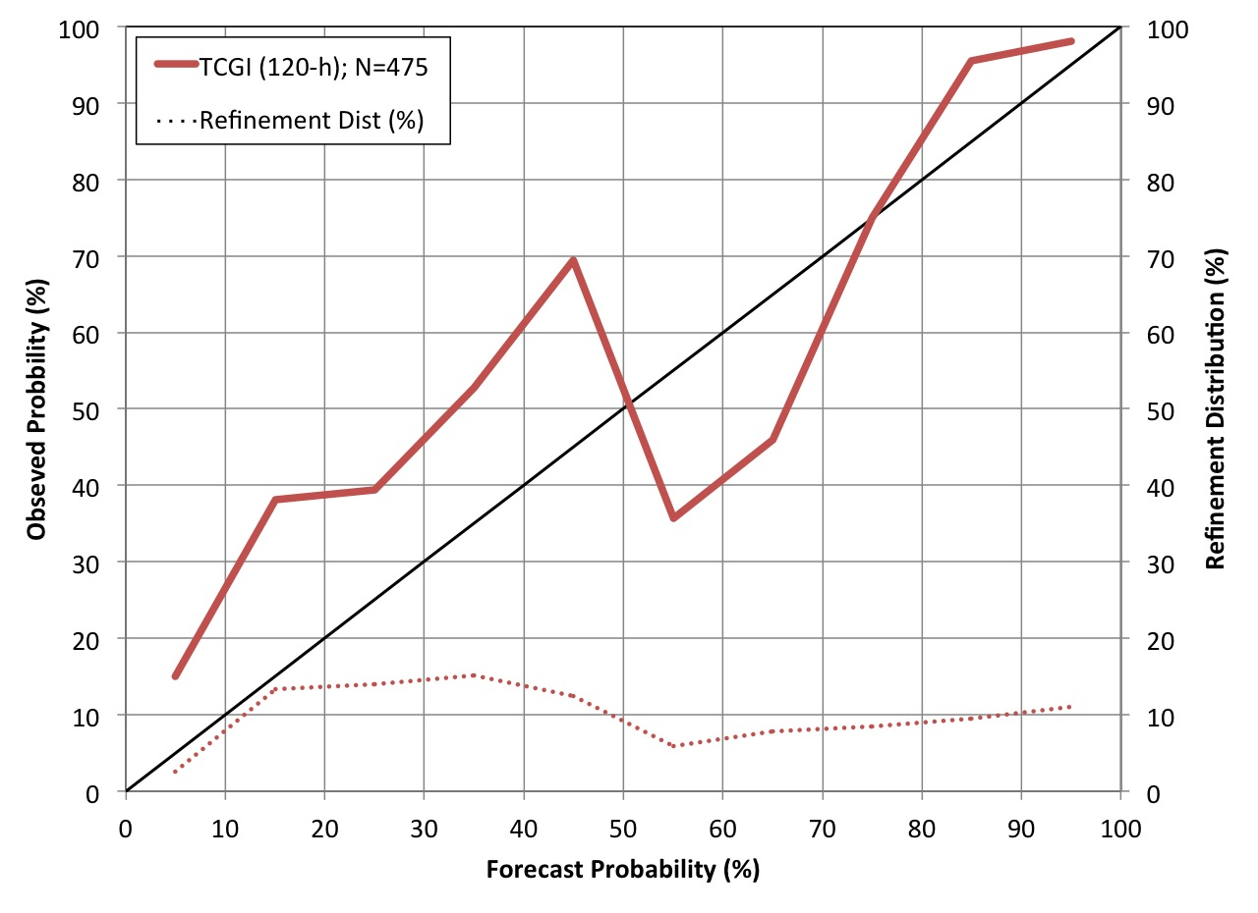
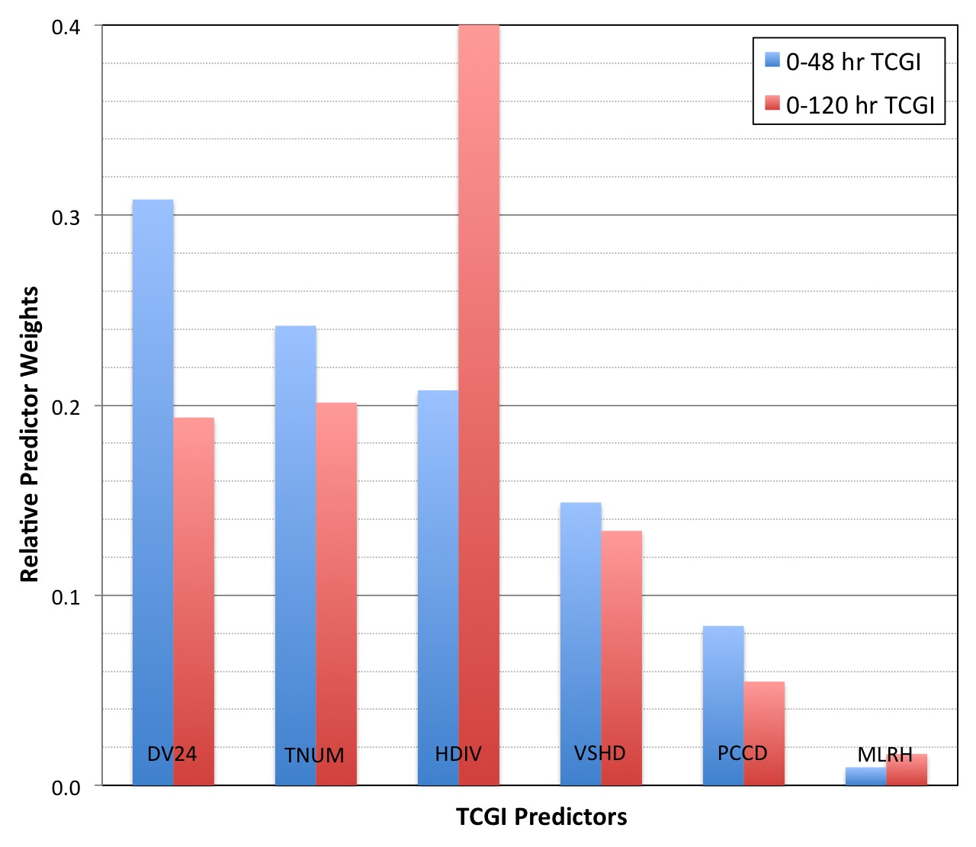
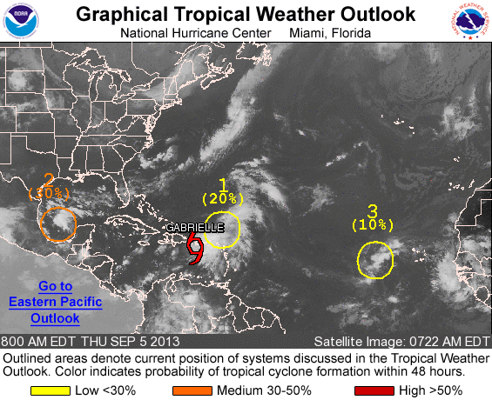
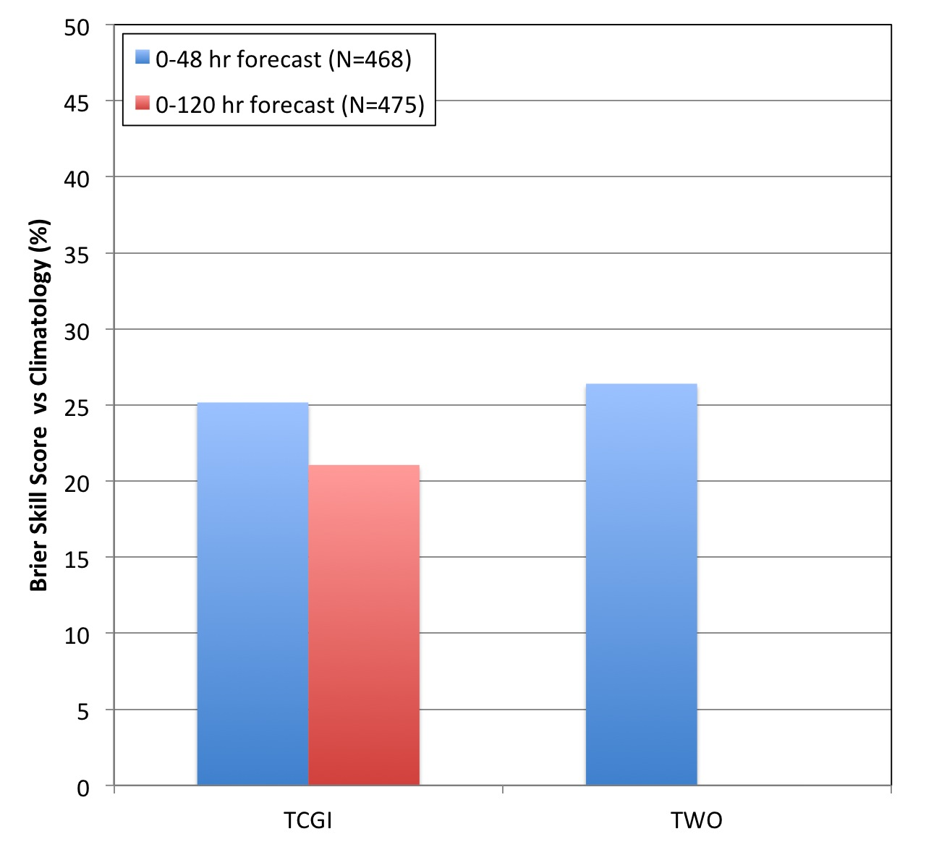
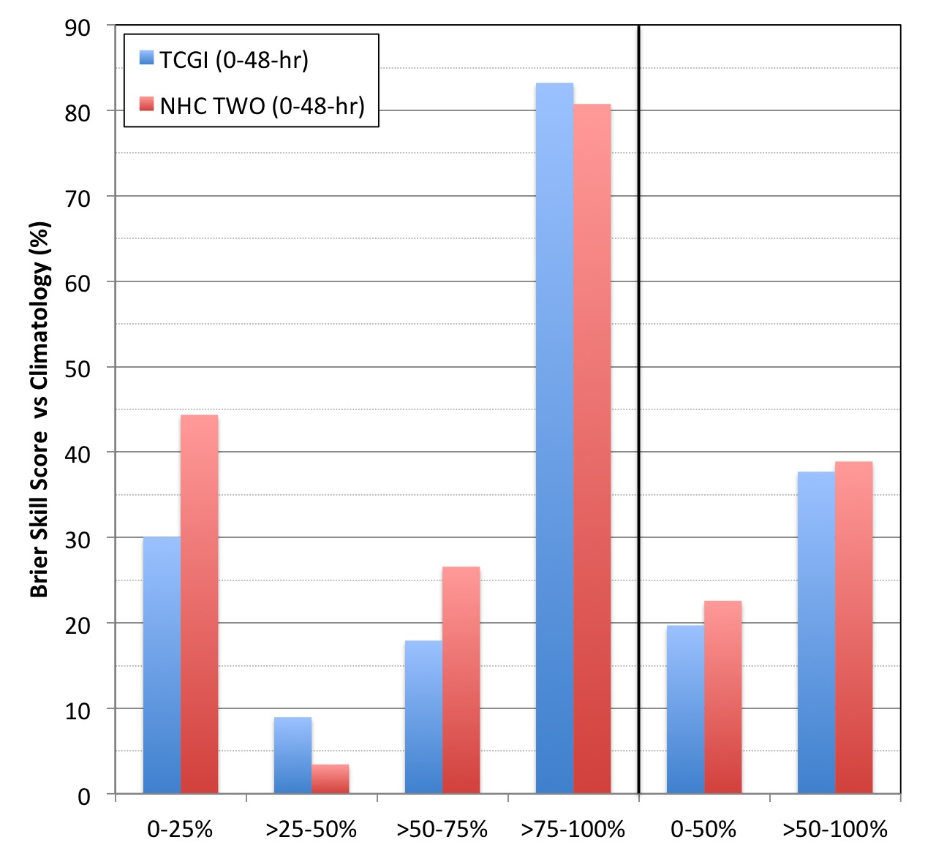
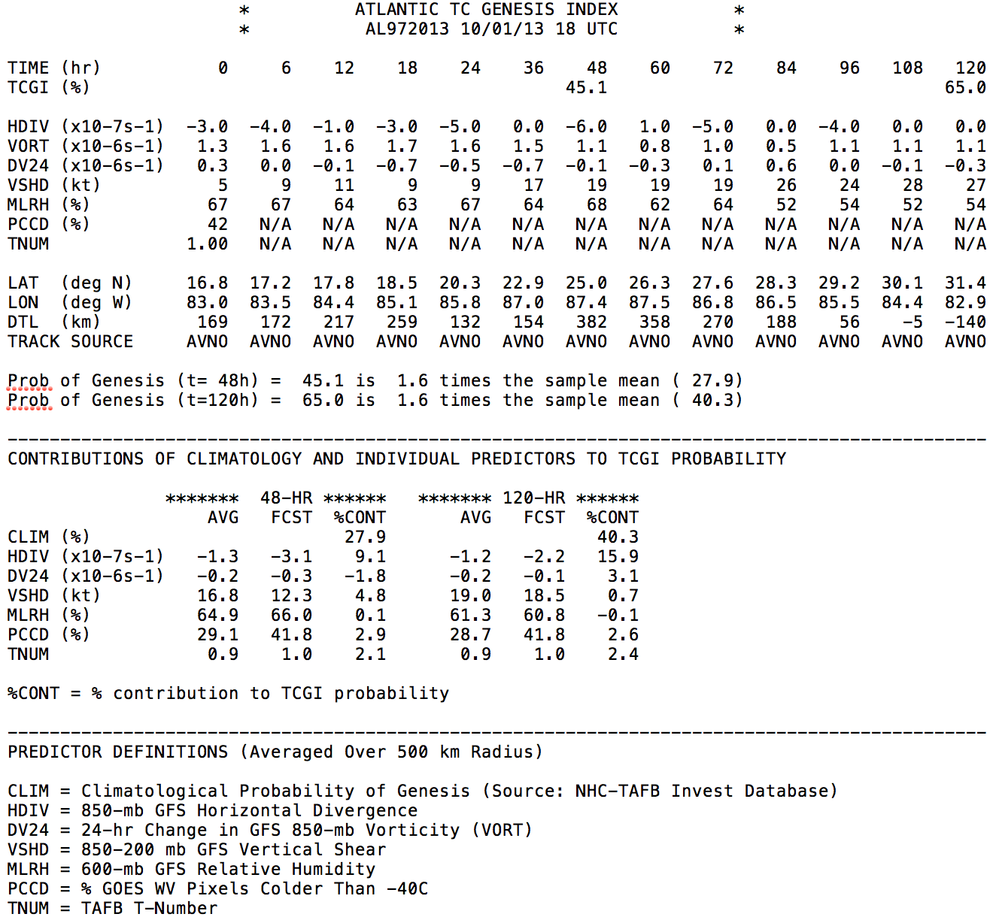
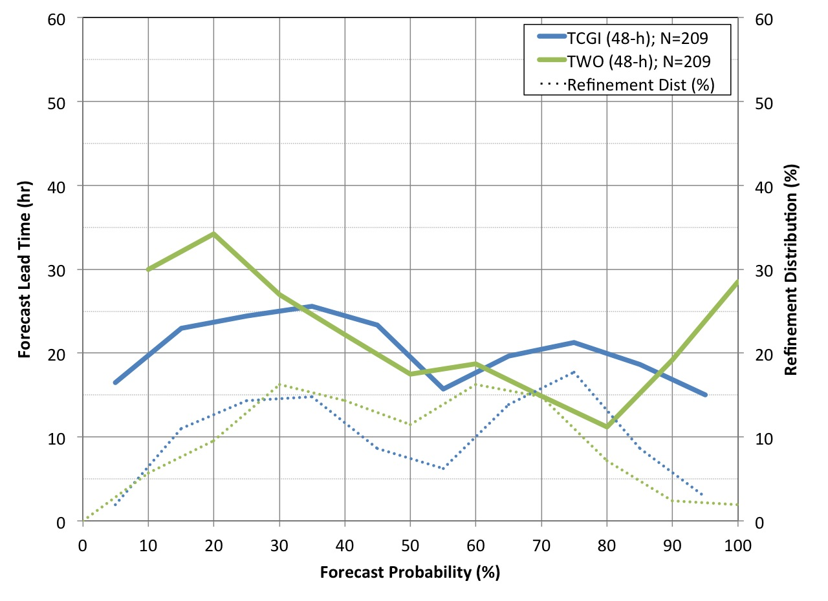
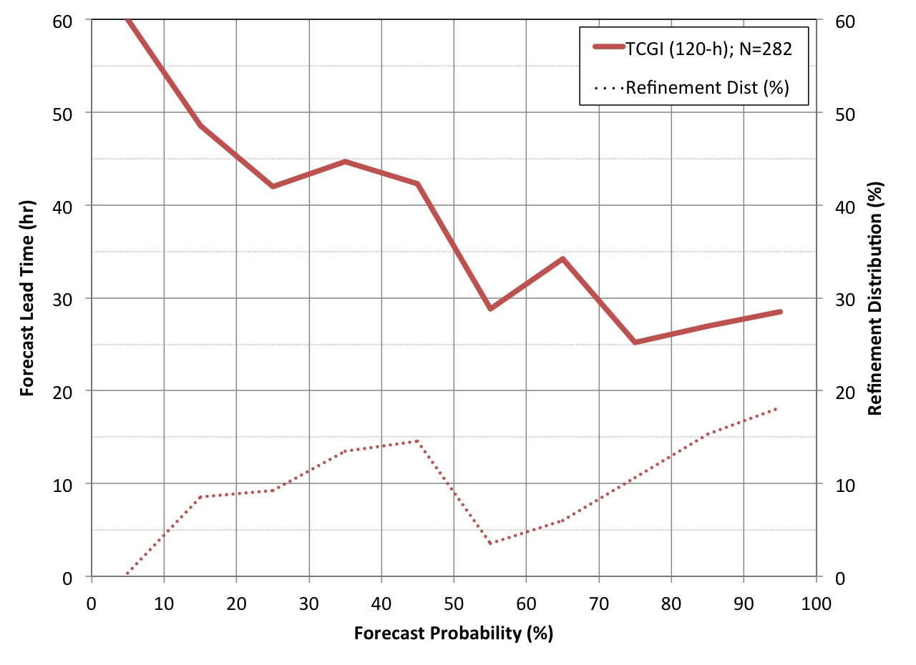
Development of a Tropical Cyclone Genesis Index (TCGI)
for the North Atlantic
Jason P. Dunion Andrea B. Schumacher John Kaplan Joshua H. Cossuth Mark DeMaria
Univ. of Miami/CIMAS- NOAA/AOML/HRD Colorado State University-CIRA NOAA/AOML/HRD Florida State University NOAA NESDIS
1) TCGI Background
2) TCGI Development
3) TCGI Verification (2011-2013)
Motivation
North Atlantic Dataset (2001-2010)
Reliability Diagrams
The NOAA National Hurricane Center (NHC) averages over 500 tropical cyclone genesis forecasts for the North Atlantic each year…yet, there is limited objective guidance to support this effort;
Developed a 10-yr dataset of North Atlantic tropical disturbances;
Developed a special “BAMG” model to produce forecast track positions when forecast models are unable to track the tropical disturbance;
Tested 60 potential predictors derived from model analysis fields, various satellite platforms, and the NHC Best track;
Six top predictors were identified for use in TCGI;
NOAA NHC’s Tropical Weather Outlook
Defines areas of interest in the tropics where TC genesis could occur in the next 48-hr and 120-hr;
Forecasts are probabilistic, generated every 6-hr (00/06/12/18 UTC), and given in 10% increments;
NHC began producing in-house 48-hr (120-hr) TC genesis forecasts in 2007 (2009). The 48-hr (120-hr) forecasts became available to the public in 2010 (2013);
TCGI Predictors and Relative Weights:
DV24^{2,3}: 24-hr vorticity change (GFS model);
TNUM¹: Dvorak T-Number (NHC TAFB);
HDIV^{2,3}: 850 hPa horizontal divergence (GFS model)
VSHD^{2,3}: 200-850 hPa vertical shear (GFS model)
PCCD^{1,3}: % GOES water vapor pixels colder than -40ºC
MLRH^{2,3}: 600 hPa relative humidity (GFS model)
1 time zero predictor only
2 calculated continuously along the entire forecast track
3 averaged over radius=500 km
Reliability diagrams for TCGI and a homogeneous sample of NHC TWO TC genesis forecasts (61 developing and 27 non-developing disturbances). The solid blue/green (red) lines indicate the relationship between the 48-hr (120-hr) forecast and verifying genesis percentages, with perfect reliability indicated by the thin diagonal black line. The dashed lines indicate how the forecasts were distributed among the possible forecast values.
Brier Skill Score
TCGI Text Product
NHC TWO valid for 05 Sept 2013 1200 UTC. An active TC (Gabrielle) and three areas of interest with 0-48-hr genesis probabilities ranging from 10-30% are identified in the graphic. Tropical disturbances #1 and #3 were non-developers, while tropical disturbance #2 developed into TD 8 on 06 Sept 1200 UTC;
(Left) Brier Skill Scores for TCGI and a homogenous sample of NHC TWO genesis forecasts. Skill was measured against the climatological probability of TC genesis (2001-2010 North Atlantic dataset). (Right) Same plot except for 0-48-hr forecasts only and binned by forecast probability.
TCGI Text Product Description
TCGI genesis forecast (48-hr & 120-hr);
Predictor values along the forecast track;
Tropical disturbance position and forecast track source;
TCGI forecasts relative to climatology;
Predictor forecast contributions (48-hr & 120-hr);
TCGI predictor descriptions;
Forecast Lead Time (Genesis Cases)
Project Objectives
Develop a real-time, objective, disturbance-centric scheme for identifying the probability of TC genesis in the North Atlantic;
Provide real-time forecasts valid for synoptic times (00/06/12/18 UTC);
Provide genesis forecasts for both 0-48-hr and 0-120-hr;
Test TCGI in a real-time research mode during the 2013 Atlantic hurricane season for evaluation by forecasters at NOAA NHC;
Forecast lead times (hours before genesis) for TCGI and NHC TWO TC genesis forecasts. The solid blue/green (red) lines indicate the relationship between the 48-hr (120-hr) forecast probability and the forecast lead-time. The dashed lines indicate how the forecasts were distributed among the possible forecast values.
TCGI forecast for 2013 Pre-Tropical Storm Karen
This NOAA Joint Hurricane Testbed project was funded by the US Weather Research Program in NOAA/OAR's Office of Weather and Air Quality (Grant #: NA11OAR4310207)

