Slide 1
Visible/SWIR

Slide 2
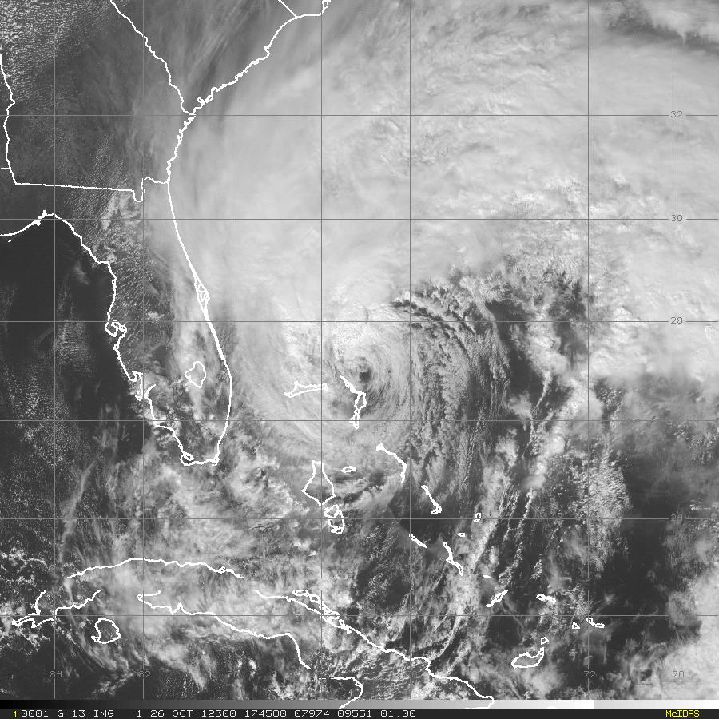
Hurricane Sandy 26 October 2012 1745 UTC: Visible (0.63 μm)
G-IV Flight Track
GPS Dropsonde Point
MacDill AFB
30
25
20
33
1
10
15
5

Slide 3
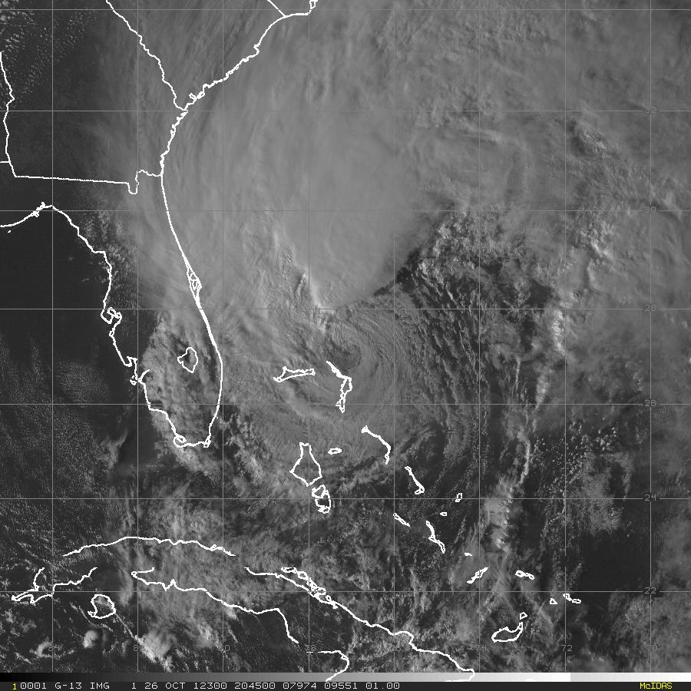
Hurricane Sandy 26 October 2012 2045 UTC: Visible (0.63 μm)
G-IV Flight Track
GPS Dropsonde Point
MacDill AFB
30
25
20
33
1
10
15
5

Slide 4
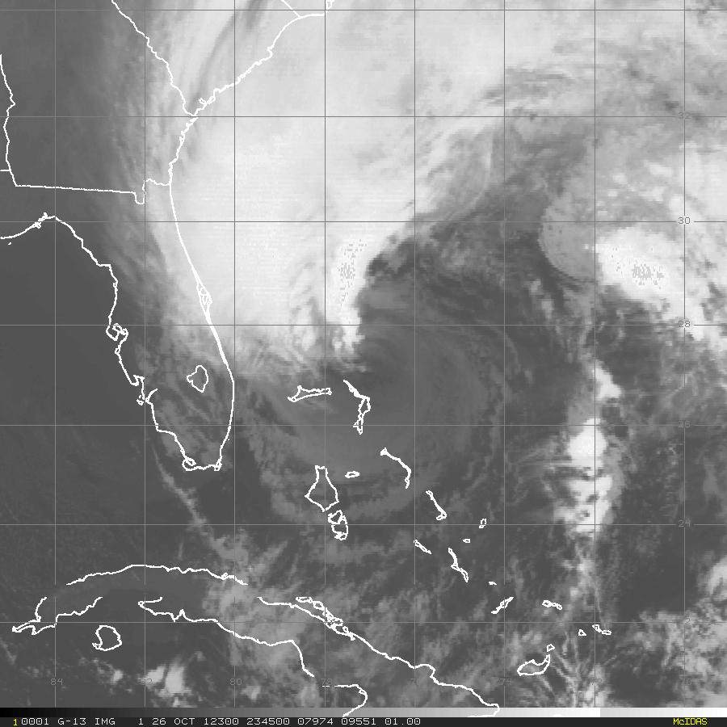
Hurricane Sandy 26 October 2012 2345 UTC: Visible (0.63 μm)
G-IV Flight Track
GPS Dropsonde Point
MacDill AFB
30
25
20
33
1
10
15
5

Slide 5
IR

Slide 6
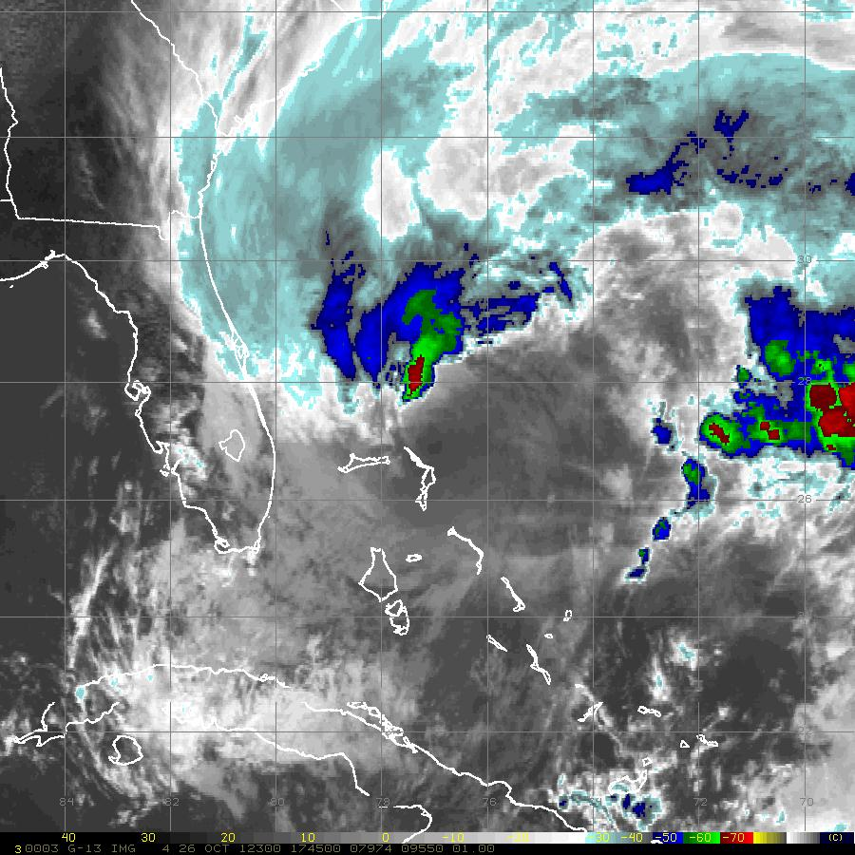
Hurricane Sandy 26 October 2012 1745 UTC: IR (10.7 μm)
G-IV Flight Track
GPS Dropsonde Point
MacDill AFB
30
25
20
33
1
10
15
5

Slide 7
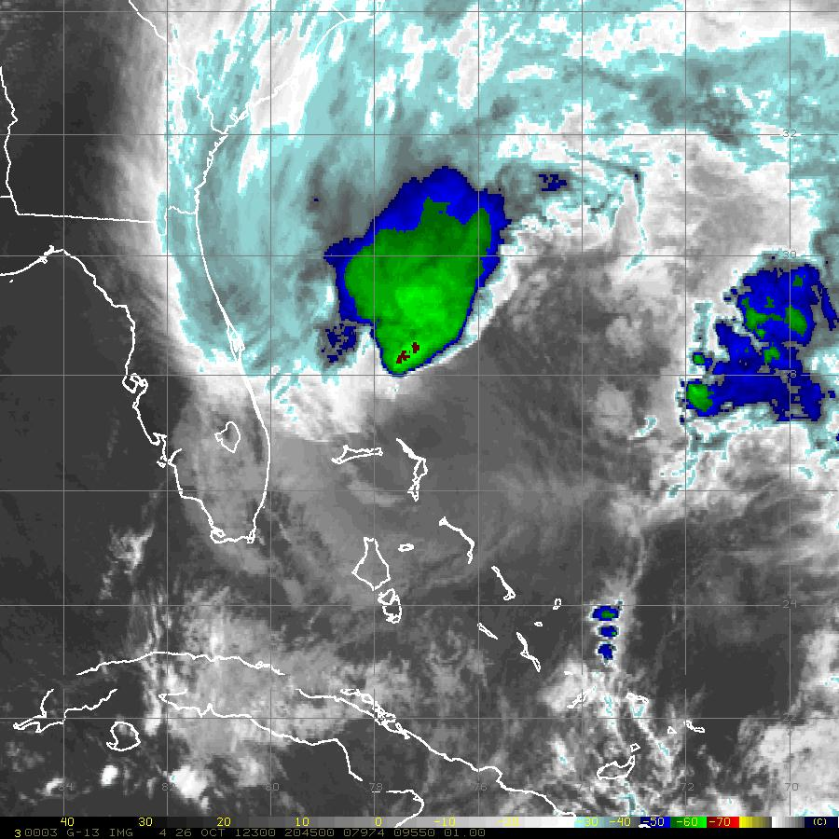
Hurricane Sandy 26 October 2012 2045 UTC: IR (10.7 μm)
G-IV Flight Track
GPS Dropsonde Point
MacDill AFB
30
25
20
33
1
10
15
5

Slide 8
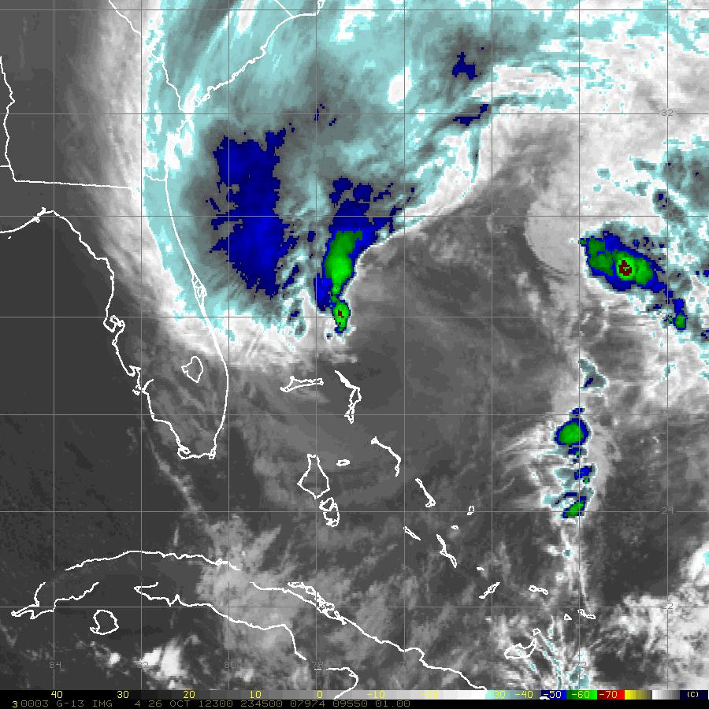
Hurricane Sandy 26 October 2012 2345 UTC: IR (10.7 μm)
G-IV Flight Track
GPS Dropsonde Point
MacDill AFB
30
25
20
33
1
10
15
5

Slide 9
WVIR

Slide 10
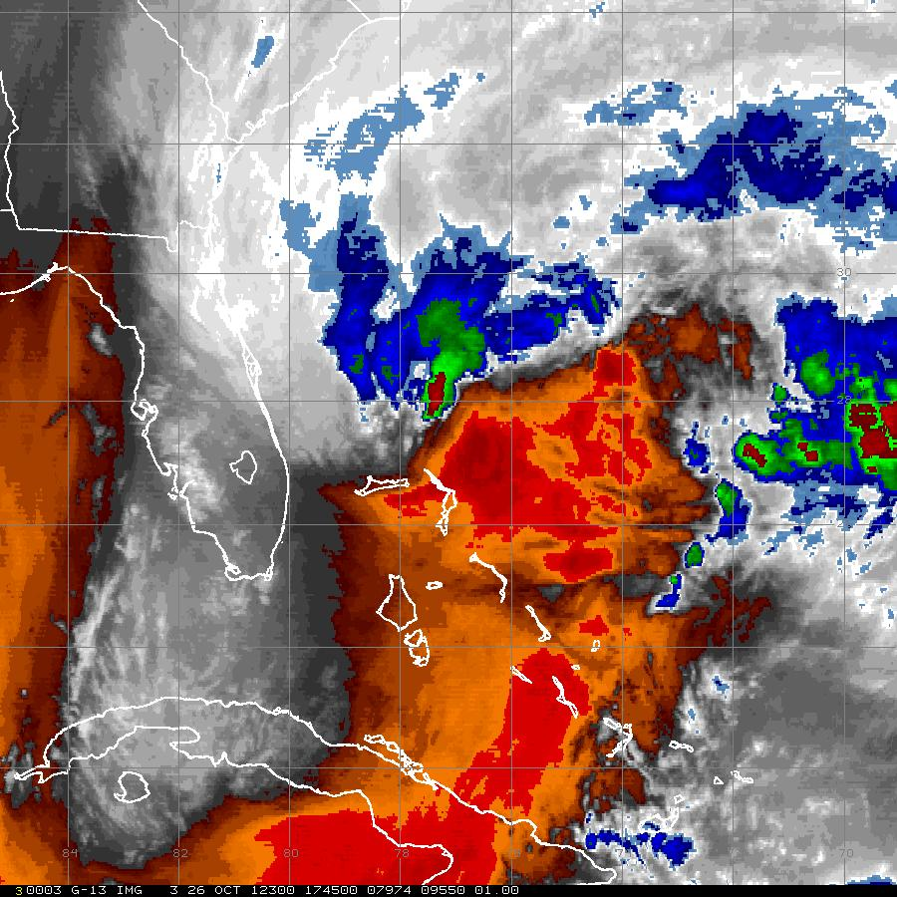
Hurricane Sandy 26 October 2012 1745 UTC: WVIR (6.5 μm)
G-IV Flight Track
GPS Dropsonde Point
MacDill AFB
30
25
20
33
1
10
15
5

Slide 11
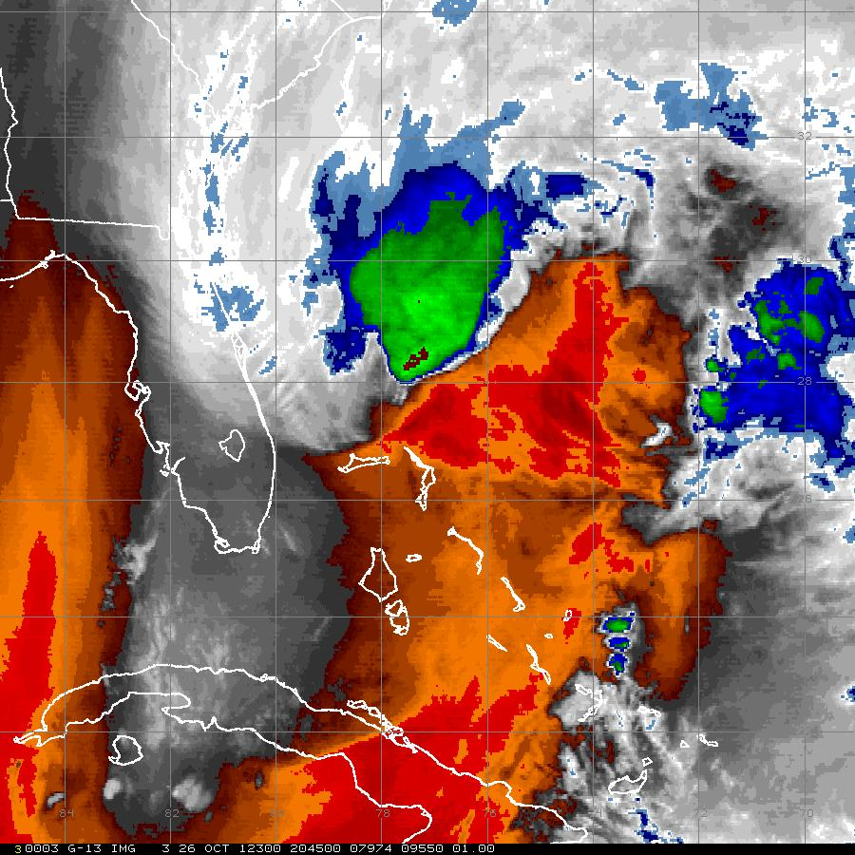
Hurricane Sandy 26 October 2012 2045 UTC: WVIR (6.5 μm)
G-IV Flight Track
GPS Dropsonde Point
MacDill AFB
30
25
20
33
1
10
15
5

Slide 12
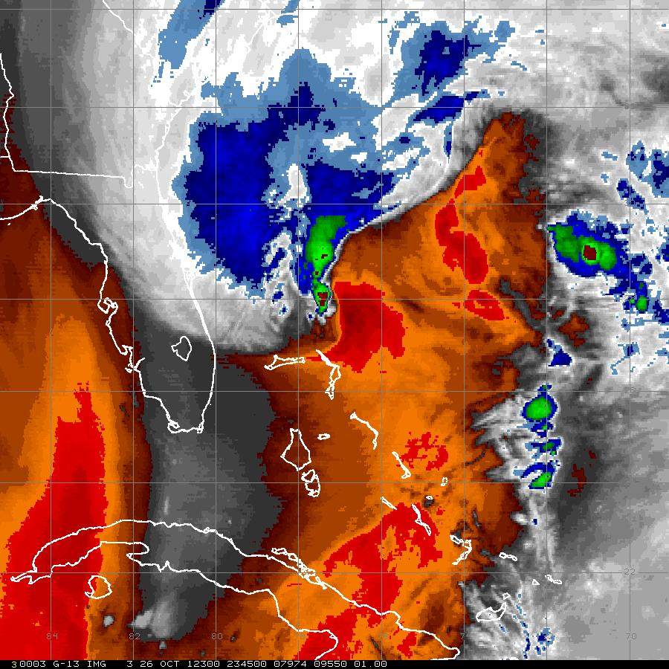
Hurricane Sandy 26 October 2012 2345 UTC: WVIR (6.5 μm)
G-IV Flight Track
GPS Dropsonde Point
MacDill AFB
30
25
20
33
1
10
15
5

Slide 13
MIMIC TPW

Slide 14
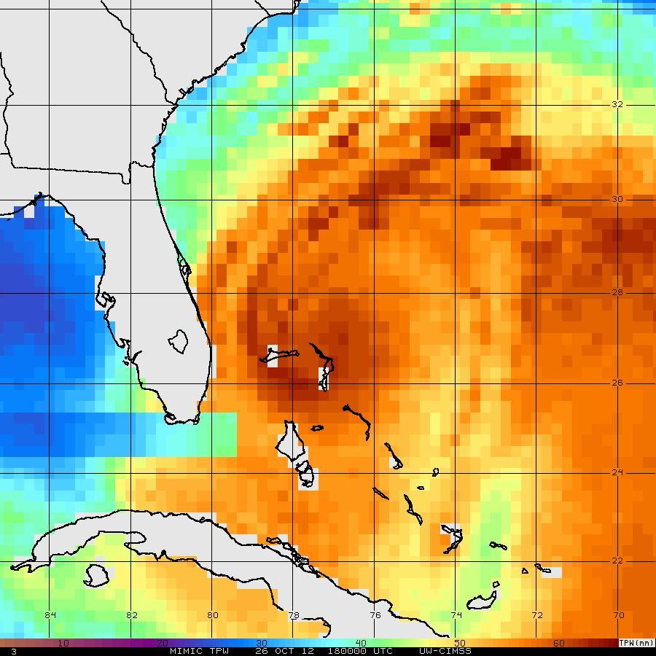
Hurricane Sandy 26 October 2012 1800 UTC: WVIR (6.5 μm)
G-IV Flight Track
GPS Dropsonde Point
MacDill AFB
30
25
20
33
1
10
15
Missing Missing Missing
5

Slide 15
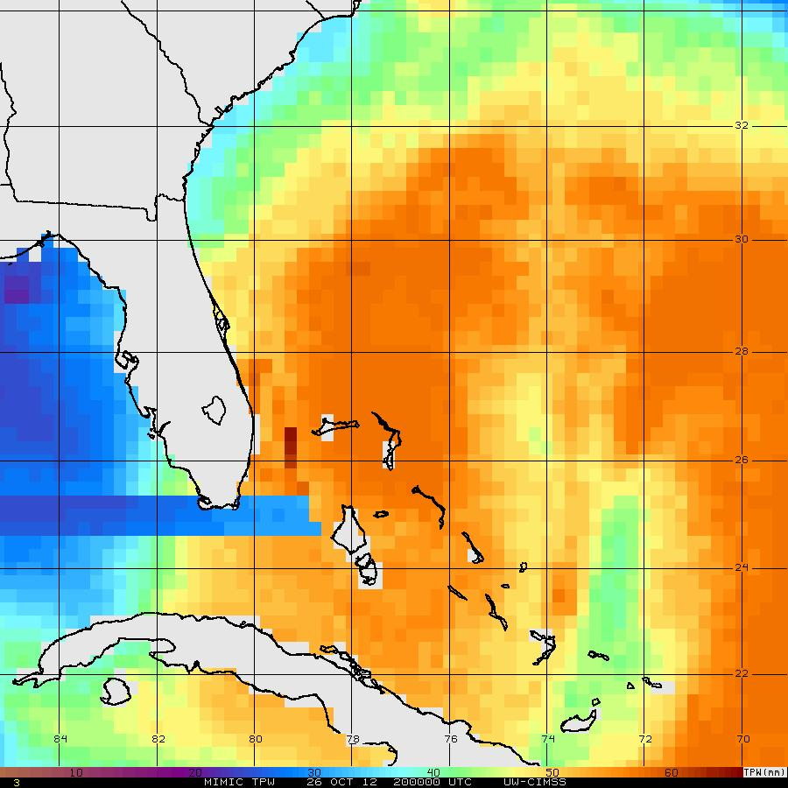
Hurricane Sandy 26 October 2012 2100 UTC: WVIR (6.5 μm)
G-IV Flight Track
GPS Dropsonde Point
MacDill AFB
30
25
20
33
1
10
15
Missing Missing Missing
5

Slide 16
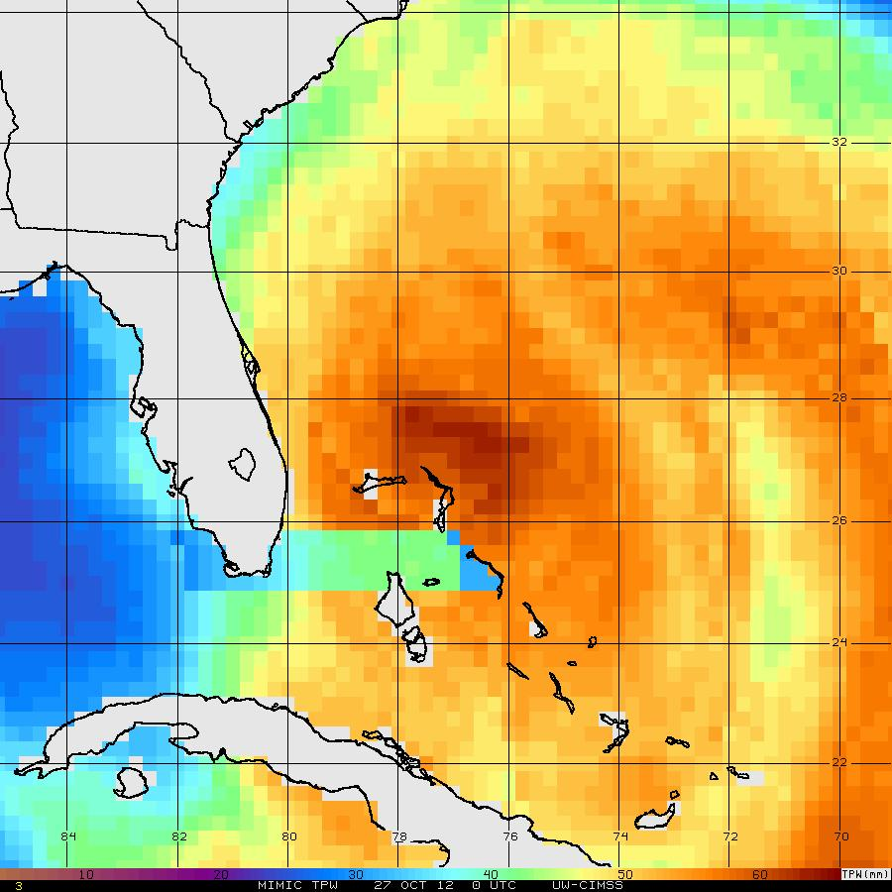
Hurricane Sandy 27 October 2012 0000 UTC: WVIR (6.5 μm)
G-IV Flight Track
GPS Dropsonde Point
MacDill AFB
30
25
20
33
1
10
15
Missing Missing Missing
5

