Slide 1


NOAA G-IV Ground-Based LPS Training
June 23, 2017

Slide 2
Motivation for G-IV
Ground-Based LPSs

Slide 3
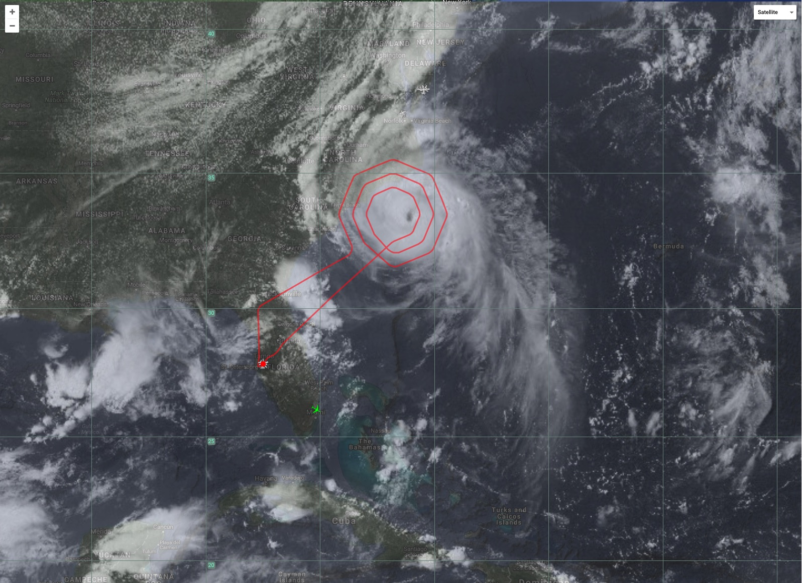
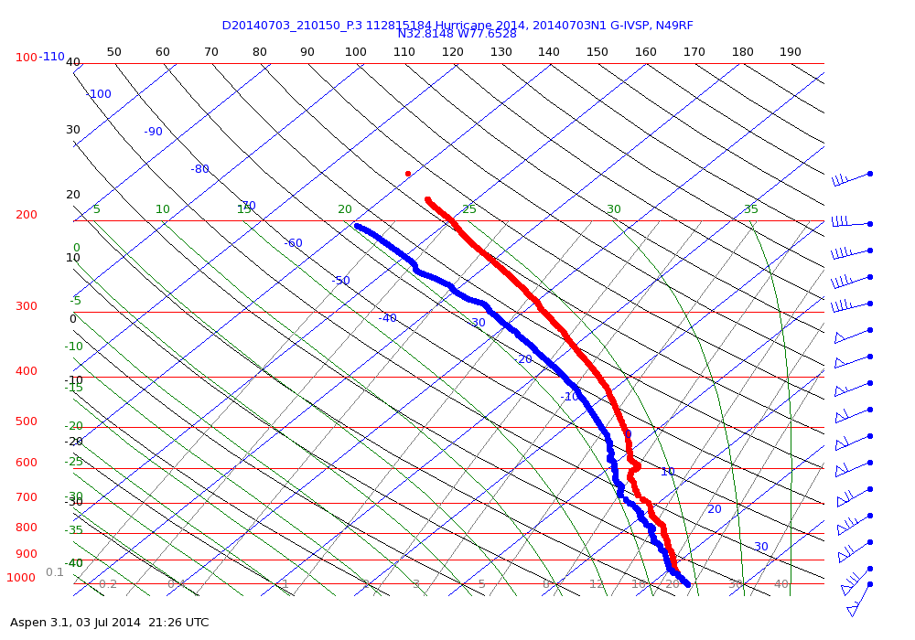
Hurricane Arthur (80 kt Hurricane): 20140703N1
flight plan: ever-nearing circumnavigation of the center with 3 progressively tightening circles around the eye. With Arthur not quite moving as fast as planned, the final circle ended up across the top of the center.
Note: the G-IV does NOT have a navigator
Notes:
Today's G-IV mission overflew both the eyewall and eye of Arthur from 13.5 km so there should be some exciting data to examine from the Tail Doppler Radar with the "superobs" now being transmitted off the plane in a manner similar to what is done on the P-3.
The attached flight plan called for an ever-nearing circumnavigation of the center with three progressively tightening circles around the eye. With Arthur not quite moving as fast as planned, the final circle ended up across the top of the center.
skewt of the dropsonde launched over the SE eyewall, which fell into 84 knot winds below at 943mb

Slide 4
2017 HRD HFP Research Missions

Slide 5
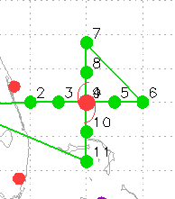
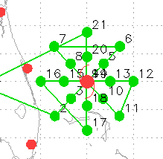
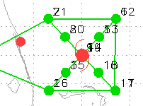
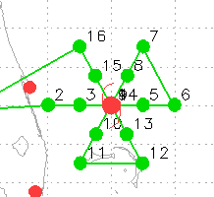
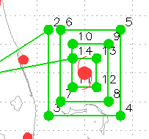
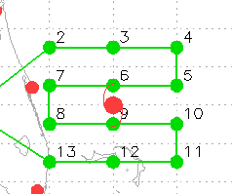
HRD HFP G-IV Patterns
Figure-4
TDR, ET Transition
Rotated Figure-4
TDR, ET Transition
Alpha
TDR
Butterfly
TDR, GENEX, ET Transition
Square Spiral
TDR
Lawn Mower
TDR, GENEX

Slide 6
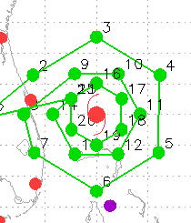
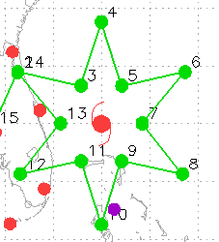
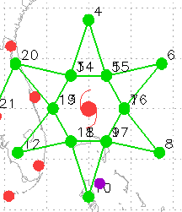
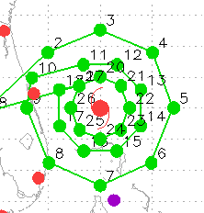
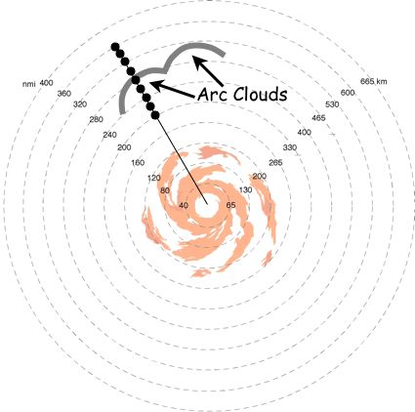
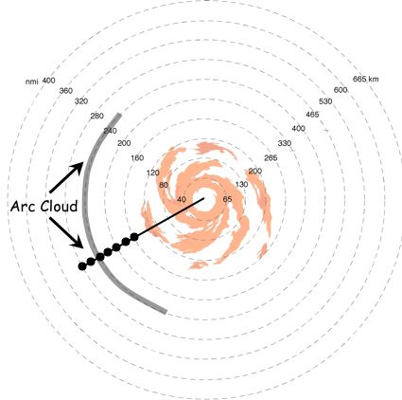
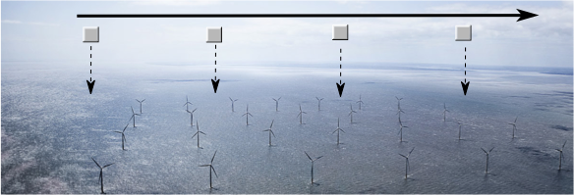
HRD HFP G-IV Patterns
Circumnavigation (Hexagon, Octagon)
TDR, SFMR Validation, GENEX (hex),
AIPEX (oct:1, hex:2), TC in Shear, SEF
Star (w/ circumnav, w/o circumnav)
AIPEX, TC in Shear, Diurnal Cycle
Arc Cloud Module
Offshore Winds Module

Slide 7
G-IV Mission Pre-Brief

Slide 8
G-IV Mission Pre-Brief/Communicating with the G-IV
Participating in the mission pre-brief with the G-IV crew
AOC telecon: 866-556-6116; participant code: 6011033
usually 90 min before take-off
Provide any relavent input to the crew (e.g. expected track adjustments, extra GPS dropondes, etc.)
confirm that N49RF will be the XChat channel for communication
note: when the G-IV is deployed, AOC may not set up a telecon
Communicating with the G-IV
Use XChat for all communications (e.g. XChat Azure-Mac and MTS XChat)
G-IV Flight Director handle is usually XX_N49_FD
type in the FD’s handle first in your message >> that way he/she will get a flashing alert and will more easily see that you’re trying to reach him/her
If you can’t reach the G-IV FD, feel free to reach out to another G-IV crewmember

Slide 9
Tools for Situational Awareness
During G-IV Missions

Slide 10
NASA MTS
G-IV Flight tracks
Planned Flight Tracks
G-IV (NOAA-49) Plan 1 or G-IV (NOAA-49) Plan 2
Click on the track or dropsponde points to see details (e.g. track timing, drop #)
G-IV Range Ring (30-min)
Operations & Planning >> + Add >> Range Ring(s) >> Add
Asset >> NOAA G-IV (N49RF)
Mode >> Time (Minutes); Duration >> 30; Label >> G-IV 30-min >> Add
G-IV Skew-Ts
https://www.seb.noaa.gov/pub/acdata/
2016 >> AVAPS >> 20161006N1 >> ASPEN_FILES >> SKEWT
G-IV ETA Ruler
Click on the G-IV aircraft icon >> drag it to a new location
Asset Tools pop-up window >> Create Ruler from the asset to the new position
One end of the ruler will follow the G-IV…the other end of the ruler will show the ETA to that point (based on current aircraft speed)
Midpoints along the ruler can also be added
Ruler
Operations & Planning >> + Add >> Ruler >> Add
Label >> Ruler 1

Slide 11
NASA MTS
Points of Interest (e.g. NHC center position)
Operations & Planning >> + Add >> Point of Interest >> Add
Enter Coordinates >> Latitude, Longitude; Label >> NHC 23June18z
Setting High Res Track data flow when using aircraftX >> Waypoints
MTS optimizes tracks using a path reduction algorithm
For full res track, goto: settings menu (gear icon) >> uncheck Optimize tracks
Satellite Overlays
Bundles >> NOAA Products >> Default Products >> GOES Standard Products
Date/time stamp should appear in the bottom left corner of the tracking window
Occasionally check the date/time stamp to make sure the image is up to date
Satellite images refresh every 2-min… to force a refresh: GOES Visible >> Refresh
Adding transparency to a satellite image: GOES Visible >> Configure >> Opacity
CIMSS Cloud Top Heights & Tropical Overshooting Tops
Pilot Situational Awareness >> CTH/TOT/Lightning
Note: G-IV flight level ranges from ~41-45,000 ft (steady climb as fuel burns off)
CTHs: useful for determining height of cirrus/convection along th track
CTHs at flight-level >> could just be non-convective cirrus canopy
Also use TOTs & lightning to identify areas of active convection
G-IV pilots will always make the call re: safety (you provide the ’heads up’)

Slide 12
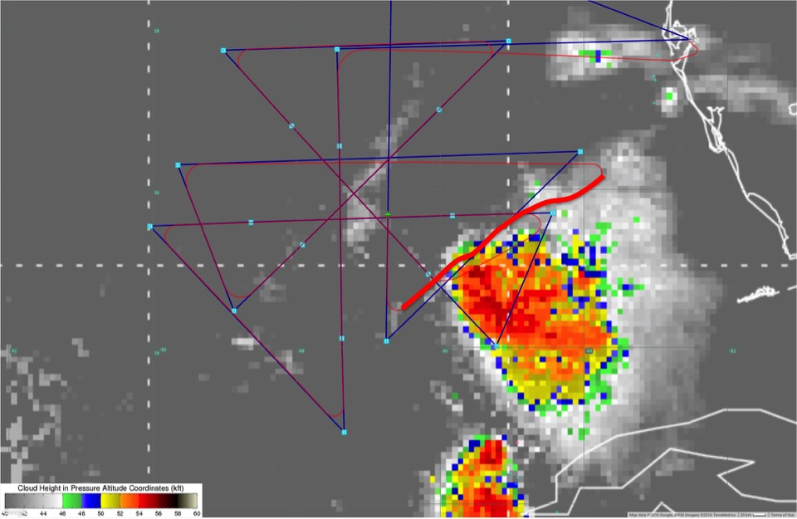
Tropical Storm Colin: 20160606N1
HRD TC in Shear Experiment
CIMSS Cloud Top Height Product

Slide 13
Modifying the G-IV Track &
Drop Points During the Mission

Slide 14
Modifying the G-IV Track/Drops During a Mission
G-IV Track Change Notes
Plan to give the pilots at least 30-min heads up for WP changes (the 30-min range ring is helpful for being aware of that timing)
Extra drops don’t usually require as much lead time to the FD, but give as much heads up as possible. Two extra drops between drops 2 & 3 >> drops 2A and 2B.
Note: the G-IV range ring will be dynamic through the mission (MTS will change its size depending on the G-IV cruising speed)
Note: MTS range rings cover up everything inside the range ring and doesn’t allow you to click on layers below it…just unselect & re-select as needed
Remember: the G-IV does NOT have a navigator
Remember: the G-IV crew works in earth relative space
G-IV Waypoints & GPS Dropsonde Points
Note: tkmap adds interpolated points as dropsonde points and not as waypoints
This means that the turns1.txt file might contain fewer points than the drops1.txt file >> since every WP has a drop point, use drop points as your reference
When discussing waypoints and dropsonde points with the G-IV flight director, be aware of possible number sequence differences between the turn & drop files

Slide 15
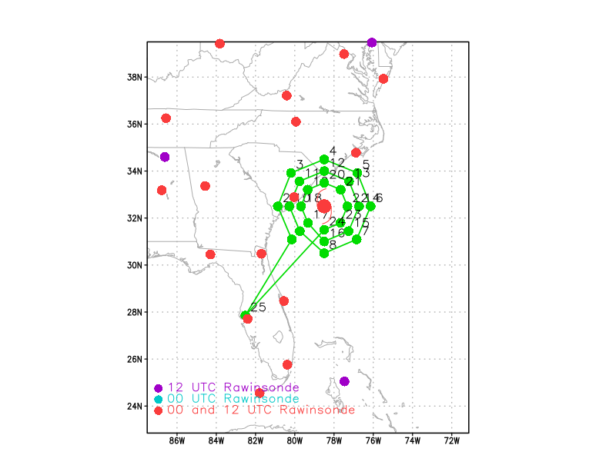
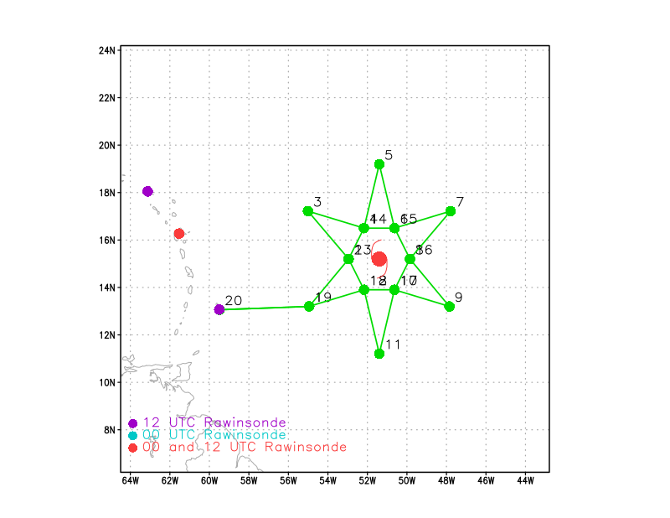
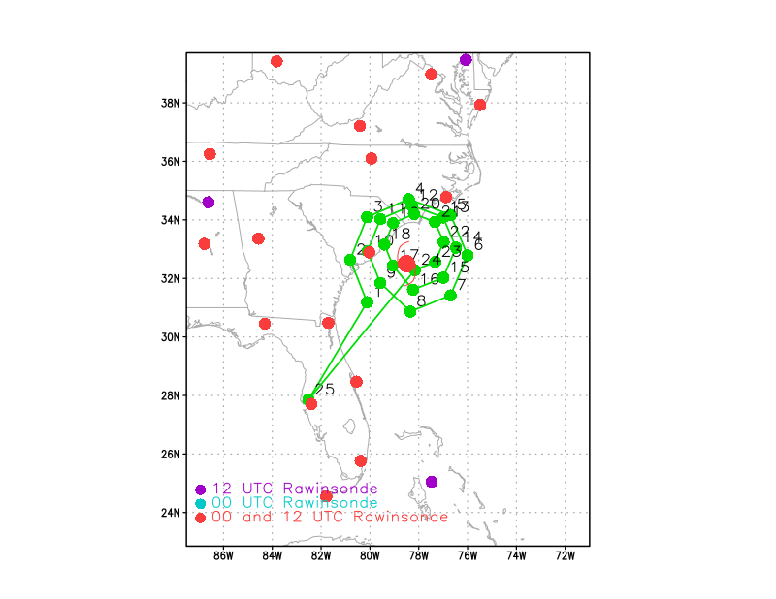
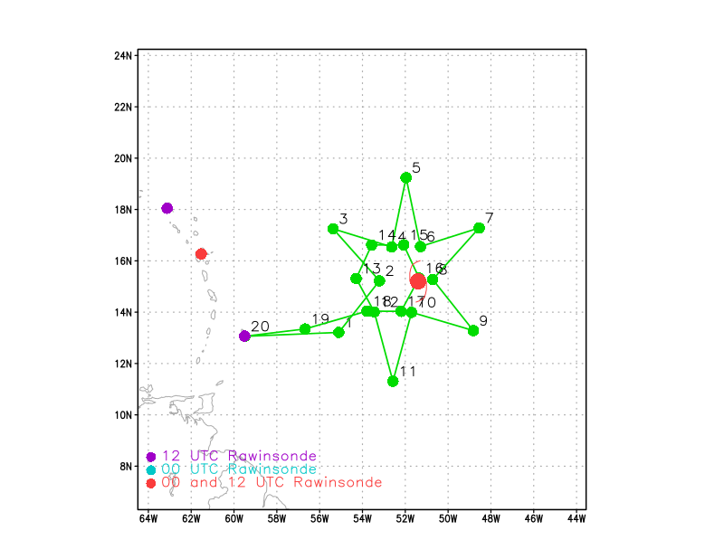
Adjusting G-IV Patterns
Circumnav (120/90/60 nm)
Star Pattern with 90 nm Circumnav

Slide 16
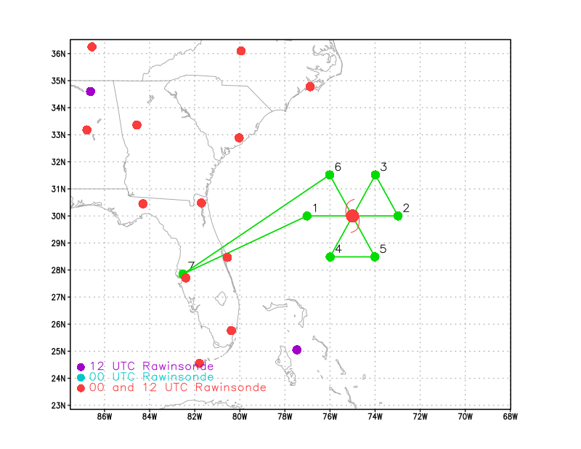
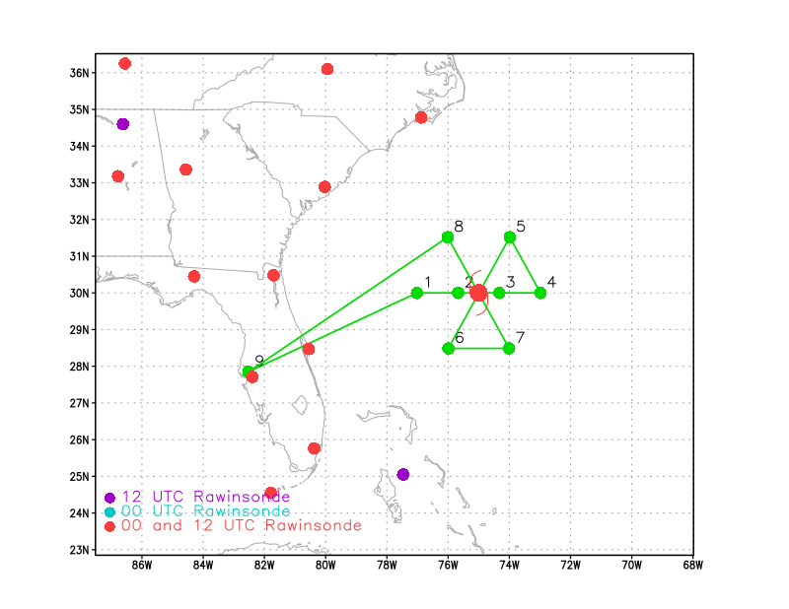
TKMAP turn files vs drop files

Slide 17


G-IV Ground-Based LPS
Helps ensure that HRD’s research missions are successful
…but…admittedly…
It’s not the Accra…

