Slide 1
60 year history of the
Hurricane Research Division
Atlantic Oceanographic and meteorological Laboratory
Neal M. Dorst
National Hurricane Conference
Orlando, FL
March 22, 2016

Slide 2
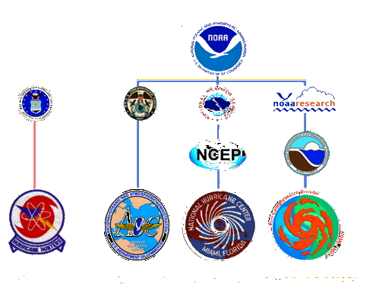
What is the Hurricane Research Division?

Slide 3
History of The Hurricane Problem
Tropical cyclones have plagued coastal communities for millennia.
Much of their life cycle was spent out at sea.
They provided paltry warning when they approach land.
It was difficult to take observations in them when they were over land.
Little was known about them well into the 19th Century.

Slide 4
History of The Hurricane Problem
First efforts to reconstruct their paths begun in 1840s
Invention of the radio telegraph in 1900 helped in real-time tracking storms at sea.
Capt. Len Povey (CAEC) carried out first aerial reconnaissance of Labor Day hurricane 1935.
Maj. Joe Duckworth (USAAF) flew first aerial penetration of hurricane in 1943.
Navy and Air Force Hurricane Hunter and Typhoon Tracker squadrons established in 1946.
Notes:
CAEC = Cuerpo de Aviación del Ejército de Cuba
USAAF = United States Army Air Force

Slide 5
History of The Hurricane Problem
  For the first ten years, Hurricane Hunters carried out basic reconnaissance duties :
  Fix the center of the storm
  Estimate the maximum wind speed (via eyeball)
  Measure the width of the storm
  Little use was made of reconnaissance flights by scientists despite being an excellent platform. Exceptions:
  Herb Riehl (Univ. of Chicago)
  Bob Simpson (U.S. Weather Bureau)

Slide 6
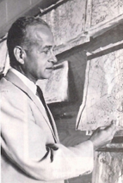
Reconnaissance for Research
Herbert Riehl contracts with U.S Navy for Project Tyrena (1947-49)
  Examine previous two years of Navy Typhoon Tracker flights
  Conduct special flights from Guam into typhoons to gather information on storm structure and formation
Dr. Herbert Riehl
Notes:
Earl W. Barrett, W. Ferguson Hall, and Lester F. Hubert UChicago grad students on Project Tyrena

Slide 7
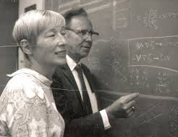
Reconnaissance for Research
Bob Simpson ‘piggybacks’ on Air Force flights (1947-54)
  Using his own leave time
  Directs mission between fixes
  During Typhoon Marge 1951 does detailed examination of eye structure
  Simpson urged full scale study of storms
Drs. Joanne and Bob Simpson

Slide 8
Shift in emphasis
From 1945 to 1953 Florida was the target of a dozen hurricanes.

Slide 9
Shift in emphasis
But in 1953 the pattern shifted and in 1954 the northeastern United States was slammed by Hurricanes Carol, Edna, and Hazel.
$750 million in damage to US (1954 dollars)
Congress demands the Weather Bureau do something about the hurricane problem.

Slide 10
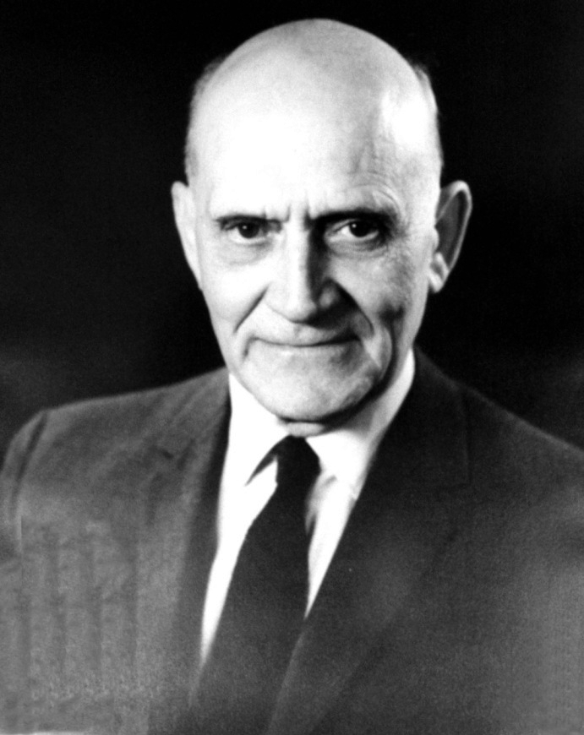
Shift in emphasis
The Weather Bureau in this era did not engage in much basic research. Other than the Thunderstorm Project (1946-47) the emphasis was on applied research and instrument innovation.
Weather Bureau Chief
Dr. Francis Reichelderfer

Slide 11
Shift in emphasis
Weather Bureau Chief Francis Reichelderfer asks Bob Simpson to expand his previous plans to meet this new demand.
By 1955, the National Hurricane Research Project (NHRP) is funded and Reichelderfer selects Simpson to be first director (over Riehl).
The Project is scheduled to last 3 years (1956-58).
Weather Bureau Chief
Dr. Francis Reichelderfer

Slide 12

National Hurricane Research Project
Main Objectives
Investigate disturbances and how they form into hurricanes.
Examine storm structure and formulate an energy budget.
Study cloud formation and rain distribution and possibility of weather modification.
Determine which factors are most important in forecasting the track.

Slide 13
National Hurricane Research Project
Tools available
Operational base at Morrison Air Field (WPB International)
Two WB-50s and one WB-47 jet with punch card recorders
Expanded network of radiosonde stations around the Caribbean
Constant altitude balloon with radio beacon to be launched in hurricane eye
Movie cameras at coastal radar sites to make time lapse films
Coastal tower and oil rig instruments to measure landfalling storms
HUGO suborbital rockets to photograph hurricanes from above
Notes:
HUGO stands for Highly Unusual Geophysical Operation

Slide 14
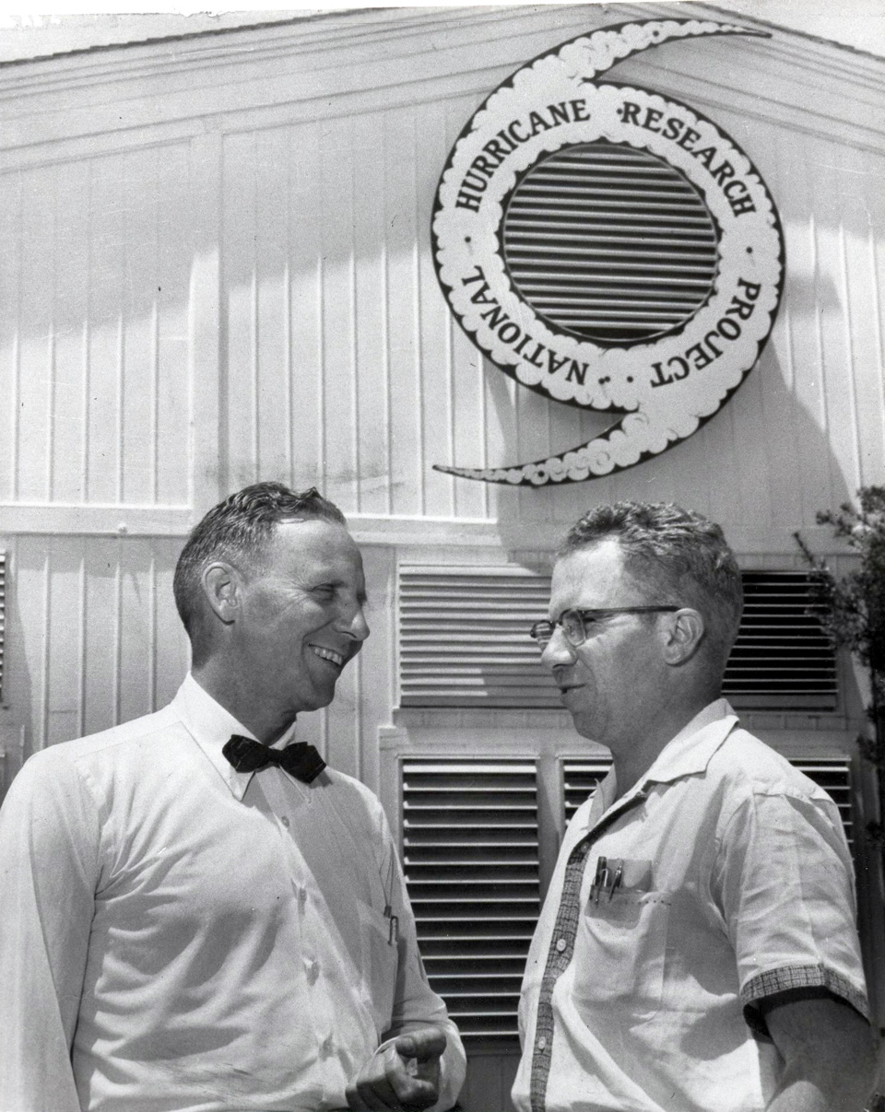
National Hurricane Research Project
Research Operational Base opens April 1956
Noel LaSeur (FSU) deputy director
R. Cecil Gentry (USWB) associate director
Staff 28 scientists, technicians, and staff
Notes:
Art Yeomans directed operations and Art Johnson ran the data collection and processing side.

Slide 15
National Hurricane Research Project
Studies of average tropical sounding, maximum potential intensity of hurricanes, and storm surge damage survey from Audrey 1957
1956 and 1957 hurricane seasons were quiet and only 27 storm sorties flown.
Project critics threatened to end NHRP prematurely.
But 1958 had 40 missions flown including Major Hurricane Helene in which the balloon beacon was deployed successfully.
Notes:
Hurricane Helene saw successful deployment of hurricane beacon.

Slide 16
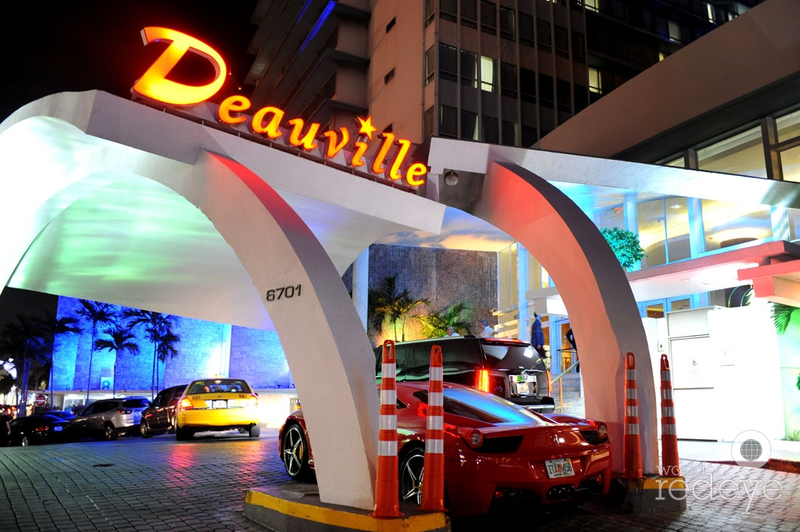
National Hurricane Research Project
After 1958 hurricane season, Simpson convened first AMS hurricane conference on Miami Beach.
A panel of experts at conference requested the Weather Bureau continue NHRP.
Deauville Hotel
Site of first hurricane conference
Notes:
Panel led by Eric Palmen and contained other meteorological luminaries

Slide 17
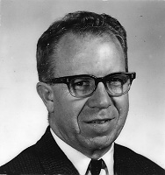
National Hurricane Research Project
Reichelderfer agrees to make NHRP permanent.
Simpson leaves to get his doctorate at Univ. of Chicago.
Cecil Gentry becomes new director.
Moves operations to Miami to co-locate with Warning Center.
Cecil Gentry
Notes:
Simpson resumed studies for doctorate that were postponed during WWII.

Slide 18
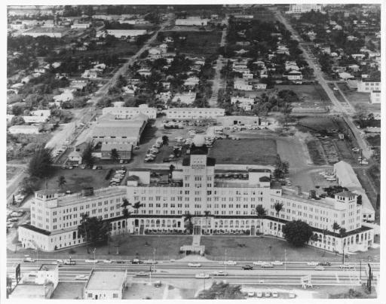
National Hurricane Research Project
Commerce agrees to obtain aircraft for new ‘flying laboratories’.
NHRP forms aircraft group, becomes Research Flight Facility (RFF).
Combination of NHRP, RFF, and Miami Hurricane Warning office dubbed ‘National Hurricane Central’.
Miami Aviation Building
NE of Miami International
Notes:
Aviation Building near Miami International. Known as the ‘chicken coop’ because it at one time housed birds.

Slide 19
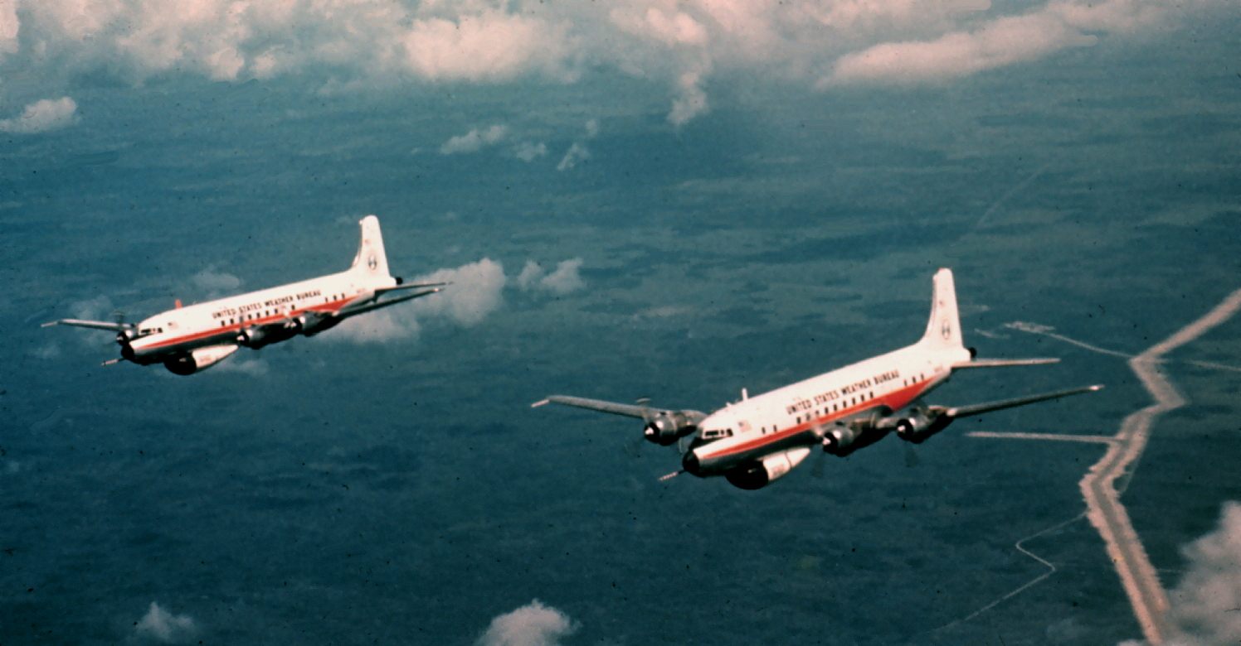
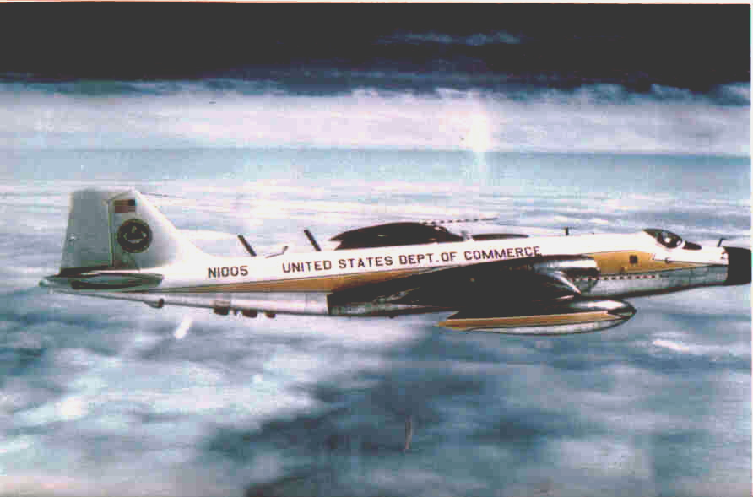
National Hurricane Research Project
RFF acquires two DC-6 and one B-57 airplanes.
Instrumented and data now recorded on magnetic tape.
Operate out of Miami International Airport.

Slide 20
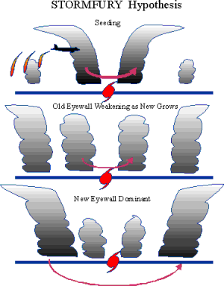
Project STORMFURY
1961 Hurricane Esther seeded by joint US Navy and Weather Bureau air fleets.
1962 Project STORMFURY formally agreement with Simpson named director.
NHRP lead Weather Bureau agency.
Over next 20 years seeding experiments carried out on just three other storms.

Slide 21
Project STORMFURY
Project STORMFURY becomes main focus of NHRP planning and personnel.
Increase hiring of cloud physicists, theorists, and computer technicians
Most extensive experiments into Hurricane Debbie 1969.
Funding ends in 1982 with inconclusive results.

Slide 22
Project STORMFURY
Too few experiments. Needed 100s of seeding cases.
Cloud physics different than theorized.
Computer models biased to show expected results.
Naturally occurring eyewall replacement cycles.

Slide 23
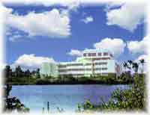
Atlantic Oceanographic and Meteorological Laboratory
In 1964, NHRP renamed National Hurricane Research Laboratory (NHRL). Moved to research wing of Weather Bureau.
In 1967, Atlantic Oceanographic and Meteorological Laboratories moved to Miami.
In 1980, NHRL placed under AOML.
In 1984, NHRL moved physically to AOML building on Virginia Key. Ends 24 yr. co-location with NHC.
Renamed Hurricane Research Division of AOML.
Notes:
And now a brief word about bureaucracy…

Slide 24
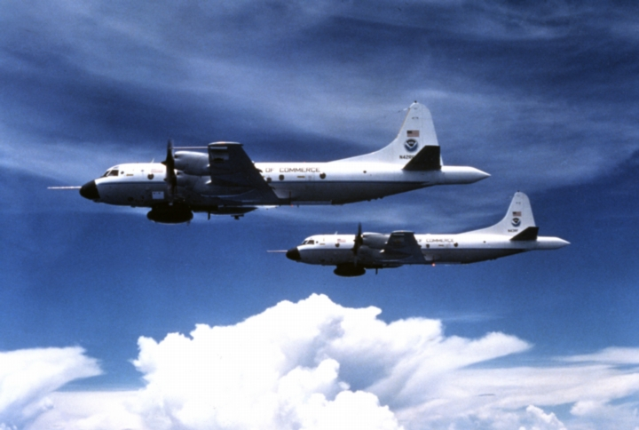
P-3 aircraft
Due to requirements of STORMFURY and political pressure after Hurricane Camille (1969), NOAA upgrades flying laboratories in 1975-76.
P-3 were modified from Navy patrol airframes.
Improved radars and cloud physics instrumentation.

Slide 25
P-3 aircraft
Begin Long-Term Monitoring experiments.
Documentation of eyewall replacement cycles.
1984 Doppler capabilities added to tail radar.
Mapping wind field of inner core
Improved understanding of storm dynamics and structure.

Slide 26
P-3 aircraft
P3s have been in service for forty years.
Recently re-winged.
Radars upgraded.
Will be in service for at least ten more years.

Slide 27
Land Based Radar
Developed technology to record radar data from National Weather Service radars
Studied changes in landfalling hurricanes from Frederic to Andrew.

Slide 28
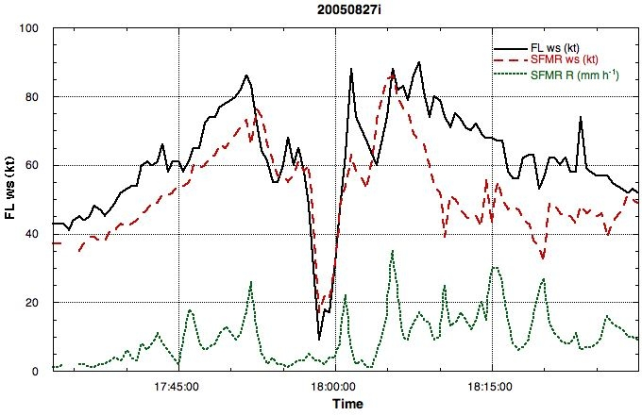
Stepped Frequency Microwave Radiometer
In 1980, NASA SFMR instrument flown into Hurricane Allen.
HRD helps develop and test technology on hurricane flights.
2009 Operational version installed on USAF Hurricane Hunters

Slide 29
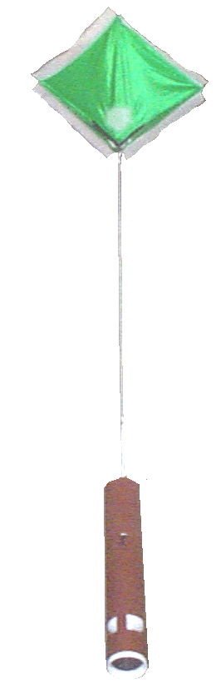
GPS dropwindsondes
In 1996, a new generation of dropsondes using GPS technology is introduced.
More accurate and improved moisture tolerance.
Able to deploy in the eyewall and discovered highest winds lower down.
No more ‘vertical evacuation’

Slide 30
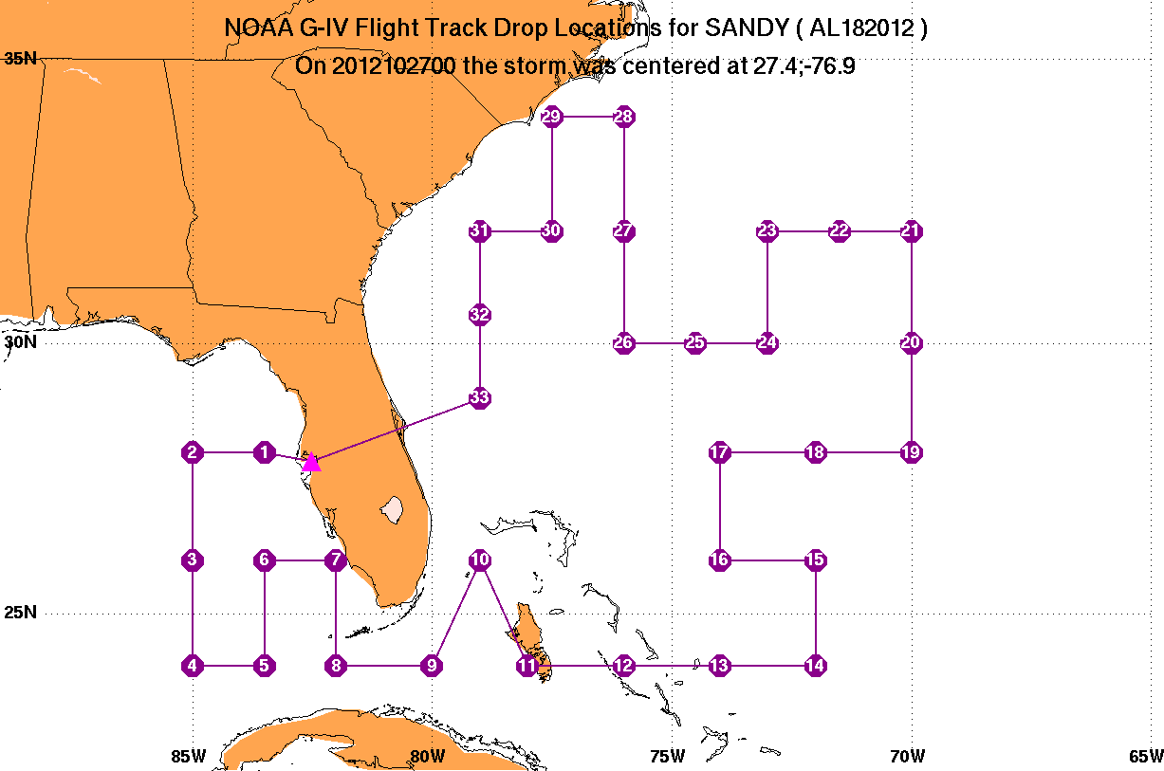
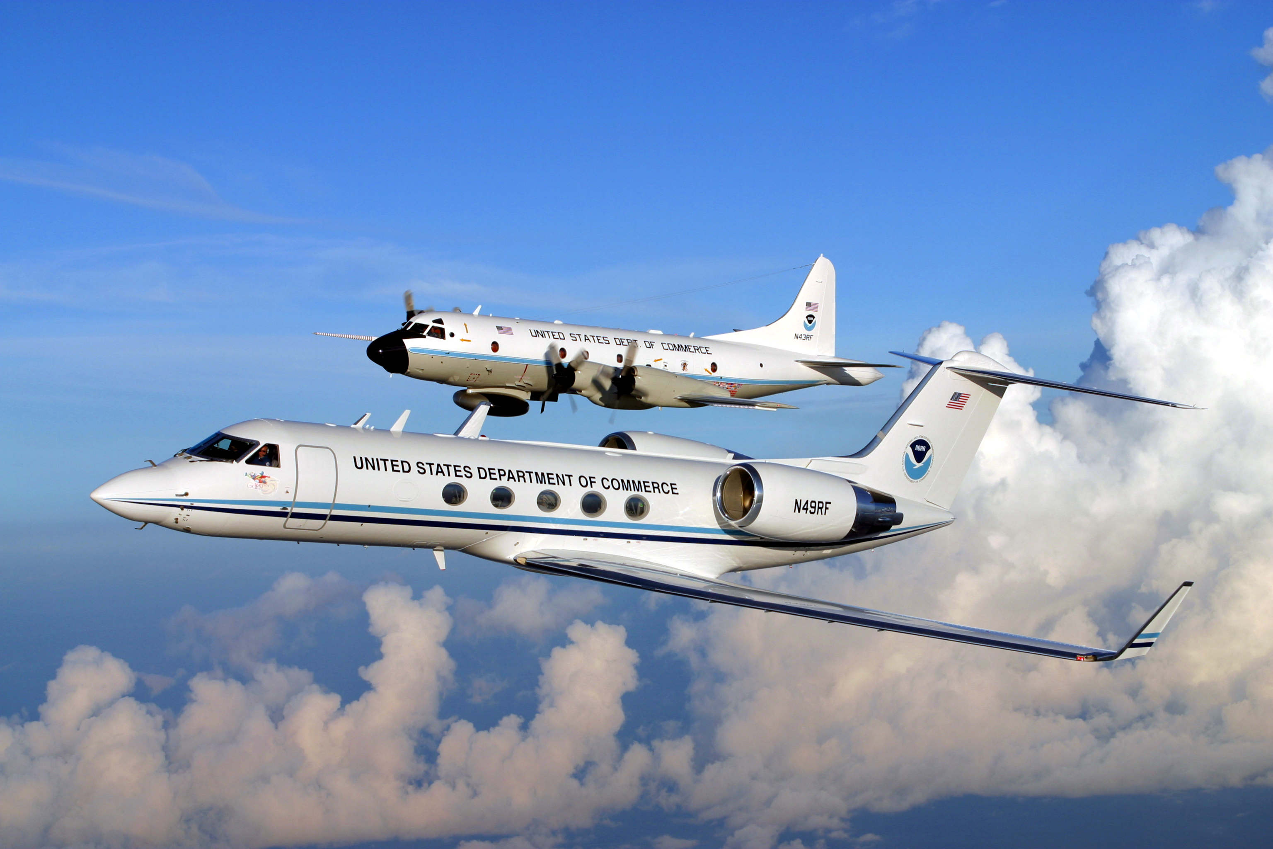
Gulfstream IV jet
In 1982, HRD flies experiments where dropsondes are deployed around Hurricane Debbie to improve computer track forecast.
Studies indicate it’s possible to improve track forecasts by 20-30% using tactic.
1996 NOAA acquires high altitude G-IV jet whose primary duty is perform Synoptic Surveillance flights.

Slide 31
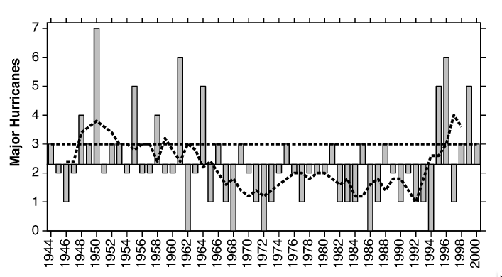
Hurricane Climatology
Studies showed relationship between El Nino and hurricane activity.
Dramatic shift to more active hurricane seasons in 1995 led to study of relationship of multi-decadal ocean temperature cycles and storm activity.
HRD contributes to NOAA hurricane seasonal forecasts.

Slide 32
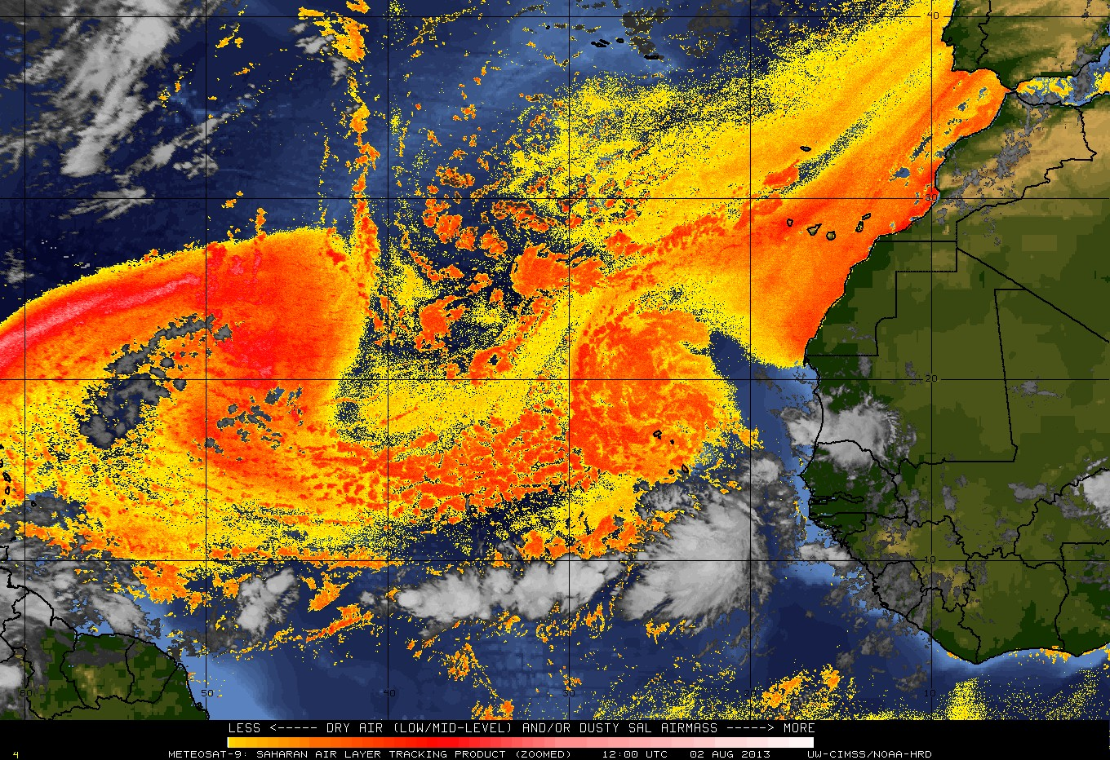
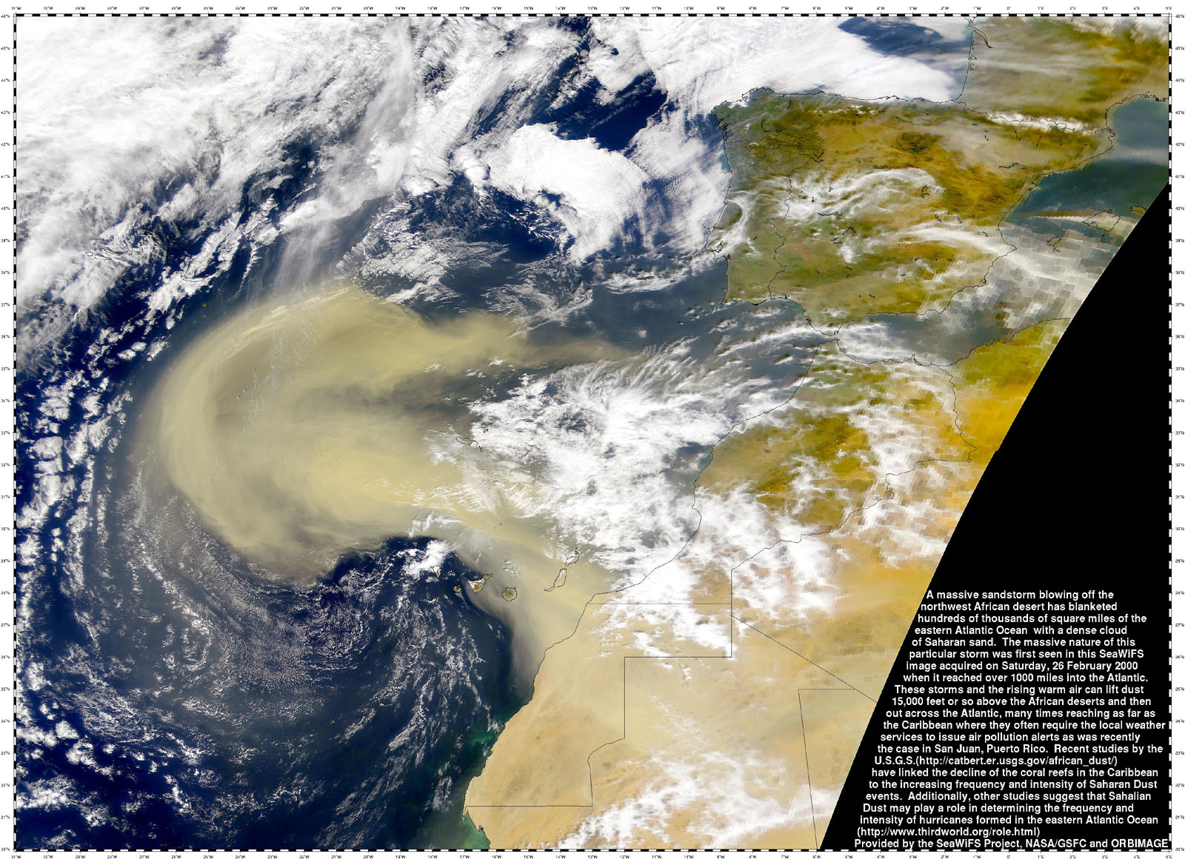
Saharan Air Layer
NHRL studies SAL in early 1970s
2000 CIMSS/HRD develops satellite differencing scheme that depicts dry/dusty air associated with SAL outbreaks.
Studies relate TC interaction with SAL
Effects of SAL on hurricane climatology
Notes:
Saharan Air Layer outbreak: 02 Aug 2013
-click next to loop the images
-uses the Meteosat split window channels (11 and 12 microns to track the SAL’s dry and possibly dusty air
-this was an exceptionally large SAL outbreak
-this imagery was part of the GOES-R proving ground demonstration at NHC for the past few years

Slide 33
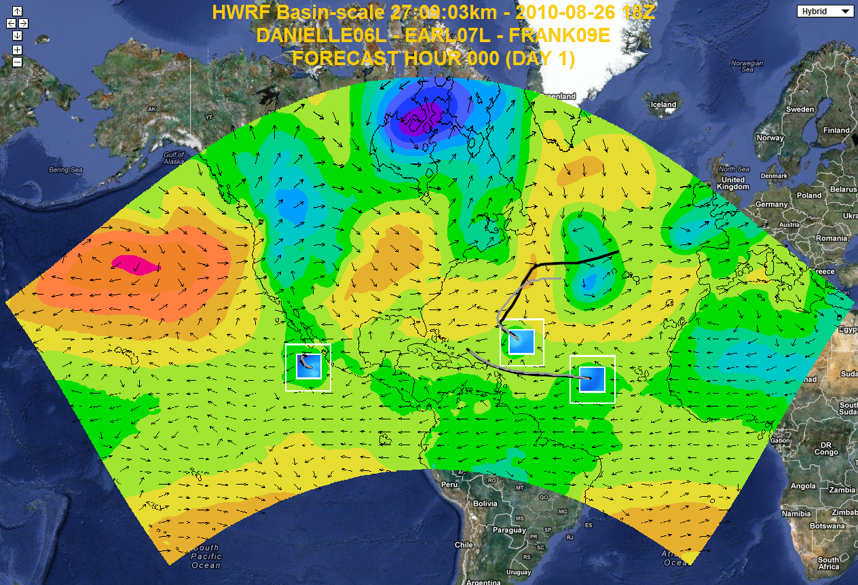
Modeling efforts
Hurricane Katrina (2005) prompts Congress to fund research into improving intensity forecasts: Hurricane Forecast Improvement Project (HFIP).
HRD increases personnel to include experts in modeling and data assimilation.
Testbed version of NOAA’s Hurricane Weather Research and Forecasting (HWRF) model.
HWRF first model to show skill in intensity forecasts.

Slide 34
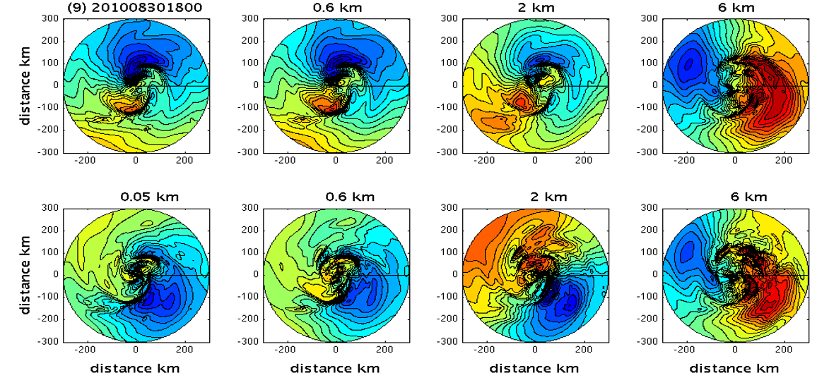
Modeling efforts
Hurricane Ensemble Data Assimilation System (HEDAS) developed to aid in ingesting inner core data into HWRF.
Investigate using new observing platforms to improve intensity forecasts.

Slide 35
Diurnal Pulsing
6 hour differencing storm-centered satellite loops reveal pulses of cold cloud tops moving away from the storm center at the same times of day.
Investigating if this is related to convection or just in the high clouds.
Notes:
TC diurnal cycle for 2005 Hurricane Emily (Cat 4)
-IR on the left, 6 hr IR temperature trend on the right
-for the differencing imagery, the yellows to pinks show trends of IR cooling and let us track diurnal pulses as they move away from the storm
-diurnal pulses form in/near the inner core each night around sunset and steadily propagate away from the storm overnight, reaching radii of 400-500 km by the following afternoon (local time)
-click next >> the IR image will animate…notice how the storm rapidly expands over time. The storm looks a bit shabby as it goes expands
-click next >> not the IR temp trend imagery loops…notice the cool ring in the IR steadily expanding outward over time. This diurnal pulse is right on the diurnal clock.

Slide 36
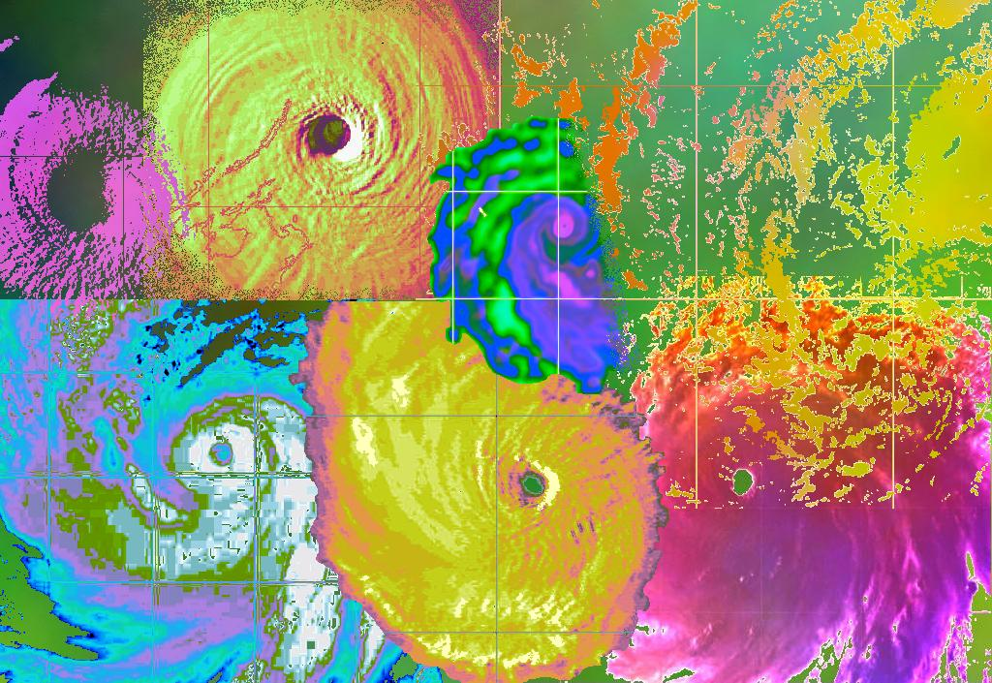
Questions?

