Slide 1



Fantastic Wind center tracks
and where to find them
Neal M. Dorst
AOML/hrd
IRR Report
Jan. 18, 2024

Slide 2
IRR Purpose
Examine the nature of wind field center
Review the history of the best track and wind center tracks
Familiarize the viewer with the current method of developing wind center tracks
Compare wind centers with operational fixes and Best Track
Suggest which tracks should be used with different data

Slide 3
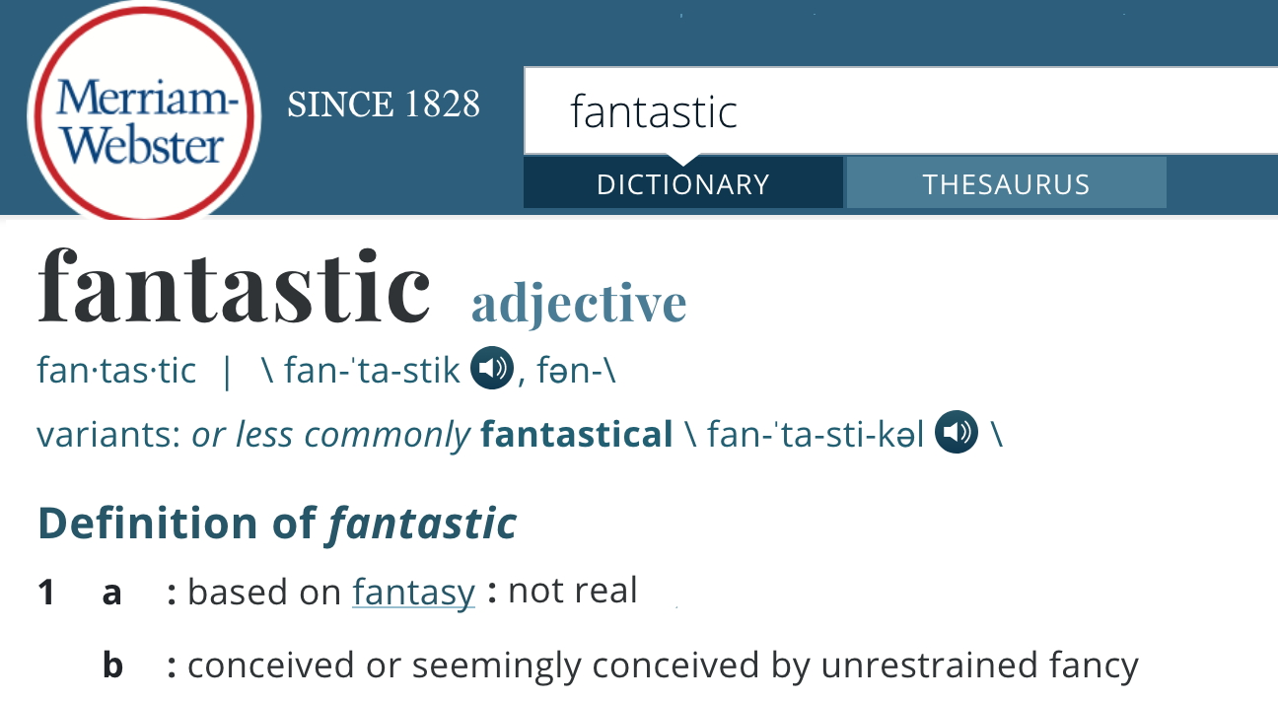

Slide 4
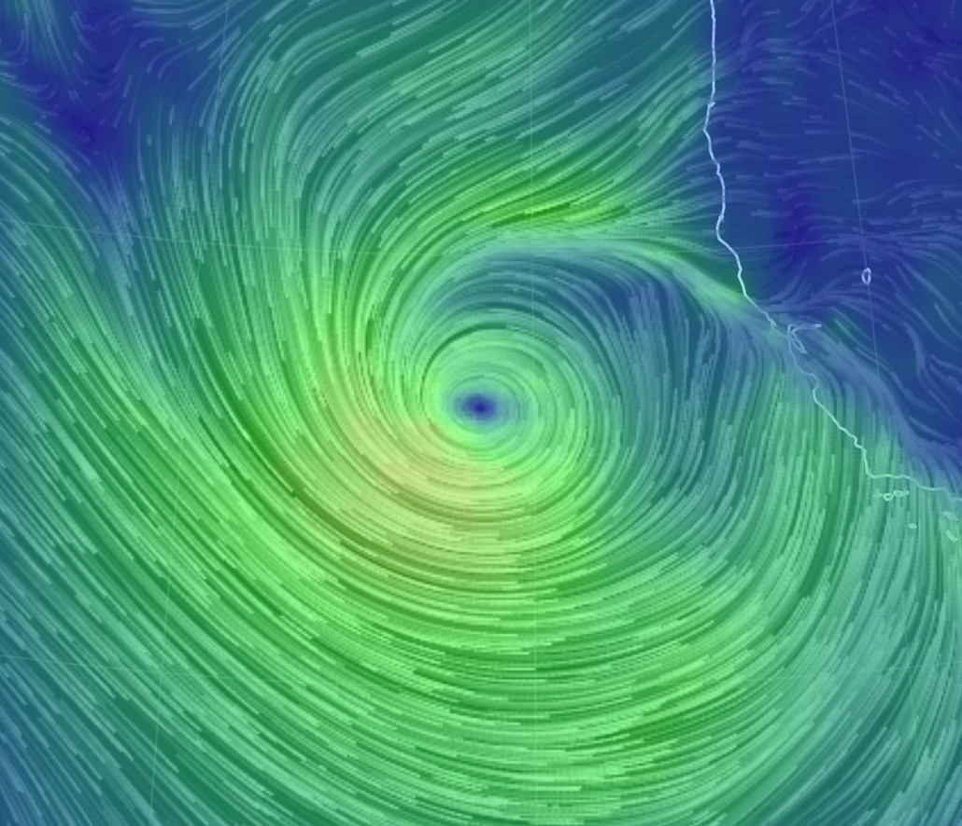
WIND CENTER
Find the wind field center where the windspeed goes to zero.

Slide 5
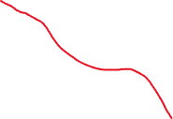
WIND CENTER
String together the wind centers…
…and Bob’s Your Uncle

Slide 6
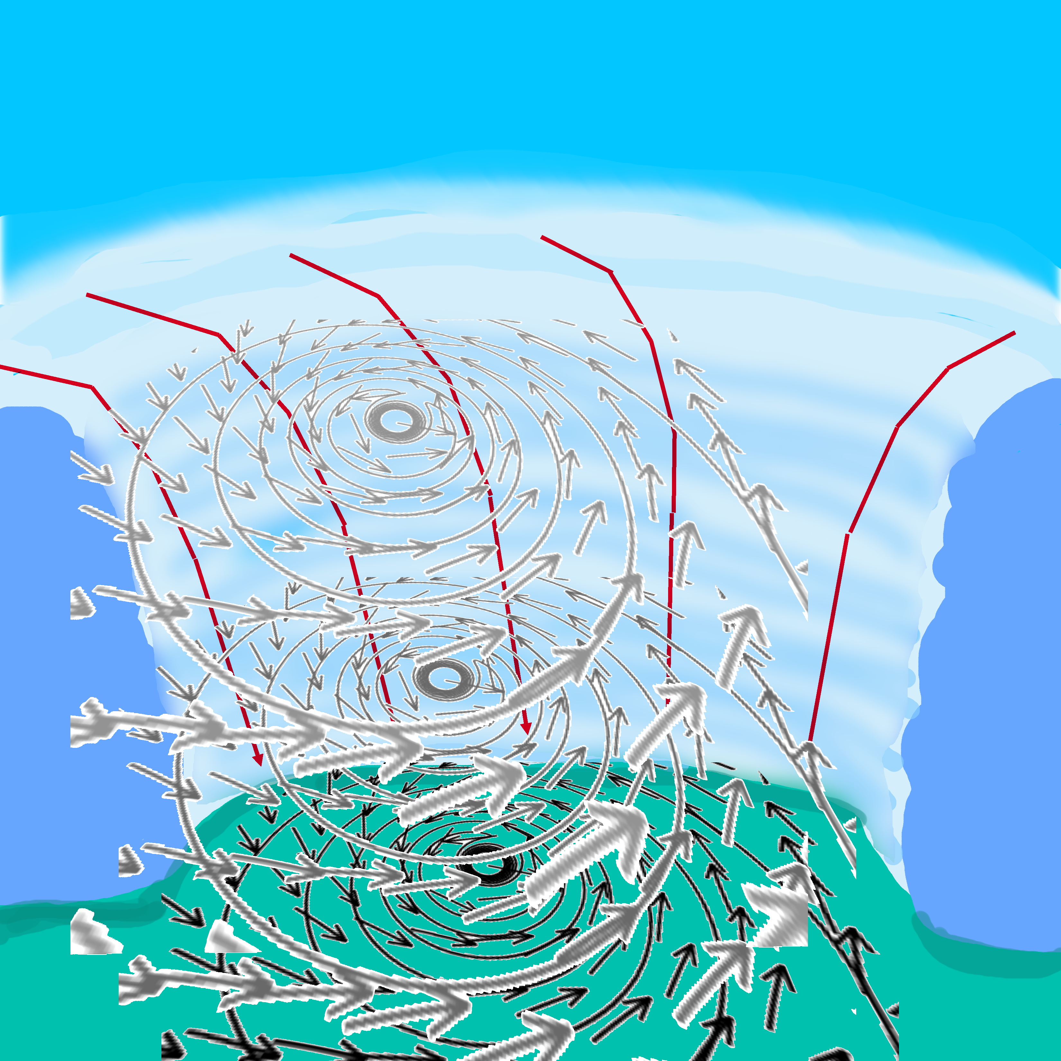
However, Bob is not your uncle
The hurricane wind field is a complex, dynamic, three-dimensional phenomenon.

Slide 7
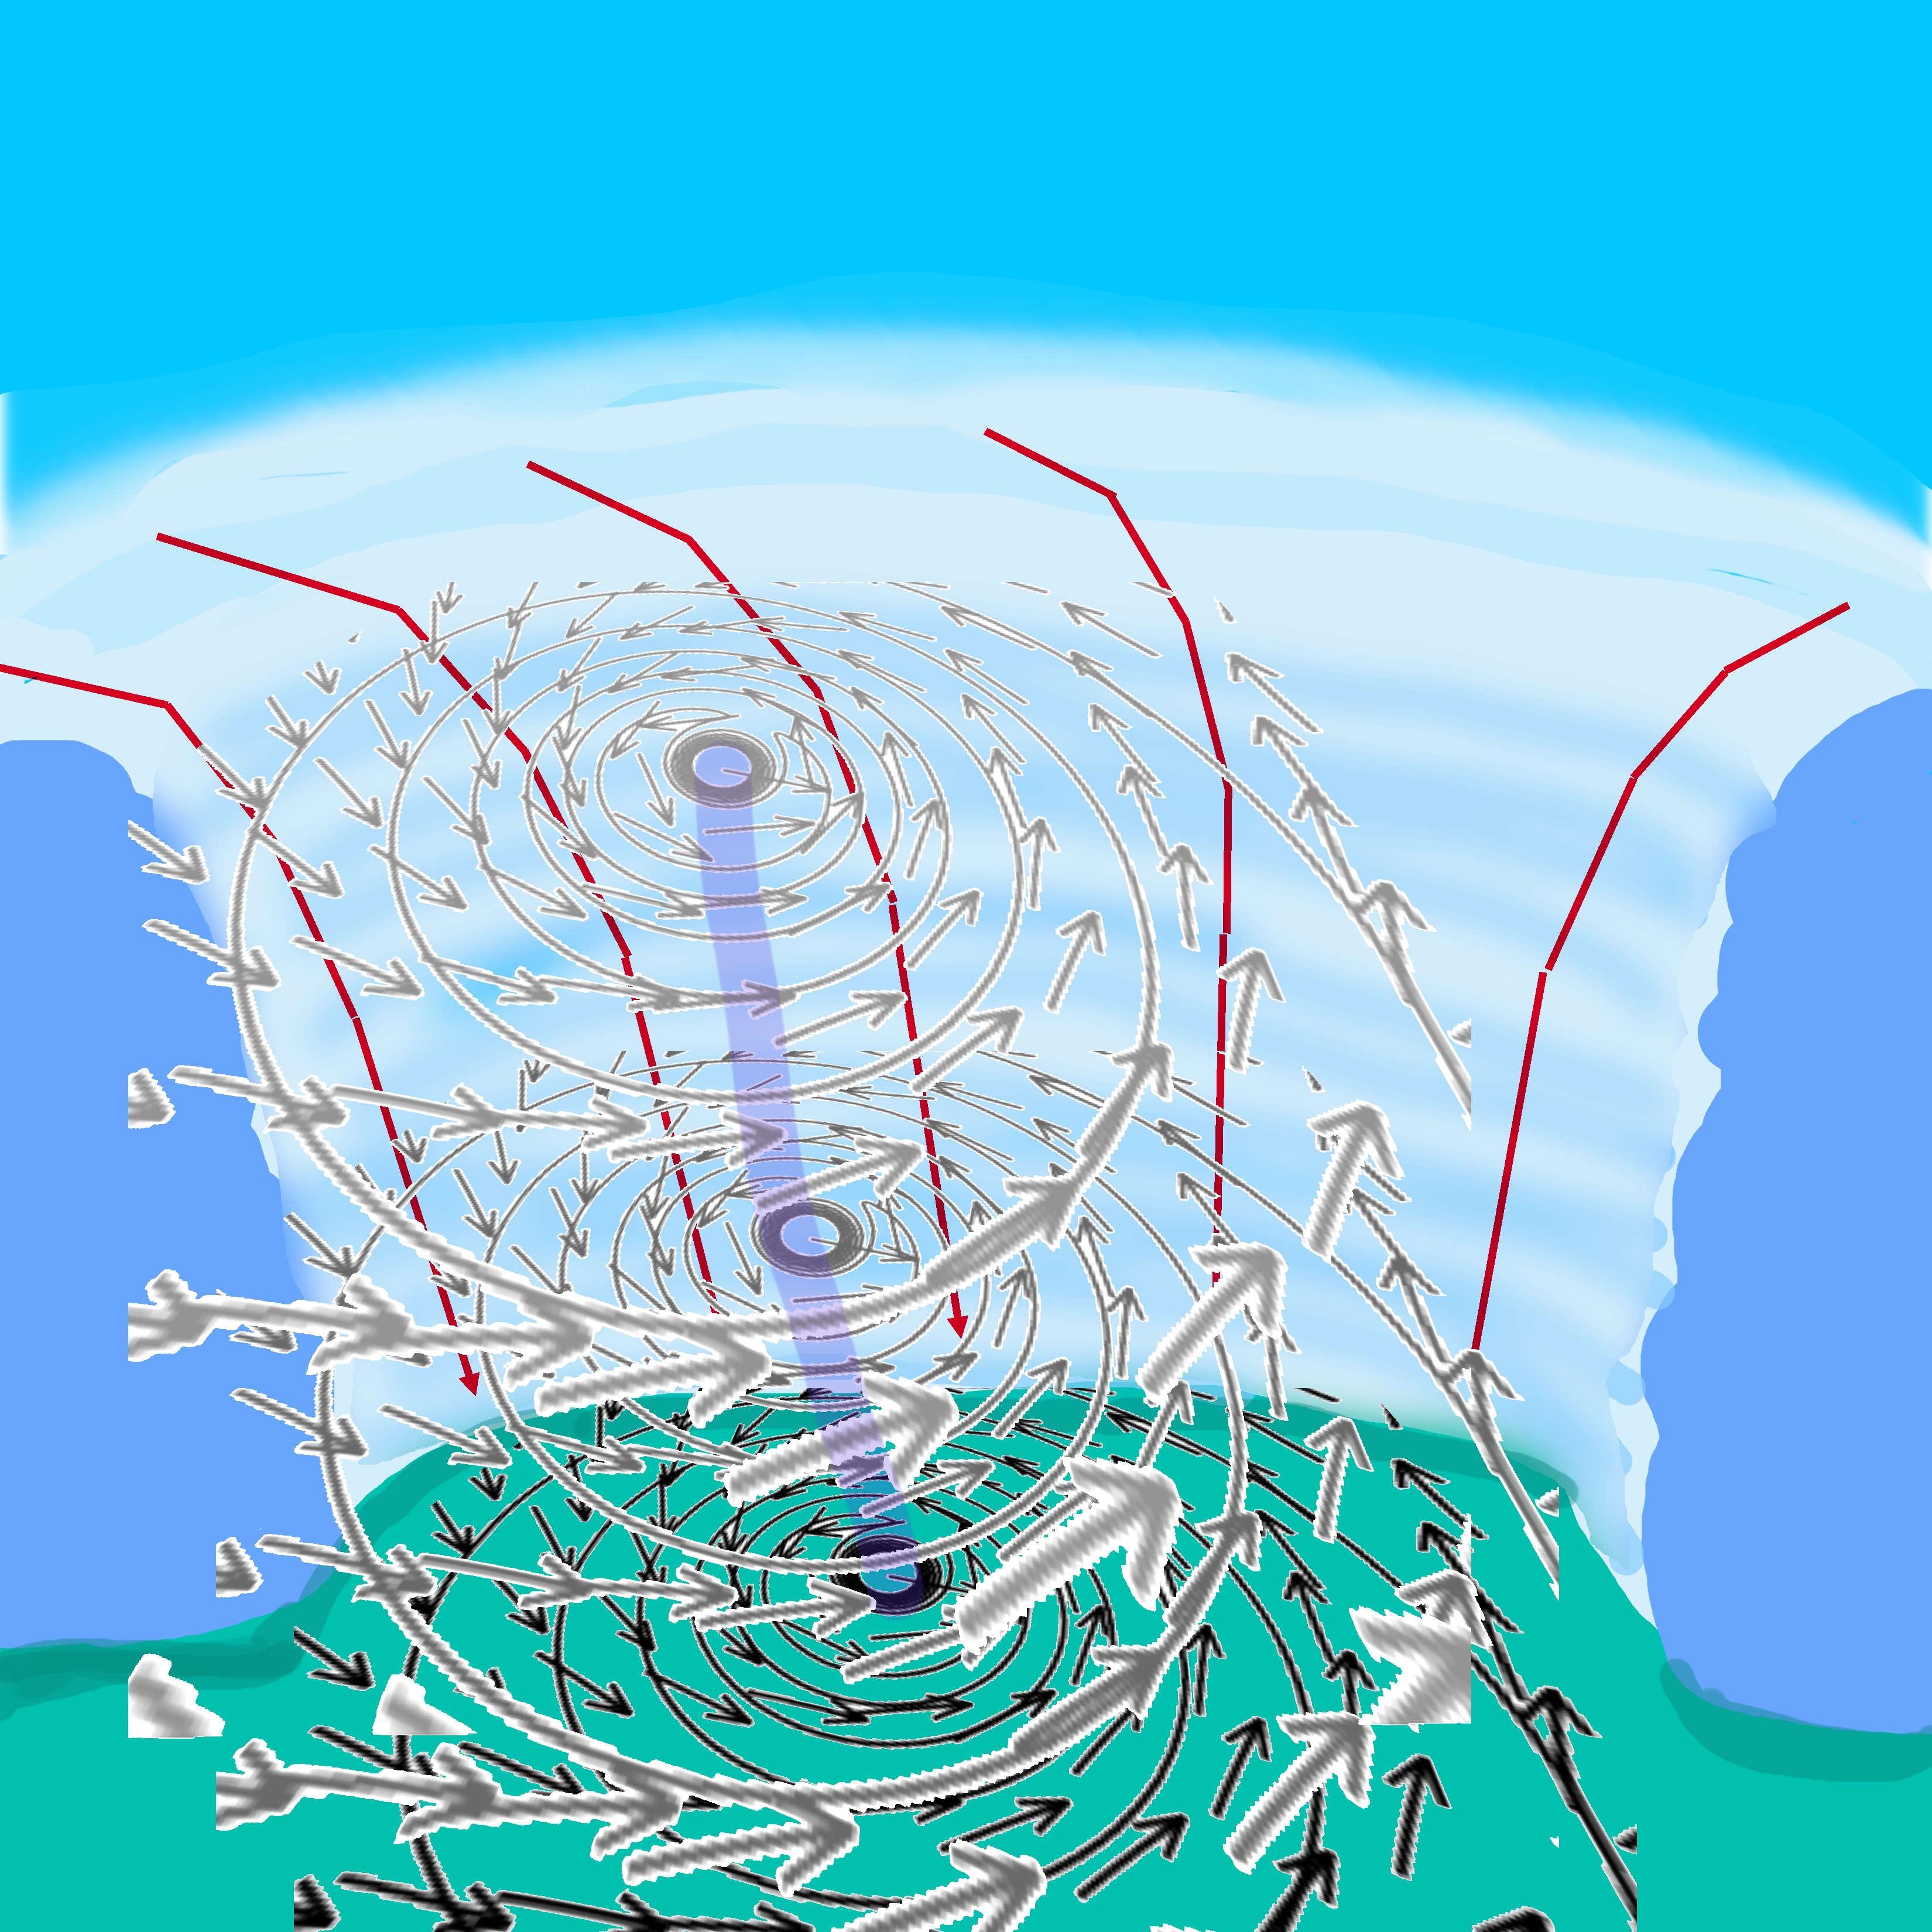
However, Bob is not your uncle
The wind centers are not stacked vertically, and can dissipate or reform.

Slide 8
Axiom
Any attempt to straight jacket a complex, dynamic, three-dimensional phenomenon into an artificial, two-dimensional construct will always involve compromise. There is
no 1 perfect storm track !

Slide 9
Codicil to the Axiom
NHC’s ”best track” is a misnomer.

Slide 10
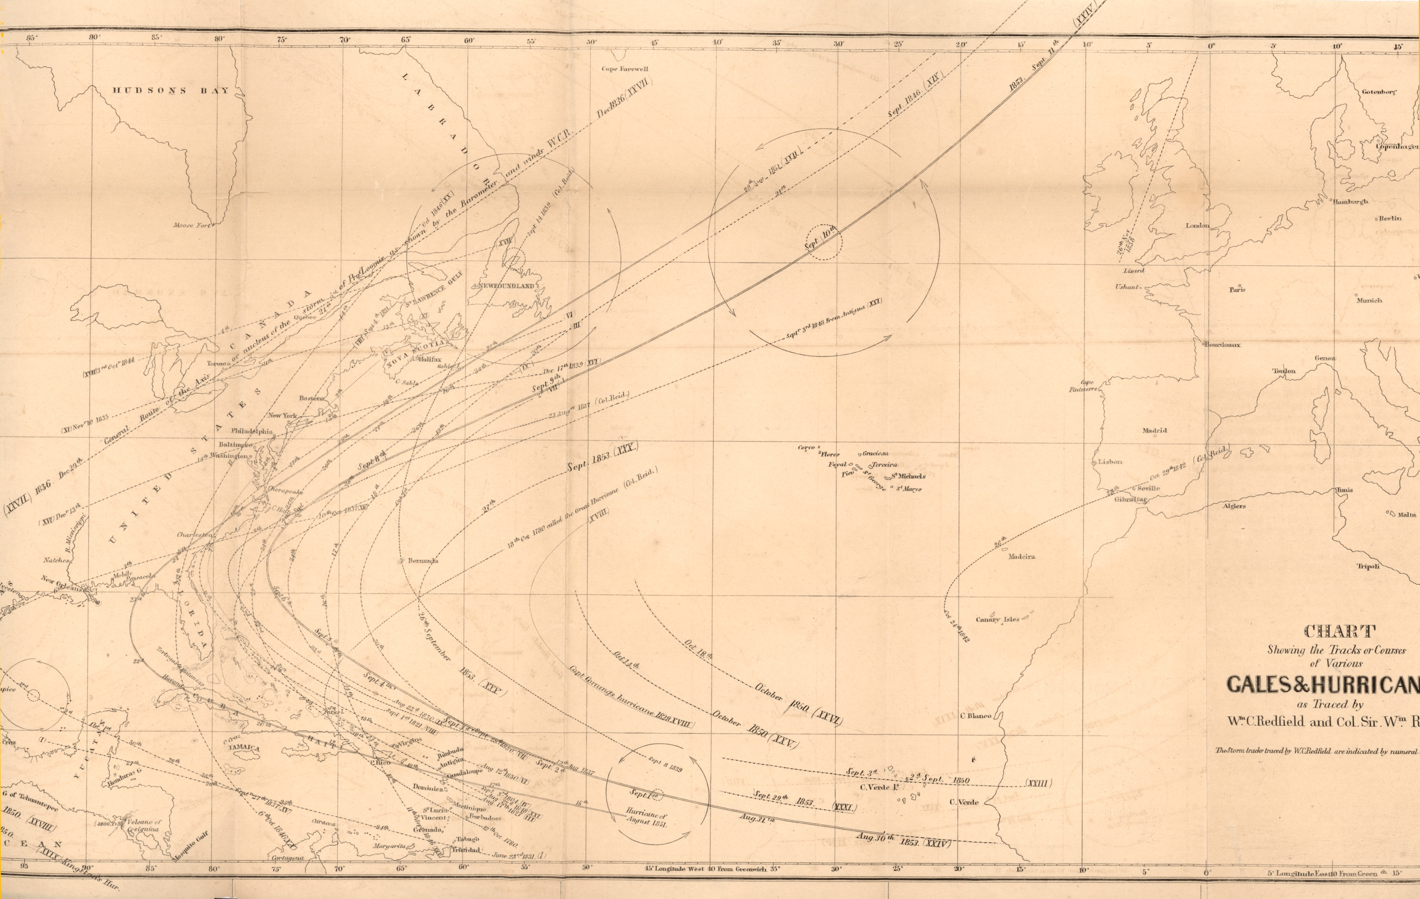
history
In 1851, William Redfield and Col. Sir William Reid reconstructed the tracks of several hurricanes from the previous few years. Thereafter, tracks would be published intermittently in science journals. Eventually the U.S. Weather Bureau would publish yearly hurricane season summaries with tracks in the Monthly Weather Review.

Slide 11
history
In 1959, as part of the National Hurricane research Project (NHRP) the weather bureau’s office of climatology produces an atlas of North Atlantic hurricane tracks from 1886-1958. These were taken from the yearly MWR hurricane season reports. Subsequent editions of this atlas expand the years covered. Currently 1851 to present.

Slide 12
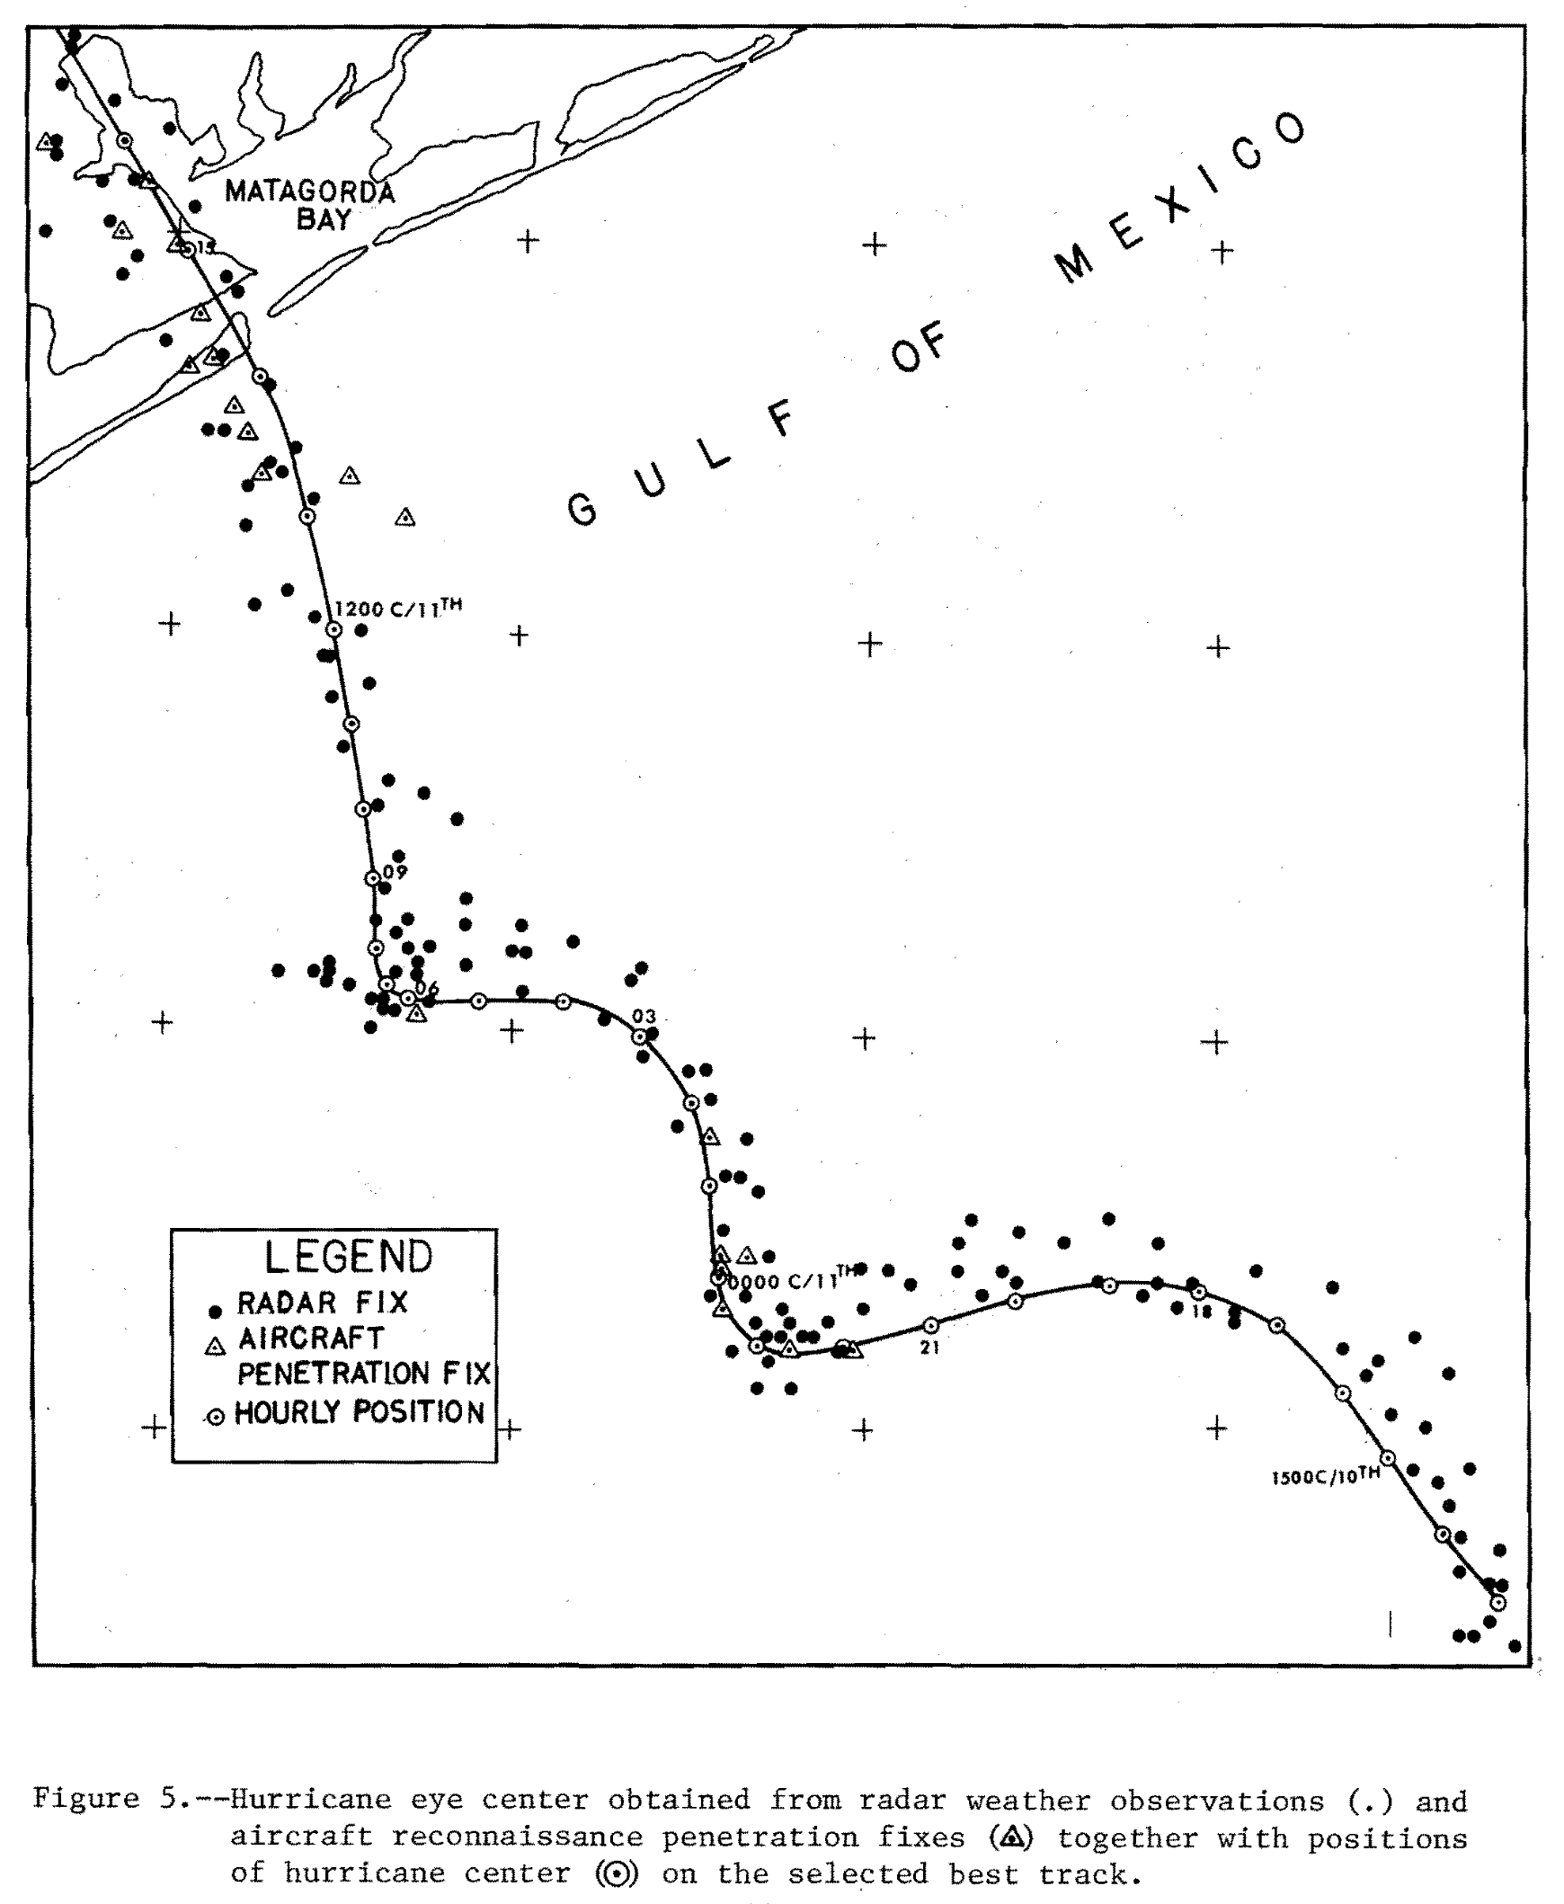
History of best tracks
In a post-storm report on Hurricane Carla (1961) Information on the position of the eye was drawn from 3 land-based radars and aircraft fixes.
Conflicting positions were resolved into a best guess track.

Slide 13
History of best tracks
the Term was shortened to ‘best track’. For subsequent storms, constructs of similar best guess tracks become a regular feature.

Slide 14
History of best tracks
In 1969, John Hope and Charlie Neumann digitized the latest North Atlantic hurricane atlas onto 80-column punch cards. To minimize the number of cards used, each day (four 6-hour fixes) of each storm had to fit on one card.

Slide 15
History of best tracks
This required that the Maximum wind speeds be given in whole knots, the central pressure in whole millibars, and the latitude and longitude of each fix be given to the nearest tenth of a degree. This puts minimum position error at ±11km or ± 6 nautical miles.

Slide 16
History of best tracks
Subsequent versions of this hurricane database (hurdat) retained this format. HURDAT2 (the new ‘best track’ file) does allow for non-synoptic time observations such as landfall or peak intensity, but all the variables precisions remain the same. The radii of various wind levels were added for recent storms.
AL062017, EMILY, 11,
20170730, 1800, , TD, 28.4N, 85.4W, 30, 1009, 0, 0, 0, 0, 0, 0, 0, 0, 0, 0, 0, 0,
20170731, 0000, , TS, 28.0N, 84.6W, 35, 1008, 0, 30, 0, 0, 0, 0, 0, 0, 0, 0, 0, 0,
20170731, 0600, , TS, 27.7N, 83.9W, 40, 1006, 20, 40, 40, 0, 0, 0, 0, 0, 0, 0, 0, 0,
20170731, 1200, , TS, 27.5N, 83.1W, 45, 1003, 20, 50, 40, 0, 0, 0, 0, 0, 0, 0, 0, 0,
20170731, 1445, L, TS, 27.5N, 82.7W, 50, 1001, 20, 50, 40, 0, 0, 20, 20, 0, 0, 0, 0, 0,
20170731, 1800, , TS, 27.5N, 82.2W, 35, 1005, 0, 50, 40, 0, 0, 0, 0, 0, 0, 0, 0, 0,

Slide 17
History of best tracks
At the end of every hurricane season, hurricane specialists are assigned to write Tropical Cyclone Reports for each storm in the Atlantic and East Pacific. For each report they review all of the operational center fixes, radar center reports, and satellite fixes and prepare a ‘Best Track’. This track is highly smoothed and is a compromise between all of these different fixes. Each ’Best Track’ is then added to the HURDAT2.
AL062017, EMILY, 11,
20170730, 1800, , TD, 28.4N, 85.4W, 30, 1009, 0, 0, 0, 0, 0, 0, 0, 0, 0, 0, 0, 0,
20170731, 0000, , TS, 28.0N, 84.6W, 35, 1008, 0, 30, 0, 0, 0, 0, 0, 0, 0, 0, 0, 0,
20170731, 0600, , TS, 27.7N, 83.9W, 40, 1006, 20, 40, 40, 0, 0, 0, 0, 0, 0, 0, 0, 0,
20170731, 1200, , TS, 27.5N, 83.1W, 45, 1003, 20, 50, 40, 0, 0, 0, 0, 0, 0, 0, 0, 0,
20170731, 1445, L, TS, 27.5N, 82.7W, 50, 1001, 20, 50, 40, 0, 0, 20, 20, 0, 0, 0, 0, 0,
20170731, 1800, , TS, 27.5N, 82.2W, 35, 1005, 0, 50, 40, 0, 0, 0, 0, 0, 0, 0, 0, 0,

Slide 18
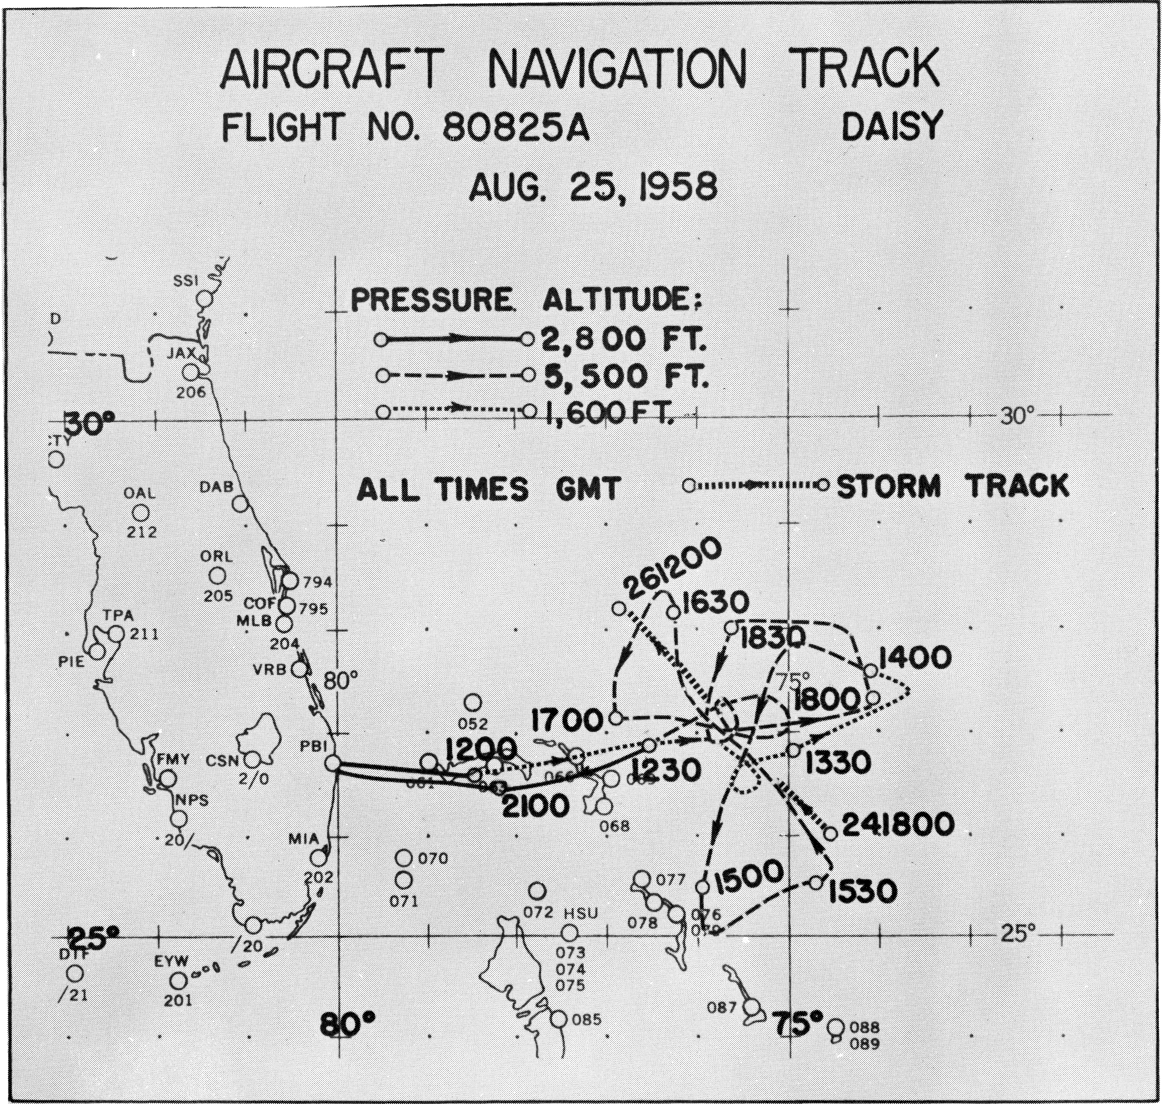
History of wind center tracks
Starting in 1956, NHrp began flying research missions into hurricanes. Data, including wind speed and direction, are digitally recorded (first on punch cards then magnetic tape). This allowed the wind centers to be calculated on each pass through the eye.

Slide 19
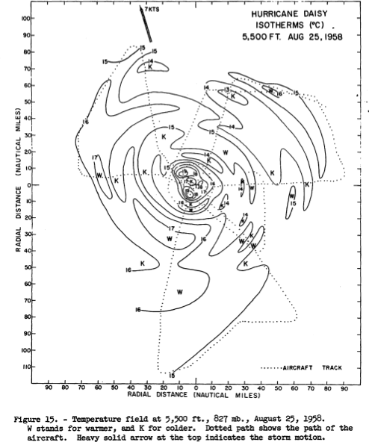
History of wind center tracks
After the flight, a wind center track would then be linearly interpolated between fixes. The other data could then be plotted in storm-relative coordinates.

Slide 20
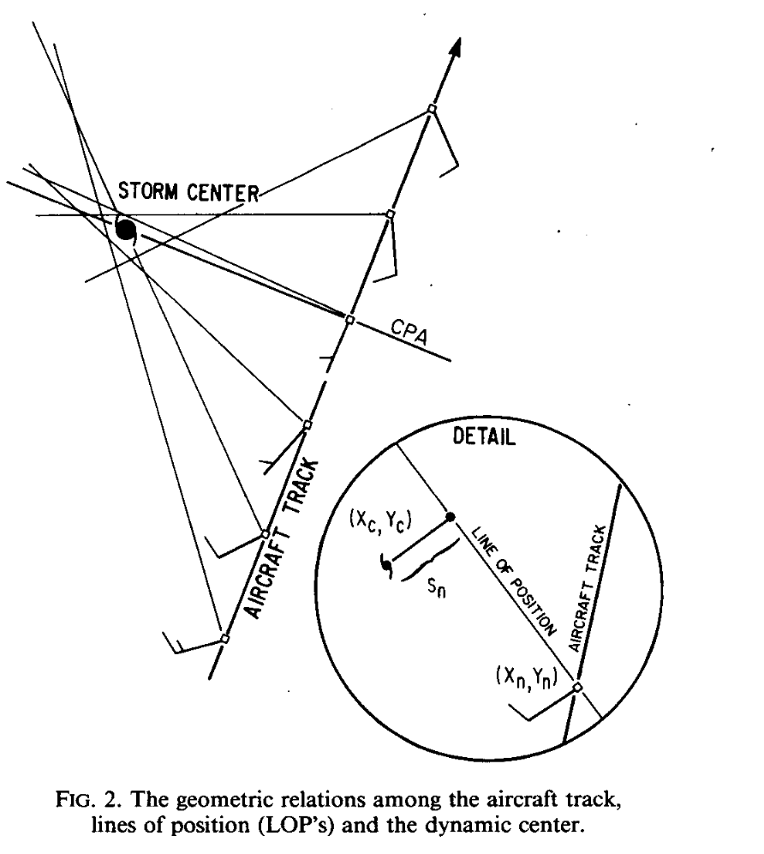
History of wind center tracks
In 1982, Hugh Willoughby and Marcy Chelmow published a paper documenting an objective process for determining the dynamic wind center from aircraft data.

Slide 21
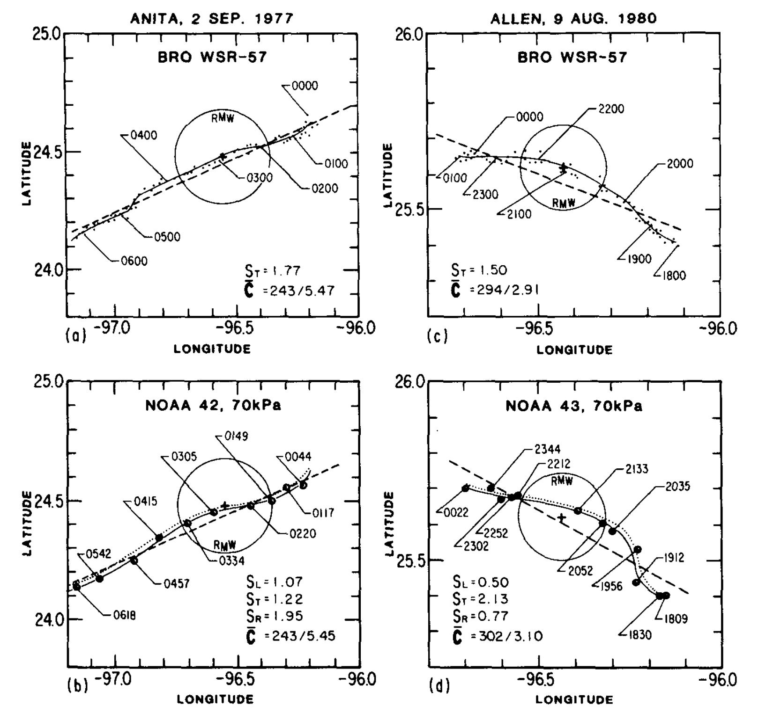
History of wind center tracks
They compared the fixes from land-based radar to their objective dynamic wind centers. They noted that the wind center track might deviate from radar center due to intense convection in the Eyewall.

Slide 22
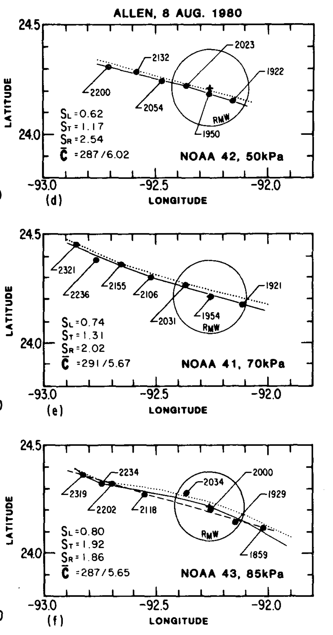
History of wind center tracks
Wind center tracks from 3 NOAA aircraft flying at different levels, while close, were not vertically aligned. Some of this was due to bias in the navigation system, But also the wind centers at different pressure levels weren’t completely vertical.

Slide 23
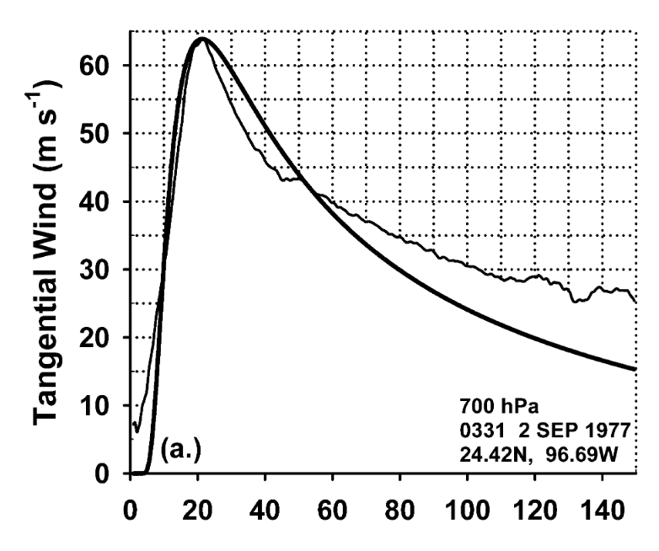
History of wind center tracks
Willoughby and ed rahn create an objective process fitting wind centers to a polynomial track of up to 20 splines. These tracks were then used to make a database of radial wind profiles.

Slide 24
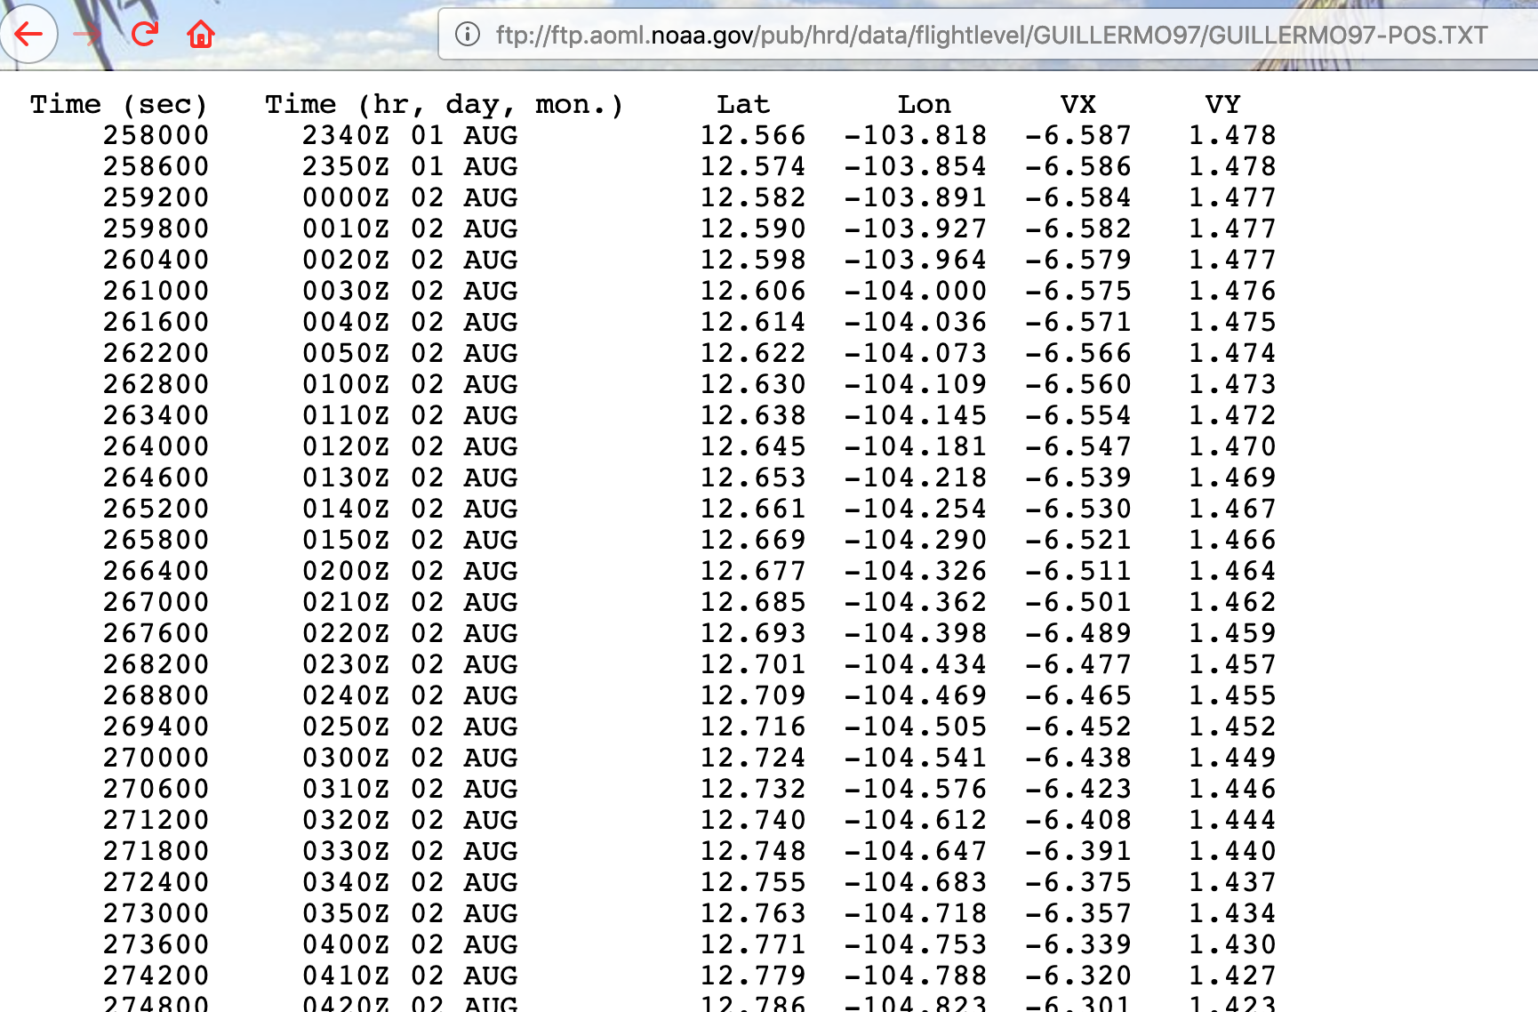
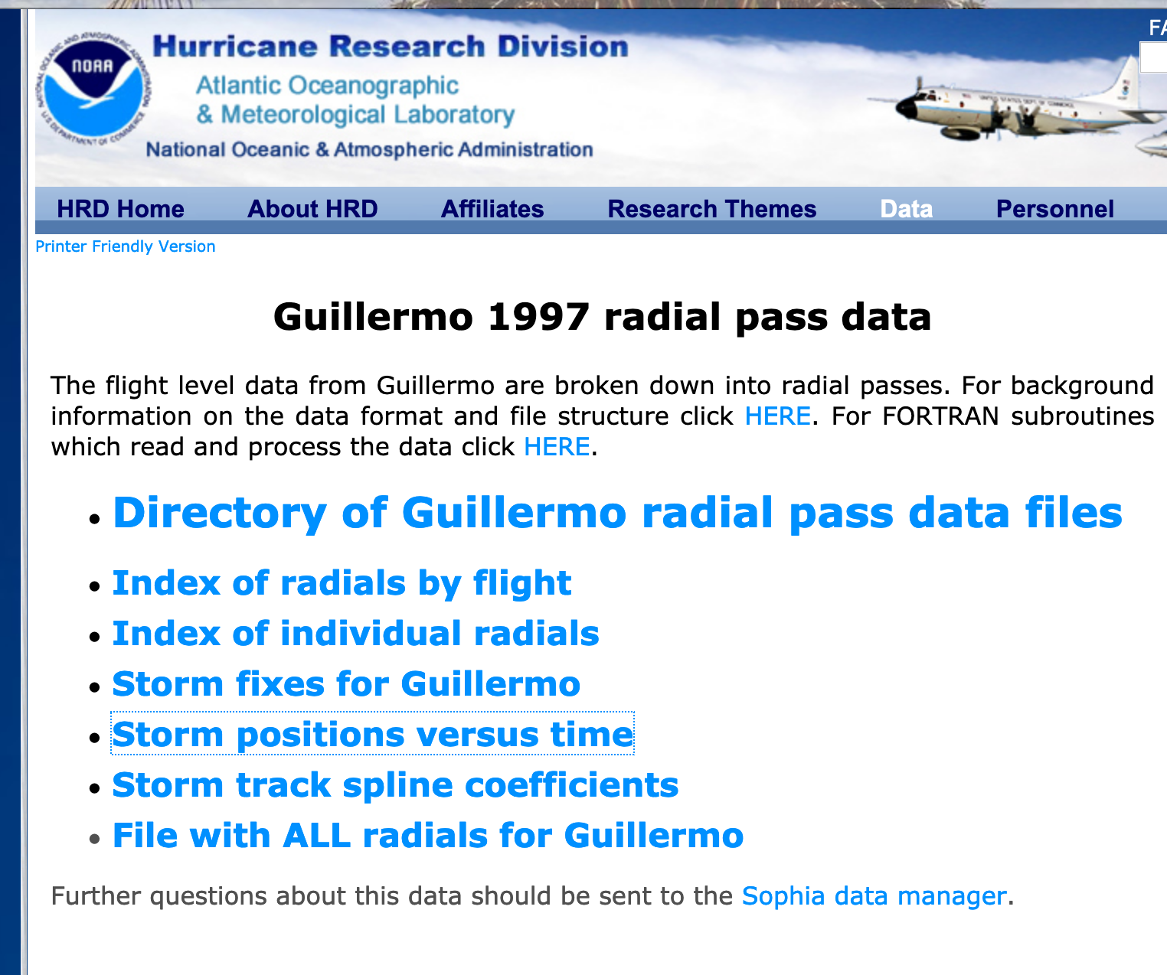
History of wind center tracks
They created A database of The wind center fixes, tracks, and wind profiles by radial pass. These are available on HRD’s data portal which is linked to the storm data catalog on HRD’s website.

Slide 25
History of wind center tracks
A wind center track was provided with positions every ten minutes and positions to one thousandth of a degree. spline coefficients for reproducing the track curve were included and Each radial pass into and out of the eye were indexed and archived.

Slide 26
History of wind center tracks
After Ed Rahn’s death in 2004, production of these wind profiles and storm tracks ceased. (The last year completed was 2001.) In 2008, an effort to resume their creation was stymied by the loss of some legacy software. However, enough programs were recovered to allow the production of storm wind centers and spline tracks. The following revised method is now used to produce them.

Slide 27
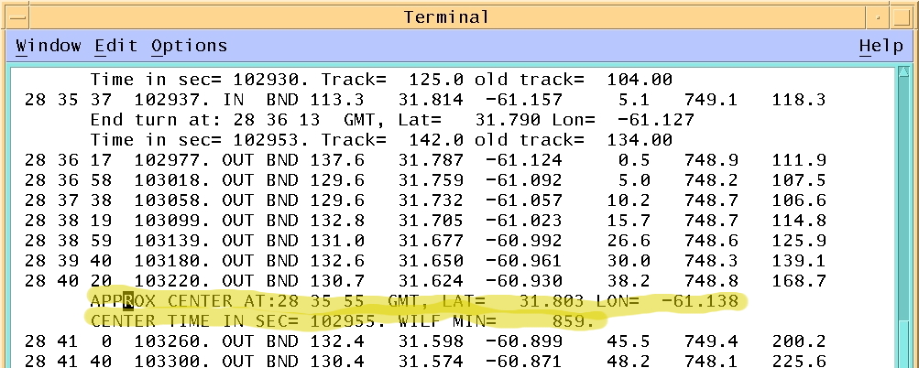
Current method
After any flight where there was a storm center penetration, a scanning program is run on the one-second data. A setup file is created of first-guess center fixes and pass start and end times.

Slide 28
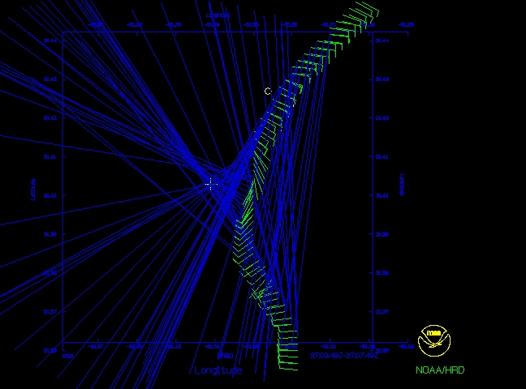
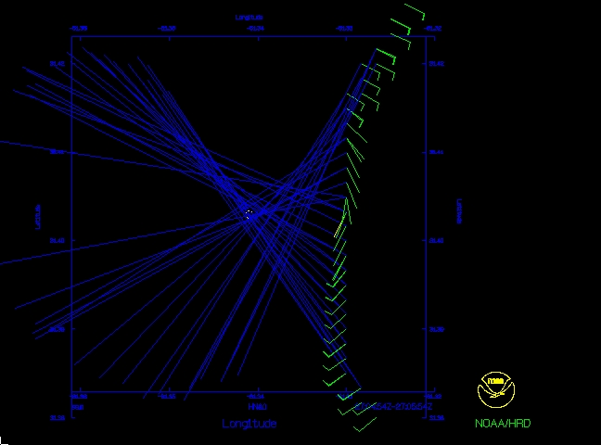
Current method
The objective program is far from perfect. Each center fix is checked and refined subjectively. Erroneous fixes are rejected and any missed wind centers may be added.

Slide 29
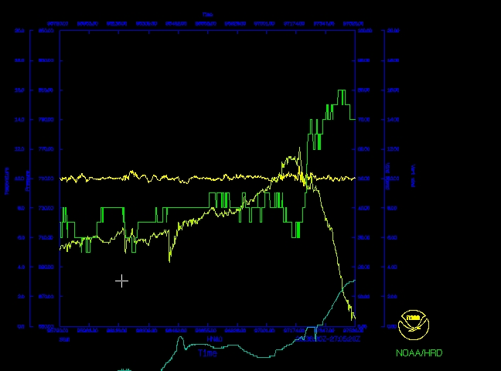
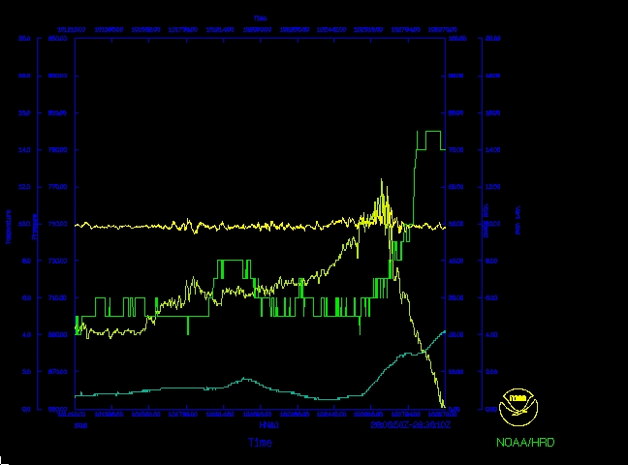
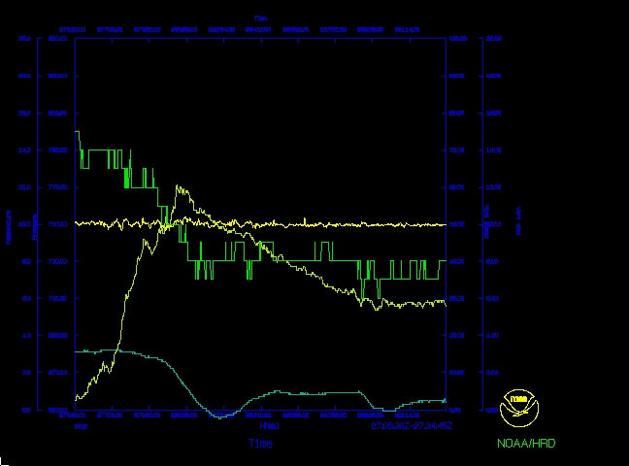
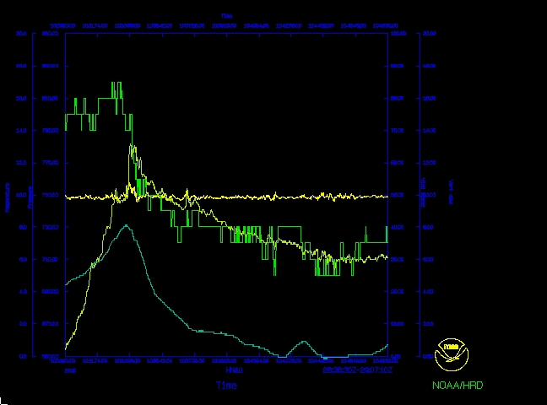
Current method
pass start and end times are adjusted to exclude orbits in the eye and any large altitude excursions.

Slide 30
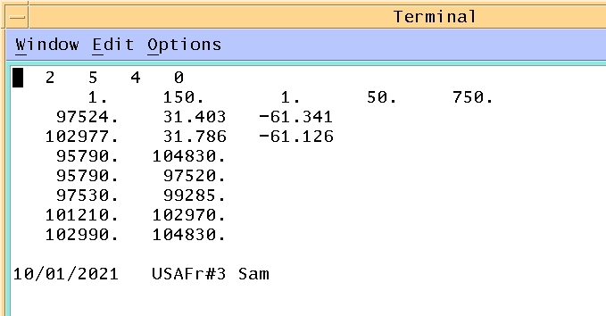
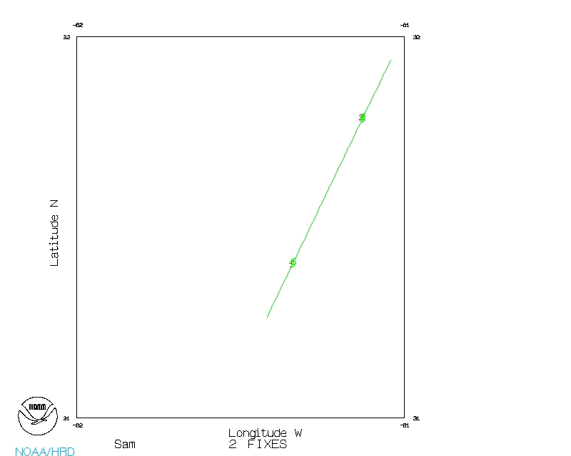
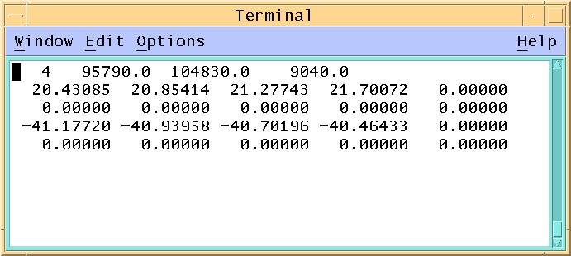
Current method
The resulting setup file is saved and a track (of up to 20 splines) is made from it. Each mission has an individual wind center and track file that can be used exclusively for that mission’s data. These files are archived on thor3.

Slide 31
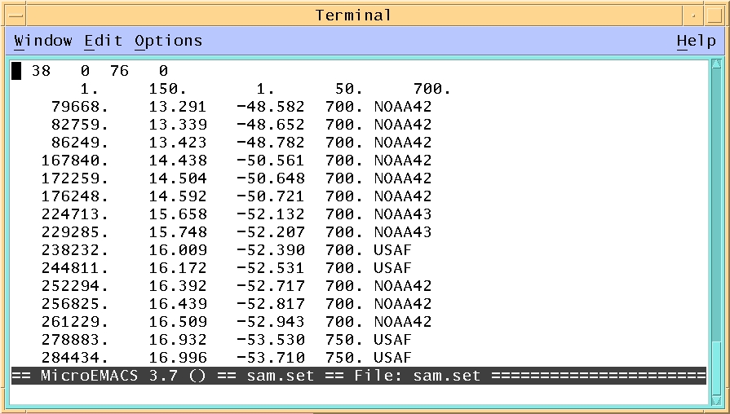
Current method
Once all penetrating missions for a storm are processed, a larger setup file is created from all the storm fixes.

Slide 32
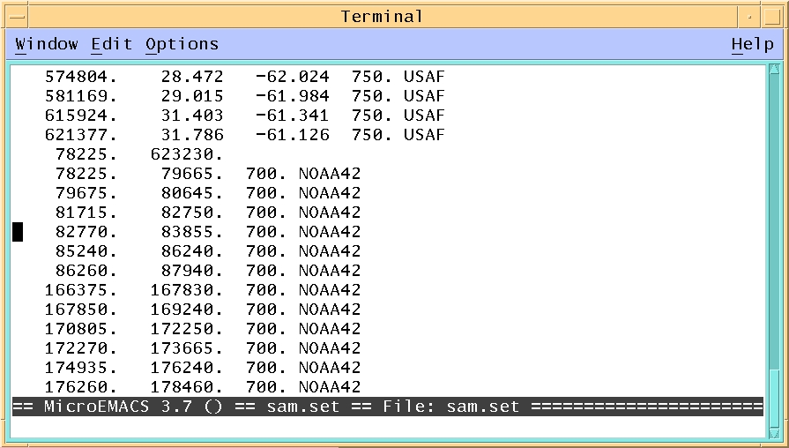
Current method
And all of the start and end times of each pass in and out of the eye are listed along with altitude and source aircraft. All time are relative to 00z of the date of the first aircraft mission.

Slide 33
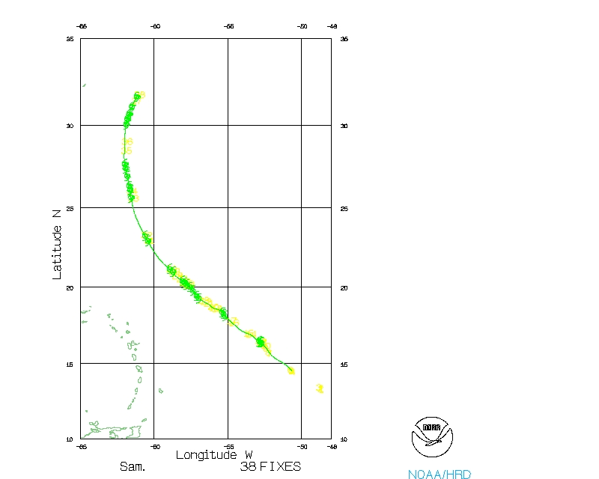
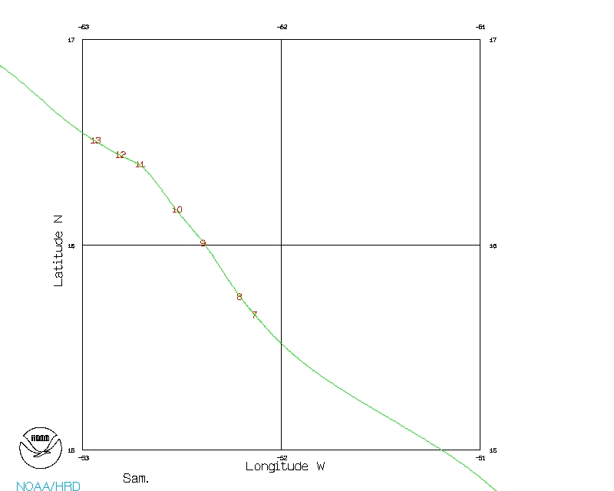
Current method
Since the number of fixes for the storm would be too large for a single 20-spline track, the track is created by fitting each set of 3 or 4 fixes to a spline curve ...

Slide 34
Current method
Since the number of fixes for the storm would be too large for a single 20-spline track, the track is created by fitting each set of 3 or 4 fixes to a spline curve then stringing these smaller curves together.

Slide 35
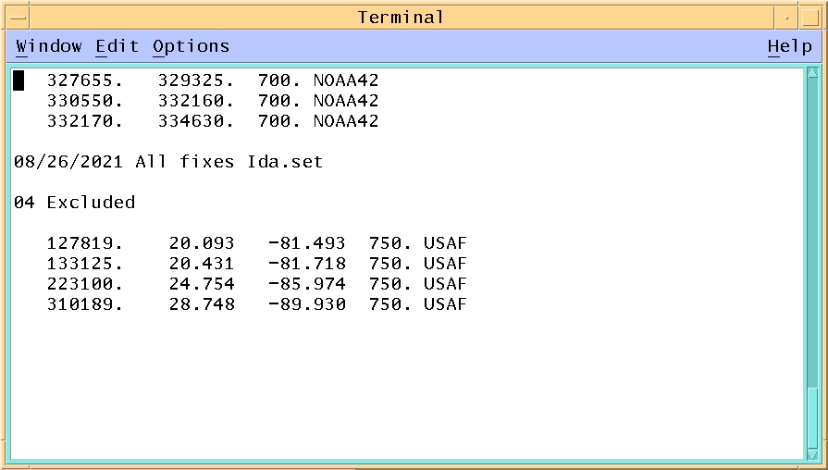
Current method
At this point it may be found there are conflicts between fixes from different missions. This may be due to different altitudes or being too close in time. Fixes may be excluded from the final track.

Slide 36
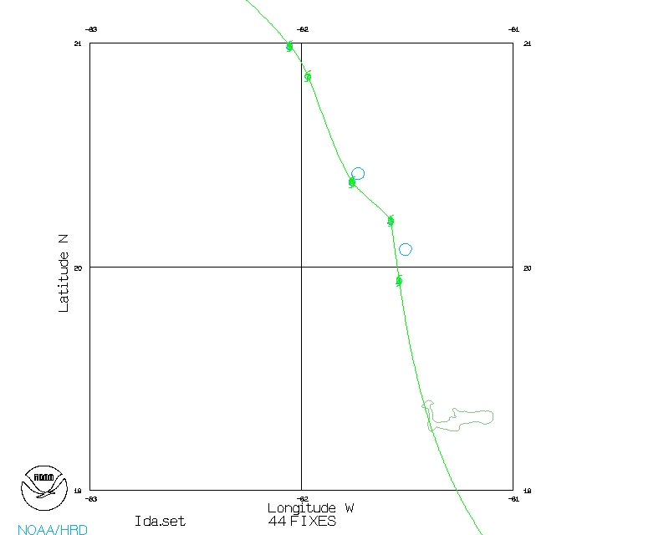
Current method
At this point it may be found there are conflicts between fixes from different missions. This may be due to different altitudes or being too close in time. Fixes may be excluded from the final track.

Slide 37
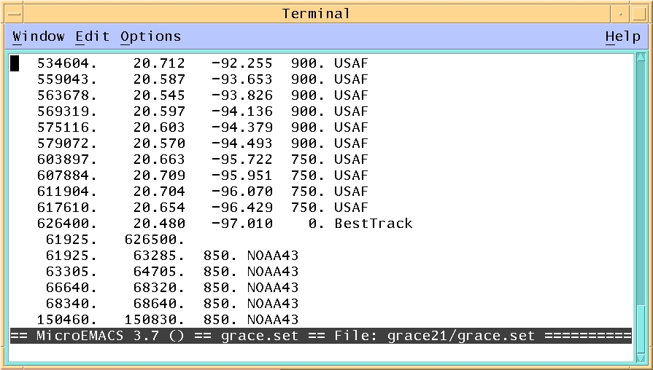
Current method
Also points may be added. If There is a large time gap between missions, best track fixes could be added. Also landfall points may be added to constrain the track.

Slide 38
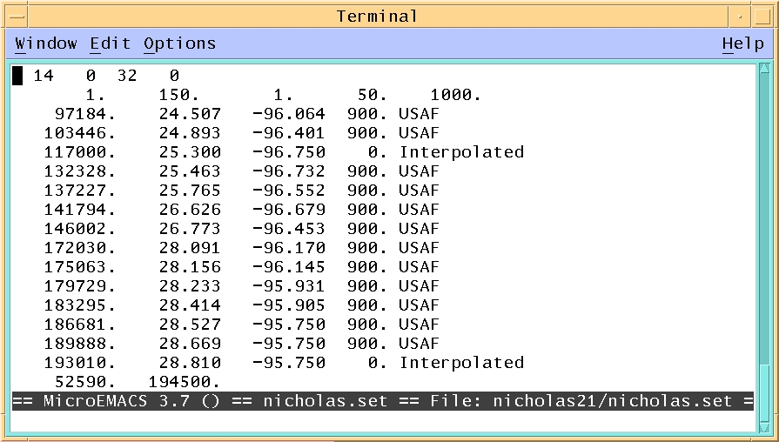
Current method
Interpolated points may be inserted to help define complicated loops or turns.

Slide 39
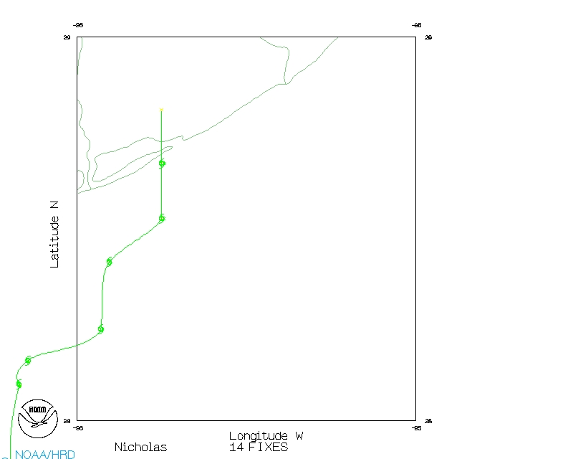
Current method
Interpolated points may be inserted to help define complicated loops or turns.

Slide 40
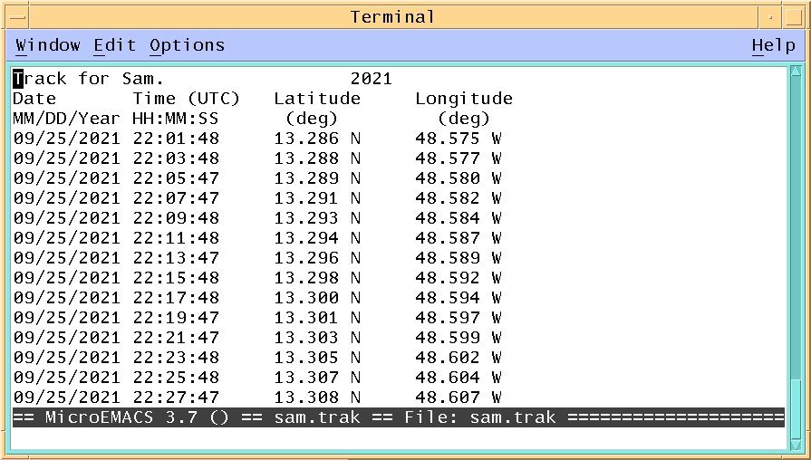
Current method
the position of the wind center track is then output at two-minute intervals. The position precision is the thousandths of a degree ±.1km or ± .06 nautical miles

Slide 41
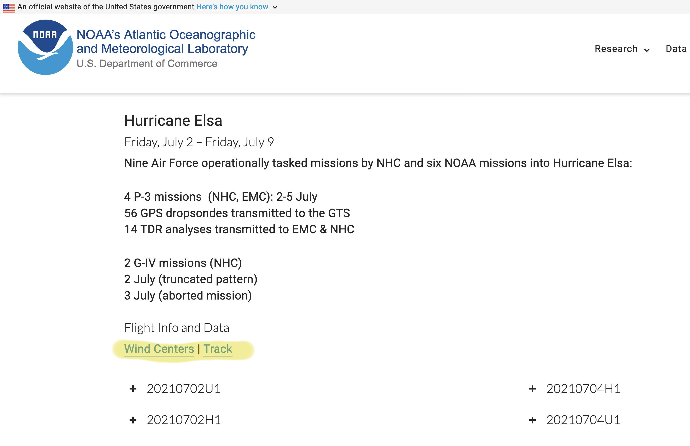
Current method
the wind centers and track files are archived on our data portal and then linked to the storm’s top section on the main hurricane field program data page.

Slide 42
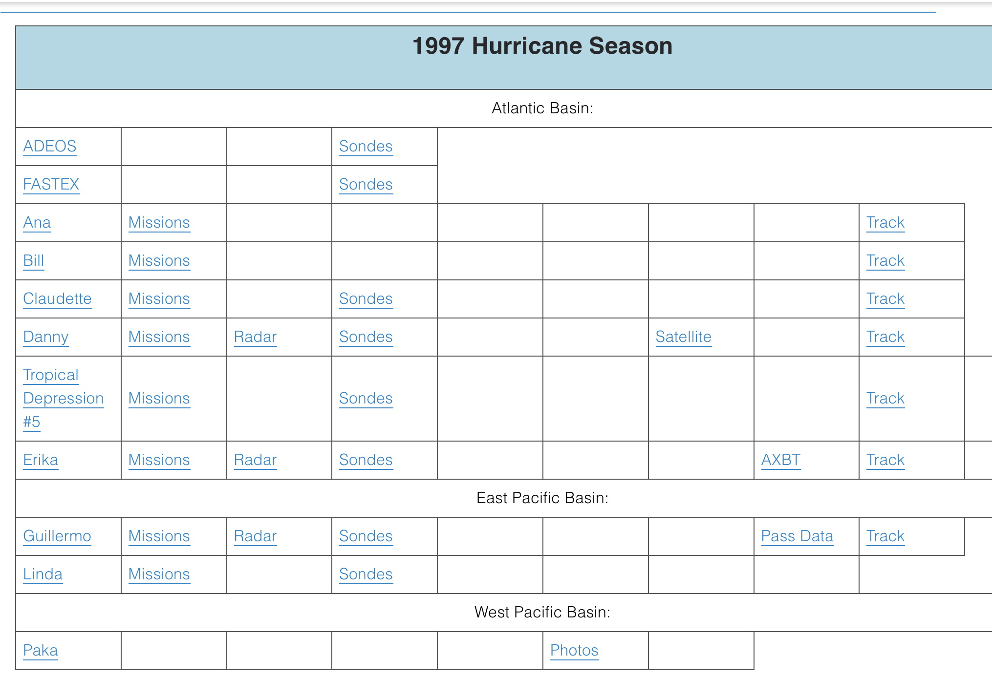
Current method
Currently, wind centers and track files are available for hurricane season 1997-2022. Work has started on the 2023 season.

Slide 43
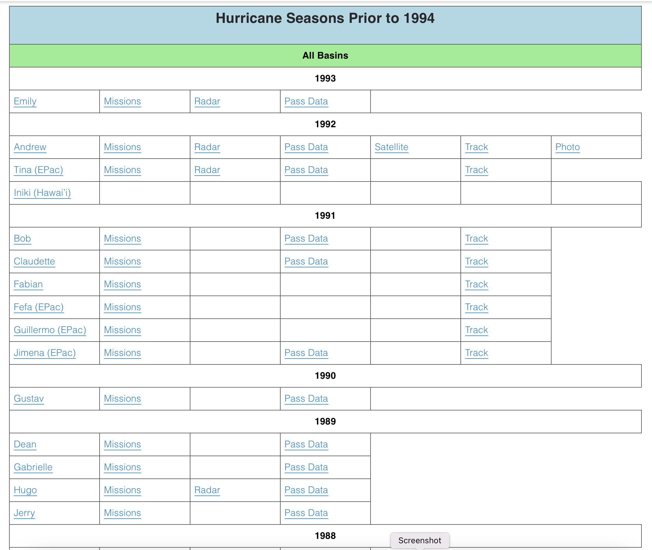
Current method
backfilling is continuing for storms prior to 1997. For some important storms such as Andrew, tracks and fixes were prioritized. Some previous storms are part of the Willoughby-Rahn database.

Slide 44
wind Centers vs. Ops fixes
For the 2020 season, due to COVID restrictions, there was a delay in making the one-second data available. As a stop-gap measure, operational fixes were used to create the wind Center tracks for several storms. When the one-second data became available these tracks were replaced. However, this left a data set of operational fixes that could be compared to the refined wind centers.

Slide 45
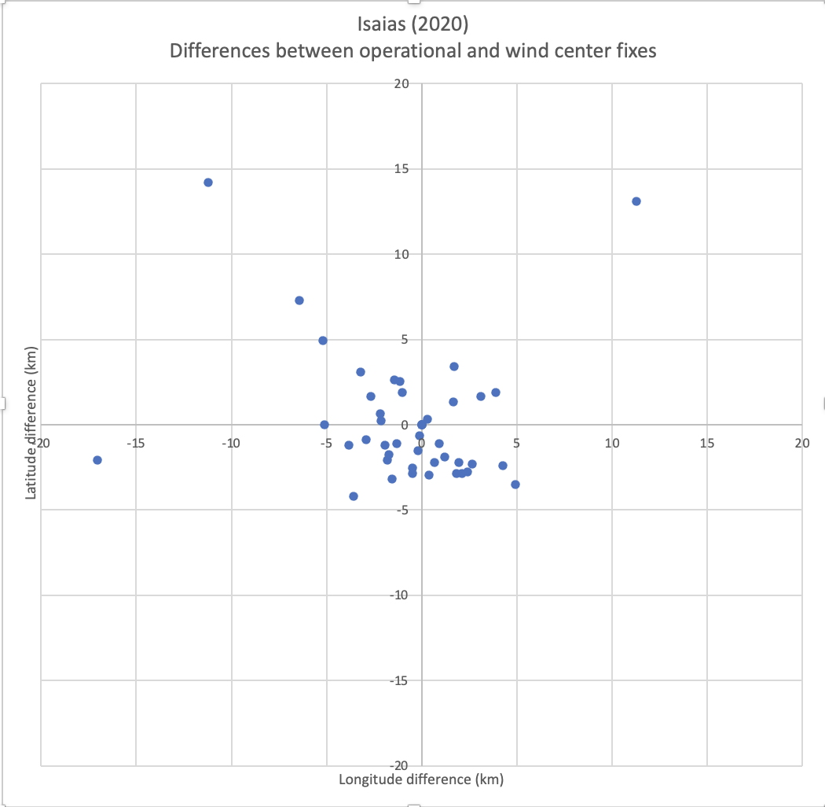
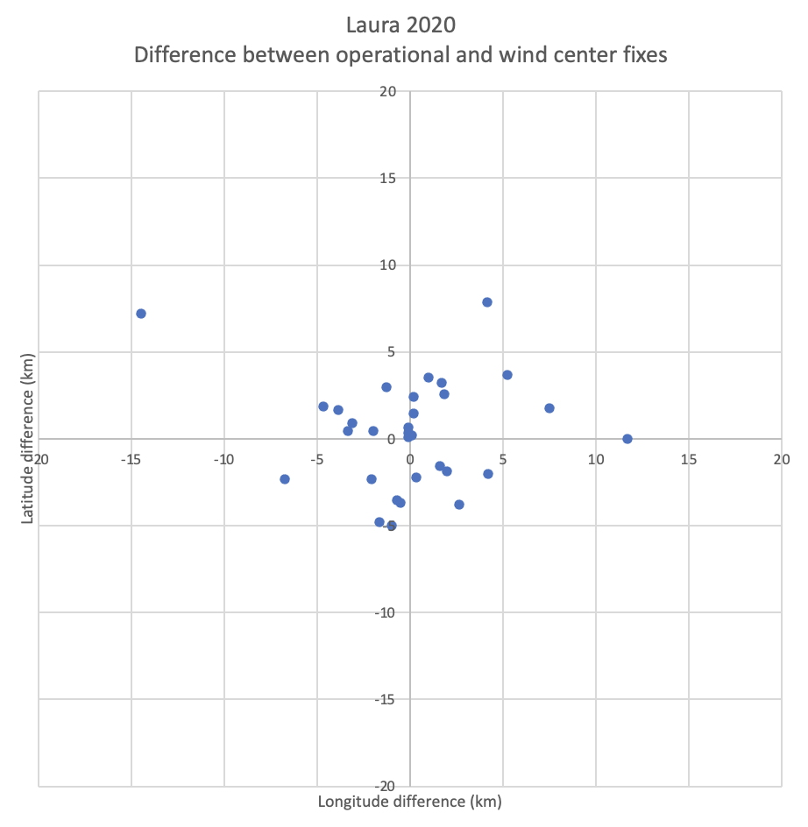
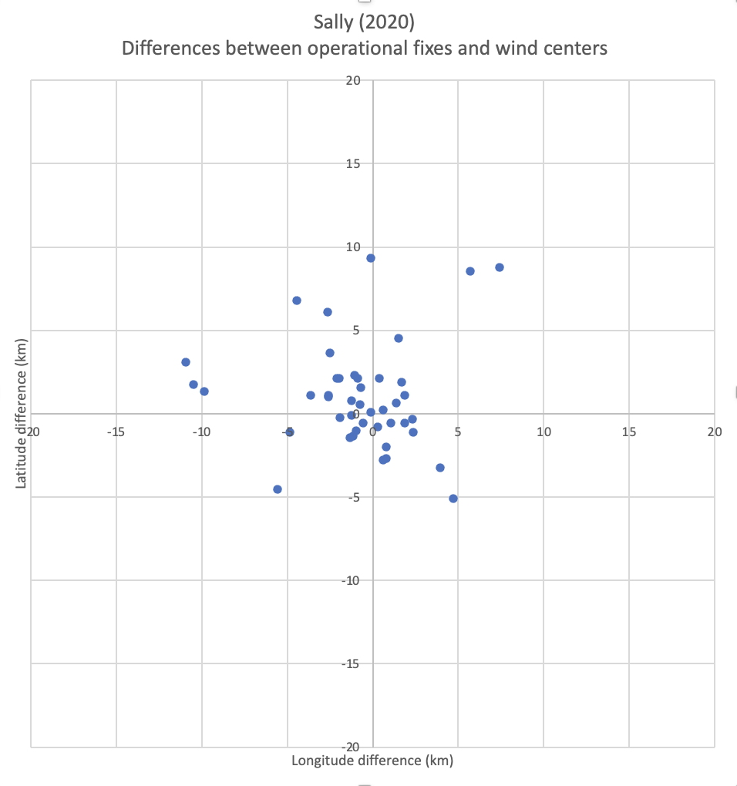
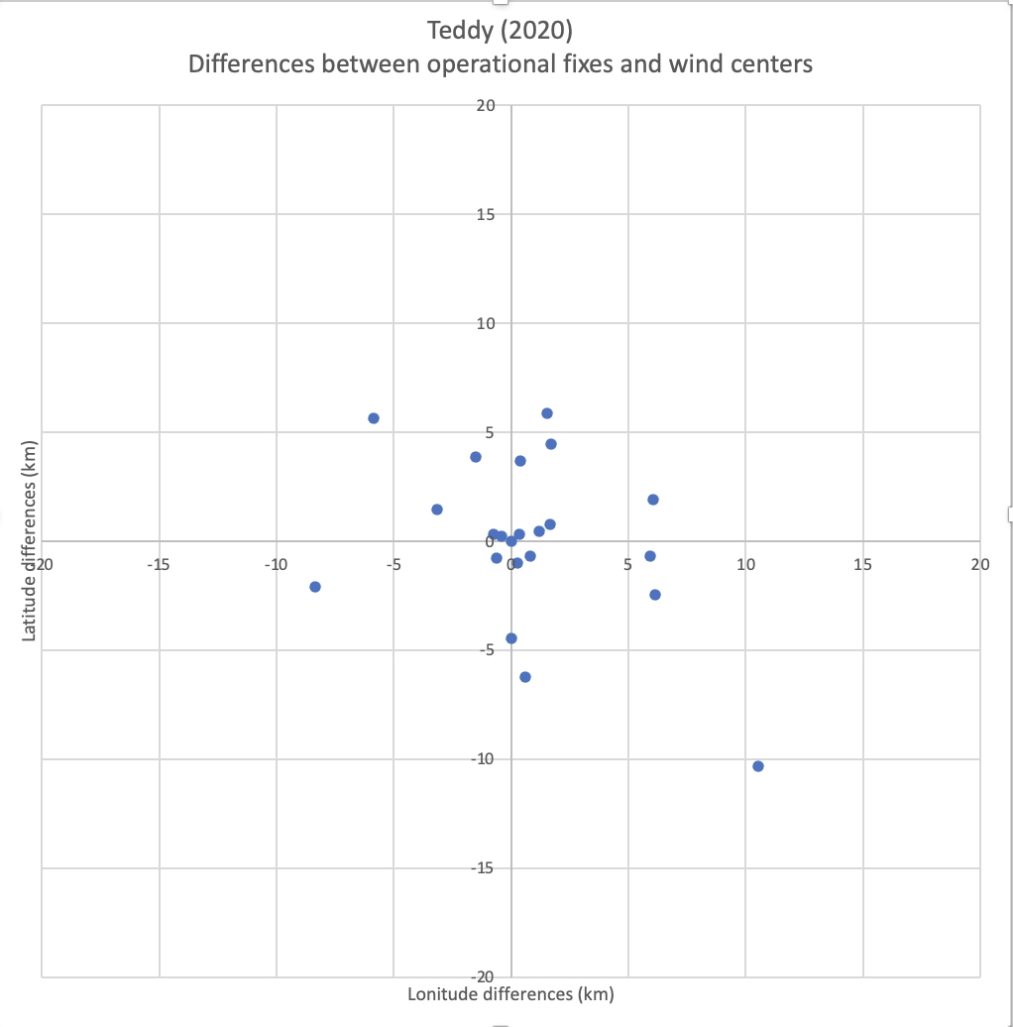
wind Centers vs. Ops fixes
For the 2020 season, the operational fixes were compared to the wind Centers for several storms. Most were within 10 km of each other.

Slide 46
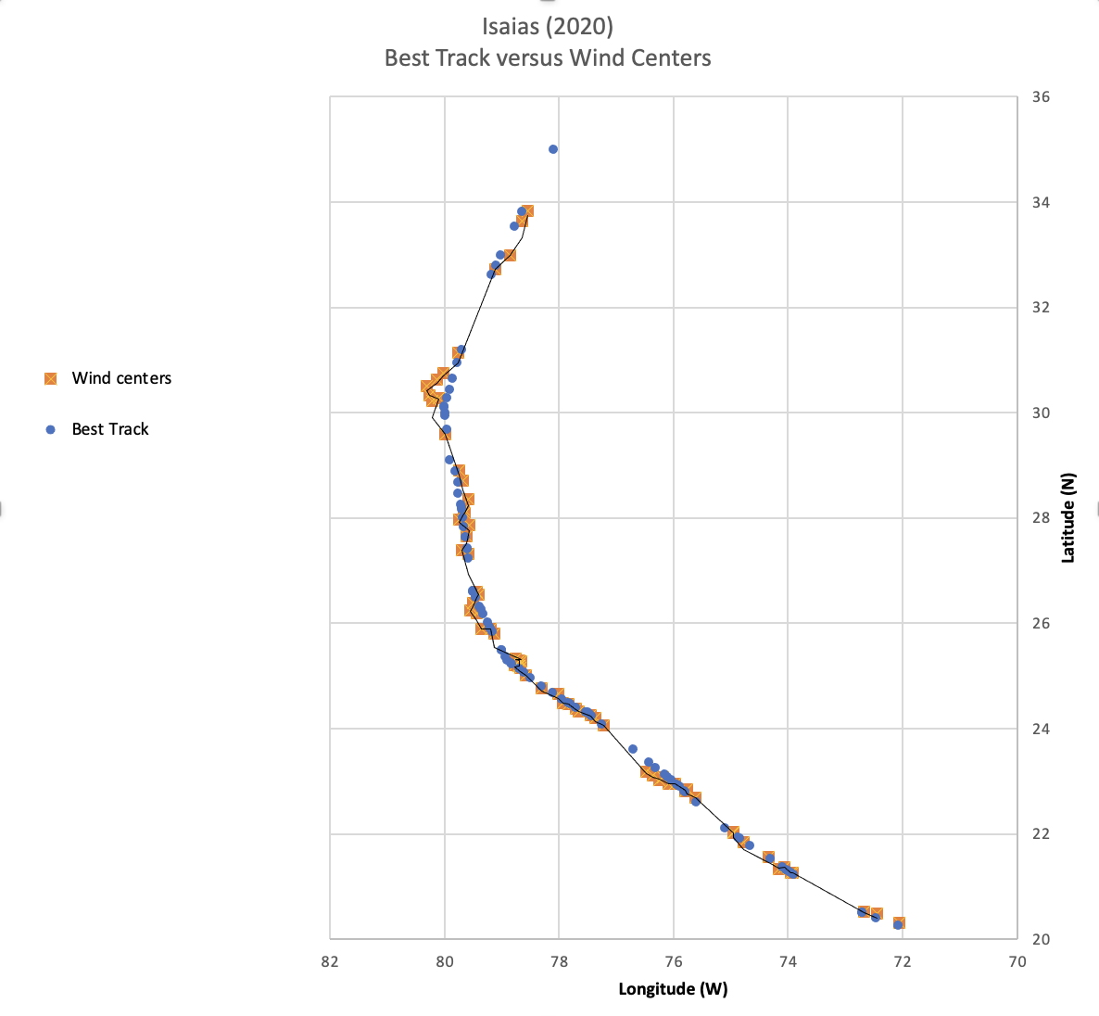
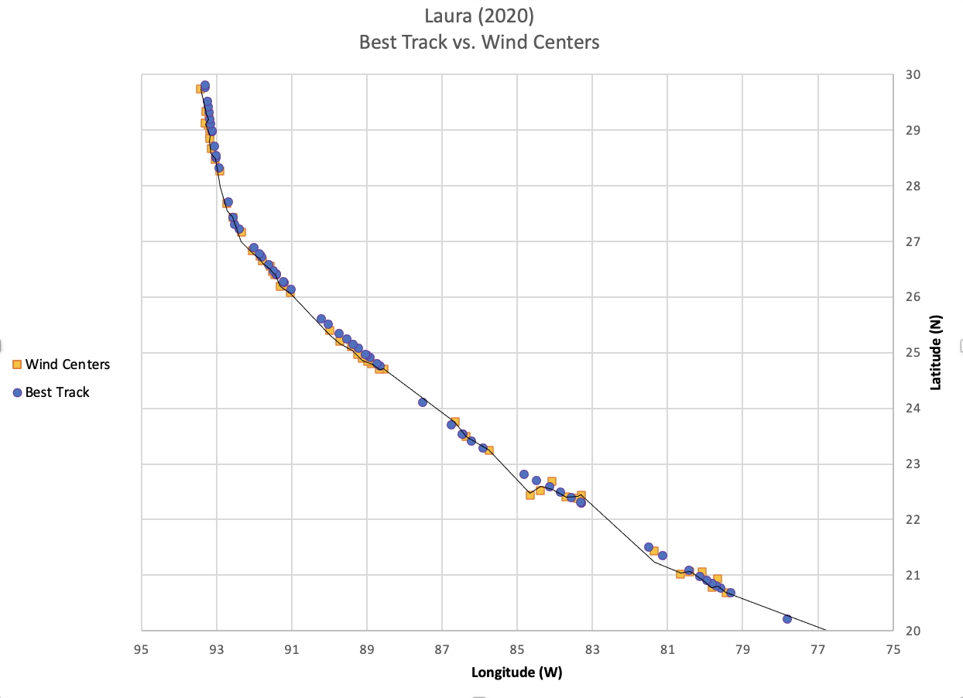
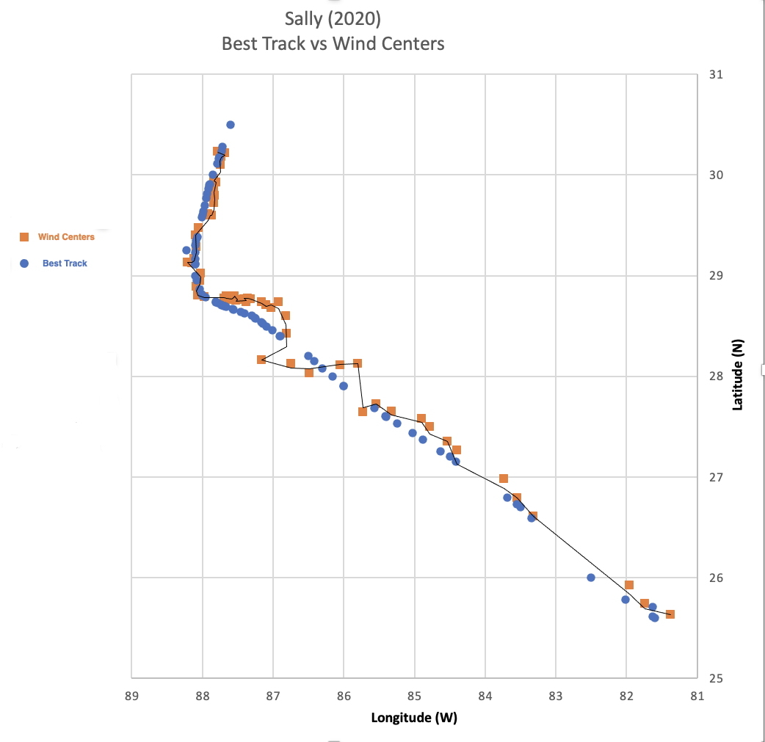
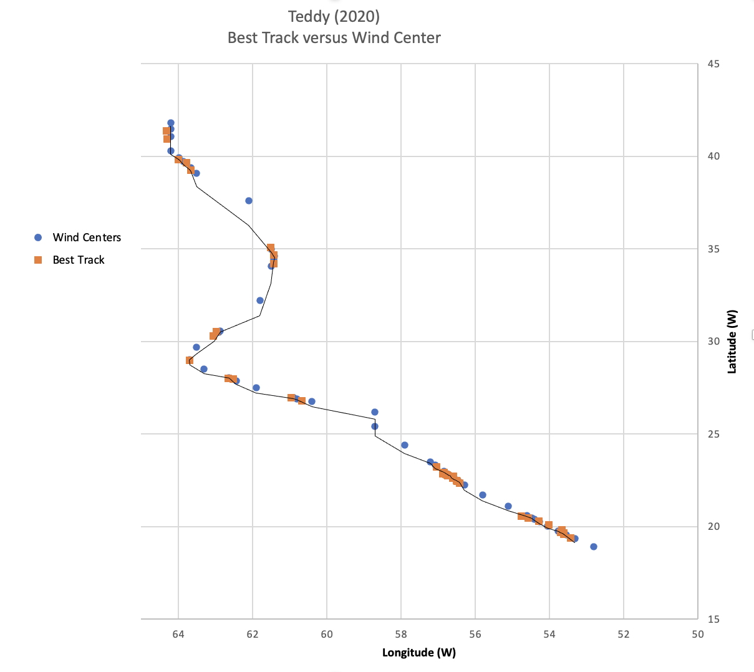
wind Centers vs. Best Track
For these storms, the Best Tracks were compared to the refined wind Center tracks.

Slide 47
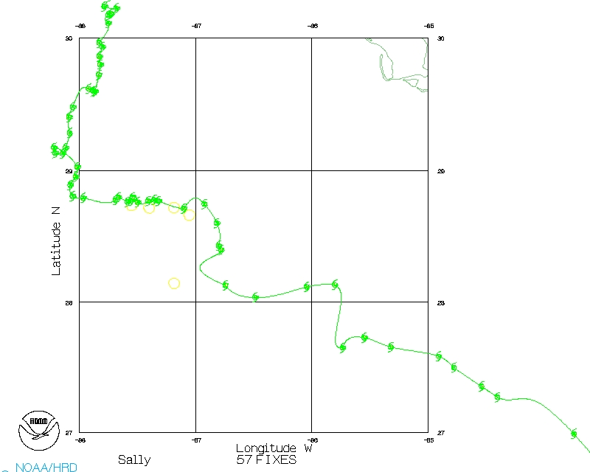
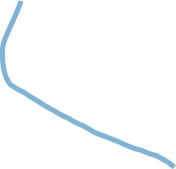
wind Centers vs. Best Track
For these storms, the Best Tracks were compared to the refined wind Center tracks.

Slide 48
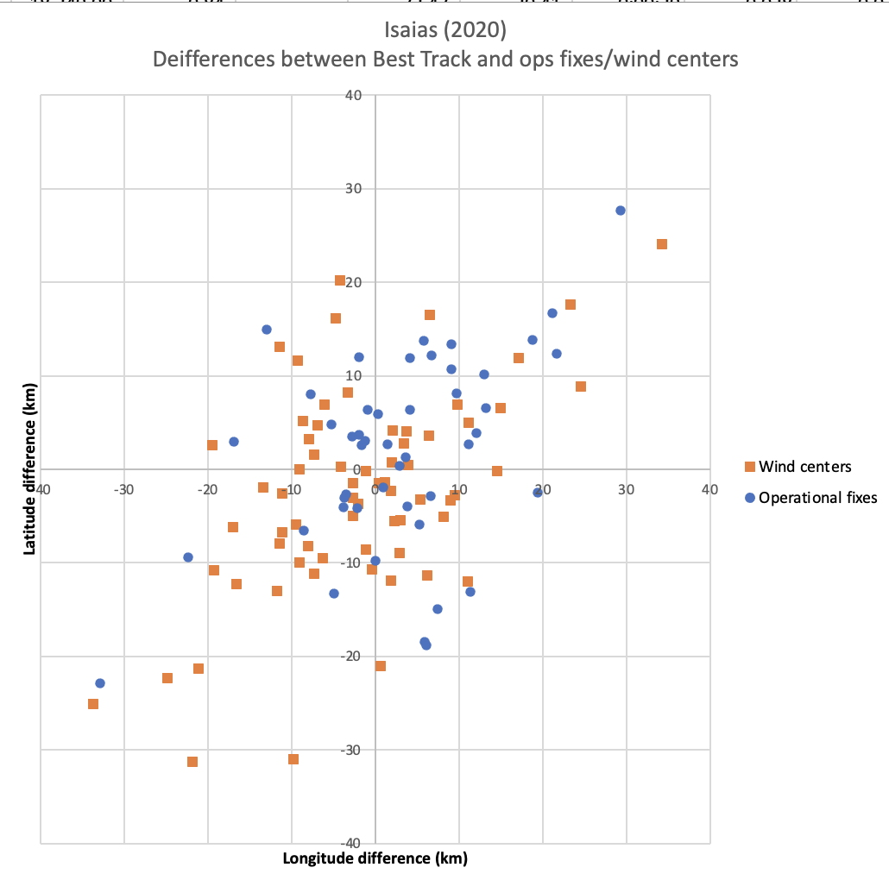
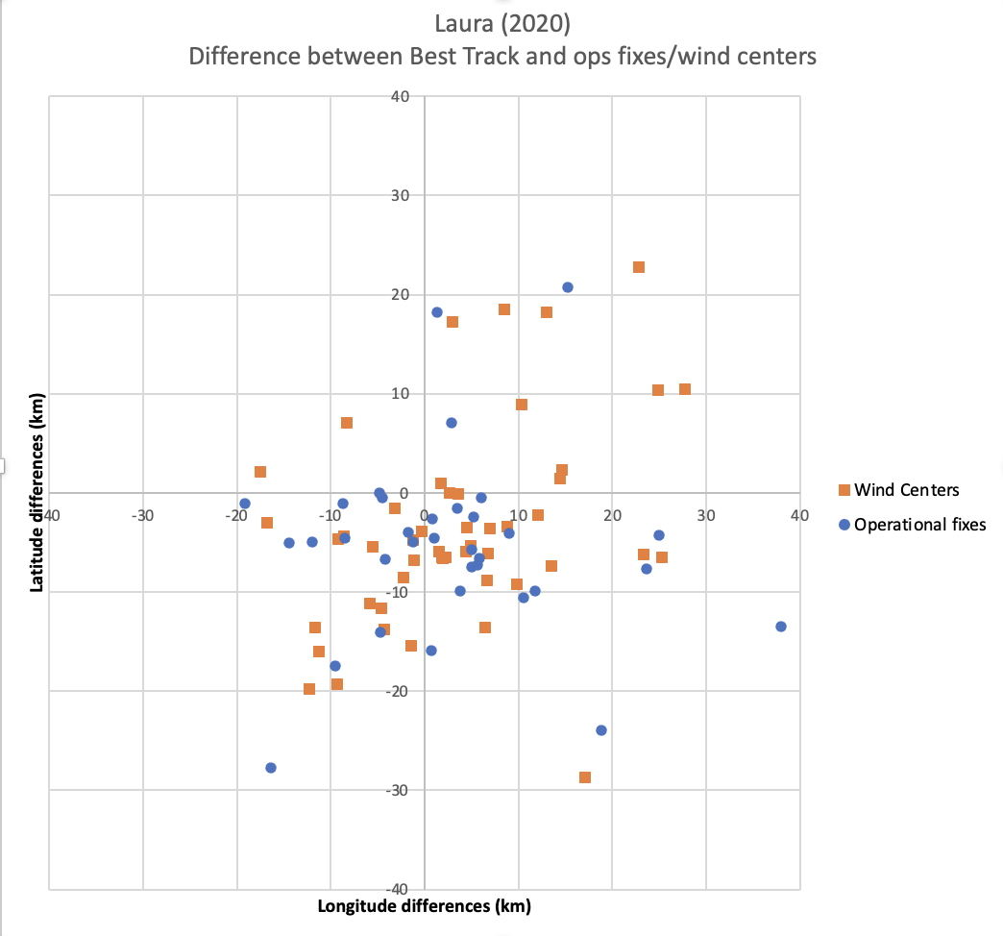


wind Centers vs. Best Track
There was considerably more scatter between Best Tracks and the wind Centers than between operational fixes and refined wind centers.

Slide 49
which track should be used?
Track | Best Track | Wind Center Track
Motion characteristics | Smoothed and Conservative | Loops and trochoidal oscillations
Time resolution | 6 hours | 2 minutes
Position resolution | .1 degree | .001 degree
Best use | Overall storm motion | Aircraft radar, wind field and dropsondes
Repository | HURDAT2 | HRD data portal
Where to find them | https://www.nhc.noaa.gov/data/hurdat/ | https://www.aoml.noaa.gov/ftp/hrd/data/flightlevel/ YEAR/STORM

Slide 50
Questions?

