Slide 1
The History of Aerial Hurricane Reconnaissance and Research
Neal M. Dorst
AOML Hurricane Research Division
Nov. 11, 2024
Museum of Discovery and Science

Slide 2
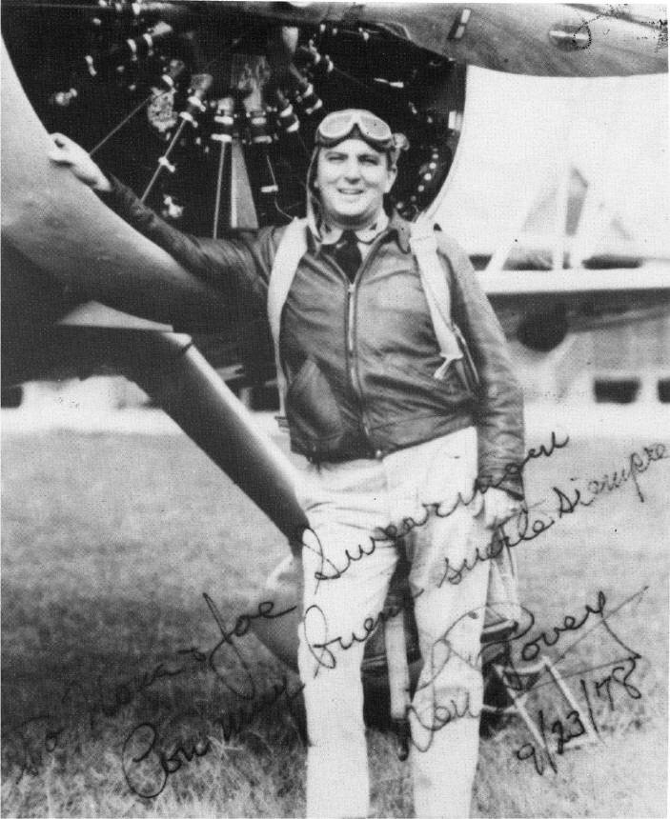
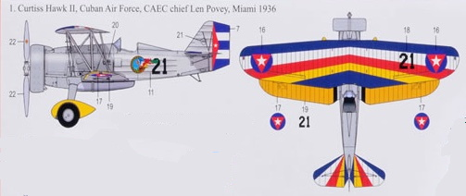
The First Reconnaissance Flight
Infamous Labor Day hurricane 1935
Jacksonville Hurricane Warning Center ‘lost’ hurricane over the Florida Straits
Seen by Pan Am pilot on morning of Sept. 2nd north of where predicted
Capt. Len Povey of Cuban Army Air Corps volunteers to pilot his Curtiss Hawk II around the storm
Warnings issued for the Florida Keys
People with road access flee, lives saved

Slide 3
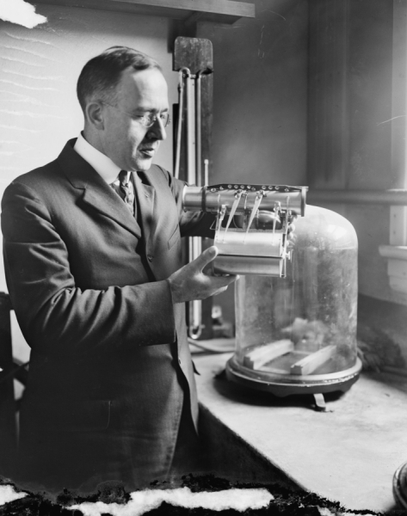
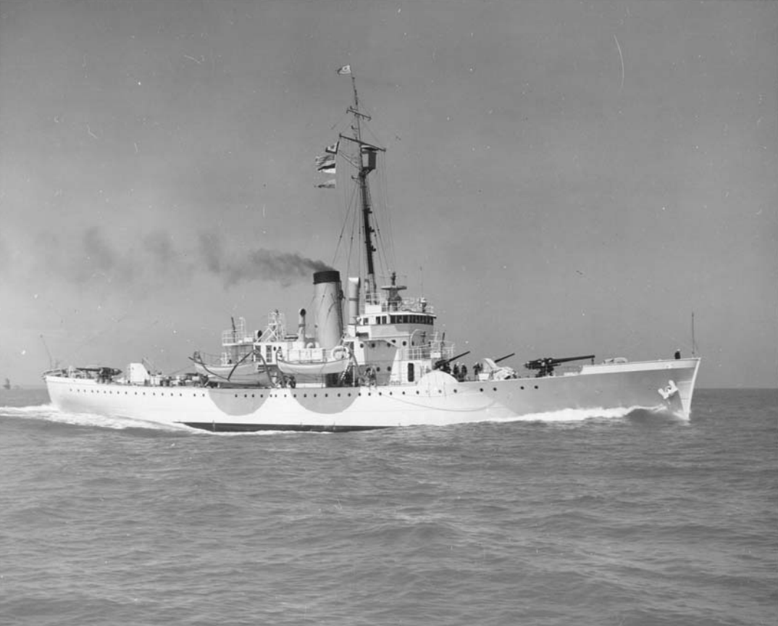
Aerial Reconnaissance proposed
Willis Gregg, Weather Bureau Chief, proposes hiring private pilots to reconnoiter any hurricanes near the U.S.
No budget for the plan
Instead Coast Guard cutters sent in Gulf hurricanes
USCG captains turn back before reaching storm center
Gregg plan never used

Slide 4
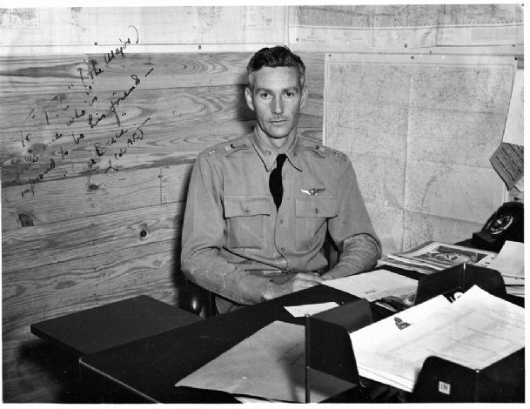
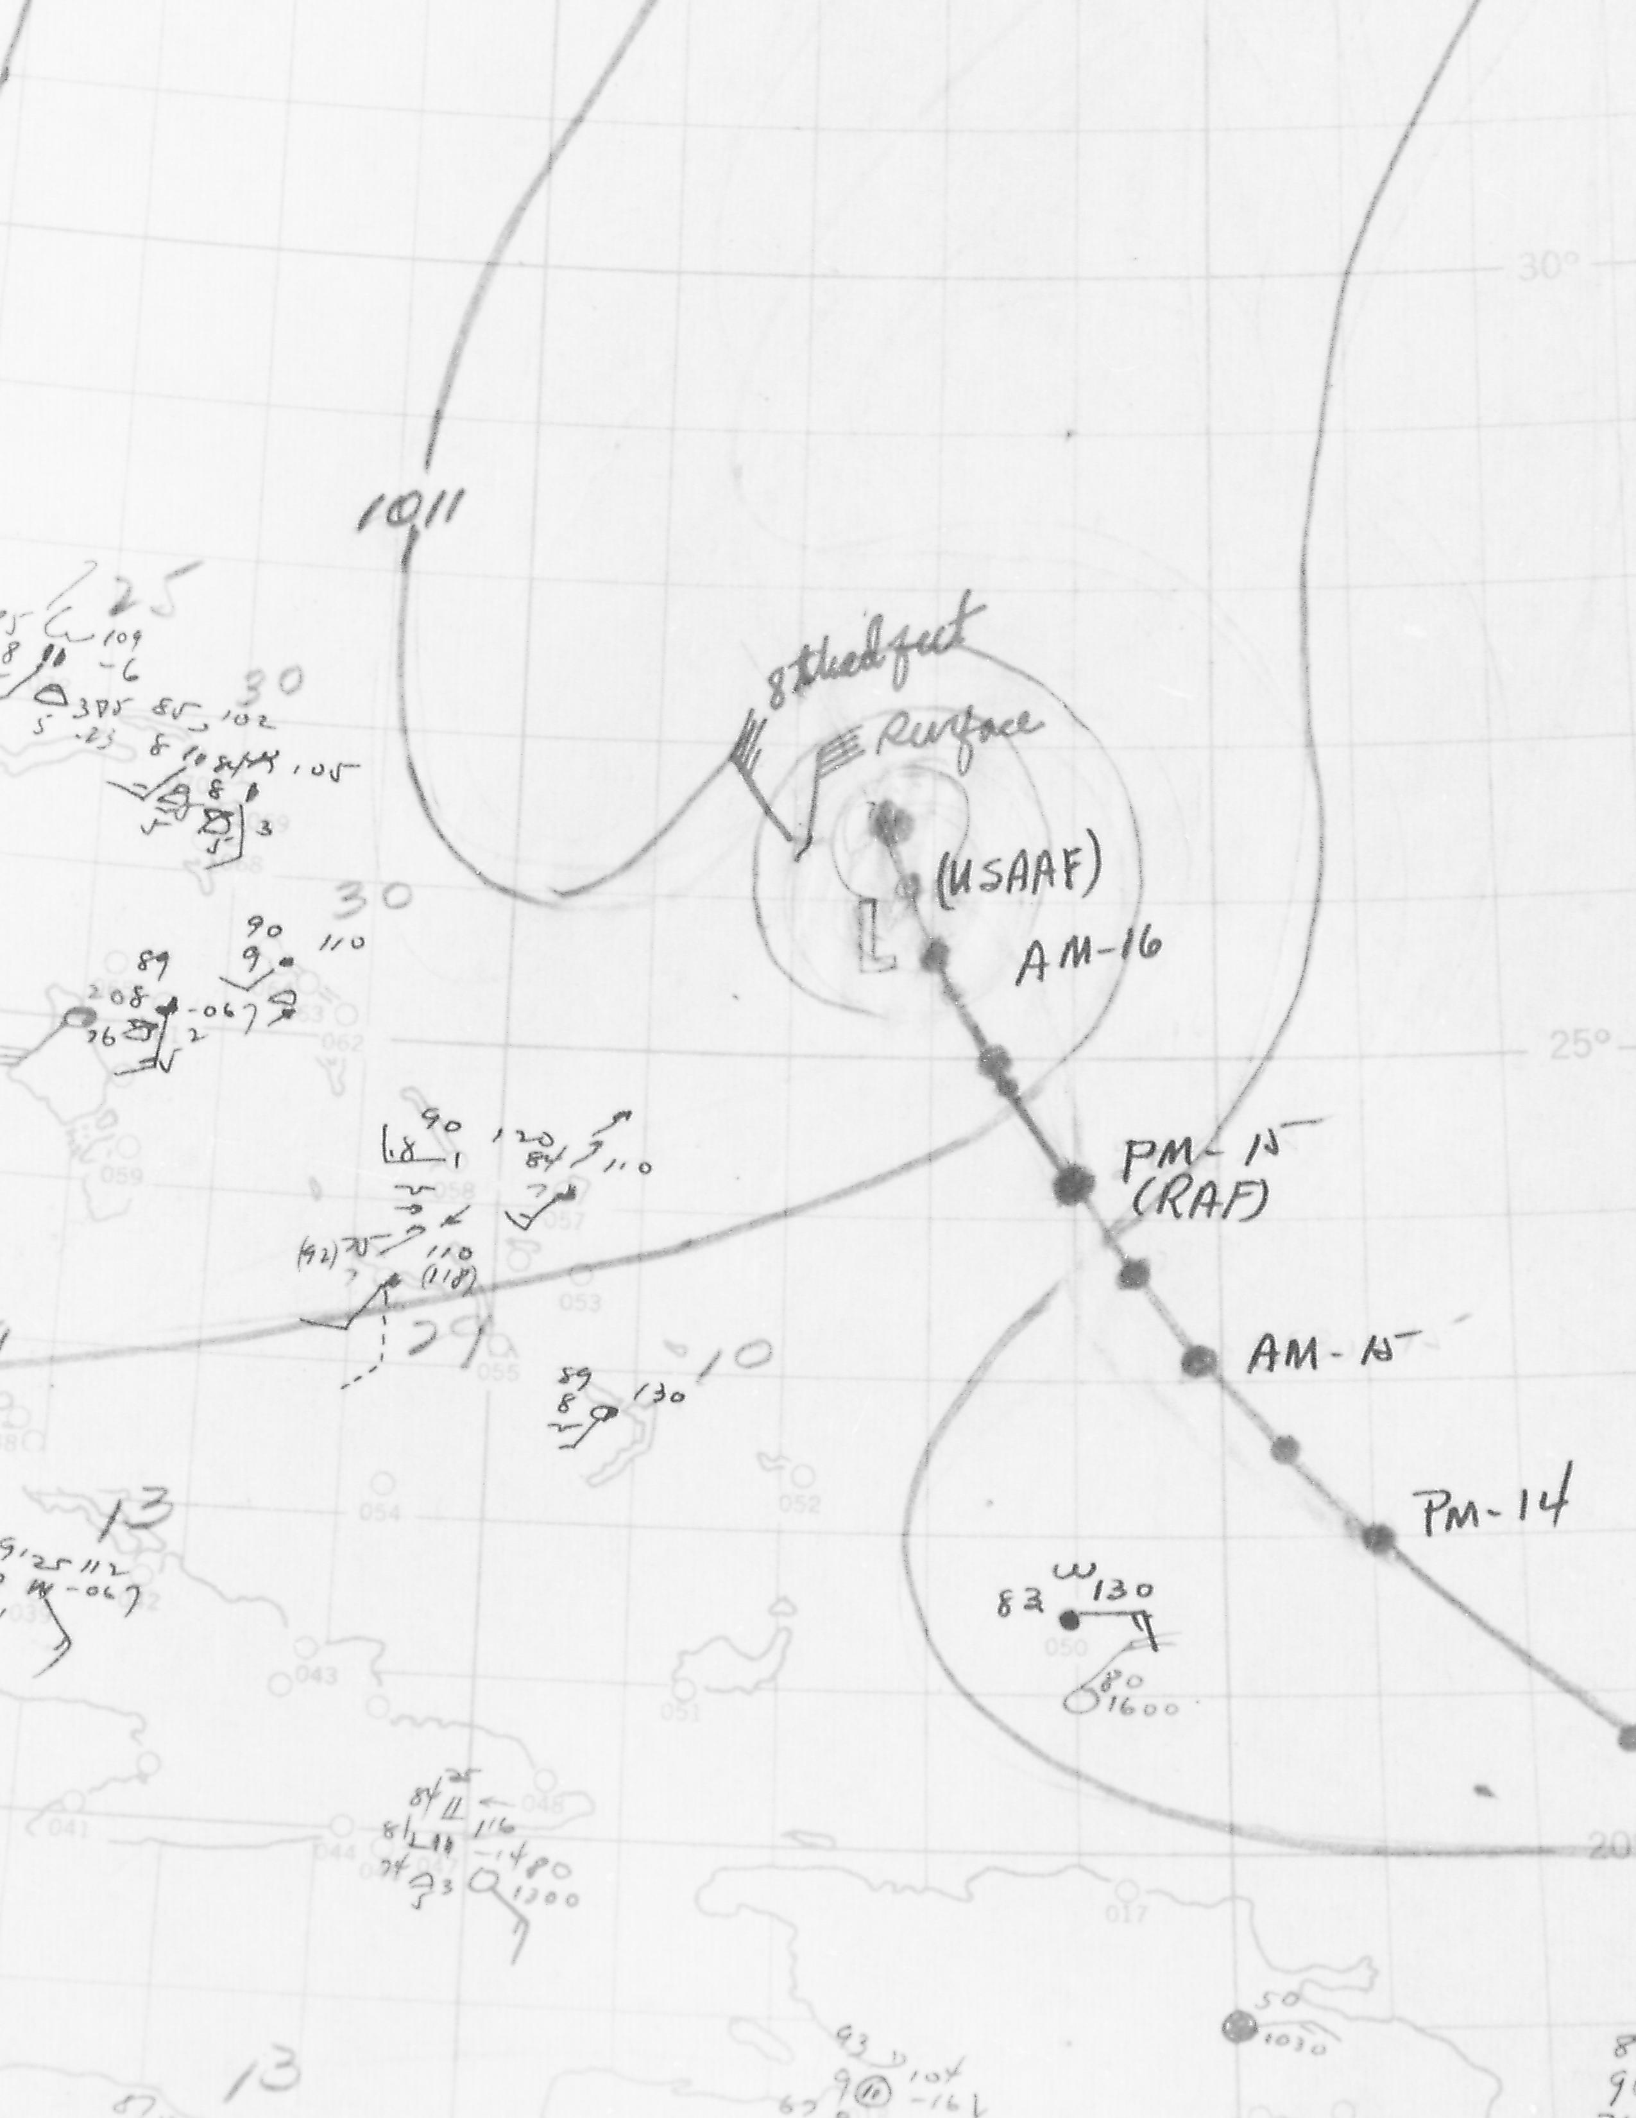
World War II
During the War ships maintain radio silence
No weather reports from sea and hence no hurricane warnings
In 1943, US Weather Bureau reaches agreement with Army and Navy to send patrol planes out to hunt for hurricanes
In July 1943, a ‘surprise’ hurricane strikes Galveston. Lt. Col. Joe Duckworth flies AT-6 plane into the eye of a hurricane over Texas
  First eye penetration
  Not authorized reconnaissance
In August 1943, first tasked reconnaissance flight into a hurricanes occurs over the Bahamas.

Slide 5
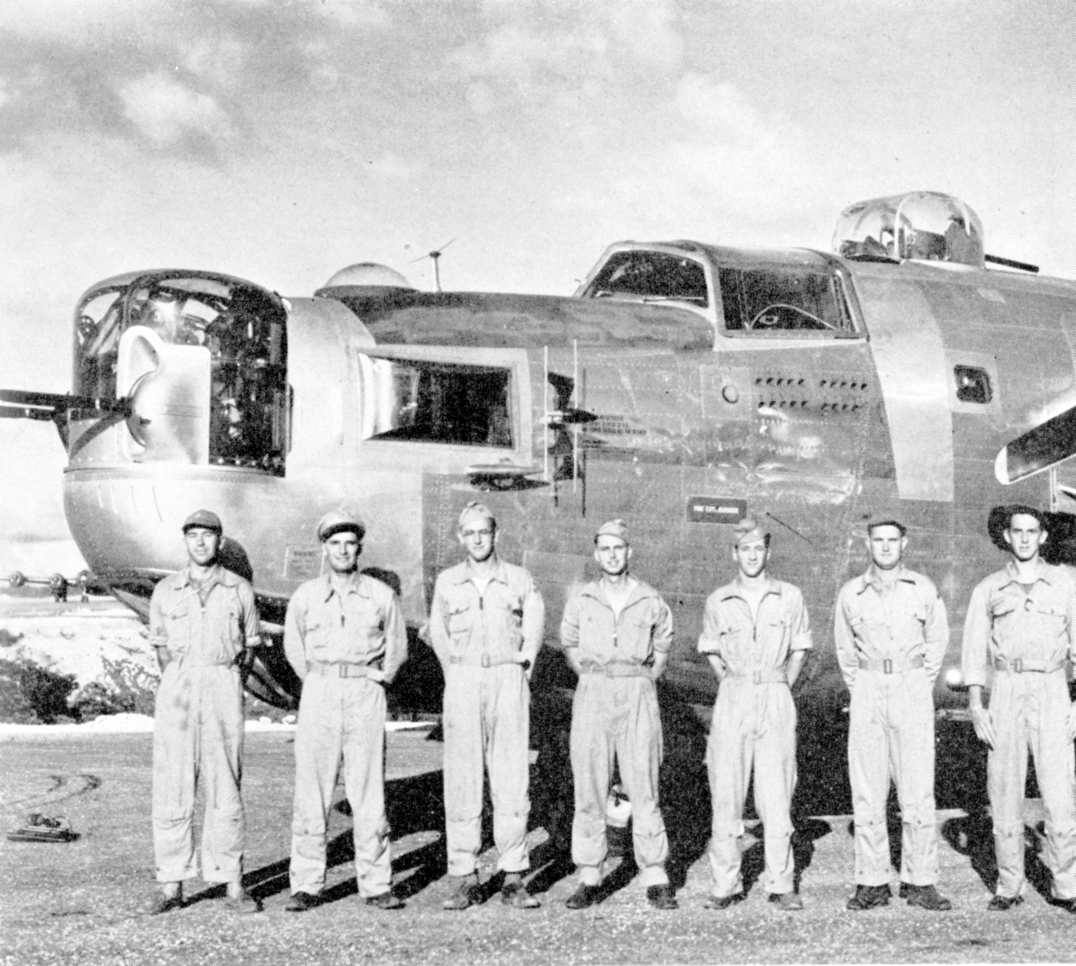

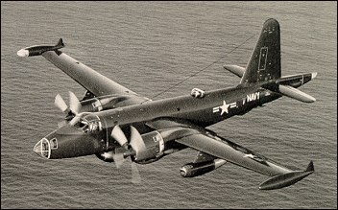
Post World War II
Army and Navy form weather patrol squadrons around the globe
Designate their Atlantic patrol squadrons Hurricane Hunters and west Pacific squadrons Typhoon Trackers and Typhoon Chasers
Develop techniques for locating eye of the storm and estimating wind speeds by appearance of the sea surface
Vastly improve tracking and warning time of approaching storms
Several aircraft and crews lost in storms

Slide 6
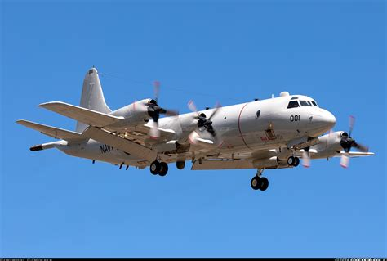
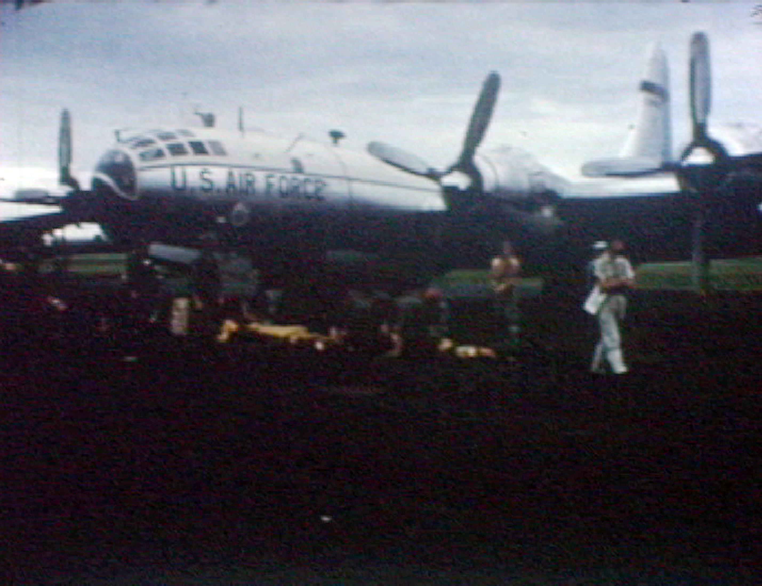
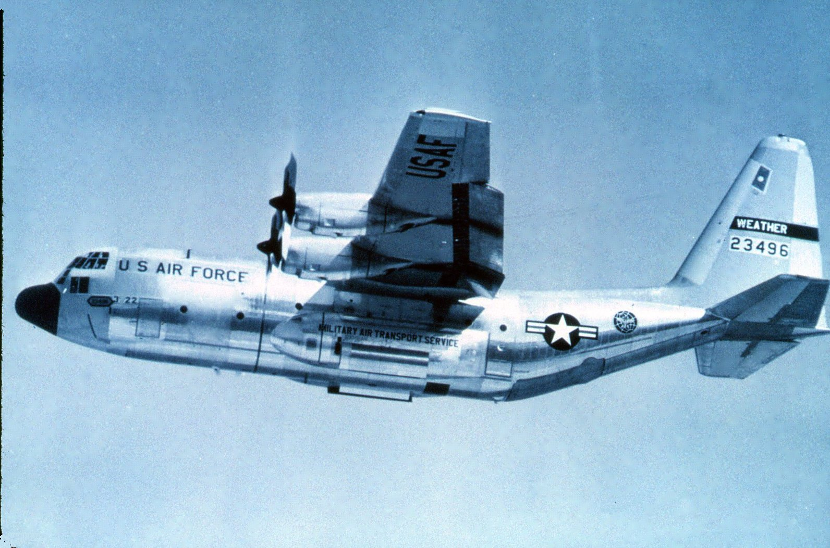
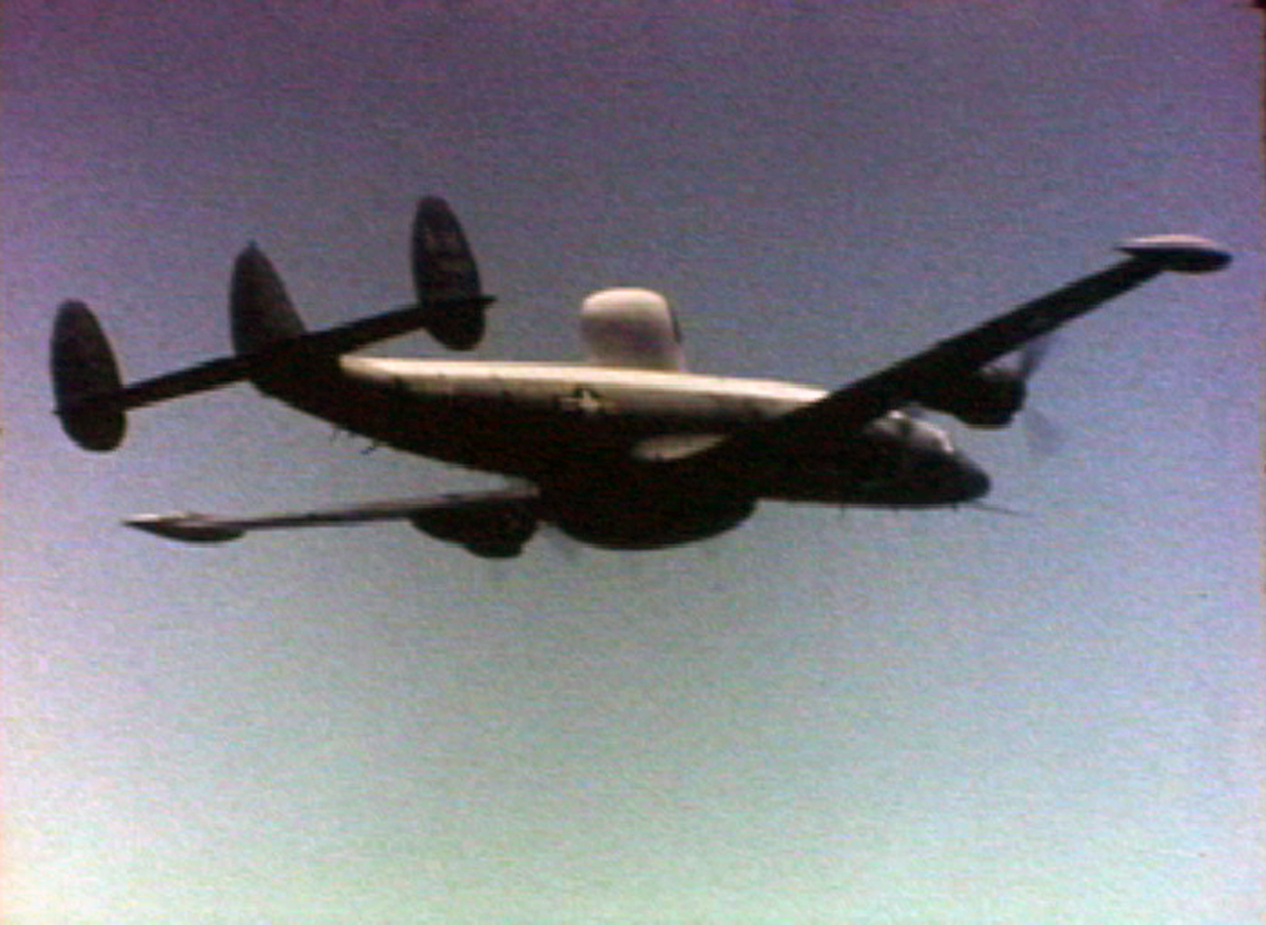
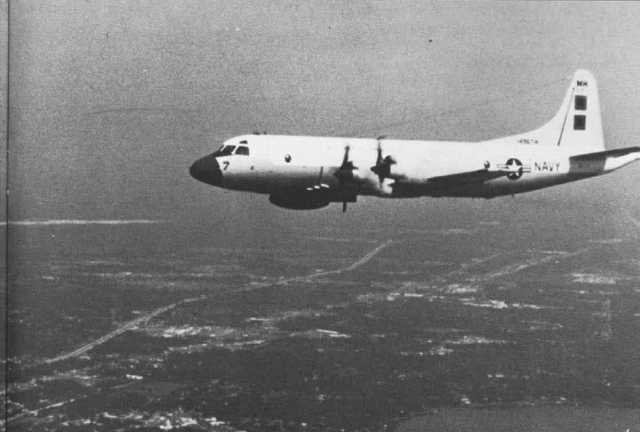
Reconnaissance aircraft
Older airframes, repurposed cargo and patrol planes
Air Force
  WB-29 Superfortress
  WB-50 Superfortress
  WC-130 Hercules
Navy
  P-2V Neptune
  WC-121 Super Constellation
  WP-3 Orion

Slide 7
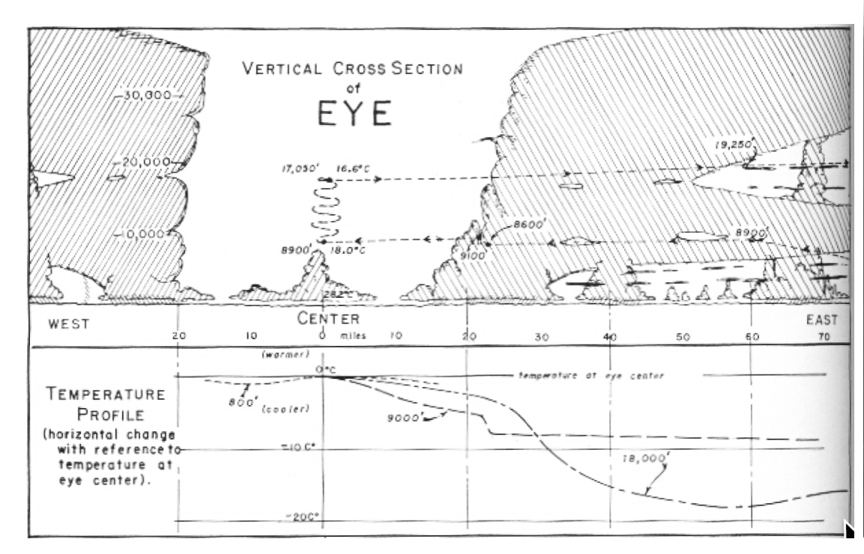
Bob Simpson ‘piggybacks’ on recco flights
Robert H. Simpson instructor at Army Air Force weather school in Panama
Students ‘fly their forecast’ on radar-equipped DC-3
Simpson flies into hurricane south of Hispañola on DC-3, able to examine the storm in detail
Begins to advocate using reconnaissance flights to gather scientific data
In 1950, flies on special Air Force flight into Typhoon Marge

Slide 8
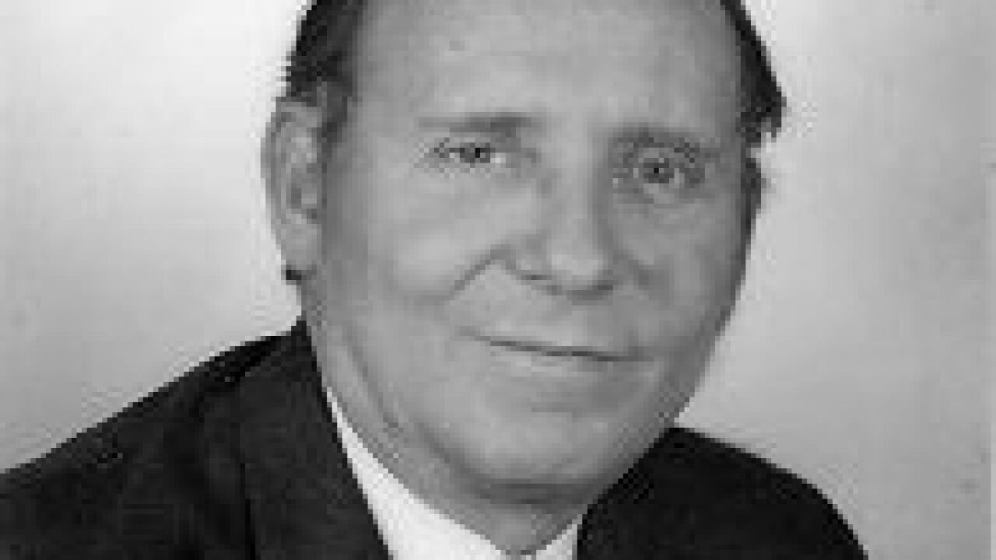
Bob Simpson ‘piggybacks’ on recco flights
Simpson continues ‘piggyback’ flights on recon missions on his personal time
Develops a plan to carry out research on hurricanes using aircraft.
No money in budget for research

Slide 9
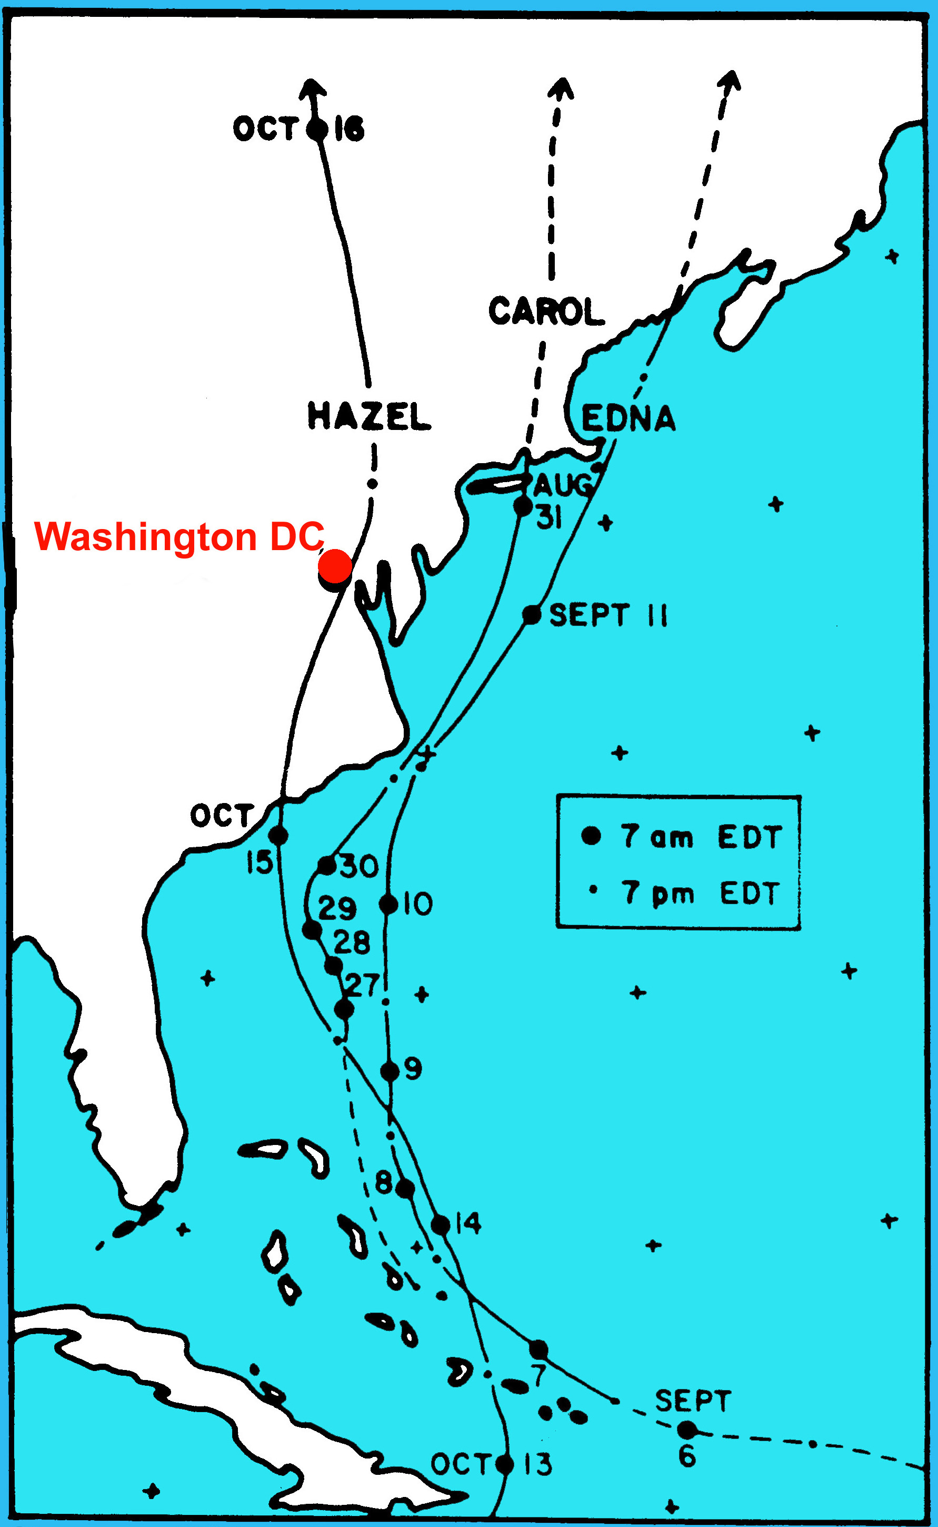
Disasters spur action
1954 hurricanes Carol, Edna, and Hazel bring disaster to U.S. east coast especially New England
Congress spurred to action by angry public, increases budget of Weather Bureau to begin National Hurricane Research Project
Bob Simpson appointed first director

Slide 10
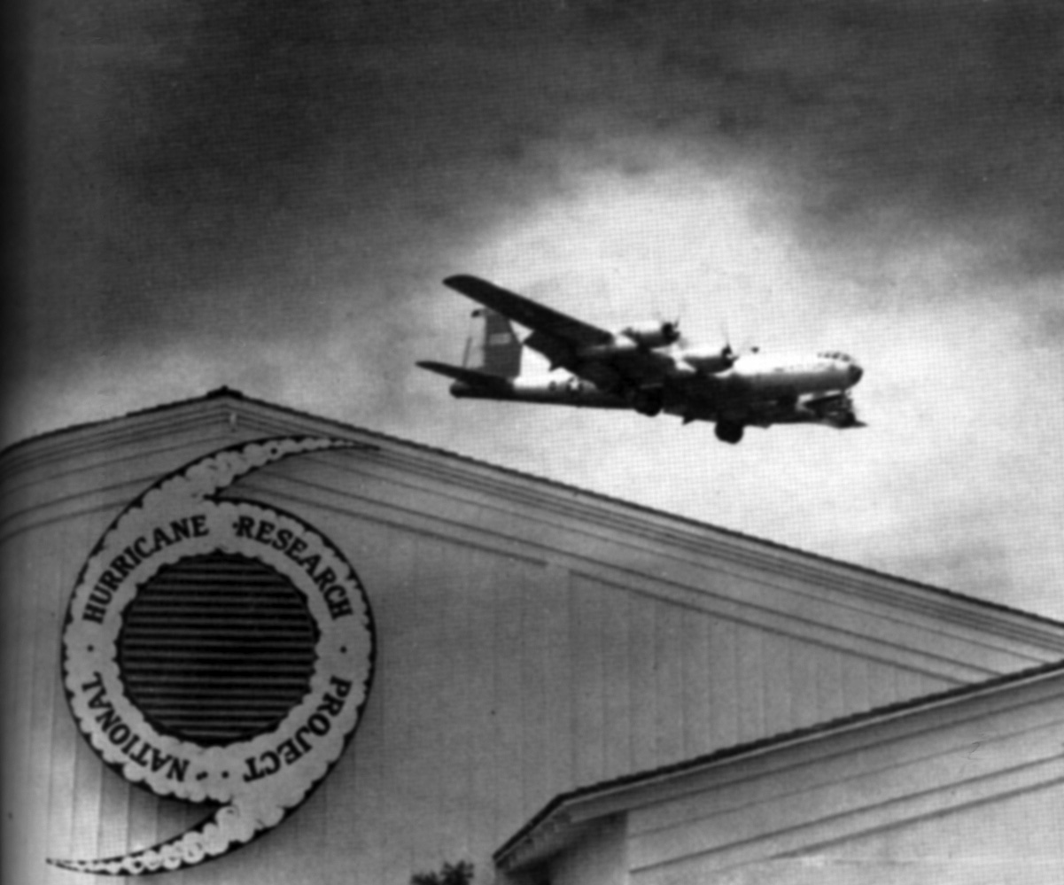
National Hurricane Research Project
NHRP planned to last three years (1956-1958)
Use Air Force planes based at Palm Beach airport to examine hurricanes
Record flight-level data on punch cards
Process data immediately
Examine dynamics and energetics of storms
Test new observational technology
Study possible modification methods

Slide 11
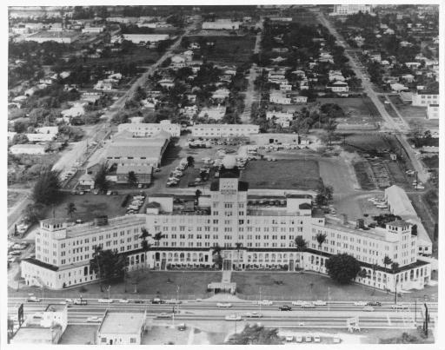
National Hurricane Research Project
Successful results lead to Weather Bureau extending the Project indefinitely
Moves to Miami and co-locates with Miami Hurricane Warning Center (MHWC)
Weather Bureau leases aircraft for weather research based at Miami International Airport
Combined NHRP, MHWC, and aircraft facilities dubbed “National Hurricane Central”

Slide 12
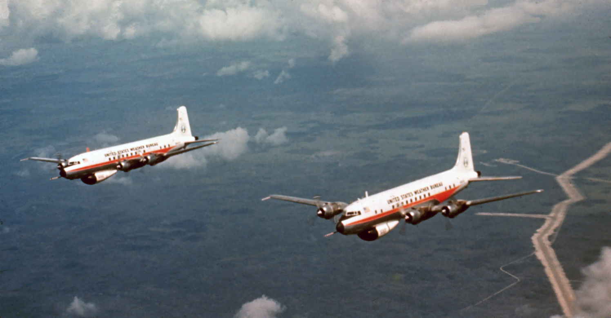
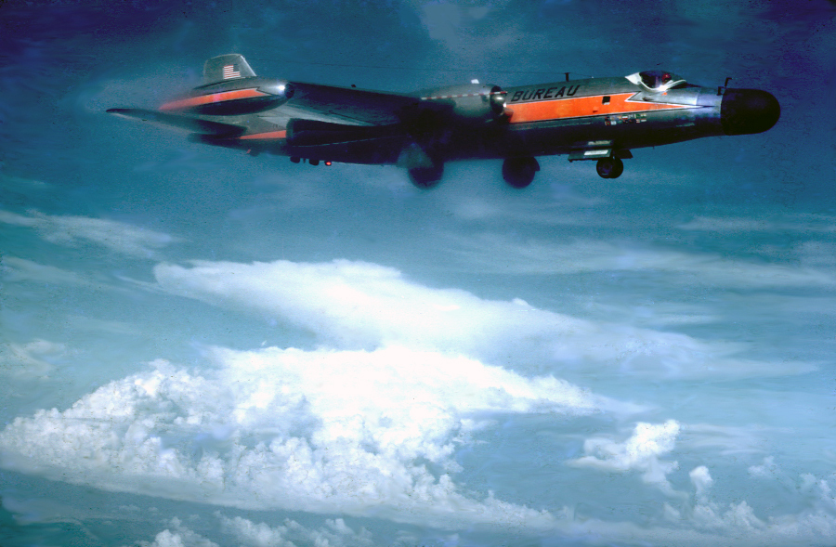
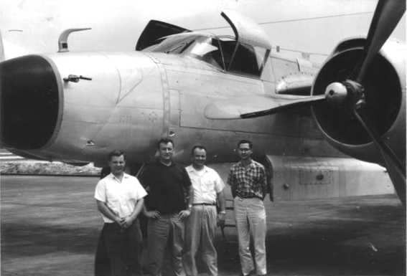
Research aircraft
2 DC-6 (dubbed 39 Charlie and 40 Charlie)
High altitude B-57 jet
B-26 mid-level turboprop
C-54 for cargo and transport
Becomes the Research Flight Facility (RFF)
Involved in other weather research projects (winter storms, thunderstorms, jet stream)

Slide 13
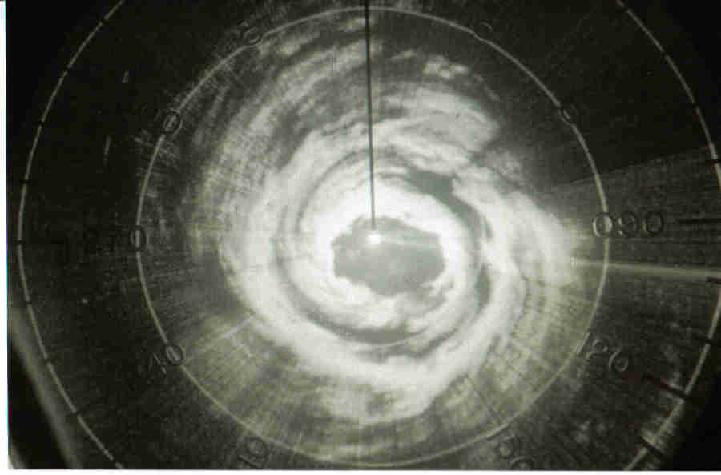
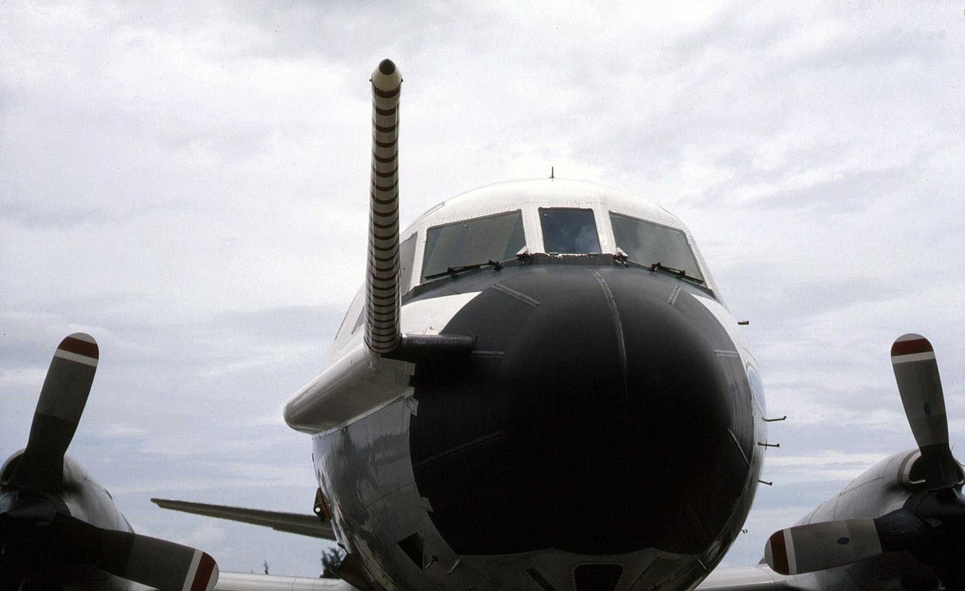
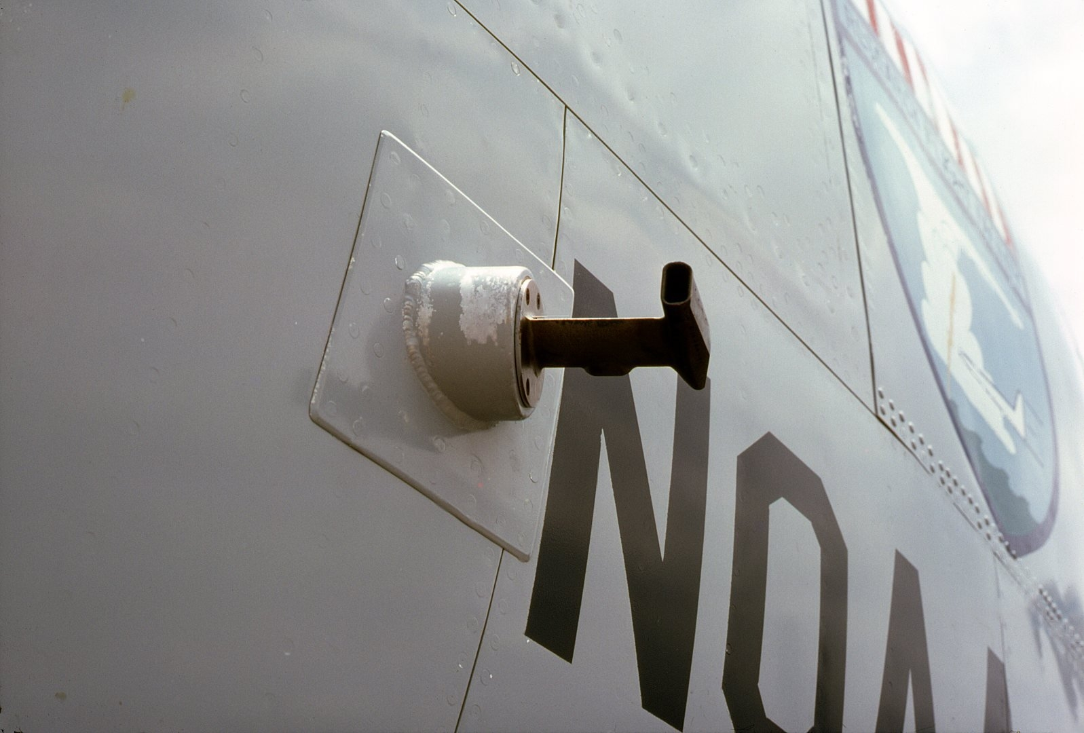
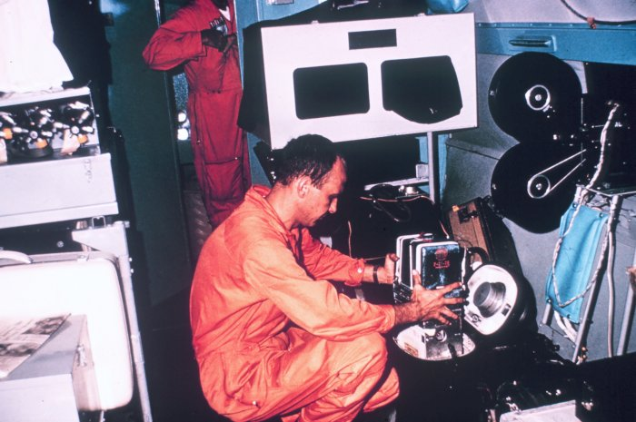
Research aircraft
Radars in the belly and tail of DC-6
Measure temperature, humidity, pressure, and wind along flight path recorded on magnetic tape
Measure cloud drops and ice particles
Time lapse movie cameras in nose and over wings
Capable of dropping sensors to measure conditions below aircraft

Slide 14
Reconnaissance aircraft
Upgraded after Hurricane Camille (1969)
Better radars and weather instruments
Recording flight-level data
Newer models (WC-130J and WP-3C)

Slide 15
Project STORMFURY
1962-1982
Test hypothesis that seeding hurricanes with silver iodide will weaken them
Weather Bureau (NOAA), Navy, Air Force along with private and academic partners
Only 4 storms seeded
Results inconclusive but pointing toward negative conclusion
Did greatly advance understanding of hurricane structure, cloud physics, and dynamics

Slide 16
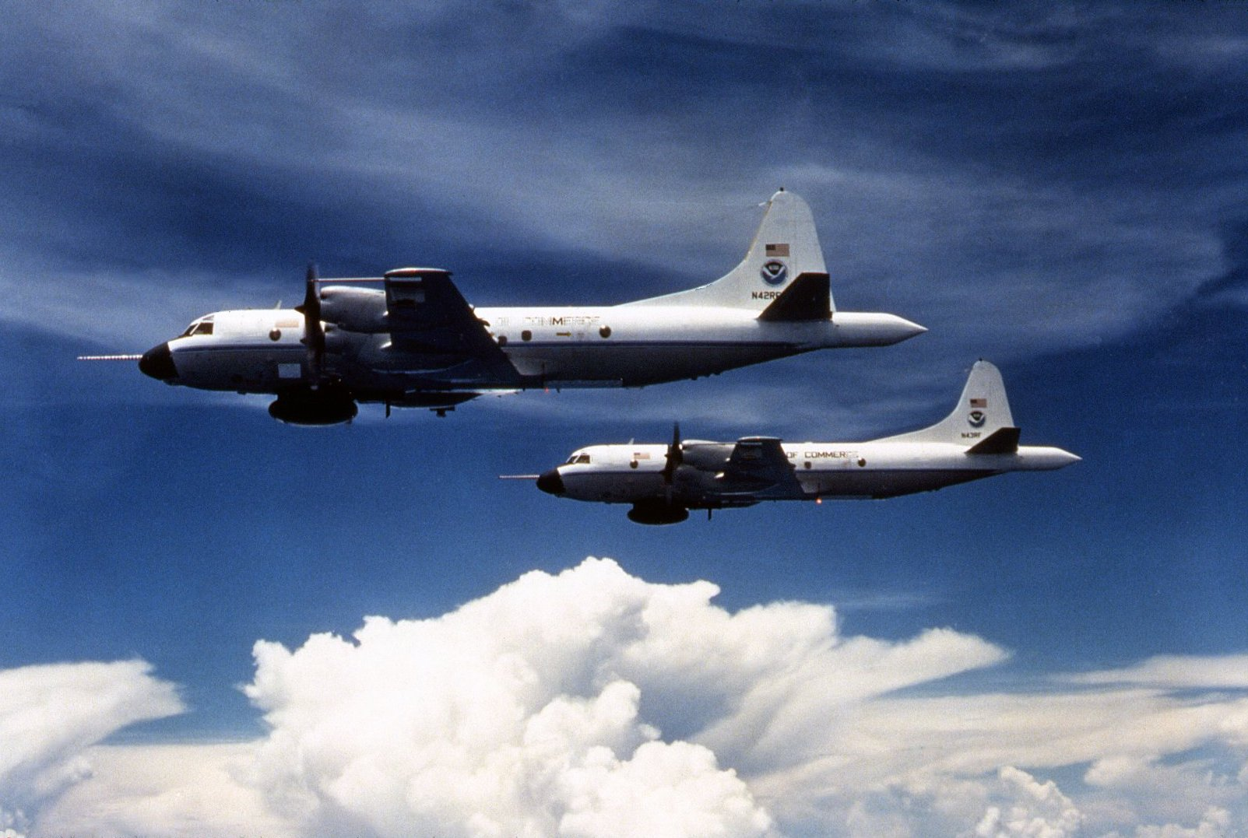
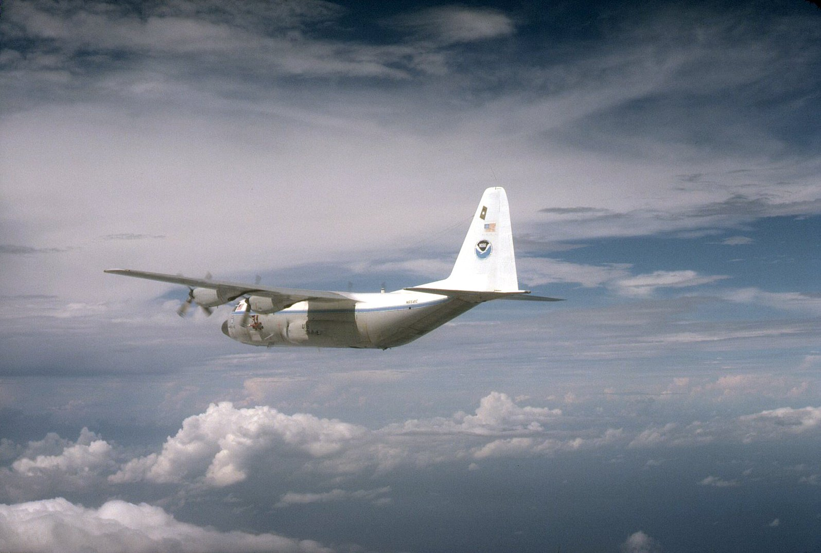
NOAA P-3 Orions
Project STORMFURY leads to acquisition of new research aircraft
1975 & 1976 2 new P-3Ds available (N42RF & N43RF)
Supplemented by C-130 acquired from Air Force (N41RF)
Digital radar, upgraded to Doppler in 1984
Knollenberg cloud probes
Improved dropsondes
Long-term studies of hurricane life cycle
Synoptic surveillance studies

Slide 17


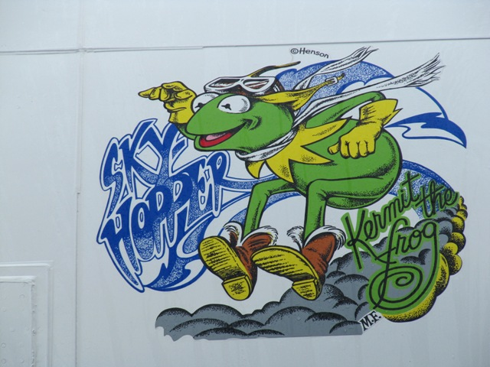
NOAA P-3 Orions
C-130 nicknamed “NOAA’s Ark”
N43RF called “Pig sty”
After a clean up renamed “Miss Piggy”
N42RF named “Kermit”
Henson Studios design nose art

Slide 18
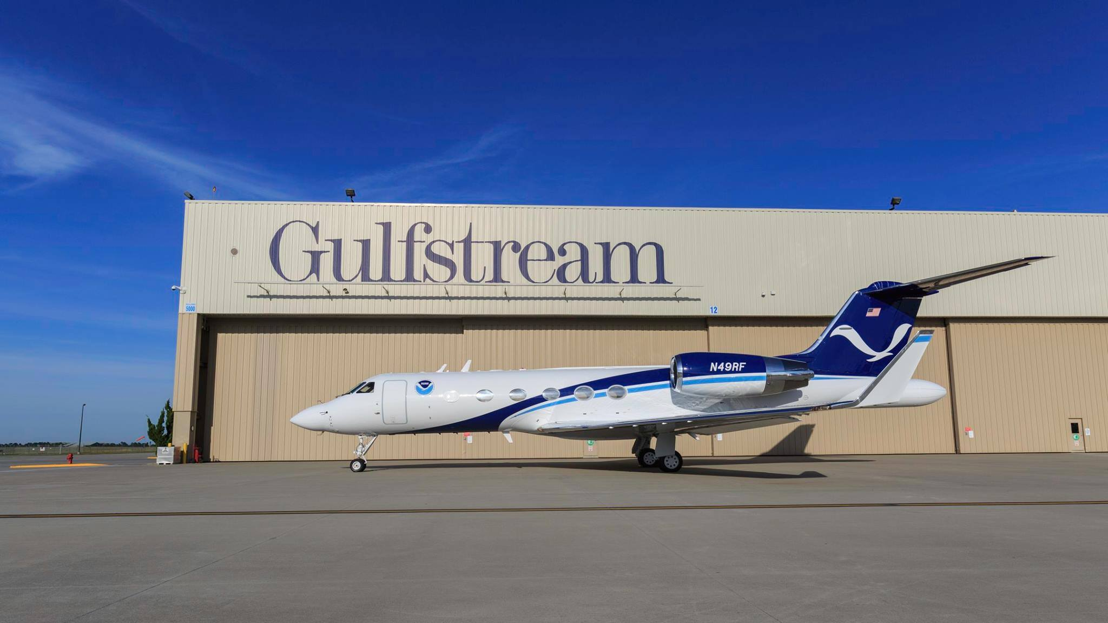

NOAA G-IV Gulfstream
Dropsonde Surveillance experiment lead to better forecasts
NOAA acquires high-altitude jet to drop sondes from high altitude
Begins service in 1996
Nicknamed ‘Gonzo’

Slide 19

Reconnaissance aircraft
With advent of satellites, weather patrol squadrons pared down
Typhoon squadrons disbanded
Navy Hurricane Hunters VW-4 disbanded 1975
Air Force Hurricane Hunters moved to Reserves

Slide 20
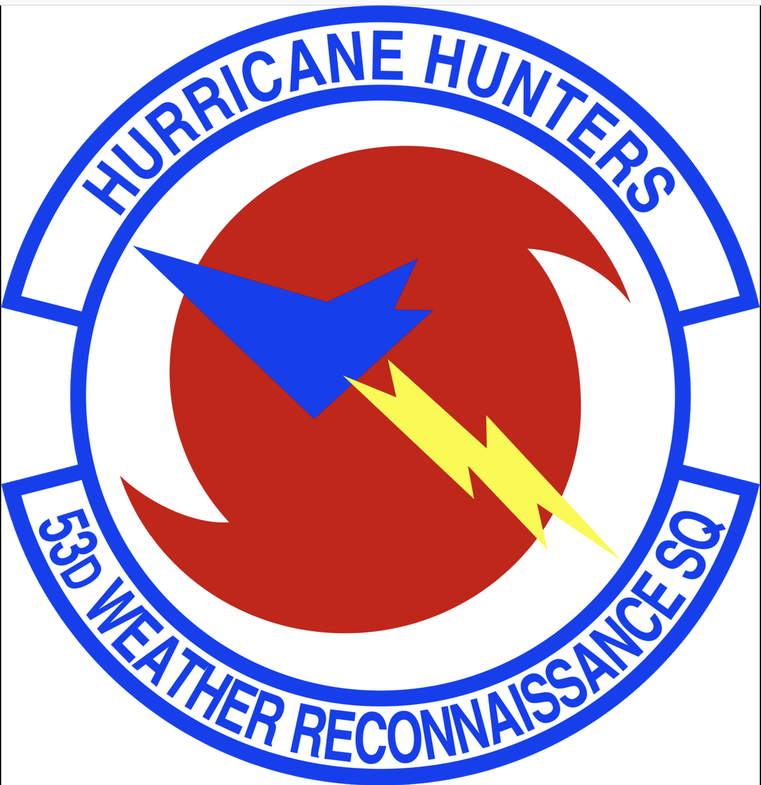
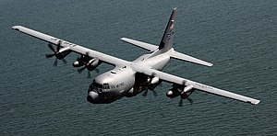
53rd Weather Reconnaissance Squadron (WRS)
Based at Keesler AFB in Biloxi, MS
Part of 403rd Wing of the Air Force Reserves
10 WC-130Js
20 flight crews (~120 personnel)
Carry out the bulk of reconnaissance missions
Assists research missions, deploying ocean buoys and dropsondes

Slide 21
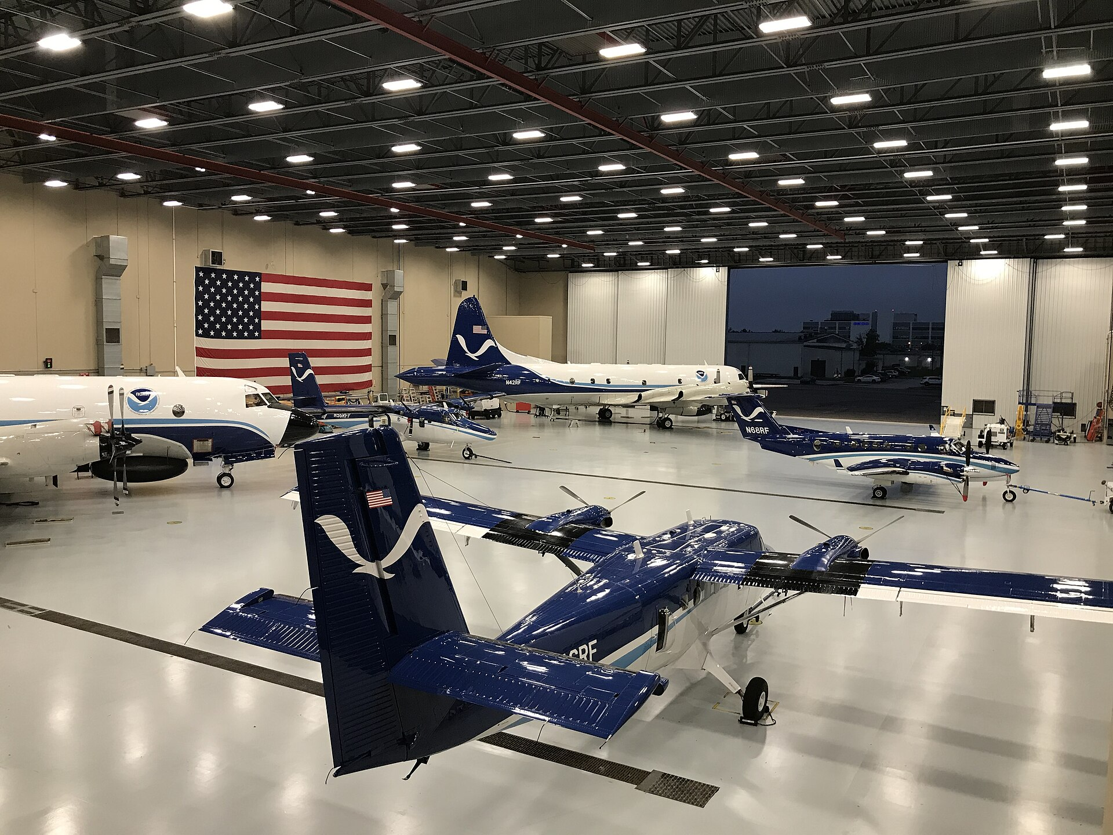
NOAA Aircraft Operations Center
Descended from RFF
1993 moved to MacDill AFB
2017 moved to Linder-Lakeland Airport in Lakeland, FL
2 P-3s, G-IV, 4 De Havilland Twin Otter, and 3 Beechcraft King Air
Carry out air chemistry studies, ice surveys, marine mammal census, hydrological measurements, and disaster surveys
~200 personnel, pilots, navigators, flight engineers, electronic technicians, scientist, and support people

Slide 22
NOAA Aircraft Operations Center
2 Radars (belly, tail)
Stepped Frequency Microwave Radiometer (SFMR)
cloud physics probes
Launch oceanic and atmospheric expendables
Laser radar (LIDAR )
Black Swift S0 and Altius 600 drones

Slide 23

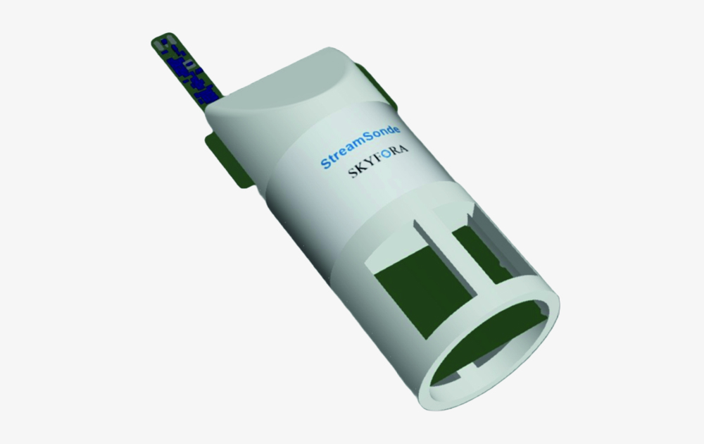
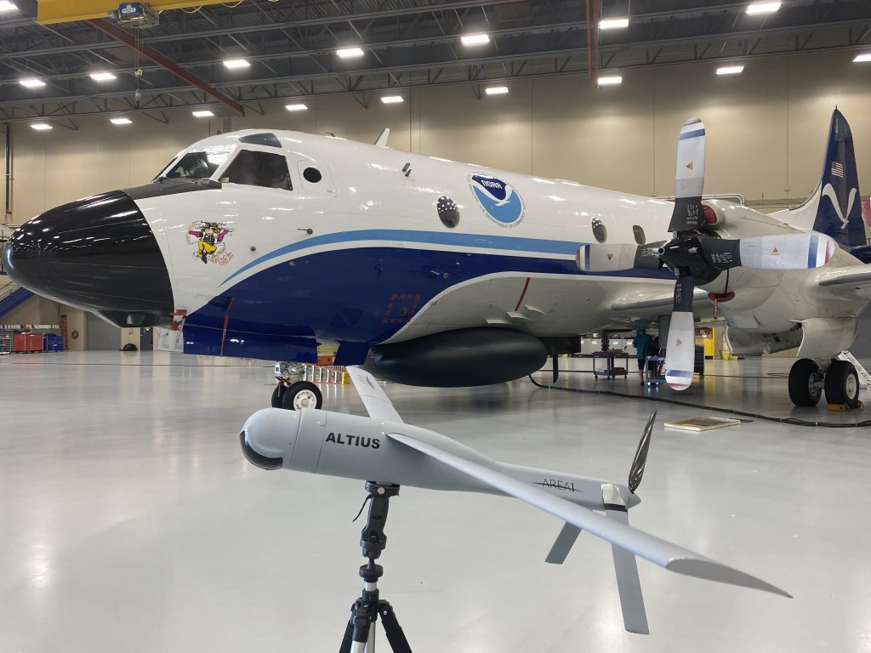
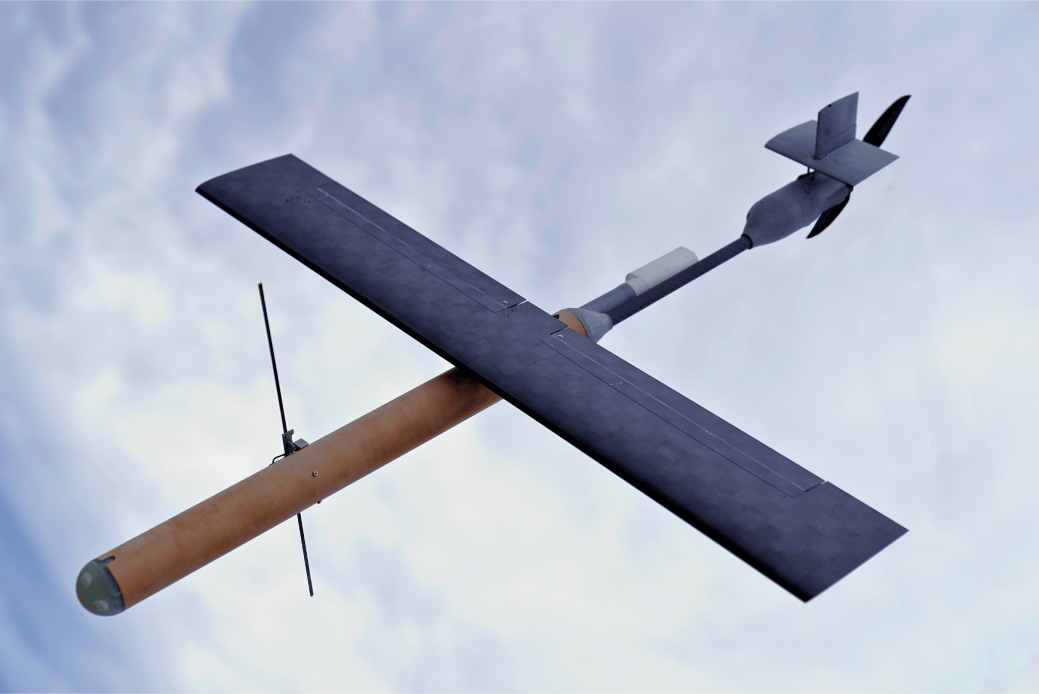
The Future
New G550 jet replacing G-IV
Improvement to remote sensing
  Radar
  SFMR
  Streamsondes
  Swarmsondes
  Drones
  New technologies
Use AI and machine learning for track planning and data processing

Slide 24
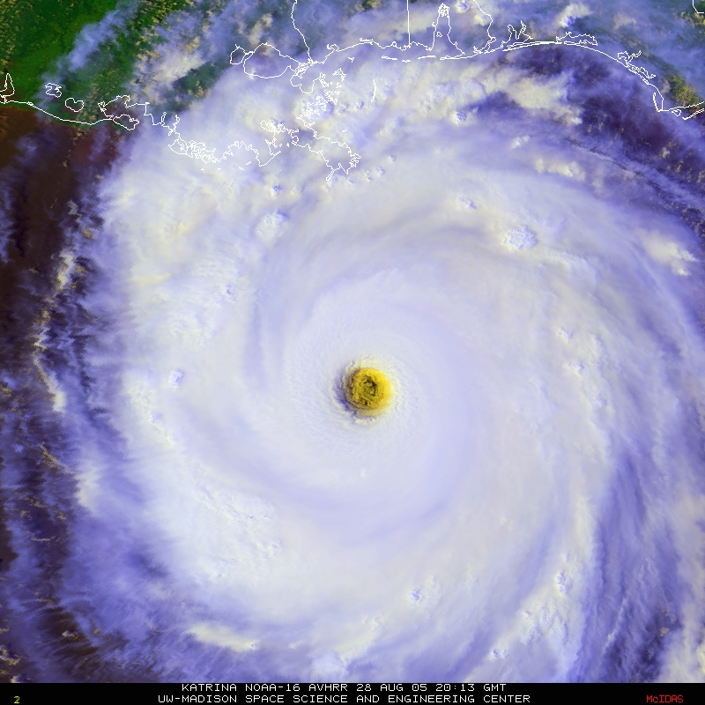
Why fly?
Still needed to collect precise information on storm strength and structure
Better scientific insights into hurricane dynamics
Test new technologies and provide ‘ground truth’ for satellites

Slide 25
Questions?

