Slide 1
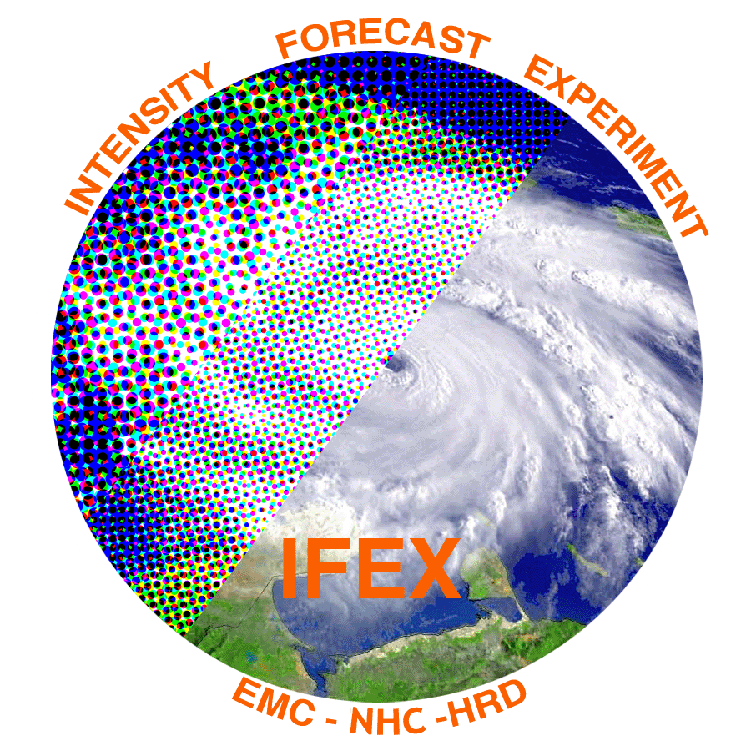
2018 NOAA/AOML/HRD Hurricane Field Program
Intensity Forecast Experiment (IFEX)
AL09/Isaac Debrief

Slide 2
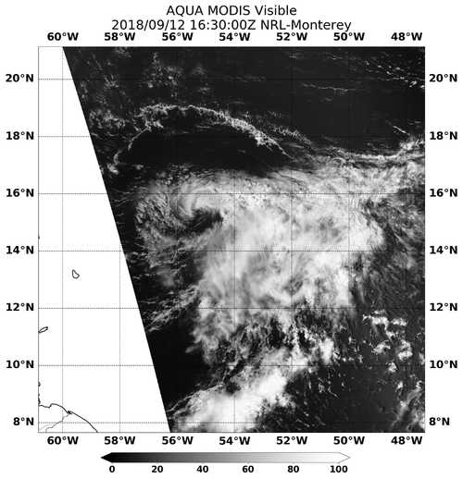
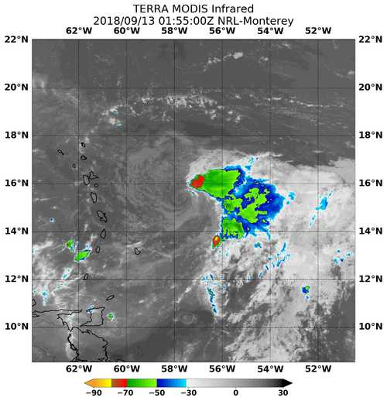
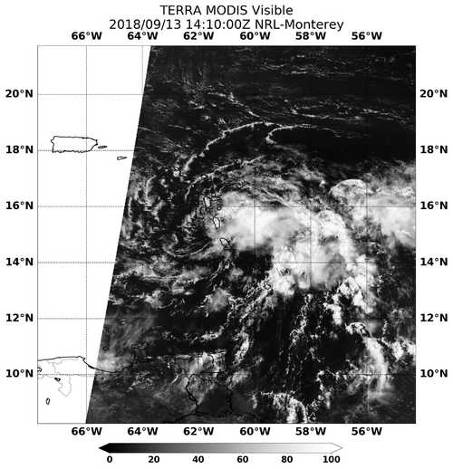
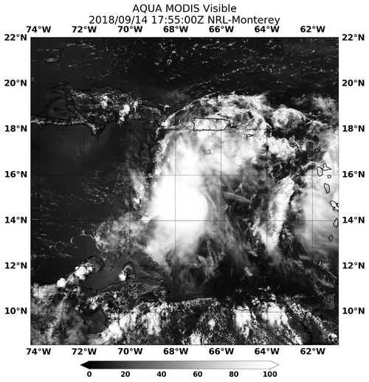
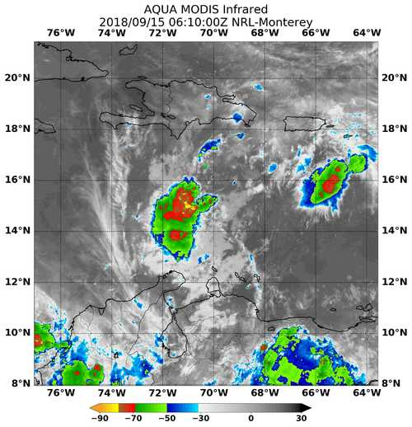
2018 NOAA/AOML/HRD Hurricane Field Program
Intensity Forecast Experiment (IFEX)
AL09/Isaac Debrief
September 12-15
180912H1
180912H2
180913H1
5 NHC-tasked P-3 Missions
38 P-3 Flight Hours
55 Dropsondes
0 AXBTs
Agenda
Missions Overview
Deployment Overview
180912H1 (Holbach)
180912H2 (Alaka)
180913H1 (Holbach)
180914H1 (No HRD)
180915H1 (No HRD)
180914H1
180915H1

Slide 3
2018 NOAA/AOML/HRD Hurricane Field Program
Intensity Forecast Experiment (IFEX)
AL09/Isaac Debrief
Purpose:
NHC-tasked reconnaissance missions into Tropical Storm Isaac
Possibly meet Early Stage Experiment Objectives, but trending away from any research interest, unless the storm showed showed signs of potential reorganization
Target:
Tropical Storm Isaac as it approached the Leeward Islands, possibly bringing tropical storm conditions to St. Croix and Puerto Rico
Mission Timeline:
Takeoffs based on meeting the NHC fix requirements

Slide 4
2018 NOAA/AOML/HRD Hurricane Field Program
Intensity Forecast Experiment (IFEX)
AL09/Isaac Debrief
Mission Highlights:
5 NHC-tasked fix missions into Isaac as it passed through the islands, and south of St. Croix, Puerto Rico, and Hispaniola
The storm gradually weakened throughout these missions, beginning as a sheared tropical storm (exposed low-level circulation), and ending as an open wave in the central Caribbean
The third mission [180913H1] recovered in Lakeland after completing the fix due to possible T.S. conditions at St. Croix -- subsequently missed fixes on 9/13 and 9/14
The P-3 returned to St. Croix on 14 September [180914H1], with a mission enroute through the remnants of Isaac
EMC did not request transmission of P-3 data from the first 3 missions due to Florence

Slide 5
2018 NOAA/AOML/HRD Hurricane Field Program
Intensity Forecast Experiment (IFEX)
AL09/Isaac Debrief
Deployment Notes:
HRD onboard participation in the first three missions, operating out of St. Croix
Logistic challenges setting up for another deployment while already deployed. Gratitude to Kristy (AOC) and Lisa.
Due to the lack of certainty on tasking, and of research interest, the PM crew was pulled from St. Croix after one flight [180912H2], and the AM crew returned to Lakeland on the 180913H1 mission (their 2nd mission), but did not return to St. Croix the following day
HRD did support TDR ground processing (Reasor) for the final 2 missions [180914H1, 180915H1], once the EMC requirements for Florence were complete; no other HRD staffing supported these final two NHC missions
Some possibility of reorganization -- convection did become more active -- but still devolved into open wave

Slide 6
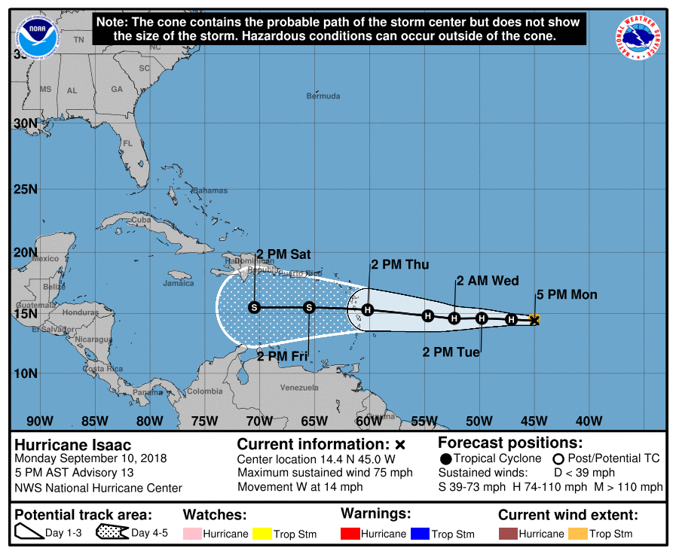
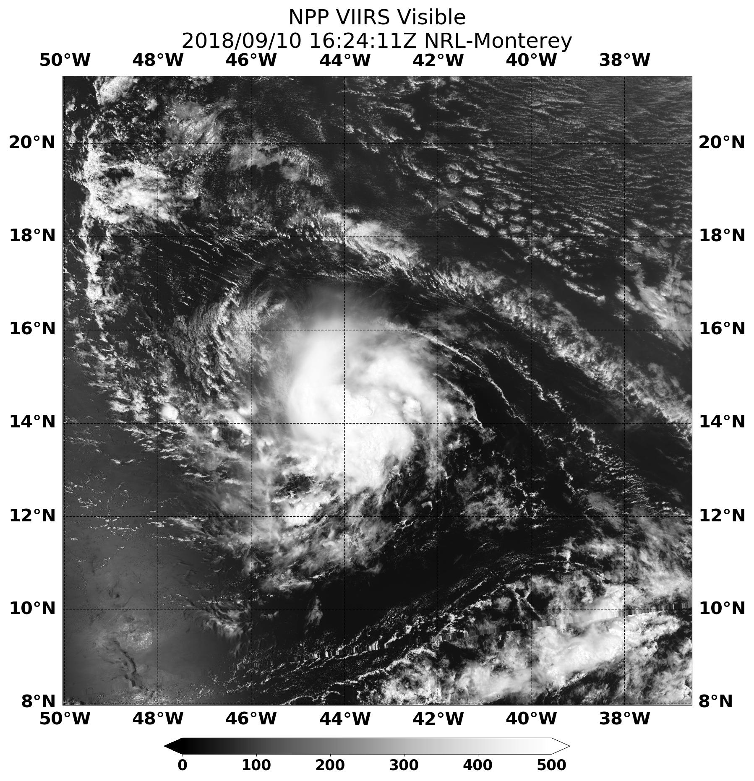
2018 NOAA/AOML/HRD Hurricane Field Program
Intensity Forecast Experiment (IFEX)
AL09/Isaac Debrief
Monday, September 10
INIT 10/2100Z 14.4N 45.0W 65 KT 75 MPH 12H 11/0600Z 14.5N 47.1W 70 KT 80 MPH 24H 11/1800Z 14.6N 49.8W 75 KT 85 MPH 36H 12/0600Z 14.6N 52.3W 75 KT 85 MPH 48H 12/1800Z 14.8N 54.7W 75 KT 85 MPH 72H 13/1800Z 15.3N 60.2W 70 KT 80 MPH 96H 14/1800Z 15.5N 65.5W 60 KT 70 MPH 120H 15/1800Z 15.5N 70.5W 50 KT 60 MPH
NRL

Slide 7
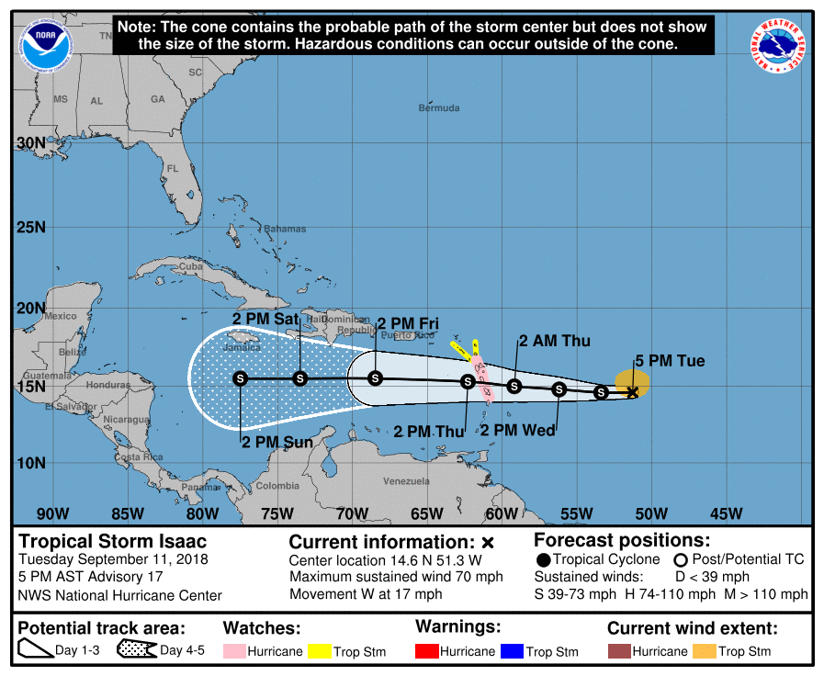
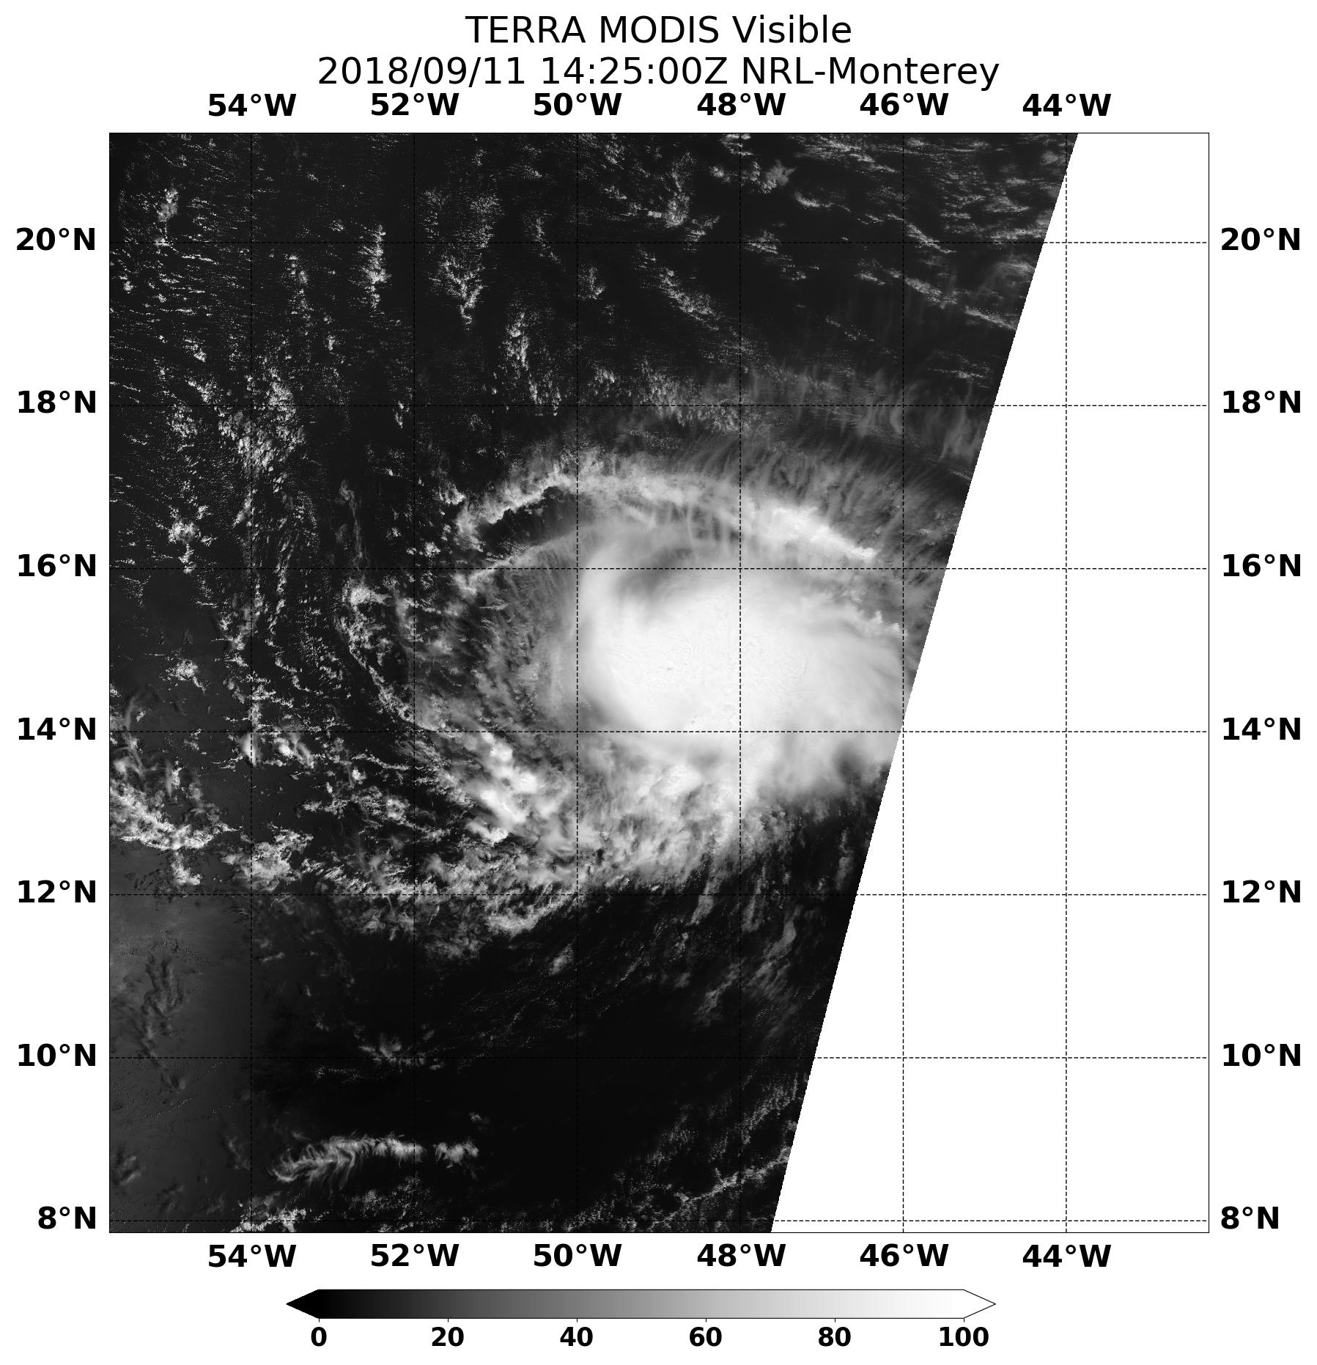
2018 NOAA/AOML/HRD Hurricane Field Program
Intensity Forecast Experiment (IFEX)
AL09/Isaac Debrief
Tuesday, September 11
INIT 11/2100Z 14.6N 51.3W 60 KT 70 MPH 12H 12/0600Z 14.6N 53.4W 60 KT 70 MPH 24H 12/1800Z 14.8N 56.2W 60 KT 70 MPH 36H 13/0600Z 15.0N 59.2W 60 KT 70 MPH 48H 13/1800Z 15.3N 62.3W 55 KT 65 MPH 72H 14/1800Z 15.5N 68.5W 50 KT 60 MPH 96H 15/1800Z 15.5N 73.5W 45 KT 50 MPH 120H 16/1800Z 15.5N 77.5W 45 KT 50 MPH
NRL

Slide 8
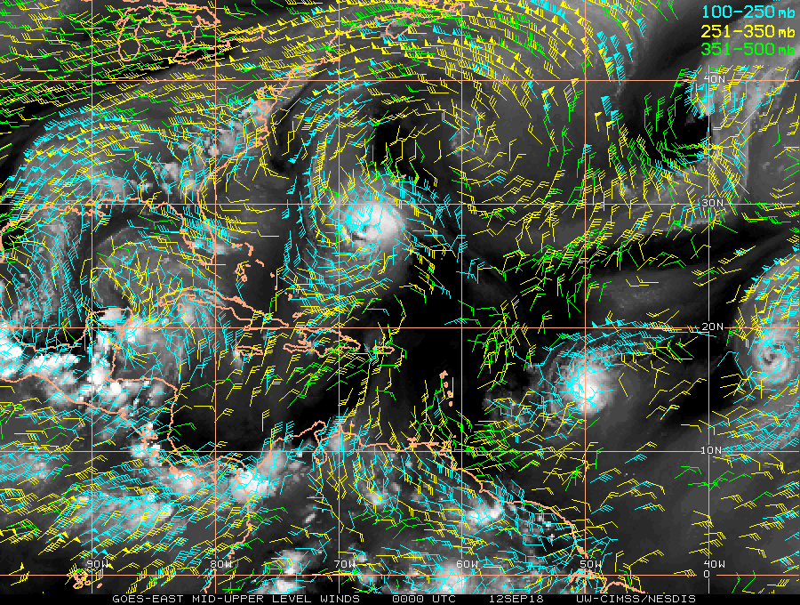
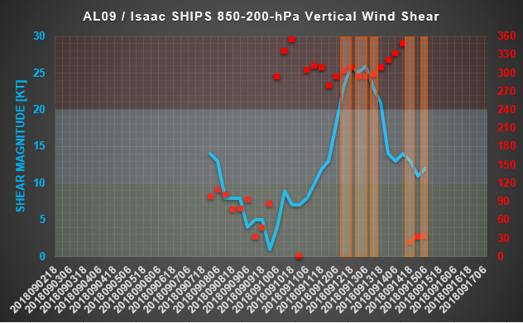
2018 NOAA/AOML/HRD Hurricane Field Program
Intensity Forecast Experiment (IFEX)
AL09/Isaac Debrief
P-3
“High” Shear
“Moderate” Shear
“Low” Shear

Slide 9
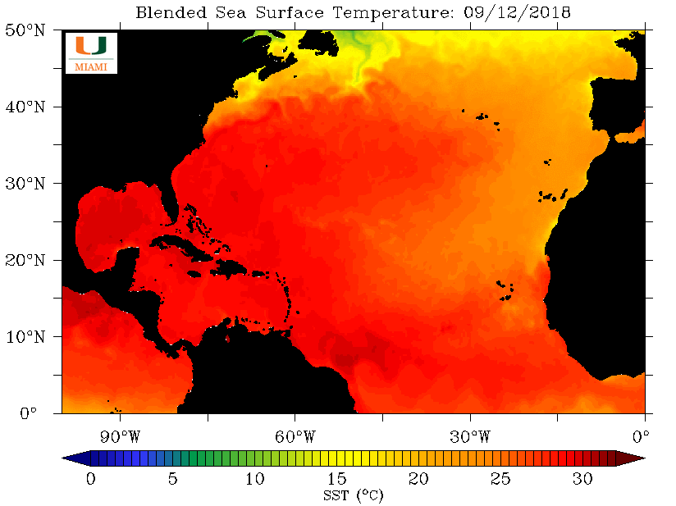
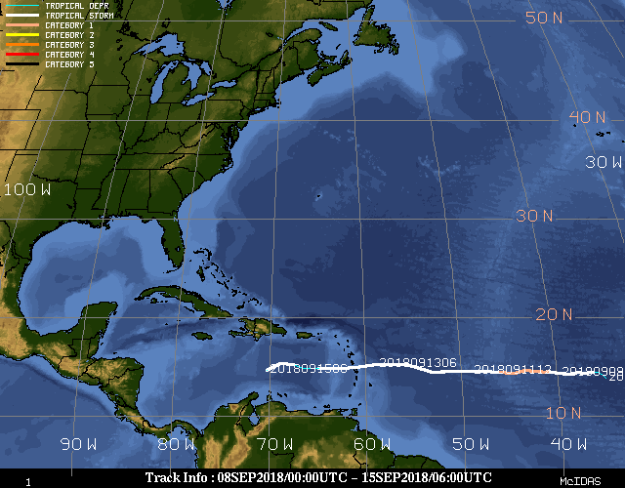
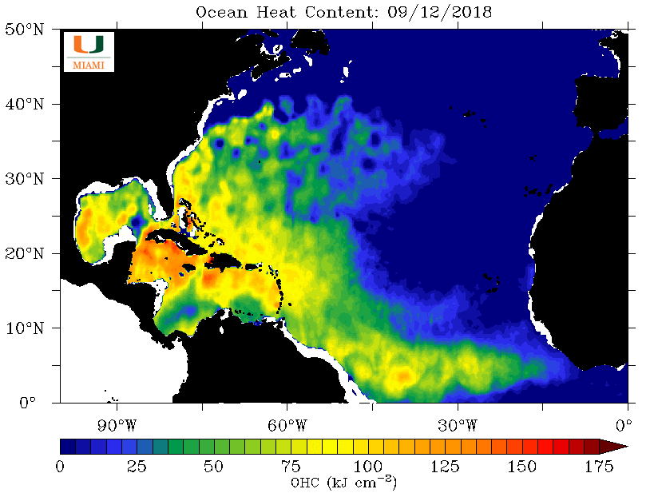
2018 NOAA/AOML/HRD Hurricane Field Program
Intensity Forecast Experiment (IFEX)
AL09/Isaac Debrief
CIMSS

Slide 10
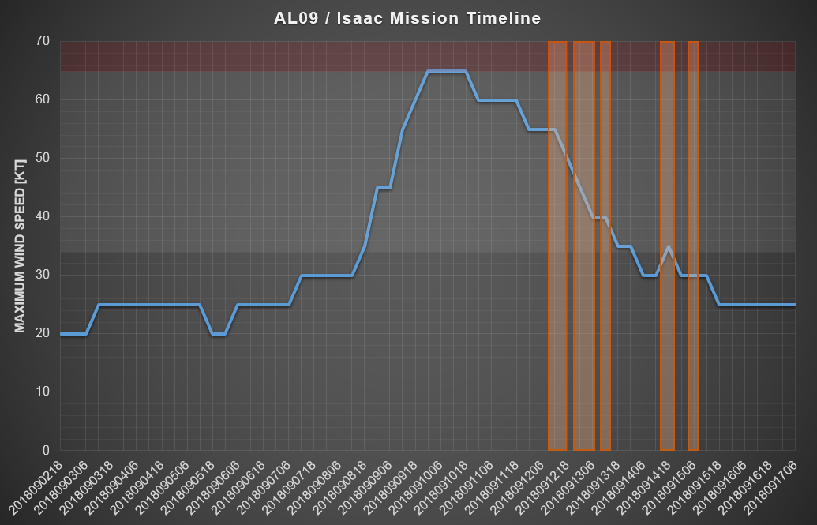
2018 NOAA/AOML/HRD Hurricane Field Program
Intensity Forecast Experiment (IFEX)
AL09/Isaac Debrief
Category 1 Hurricane
P-3
Tropical Storm

Slide 11
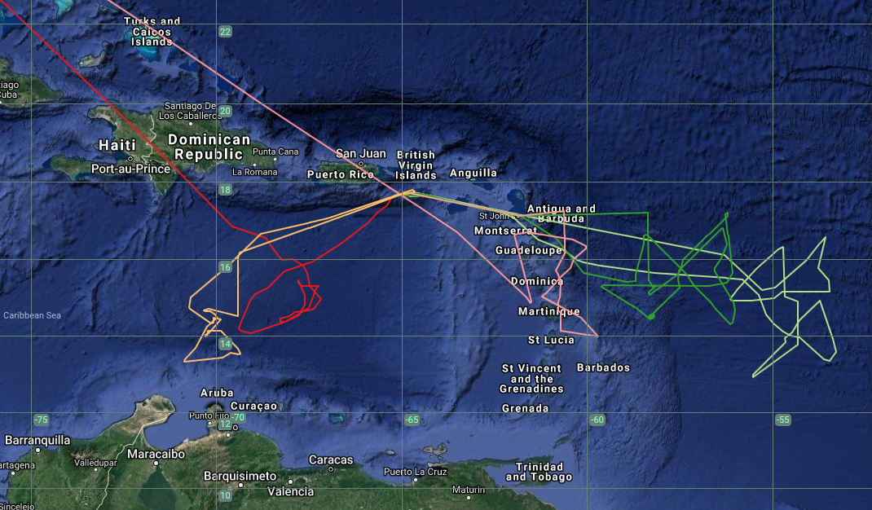
2018 NOAA/AOML/HRD Hurricane Field Program
Intensity Forecast Experiment (IFEX)
AL09/Isaac Debrief
P-3 Flight Tracks
180912H2
180915H1
180914H1
180913H1
180912H1

Slide 12
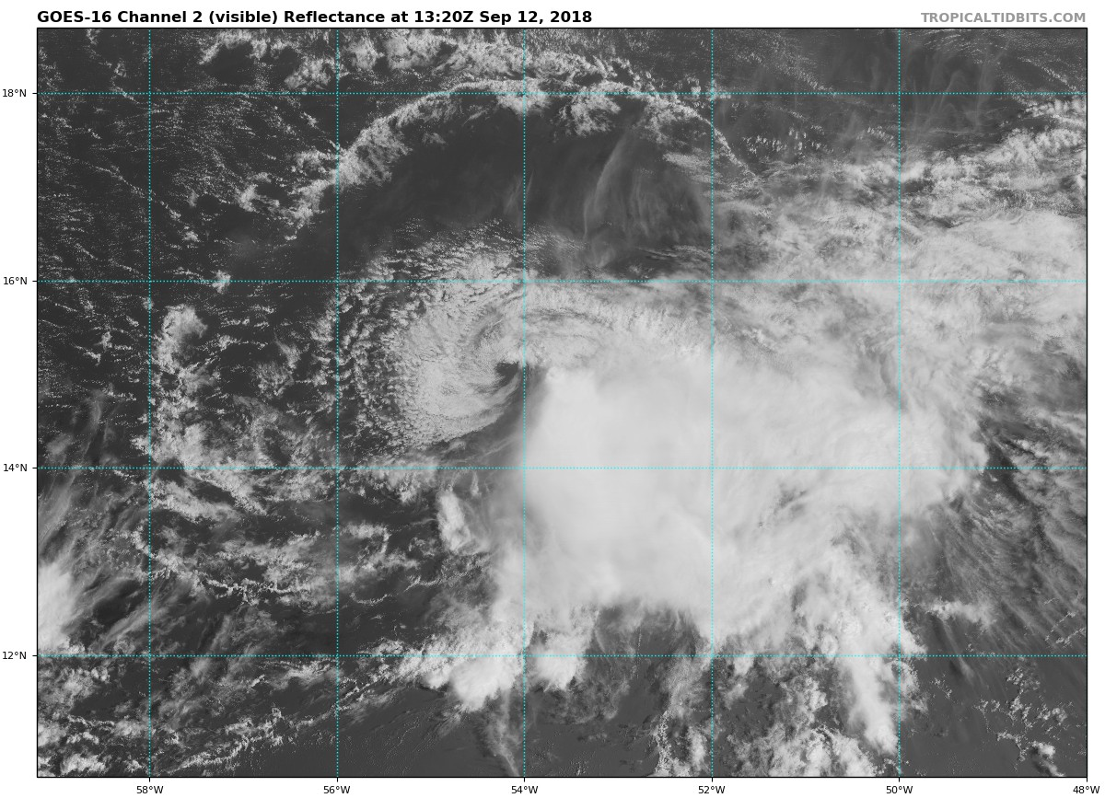
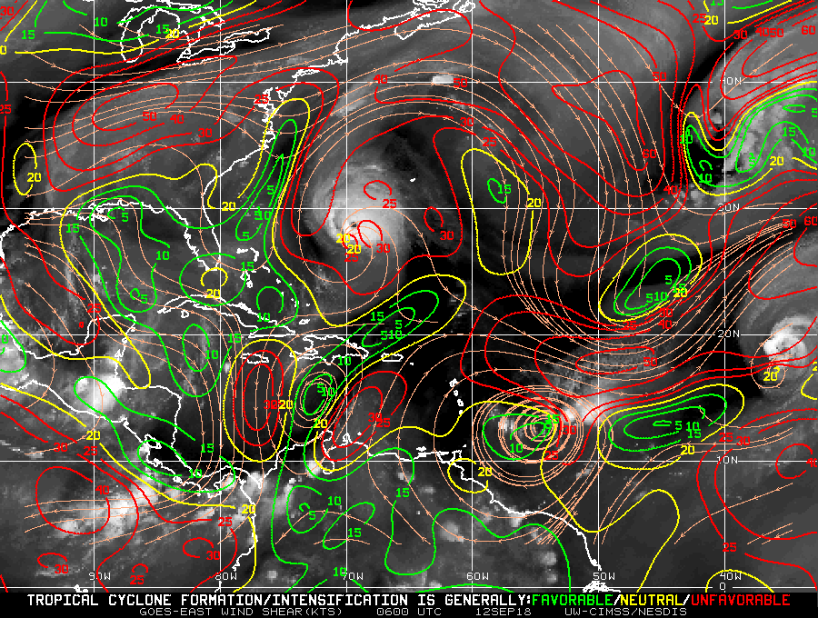
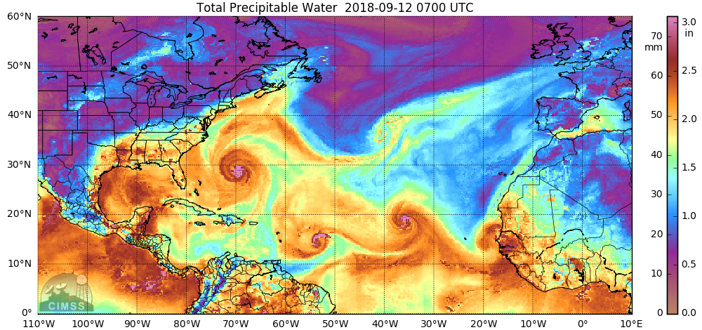
2018 NOAA/AOML/HRD Hurricane Field Program
Intensity Forecast Experiment (IFEX)
AL09/Isaac Debrief
20180912H1
LPS: Holbach
Radar: Christophersen
Sondes: Sellwood
Ground Radar: Griffins
NHC-tasked fix mission for 1130Z and 1730Z fixes
Initial intensity: 50 kt, 1000 mb
18 kt SHIPS analyzed shear
Dry air to west and south
Rotated Fig-4 flight pattern
Takeoff: 0944Z from STX
Landing: 1834Z at STX
Expendables: 19 sondes (11 NWS, 8 HRD)

Slide 13
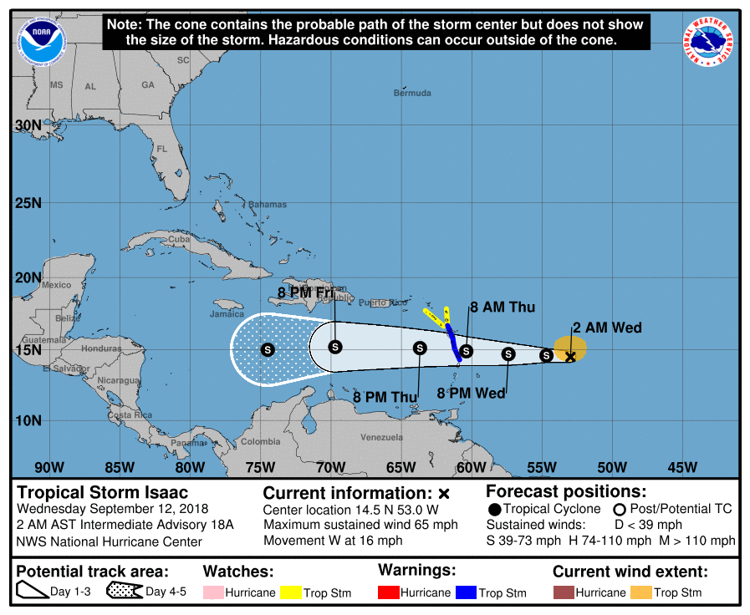
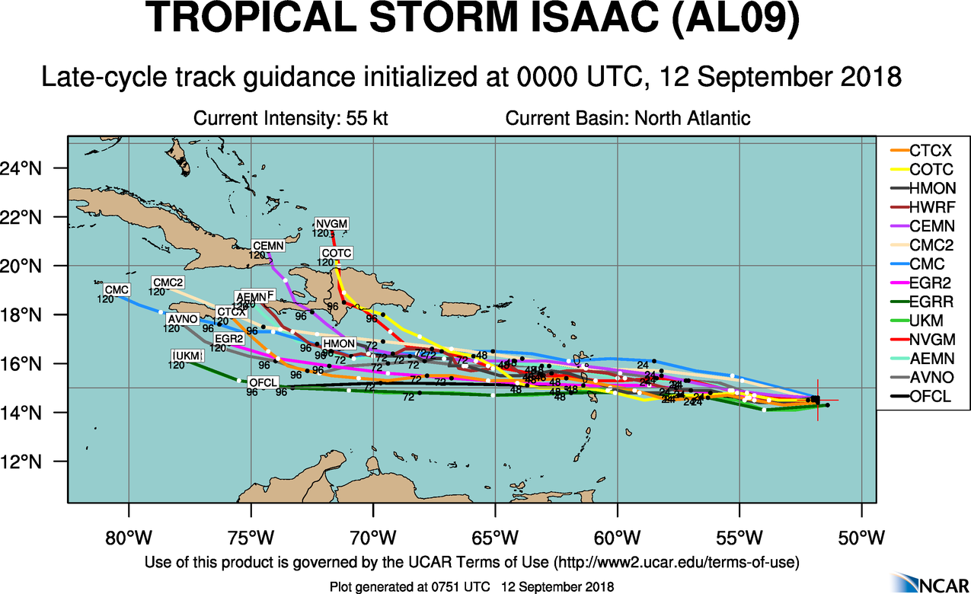
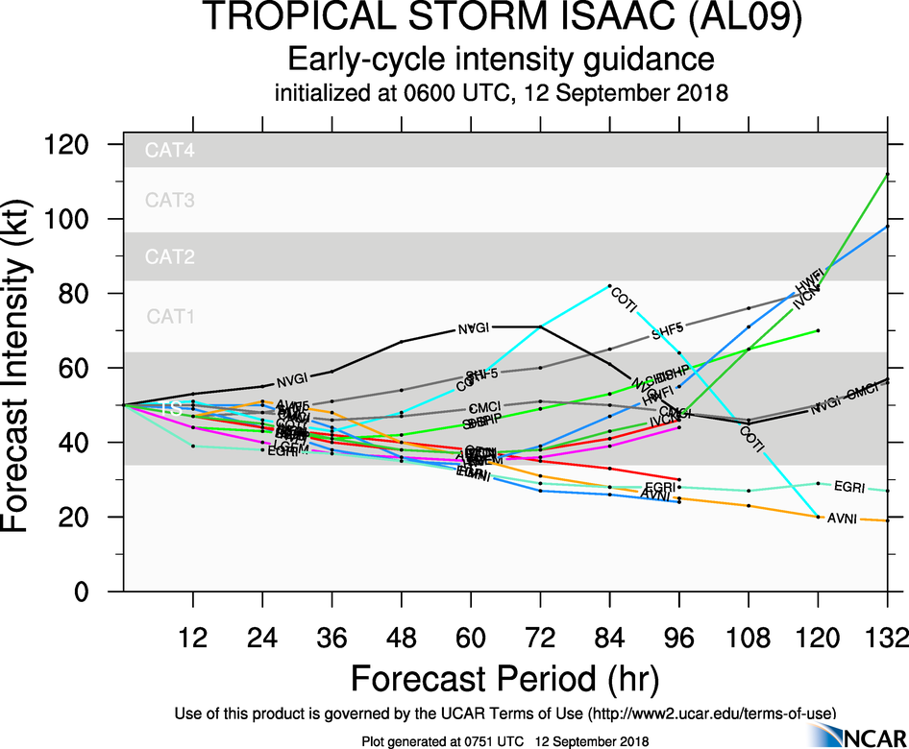
2018 NOAA/AOML/HRD Hurricane Field Program
Intensity Forecast Experiment (IFEX)
AL09/Isaac Debrief
20180912H1

Slide 14
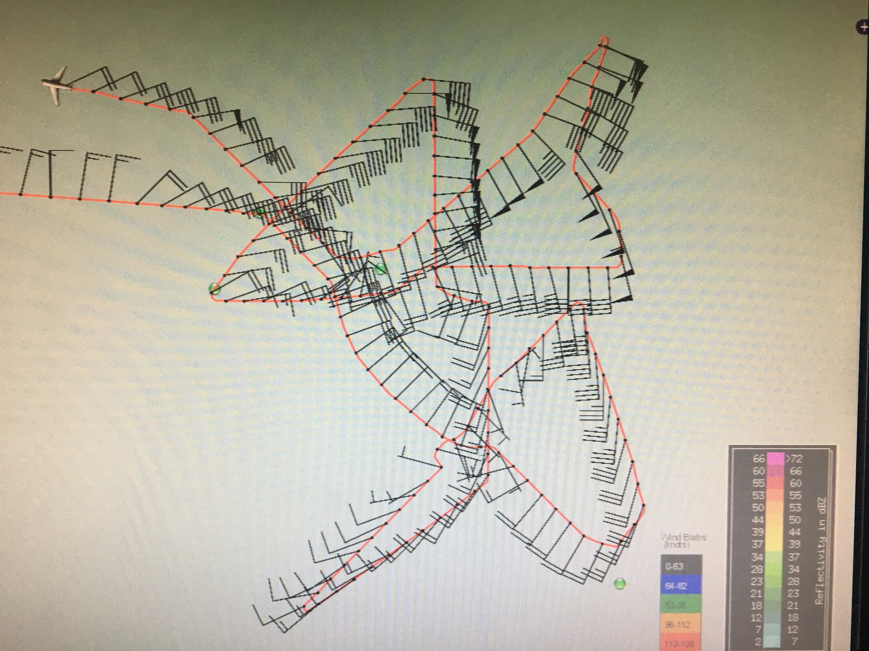
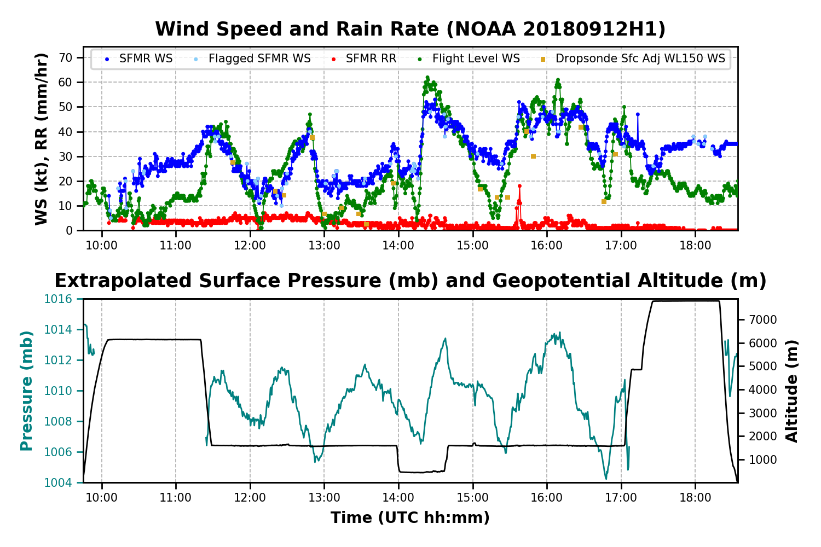
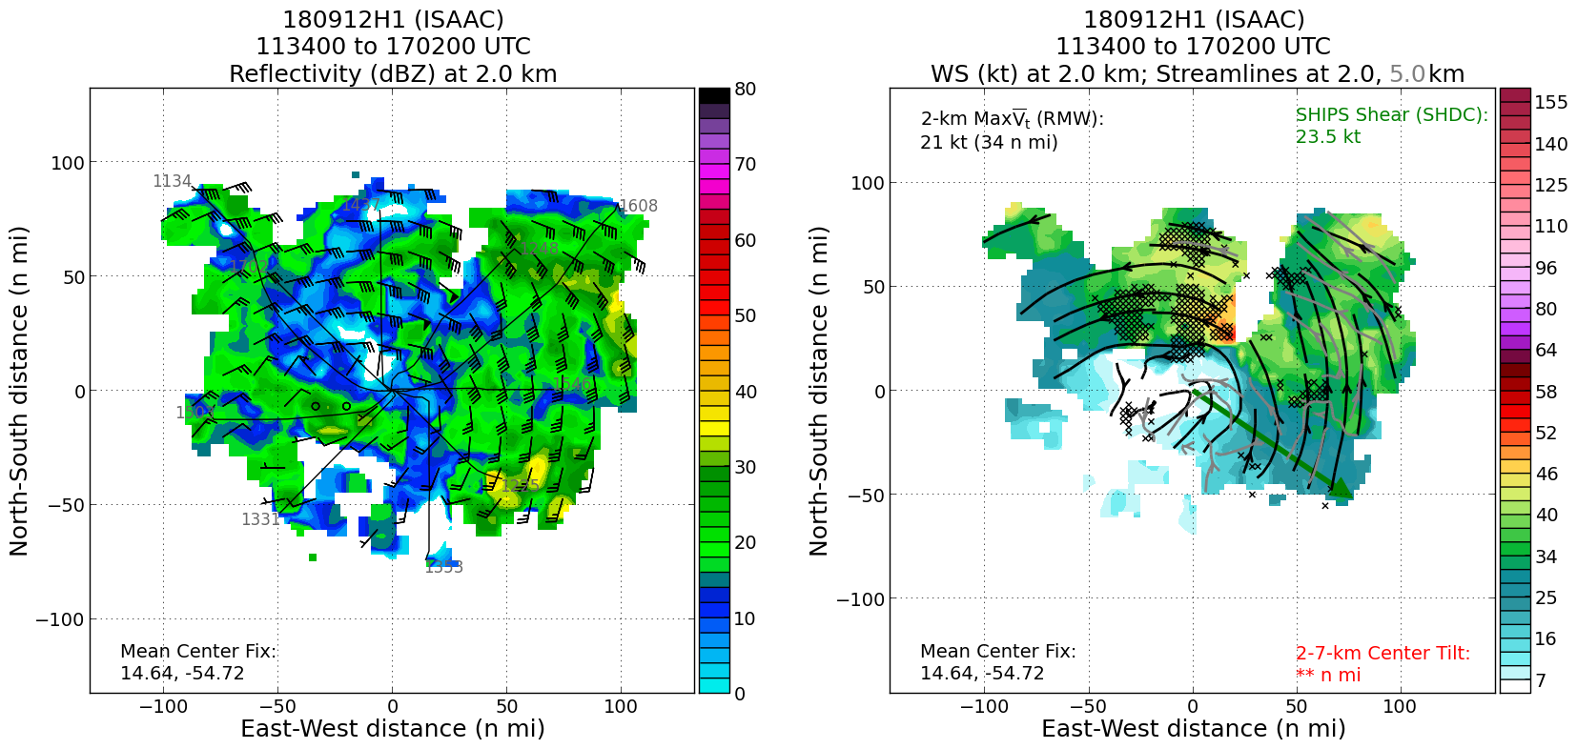
2018 NOAA/AOML/HRD Hurricane Field Program
Intensity Forecast Experiment (IFEX)
AL09/Isaac Debrief
20180912H1
Max FL wind 62 kts, Max SFMR wind 53 kts, min slp 1004 mb

Slide 15
2018 NOAA/AOML/HRD Hurricane Field Program
Intensity Forecast Experiment (IFEX)
AL09/Isaac Debrief
20180912H1
Summary:
Completed 5 center fixes
Flight level center displaced from surface center made fixing at 5000 ft difficult
Third fix was at 1500 ft
Final two fixes were combination of NHC estimation, visible satellite estimate, navigator DR center, and visual estimation.
Completed 5 TDR analyses, but did not transmit to EMC
C-band IWRAP was not operating because of bad power supply

Slide 16
2018 NOAA/AOML/HRD Hurricane Field Program
Intensity Forecast Experiment (IFEX)
AL09/Isaac Debrief
Tropical Storm Isaac
Mission 180912H2
Crew
Lead Project Scientist: Alaka
Radar: Zawislak
Dropsonde/AXBT: Ryan
Flight Director: Sears
Pilots: Price, Abitbol, Heystek, Sloan
Navigator: B. Richards
Systems Engineer: Warnecke
Data Technician: T. Richards
Electronics Technician: Peek
Other: Sapp, Kahn, Sanchez
Objectives
NHC-tasked mission, 6-hrly center fixes
tropical storm experiencing increasing shear, with dry air upshear
forecasts suggested dissipation possible, but still a threat to U.S. islands

Slide 17
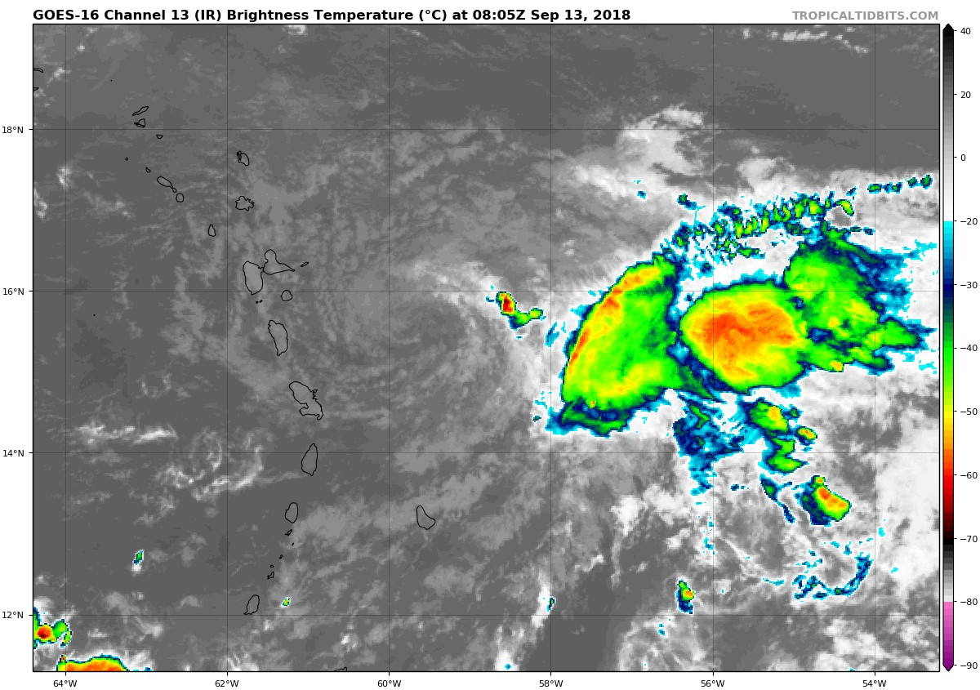
2018 NOAA/AOML/HRD Hurricane Field Program
Intensity Forecast Experiment (IFEX)
AL09/Isaac Debrief
Mission 180912H2 into Tropical Storm Isaac
Takeoff: 2132 UTC (STX)
Landing: 0630 UTC (STX)
Pattern: Alpha/Fig. 4
Drops: 19 (end/mid/ctr)
AXBTs: 0
Fixes: 5 w/ drops
12/15Z: 15.0N, 54.7W 50 kt
LPS: Alaka
Radar: Zawislak
Drops: Ryan
Grnd Radar: Reasor
OBJECTIVES
NHC center fixes (2330Z, 0530Z)
Assess threat to U.S. islands
HIGHLIGHTS
Convection confined to E semicircle
Forecasts called for dissipation
Surface circulation almost open to SW
Increasing shear w/ dry air upstream

Slide 18
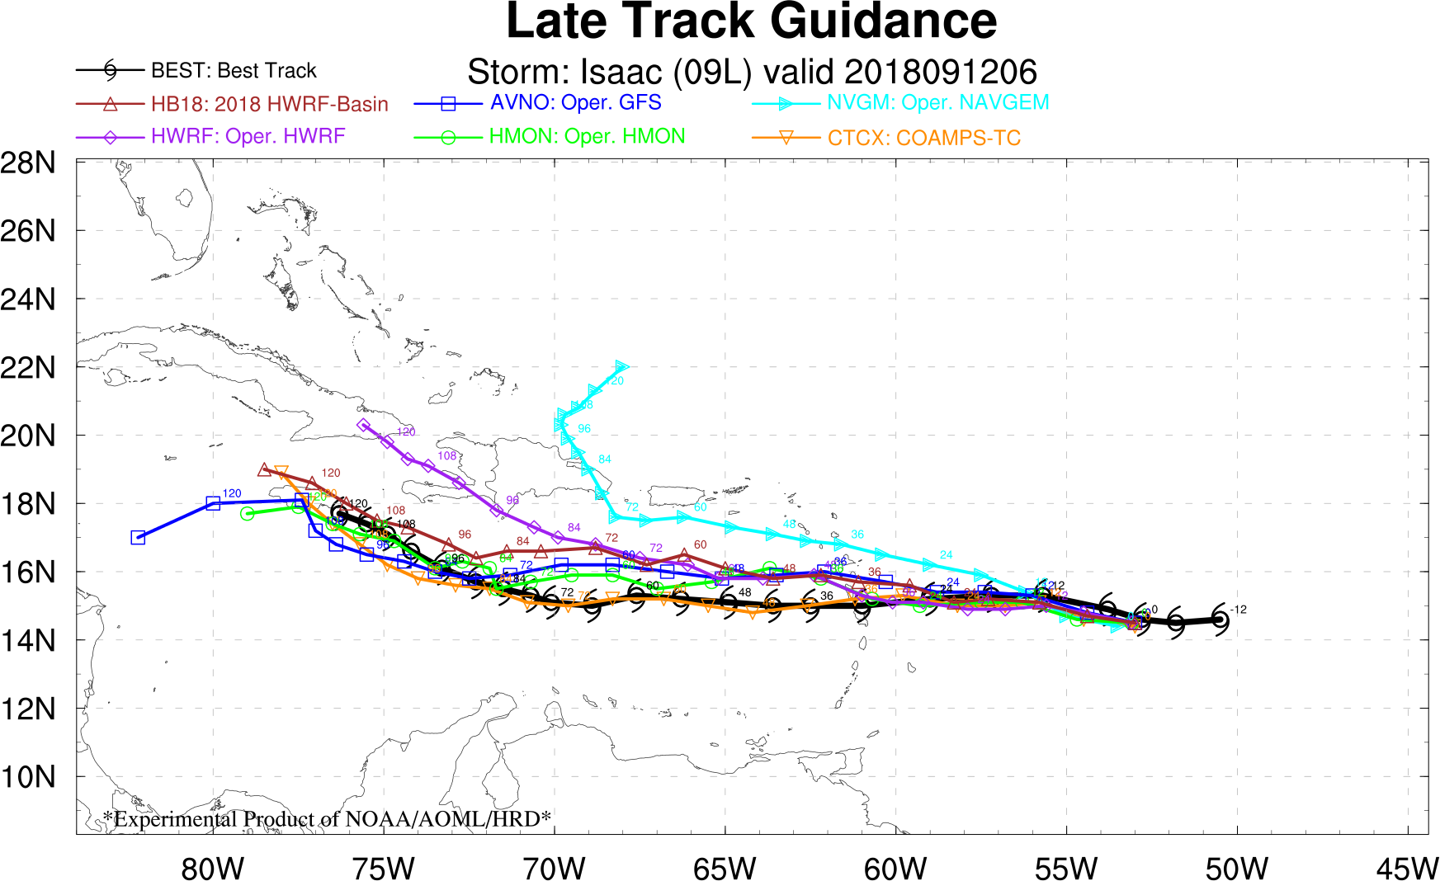
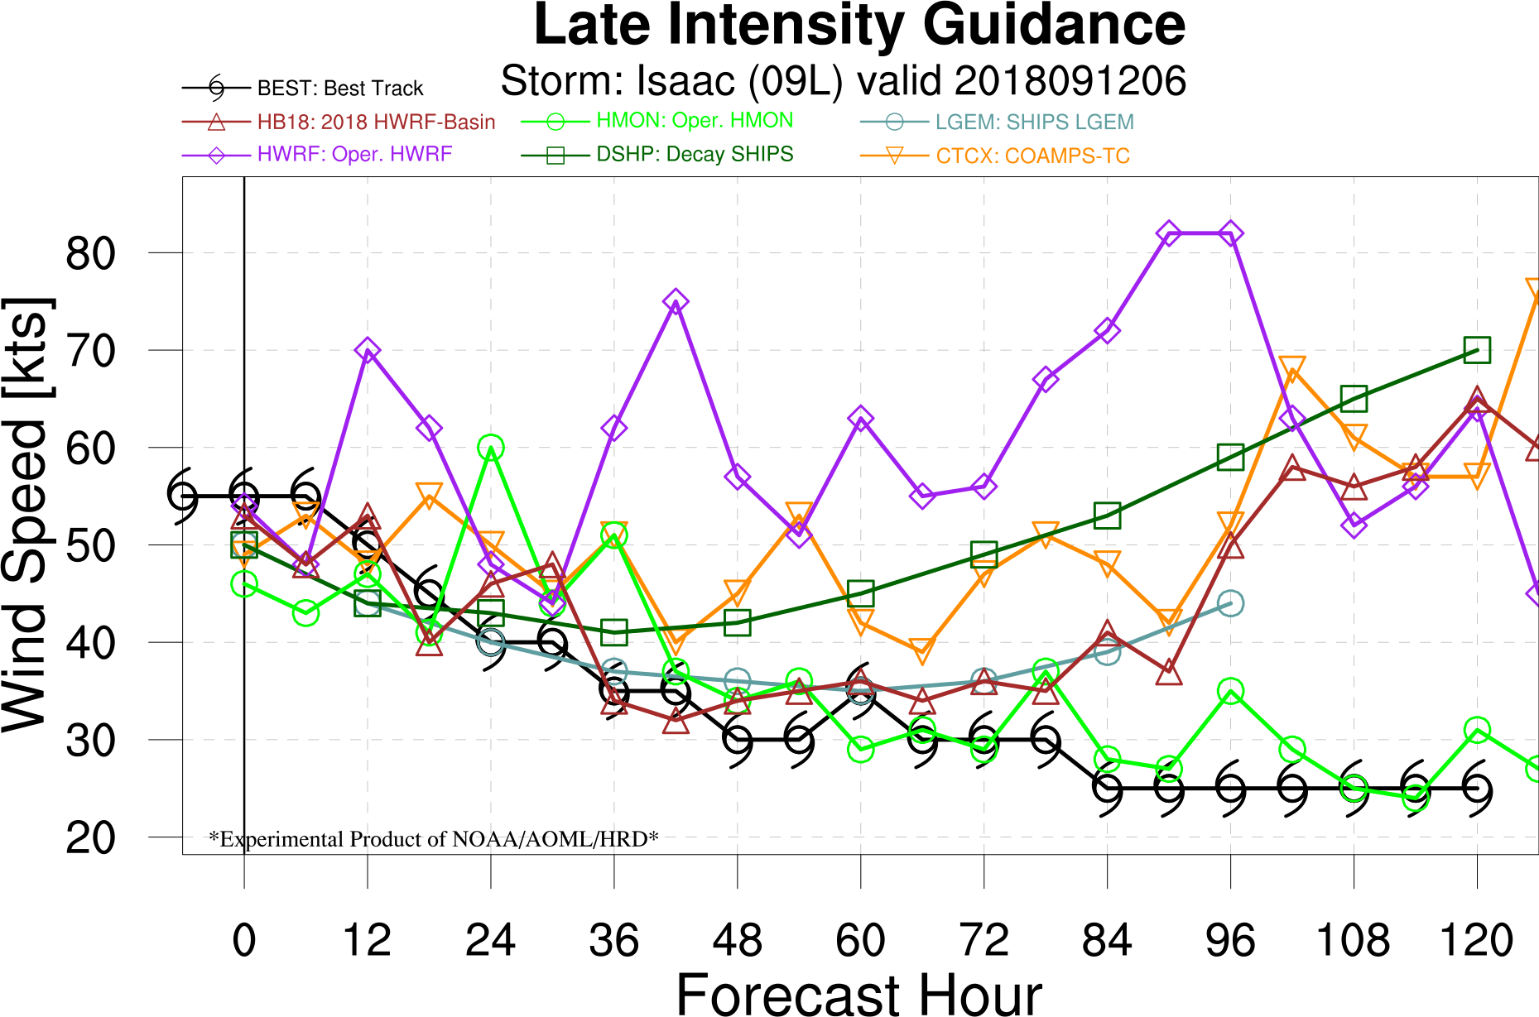
2018 NOAA/AOML/HRD Hurricane Field Program
Intensity Forecast Experiment (IFEX)
AL09/Isaac Debrief
Forecast Guidance
Models disagreed about the intensity → HWRF vs. HB18
Models mostly agreed about due west track, although chance to turn north
Overall, seemed like dissipation was likely in the short term, but conditions were more favorable after 3 days. Would the vortex hold together for that long?

Slide 19
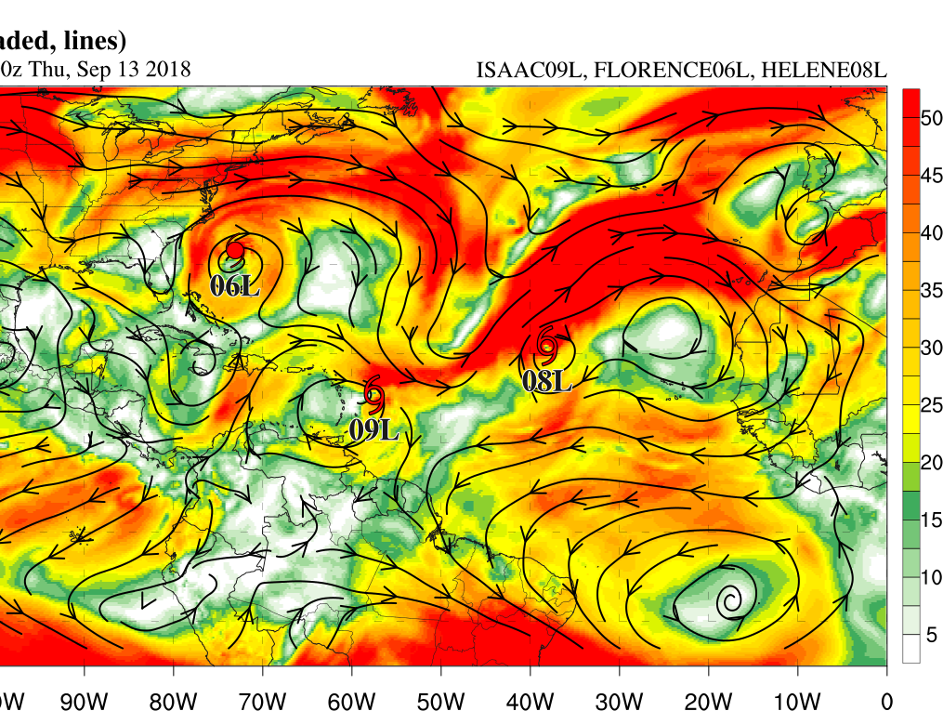
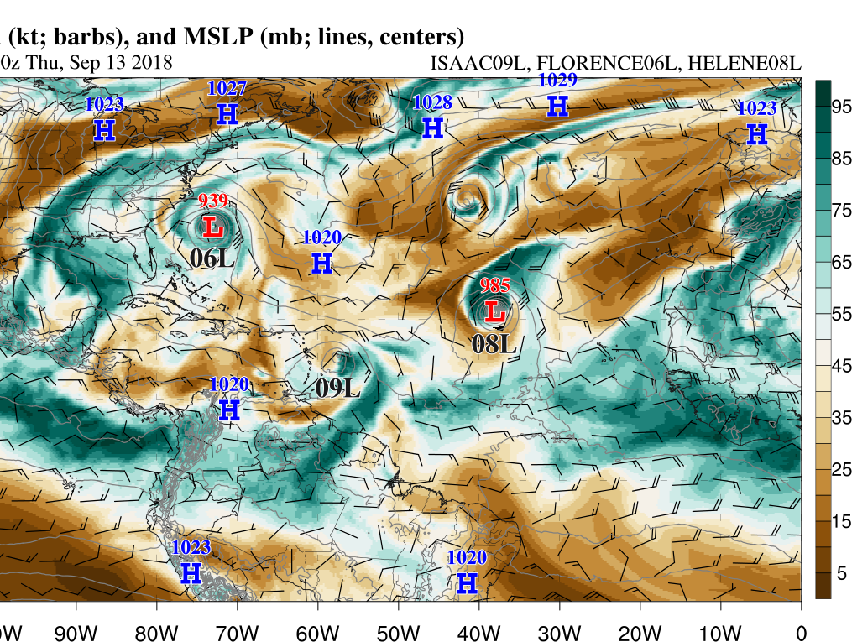
2018 NOAA/AOML/HRD Hurricane Field Program
Intensity Forecast Experiment (IFEX)
AL09/Isaac Debrief
Prevalent Environmental Conditions
Strong shear resulting from enhanced upper-level low between Florence and Helene
Dry air ahead of Isaac more easily entrained into TC circulation
36-h forecast of 200-850 mb wind shear (kt, shaded, lines) from Basin-Scale HWRF valid at 0000 UTC 13 September 2018.
36-h forecast of 700-400 mb relative humidity (%, shaded), 700-400 mb wind (kt, barbs) and MSLP (mb, lines, centers) from Basin-Scale HWRF valid at 0000 UTC 13 September 2018.

Slide 20
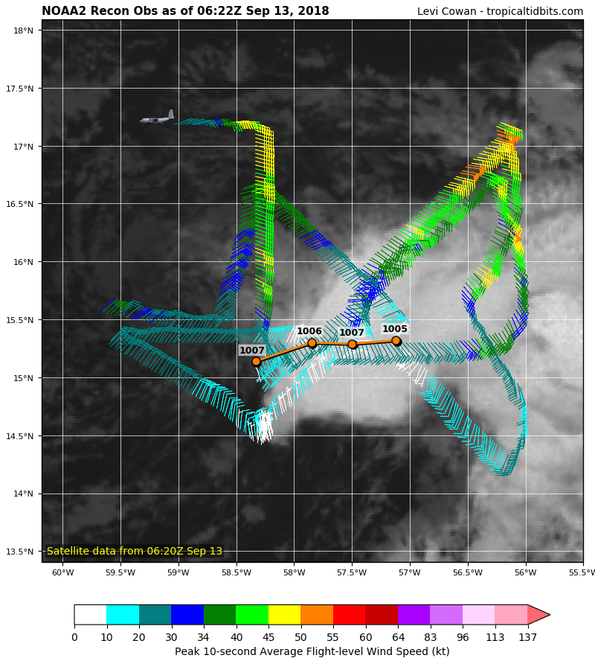
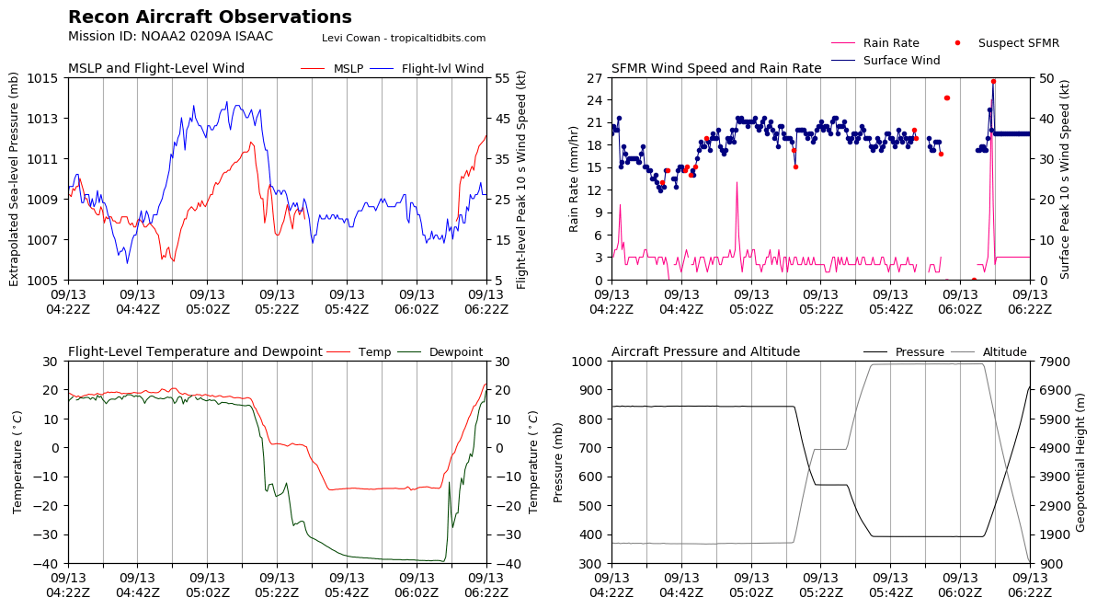
2018 NOAA/AOML/HRD Hurricane Field Program
Intensity Forecast Experiment (IFEX)
AL09/Isaac Debrief
Flight Conditions
Isaac was on a weakening trend during this mission.
Very difficult to complete the last NHC fix → circulation appeared open to the southwest at flight level.

Slide 21
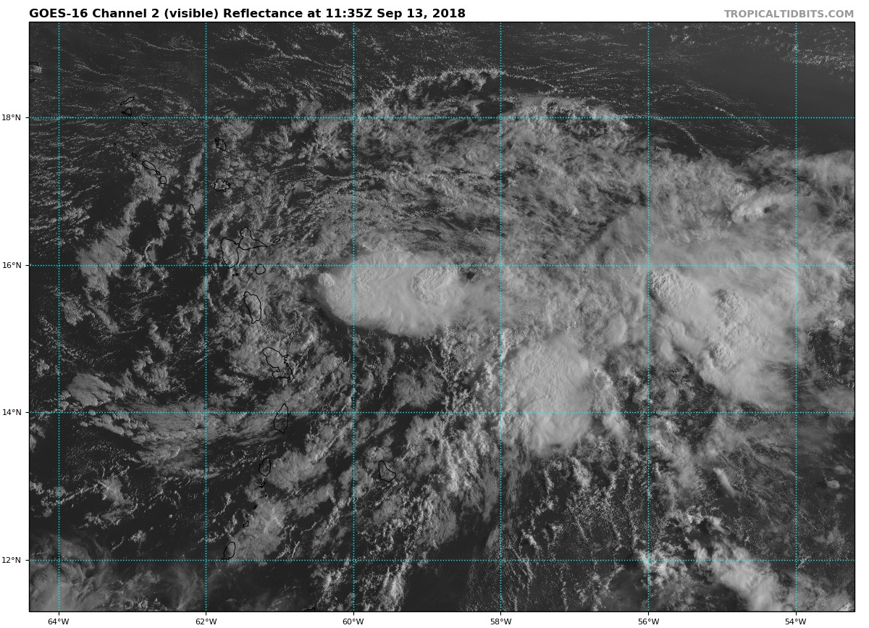
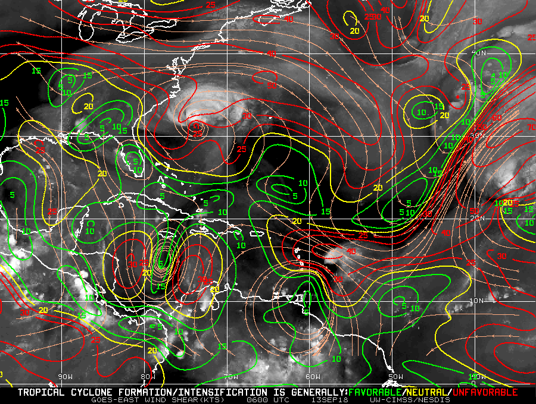
2018 NOAA/AOML/HRD Hurricane Field Program
Intensity Forecast Experiment (IFEX)
AL09/Isaac Debrief
20180913H1
LPS: Holbach
Radar: Christophersen
Sondes: Sellwood
Ground Radar: Griffins
NHC-tasked fix mission for 1130Z and 1730Z fixes
Initial intensity: 40 kt, 1006 mb
26 kt SHIPS analyzed shear
Out-running deep convection
Takeoff: 1025Z from STX
Landing: 1837Z at LAL
Expendables: 9 sondes (8 NWS, 1 HRD)

Slide 22
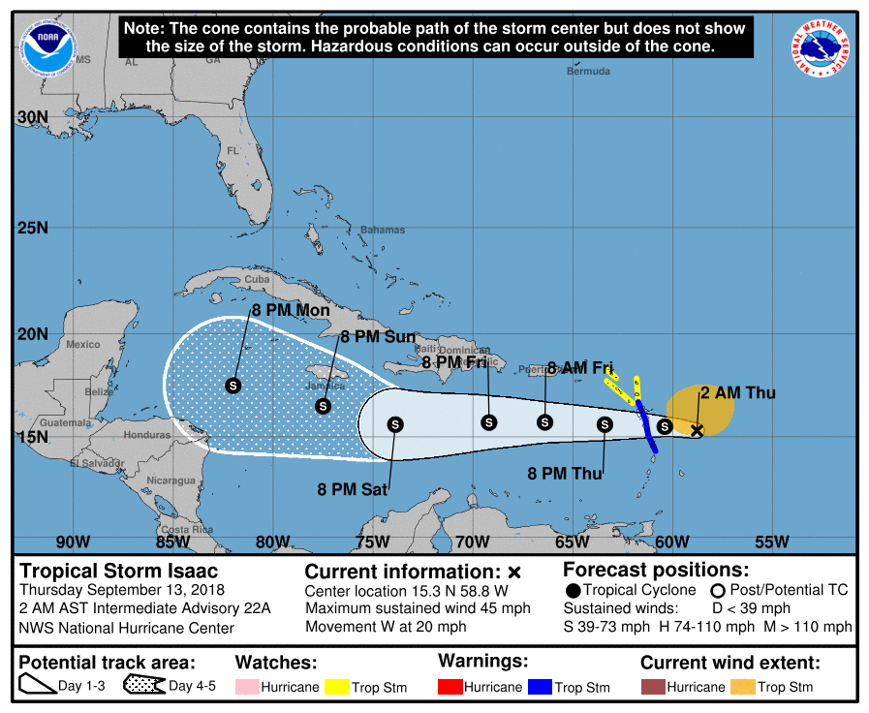
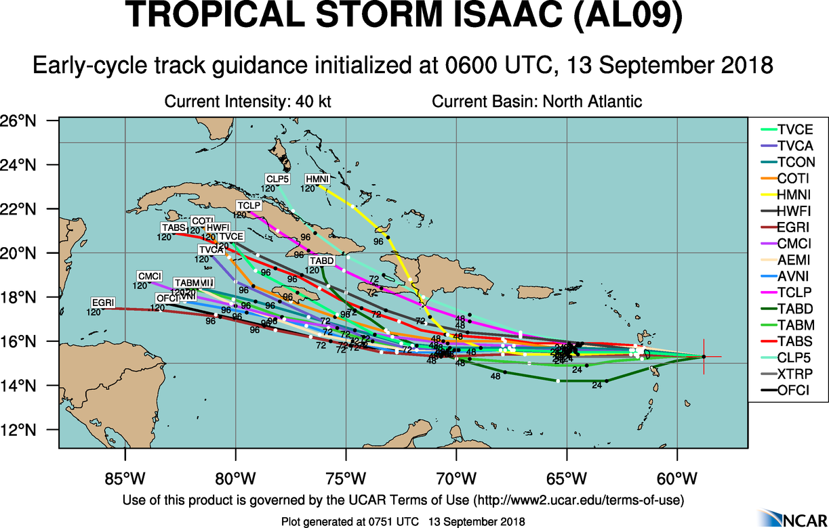
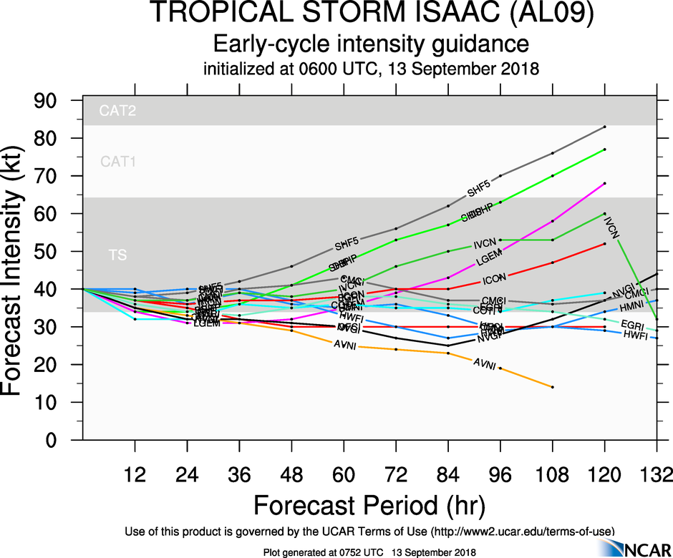
2018 NOAA/AOML/HRD Hurricane Field Program
Intensity Forecast Experiment (IFEX)
AL09/Isaac Debrief
20180913H1

Slide 23
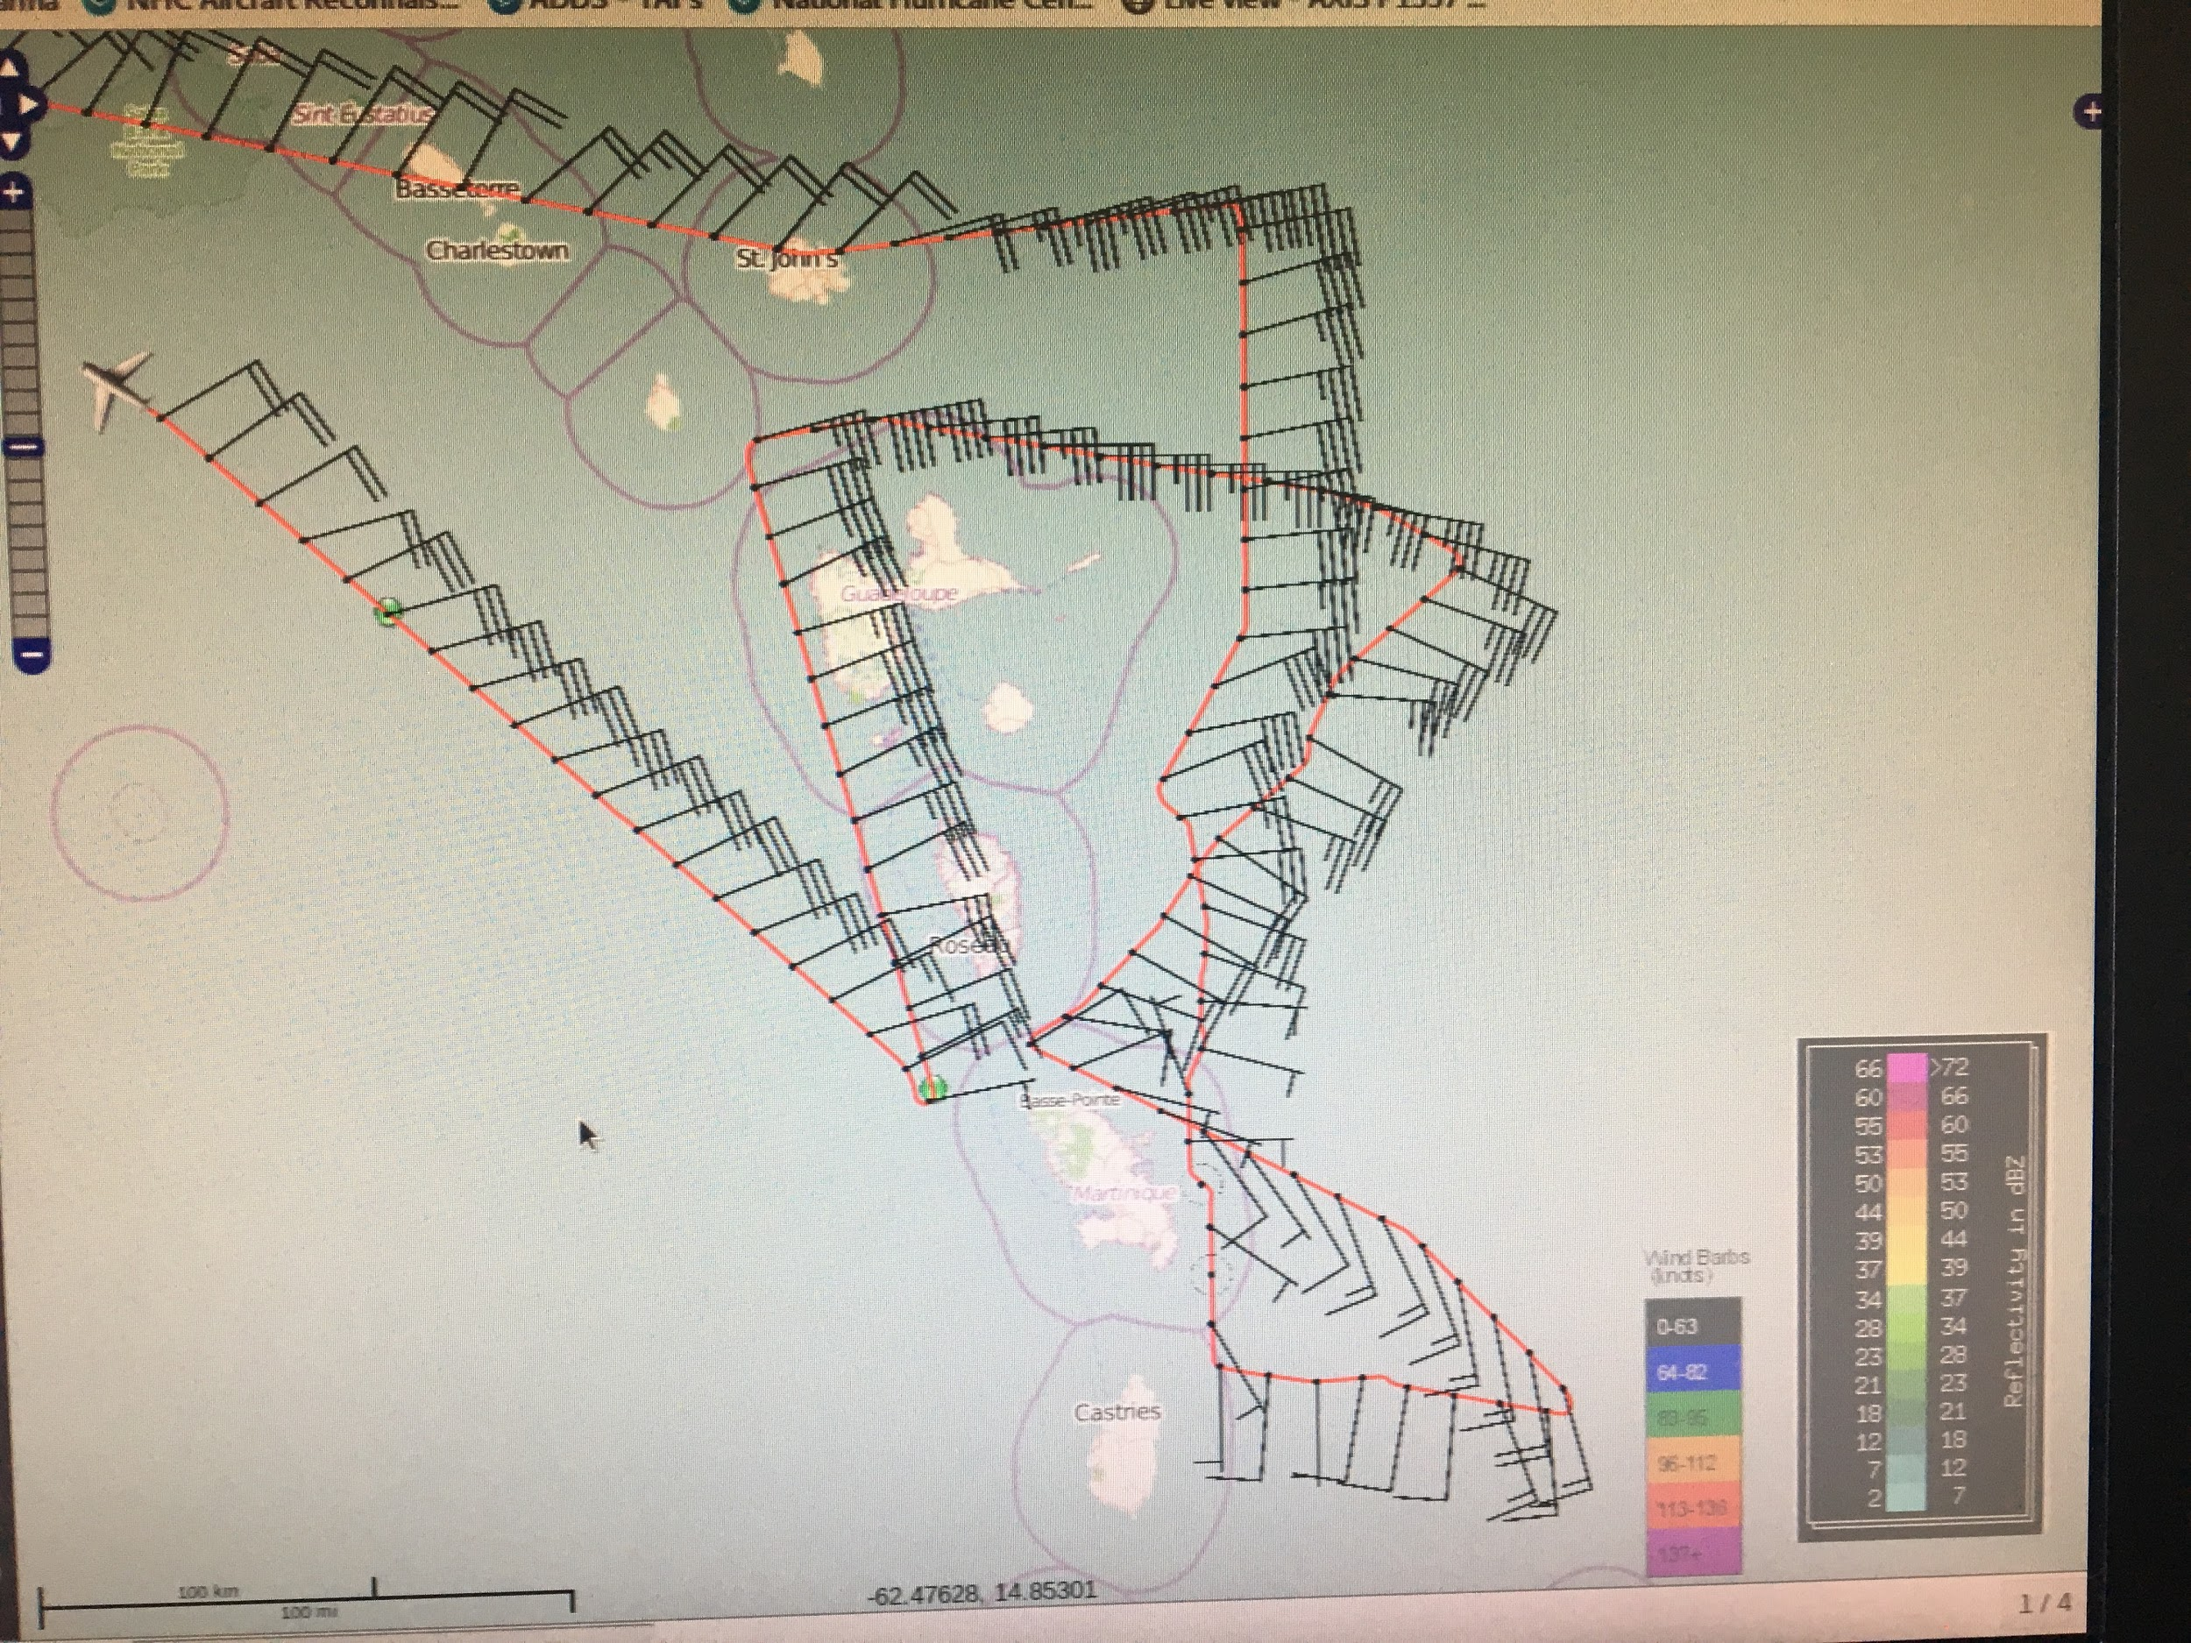
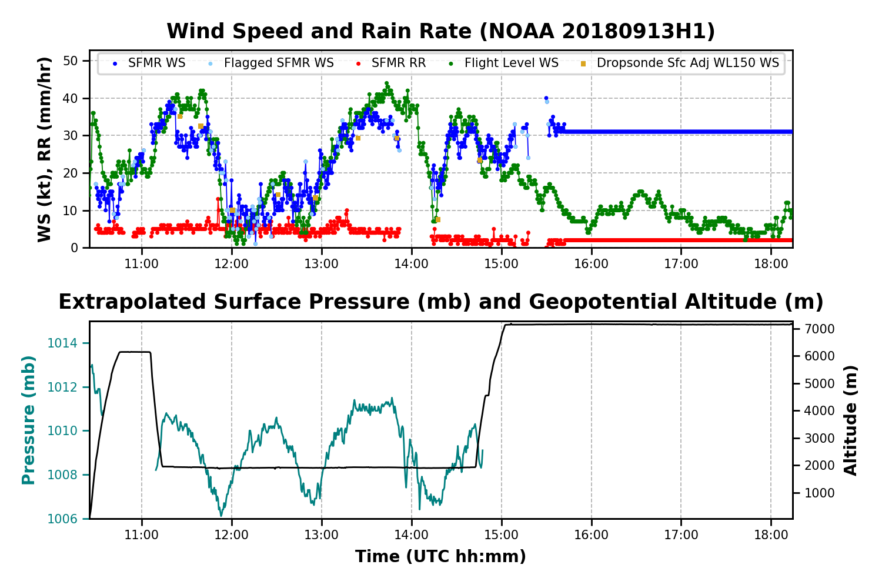
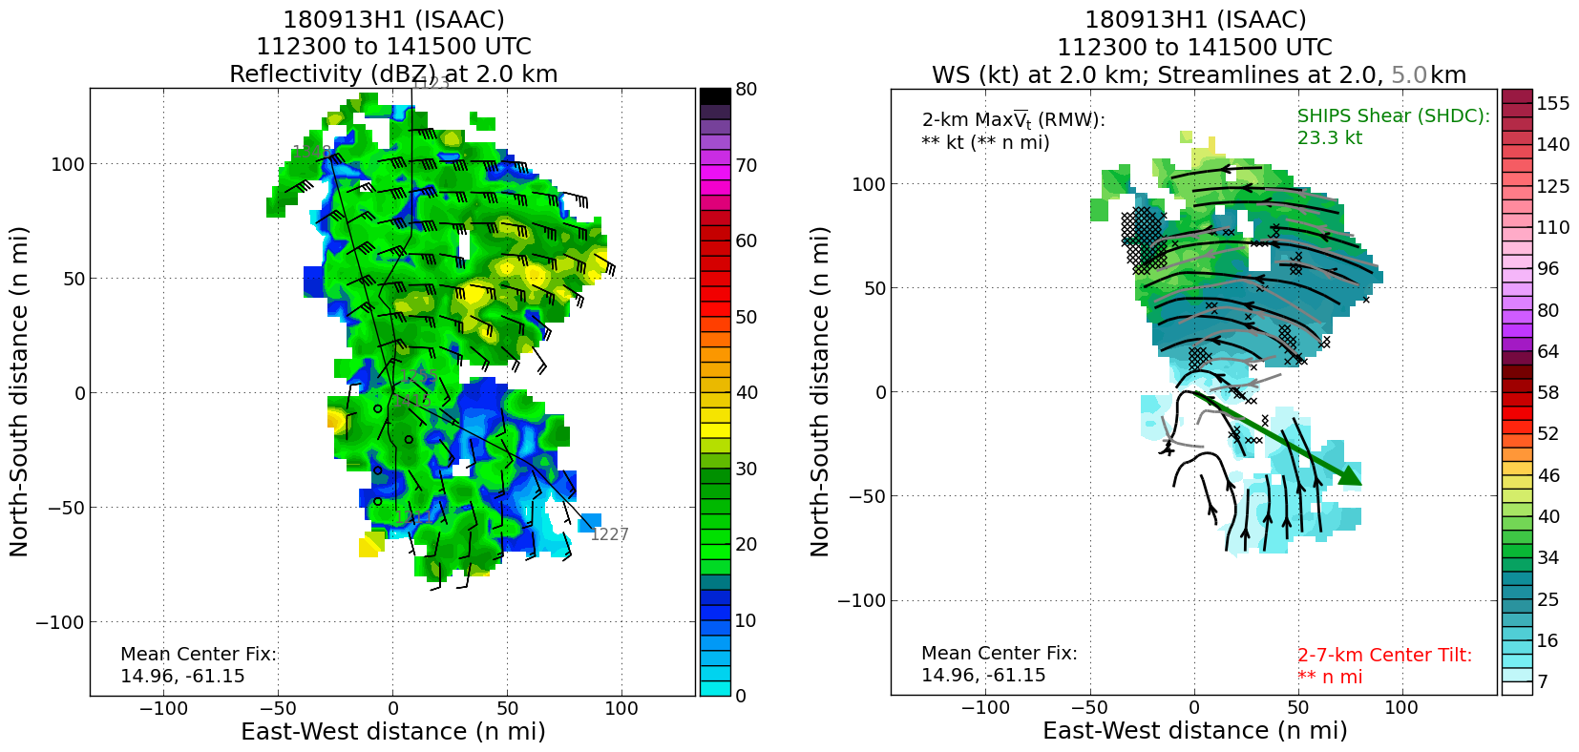
2018 NOAA/AOML/HRD Hurricane Field Program
Intensity Forecast Experiment (IFEX)
AL09/Isaac Debrief
20180913H1
Max FL wind 44 kts, Max SFMR wind 39 kts, min slp 1006 mb

Slide 24
2018 NOAA/AOML/HRD Hurricane Field Program
Intensity Forecast Experiment (IFEX)
AL09/Isaac Debrief
20180913H1
Summary:
Completed 3 center fixes before needing to depart for Lakeland
Unable to satisfy 1730Z fix requirement
First fix was based on flight level winds at 6000 ft
Flight level winds were too weak on south side to fix center for final two passes
NHC provided us with locations to release a “center” drop
Visible satellite imagery wasn’t as useful for getting center position estimates
Collected TDR data, but did not transmit to EMC
C-band IWRAP was not operating because of bad power supply

Slide 25
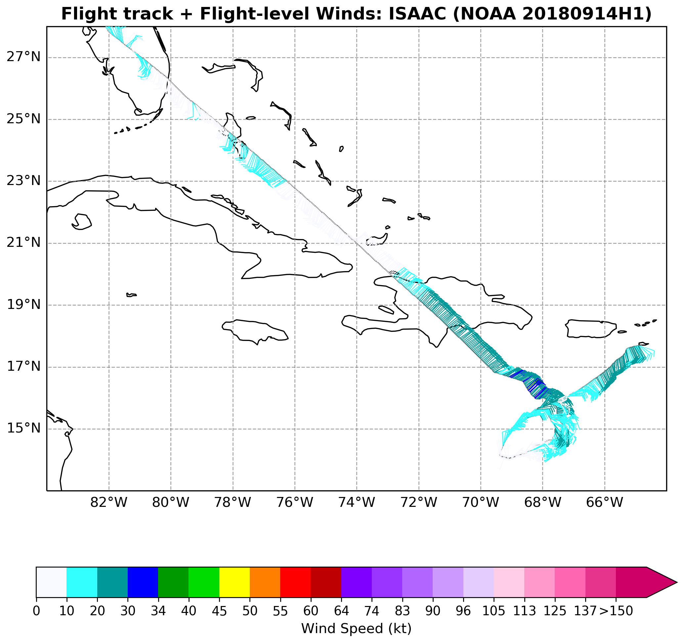
2018 NOAA/AOML/HRD Hurricane Field Program
Intensity Forecast Experiment (IFEX)
AL09/Isaac Debrief
20180914H1
180914H1

Slide 26
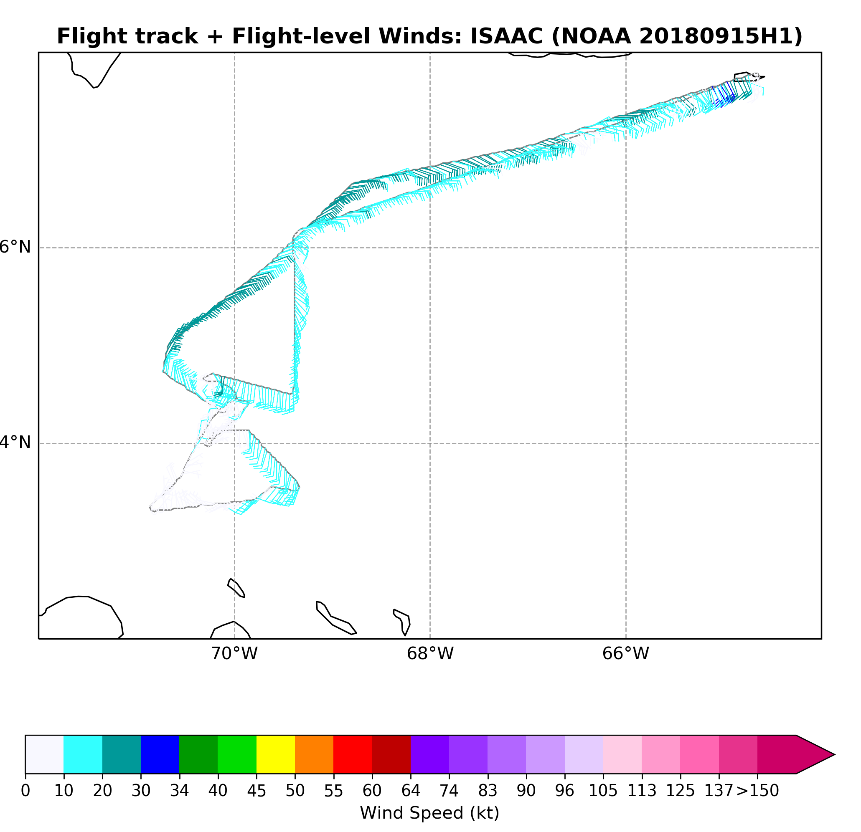
2018 NOAA/AOML/HRD Hurricane Field Program
Intensity Forecast Experiment (IFEX)
AL09/Isaac Debrief
20180915H1
180915H1

